Slide 1
Considering alternatives for
GOES-R ABI scan modes:
“Continuous FD”, “Flex”, and “Hybrid”
Timothy J. Schmit (tim.j.schmit@noaa.gov)
NOAA/NESDIS/Satellite Applications and Research
Advanced Satellite Products Branch (ASPB)
Chris Velden (ChrisV@ssec.wisc.edu)
UWisc. - CIMSS
Madison, WI

Slide 2
Thanks to…
Jordan Gerth, Mat Gunshor, Justin Sieglaff, John Cintineo
Kevin Ludlum, GOES operators, GOES shift supervisors, etc.
EUMETAT, JAM, KMA, etc.

Slide 3
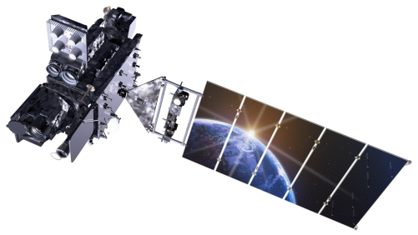
Outline
ABI (Advanced Baseline Imager) Modes
Flex
Continuous Full Disk
Hybrid
Etc.
Other advanced images
Links
Back-up
Lockheed Martin

Slide 4
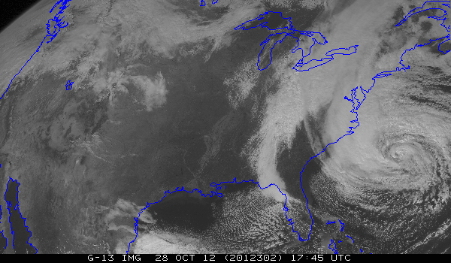
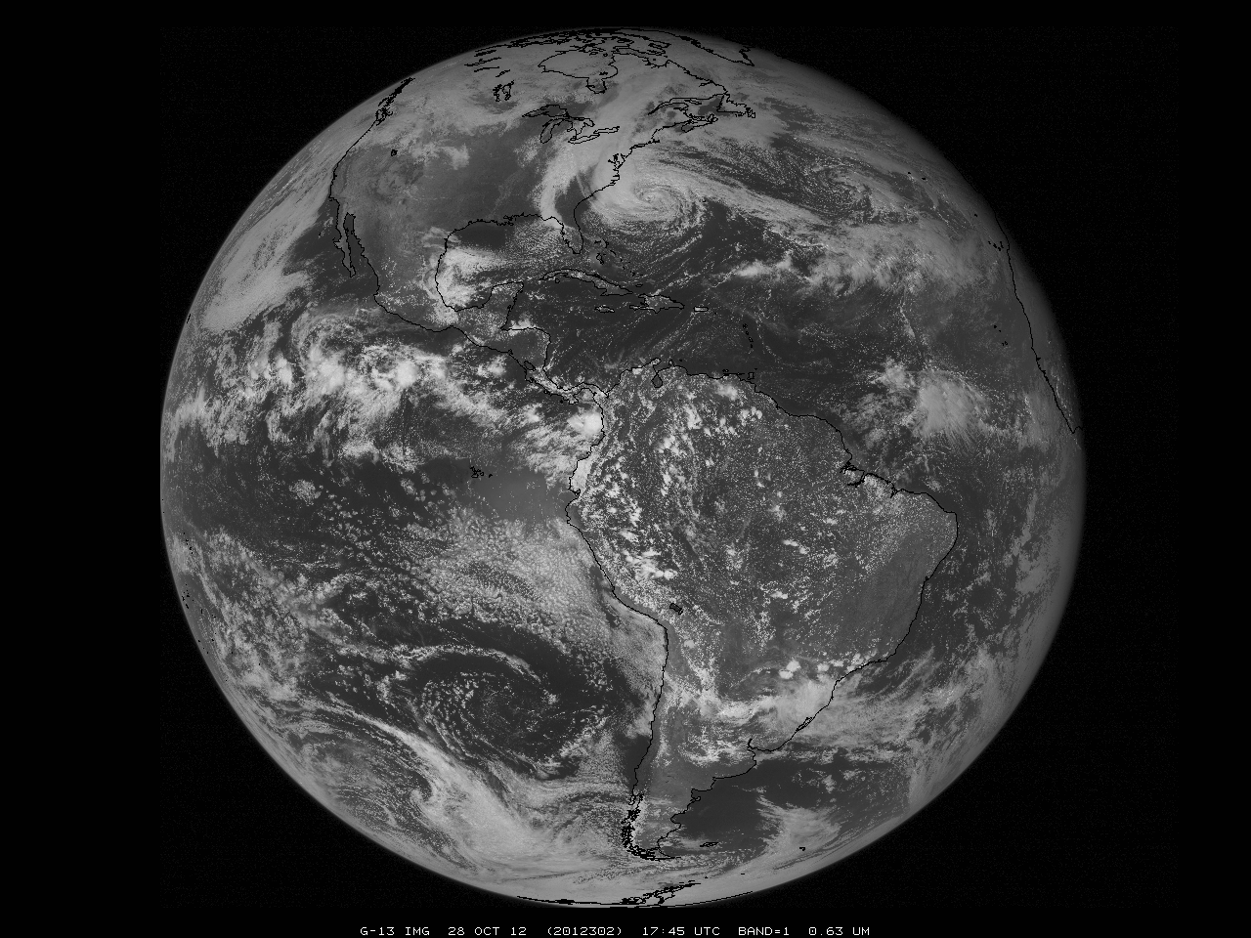
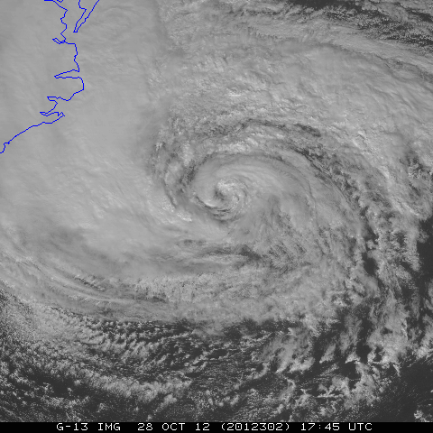
GOES-R ABI GOES-East
Full Disk
CONUS
Mesoscale
Possible scan modes for the east ABI (per hour):
Continuous FD--Full disk scan every 5 minutes, OR
FLEX--Full disk scan every 15 mins + continuous 5-min “PACUS” images + two
selectable Mesoscale areas with continuous 1-min scans,
Notes:
Sizes are approximate.

Slide 5
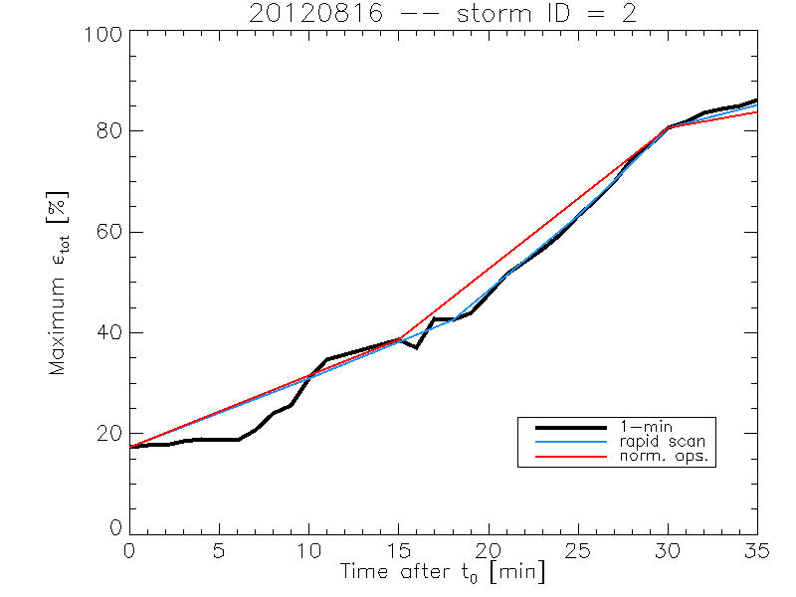
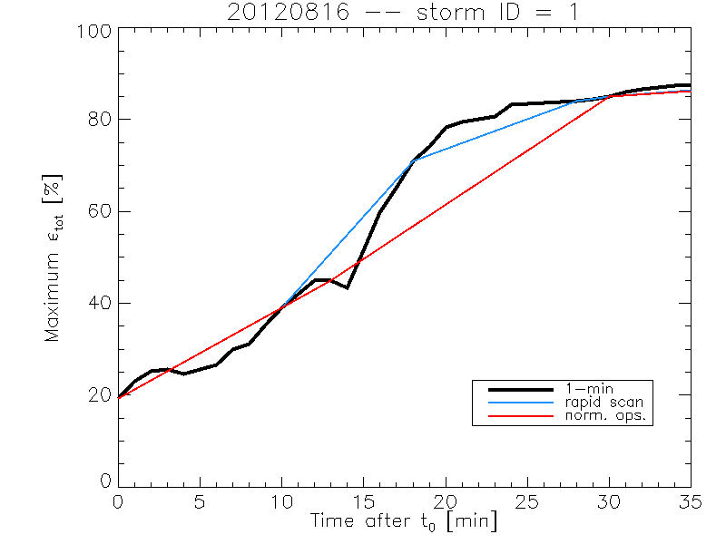
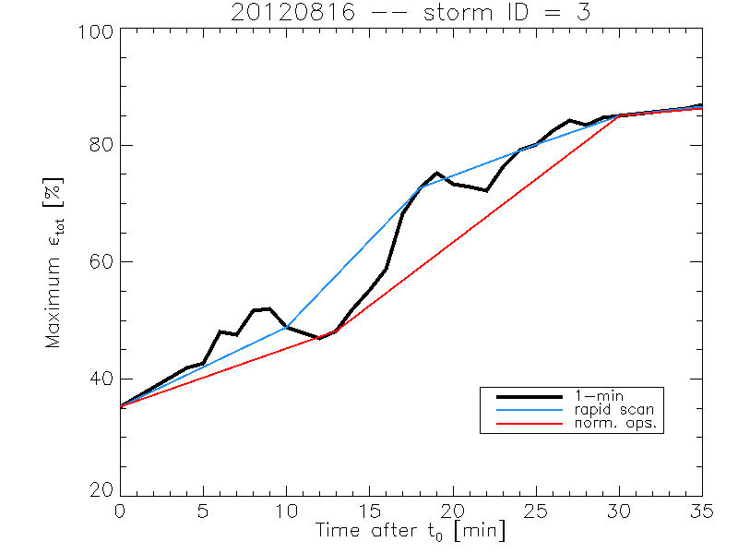
Rate of temporal cooling in the longwave infrared band
Cintineo et al., 2013 (CIMSS)

Slide 6
Possible ABI Modes of Operation (assuming GOES-West positioning)
Continuous Full Disk : Provides uninterrupted scans of the full disk every 5 minutes.
Flex : Provides a FD scan every 15 minutes, a CONUS every 5 minutes, and a Mesoscale every 30 seconds (or two Mesoscale areas with 1-min. scans)
Mesoscale: Provides coverage over a selectable 1000x1000km box with a
temporal resolution of 30 seconds. Option: Two Meso areas with
1-min. scans, with one “fixed” over Hawaii.
CONUS: Provides coverage that includes southern Alaska, the western
continental US, and northeastern Pacific Ocean regions (but not
Hawaii) every 5 minutes. Referred to as “PACUS” (note quotes)
Hybrid : Provides “PACUS” coverage every 5 minutes, a FD scan every 15 minutes (except every 5 minutes near the top of every hour), and Mesoscale coverage every 30 seconds (except for a 15-min. period near the top of every hour, when it becomes 5-min.)
ITT scan mode video: http://www.youtube.com/watch?v=p8SgXJSMOfc&feature=player_embedded
Notes:
http://www.goes-r.gov/spacesegment/abi.html

Slide 7
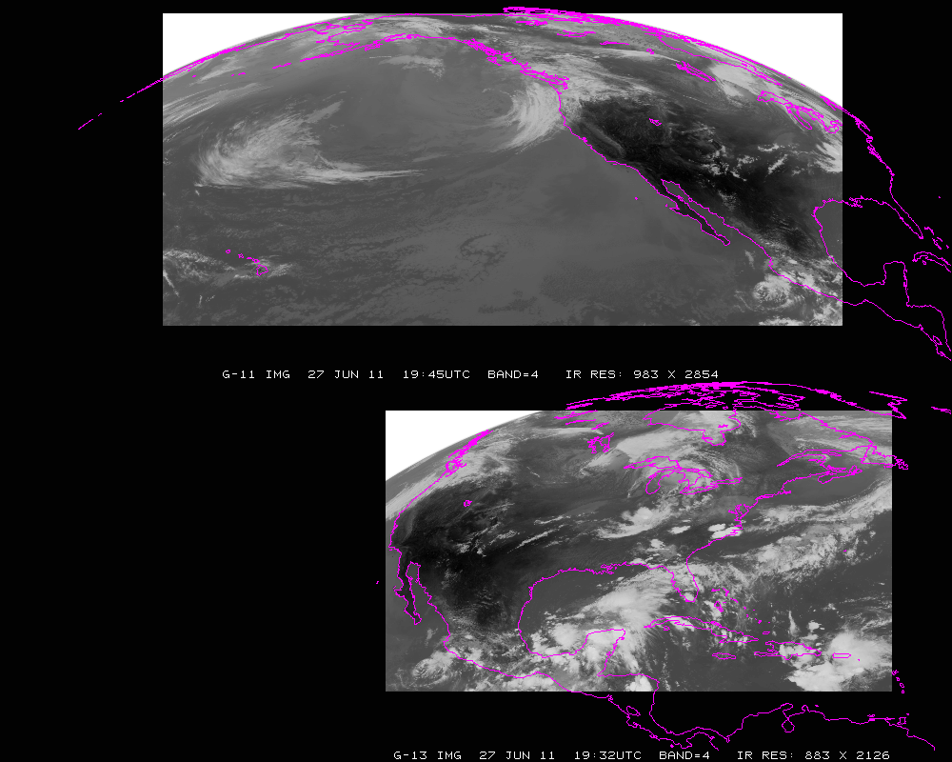
Current GOES Imager scans: GOES-W PACUS (upper) and GOES-E CONUS (right). Note that PACUS is one-third larger. These regions are sub-selected for AWIPS.

Slide 8
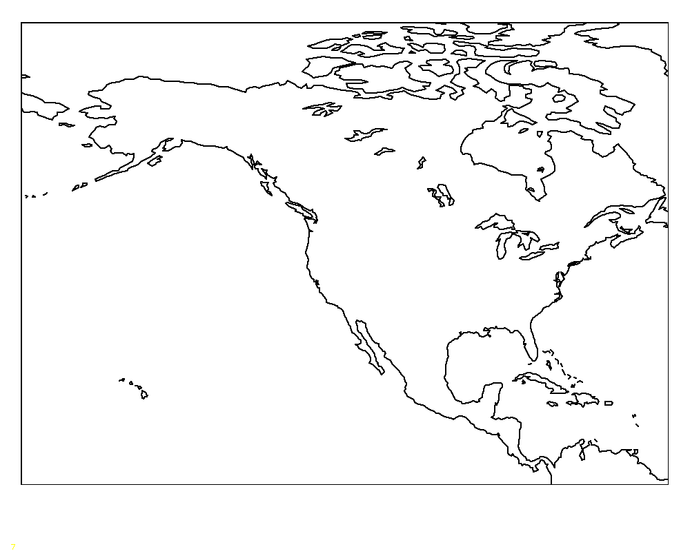
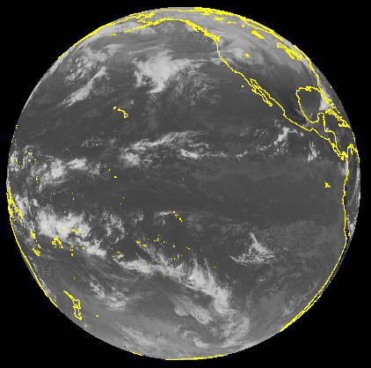
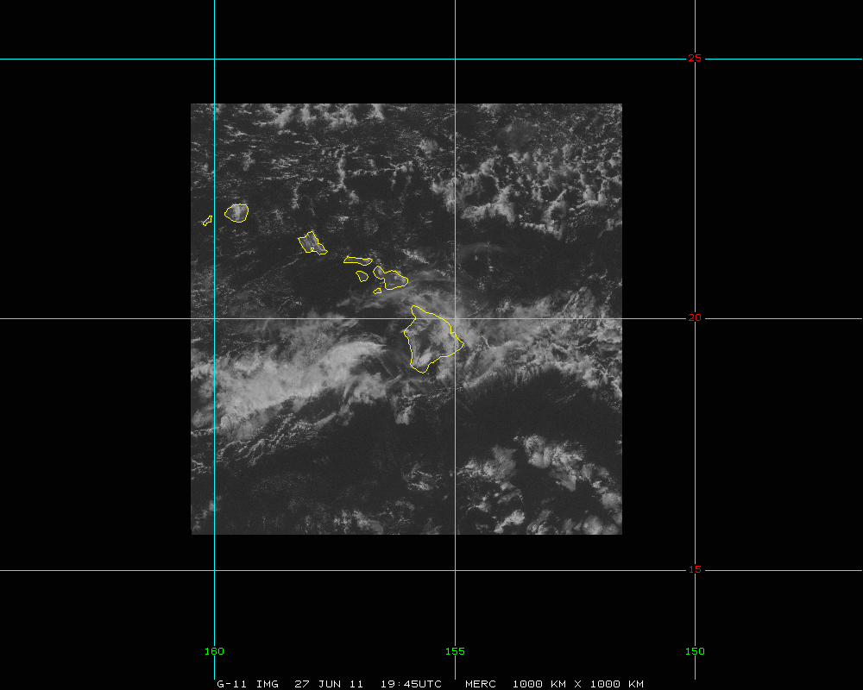
GOES-West
“5 min PACUS”
Full Disk
meso
Mesoscale
Possible scan modes for the west ABI (per hour):
Continuous FD--Full disk scan every 5 minutes, OR
FLEX--Full disk scan every 15 mins + continuous 5-min “PACUS” images + two
selectable Mesoscale areas with continuous 1-min scans, OR…

Slide 9
GOES-West
“5 min PACUS”
Full Disk
meso
Possible scan modes for the west ABI (per hour):
Hybrid - For ¾ of the hour: FLEX mode (Full disk scan every 15 mins + 5 min
“PACUS” images + two 1-min. mesoscales); for ¼ of the hour: FD mode
(5-min. FD scans for AMV production)
Mesoscale

Slide 10
~ mode 3 (mp4)
http://cimss.ssec.wisc.edu/goes/srsor2013/900x900_GOES_B1_WI_MODE3_animated_2013233_170000_182_2013233_230000_182_X.mp4

Slide 11
~ mode 3
(mpeg)
Notes:
mpeg

Slide 12
~ mode 3.25
(mp4)
http://cimss.ssec.wisc.edu/goes/srsor2013/900x900_GOES_B1_WI_MODE325_animated_2013233_170000_182_2013233_224500_182_X.mp4

Slide 13
~ mode 3.25
(mpeg)
Notes:
mpeg

Slide 14
~ mode 3
(mp4)
http://cimss.ssec.wisc.edu/goes/srsor2013/900x900_GOES_B1_NV_MODE3_animated_2013231_140000_182_2013231_210000_182_X.mp4

Slide 15
~ mode 3
(mpeg)
Notes:
mpeg

Slide 16
~ mode 3
(mpeg)
Notes:
mpeg

Slide 17
~ mode 3.25
(mpeg)
Notes:
mpeg

Slide 18
~ mode 3
(mpeg)
Notes:
mpeg

Slide 19
~ mode 3.25
(mp4)
http://cimss.ssec.wisc.edu/goes/srsor2013/900x900_GOES_B1_NV_MODE325_animated_2013231_140000_182_2013231_204500_182_X.mp4

Slide 20
~ mode 3.25
(mpeg)
Notes:
mpeg

Slide 21
“Continuous FD” Mode of Operations Pros Cons
Uninterrupted scans of the entire ABI viewing footprint at 5-min. intervals
Improved operational cloud-tracked winds vs. 15-min sampling
No need for NWS to request special scanning operations
Give up the mesoscale sampling and products
Will miss rapidly changing/evolving events
No ‘targeted’ observations, e.g. event-driven scanning

Slide 22
“Flex” Mode of Operations Pros Cons
Syncs FD sampling (15-min) with other future geo satellites
Provides for 5-min scans over western US, southern Alaska and northeast Pacific
Allows for selectable and uninterrupted mesoscale sampling (e.g. Hawaii and rapidly changing events, etc.)
Operational cloud-tracked winds (outside of “PACUS” domain) limited to 15-min. imagery (sub-optimal)
Other cloud products less frequently available for aviation and global NWP applications outside of the “PACUS”

Slide 23
“Flex” Mode (Continued) Level 2
With more rapid scan comes opportunities to find more holes in the clouds that may enable the generation of more L2 products (over time and space), application of compositing techniques, better opportunities for data fusion with polar products, GLM, etc...

Slide 24
“Hybrid” Mode of Operations Pros Cons
All of Flex mode pros, except the mesoscale views will be interrupted for one-fourth of the hour
Allows FD cloud-tracked winds to be produced from 5-min. images once per hour
1-min. or 30-sec mesoscale sampling will be interrupted every hour (replaced by 5-min. scans for a duration of 15 min.)
Introduces a discontinuity in the animations once per hour (for 15 min).

Slide 25
Summary of ABI Operational Scan Mode Alternatives
Continuous FD mode of operations would be great for large-scale animations and improved cloud-track wind derivation, but no ‘super-rapid-scan’ (SRS) imaging for mesoscale events.
Flex mode of operations would provide unique opportunities for mesoscale imaging (SRS), but would be sub-optimal for cloud-tracked winds over most of the viewing region (important for global NWP).
Hybrid mode of operations would allow improved cloud-tracked winds and mesoscale sampling, but with small interruptions to the SRS animations (and any derived products)

Slide 26
Are there other options?
a Northern Hemi scan option (say every 2.5 min) with a FD every 15 min?
Assume that GOES-East and –West could be operated differently
just FD and meso (where the FD would then take more than 5 min)
Best way to involve operational forecasters in these decisions?

Slide 27
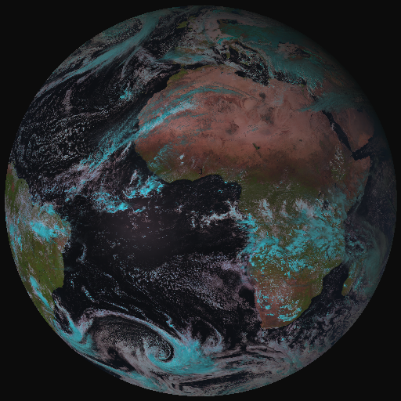
From MSG-SEVIRI to MTG-FCI
MTG FCI outbids MSG SEVIRI observations on cloud, aerosol, moisture and fire:
by adding new channels
by improving temporal-,
spatial-, and radiometric
resolution
a Full-Disk High-Spectral-resolution
Imagery (FDHSI)
High-Resolution Fast Imagery
Coverage Repeat cycle FDHSI mission 18ºx18º 10 min
HRFI mission 1/4 FD 2.5 min
Notes:
Flexible Combined Imager

Slide 28
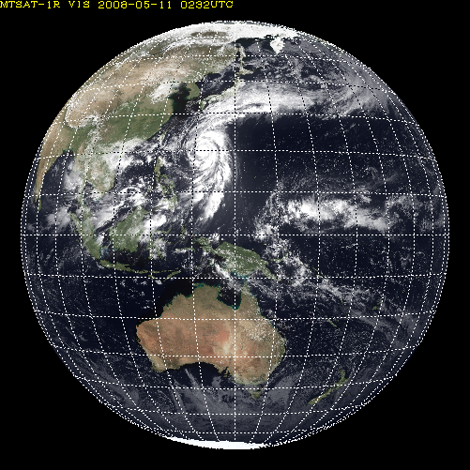
AHI Sectored Observations in 10 minutes
Full disk
Interval : 10 minutes (6 times per hour)
23 swath
Region 1 JAPAN (North-East)
Interval : 2.5 minutes (4 times in 10minutes)
Dimension : EW x NS: 2000 x 1000 km
2 swath
Region 1
N-E JAPAN
Region 2
S-W JAPAN
Region 3
Typhoon
Region 2 JAPAN (South-West)
Interval : 2.5 minutes (4 times in 10minutes)
Dimension : EW x NS: 2000 x 1000 km
2 swath
Region 3 Typhoon
Interval : 2.5 minutes (4 times in 10minutes)
Dimension : EW x NS: 1000 x 1000 km
2 swath
Region 5
Land mark
Region 4
Land mark
Region 4 Land mark
Interval : 0.5 minutes (20 times in 10minutes)
Dimension : EW x NS: 1000 x 500 km
1 swath
Region 5 Land mark
Interval : 0.5 minutes (20 times in 10minutes) Dimension : EW x NS: 1000 x 500 km
1 swath

Slide 29
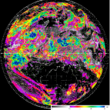
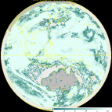
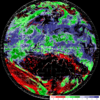
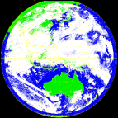
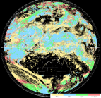
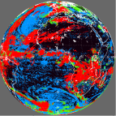
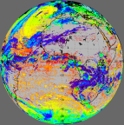
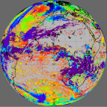
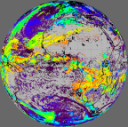
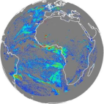
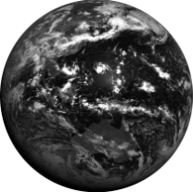
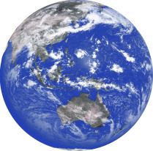
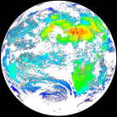
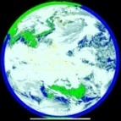
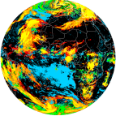
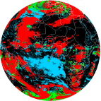
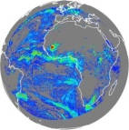
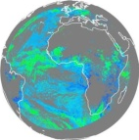
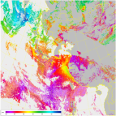
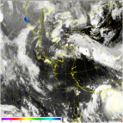
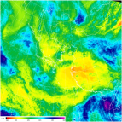
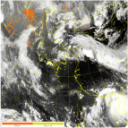
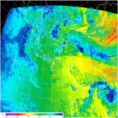
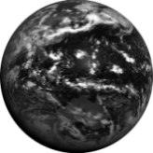
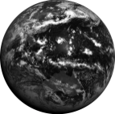
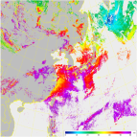
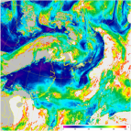
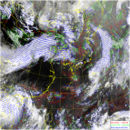
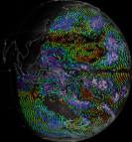
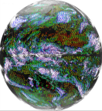
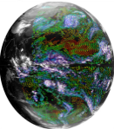
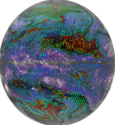
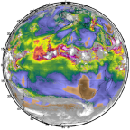
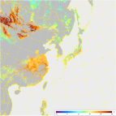
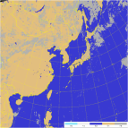
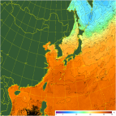
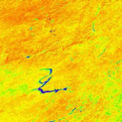
4.3 COMS & GEO-KOMPSAT-2A
resolution 4times upgrade
channel 3times increase
products 3.5 times increase
COMS
Geo-KOMPSAT-2A
COMS
Geo-KOMPSAT-2A
COMS
VIS 1km
IR 4km
Geo-KOMPSAT-2A
VIS 0.5~1km
IR 2km
1
(Black and white)
4
(color image)
Cloud/pre. : 5
Cloud/pre. :19
VIS
Observation frequency 4 times
Aerosol : 5
Aerosol : 16
1hr
2
SW IR
O
Full disk : 1
Full disk : 4
AMV : 3
AMV : 6
4
10
NH : 2
NH : 10
IR
Land sfc. : 3
Land sfc. : 11
…....
KP : every 15min
KP : every 2min
5 channel
16 channel
Total : 16
Total : 52

Slide 30
Links/ Reference
http://cimss.ssec.wisc.edu/goes/srsor/GOES-14_SRSOR.html
http://cimss.ssec.wisc.edu/goes/srsor2013/GOES-14_SRSOR.html
http://cimss.ssec.wisc.edu/goes/srsor2013/?C=M;O=D
(look for ‘MODE’ animations)
Geostationary Operational Environmental Satellite (GOES)-14 super rapid scan operations to prepare for GOES-R Timothy J. Schmit; Steven J. Goodman; Daniel T. Lindsey; Robert M. Rabin; Kristopher M. Bedka; Mathew M. Gunshor; John L. Cintineo; Christopher S. Velden; A. Scott Bachmeier; Scott S. Lindstrom; Christopher C. Schmidt J. Appl. Remote Sens. 7 (1), 073462 (December 16, 2013); doi: 10.1117/1.JRS.7.073462

Slide 31
ABI scans about 5 times faster
than the current GOES imager
Anticipated scan mode for the ABI:
- Full disk images every 15 minutes + 5 min CONUS images + mesoscale.

Slide 32
ABI can offer Continental US images every 5 minutes for routine monitoring of a wide range of events (storms, dust, clouds, fires, winds, etc).
This is every 15 or 30 minutes with the current GOES in routine mode.
Notes:
Approx. size of CONUS

Slide 33
Notes:
Approx. size of CONUS

Slide 34
Mesoscale images every 30 seconds for rapidly changing phenomena
(thunderstorms, hurricanes, fires, etc). Or two regions every 60 seconds.
Notes:
Approx. size of meso-scale showing “Franklin”.

