Slide 1
Considering alternatives for
GOES-R ABI scan modes:
“Continuous FD”, “Flex”, and “Hybrid”
Timothy J. Schmit (tim.j.schmit@noaa.gov)
NOAA/NESDIS/Satellite Applications and Research
Advanced Satellite Products Branch (ASPB)
Chris Velden (ChrisV@ssec.wisc.edu)
UWisc. - CIMSS
Madison, WI

Slide 2
Possible ABI Modes of Operation (assuming GOES-West positioning)
Continuous Full Disk : Provides uninterrupted scans of the full disk every 5 minutes.
Flex : Provides a FD scan every 15 minutes, a CONUS every 5 minutes, and a Mesoscale every 30 seconds (or two Mesoscale areas with 1-min. scans)
Mesoscale: Provides coverage over a selectable 1000x1000km box with a
temporal resolution of 30 seconds. Option: Two Meso areas with
1-min. scans, with one “fixed” over Hawaii.
CONUS: Provides coverage that includes southern Alaska, the western
continental US, and northeastern Pacific Ocean regions (but not
Hawaii) every 5 minutes. Referred to as “PACUS” (note quotes)
Hybrid : Provides “PACUS” coverage every 5 minutes, a FD scan every 15 minutes (accept every 5 minutes near the top of every hour), and Mesoscale coverage every 30 seconds (except for a 15-min. period near the top of every hour, when it becomes 5-min.)
ITT scan mode video: http://www.youtube.com/watch?v=p8SgXJSMOfc&feature=player_embedded
Notes:
http://www.goes-r.gov/spacesegment/abi.html

Slide 3
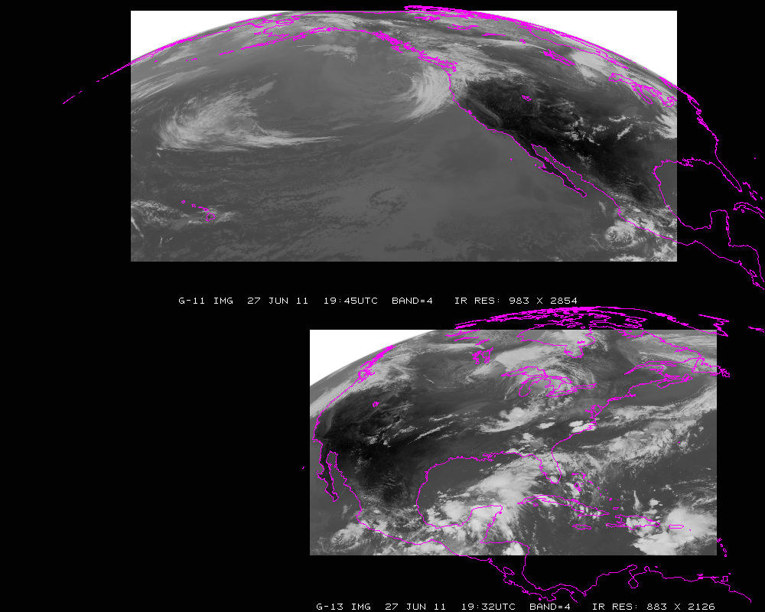
Current GOES Imager scans: GOES-W PACUS (upper) and GOES-E CONUS (right). Note that PACUS is one-third larger. These regions are sub-selected for AWIPS.

Slide 4
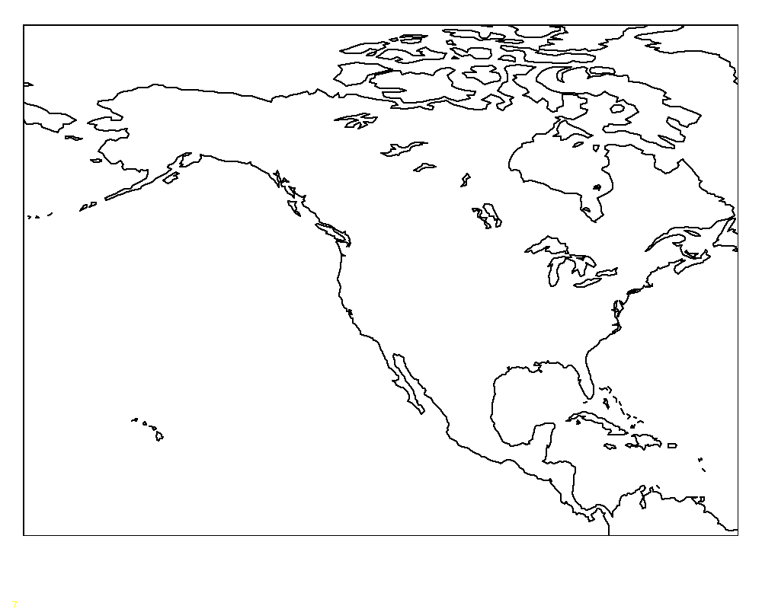
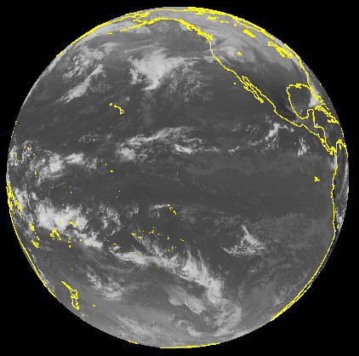
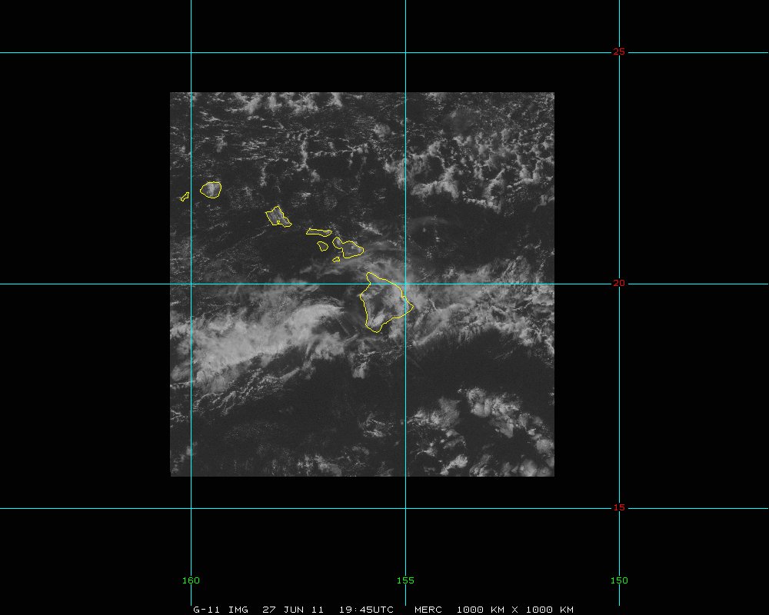
GOES-West
“5 min PACUS”
Full Disk
meso
Mesoscale
Possible scan modes for the west ABI (per hour):
Continuous FD--Full disk scan every 5 minutes, OR
FLEX--Full disk scan every 15 mins + continuous 5-min “PACUS” images + two
selectable Mesoscale areas with continuous 1-min scans, OR…

Slide 5
GOES-West
“5 min PACUS”
Full Disk
meso
Possible scan modes for the west ABI (per hour):
Hybrid - For ¾ of the hour: FLEX mode (Full disk scan every 15 mins + 5 min
“PACUS” images + two 1-min. mesoscales); for ¼ of the hour: FD mode
(5-min. FD scans for AMV production)
Mesoscale

Slide 6
“Continuous FD” Mode of Operations Pros Cons
Uninterrupted scans of the entire ABI viewing footprint at 5-min. intervals
Improved operational cloud-tracked winds vs. 15-min sampling
No need for NWS to request special scanning operations
Give up the mesoscale sampling and products
Will miss rapidly changing/evolving events
No ‘targeted’ observations, e.g. event-driven scanning

Slide 7
“Flex” Mode of Operations Pros Cons
Syncs FD sampling (15-min) with other future geo satellites
Provides for 5-min scans over western US, southern Alaska and northeast Pacific
Allows for selectable and uninterrupted mesoscale sampling (e.g. Hawaii and rapidly changing events, etc.)
Operational cloud-tracked winds (outside of “PACUS” domain) limited to 15-min. imagery (sub-optimal)
Other cloud products less frequently available for aviation and global NWP applications outside of the “PACUS”

Slide 8
“Hybrid” Mode of Operations Pros Cons
All of Flex mode pros, except the mesoscale views will be interrupted for one-fourth of the hour
Allows FD cloud-tracked winds to be produced from 5-min. images once per hour
1-min. or 30-sec mesoscale sampling will be interrupted every hour (replaced by 5-min. scans for a duration of 15 min.)
Introduces a discontinuity in the animations once per hour (for 15 min).

Slide 9
Summary of ABI Operational Scan Mode Alternatives
Continuous FD mode of operations would be great for large-scale animations and improved cloud-track wind derivation, but no ‘super-rapid-scan’ (SRS) imaging for mesoscale events.
Flex mode of operations would provide unique opportunities for mesoscale imaging (SRS), but would be sub-optimal for cloud-tracked winds over most of the viewing region (important for global NWP).
Hybrid mode of operations would allow improved cloud-tracked winds and mesoscale sampling, but with small interruptions to the SRS animations (and any derived products)

