Slide 1



A near real time regional GOES-R/JPSS data assimilation system for high impact weather applications
Jun Li@, Timothy J. Schmit&, Jinlong Li@, Pei Wang@, Steve Goodman#
@CIMSS/SSEC, University of Wisconsin-Madison
&Center for Satellite Applications and Research, NESDIS, NOAA
#GOES-R Program Office, NESDIS, NOAA
WoF/HIW Workshop
01 - 03 April 2014, Norman, Oklahoma

Slide 2
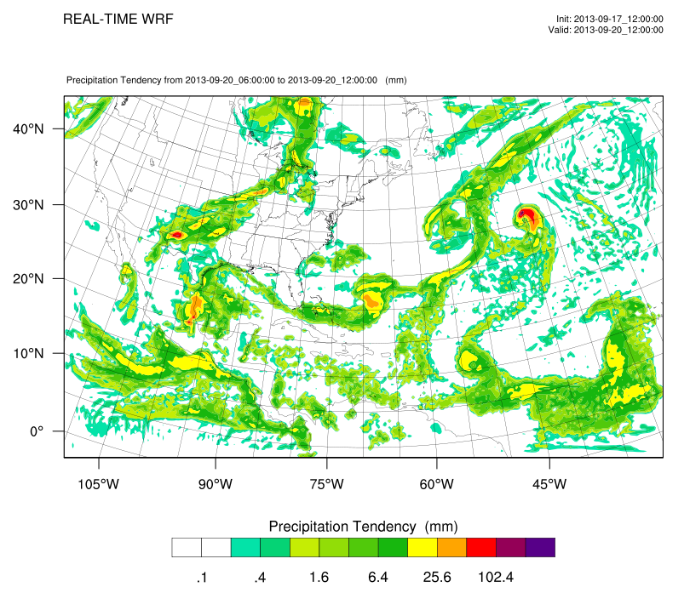
In collaboration with: Mark DeMaria, John L. (Jack) Beven, Sid Boukabara, Fuzhong Weng etc.
Acknowledgement: GOES-R HIW Program, JPSS PGRR Program, JCSDA S4 computer, SSEC Data Center
Motivation
Research to better use of JPSS/GOES-R data in a mesoscale NWP model for applications;
Accelerate the R2O transition
  offline case studies followed by online demonstration
  Transfer research progress (e.g., handling clouds, using moisture information etc.) to operation with collaborating with NCEP team
Tropical storm Humberto
http://cimss.ssec.wisc.edu/sdat

Slide 3
Recent progress
A regional Satellite Data Assimilation system for Tropical storm forecasts (SDAT) has been developed and running in near real time (NRT) at CIMSS since August 2013, analysis and evaluation of SDAT are ongoing;
  Based on WRF/GSI;
  Conventional and satellite including GOES Sounder, AMSU-A (N15, N18, N19, metop-a, aqua), ATMS (Suomi-NPP), HIRS4 (N19, metop-a), AIRS (aqua), IASI (metop), and MHS (N18, N19, metop).
“Tracker" program was implemented since October 2013 for post process;
Besides GOES radiance assimilation, Layer Precipitable Water (LPW) forward operator has been developed within GSI for assimilating GOES-R water vapor information;
Research progress has been made using SDAT on
  Radiance assimilation versus sounding assimilation;
  Better cloud detection for radiance assimilation;
  Cloud-cleared radiance assimilation.

Slide 4
Satellite Data Assimilation for Tropical cyclone forecast (SDAT)
http://cimss.ssec.wisc.edu/sdat
GDAS/GFS data
GSI/WRF Background & boundary preprocessing
Conventional obs data
GSI background at time t-t0 hrs
Data preparation
Radiance obs data
GSI analysis at time t-t0 hrs
WRF boundary
update
JPSS and other satellite DP data
WRF 6 hours forecast
Analysis and forecast
Bufr conversion
cycle above process to time t
GSI background at time t
CIMSS SFOV rtv (AIRS/CrIMSS)
Satellite standard DP (soundings, tpw, winds)
GSI analysis at time t
IMAPP/CSPP data transfer
update
WRF 72 hours final forecast
Diagnosis, plotting and validation
WRF postprocessing
Data archive

Slide 5
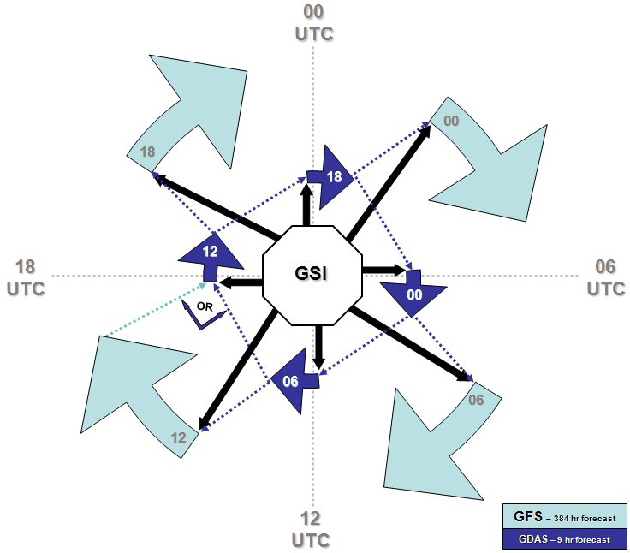
Timeline of GFS, GDAS and SDAT in realtime
GFS: refers to the "early run“, is initiated approximately 2 hours and 45 minutes after the cycle time. The gfs run gets the full forecasts (384 hrs) delivered in a reasonable amount of time.
GDAS: refers to the "final run", is initiated approximately 6 hours after the cycle time. The gdas allows for the assimilation of later arriving data. The gdas run includes a 9 hrs forecast to provide the first guess to both the gfs and gdas for next cycle.
SDAT: is initiated 5 hrs and 30 minutes after the cycle time. It needs latest gfs forecast and earlier gdas run as boundary and initial conditions. SDAT runs 72 hrs forecast after analysis.
sdat
18
gfs
gdas
00
12
06
SDAT 72 hr forecast

Slide 6
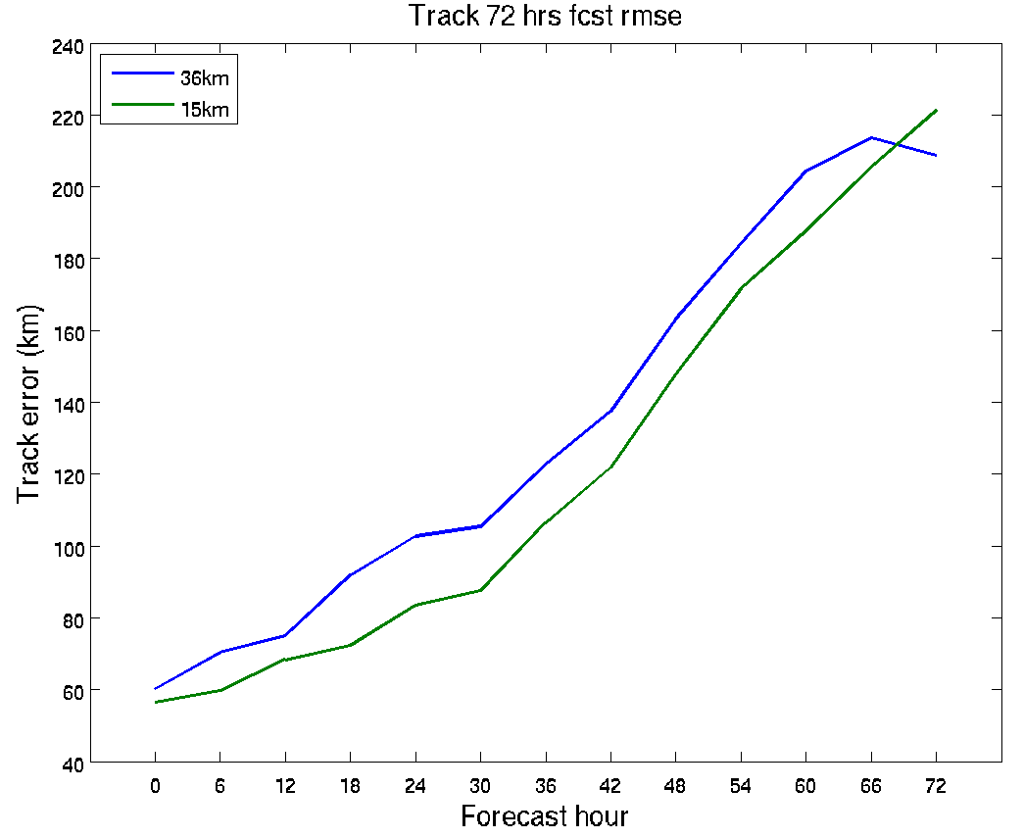
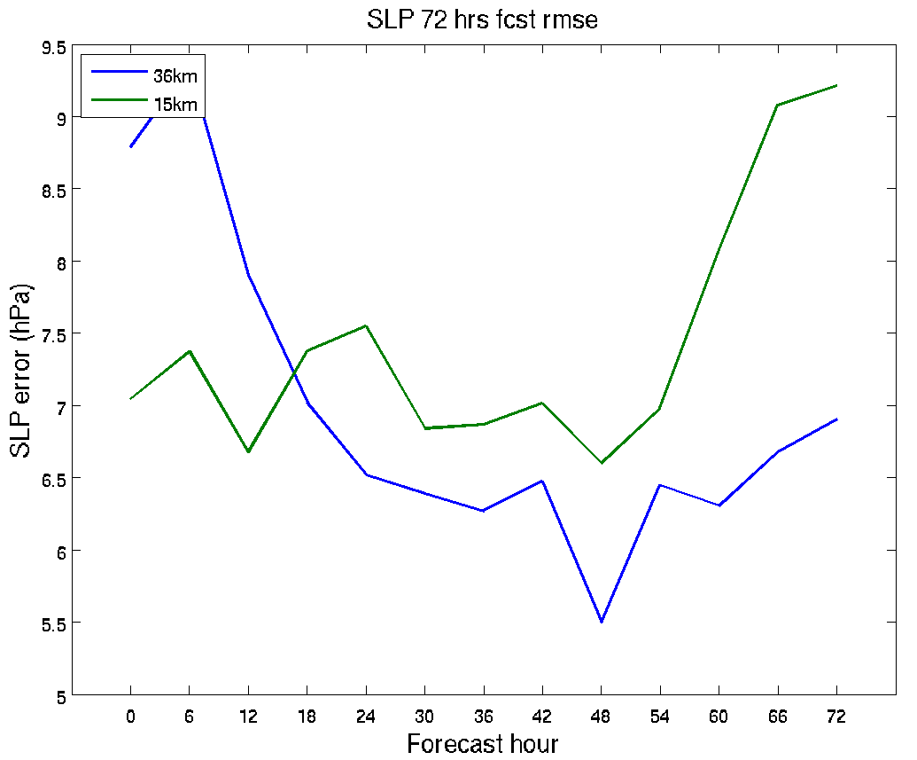
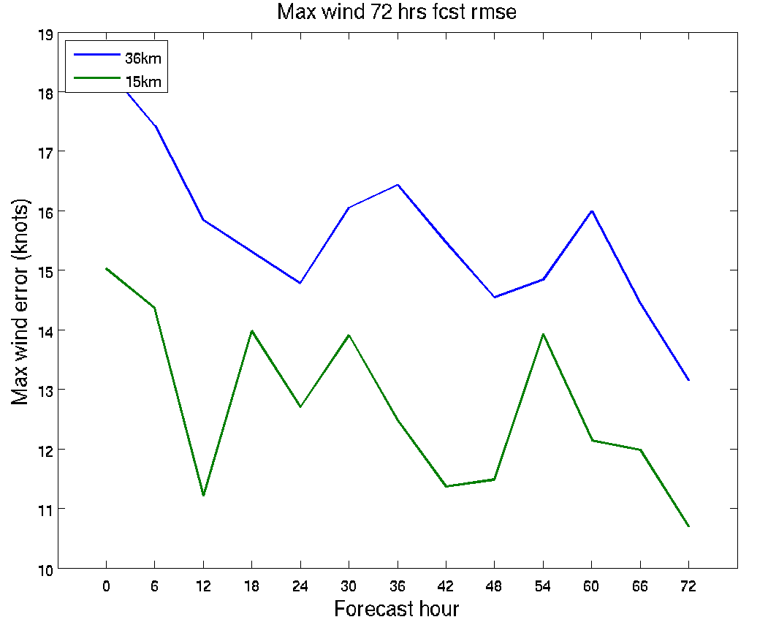
Hurricane Sandy (2012) − Horizontal resolution impact
(Sandy: 18 UTC 20121022 – 00 UTC 20121030)
Track forecast error
SLP forecast error
Maximum wind forecast error
High resolution (15 km) run shows consistent improvement in hurricane track and maximum wind speed.

Slide 7
Flow chart to run standard vortex tracker
Check NATL hurricane
No
Exit
Loop each NATL hurricane
Yes
Link wrf output file
Prepare tcvital data,
Prepare input parameter, data
Loop forecast time
Run tracker
Disjoin wrf output
(extract individual time data)
Reorganize tracker output
Prepare ncl plot input
Run unipost
(diagnosis and vertical interpolation)
Plot individual storm track/intensity
Do copygb
(horizontal interp. and map conversion)
Plot all hurricane track together
File archive/storage
Merge all single diagnostic files into one grib file
(Tracking variables: mslp, vorticity and gph at 700,850 mb, winds at 10m, 700, 850 mb)
Notes:
Trackers: mslp, vorticity and gph at 700,850 mb, winds at 10m, 700, 850 mb,
Method: Find minimum/maximum points based on Gaussian weighted-average data surrounding the guess position, then do center fixes through a few iterations, then do quality check (mslp gradient, VT at 850 mb, mslp_850 center difference, storm translation speed), finally average these parameters to get mean position,

Slide 8
SDAT serves as research testbed
Research progress has been made using SDAT on
  Impact of Infrared (IR) and Microwave (MW) sounders;
  Radiance assimilation versus sounding assimilation;
  Better cloud detection for radiance assimilation;
  Cloud-cleared radiance assimilation.

Slide 9
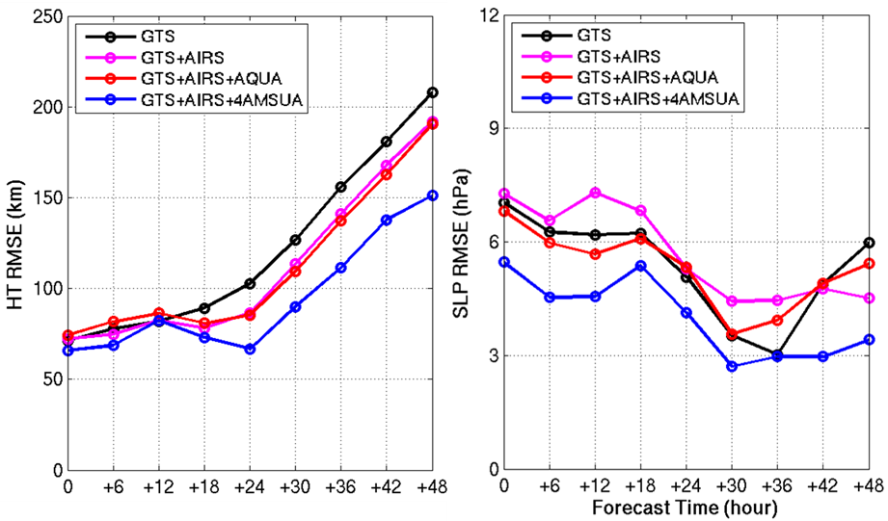
Hurricane Irene (2011) – data impact studies
4AMSUA from N15, N18, Metop-a and Aqua
Data are assimilated every 6 hours from 06 UTC August 22 to 00 UTC August 24, 2011 followed by 48-hour forecasts (WRF regional NWP model with 12 km resolution). Hurricane track (HT) (left) and central sea level pressure (SLP) root mean square error (RMSE) are calculated.
Notes:
In all the assimilation experiments, data are assimilated every 6 hours from 06 UTC August 22 to 00 UTC August 24, 2011 followed by 48-hour forecasts, the spatial resolution of WRF is 12 km in these experiments. Figure 2 shows the track and intensity (central sea level pressure) root mean square error (RMSE) for the forecasts of 00 hour, 06 hour, …., and 48 hours. The 00 hour forecast is from the analysis after assimilation. The AIRS and AMSU channels used are the same as that that used in the NCEP global NWP models, and AIRS and AMSU radiances are used in these experiments. It can be seen than when AIRS and all available AMSU (NOAA15, NOAA18, Aqua and Metop –A) are used, the track and intensity forecasts have the best accuracy (smallest RMSEs) during the forecast period, indicating that both advanced IR and microwave sounder data are needed for improving the tropical cyclone forecasts. Since the soundings are ingested into the PrepBUFR format, our next work is to compare assimilation of radiances and assimilation of soundings.

Slide 10
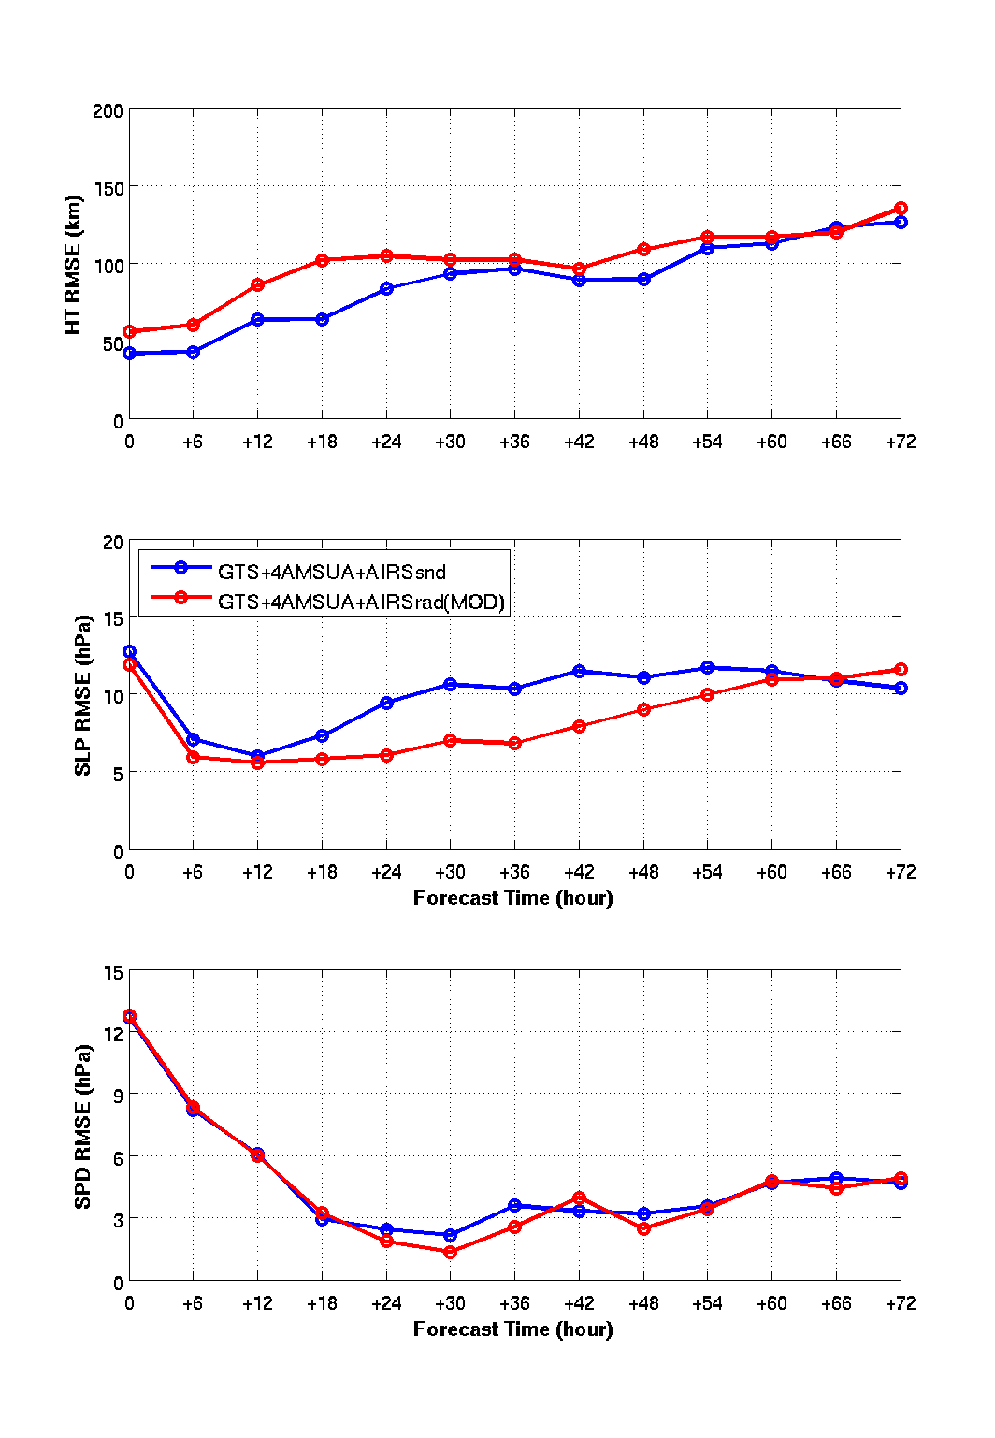
Hurricane Sandy (2012) – radiance vs sounding
4AMSUA from N15, N18, Metop-a and Aqua
Sounding retrievals use much more channels.
(m/s)
“On the Equivalence between Radiance and Retrieval Assimilation”
By Migliorini (2012) (University of Reading ) – Monthly Weather Review
“Assimilation of transformed retrievals may be particularly advantageous for remote sounding instruments with a very high number of channels or when efficient radiative transfer models used for operational assimilation of radiance measurements are not able to model the spectral regions (e.g., visible or ultraviolet) observed by the instrument.”
Notes:
Forecasts started at 00 UTC 28 Oct 2012 valid 00 UTC 30 Oct 2012. WRF/GSI with 12 km resolution.

Slide 11
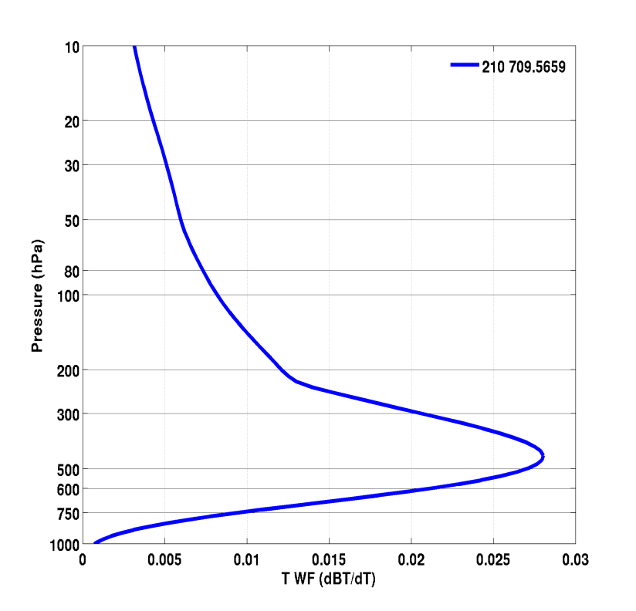
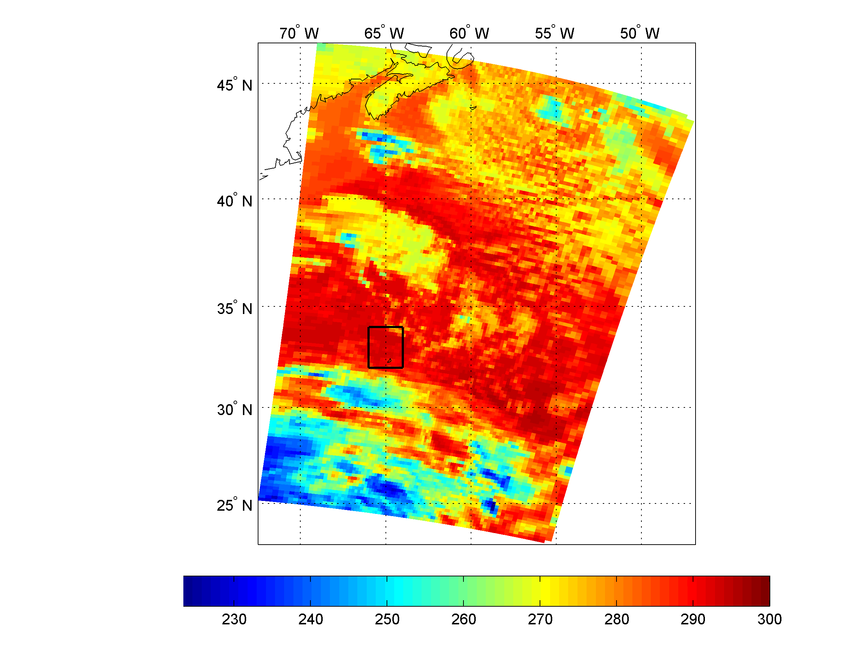
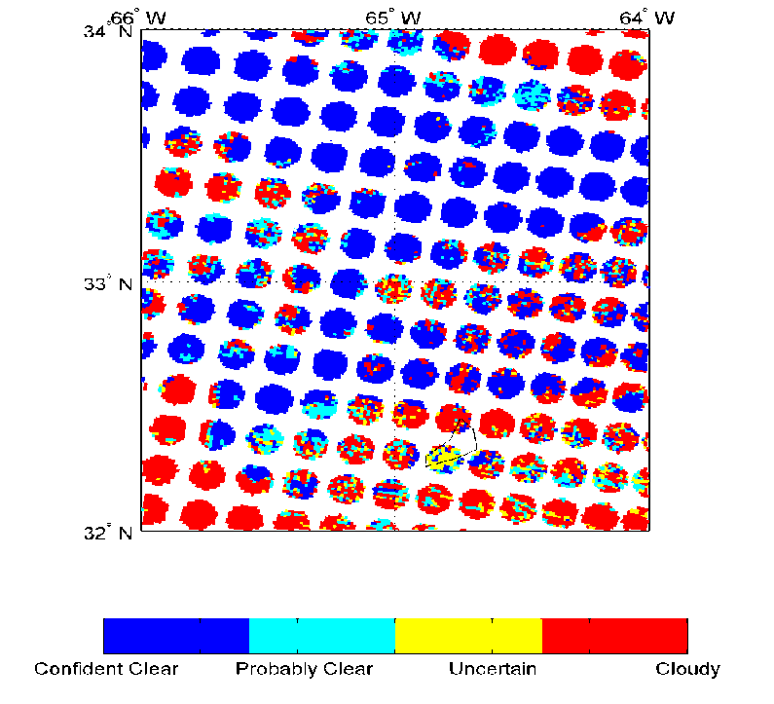
Better cloud detection for hyperspectral IR radiance assimilation
AIRS stand-alone cloud detection
MODIS cloud detection
Channel Index 210, Wave number 709.5659
AIRS data at 06 UTC 25 October 2012 (Sandy)
AIRS sub-pixel cloud detection with MODIS
AIRS 11.3 µm BT (K)
Wang et al. 2014 (GRL)

Slide 12
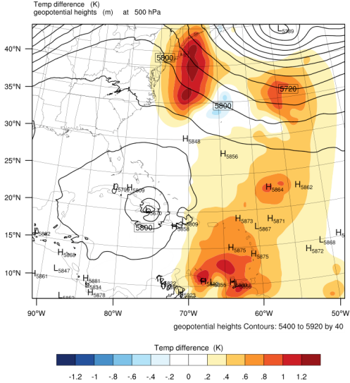
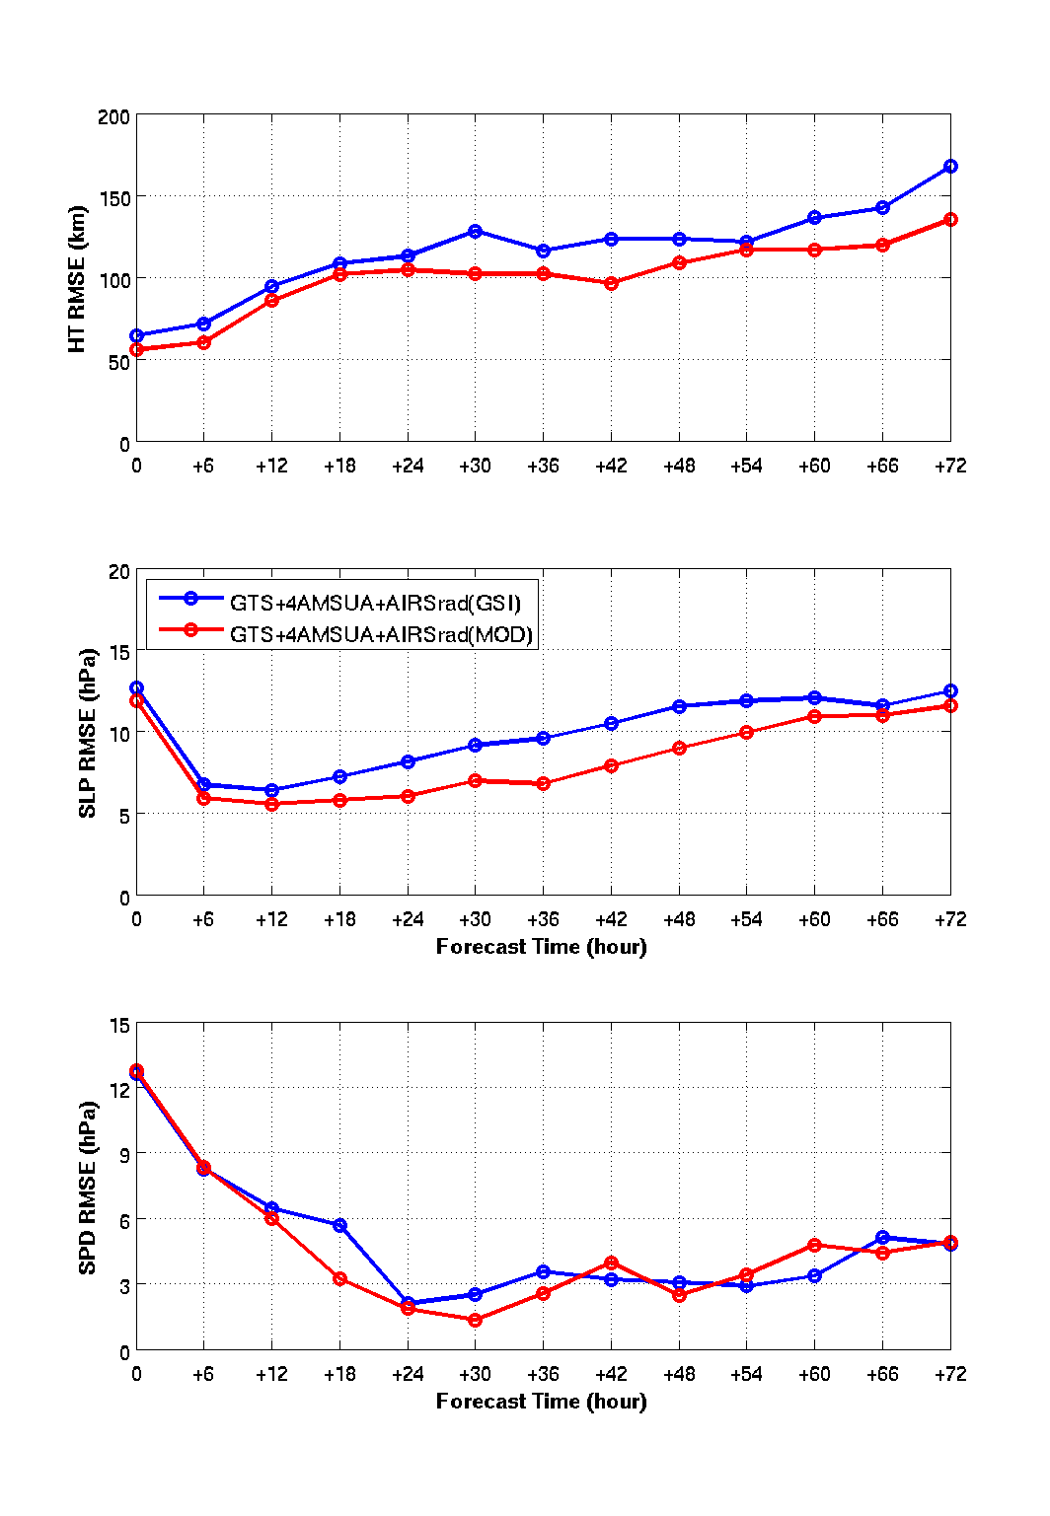
Handling clouds in radiance assimilation (cont.)
Hurricane Sandy (2012) forecast RMSE
(m/s)
500 hPa temperature analysis difference (AIRS(MOD) - AIRS(GSI))
72-hour forecasts of Sandy from 06z 28 to 00z 30 Oct, 2012
Wang et al. 2014 (GRL)

Slide 13
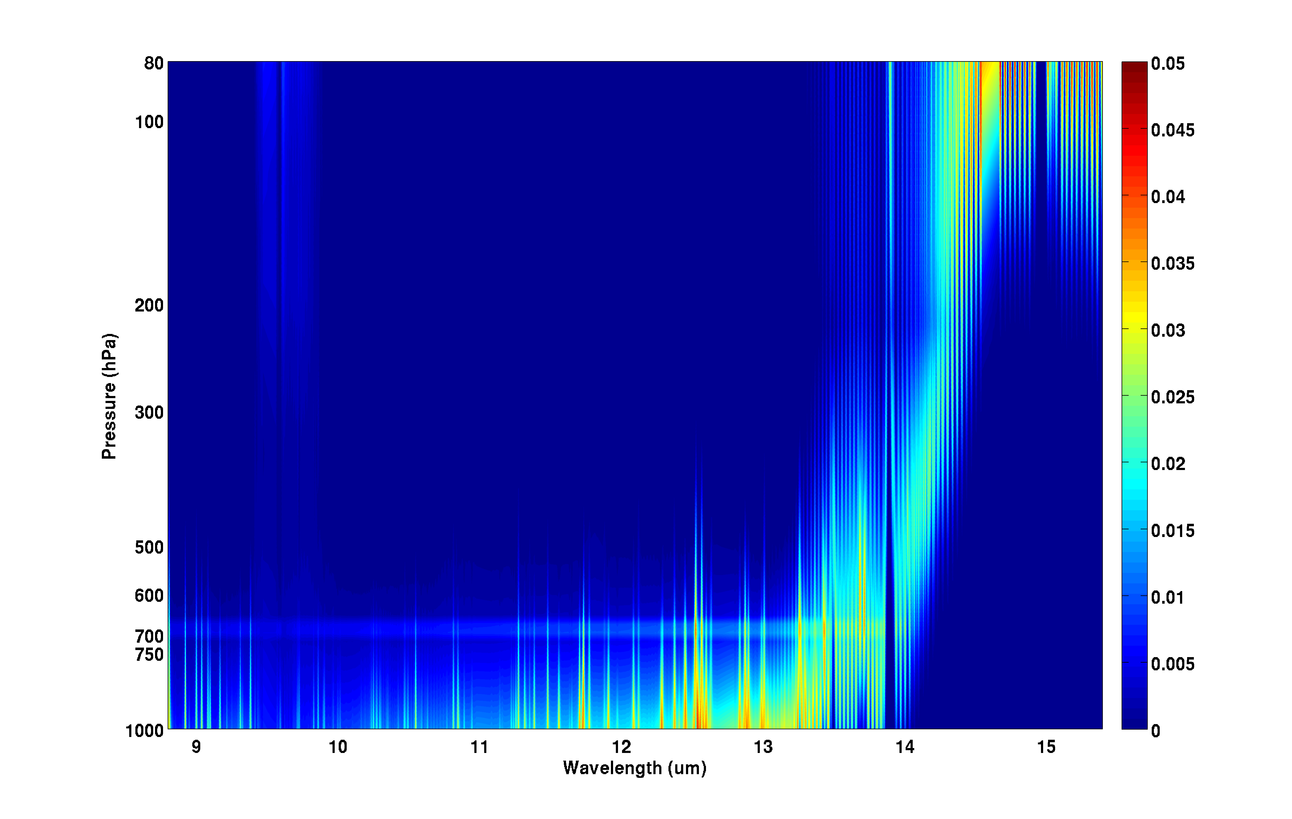
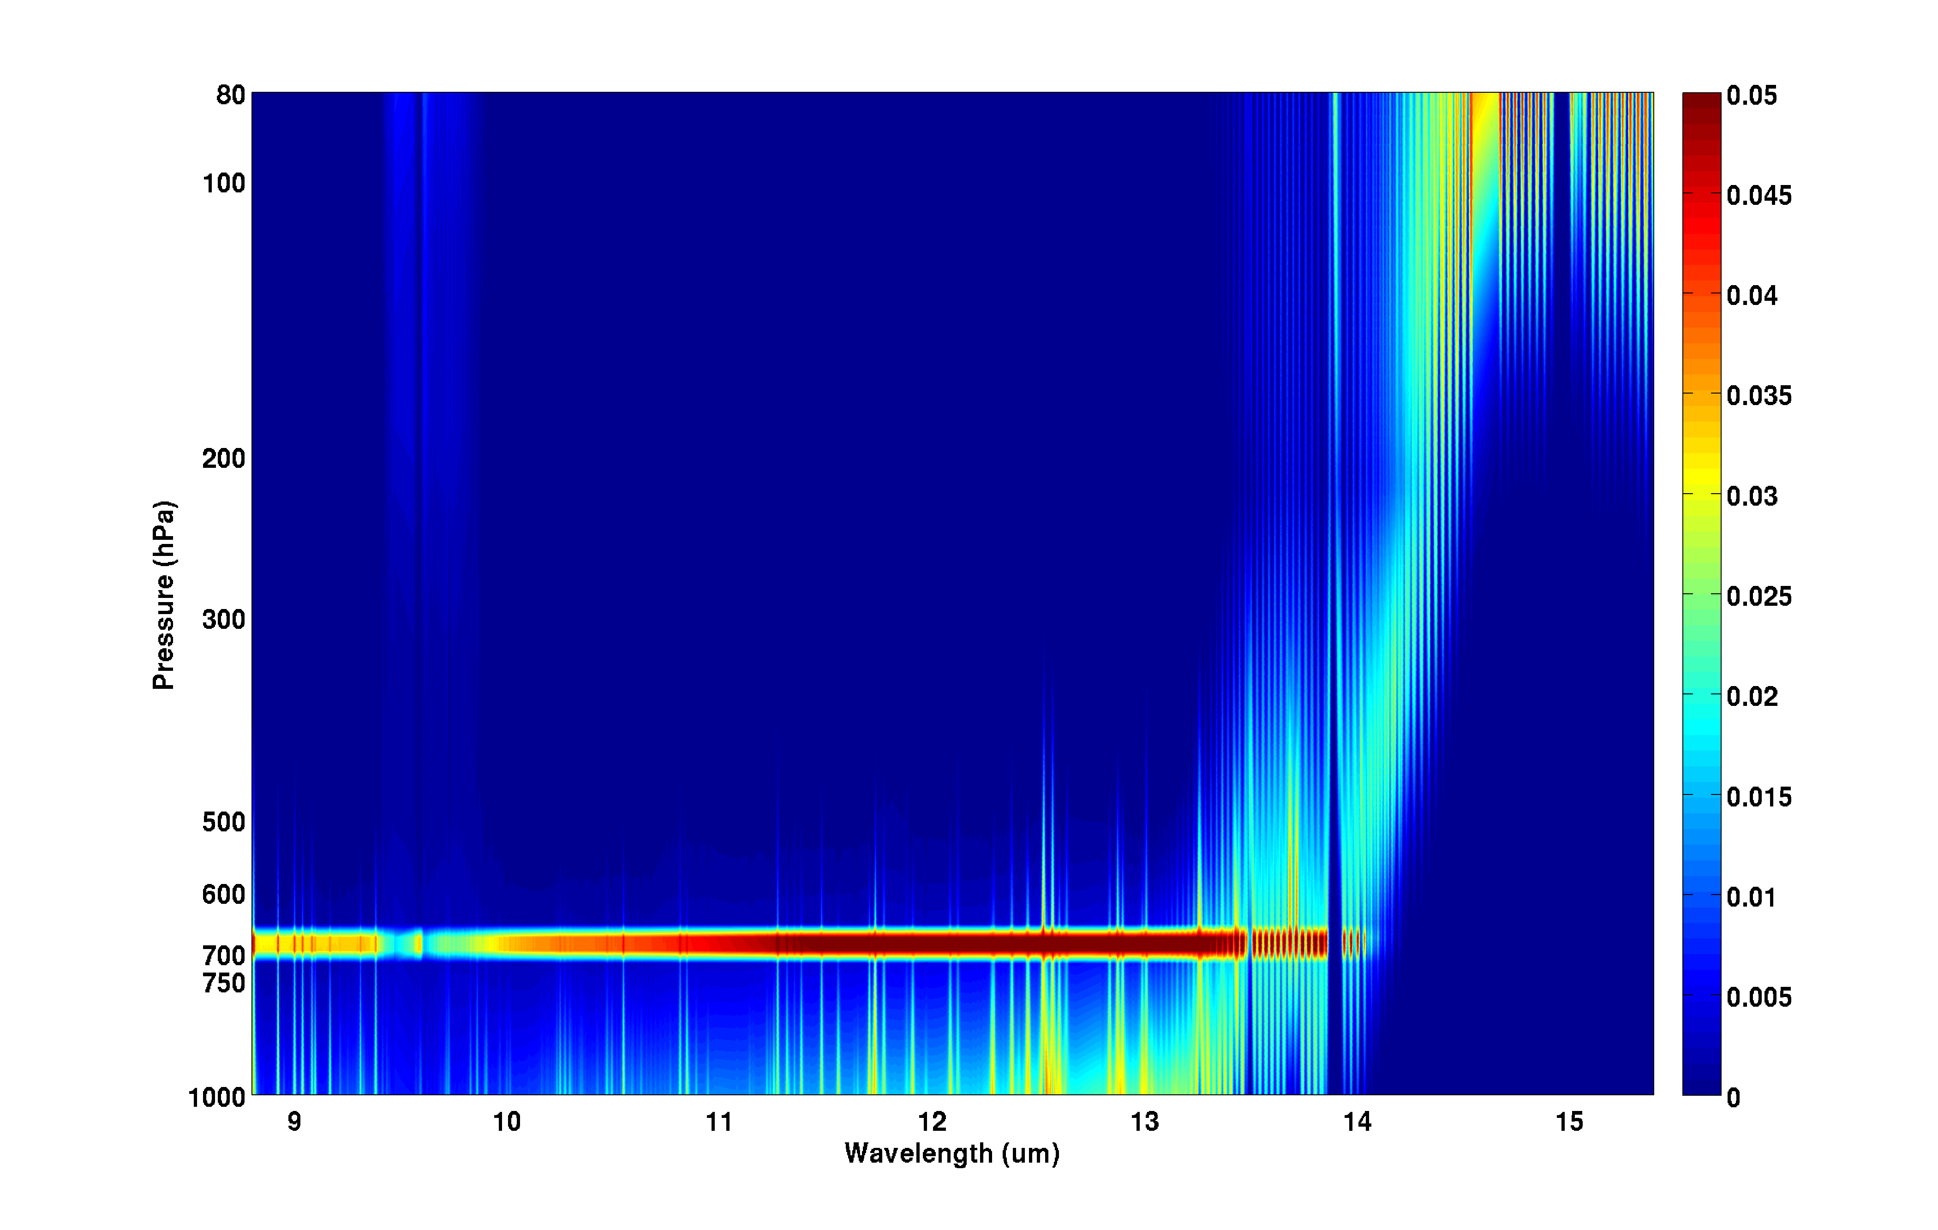
AIRS longwave temperature Jacobian with a cloud level at 700 hPa.
Challenges on assimilating radiances in cloudy situation:
(1) Both NWP and RTM have larger uncertainty;
(2) Big change of Jacobian at cloud level
COT = 0.05
COT = 0.5

Slide 14
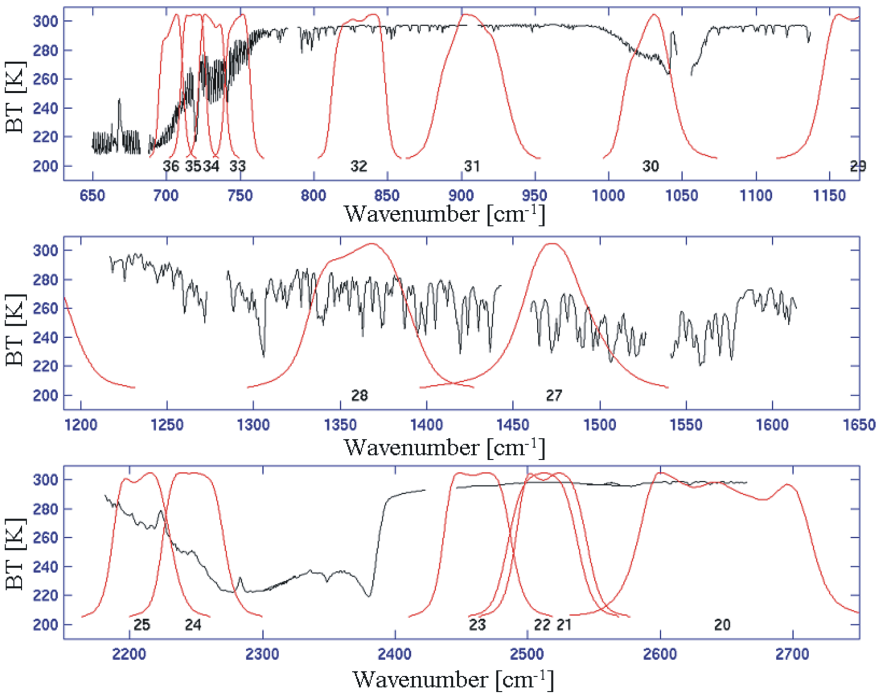
Aqua MODIS IR SRF Overlay on AIRS Spectrum
Direct spectral relationship between IR MODIS and AIRS provides unique application of MODIS in AIRS cloud_clearing !

Slide 15
R¹
R²
AIRS/MODIS cloud-clearing (Li et al.2005)
is NEdR for MODIS band
solve

Slide 16
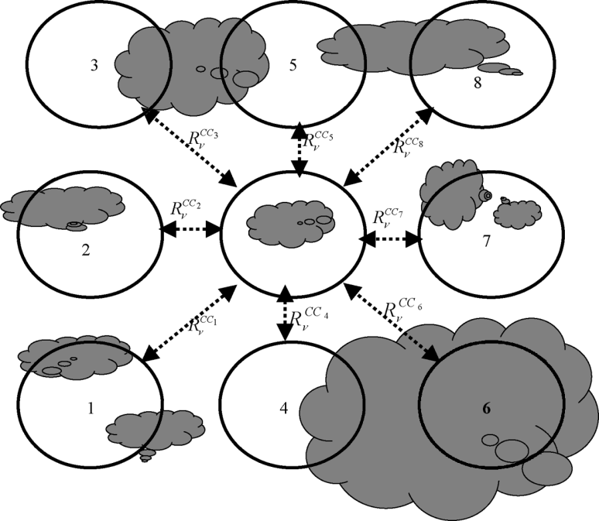
For each cloudy AIRS FOV, 8 pairs are used to derive 8 AIRS CC radiance spectra;
Compare AIRS CC radiances with MODIS clear radiance observations within the AIRS FOV, find the best pair and the corresponding CC radiance spectrum.
AMSU-A
AIRS

Slide 17
AIRS global clear and cloud clearing brightness temperature (descending) on Jan. 1, 2004.

Slide 18
Rienecker et al. 2008: GMAO’s Atmospheric Data Assimilation
Contributions to the JCSDA and future plans, JCSDA Seminar, 16 April 2008.
• GEOS-5 model resolution: 1°x1.25°x72L
• Time frame: Jan 01 to Feb 15 2004
• Other Radiance data:
– HIRS-2/HIRS3 (clear channels)
– AMSU-A/EOS-AMSU-A
– AMSU-B/MHS
– SSM-I
– GOES Sounders

Slide 19
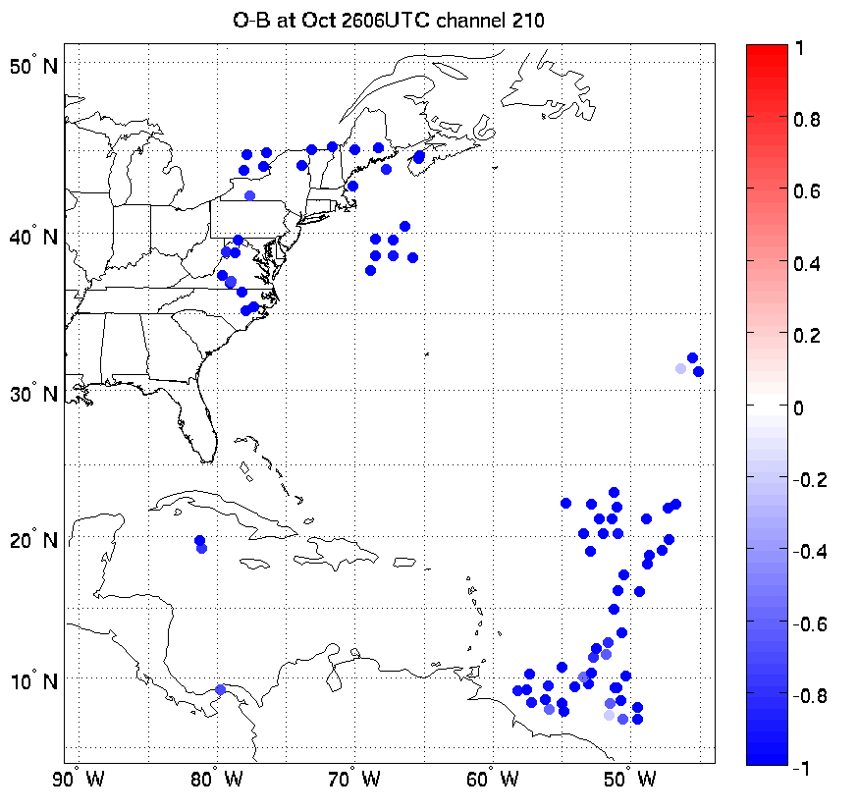
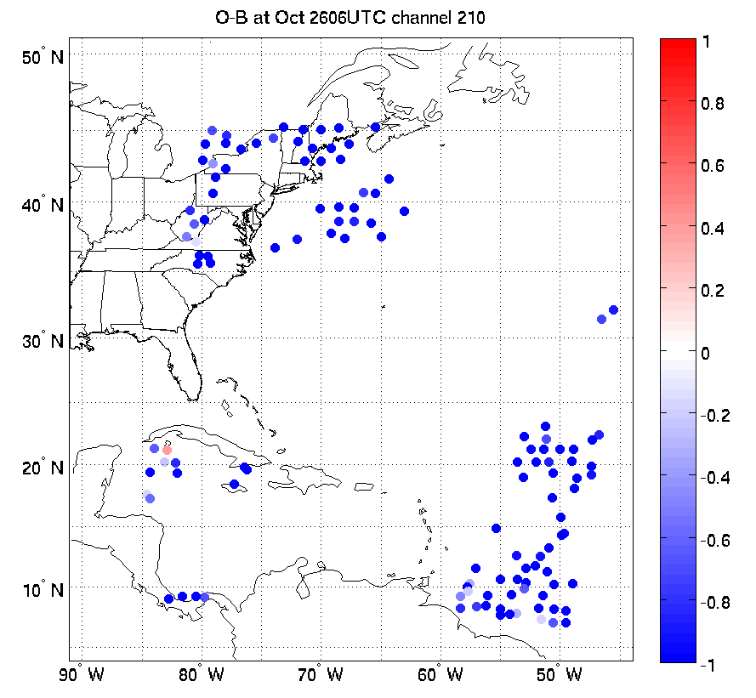
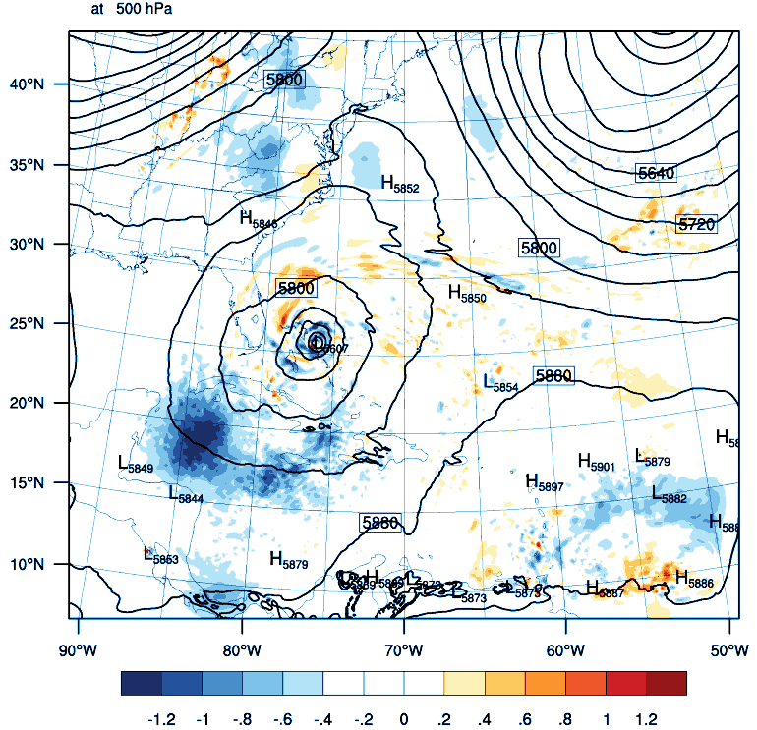
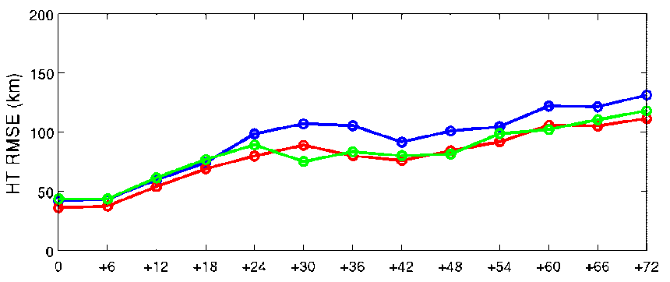
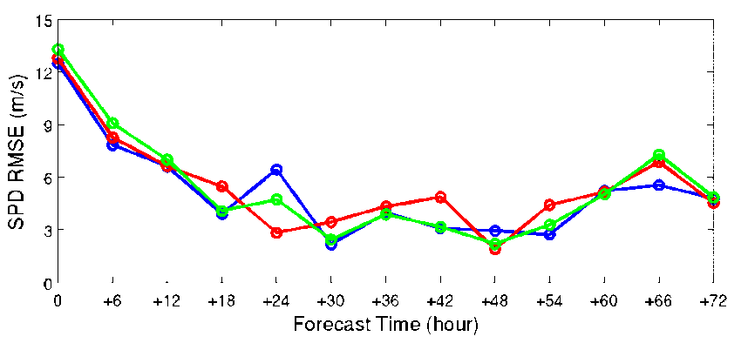
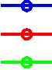
AIRS Channel 210, 2012-10-26-06 Z
AIRS clr
AIRS clr + AIRS cc
Track forecast error
GTS+4AMSU+AIRS (GSI)
GTS+4AMSU+AIRS (clr)
GTS+4AMSU+AIRS(clr+cc)
Maximum wind speed forecast error
T analysis difference at 500 hPa between AIRS clr+cc and AIRS clr
Notes:
Forecasts started at 00 UTC 28 Oct 2012 valid 00 UTC 30 Oct 2012. WRF/GSI. AIRS (GSI) means AIRS cloud detection with GSI system. AIRS channel 210: 709.57 cm**-1.

Slide 20
SDAT evaluation
Hurricane Sandy (2012) and 2013 hurricanes
Near real-time demonstration
GOES Imager brightness temperature measurements

Slide 21
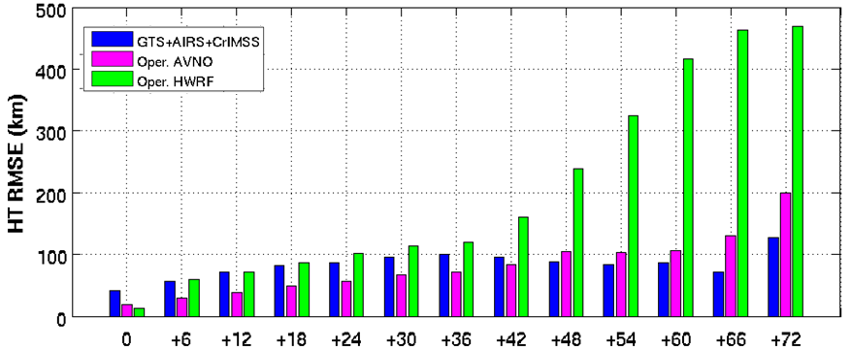
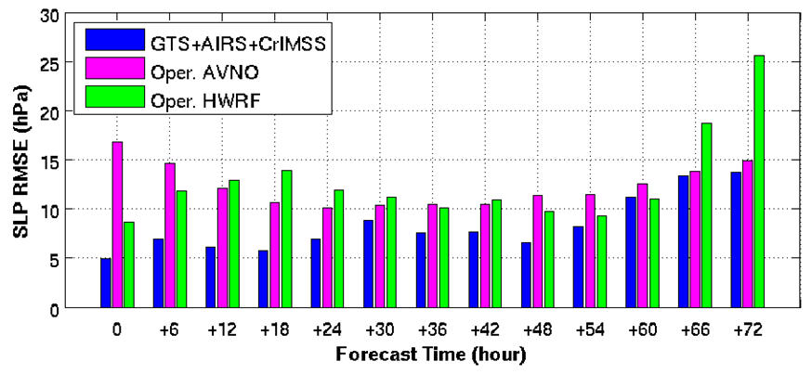
Hurricane Sandy (2012) 72-hour forecast experiments with SDAT
Track forecast RMSE
SLP forecast RMSE
Sandy forecast RMSE (km) from CIMSS experimental (WRF/GSI with 12 km resolution) with GTS, AIRS and CrIMSS data assimilated, operational HWRF, and GFS (AVNO). Forecasts start from 12 UTC 25 Oct and valid 18 UTC 30 Oct 2012.

Slide 22
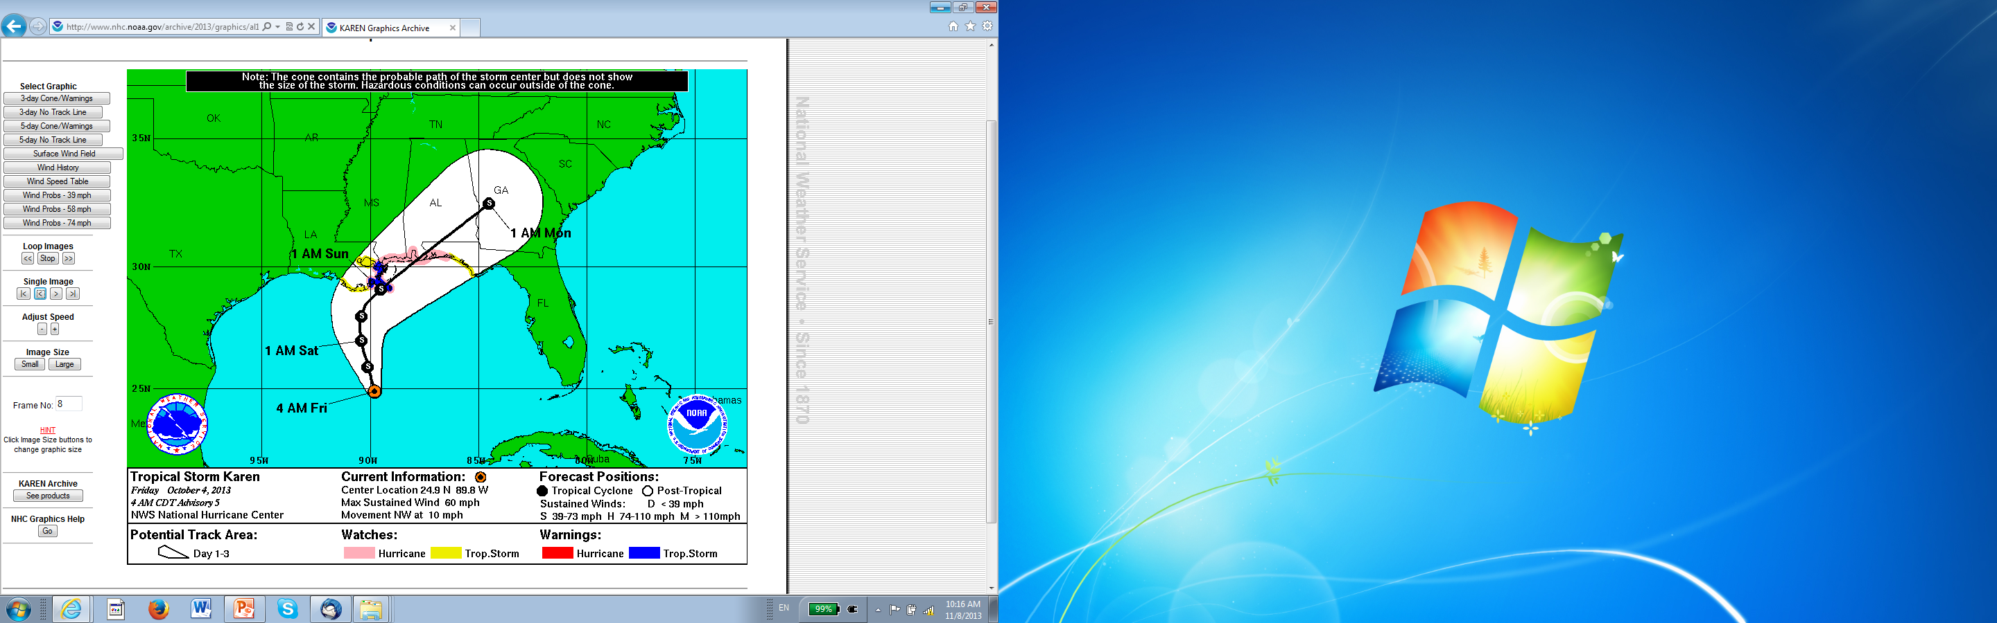
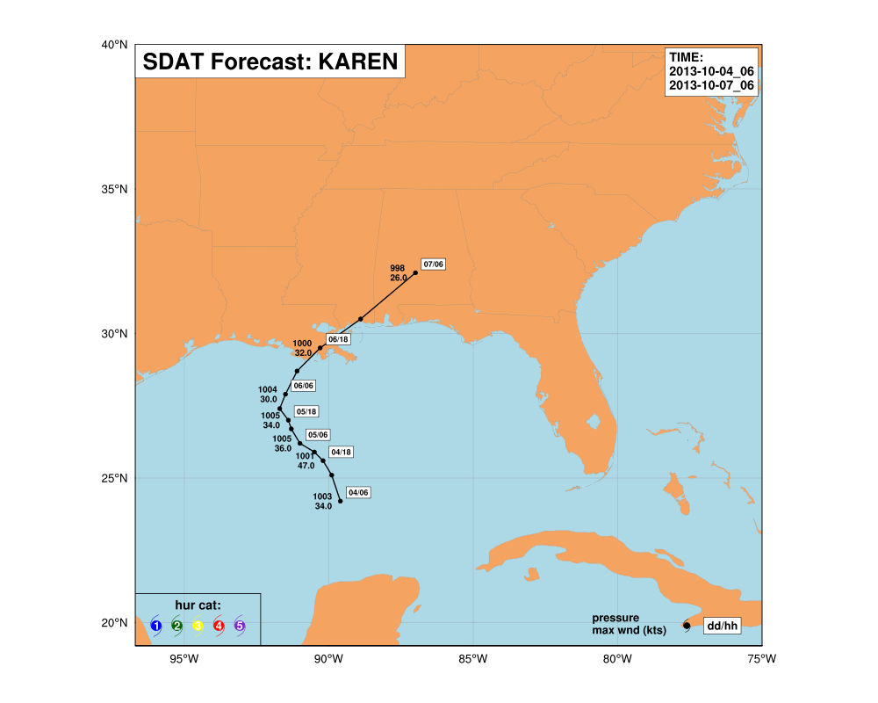
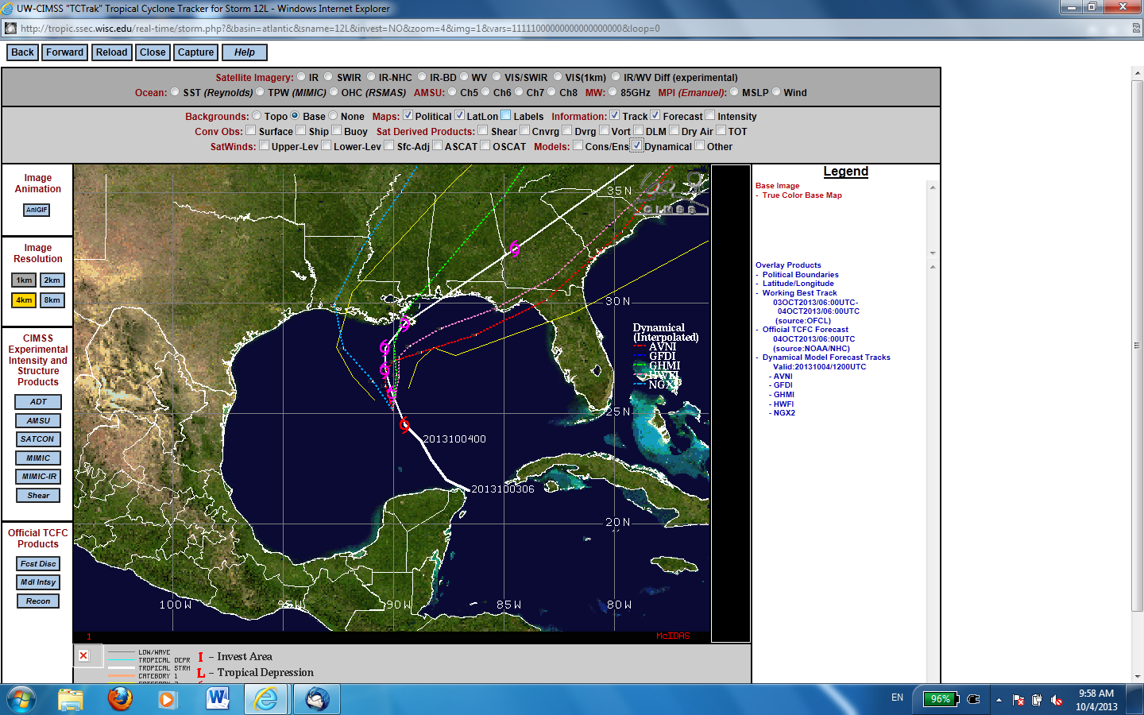
Realtime forecasts: storm Karen (2013)
Upper Left: NHC 4 AM CDT (09 UTC) Advisory (Friday 04 October 2013)
Lower left: SDAT track forecasts started at 06 UTC 04 October valid 06 UTC 07 October 2013)
Lower right: Other dynamic models
(06UTC)
(09UTC)
SDAT 3-day forecasts

Slide 23
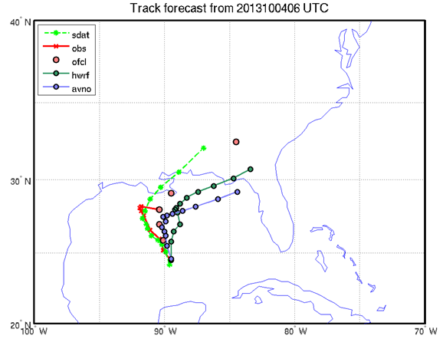
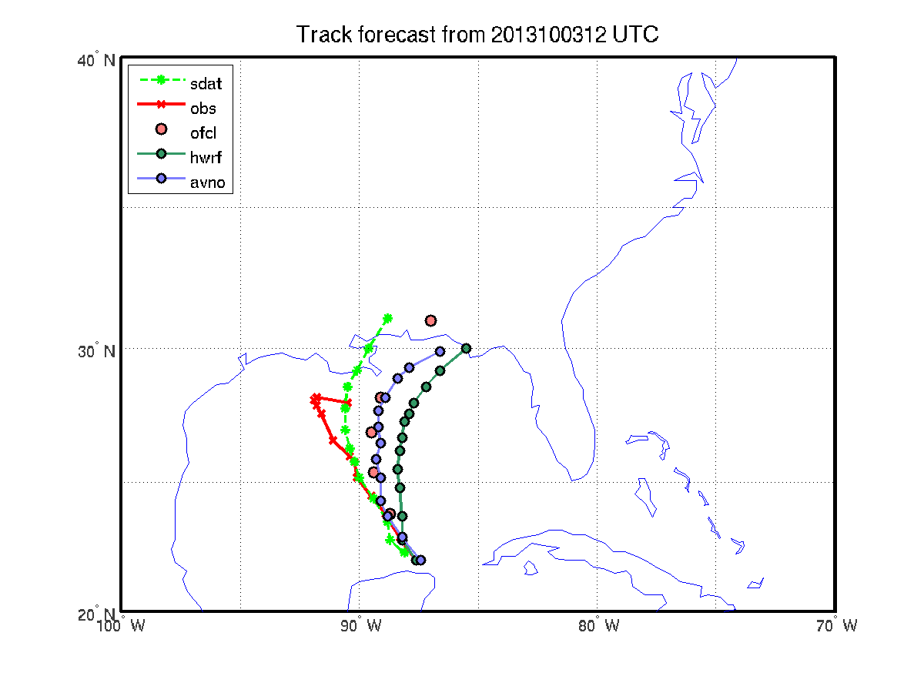
Hurricane Karen 72 hours forecast
2013100312 - 201100612
ofcl
sdat
hwrf
avno
Best track data only available until 06 UTC 6 Oct. 2013
Hurricane Karen track forecasts matched with available observations.

Slide 24
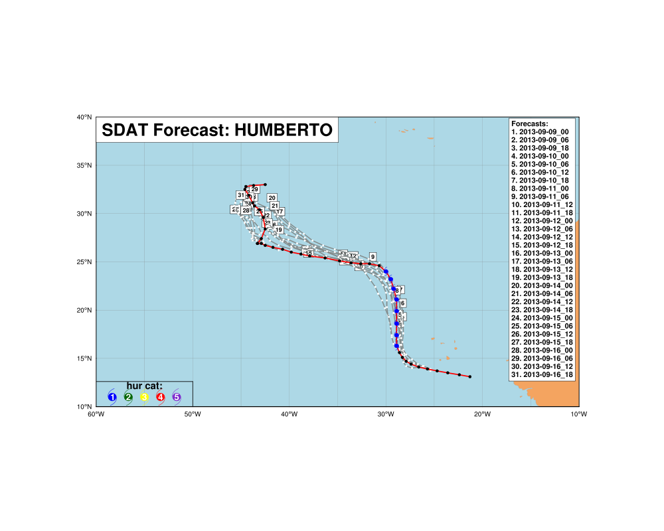
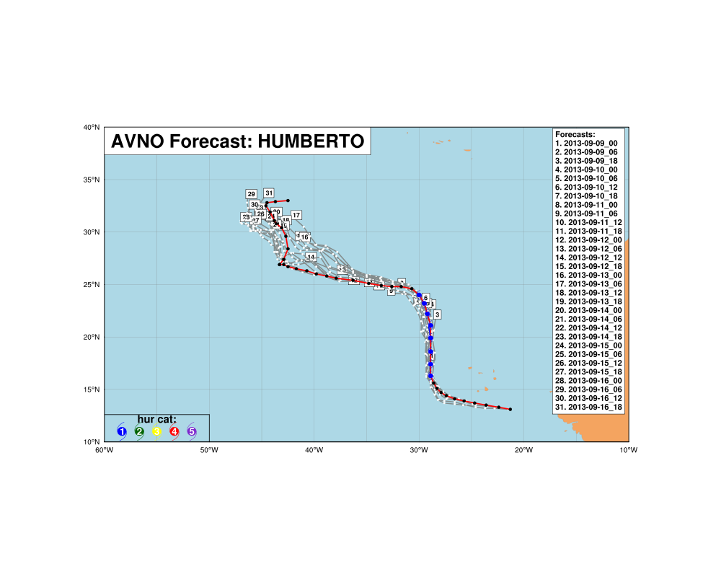
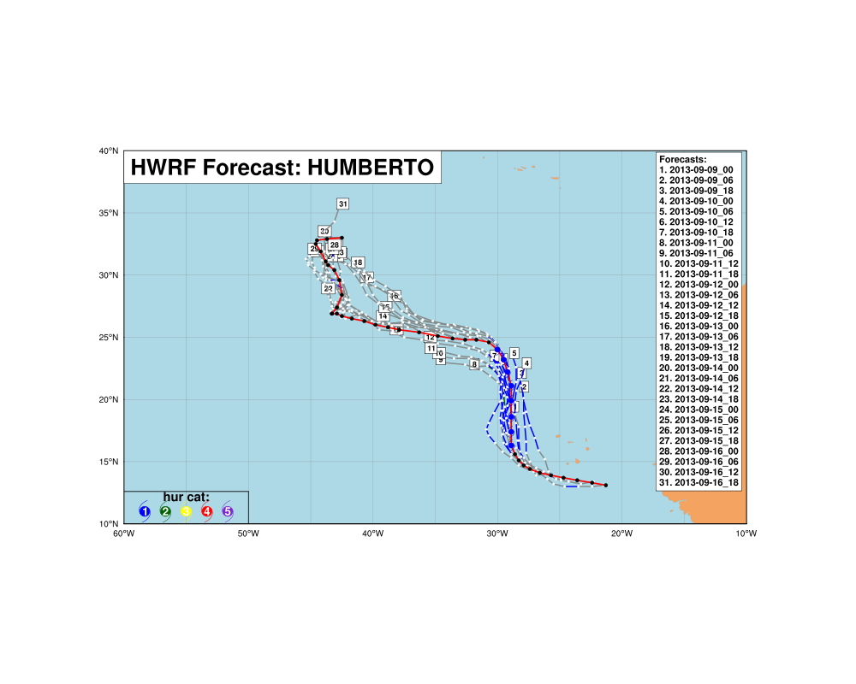
Life cycle- Humberto 72 hours forecast
2013090900 - 2013091618

Slide 25
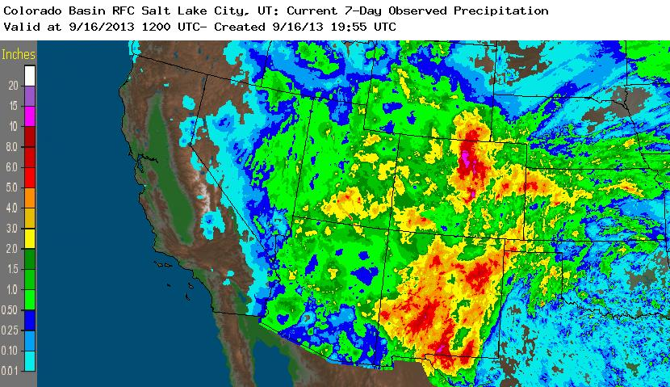
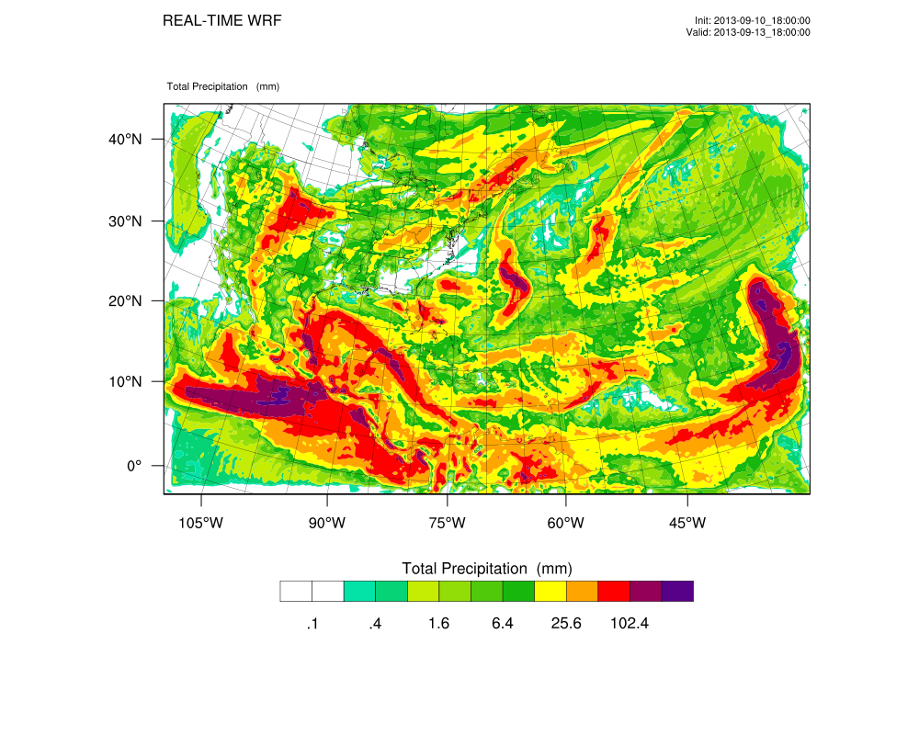
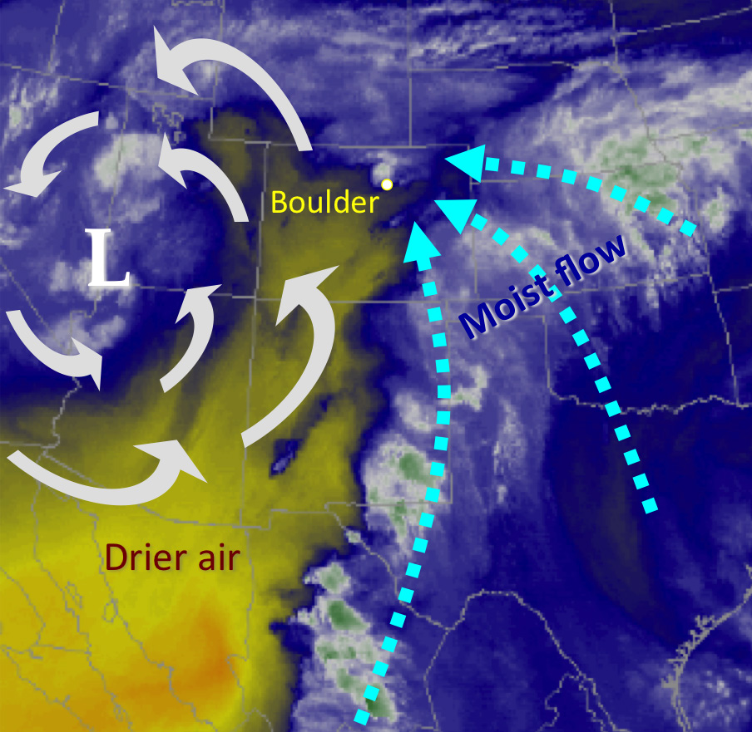
During the week starting on September 9, 2013, a slow-moving cold front stalled over Colorado, clashing with warm humid monsoonal air from the south. This resulted in heavy rain and catastrophic flooding along Colorado's Front Range from Colorado Springs north to Fort Collins. The situation intensified on September 11 and 12. Boulder County was worst hit, with 9.08 inches (231 mm) recorded September 12 and up to 17 inches (430 mm) of rain recorded by September 15, which is comparable to Boulder County's average annual precipitation (20.7 inches, 525 mm).
7-day observed precipitation (inches) valid at 9/16/2013 12 UTC
The 72 hour cumulative forecasts (mm) from SDAT started at 18 UTC on 10 September 2013.
Notes:
Deep plumes of moisture (blue, white, and green) are drawn
towards the Front Range from the Pacific and the Gulf of Mexico by the circulation around an upper-level low (L) over the Great Basin, at 11:15 pm MDT on September 11, 2013, during the peak rainfall intensity in Boulder. Drier air is shown in yellow. (Satellite image: CIMSS, University of Wisconsin).

Slide 26
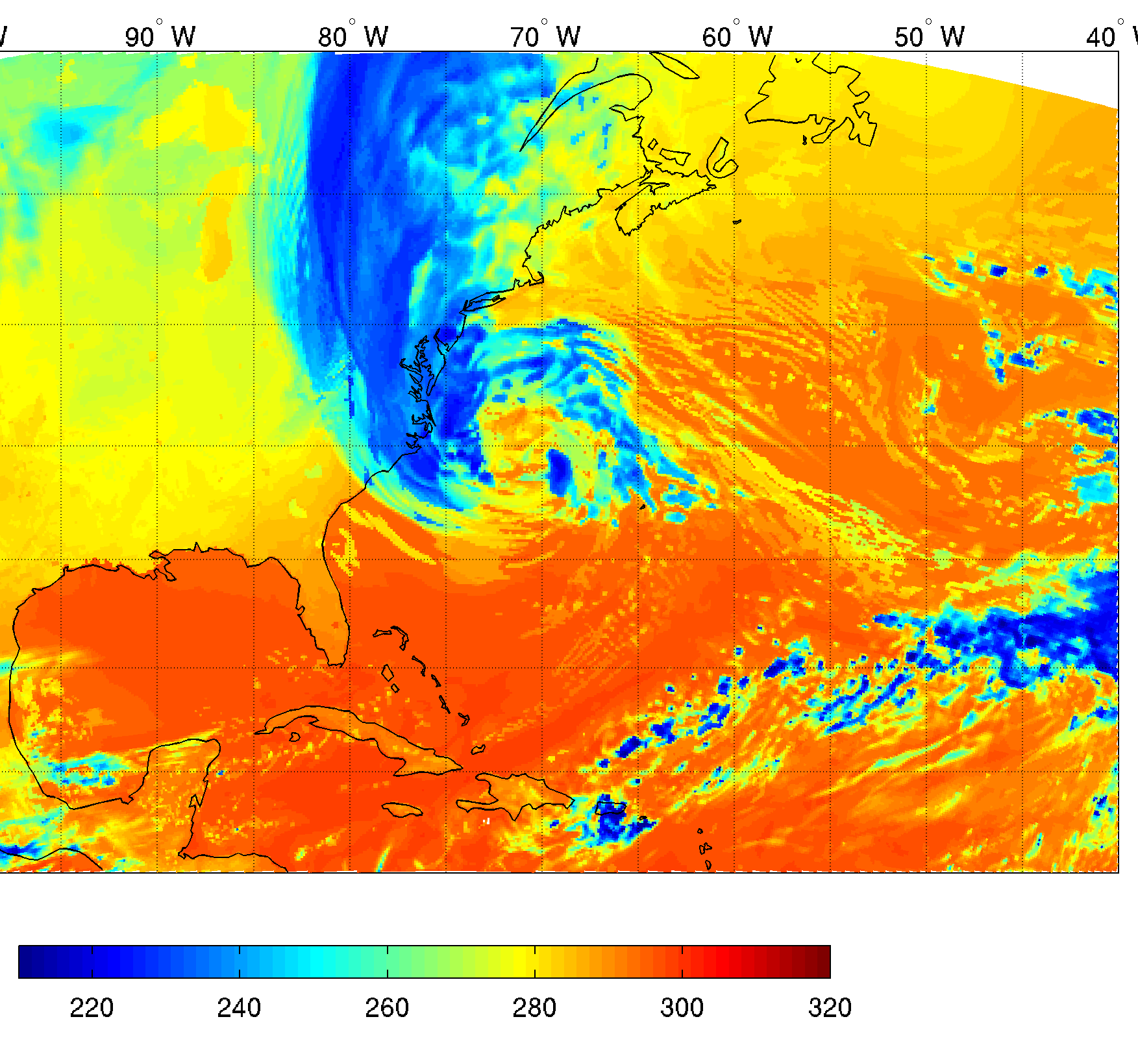
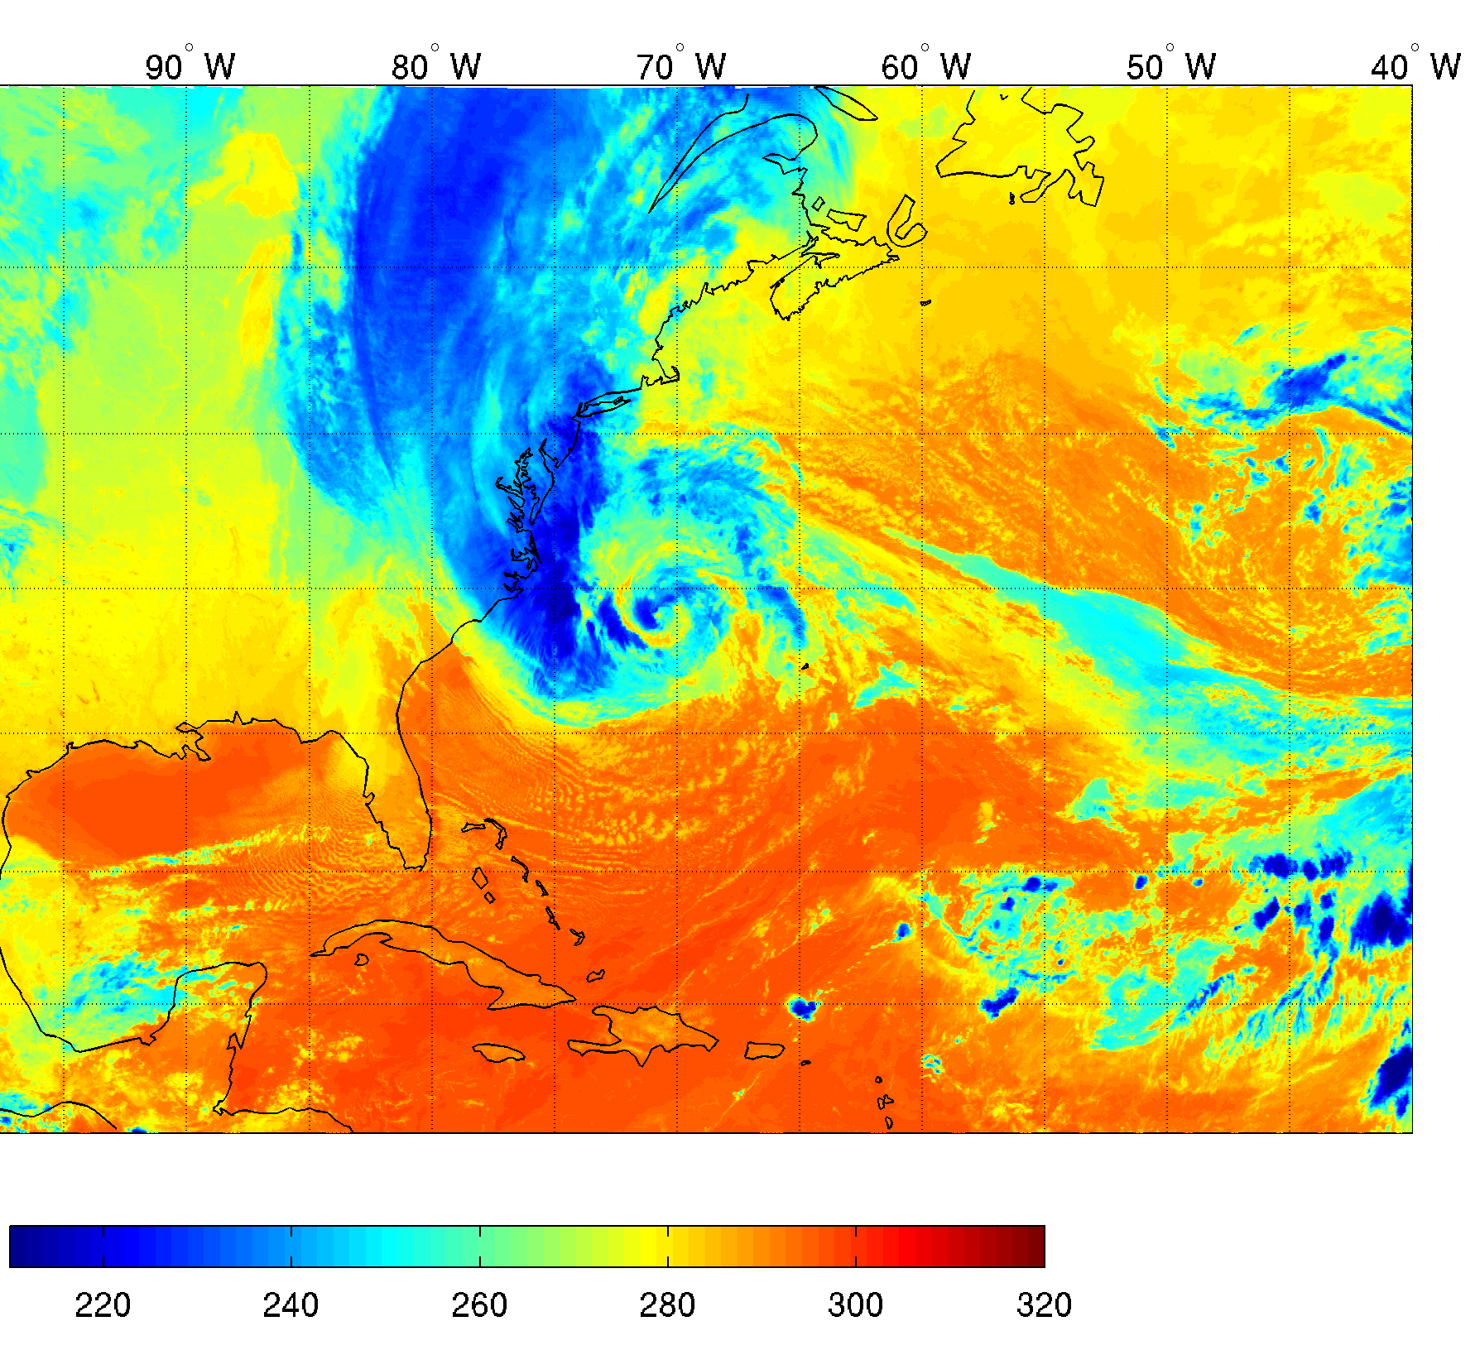
Forecast verification with GOES Imager/GOES-R ABI
This verification with GOES Imager will be part of SDAT before May 2014
Simulated GOES-13 Imager 11 µm BT
from SDAT experimental forecasts
(36 hour forecasts for Hurricane Sandy started 18 UTC 27 October 2012)
GOES-13 Imager 11 µm BT observations

Slide 27
Summary and plans
Summary
  A near realtime satellite data assimilation for tropical cyclone (SDAT) system has been developed at CIMSS.
  A few tools have been developed for satellite data preparation, conversion, model; validation and post-analysis.
  Researches have been conducted on satellite data impacts, handling clouds, assimilation strategies, etc.
  The system has been run in near realtime since August 2013. The system is pretty stable and the preliminary validations are encouraging.
Plans
  Collaborate with CIRA on the application of SDAT in proving ground the coming hurricane season to get the track/intensity information in the Automated Tropical Cyclone Forecast (ATCF) system that NHC uses;
  Collaborate with EMC on using hybrid GSI and HWRF etc;
  Collaborate with Dr. Mark DeMaria to put our realtime hurricane forecast into his statistical model ensemble for realtime application;
  Develop layer precipitable water (LPW) module and tools in GSI, test its impact;
  More focus on how to use moisture information (radiance, soundings, TPW, LPW)
  Combine both GOES and LEO sounder data, prepare for GOES-R data application;
  Simulated GOES imager (11 and 6.7 µm) and ABI IR bands from SDAT forecasts in NRT.
http://cimss.ssec.wisc.edu/sdat

