Slide 1
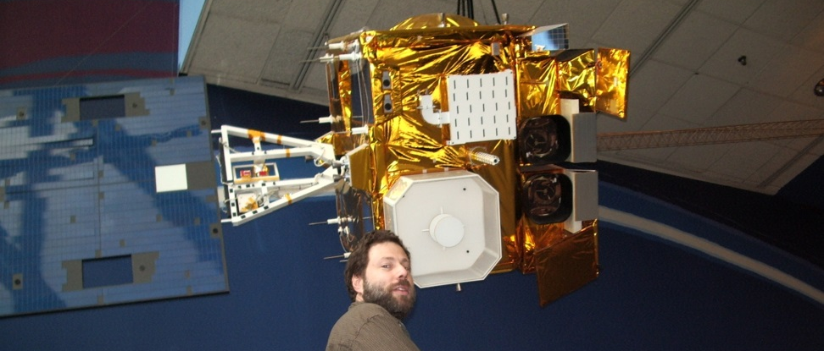
Current GOES (Imager and Sounder)
de facto NOAA GOES Instrument Scientist
GOES-14 1min lead (idea, schedule, sector placement)
GOES-V/W Science Support (geo-OSSE, etc.)
GOES-R AWG Imagery Team Lead
Responsible for team with the KPP.
GOES-R AWG Soundings Team Lead
Legacy (10km) DPI, etc.
GOES Product Working Group
Key member wrt ABI
Waivers, etc.
GOES-R (Misc)
DOE, CWG/CVCT, AHI, ABI scan modes, etc.
Other committees
NOAA Satellite Conference.
AMS co-chair for Next Satellite Symposium
Education/Outreach
Web Apps
ABI band fact sheets
Roof Top Cameras + GOES
OSPO Support
Support when needed, imager and sounder (outages)
Calibration (dropped blocks, stray light)
Navigation
Product impacts (RSO schedules)
Tim Schmit

Slide 2
GOES-14 Super Rapid Scan Operations to Prepare for GOES-R (SRSOR)
SRSOR for 2015 include May 18-June 12, and August 10-22:
http://cimss.ssec.wisc.edu/goes/srsor2015/GOES-14_SRSOR.html
Data during parts of 2012 (Hurricane Sandy, convection), 2013 (CA Rim Fire, convection) and 2014 (Hurricane Marie, convection).
GOES-14 provided very unique data and offered a glimpse into the possibilities that will be provided by the ABI on GOES-R in one minute mesoscale imagery
Used by many in the NWS, including NOAA’s Storm Prediction Center (SPC), Weather Prediction Center (WPC) and others.
GOES-14 visible image showing rapid convective
(loops over just half an hour)
Notes:
http://cimss.ssec.wisc.edu/goes/srsor2015/GOES-14_SRSOR.html

Slide 3
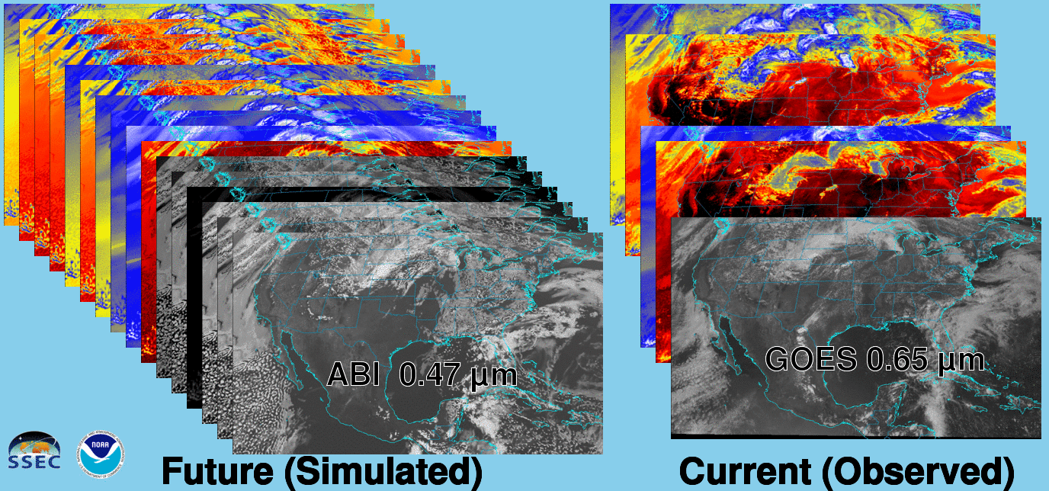
Future vs. Current Spectral Bands
The current GOES (right) has 5 spectral bands, while the GOES-R series ABI (left) will have 16 spectral bands.

Slide 4
Educational Webapps Developed
NOAA NESDIS ASPB teamed up with CIMSS researchers to develop three educational WebApps to explore space, time and spectral resolutions of satellite imagery.
Part of the GOES-R Educational Proving Ground at CIMSS:
http://cimss.ssec.wisc.edu/education/goesr
Teacher feedback: “…. Wow!! This is awesome!! This is impressive. Thank you for sharing. This is great. Thanks for all your hard work and help!!!! We are honored and will use it next week … Earth SySTEM Teacher Academy”
Sample interactive “Bandapp” educational webapp using simulated ABI images:
http://cimss.ssec.wisc.edu/goes/webapps/bandapp/
T. Schmit
Notes:
Tim Schmit, ASPB
https://ams.confex.com/ams/95Annual/webprogram/Paper265203.html ABI = Advanced Baseline Imager
Other new webapps: one to change both the spatial and temporal sampling and the other only the pixel sampling

