Slide 1
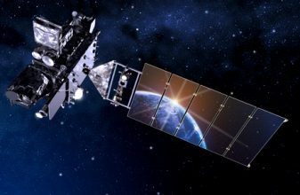
GOES-R Overview
Tim Schmit
NOAA NESDIS STAR
Madison, WI
Fall 2016

Slide 2
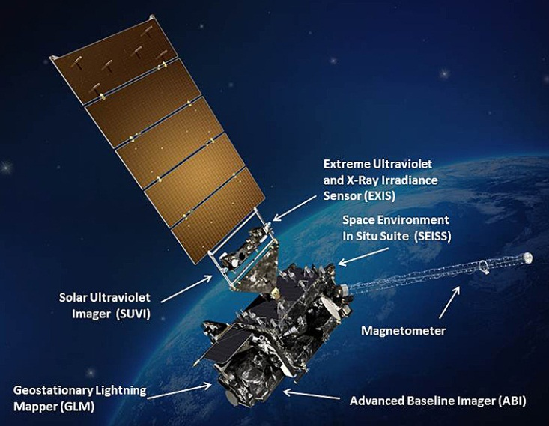
GOES-R
Next generation of NOAA/NASA geo weather satellites
R-Series includes 4 satellites (R, S, T, U)
First to launch in 04 Nov 2016
Represents first major upgrade in over 20 years
Earth-pointing instruments
Geostationary Lightning Mapper (GLM)
Advanced Baseline Imager (ABI)
3x more spectral bands
4x spatial resolution
5x temporal coverage
Space weather and solar imaging instruments
Space Environment in-Situ Sensor Suite (SEISS)
Magnetometer
Solar Ultra-Violet Imager (SUVI)
Extreme Ultraviolet and X-ray Irradiance Sensors (EXIS)

Slide 3
GOES-R
Notes:
Graphic from LM

Slide 4
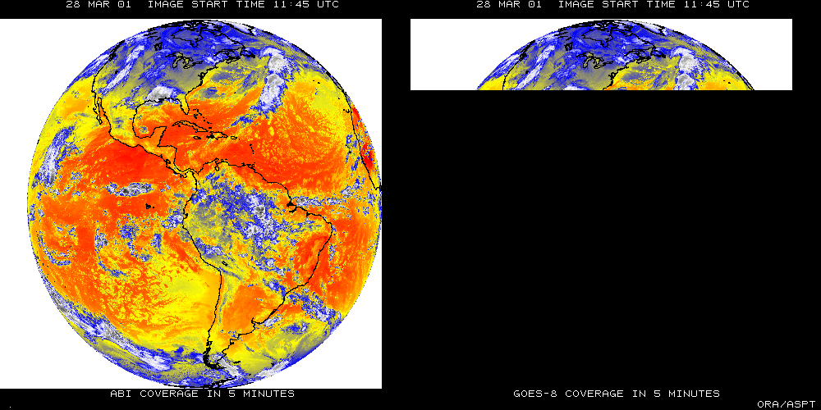
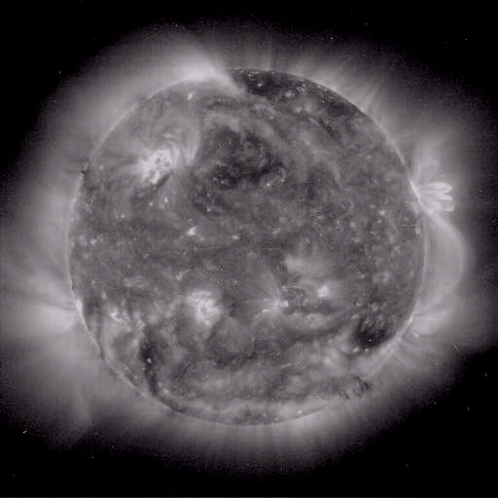
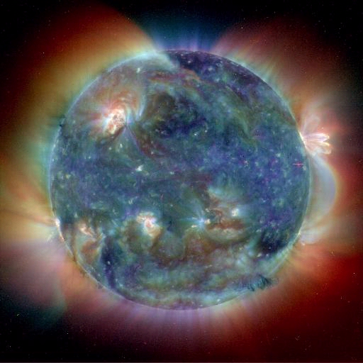
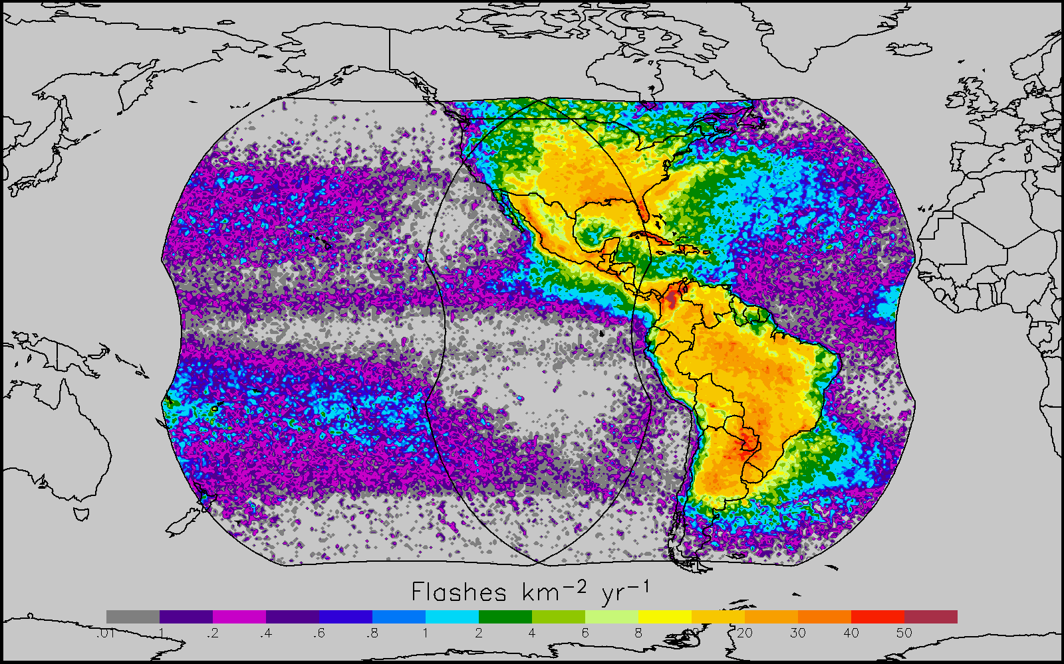
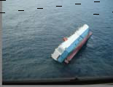
GOES-R main instruments
ABI – Advanced Baseline Imager
Space Weather/Solar
SEISS
SUVI
EXIS
Magnetometer
ABI covers the earth 5X faster than current Imager
Geostationary Lightning Mapper
Images courtesy of SOHO EIT, a joint NASA/ESA program
Unique Payload Services
No Sounder

Slide 5
Geostationary Lightning Mapper(GLM)
~ 10 km across field of view with 8 km CONUS, 14 km at edge of field of view
Detects extent of total lightning activity
Day/night coverage with 70-90% flash detection (better at night)
Near-uniform detection efficiency spatially across the domain
Continuous coverage (2 ms frame rate)
<20 sec latency
East/West GLM FOV
Figures courtesy of Steve Goodman

Slide 6
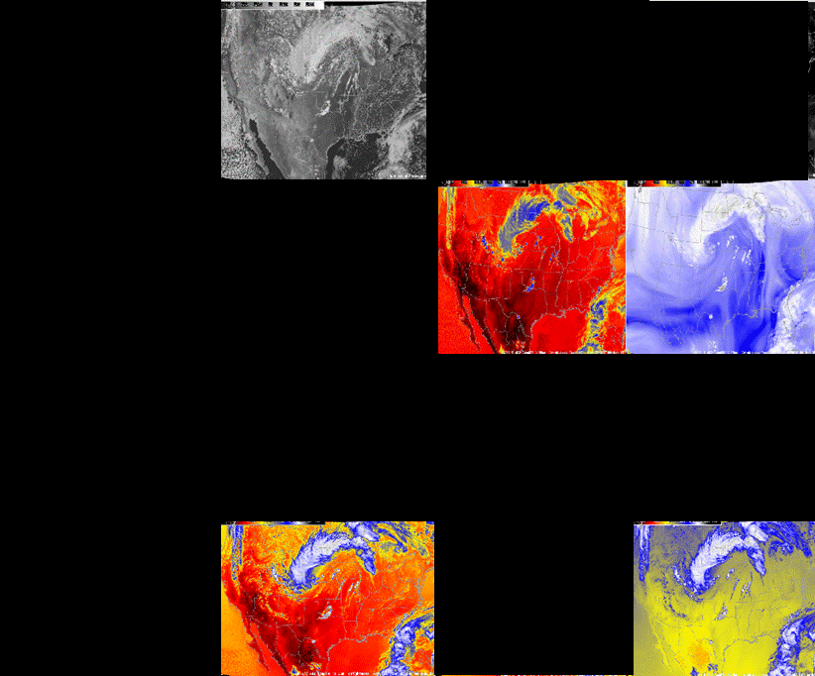
Current GOES Spectral Bands (5)
VIS
1 VIS
0 NIR
4 IR
NIR
WV
IRW
CO2
Figures courtesy of Tim Schmit

Slide 7
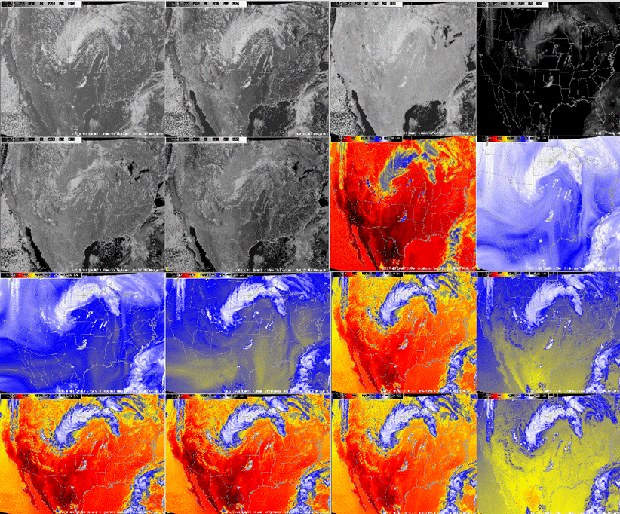
ABI Spectral Bands (16)
0.47 μm
0.64 μm
0.86 μm
1.38 μm
2 VIS
4 NIR
10 IR
1.61 μm
2.26 μm
3.9 μm
6.19 μm
6.95 μm
7.34 μm
8.5 μm
9.61 μm
10.35 μm
11.2 μm
12.3 μm
13.3 μm
Figures courtesy of Tim Schmit

Slide 8
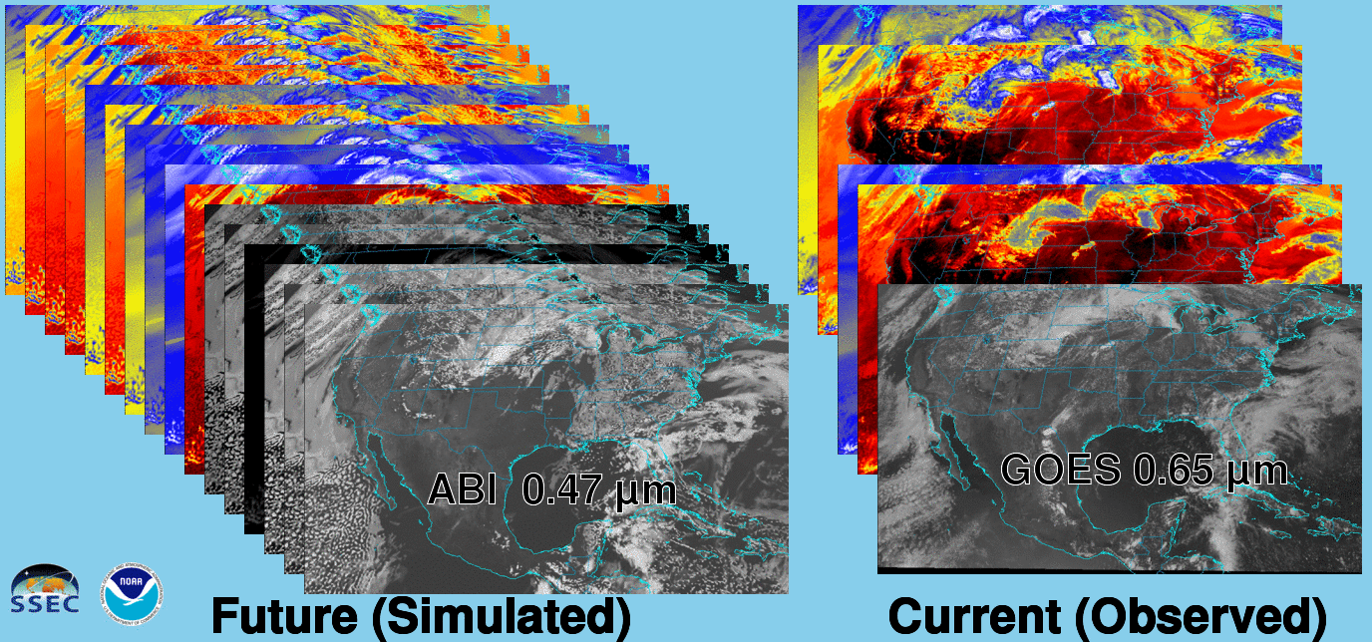
Future vs. Current Spectral Bands
The current GOES (right) has 5 spectral bands, while the GOES-R series ABI (left) will have 16 spectral bands.

Slide 9
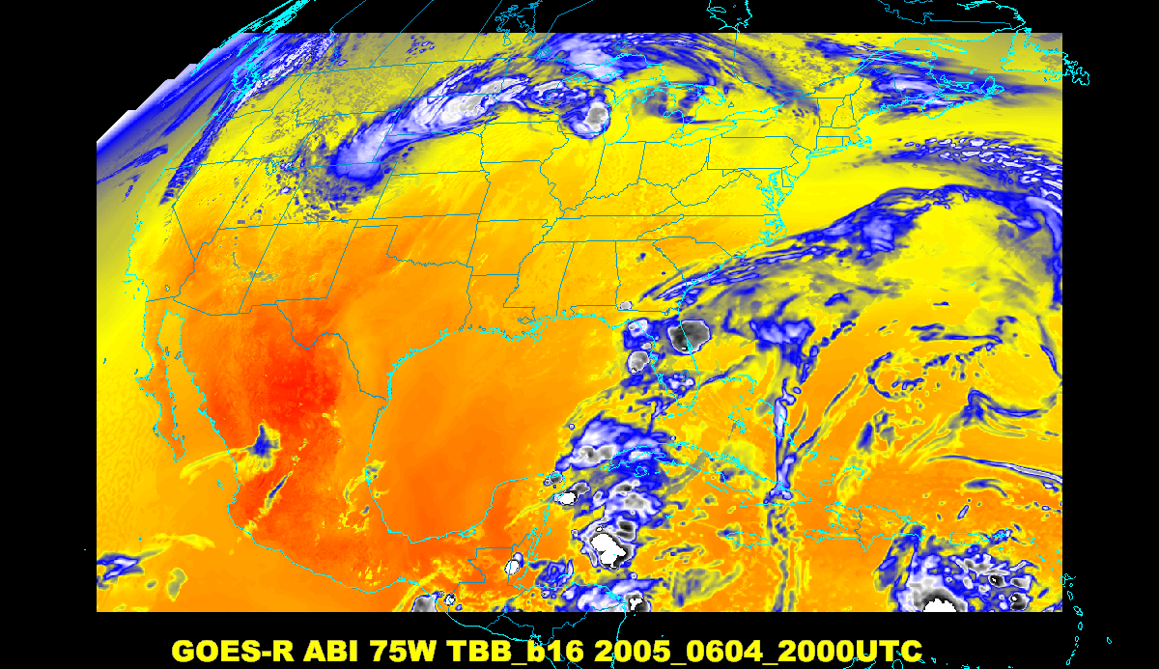
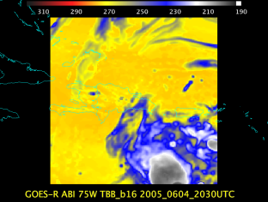
Baseline ABI Scan Modes
Scan mode (3) or ‘flex mode’ for the ABI:
- Full disk every 15 minutes + 5 min CONUS
+ 1-min mesoscales (2 locations).
[Scan mode (4) or ‘Continuous Full Disk’ (CFD) is a full disk every 5 min]
Notes:
CONUS image is the shifted center point.

Slide 10
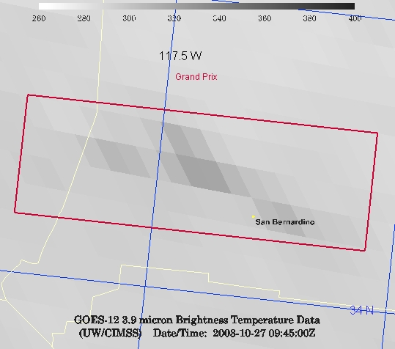
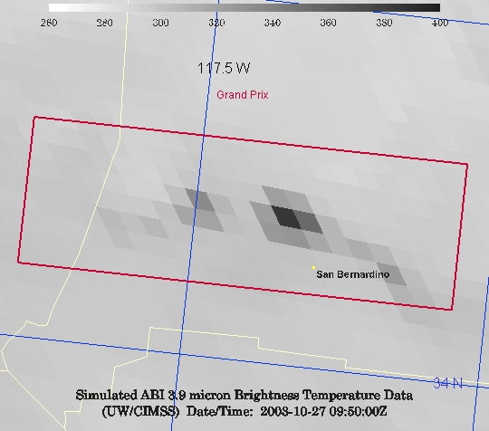
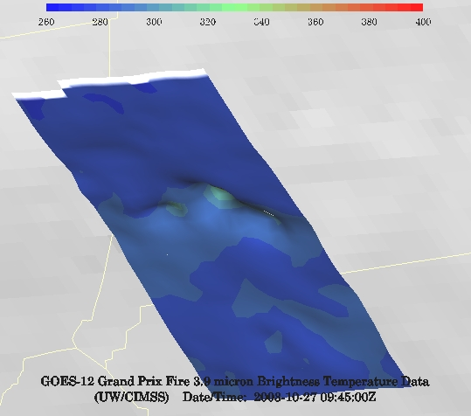
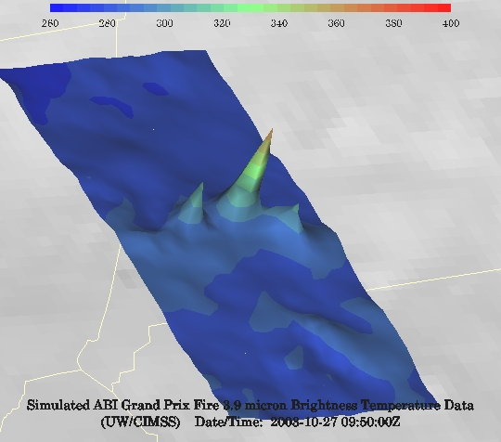
GOES-12 and GOES-R ABI
Simulation of Grand Prix Fire/Southern California
GOES-12
GOES-R ABI
GOES-12
GOES-R ABI
Notes:
Here are two different fires from J. Feltz of CIMSS (using mcidas-v). What we can see is a more defined peak in the higher resolution data and it is easier to pick out individual hotspots. In addition, the higher saturation temperature of the ABI allows us to see that the fire is around 370K. ABI is simulated from MODIS.

Slide 11
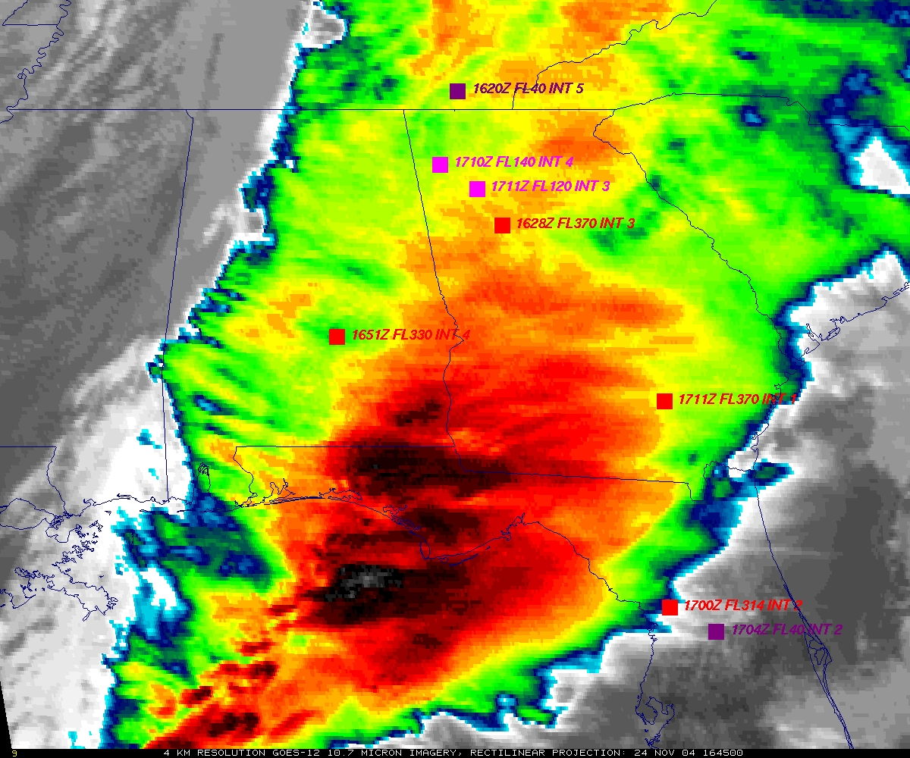
GOES
Figure courtesy of K. Bedka and W. Feltz

Slide 12
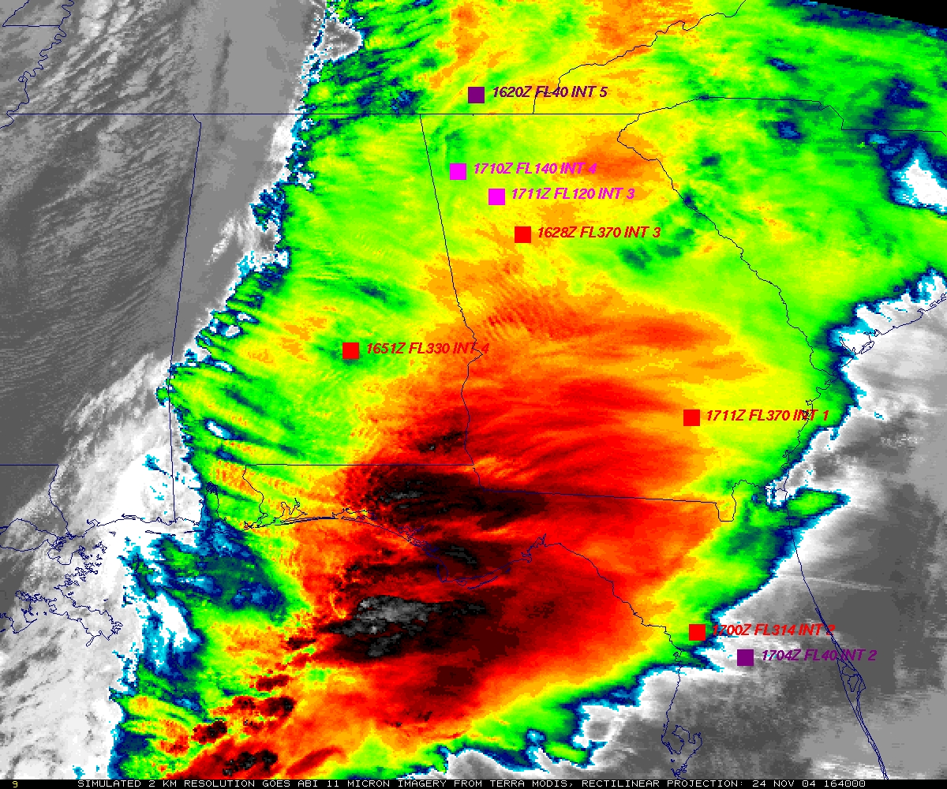
“ABI” from MODIS
Figure courtesy of K. Bedka and W. Feltz

Slide 13
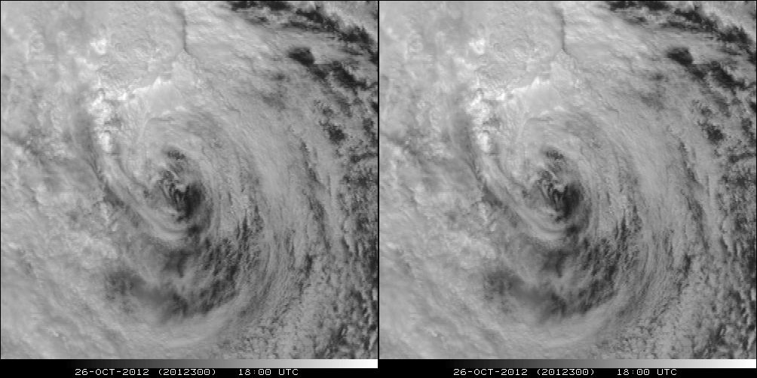
A Glimpse into the Future
ABI-like
Hurricane Sandy from GOES-14 at two temporal resolutions

Slide 14
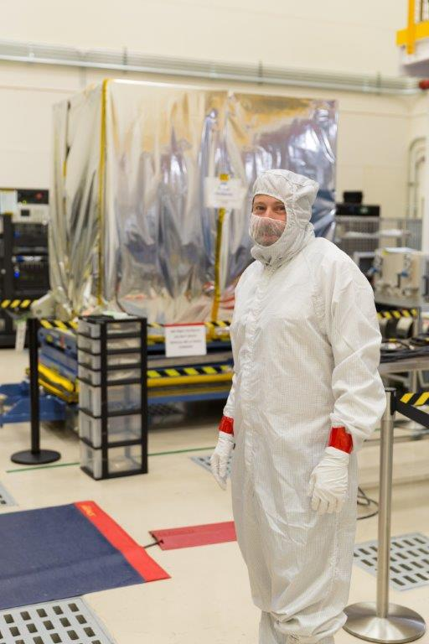
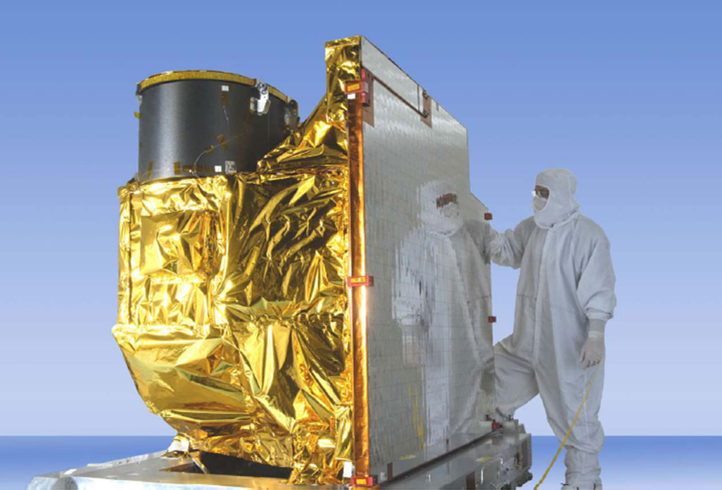
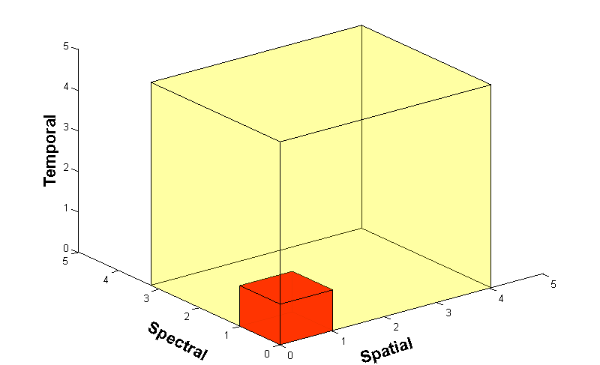
Advanced Baseline Imager (ABI)
ABI on GOES-S
5
4
3
X
Faster coverage (5-minute full disk vs. 25-minute)
X
Improved spatial resolution
(2 km IR vs. 4 km)
X
More spectral bands (16 on ABI vs. 5 on the current imager)
Notes:
Slide from J. Gerth, CIMSS.

Slide 15
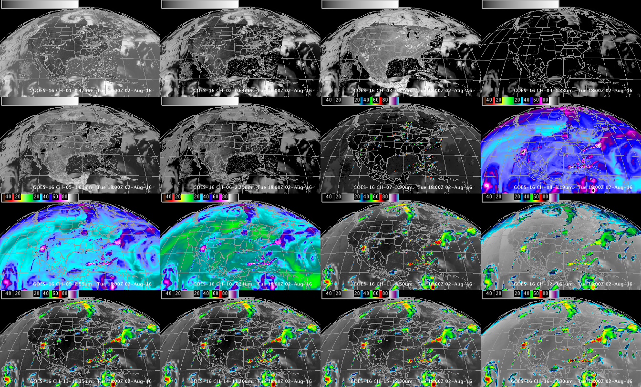
DOE-4 Simulated ABI Spectral bands
0.47 μm
0.64 μm
0.86 μm
1.37 μm
1.6 μm
2.2 μm
3.9 μm
6.2 μm
6.9 μm
7.3 μm
8.4 μm
9.6 μm
10.3 μm
11.2 μm
12.3 μm
13.3 μm
GOES-R ABI Imagery simulated at UW via AWG Proxy, processed via the Ground System, acquired via NOAAPort, shown in AWIPS-II (default enhancements)

Slide 16
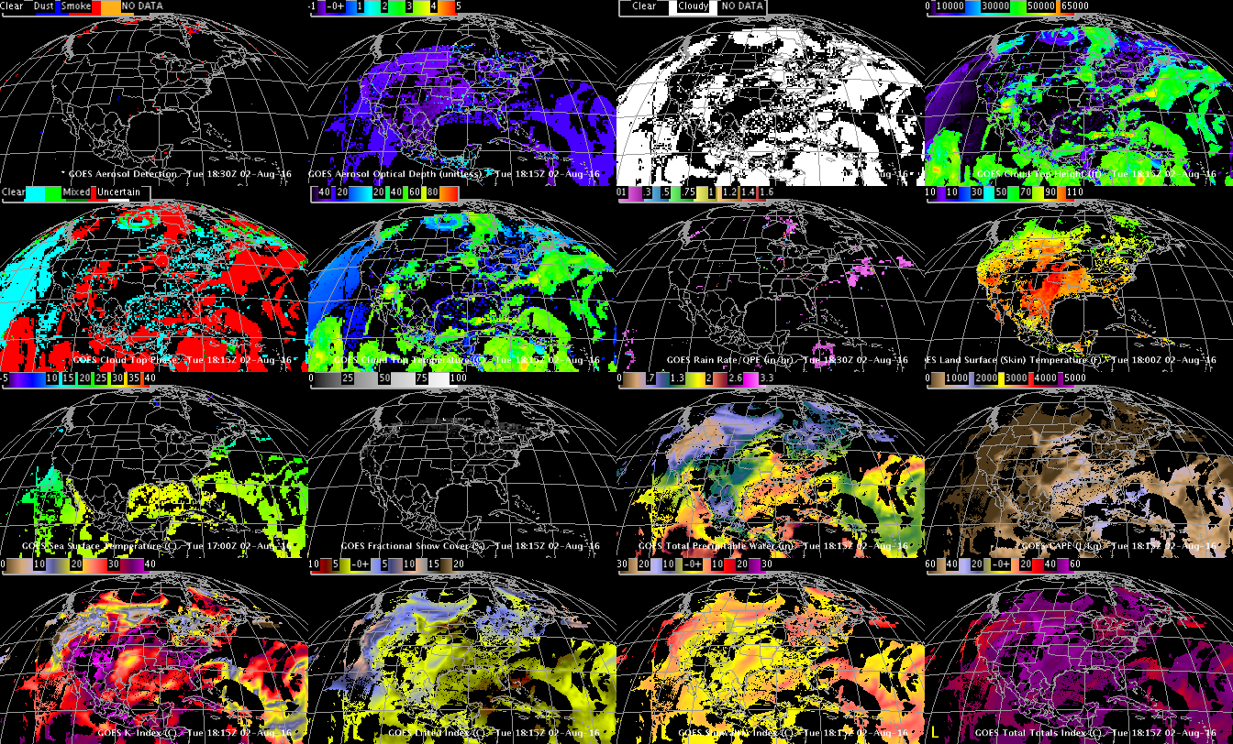
DOE-4 Simulated ABI (select) Derived Products
Aerosol Detection
Aerosol Optical Depth
Cloud Mask
Cloud Top Height
Cloud Top Phase
Cloud Top Pressure
Rain Rate
LST
SST
Snow
TPW
CAPE
K-index
Lifted Index
Showalter
Total Totals
Using GOES-R ABI Imagery simulated at UW via AWG Proxy, processed via the Ground System, acquired via NOAAPort, in AWIPS-II (default enhancements)

Slide 17
http://www.goes-r.gov
Notes:
The subjects of this GOES-R Baseline products training are the aerosol products boxed in yellow.

Slide 18
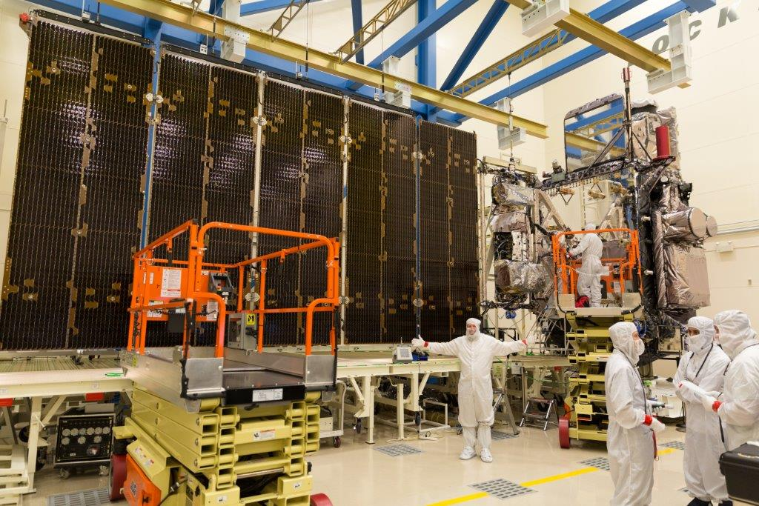
GOES-R ABI
Spectral, Spatial and Temporal
Improved, Improved and Improved
ABI
Me!
Lockheed Martin

Slide 19
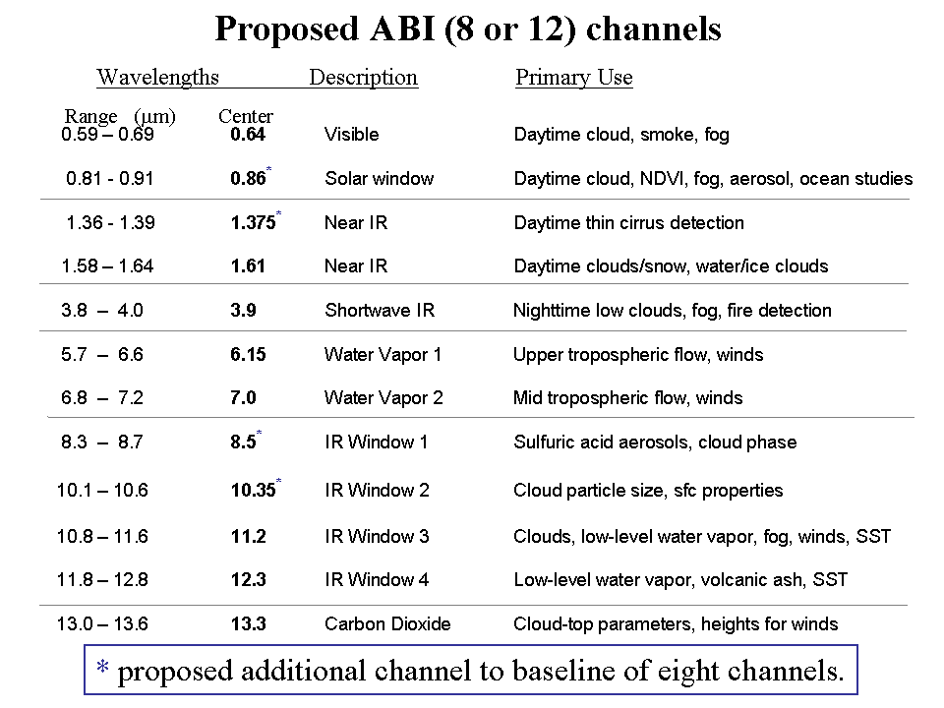
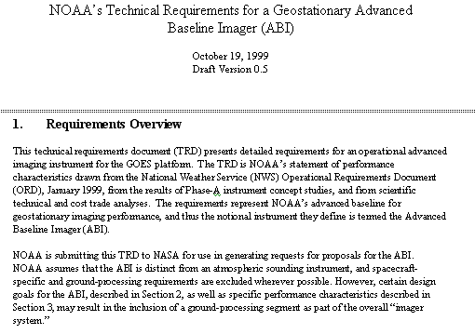
Mission Planning
STAR very involved during the early GOES-R series development. This includes: formulation studies for both ABI and advanced geostationary sounder, ABI band selection and modification, Technical Requirement Documents, Performance and Operational Requirements Document, etc.
ABI/ABS Requirements.
circa 1999/2000
Originally ABI was only 8 spectral bands, now it is 16. All ABI bands were modified with input from STAR and it’s Cooperative Institutes.
Notes:
Significant remaining scientific challenges for the specific science topic
Next step(s)
Instruments (current/future), techniques, testbed, transition, …
Path into applications/operations
Who will use it and how
How will it get out to the real world

Slide 20
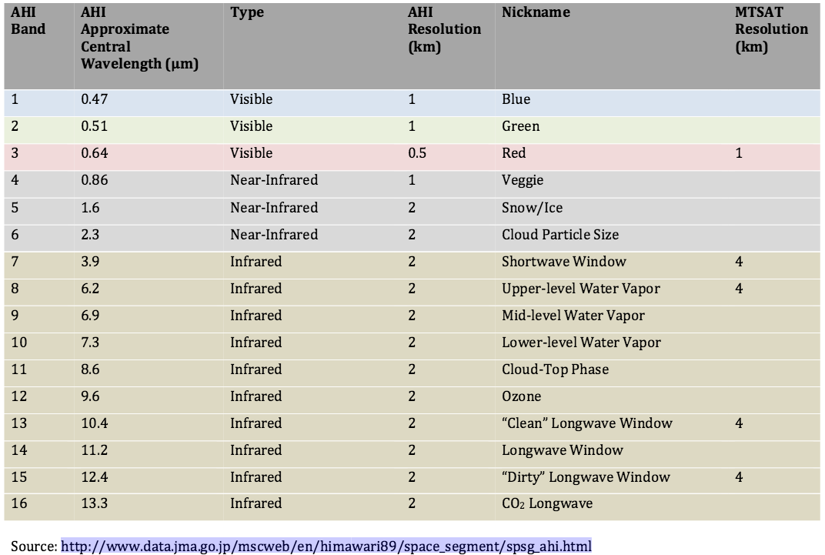
Advanced Himawari Imager Spectral Bands

Slide 21
AHI: Spectral (20-September-2015)
Visible
Near- infrared
Infrared

Slide 22
Mount Pavlof volcano in Alaska
animation

Slide 23
Tropical Cyclones (Meranti)

Slide 24
Solar Eclipse

Slide 25
AHI with Simulated Green Band

