Slide 1
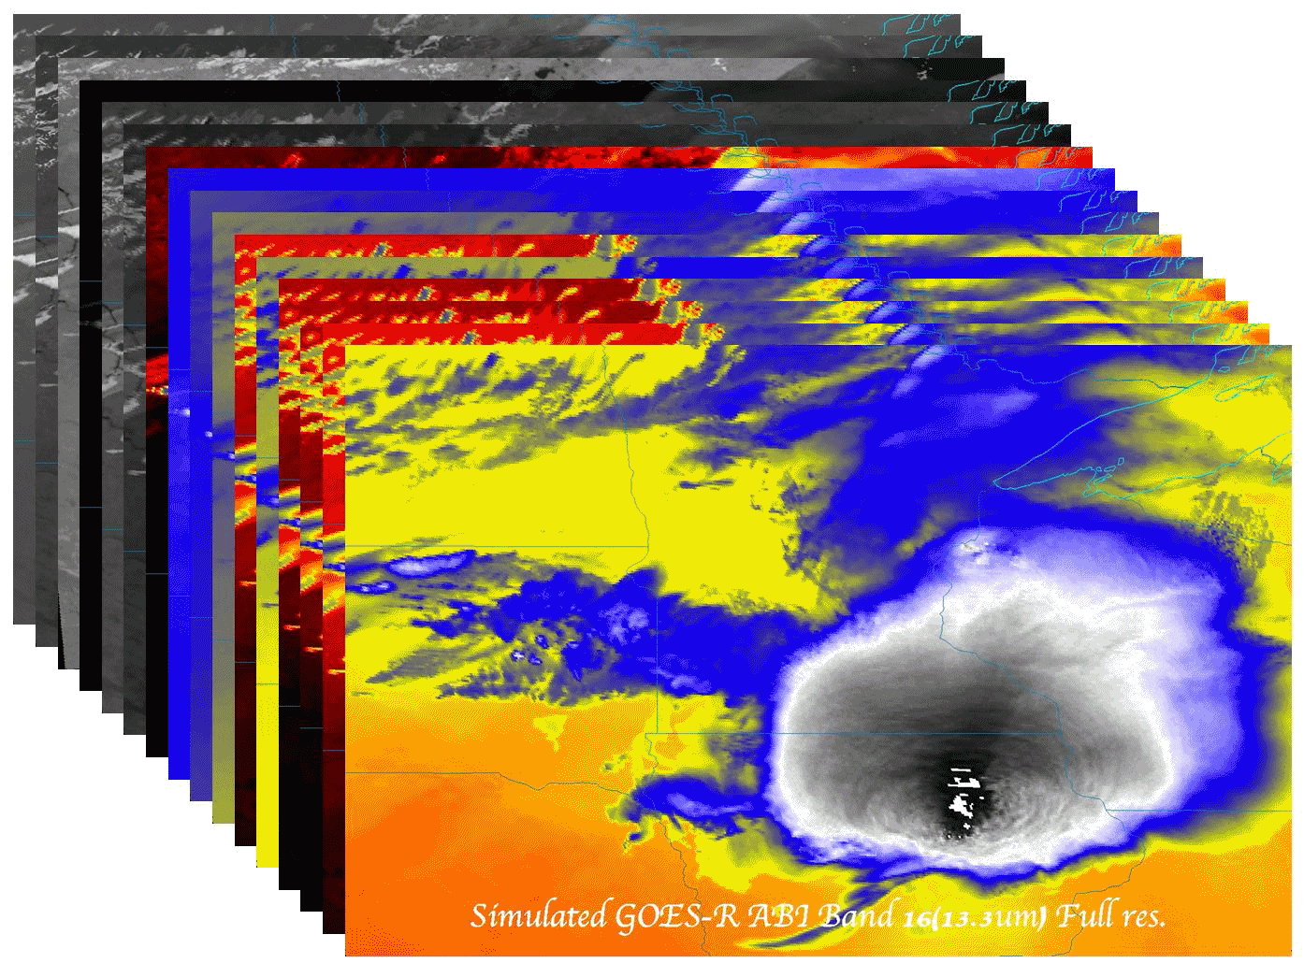
The ABI (Advanced Baseline Imager) on the GOES (Geostationary Operational Environmental Satellite)-R series
Timothy J. Schmit (tim.j.schmit@noaa.gov)
NOAA/NESDIS/Satellite Applications and Research
Advanced Satellite Products Branch (ASPB)
Madison, WI
Satellites & Education Conference XXVII
Madison, WI
31 July 2014
UW-Madison

Slide 2
Thanks to…
Steven J. Goodman, Daniel T. Lindsey, Robert M. Rabin, Kristopher M. Bedka, John L. Cintineo, Christopher S. Velden, A. Scott Bachmeier, Scott S. Lindstrom, Mathew M. Gunshor, Christopher C. Schmidt
Joleen Feltz, Tom Whittaker, Margaret Mooney, Andy Heidinger, William Straka, Jun Li, Steve Ackerman, Bob Aune, Don Hillger, Paul Menzel, Tony Schreiner, Justin Sieglaff, Jim Jung, Elaine Prins, Brad Pierce, Wayne Feltz, Jean Phillips, Gary Wade, Don Hillger, Jinlong Li, Jing Zheng, Allen Huang, Bob Rabin, the SSEC data center, Mike Pavolonis, Jaime Daniels, ASPB, STAR, NESDIS, NSSL, MUG, Kevin Ludlum, GOES operators, GOES shift supervisors, Mark DeMaria, and many others!
GOES-R Program Office, NASA, Exelis Industries, other industry partners, etc.
You.

Slide 3
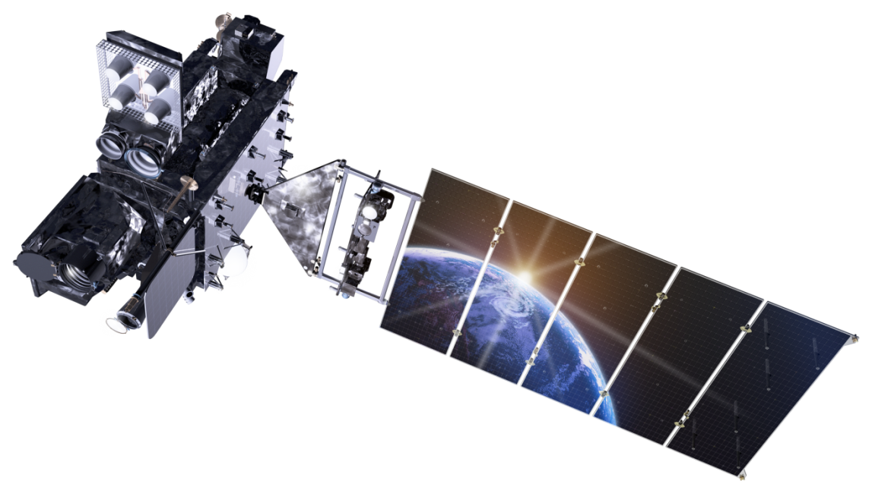
Outline
GOES
GOES-R
ABI (Advanced Baseline Imager)
Spectral
Spatial
Temporal
GOES-14 SRSOR (2012 and 2013 and 2014)
Satellite applet
References
Summary
Lockheed Martin

Slide 4
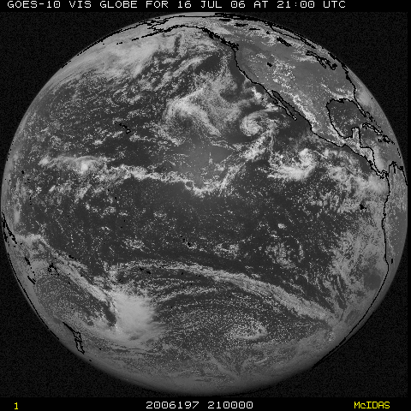
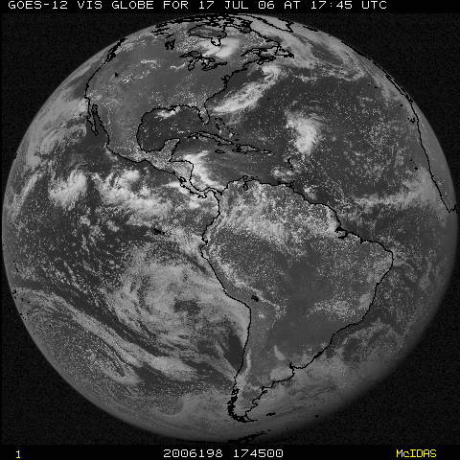
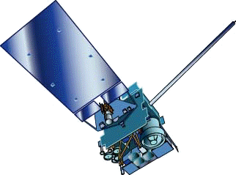
NOAA GOES Constellation
GOES-West
GOES-15
(135W)
GOES-East
GOES-13
(75W)
GOES-14 (105W) Storage

Slide 5
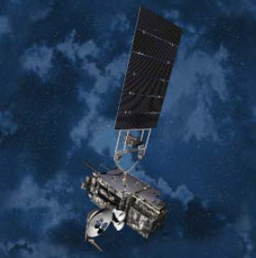
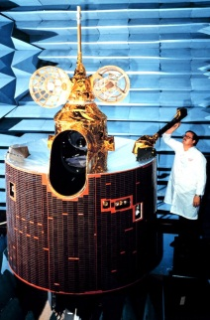
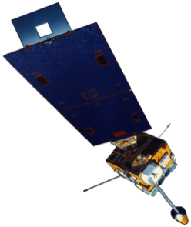
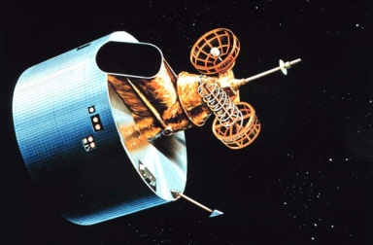
GOES History
GOES-1-3
Launched
1975
1977 1978
One visible and one infrared.
Operational.
GOES-4-7
Launched
1980
1981
1983
1987
VISSR–VAS visible, 12 IR. MSI (visible, IRW, and 2 additional IR channels)
GOES-8-12
Launched
1994
1995
1997
2000
2001
3-axis stabilized.
Imager Bands: 4 IR; 1 visible.
Operational Sounder
(18 IR bands)
GOES-13-15
Launched
2005
2009
2010
Better navigation and calibration.
No eclipse outages.
Better spatial resolutions for the 6.5 um on GOES-12+ and the 13.3 um band on GOES-14/15.
Operational Sounder
GOES-R/S/T/U
Planned Launch
2015
2017
2020
2025
Faster coverage.
16 Imager Bands.
Improved spatial.
No sounder.
Lightning Sensor
Notes:
The circles represent an estimate of the impact of GOES on regional scale numerical models.

Slide 6
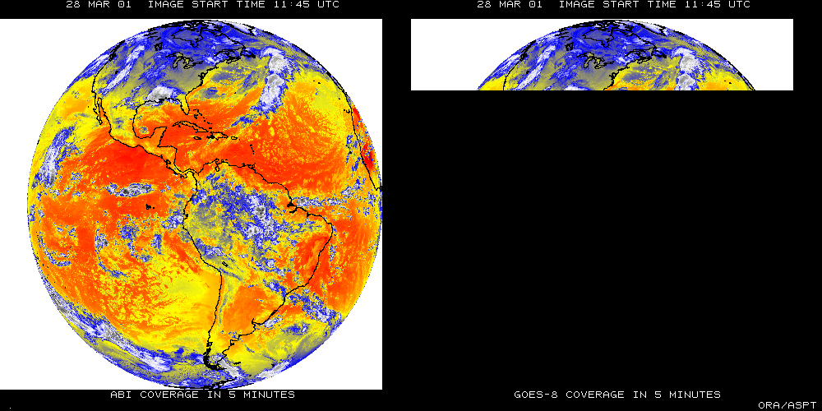
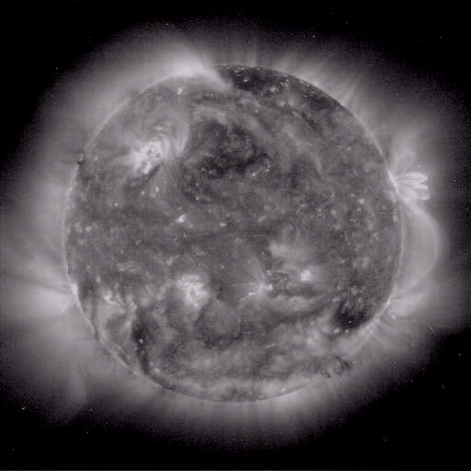
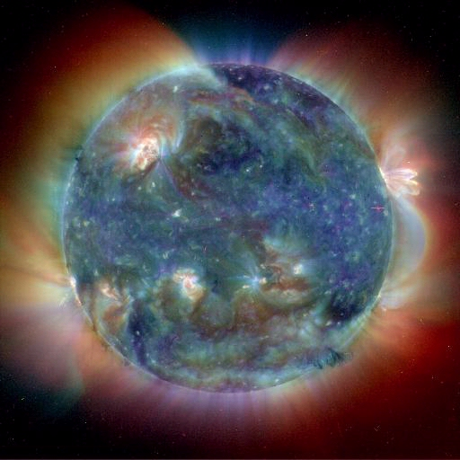
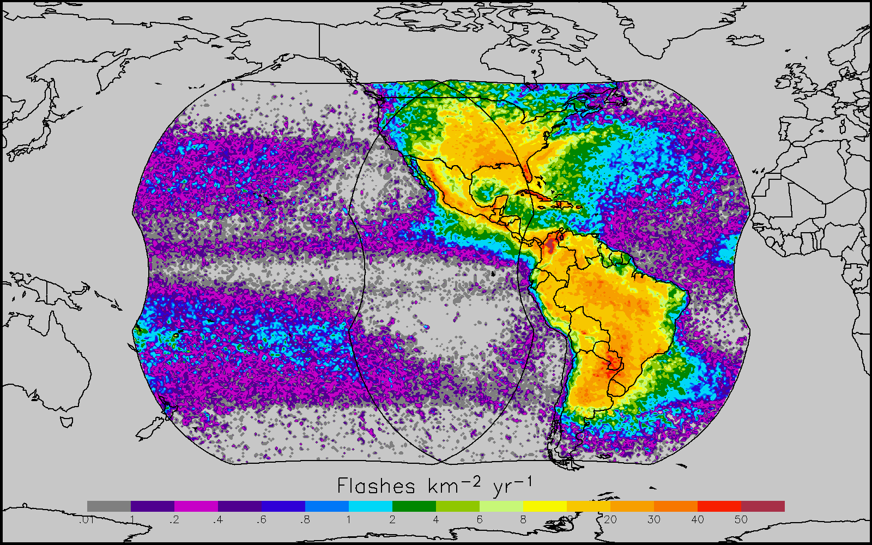
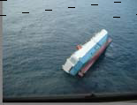
GOES-R main instruments
ABI – Advanced Baseline Imager
Space Weather/Solar
SEISS
SUVI
EXIS
Magnetometer
ABI covers the earth 5X faster than current Imager
Geostationary Lightning Mapper
Images courtesy of SOHO EIT, a joint NASA/ESA program
Unique Payload Services
No Sounder

Slide 7
GOES-R Series Overview
No dedicated Sounder
Advanced Baseline Imager (ABI)
Geostationary Lightning Mapper (GLM)
Space Weather
Space Environmental In-Situ Suite (SEISS)
Solar Ultra Violet Imager (SUVI)
Extreme Ultra Violet/X-Ray Irradiance Sensor (EXIS)
Magnetometer
Communications
GOES Rebroadcast (GRB)
Low Rate Information Transmissions (LRIT)
Emergency Managers Weather Information Network (EMWIN)
Search and Rescue (SAR)
Data Collection System (DCS)
Notes:
Advanced Baseline Imager (ABI) Earth-viewing
Geostationary Lightning Mapper (GLM) Earth-viewing
Solar Ultra-Violet Imager (SUVI) Sun-viewing
EUVS and XRS Irradiance Sensors (EXIS) Sun-viewing
Space Environment In-Situ Suite (SEISS) Space-viewing
Magnetometer (MAG) Space-viewing

Slide 8
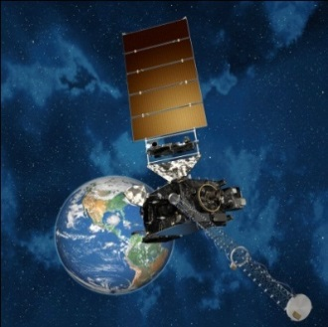
Continuity of GOES Operational Satellite Program
GOES-R Launch Readiness 2Q FY 2016
8
Notes:
GOES-R moved from October 2015 Launch Commitment Date to 2Q FY2016 and GOES-S shifted to 3Q FY17. GOES-T and U LCD remain unchanged.

Slide 9
GOES-R Spacecraft and Instruments
Notes:
Graphic from LM

Slide 10
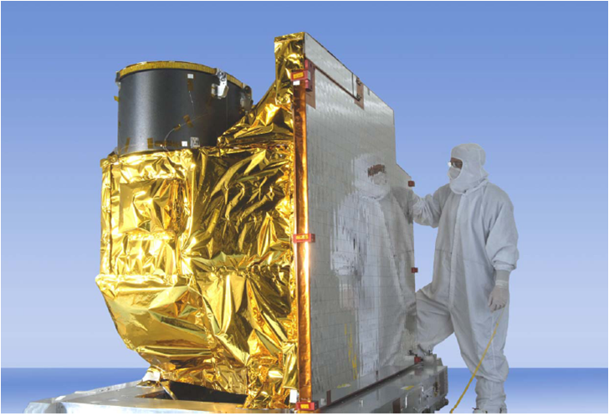
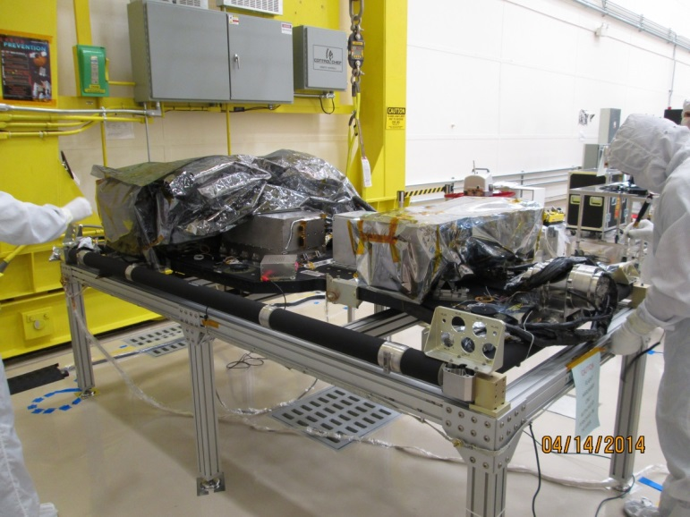
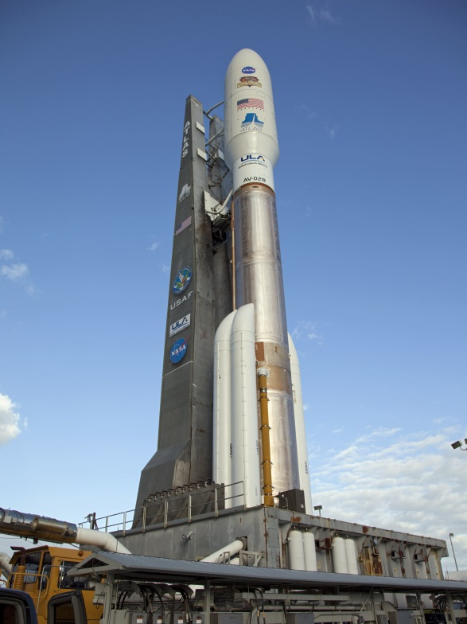
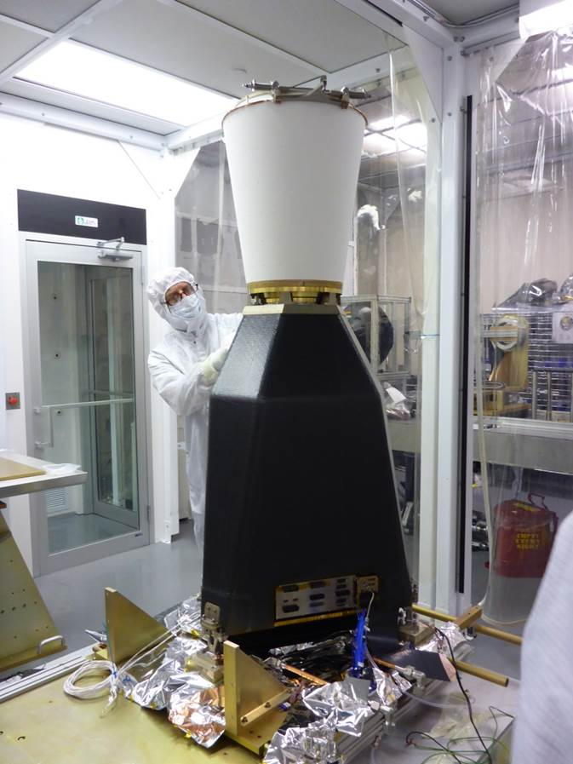
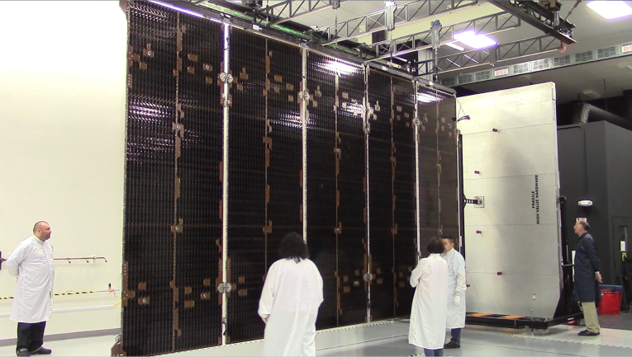
GOES- R Flight Segment
GOES-R ABI
SUVI and EXIS (solar/space instruments
GLM vibration testing complete
Atlas V 541 ELV
Solar Array Wing deployment
10
Notes:
Credit: GOES-R web page and G. Mandt presentation

Slide 11
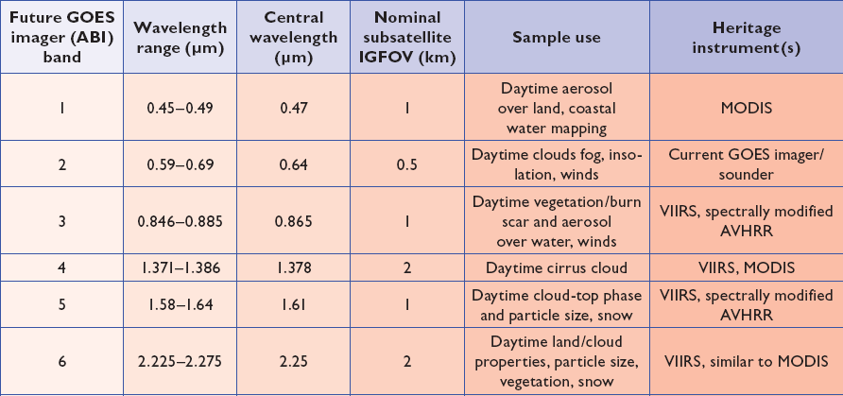
ABI bands 1-6
6 visible or near infrared bands on the ABI, compared to only one on today’s imager
Notes:
Final column added: heritage. The ABI band 1 was suggested by Dr. Fred Mosher at a GOES Users' Conference.
The ABI band 3 was suggested by the late Dr. C. Rao (of the then ORA).
Some of these bands have been shifted to more closely match those on the VIIRS.

Slide 12
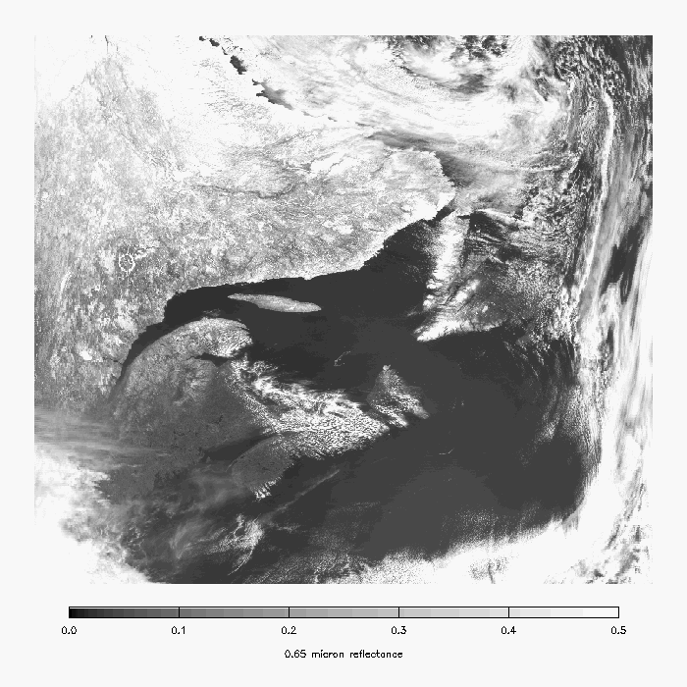
MODIS 0.65 µm -- Snow is bright (but so are clouds).
Snow
Notes:
Image from A. Heidnger of ASPB.

Slide 13
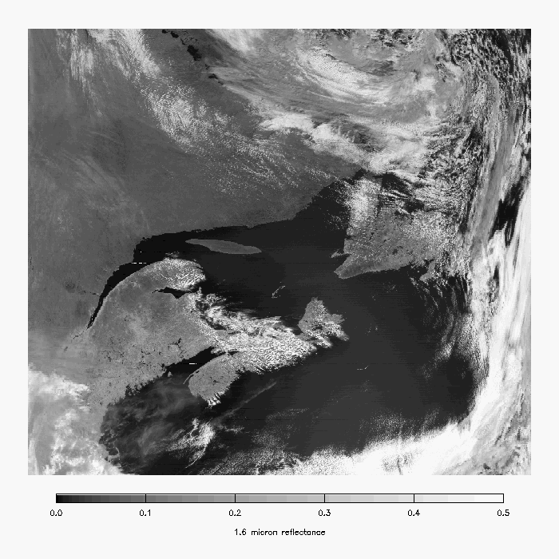
MODIS 1.6 µm -- Snow is darker.
Snow
Notes:
Image from A. Heidnger of ASPB.

Slide 14
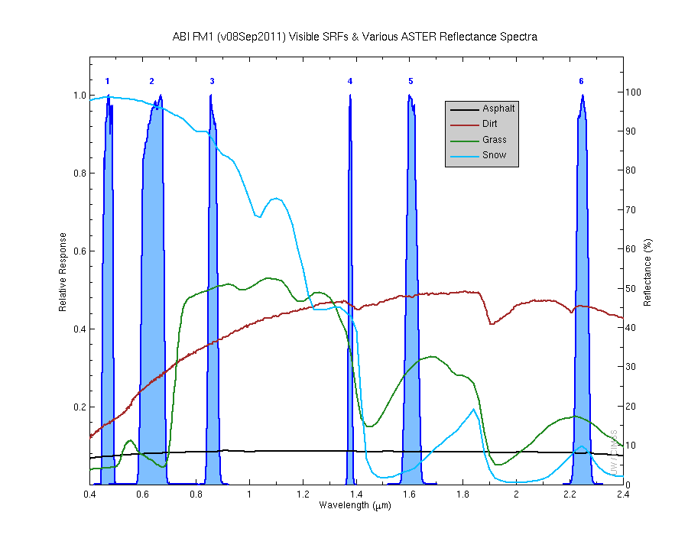
Visible and near-IR channels on the ABI
Aerosols, Insolation
Clouds, Snow
Vegetation, Imagery
Cloud mask, Suspended matter
Snow, Phase
Cloud Particle size
Sample use only, many other uses
The ABI visible and near-IR bands have many uses.
Notes:
Schmit, T. J., M. M. Gunshor, W. P. Menzel, J. J. Gurka, J. Li, and A. S. Bachmeier, 2005: Introducing the next-generation Advanced Baseline Imager on GOES-R. Bull. Amer. Meteor. Soc., 86, 1079-1096.

Slide 15
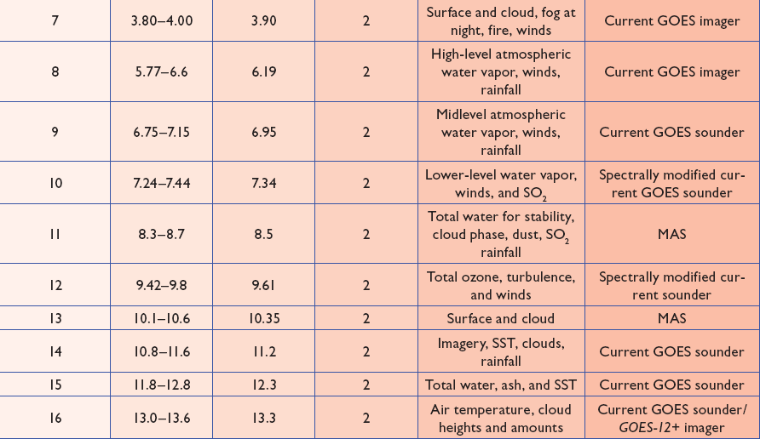
ABI bands 7-16
10 infrared bands on the ABI, compared to four on today’s imager
Notes:
The ABI band 10 was modified to better depict upper-level SO2. (G. Ellrod and others)
The ABI band 11 was suggested by Steve Ackerman (CIMSS), based on HIRS experience.
The ABI band 13 was suggested by W. P. Menzel (then NOAA NESDIS).

Slide 16
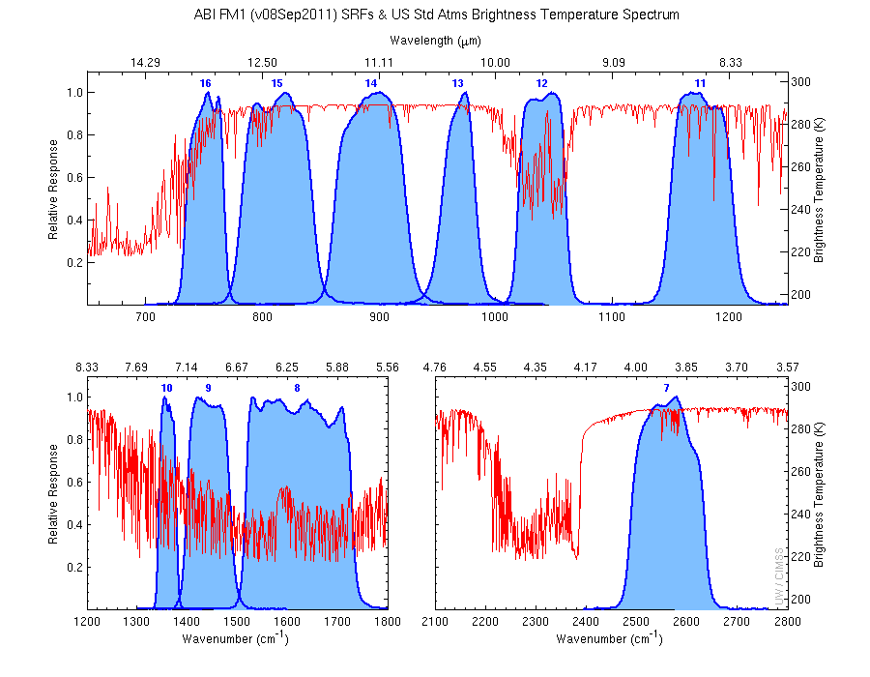
The IR channels on the ABI
Clouds, Stability Indices
SST, Fires, Radiances
Ozone, Downward Radiation
Rainfall, Aerosol
Hurricane, Imagery
Cloud Phase, SST
Sample use only, many other uses
SO2, Radiances
Winds, WV profiling
TPW, Rainfall rate
Fires, Fog
ABI has many more bands than the current operational GOES imagers.
Notes:
Schmit, T. J., M. M. Gunshor, W. P. Menzel, J. J. Gurka, J. Li, and A. S. Bachmeier, 2005: Introducing the next-generation Advanced Baseline Imager on GOES-R. Bull. Amer. Meteor. Soc., 86, 1079-1096.

Slide 17
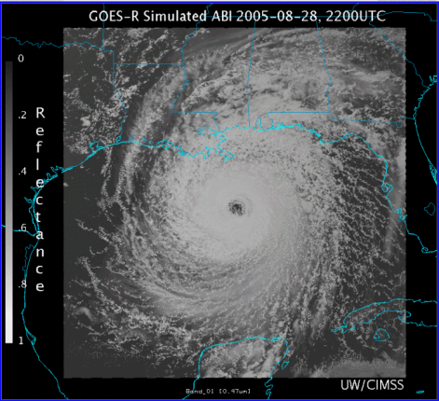
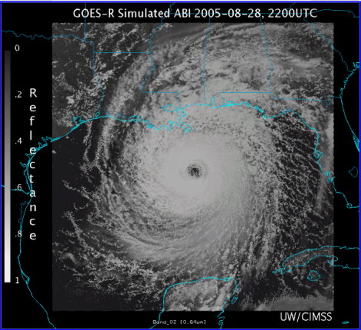
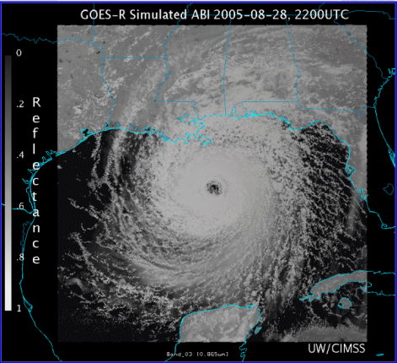
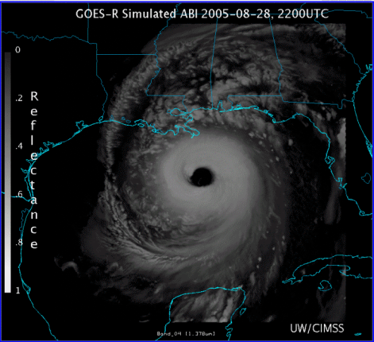
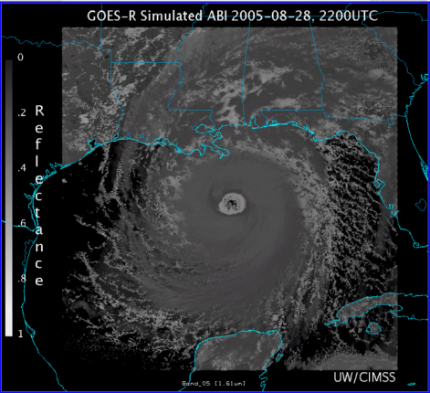
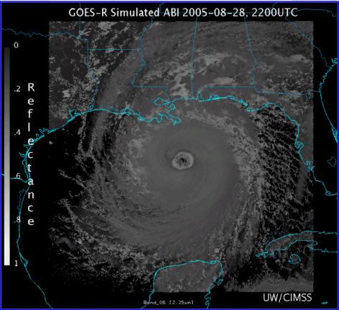
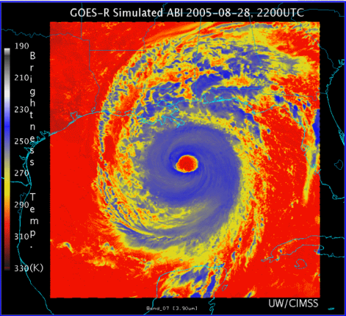
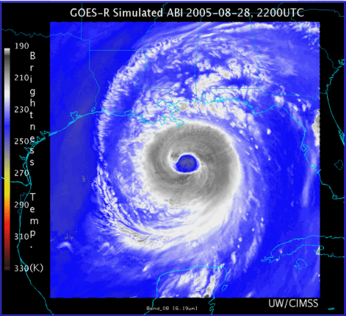
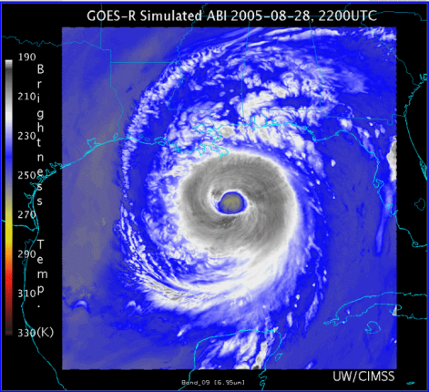
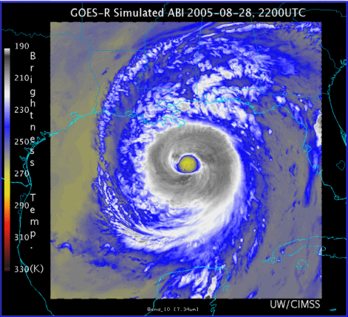
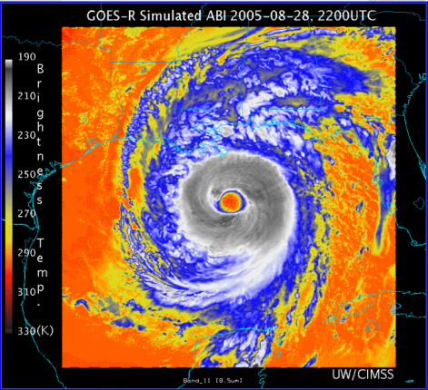
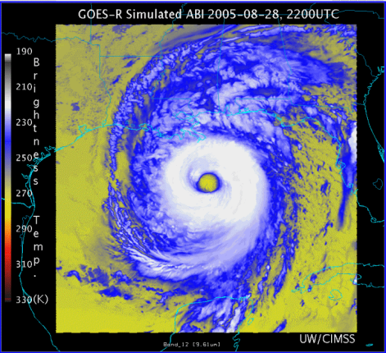
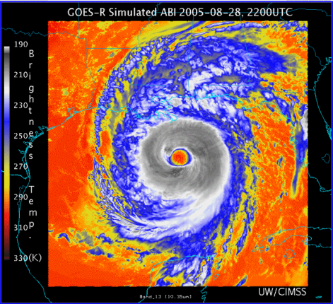
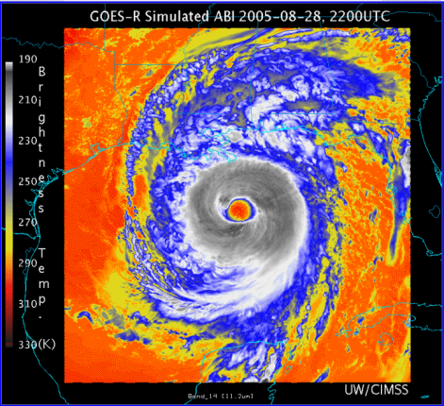
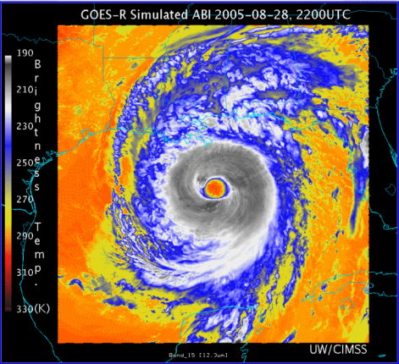
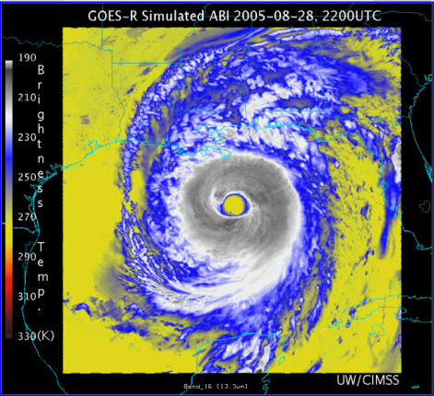
0.47 μm
0.64 μm
0.86 μm
1.38 μm
AWG Proxy ABI Simulations of Hurricane Katrina
1.61 μm
2.26 μm
3.9 μm
6.19 μm
NOAA/NESDIS STAR and GOES-R Imagery Team
6.95 μm
7.34 μm
8.5 μm
9.61 μm
10.35 μm
11.2 μm
12.3 μm
13.3 μm
Notes:
As shown in mcidas-v

Slide 18
Corresponding current Imager bands of Hurricane Katrina
NOAA/NESDIS STAR

Slide 19
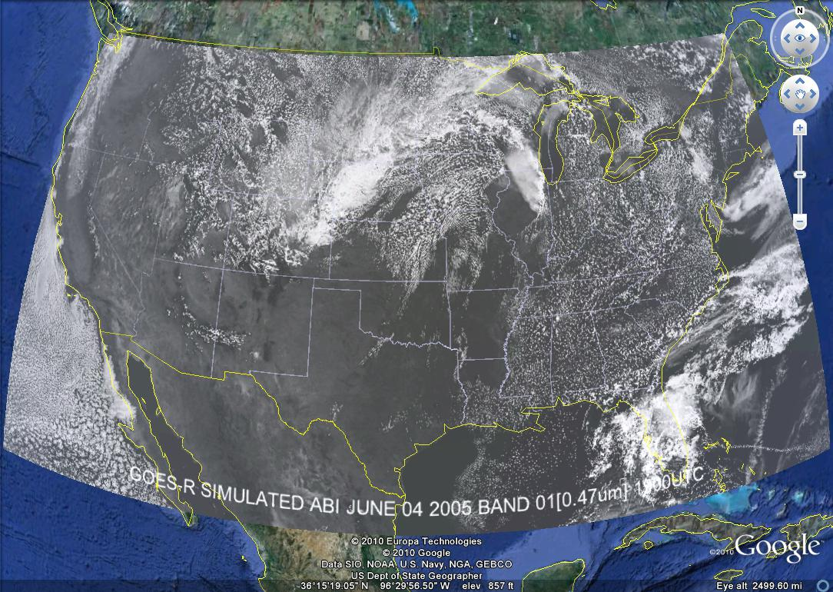
These NWP model simulations were performed on the 'cobalt' supercomputer at the National Center for Supercomputing Applications at the University of Illinois.

Slide 20
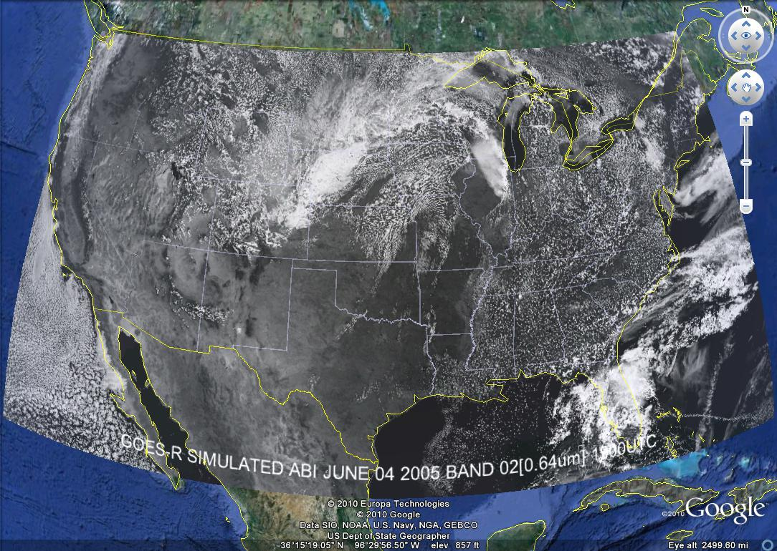

Slide 21
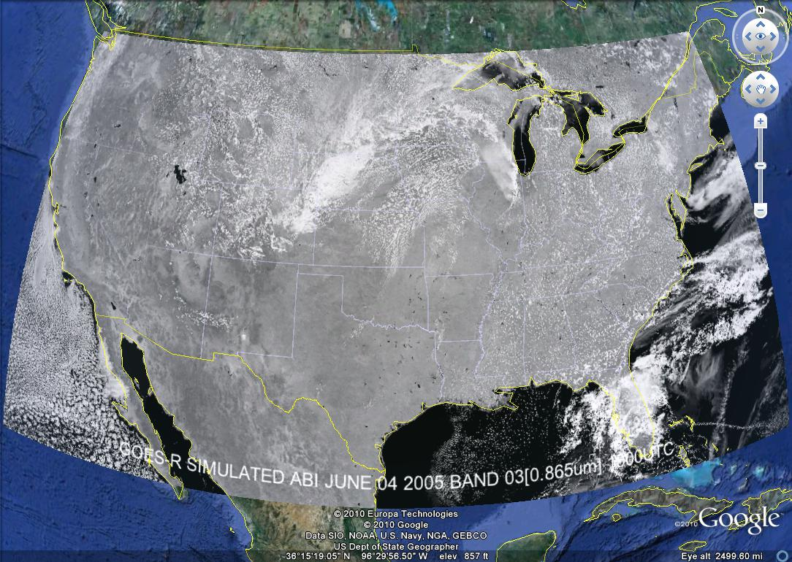

Slide 22
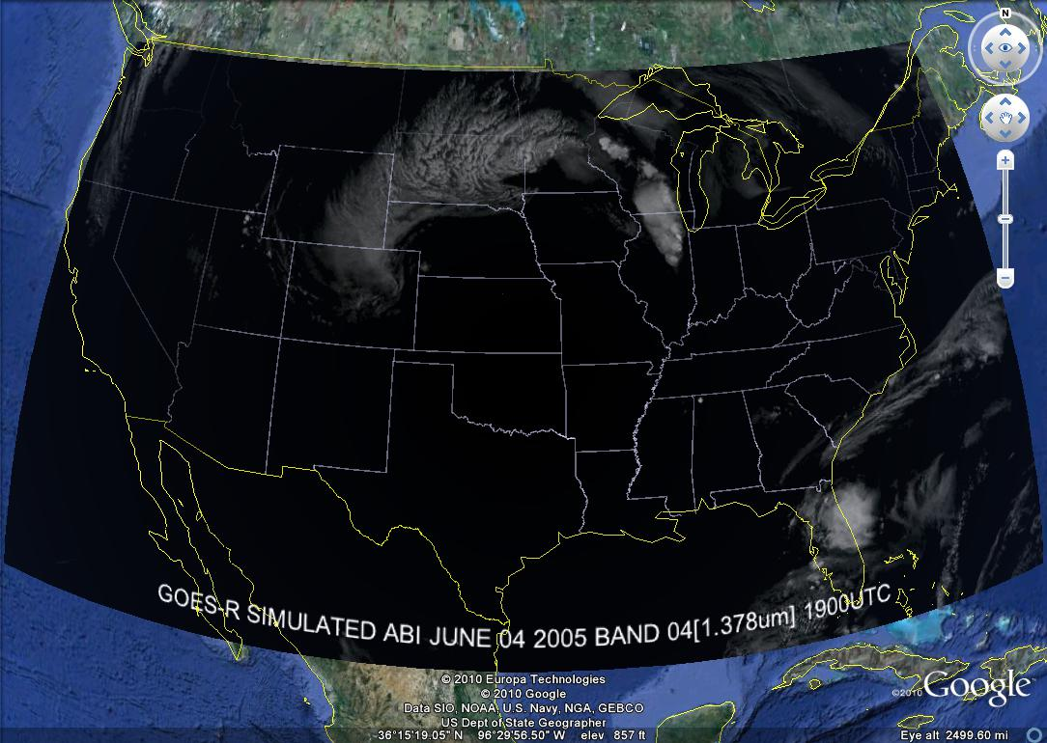

Slide 23
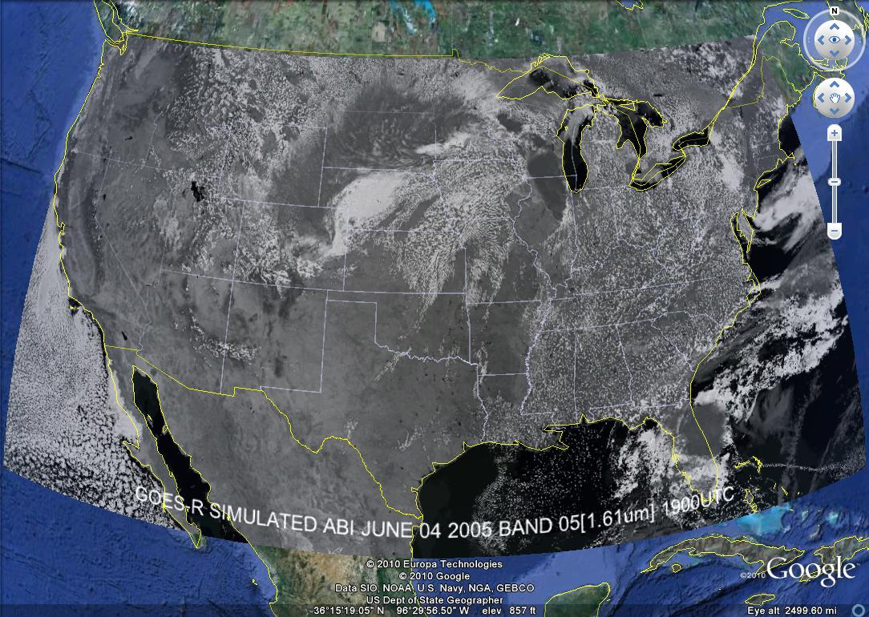

Slide 24
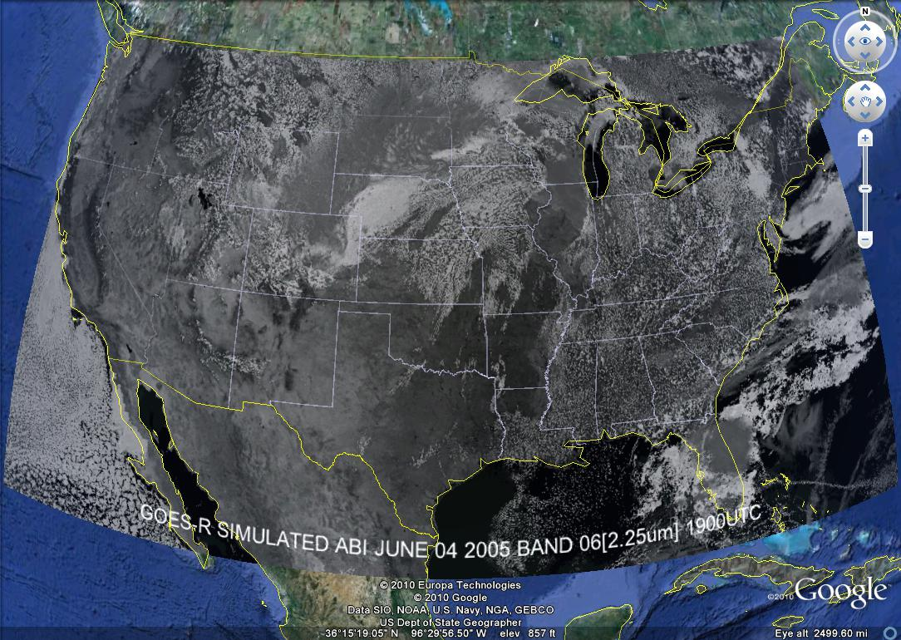

Slide 25
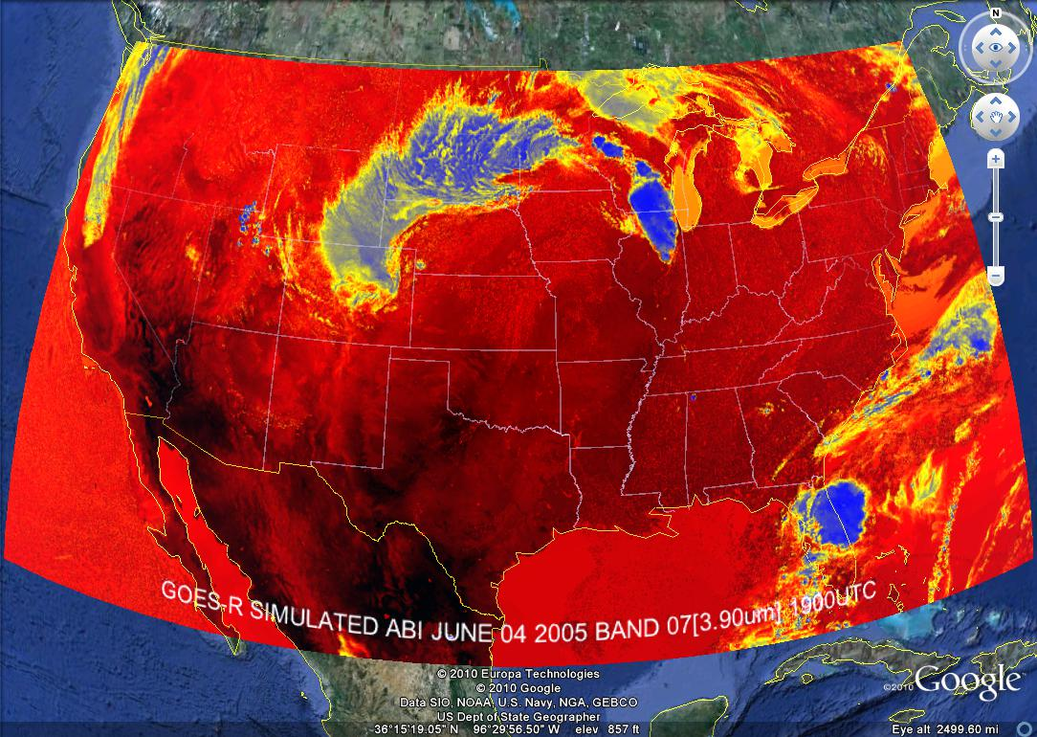

Slide 26
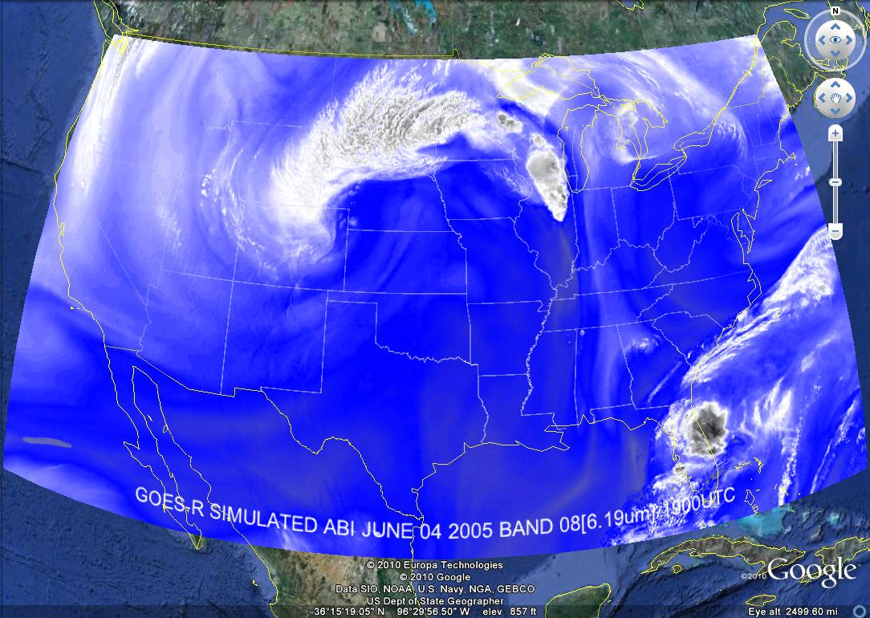

Slide 35
Nocturnal Fog/Stratus Over the Northern Plains
GOES-10 4 minus 11 μm Difference
ABI image (from MODIS) shows greater detail in structure of fog.
Notes:
Schmit, T. J., M. M. Gunshor, W. P. Menzel, J. J. Gurka, J. Li, and A. S. Bachmeier, 2005: Introducing the next-generation Advanced Baseline Imager on GOES-R. Bull. Amer. Meteor. Soc., 86, 1079-1096.

Slide 36
Nocturnal Fog/Stratus Over the Northern Plains
“ABI” 4 minus 11 μm Difference
ABI image (from MODIS) shows greater detail in structure of fog.
Notes:
Note the ABI (from MODIS) image is better spatial resolution and better signal-to-noise ratio then the GOES-10 imager.
Schmit, T. J., M. M. Gunshor, W. P. Menzel, J. J. Gurka, J. Li, and A. S. Bachmeier, 2005: Introducing the next-generation Advanced Baseline Imager on GOES-R. Bull. Amer. Meteor. Soc., 86, 1079-1096.

Slide 37
GOES-12 and GOES-R ABI
Simulation of Grand Prix Fire/Southern California
GOES-12
GOES-R ABI
GOES-12
GOES-R ABI
Notes:
Here are two different fires from J. Feltz of CIMSS (using mcidas-v). What we can see is a more defined peak in the higher resolution data and it is easier to pick out individual hotspots. In addition, the higher saturation temperature of the ABI allows us to see that the fire is around 370K. ABI is simulated from MODIS.

Slide 38
ABI Scan Modes
Scan mode (3) or ‘flex mode’ for the ABI:
- Full disk every 15 minutes + 5 min CONUS
+ 1-min mesoscales (2 locations).
[Scan mode (4) or ‘Continuous Full Disk’ (CFD) is a full disk every 5 min]

Slide 39
GOES-15: Sample “1-min” imagery
1-min
30-min
Visible data from the GOES-15 NOAA Science Test, lead by Hillger and Schmit
Notes:
Igor

Slide 40
ABI scans about 5 times faster
than the current GOES imager
Scan mode (3) for the ABI:
- Full disk images every 15 minutes + 5 min CONUS images + mesoscale.

Slide 41
ABI can offer Continental US images every 5 minutes for routine monitoring of a wide range of events (storms, dust, clouds, fires, winds, etc).
This is every 15 or 30 minutes with the current GOES in routine mode.
Notes:
Approx. size of CONUS

Slide 42
Notes:
Approx. size of CONUS

Slide 43
Mesoscale images every 30 seconds for rapidly changing phenomena
(thunderstorms, hurricanes, fires, etc). Or two regions every 60 seconds.
Notes:
Approx. size of meso-scale showing “Franklin”.

Slide 44
ABI CONUS sectors from East and West (proposed)
Notes:
Different days simulated.

Slide 45
GOES-14 Super Rapid Scan Operations to Prepare for GOES-R
SRSOR (Super Rapid Scan Operations for GOES-R) from GOES-14 imager
Data between mid-August and September 24th and late October 2012; and two days in June and 12 days in mid-August, 2013; and mid-May (8-24), 2014
http://cimss.ssec.wisc.edu/goes/srsor/GOES-14_SRSOR.html and
http://cimss.ssec.wisc.edu/goes/srsor2013/GOES-14_SRSOR.html
http://cimss.ssec.wisc.edu/goes/srsor2014/GOES-14_SRSOR.html
GOES-14 provided very unique data and offered a glimpse into the possibilities that will be provided by the ABI on GOES-R in one minute mesoscale imagery
Many phenomena were observed
GOES-14 visible image showing rapid convective development

Slide 47
Visible+Infrared

Slide 48
SRSOR GOES-14 2014 Color-enhanced infrared window (1 vs 15 min)
Note the ‘enhanced-v’ is seen first on the 1 minute data.

Slide 49
Three Groups of Users
Direct use of radiances/imagery
Numerical models
Forecasters
Broadcasters
General public/private sector/Internet
Direct use of satellite products
Numerical models
Forecasters
Blended products, etc.
General public/private sector/Internet
Use of services which use data/products
Basically everyone!

Slide 50
GOES-R ABI Products
Baseline Products
Future Capabilities
Advanced Baseline Imager (ABI)
Aerosol Detection (Including Smoke and Dust) Aerosol Optical Depth (AOD) Clear Sky Masks Cloud and Moisture Imagery Cloud Optical Depth Cloud Particle Size Distribution Cloud Top Height Cloud Top Phase Cloud Top Pressure Cloud Top Temperature Derived Motion Winds Derived Stability Indices Downward Shortwave Radiation: Surface Fire/Hot Spot Characterization Hurricane Intensity Estimation Land Surface Temperature (Skin) Legacy Vertical Moisture Profile Legacy Vertical Temperature Profile Radiances Rainfall Rate/QPE Reflected Shortwave Radiation: TOA Sea Surface Temperature (Skin) Snow Cover Total Precipitable Water Volcanic Ash: Detection and Height
Advanced Baseline Imager (ABI)
Absorbed Shortwave Radiation: Surface Aerosol Particle Size Aircraft Icing Threat Cloud Ice Water Path Cloud Layers/Heights Cloud Liquid Water Cloud Type Convective Initiation Currents Currents: Offshore Downward Longwave Radiation: Surface Enhanced “V”/Overshooting Top Detection Flood/Standing Water Ice Cover Low Cloud and Fog Ozone Total Probability of Rainfall Rainfall Potential Sea and Lake Ice: Age Sea and Lake Ice: Concentration Sea and Lake Ice: Motion Snow Depth (Over Plains) SO₂ Detection Surface Albedo Surface Emissivity Tropopause Folding Turbulence Prediction Upward Longwave Radiation: Surface Upward Longwave Radiation: TOA Vegetation Fraction: Green Vegetation Index Visibility

Slide 51
Overshooting Tops and Thermal Couplets from GOES

Slide 52
Overshooting Tops and Thermal Couplets from GOES

Slide 53
http://www.lightningmaps.org

Slide 54
Pseudo-Natural Color

Slide 55
http://cimss.ssec.wisc.edu/wxfest/

Slide 56
http://cimss.ssec.wisc.edu/goes/applets/overview.html

Slide 59
http://cimss.ssec.wisc.edu/goes/applets/overview.html

Slide 61
http://cimss.ssec.wisc.edu/goes/srsor2014/GOES-14_SRSOR.html

Slide 62
http://cimss.ssec.wisc.edu/goes/srsor2014/GOES-14_SRSOR.html

Slide 63
http://cimss.ssec.wisc.edu/goes/srsor2014/GOES-14_SRSOR.html

Slide 66
Select date….
http://www.ssec.wisc.edu/data/1min/

Slide 67
Zoom…
http://www.ssec.wisc.edu/data/1min/

Slide 68
http://www.ssec.wisc.edu/data/1min/

Slide 69
Select band 4 (IR)….
http://www.ssec.wisc.edu/data/1min/

Slide 70
Summary
The GOES-R ABI provides mission continuity
Imagery is the Key Product Parameter
Similar imagers will be launched by Japan, Europe, and Korea
2. Two times the image navigation quality
3. Three times the number of imaging bands
4. Four times the spatial resolutions
5. Five times the coverage rate
- Special GOES-14 1-min data pathfinder
- http://cimss.ssec.wisc.edu/goes/srsor2014/GOES-14_SRSOR.html

Slide 71
More information
GOES-R:
http://www.goes-r.gov
GOES and NASA:
http://goespoes.gsfc.nasa.gov/goes/index.html
http://goes.gsfc.nasa.gov/text/goes.databookn.html
UW/SSEC/CIMSS/ASPB:
http://cimss.ssec.wisc.edu/goes/applets/overview.html
http://cimss.ssec.wisc.edu/goes/blog/
http://www.ssec.wisc.edu/data/geo/
http://cimss.ssec.wisc.edu/wxfest/
http://www.ssec.wisc.edu/data/1min/
http://cimss.ssec.wisc.edu/goes/srsor/GOES-14_SRSOR.html
AMS BAMS Article on the ABI (Aug. 2005)

Slide 72
Acknowledgements
The authors would like to thank the entire GOES and GOES-R teams; both within the government, industry and academia.
The views, opinions, and findings contained in this presentation are those of the authors and should not be construed as an official National Oceanic and Atmospheric Administration or U.S. Government position, policy, or decision.

Slide 73
Approximate spectral and spatial resolutions of US GOES Imagers
~ Band Center (um) | GOES-6/7 | GOES-8/11 | GOES-12/N | GOES-O/P | GOES-R+
0.47
0.64
0.86
1.6
1.38
2.2
3.9
6.2
6.5/6.7/7 | 14km
7.3
8.5
9.7
10.35
11.2
12.3
13.3
Visible
Near-IR
Box size represents detector size
8
4
2
“MSI mode”
Infrared
Notes:
0.40 inches = 4km; 0.80 inches = 8km
MSI is Multi-Spectral Imaging Mode (dashed boxes)
This does not show other improvements: SNR, MTF, bit-depth, navigation, coverage rates, etc.

Slide 74
SRSOR Links
http://cimss.ssec.wisc.edu/goes/srsor/GOES-14_SRSOR.html
http://cimss.ssec.wisc.edu/goes/srsor2013/GOES-14_SRSOR.html
http://cimss.ssec.wisc.edu/goes/srsor2014/GOES-14_SRSOR.html
http://www.nesdis.noaa.gov/fourbox/09-23-13/

Slide 75
References
Schmit T.J., Goodman S.J., Lindsey D.T., R. M. Rabin, K. M. Bedka, M. M. Gunshor, J. L. Cintineo, C. S. Velden, A. S. Bachmeier, S. S. Lindstrom, and C. C. Schmidt, 2013: Geostationary operational environmental satellite (GOES)-14 super rapid scan operations to prepare for GOES-R. J. Appl. Remote Sens. 0001;7(1):073462. doi:10.1117/1.JRS.7.073462.
http://remotesensing.spiedigitallibrary.org/article.aspx?articleid=1790703
Schmit, Timothy J.; Gunshor, Mathew M.; Menzel, W. Paul; Gurka, James J.; Li, Jun and Bachmeier, A. Scott. Introducing the next-generation Advanced Baseline Imager on GOES-R. Bulletin of the American Meteorological Society, Volume 86, Issue 8, 2005, pp.1079-1096.
http://journals.ametsoc.org.ezproxy.library.wisc.edu/doi/pdf/10.1175/BAMS-86-8-1079

Slide 76
Training and User Education Materials
New!
Online Training Modules
How Satellite Observations Impact NWP
GOES-R ABI: Next Generation Satellite Imaging (COMET)
GOES-R: Benefits of Next-Generation Environmental Monitoring (COMET)
Satellite Hydrology and Meteorology for Forecasters (SHyMet)
SPoRT product training modules
VISIT Training Resources
Commerce Learning Center
New!
Printed Materials
GOES-R Fact Sheets (18)
User Readiness Plan
GRB Downlink Specifications and Product Users Guide
Proving Ground Demonstration Final Reports and Annual Reports
76
Notes:
GOES-R: Benefits of Next Generation Environmental Monitoring - Includes an overview of the mission, instruments, system and services, satellite synergy, the role of GOES-R in the Global Observing System as well an environmental monitoring section that addresses the benefits of GOES-R and the ability to monitor 13 unique hazards and phenomena.
GOES-R 101 - Targeted for Forecasters and anyone else interested in basic aspects of GOES-R
Satellite Hydrology and Meteorology (SHyMeT) - Dedicated to operational satellite meteorology. The Forecaster track of the SHyMet course covers satellite imagery interpretation, including feature identification, water vapor channels, and what to expect on GOES-R. There is a session on remote sensing data for operational hydrology as well as one relating to aviation hazards. Other topics include an understanding of the Dvorak method in tropical cyclone analysis and the utility of cloud composites in forecasting
CIMSS Satellite Meteorology for Grades 7-12 -Meteorology is an excellent topic to introduce middle and high school students to geoscience, physics, chemistry, and applied mathematics. Satellite Meteorology provides scientists and educators with exciting tools for investigation, inquiry, analysis and stewardship.
Commerce Learning Center: Forecasters can take these training courses and get credit for taking them

Slide 77
Thank you!
For more information visit www.goes-r.gov

