Slide 1
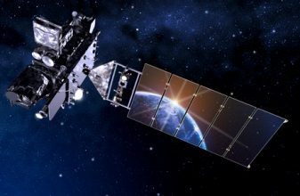
GOES-R Overview
SOO training
Kansas City
Fall 2016 / Spring 2017

Slide 2
Thanks to…
Tim Schmit
Bill Line
Jordan Gerth
Scott Lindstrom
Mat Gunshor
Steve Goodman
Kathryn Mozer
Matt Seybold
Kathleen Strabala
Dan Nietfeld
SSEC data center
Kaba Bah
Steve Miller and Dan Lindsey
JMA
ITT / Harris and the Entire GOES-R team!

Slide 3
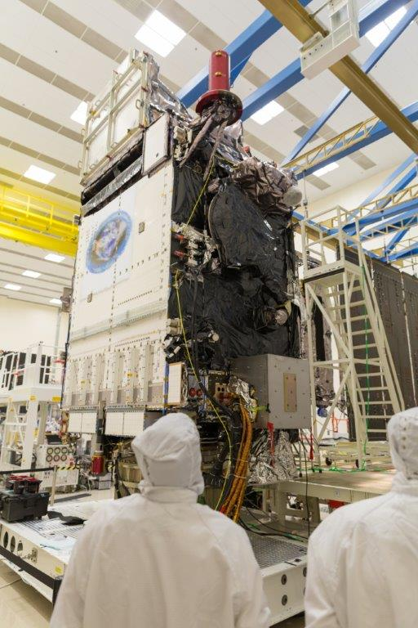
Outline
Introduction
GLM
GOES-R ABI
Spectral
Spatial
Temporal
Data
Summary
Lockheed Martin

Slide 4
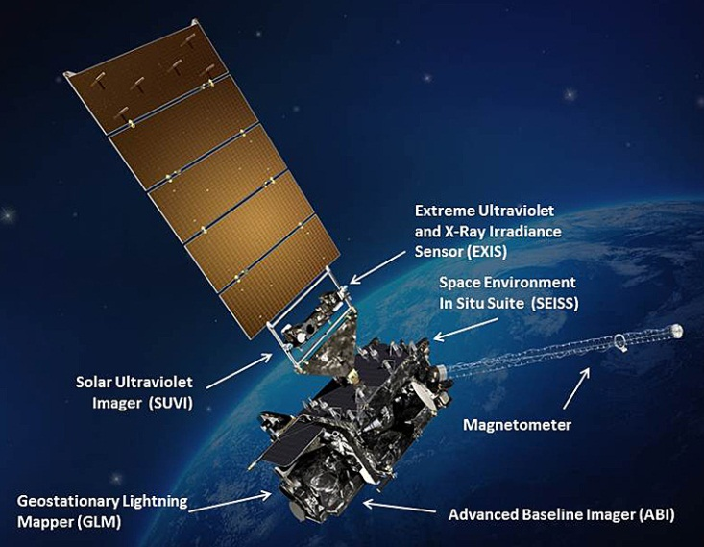
GOES-R
Next generation of NOAA/NASA geo weather satellites
R-Series includes 4 satellites (R, S, T, U)
First to launch in 04 Nov 2016
Represents first major upgrade in over 20 years
Earth-pointing instruments
Geostationary Lightning Mapper (GLM)
Advanced Baseline Imager (ABI)
3x more spectral bands
4x spatial resolution
5x temporal coverage
Space weather and solar imaging instruments
Space Environment in-Situ Sensor Suite (SEISS)
Magnetometer
Solar Ultra-Violet Imager (SUVI)
Extreme Ultraviolet and X-ray Irradiance Sensors (EXIS)

Slide 5
GOES-R
Notes:
Graphic from LM

Slide 6
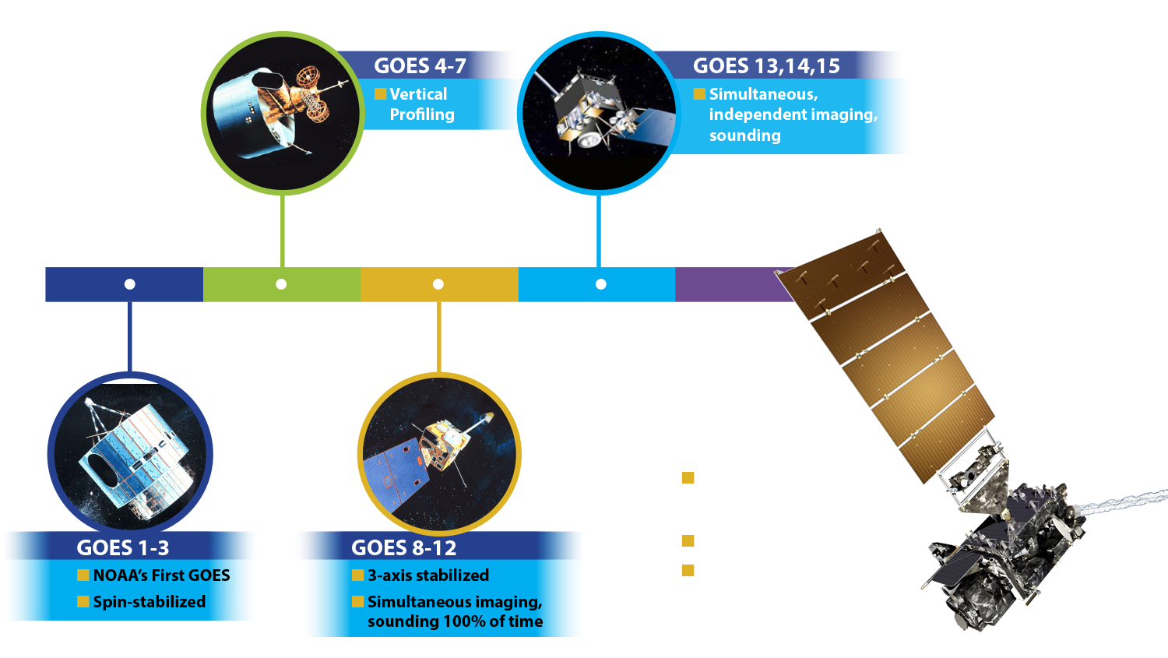
A History of GOES “Weather” Satellites
ATS
SMS
Notes:
The focus of this Short Course is to describe the advancements with the GOES-R series

Slide 7
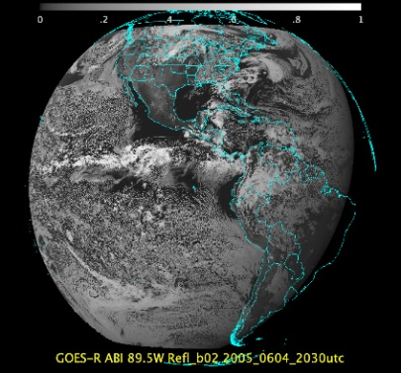
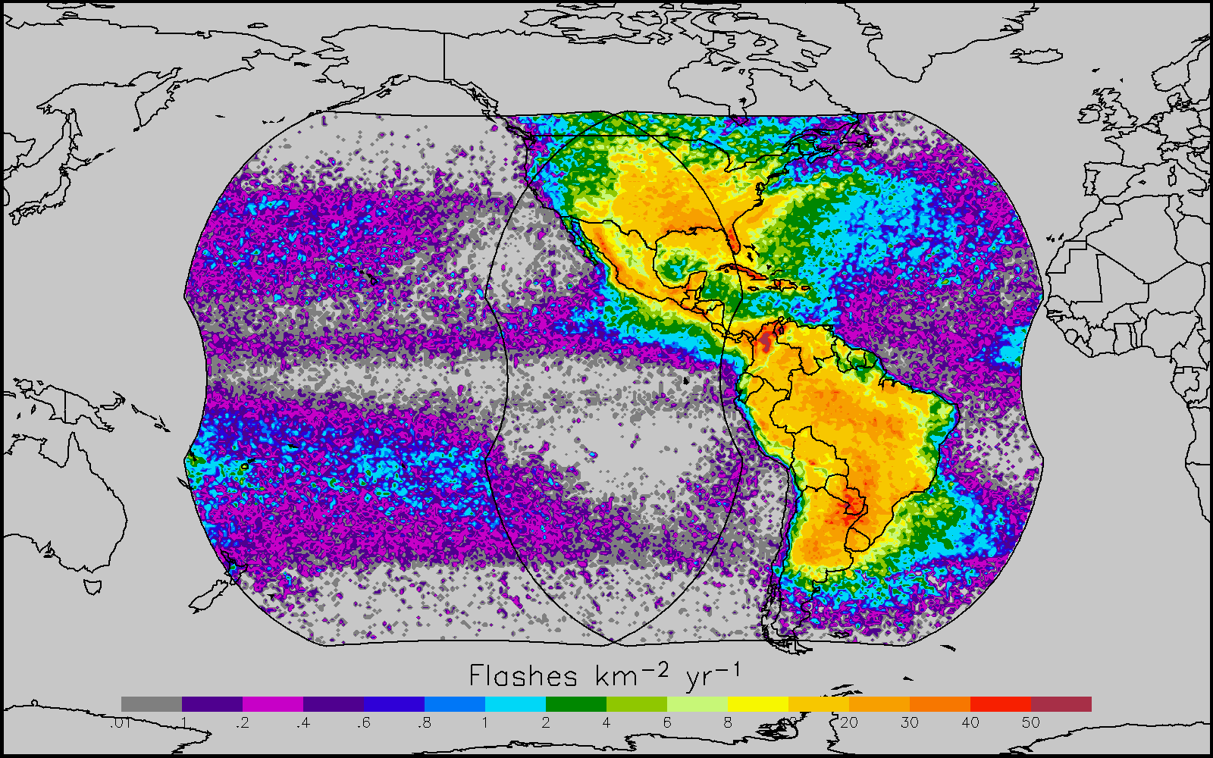
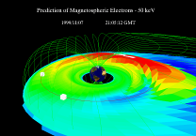
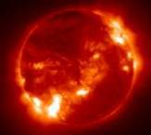
Why GOES-R ?
The GOES-R series will provide significant improvements in the detection and observations of meteorological phenomena that directly impact public safety, protection of property, and our Nation’s economic health and prosperity.
ABI
GLM
SEISS and MAG
EXIS and SUVI
Visible & IR Imagery
Lightning Mapping
Space Weather Monitoring
Solar Imaging
Improves hurricane track & intensity forecasts
Increases thunderstorm & tornado warning lead time
Improves aviation flight route planning
Data for long-term climate variability studies
Improved air quality warnings and alerts
Improves solar flare warnings for communications and navigation disruptions
More accurate monitoring of energetic particles responsible for radiation hazards to humans and spacecraft
Better monitoring of Coronal Mass Ejections to improve geomagnetic storm forecasting
7

Slide 8
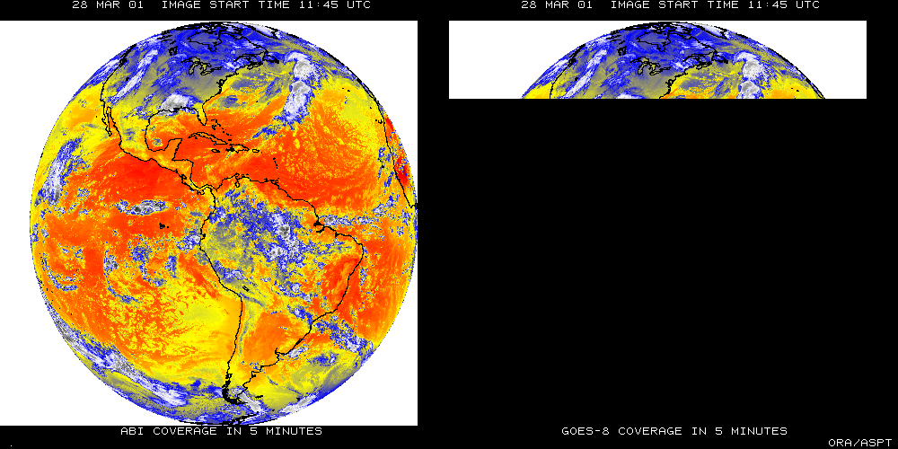
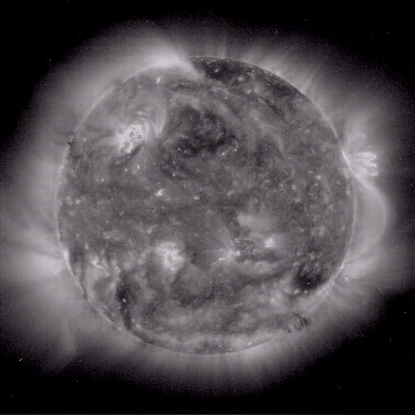
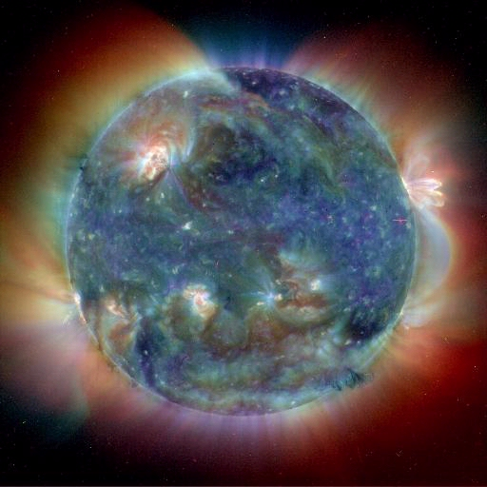
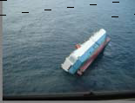
GOES-R main instruments
ABI – Advanced Baseline Imager
Space Weather/Solar
SEISS
SUVI
EXIS
Magnetometer
ABI covers the earth 5X faster than current Imager
Geostationary Lightning Mapper
Images courtesy of SOHO EIT, a joint NASA/ESA program
Unique Payload Services
No Sounder

Slide 9
Geostationary Lightning Mapper(GLM)
~ 10 km across field of view with 8 km CONUS, 14 km at edge of field of view
Detects extent of total lightning activity
Day/night coverage with 70-90% flash detection (better at night)
Near-uniform detection efficiency spatially across the domain
Continuous coverage (2 ms frame rate)
<20 sec latency
East/West GLM FOV
Figures courtesy of Steve Goodman

Slide 10
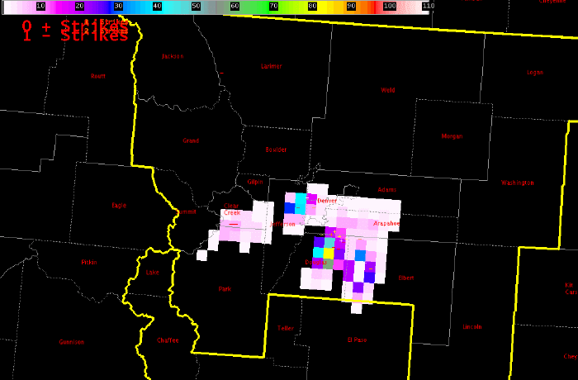
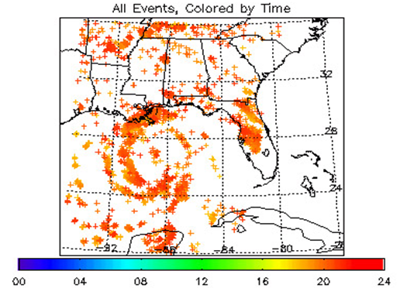
Geostationary Lightning Mapper(GLM)
Mission Benefits
Potential to improve warning decision-making when combined with radar and imaging
Cover data sparse regions
Diagnosing convective storm structure and evolution
Aviation and marine convective weather hazards
Tropical cyclone intensity change
Decadal changes of extreme weather – thunderstorms/ lightning intensity and distribution
PGLM Total Lightning - Denver
Hurricane Katrina
Figures courtesy of Steve Goodman

Slide 11
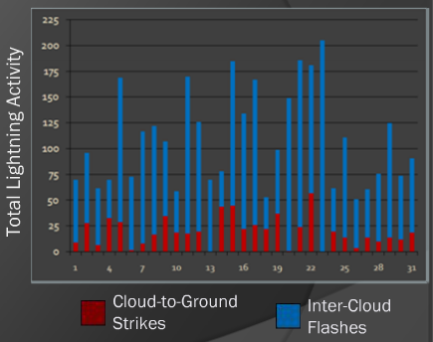
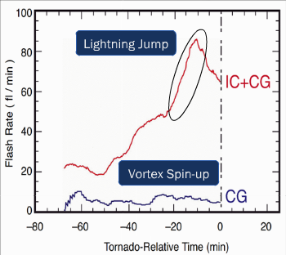
Benefits of Total Lightning
Cloud-to-ground AND intra-cloud flashes
Stronger, deeper updrafts lead to more lightning, with most lightning in-cloud
Total Lightning is driven by updraft in mixed phase region (above 10C)
Increase in total lightning signifies strengthening updraft
Rapid increase often precedes occurrence of severe weather by 10s of minutes.
Figures courtesy of NASA/SPoRT

Slide 12
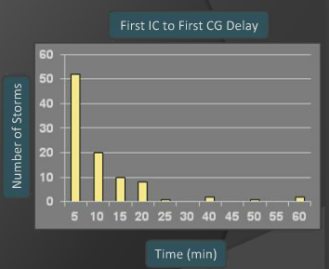
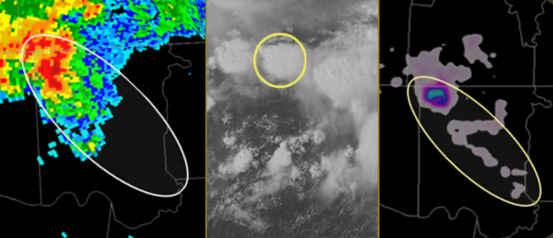
Total Lightning for DSS
Total Lightning- in –cloud and cloud-to-ground lightning extent information valuable for support of outdoor events
Figures courtesy of NASA/SPoRT

Slide 13
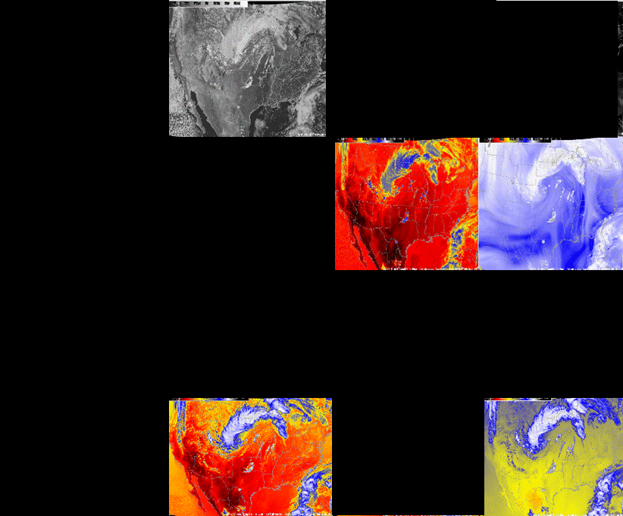
Current GOES Spectral Bands (5)
VIS
1 VIS
0 NIR
4 IR
NIR
WV
IRW
CO2
Figures courtesy of Tim Schmit

Slide 14
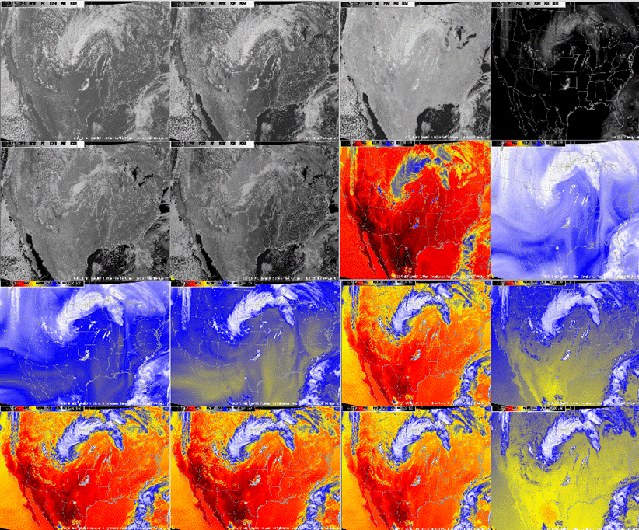
ABI Spectral Bands (16)
0.47 μm
0.64 μm
0.86 μm
1.38 μm
2 VIS
4 NIR
10 IR
1.61 μm
2.26 μm
3.9 μm
6.19 μm
6.95 μm
7.34 μm
8.5 μm
9.61 μm
10.35 μm
11.2 μm
12.3 μm
13.3 μm
Figures courtesy of Tim Schmit

Slide 15
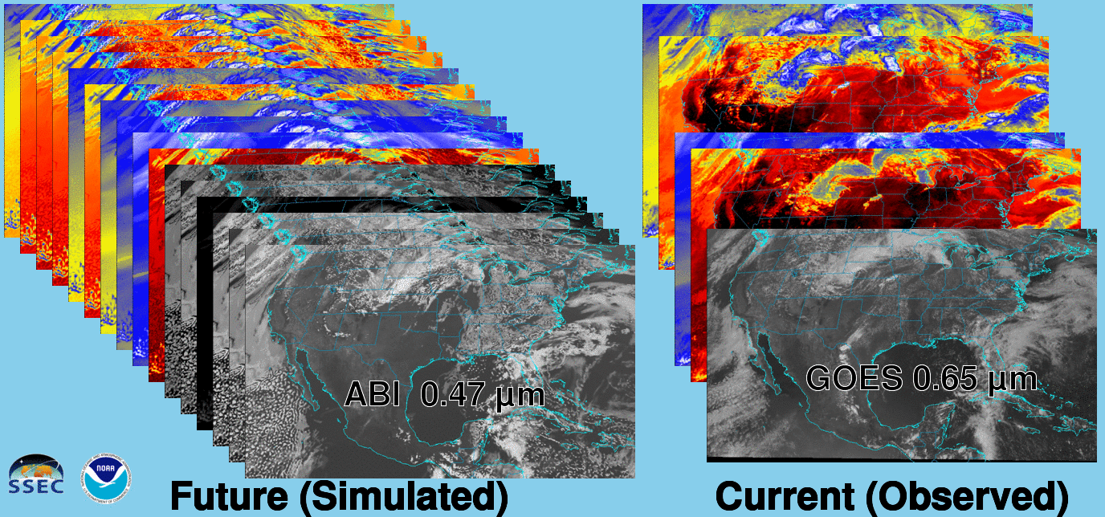
Future vs. Current Spectral Bands
The current GOES (right) has 5 spectral bands, while the GOES-R series ABI (left) will have 16 spectral bands.

Slide 16
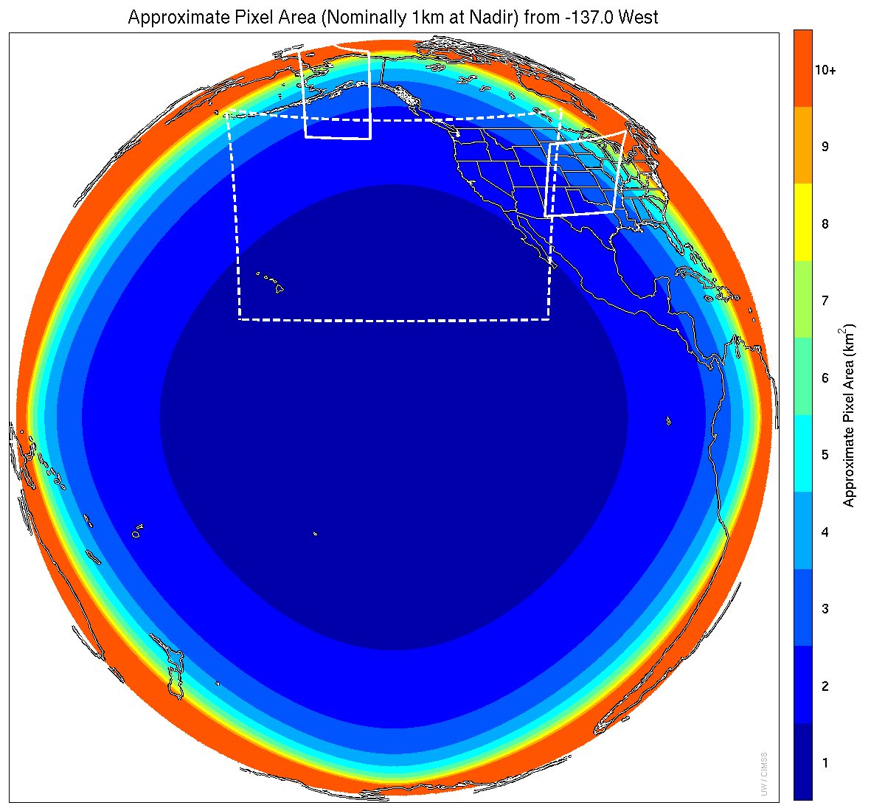
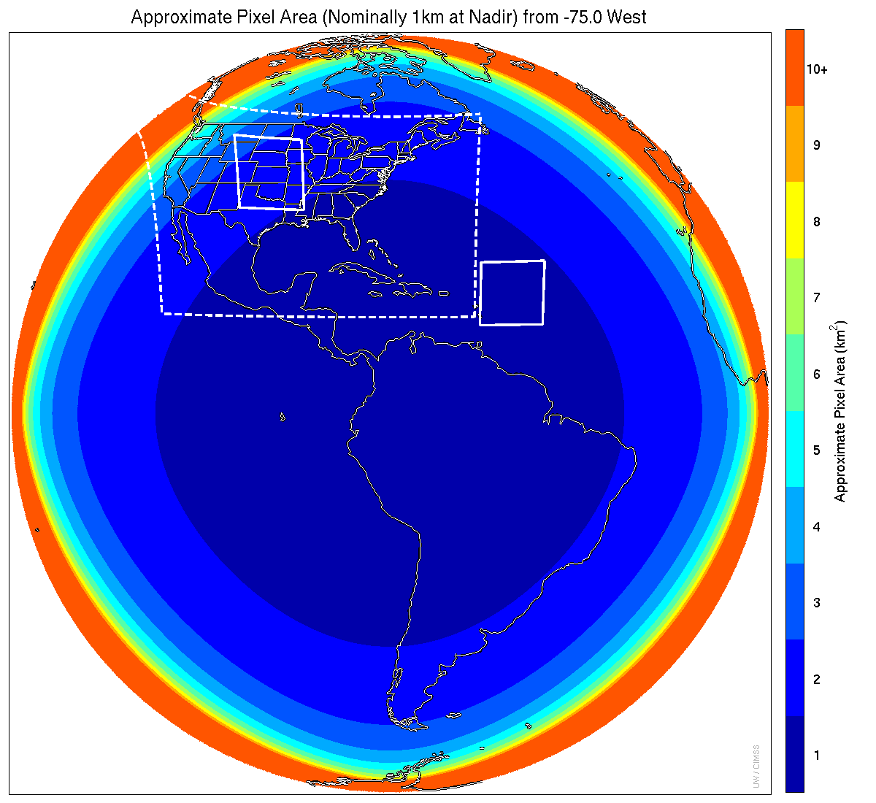
ABI: Temporal
GOES-R: Current:
Flex Mode Routine
Full Disk: 15 min 3-hr
CONUS: 5 min 15-min
Mesoscale: 30-sec n/a
or, 2 x 1-min
GOES-West in Flex Mode
GOES-East in Flex Mode
Figures courtesy of Tim Schmit

Slide 17
Meso-scale box locations are movable
1 min
1 min
5 min
15 min
West
Notes:
1-km² spatial resolution at satellite nadir. Pixel Areas are approximate. Each bin is rounded to the nearest 1km² until we get to 9.5km² and then all are binned into the red 10+ area. So the first, dark blue, ring covers pixel areas from 1 to 1.49km² and is labeled “1”, above 1.5 to below 2.5km² goes into the next ring and is called “2”, etc. GOES-West location. Proposed CONUS sector, approved by the NWS NOAT. Two meso-scale image sectors shown; these are selectable. The same central lat/lon used for these mesoscales produces a different sized and shaped area for different satellite locations.

Slide 18
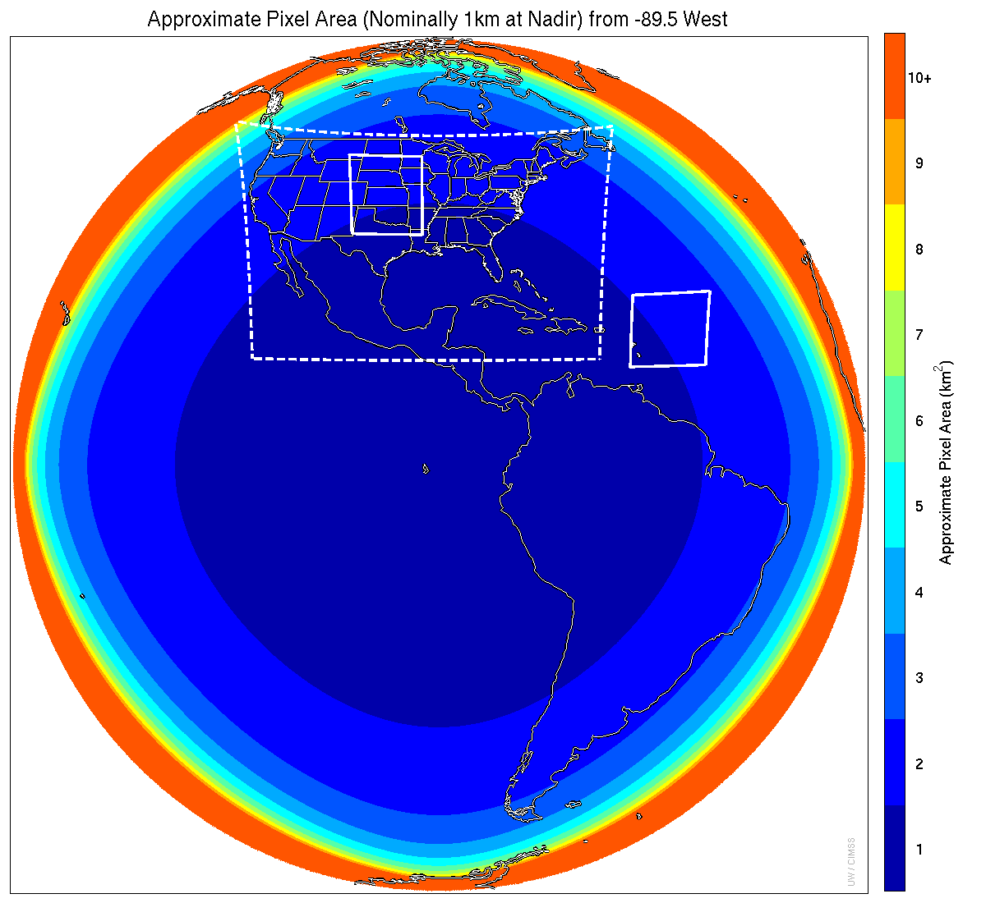
Meso-scale box locations are movable
1 min
5 min
1 min
15 min
Central
Notes:
1-km² spatial resolution at satellite nadir. Pixel Areas are approximate. Each bin is rounded to the nearest 1km² until we get to 9.5km² and then all are binned into the red 10+ area. So the first, dark blue, ring covers pixel areas from 1 to 1.49km² and is labeled “1”, above 1.5 to below 2.5km² goes into the next ring and is called “2”, etc. GOES-Test location. PUG CONUS sector. Two meso-scale image sectors shown; these are selectable. The same central lat/lon used for these mesoscales produces a different sized and shaped area for different satellite locations.

Slide 19
Meso-scale box locations are movable
1 min
5 min
1 min
15 min
East
Notes:
1-km² spatial resolution at satellite nadir. Pixel Areas are approximate. Each bin is rounded to the nearest 1km² until we get to 9.5km² and then all are binned into the red 10+ area. So the first, dark blue, ring covers pixel areas from 1 to 1.49km² and is labeled “1”, above 1.5 to below 2.5km² goes into the next ring and is called “2”, etc. GOES-East location. Proposed CONUS sector, approved by the NWS NOAT. Two meso-scale image sectors shown; these are selectable. The same central lat/lon used for these mesoscales produces a different sized and shaped area for different satellite locations.

Slide 20
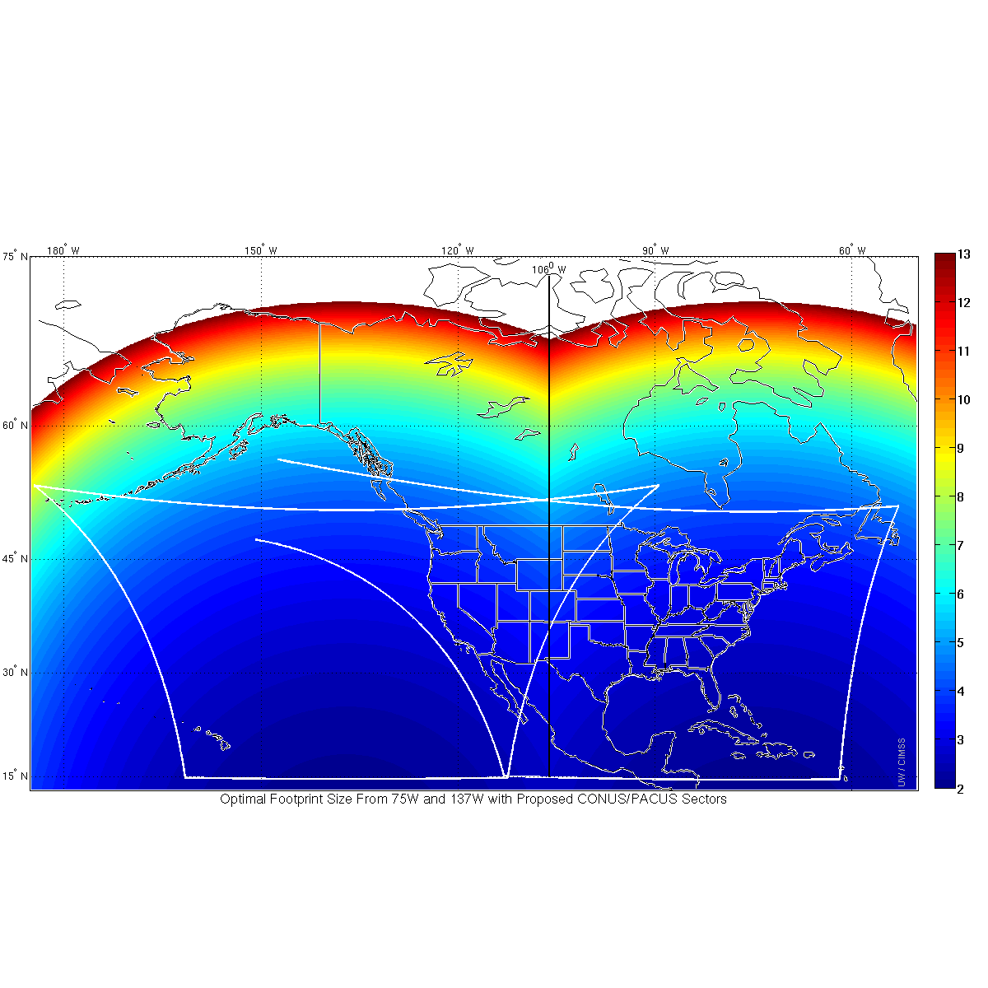
ABI IR Pixel size from West and East
(proposed ABI CONUS West and East)
East Optimal
West Optimal

Slide 21
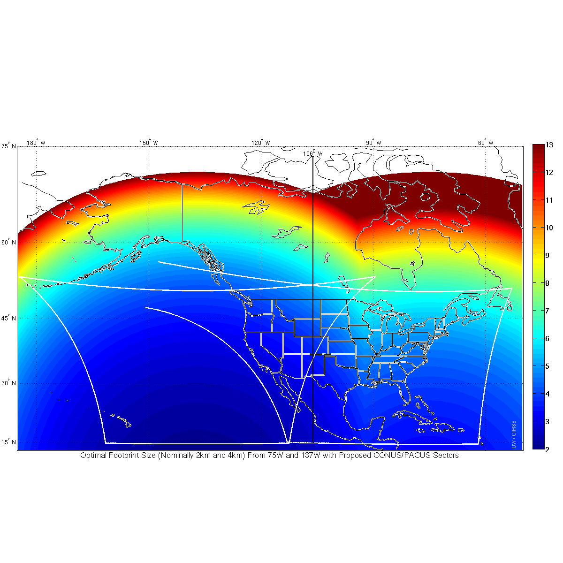
GOES-R as GOES West GOES-13 as GOES East Infrared Resolution color coded
106 W
GOES-R resolution is better than GOES-13 far to the east of the midpoint
(106 W) between the two sub-satellite points (all the way to ~92 W!)
Similarly, if GOES-R were GOES-East, there would be better pixel resolution
Compared to GOES-15 all the way to 120 W!
Notes:
So, If GOES-R is GOES-West at 137 W, and GOES-13 remains GOES-East at 75 W, the midpoint longitudinally is 106 W. But that's not where satellite resolution would be the same from each satellite; rather, GOES-R would have better spatial Resolution than GOES-13 all the way to 92 W, the approximate longitude of Duluth Minnesota at the western tip of Lake Superior. If GOES-R were GOES-East, superior spatial resolution from that GOES-East (relative to the resolution of GOES-14 or GOES-15 as GOES-West at 135W) would extend west all the way to 120 W, the longitude of Reno NV and Santa Barbara CA.
When GOES-R and GOES-S both are operational as GOES-East and GOES-West, the poorest spatial resolution will be along the 106W longitude line. Glasgow MT, and thereabouts, will have dubious distinction of the worst horizontal spatial resolution in CONUS – because it's halfway between the two satellites and farthest north.

Slide 22
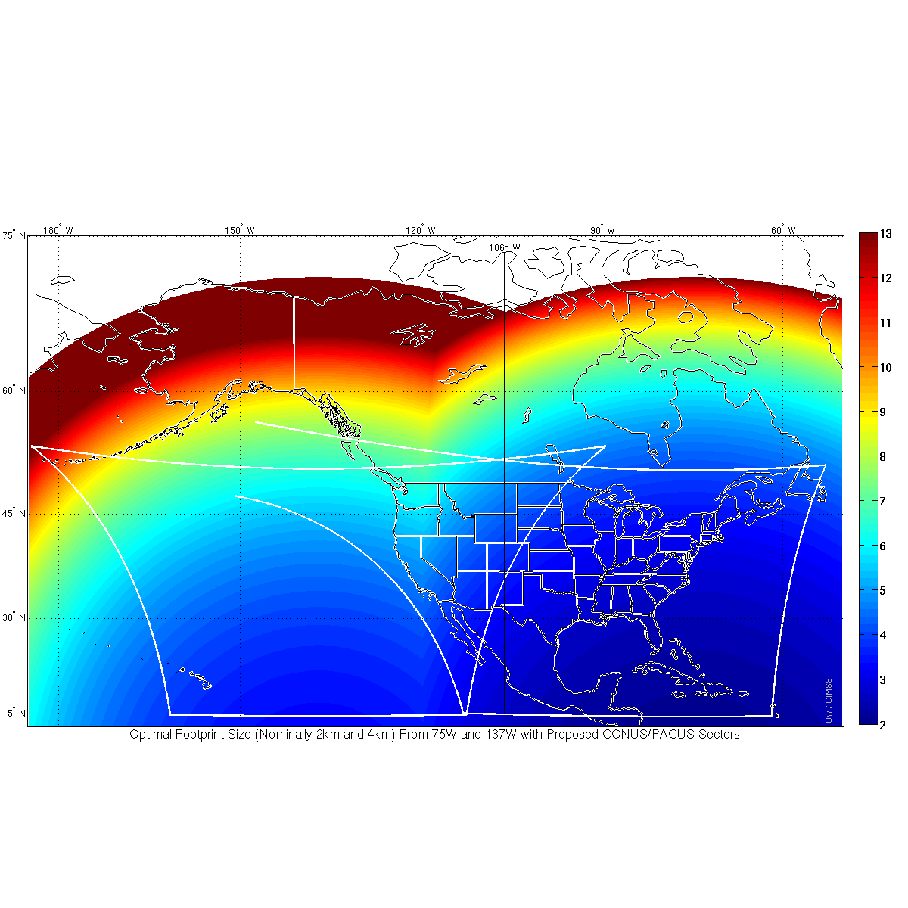
GOES-R as GOES East GOES-15 as GOES West Infrared Resolution color coded
106 W
GOES-R resolution is better than GOES-15 far to the west of the midpoint
(106 W) between the two sub-satellite points (all the way to ~120 W!)
Notes:
So, If GOES-R is GOES-West at 137 W, and GOES-13 remains GOES-East at 75 W, the midpoint longitudinally is 106 W. But that's not where satellite resolution would be the same from each satellite; rather, GOES-R would have better spatial Resolution than GOES-13 all the way to 92 W, the approximate longitude of Duluth Minnesota at the western tip of Lake Superior. If GOES-R were GOES-East, superior spatial resolution from that GOES-East (relative to the resolution of GOES-14 or GOES-15 as GOES-West at 135W) would extend west all the way to 120 W, the longitude of Reno NV and Santa Barbara CA.
When GOES-R and GOES-S both are operational as GOES-East and GOES-West, the poorest spatial resolution will be along the 106W longitude line. Glasgow MT, and thereabouts, will have dubious distinction of the worst horizontal spatial resolution in CONUS – because it's halfway between the two satellites and farthest north.

Slide 23
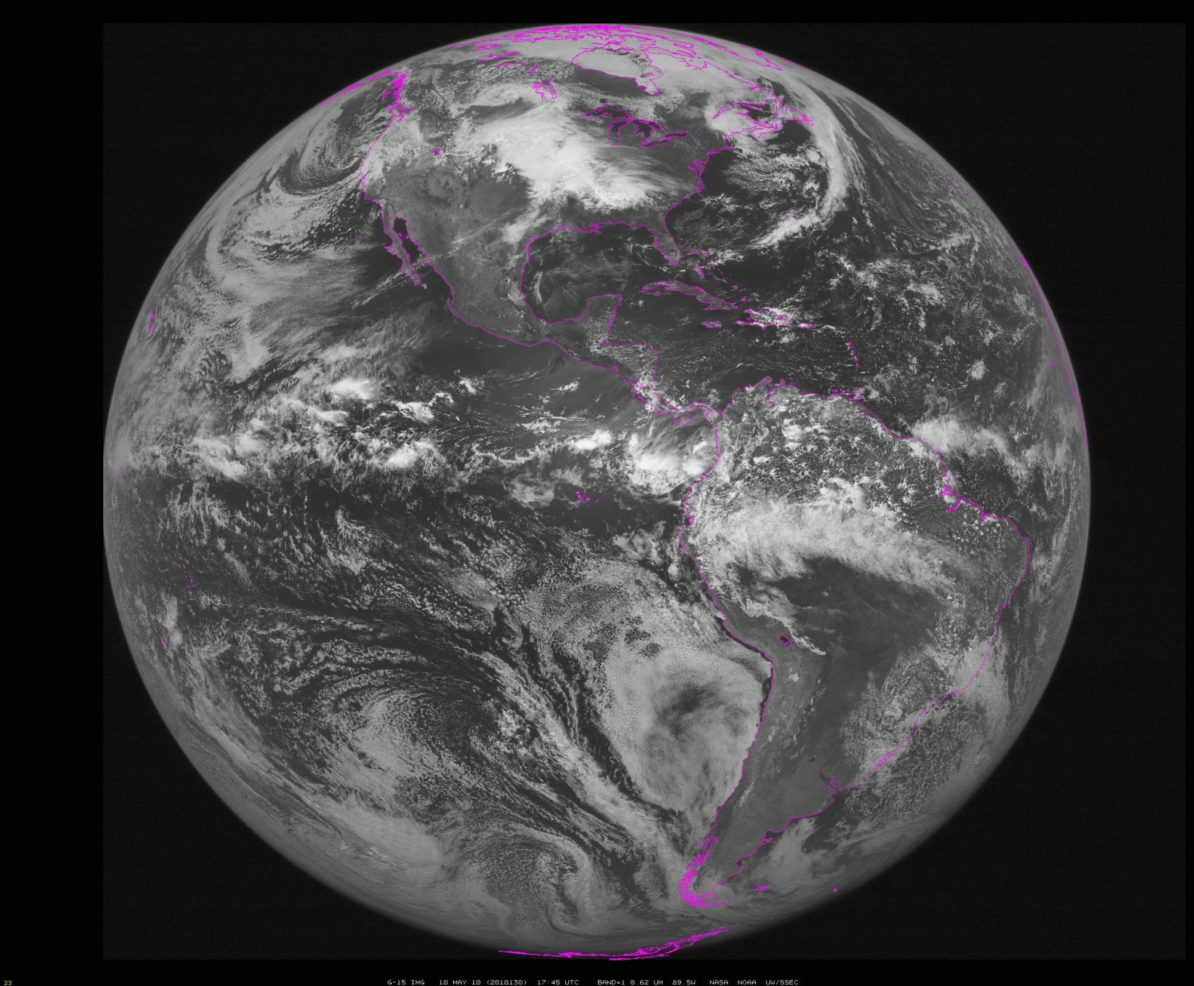
~90W
Notes:
Data from SSEC Data Center

Slide 24
GOES-14 Super Rapid Scan Operations for GOES-R (SRSOR)
Aug, Sep, Oct 2012: 38 days
Jun, Aug 2013: 14 days
May and Aug 2014: 30 days
May, Jun, Aug 2015: 36 days
Feb, April/May, Aug 2016: 69 days
Daily changing, ~1500 km x 2000 km sector;
Prepares users for GOES-R capability
http://cimss.ssec.wisc.edu/goes/srsor2016/GOES-14_SRSOR.html
Figure courtesy of T. Schmit, CIMSS
GOES-R ABI (Meso)
1 per minute for 2 locations
Operational
With FD + CONUS
+ higher spatial/spectral resolutions
GOES (SRSOR)
~1 per minute (26 every 30)
Experimental
No other imagery

Slide 25
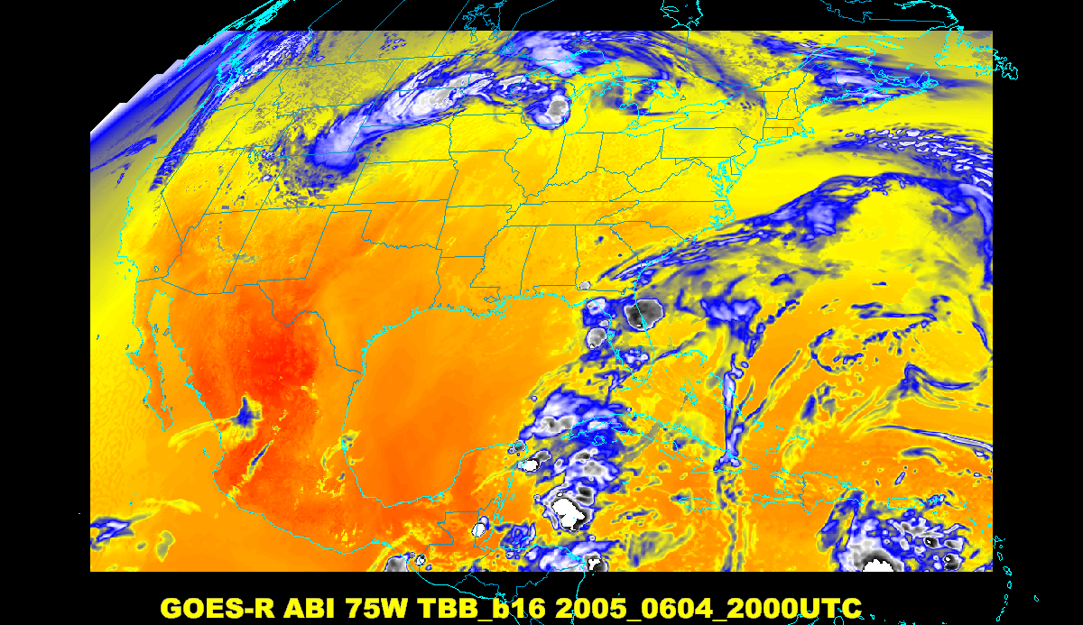
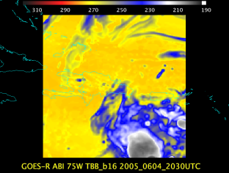
Baseline ABI Scan Modes
Scan mode (3) or ‘flex mode’ for the ABI:
- Full disk every 15 minutes + 5 min CONUS
+ 1-min mesoscales (2 locations).
[Scan mode (4) or ‘Continuous Full Disk’ (CFD) is a full disk every 5 min]
Notes:
CONUS image is the shifted center point.

Slide 26
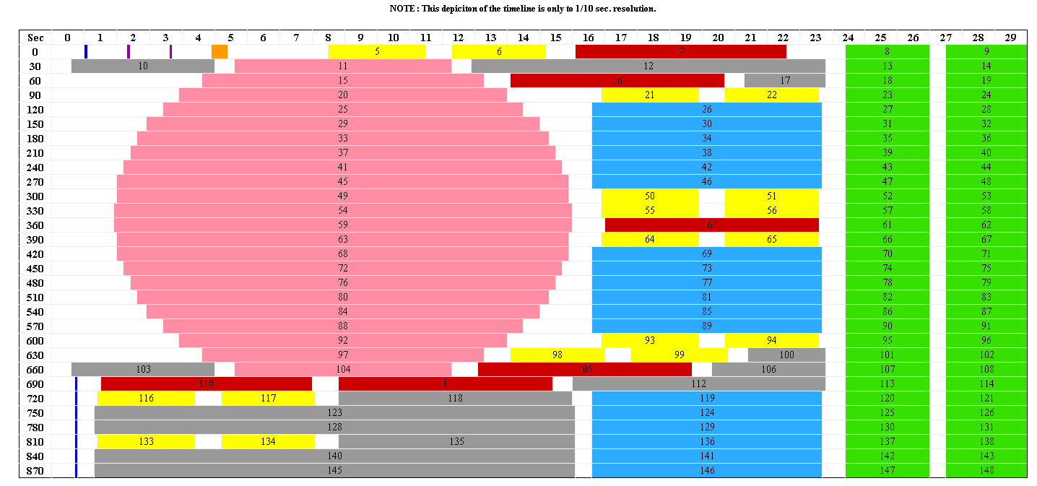
Scan Mode 3 Timeline (Flex Mode) Delivers Storm Watch Every 30 Seconds
30 seconds
Blackbody
IR Star
Spacelook
Vis Star
CONUS
Meso
Full
Disk
Nadir
Note: Autonomous spacelook collected with each Full Disk swath
MISTiC
Meso: one every 30 seconds or two at 1 minute intervals each
Scene locations can be changed on the fly (no interruption of timeline)

Slide 27
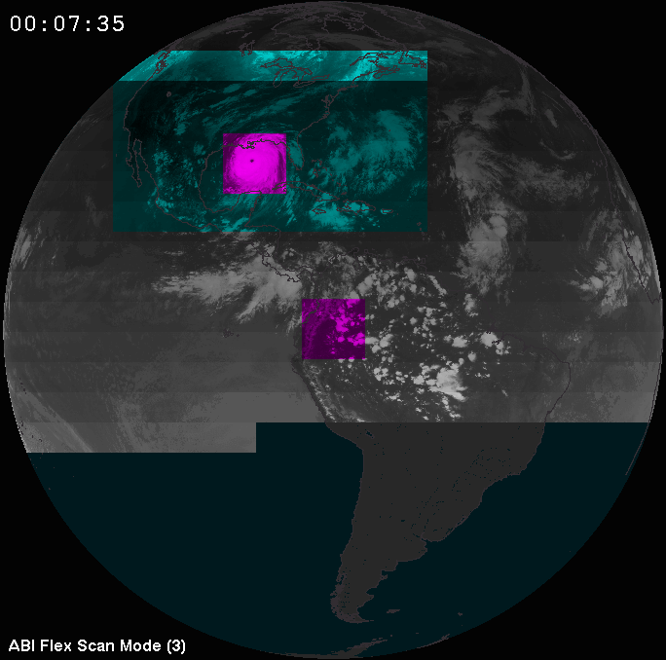
ABI Scan Strategy
Time->
CONUS
Meso
Meso
Full
Disk
Concept of the ABI “flex mode” diagram
(image fades with time)

Slide 28
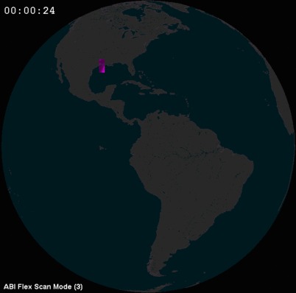
Flex Mode Concept

Slide 29
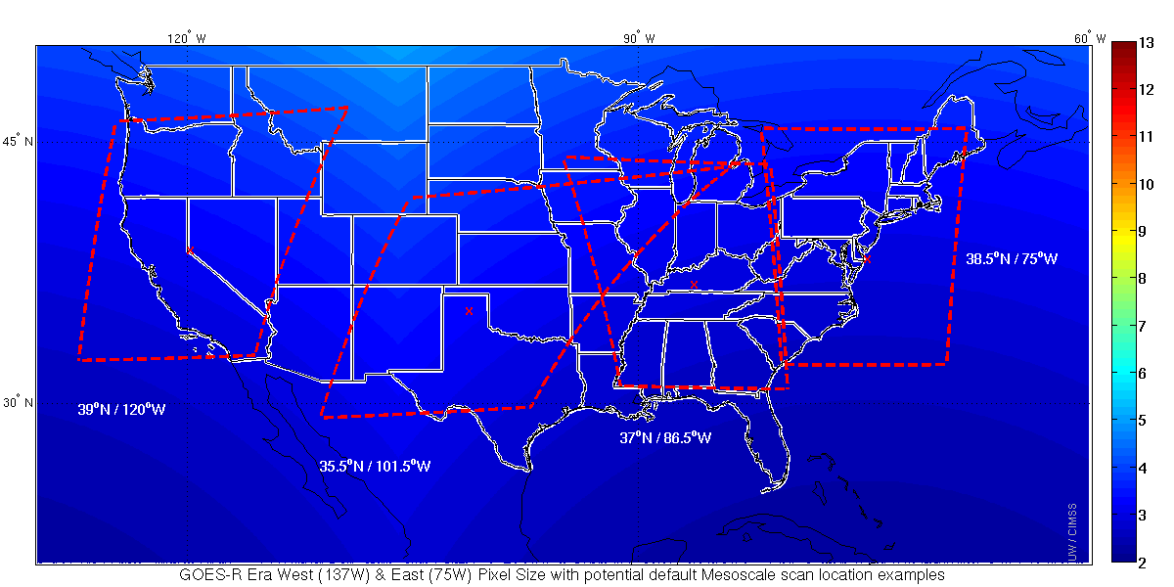
Default Meso Locations
Two meso from GOES-West and two from GOES-East

Slide 30
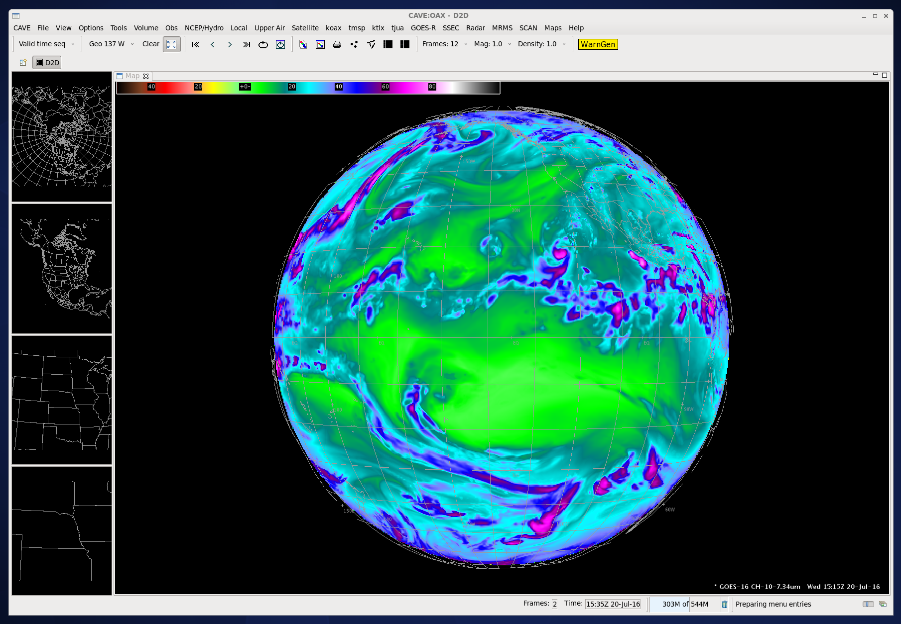

Slide 31
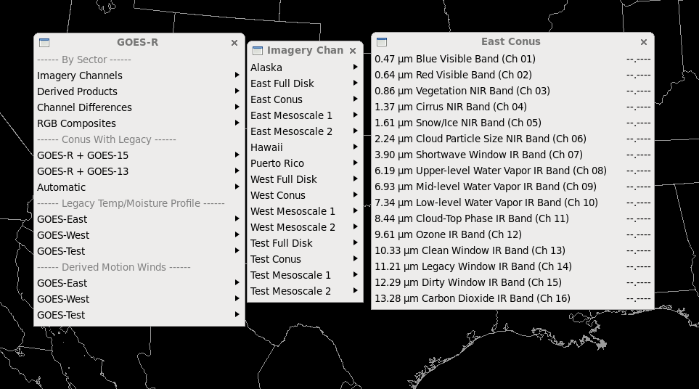

Slide 32
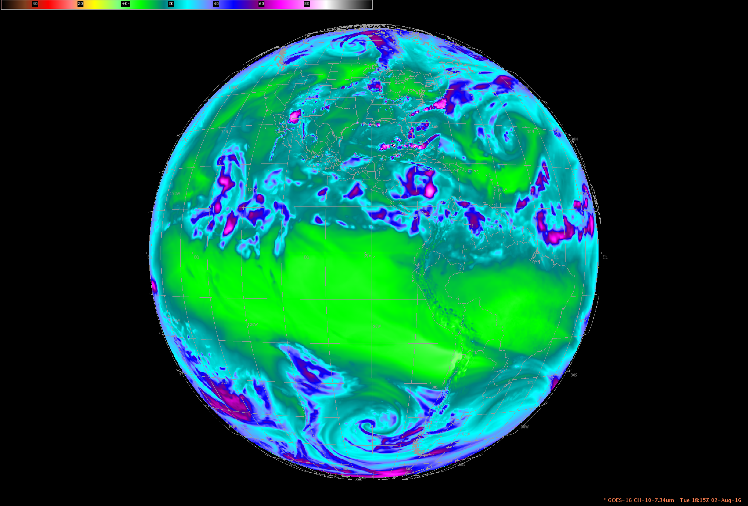
DOE-4 Simulated ABI: Full Disk sector
Central location

Slide 33
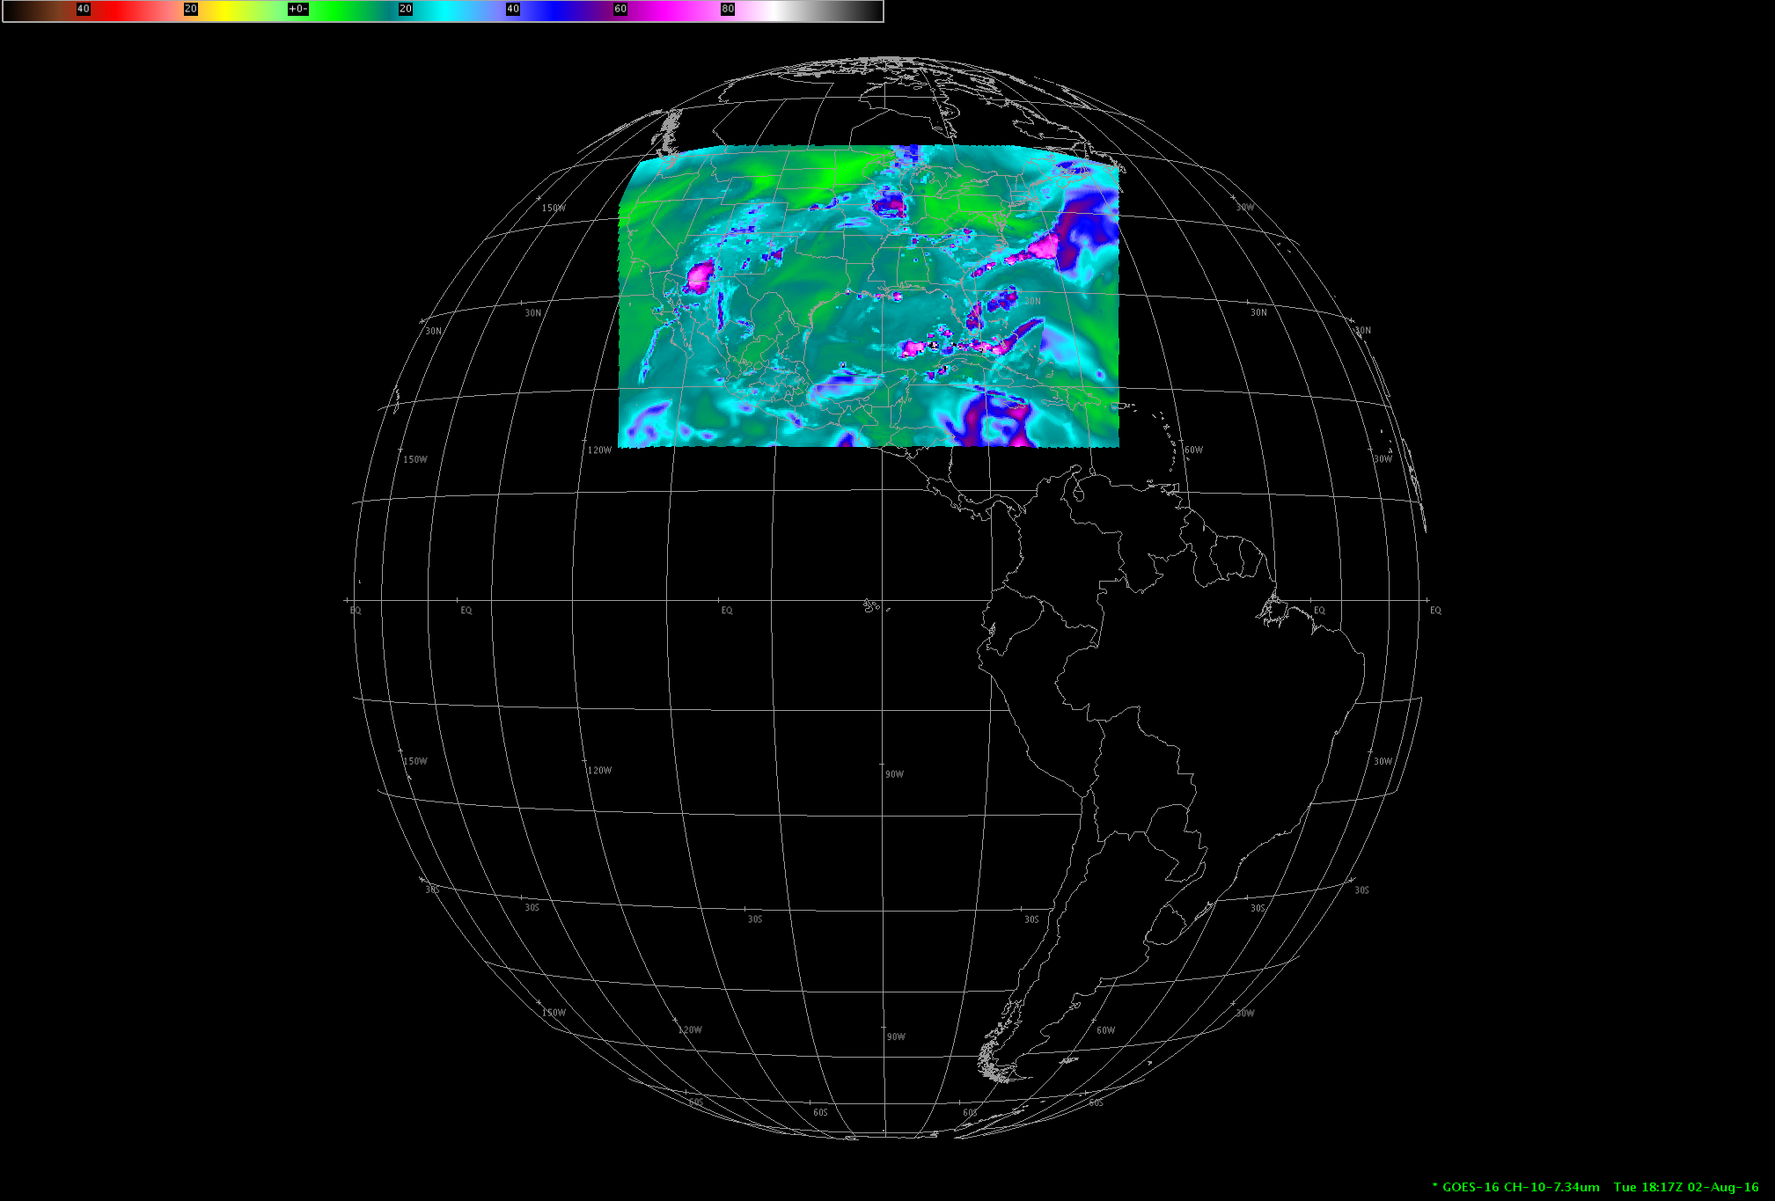
DOE-4 Simulated ABI: CONUS sector
Central location

Slide 34
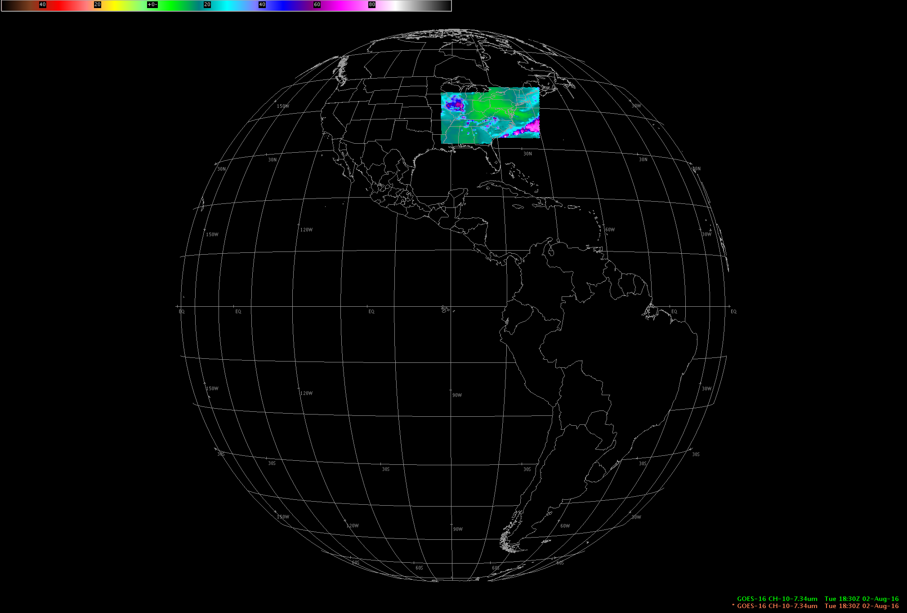
DOE-4 Simulated ABI: 2 meso-scale sectors
Central location

Slide 35
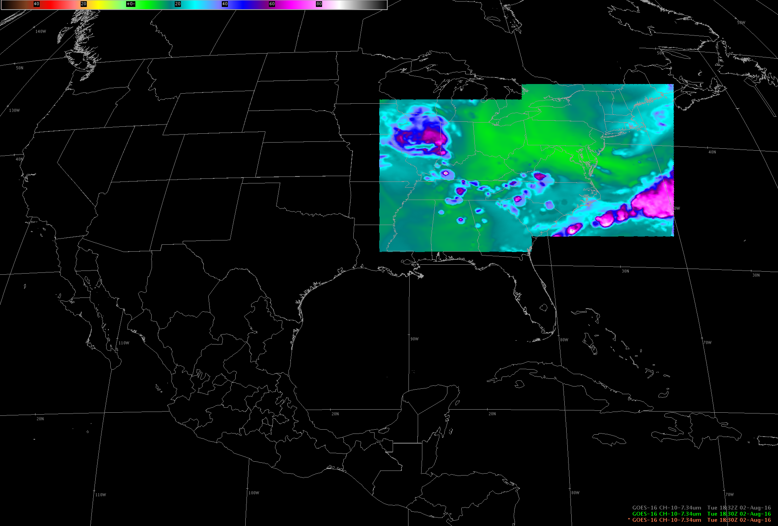
DOE-4 Simulated ABI: meso-scale sectors (default)
Central location

Slide 36
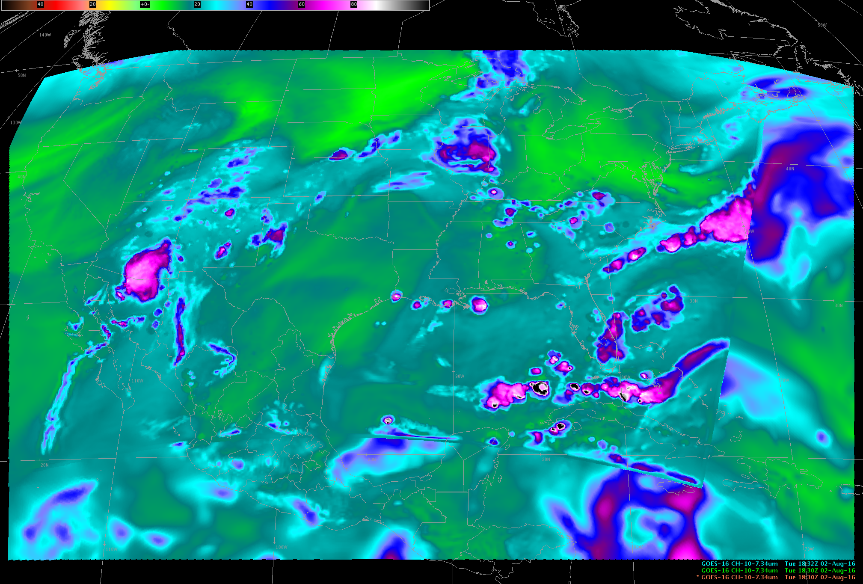
DOE-4 Simulated ABI: CONUS sector
Central location

Slide 37
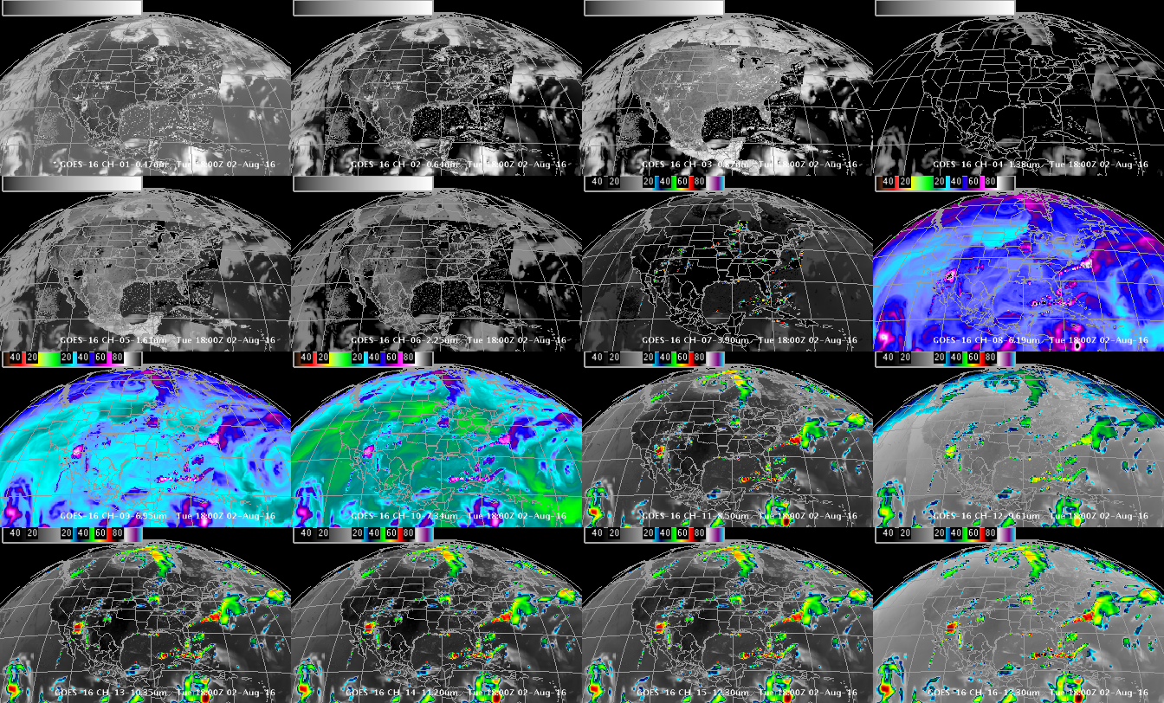
DOE-4 Simulated ABI Spectral bands
0.47 μm
0.64 μm
0.86 μm
1.37 μm
1.6 μm
2.2 μm
3.9 μm
6.2 μm
6.9 μm
7.3 μm
8.4 μm
9.6 μm
10.3 μm
11.2 μm
12.3 μm
13.3 μm
GOES-R ABI Imagery simulated at UW via AWG Proxy, processed via the Ground System, acquired via NOAAPort, shown in AWIPS-II (default enhancements)

Slide 38
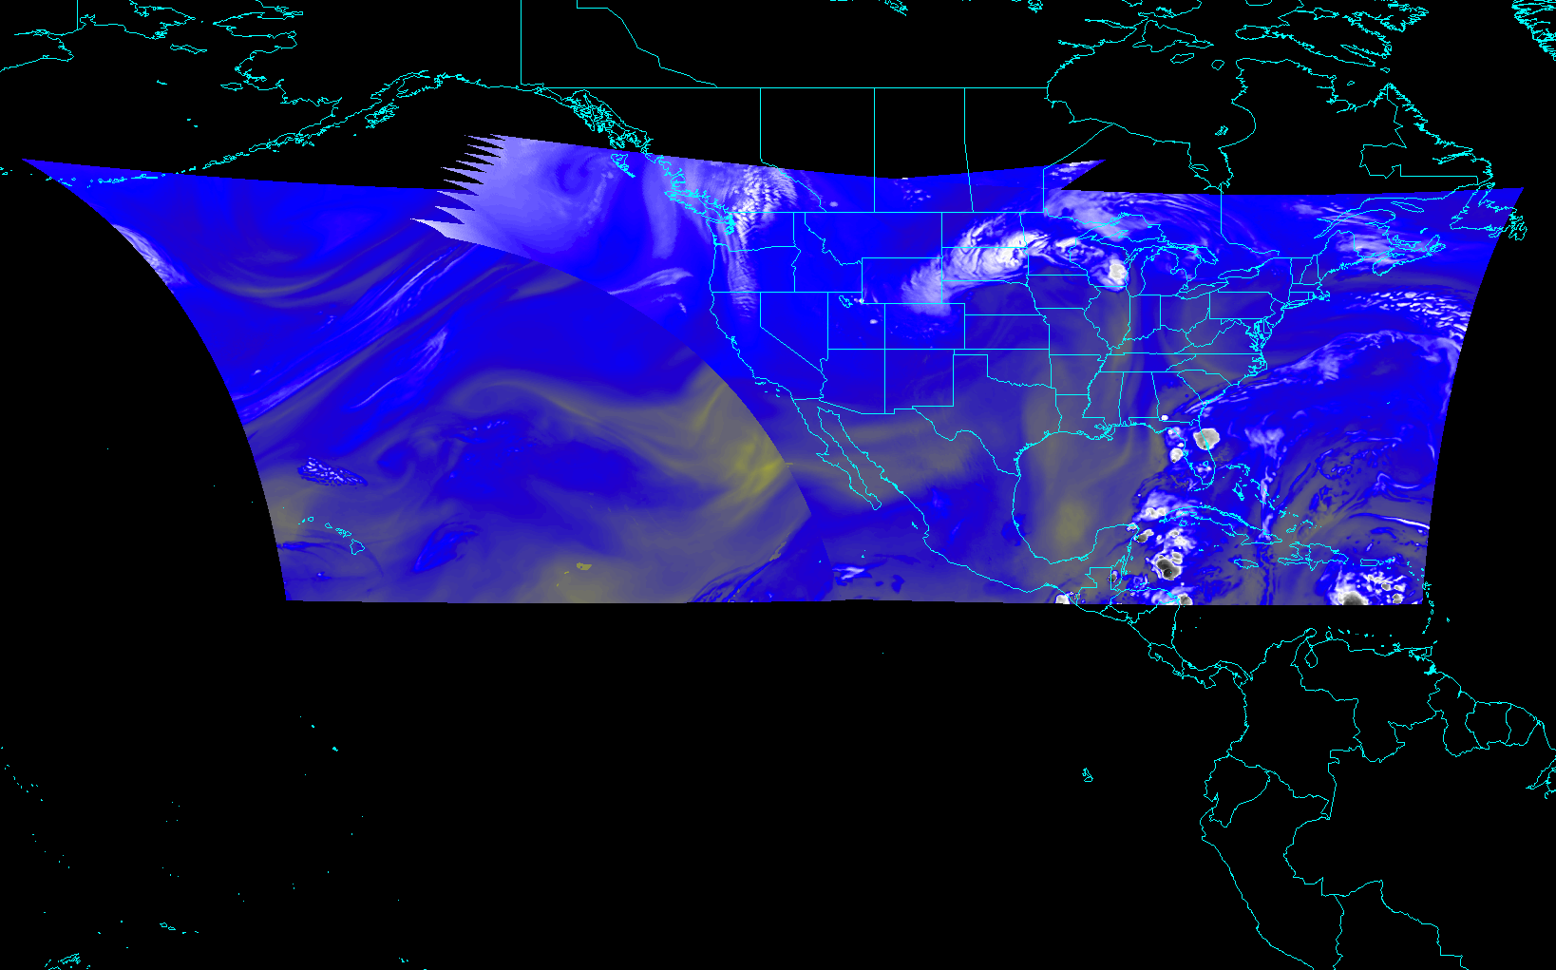
Redo with AWIPS combined image (default color map?)
ABI CONUS from East and West
Notes:
Different days simulated.

Slide 39
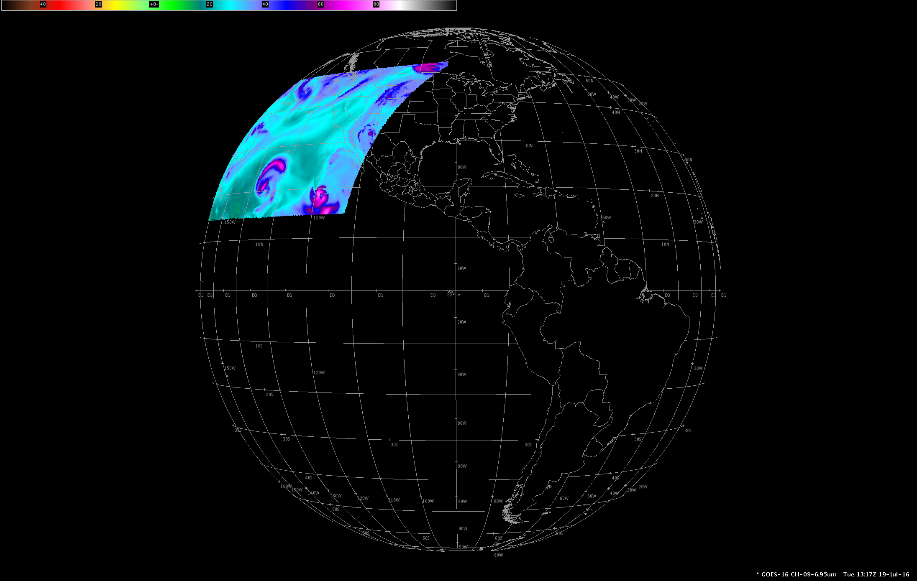
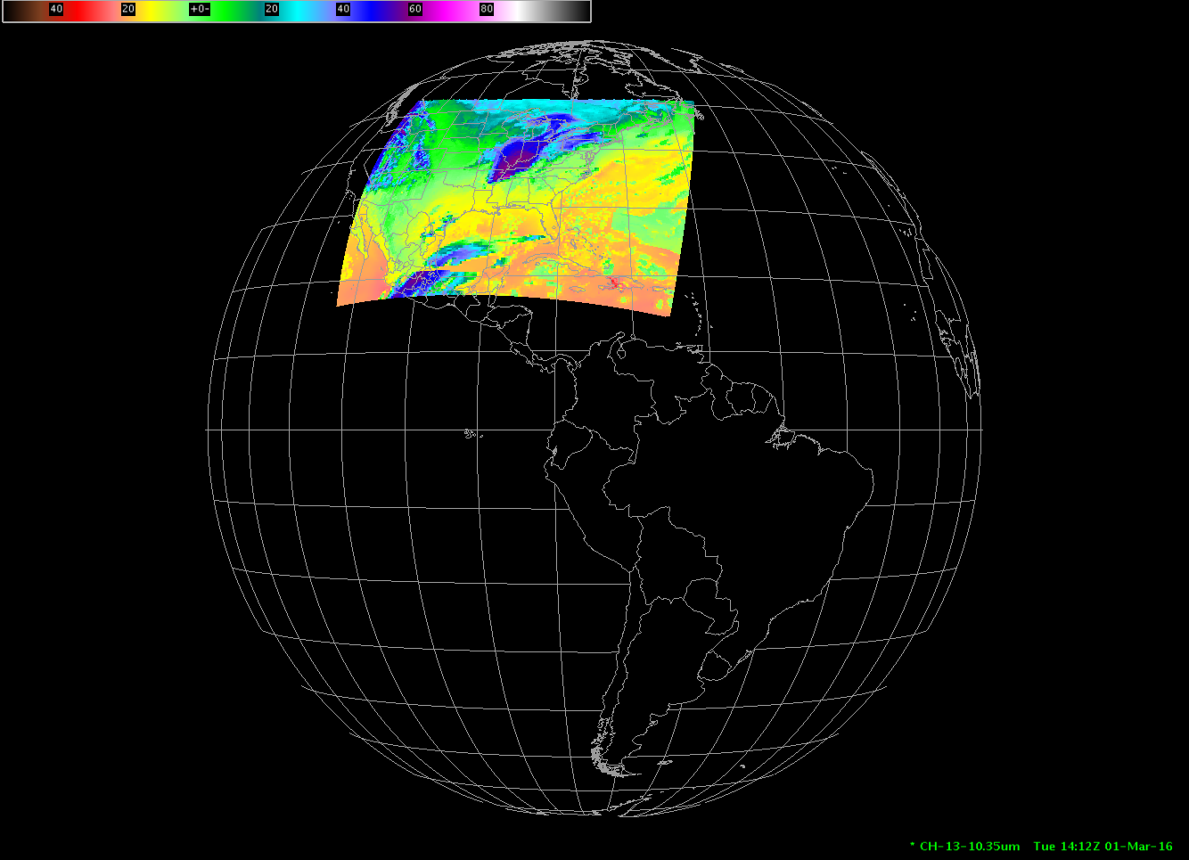
Redo with AWIPS combined image (default color map?)
ABI CONUS from West and East
Notes:
Different days simulated.

Slide 40
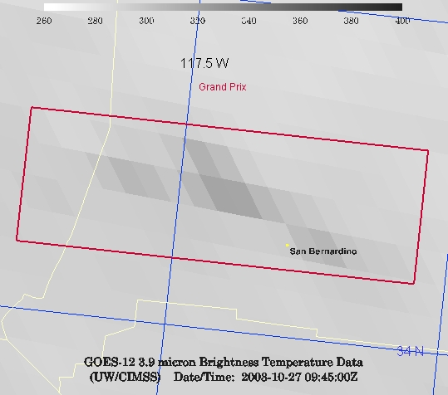
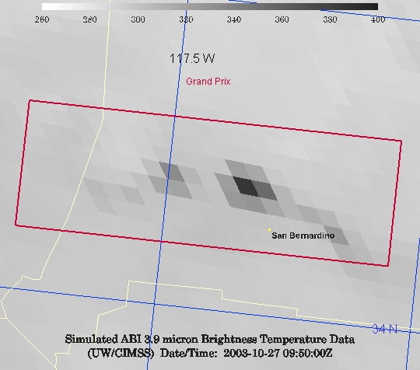
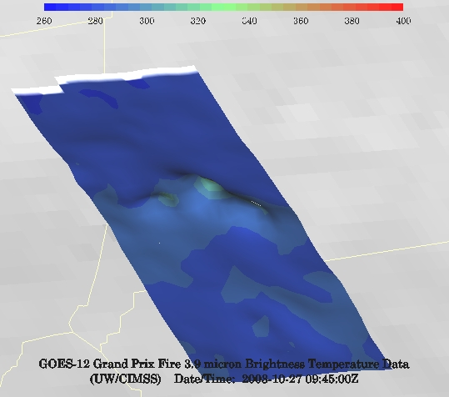
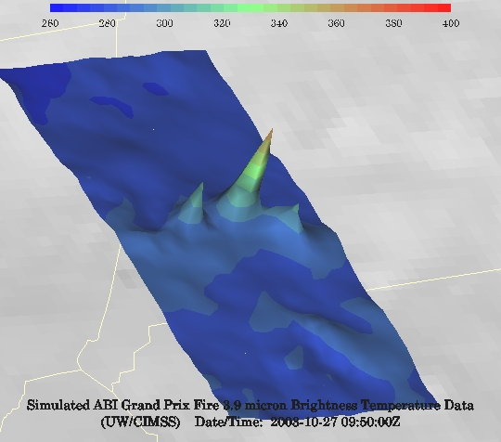
GOES-12 and GOES-R ABI
Simulation of Grand Prix Fire/Southern California
GOES-12
GOES-R ABI
GOES-12
GOES-R ABI
Notes:
Here are two different fires from J. Feltz of CIMSS (using mcidas-v). What we can see is a more defined peak in the higher resolution data and it is easier to pick out individual hotspots. In addition, the higher saturation temperature of the ABI allows us to see that the fire is around 370K. ABI is simulated from MODIS.

Slide 41
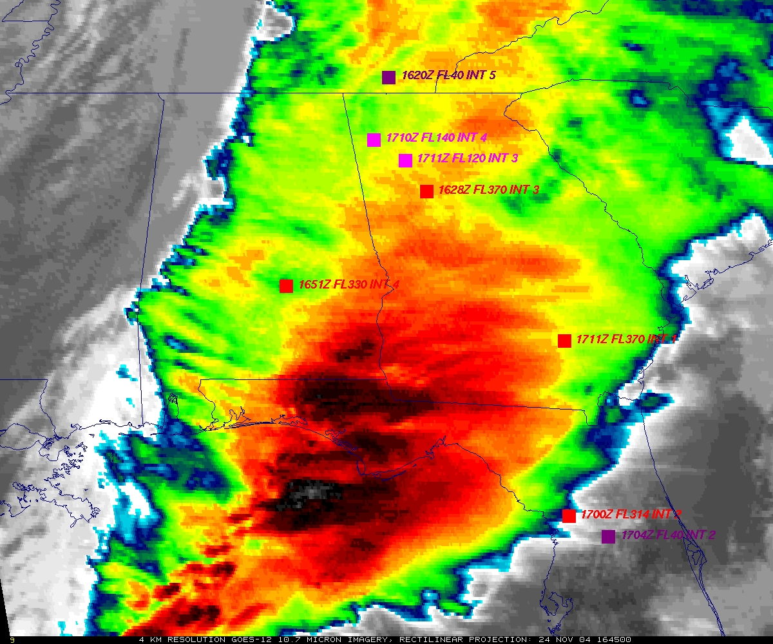
GOES
Figure courtesy of K. Bedka and W. Feltz

Slide 42
“ABI” from MODIS
Figure courtesy of K. Bedka and W. Feltz

Slide 43
GOES Spatial Resolution

Slide 44
MODIS Spatial Resolution
Note that this is finer than what the ABI IR bands will be.

Slide 45
ABI
Pixels size by latitude, along the longitude line of satellite nadir.
In general, even at 50 degrees view angles, the spatial resolution of the ABI is comparable to today’s imager at the satellite sub-point.
Figure from J. Key, ASPB

Slide 46
A Glimpse into the Future
ABI-like
Hurricane Sandy from GOES-14 at two temporal resolutions

Slide 47
What is NEdT?
NEdT = Noise Equivalent delta Temperature
Units: K
An estimate of noise used for IR bands
Valid at a reference temperature
Lower number is better
Recall the ABI has a much improved field-of-view size
so the same NEdT is really an improvement

Slide 48
ABI (and GOES) NEdT (K)
ABI |  |  |  | GOES |  |  | -12 | -15
Number | Nominal Central Freq. (µm) | Spec | Worst Case Estimate | Number | Nominal Central Freq. (µm) | Spec | Measured (PLT) | Measured (PLT)
7 | 3.9 | 0.1 | 0.064 | 2 | 3.9 | 1.4 | 0.130 | 0.063
8 | 6.2 | 0.1 | 0.016
9 | 6.9 | 0.1 | 0.015 | 3 | 6.7/6.5 | 1.0 | 0.15 | 0.17
10 | 7.3 | 0.1 | 0.023
11 | 8.4 | 0.1 | 0.022
12 | 9.6 | 0.1 | 0.021
13 | 10.3 | 0.1 | 0.032
14 | 11.2 | 0.1 | 0.022 | 4 | 10.7 | 0.35 | 0.11 | 0.06
15 | 12.3 | 0.1 | 0.031 | 5 | 12.0 | 0.35
16 | 13.3 | 0.3 | 0.068 | 6 | 13.3 | 0.32 | 0.19 | 0.13

Slide 49
http://www.goes-r.gov
Notes:
The subjects of this GOES-R Baseline products training are the aerosol products boxed in yellow.

Slide 50
Cloud Top Phase

Slide 51
Cloud Top Height + TPW

Slide 52
DOE-4 Simulated ABI (select) Derived Products
Aerosol Detection
Aerosol Optical Depth
Cloud Mask
Cloud Top Height
Cloud Top Phase
Cloud Top Pressure
Rain Rate
LST
SST
Snow
TPW
CAPE
K-index
Lifted Index
Showalter
Total Totals
Using GOES-R ABI Imagery simulated at UW via AWG Proxy, processed via the Ground System, acquired via NOAAPort, in AWIPS-II (default enhancements)

Slide 53
GOES-R Launch
16 Nov 2016 (TBR)
Cape Canaveral Air Force Station, Florida
Atlas V 541, United Launch Alliance

Slide 54
Post Launch Plans

Slide 55
Post Launch Plans
ABI imagery to AWIPS via NOAAPORT or GRB:
L + 101 (TBC)
GLM data to AWIPS via NOAAPORT or GRB:
L + 165 (TBC)
ABI Level2 products to AWIPS via NOAAPORT or GRB:
validated in a rolling fashion once the L1b data is declared beta

Slide 56
Advanced Baseline Imager (ABI)
ABI on GOES-S
5
4
3
X
Faster coverage (5-minute full disk vs. 25-minute)
X
Improved spatial resolution
(2 km IR vs. 4 km)
X
More spectral bands (16 on ABI vs. 5 on the current imager)
Notes:
Slide from J. Gerth, CIMSS.

Slide 57
GOES-R ABI
Spectral, Spatial and Temporal
Improved, Improved and Improved
ABI
Lockheed Martin

Slide 58
Summary
1. The GOES-R ABI provides mission continuity
2. Two times the image navigation quality
3. Three times the number of imaging bands
4. Four times the spatial resolutions
5. Five times the coverage rate
- Special GOES-14 1-min data pathfinder
http://www.goes-r.gov

Slide 59
GOES-R Series web site
http://www.goes-r.gov
Lockheed Martin

