Slide 1
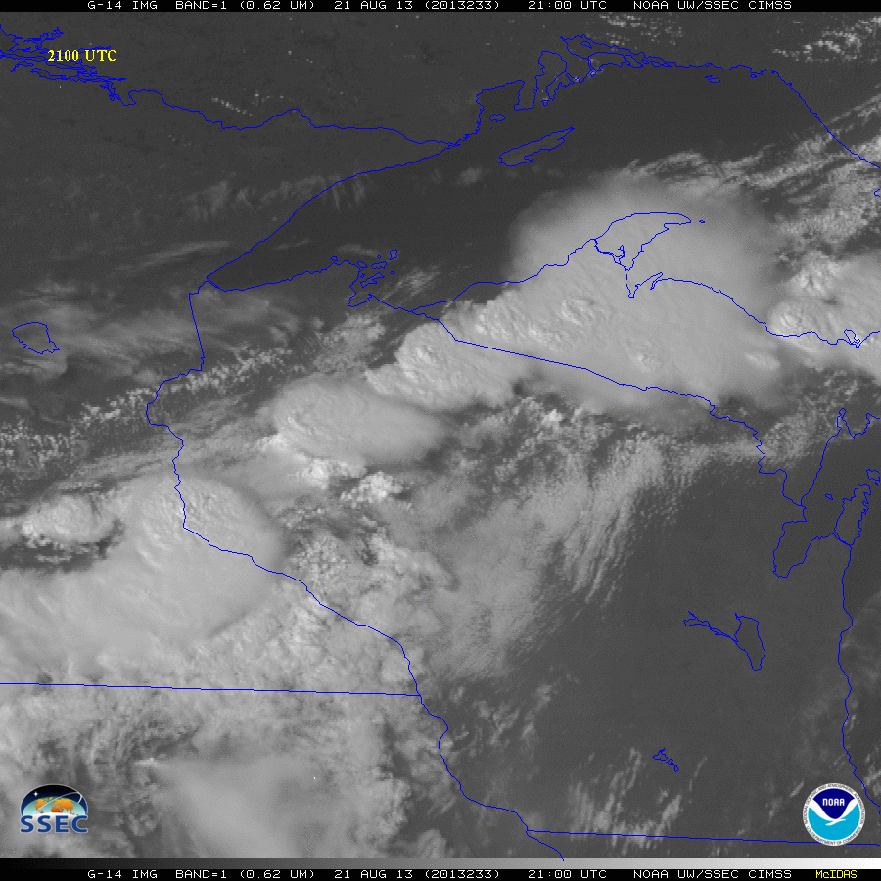
GOES-14: Special Rapid Scanning offers glimpse of the ABI
SRSOR (Super Rapid Scan Operations for GOES-R) from GOES-14 imager
Many weeks of data during 2012 (eg, Hurricane Sandy, etc.)
For 2013, two days in June and 12 days in mid-August, 2013.
http://cimss.ssec.wisc.edu/goes/srsor2013/GOES-14_SRSOR.html
Many phenomena were observed: convection, hurricanes, fires, smoke, etc.
Data to many operational groups
http://cimss.ssec.wisc.edu/goes/srsor2013/900x900_GOES_B1_CONV_WI_animated_2013233_173000_182_2013234_010000_182_X.mp4
Animation from GOES-14 Imager visible image at 1-min time resolution.
GOES-14 provided very unique information and offers a glimpse into the possibilities that will be provided by the ABI on GOES-R.
(Schmit, Nelson, Bachmeier, Bellon, Gunshor, Velden, SSEC Data Center…)
Notes:
Note that the image is only an image, the loop could be embedded, but make sure all the frames show. If not, just show ‘stand-alone’.

Slide 2
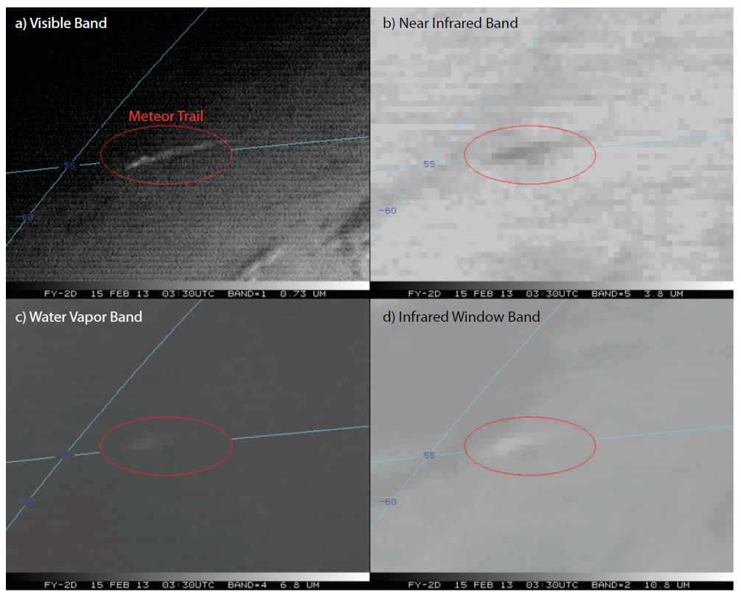
Paper Published on Meteor Trails over Russia in February of 2013 in the PNAS
A paper was published in the Proceedings of the National Academy of Sciences (PNAS) regarding using weather satellites to study atmospheric bolides (large meteors), in this case over Russia in February of 2013
S. D. Miller, W. C. Straka III, A. S. Bachmeier, T. J. Schmit, P. T. Partain, and Y. Noh, 2013: Earth-viewing satellite perspectives on the Chelyabinsk meteor event PNAS October 2013; doi:10.1073/pnas.1307965110
http://www.pnas.org/content/early/2013/10/15/1307965110.full.pdf+html
This is an example of using ‘weather’ satellites for other uses.
FY-2D multi-spectral imagery (0330 UTC)
MTSAT visible at an oblique view angle (animation)
(Bachmeier, Straka, Schmit, SSEC Data Center…)
Notes:
http://www.news.colostate.edu/Release/7044 (CSU press release). http://www.csmonitor.com/Science/2013/1021/Meteor-that-bombed-Russia-left-telltale-tracks-seen-from-space (Christian Science Monitor).

