Slide 1
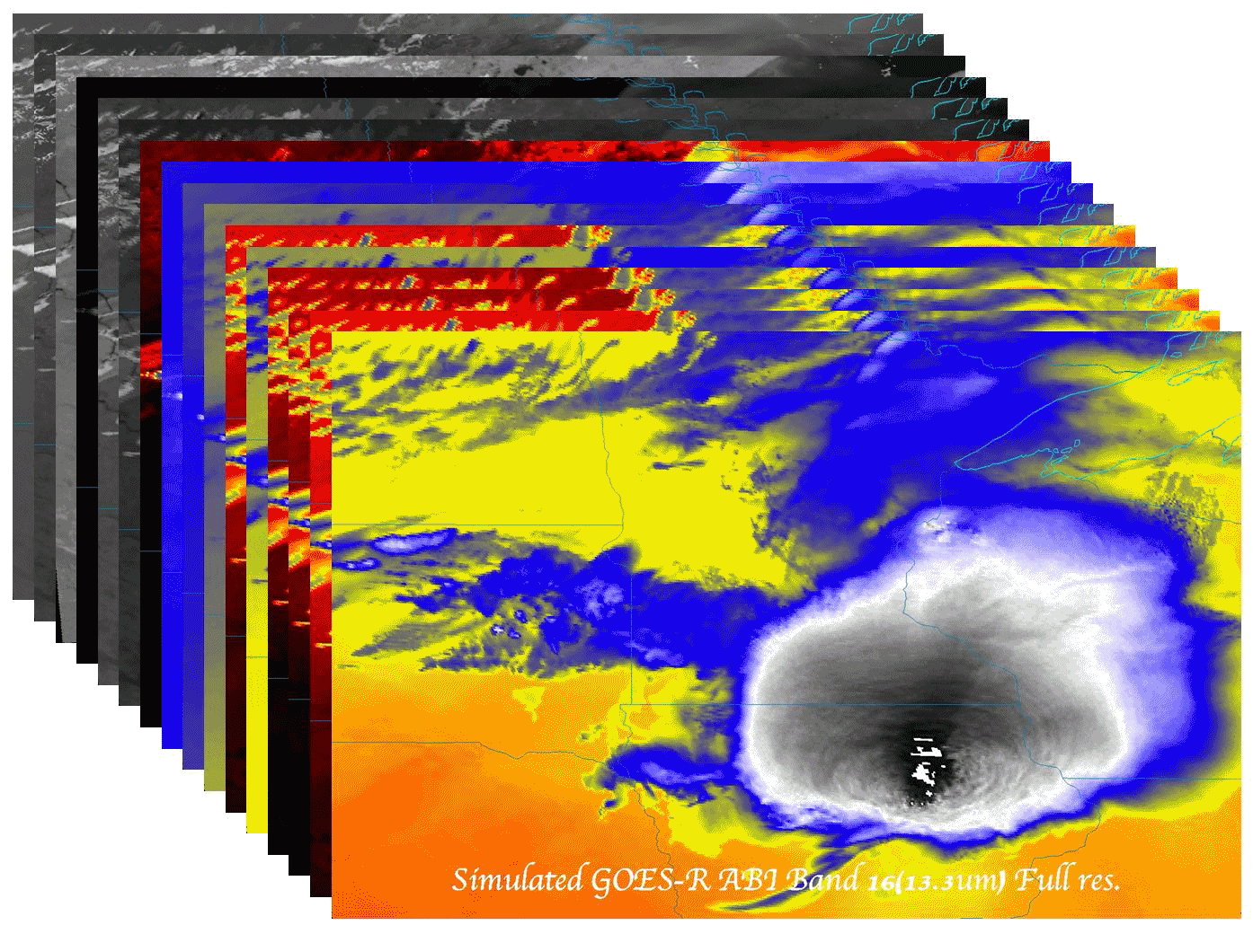
Mesoscale Observations: GOES-14 Imager 1-Minute Rapid Scan Data
Timothy J. Schmit (tim.j.schmit@noaa.gov)
NOAA/NESDIS/Satellite Applications and Research
Advanced Satellite Products Branch (ASPB), Madison, WI
M. M. Gunshor, J. Sieglaff, W. Line, A. S. Bachmeier, S. Lindstrom,
D. T. Lindsey, F. Alsheimer, D. B. Radell, R. M. Rabin, C. M. Gravelle,
K. Bah, and S. J. Goodman
27th Severe Local Storms Conference
Madison, WI
3 November 2014
UW-Madison

Slide 2
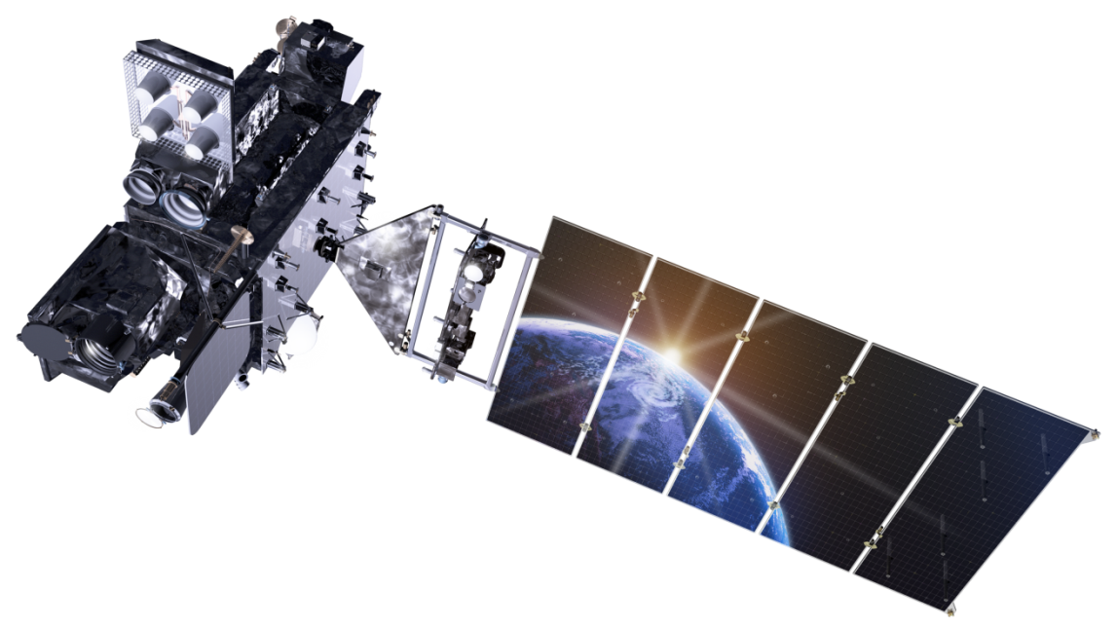
Outline
GOES RSO
Recent GOES-West updates
GOES-R Rapid Scans
Baseline scan strategies
GOES SRSOR
2014 overview
SRSOR 2012/2013 recap
SRSOR examples
More information
Links (animations/references/data)
Lockheed Martin

Slide 3
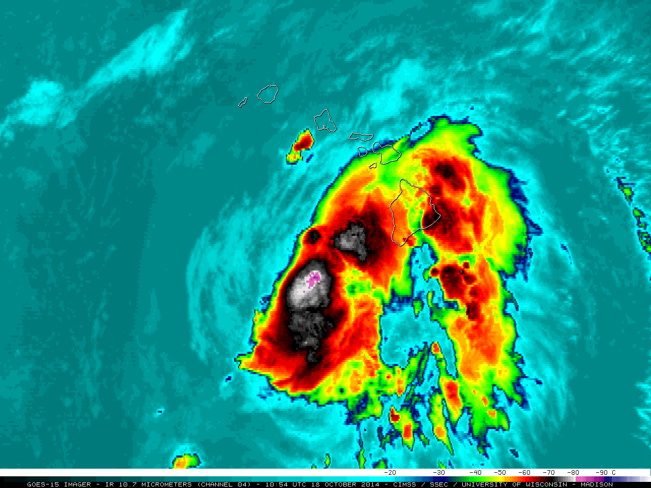
GOES-West RSO
As a result of recent testing, GOES-15 (West) is once again able to provide Rapid Scan Operations (RSO) over Hawaii
RSO was called for almost 6 days to monitor Tropical Cyclone Ana
http://www.ospo.noaa.gov/Operations/GOES/schedules.html
http://cimss.ssec.wisc.edu/goes/blog/archives/16856
http://cimss.ssec.wisc.edu/goes/blog/archives/17027

Slide 4
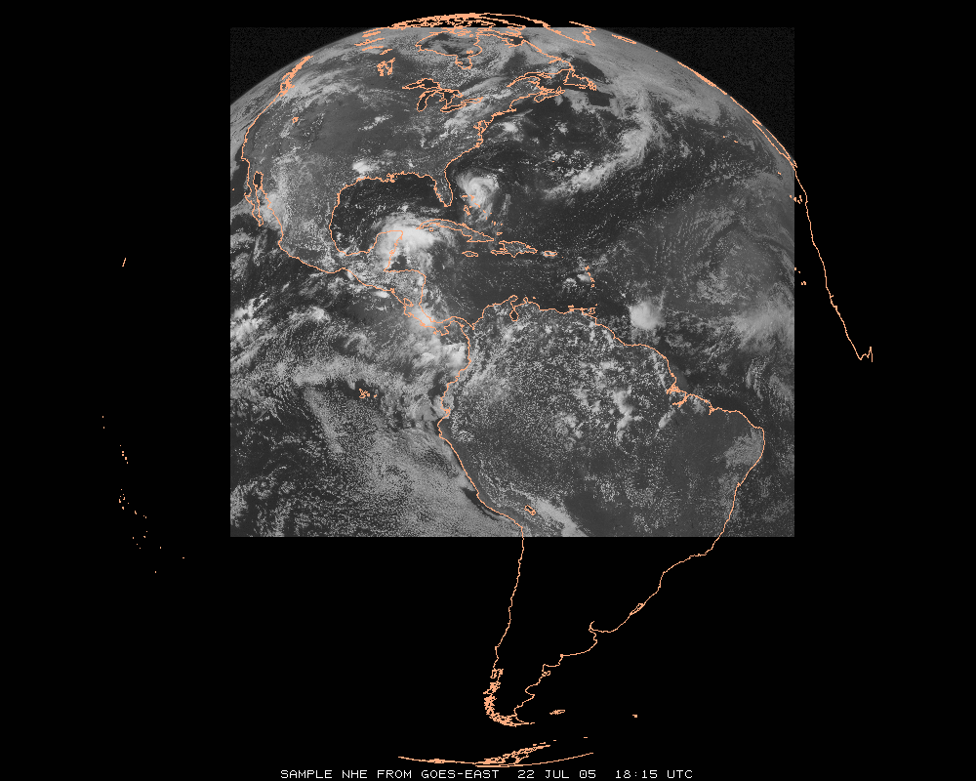
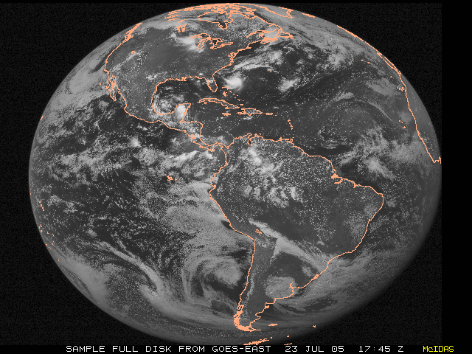
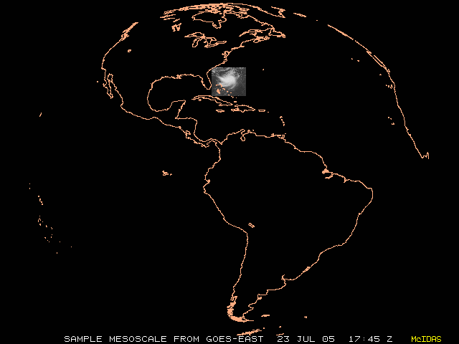
GOES Imager Schedules
http://cimss.ssec.wisc.edu/goes/blog/archives/13001
 | Routine | RSO | SRSO | SRSOR | SRSOR (No FD) | GOES-R ABI
# of images (in 3 hrs) | 16 | 26 | 56 | 129 | 157 | ~400
# of images covering part of CONUS (in 3 hrs) | 11 | 21 | 56* | 129* | 157* | ~400*
Finest delta-time (min) | 15 | 5 | 1 | 1 | 1 | 0.5
2nd largest delta-time (min) | 15 | 10 | 10 | 4 | 4 | 5
Largest delta-time (min) | 30 | 30 | 30 | 30 | 15 | 15
Sectors Scanned (listed by size) | FD, NHE,CONUS, SHEMI | FD, NH, CONUS, SA | FD, NH, CONUS, MESO | FD, MESO | FD, MESO | FD, CONUS, MESO
Run operationally? | Yes | Yes | Yes | No | No | Yes
Full Disk
NH-Extended
N. Hemisphere
CONUS
Mesoscale
Notes:
Example here is GOES-East on a ‘normal’ day.
ABI is mode 3, or ‘flex mode’.
* = depends on locations of meso-scale images.
RSO = Rapid Scan Operations
SRSO = Super Rapid Scan Operations
SRSOR = Super Rapid Scan Operations for GOES-R
FD = Full Disk
NHE = Northern Hemisphere Extended
NH = Northern Hemisphere
CONUS = Continental U.S.
SHEMI = Southern Hemisphere
SHSS = Southern Hemisphere Short Scan
MESO = meso-scale
More info: http://www.ospo.noaa.gov/Operations/GOES/schedules.html
Tim Schmit, NOAA NESDIS

Slide 5
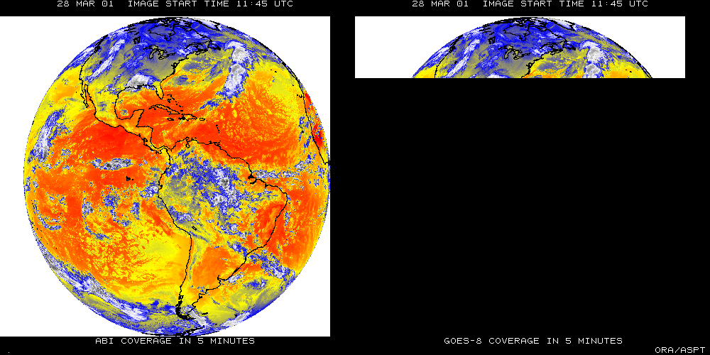
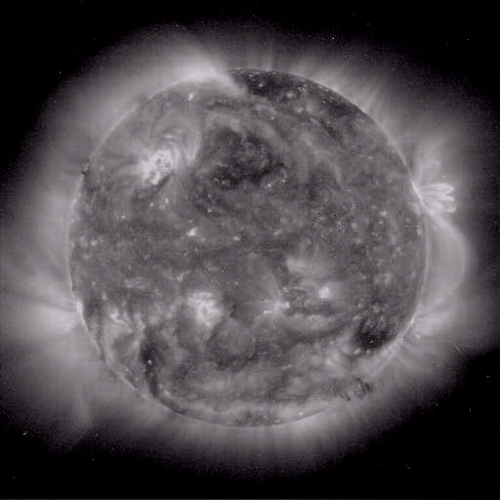
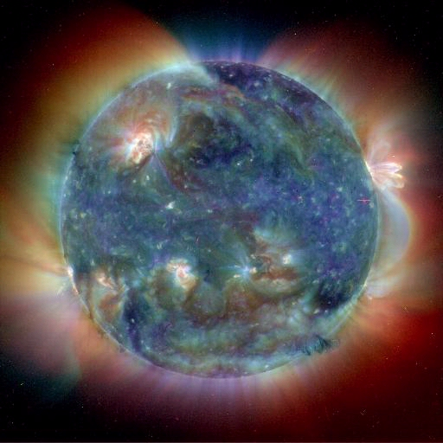
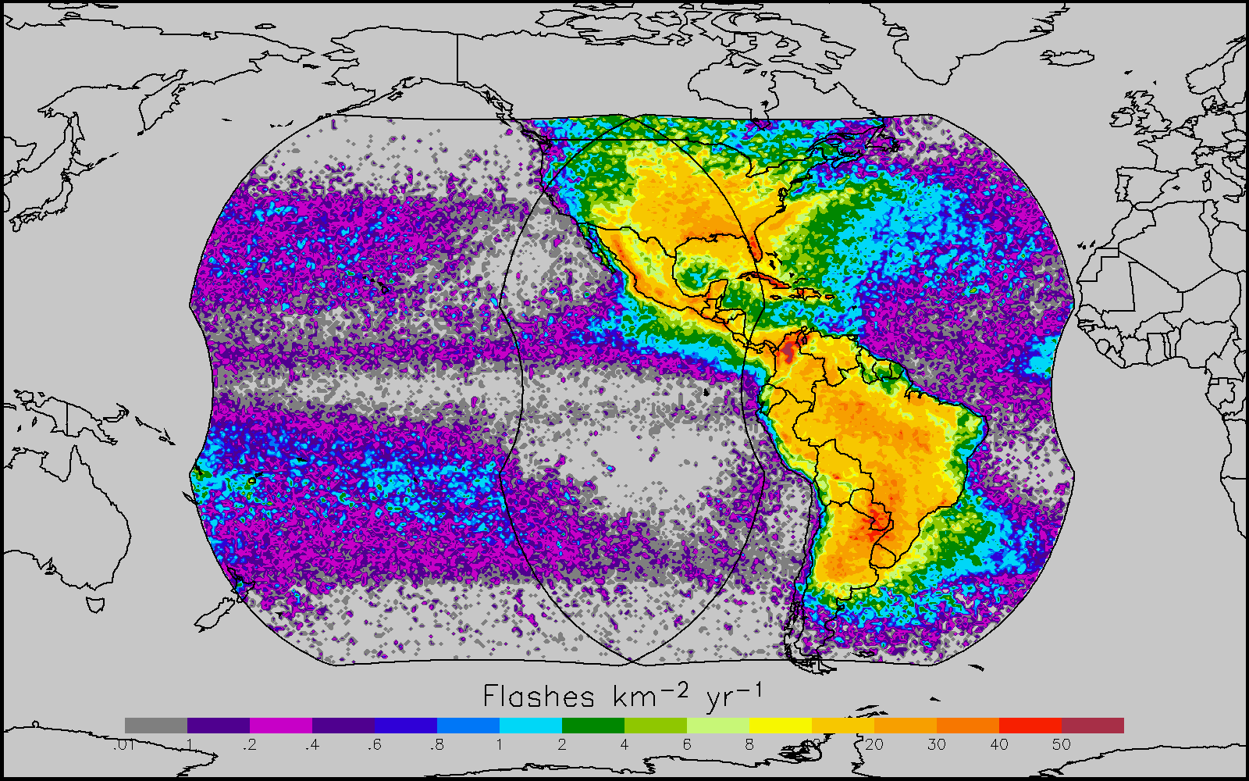
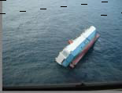
GOES-R main instruments
ABI – Advanced Baseline Imager
Space Weather/Solar
SEISS
SUVI
EXIS
Magnetometer
ABI covers the earth 5X faster than current Imager
Geostationary Lightning Mapper
Images courtesy of SOHO EIT, a joint NASA/ESA program
Unique Payload Services
No Sounder

Slide 6
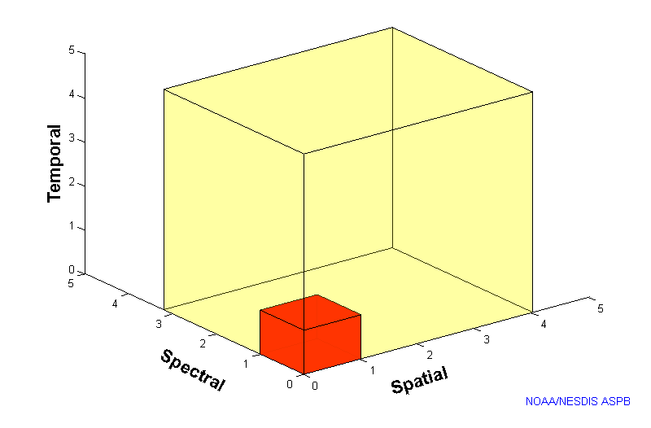
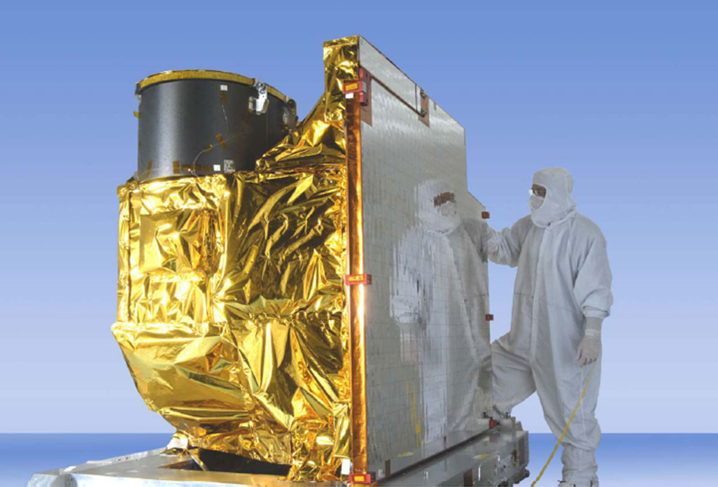
Advanced Baseline Imager
5
4
3
X
Faster scanning (5-minute full disk vs. 25-minute)
X
Improved spatial resolution (2 km IR vs. 4 km)
X
More spectral bands (16 on ABI vs. 5)
Notes:
Slide from J. Gerth, CIMSS.

Slide 7
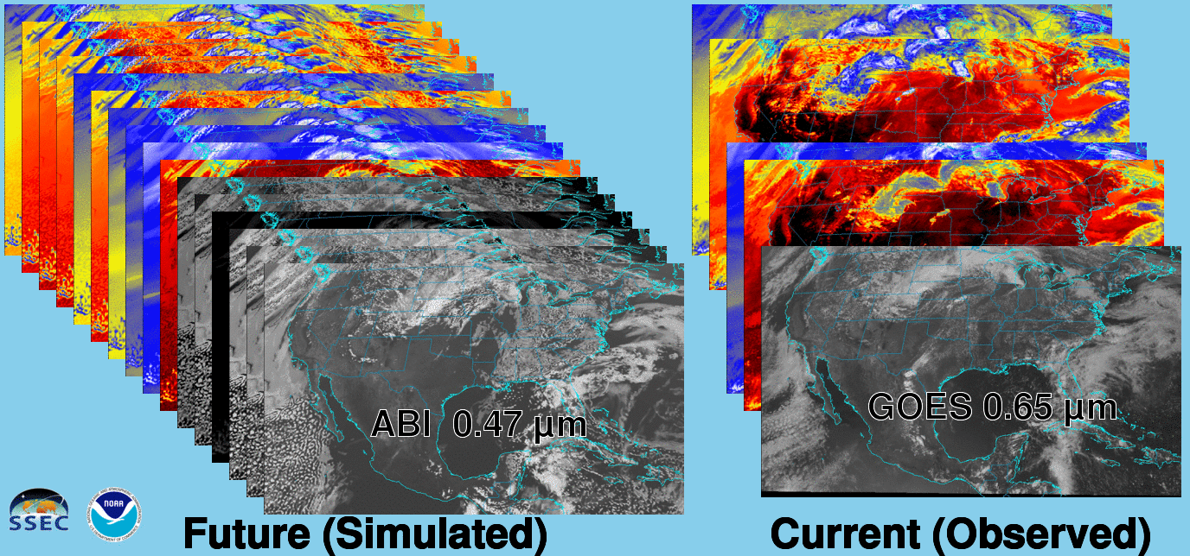
Future vs. Current Spectral Bands
The current GOES (right) has 5 spectral bands, while the GOES-R series ABI (left) will have 16 spectral bands.

Slide 8
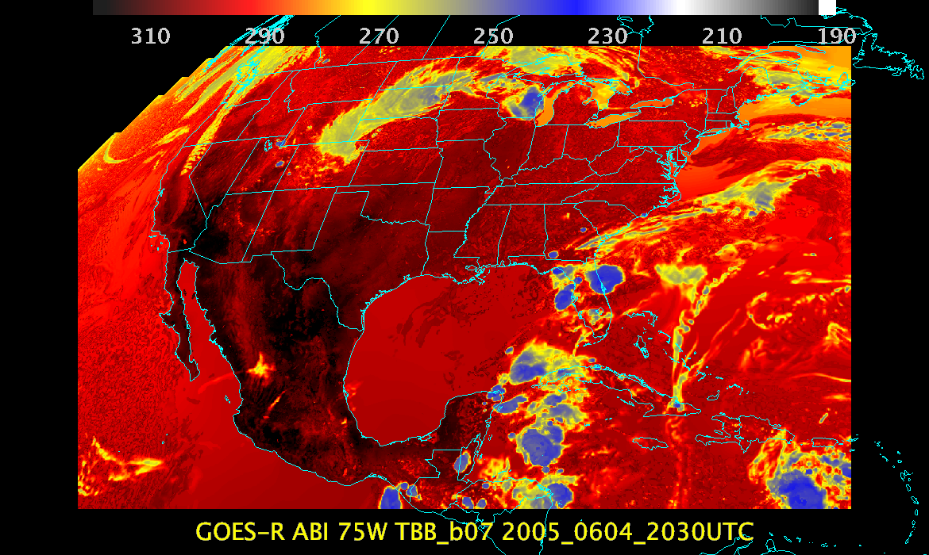
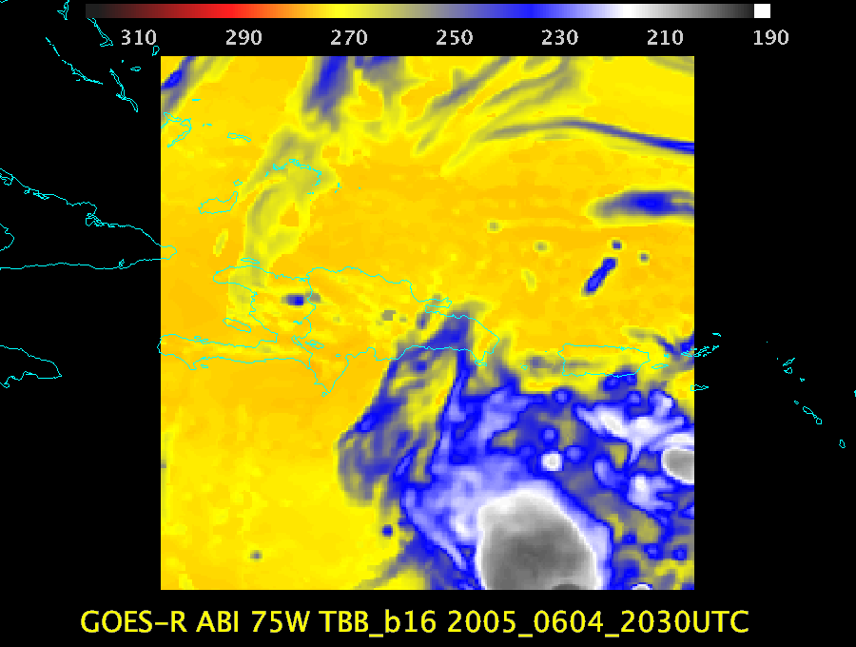
ABI Scan Modes
FD
CONUS
MESO
Scan mode (3) or ‘flex mode’ for the ABI:
- Full disk every 15 minutes + 5 min CONUS
+ 1-min mesoscales (2 locations).
[Scan mode (4) or ‘Continuous Full Disk’ (CFD) is a full disk every 5 min]

Slide 9
Example of Flex Mode Scanning
The ABI may also be operated in a five-minute continuous full disk mode.

Slide 10
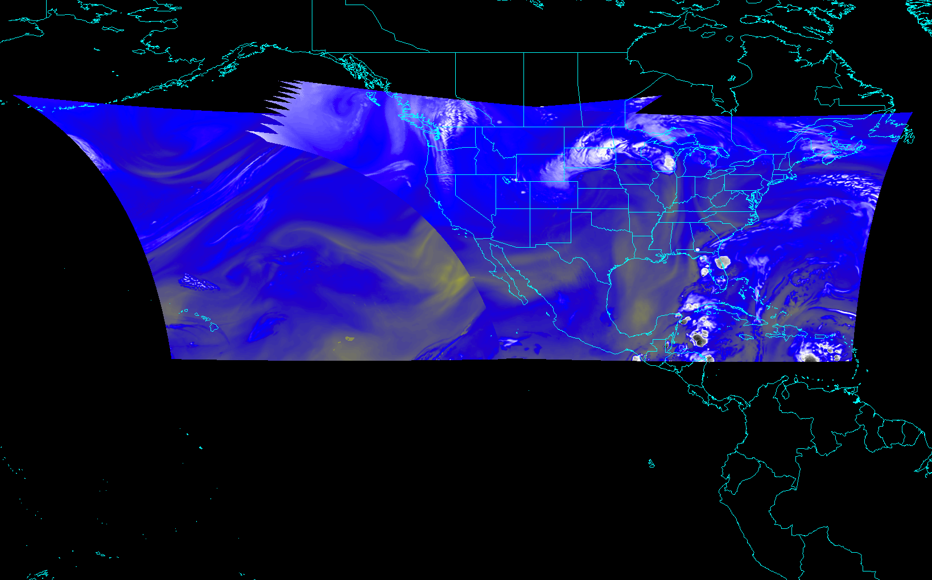
ABI CONUS sectors from East and West (proposed)
Notes:
Different days simulated.

Slide 11
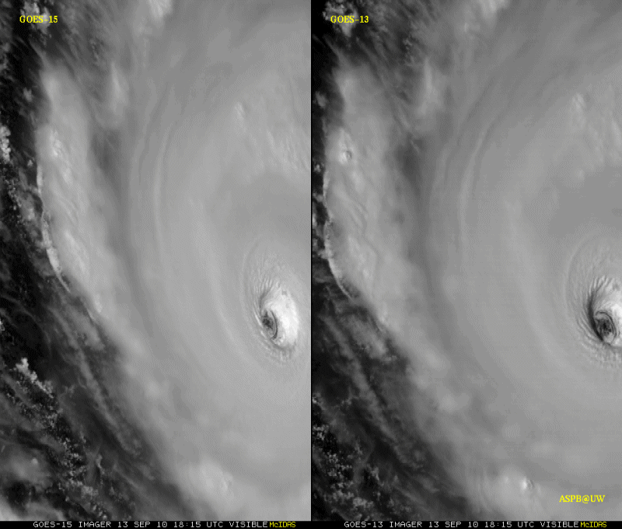
GOES-15: Sample “1-min” imagery
1-min
30-min
Visible data from the GOES-15 NOAA Science Test, lead by Hillger and Schmit
Notes:
Igor

Slide 12
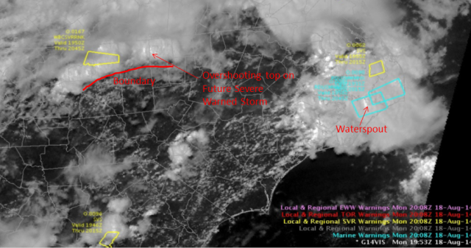
GOES-14: Special Rapid Scanning offers glimpse of the ABI
SRSOR (Super Rapid Scan Operations for GOES-R) from GOES-14 imager
More SRSOR data in both May 8-24 and August 14-28 of 2014.
http://cimss.ssec.wisc.edu/goes/srsor2014/GOES-14_SRSOR.html
Many phenomena were observed: convection, hurricanes, fires, smoke, ...
Data used by the NWS.
Data achived at a number of locations, including NOAA NESDIS CLASS.
NWS Forecaster: SRSOR “….certainly increased our confidence in our warning decisions and ultimately made the process more efficient … having the Super Rapid Scan data very valuable and very worthwhile, … should be able to be built into everyday operations at NWS weather forecast offices around the country.”
GOES-14 Image from CIMMSE blog
http://cimmse.wordpress.com/2014/08/24/an-example-of-how-goes-14-super-rapid-scan-operations-for-goes-r-helped-during-warning-operations-at-nws-wfo-raleigh-nc-on-18-august-2014/
GOES-14 provided very unique information and offers a glimpse into the possibilities that will be provided by the ABI on GOES-R.
Notes:
Data was provided to many groups: WPC, OPC, AWC, SPC, SAB, several WFO, who used the data for discussions and forecasts.

Slide 13
GOES-14 Super Rapid Scan Operations to Prepare for GOES-R
SRSOR (Super Rapid Scan Operations for GOES-R) from GOES-14 imager
Data between mid-August and September 24th and late October 2012; and two days in June and 12 days in mid-August, 2013; and mid-May (8-24), 2014
http://cimss.ssec.wisc.edu/goes/srsor/GOES-14_SRSOR.html and
http://cimss.ssec.wisc.edu/goes/srsor2013/GOES-14_SRSOR.html
http://cimss.ssec.wisc.edu/goes/srsor2014/GOES-14_SRSOR.html
GOES-14 provided very unique data and offered a glimpse into the possibilities that will be provided by the ABI on GOES-R in one minute mesoscale imagery
Many phenomena were observed
GOES-14 visible image showing rapid convective development

Slide 14
Future vs Current Imagery

Slide 15
SRSOR GOES-14 2014 Color-enhanced infrared window (1 vs 15 min)
Note the ‘enhanced-v’ is seen first on the 1 minute data.

Slide 16
Notes:
http://remotesensing.spiedigitallibrary.org/data/Journals/APPRES/926148/JARS_7_1_073462_ds001.mov

Slide 17
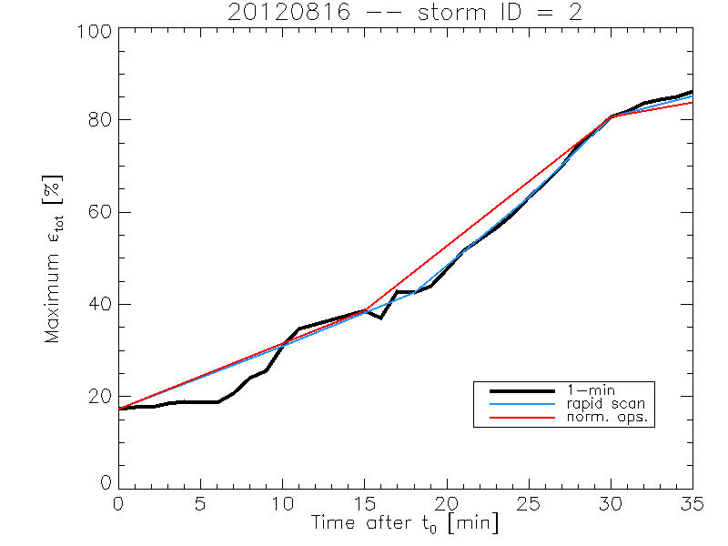
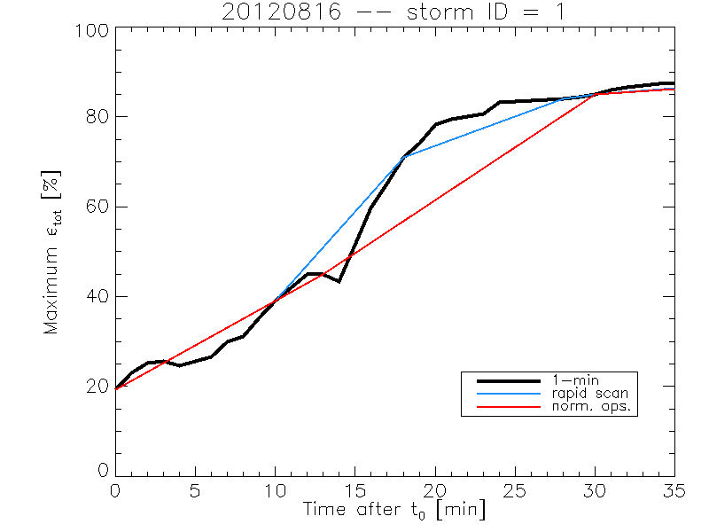
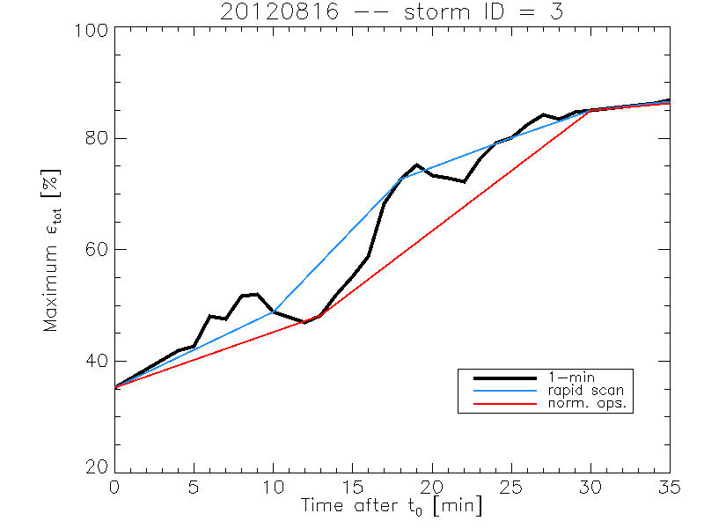
Rate of temporal cooling in the longwave infrared band
Cintineo et al., 2013 (CIMSS)

Slide 18
SRSOR in SPC
7 direct references in SPC text forecast products during May and August GOES-14 SRSOR periods
SPC forecasters consistently viewed the 1-min imagery in Operations, incorporating it into their decision-making
Allowed for easier analysis, identification and tracking of:
deepening and clumping of BL cu, vertical growth of cumulus convection, identification and tracking of boundaries, overshooting and collapsing storm tops, character of storm anvils, convectively generated outflow, gravity wave progression, visual assessment of storm-top divergence and flanking line development, diagnosis of near-storm environment though convective trends and cloud character,
All on time scales not otherwise available.
Over time, this imagery will allow forecasters to gain a better understanding of processes related to CI
William Line, SPC Satellite Liaison

Slide 19
GOES-14 SRSOR in SPC
“The one-minute imagery helped me to anticipate areas of new convective development as well, which was useful in developing short-term forecasts and mesoscale discussions for severe weather. ”
“… having the data available routinely would very likely, over time, allow forecasters to gain a better understanding of processes related to convective initiation, as these processes occurring within a cu field would be visually revealed in high temporal -resolution data in a way that 15- or 30-minute imagery cannot as clearly depict.”
“In the pre-storm environment, these data were especially helpful in monitoring the vertical growth of cumulus convection and in the identification of boundaries.”
“I found it to be very useful in… Using cloud character and trends to diagnose boundary locations and motion, and nowcast their potential for either CI or influences on upshear storms to interact therewith.”
“This has provided extra confidence and lead time for the issuance of two mesoscale discussions compared to the normal satellite update frequency/latency. … quite striking. It’s analogous to the difference between watching high-def TVs vs. standard def, ... Satellite imagery at 1-min temporal resolution needs to become the new standard for severe weather operations.”
“Post-storm initiation, the high-resolution data allowed for careful analysis of overshooting and collapsing tops, the character of the storm anvils (ie. health of the storm) and the identification of convectively generated outflows.”
http://satelliteliaisonblog.wordpress.com/category/spc/
Notes:
Highlights added.

Slide 20
http://www.goes-r.gov

Slide 21
GOES-R ABI Products
Baseline Products
Future Capabilities
Advanced Baseline Imager (ABI)
Aerosol Detection (Including Smoke and Dust) Aerosol Optical Depth (AOD) Clear Sky Masks Cloud and Moisture Imagery Cloud Optical Depth Cloud Particle Size Distribution Cloud Top Height Cloud Top Phase Cloud Top Pressure Cloud Top Temperature Derived Motion Winds Derived Stability Indices Downward Shortwave Radiation: Surface Fire/Hot Spot Characterization Hurricane Intensity Estimation Land Surface Temperature (Skin) Legacy Vertical Moisture Profile Legacy Vertical Temperature Profile Radiances Rainfall Rate/QPE Reflected Shortwave Radiation: TOA Sea Surface Temperature (Skin) Snow Cover Total Precipitable Water Volcanic Ash: Detection and Height
Advanced Baseline Imager (ABI)
Absorbed Shortwave Radiation: Surface Aerosol Particle Size Aircraft Icing Threat Cloud Ice Water Path Cloud Layers/Heights Cloud Liquid Water Cloud Type Convective Initiation Currents Currents: Offshore Downward Longwave Radiation: Surface Enhanced “V”/Overshooting Top Detection Flood/Standing Water Ice Cover Low Cloud and Fog Ozone Total Probability of Rainfall Rainfall Potential Sea and Lake Ice: Age Sea and Lake Ice: Concentration Sea and Lake Ice: Motion Snow Depth (Over Plains) SO₂ Detection Surface Albedo Surface Emissivity Tropopause Folding Turbulence Prediction Upward Longwave Radiation: Surface Upward Longwave Radiation: TOA Vegetation Fraction: Green Vegetation Index Visibility

Slide 22
Overshooting Tops and Thermal Couplets from GOES

Slide 23
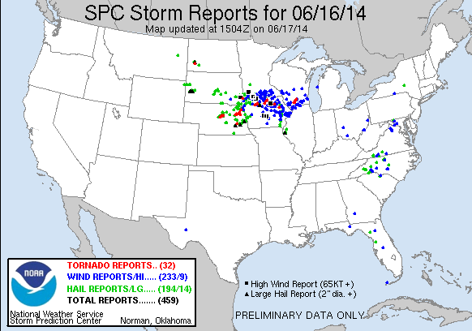
Overshooting Tops and Thermal Couplets from GOES

Slide 24
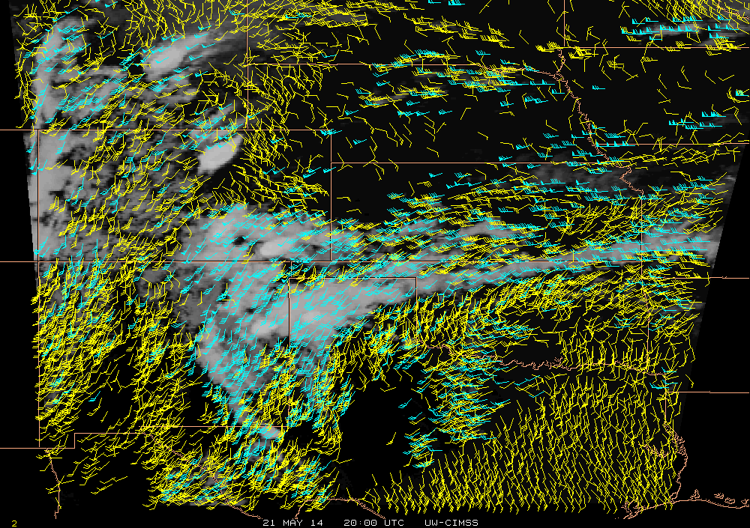
Sample meso-scale AMVs derived from GOES-14 SRSOR data
21-May-2014
C. Velden, CIMSS

Slide 25
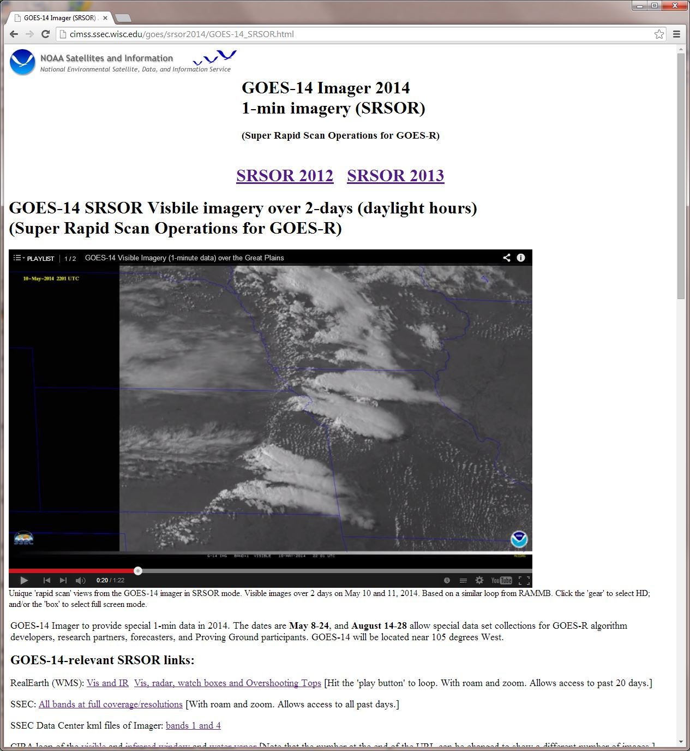
http://cimss.ssec.wisc.edu/goes/srsor2014/GOES-14_SRSOR.html

Slide 26
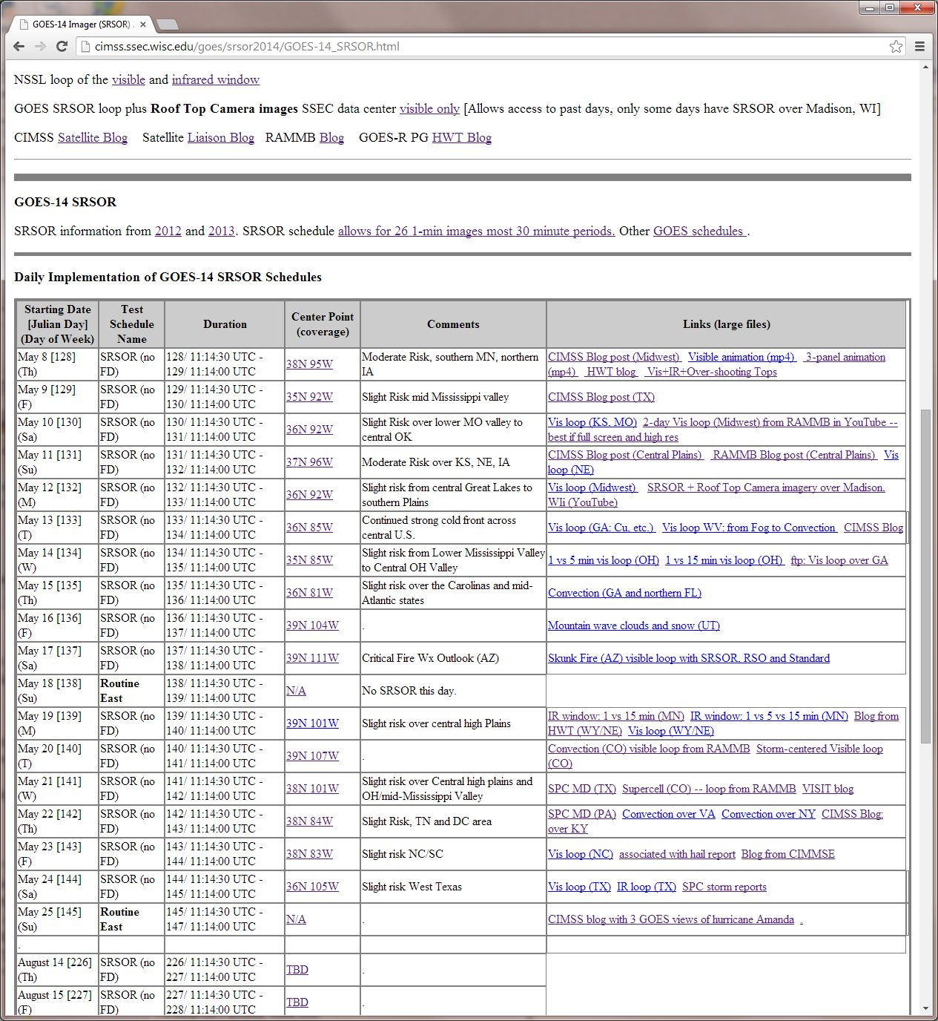
http://cimss.ssec.wisc.edu/goes/srsor2014/GOES-14_SRSOR.html

Slide 27
http://cimss.ssec.wisc.edu/goes/srsor2014/GOES-14_SRSOR.html

Slide 28
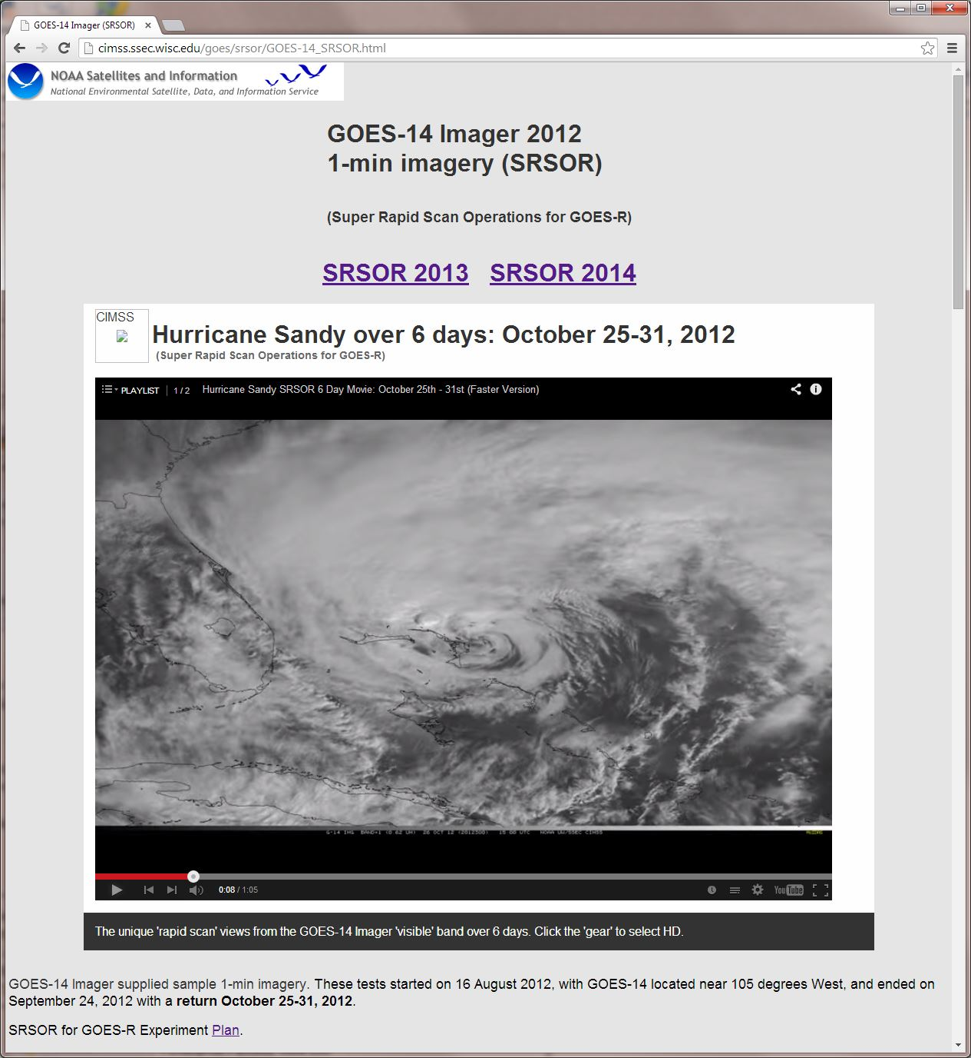

Slide 29
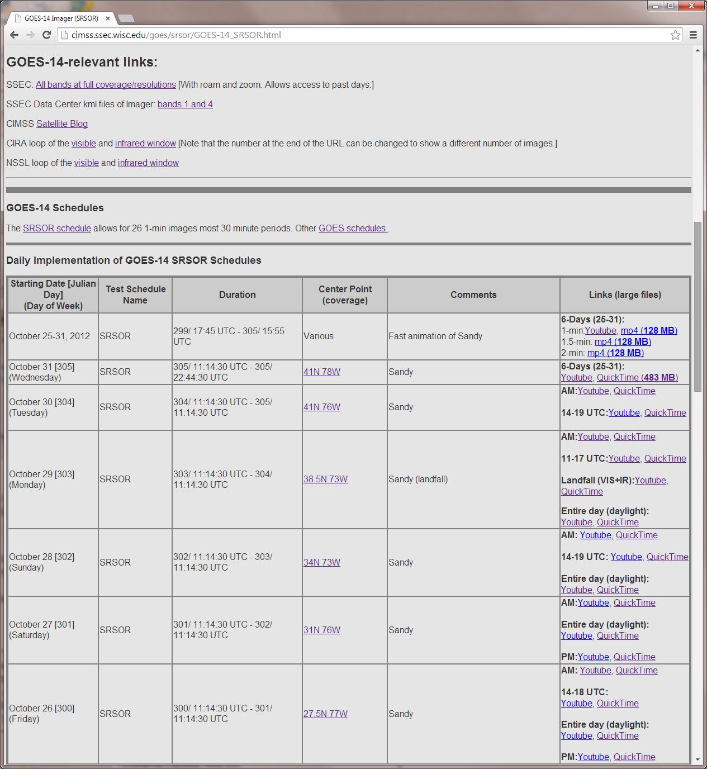

Slide 30
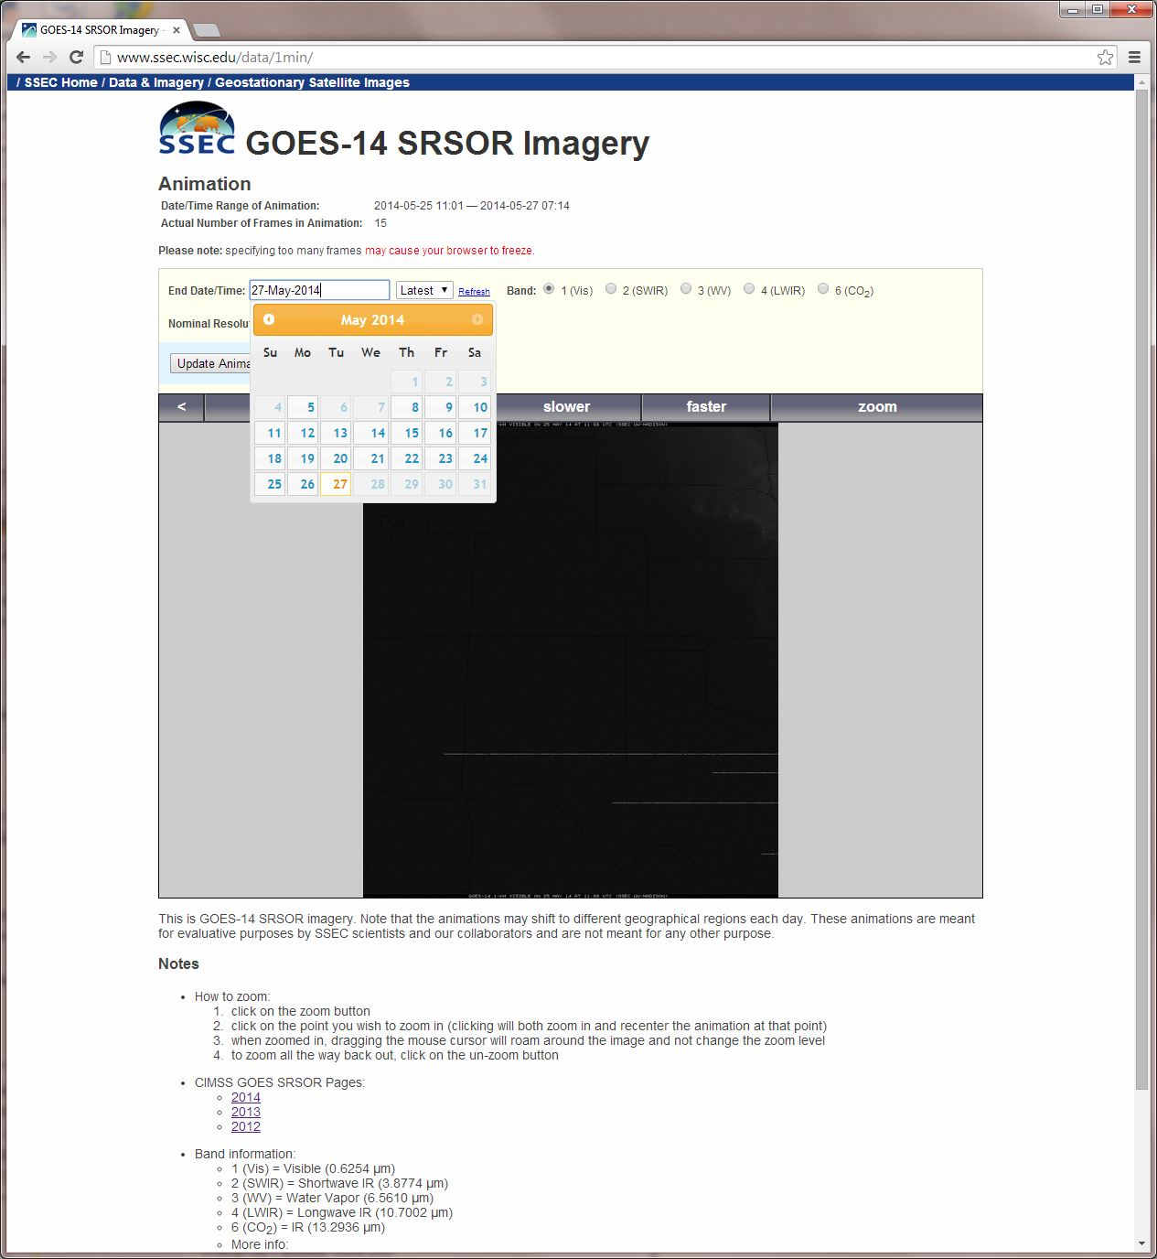
Select date….
http://www.ssec.wisc.edu/data/1min/

Slide 31
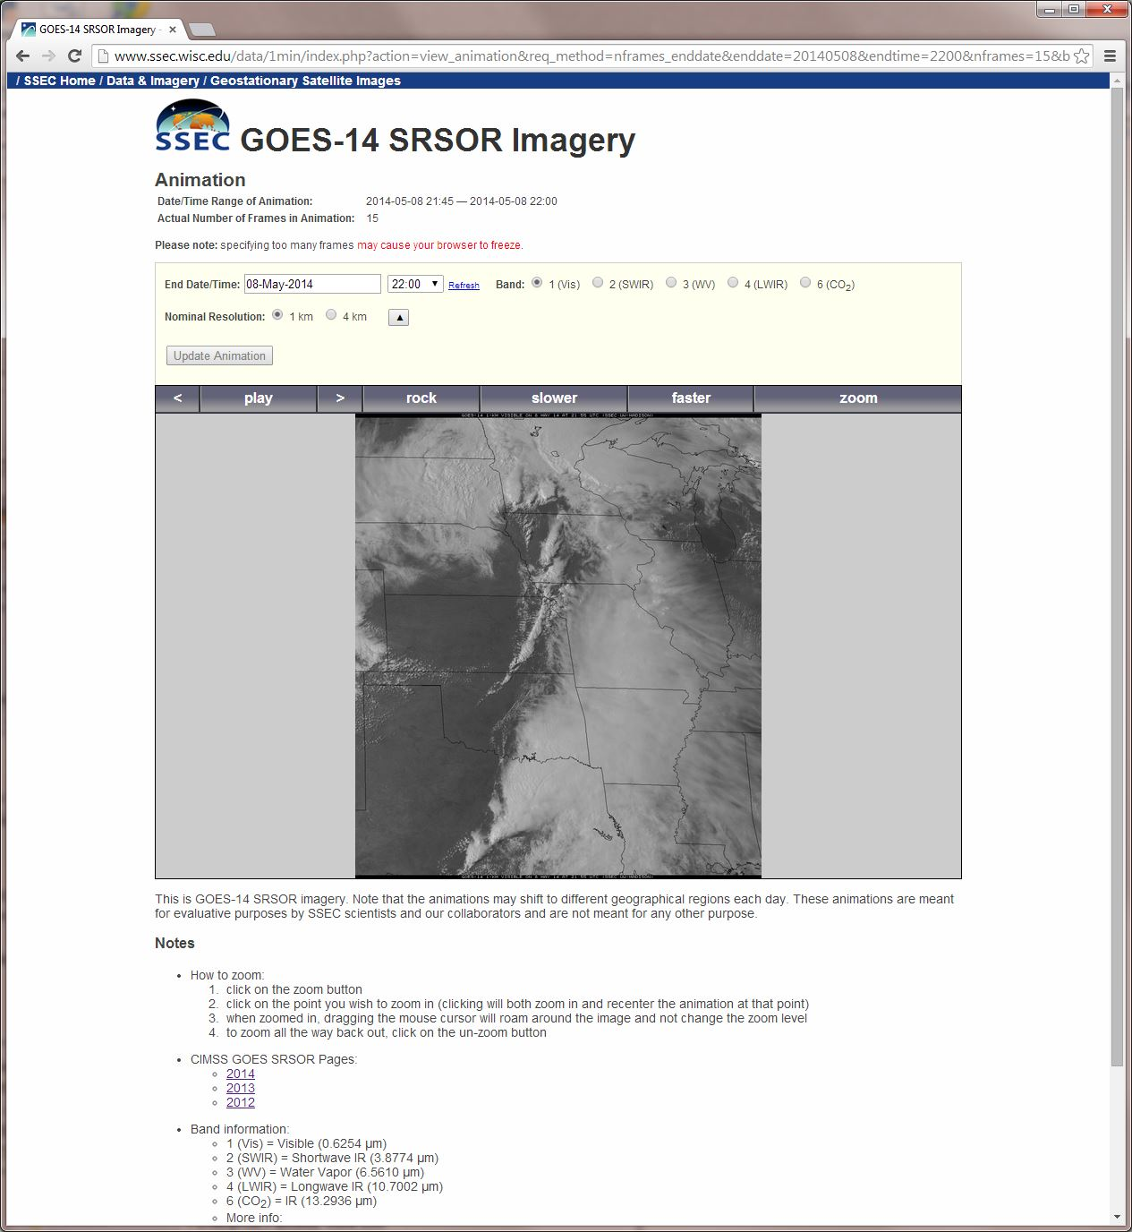
Zoom…
http://www.ssec.wisc.edu/data/1min/

Slide 32
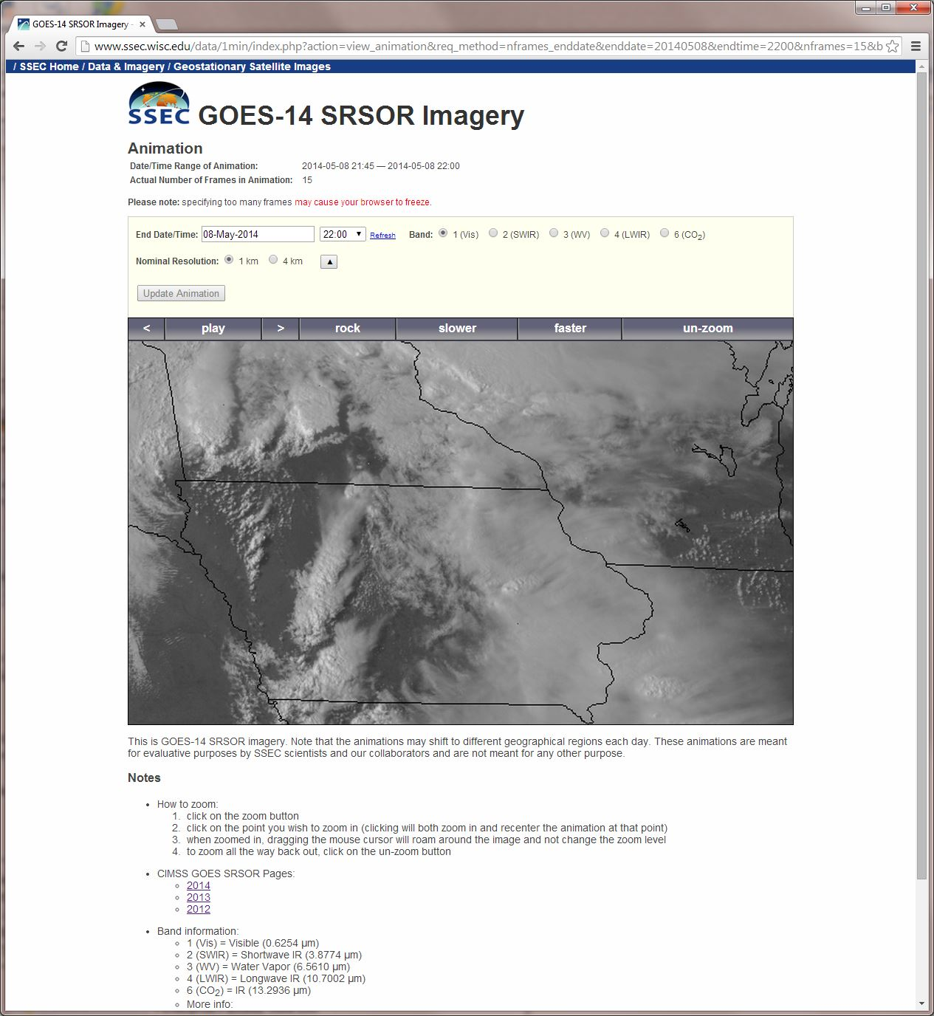
http://www.ssec.wisc.edu/data/1min/

Slide 33
More 1-min data…
Plans call for SRSOR again in parts of the spring and summer of 2015

Slide 34
Approximate spectral and spatial resolutions of US GOES Imagers
~ Band Center (um) | GOES-6/7 | GOES-8/11 | GOES-12/N | GOES-O/P | GOES-R+
0.47
0.64
0.86
1.6
1.38
2.2
3.9
6.2
6.5/6.7/7 | 14km
7.3
8.5
9.7
10.35
11.2
12.3
13.3
Visible
Near-IR
Box size represents pixel size
8
4
2
“MSI mode”
Infrared
Notes:
0.40 inches = 4km; 0.80 inches = 8km
MSI is Multi-Spectral Imaging Mode (dashed boxes)
This does not show other improvements: SNR, MTF, bit-depth, navigation, coverage rates, etc.

Slide 35
Summary
1. The GOES-R ABI provides mission continuity
2. Two times the image navigation quality
3. Three times the number of imaging bands
4. Four times the spatial resolutions
5. Five times the coverage rate
- Special GOES-14 1-min data pathfinder

Slide 36
Accepted References
Schmit, T. J., and co-authors, 2014: Rapid Refresh Information of Significant Events: Preparing users for the next generation of geostationary operational satellites, Bull. Amer. Meteor. Soc., accepted.
http://journals.ametsoc.org/doi/pdf/10.1175/BAMS-D-13-00210.1
Schmit T.J., Goodman S.J., Lindsey D.T., R. M. Rabin, K. M. Bedka, M. M. Gunshor, J. L. Cintineo, C. S. Velden, A. S. Bachmeier, S. S. Lindstrom, and C. C. Schmidt, 2013: Geostationary operational environmental satellite (GOES)-14 super rapid scan operations to prepare for GOES-R. J. Appl. Remote Sens. 0001;7(1):073462. doi:10.1117/1.JRS.7.073462.
http://remotesensing.spiedigitallibrary.org/article.aspx?articleid=1790703
Schmit, Timothy J.; Gunshor, Mathew M.; Menzel, W. Paul; Gurka, James J.; Li, Jun and Bachmeier, A. Scott. Introducing the next-generation Advanced Baseline Imager on GOES-R. Bulletin of the American Meteorological Society, Volume 86, Issue 8, 2005, pp.1079-1096.
http://journals.ametsoc.org.ezproxy.library.wisc.edu/doi/pdf/10.1175/BAMS-86-8-1079

Slide 37
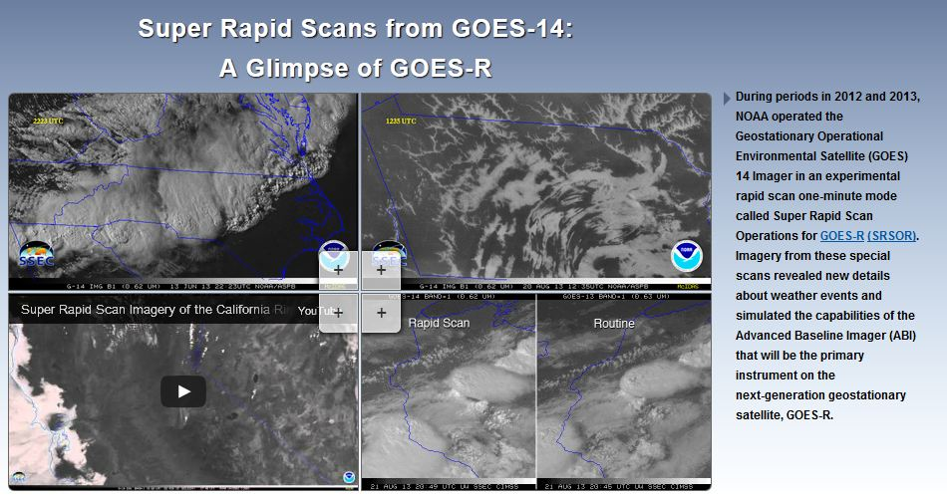
SRSOR Links
http://cimss.ssec.wisc.edu/goes/srsor/GOES-14_SRSOR.html
http://cimss.ssec.wisc.edu/goes/srsor2013/GOES-14_SRSOR.html
http://cimss.ssec.wisc.edu/goes/srsor2014/GOES-14_SRSOR.html
http://www.nesdis.noaa.gov/fourbox/09-23-13/

