Slide 1
Stray Light Analysis GOES-13 Imager
Tim Schmit, ASPB
Tony Schreiner, CIMSS
6-January-2011

Slide 2
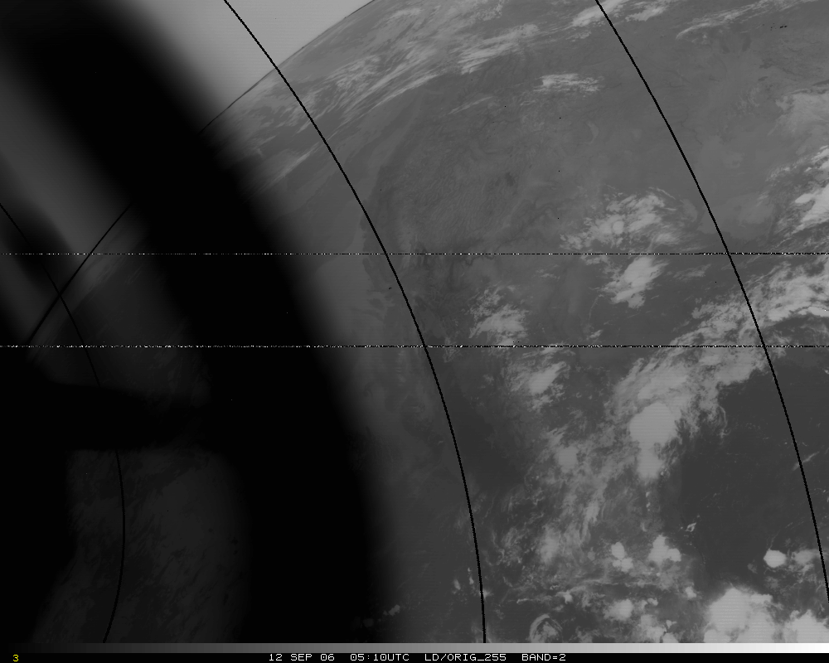
Band 2, Original – too hot by several K!
Band 2, Original – too hot by 50K!

Slide 3
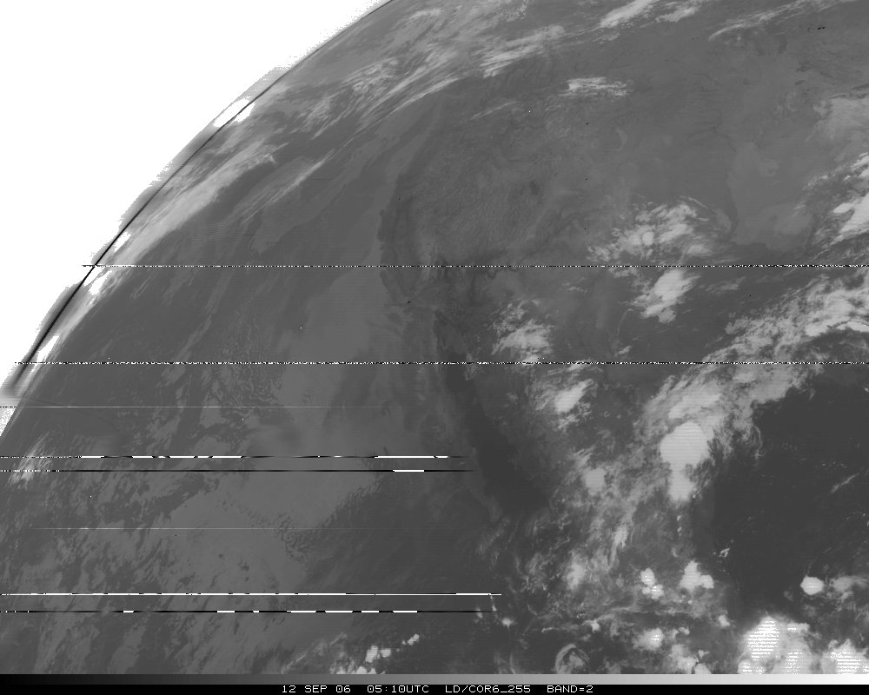
Band 2, Corrected
Notes:
Ignore missing lines, due to ingest.

Slide 4
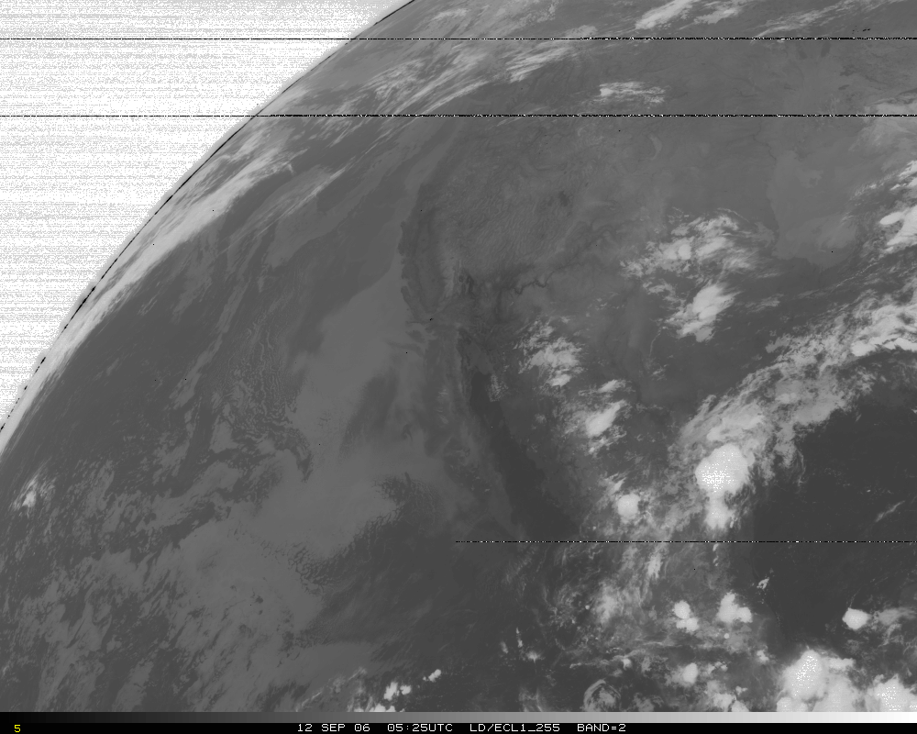
Band 2, later image
Notes:
Ignore missing lines, due to ingest.

Slide 5
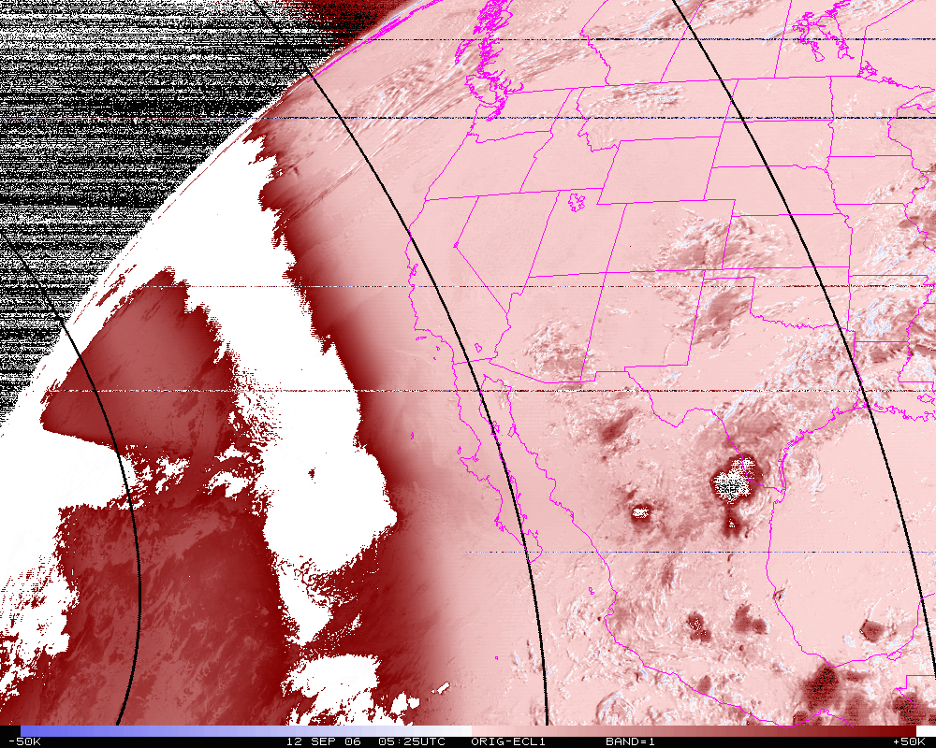
Band 2, difference image (org-eclipse)
Notes:
Note that the max different is over 50K!

Slide 6
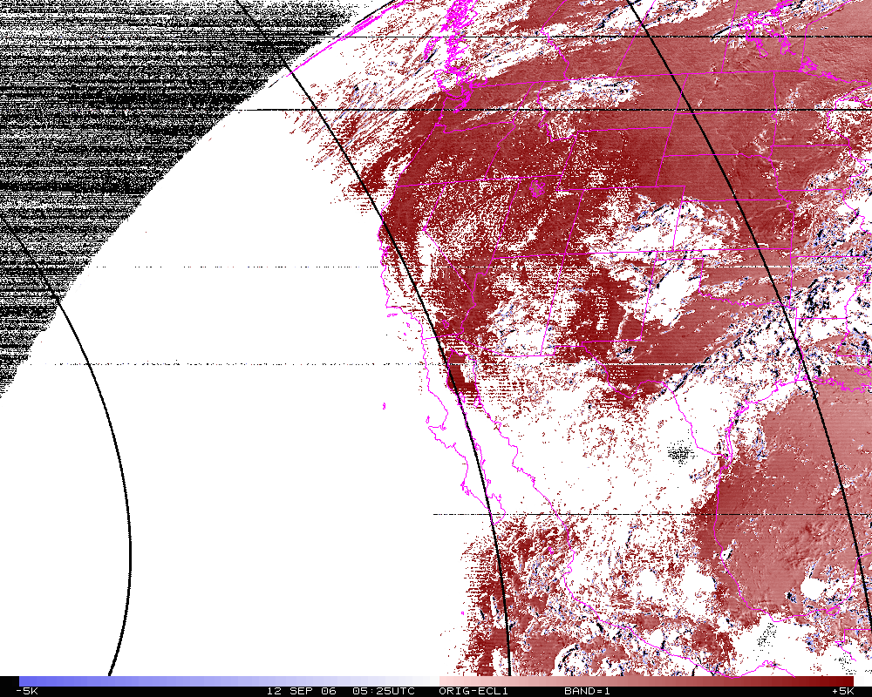
Band 2 Difference
N=14342
Mean= 4.0K
Band 2, difference image (org-eclipse). Smaller range.
Notes:
Note that even far from the sun, there’s still a 4K difference.

Slide 7
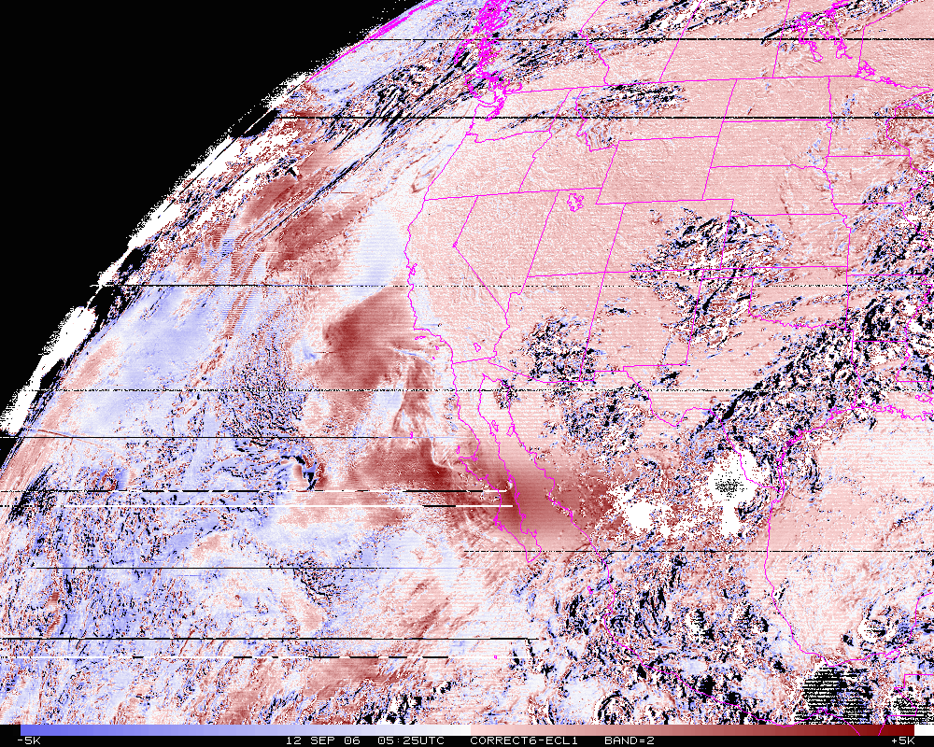
Band 2 Difference
N=14342
Mean= 0.6K
Band 2, difference image (corrected-eclipse). Smaller range.

Slide 8
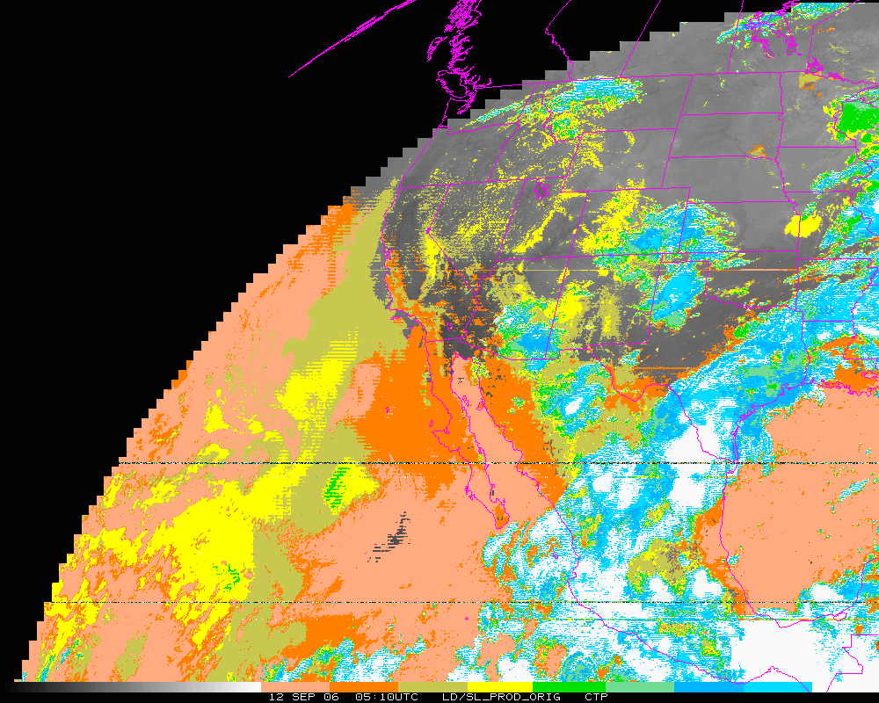
Cloud-top Pressure (color-range). Original – too “cloudy” over some regions, but misses other clouds!
Clear Low cloud High Cloud
Notes:
Derived Product of cloud not correct with data with stray light.

Slide 9
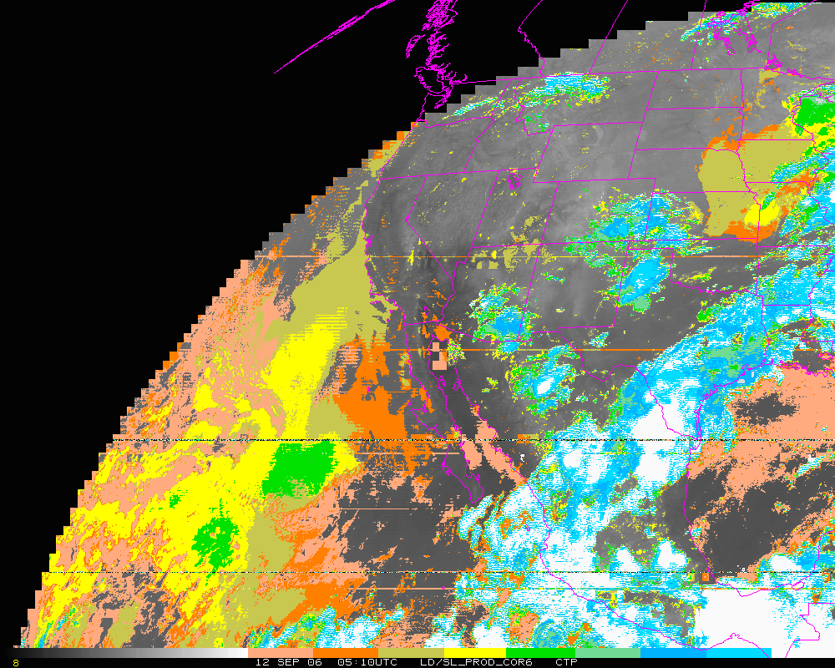
Cloud-top Pressure (color-range). Corrected. In general, corrected both regions.
Clear Low cloud High Cloud
Notes:
…outside of 6 degrees.

Slide 10
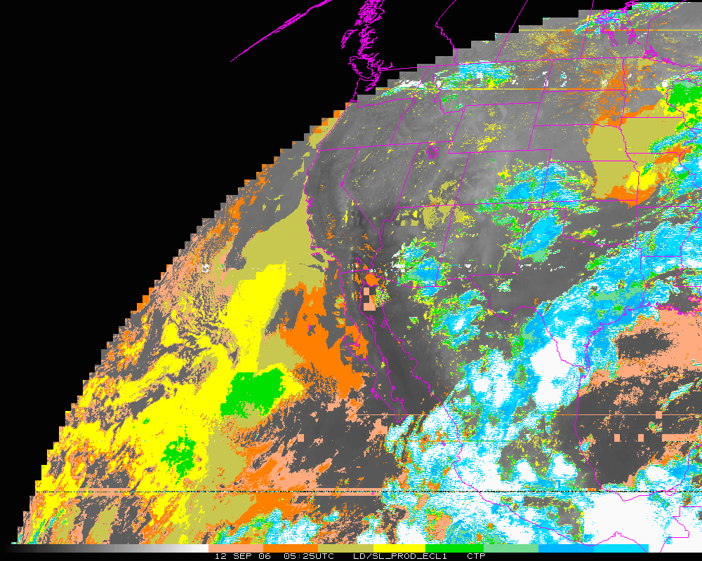
Cloud-top Pressure (color-range). Later image.
Clear Low cloud High Cloud
Notes:
Derived Product of cloud much improved after stray light correction.

Slide 11
Stray Light Analysis GOES-13 Imager
Tim Schmit
ASPB
Day 255

Slide 12
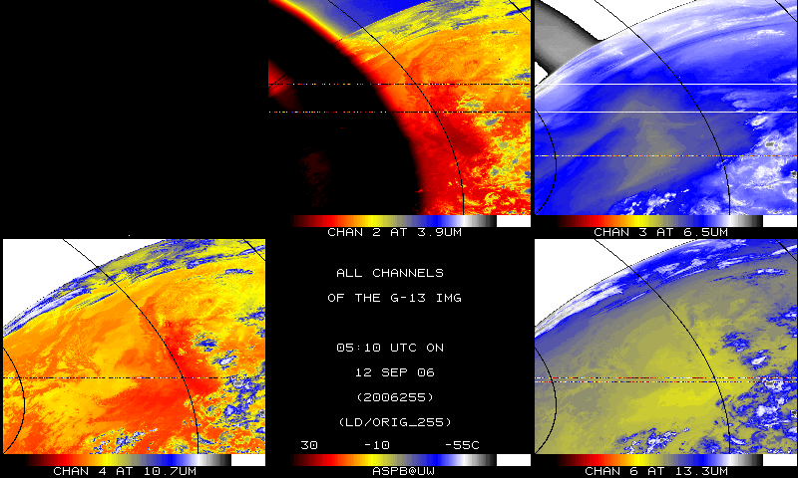
IR bands, Original

Slide 13
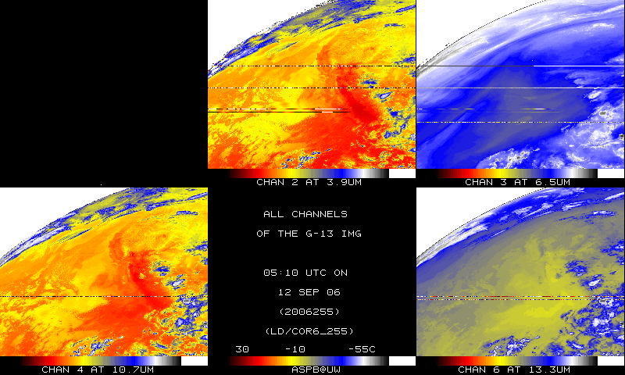
IR bands, Corrected

Slide 14
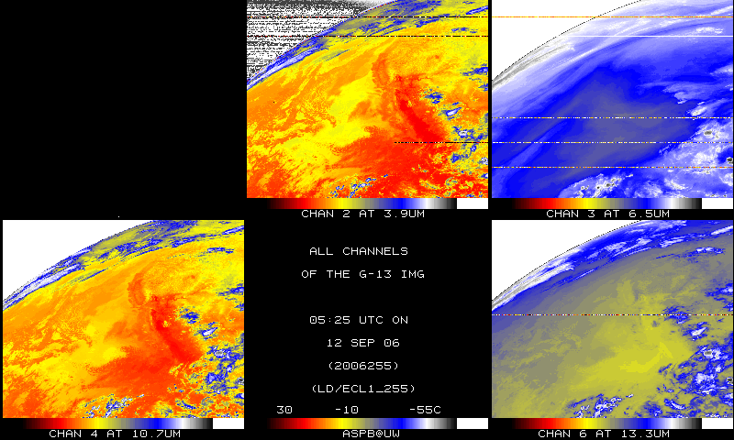
IR bands, 15-minutes later

