Slide 1
GOES-13 Imager 12/053/04:39 Southern Hemi, Channel 2
Uncorrected for SL
SL Corrected
J. Paul Douglas

Slide 2
GOES-13 Imager 12/053/05:09 Southern Hemi, Channel 2
Uncorrected for SL
SL Corrected
J. Paul Douglas

Slide 3
GOES-13 Imager 12/053/05:39 Southern Hemi, Channel 2
Uncorrected for SL
SL Corrected
An artifact has been introduced
J. Paul Douglas

Slide 4
Artifact in the 5:39 Corrected Frame (0 GVAR count issue can be addressed next release)
J. Paul Douglas

Slide 5
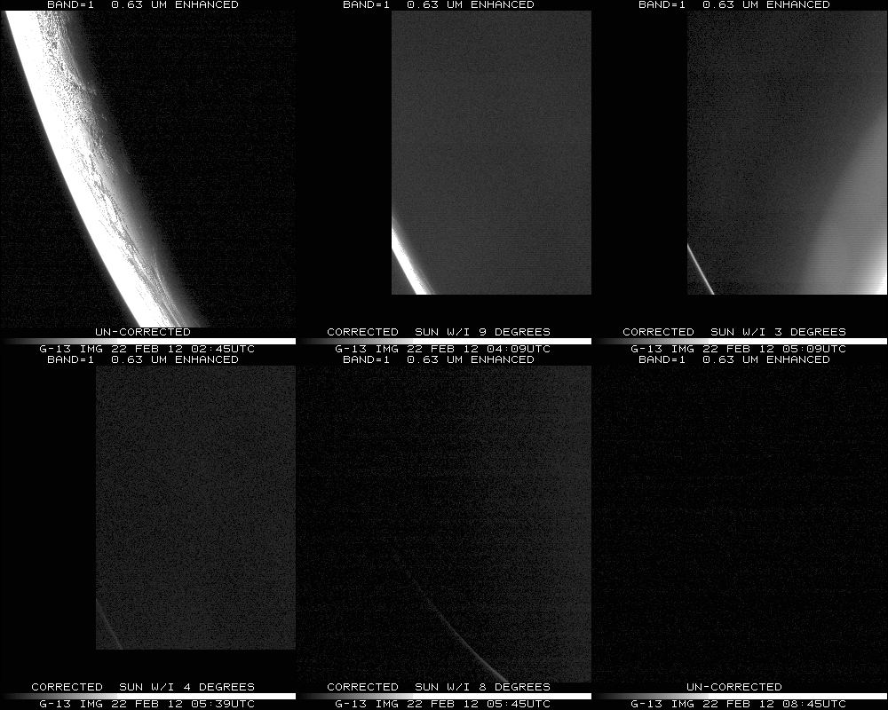
Notes:
Data from SSEC Data Center

Slide 6
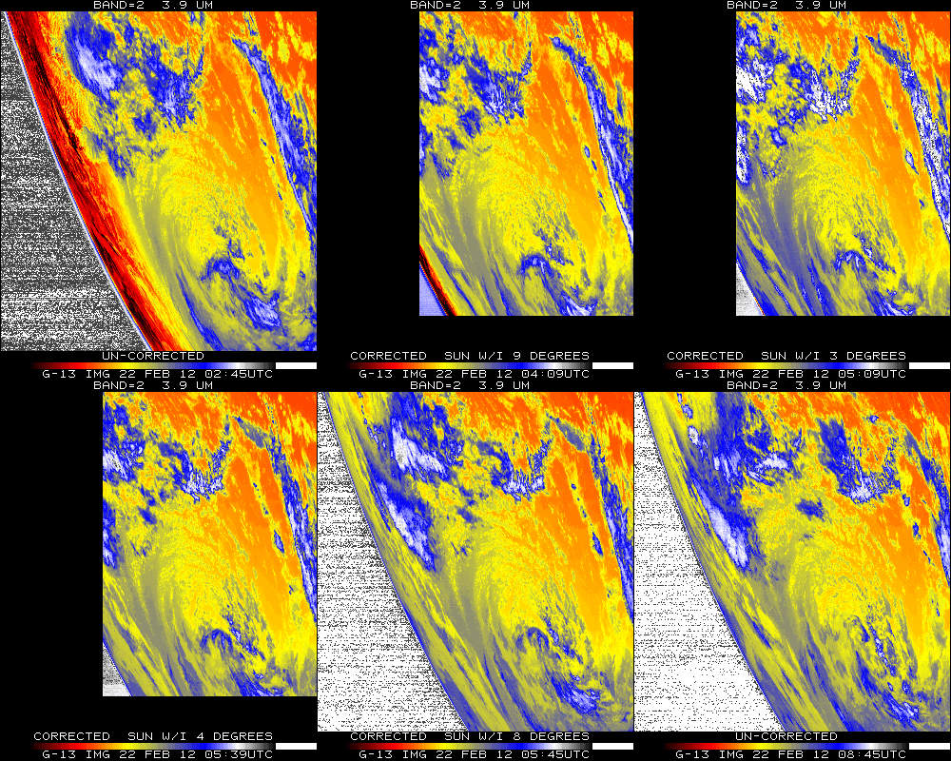
Notes:
Data from SSEC Data Center

Slide 7
PC E -44 122 PANEL=1;C PANEL=1;IMGPROBE STAT BOX TEMP MOD=N PAN=1 etc
Mean TBB of a cloud for the 6 times:
Calb Pixels Minimum Maximum Mean Stn. Dev.
---- -------- ------- ------- ------- -----------
TEMP 242 266.6 272.4 268.0 0.946
TEMP 242 265.3 271.1 266.5 1.042
TEMP 242 258.7 265.3 260.6 1.084
TEMP 242 265.7 270.4 266.9 0.812
TEMP 242 265.3 271.1 267.0 1.019
TEMP 242 265.7 270.7 267.4 1.164
Image Coord Earth Coord
Minimum Value: 12089/9985 -44:23:34/ 122:55:34
Maximum Value: 12053/10113 -43:37:35/ 120:22:18
Notes:
Using McIDAS-X. Note too cold of cloud (over correction) in this band (2) at 05:09Z.

Slide 8
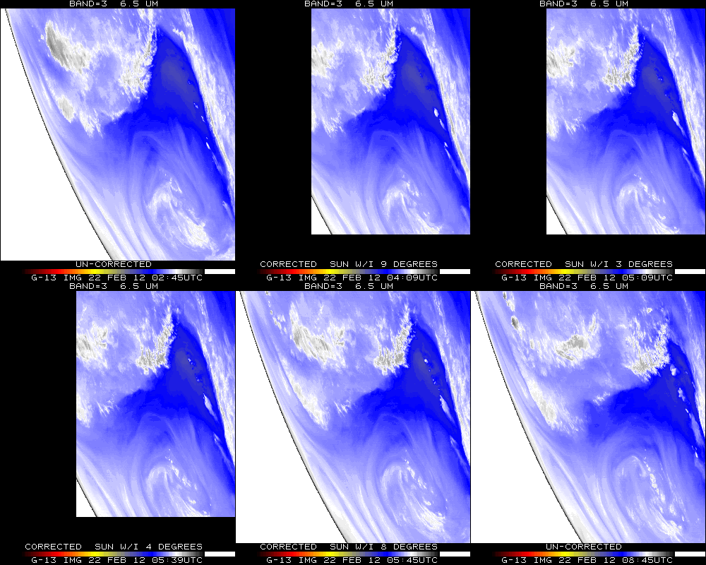
Notes:
Data from SSEC Data Center

Slide 9
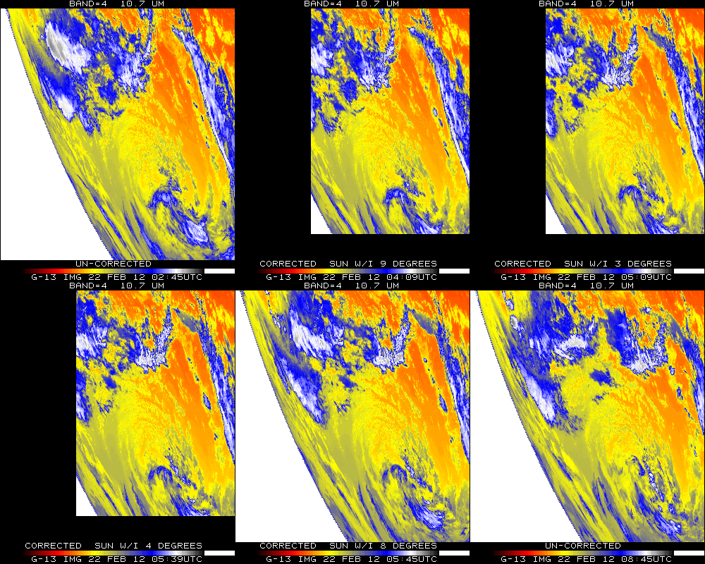
Notes:
Data from SSEC Data Center

Slide 10
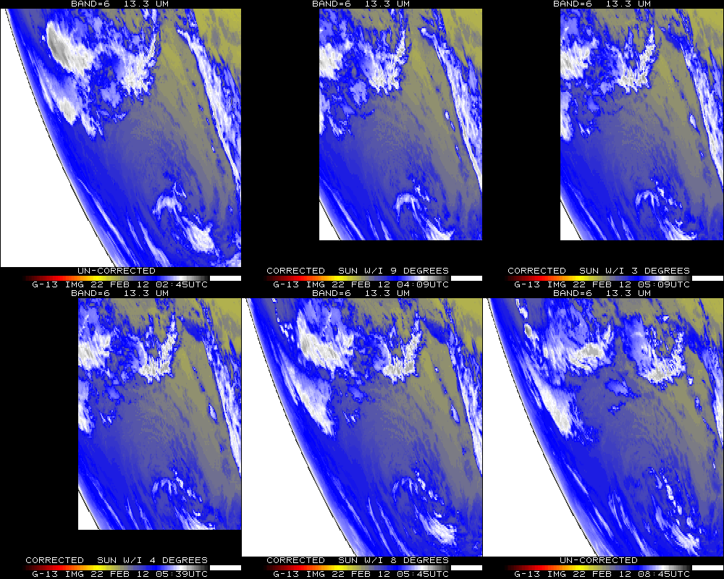
Notes:
Data from SSEC Data Center

Slide 11
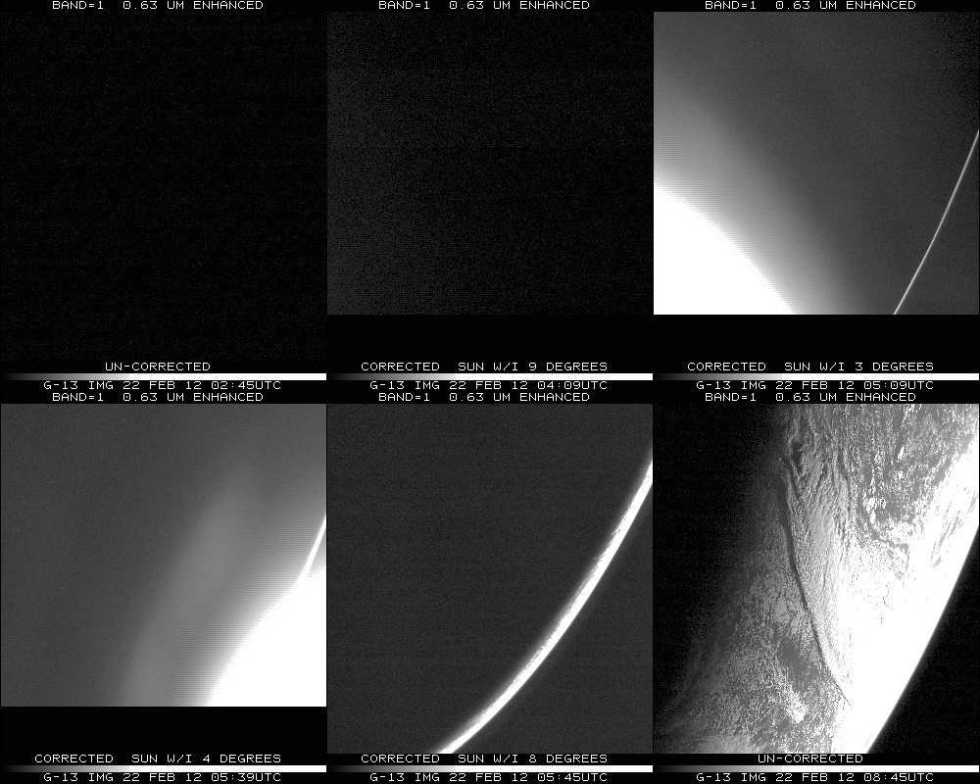
Notes:
Data from SSEC Data Center

Slide 12
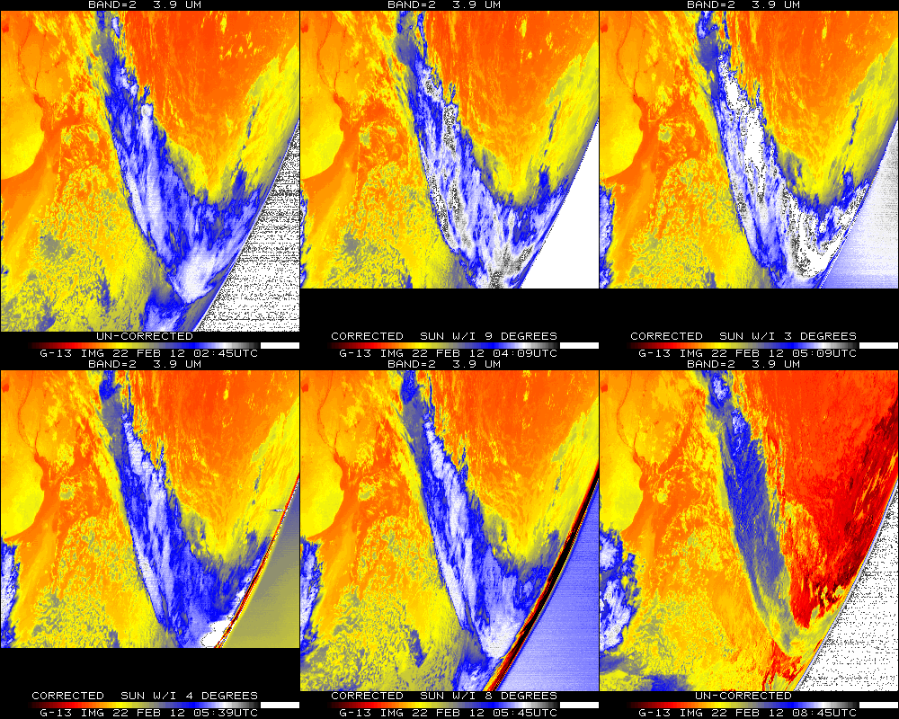
Notes:
Data from SSEC Data Center

Slide 13
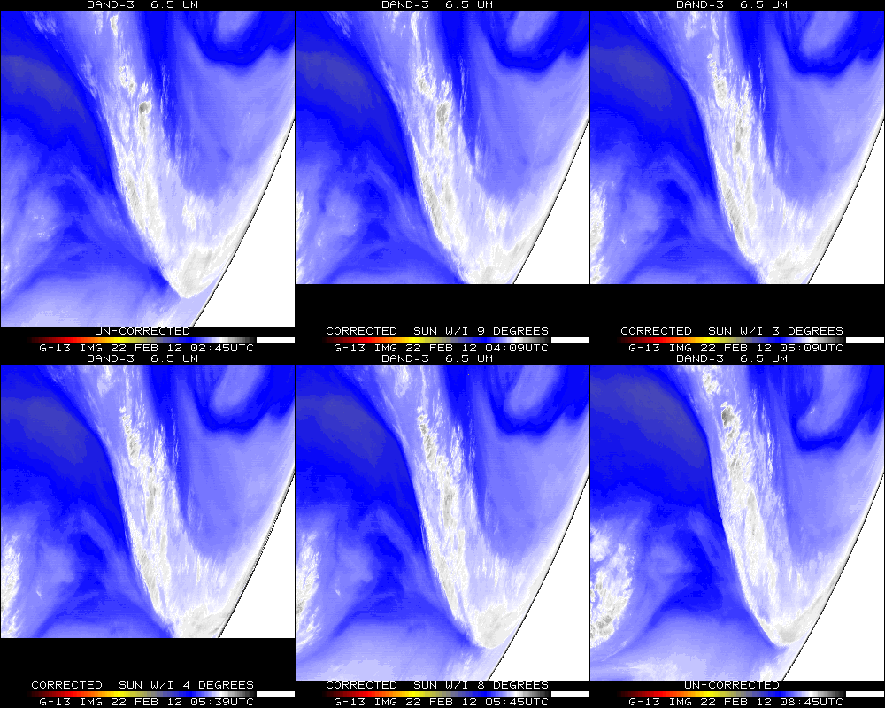
Notes:
Data from SSEC Data Center

Slide 14
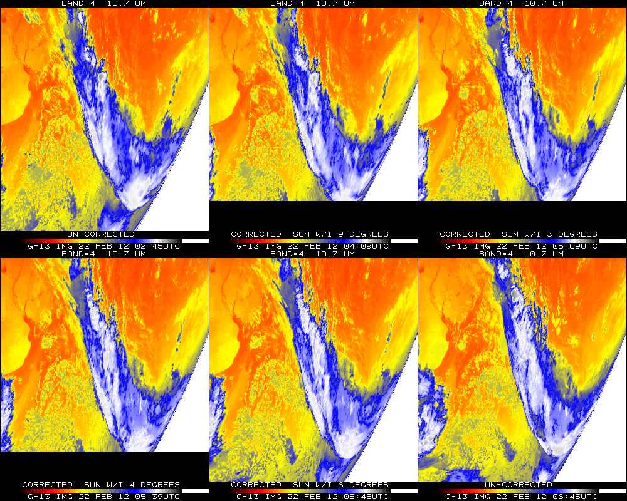
Notes:
Data from SSEC Data Center

Slide 15
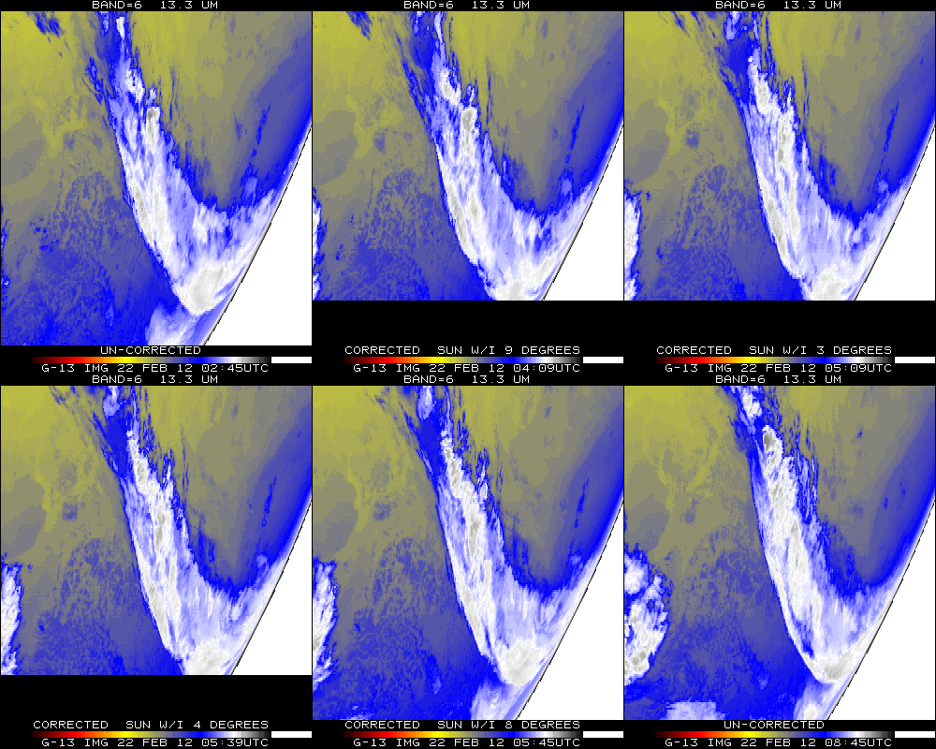
Notes:
Data from SSEC Data Center

Slide 16
STRAYLIGHT 1104
(STRAYLIGHT.PGM) *START execution on 2012053 (Wednesday February 22, 2012) at 212258 (HHMMSS) UTC
(STRAYLIGHT.PGM) Input program commandline (in 80-byte segments):
STRAYLIGHT 1104
(STRAYLIGHT.FOR) OPEN/READ GOES areafile: /crc2/cimss/tims/goes14/AREA1104
(STRAYLIGHT.FOR) Area 1104 directory information (Image type, SSEC sensor source #, image ccyyddd, image hhmmss):
4, 180, 2012053, 53900
(STRAYLIGHT.FOR) Check each image line for Stray Light Correction (SLC) information.
(STRAYLIGHT.FOR) Input area AREA1104 lines contain prefixes -- size= 488 bytes= 122 words
(STRAYLIGHT.FOR) Size of prefix DOC (4-byte words)= 119, CAL= 0, BND= 2
(STRAYLIGHT.FOR) Read input area AREA1104 line prefixes now.
(STRAYLIGHT.FOR) All 567 AREA1104 line prefixes now read.
(STRAYLIGHT.FOR) SLCE (# lines w/SLC enabled) = 567, SLCD (# lines w/SLC disabled) = 0
(STRAYLIGHT.FOR) SLCP (# lines w/SLC performed) = 567, SLCNP (# lines w/SLC not performed) = 0
(STRAYLIGHT.FOR) SLCP_FIRST (1st line w/SLC performed) = 1, SLCP_LAST (last line w/SLC performed) = 567
(STRAYLIGHT.FOR) SUNE (# lines w/sun on e/side of earth) = 567, SUNW (# lines w/sun on w/side of earth) = 0
(STRAYLIGHT.FOR) SUNN (# lines w/sun on n/side of earth) = 0, SUNS (# lines w/sun on s/side of earth) = 567
(STRAYLIGHT.FOR) 567 nonzero values were found for the parameter: min_sun_angle_range_of_earth_pixels_in_a_scan
(STRAYLIGHT.FOR) Smallest value = 4 found at line # 379
(STRAYLIGHT.FOR) Largest value = 7 found at line # 1
(STRAYLIGHT.PGM) NOTE: NO errors were returned from STRAYLIGHT.FOR -- Continue.
(STRAYLIGHT.PGM) DONE!
Notes:
Code from SSEC/CIMSS.

