Slide 1
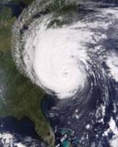
Moving from RGB "versus" quantitative products to RGB “with” quantitative products
Timothy J. Schmit (tim.j.schmit@noaa.gov)
NOAA/NESDIS/Satellite Applications and Research
Advanced Satellite Products Branch (ASPB)
Joleen Feltz
CIMSS
Madison, WI
UW-Madison

Slide 2
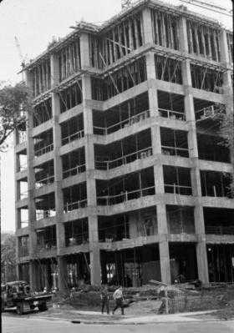
Thanks
Inputs from many others
Jun Li
Mike Pavolonis
Don Hillger
Steve Miller
Tom Rink
Andy Heidinger
Jason Otkin
Will Straka
Steve Goodman
Jaime Daniels
Etc.

Slide 3
Outline
Concept
Combining qualitative and quantitative products
“Removing the tyranny of versus…”
Examples
Sounder
Imager
GOES-R ABI

Slide 4
Bridging the Gap in imagery
Qualitative
Quantitative
BBoth
Both

Slide 5
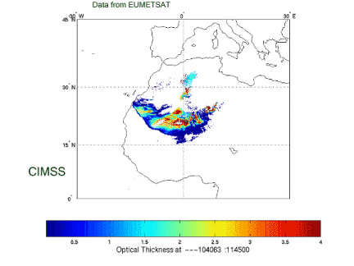
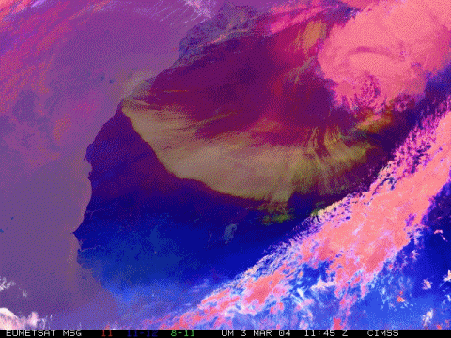
Aerosol/Dust Optical Thickness Retrieval
Data from SEVIRI
Dust Aerosol Optical Depth
From Jun LI, CIMSS
CIMSS/NSMC

Slide 6
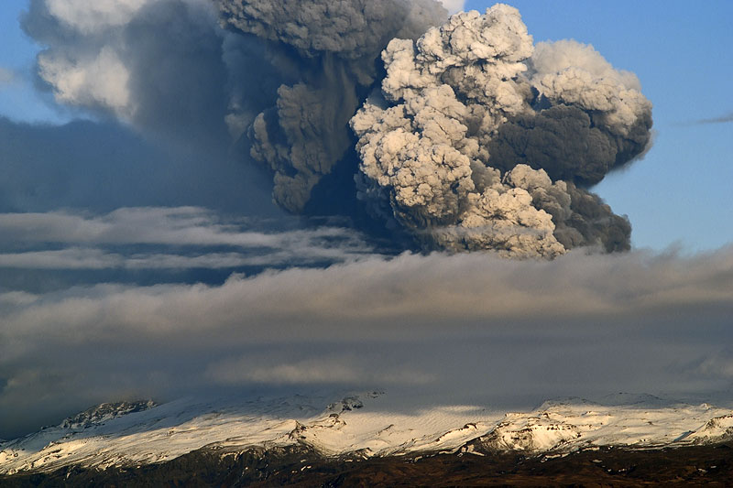
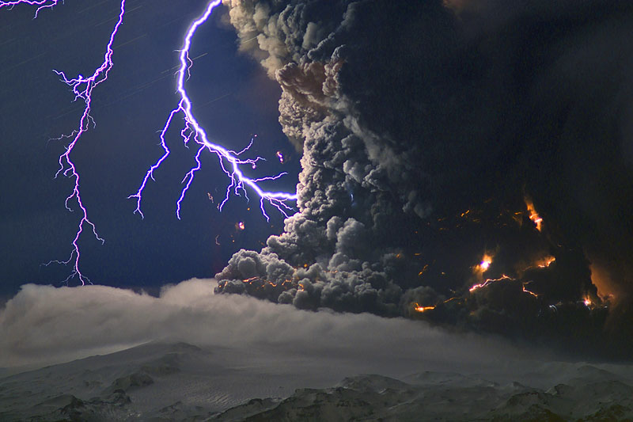
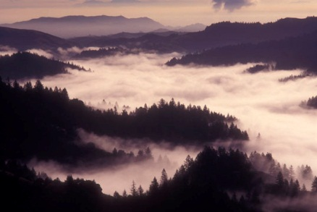
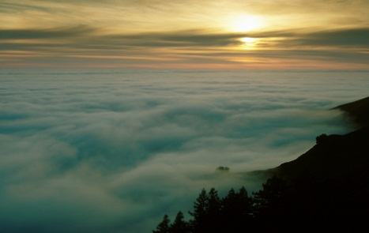
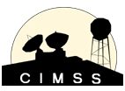
An Overview of New and Unique GOES-R Products for Hazard Assessment
Marco Fulle - www.stromboli.net
Mike Pavolonis
(NOAA/NESDIS)
Justin Sieglaff, Dan Hartung, and Corey Calvert
(UW-CIMSS)

Slide 7
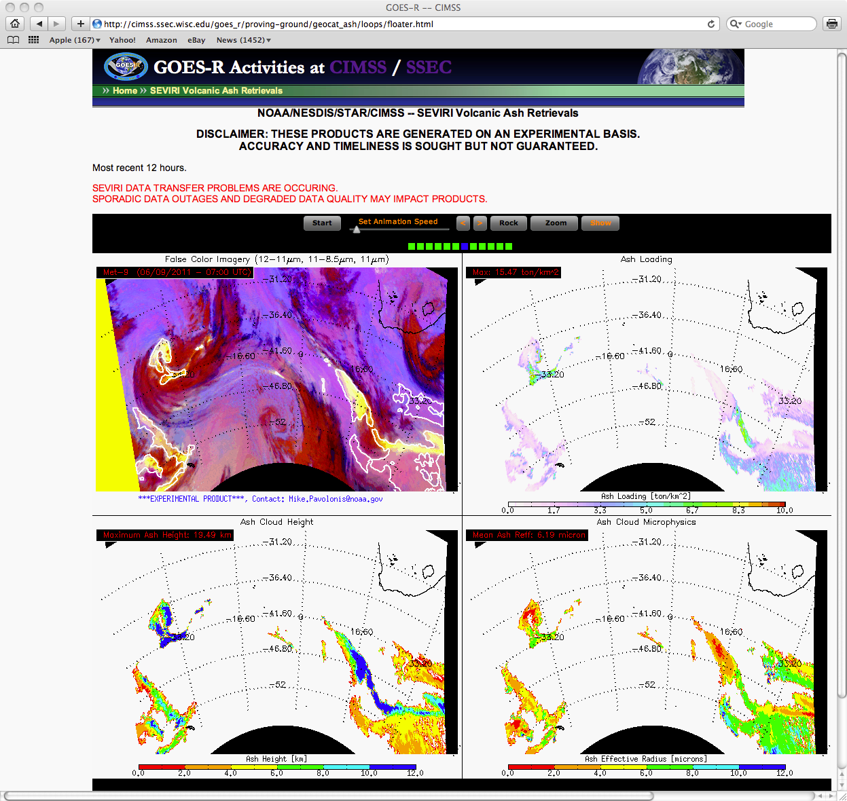
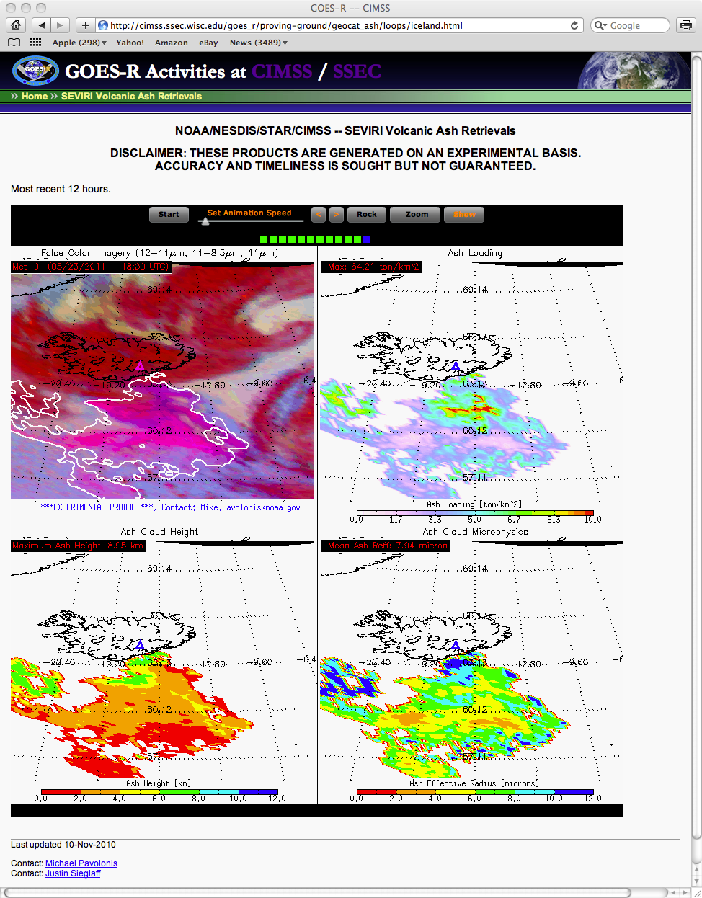
http://cimss.ssec.wisc.edu/goesr/proving-ground/geocat_ash
Cordon Caulle
Grimsvotn
Using contours to highlight quantitative product (over RGB)
Notes:
-June 4
-May 21

Slide 8
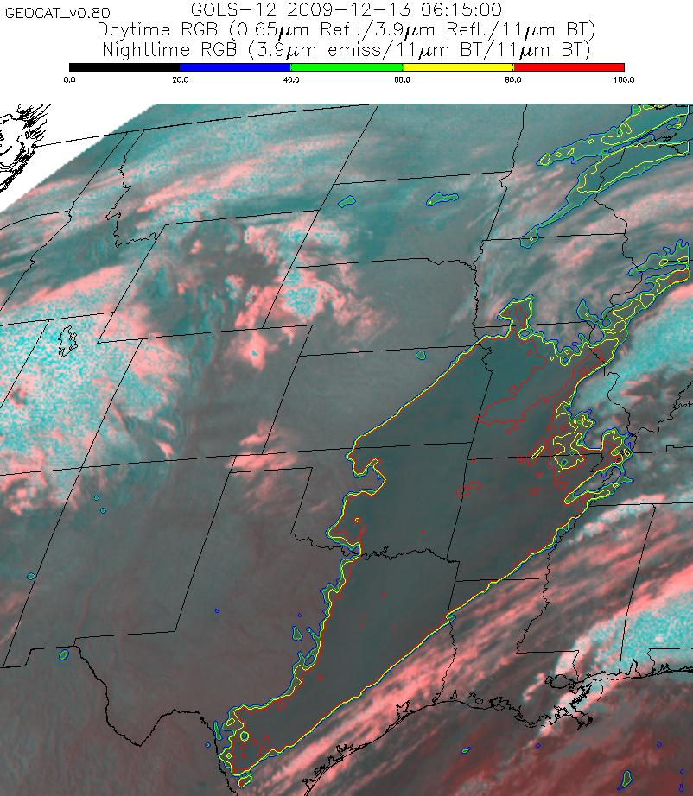
The quantitative assessment of cloud ceiling can be overlaid on top of imagery to make the product more appealing to forecasters.
The ability to contour the IFR and MVFR probabilities will soon be available in AWIPS.
Using contours to highlight quantitative product (over RGB)

Slide 9
Outline
Concept
Combining qualitative and quantitative products
“Removing the tyranny of versus…”
Examples
Sounder
Imager
GOES-R ABI

Slide 10
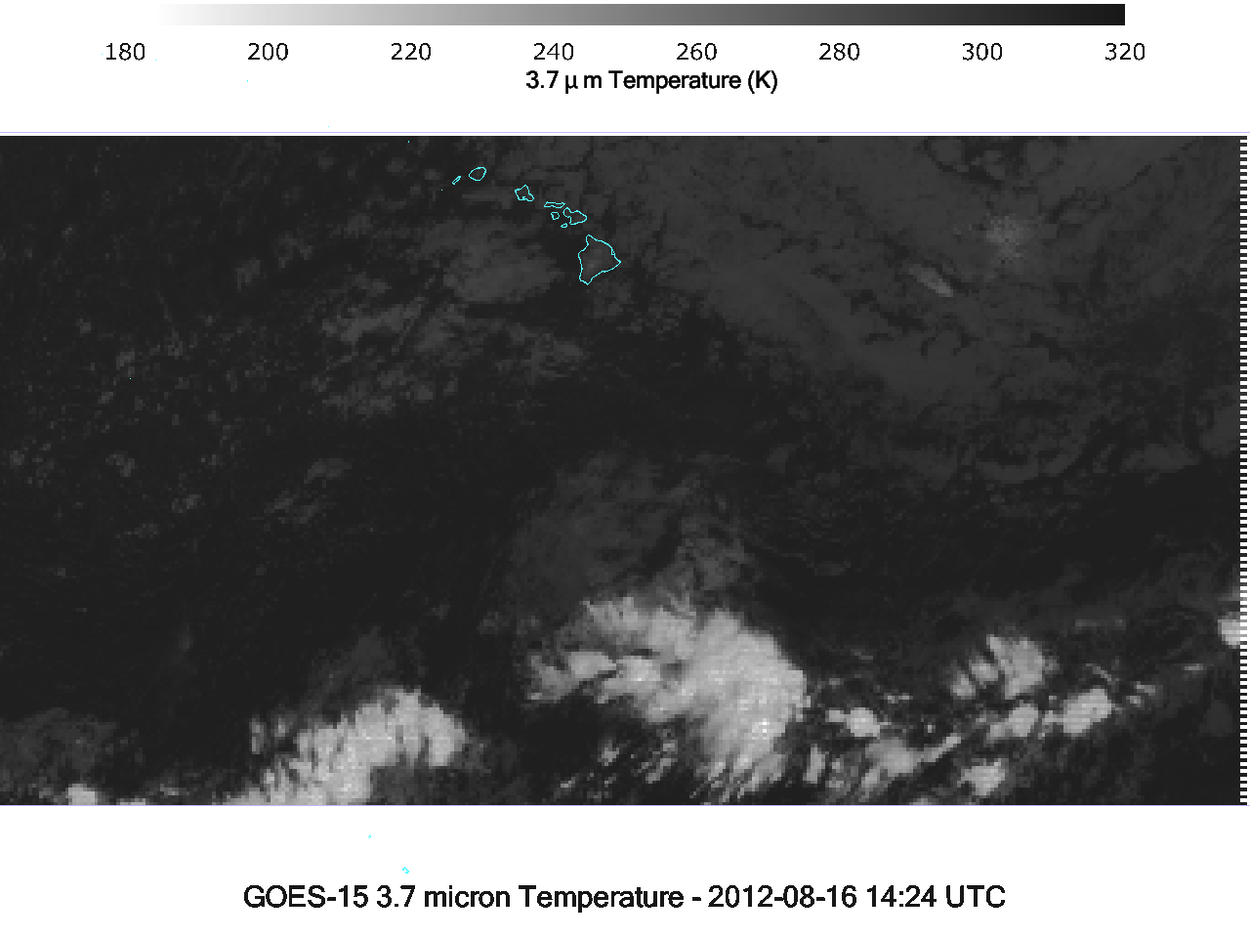

Slide 11
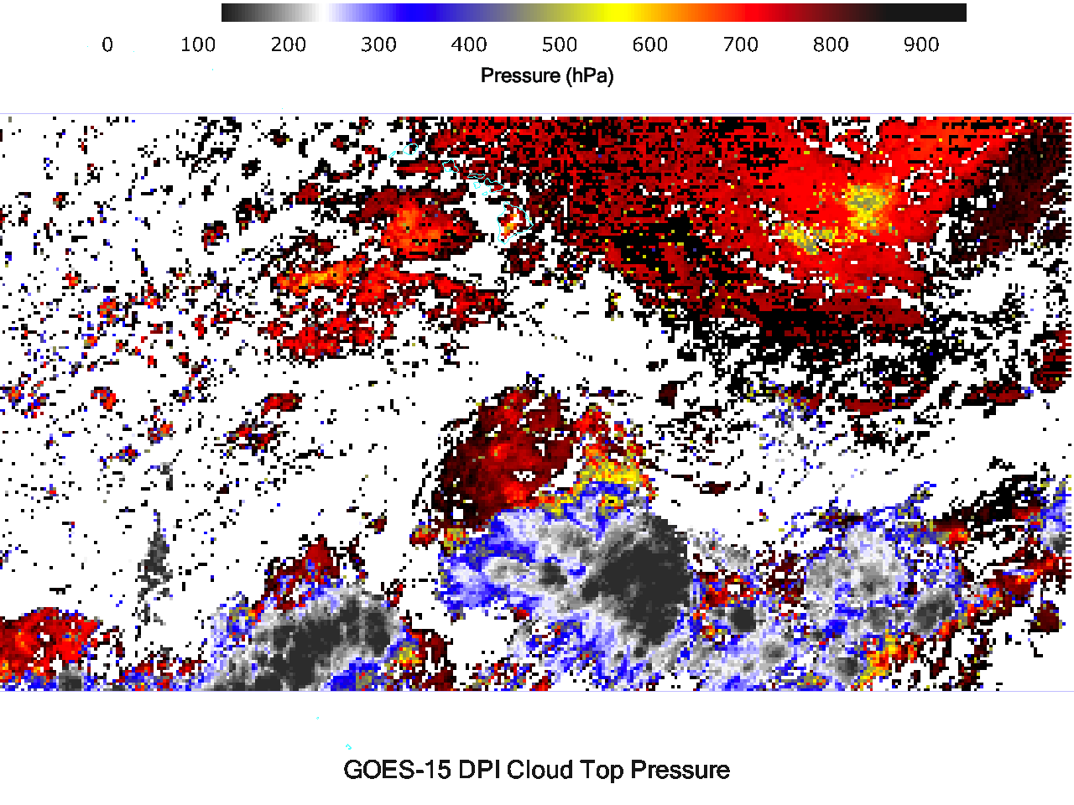

Slide 12
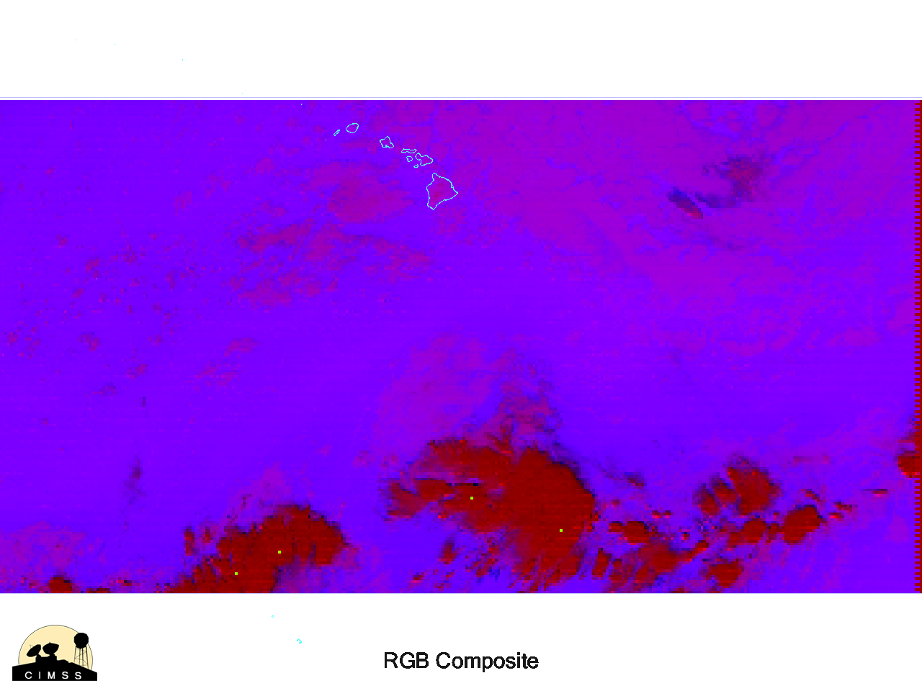

Slide 13
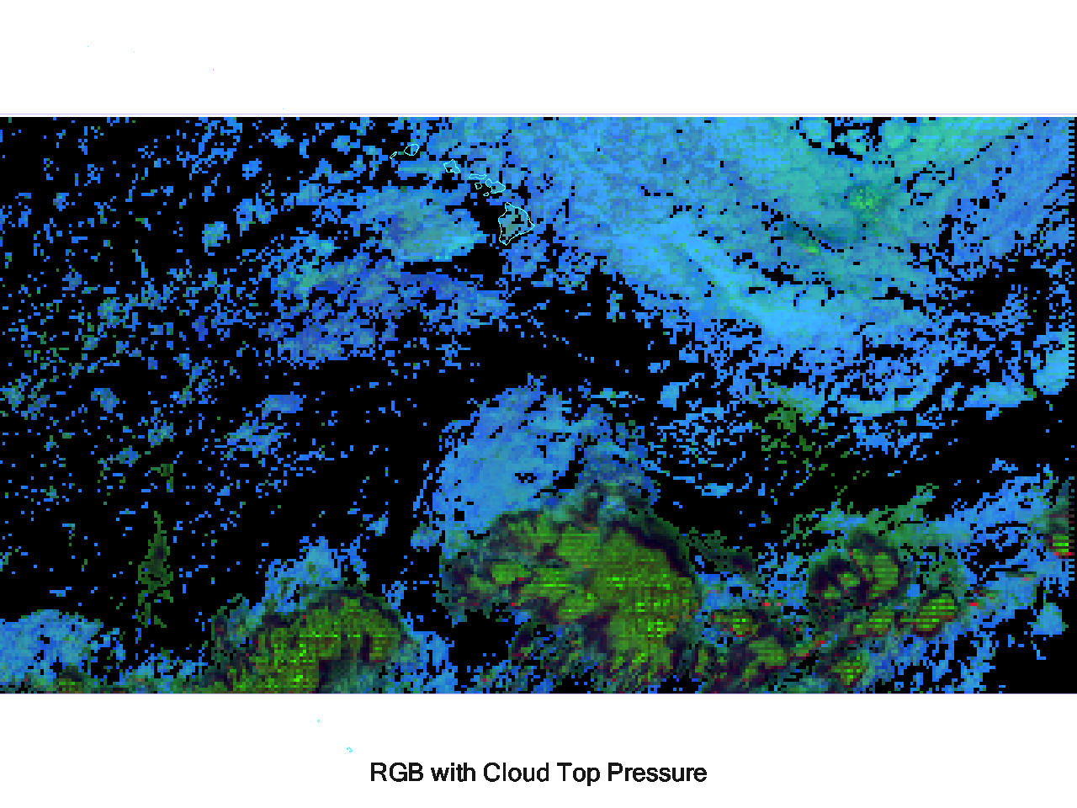

Slide 14
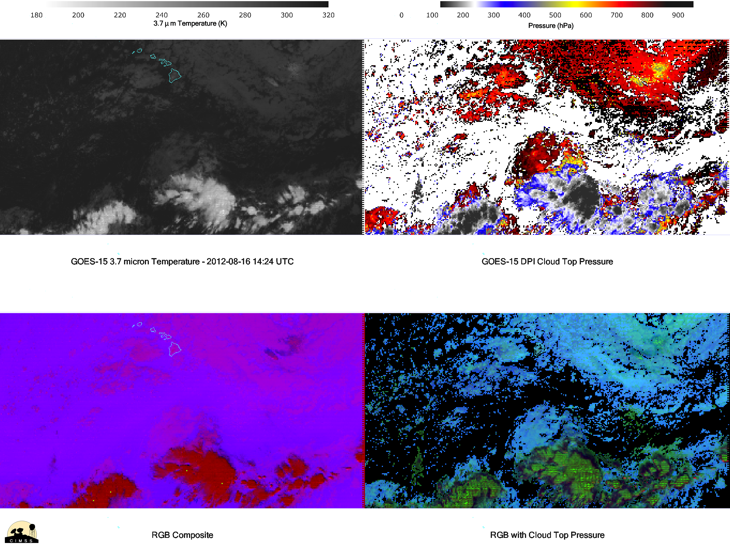

Slide 15
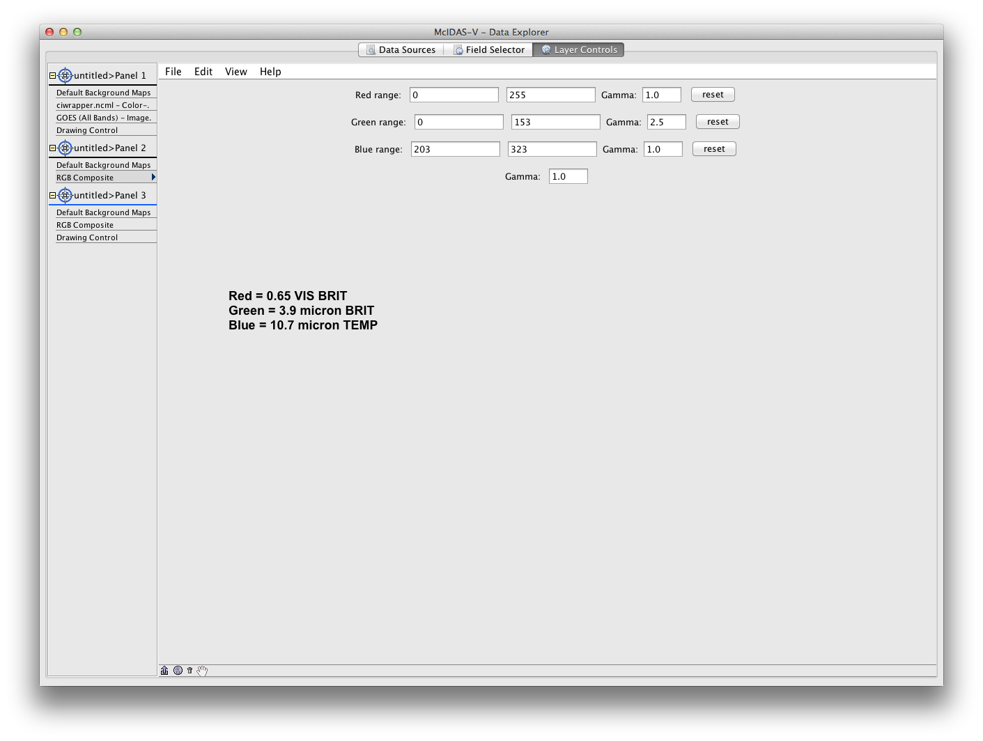
McIDAS-V

Slide 16
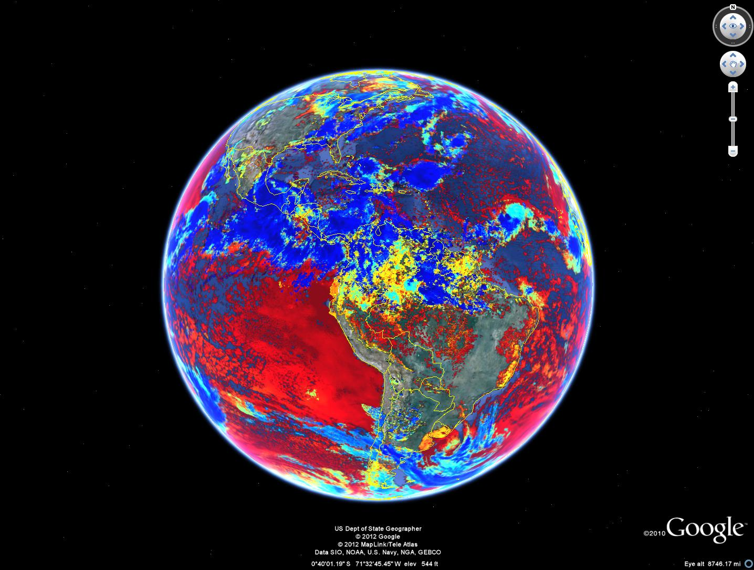
Cloud-top temperature
Data from Andy Heidinger

Slide 17
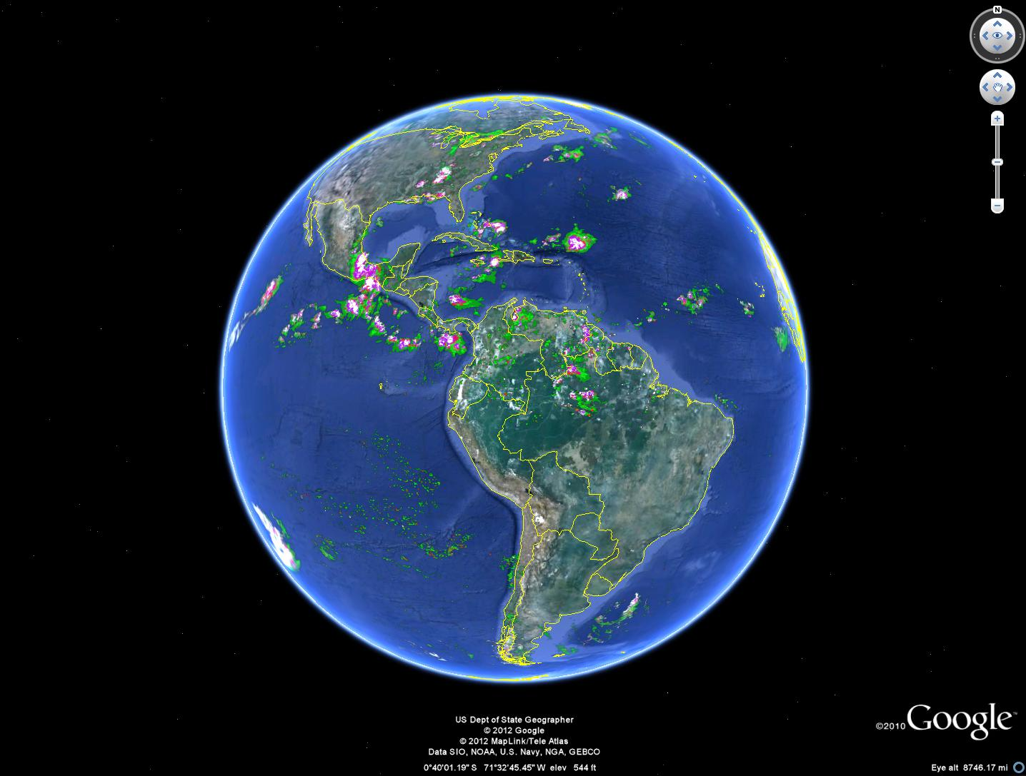
Rain Rate
Data from Andy Heidinger

Slide 18
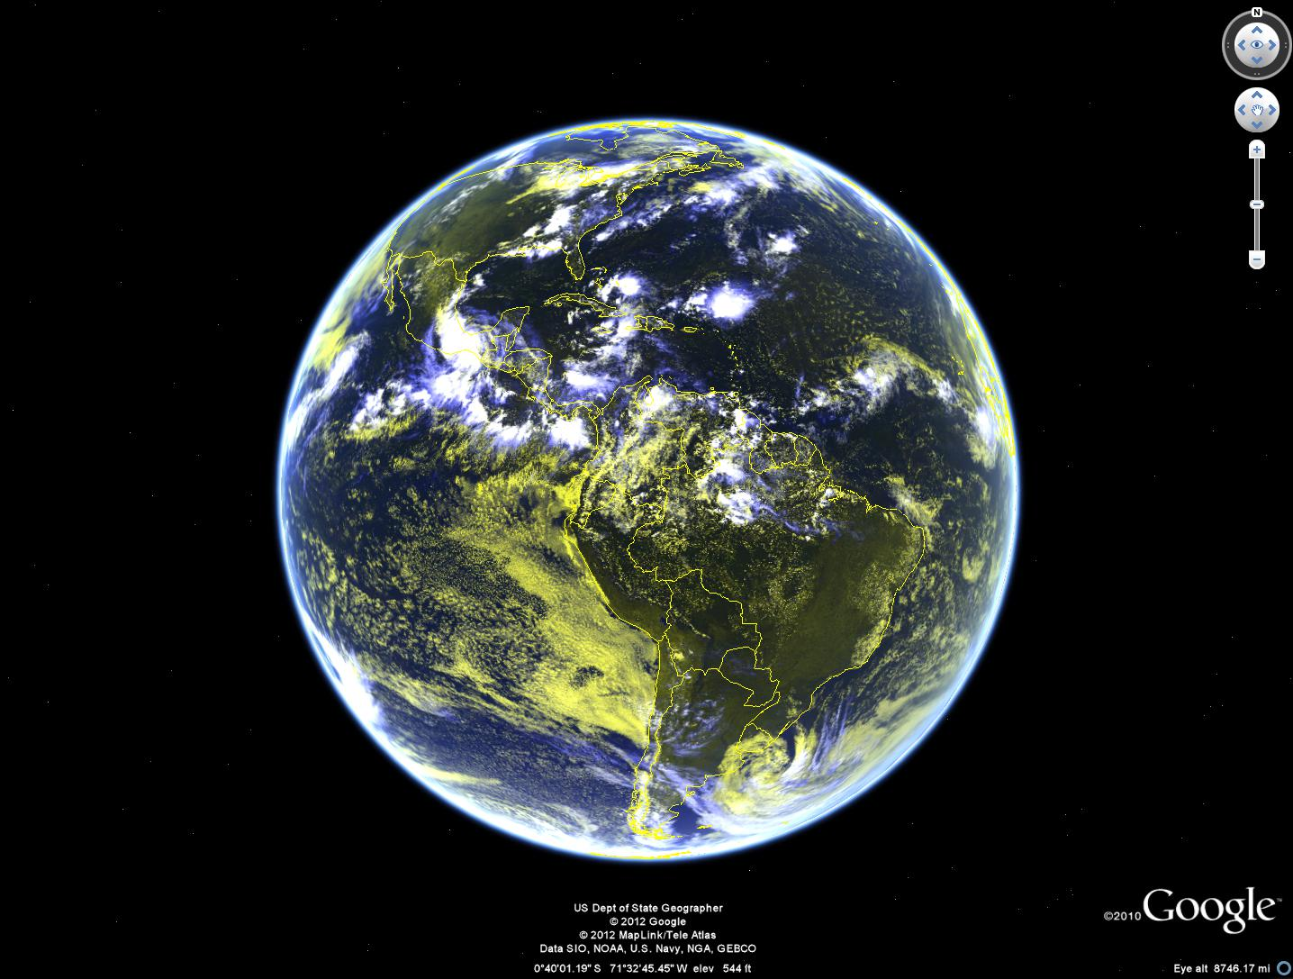
False color
Data from Andy Heidinger

Slide 19
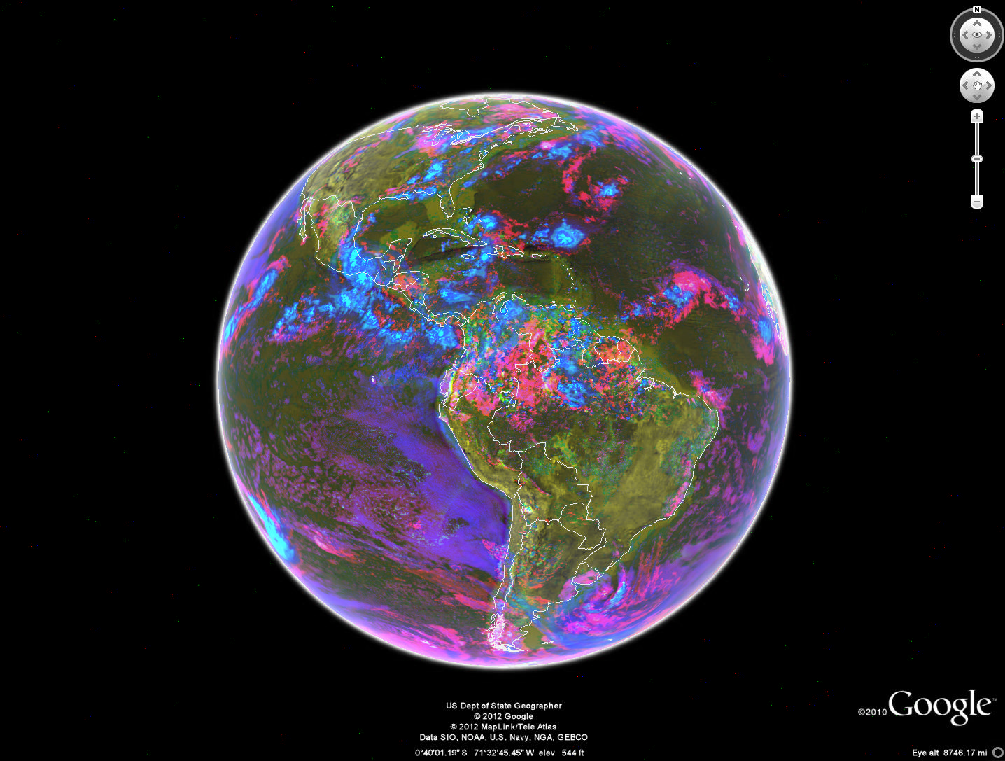
Cloud top temperature + Rain Rate + False color
This is only meant to show the concept of merging imagery and products.

Slide 20
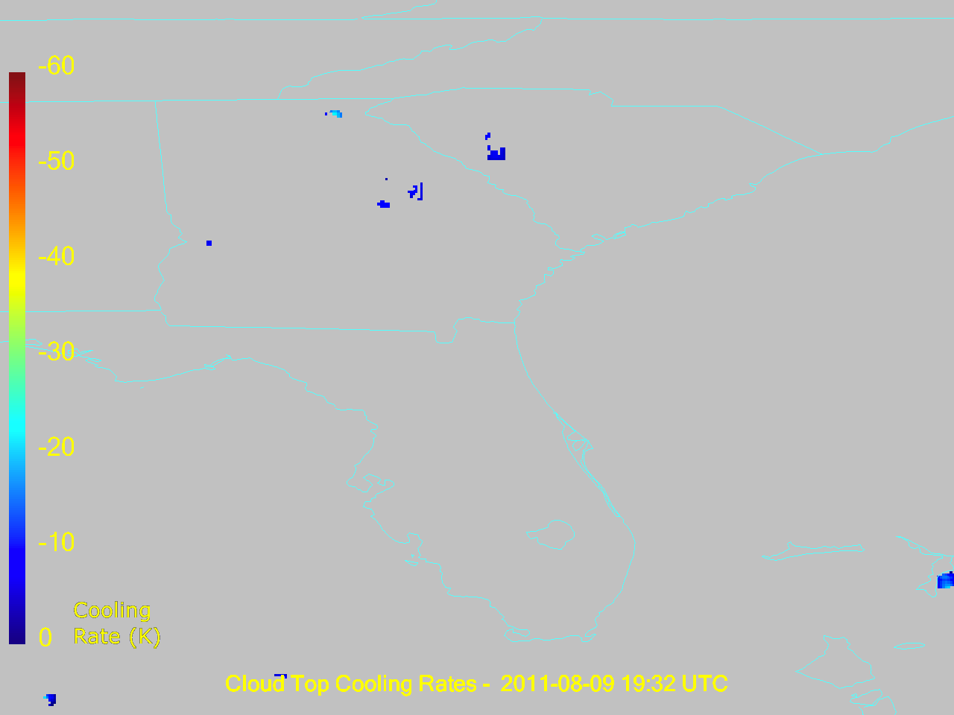

Slide 21
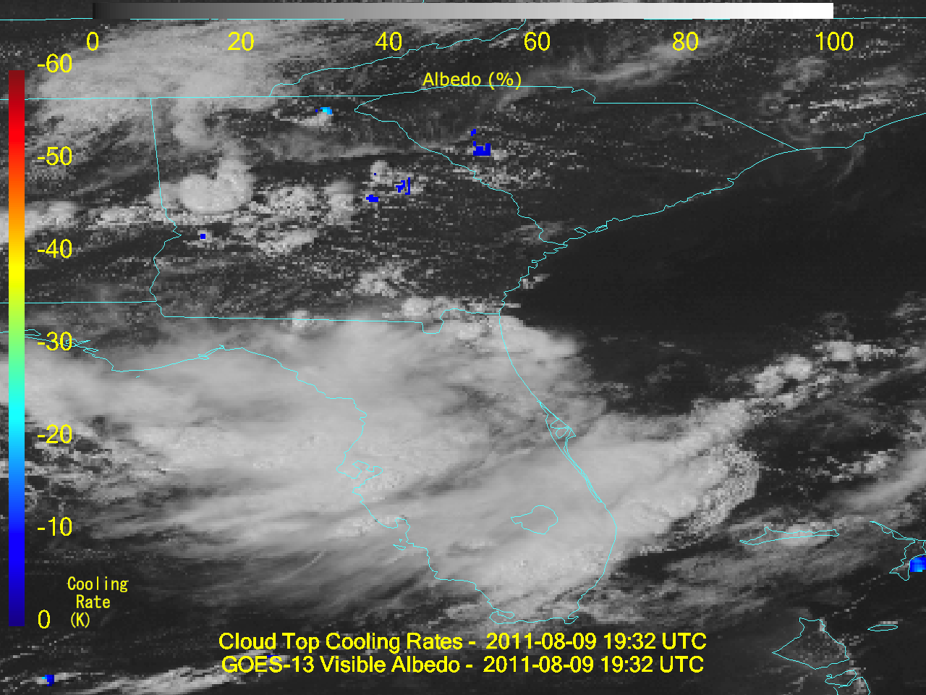

Slide 22
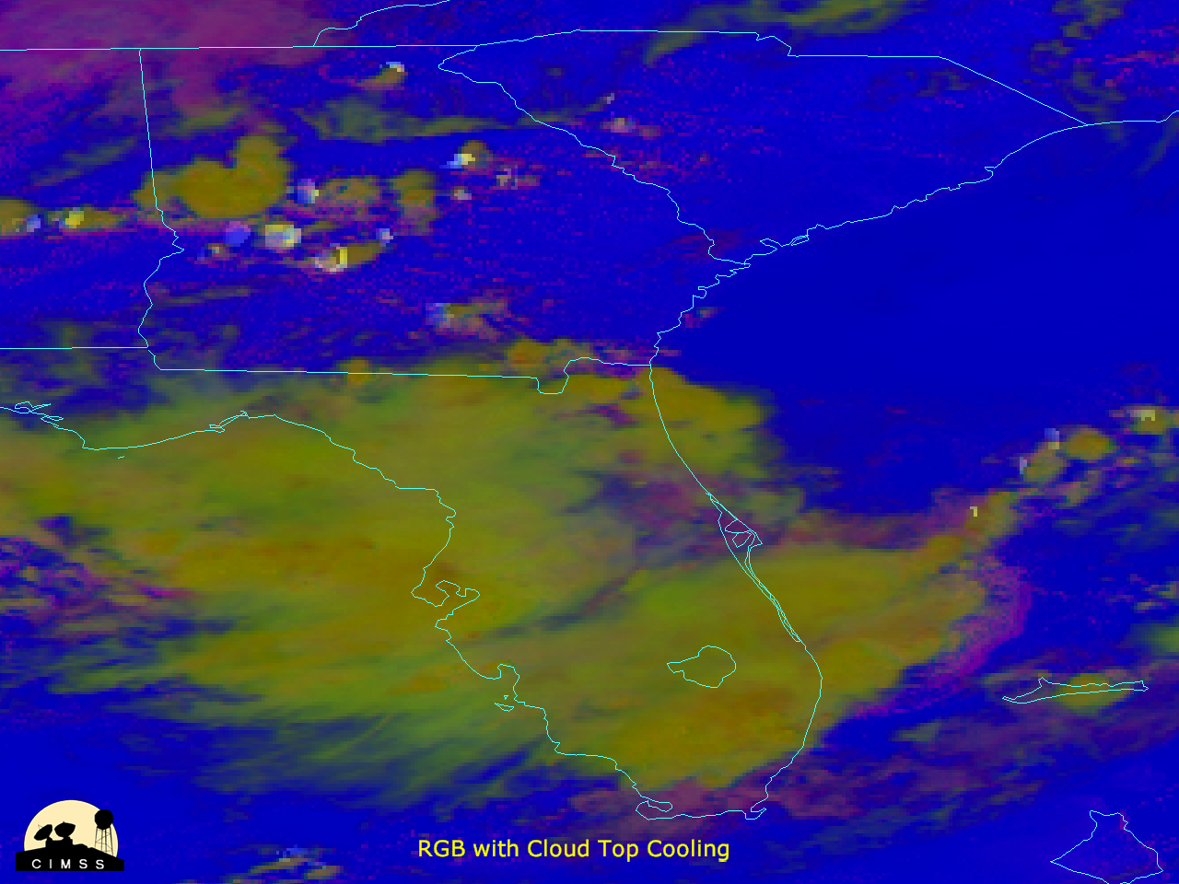

Slide 23
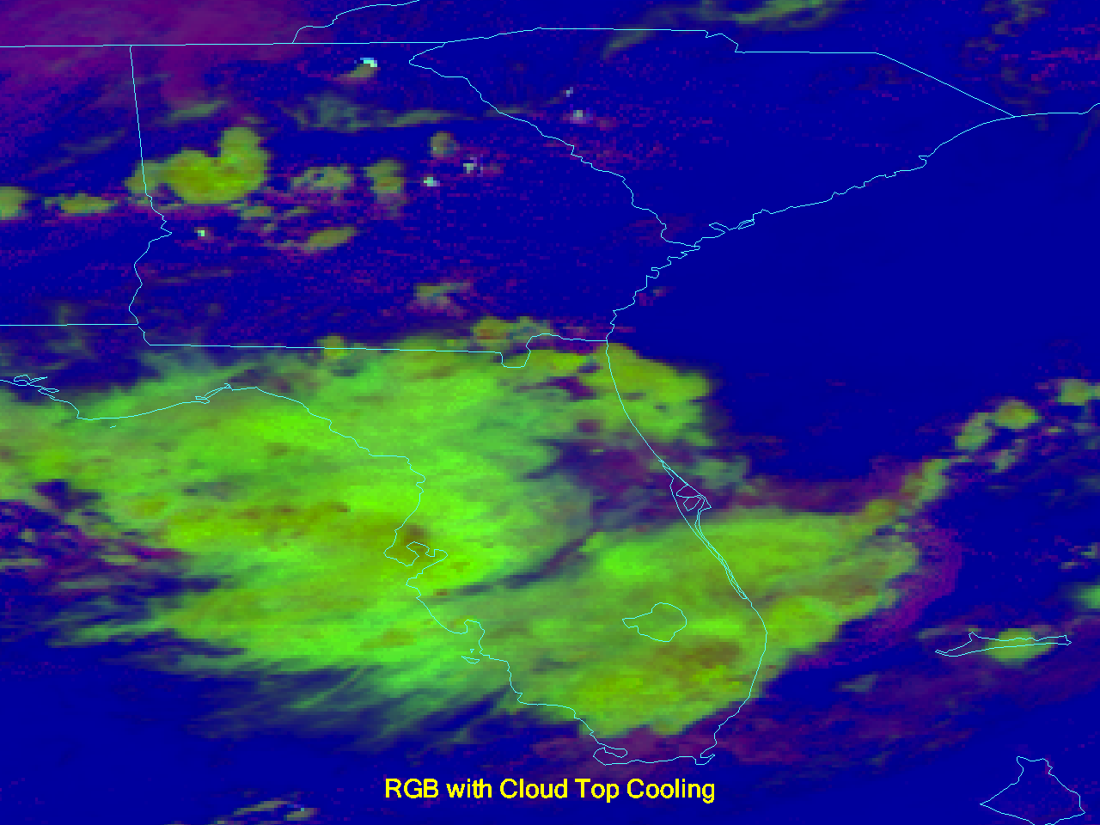

Slide 24
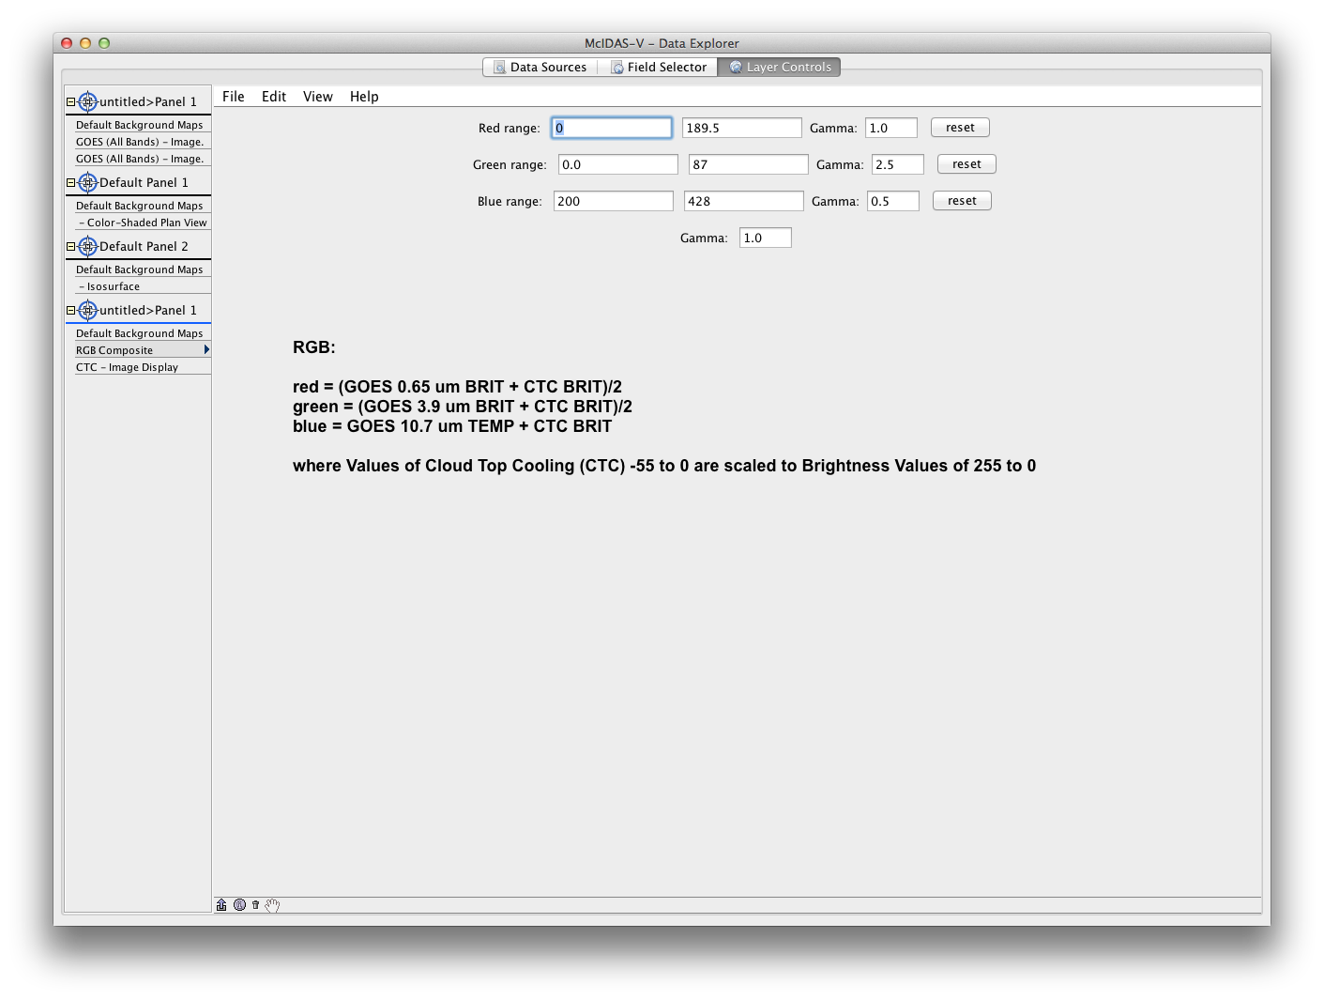
McIDAS-V

Slide 25
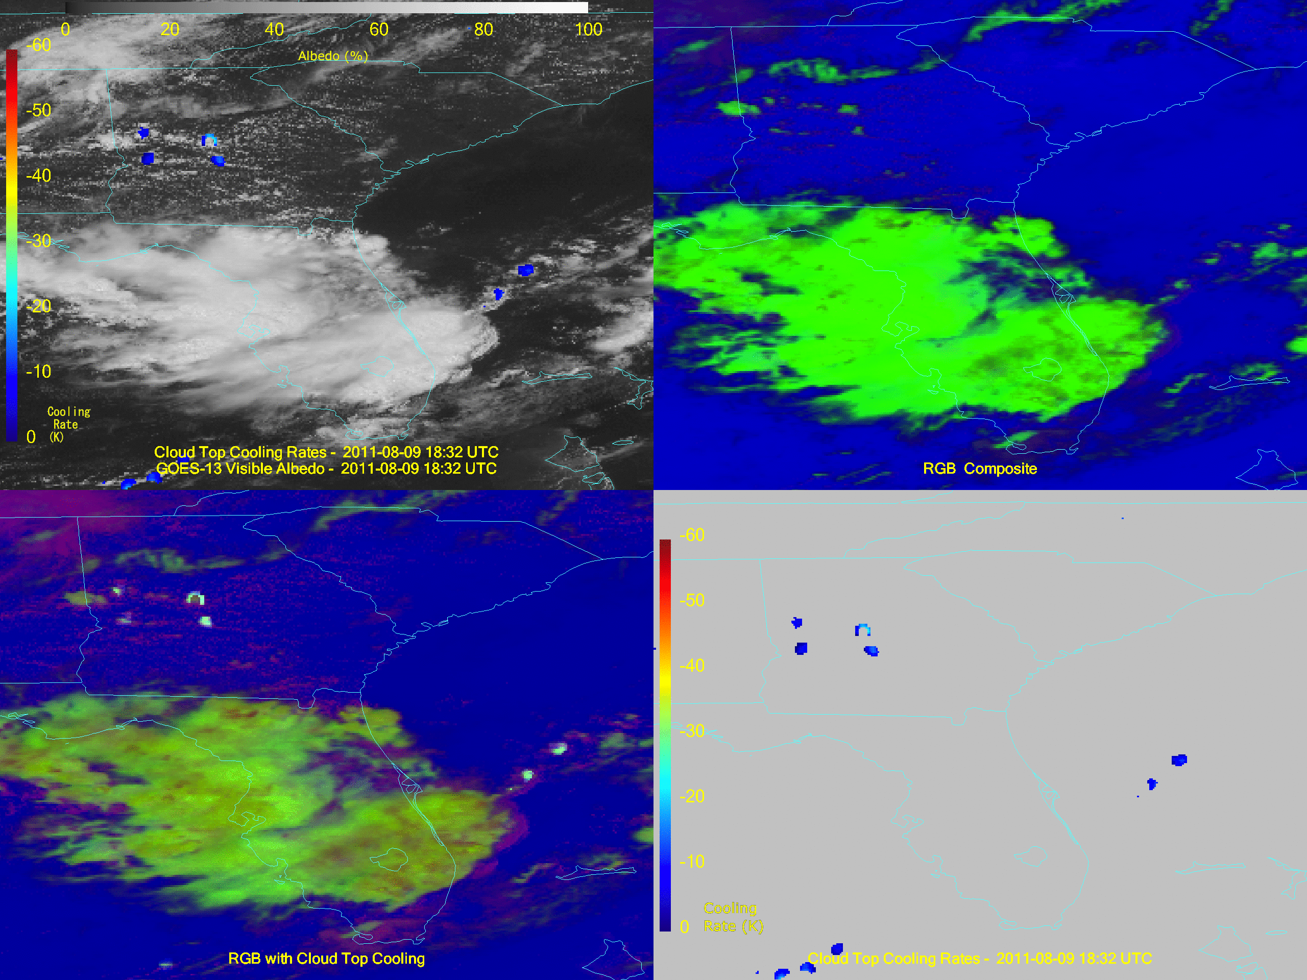
Animation

Slide 26
Outline
Concept
Combining qualitative and quantitative products
“Removing the tyranny of versus…”
Examples
Sounder
Imager
GOES-R ABI

Slide 27
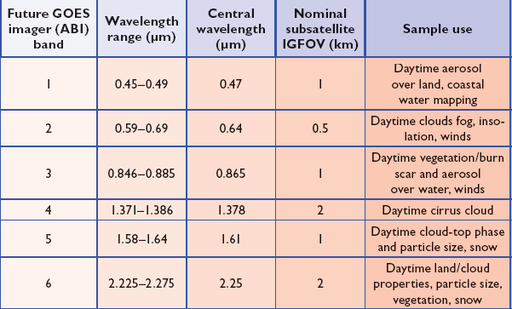
ABI Visible/Near-IR Bands
No ‘green’ band due to ‘lack of user requirement’.
Schmit et al, 2005
Notes:
Schmit, T. J., M. M. Gunshor, W. P. Menzel, J. J. Gurka, J. Li, and A. S. Bachmeier, 2005: Introducing the next-generation Advanced Baseline Imager on GOES-R. Bull. Amer. Meteor. Soc., 86, 1079-1096.

Slide 28
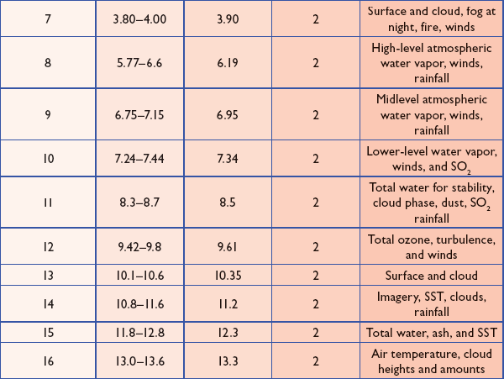
ABI IR Bands
Schmit et al, 2005
Notes:
Schmit, T. J., M. M. Gunshor, W. P. Menzel, J. J. Gurka, J. Li, and A. S. Bachmeier, 2005: Introducing the next-generation Advanced Baseline Imager on GOES-R. Bull. Amer. Meteor. Soc., 86, 1079-1096.

Slide 29
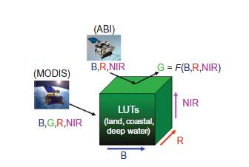
Miller et al.
Miller, Steven D.; Schmidt, Christopher C.; Schmit, Timothy J. and Hillger, Donald W. A case for natural colour imagery from geostationary satellites, and an approximation for the GOES-R ABI. International Journal of Remote Sensing, Volume 33, Issue 13, 2012, pp.3999-4028.
Notes:
Reference:

Slide 30
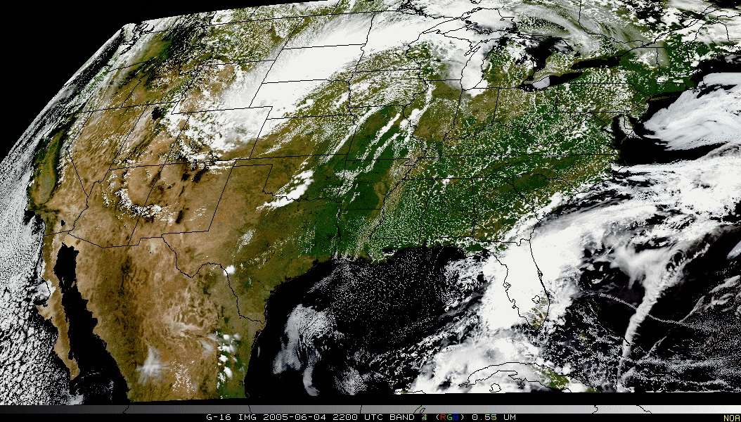
Pseudo-Natural Color

Slide 31
GOES-R ABI Products
Baseline Products
Future Capabilities
Advanced Baseline Imager (ABI)
Aerosol Detection (Including Smoke and Dust) Aerosol Optical Depth (AOD) Clear Sky Masks Cloud and Moisture Imagery Cloud Optical Depth Cloud Particle Size Distribution Cloud Top Height Cloud Top Phase Cloud Top Pressure Cloud Top Temperature Derived Motion Winds Derived Stability Indices Downward Shortwave Radiation: Surface Fire/Hot Spot Characterization Hurricane Intensity Estimation Land Surface Temperature (Skin) Legacy Vertical Moisture Profile Legacy Vertical Temperature Profile Radiances Rainfall Rate/QPE Reflected Shortwave Radiation: TOA Sea Surface Temperature (Skin) Snow Cover Total Precipitable Water Volcanic Ash: Detection and Height
Advanced Baseline Imager (ABI)
Absorbed Shortwave Radiation: Surface Aerosol Particle Size Aircraft Icing Threat Cloud Ice Water Path Cloud Layers/Heights Cloud Liquid Water Cloud Type Convective Initiation Currents Currents: Offshore Downward Longwave Radiation: Surface Enhanced “V”/Overshooting Top Detection Flood/Standing Water Ice Cover Low Cloud and Fog Ozone Total Probability of Rainfall Rainfall Potential Sea and Lake Ice: Age Sea and Lake Ice: Concentration Sea and Lake Ice: Motion Snow Depth (Over Plains) SO₂ Detection Surface Albedo Surface Emissivity Tropopause Folding Turbulence Prediction Upward Longwave Radiation: Surface Upward Longwave Radiation: TOA Vegetation Fraction: Green Vegetation Index Visibility

Slide 32
Summary
Consider ways to ‘bring together’ qualitative imagery and quantitative products
This may mean to produce more quantitative products at full spatial resolutions
GOES-R will offer many options, given the number of spectral bands and derived products.
Ideally, our display systems could easily show or combine images and products (via contours, over-lays and RGB combinations)!

Slide 33
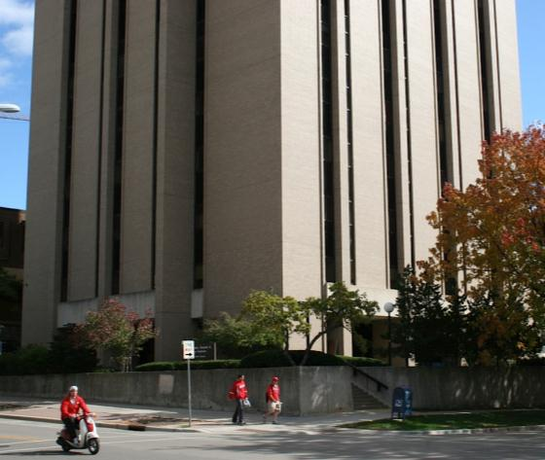
From ‘grayscale’ to full color!

