Slide 1
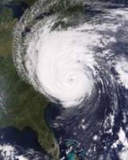
Moving from "versus" quantitative products to RGB “with” quantitative products
Timothy J. Schmit (tim.j.schmit@noaa.gov)
NOAA/NESDIS/Satellite Applications and Research
Advanced Satellite Products Branch (ASPB)
Joleen Feltz
CIMSS
Madison, WI
UW-Madison
Notes:
Thank you for the invitation to this workshop. Sorry I can’t attend in person. Hurricane image is with the ‘simulating green’ LUT approach (from MODIS).

Slide 2
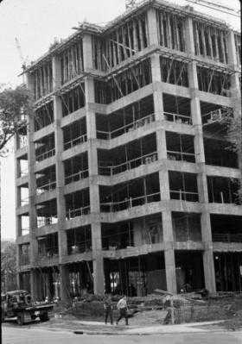
Thanks
Inputs from many others
Tom Rink
Jun Li
Mike Pavolonis
Don Hillger
Steve Miller
Jordan Gerth
Andy Heidinger
Mat Gunshor
Jason Otkin
Will Straka
Steve Goodman
Jaime Daniels
Chris Schmidt
Etc.
Notes:
Thanks to many. The SSEC building in 1967. Picture from Jean Phillips.

Slide 3
Outline
Concept
Combining qualitative and quantitative products
“Removing the tyranny of versus…”
Examples
Sounder
Imager
GOES-R ABI

Slide 4
Bridging the gap in imagery
Qualitative
Quantitative
BBoth
Both
Notes:
Right now most views are either qualitative images OR quantitative derived products. How best to combine the strengths?

Slide 5
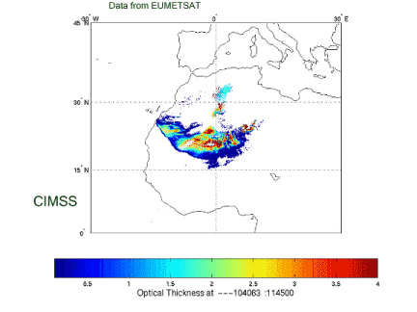
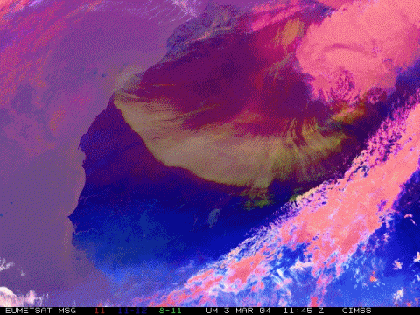
Aerosol/Dust Optical Thickness Retrieval
Data from SEVIRI
Dust Aerosol Optical Depth
From Jun LI, CIMSS
CIMSS/NSMC
Notes:
Classic example: quantitative on left, qualitative on right (not this isn’t the official ‘dust’ RGB enhancement). Both have strengths and weaknesses.

Slide 6
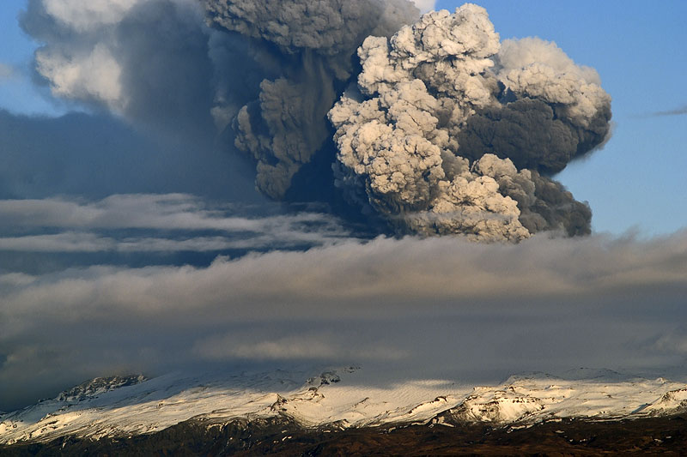
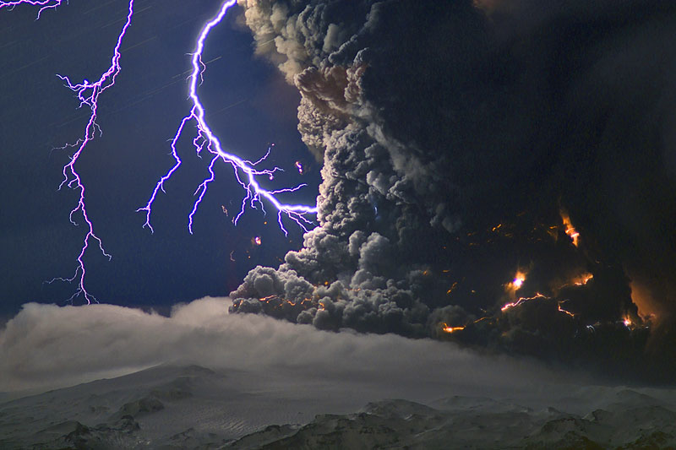
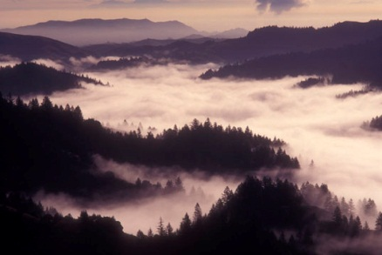
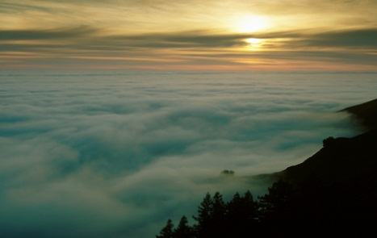
An Overview of New and Unique GOES-R Products for Hazard Assessment
Marco Fulle - www.stromboli.net
Mike Pavolonis
(NOAA/NESDIS)
Justin Sieglaff, Dan Hartung, and Corey Calvert
(UW-CIMSS)
Notes:
Following slides from Mike Pavolonis (ASPB) in Madison, WI.

Slide 7
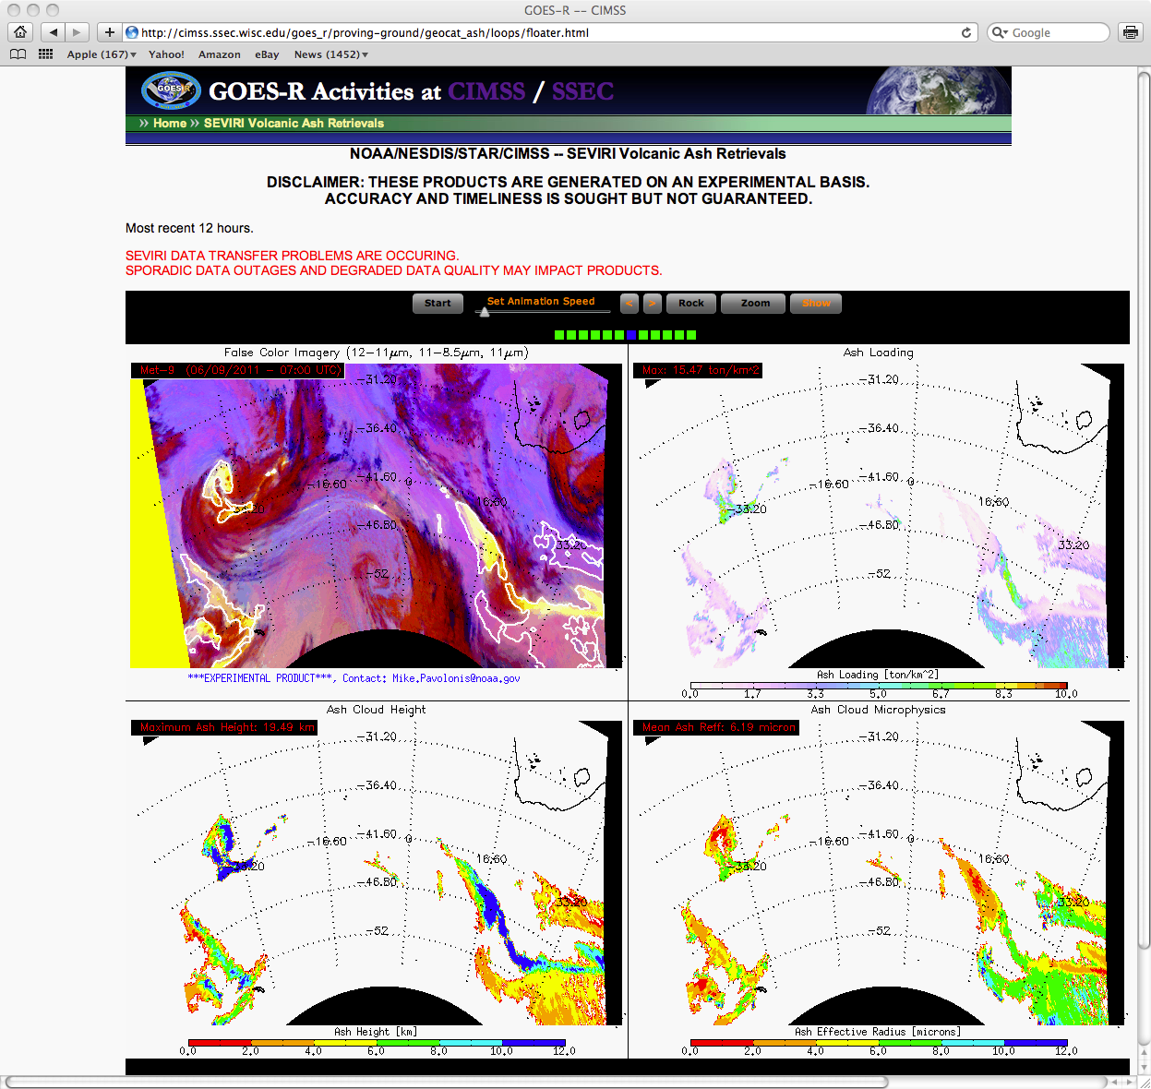
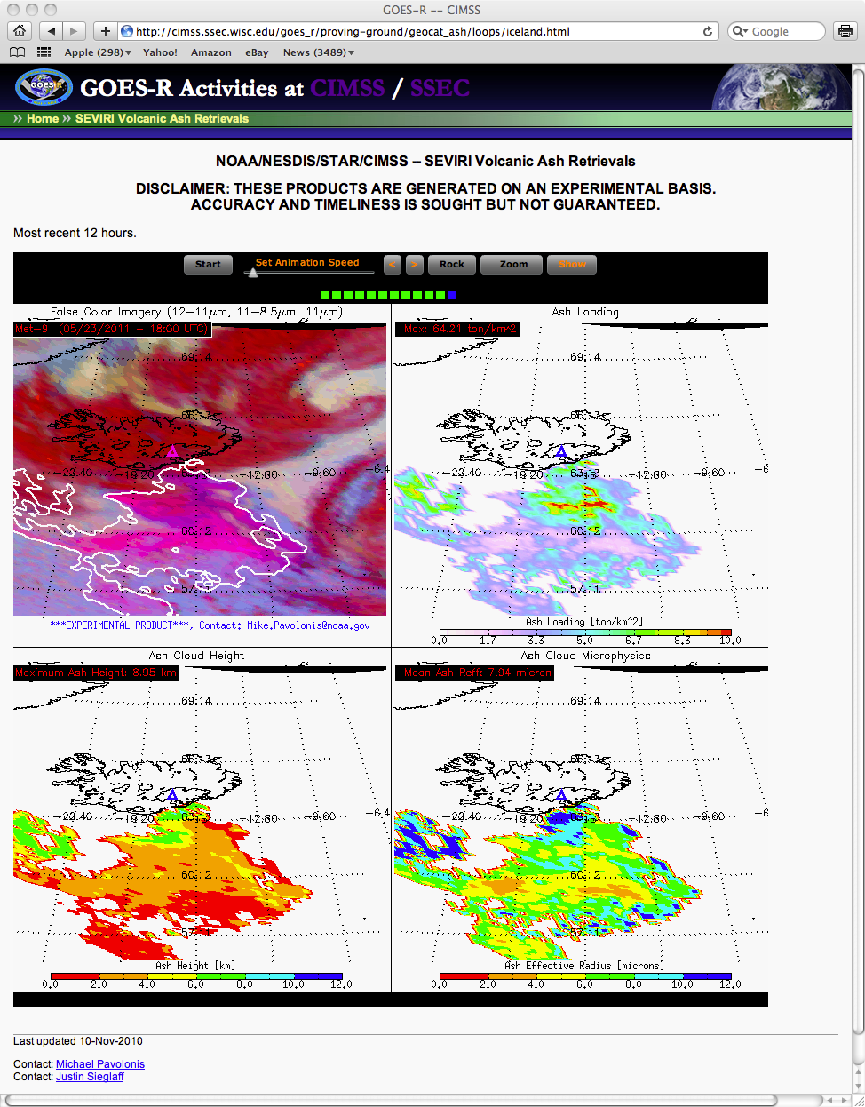
http://cimss.ssec.wisc.edu/goesr/proving-ground/geocat_ash
Cordon Caulle
Grimsvotn
Using contours to highlight quantitative product (over RGB)
Notes:
Using contours is one method to “combine” a quantitative product with an RGB.
-June 4
-May 21

Slide 8
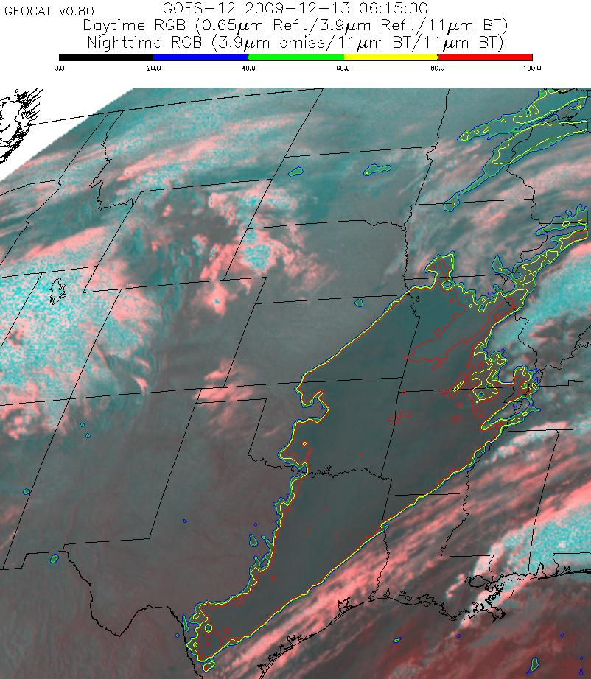
The quantitative assessment of cloud ceiling can be overlaid on top of imagery to make the product more appealing to forecasters.
The ability to contour the IFR and MVFR probabilities will soon be available in AWIPS.
Using contours to highlight quantitative product (over RGB)
Notes:
Using contours is one method to “combine” a quantitative product with an RGB. This case for cloud ceilings.

Slide 9
Outline
Concept
Combining qualitative and quantitative products
“Removing the tyranny of versus…”
Examples
Sounder
Imager
GOES-R ABI
Notes:
How do we “remove the tyranny of ‘versus’?”

Slide 10
GOES Sounder
Notes:
GOES Sounder: 18 IR bands and 1 visible.

Slide 11
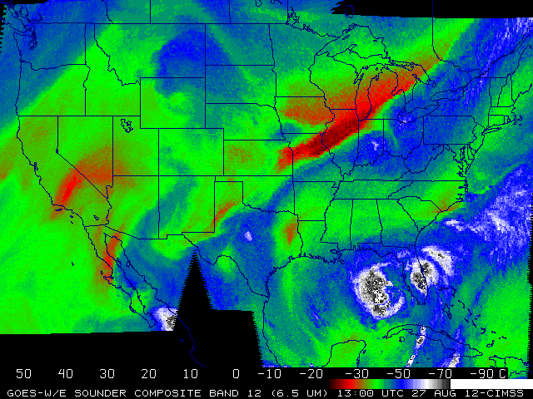
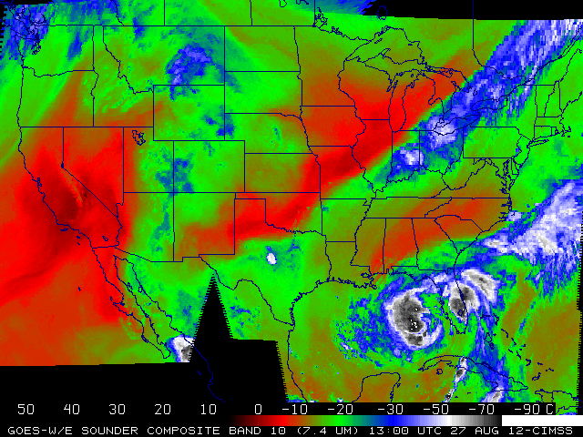
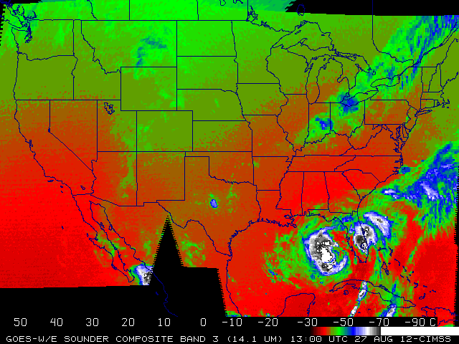
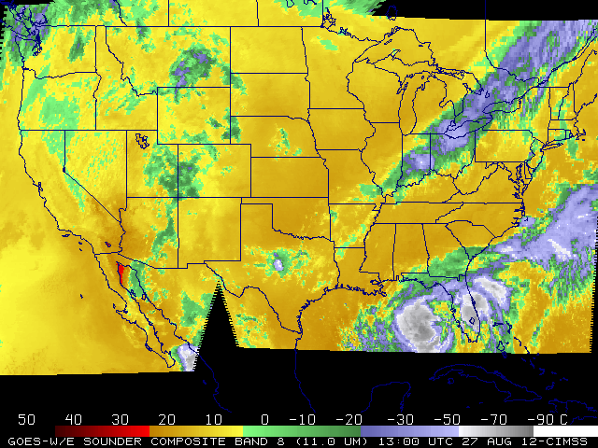
GOES Sounder: Bands at 6.5, 7.4, 14.1 and 11 micrometers
Notes:
Top two images are two ‘water vapor’ bands (centered at 6.5 and 7.4 um).

Slide 12
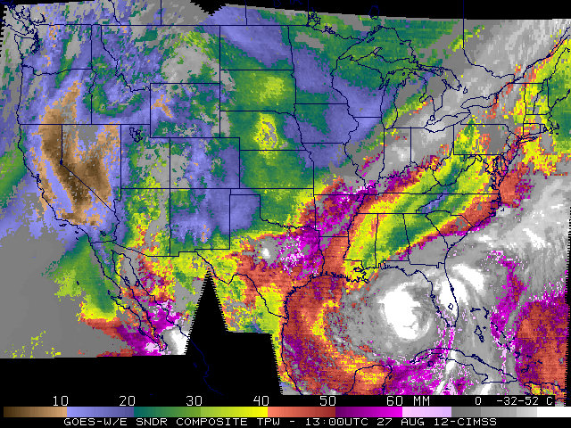
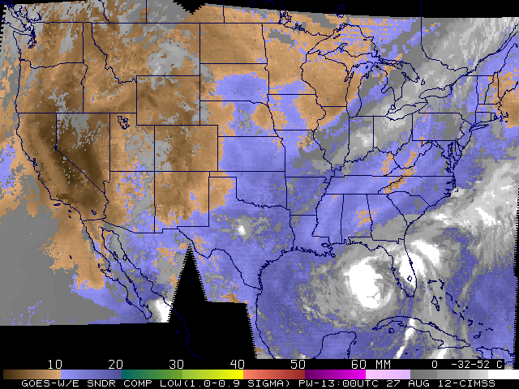
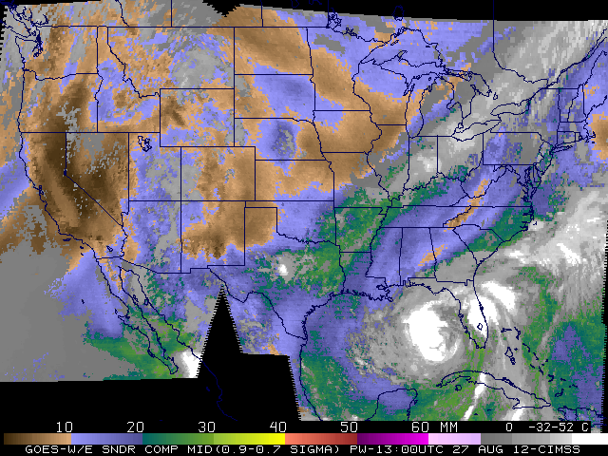
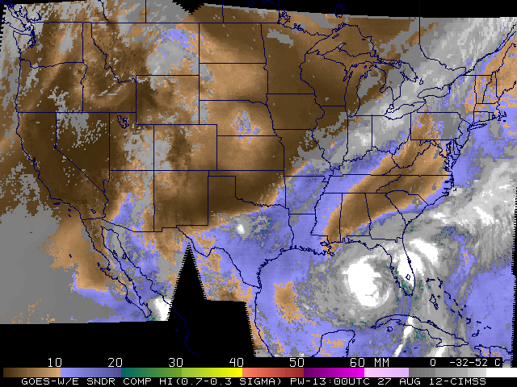
GOES Sounder Derived Products: Total PW, Low, Middle and High
Notes:
Quantitative PW built from retrievals: TPW and 3 layers (surface to 0.9 sigma, 0.9 to 0.7 sigma, 0.7 to 0.3 sigma). Shown in mcidas-x.
http://cimss.ssec.wisc.edu/goes/rt/viewdata.php?product=pwa_us3

Slide 13
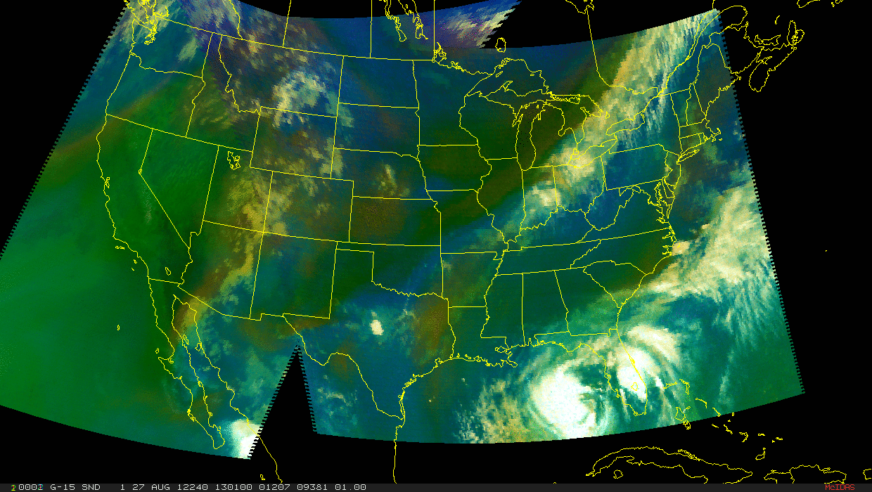
GOES Sounder “Airmass” RGB: Image from CIRA
Notes:
- How might the retrieved values be incorporated with imagery?
http://rammb.cira.colostate.edu/research/goes-r/proving_ground/cira_product_list/goes_sounder-based_rgb_air_mass_product.asp
http://rammb.cira.colostate.edu/ramsdis/online/images/latest/goes-r_proving_ground/sounder_airmass.gif
The RGB air mass product is generated from MSG channels 12 (WV6.51), 10 (WV7.43), 9 (IR9.71), and 8 (IR11.03). The raw imagery is ingested from CIRA’s local GOES servers and generated using Man computer Interactive Data Access System (MCIDAS) and the following recipe developed by European Organization for the Exploitation of Meteorological Satellites (EUMETSAT).
Beam Channel Range Gamma Red WV6.2 - WV7.3 -25 ... 0 K 1 Green IR9.7 - IR10.8 -40 ... +5K 1 Blue WV6.2 +243 ... +208 K 1

Slide 14
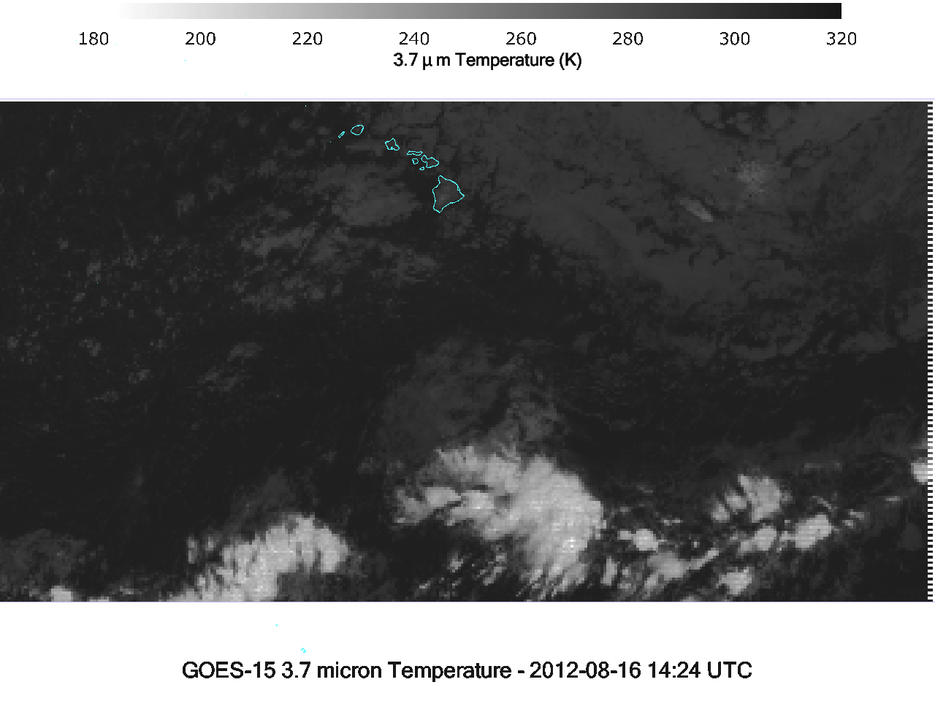
Notes:
GOES Sounder (over Pacific)

Slide 15
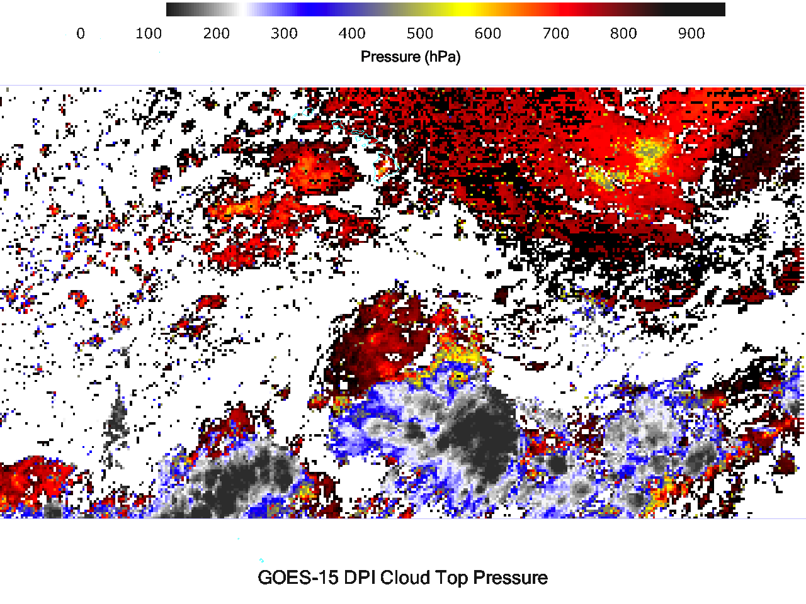
Notes:
Derived Cloud top pressure from many of the sounder IR bands.

Slide 16
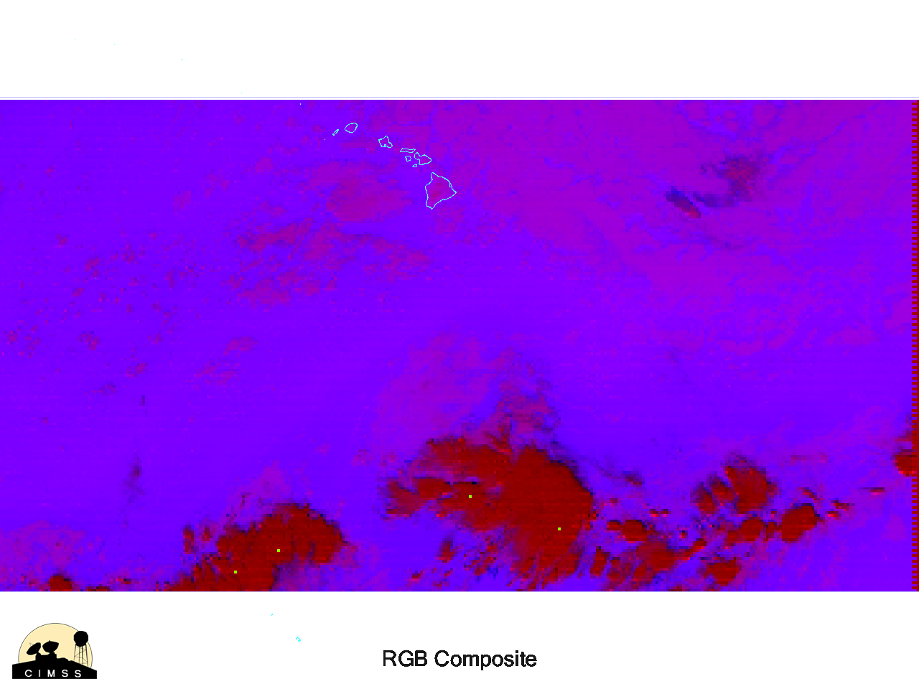
Notes:
RGB

Slide 17
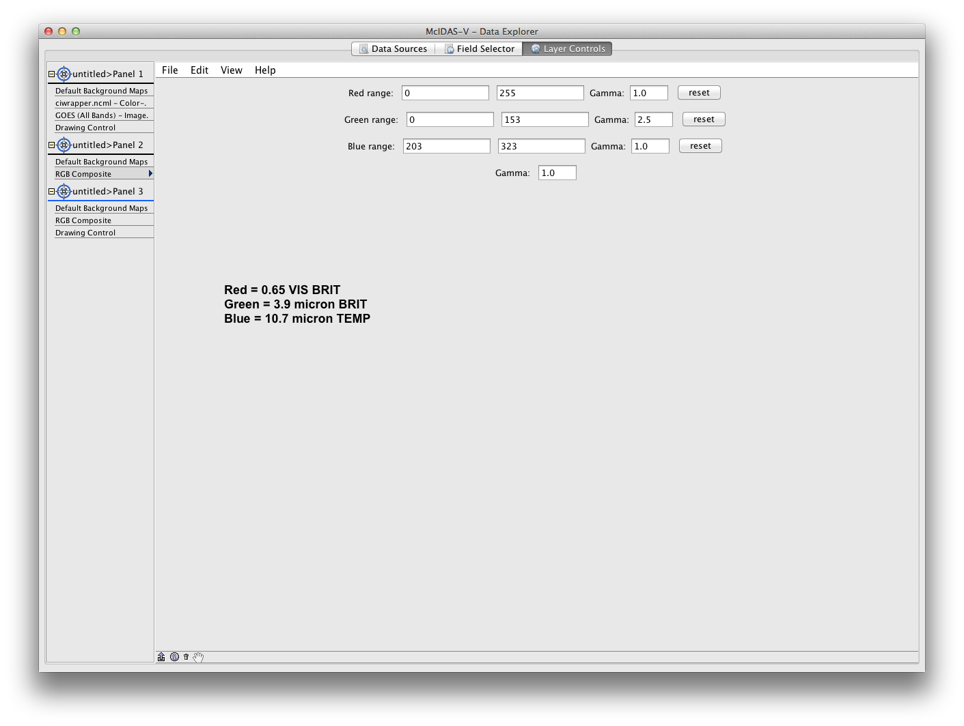
McIDAS-V
Notes:
Images made in mcidas-v by Joleen Feltz, CIMSS.

Slide 18
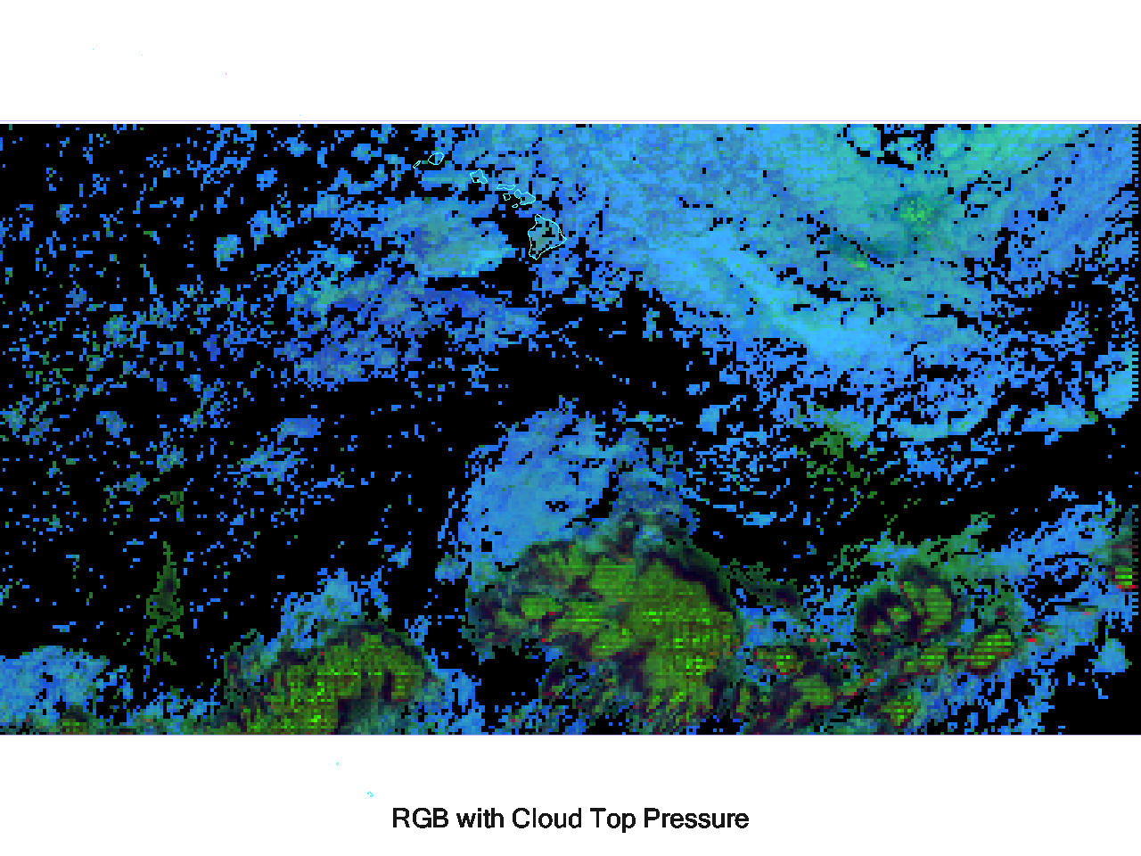
Notes:
Combined RGB with CTP. Shown in mcidas-v.

Slide 19
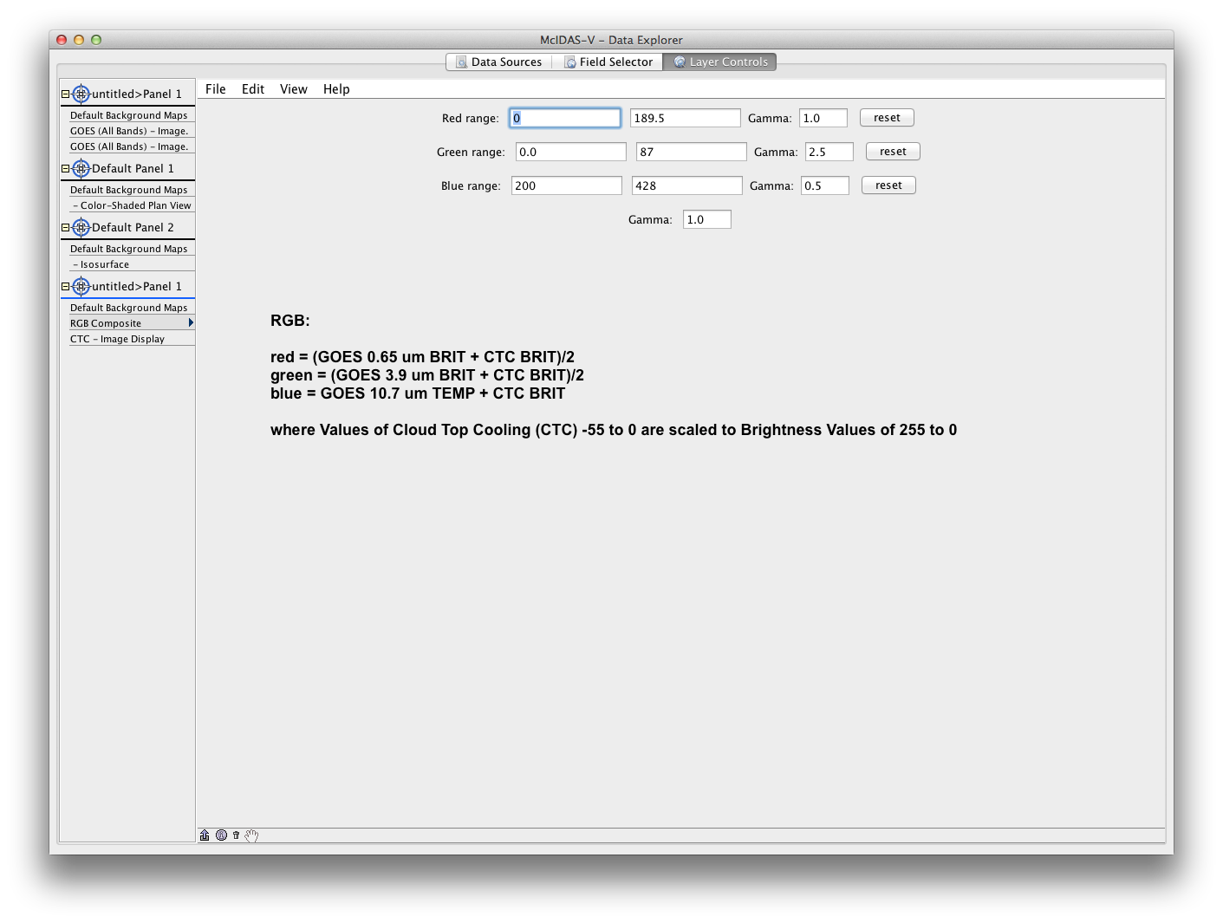
McIDAS-V
Notes:
Images made in mcidas-v by Joleen Feltz, CIMSS.

Slide 20
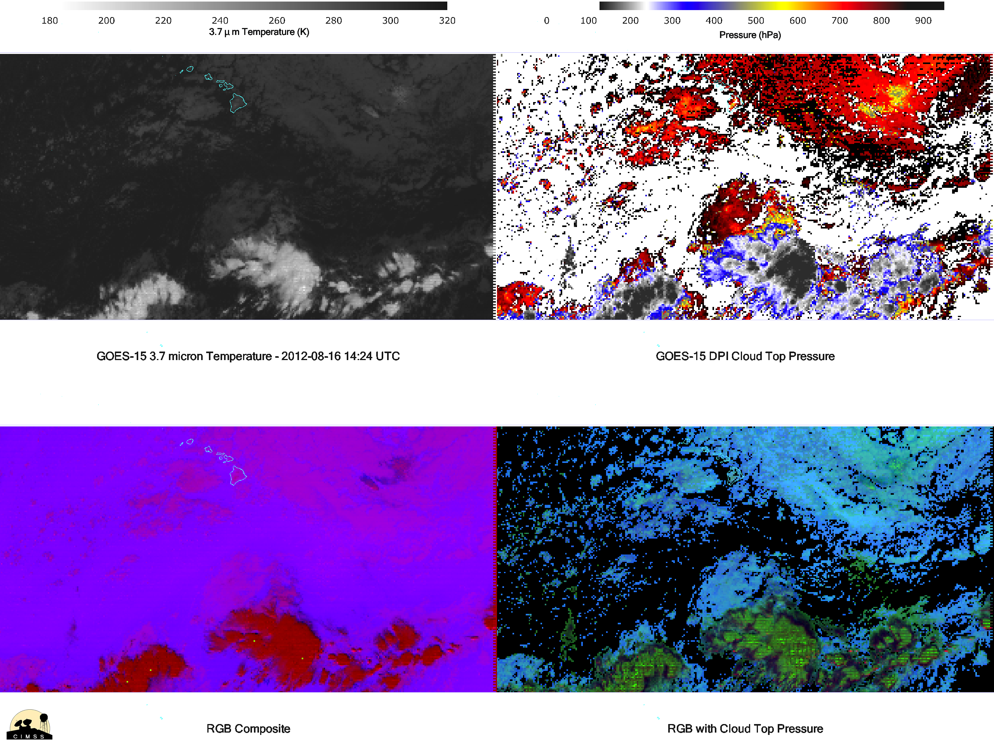
Notes:
This is to show the concept of combining imagery with products.

Slide 21
Outline
Concept
Combining qualitative and quantitative products
“Removing the tyranny of versus…”
Examples
Sounder
Imager
GOES-R ABI
Notes:
How do we “remove the tyranny of ‘versus’?”

Slide 22
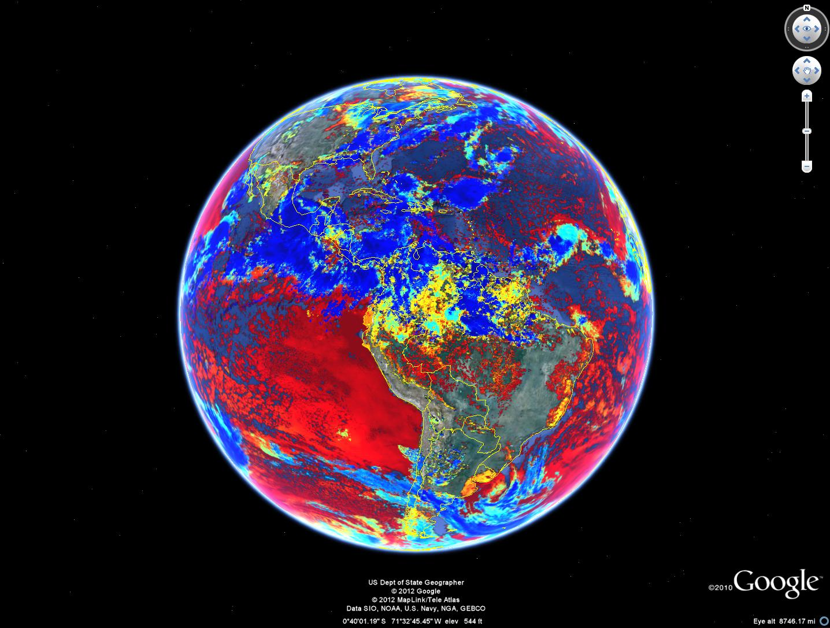
Cloud-top temperature
Data from Andy Heidinger
Notes:
Another example, now from the GOES imager. Cloud Top Pressure.

Slide 23
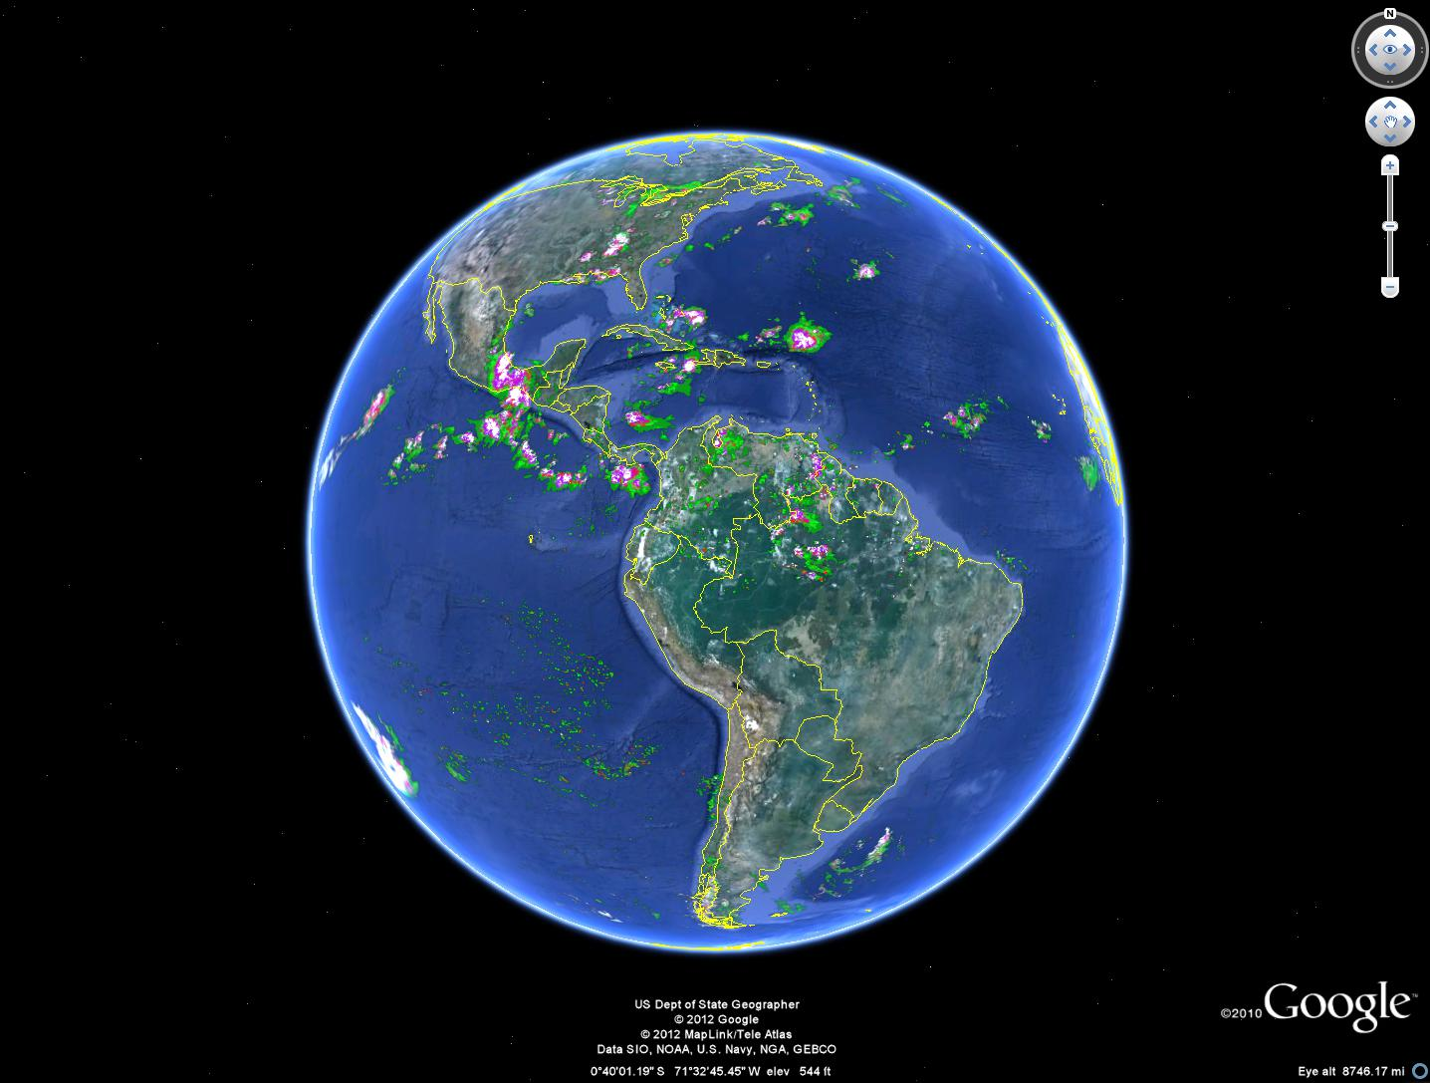
Rain Rate
Data from Andy Heidinger
Notes:
Rain Rate.

Slide 24
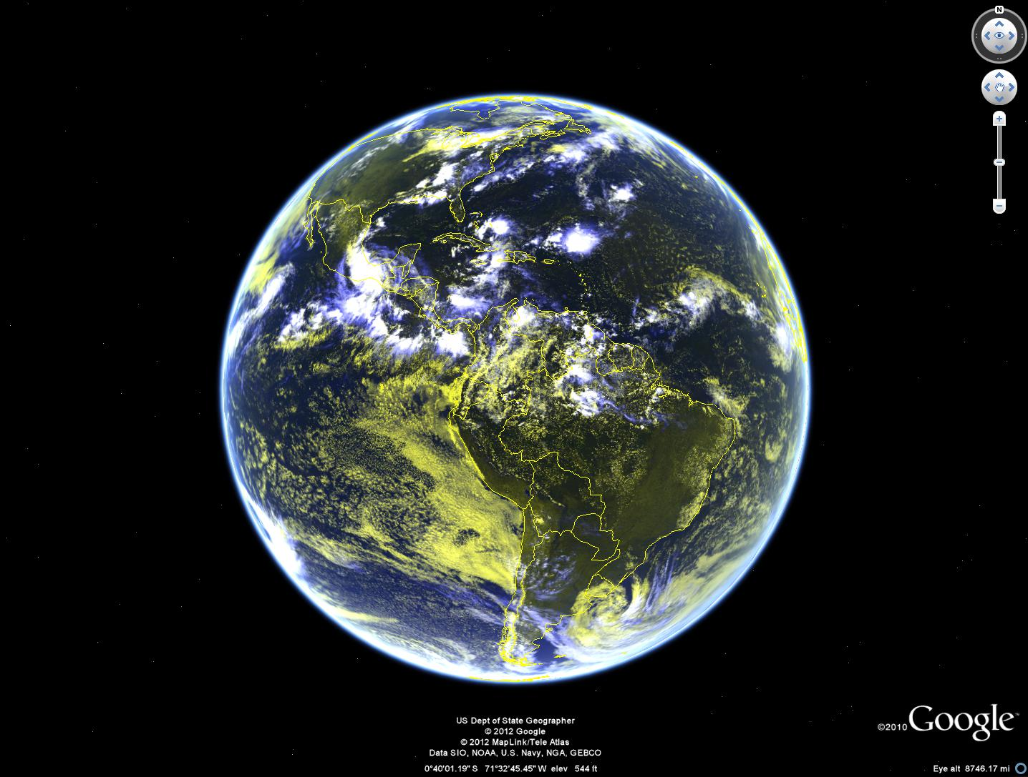
False color
Data from Andy Heidinger
Notes:
False color with vis and IR.

Slide 25
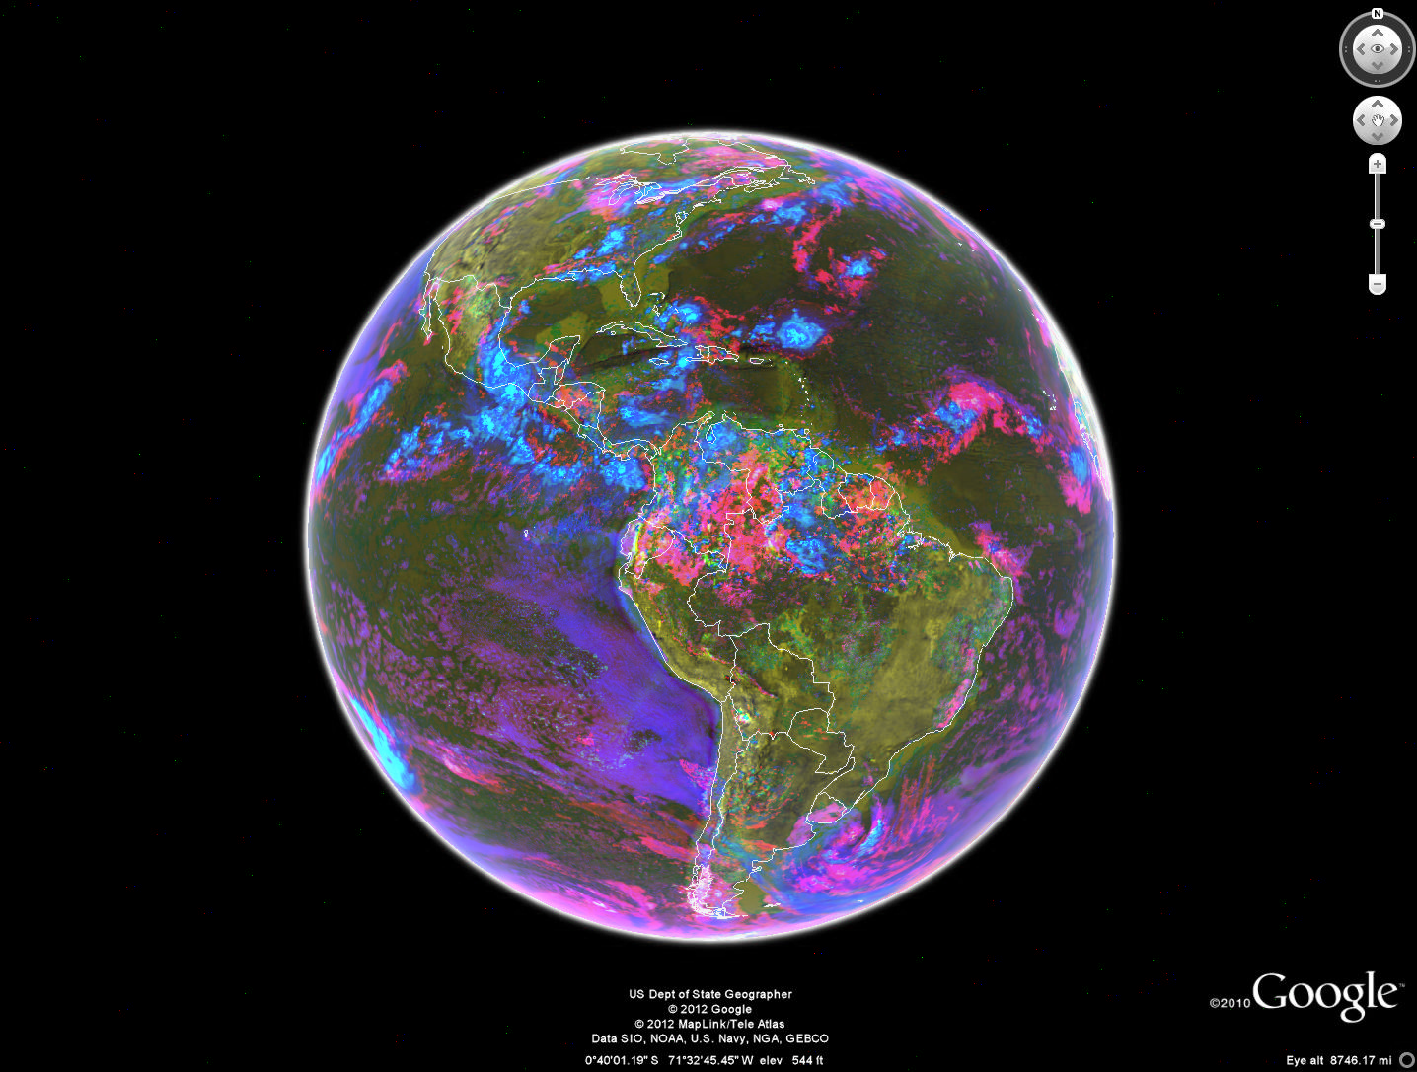
Cloud top temperature + Rain Rate + False color
This is only meant to show the concept of merging imagery and products.
Notes:
Used paint shop pro with equal weightings for this image.

Slide 26
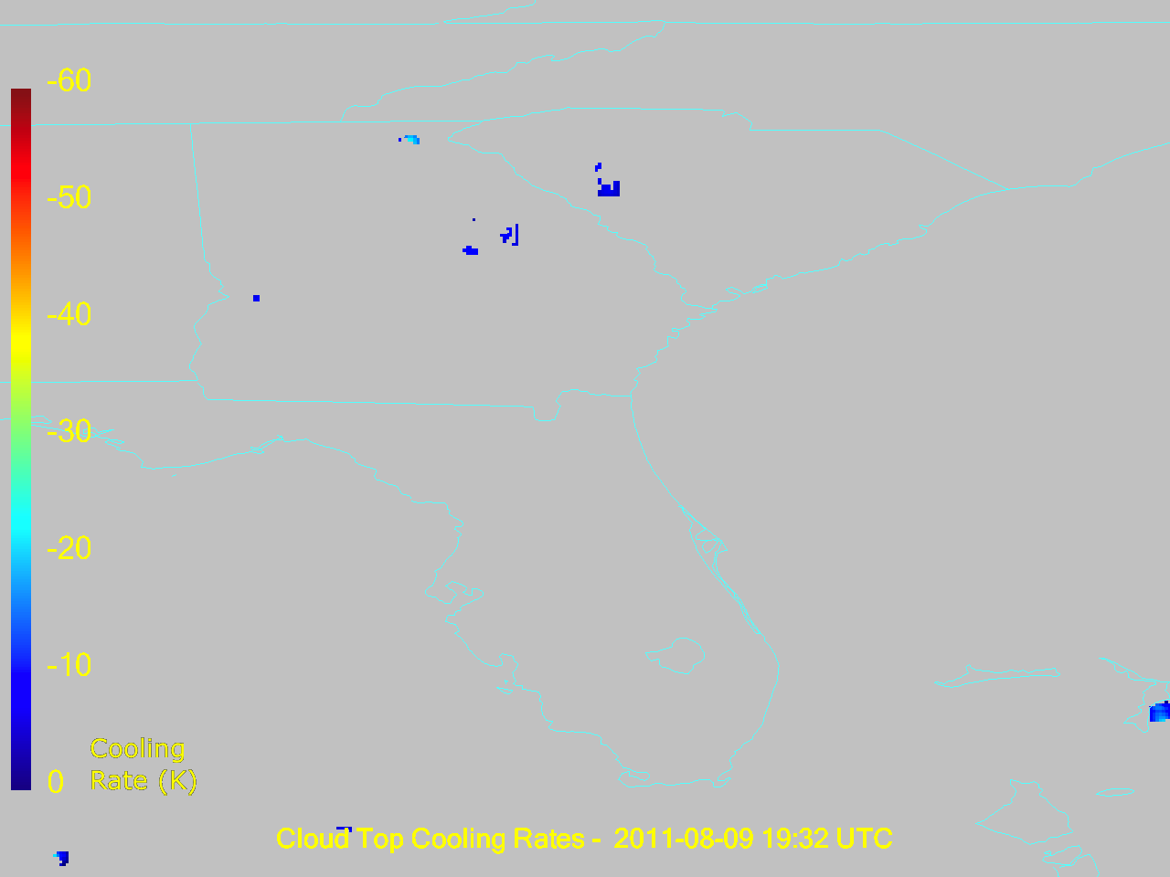
Notes:
Images made in mcidas-v by Joleen Feltz, CIMSS.
No ‘context'

Slide 27
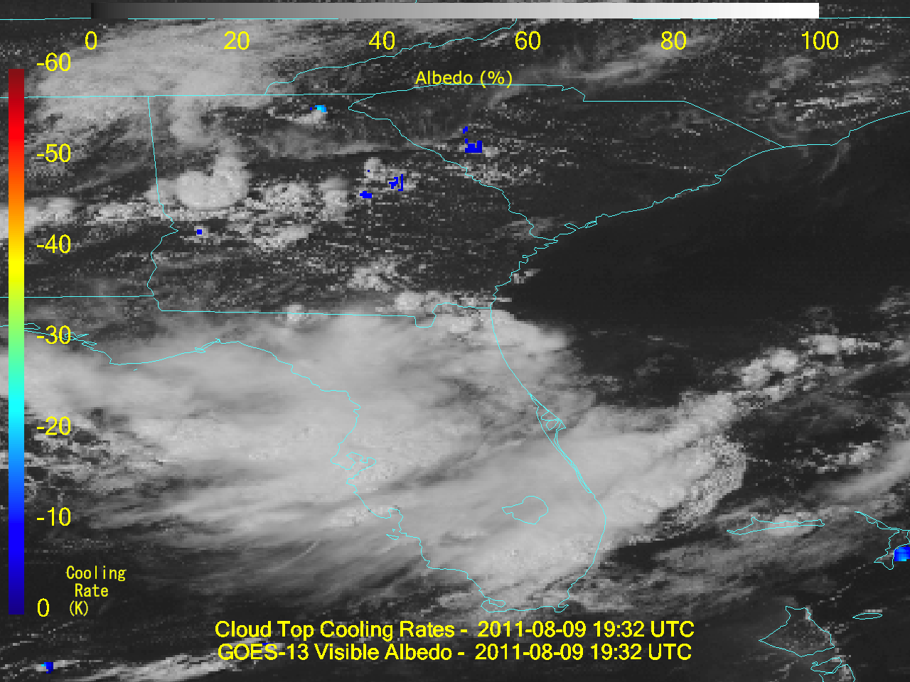
Notes:
Plotting over clouds adds some ‘context’.

Slide 28
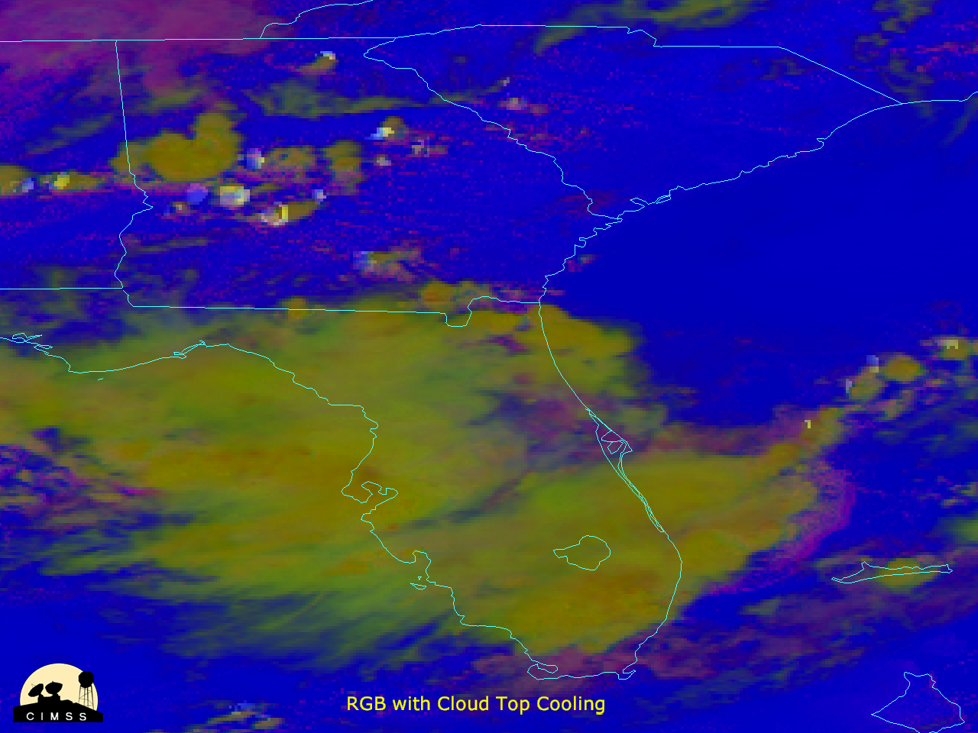
Notes:
RGB

Slide 29
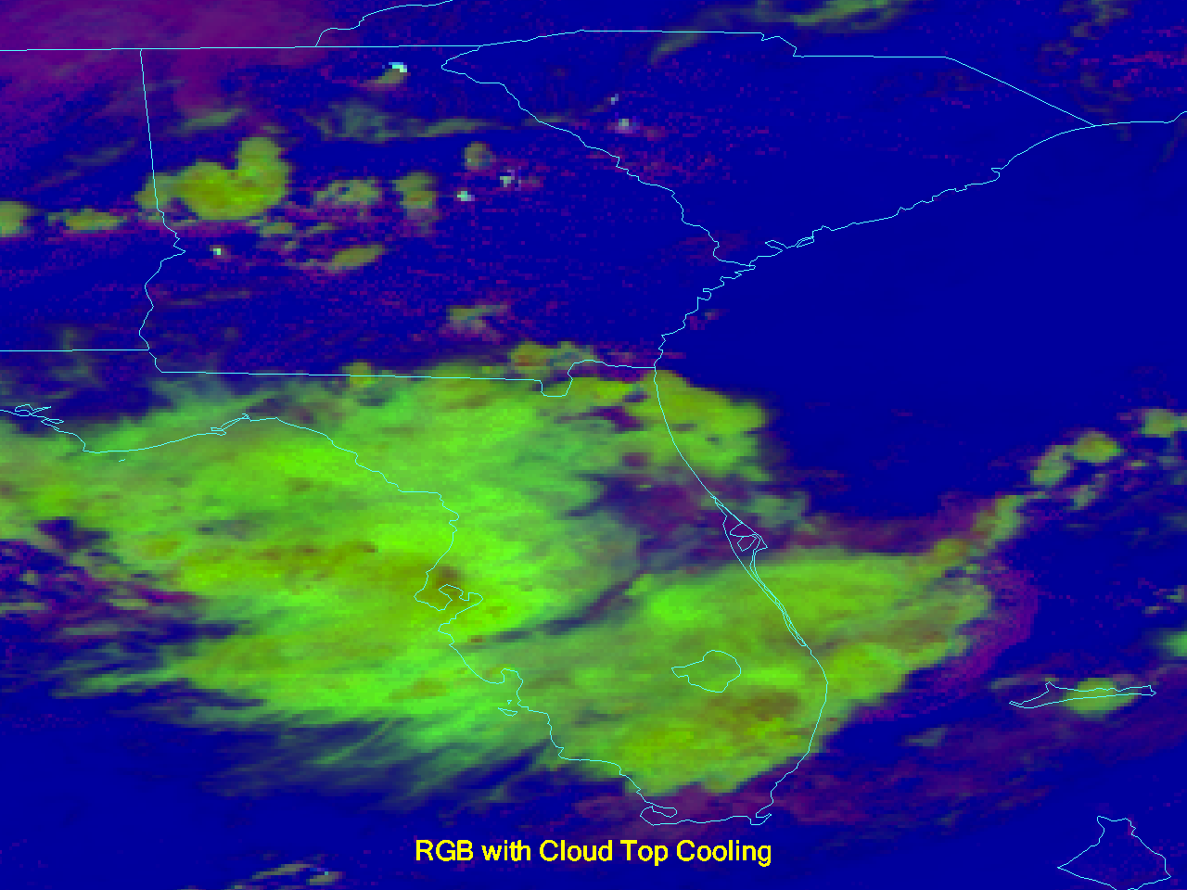
Notes:
RGB + CTC.

Slide 30
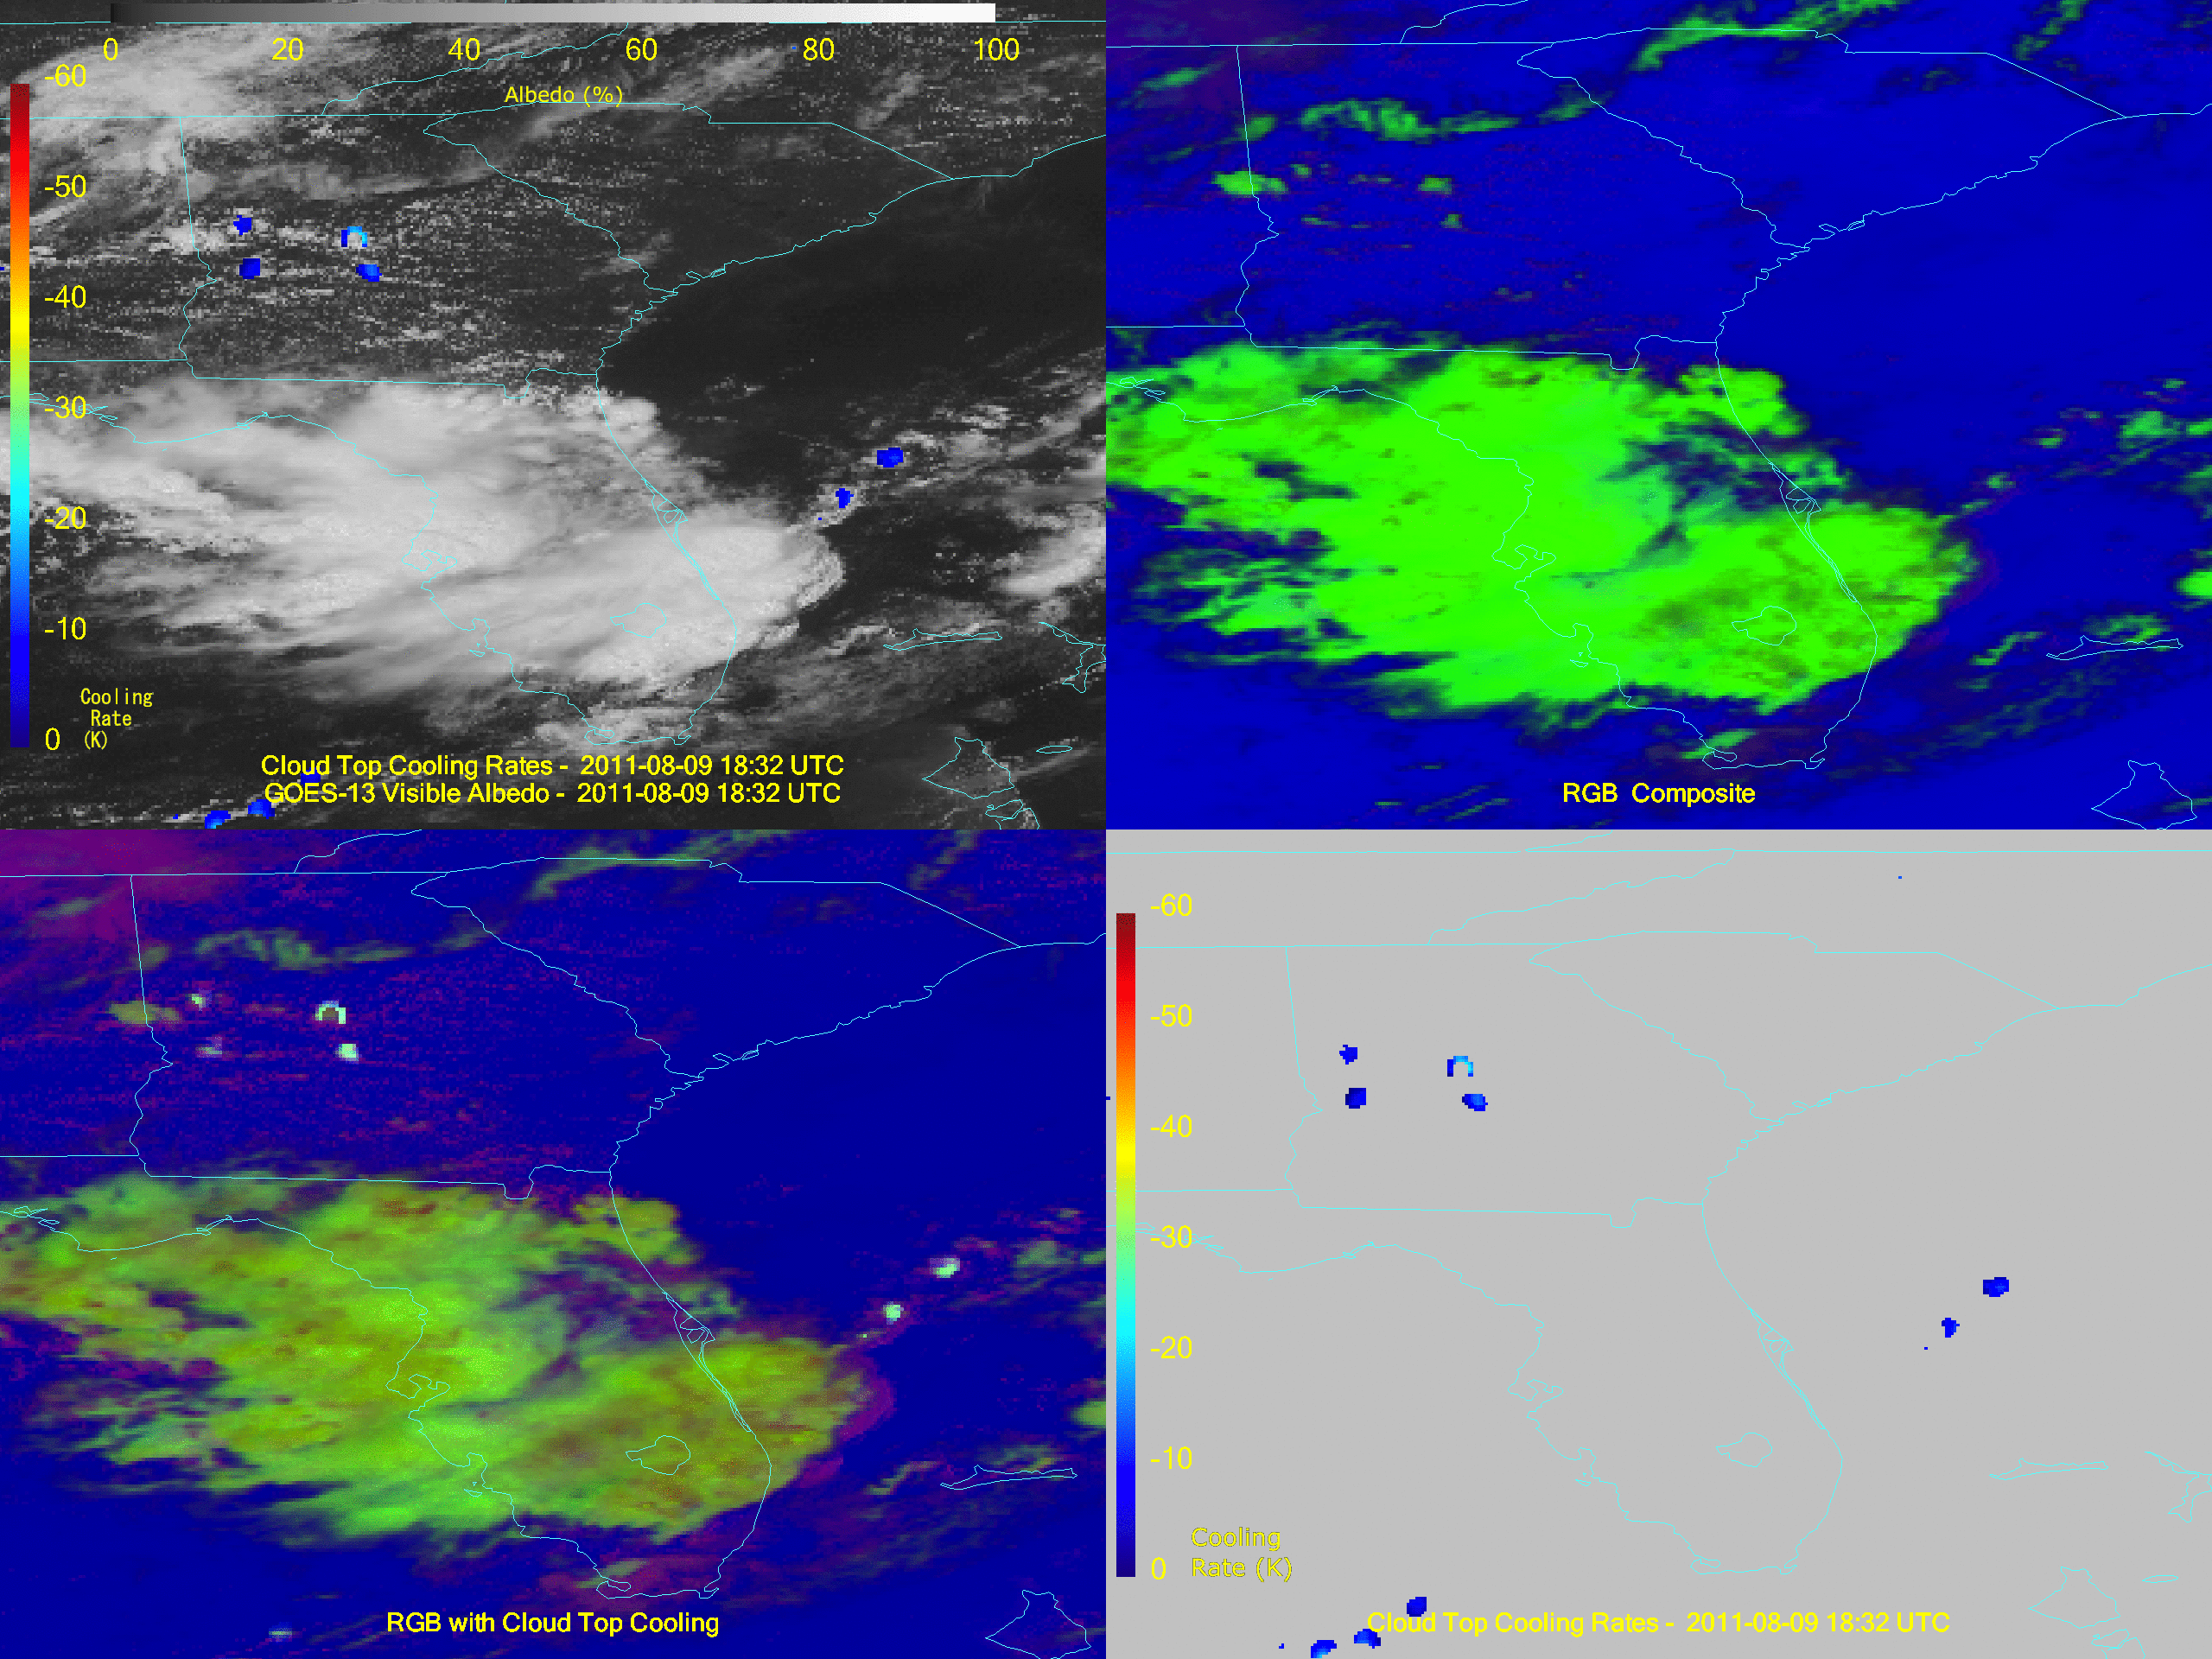
Animation
Notes:
Animated gif.

Slide 31
Outline
Concept
Combining qualitative and quantitative products
“Removing the tyranny of versus…”
Examples
Sounder
Imager
GOES-R ABI
Notes:
Now on to the ABI. More info at:
http://www.goes-r.gov/
Or
http://cimss.ssec.wisc.edu/goes/abi/

Slide 32
The Advanced Baseline Imager:
ABI Current
Spectral Coverage
16 bands 5 bands
Spatial resolution
0.64 μm Visible 0.5 km Approx. 1 km
Other Visible/near-IR 1.0 km n/a
Bands (>2 μm) 2 km Approx. 4 km
Spatial coverage
Full disk 4 per hour Scheduled (3 hrly)
CONUS 12 per hour ~4 per hour
Mesoscale Every 30 sec n/a
Visible (reflective bands)
On-orbit calibration Yes No

Slide 33
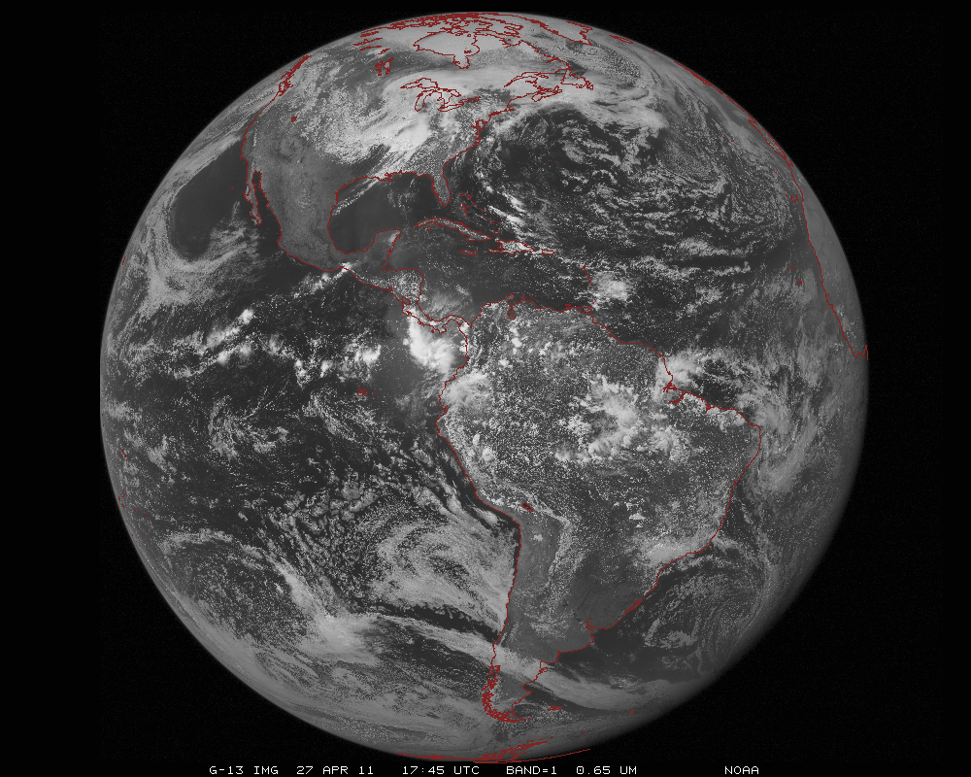
ABI scans about 5 times faster
than the current GOES imager
Anticipated scan mode for the ABI:
- Full disk images every 15 minutes + 5 min CONUS images + mesoscale.

Slide 34
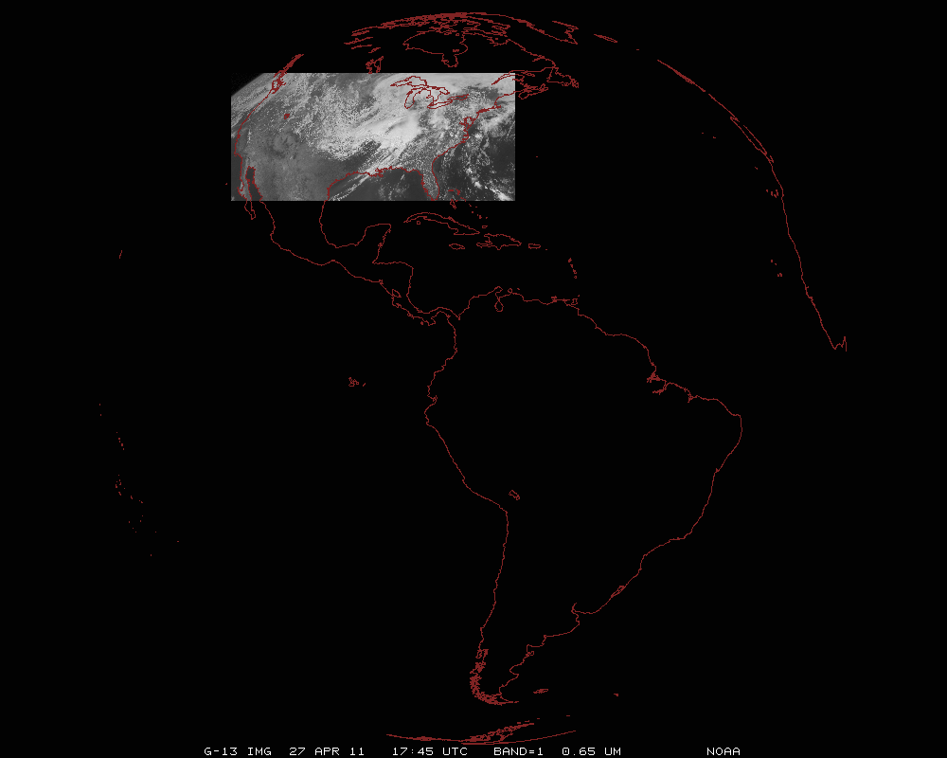
ABI can offer Continental US images every 5 minutes for routine monitoring of a wide range of events (storms, dust, clouds, fires, winds, etc).
This is every 15 or 30 minutes with the current GOES in routine mode.
Notes:
Approx. size of CONUS

Slide 35
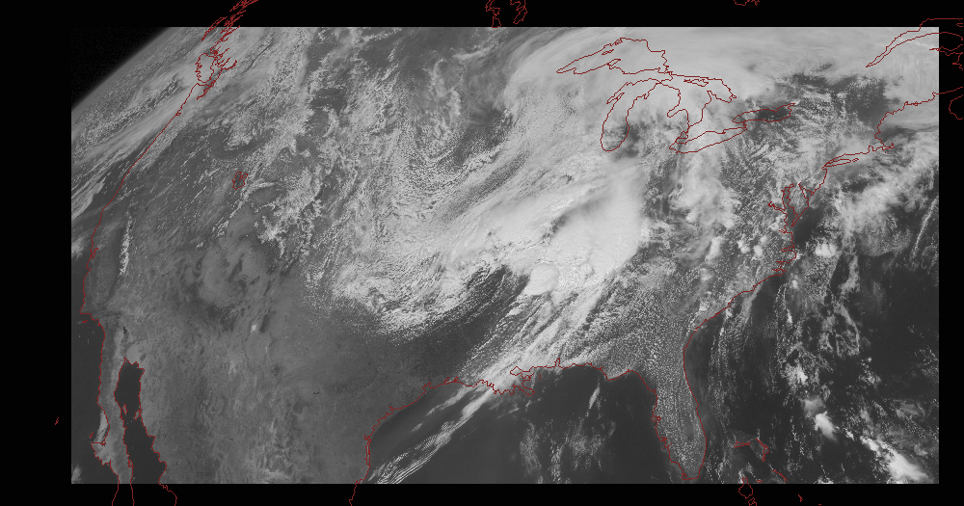
Notes:
Approx. size of CONUS

Slide 36
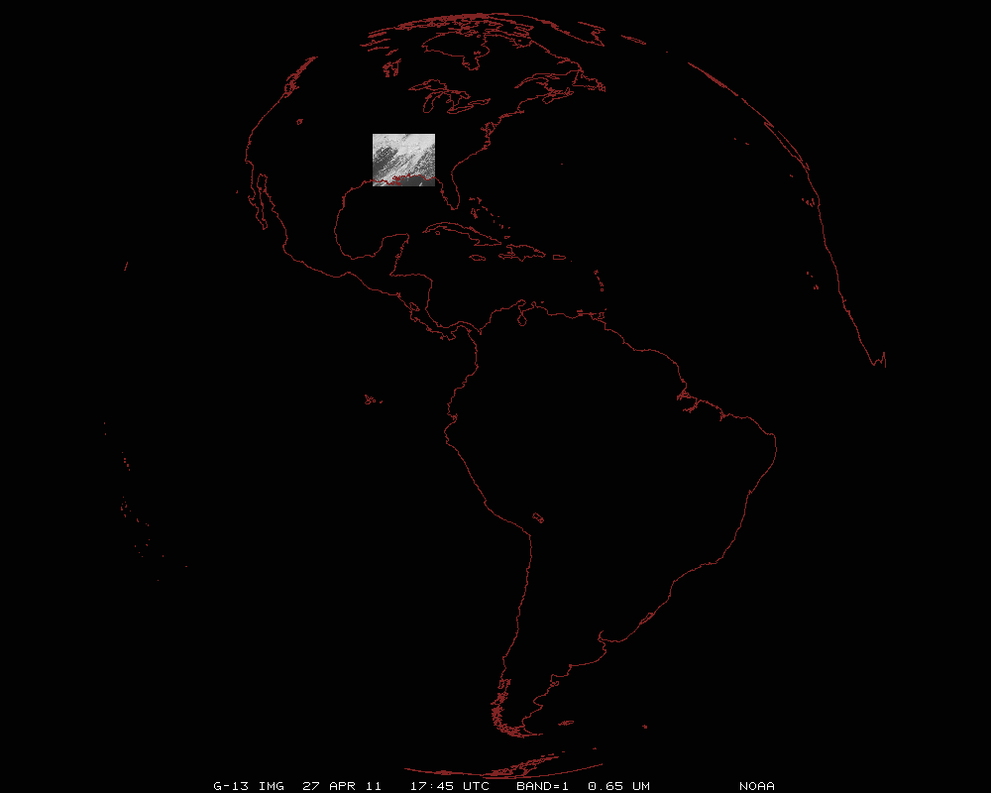
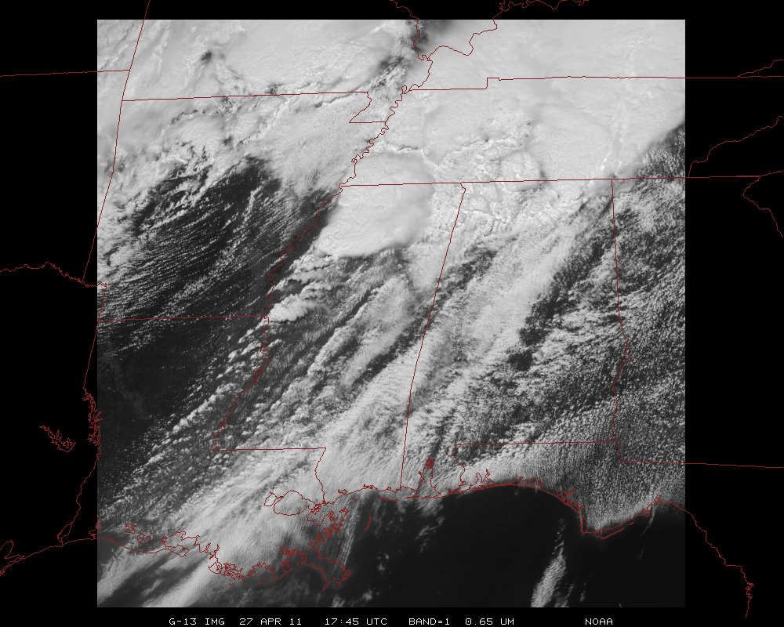
Mesoscale images every 30 seconds for rapidly changing phenomena
(thunderstorms, hurricanes, fires, etc). Or two regions every 60 seconds.
Notes:
Approx. size of meso-scale showing “Franklin”.

Slide 37
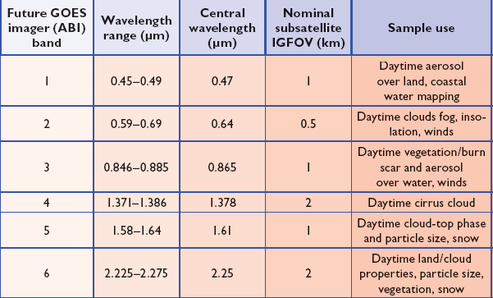
ABI Visible/Near-IR Bands
No ‘green’ band due to ‘lack of user requirement’.
Schmit et al, 2005
Notes:
Schmit, T. J., M. M. Gunshor, W. P. Menzel, J. J. Gurka, J. Li, and A. S. Bachmeier, 2005: Introducing the next-generation Advanced Baseline Imager on GOES-R. Bull. Amer. Meteor. Soc., 86, 1079-1096.

Slide 38
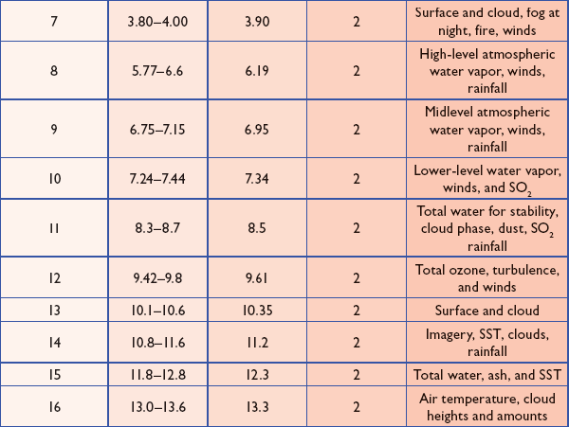
ABI IR Bands
Schmit et al, 2005
Notes:
Schmit, T. J., M. M. Gunshor, W. P. Menzel, J. J. Gurka, J. Li, and A. S. Bachmeier, 2005: Introducing the next-generation Advanced Baseline Imager on GOES-R. Bull. Amer. Meteor. Soc., 86, 1079-1096.

Slide 39
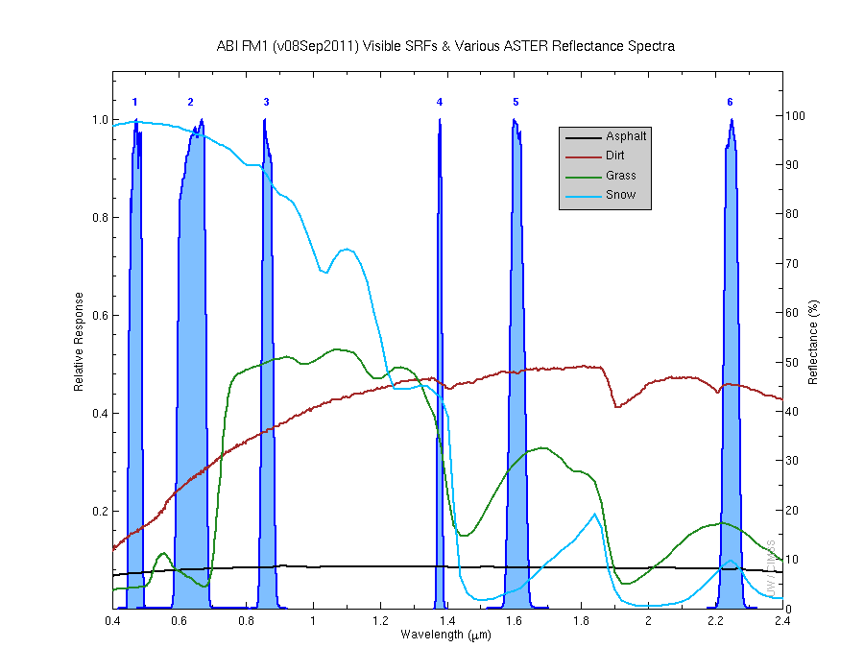
Visible and near-IR channels on the ABI
Aerosols, Insolation
Clouds, Snow
Vegetation, Imagery
Cloud mask, Suspended matter
Snow, Phase
Cloud Particle size
Sample use only, many other uses
The ABI visible and near-IR bands have many uses.
Notes:
Schmit, T. J., M. M. Gunshor, W. P. Menzel, J. J. Gurka, J. Li, and A. S. Bachmeier, 2005: Introducing the next-generation Advanced Baseline Imager on GOES-R. Bull. Amer. Meteor. Soc., 86, 1079-1096.

Slide 40
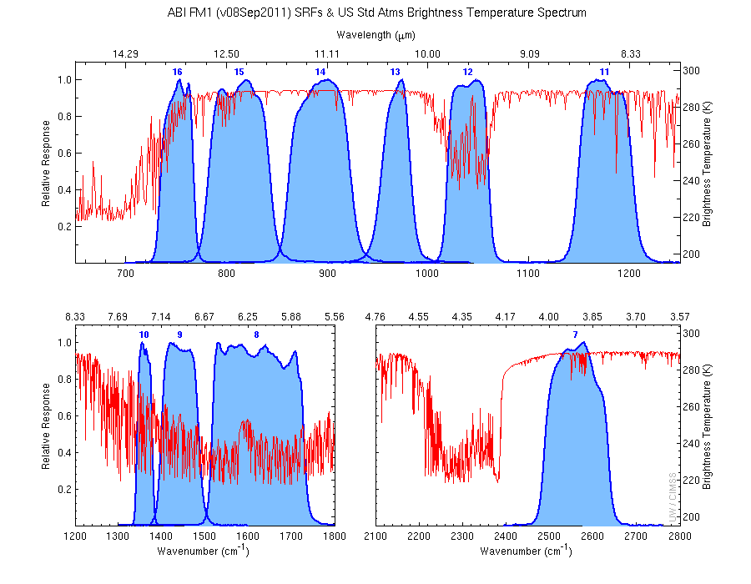
The IR channels on the ABI
Clouds, Stability Indices
SST, Fires, Radiances
Ozone, Downward Radiation
Rainfall, Aerosol
Hurricane, Imagery
Cloud Phase, SST
Sample use only, many other uses
SO2, Radiances
Winds, WV profiling
TPW, Rainfall rate
Fires, Fog
ABI has many more bands than the current operational GOES imagers.
Notes:
Schmit, T. J., M. M. Gunshor, W. P. Menzel, J. J. Gurka, J. Li, and A. S. Bachmeier, 2005: Introducing the next-generation Advanced Baseline Imager on GOES-R. Bull. Amer. Meteor. Soc., 86, 1079-1096.

Slide 41
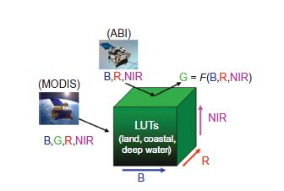
Miller et al.
Miller, Steven D.; Schmidt, Christopher C.; Schmit, Timothy J. and Hillger, Donald W. A case for natural colour imagery from geostationary satellites, and an approximation for the GOES-R ABI. International Journal of Remote Sensing, Volume 33, Issue 13, 2012, pp.3999-4028.

Slide 42
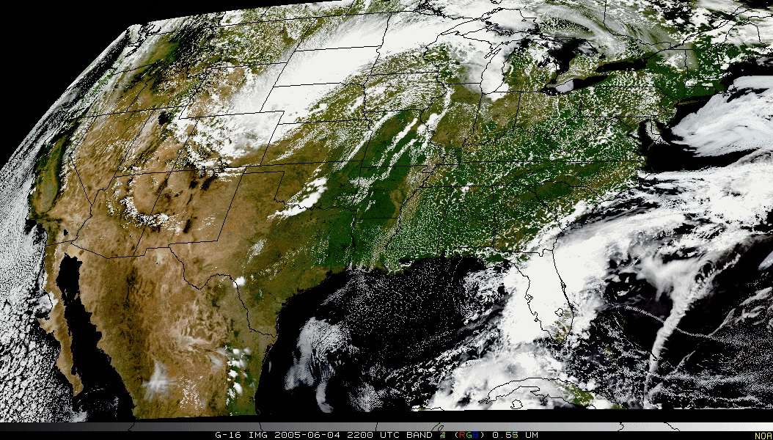
Pseudo-Natural Color

Slide 43
GOES-R ABI Products
Baseline Products
Future Capabilities
Advanced Baseline Imager (ABI)
Aerosol Detection (Including Smoke and Dust) Aerosol Optical Depth (AOD) Clear Sky Masks Cloud and Moisture Imagery Cloud Optical Depth Cloud Particle Size Distribution Cloud Top Height Cloud Top Phase Cloud Top Pressure Cloud Top Temperature Derived Motion Winds Derived Stability Indices Downward Shortwave Radiation: Surface Fire/Hot Spot Characterization Hurricane Intensity Estimation Land Surface Temperature (Skin) Legacy Vertical Moisture Profile Legacy Vertical Temperature Profile Radiances Rainfall Rate/QPE Reflected Shortwave Radiation: TOA Sea Surface Temperature (Skin) Snow Cover Total Precipitable Water Volcanic Ash: Detection and Height
Advanced Baseline Imager (ABI)
Absorbed Shortwave Radiation: Surface Aerosol Particle Size Aircraft Icing Threat Cloud Ice Water Path Cloud Layers/Heights Cloud Liquid Water Cloud Type Convective Initiation Currents Currents: Offshore Downward Longwave Radiation: Surface Enhanced “V”/Overshooting Top Detection Flood/Standing Water Ice Cover Low Cloud and Fog Ozone Total Probability of Rainfall Rainfall Potential Sea and Lake Ice: Age Sea and Lake Ice: Concentration Sea and Lake Ice: Motion Snow Depth (Over Plains) SO₂ Detection Surface Albedo Surface Emissivity Tropopause Folding Turbulence Prediction Upward Longwave Radiation: Surface Upward Longwave Radiation: TOA Vegetation Fraction: Green Vegetation Index Visibility

Slide 44
SRSOR
Super Rapid Scan Operations for GOES-R
GOES-14 Special 1-min imagery
Almost 900 images per day!
Select days between mid-August and end of October.
Java-script images at
http://www.ssec.wisc.edu/data/1min
http://cimss.ssec.wisc.edu/goes/srsor/GOES-14_SRSOR_test.html

Slide 45
Click to animate

Slide 46
Summary
Consider ways to ‘bring together’ qualitative imagery and quantitative products
This may mean to produce more quantitative products at full spatial resolutions
GOES-R will offer many options, given the number of spectral bands and derived products.
Ideally, our display systems could easily show or combine images and products (via contours, over-lays and RGB combinations)!

Slide 47
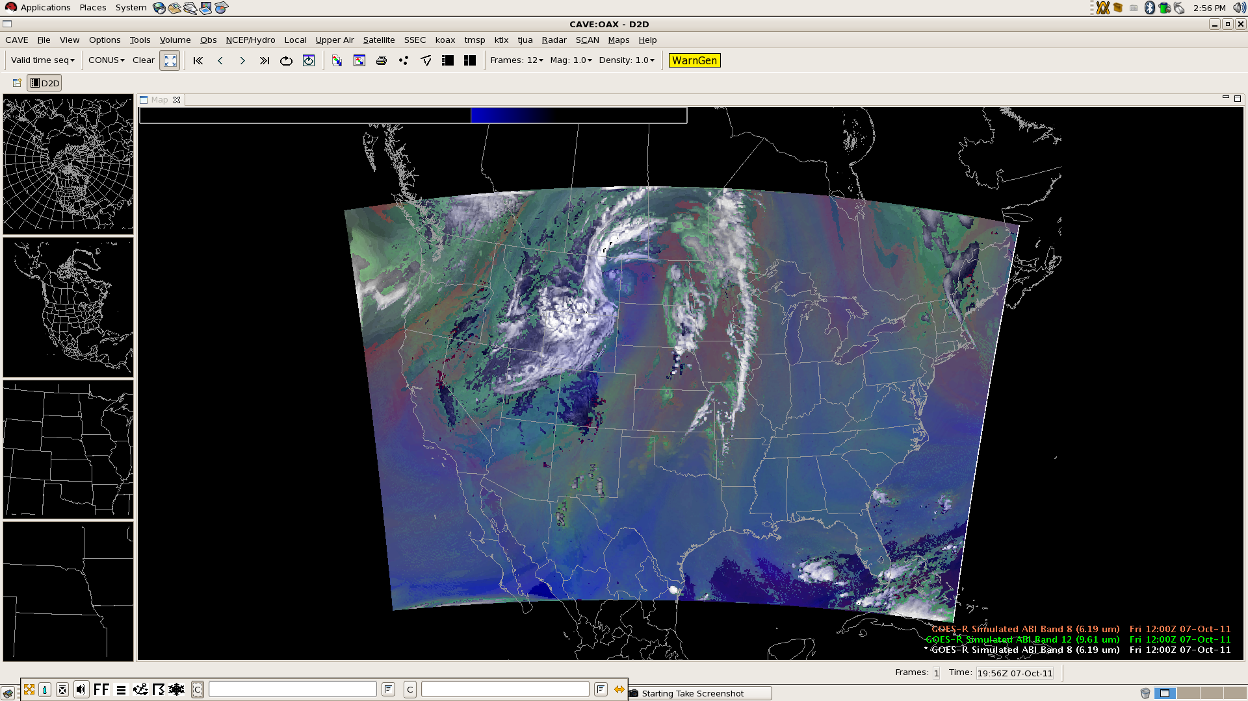
Building an RGB: Composite
Sample data combined in AWIPS-II.
Composite clearly indicates trough over western United States, dry slot, and differential tropospheric moisture
Notes:
From Jordan Gerth. Sample in AWIPS-II.
http://www.goes-r.gov/downloads/GUC-7/day1/session01/05-Gerth-AWIPSII.pptx

Slide 48
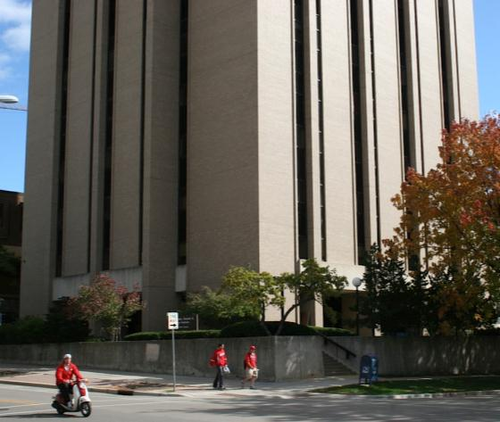
From ‘grayscale’ to full color!

