Slide 1



Preparing for GOES-R Aerosol Optical Depth
Using Proxy Data
R. Bradley Pierce
NOAA/NESDIS/STAR
Shobha Kondragunta
NOAA/NESDIS/STAR
Hai Zhang and Mi Zhou
IMSG
NOAA Satellite Aerosol Product Workshop for Science and Operational Users, September 13-14, 2016
National Center for Weather and Climate Prediction (NCWCP), College Park, MD 20740

Slide 2
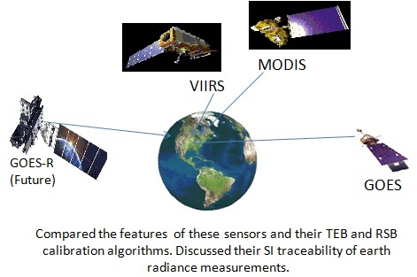
The GOES-R Advanced Baseline Imager
Nov 04, 2016 Launch
GOES-R ABI will have five channels between 0.47 and 2.25 μm with on-orbit calibration that can be used to retrieve aerosol properties over land and ocean.
The ABI aerosol algorithm is based on heritage MODIS and VIIRS algorithms.
The ABI AOD retrieval is at 2-km spatial resolution and 5- and 15- minute temporal resolution during daytime (VIIRS EDR AOD retrieval is once per day at 6km, MODIS C6 AOD retrieval is once per day at 3km)
http://www.star.nesdis.noaa.gov/goesr/docs/ATBD/AOD.pdf

Slide 3
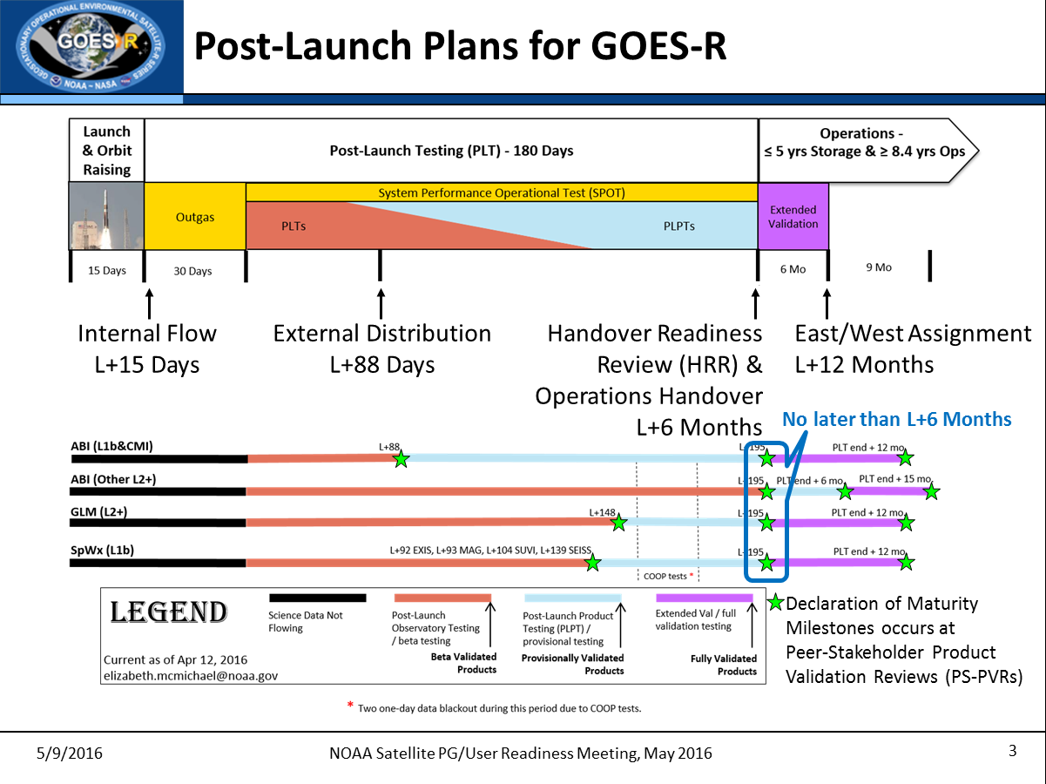
From Matt Seybold (GOES-R Data Operations Manager, OSPO/SPSD)

Slide 4
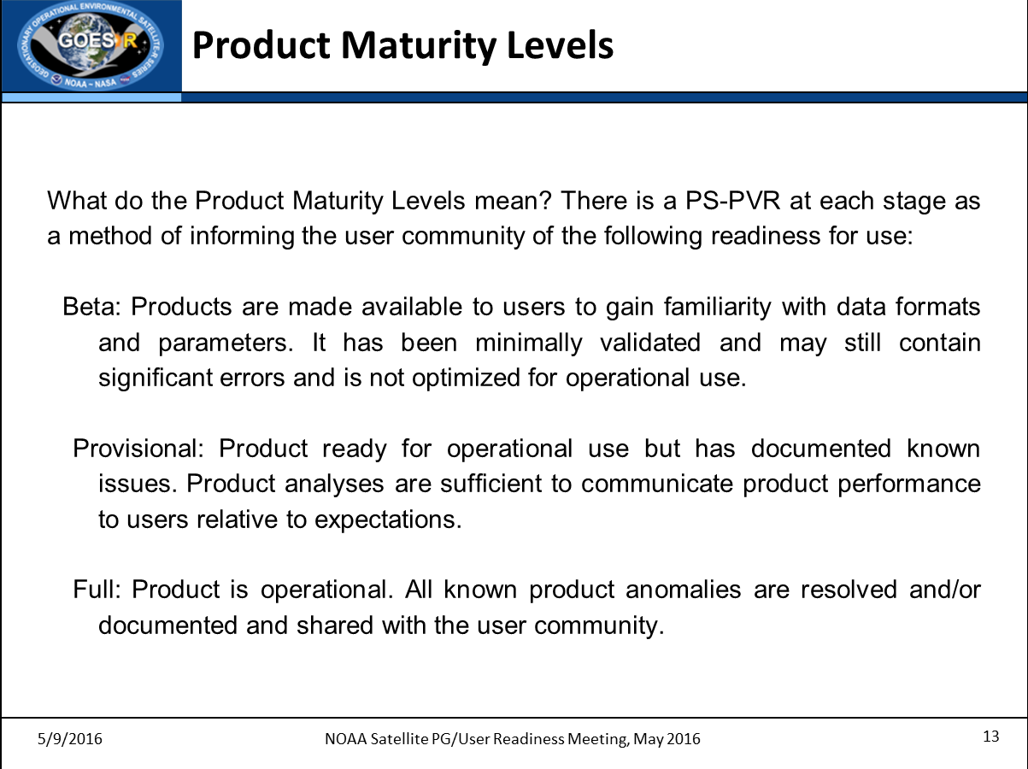
From Matt Seybold (GOES-R Data Operations Manager, OSPO/SPSD)

Slide 5
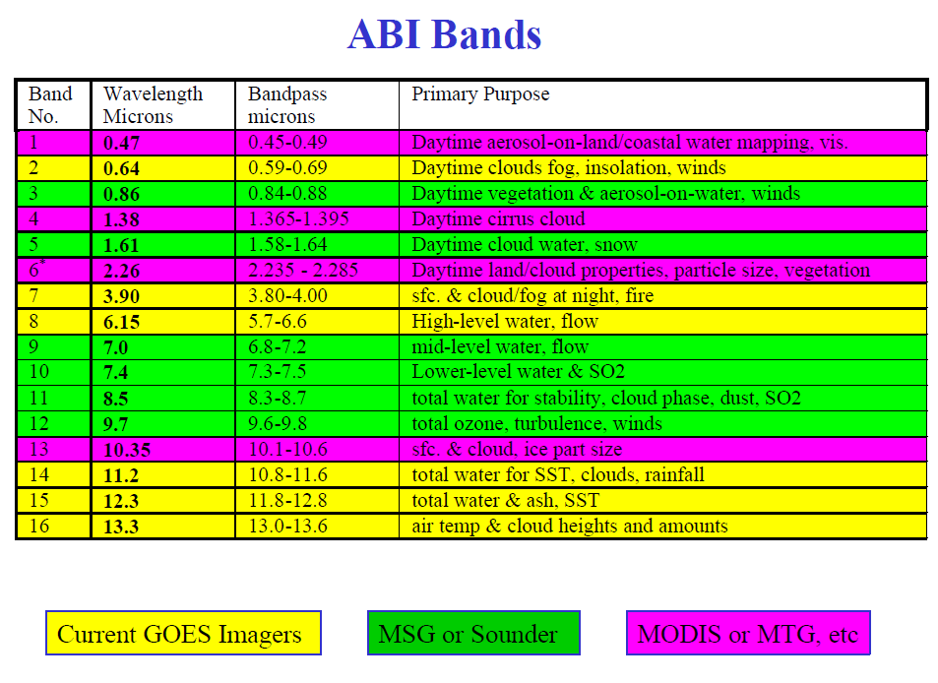
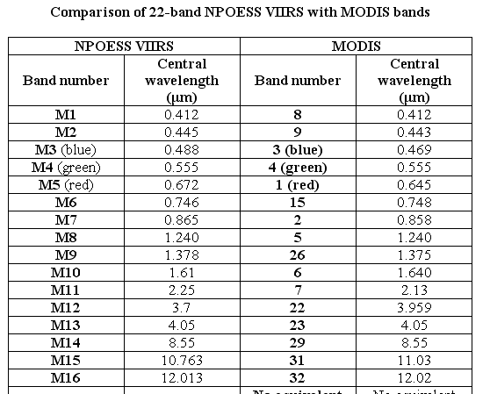
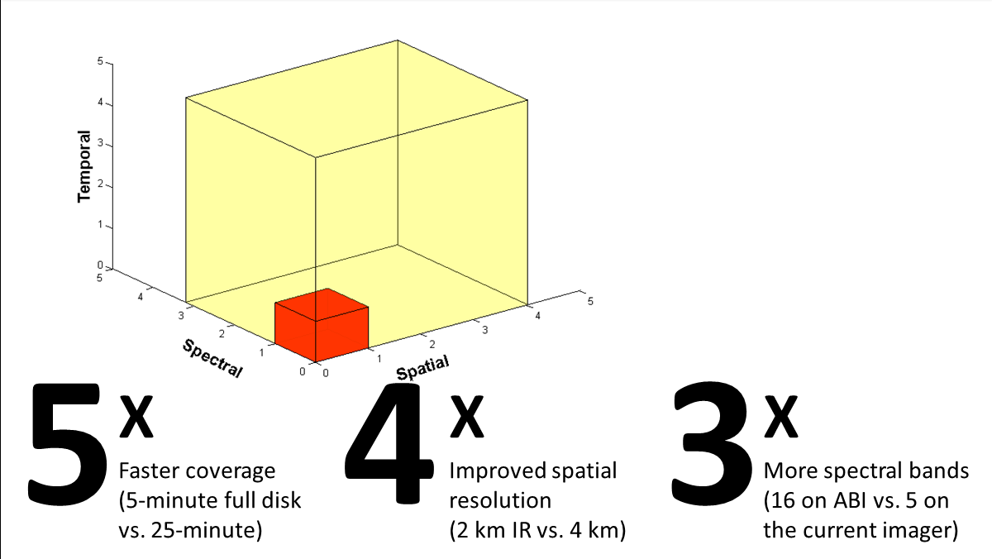
The ABI aerosol algorithm is based on heritage MODIS and VIIRS algorithms.
ABI verses Current GOES

Slide 6
The ABI aerosol algorithm is based on heritage MODIS and VIIRS algorithms.
ABI verses Current GOES

Slide 7
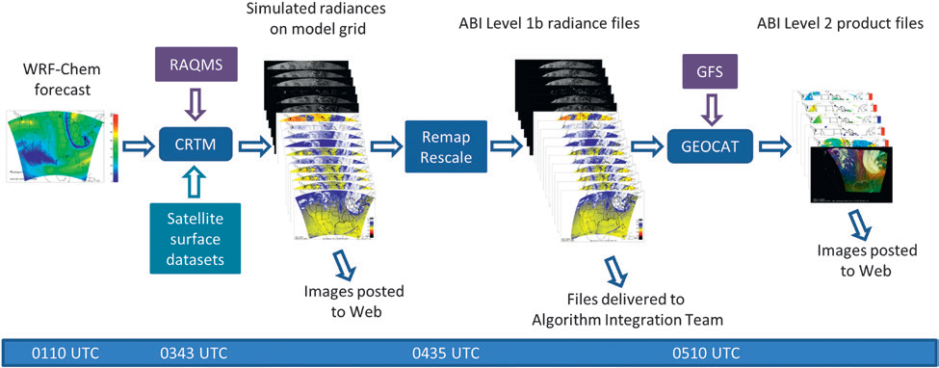
Real-time Simulation of the GOES-R ABI
High resolution (8km) Weather Research and Forecasting (WRF) model with chemistry (WRF-Chem) meteorological, cloud, and aerosol prediction
Community Radiative Transfer Model (CRTM) forward modeling
MODIS Bi-directional reflectance function (BRDF) surface reflectance
Used for
  GOES-R Ground System testing (Data Operations Exercise to test data flows)
  User Readiness (test data formats, display software...)
  Product Evaluation (running algorithms to catch deficiencies)
Greenwald, T. J. et al. (2015), Real-Time Simulation of the GOES-R ABI for User Readiness and Product Evaluation.
Bulletin of the American Meteorological Society 05/2015; DOI:10.1175/BAMS-D-14-00007.

Slide 8
GOES-R Synthetic ABI AWG Datasets (AAWDS)
AWG@SSEC
GFS
Met+Ozone (Global)
RAQMS Aerosol (Global)
RAQMS Ozone (Global)
WRF-Chem
Met/Aerosol (CONUS)
NWP/Aerosol/Ozone Forecast –
Radiative
Transfer –
synthetic radiances
CRTM Full Disk
16 ABI bands
CRTM CONUS
16 ABI bands
Ground
System
Grid Remap
(GOES-R Full Disk GRB)
Grid Remap
(GOES-R CONUS/MESO GRB)
GOES West
GOES Test (Central)
GOES East
RaFTR software –
ABI in a box
Full Disk
Flex
Imagery, Level 2 also being generated
Via PDA
NWS
NOAA Satellite Broadcast Network (SBN) distribution
Flowchart to emulate several operational situations (satellite locations and scan modes)
…including SSEC/CIMSS, national centers, select WFOs
AWIPS II
Notes:
Advanced Baseline Imager (ABI) Algorithm Working Group (AWG)/University of Wisconsin (UW) Data Set

Slide 9
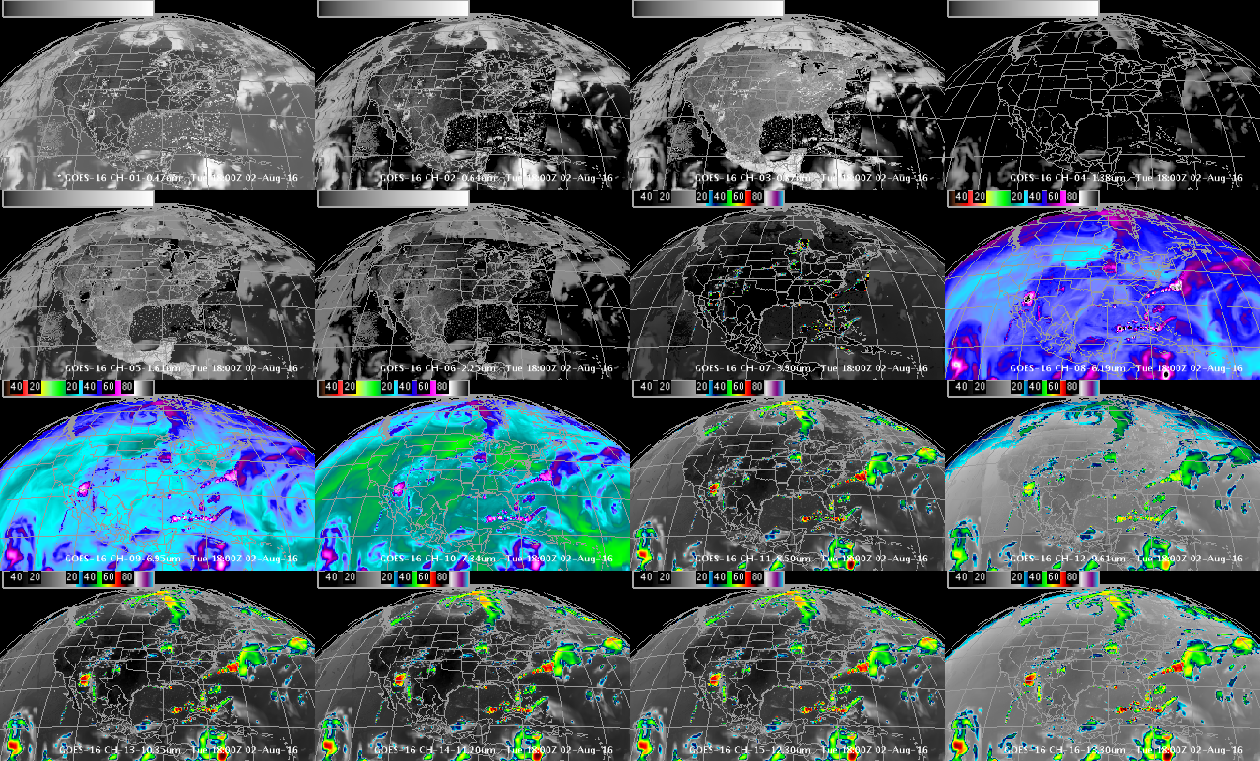
Simulated ABI Spectral bands
0.47 μm
0.64 μm
0.86 μm
1.37 μm
1.6 μm
2.2 μm
3.9 μm
6.2 μm
6.9 μm
7.3 μm
8.4 μm
9.6 μm
10.3 μm
11.2 μm
12.3 μm
13.3 μm
GOES-R ABI Imagery simulated at UW via AWG Proxy, processed via the Ground System, acquired via NOAAPort, shown in AWIPS-II (default enhancements)

Slide 10
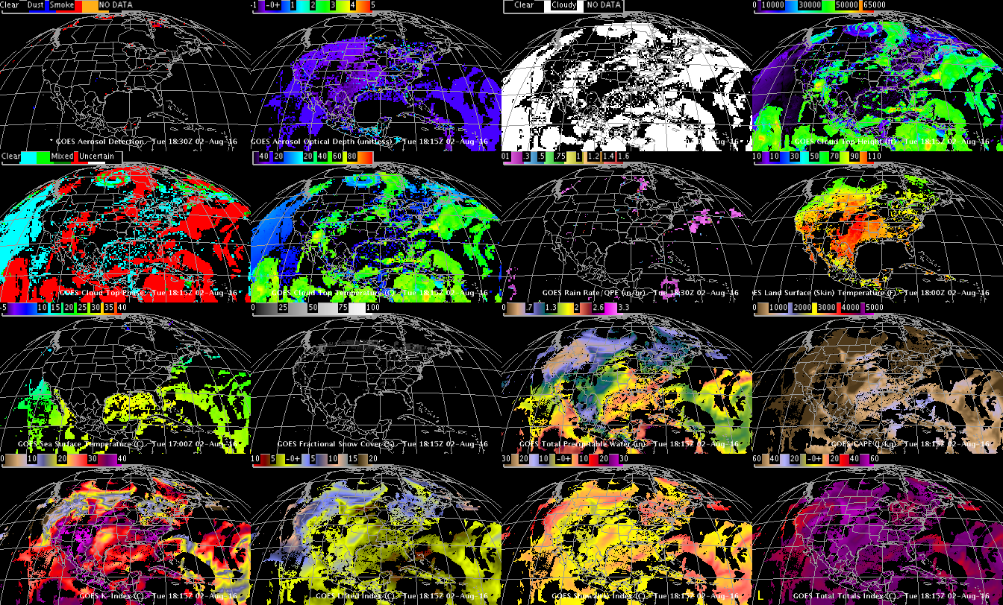
Simulated ABI (select) Derived Products
Aerosol Detection
Aerosol Optical Depth
Cloud Mask
Cloud Top Height
Cloud Top Phase
Cloud Top Pressure
Rain Rate
LST
SST
Snow
TPW
CAPE
K-index
Lifted Index
Showalter
Total Totals
Using GOES-R ABI Imagery simulated at UW via AWG Proxy, processed via the Ground System, acquired via NOAAPort, in AWIPS-II (default enhancements)

Slide 11
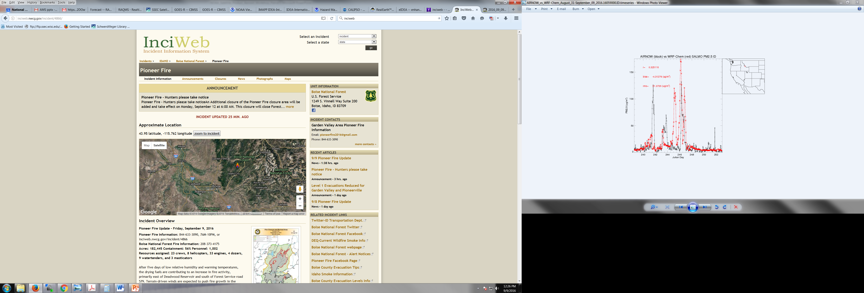
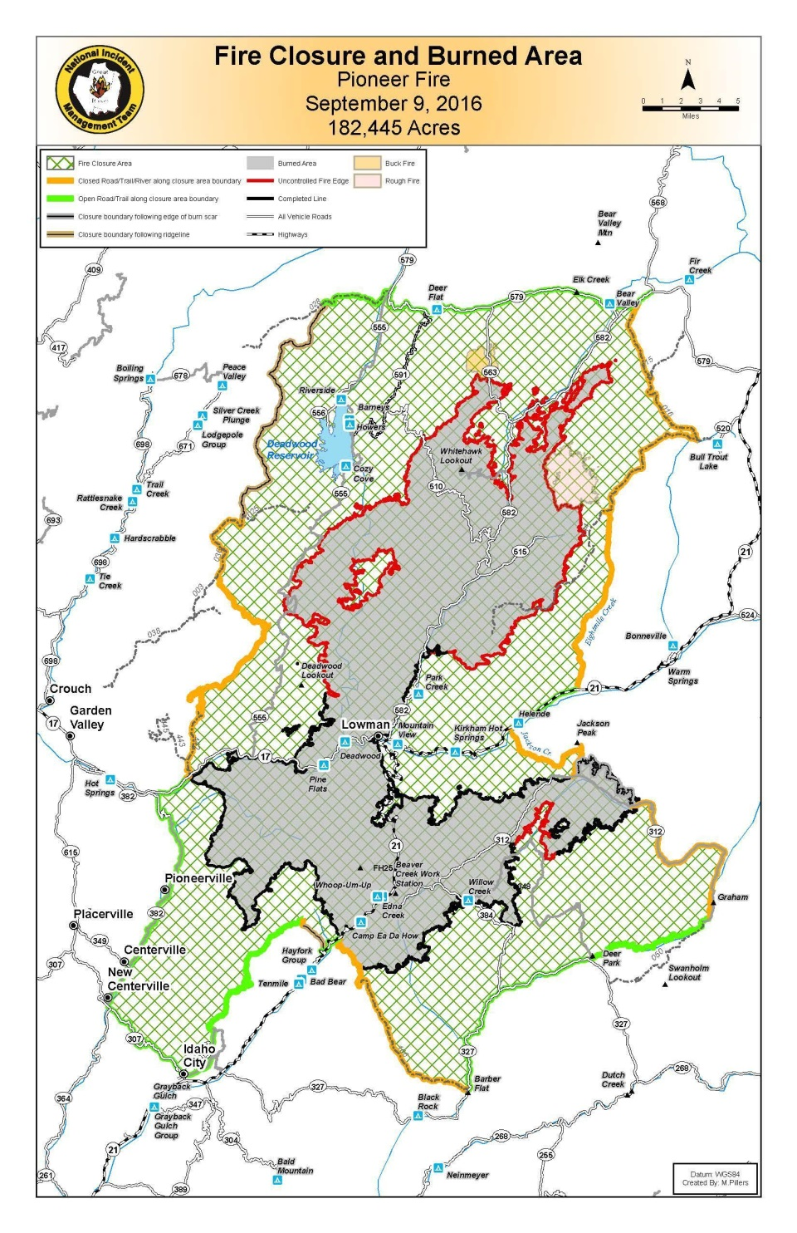
Demonstration of GOES-R ABI aerosol retrievals using synthetic ABI proxy data
Pioneer Fire, Idaho
Current as of | 9/9/2016, 11:52:28 AM
Incident Type | Wildfire
Cause | Unknown
Date of Origin | Monday July 18th, 2016 approx. 05:00 PM
Total Personnel | 1,002
Size | 182,445 Acres
Percent of Perimeter Contained | 56%
http://inciweb.nwcg.gov/incident/4866/
Notes:
Fire Background

Slide 12
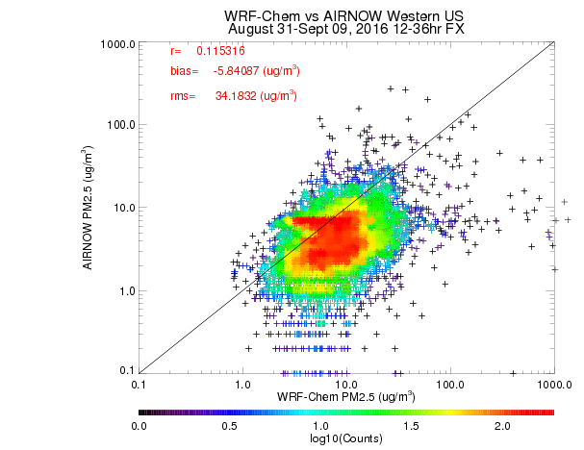
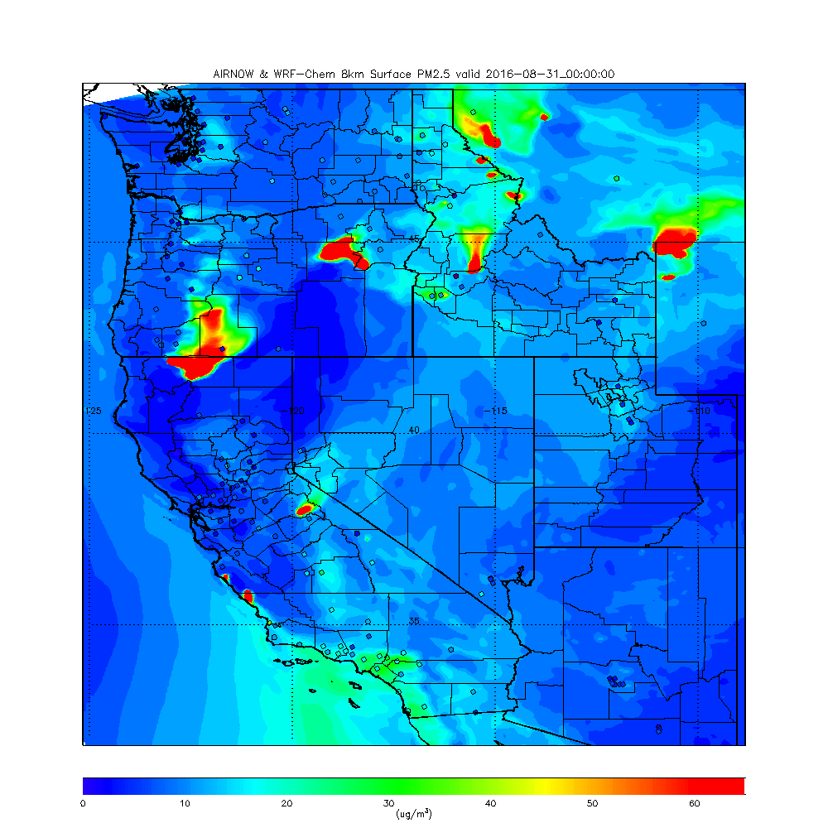
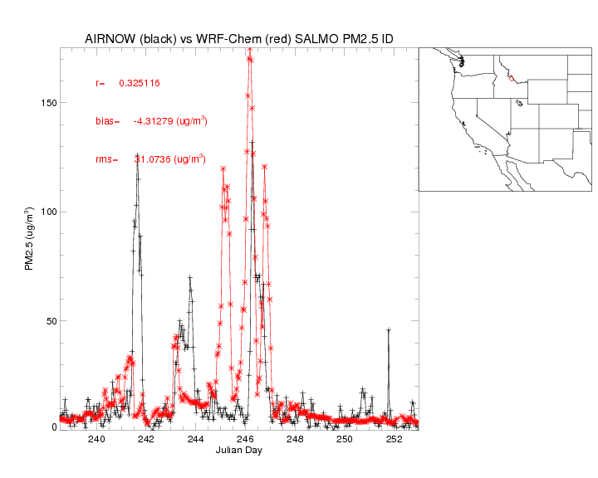
WRF-Chem surface PM2.5
Pioneer Fire August 31-September 05, 2016
Pioneer Fire
Notes:
Validation of Nature run for GOES-R ABI proxy data showing WRF-Chem generally underestimates surface PM2.5, misses exact timing of fire (due to use of previous day’s fire detection), but shows reasonable smoke plume for Pioneer fire

Slide 13
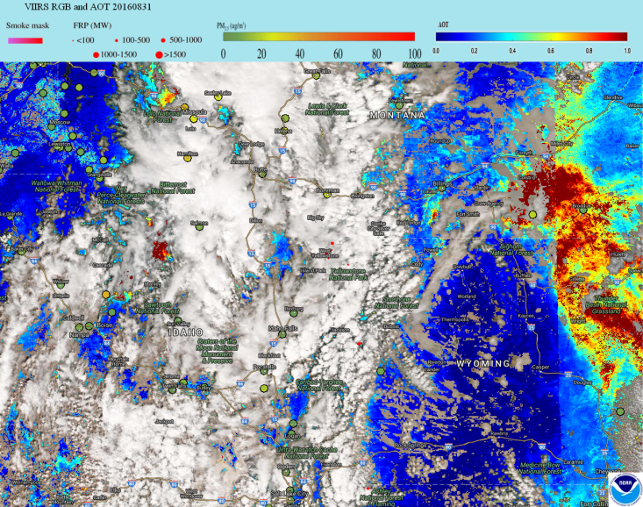
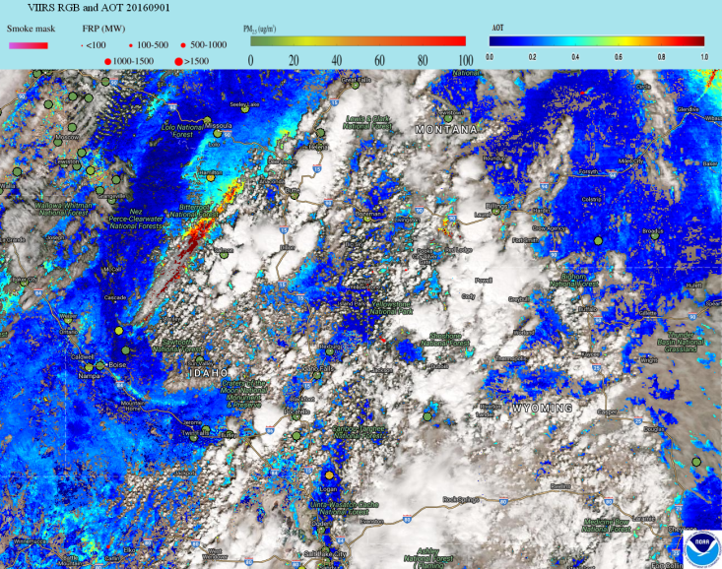
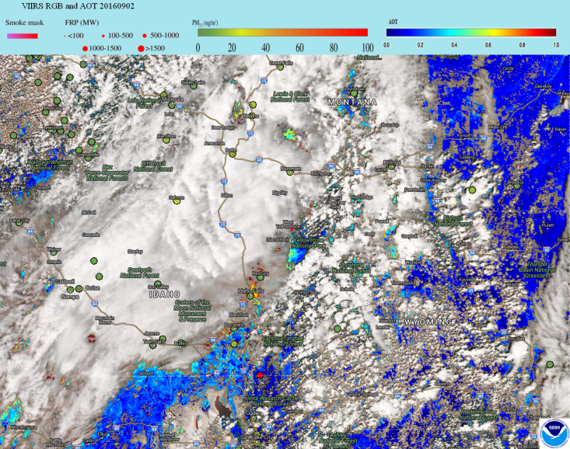
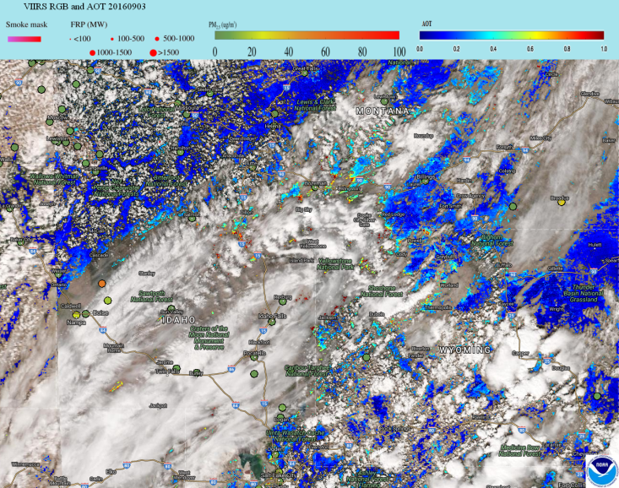
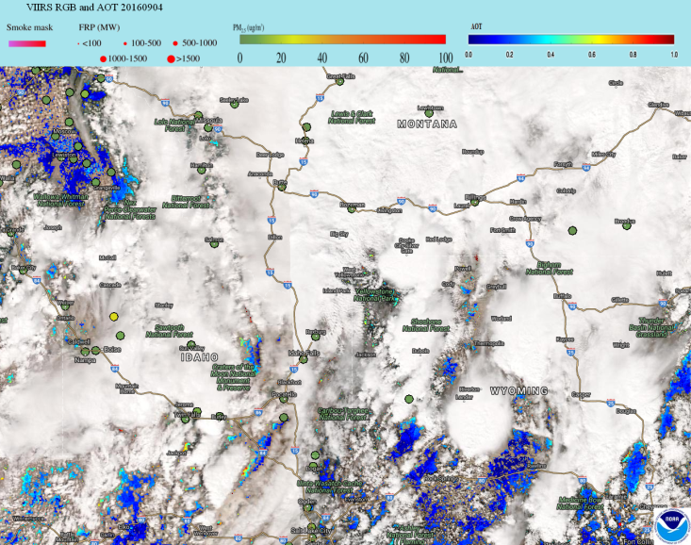
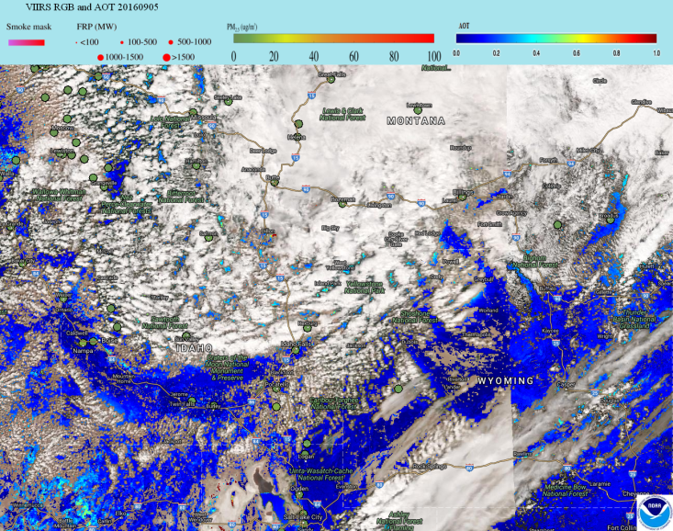
SNPP VIIRS Pioneer Fire
August 31-September 05, 2016
2016-08-31
2016-09-01
2016-09-02
2016-09-03
2016-09-04
2016-09-05
Notes:
VIIRS observations obscured 5 days out of 6

Slide 14
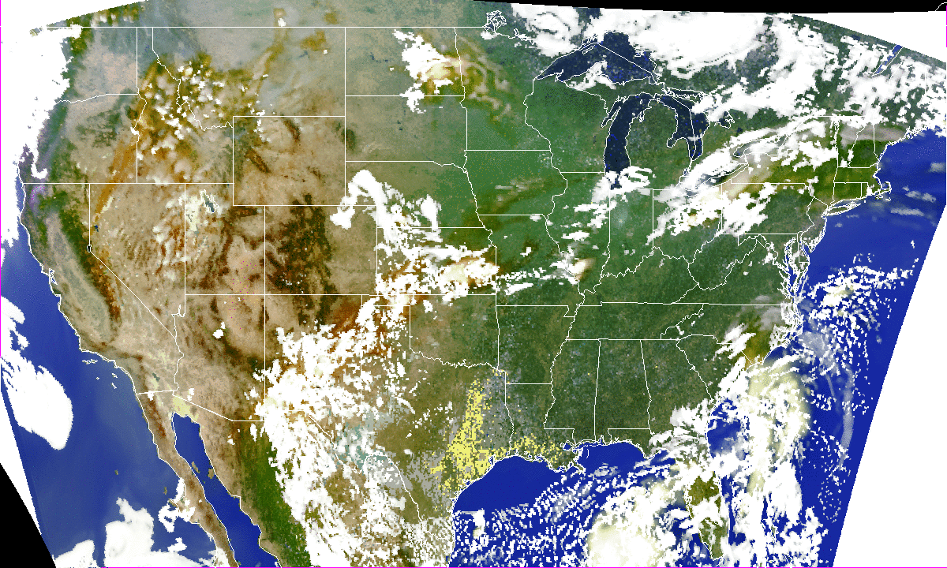
GOES-R ABI 2016-08-31 to 2016-09-05 (1600-2200 UCT)
Simulated Natural Color
Synthesized GOES-R ABI Green band:
The 0.86 μm near IR (NIR) band is utilized in a regression based LUT, along
with the Red and Blue bands, to create the needed Green band.
Notes:
August 31 through September 05 CONUS animation (16-22Z only, realistic synoptic evolution, green band generated from other bands, smoke visible in Pacific NW)

Slide 15
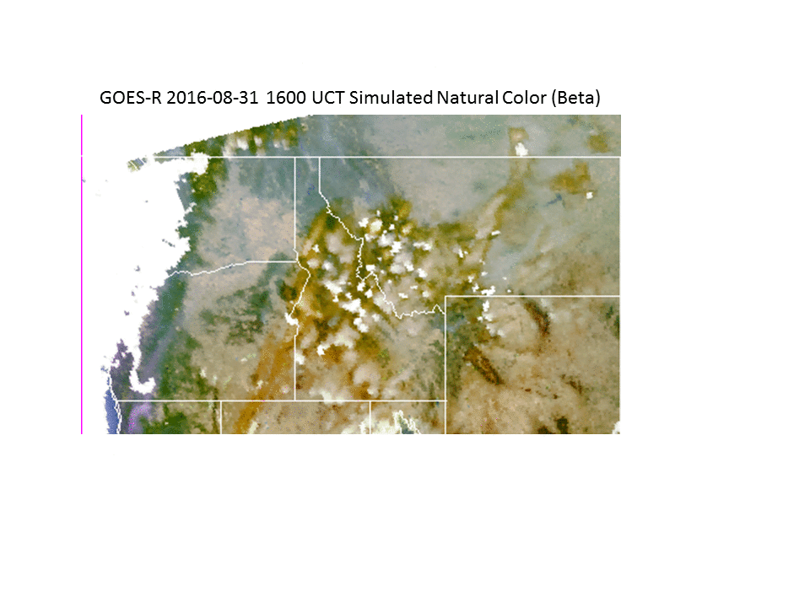
Pacific North West Zoom 2016-08-31 to 2016-09-01 (1600-2200 UCT)
Simulated Natural Color
Synthesized GOES-R ABI Green band:
The 0.86 μm near IR (NIR) band is utilized in a regression based LUT, along
with the Red and Blue bands, to create the needed Green band.
Notes:
Zoom for August 31 and Sept 01 showing that geostationary measurements provide higher temporal resolution and allow viewing between clouds, characterizing fire dynamics, smoke transport

Slide 16
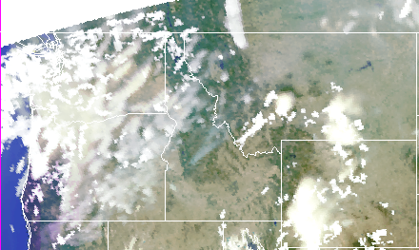
Pacific North West Zoom 2016-09-01 2200 UCT
Simulated Natural Color
GOES-R 2016-09-01 2200 UCT Simulated Natural Color/AOD (Beta)
Synthesized GOES-R ABI Green band:
The 0.86 μm near IR (NIR) band is utilized in a regression based LUT, along
with the Red and Blue bands, to create the needed Green band.
Notes:
Zoom for August 31 and Sept 01 showing that geostationary measurements provide higher temporal resolution and allow viewing between clouds, characterizing fire dynamics, smoke transport

Slide 17
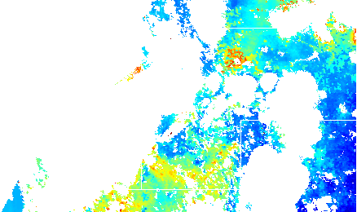
Pacific North West Zoom 2016-09-01 2200 UCT
Simulated Natural Color plus AOD
GOES-R 2016-09-01 2200 UCT Simulated Natural Color/AOD (Beta)
Synthetic GOES-R ABI AOD retrieval:
MODIS and VIIRS heritage multi-spectral AOD retrieval at high (2km) spatial and high (5 minute CONUS, 15 minute Full Disk) temporal resolution
Notes:
Zoom for Sept 01 showing multi-spectral AOD retrieval

Slide 18
Summary
GOES-R launch scheduled for November 04, 2016
Beta level maturity Aerosol Optical Depth (AOD) products available no later than Launch+6months
GOES-R Advanced Baseline Imager (ABI) multi-spectral AOD retrievals based in MODIS and VIIRS heritage algorithms
ABI will provide MODIS and VIIRS quality AOD retrievals at high spatial (2km) and temporal (5 minutes CONUS, 15 minutes Full Disk) resolution
Increased spatial and temporal resolution will increase likelihood of cloud free scenes and improve characterization of aerosol loading over the continental US as well as long-range transport of aerosols from other sources.

