Slide 1
GOES-R ABI AWIPS II Testing
Real time simulated GOES-R Advanced Baseline Imager (ABI) imagery¹ is now flowing to the Advanced Weather Interactive Processing System (AWIPS) routinely over the NOAAPORT Satellite Broadcast Network (SBN) on the new GOES-R East and West feed as part of end-to-end testing for GOES-R ABI data delivery.
NWS AWIPS II Environmental Data EXchange (EDEX) testing uses the ABI L1B Simulator RaFTR (Resample and Format, Timed Release) with input from the Real-time Proxy stream
We are currently testing ingest of the original proxy radiances (on the WRF-CHEM model grid) and the NOAAPORT AWIPS II imagery (on the AWIPS II grid) into McIDAS-V for end-to-end testing of the ground system processing of the GOES-R ABI AWIPS II imagery
¹The real time ABI imagery is generated by CIMSS/ASPB GOES-R AWG proxy data team. Meteorological and cloud forecasts from GFS and aerosol forecasts from RAQMS provide input to the CRTM to generate the full-disk 16 band ABI imagery. Nested RAQMS/WRF-CHEM meteorological, cloud and aerosol forecasts are used with the CRTM over the continental US

Slide 2
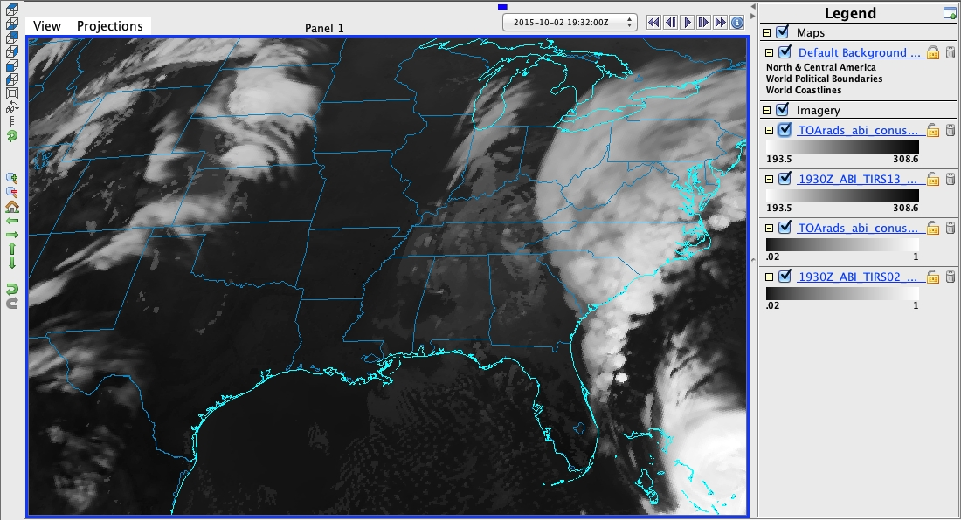
Original ABI Band 10 CONUS image at 19Z on October, 02, 2015

Slide 3
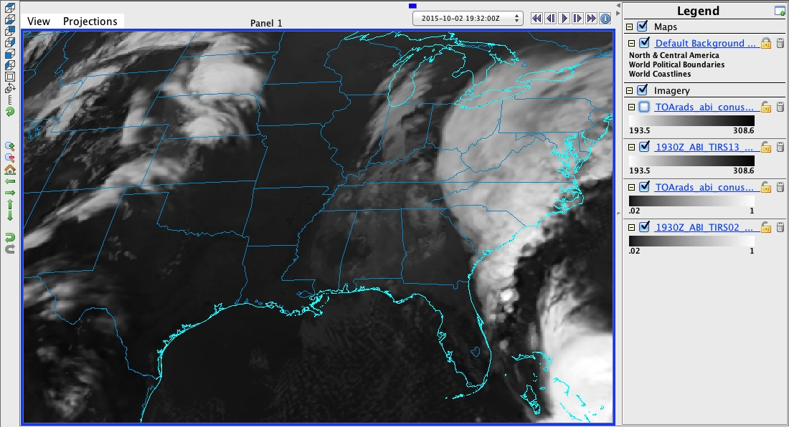
NOAAPORT ABI Band Full Disk 10 image at 19:32Z on October, 02, 2015
Differences are attributed to 32 minute time difference. RaFTR interpolates between 19Z and 20Z proxy data to obtain 19:32Z NOAAPORT image

Slide 4
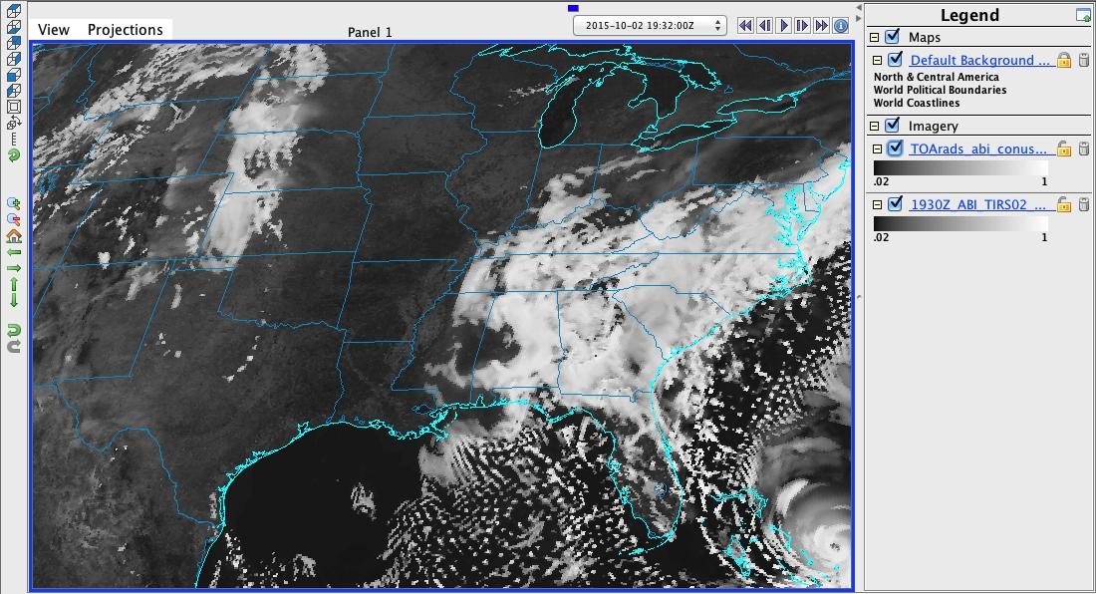
Original ABI Band 2 CONUS image at 19Z on October, 02, 2015

Slide 5
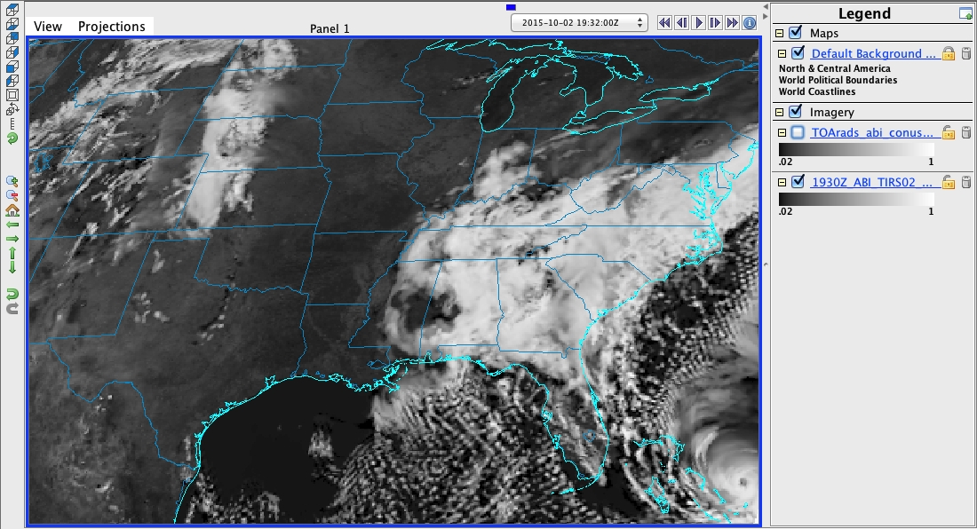
NOAAPORT ABI Band 2 Full Disk image at 19:32Z on October, 02, 2015
Clear sky differences cannot attributed to 32 minute time difference. Suggests navigation issue that needs to be investigated.

Slide 6
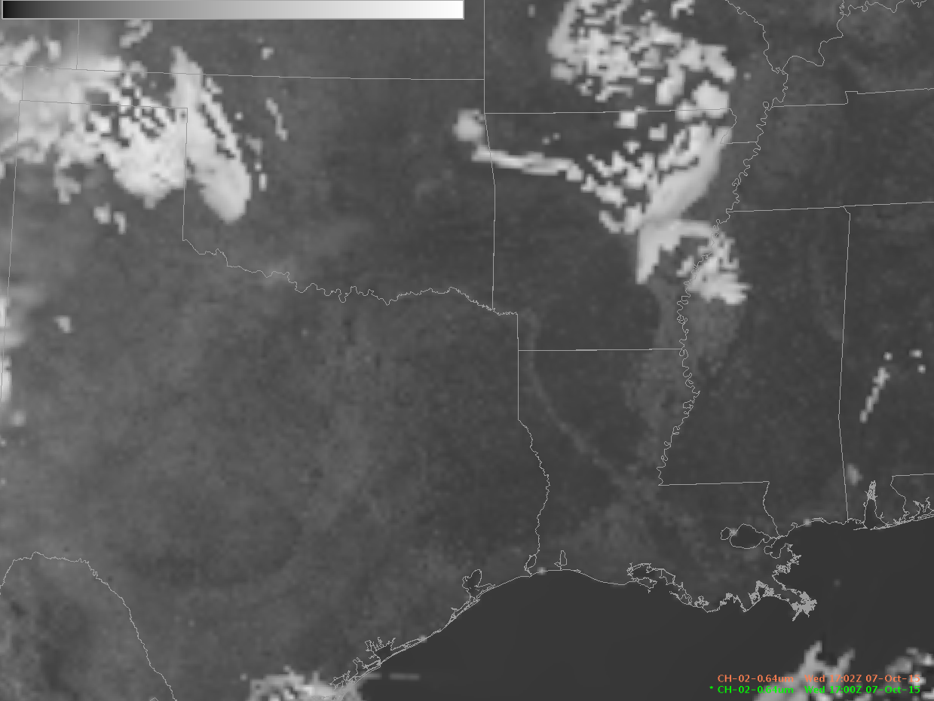
NOAAPORT Band 2 CONUS image
17:02Z October 07, 2015
(navigation performed at ground system)

Slide 7
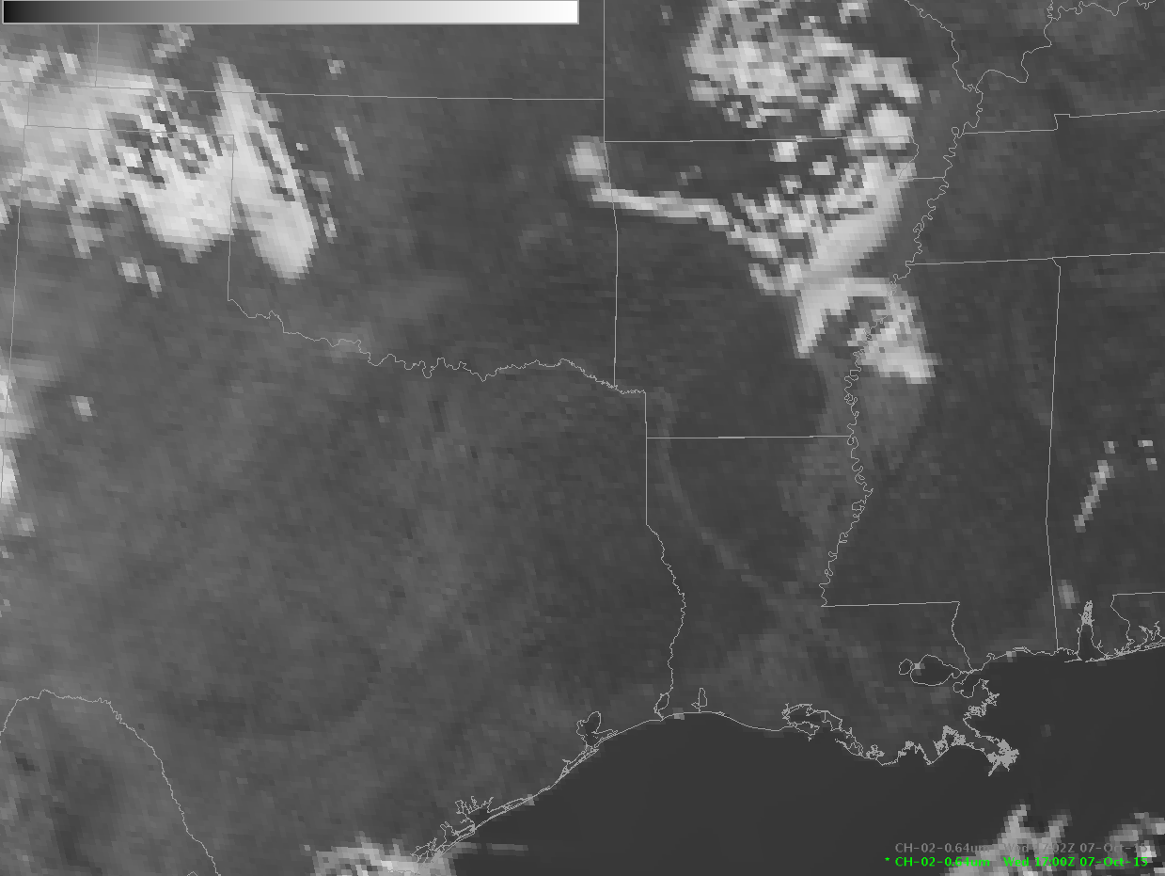
NOAAPORT Band 2 Full Disk image
17:02Z October 07, 2015
(navigation performed within AWIPS)

