Slide 1
GOES-R ABI AWIPS II Testing
Brad Pierce, Tim Schmit, Jordan Gerth, Tom Rink
CIMSS ABI Proxy Team:
Todd Schaack, Allen Lenzen, Kaba Bah, Marek Rogal, Tom Greenwald, James Davies
GOES-R Ground System Testing:
Joe Zajic, Matthew Seybold, Wayne Mackenzie, Kim Pham
Real time simulated GOES-R Advanced Baseline Imager (ABI) imagery¹ is now flowing to the Advanced Weather Interactive Processing System (AWIPS) routinely over the NOAAPORT Satellite Broadcast Network (SBN) on the new GOES-R East and West feed as part of end-to-end testing for GOES-R ABI data delivery.
NWS AWIPS II Environmental Data EXchange (EDEX) testing uses the ABI L1B Simulator RaFTR (Resample and Format, Timed Release) with input from the Real-time Proxy stream
We are currently testing ingest of the original proxy radiances (on the WRF-CHEM model grid) and the NOAAPORT AWIPS II imagery (on the AWIPS II grid) into McIDAS-V for end-to-end testing of the ground system processing of the GOES-R ABI AWIPS II imagery
¹The real time ABI imagery is generated by CIMSS/ASPB GOES-R AWG proxy data team. Meteorological and cloud forecasts from GFS and aerosol forecasts from RAQMS provide input to the CRTM to generate the full-disk 16 band ABI imagery. Nested RAQMS/WRF-CHEM meteorological, cloud and aerosol forecasts are used with the CRTM over the continental US

Slide 2
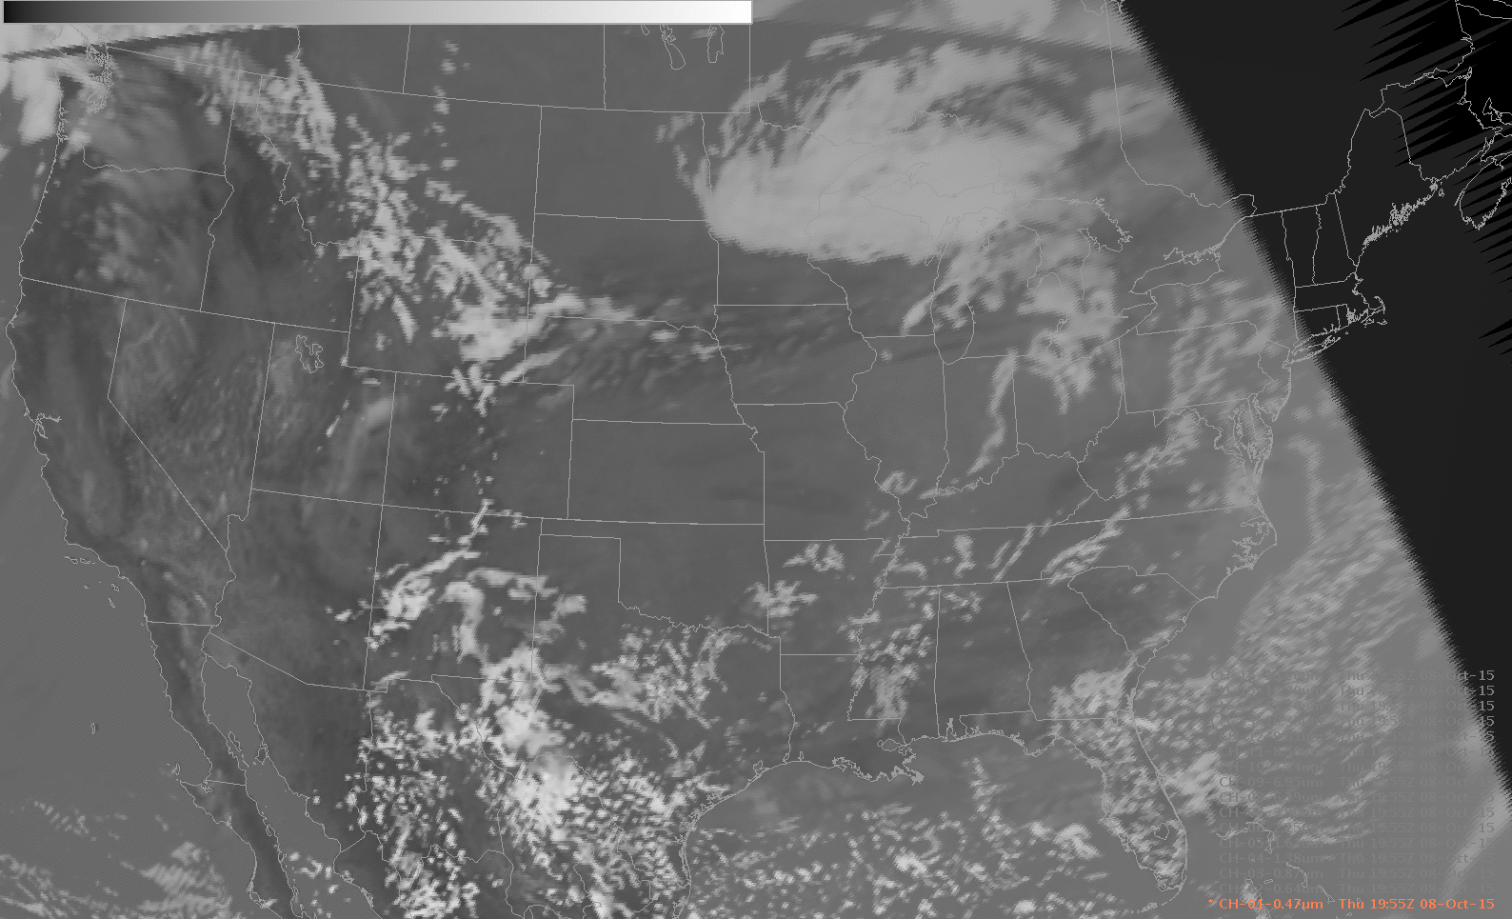
GOES-R ABI AWIPS II Testing
AWIPS II Synthetic ABI 16 Band Loop West Perspective 19:55Z 08-Oct-2015

Slide 3
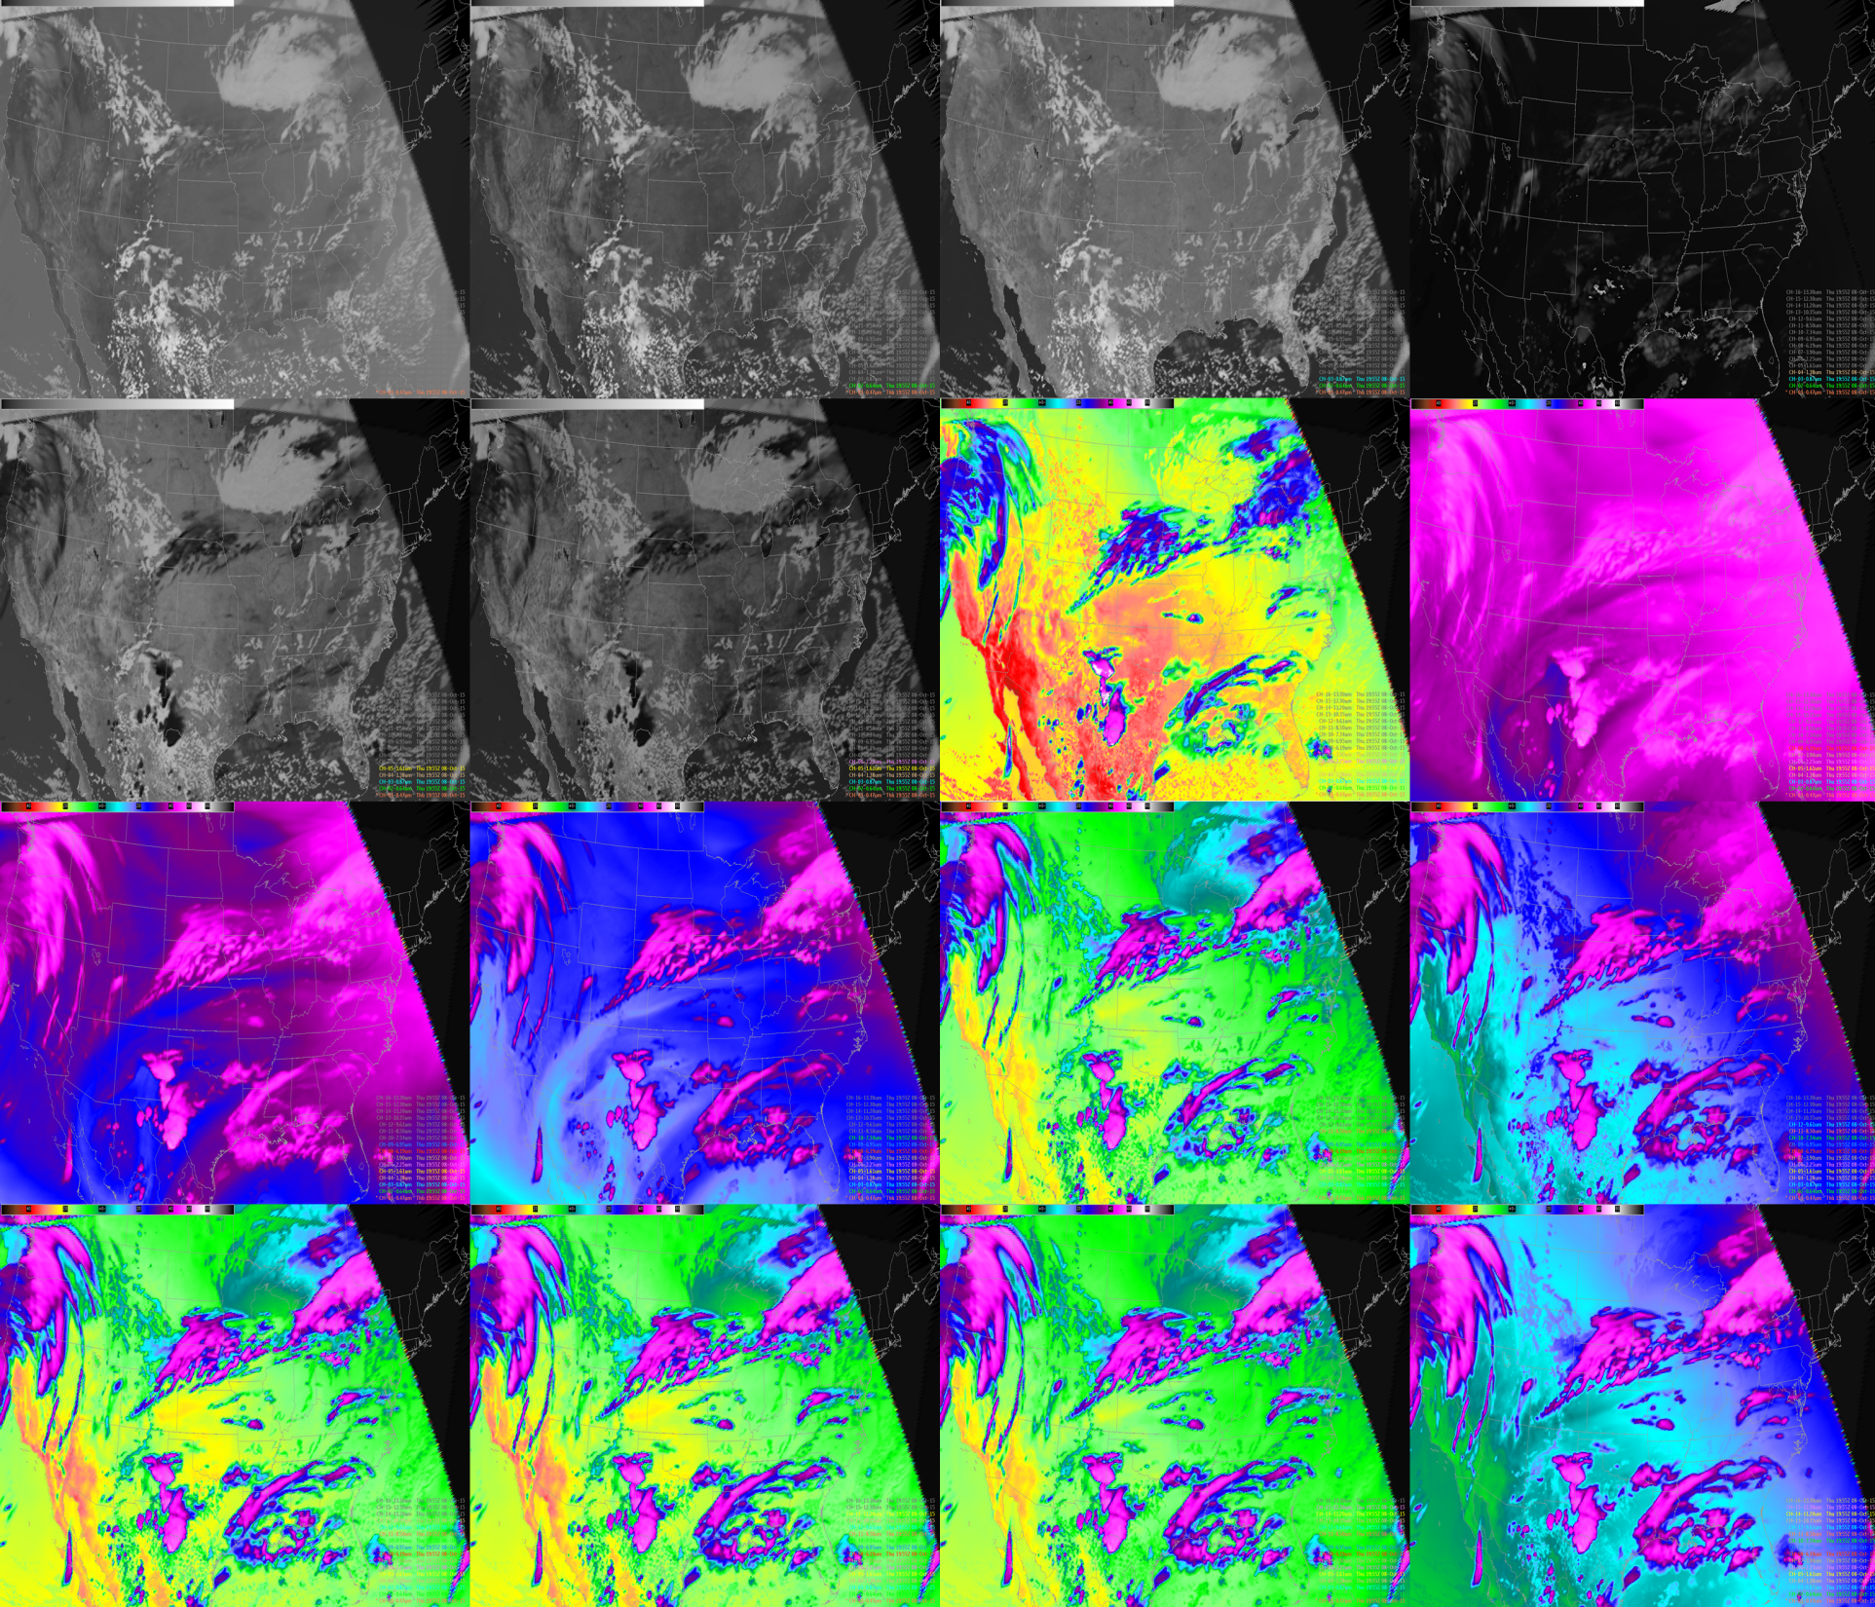
Notes:
AWIPS II Synthetic ABI 16 Band multi-panel (Band 01 upper left, Band 16 lower right) West Perspective 19:55Z 08-Oct-2015

Slide 4
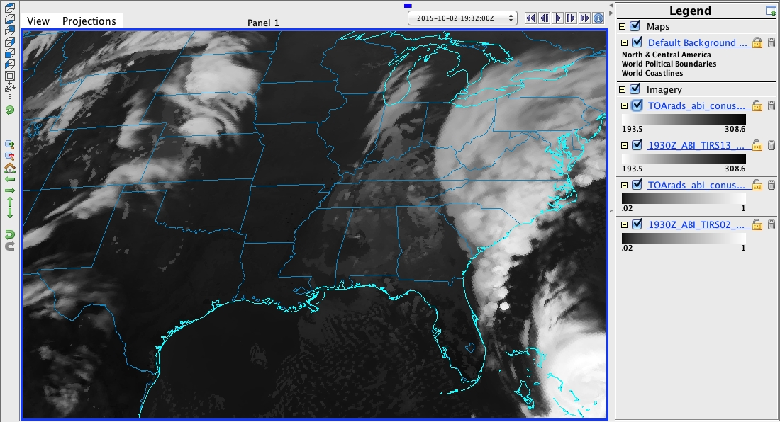
Original ABI Band 13 CONUS image at 19Z on October, 02, 2015
Notes:
McIDAS-V image at 19:00Z October 02, 2015 from Original (WRF-CHEM/CRTM)

Slide 5
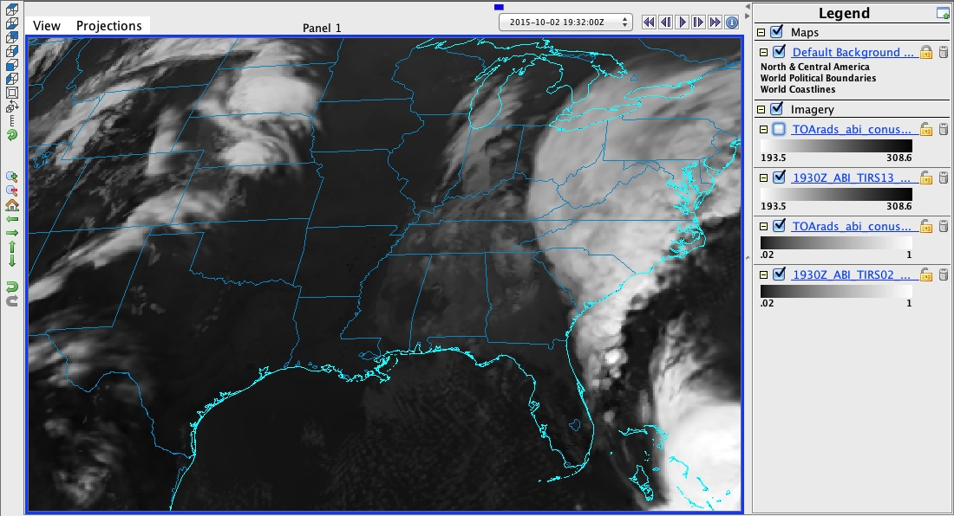
NOAAPORT ABI Band Full Disk 13 image at 19:32Z on October, 02, 2015
Differences are attributed to 32 minute time difference. RaFTR interpolates between 19Z and 20Z proxy data to obtain 19:32Z NOAAPORT image
Notes:
McIDAS-V image at 19:30Z October 02, 2015 from AWIPS II (NOAAPORT)

Slide 6
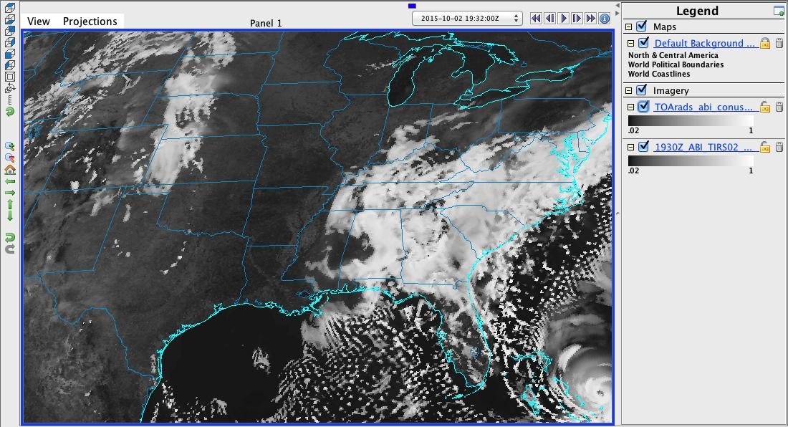
Original ABI Band 2 CONUS image at 19Z on October, 02, 2015
Notes:
McIDAS-V image at 19:00Z October 02, 2015 from Original (WRF-CHEM/CRTM)

Slide 7
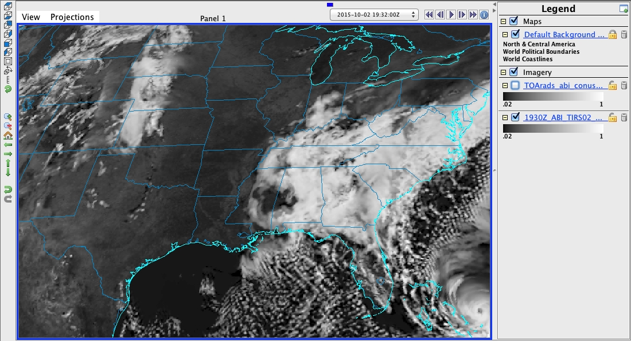
NOAAPORT ABI Band 2 Full Disk image at 19:32Z on October, 02, 2015
Clear sky differences cannot attributed to 32 minute time difference. Suggests navigation issue that needs to be investigated.
Notes:
McIDAS-V image at 19:30Z October 02, 2015 from AWIPS II (NOAAPORT)

Slide 8
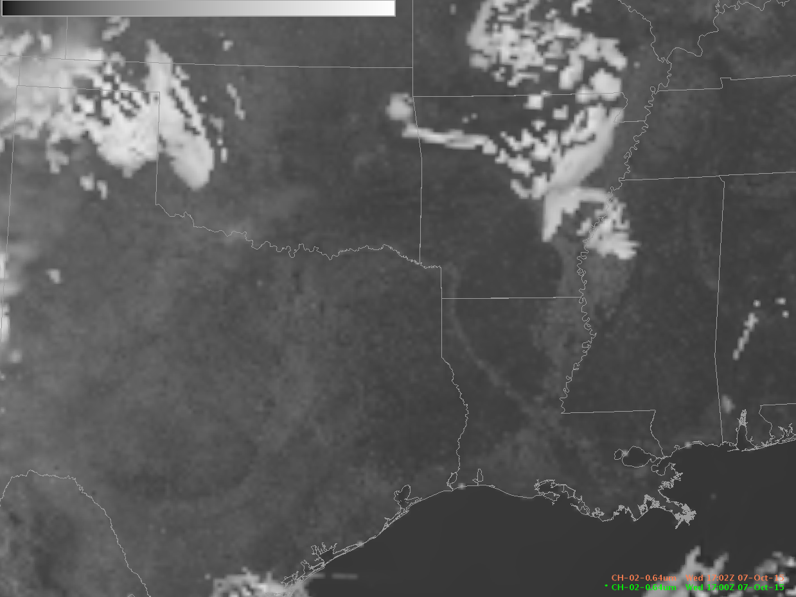
NOAAPORT Band 2 CONUS image
17:02Z October 07, 2015
(navigation performed at ground system)
Notes:
McIDAS-V image at 17:02Z October 07, 2015 from AWIPS II (NOAAPORT) CONUS Sector –note location of brighter surface within Mississippi and Red River Valleys

Slide 9
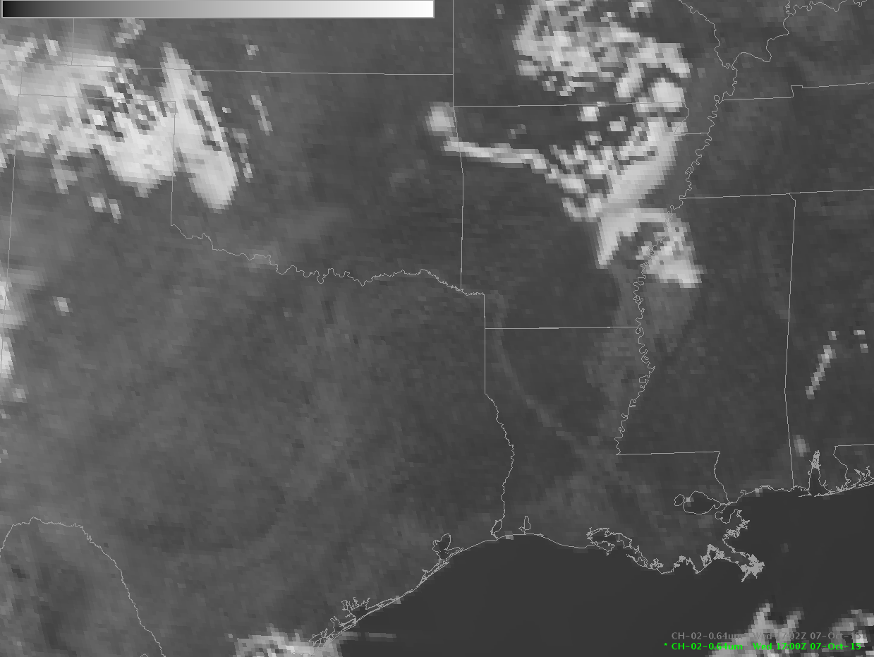
NOAAPORT Band 2 Full Disk image
17:02Z October 07, 2015
(navigation performed within AWIPS)
Notes:
McIDAS-V image at 17:02Z October 07, 2015 from AWIPS II (NOAAPORT) CONUS Sector –note the shift in location of brighter surface within Mississippi and Red River Valleys

