Slide 1
The GOES-R Launch
Timothy J. Schmit (tim.j.schmit@noaa.gov) (“@GOESguy”)
NOAA/NESDIS/Satellite Applications and Research
Advanced Satellite Products Branch (ASPB)
Madison, WI
Cape Canaveral, FL
November 2016
UW-Madison

Slide 2
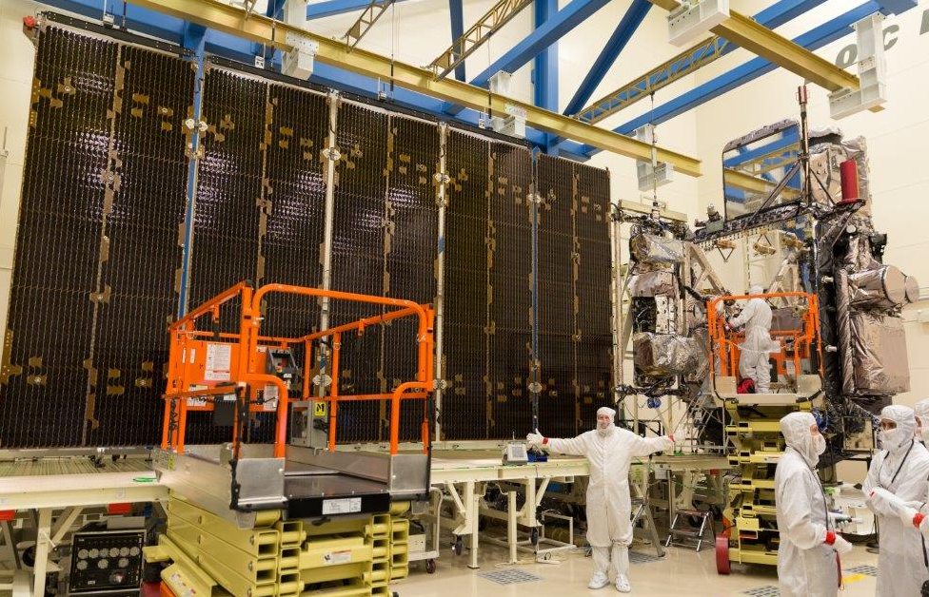
Credit: Lockheed-Martin

Slide 3
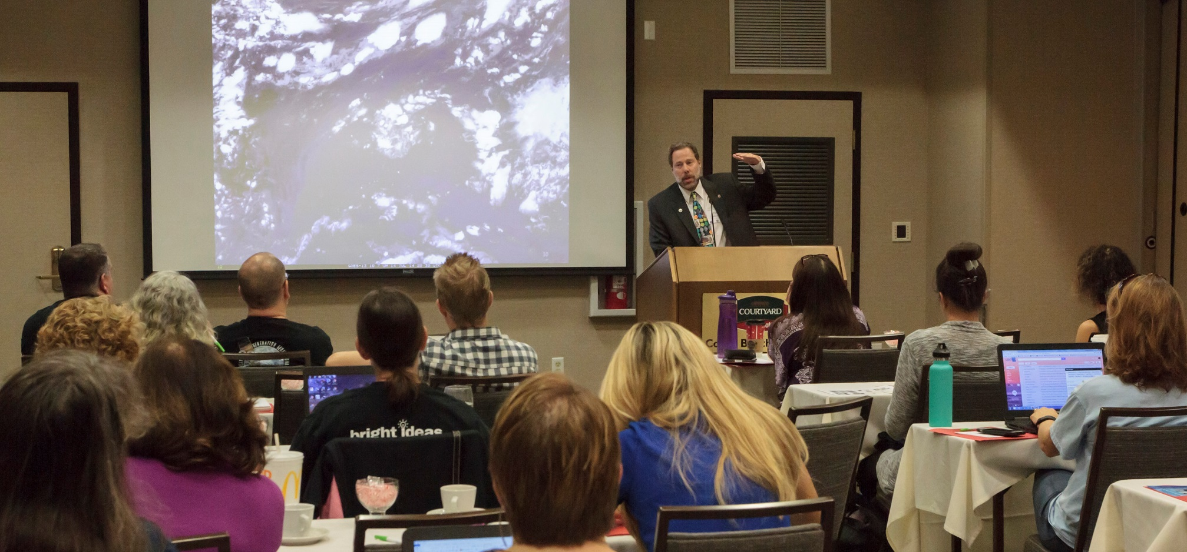
Credit: Chris Schmidt, CIMSS

Slide 4
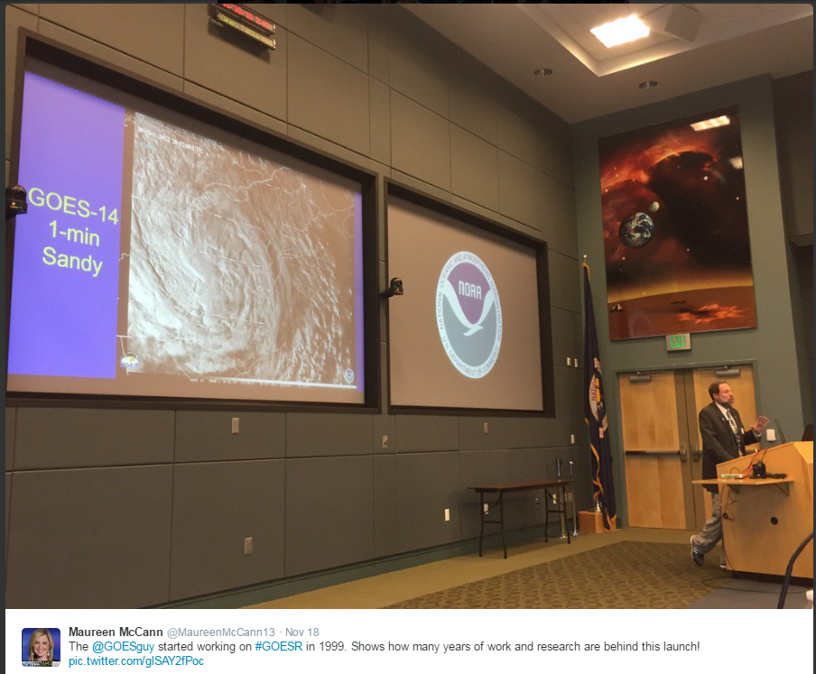

Slide 5
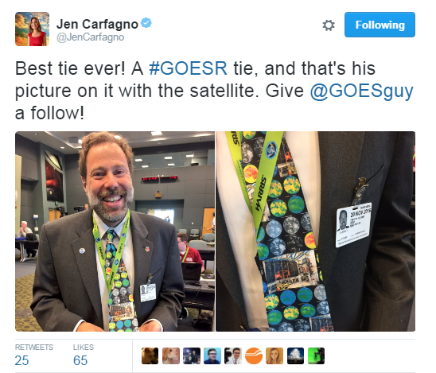

Slide 6
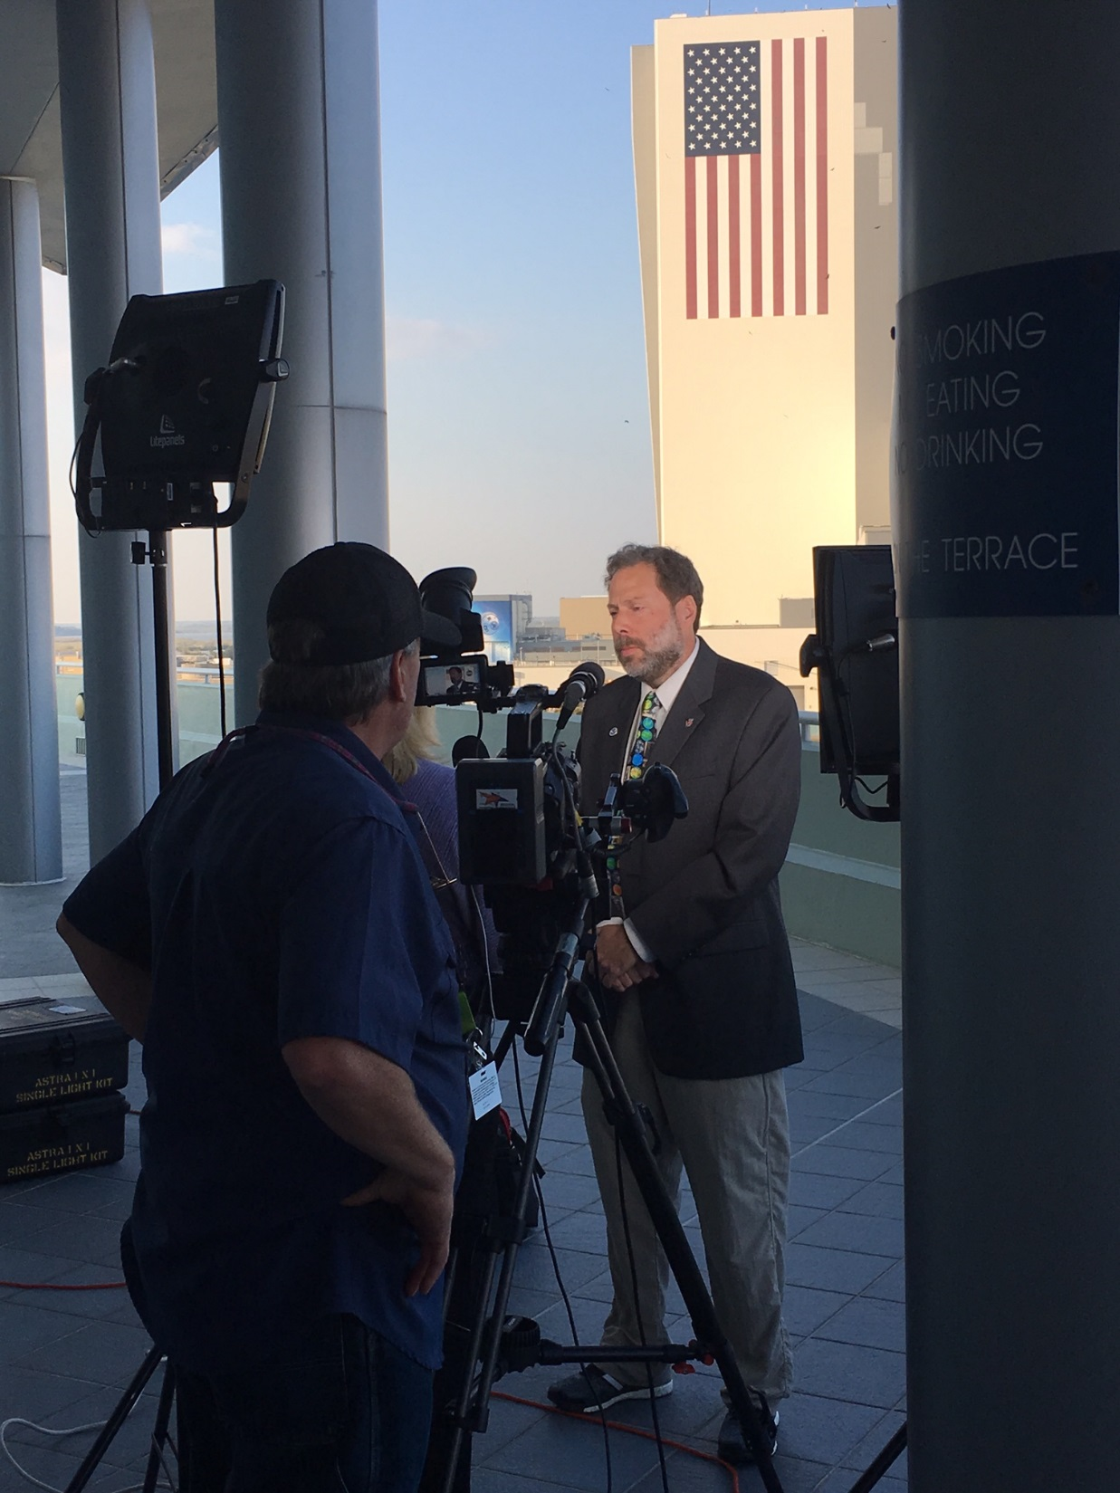
Credit: Lauren Gaches, NOAA

Slide 7
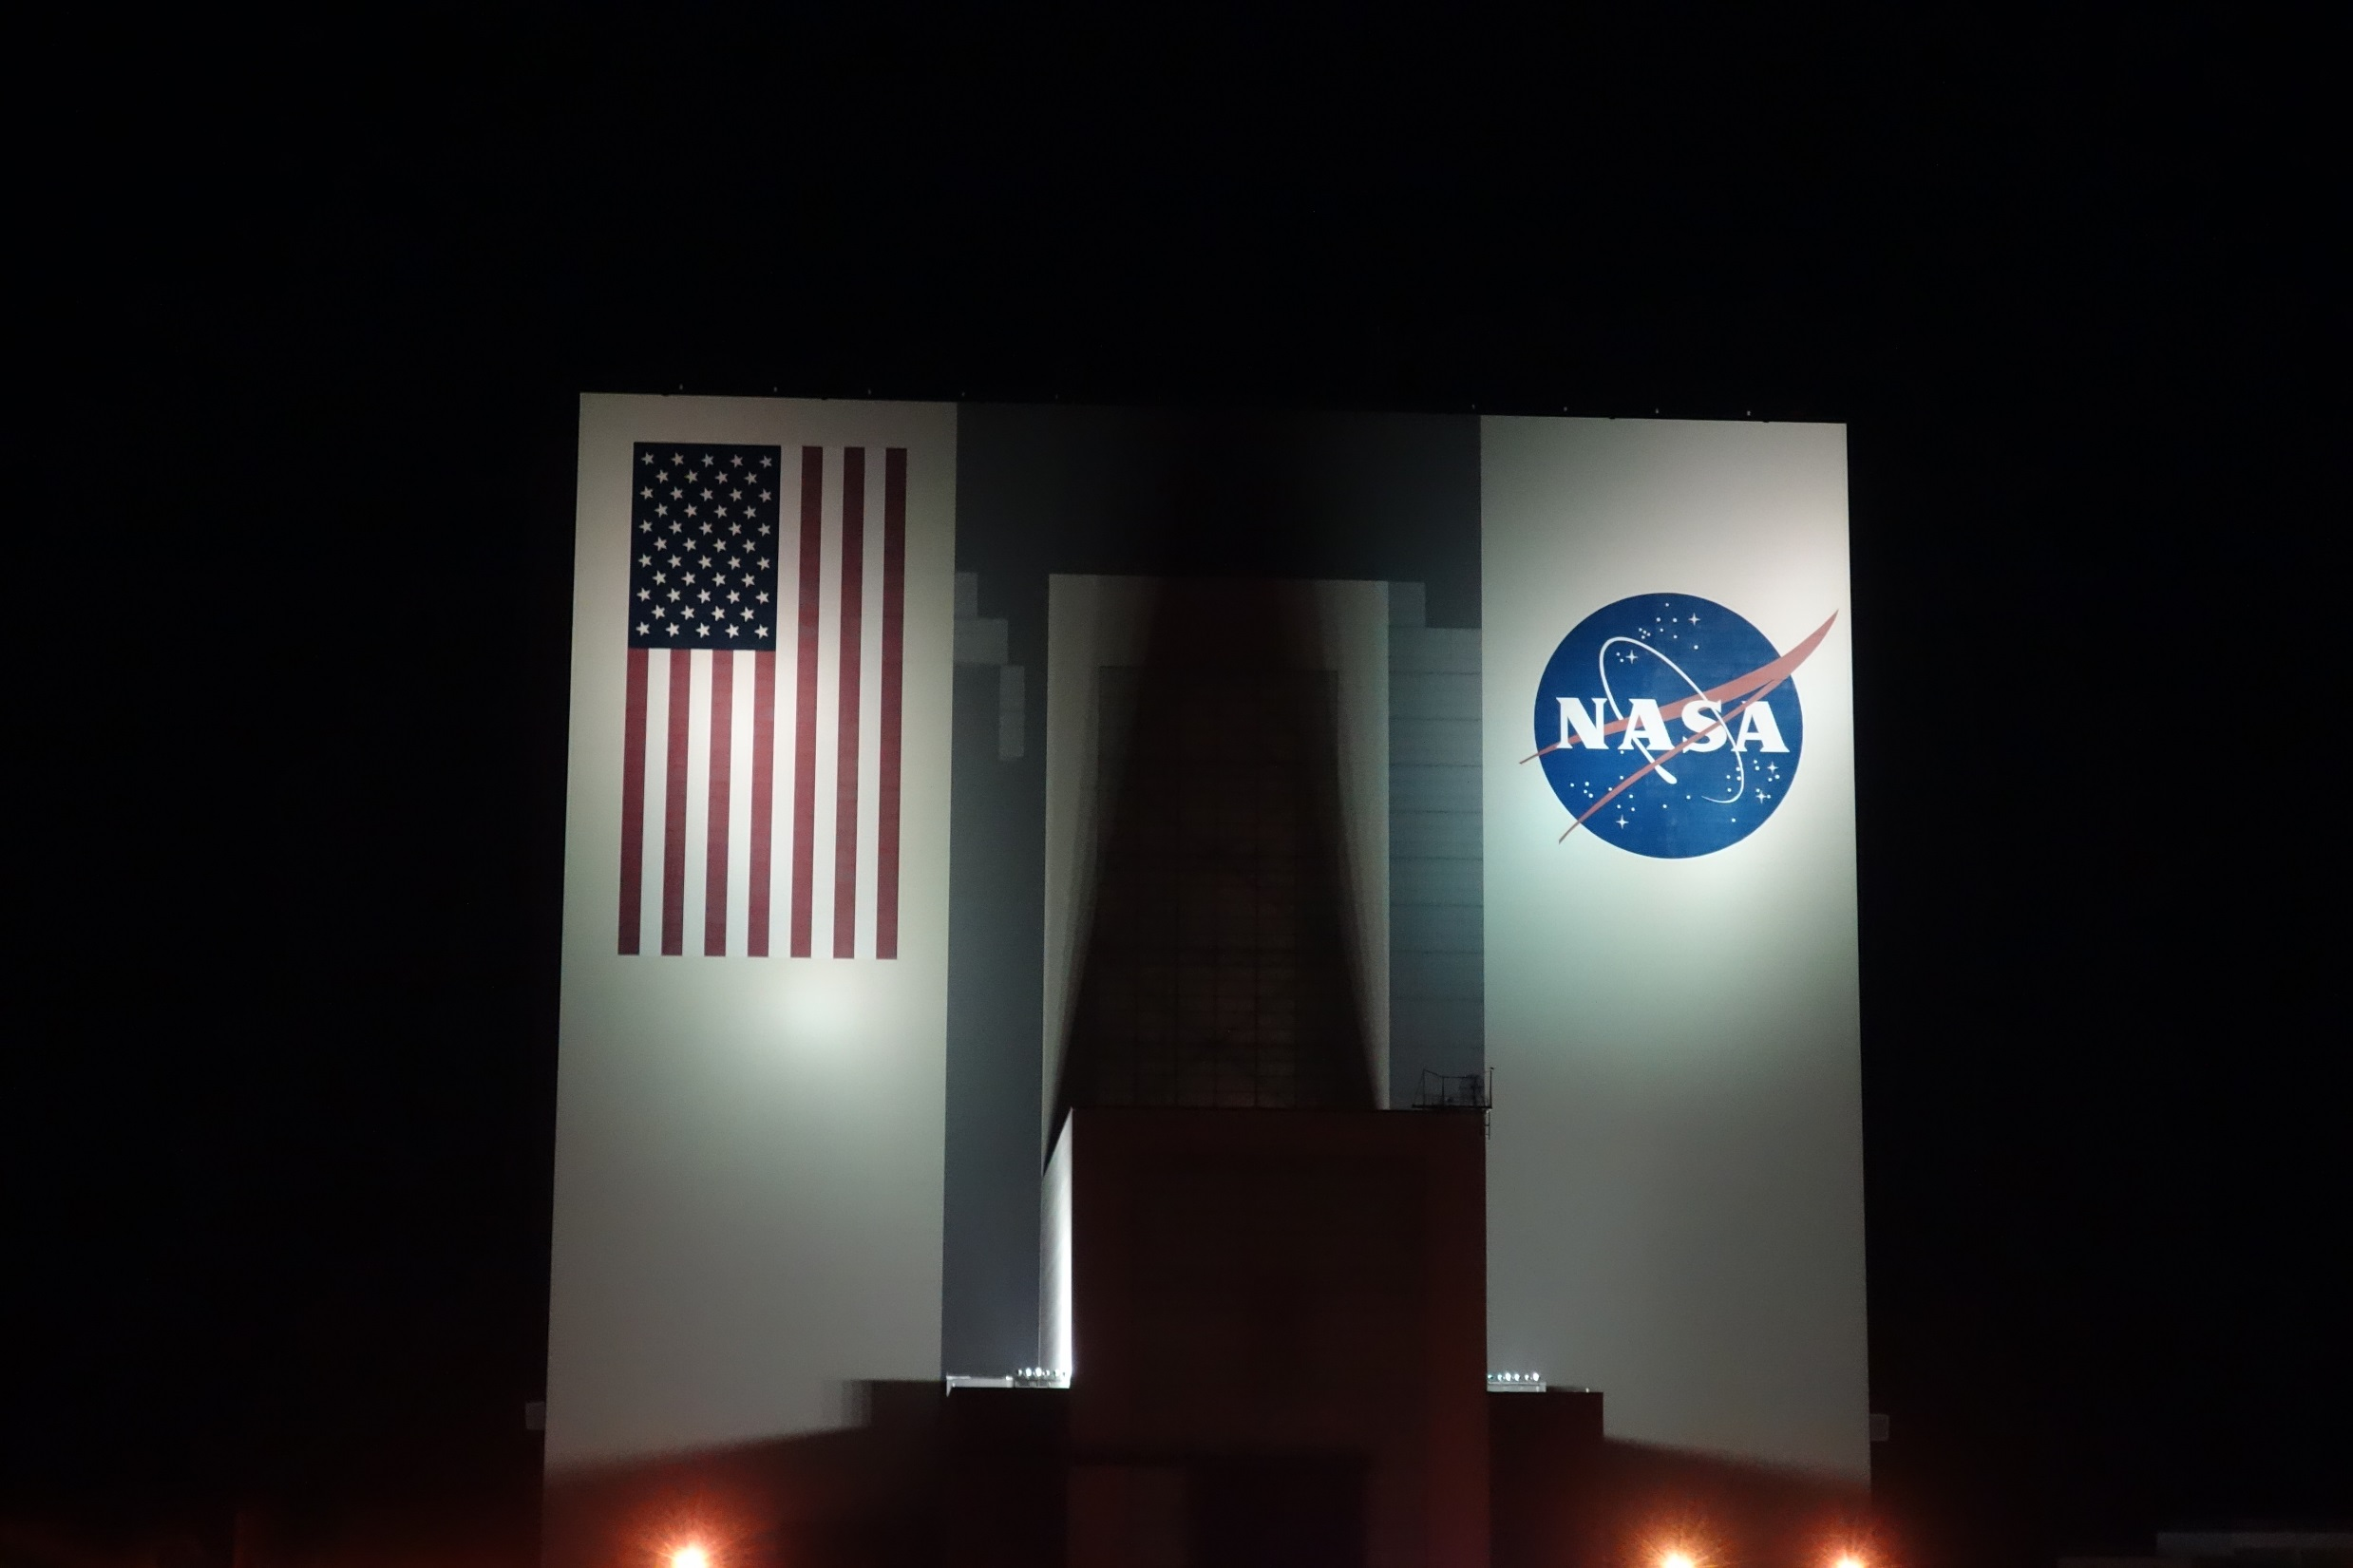

Slide 8
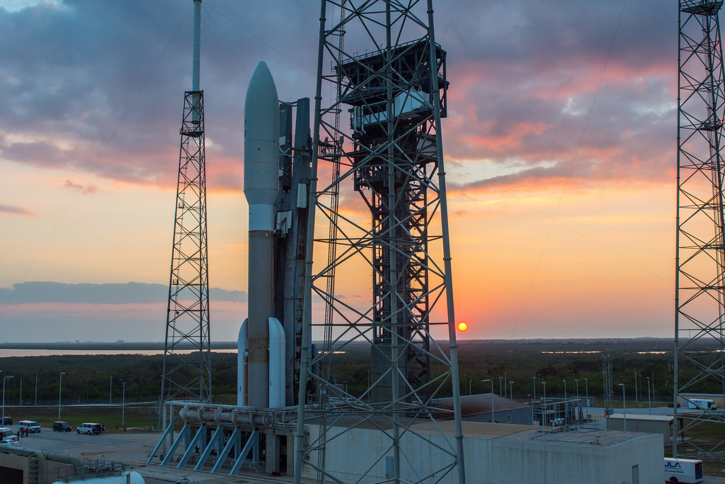
Credit: ULA / NOAA

Slide 9
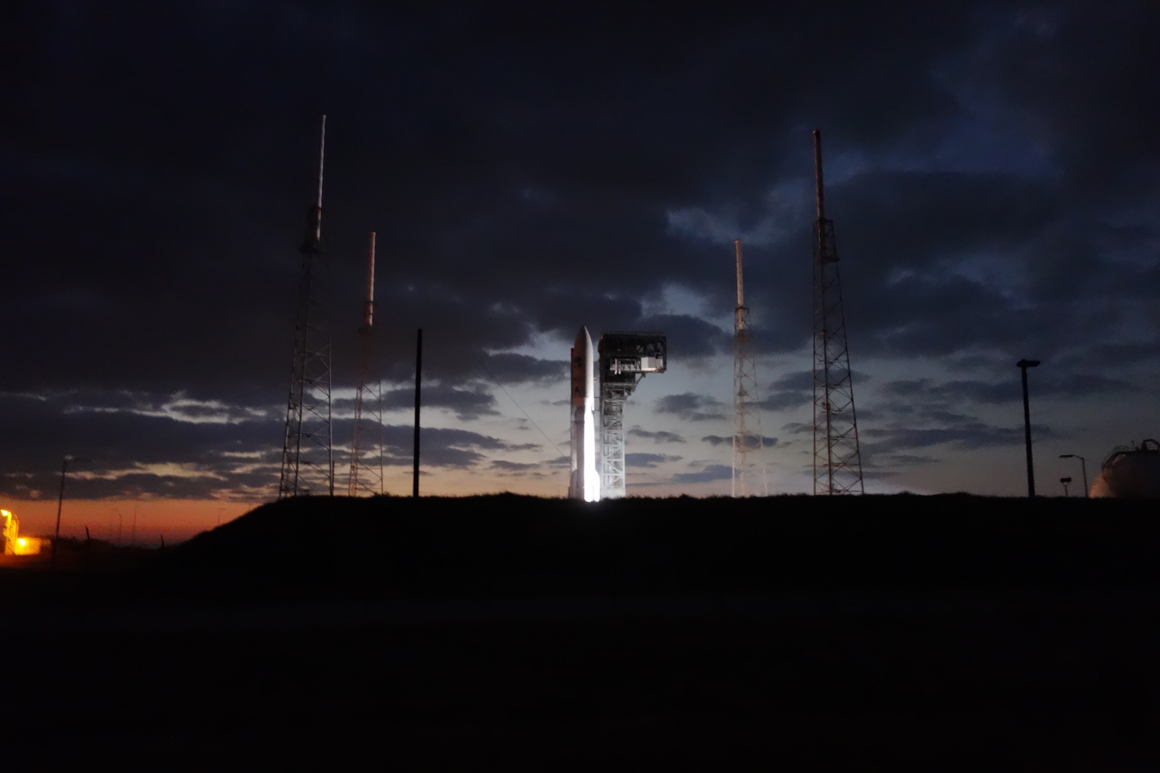

Slide 10
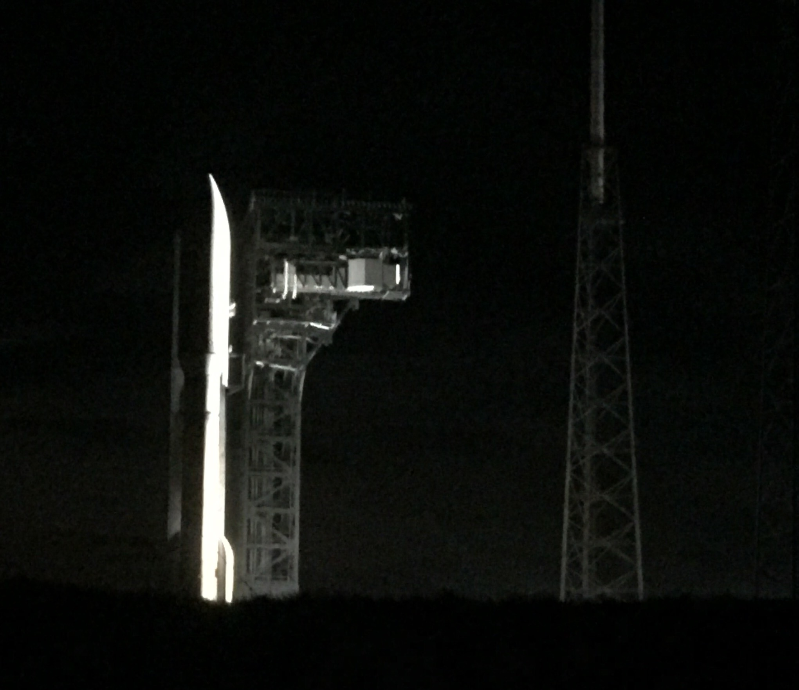

Slide 11
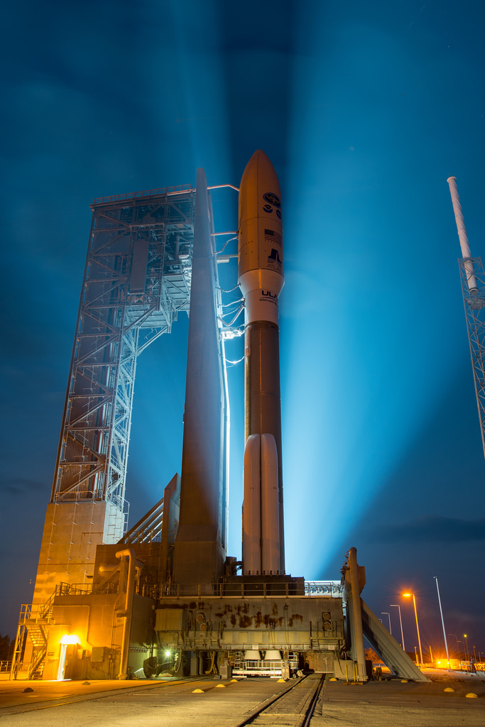
Credit: ULA / NOAA

Slide 12
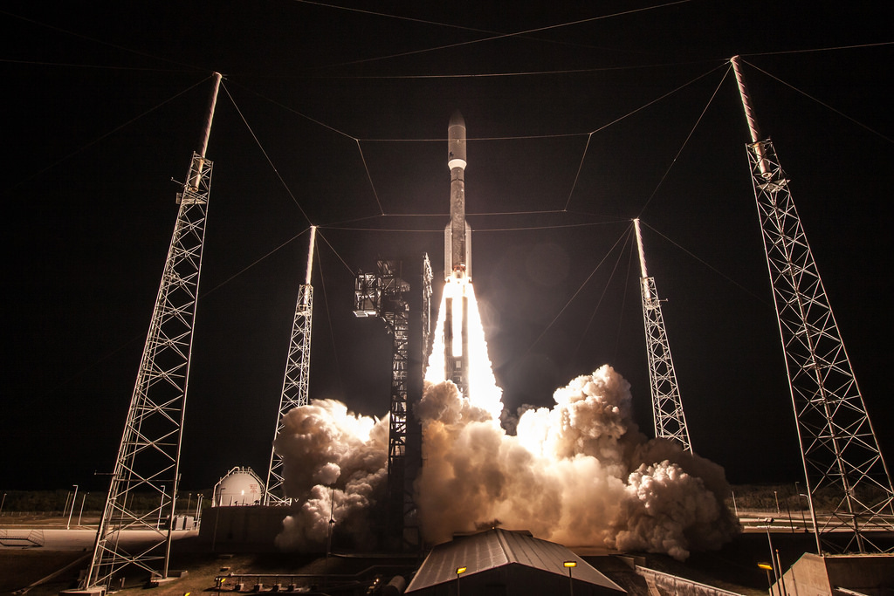
Credit: ULA / NOAA

Slide 13
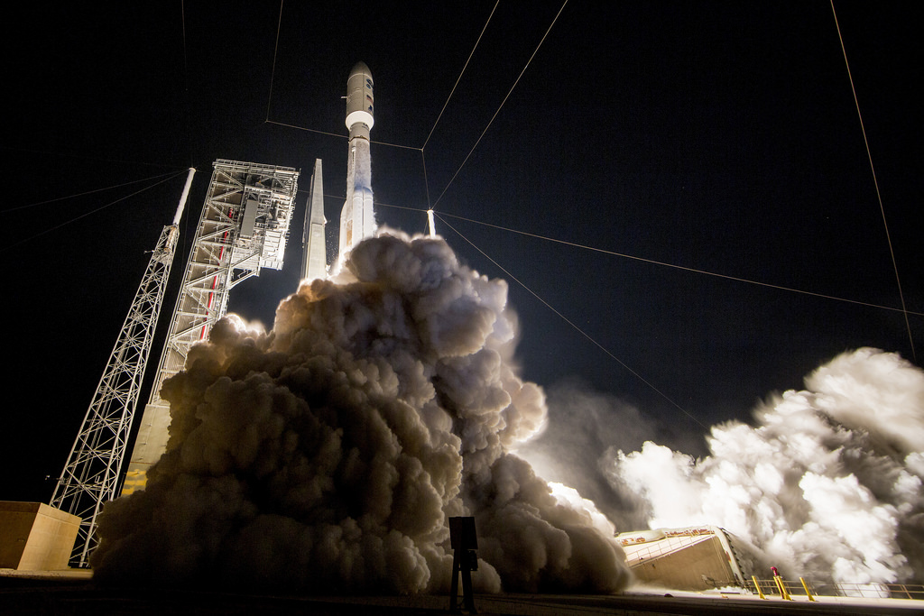
Credit: ULA / NOAA

Slide 14
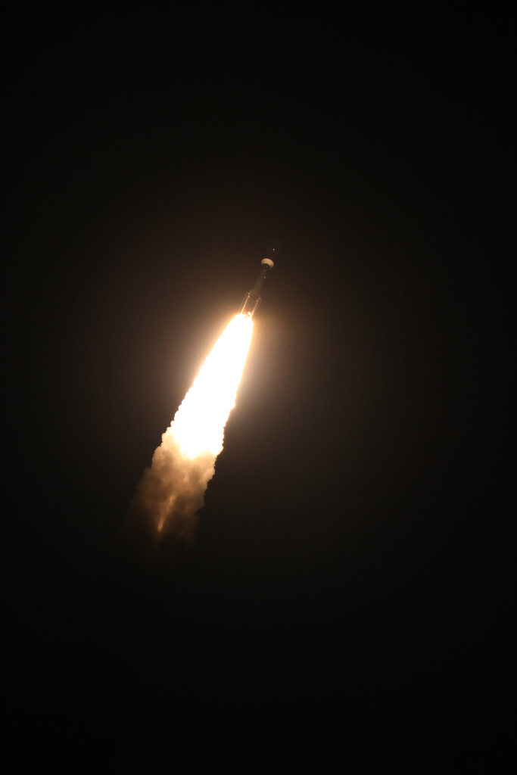
Credit: ULA / NOAA

Slide 15
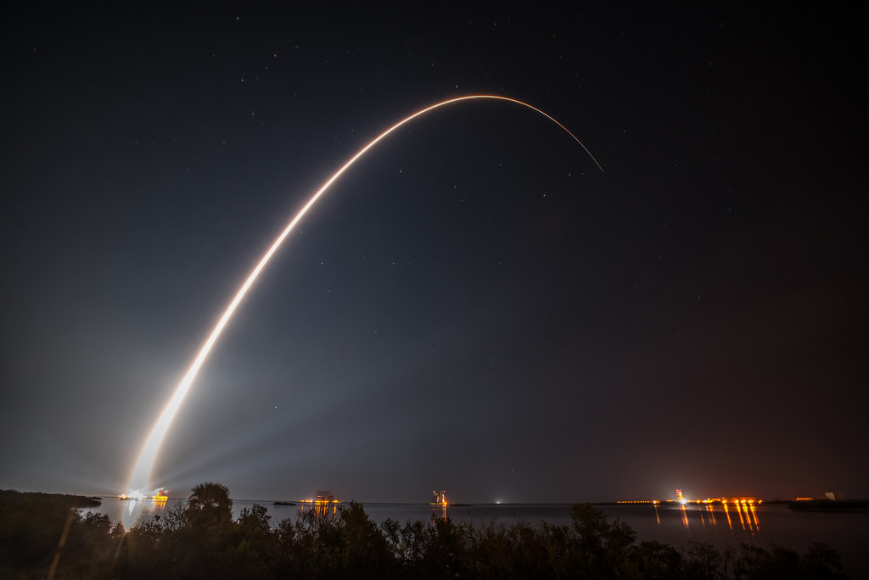
Credit: ULA / NOAA

Slide 16
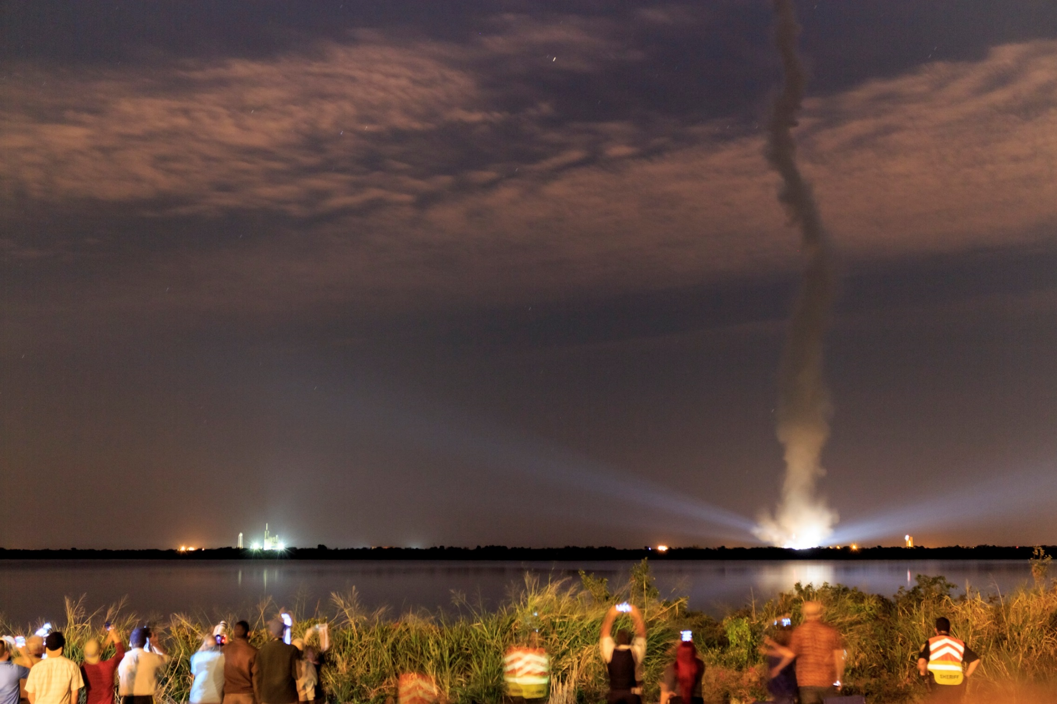
Credit: Chris Schmidt, CIMSS

Slide 17
Video from …

Slide 18
Video from ULA

Slide 19
Wx Geeks to focus on GOES-R
@DrShepherd2013
@GOESGuy
Sunday Nov 20th, 17 UTC (Noon ET).
https://twitter.com/wxgeekstwc

Slide 20
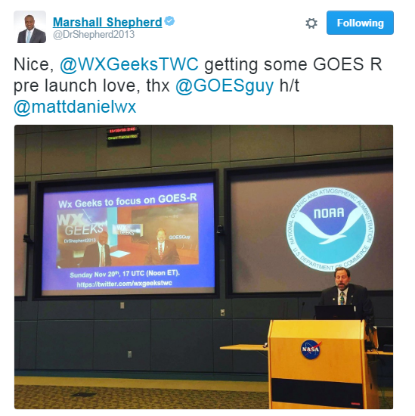

Slide 21
Fun facts:
GOES-R was the #1 on the Reddit science page
Top of trending Twitter on Saturday
A google search for GOES-R in the news section turns up more than 200K results
Notes:
Info from Lauren Gaches

Slide 22
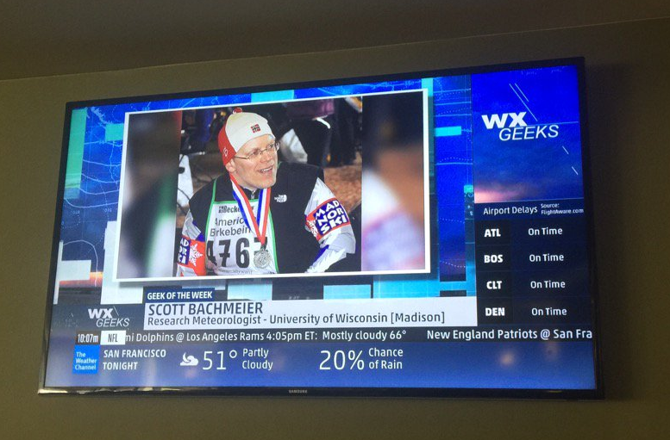

Slide 23
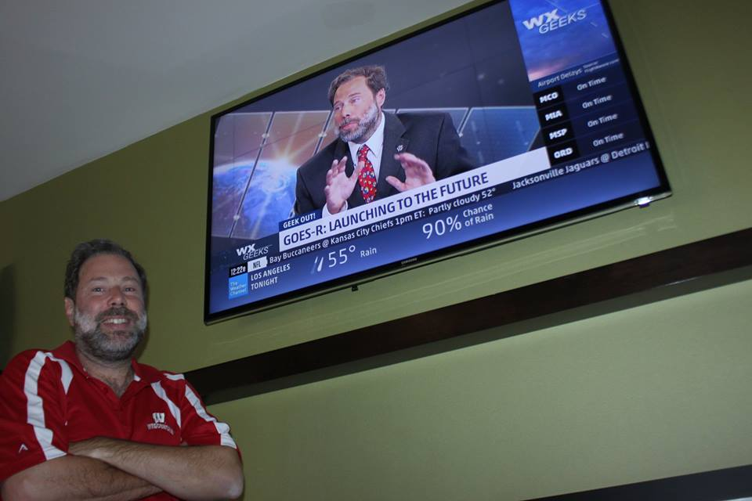
Credit: Dave Jones, Storm Center

