Slide 1
National Environmental Satellite, Data, and Information Service (NESDIS)
Satellite and Information Service
Tim Schmit, Acting ASPB Branch Chief
NOAA at CIMSS briefing, November 26, 2018

Slide 2
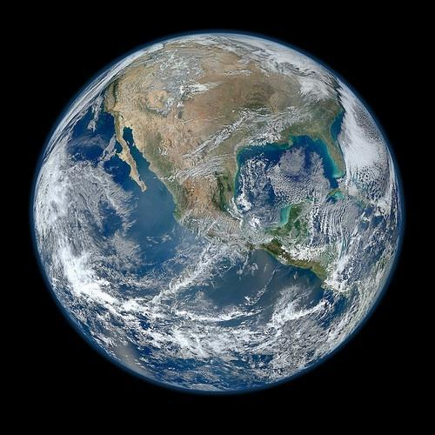
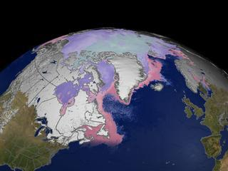
The Advanced Satellite Products Branch
NOAA/NESDIS Center for Satellite Applications and Research (STAR)
ASPB develops products from environmental satellites for short-term weather forecasting and monitoring of the earth-atmosphere system.
Notes:
GOES-17 and -16: http://cimss.ssec.wisc.edu/goes/blog/wp-content/uploads/2018/11/mollweide_ABI_band09.mp4 GOES-17: Preliminary, non-operational

Slide 3
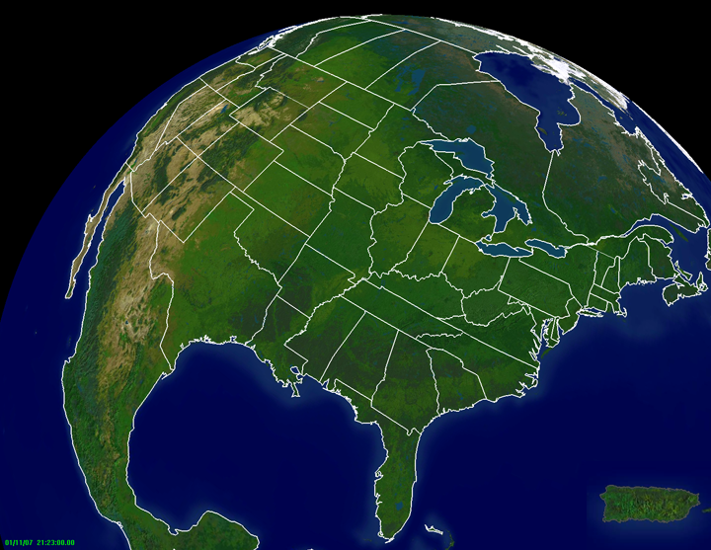
NOAA NESDIS STAR
Cooperative Research
CIRA-RAMMB
CIMSS-ASPB
CICS- SCSB
Hampton Univ
Bowie State
CREST
City College of NY
City Univ NY
Columbia Univ
Lehman College
CICS-NC
(North Carolina)
Univ. Puerto Rico

Slide 4
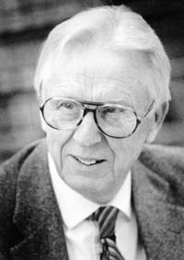
NOAA at CIMSS: History
The name has changed, but federal NOAA employees have been in Madison since the mid 1970s.

Slide 5
NOAA at CIMSS
NOAA ASPB, along with CIMSS, makes significant contributions
1). Satellite mission planning,
2). Satellite sensor calibration,
3). Satellite product development and validation, including many GOES-R and JPSS products,
4). Satellite-based Climate Data Records and analysis,
5). Nowcasting applications for improving advisories, warnings, and aviation support,
6). Proving Grounds, education, outreach and user training,
7). NWP support
- current: satellite products for data assimilation,
- past: data assimilation and model development work,
8). International expert panels
9). Other
- Weather Improvement Act
- GOES-17 ABI Issues

Slide 6
ASPB/CIMSS AWG Teams
Advanced Baseline Imager (ABI) Baseline Products
Aerosol Detection (Including Smoke and Dust)
Aerosol Optical Depth (AOD)
Clear Sky Masks | @CIMSS/ASPB
Cloud and Moisture Imagery | @CIMSS/ASPB
Cloud Optical Depth | @CIMSS/ASPB
Cloud Particle Size Distribution | @CIMSS/ASPB
Cloud Top Height | @CIMSS/ASPB
Cloud Top Phase | @CIMSS/ASPB
Cloud Top Pressure | @CIMSS/ASPB
Cloud Top Temperature | @CIMSS/ASPB
Derived Motion Winds | @CIMSS/ASPB*
Derived Stability Indices | @CIMSS/ASPB
Downward Shortwave Radiation: Surface
Fire/Hot Spot Characterization | @CIMSS/ASPB*
Hurricane Intensity Estimation | @CIMSS/ASPB
Land Surface Temperature (Skin)
Legacy Vertical Moisture Profile | @CIMSS/ASPB
Legacy Vertical Temperature Profile | @CIMSS/ASPB
Radiances
Rainfall Rate / QPE
Reflected Shortwave Radiation: TOA
Sea Surface Temperature (Skin)
Snow Cover | @CIMSS/ASPB
Total Precipitable Water | @CIMSS/ASPB
Volcanic Ash: Detection and Height | @CIMSS/ASPB
Advanced Baseline Imager (ABI) Pathfinders Products
Aerosol Particle Size
Cloud Layers/Heights | @CIMSS/ASPB
Ice Thickness | @CIMSS/ASPB
Ice: Concentration | @CIMSS/ASPB
Ice: Motion | @CIMSS/ASPB
Low Cloud and Fog | @CIMSS/ASPB
Land Surface Temperature
GOES-R Program
ABI Level 2 (derived products)
Total: 22 out of 31
AWG = Algorithm Working Group
For CIMSS/ASPB products, Team Lead is ASPB and science team is at CIMSS.
* Team lead is in DC, algorithm developer and science team at CIMSS.
Notes:
The only other thing I wanted to say about AWG is show the list of baseline and Pathfinder ABI products. There are about this many “option 2” products too that are sort of just in limbo now.

Slide 7
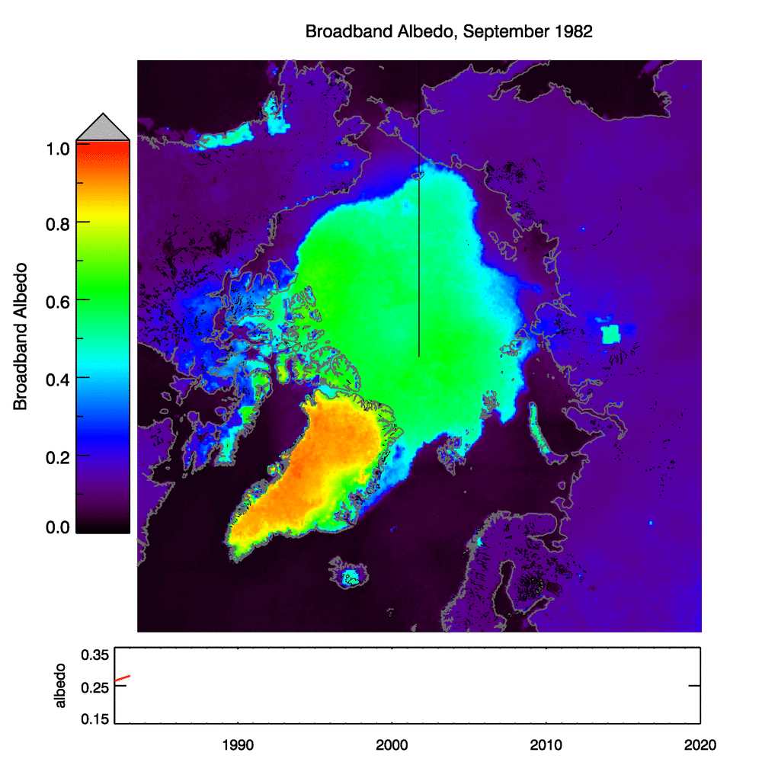
A Satellite-based Climate Data Record for the Arctic and Antarctic
AVHRR Polar Pathfinder Extended (APP-x):
1982 – present, updated daily
Cloud properties, surface temperature, albedo, and ice thickness, surface and top-of-atmosphere radiation
Arctic and Antarctic
25 km resolution, twice daily
Available from the NOAA National Centers for Environmental Information (NCEI)
Arctic surface albedo in September,
1982-2018 (animation)
POC: Jeff Key, NESDIS Center for Satellite Applications and Research (Jeff.Key@noaa.gov)
Notes:
Animation.

Slide 8
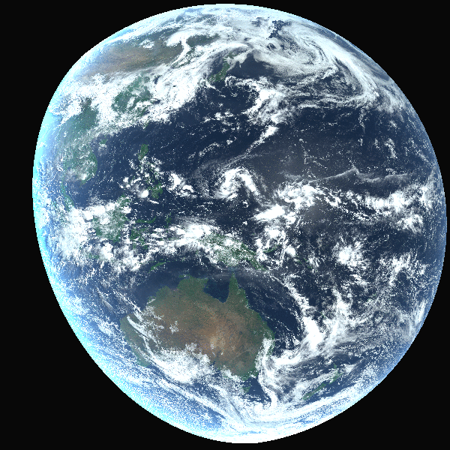
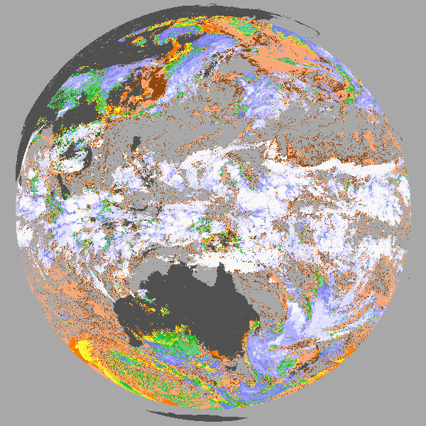
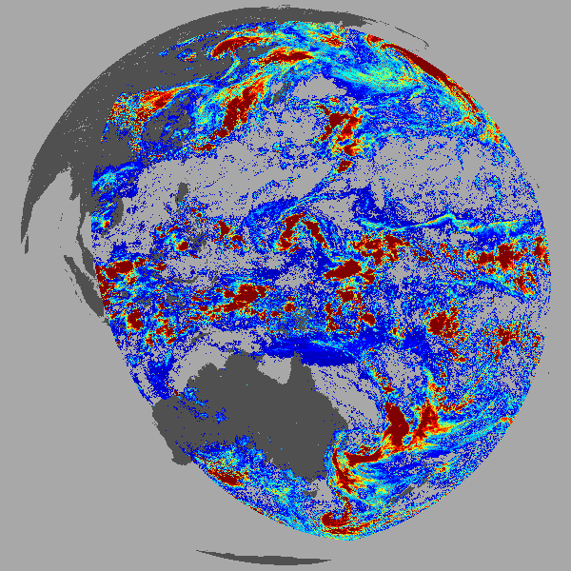
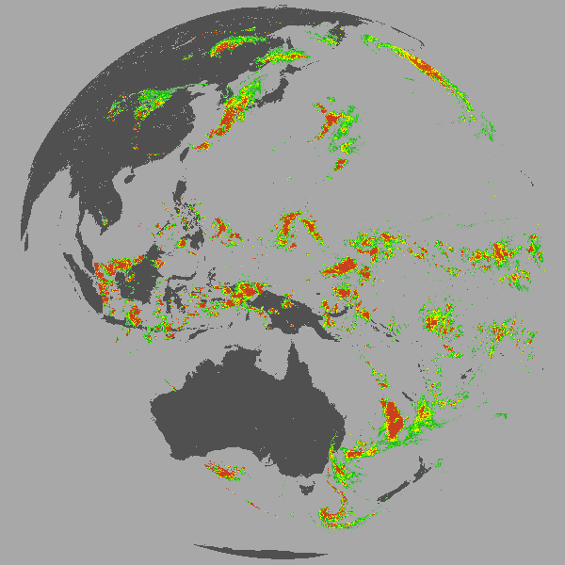
NOAA/NESDIS Imager Cloud Product Highlights
JPSS NOAA-20 NDE Products are in the midst of Beta Reviews and should reach provisional by September.
NCEP is now using the VIIRS Cloud Mask and Height to screen CrIS data for its radiance assimilation.
GOES-R products are provisional.
ECMWF is using the cloud mask for its Clear-Sky Radiance assimilation.
Moderate Assurance
We run the NOAA Enterprise Algorithms on GOES-15, GOES-16, MSG-11, MSG-8, COMS, AVHRR, MODIS and VIIRS.
We serve data to ESRL, NREL, NCEI and NWS AWC.
Example Moderate Assurance Processing Done at CIMSS for AHI
Cld Top Pressure.
Cld Optical Depth.
Cld Derived Rain.
POC: Andy Heidinger, NESDIS Center for Satellite Applications and Research (Andrew.Heidinger@noaa.gov@noaa.gov)

Slide 9
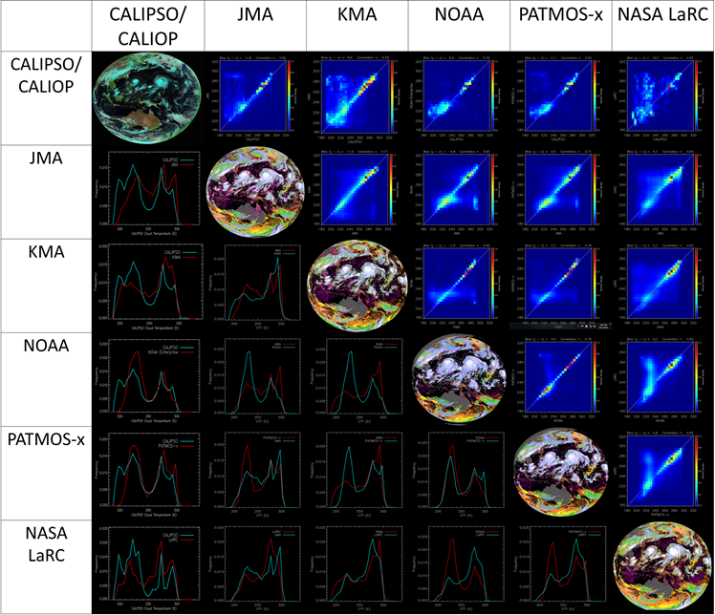
International Clouds Working Group (ICWG)
Next Workshop was hosted by CIMSS in November 2018.
~ 80 participants.
A. Heidinger is the now the co-chair with Rob Roebeling of EUMETSAT
A large part of this WG is cloud product intercomparison (see image on right).
We expect to compare products from NOAA, NASA, JMA, KMA, CMA, EUMETSAT and others on pre-selected geo and polar scenes.
Critical components of GOES-R and JPSS validation efforts.
Expect users from NCEP, NCAR and NWS to attend.
Example of cloud temperature inter-comparison from ICWG-1
POC: Andy Heidinger, NESDIS Center for Satellite Applications and Research (Andrew.Heidinger@noaa.gov@noaa.gov)

Slide 10
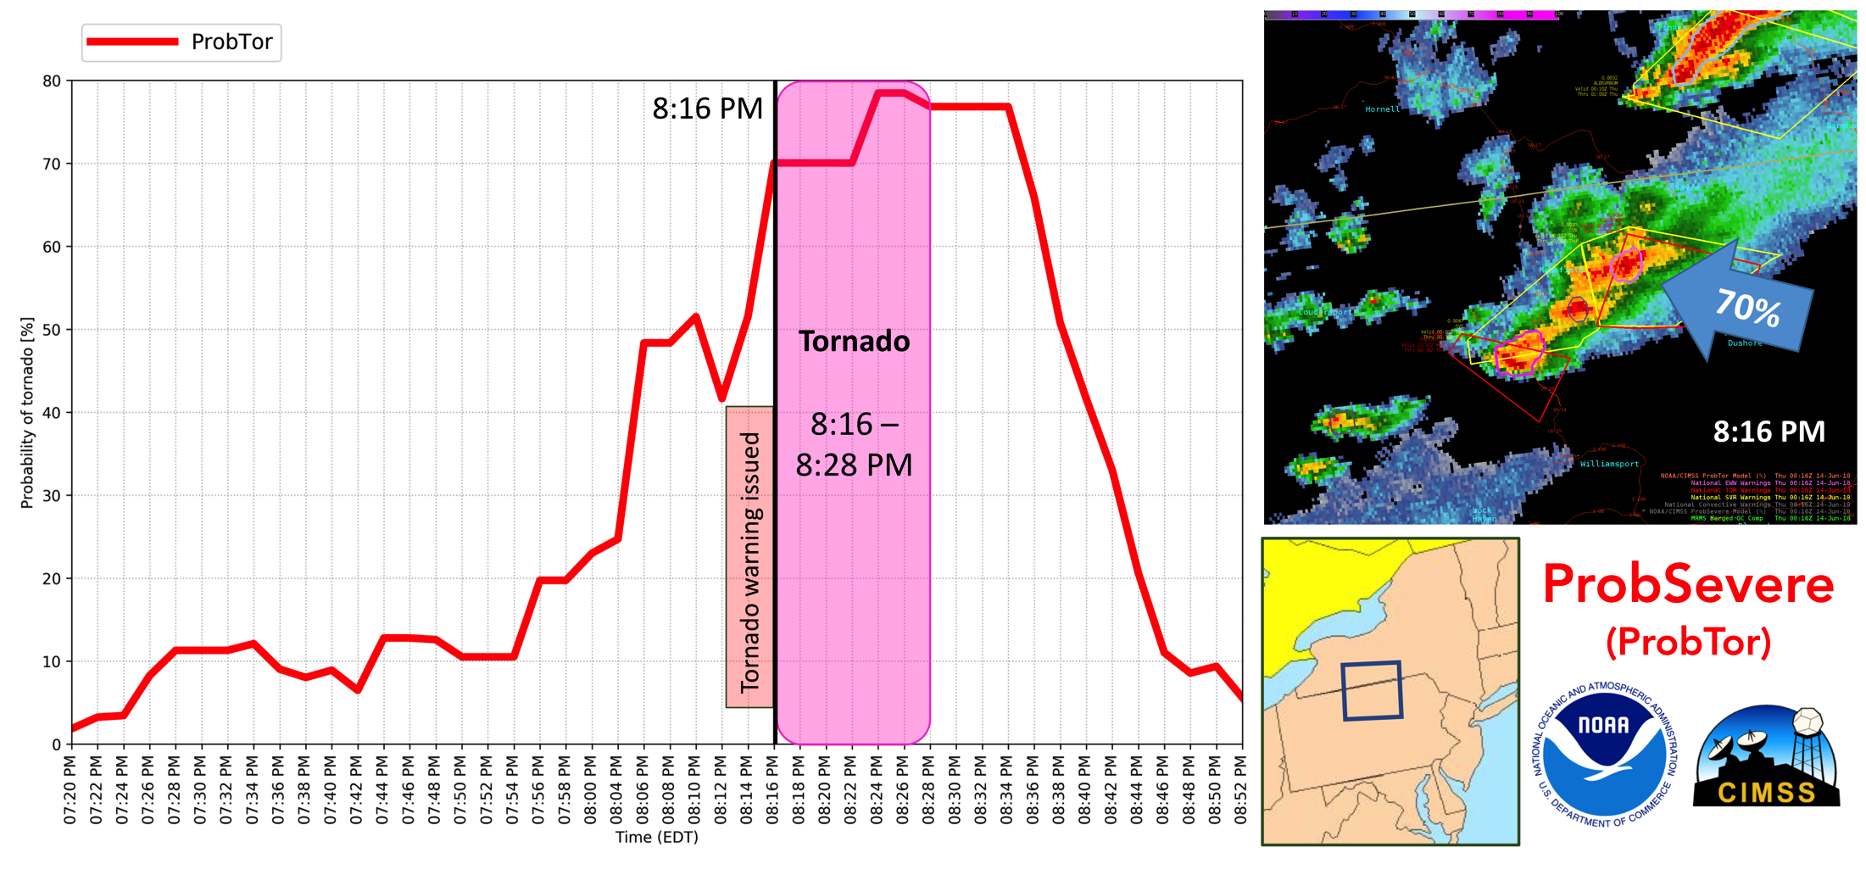
Transforming Data to Environmental Intelligence
“Probability of Severe” (ProbSevere) model for improved severe thunderstorm and tornado warnings
Automated volcanic eruption detection and ash cloud tracking in direct support of NOAA obligation to the International Civil Aviation Organization (ICAO) International Airways Volcano Watch (IAVW)
Products for increasing aviation safety and efficiency in low visibility conditions
Tornado guidance from ProbSevere model
Timely detection of volcanic eruptions + info for improved ash cloud forecasting
POC: Michael Pavolonis, NESDIS Center for Satellite Applications and Research (Mike.Pavolonis@noaa.gov)

Slide 11
GOES-17 vs GOES-15 Full Disks
POC: Tim Schmit, NESDIS Center for Satellite Applications and Research (Tim.J.Schmit@noaa.gov)
Preliminary, non-operational
Notes:
http://cimss.ssec.wisc.edu/goes/blog/wp-content/uploads/2018/11/FD_ABI137_WEST128_VIS_loop_2018322_120038_2018323_153038_faster.mp4

Slide 12
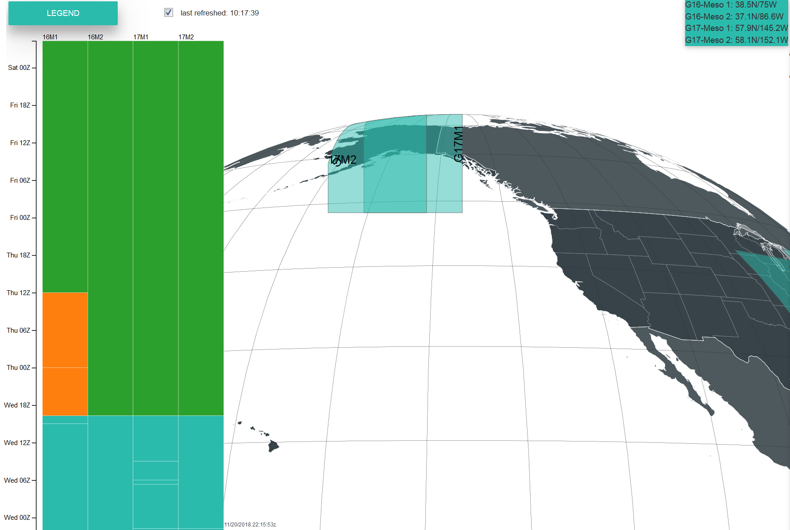
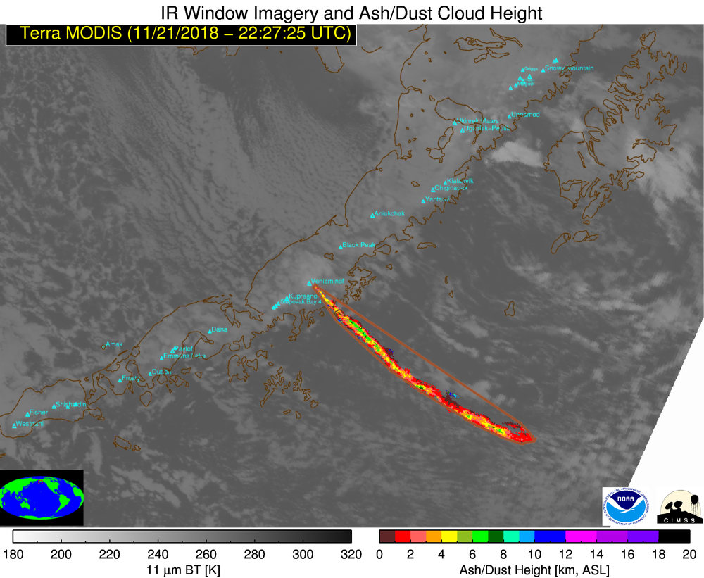
GOES-17 Meso-locations
POC: Tim Schmit, NESDIS Center for Satellite Applications and Research (Tim.J.Schmit@noaa.gov)

Slide 13
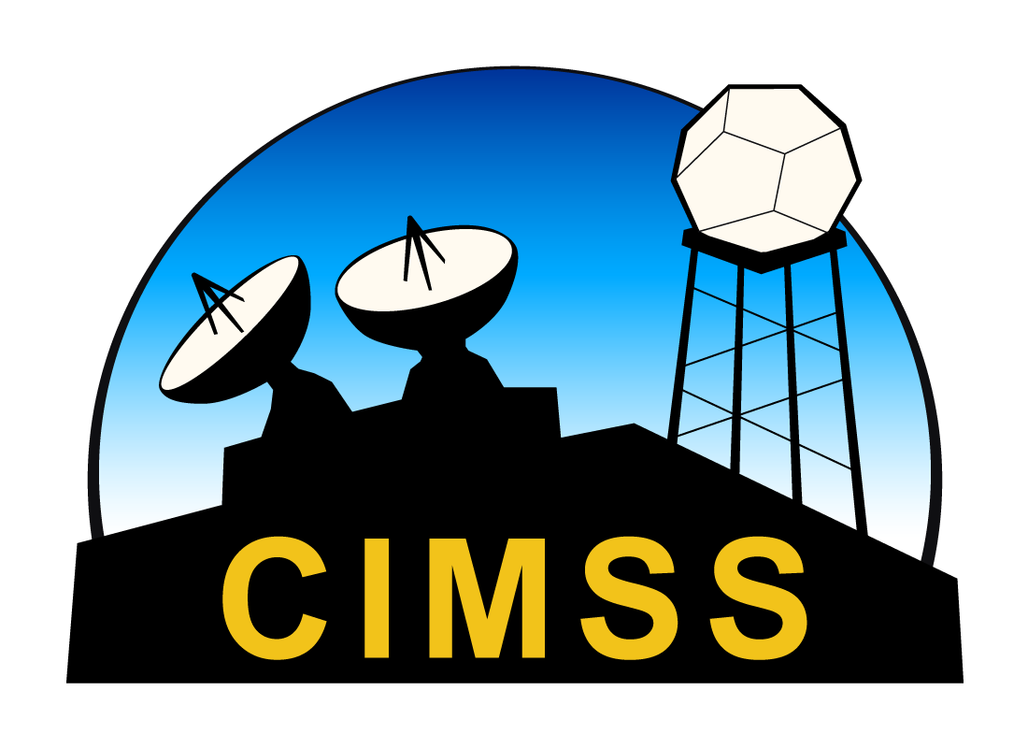
NCEI/CIMSS
Research-To-Operations projects in collaboration with the National Hurricane Center
Lead Authorship in USGCRP/NCA, CLIVAR, WMO, and IPCC reports
Targeted research in the relationships between climate variability and change and tropical cyclones
Formal interactions and collaborations with NOAA stakeholders, primarily from the Insurance/Reinsurance, Oil and Gas Producer, Catastrophe Modeling, and Disaster Risk Reduction sectors
POC: James Kossin, NCEI Center for Weather and Climate (james.kossin@noaa.gov)

Slide 14
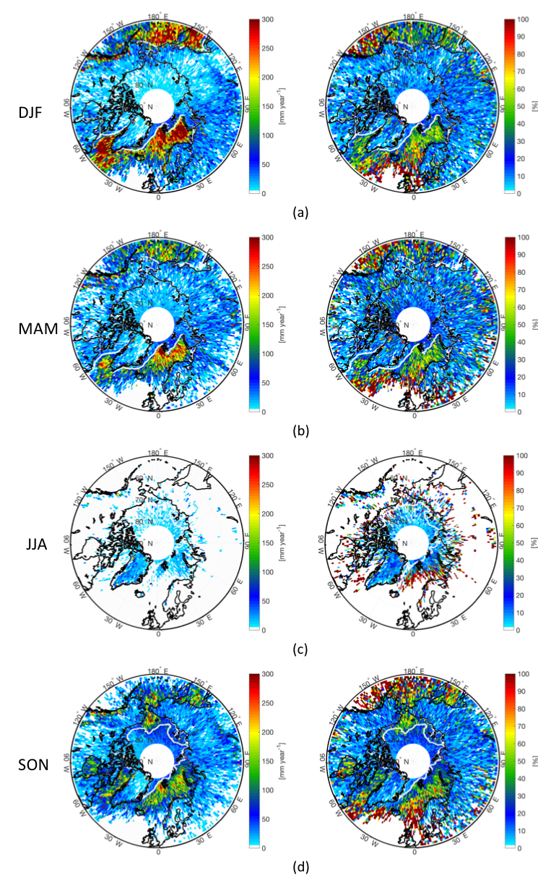
Mark Kulie
Joins ASPB November 26
PhD (UW-Madison; 2010) – Snowfall remote sensing
Satellite-based global snowfall mapping
Monitoring long-term snowfall changes
Improving satellite + NWP snowfall QPE
Ground-based snow microphysics observations (Marquette, MI NWSWFO)
Great Lakes lake-effect snow product development (GOES + NEXRAD)
CloudSat seasonal convective snow QPE (left) and
occurrence fraction (right) (Kulie and Milani 2018).

Slide 15
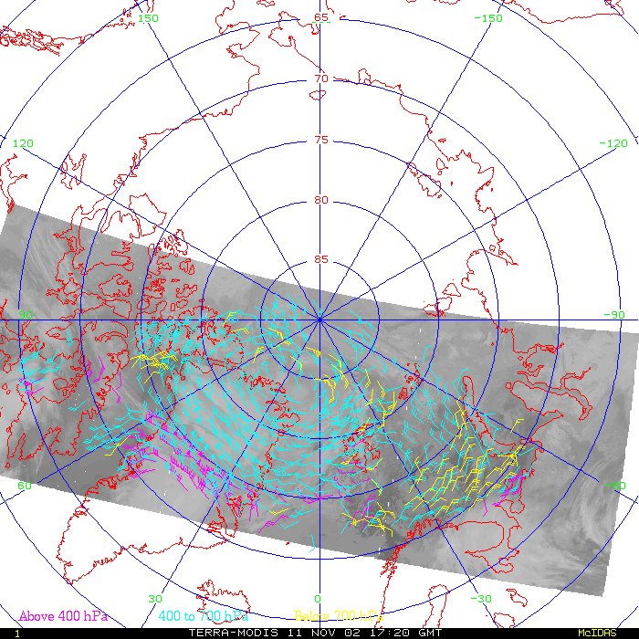
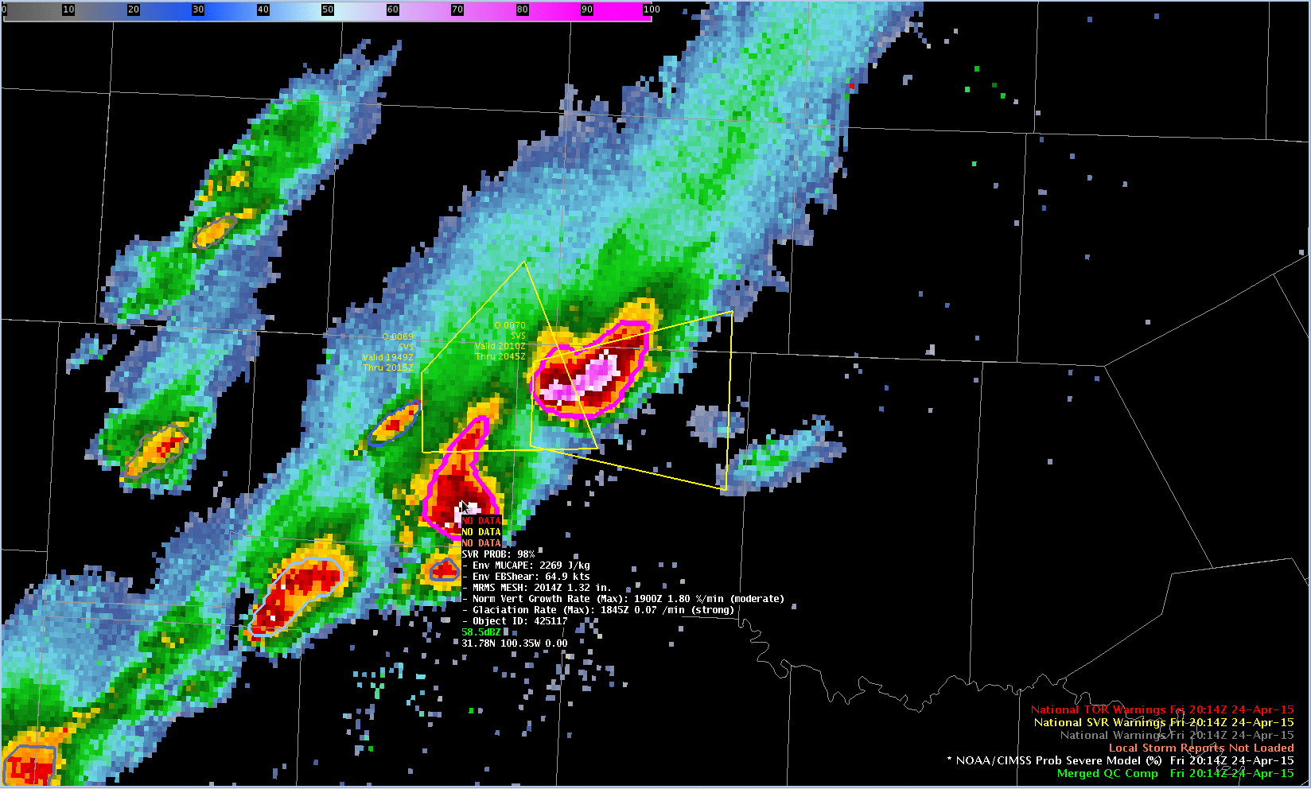
ASPB Priorities
Weather
GOES products: imagery, soundings, winds, fires, clouds, clear-sky brightness temperature, snow/ice, aviation
POES products: polar winds, global clouds, snow/ice, volcanic ash
Air quality modeling and data assimilation
Satellite data assimilation
Nearcasting
Instruments
Calibration
Inter-calibration
Sensor performance analysis
Validation
Instruments: GOES-R/S, JPSS; Tundra Orbit, etc.

Slide 16
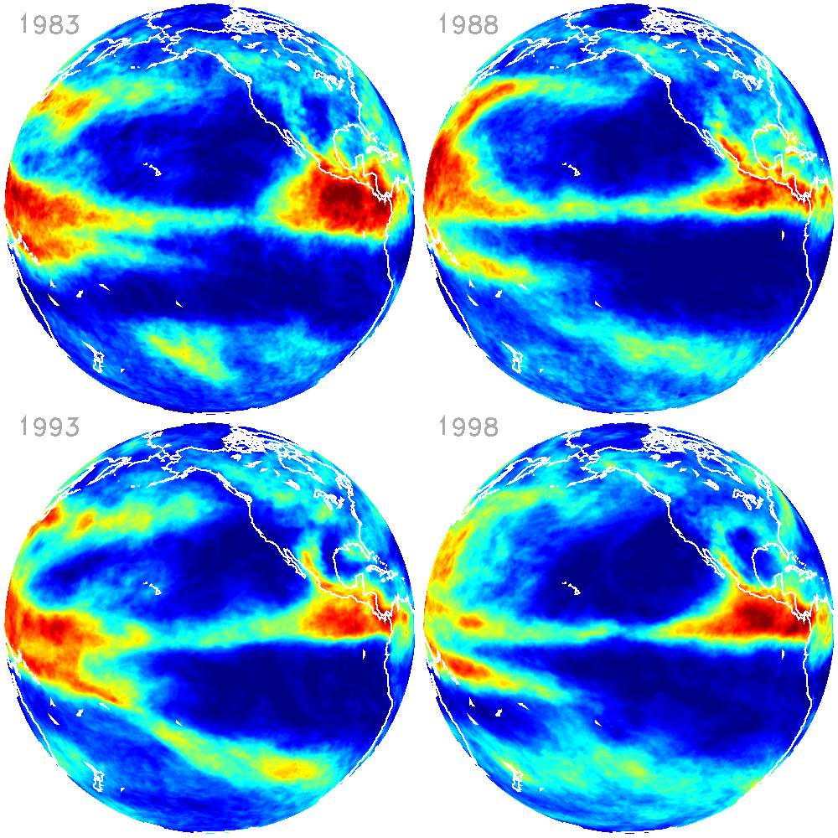
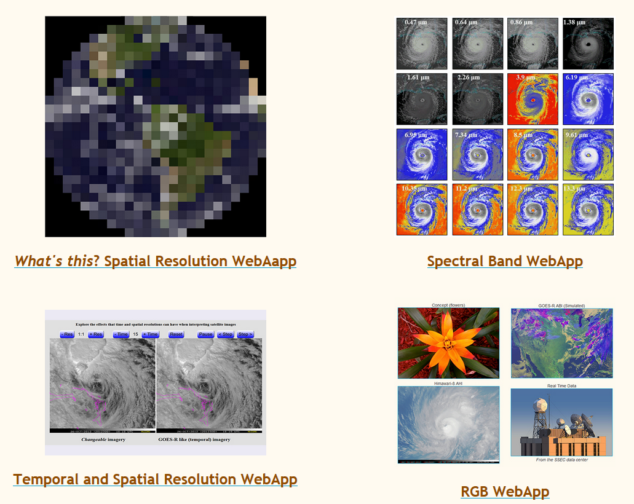
ASPB Priorities, cont.
Climate
Global cloud cover
Polar clouds, winds, snow and ice
Biomass burning
Feedbacks and interactions
Outreach and Service
Bringing new products into AWIPS
Training (e.g., VISITview, distance learning)
Proving Ground
Mentoring graduate and undergraduate students
International activities
Global Cryosphere Watch
GEO/GEOS, CEOS, CGMS, WMO, ESA, EUMETSAT
Notes:
Webapps: http://cimss.ssec.wisc.edu/education/goesr/webapps

