Slide 1
The Advanced Baseline Imager (ABI) on the GOES-R Series
Timothy J. Schmit (tim.j.schmit@noaa.gov) (“GOESguy”)
NOAA/NESDIS/Satellite Applications and Research
Advanced Satellite Products Branch (ASPB)
Madison, WI
Plus many, many more…
November 29, 2016
UW-Madison

Slide 2
Thanks to…
GOES-R Program Office
Bill Line
Jordan Gerth
Scott Lindstrom
Mat Gunshor
Steve Goodman
Kathryn Mozer
Matt Seybold
Kathleen Strabala
Dan Nietfeld
SSEC data center
Kaba Bah
Steve Miller and Dan Lindsey
JMA
ITT / Harris and the Entire GOES-R team!

Slide 3
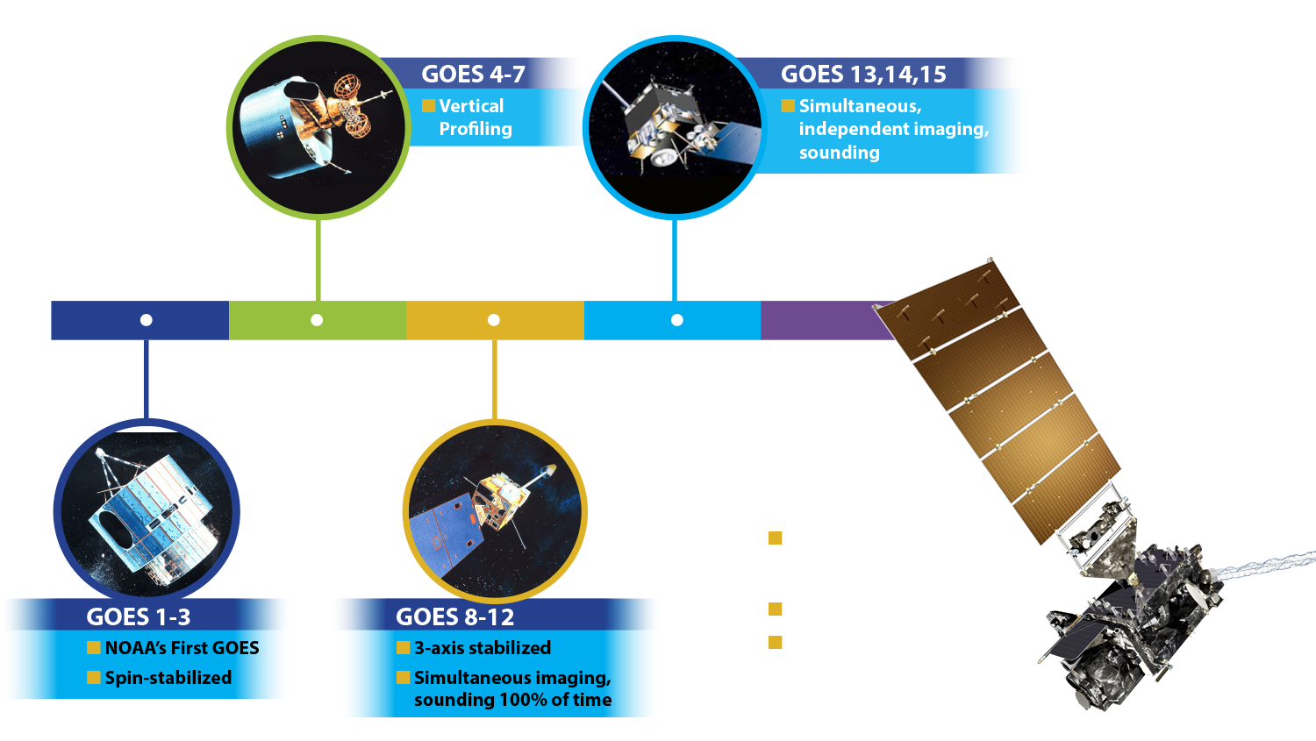
A History of GOES “Weather” Satellites
ATS
SMS
Notes:
The focus of this Short Course is to describe the advancements with the GOES-R series

Slide 4
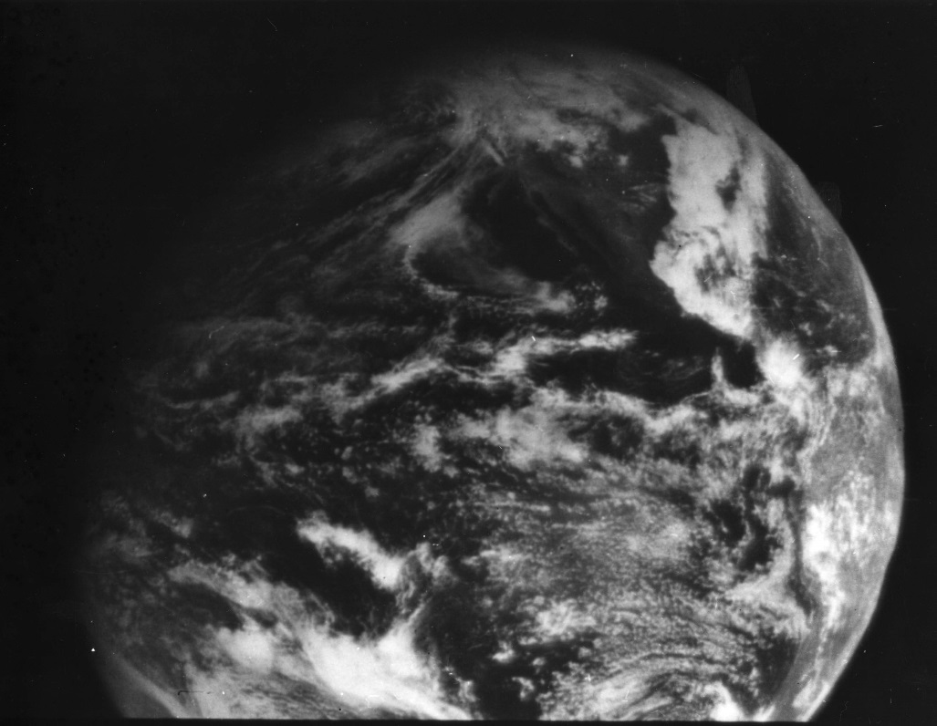
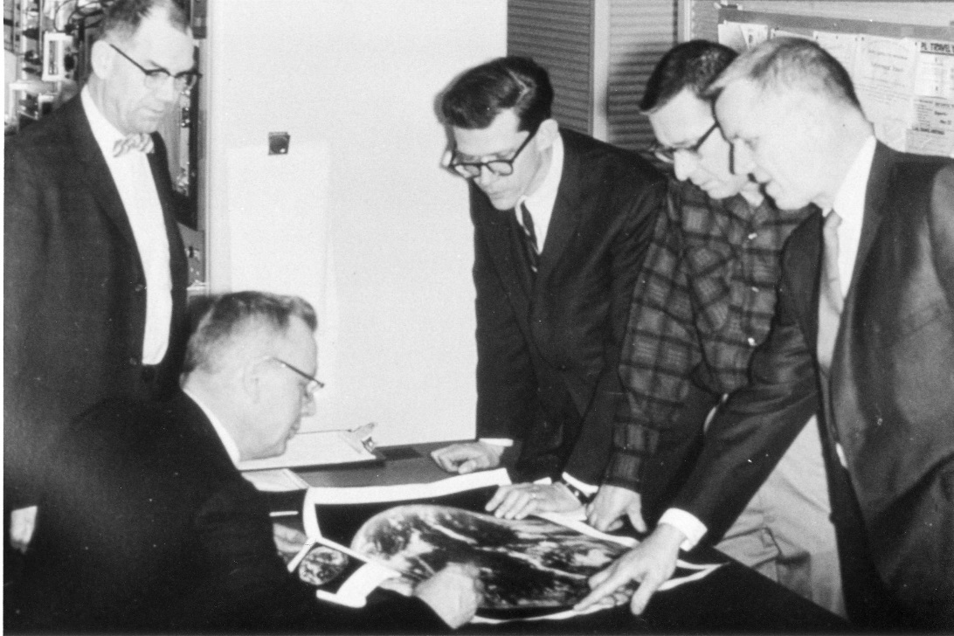
1966: ATS-1 launched
Applications Technology Satellite (ATS)-1 was the first geostationary imager, launched 6 December 1966. Imaging instrument designer and SSEC co-founder, Verner E. Suomi, proclaimed, “the clouds move, not the earth”.
11 December 1966
Notes:
http://cimss.ssec.wisc.edu/news/geo_image_anniversary.html

Slide 5
Suomi Introduced Time Continuous Imaging
Chicago Tribune
makes cautious
announcement
on 5 Dec 1966
of pending new
“weather eye”
On 7 Dec 1966 Tribune
declares
“multipurpose moonlet”
successfully launched

Slide 6
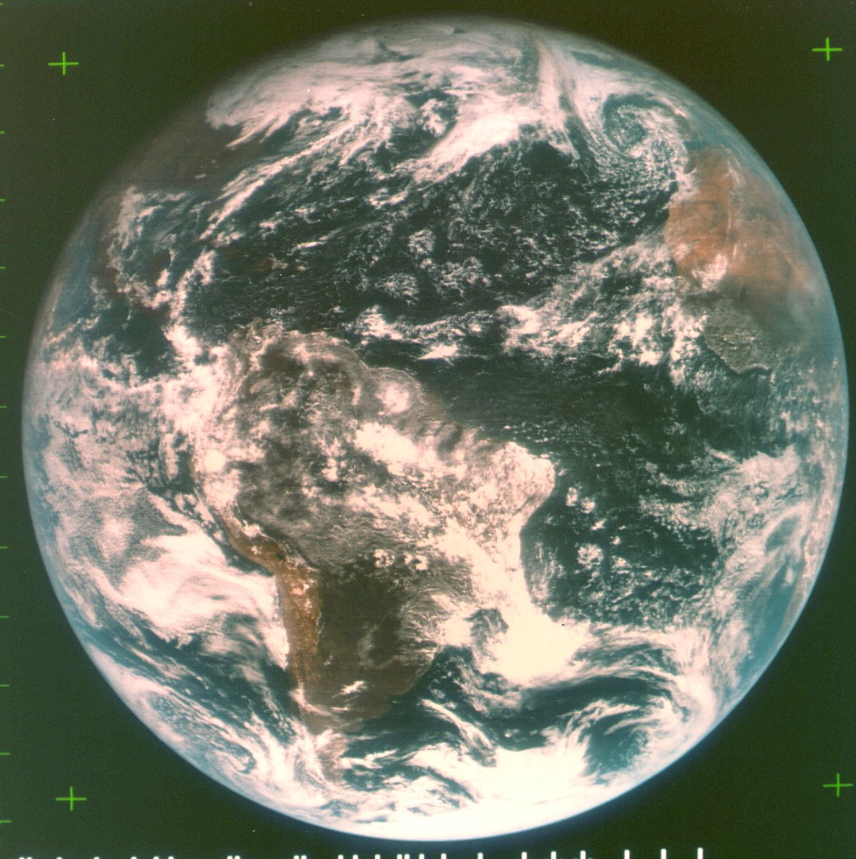
ATS-III November 18, 1967
The spin scan cloud camera provided full disk visible images of the earth and its cloud cover every 20 minutes.
Note the ‘natural color’ image from the 3 visible spectral bands.
Notes:
Natural color images from the geo perspective are possible, as demonstrated in 1967.

Slide 7
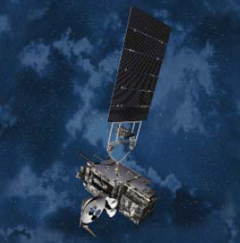
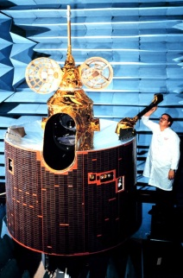
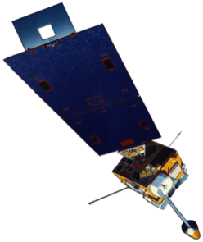
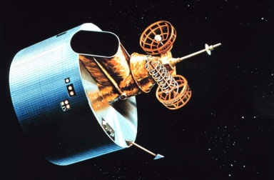
GOES History
GOES-1/3
Launched
1975
1977 1978
One visible and one infrared .
Operational.
GOES-4/7
Launched
1980
1981
1983
1987
VISSR–VAS visible, 12 IR. MSI (visible, IRW, and 2 additional IR channels)
GOES-8/12
Launched
1994
1995
1997
2000
2001
3-axis stabilized.
Imager Bands: 4 IR; 1 visible.
Operational Sounder
(18 IR bands)
GOES-13/14/15
Launched
2005
2009
2010
Better navigation and calibration.
No eclipse outages.
Better spatial resolutions for the 6.5 um on GOES-12+ and the 13.3 um band on GOES-14/15.
Operational Sounder
GOES-R/S+
Planned Launch
2015
2017
2020
2025
Faster coverage.
16 Imager Bands.
Improved spatial.
No sounder.
GLM
1G 2G 3G 4G 5G
Notes:
The circles represent an estimate of the impact of GOES on regional scale numerical models.

Slide 8
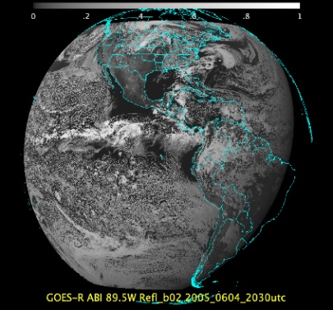
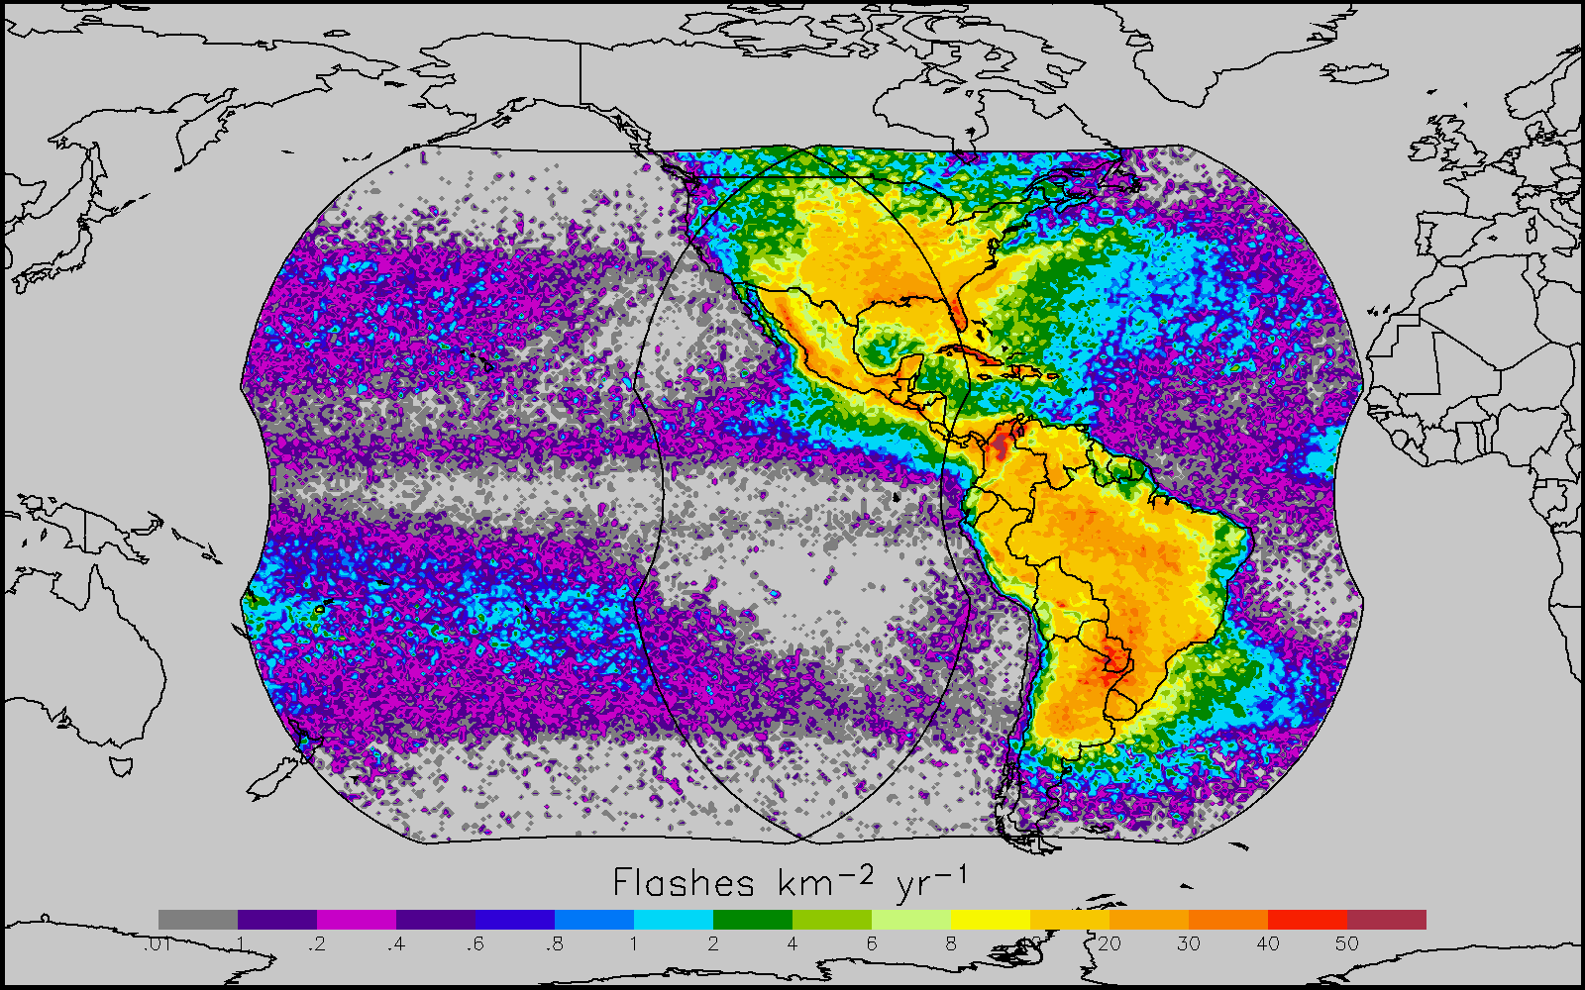
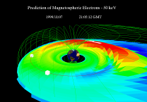
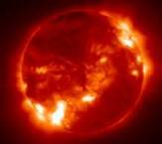
Why GOES-R ?
The GOES-R series will provide significant improvements in the detection and observations of meteorological phenomena that directly impact public safety, protection of property, and our Nation’s economic health and prosperity.
ABI
GLM
SEISS and MAG
EXIS and SUVI
Visible & IR Imagery
Lightning Mapping
Space Weather Monitoring
Solar Imaging
Improves hurricane track & intensity forecasts
Increases thunderstorm & tornado warning lead time
Improves aviation flight route planning
Data for long-term climate variability studies
Improved air quality warnings and alerts
Improves solar flare warnings for communications and navigation disruptions
More accurate monitoring of energetic particles responsible for radiation hazards to humans and spacecraft
Better monitoring of Coronal Mass Ejections to improve geomagnetic storm forecasting
8

Slide 9
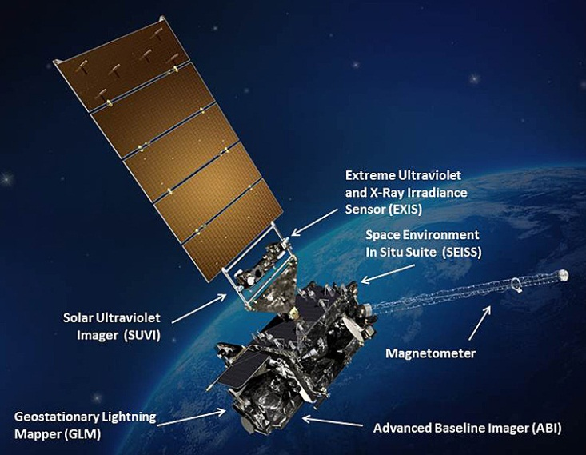
GOES-R
Next generation of NOAA/NASA geo weather satellites
R-Series includes 4 satellites (R, S, T, U)
First to launch in Nov 2016
Represents first major upgrade in over 20 years
Earth-pointing instruments
Geostationary Lightning Mapper (GLM)
Advanced Baseline Imager (ABI)
3x more spectral bands
4x spatial resolution
5x temporal coverage
Space weather and solar imaging instruments
Space Environment in-Situ Sensor Suite (SEISS)
Magnetometer
Solar Ultra-Violet Imager (SUVI)
Extreme Ultraviolet and X-ray Irradiance Sensors (EXIS)

Slide 10
GOES-R
Notes:
Graphic from LM

Slide 11
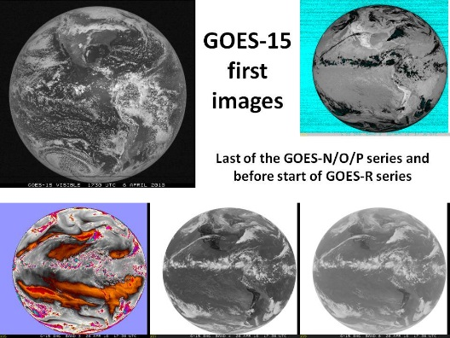
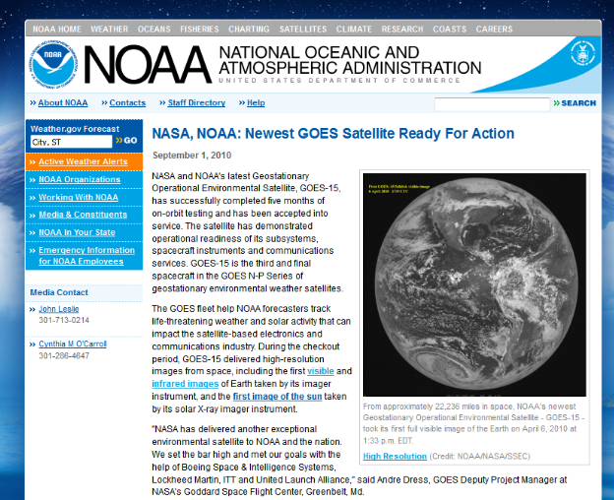
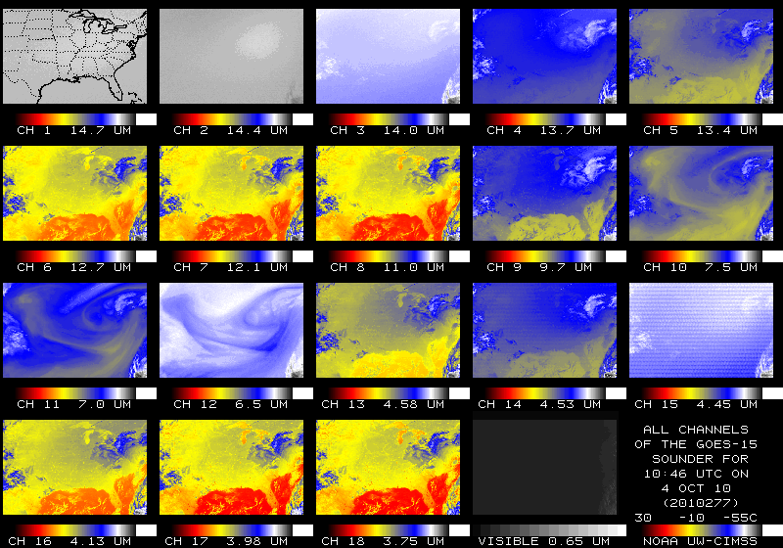
GOES Science Tests (eg, Post-Launch Tests)
With Don Hillger. etc.
STAR, along with several Cooperative Institutes, have had active roles in the Science Test part of Post Launch Testing for the GOES
Science Test coordination involved CIMSS, CIRA, NASA/MSFC, SAB, and OSPO (and others).
GOES-15 Science Test web page http://rammb.cira.colostate.edu/projects/goes-p/ provides test schedules, daily implementation of those schedules, and initial results of the tests.
Several GOES-15-related issues were addressed:
Testing of solar-contamination of images taken during keep out zones
Characterization of Sounder striping
Data flow was tested to AWIPS/NWS level
Comparisons with high-spectral infrared AIRS and IASI have found a bias of Imager bands 3 and 6.
Unique 1-min rapid scan imagery acquired
NOAA Technical Reports have been published.
First GOES-15 Imager (all bands).
GOES-15 Sounder (all bands).
Significance: The NOAA Science test is a critical function to ensure the GOES are ultimately operational. There are many goals of the Science Test, including to assess the data quality, generate products, investigate instrument changes, and collect unique rapid-scan imagery. STAR, along with several Cooperative Institutes, have been active in all the GOES PLTs.
Notes:
GOES-P was called GOES-15 after it successfully obtained geostationary orbit.
The Science Tests are time for learning about the satellite and collecting unique data, but to discover things wrong and a chance to correct them. With GOES-15 the main changes involved …
Full-disk GOES images courtesy of CIRA.

Slide 12
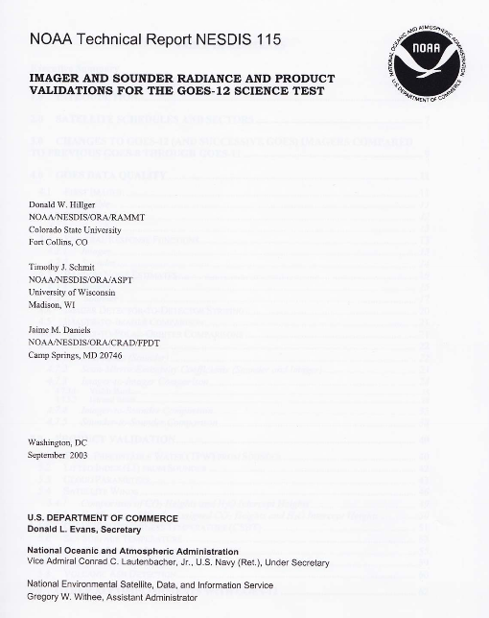
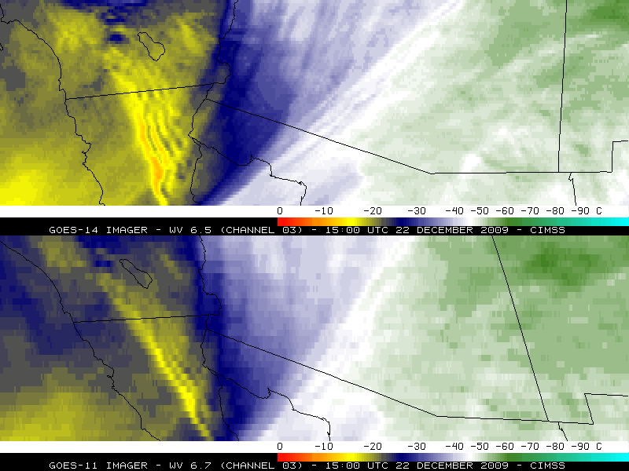
GOES Science Tests (eg, Post-Launch Tests)
STAR, along with several Cooperative Institutes, have had active roles in the Science Test part of Post Launch Testing for all the GOES:
Pre-GOES and GOES-1 – 3
GOES-4 – 7
GOES-8, -9, -10, -11, -12
GOES-13, -14, -15
NOAA Tech reports included instrument characterizations, imagery and level 2 products.
Notes:
GOES-P was called GOES-15 after it successfully obtained geostationary orbit.
The Science Tests are time for learning about the satellite and collecting unique data, but to discover things wrong and a chance to correct them. With GOES-15 the main changes involved …
Full-disk GOES images courtesy of CIRA.

Slide 13
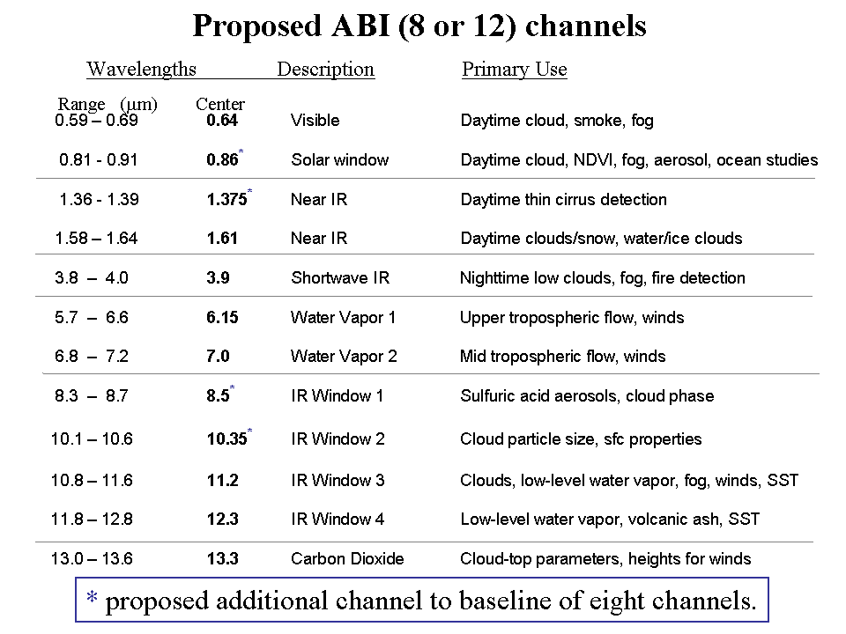
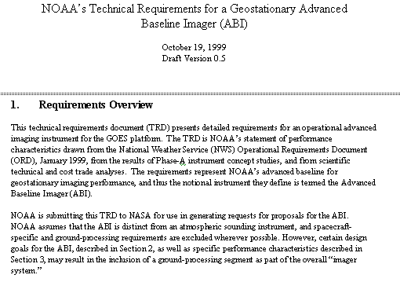
Mission Planning
STAR and CIMSS very involved during the early GOES-R series development. This includes: formulation studies for both ABI and Advanced Baseline Sounder (ABS), ABI band selection and modification, etc.
ABI/ABS Requirements.
circa 1999/2000
Originally ABI was only 8 spectral bands, now it is 16. All ABI bands were modified with input from STAR and its Cooperative Institutes.
Notes:
Significant remaining scientific challenges for the specific science topic
Next step(s)
Instruments (current/future), techniques, testbed, transition, …
Path into applications/operations
Who will use it and how
How will it get out to the real world

Slide 14
1 0.52 – 0.72 0.62 Visible Daytime clouds, fog 8 1.3 – 1.9 1.6 Near IR Daytime clouds/snow, water/ice clouds 2 3.8 – 4.0 3.9 Shortwave IR Nighttime low clouds, fog, fire detection 3 6.5 – 7.0 6.75 Water Vapor 1 Upper tropospheric flow, winds 6 7.0 – 7.5 7.25 Water Vapor 2 Mid tropospheric flow, winds 4 10.2 – 11.2 10.7 IR Window 3 Clouds, low-level water vapor, fog, winds 5 11.5 – 12.5 12.0 IR Window 4 Low-level water vapor, volcanic ash 7 13.2 – 13.8 13.5 Carbon Dioxide Cloud-top parameters, heights for winds
ABI - 8
# Wavelengths Description Primary Use
Range (μm) Center
Launch was planned for 2008!
ABI – circa 1999
(8 total bands, most spectrally wide)
Notes:
These 8 bands represent the current GOES imager “six” and 1.6 and 7.2 um bands.

Slide 15
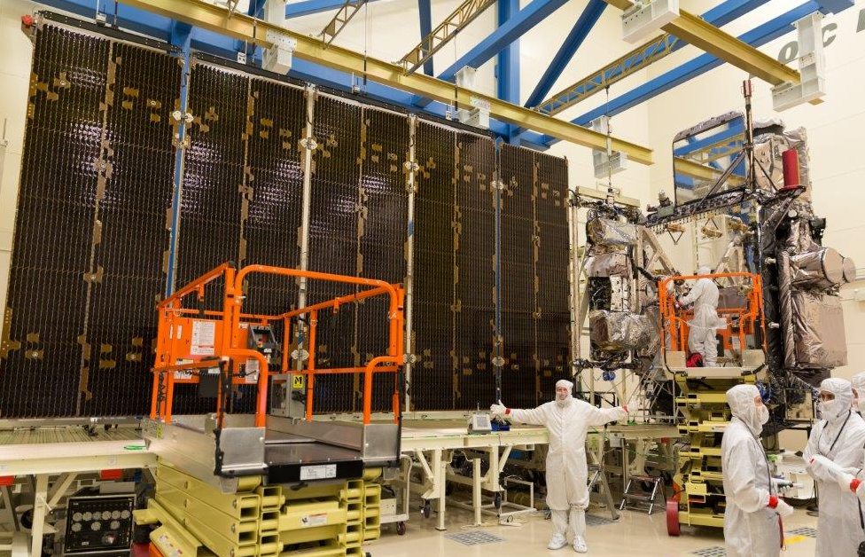
Credit: Lockheed-Martin

Slide 16
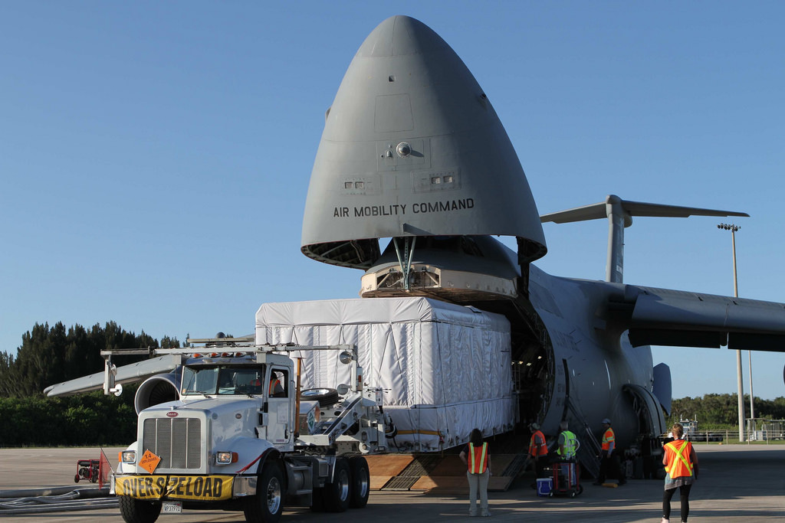
Credit: NOAA / NASA

Slide 17
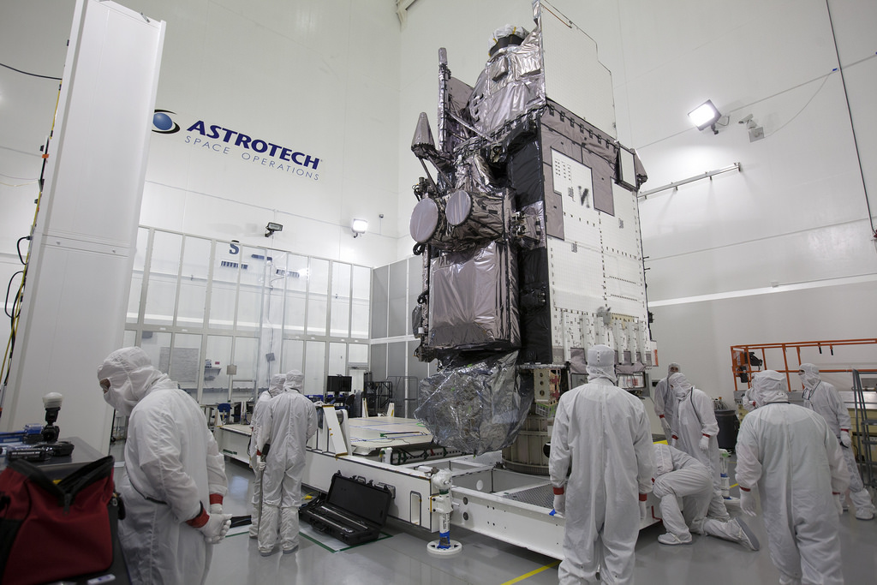
Credit: NOAA / NASA

Slide 19
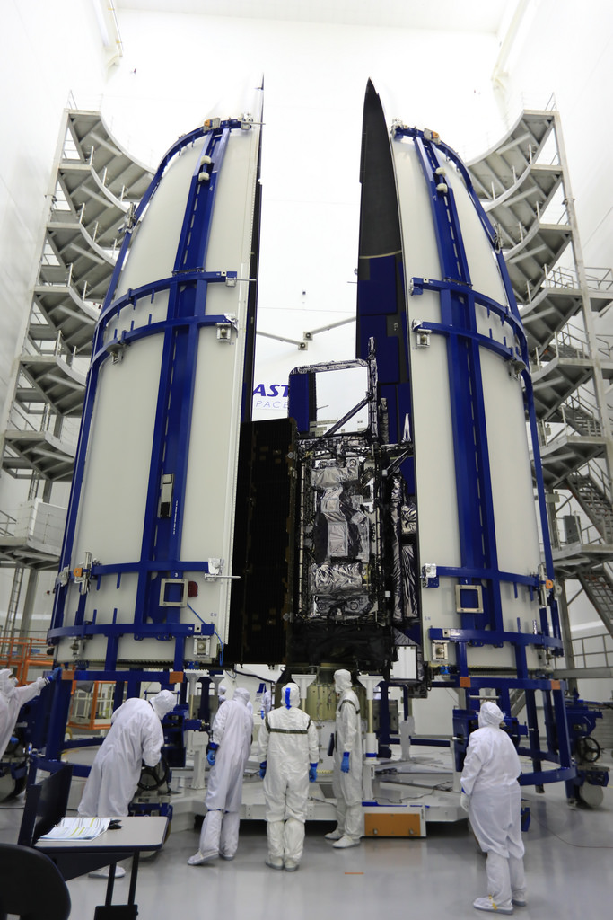
Credit: NOAA / NASA

Slide 20
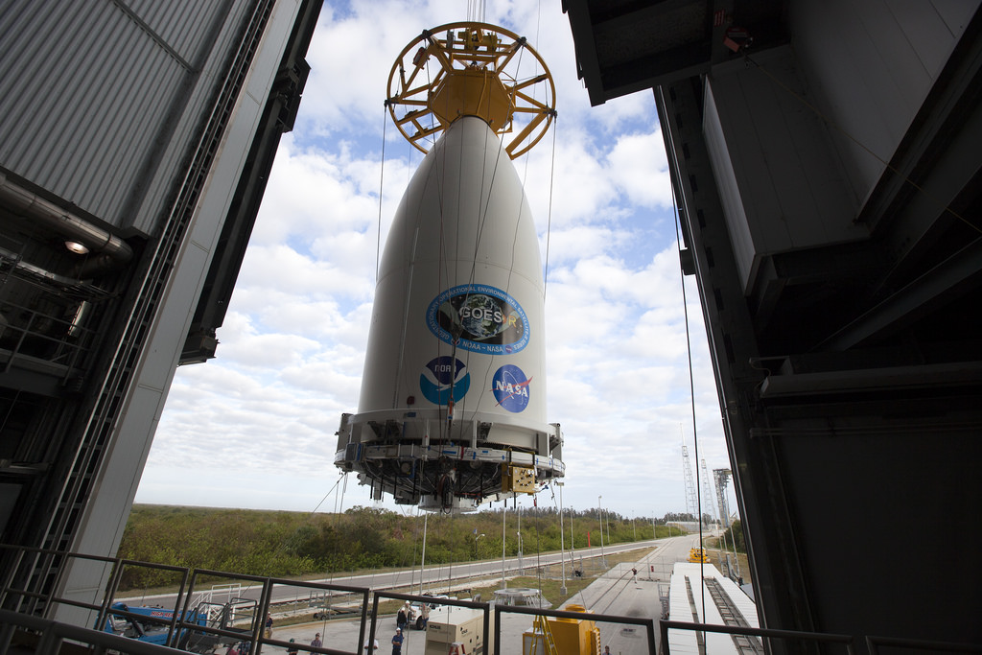
Credit: NOAA / NASA / ULA

Slide 21
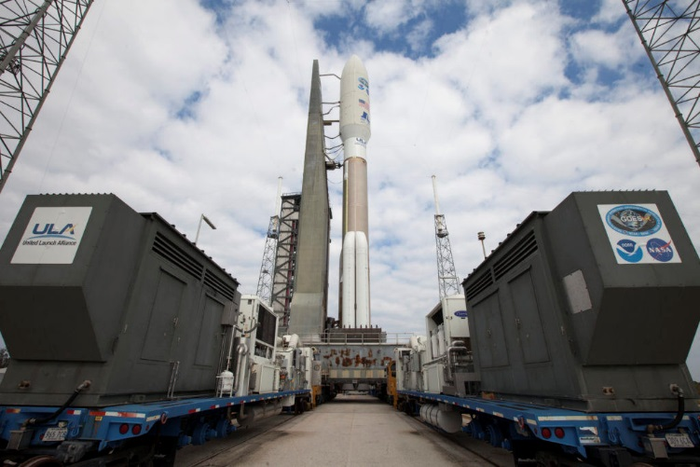
Credit: NOAA / NASA / ULA

Slide 22
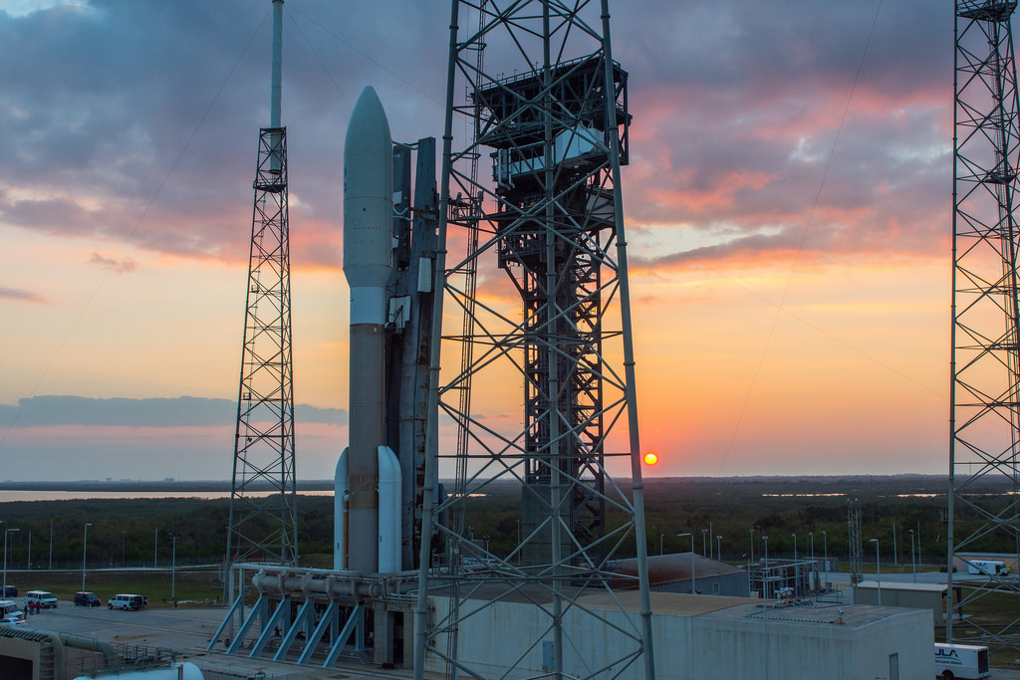
Credit: ULA / NOAA

Slide 23
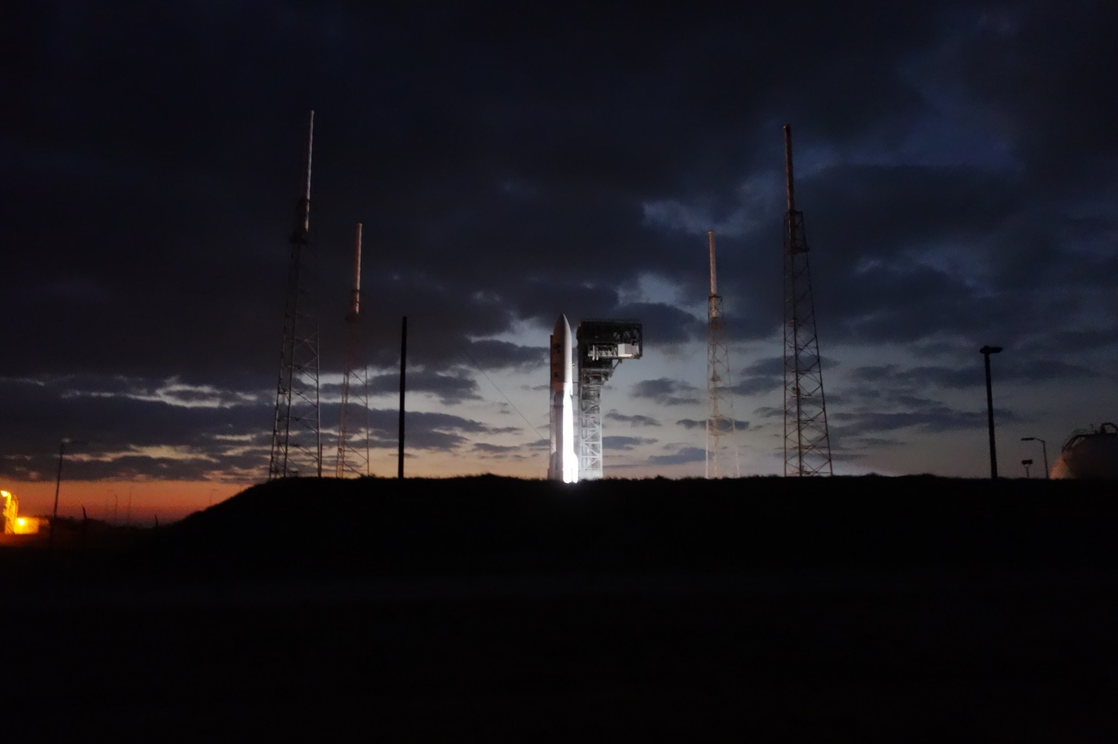

Slide 24
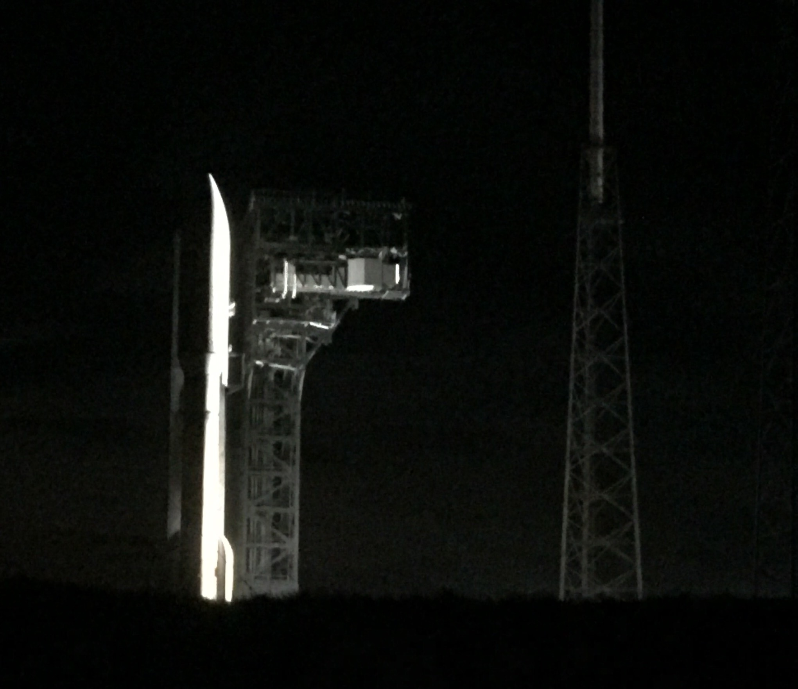

Slide 25
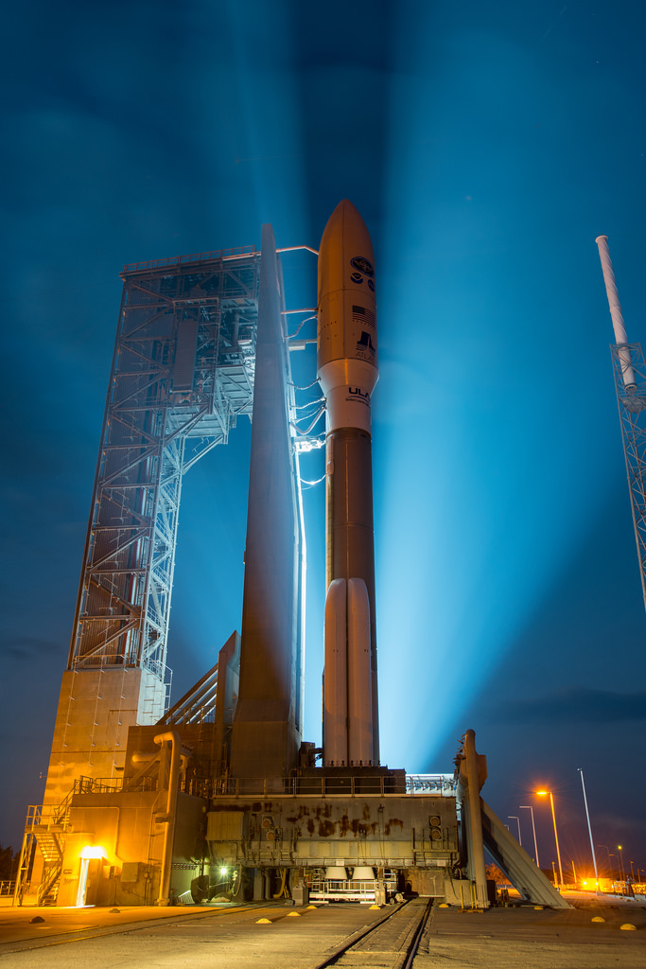
Credit: ULA / NOAA

Slide 26
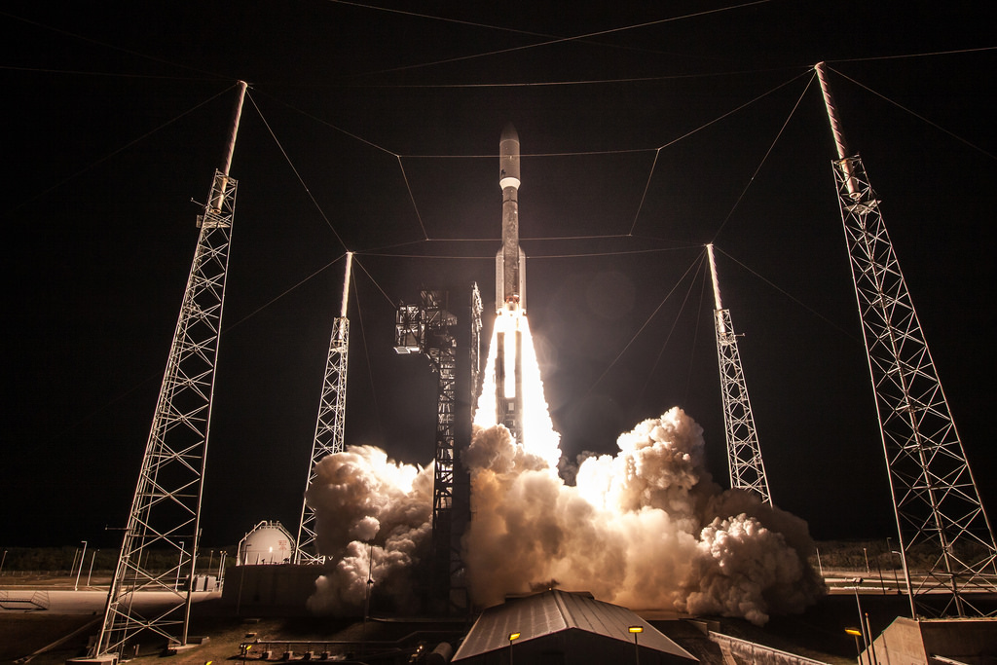
Credit: ULA / NOAA

Slide 27
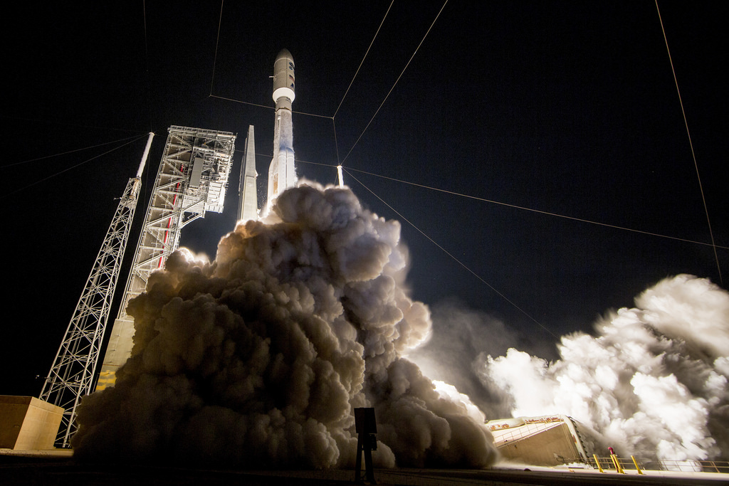
Credit: ULA / NOAA

Slide 28
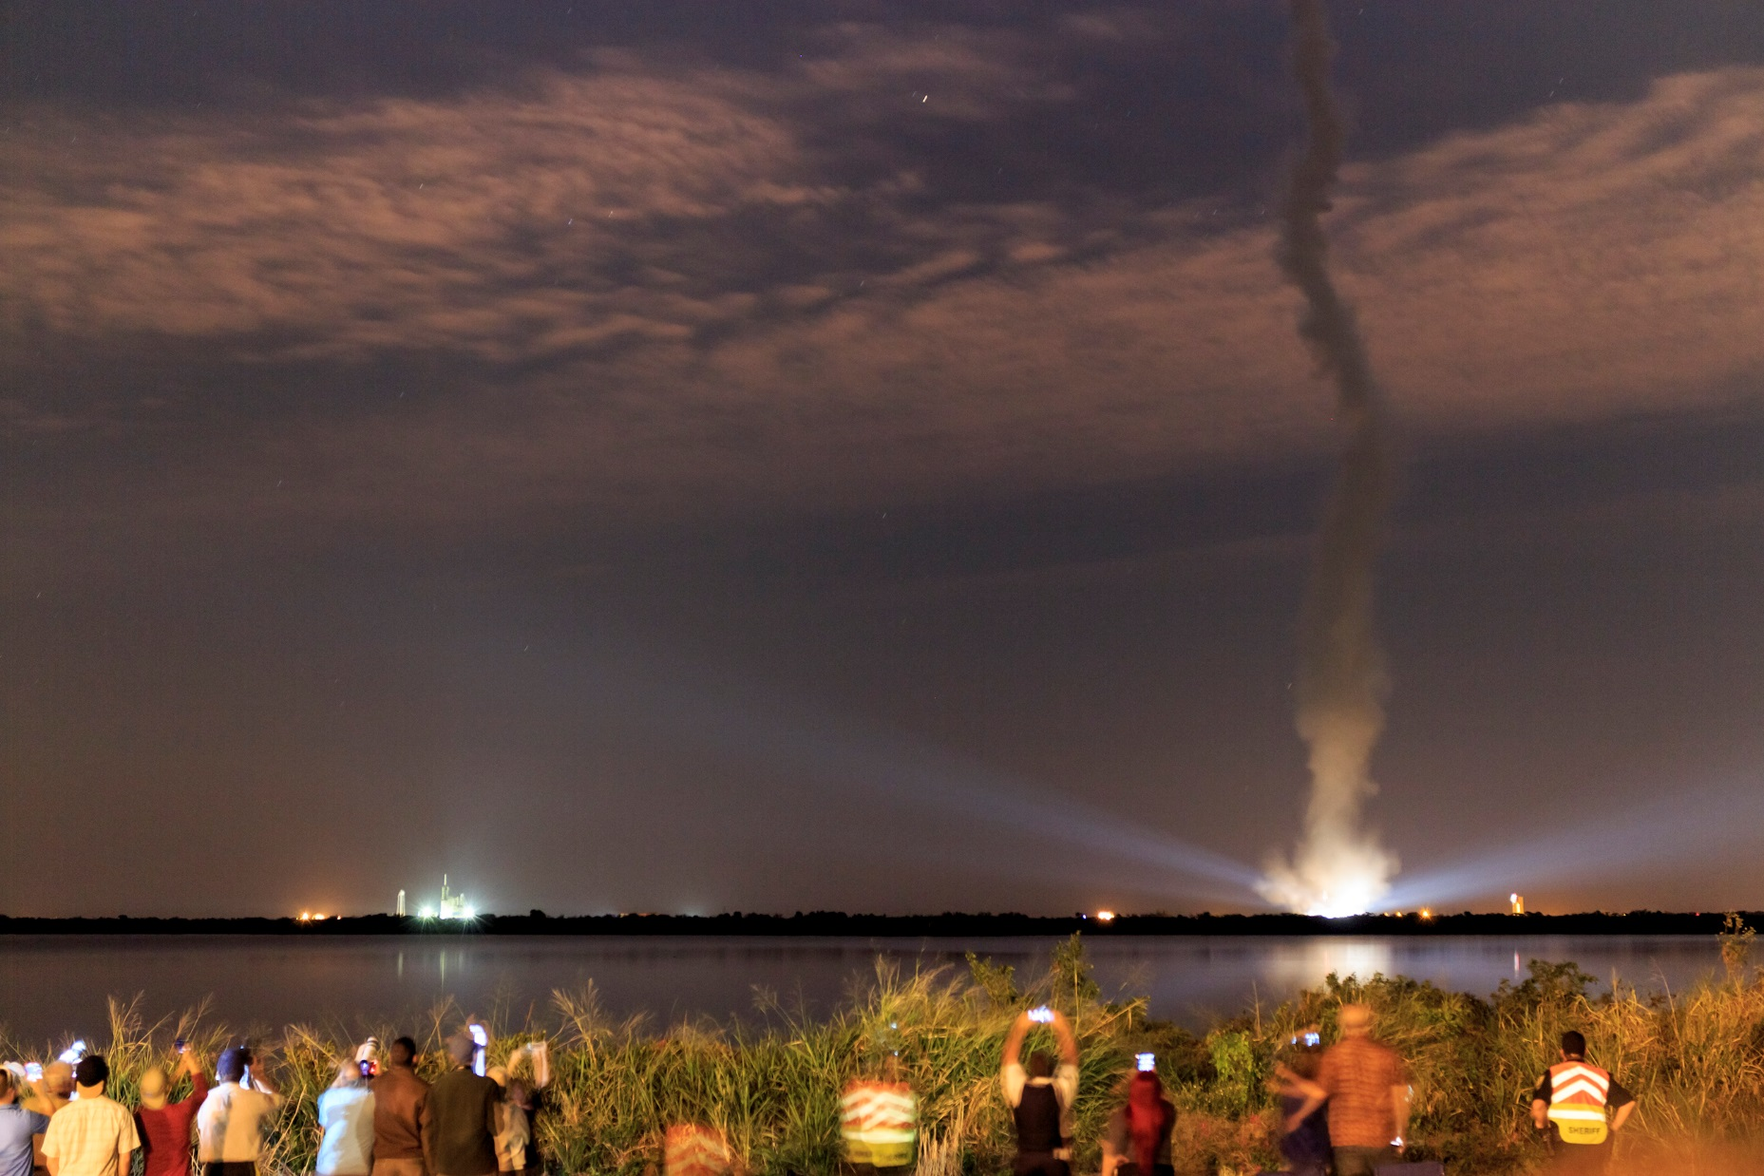
Credit: Chris Schmidt, CIMSS

Slide 29
ABI: Bands 1-6 (Visible / NearIR)
ABI Band | Wavelength (µm) | Wavelength range (µm) | Sub-point pixel spacing (km) | Descriptive Name
1 | 0.47 | 0.45 - 0.49 | 1 | “Blue”
2 | 0.64 | 0.60 - 0.68 | 0.5 | “Red”
3 | 0.864 | 0.847 - 0.882 | 1 | “Veggie”
4 | 1.373 | 1.366 - 1.380 | 2 | “Cirrus”
5 | 1.61 | 1.59 - 1.63 | 1 | “Snow/Ice”
6 | 2.24 | 2.22 -2.27 | 2 | “Cloud Particle Size”
Six visible or near visible bands on ABI, one on heritage imager
Notes:
Based on Schmit et al, 2017. stars = today’s imager band.

Slide 30
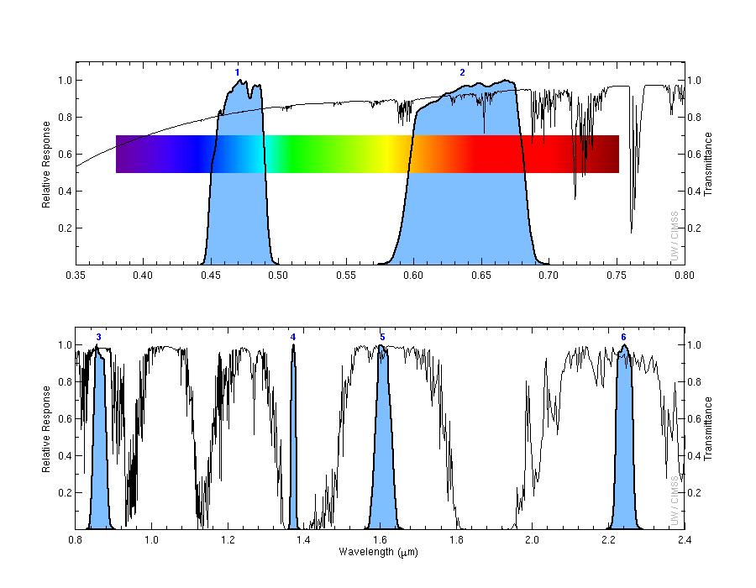
ABI Spectral Bands (1-6)
Visible
Near-IR

Slide 31
ABI: Bands 7-16 (Infrared)
ABI Band | Wavelength (µm) | Wavelength range (µm) | Sub-point pixel spacing (km) | Descriptive Name
7 | 3.90 | 3.80 - 3.99 | 2 | “Shortwave window”
8 | 6.19 | 5.79 - 6.59 | 2 | “Upper-level Water Vapor”
9 | 6.93 | 6.72 - 7.14 | 2 | “Mid-Level Water Vapor”
10 | 7.34 | 7.24 - 7.43 | 2 | “Lower/Mid-level Water Vapor”
11 | 8.44 | 8.23 - 8.66 | 2 | “Cloud-top Phase”
12 | 9.61 | 9.42 - 9.80 | 2 | “Ozone”
13 | 10.33 | 10.18 - 10.48 | 2 | “Clean longwave window”
14 | 11.21 | 10.82 - 11.60 | 2 | “Longwave window”
15 | 12.29 | 11.83 - 12.75 | 2 | “Dirty longwave window”
16 | 13.28 | 12.99 - 13.56 | 2 | “CO₂”
10 infrared bands on the ABI, four on heritage imager
Notes:
Based on Schmit et al, 2017. stars = today’s imager band.

Slide 32
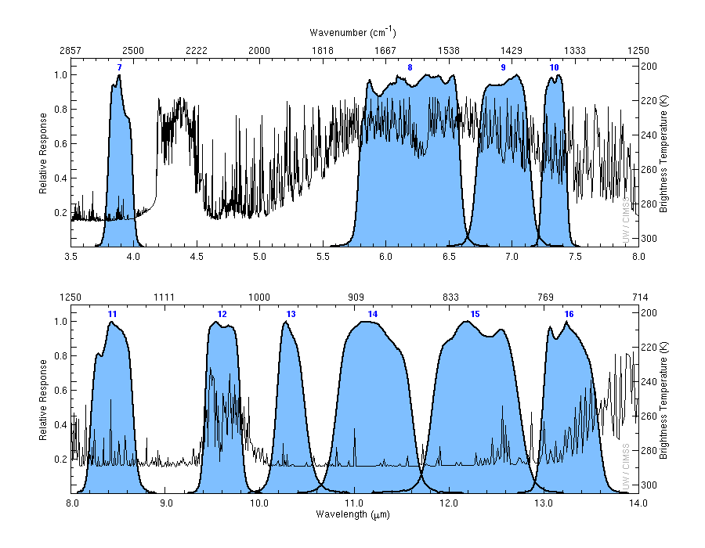
ABI IR Spectral Bands (7-16)
cool
hot

Slide 33
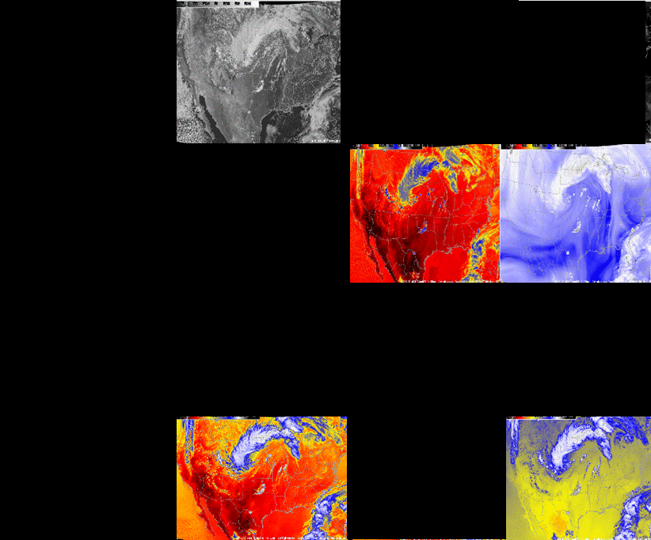
Current GOES Spectral Bands (5)
VIS
1 VIS
0 NIR
4 IR
NIR
WV
IRW
CO2
Figures courtesy of Tim Schmit

Slide 34
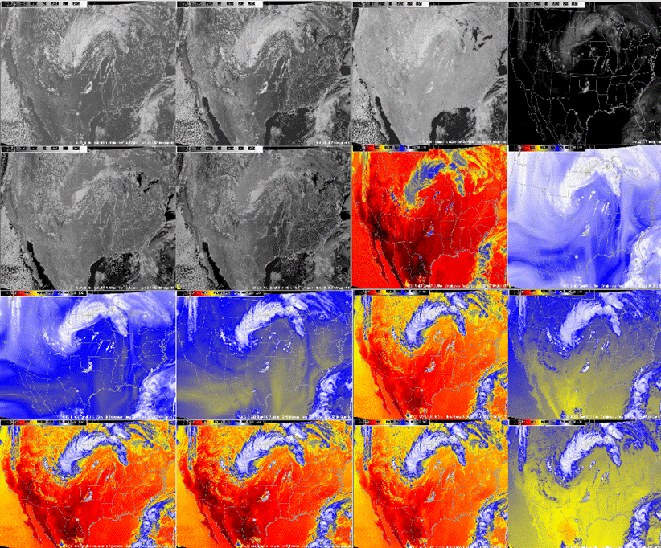
ABI Spectral Bands (16)
0.47 μm
0.64 μm
0.86 μm
1.38 μm
2 VIS
4 NIR
10 IR
1.61 μm
2.26 μm
3.9 μm
6.19 μm
6.95 μm
7.34 μm
8.5 μm
9.61 μm
10.35 μm
11.2 μm
12.3 μm
13.3 μm
Figures courtesy of Tim Schmit

Slide 35
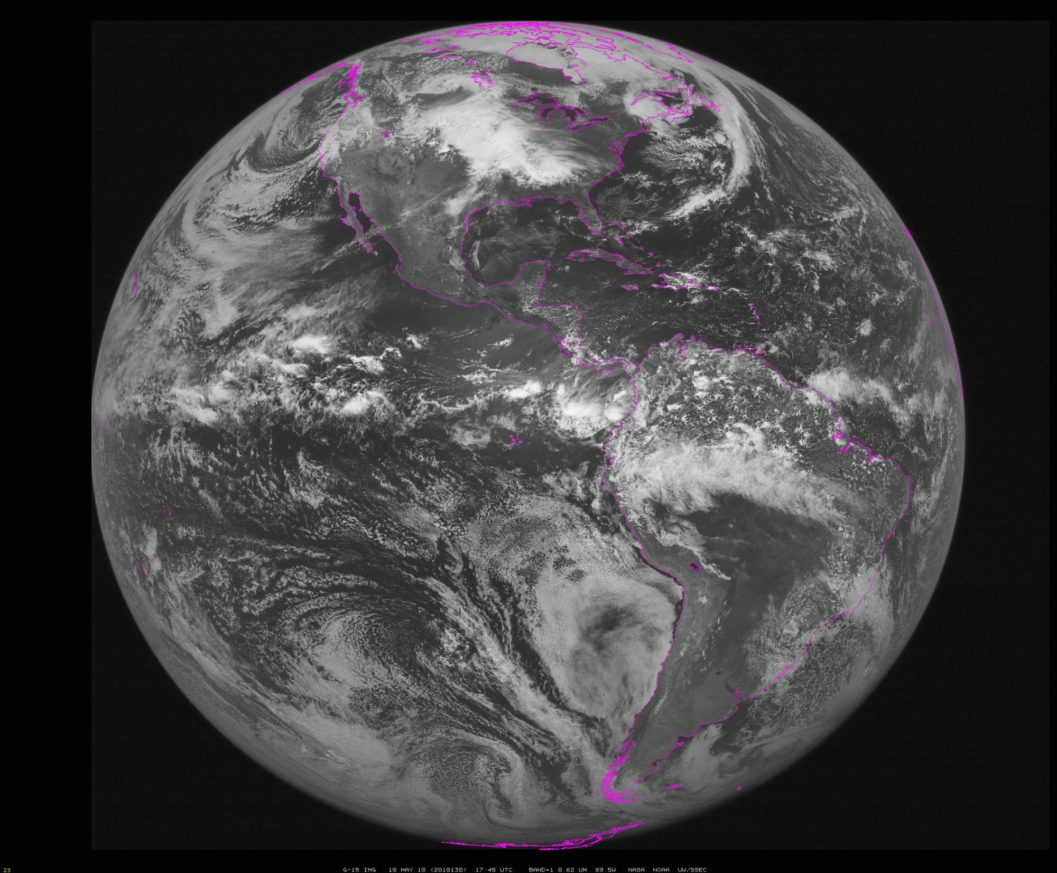
~90W
Notes:
Data from SSEC Data Center

Slide 36
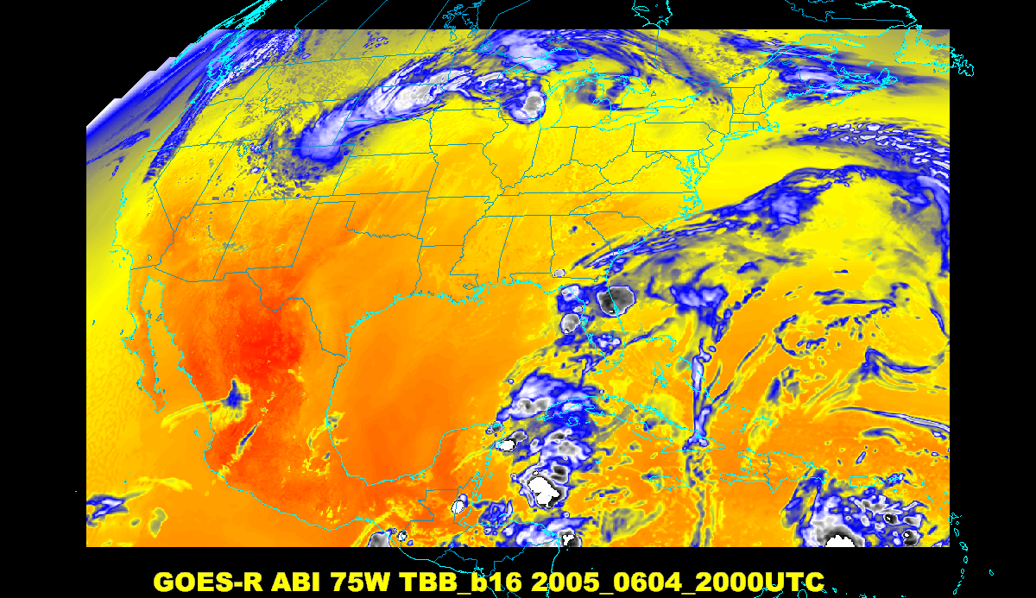
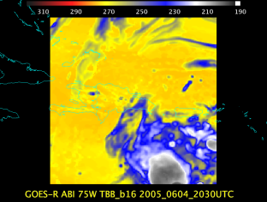
Baseline ABI Scan Modes
Scan mode (3) or ‘flex mode’ for the ABI:
- Full disk every 15 minutes + 5 min CONUS
+ 1-min mesoscales (2 locations).
[Scan mode (4) or ‘Continuous Full Disk’ (CFD) is a full disk every 5 min]
Notes:
CONUS image is the shifted center point.

Slide 37
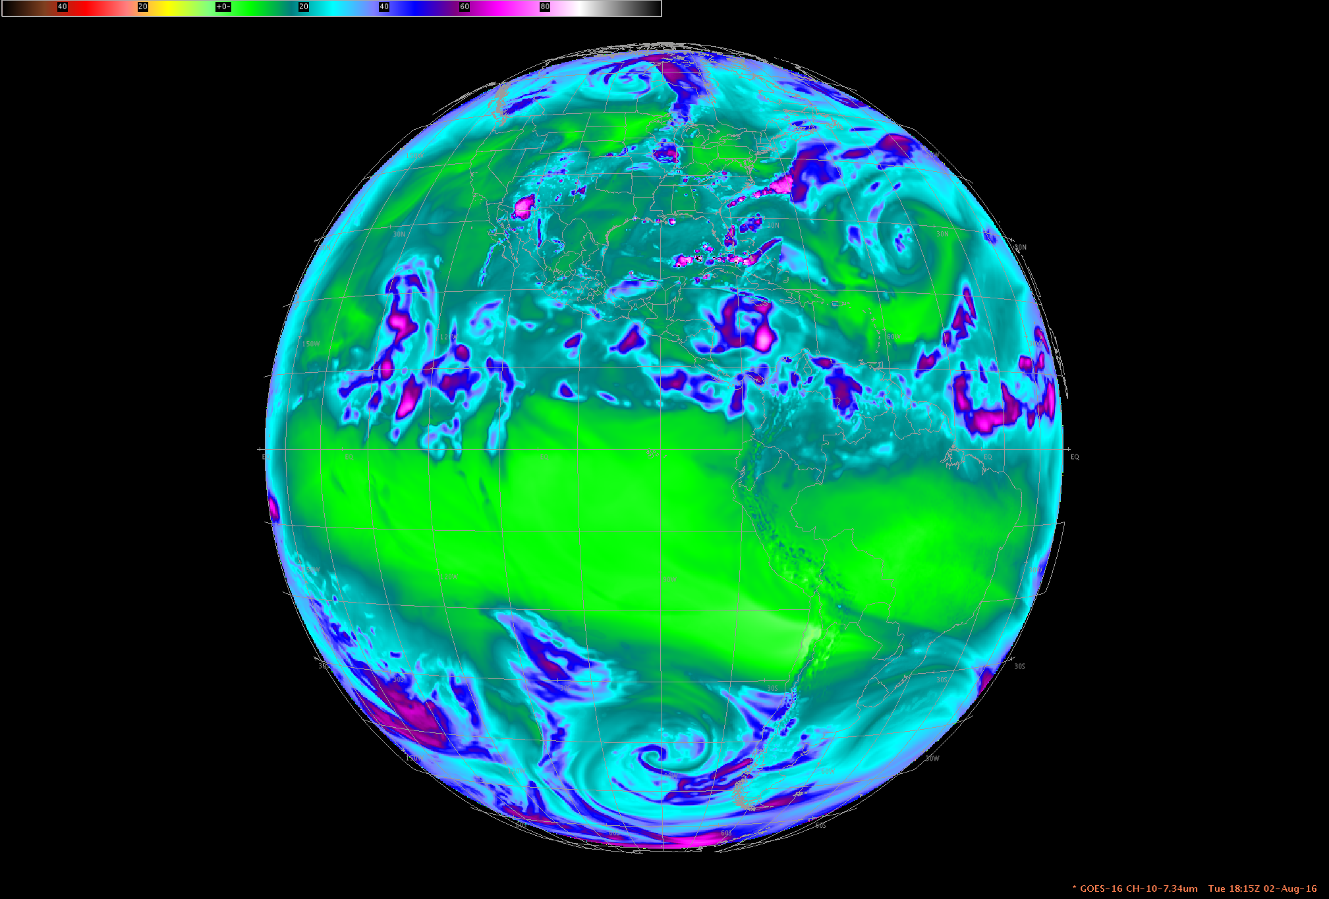
DOE-4 Simulated ABI: Full Disk sector
Central location

Slide 38
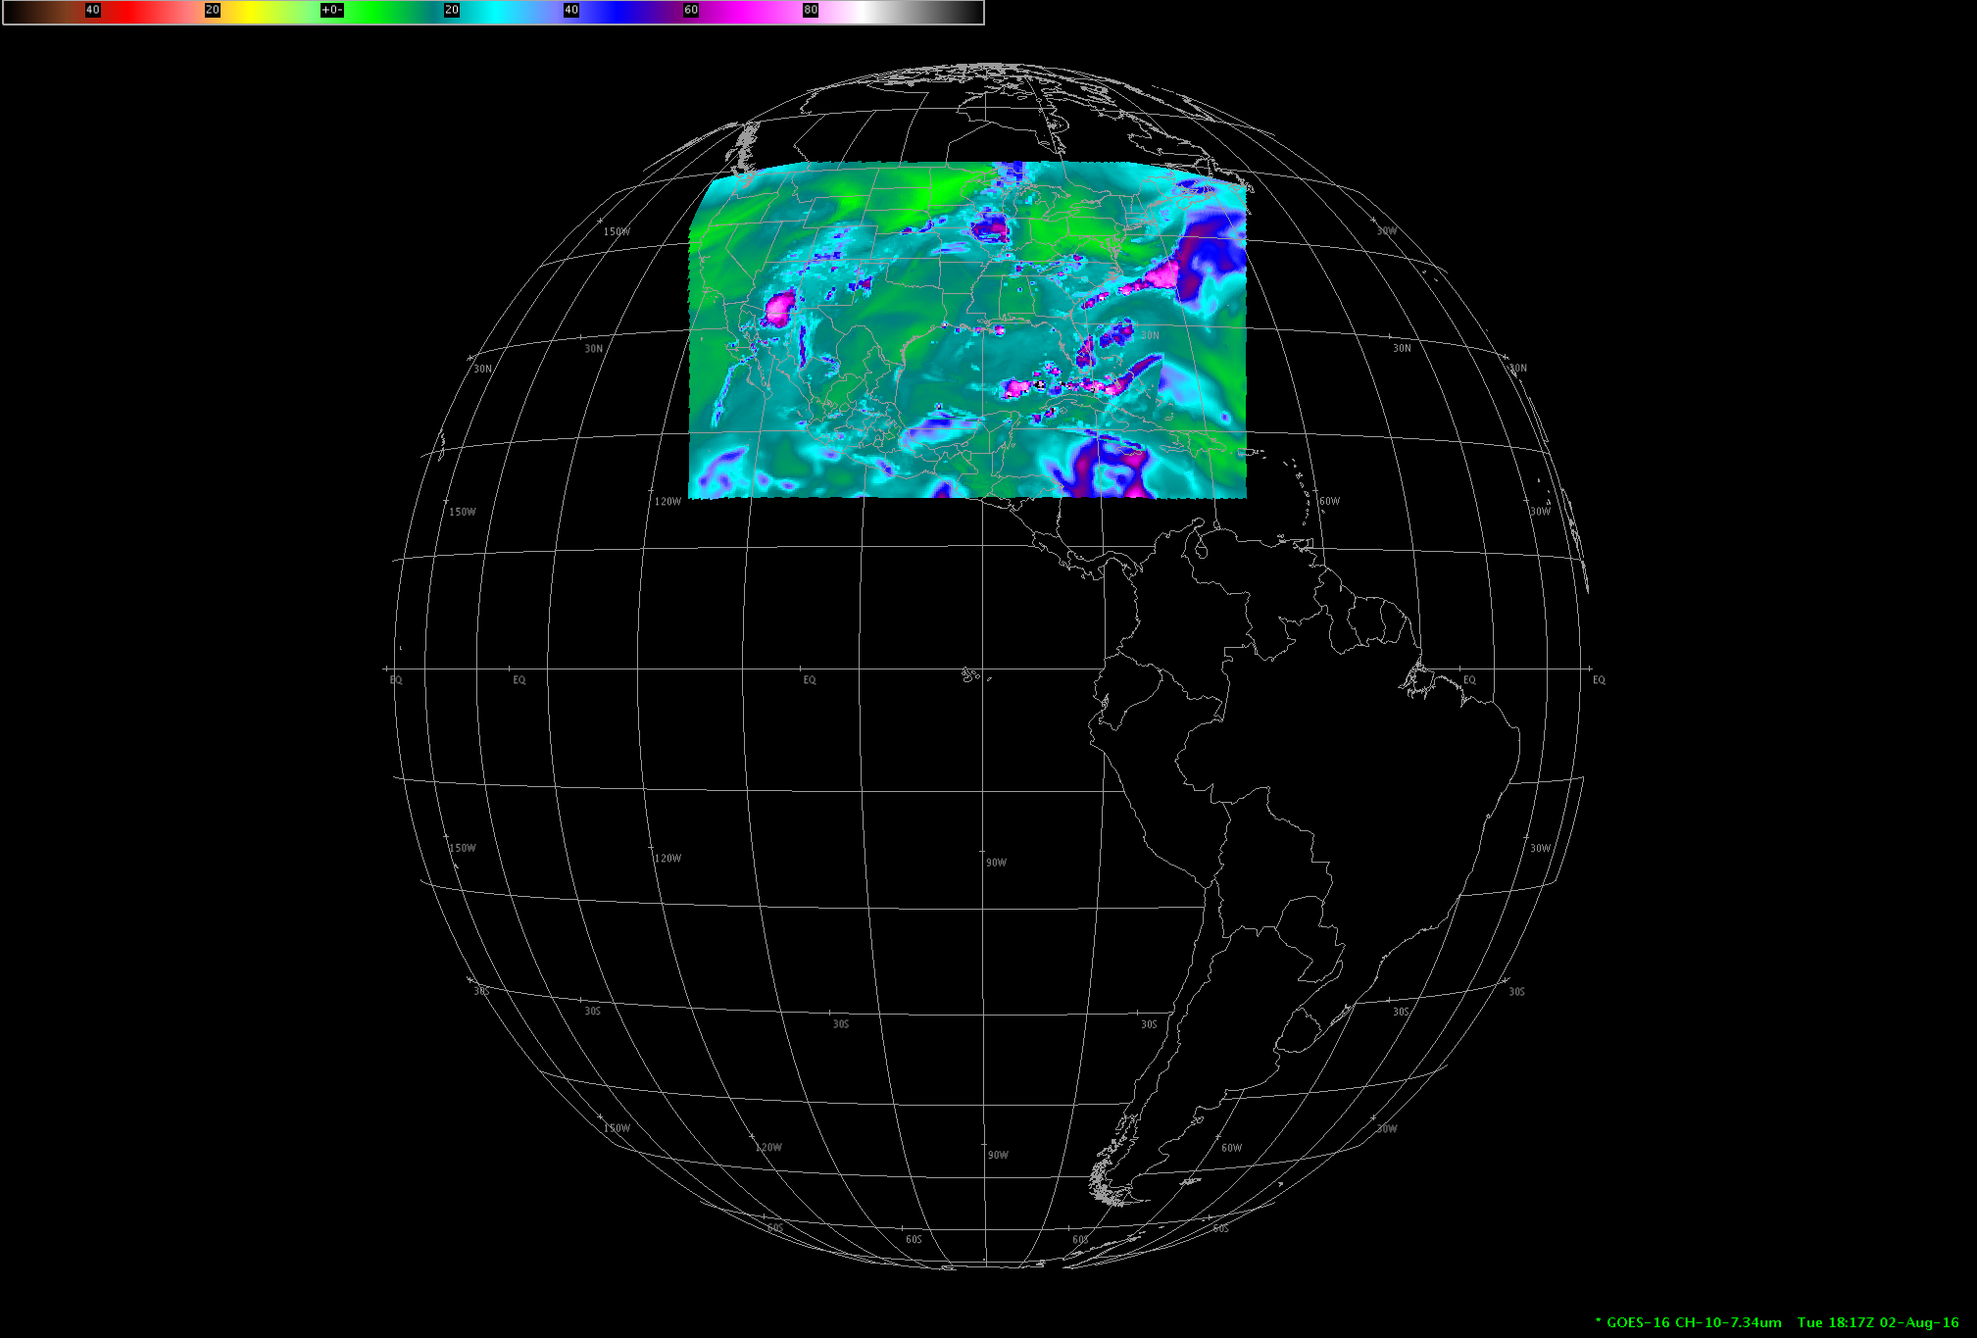
DOE-4 Simulated ABI: CONUS sector
Central location

Slide 39
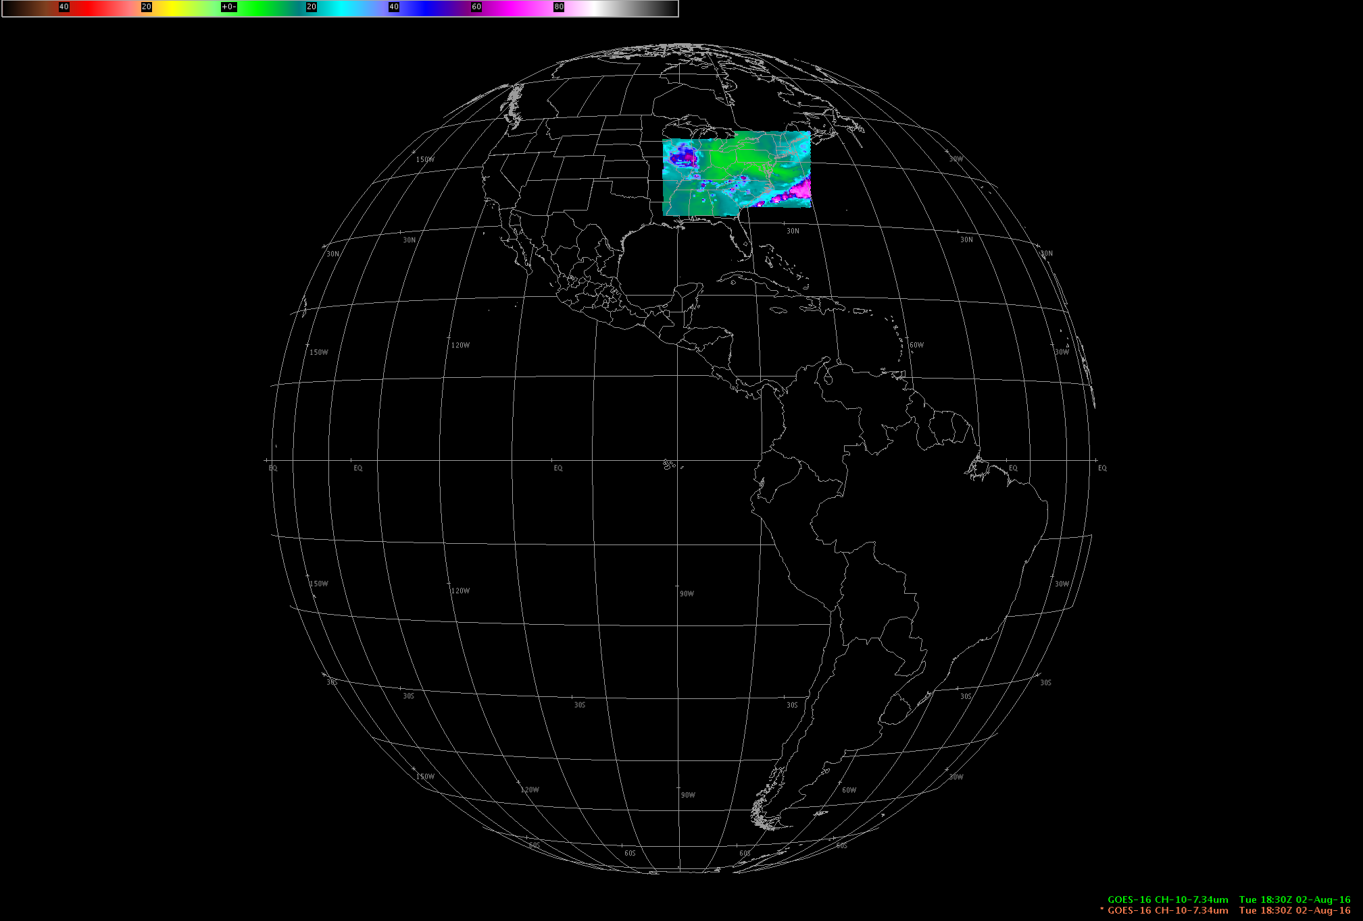
DOE-4 Simulated ABI: 2 meso-scale sectors
Central location

Slide 40
Supercell
Notes:
Animation.

Slide 41
1-min imagery
ABI-(time) like
1-min mode (SRSOR from GOES-14)
Operational (GOES-13)
Notes:
animation

Slide 42
Lake Effect Snow
Notes:
Animation.

Slide 43
AHI with Simulated Green Band
Notes:
Animation.
Not a baseline product.

Slide 44
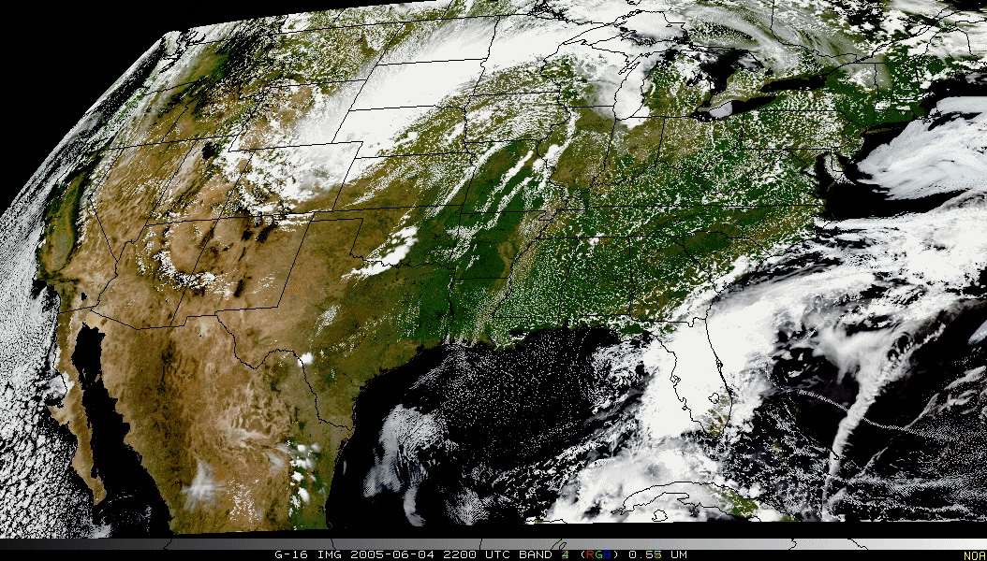
Pseudo-Natural Color

Slide 45
Simulated ABI with Simulated Green Band
Kaba Bah, CIMSS
Notes:
Not a baseline product.

Slide 46
http://www.goes-r.gov
Notes:
The subjects of this GOES-R Baseline products training are the aerosol products boxed in yellow.

Slide 47
Summary
1. The GOES-R ABI provides mission continuity
2. Two times the image navigation quality
3. Three times the number of imaging bands
4. Four times the spatial resolutions
5. Five times the coverage rate
- Special GOES-14 1-min data pathfinder
http://www.goes-r.gov

Slide 48
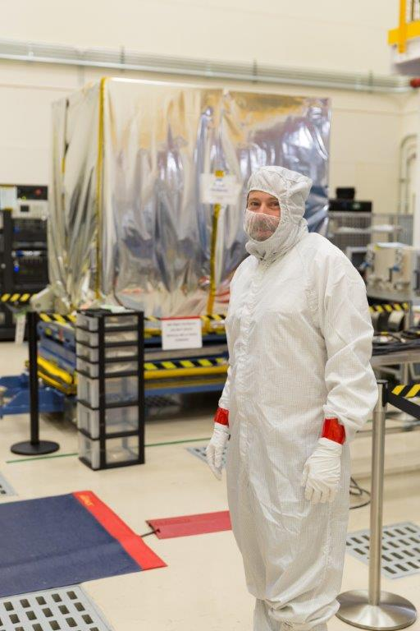
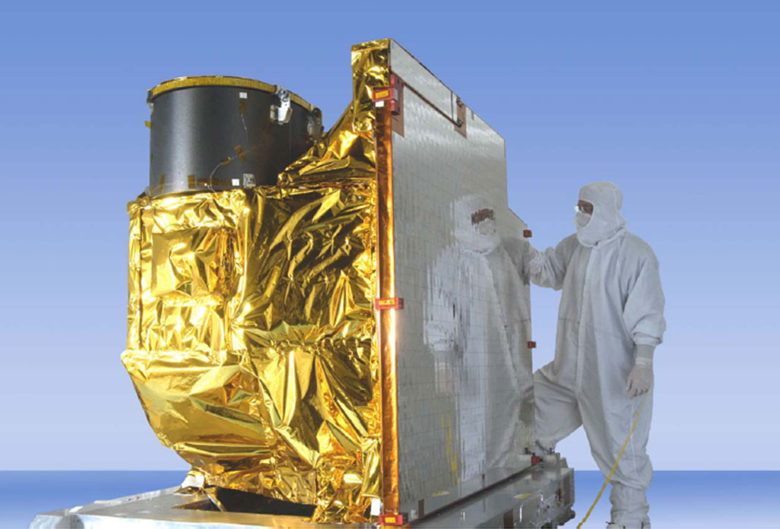
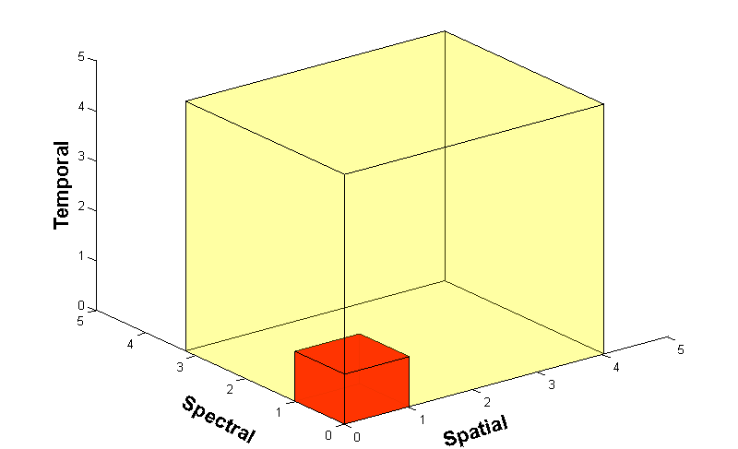
Advanced Baseline Imager (ABI)
ABI on GOES-S
5
4
3
X
Faster coverage (5-minute full disk vs. 25-minute)
X
Improved spatial resolution
(2 km IR vs. 4 km)
X
More spectral bands (16 on ABI vs. 5 on the current imager)
Notes:
Slide from J. Gerth, CIMSS.

Slide 49
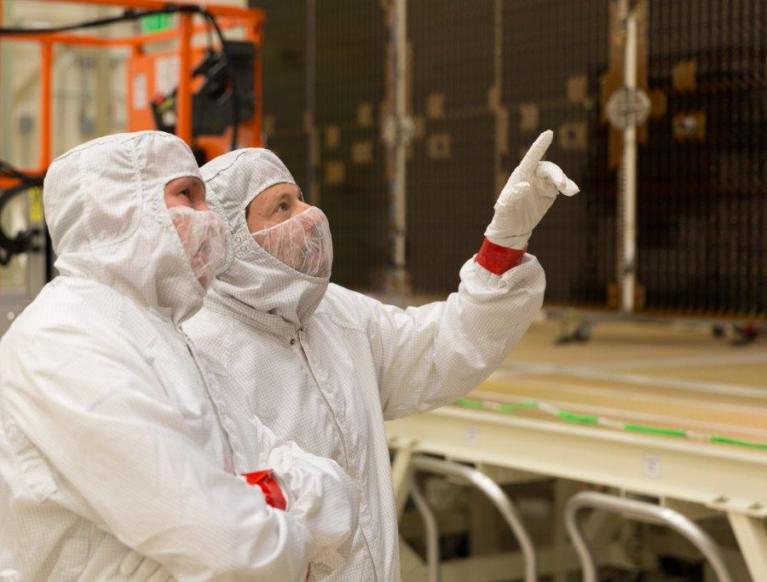
GOES-R Series web site
http://www.goes-r.gov
Lockheed Martin

