Slide 1


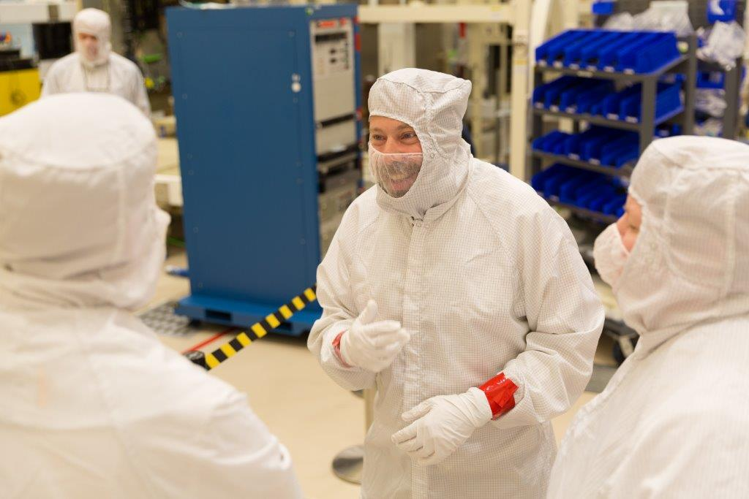

The GOES-R/16
Advanced Baseline Imager (ABI)
  Timothy J. Schmit (tim.j.schmit@noaa.gov)
  NOAA/NESDIS/Satellite Applications and Research
Advanced Satellite Products Branch (ASPB) Madison, WI
  Plus many, many more…
CMOS
Toronto, Canada
June 6, 2017
UW-Madison

Slide 2

Thanks to…
Mat Gunshor
Jordan Gerth
Scott Lindstrom
Kathleen Strabala
Bill Line
SSEC data center
Scott Bachmeier
Kaba Bah
Steve Miller
Dan Lindsey
Jaime Daniels
Paul Menzel
Steve Goodman
Chris Schmidt
Chad Gravelle
JMA
SSEC Real Earth team
ITT / Harris
Lockheed-Martin
Entire GOES-R team!
Dave Jones
COMET
You.

Slide 3
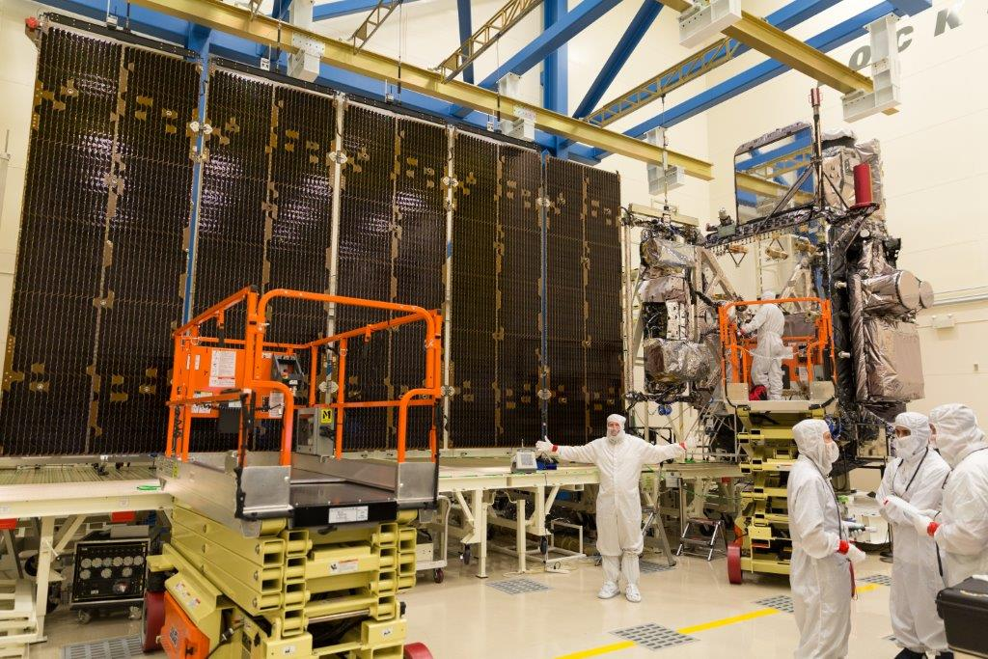
GOES-R Advanced Baseline Imager (ABI)
  Spectral
    Improved!
  Spatial
    Improved!
  Temporal
    Improved!
  Calibration
    Improved!
Lockheed Martin

Slide 4
The Advanced Baseline Imager:
ABI Current Imager
Spectral Coverage
16 bands 5 bands
Spatial resolution
0.64 μm Visible 0.5 km Approx. 1 km
Other Visible/near-IR 1.0 km n/a
Bands (>2 μm) 2 km Approx. 4 km
Spatial coverage
Full disk 4 per hour Scheduled (3 hrly)
CONUS 12 per hour ~4 per hour
Mesoscale 2 every 1-min n/a
Notes:
The ABI allows more bands, finer spatial resolution, faster refresh rates and on-orbit calibration of all bands!

Slide 5
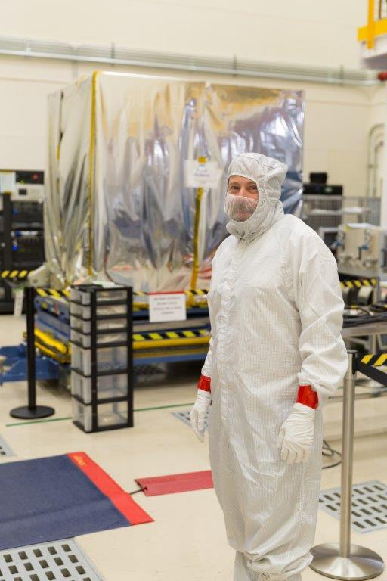
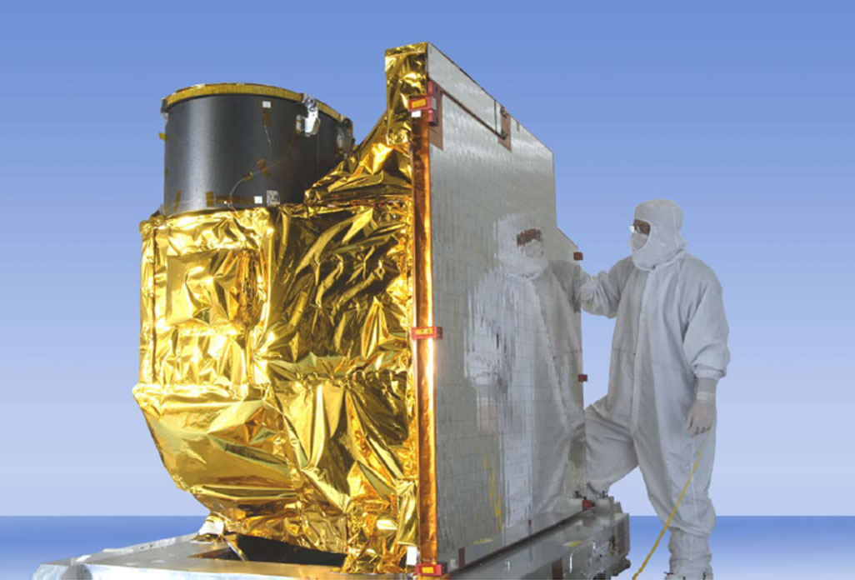

Advanced Baseline Imager (ABI)
ABI on GOES-S
5
4
3
X
Faster coverage
(5-minute full disk vs. 25-minute)
X
Improved spatial
resolution
(2 km IR vs. 4 km)
X
More spectral bands (16 on ABI vs. 5 on the current imager)
Notes:
Slide from J. Gerth, CIMSS.

Slide 6
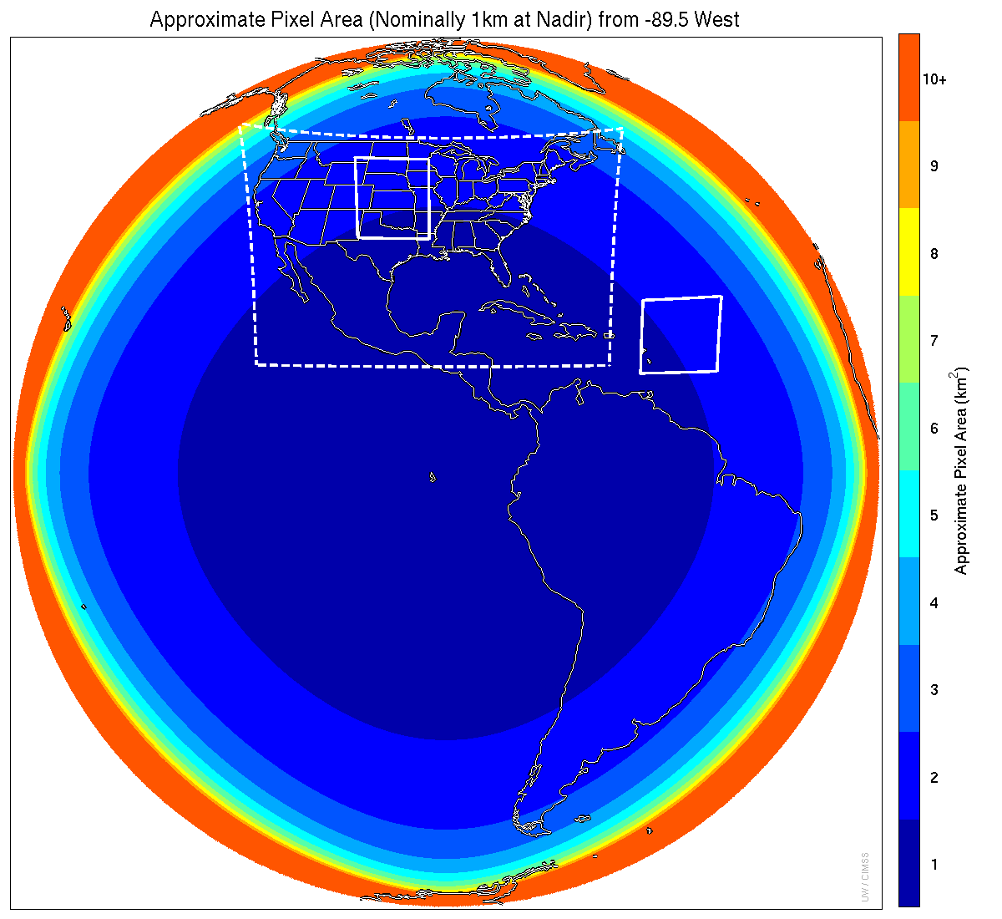
Meso-scale box locations are movable
1 min
5 min
1 min
15 min
Central
Scan mode (3) or ‘flex mode’ for the ABI:
- Full disk every 15 minutes + 5 min CONUS
+ 1-min mesoscale sectors (2 locations).
[Scan mode (4) or ‘Continuous Full Disk’ (CFD) is a full disk every 5 min]
Notes:
1-km² spatial resolution at satellite nadir. Pixel Areas are approximate. Each bin is rounded to the nearest 1km² until we get to 9.5km² and then all are binned into the red 10+ area. So the first, dark blue, ring covers pixel areas from 1 to 1.49km² and is labeled “1”, above 1.5 to below 2.5km² goes into the next ring and is called “2”, etc. GOES-Test location. PUG CONUS sector. Two meso-scale image sectors shown; these are selectable. The same central lat/lon used for these mesoscales produces a different sized and shaped area for different satellite locations.

Slide 7
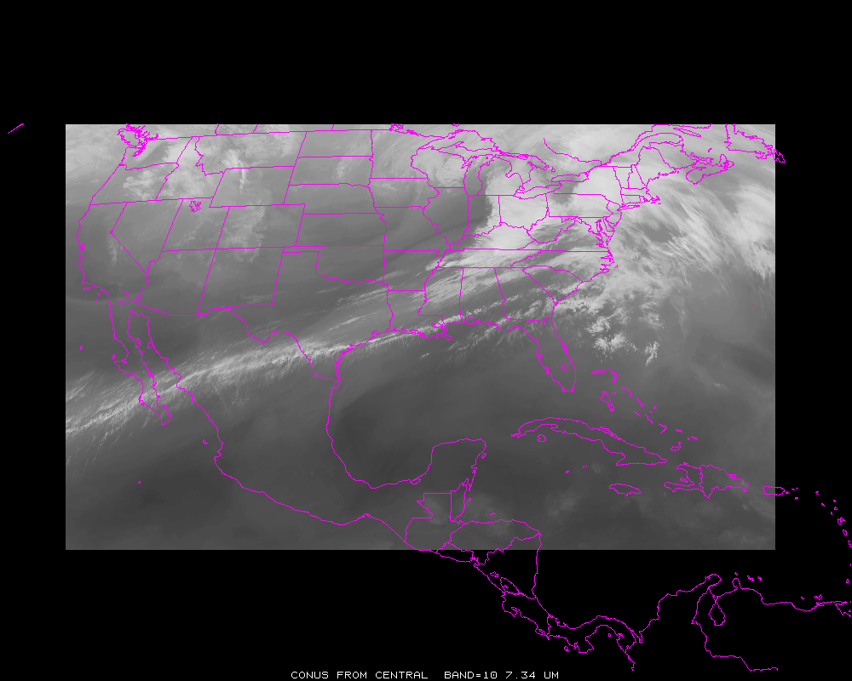
ABI CONUS Sector (Central)

Slide 8
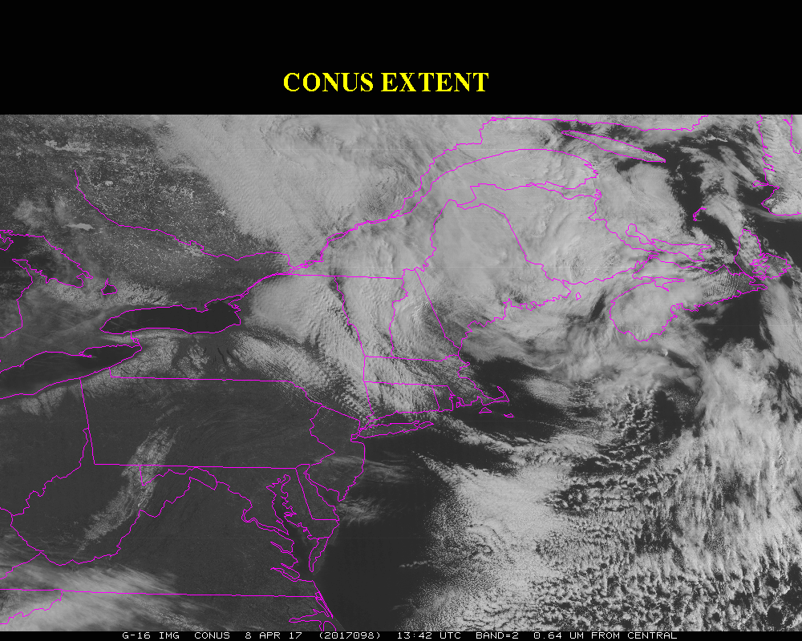

Slide 9
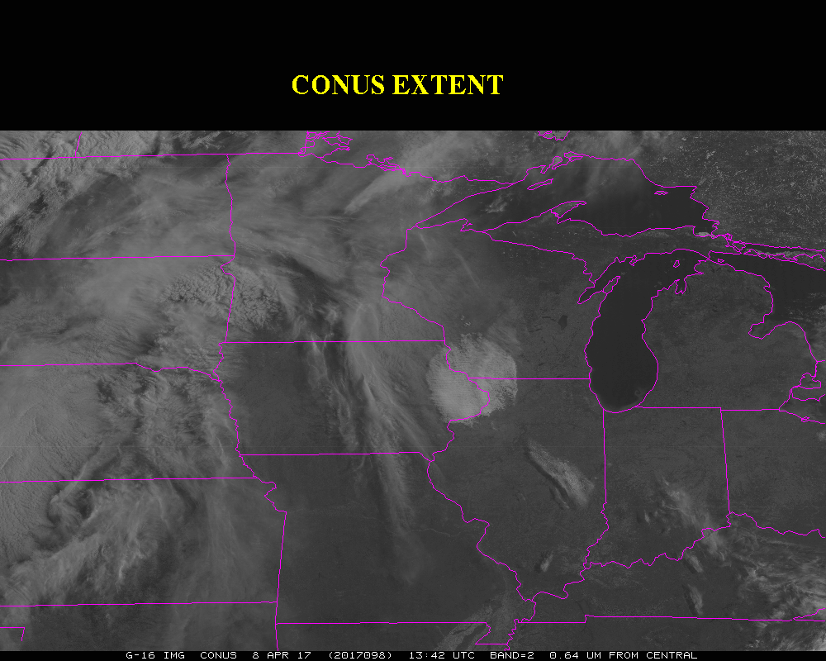

Slide 10
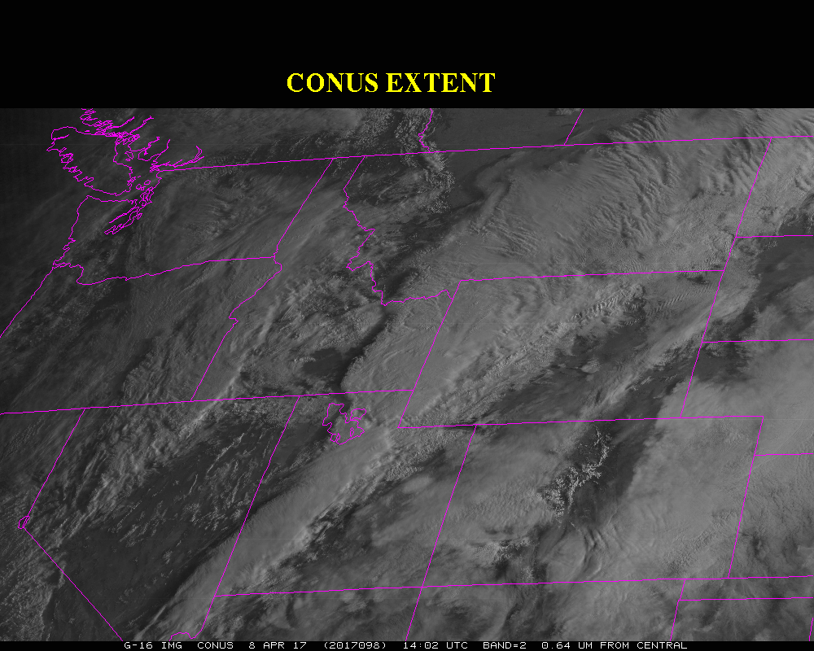

Slide 11
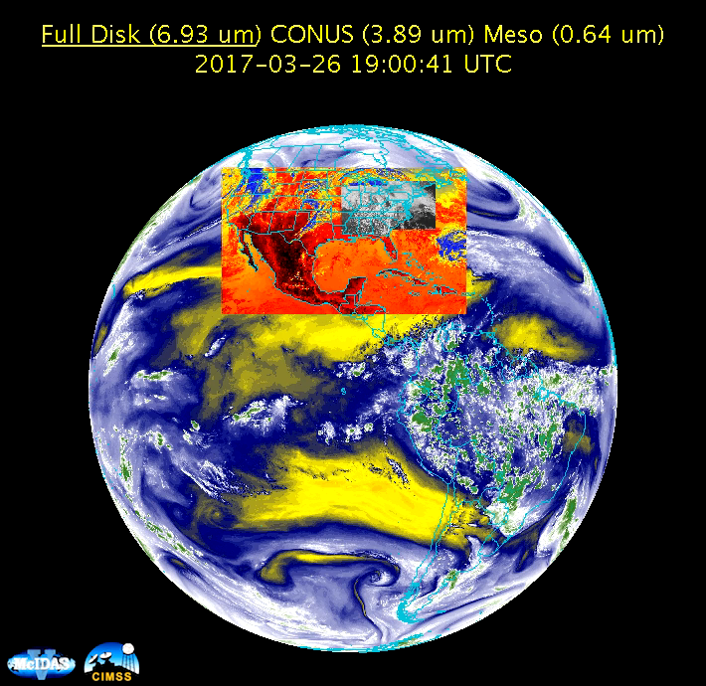
ABI Sectors

Slide 12
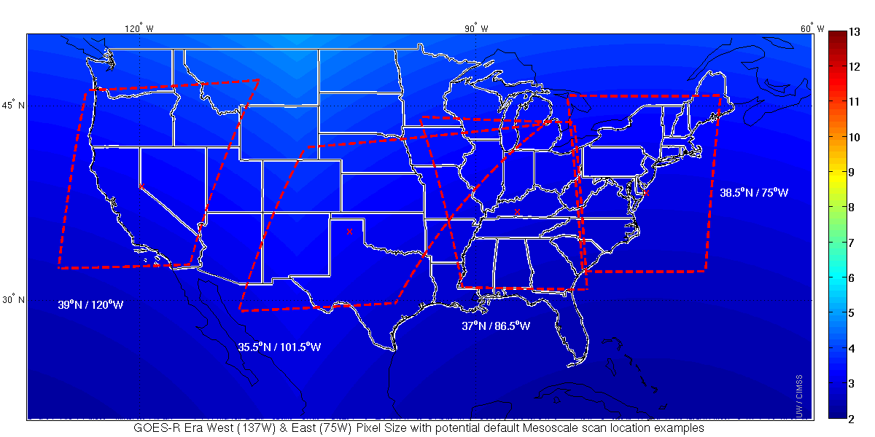
Default Meso Locations
Two meso from GOES-West and two from GOES-East

Slide 13
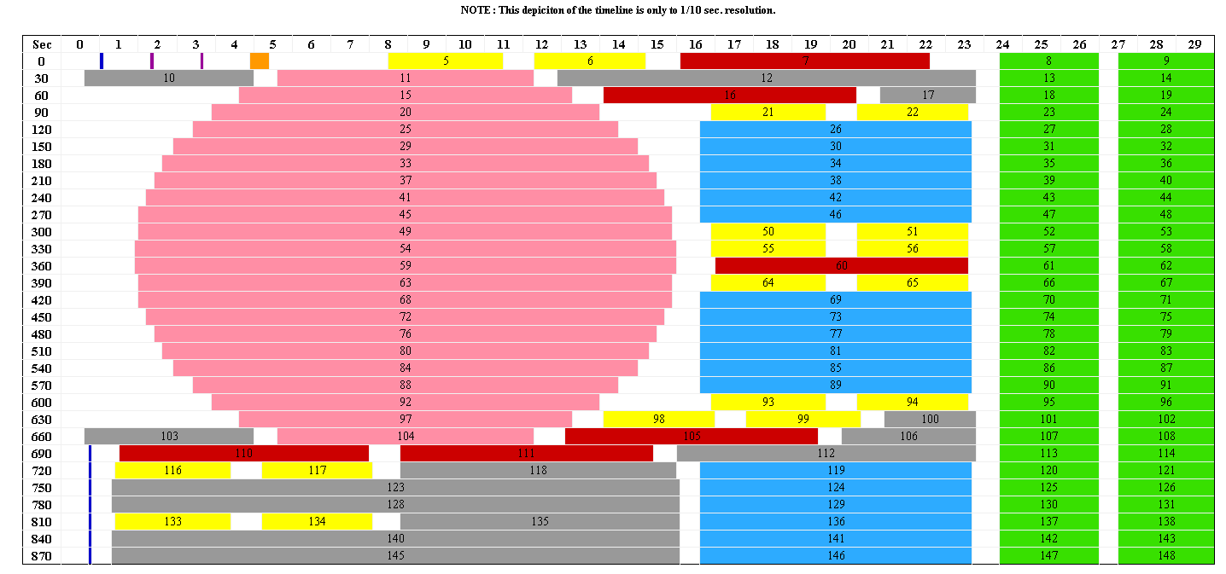
Scan Mode 3 Timeline (Flex Mode) Delivers Storm Watch Every 30 Seconds
30 seconds
Blackbody
IR Star
Spacelook
Vis Star
CONUS
Meso
Full
Disk
Nadir
Note: Autonomous spacelook collected with each Full Disk swath
MISTiC
Meso: one every 30 seconds or two at 1 minute intervals each
Scene locations can be changed on the fly (no interruption of timeline)

Slide 14
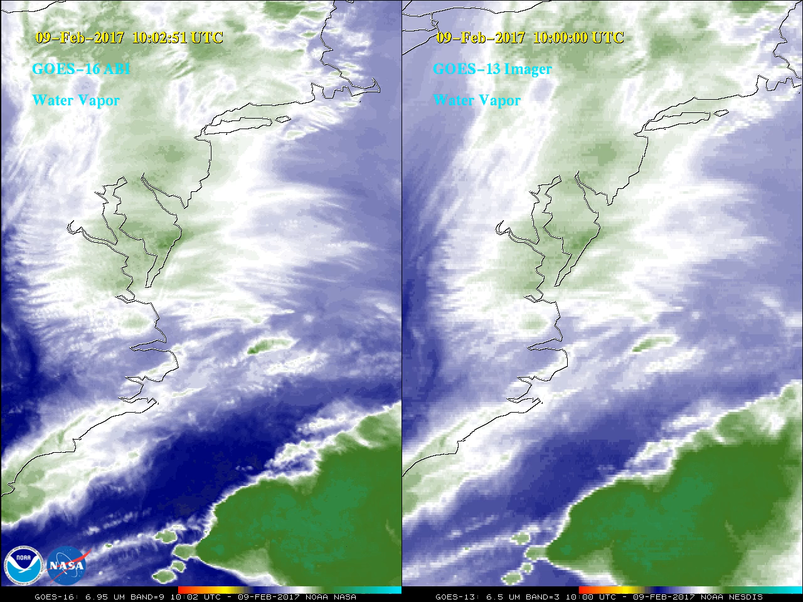
ABI vs GOES-13

Slide 15
ABI: Bands 1-6 (Visible / NearIR)
ABI Band | Wavelength (µm) | Wavelength range (µm) | Sub-point pixel spacing (km) | Descriptive Name
1 | 0.47 | 0.45 - 0.49 | 1 | “Blue”
2 | 0.64 | 0.60 - 0.68 | 0.5 | “Red”
3 | 0.864 | 0.847 - 0.882 | 1 | “Veggie”
4 | 1.373 | 1.366 - 1.380 | 2 | “Cirrus”
5 | 1.61 | 1.59 - 1.63 | 1 | “Snow/Ice”
6 | 2.24 | 2.22 -2.27 | 2 | “Cloud Particle Size”
Six visible or near visible bands on ABI, one on heritage imager
Notes:
Based on Schmit et al, 2017. stars = today’s imager band.

Slide 16
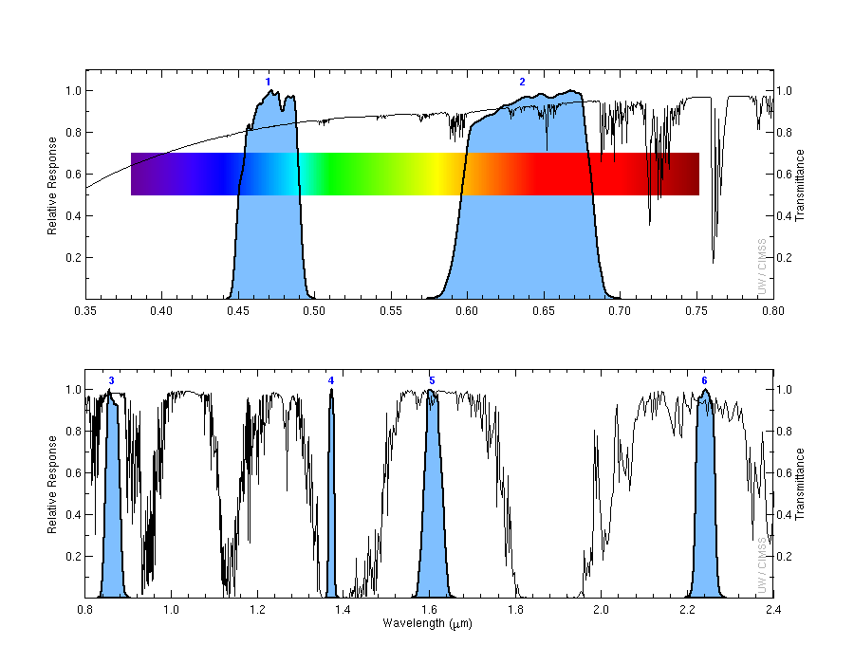
ABI Spectral (Vis and near-IR) Bands
Visible
Near-IR

Slide 17
ABI: Bands 7-16 (Infrared)
ABI Band | Wavelength (µm) | Wavelength range (µm) | Sub-point pixel spacing (km) | Descriptive Name
7 | 3.90 | 3.80 - 3.99 | 2 | “Shortwave window”
8 | 6.19 | 5.79 - 6.59 | 2 | “Upper-level Water Vapor”
9 | 6.93 | 6.72 - 7.14 | 2 | “Mid-Level Water Vapor”
10 | 7.34 | 7.24 - 7.43 | 2 | “Lower/Mid-level Water Vapor”
11 | 8.44 | 8.23 - 8.66 | 2 | “Cloud-top Phase”
12 | 9.61 | 9.42 - 9.80 | 2 | “Ozone”
13 | 10.33 | 10.18 - 10.48 | 2 | “Clean longwave window”
14 | 11.21 | 10.82 - 11.60 | 2 | “Longwave window”
15 | 12.29 | 11.83 - 12.75 | 2 | “Dirty longwave window”
16 | 13.28 | 12.99 - 13.56 | 2 | “CO₂”
10 infrared bands on the ABI, four on heritage imager
Notes:
Based on Schmit et al, 2017. stars = today’s imager band.

Slide 18
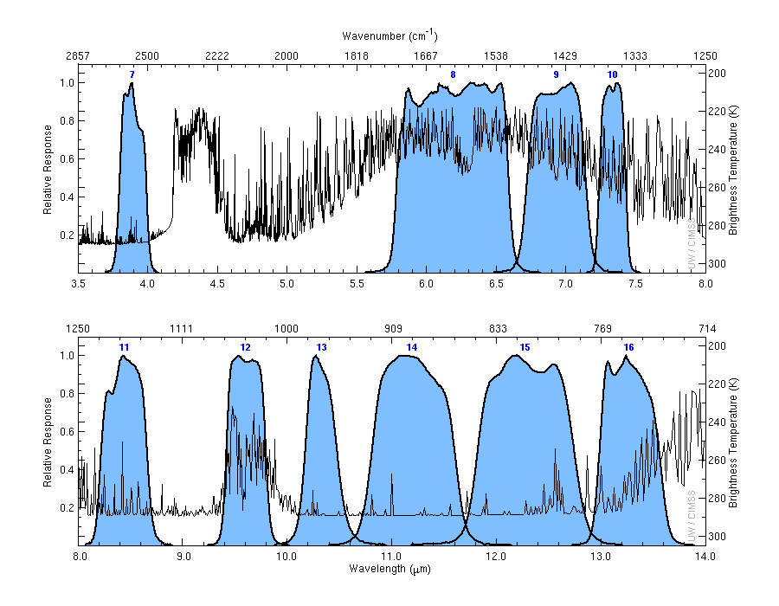
ABI Spectral (IR) Bands

Slide 19
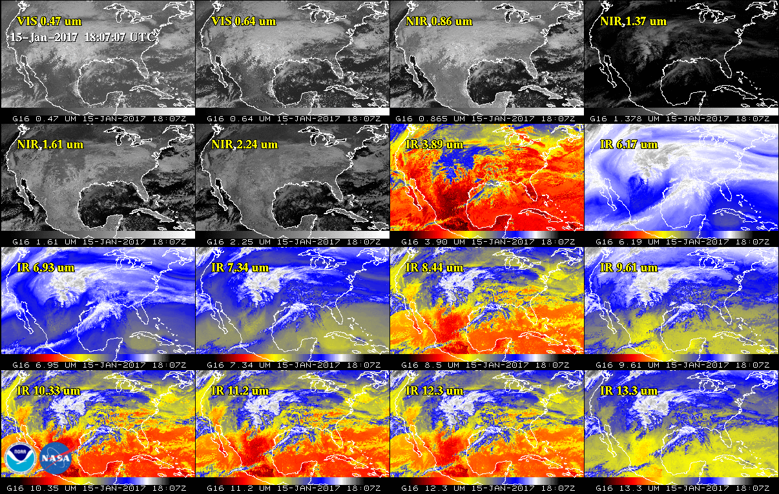
ABI GOES-16 Spectral Bands (16)
2 VIS
4 NIR
10 IR

Slide 20
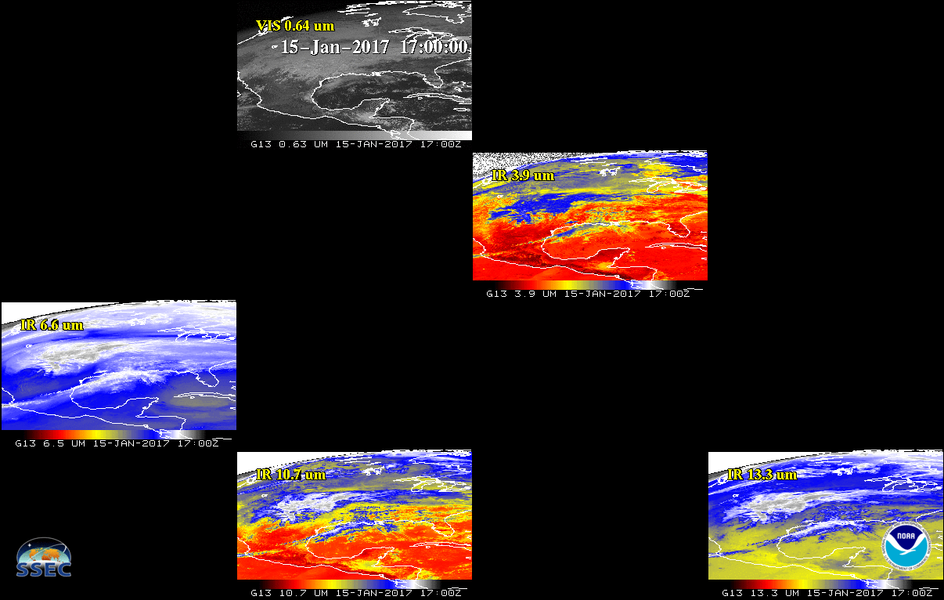
Current GOES Spectral Bands (5)
VIS
1 VIS
0 NIR
4 IR
NIR
WV
IRW
CO2
GOES-East

Slide 21
ABI Spectral Bands (16)
2 VIS
4 NIR
10 IR

Slide 22
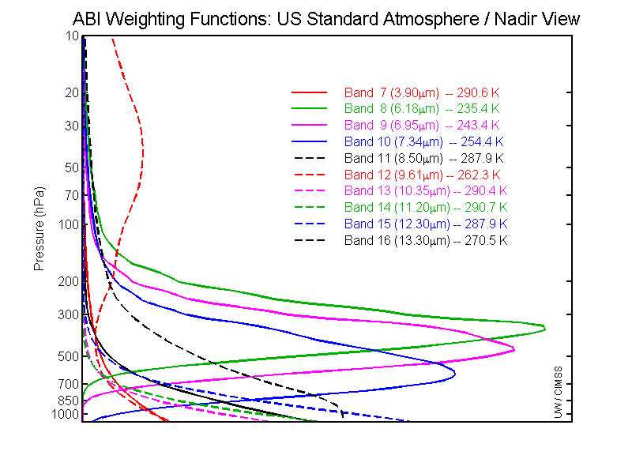
GOES-R ABI Weighting Functions
ABI has only 1 CO₂ band, so upper-level temperature will be degraded compared to the current sounder

Slide 23
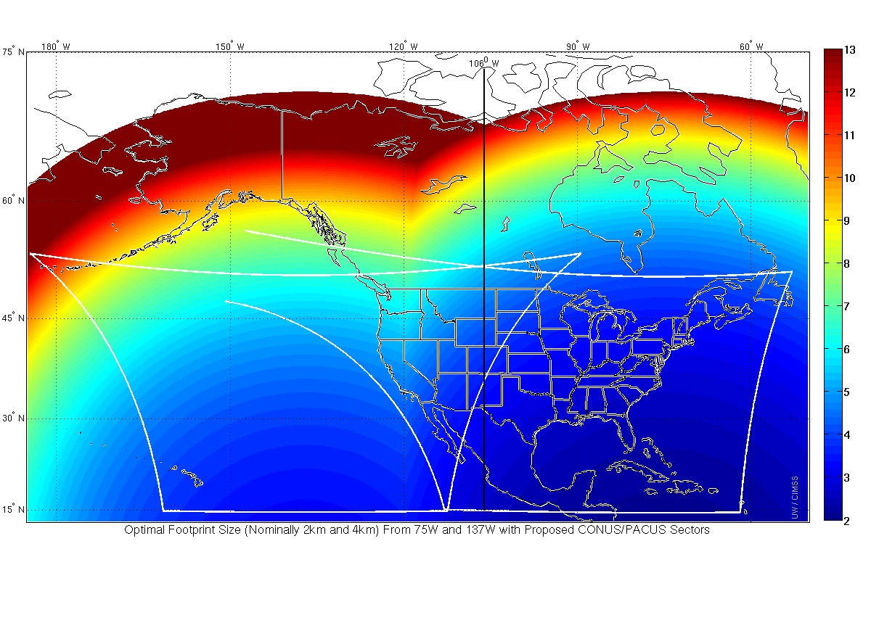
GOES-R (16) as GOES-East
GOES-15 as GOES-West
106 W
The spatial resolution from the GOES-R ABI is better than current GOES
to 120 degrees West. (And improved temporal resolution beyond that)
Notes:
So, If GOES-R is GOES-West at 137 W, and GOES-13 remains GOES-East at 75 W, the midpoint longitudinally is 106 W. But that's not where satellite resolution would be the same from each satellite; rather, GOES-R would have better spatial Resolution than GOES-13 all the way to 92 W, the approximate longitude of Duluth Minnesota at the western tip of Lake Superior. If GOES-R were GOES-East, superior spatial resolution from that GOES-East (relative to the resolution of GOES-14 or GOES-15 as GOES-West at 135W) would extend west all the way to 120 W, the longitude of Reno NV and Santa Barbara CA.
When GOES-R and GOES-S both are operational as GOES-East and GOES-West, the poorest spatial resolution will be along the 106W longitude line. Glasgow MT, and thereabouts, will have dubious distinction of the worst horizontal spatial resolution in CONUS – because it's halfway between the two satellites and farthest north.

Slide 24
Recent Mode 3 (Flex mode)
“Time-Time” chart
Note the ‘white’ space is instrument idle time.
DRAFT!
Notes:
Copy and pasted from excel. Pasted as a picture. Resized to 44% by 44% of original. Arrange -> Align -> Align Center & Align Middle

Slide 25
ABI Scan Mode ”6” with 10-min FD
In 10-min:
  1 Full Disk +
  2 CONUS +
  20 Meso-scale
The 10-min Full Disk would offer synergy with other geos and improved AMVs outside of CONUS, plus still allow for meso-scale observations.
Data from the mode has been collected during the PLPT (Post Launch Products Test).
This mode maintains the scan sectors (same size/locations) as in mode 3 and is currently under contract for the needed ground system modifications.
Notes:
Copy and pasted from excel. Pasted as a picture. Resized to 44% by 44% of original. Arrange -> Align -> Align Center & Align Middle

Slide 26
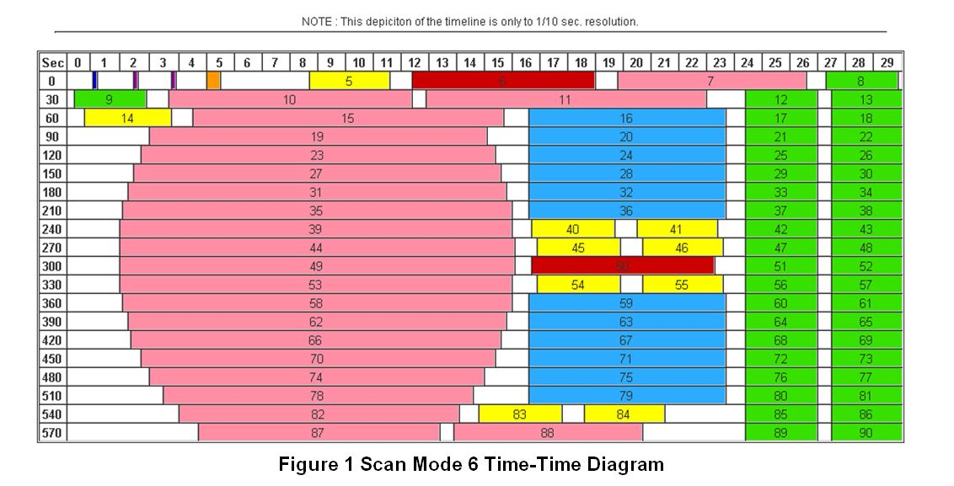
ABI Scan Mode ”6” with 10-min FD
Note less ‘white space’ than scan mode 3 (flex mode)
Time-time diagram from Exelis, now Harris Corp.
Notes:
Copy and pasted from excel. Pasted as a picture. Resized to 44% by 44% of original. Arrange -> Align -> Align Center & Align Middle

Slide 27
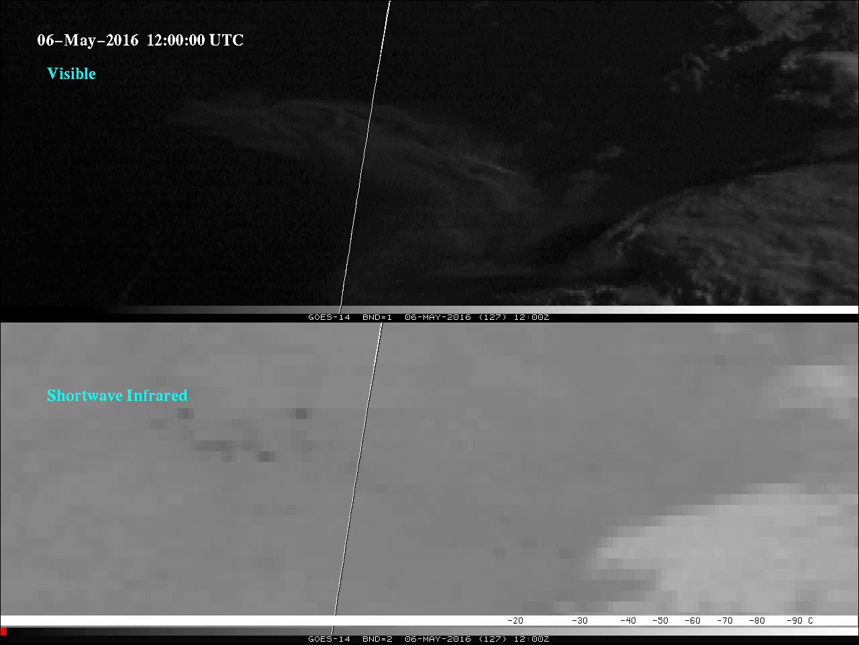
Fort McMurray Fires (GOES-14)
Notes:
Animation.

Slide 28
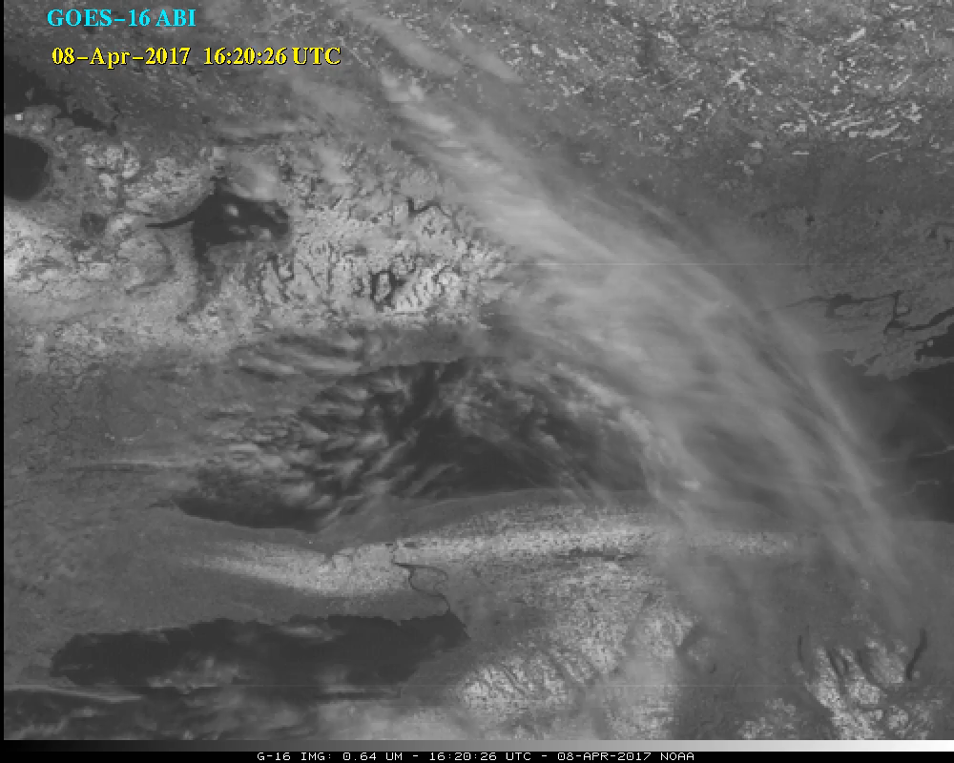
ABI “Red” Band (0.62 um)

Slide 29
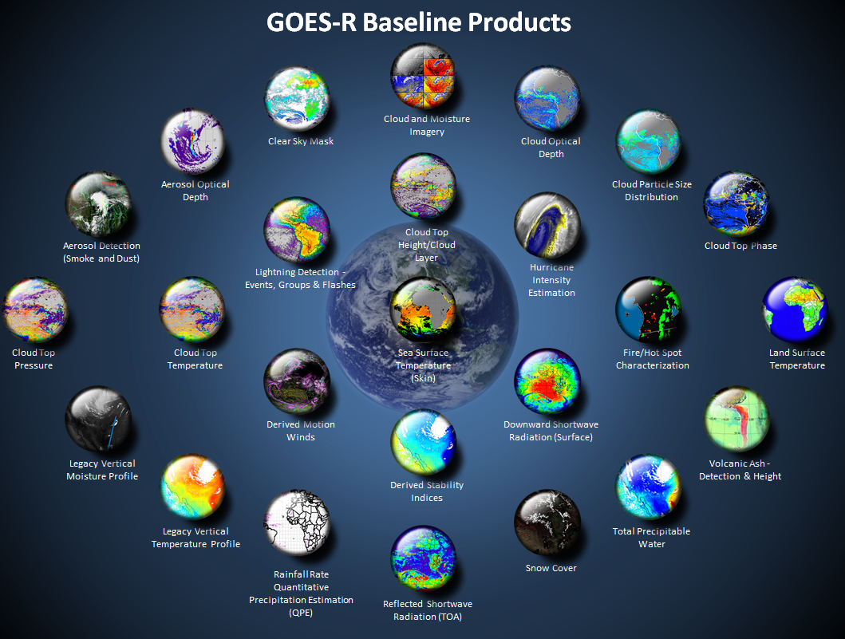
Many critical derived quantities
http://www.goes-r.gov

Slide 30
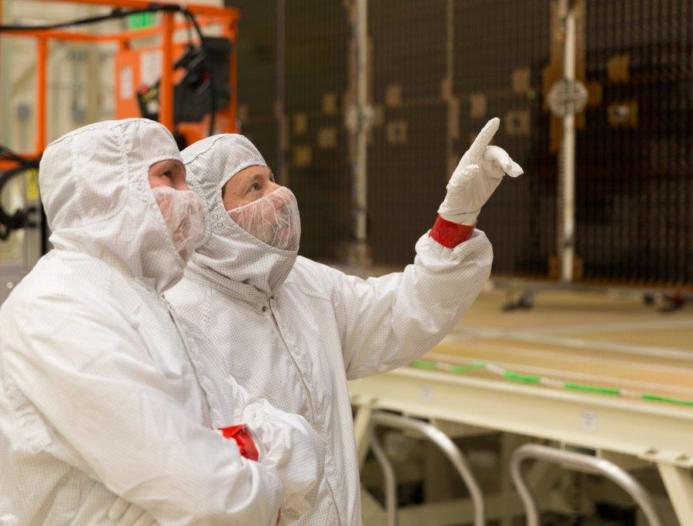
GOES-R Series web sites
http://www.goes-r.gov
http://cimss.ssec.wisc.edu/goes-r/
http://cimss.ssec.wisc.edu/goes/goesr.html
GOES-16 data shown are preliminary, experimental, during on-orbit testing.
Lockheed Martin

Slide 31
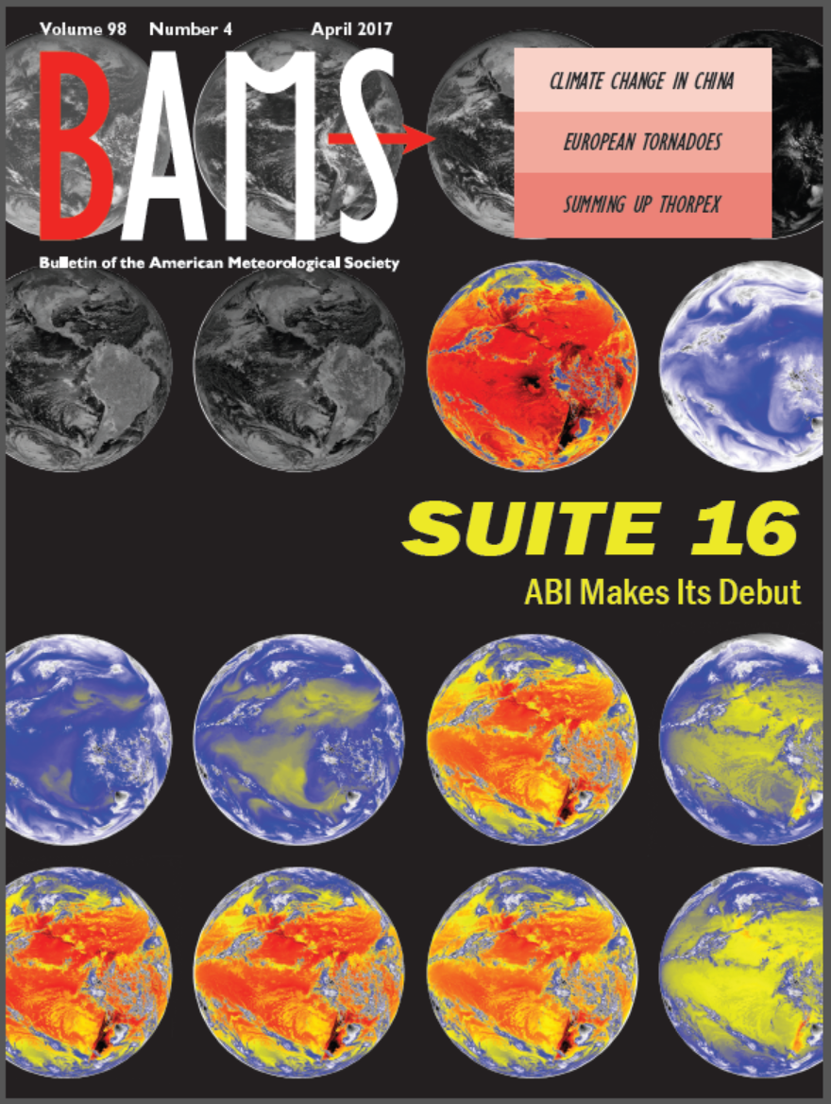
A Closer Look at the ABI
http://journals.ametsoc.org/doi/abs/10.1175/BAMS-D-15-00230.1
April BAMS issue

Slide 32

Thunder Bay (GOES-16)
Notes:
Animation.

