Slide 1
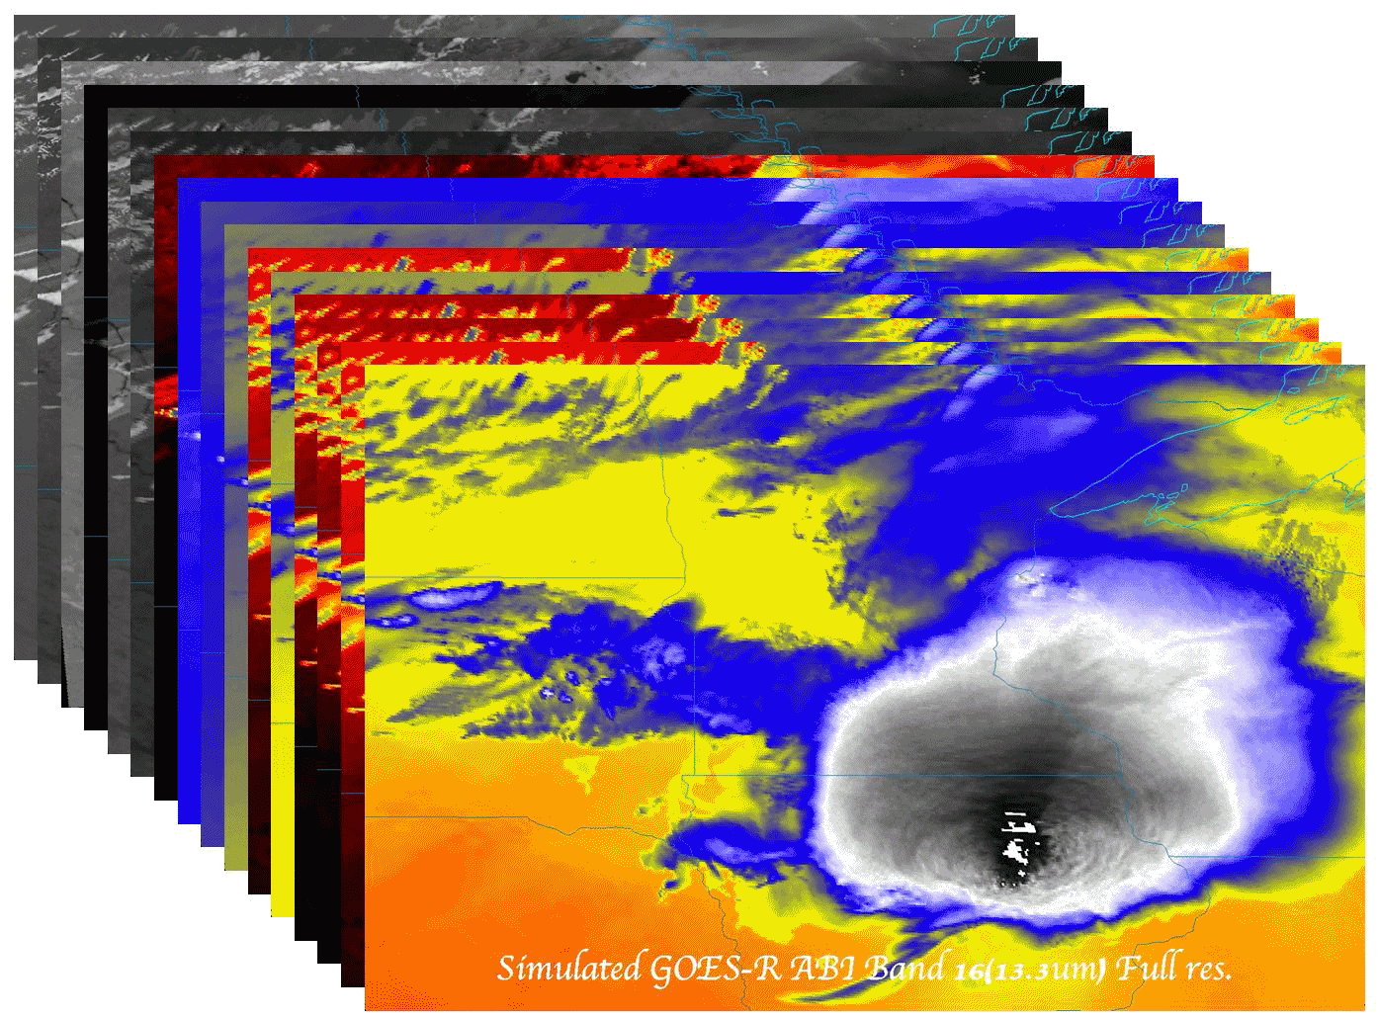
GOES-R ABI INR:
A Users Perspective
Timothy J. Schmit (tim.j.schmit@noaa.gov)
NOAA/NESDIS/Satellite Applications and Research
Advanced Satellite Products Branch (ASPB)
Madison, WI
Jaime Daniels, STAR
Mat Gunshor, Scott Bachmeier, CIMSS
GOES-R POSST Meeting
March, 2014
UW-Madison

Slide 2
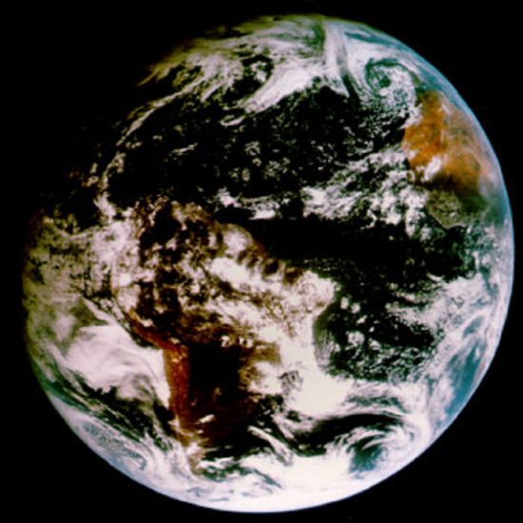
Outline
Current GOES
AWG (Algorithm Working Group)
INR assessment via image loops
System testing with simulated INR values?
Summary
More information
Questions

Slide 3
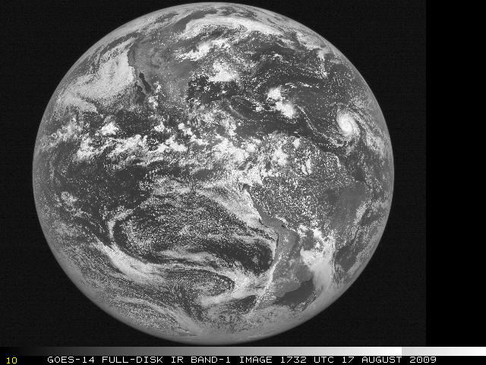
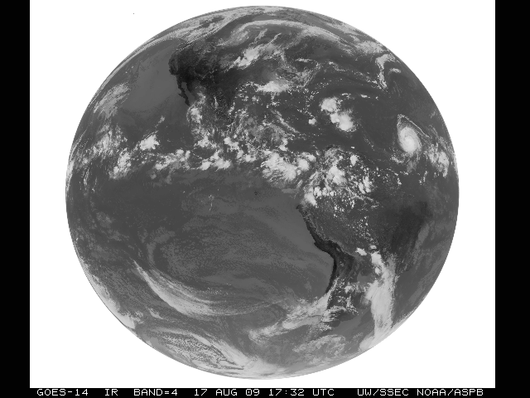
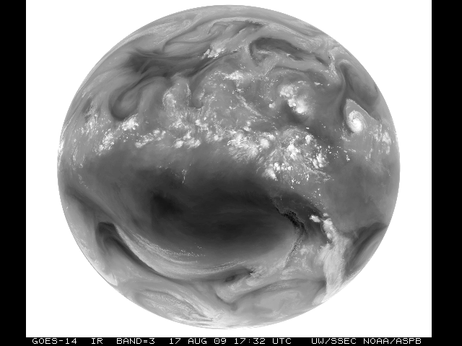
GOES-14 Science Test December 2009
Don Hillger, Deb Molenar, Dan Lindsey, John Knaff
NOAA/NESDIS/Satellite Applications and Research
Regional And Mesoscale Meteorology Branch (RAMMB)
Dave Watson, Mike Hiatt, Dale Reinke, etc.
CIRA, Colorado State University
Fort Collins CO
Don Hillger and Tim Schmit co-lead the NOAA Science Test

Slide 4
GOES-14 Science Test – December 2009
Hillger, D.W., and T.J. Schmit, 2010: The GOES-14 Science Test: Imager and Sounder Radiance and Product Validations. NOAA Technical Report NESDIS 131, 1-119.
http://rammb.cira.colostate.edu/projects/goes-o/NOAA_Tech_Report_NESDIS_131_GOES-14_Science_Test_with_Corrigendum.pdf

Slide 5
GOES Science Test Goals
For all GOES check-outs, the goals of the Science Test include:
To assess the quality of the GOES radiance data. This is accomplished by comparison to other satellite measurements or by calculating the signal-to-noise ratio compared to specifications, as well as assess the striping in the imagery due to multiple detectors.
To generate products from the GOES data stream and compare to those produced from other satellites. These included several Imager and Sounder products currently used in operations.
Rapid-scan imagery of interesting weather cases are collected with temporal resolutions as fine as every 30 seconds, a capability of rapid-scan imagery from GOES-R that is not implemented operationally on current GOES.

Slide 6
GOES-14 NOAA/Science Test Website
http://rammb.cira.colostate.edu/projects/goes-o/

Slide 7
GOES-O Test Schedules
Test Schedule | Imager | Sounder | Purpose
C5RTN | Emulation of GOES-East routine operations | Emulation of GOES-East routine operations | Radiance and product comparisons
C4RTN | Emulation of GOES-West routine operations | Emulation of GOES-West routine operations | Radiance and product comparisons
C1CON | Continuous 5-minute CONUS sector | 26-minute CONUS sector every 30 minutes | Test navigation, ABI-like (temporal) CONUS scans
C2SRSO | Continuous 1-minute rapid-scan (with center point specified for storm analysis) | 26-minute sector every 30 minutes (with center point same as Imager) | Test navigation, ABI-like (temporal) mesoscale scans
C3SRSO | Continuous 30-second rapid-scan (with center point over either Huntsville AL, Normal OK, or Washington DC areas) three locations only | 26-minute sector every 30 minutes (with center same as Imager) | To coordinate with lightning mapping arrays in Huntsville AL, Norman OK, or Washington DC
C6FD | Continuous 30-minute Full Disk (including off-earth limb/space view measurements) | Alternating east and west limb/space views every hour | Noise, detector-to-detector striping, fires, etc.
C7MOON | Capture moon off edge of earth (when possible) | Emulation of GOES-East routine operations | Test ABI lunar calibration concepts
C8 | Emulation of 2 km ABI through spatial over-sampling (continuous 19 minutes for same sector per specific line-shifted scan strategy) | Emulation of GOES-East routine operations | ABI-like higher-resolution product development

Slide 8
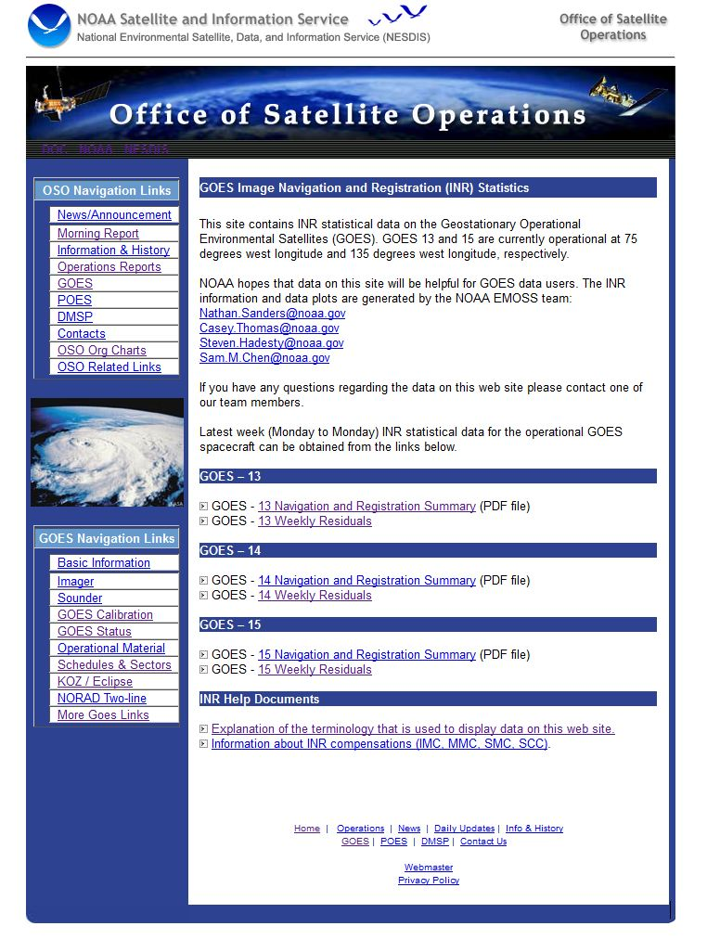
http://www.oso.noaa.gov/goes/inrstat/index.htm

Slide 9
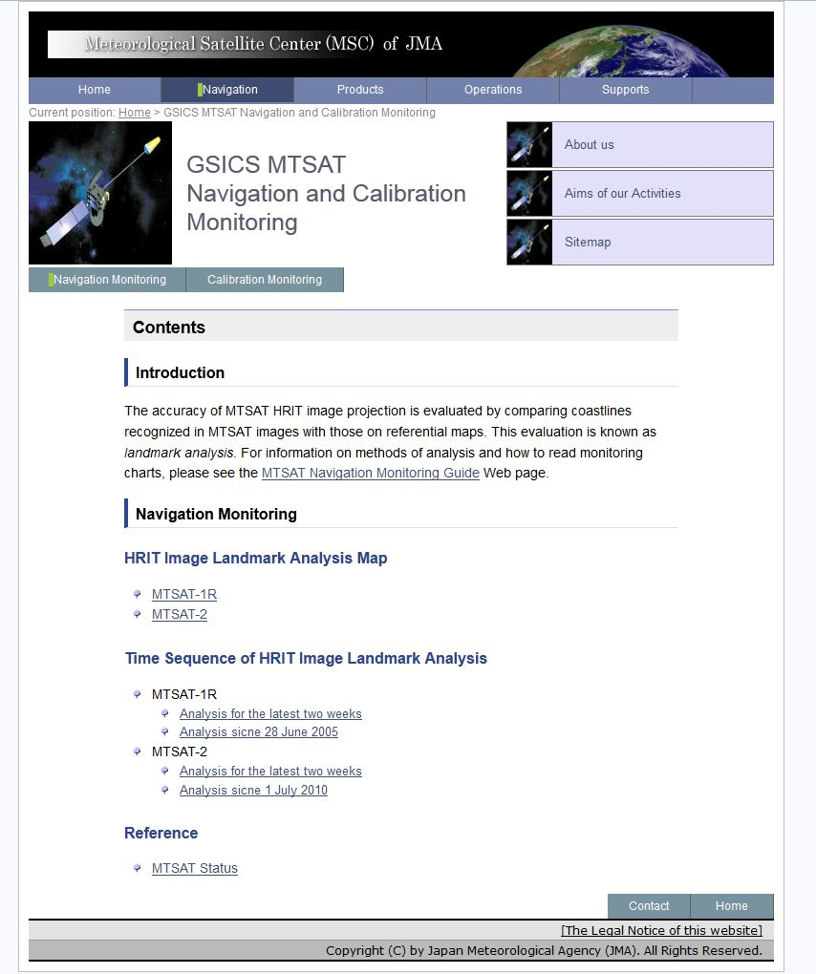
http://mscweb.kishou.go.jp/monitoring/navigation.htm

Slide 10
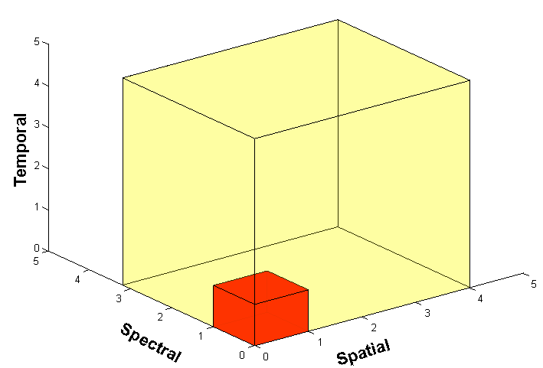
Outline
Current GOES
AWG (Algorithm Working Group)
INR assessment via image loops
System testing with simulated INR values?
Summary
More information
Questions

Slide 11
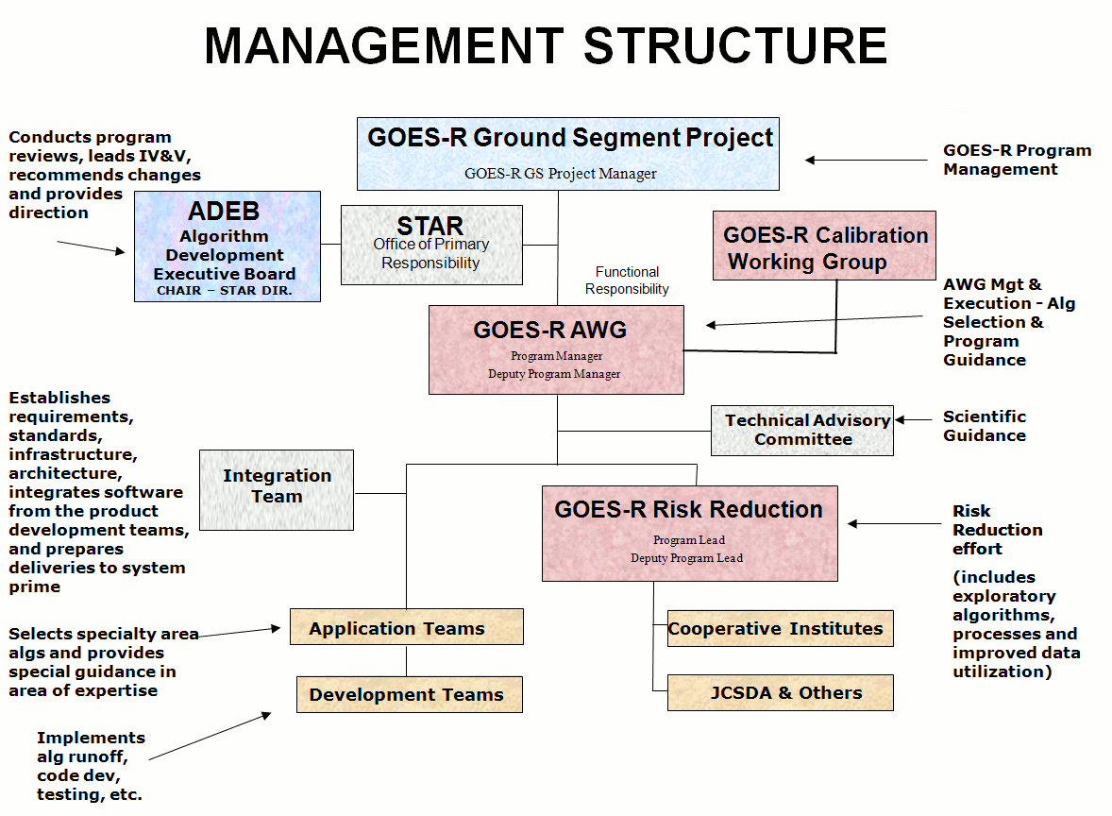
Algorithm Working Group
Mission:
To select, develop, test, validate, and demonstrate Level-2+ algorithms that meet the GOES-R F&PS requirements and provide them to the GOES-R Ground Segment.
Provide sustained life cycle validation and Level-2 product enhancements
End-to-End Capabilities
Instrument Trade Studies
Proxy Dataset Development
Algorithm Development and Testing
Product Demonstration Systems
Development of Cal/Val Tools
Integrated Cal/Val Enterprise System
Radiance and Product Validation
Algorithm and application improvements
User Readiness and Education

Slide 12
AWG Teams
GOES-R Products are Mapped to AWG Product Application Teams
AWG Product Application Teams | Team Lead
Imagery | Tim Schmit
Soundings | Tim Schmit
Winds | Jaime Daniels
Clouds | Andrew Heidinger
Aviation | Ken Pryor, Wayne Feltz
Hydrology | Robert Kuligowski
Land | Bob Yu
Cryosphere | Jeff Key
Radiation Budget | Istvan Lazslo
Lightning | Steve Goodman
SST | Alexander Ignatov
Ocean Dynamics | Eileen Maturi
Aerosols/Air Quality/Atmos. Chemistry | Shobha Kondragunta
AWG Specialty Teams | Team Lead
Proxy Data | Fuzhong Weng
Cal/Val (Sensor) | Changyong Cao
Algorithm Integration | Walter Wolf

Slide 13
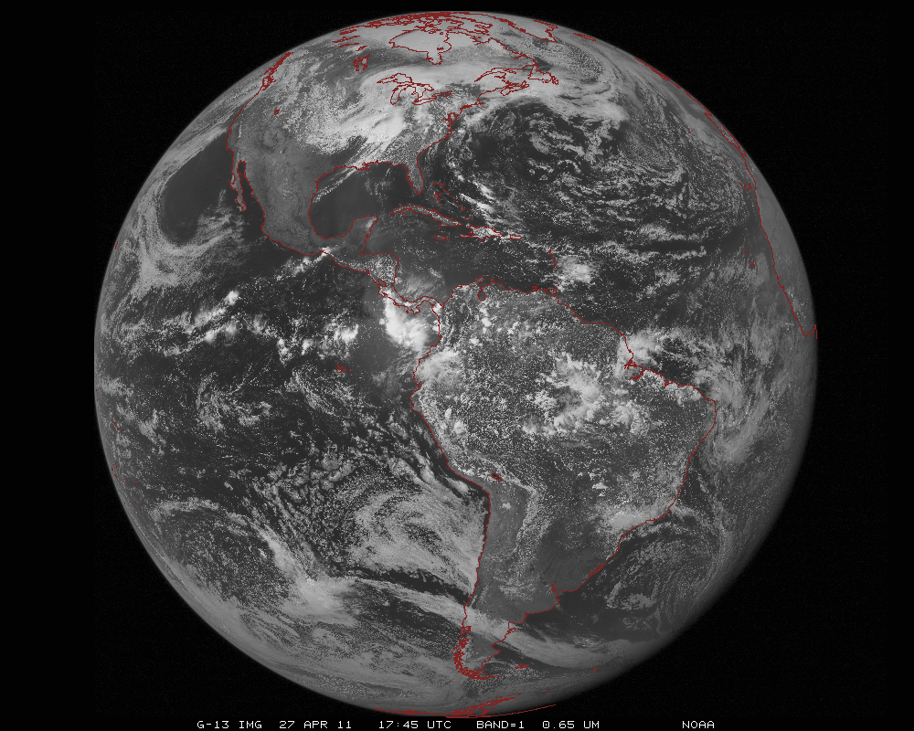
ABI scans about 5 times faster
than the current GOES imager
Anticipated scan mode for the ABI:
- Full disk images every 15 minutes + 5 min CONUS images + mesoscale.

Slide 14
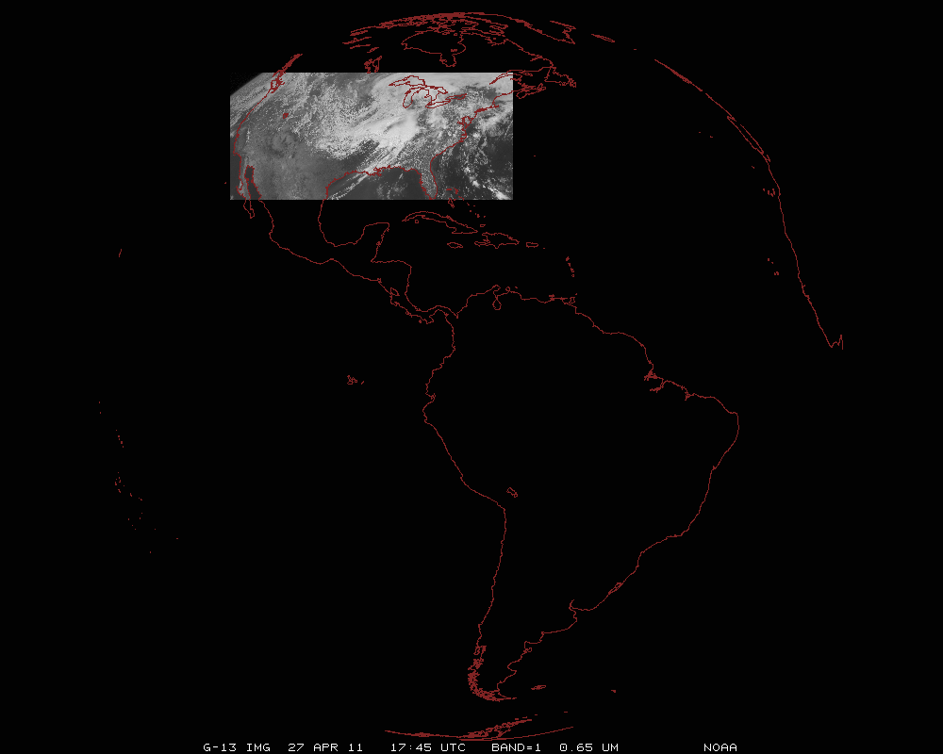
ABI can offer Continental US images every 5 minutes for routine monitoring of a wide range of events (storms, dust, clouds, fires, winds, etc).
This is every 15 or 30 minutes with the current GOES in routine mode.
Notes:
Approx. size of CONUS

Slide 15
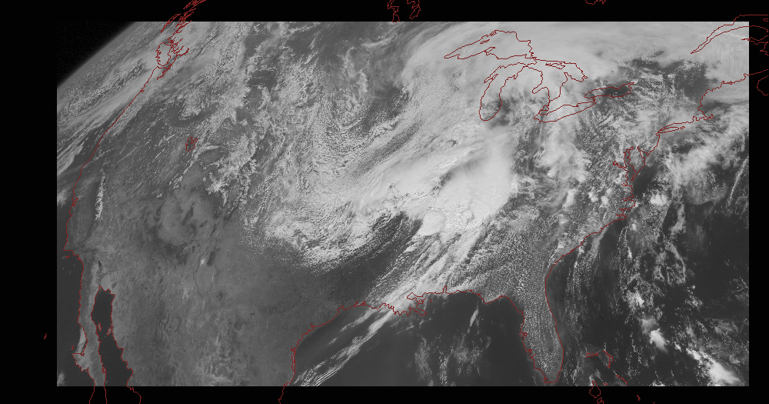
Notes:
Approx. size of CONUS

Slide 16
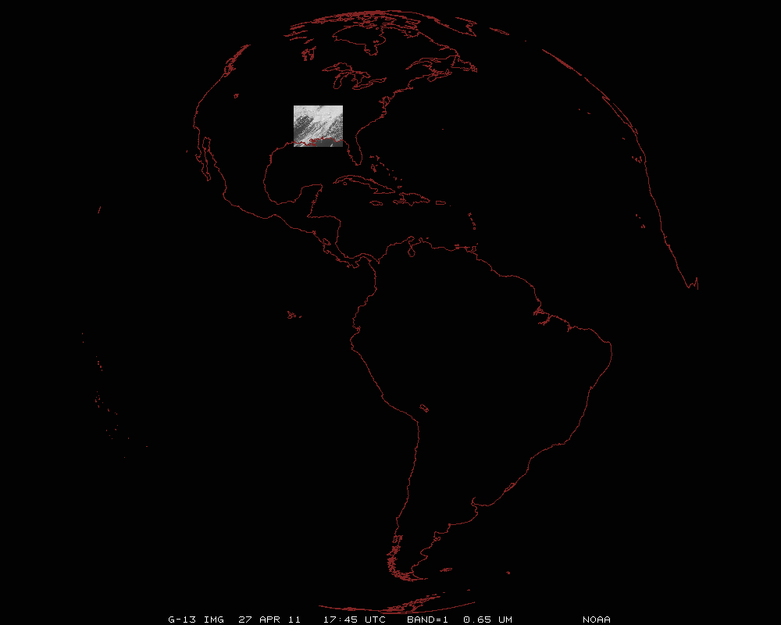
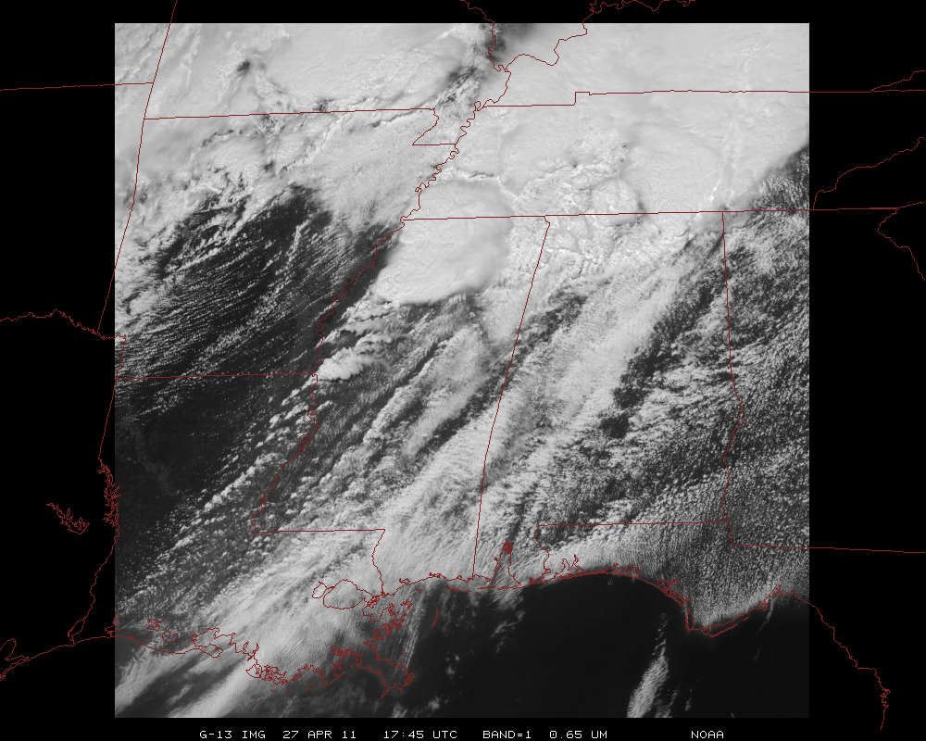
Mesoscale images every 30 seconds for rapidly changing phenomena
(thunderstorms, hurricanes, fires, etc). Or two regions every 60 seconds.
Notes:
Approx. size of meso-scale showing “Franklin”.

Slide 17
GOES-R POSST Path Forward
GOES-R Series Pre-launch POSST Activities
Post-Launch Test (PLT) Planning/ Preparation & System-Level Test Planning/Implementation
Cal&INR PLT Short Form Definition & Development
Cal&INR PLT Long Form Definition & Development
POSST Task in Coordination with
ETE I-V Testing
Data Operations Tests (DOT) Planning & Ground Segment Training
DOT I & II
Pre-Launch Instrument Cal Testing Assessment (Ends After All Instruments Delivered)
MOST Activity
Cal/INR/Product Science (CIPS) Val Tool Development
CIPS Val Tool Testing
CIPS Val Definitions & CIPS CONOPS/OPSCON Development
*Post-Launch Product Test (PLPT) Definition and Development &
CIPS OPSCON Rehearsals
CIPS OPSCON Rehearsals
DOST Activity
120 Days
90 Days
60 Days
12 months
6 Months
Internal
POSST Activity Only
Sep13
Apr14
Apr15
POSST Kick-Off
Mission Operations Review (MOR) and System Integration Review (SIR)
Flight Operations Review (FOR)
Launch
Continue pre-launch instrument cal test assessment and reporting
Finalize the GOES-R System-level Cal/Val CONOPS/OPSCON, and process it through Program configuration management
Cal/INR/Product Science (CIPS) PLT Planning
Define CIPS-related data operations validation objectives to be carried out during Data Operations Tests (DOTs)
Support SIR and MOR reviews
Complete CIPS tool development planning and begin implementation
Ground Segment Training for relevant personnel
Clarify CIPS validation schedules and milestones
Identify CIPS resource needs and risks
Adding new Operational OPSCON section.
A glimpse at PLPT Validation Maturity Stages
Another look at POSST scope. Defining high-level test objectives, test deliverables, and schedules.
Notes:
To-Do: Finalize CONOPS/OPSCON and send it off for CM. Under PLT Planning – need to create PLPT test plan that includes the types of tests and their associated data acquisitions and priorities.

Slide 18
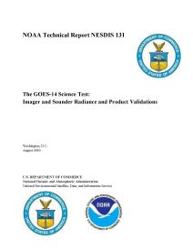
AWG Imagery Team
What: select full resolution time animations
Why: monitor animations as users will
When: during the full Post Launch Test
How well: while qualitative, full resolution animations can depict sub-pixel INR jumps
Similar to: Previous (GOES-8 to -15) PLT
http://rammb.cira.colostate.edu/projects/goes-p
http://rammb.cira.colostate.edu/projects/goes-o

Slide 19
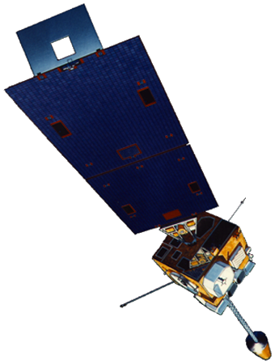
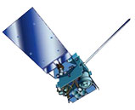
Overview
GOES-8/12 vs GOES-13/15 vs GOES-R ABI:
GOES-N/O/P bus change
- better navigation than previous generation
- earth sensor -> star tracker
GOES-R ABI
- even better (by a factor of ~2) expected INR
GOES-13/15
GOES-8/12

Slide 20
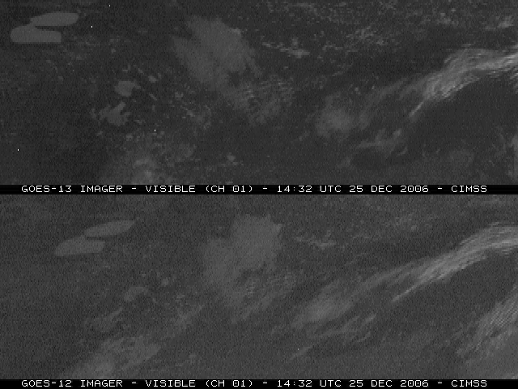
Better “navigation” on GOES-13
GOES-13:
GOES-12:
Notes:
animation

Slide 21
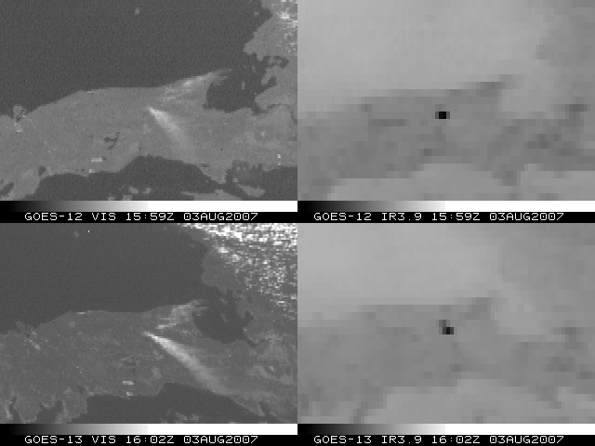
MI Fires - 3-Aug-2007
Visible
Shortwave Window
GOES-12:
GOES-13:
http://cimss.ssec.wisc.edu/goes/blog/archives/450
Notes:
http://cimss.ssec.wisc.edu/goes/blog/2007/08/03/wildfire-in-the-upper-peninsula-of-michigan/

Slide 22
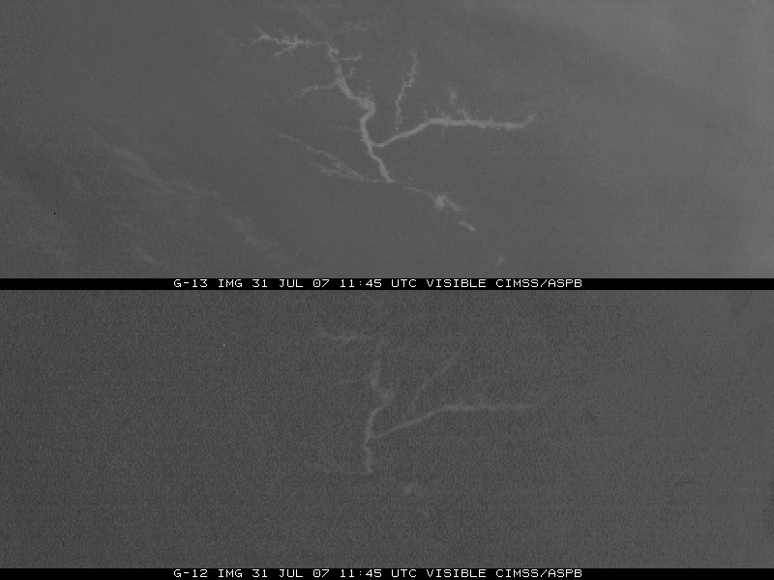
River Fog - 31-July-2007
GOES-13:
GOES-12:

Slide 23
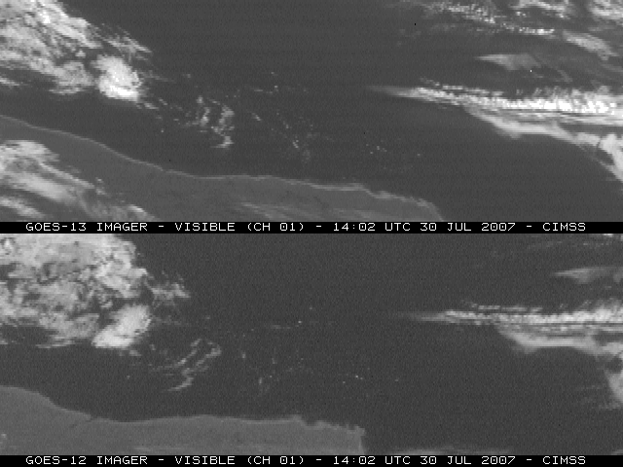
Ice Floes - 30-July-2007
GOES-13:
GOES-12:
http://cimss.ssec.wisc.edu/goes/blog/archives/440

Slide 24
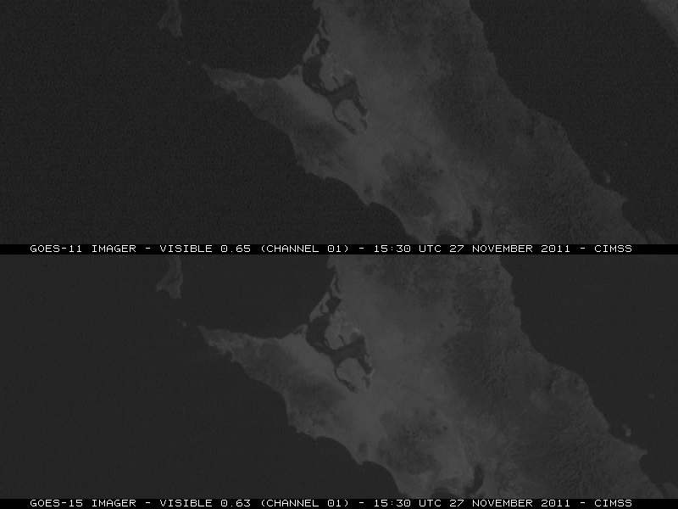
Improved Navigation & Registration GOES-15 provides a hint of ABI’s INR quality…
GOES-11
GOES-15
http://cimss.ssec.wisc.edu/goes/blog/archives/9270
Notes:
We also expect improved navigation/registration performance from the ABI which products will also benefit from, especially those that use and rely heavily on temporal information (ie, satellite winds)

Slide 25
GOES-14: Special Rapid Scanning offers glimpse of the ABI
SRSOR (Super Rapid Scan Operations for GOES-R) from GOES-14 imager
Daily scanning between mid-August and September 24th and late October 2012.
Posted many animations
http://cimss.ssec.wisc.edu/goes/srsor/GOES-14_SRSOR.html
Many phenomena were observed: convection, hurricanes, fires, smoke, etc.,
Data to many groups HPC, OPC, AWC, SPC, several regions, etc.
All data archived
Animation from GOES-14 Imager visible image at 1-min time resolution.
GOES-14 provided very unique information and offers a glimpse into the possibilities that will be provided by the ABI on GOES-R.

Slide 26
GOES-14: SRSOR – Super Rapid Scan Operations for GOES-R

Slide 27
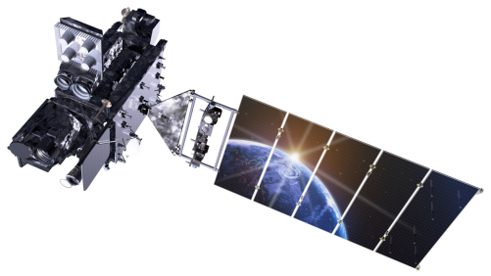
Outline
Current GOES
AWG (Algorithm Working Group)
INR assessment via image loops
System testing with simulated INR values
Summary
More information
Questions
Lockheed Martin

Slide 28
System testing with simulated INR values?
Under ‘things others should think about’…
Are there plans (pre-launch) to perturb realistic simulations with varying levels of INR performance?
run through validation programs
monitor effect on products

Slide 29
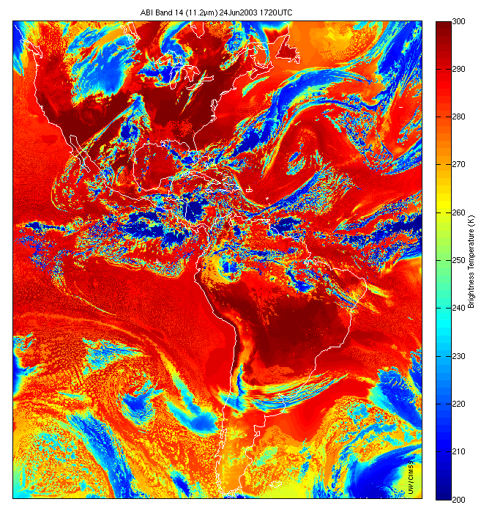
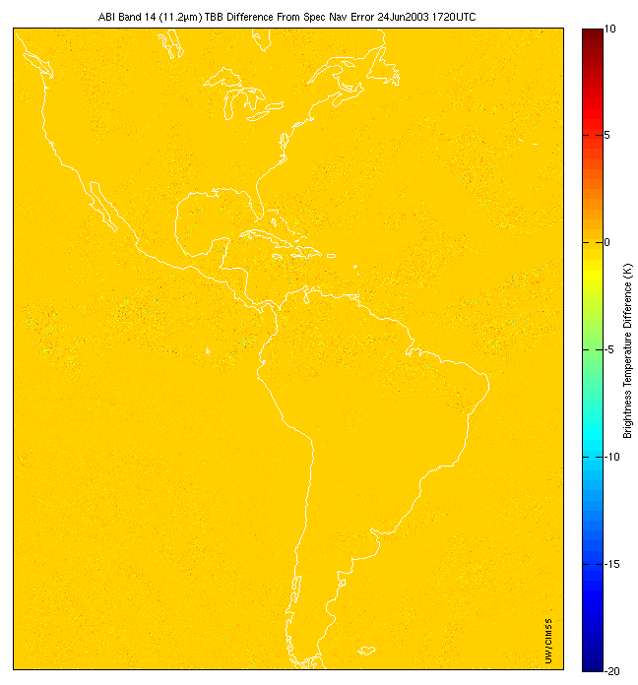
ABI band 14 (11μm) simulation from NWP model
Differences
Navigation Error Introduced
From M. Gunshor – CIMSS Proxy ABI Lead
Notes:
8 km

Slide 30
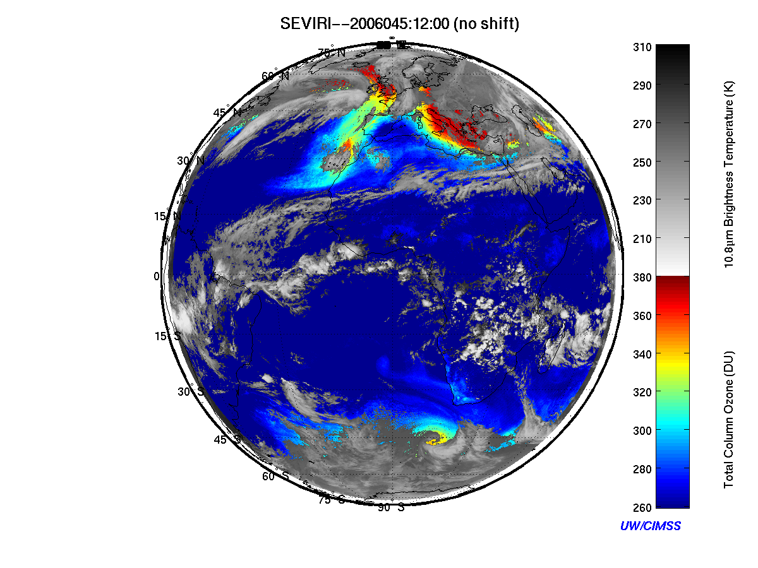
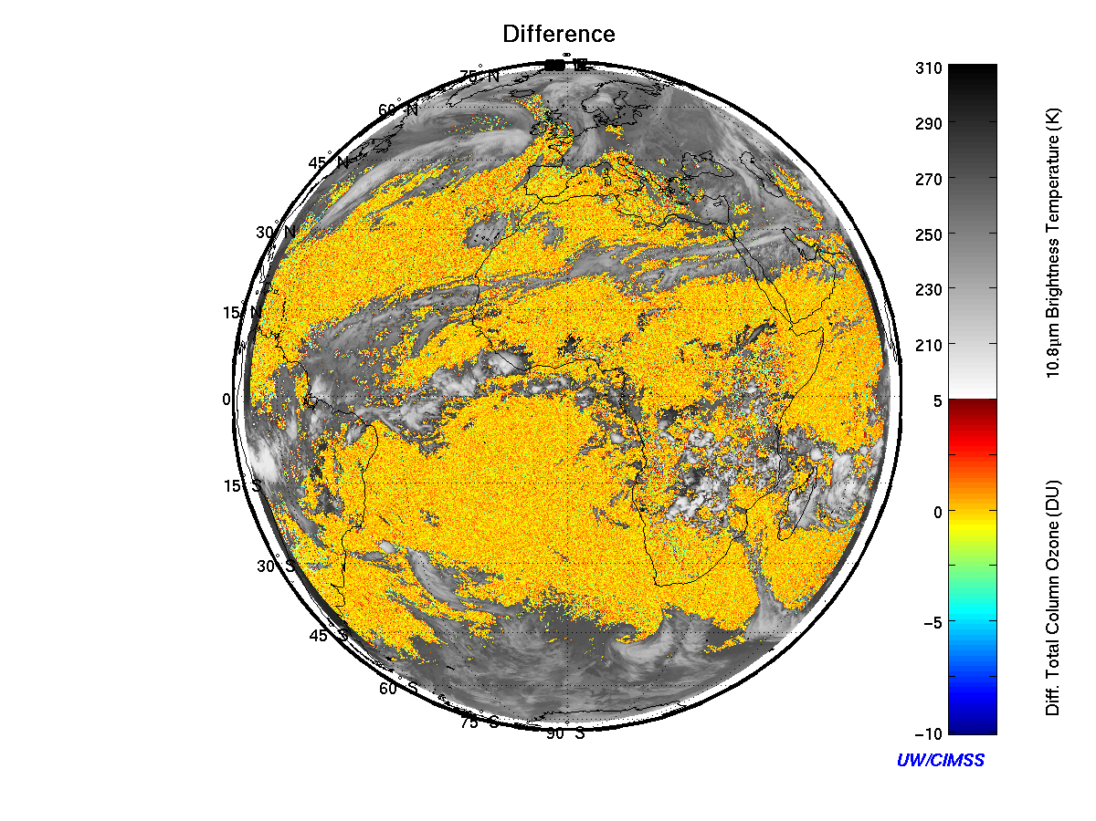
Impact of navigation error (1 pixel) on ABI/SEVIRI single FOV total column ozone (TCO) product (Jin et al. 2007). SEVIRI TCO product is composite of 2 time steps, and the temporal resolution of the product is 30 minutes.
From J. Li – AWG Sounding Team Member

Slide 31
Summary
Image loops, especially fast, full (space and time) resolution animations can be quite useful for quality assessments.
Can share any animations built during the PLT
Similar to previous GOES PLT.
2. ABI is expected to have two times the image navigation quality
3. Special GOES-14 1-min data available
Leveraging ABI with GLM wrt INR
What other tools exist or will exist wrt INR?

Slide 32
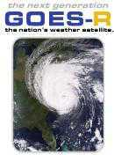
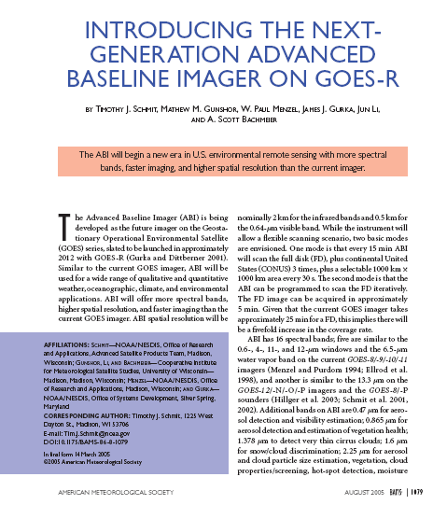
More information
GOES-R:
http://www.goes-r.gov
http://www.meted.ucar.edu/index.htm
http://cimss.ssec.wisc.edu/goes_r/proving-ground.html
(ABI WES guide with simulated images)
GOES and NASA:
http://goespoes.gsfc.nasa.gov/goes/index.html
http://goes.gsfc.nasa.gov/text/goes.databookn.html
UW/SSEC/CIMSS/ASPB:
http://cimss.ssec.wisc.edu/goes_r/proving-ground/nssl_abi/nssl_abi_rt.html
http://cimss.ssec.wisc.edu/goes/abi/
http://cimss.ssec.wisc.edu/goes/blog/
http://cimss.ssec.wisc.edu/goes/srsor/GOES-14_SRSOR.html
AMS BAMS Article on the ABI

