Slide 1
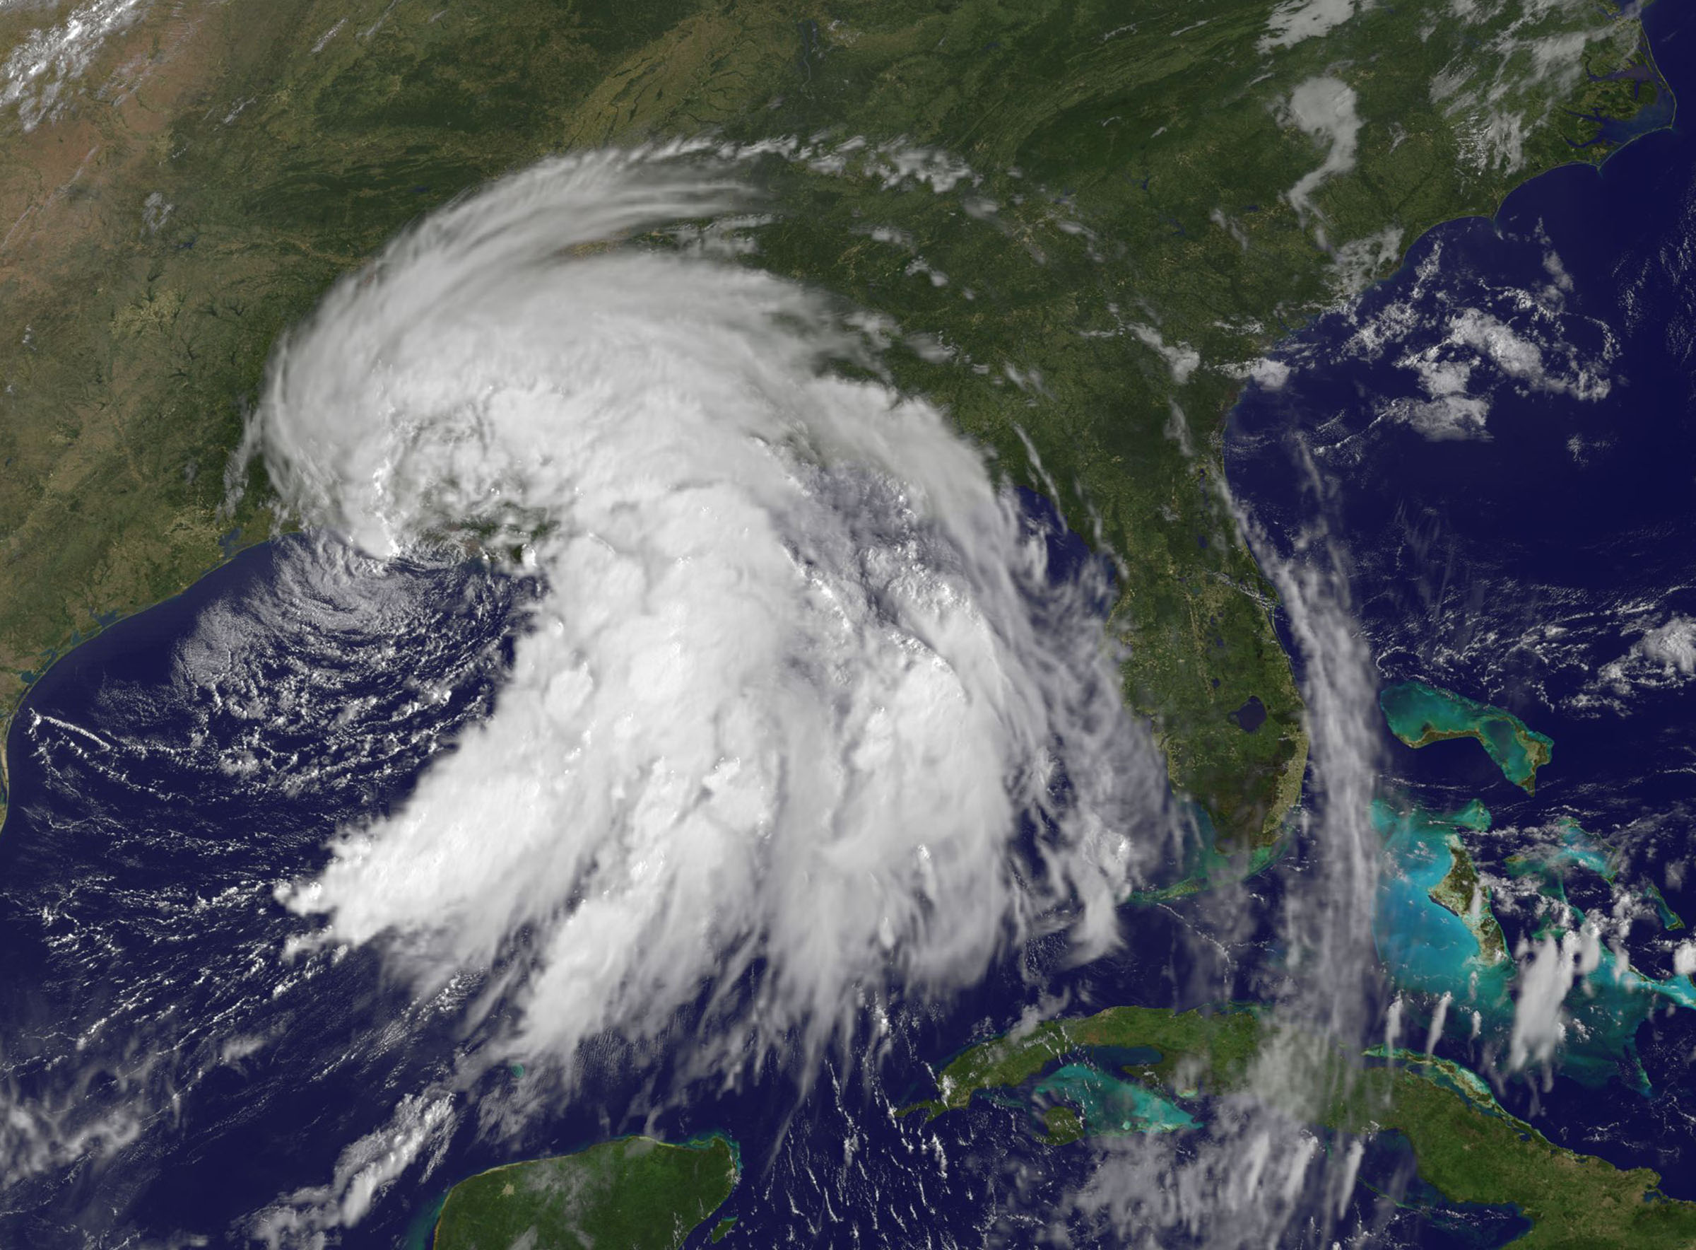
GOES-R/JPSS Program
CIMSS/ASPB Participation
GOES-R/JPSS Proving Ground Status
Wayne Feltz, Mike Pavolonis, Tim Schmit, Andy Heidinger, Jordan Gerth, Scott Bachmeier, Scott Lindstrom, Justin Sieglaff, Lee Cronce, Robert Aune, Gary Wade, Brad Pierce, Kaba Bah, Will Straka, Jason Otkin, Sarah Monette, Chris Velden, Ralph Petersen, Russ Dengel and Chris Schmidt
July 1, 2013

Slide 2
Satellite Proving Ground @ CIMSS/ASPB
Demonstration of Satellite PG applications at National Center Testbeds/Demonstrations and NWS WFO
New simulated WRF-Chem Proxy ABI products
AWIPS-2 status
Training
SRSOR from GOES-14
Upcoming meetings/conferences
Notes:
Any new bullets?

Slide 3
1) Hazardous Weather Testbed, Norman OK
Satellite Liaison: Bill Line
HWT Products:
Simulated Cloud and Moisture Imagery (Otkin/Sieglaff/Lindsey – CIMSS/CIRA)
Legacy Temperature and Moisture Profiles (Petersen/Line - CIMSS)
Cloud Top Cooling (Sieglaff/Feltz – CIMSS)
Continue streamlining formats for AWIPS-2
NOAA HWT 2013 – Participants: Lee Cronce, Jordan Gerth, Wayne Feltz, and Jason Otkin
Future planning will be coordinated with new liaison
UW-Madison satellite applications “Boot Camp” will be held 8-19 July 2013: Bill Line, Amanda Terborg, Chad Gravelle, and Michael Folmer will be present

Slide 4
2) AWC Testbed Satellite Proving Ground
Satellite Liaison: Amanda Terborg
Aviation Weather Testbed Summer Demo: August 12 – 23, 2013
WRF Simulated ABI Imagery
GOES Cloud Top Cooling
GOES(-R) Overshooting Top
Thermodynamic NearCasting
GOES(-R) Cloud Top Height and Cloud Top Temperature
CIMSS participants
12-16 August Justin Sieglaff
12-14 August Wayne Feltz
19-23 August Jordan Gerth
VIIRS data now available for AWC but not tested in operations yet
4
Notes:
Slide 5 in main presentation – clarified ash/so2 products are for MODIS-Alaska domain

Slide 5
3) NWS Operations PG and WFO Interactions
Satellite Liaison: Chad Gravelle
Continued coordination of GOES-R Fog/Low Stratus products into operations (West Coast evaluation began in May with SEW, EKA, LOX, and MTR).
Convective Cloud-Top Cooling (part of “convective-initiation toolbox”) evaluation with CR (12 WFOs) and ER (2 WFOs) began in June, intermountain West WFO evaluation possibly in July.
Assisted in distributing VIIRS bands (including DNB) to local WFO, Monterey and Louisville, and now available to MKX, MTR, LMK, and the AK WFOs
Assisted CRH and ERH with successful display of Fog/Low Stratus products in AWIPS 2.
Working with NWS Operations PG regarding GOES-R products and and how they relate to ongoing GOES-R PG activities.

Slide 6
4) Alaska/AAWU/High Latitude Testbed
Automated ash cloud alerts from AVHRR and MODIS will be provided to the VAAC and CWSU soon (training needs to be updated first).
VIIRS NetCDF files verified to be AWIPSII compatible
VIIRS VISIT NWS training module under development
Polar2grid tool being expanded for GEOCAT AK products
Participated in OCONUS meeting 17-21 June 2013:
CIMSS: Wayne Feltz, Jordan Gerth, Ralph Petersen, Liam Gumley
NOAA ASPB: Jeff Key and Mike Pavolonis
Notes:
Slide 6 in main presentation – updated bullets to more current items

Slide 7
5) Pacific Region/Hawaii Demonstrations
Roy Huff is no longer affiliated with the GOES-R Proving Ground
Bill Ward (administrative) and Eric Lau (technical) are proper points of contact related to the GOES-R Proving Ground in Pacific Region
More information about the visiting scientist program will be forthcoming from Bill Ward; invited scientists will be scheduled according to product priority and seasonal relevance (e.g., cloud top cooling in winter months)
Welcome packet will be sent via e-mail to participants as scheduled
Contains hotel and other logistical information
Kathy Strabala (VIIRS) and Mark DeMaria (tropical cyclones) are scheduled to visit during the summer
New automated and manual monitoring of L/X-band antenna equipment will help ensure maximum uptime

Slide 8
5) Pacific Region/Hawaii Demonstrations

Slide 9
5) Pacific Region/Hawaii Demonstrations
Jordan has returned from Pago Pago, American Samoa
Forecasters at the Weather Service Office rely heavily on satellite imagery online for observational information (no weather radar)
Jordan shared information about relevant GOES-R Proving Ground activities and new interpretation techniques
Poor bandwidth on the island cannot support L/X-band antenna without significant (likely costly) upgrade
Satellite system (L/X-band antenna) data science training (Liam Gumley, Kathy Strabala, Jordan Gerth) scheduled for August 20 through August 23 at the University of Hawaii at Manoa
Syllabus developed and under review
Transition to AWIPS II at NWS Honolulu not expected until early 2015

Slide 10
6) Satellite Proving Ground for Marine, Precipitation, and Hazardous Weather Applications
Satellite Liaison: Michael Folmer
UW-CIMSS providing Overshooting-Top/Enhanced-V products (same methods as SPC delivery), N-AWIPS displayed at OPC, WPC, and SAB. Will be working with TAFB to get the product down there (Trip in late May)
Cloud top height, phase, and temperature from GOES imager are in progress for display within N-AWIPS and AWIPS
The Washington VAAC is now receiving SEVIRI based GOES-R volcanic ash products via a McIDAS ADDE server and automated alerts will soon be distributed
GOES sounder total precipitable water and stability indexes (new operational version) now available via NESDIS
Coordinated CIMSS GOES-R PG collaborations with 2013-2014 Satellite Proving Ground for Marine, Precipitation, and Hazardous Weather Applications demonstrations
Other GOES-R PG decision support products requested within plan available once approved by NOAT governance process

Slide 11
7) NHC Proving Ground
Begins August 1
CIMSS will provide updated versions of the Hurricane Intensity Estimate (HIE) and Tropical Overshooting Tops (TOTs).
Hurricane Intensity Estimate
provides TC analysts with a completely objective and operationally-proven tool to estimate TC intensity using GOES-R ABI IR imagery.
As proxy data for GOES-R, the HIE employs 15-minute IR imagery from Meteosat-10 and GOES-East (CONUS sector).
Helped to upgrade Michael (2012) to major hurricane
HURRICANE MICHAEL DISCUSSION NUMBER 13 NWS NATIONAL HURRICANE CENTER MIAMI FL AL132012 …WHILE SUBJECTIVE ESTIMATES WERE NEAR 90 KT AT 0600 UTC...OBJECTIVE ESTIMATES FROM ADT AND THE GOES-R HIE PRODUCT HAVE RECENTLY BEEN BETWEEN 107 AND 110 KT. A BLEND OF THESE DATA GIVE AN INITIAL WIND SPEED OF 100 KT...MAKING MICHAEL THE FIRST MAJOR HURRICANE OF THE SEASON.

Slide 12
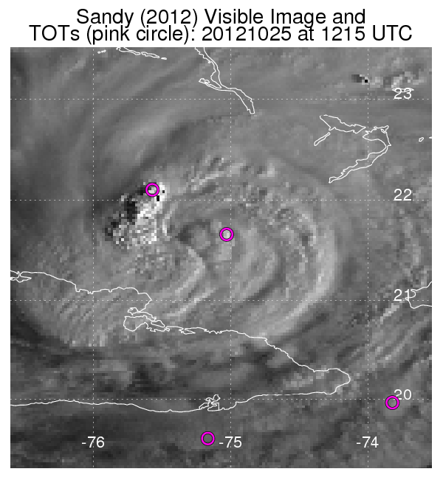
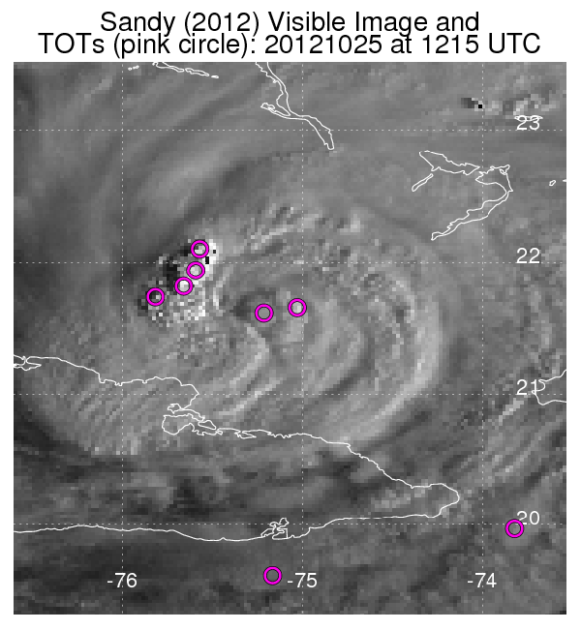
7) NHC Proving Ground
7) NHC Proving Ground
Tropical Overshooting TOTs
Objectively identifies TOT locations using cold IR pixels relative to neighbors, to isolate and quantify active vigorous convection.
Employs IR imagery from Meteosat-10 and GOES-East.
Algorithm updates based on feedback from 2012
Removal of false “TOTs” in cirrus.
Identify TOTs in
the CDO.
Training provided to NHC and TAFB in April to increase familiarity with TOTs.
Original algorithm
Updated algorithm

Slide 13
8) NWS WFO Demonstrations
NWS Milwaukee focal point: Steve Davis
CIMSS GOES-R Local Area Demonstration with MKX will continue again this summer and fall (anticipated to begin in June after MKX has transitioned to AWIPS II)
2013 activities plan in progress
Anticipated GOES-R products to be demonstrated in 2013 include:
Convective Cloud Top Cooling (coordinated with Chad Gravelle)
Nearcasting
Sky Cover (Extension of Cloud and Moisture Imagery)
Anticipated JPSS products to be demonstrated in 2013 include:
Day/Night Band

Slide 14
CIMSS/ASPB GOES-R ABI Real-time Proxy
2013 GOES-R PG Proxy activities (June 2013)
Provided forecasting support for airborne SNPP/METOP-B cal/val field mission (May 10-31, 2013). The primary objective of the mission was to collect cloud free radiance measurements from remote sensing instruments onboard the NASA ER2 during SNPP and METOP-B satellite overpasses in the vicinity of the Gulf of California.
Investigating ways of getting our simulated ABI products into AWIPS II: short term goal will be to write IDL code and utilize the ms2gt subroutines for remapping our products into AWIPS II NetCDF files.
Preparing data for a WES case focusing on 2013 Oklahoma tornado events: 6 products, including the RGB air-mass product, and the synthetic radiance/reflectance imagery, for the period of 20-29 May, 2013.
Beginning validation of proxy ABI RGB air-mass product using RGB air-mass images generated from co-located GOES-E Sounder brightness temperatures.

Slide 15
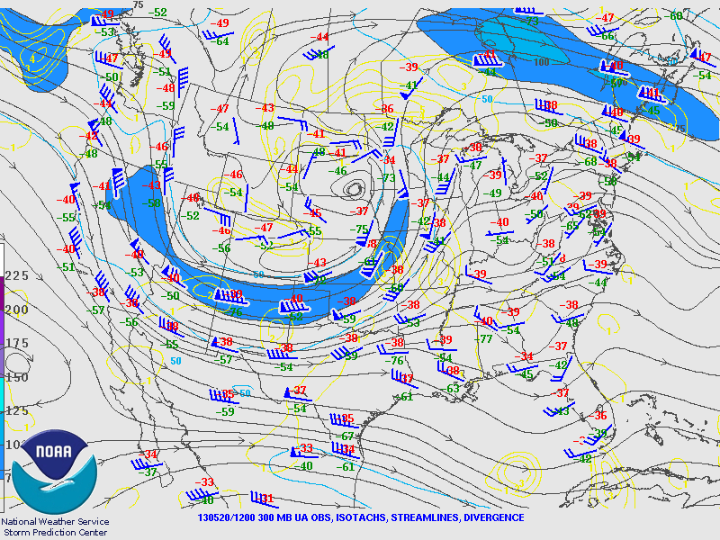
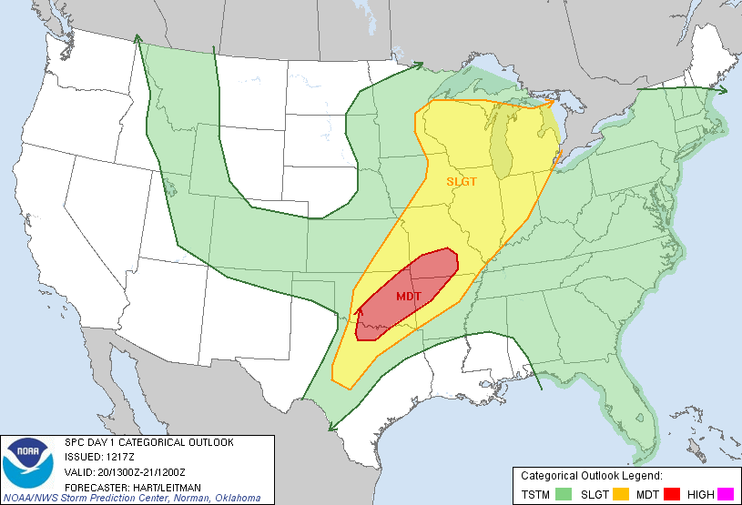
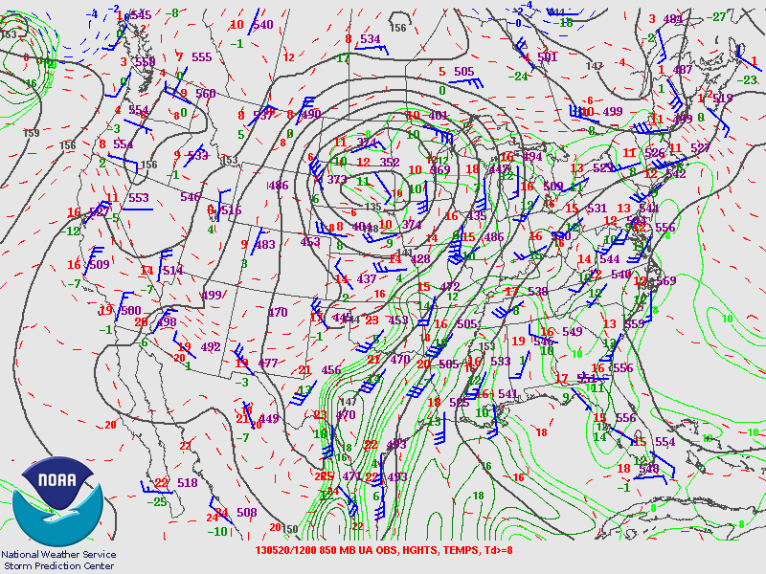
WES Case: May 20, 2013 Tornado outbreak
SPC issued a moderate risk of severe thunderstorms at 12:17Z on May 20, 2013
12Z May 20, 2013 SPC analyses show wind-shear and high dewpoints associated with upper-level trough

Slide 16
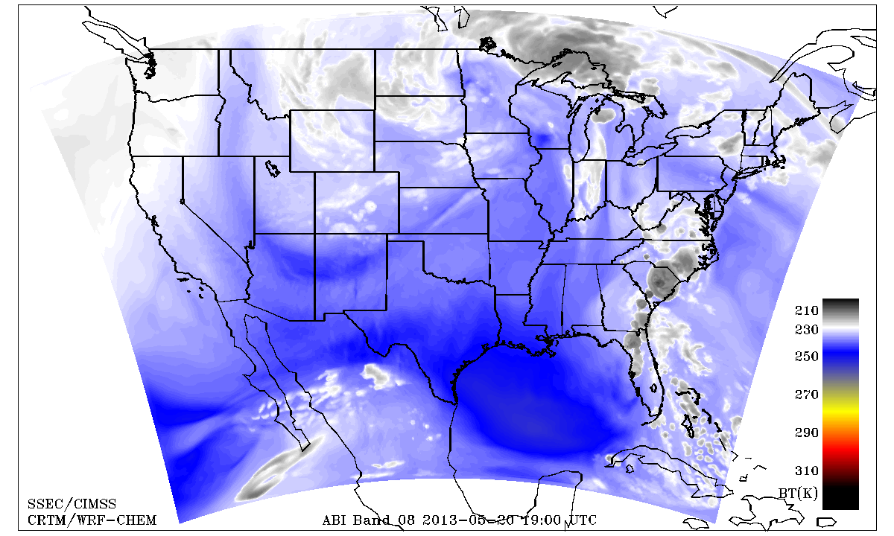
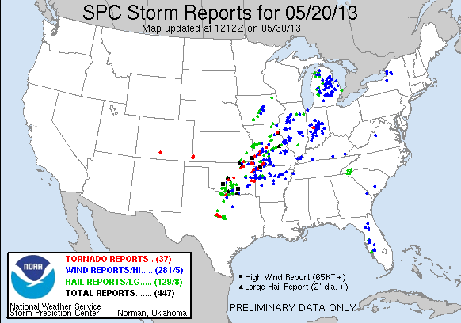
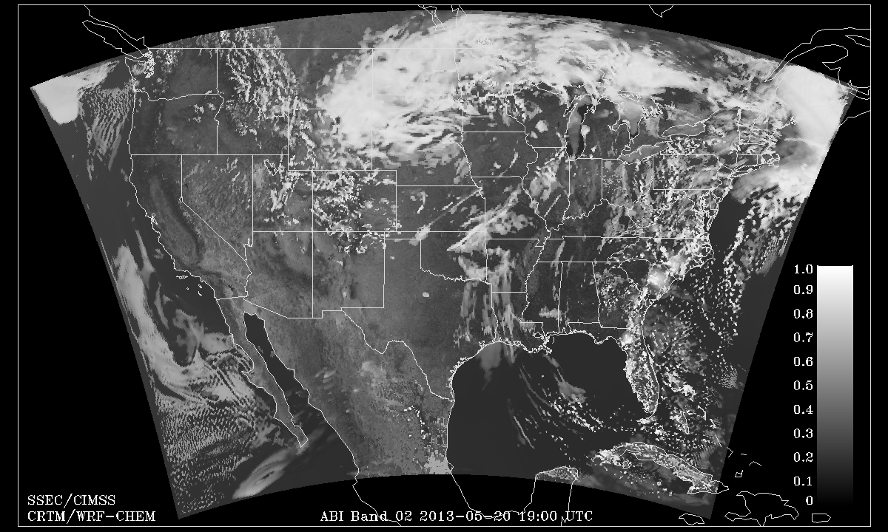
WES Case: May 20, 2013 Tornado outbreak
Tornado warning issued 2:40 p.m. CDT (19:40Z)
CIMSS WRFCHEM Proxy simulation captures onset of severe Wx that led to May 20, 2013 Tornado outbreak

Slide 17
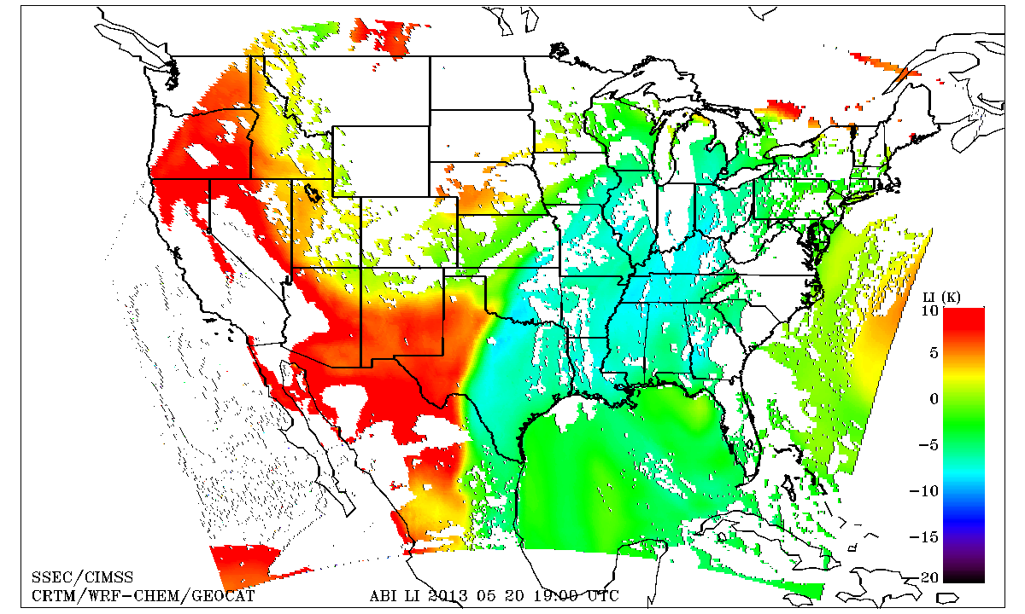
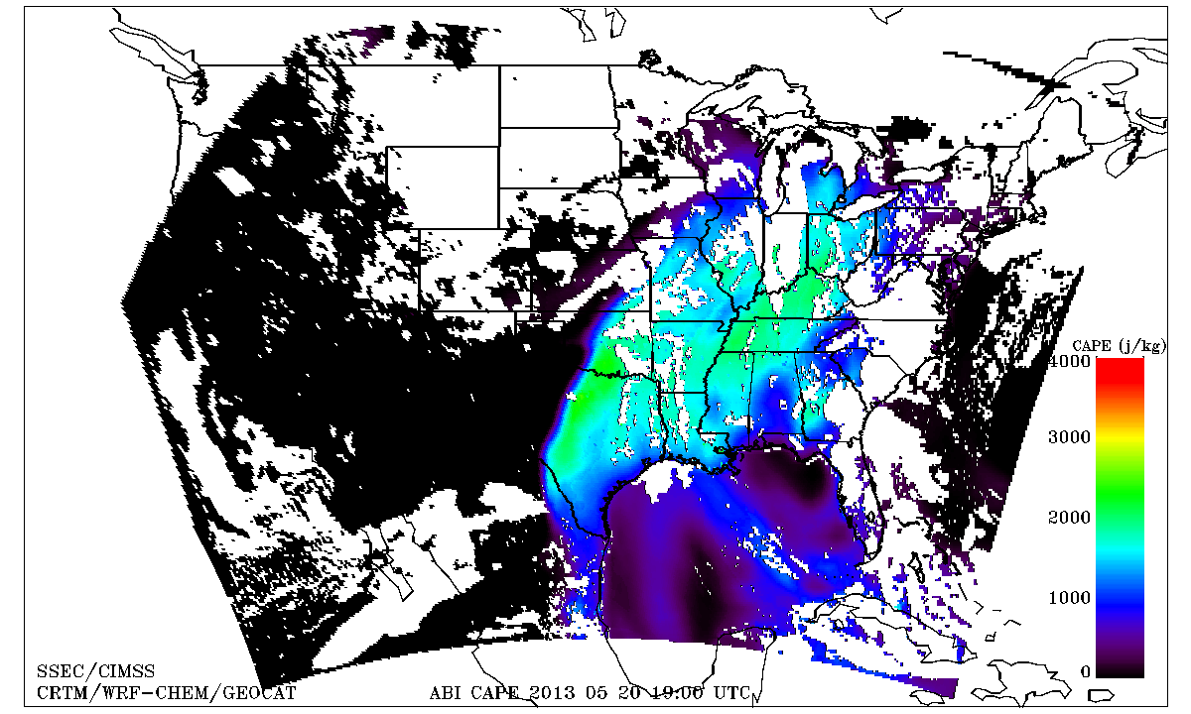
WES Case: May 20, 2013 Tornado outbreak
Dallas/Fort Worth (FWD)
GOES-R ABI LI and CAPE retrievals are in reasonable agreement with 18Z Dallas/Fort Worth, TX sounding prior to May 20, 2013 Tornado outbreak
Dallas/Fort Worth (FWD)

Slide 18
CIMSS AWIPS II Update
CIMSS actively attending AWIPS II developers’ forum conference calls and remote meetings of the EPDT
Testing of locally-produced netCDF4 files containing VIIRS imagery ongoing
Investigating performance of regionalsat plug-in
Memory issue appears resolved in latest build of OB13.4
Enhancement written for configurable of scaling byte array to real numbers via XML
Allows piecewise linear scaling with interpolation between defined points
Committed to official code repository (Dimensions) for deployment as part of OB13.5 (available in approximately two months)
Necessary for displaying and sampling satellite products such as the Fog and Low Stratus (FLS) suite
Operational use of AWIPS II at NWS Milwaukee delayed

Slide 19
Training @ CIMSS/ASPB
Many CIMSS satellite blog posts:
http://cimss.ssec.wisc.edu/goes/blog/
Short Articulate Presenter modules developed for HWT on CTC and NearCast
http://www.ssec.wisc.edu/~scottl/NearCast_HWT_Training_2013/player.html
http://www.ssec.wisc.edu/~scottl/UWCTC_HWT_Training_2013/player.html
‘Fog blog’ at http://fusedfog.blogspot.com
129 separate entries
>21000 hits ; ~100 hits per day.
1-3 new entries per week.
Notes:
Any new bullets?

Slide 20
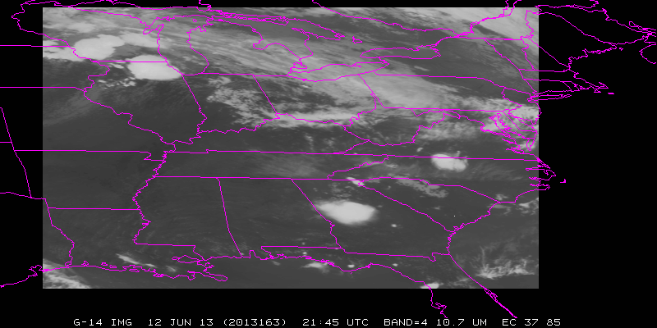
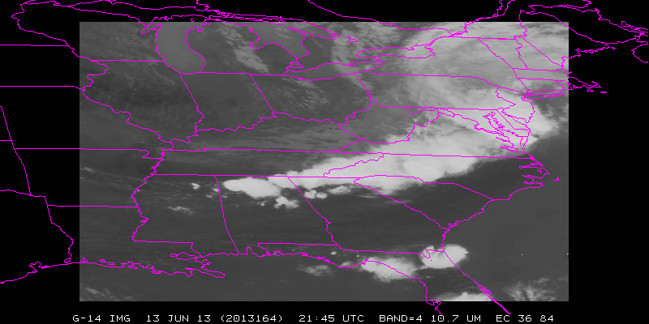
2 days of SRSOR from GOES-14
Two days (June 12 – June 14) of SRSOR over the eastern US, before the instruments were turned off.

Slide 21
2 days of SRSOR from GOES-14
Two days (June 12 – June 14) of SRSOR over the eastern US, before the instruments were turned off.
http://cimss.ssec.wisc.edu/goes/srsor2013/GOES-14_SRSOR.html
http://www.youtube.com/watch?v=EFOffqMk7nE
http://cimss.ssec.wisc.edu/goes/blog/archives/13256
http://cimss.ssec.wisc.edu/goes/blog/archives/13264
http://cimss.ssec.wisc.edu/goes/blog/archives/13001
http://youtu.be/9vVh5V2h_sg (From Scott Rudlosky)
Also had RSO from GOES-15 imager (Dan Lindsey)

Slide 22
GOES-14 Imager SRSOR special imagery showing rapid development during a data gap associated with a Full Disk scan on 12 June 2013. (Or, ‘what can happen during one Full Disk scan?)

Slide 23
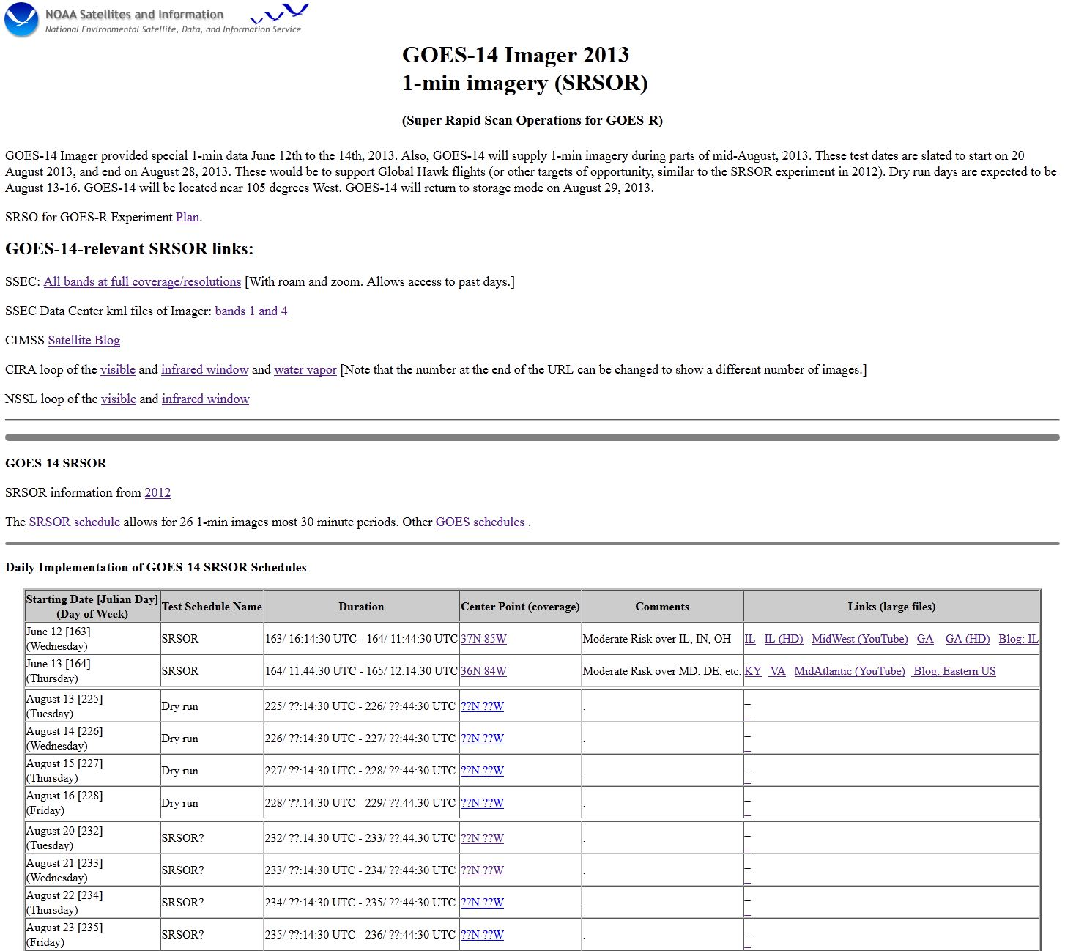
SRSOR from GOES-14
More days of SRSOR expected in mid-August.
http://cimss.ssec.wisc.edu/goes/srsor2013/GOES-14_SRSOR.html

Slide 24
Other Conferences/Meetings
2013
EUMETSAT/AMS 16-20 Sept Vienna, Austria
http://www.eumetsat.int/Home/Main/News/Conferences_and_Events/820209?l=en|
NWA 12-17 Oct Charleston, SC
http://www.nwas.org/meetings/nwa2013/
Submit abstracts for oral and poster presentations by 1 July – this is an extension from earlier deadlines.
2014
AMS Annual meeting 2-6 Feb Atlanta, GA
Abstracts ‘due’ August 1st
https://ams.confex.com/ams/94Annual/oasys.epl
http://ams.confex.com/ams/94Annual/10goesrjpss/papers/index.cgi
Virtual Meeting Satellite Week ?-? May “Madison, WI”

Slide 25
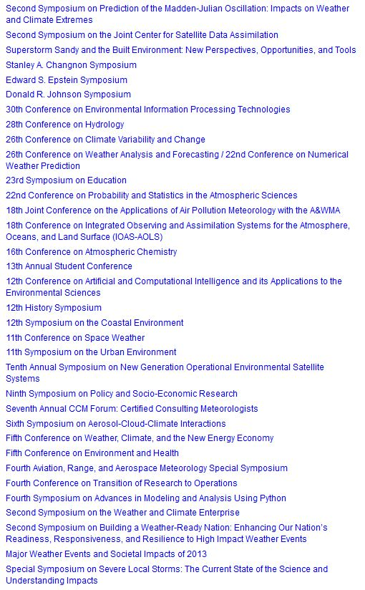
AMS annual metings

