Slide 1


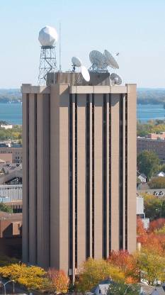
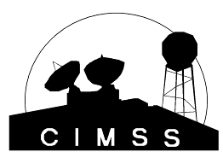
CIMSS Participation
GOES-R Proving Ground Status
November 2012
UW-Madison

Slide 2
CIMSS PG Overview
  AWIPS Weather Event Simulations
  AWIPS
  Demonstration of GOES-R AWG applications at Local NWS Offices
  Demonstration of GOES-R AWG applications at National Center Testbeds
  Near real-time NWP simulated ABI radiances
  Select Conferences/Meetings
  GOES Sounder
  GOES -15

Slide 3
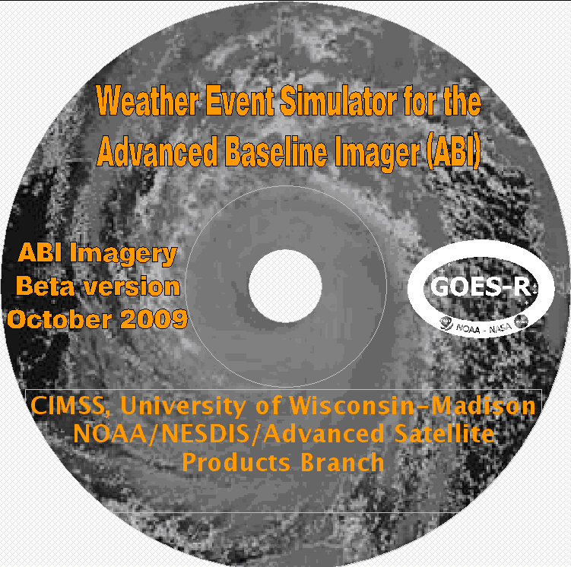
WES beta-version status
Beta release packaged:
  This contains the June-04-05-2006 storm outbreak (CONUS and mesoscale), Hurricane Katrina, band differences, a beta release of WES guide, etc.
  In 2010, a new GOES-R Weather Event Simulation (WES) was developed to simulate planned location over Pacific Ocean at 137 degrees in longitude
Contact T. Schmit for a copy.

Slide 4
AWIPS II
CIMSS remains committed to assuring a smooth transition of all CIMSS research to operations products from the existing AWIPS software to the upcoming AWIPS II. Preliminary work has been done finding a new product implementation approach for AWIPS II. AWIPS II activities are rapidly accelerating on the national scale to transition local applications between the two software environments. CIMSS is following this work. AWIPS II will soon be accessible for use at CIMSS, with training modules employing the new AWIPS software included as part of the VISIT/COMET training programs for operational satellite meteorology professional development. UW-CIMSS participated in multiple GOES-R Proving Ground organizational telcons.

Slide 5
AWIPS II – The Near Term
Necessary to meet the requirements of tomorrow’s hydrometeorological datasets
  Effectively and dynamically producing displays using the graphics card
    Integrating multiple datasets “on the fly” to minimize forecaster use of multiple products for similar information
  Modernizing and standardizing data storage repositories and the discovery database (for metadata)
    Optimizing access attempts for quickest ingest and display
  Development must continue to keep pace with existing technology
Because of the complexities resulting from a service-oriented architecture, developers will need more training to effectively extend the software
Local application development should not occur without adequate governance
  Plug-ins are essentially required to run within AWIPS II, and it is unlikely most will be able to run independently as with legacy AWIPS

Slide 6
GOES-R Proving Ground All-Hands Meeting
Cooperative Institute for Meteorological Satellite Studies (CIMSS) and Advanced Satellite Products Branch (ASPB) scientists presented “Status & Plans for the Geostationary Operational Environmental Satellite GOES-R Proving Ground (PG)” at the annual GOES-R Proving Ground All-Hands Meeting, May 18-19, 2010 in Boulder, CO. The presentation covered many activities, focusing on the variety of products that CIMSS/ASPB are providing to the National Weather Service (NWS): near realtime simulated ABI images, overshooting-top/enhanced-V, GOES Imager Convective Initiation, Weather Event Simulator (WES), MODerate-resolution Imaging Spectroradiometer (MODIS) Imagery and products, and Advanced Very High Resolution Radiometer (AVHRR) Imagery and products. In addition, two hands-on laboratory exercises were led. One allowed participants to run the ABI WES on Advanced Weather Interactive Processing System (AWIPS); the other was a web-based GOES-R ABI Weighting Function (WF) exercise, where participants could experiment with how the temperature, moisture, skin temperature, view angle, might affect the brightness temperatures of the Advanced Baseline Imager (ABI) on GOES-R/S. T. Schmit (STAR) attended as a member of the PG executive board. Several others from CIMSS and ASPB attended via the phone.

Slide 7
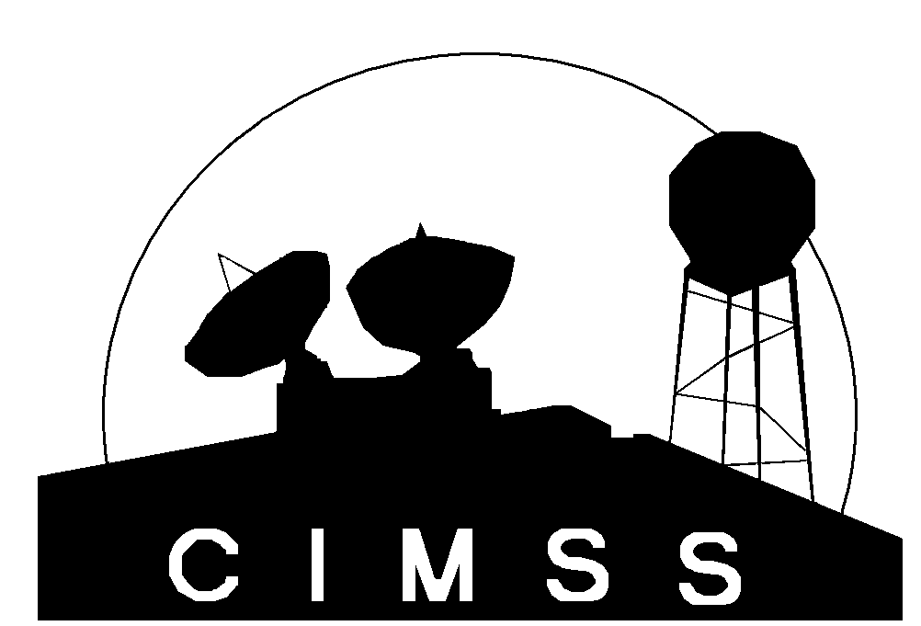


GOES-R Proving Ground Activities at Testbeds CIMSS/ASPB
Wayne F. Feltz
wayne.feltz@ssec.wisc.edu
CIMSS Proving Ground PI, Co-Chair of Aviation AWG

Slide 8
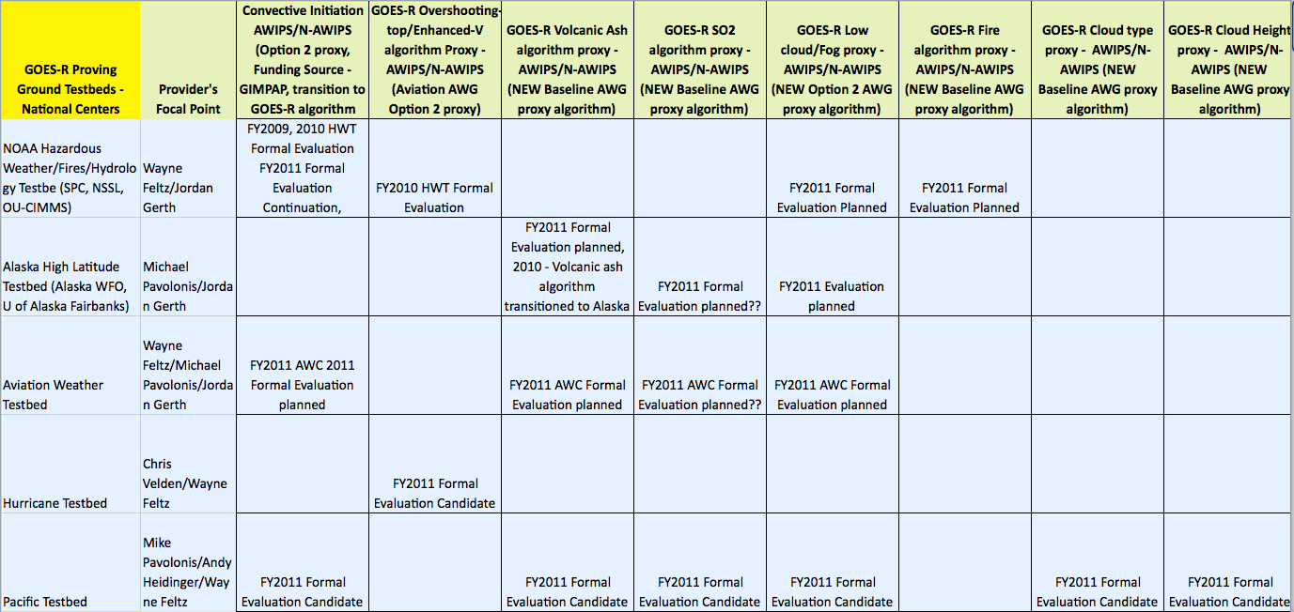
CIMSS GOES-R Proving Ground within Testbeds

Slide 9
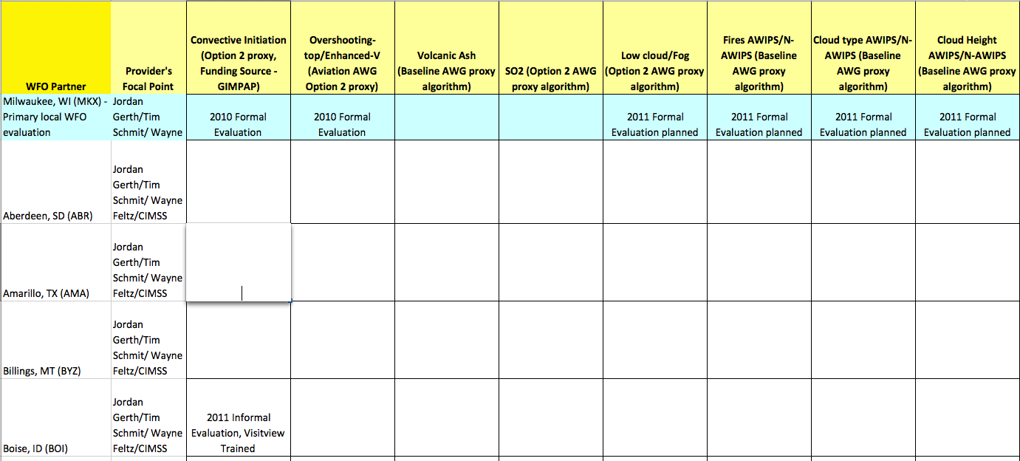
CIMSS GOES-R Proving Ground with WFO’s

Slide 10
UW-CIMSS PG Decision Support Summary
The following list of products offers opportunity for near-real time Warning Related utility. Now Available – Orange, Near Future - Green
Baseline Products:
Volcanic Ash: detection & Height - Alaska and AWC
Cloud and Moisture Imagery – All testbeds
Hurricane Intensity - NHC
Lightning Detection: Events, Groups & Flashes
Rainfall Rate / QPE
Total Precipitable Water - Pacific
Fire/Hot Spot Characterization – HWT (Hydrologic and Fire)
Option 2 Products:
Aircraft Icing Threat – NASA LaRC, Bill Smith Jr
Turbulence - AWC
Convective Initiation (UWCI used where SATCAST not automated yet)
Enhanced “V” / Overshooting Top Detection – HWT and HPC
Low Cloud and Fog – AWC and Alaska
SO₂ Detection – AWC and Alaska

Slide 11
UW-CIMSS and ASPB GOES-R Products
Baseline & Option 2
Demonstration Product (contacts) | Category | PG Testbed Activity
Cloud and Moisture Imagery (WRF ARW simulated) (Feltz/Schmit) | Baseline | HWT,HPC
Overshooting-Top/Enhanced-V (Feltz) | Option 2 | HWT, AWC
GOES Imager Convective Initiation (Feltz) | GIMPAP | HWT, Pacific, NWS

Slide 12
UW-CIMSS and ASPB GOES-R Products
Baseline & Option 2
Demonstration Product (contacts) | Category | PG Testbed Activity
Transition AVHRR volcanic ash auto-alert system to the University of Alaska - Fairbanks (UAF will distribute these products to the Anchorage VAAC). (Pavolonis) | Baseline | High Latitude Alaska and AWC
Transition GOES-R fog/low cloud and cloud phase products (generated from MODIS) to the University of Alaska - Fairbanks (UAF will distribute these products to the NWS). (Pavolonis) | Option 2 | High Latitude Alaska And AWC

Slide 13
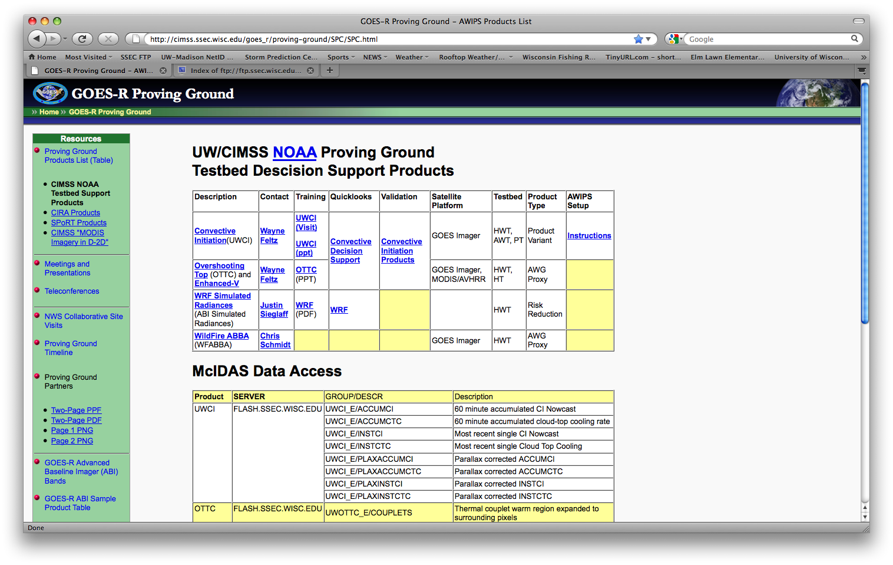
CIMSS Proving Ground Data Portal
http://cimss.ssec.wisc.edu/goes_r/proving-ground/SPC/SPC.html

Slide 14
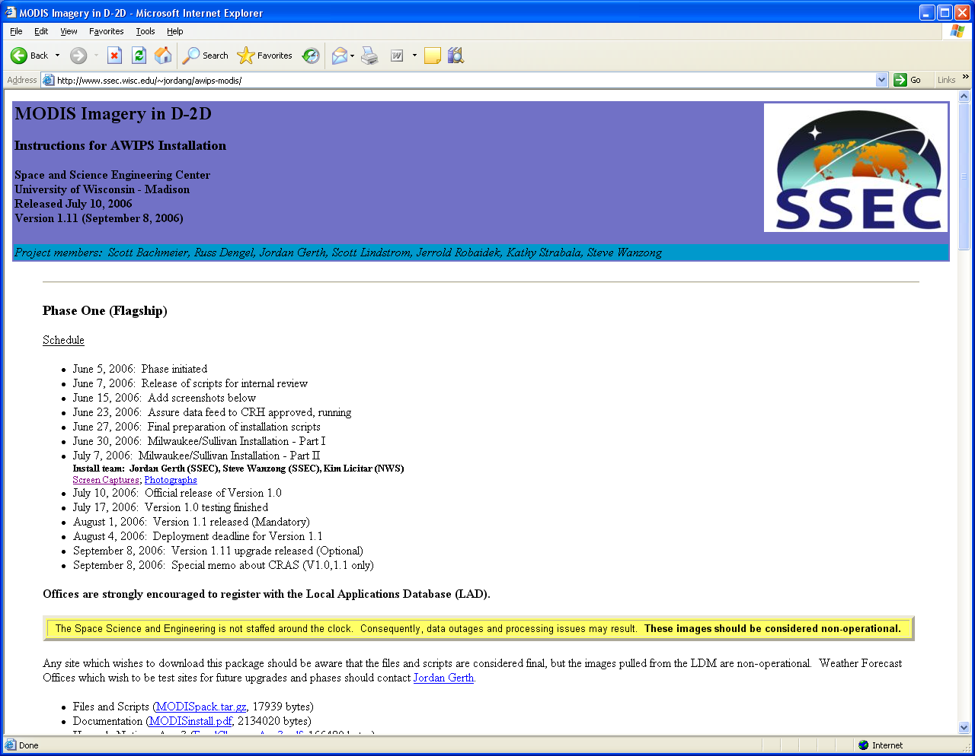
Instructions Available Online
http://cimss.ssec.wisc.edu/~jordang/awips-modis/

Slide 15
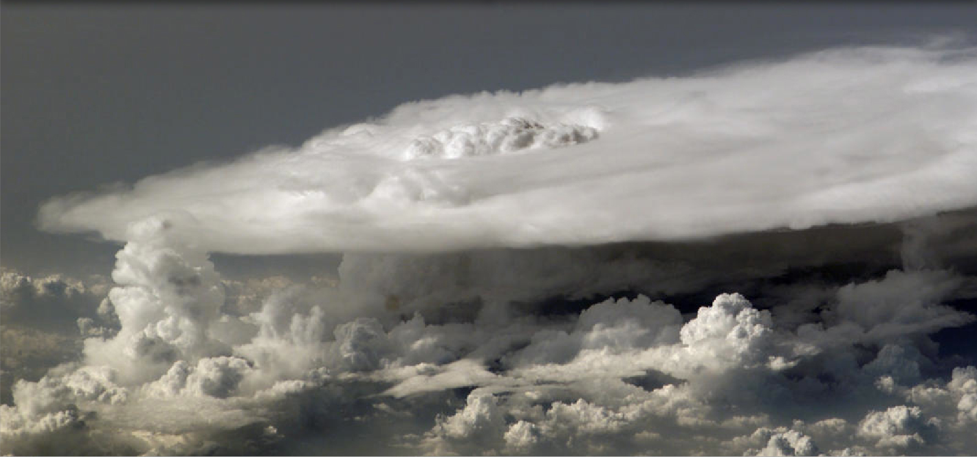
Convective Initiation

Slide 16
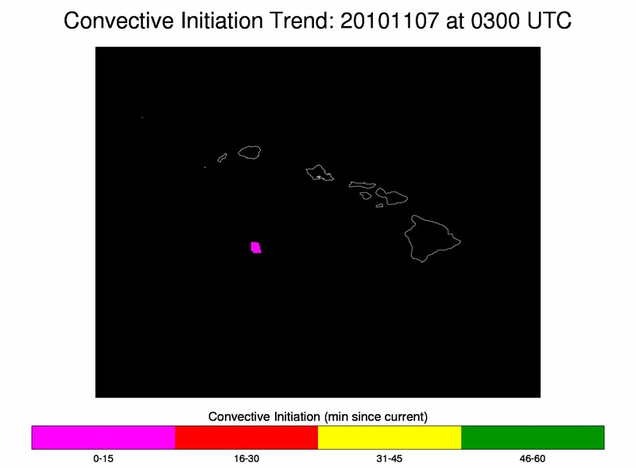
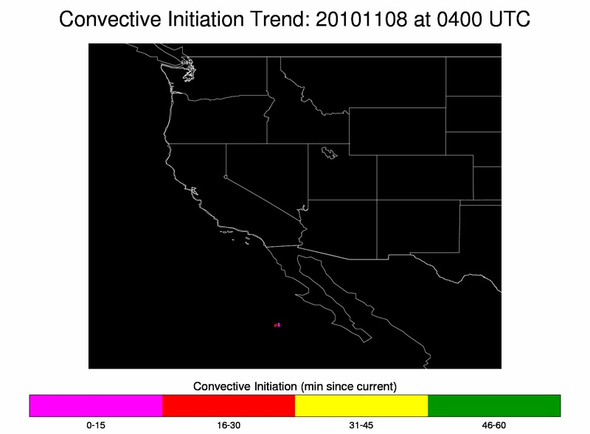
GOES-West UWCI and Overshooting-top Available

Slide 17
Overshooting-Top
Lead: Kristopher Bedka NASA LaRC SSAI

Slide 18
GOES Objective Overshooting-top Detection

Slide 19
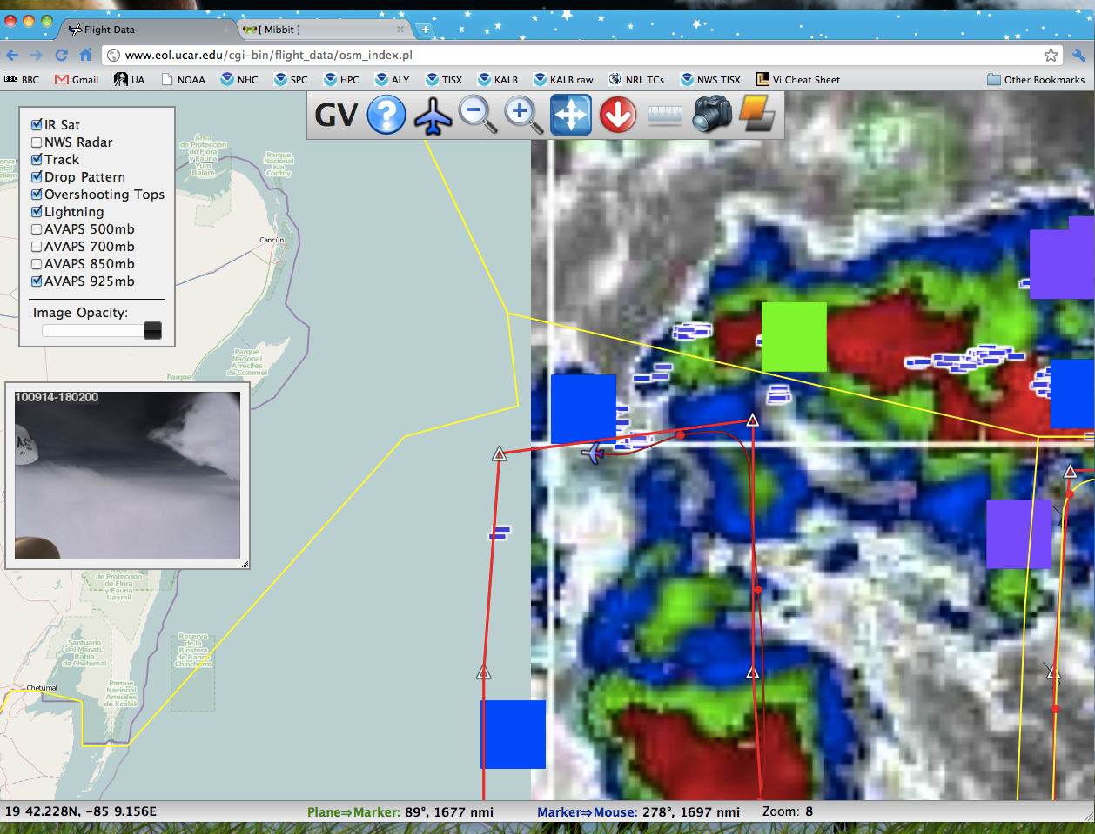
Ground Mission coordinator display
SEVIRI/GOES OT Algorithm used in PREDICT (Tropical Cyclone Experiment)

Slide 20
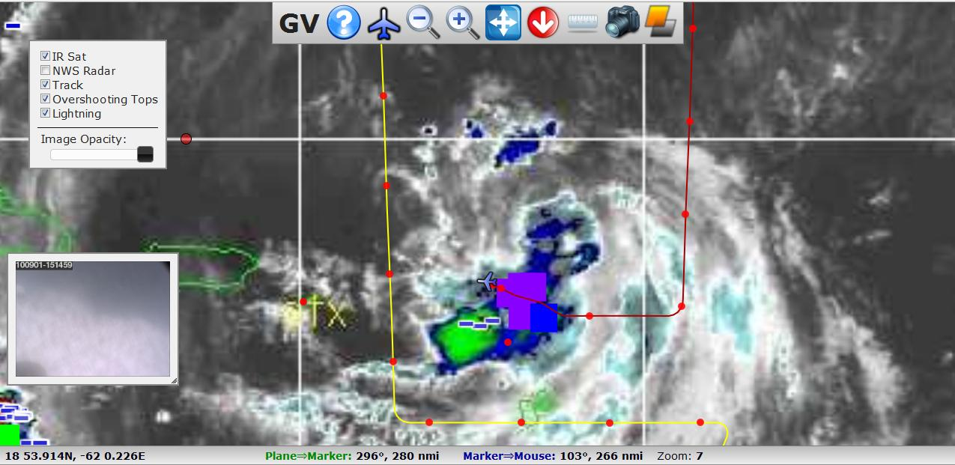
Aircraft increased altitude based on temperature data and flew over the OTs.

Slide 21
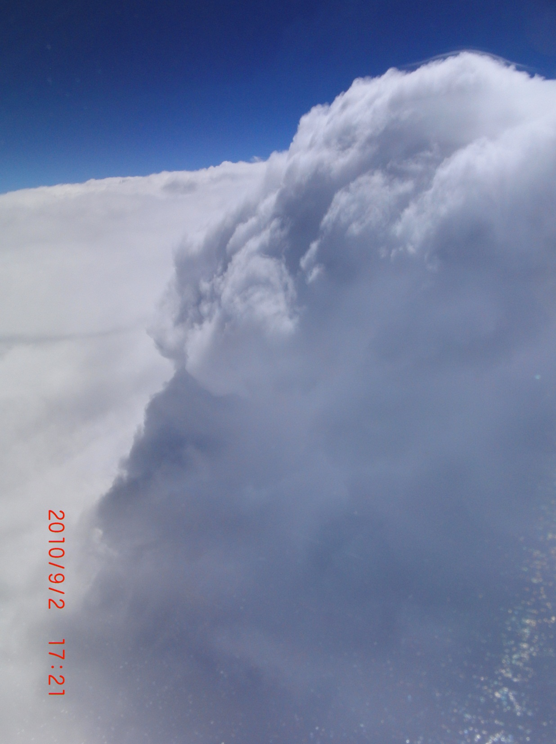
Overshoot avoided by the aircraft after receiving location

Slide 22
NSSL WRF ARW Simulated ABI Imagery

Slide 23
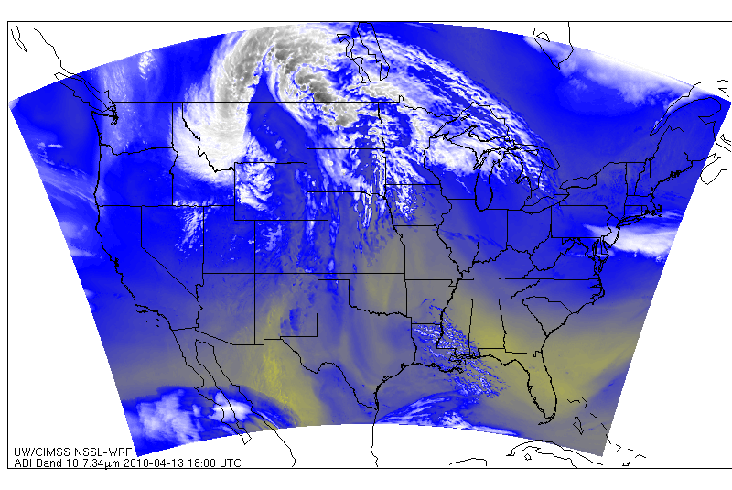
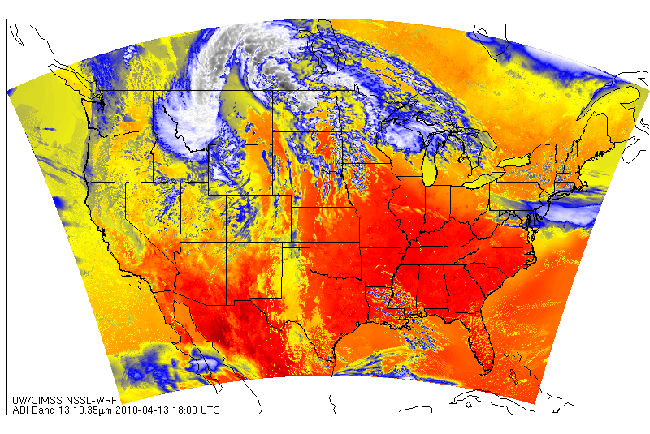
UW/CIMSS is generating simulated ABI Bands 8-16 using NSSL-WRF once daily
Webpage is updated by 11am for 11 time steps.
McIDAS areas for N-AWIPS display
ABI Band 10
(7.34 µm)
ABI Band 13
(10.35 µm)
http://cimss.ssec.wisc.edu/goes_r/proving-ground/nssl_abi/nssl_abi_rt.html
23

Slide 24
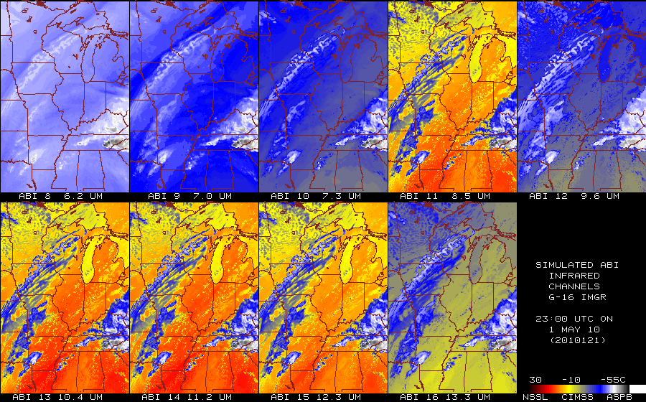
Estimated ABI Emitted-only bands
From NSSL WRF

Slide 25
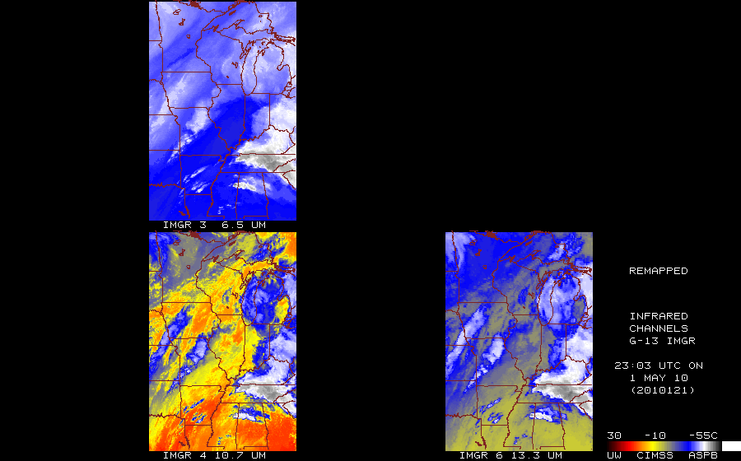
Observed GOES-13 Imager

Slide 26
N-AWIPS
Simulated
GOES-13 Observed

Slide 27
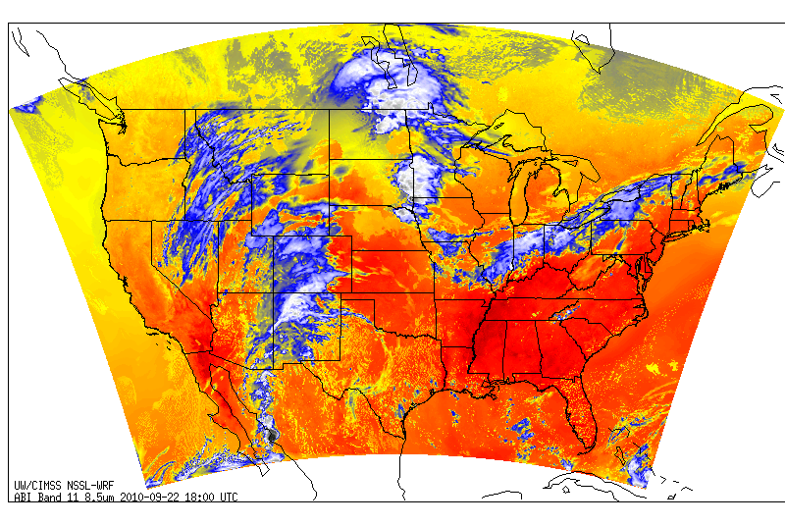
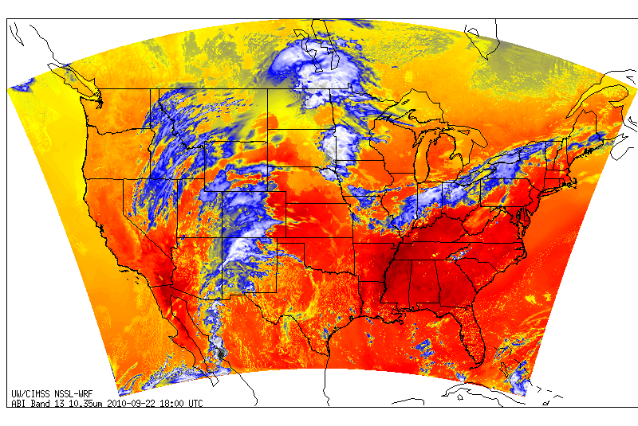
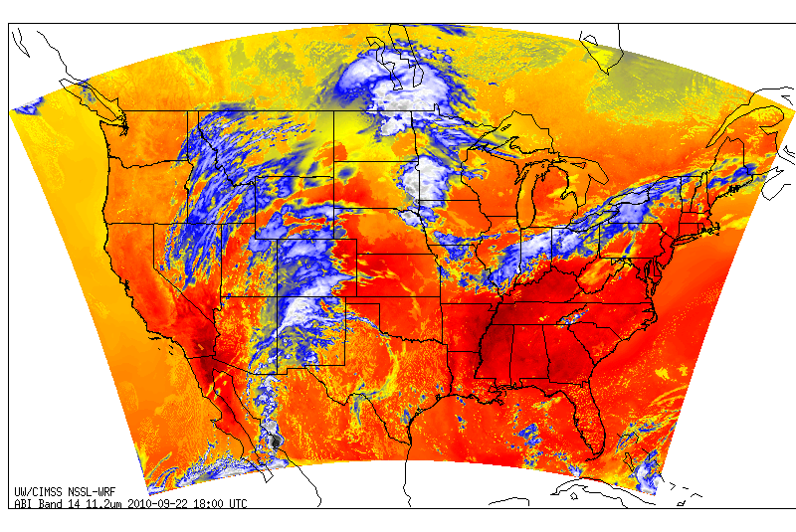
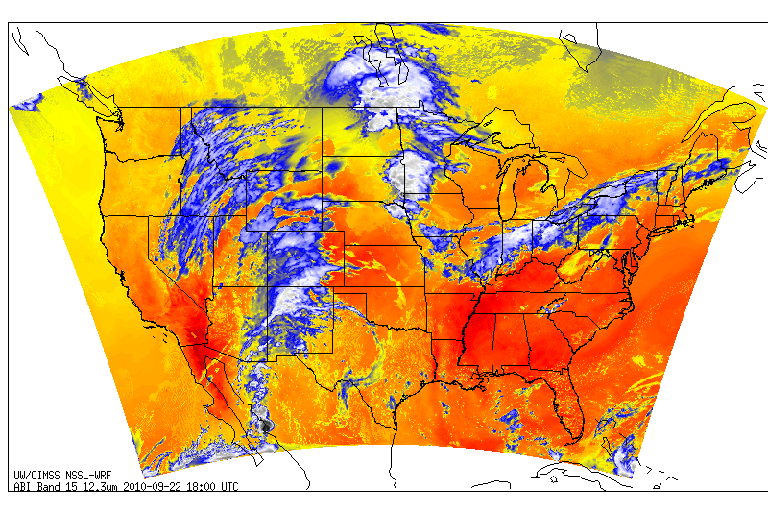
Different Spectral Channels
ABI
Band 11 (8.5 µm)
ABI
Band 13 (10.35 µm)
ABI
Band 14 (11.2 µm)
ABI
Band 15 (12.3 µm)
Images courtesy of Justin Sieglaff, CIMSS
Simulated ABI imagery from NSSL-WRF

Slide 28
Volcanic Ash/SO2

Slide 29
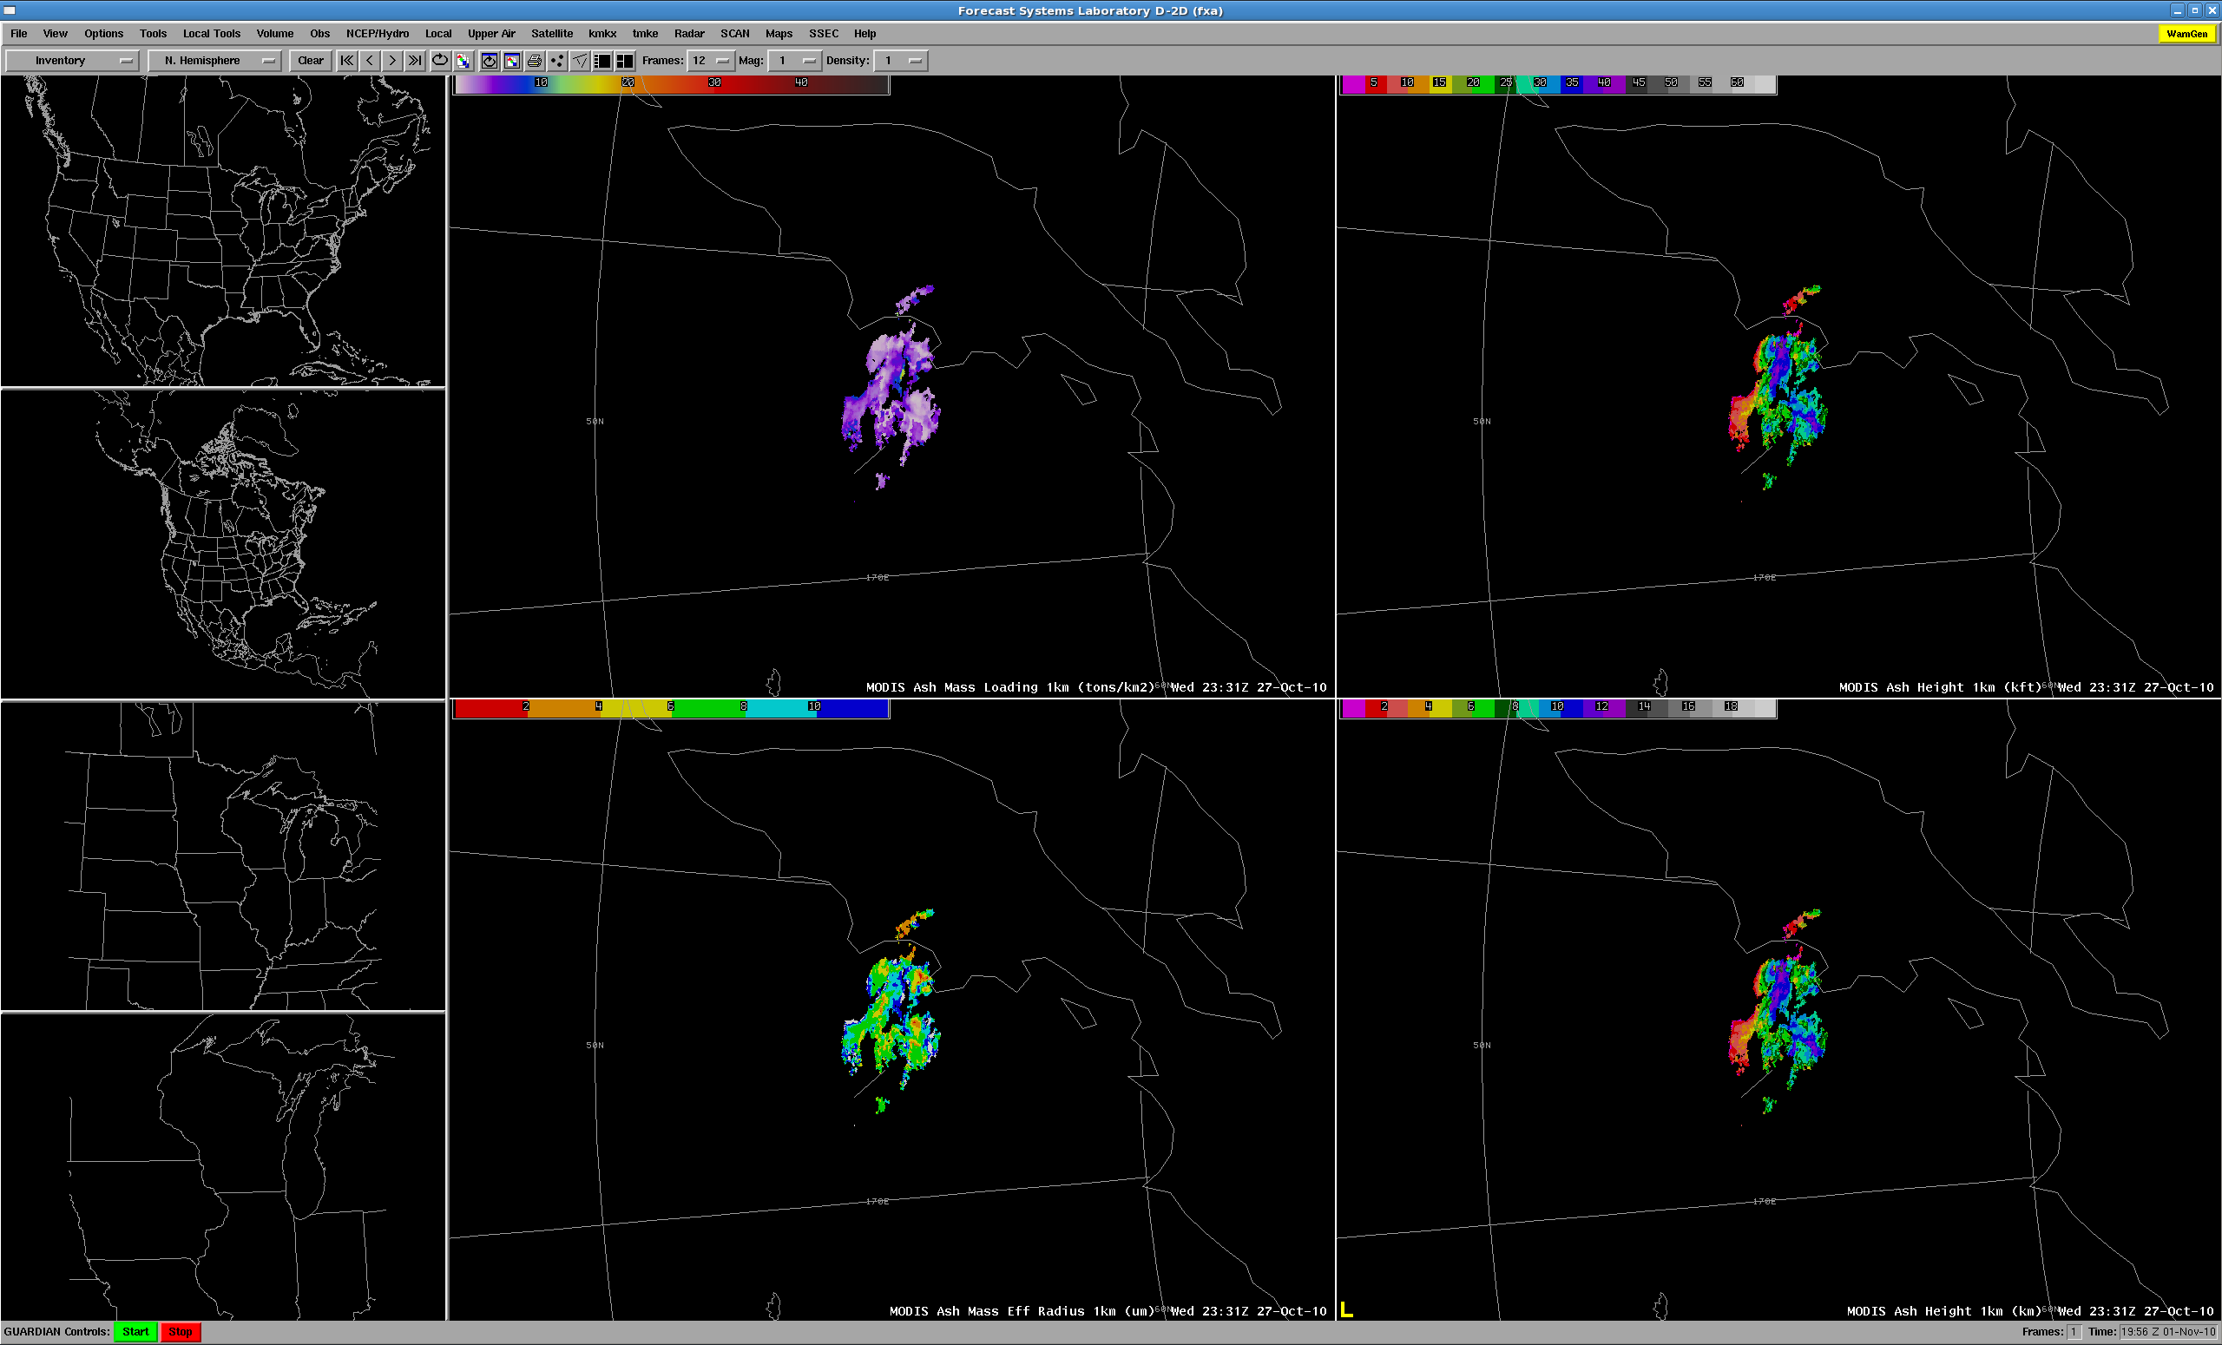
Russia October 27, 2010
Ash loading
Ash Height
Effective Radius

Slide 30
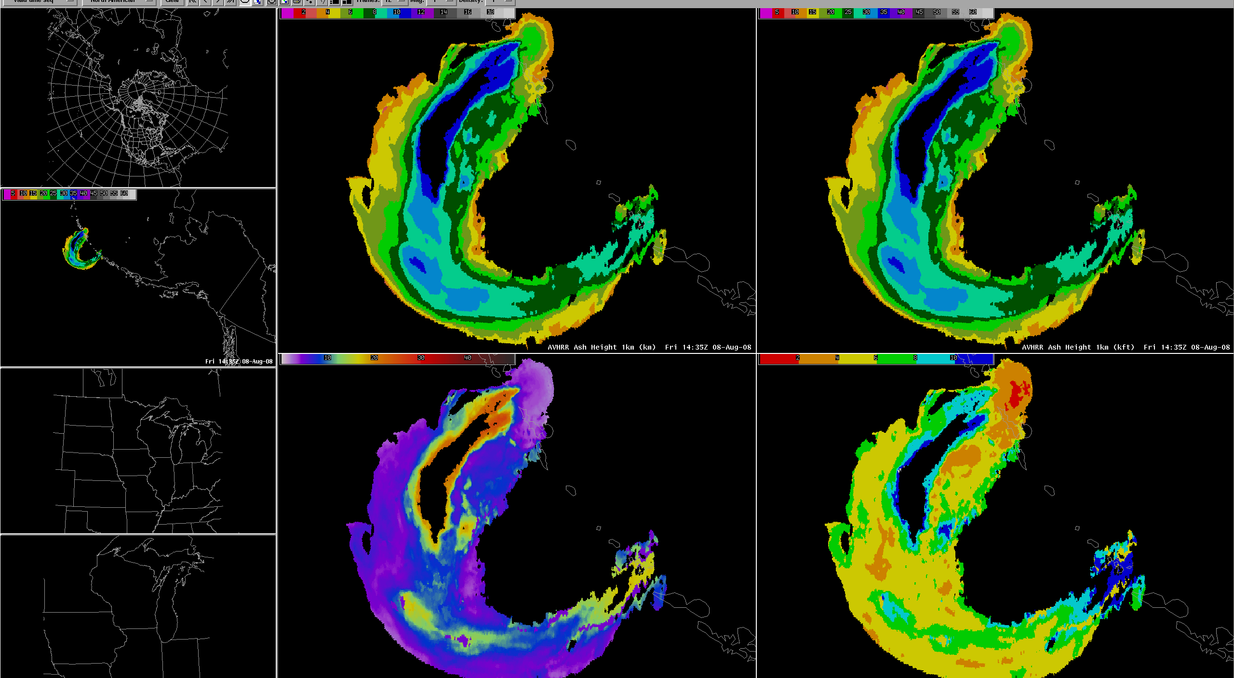
AVHRR Volash

Slide 31
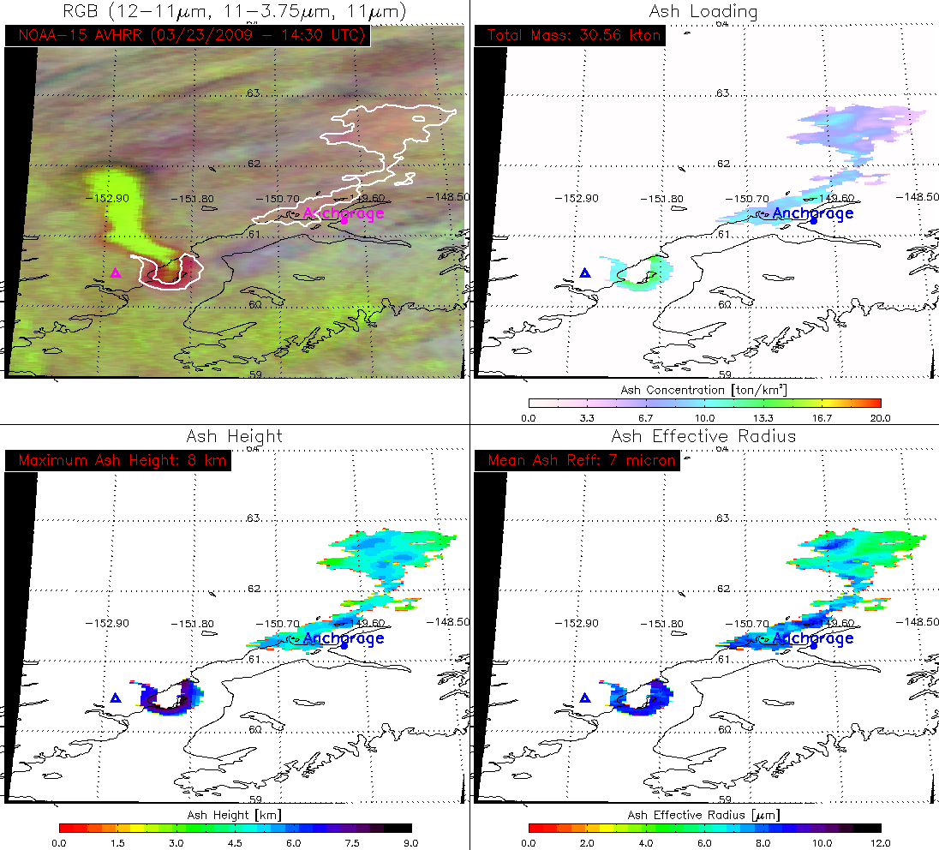
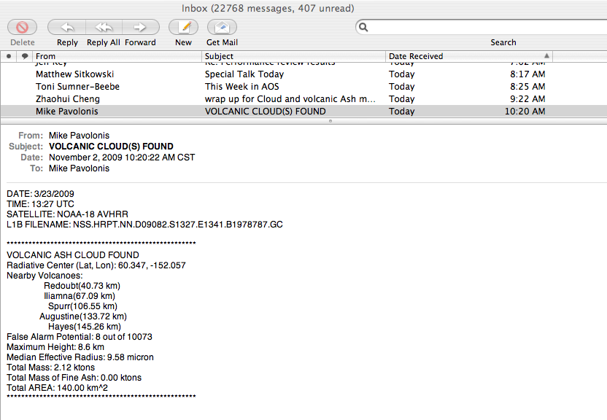
AVHRR automated ash cloud warning system
The warning criteria is fully user configurable.
In addition to the text message, an automatically generated, pre-analyzed false color image along with product images are supplied to the user.
Text Warning
Product Quick-look
Notes:
Warning criteria are configurable by: volcano, distance of cloud from nearest volcano, confidence in signal.

Slide 32
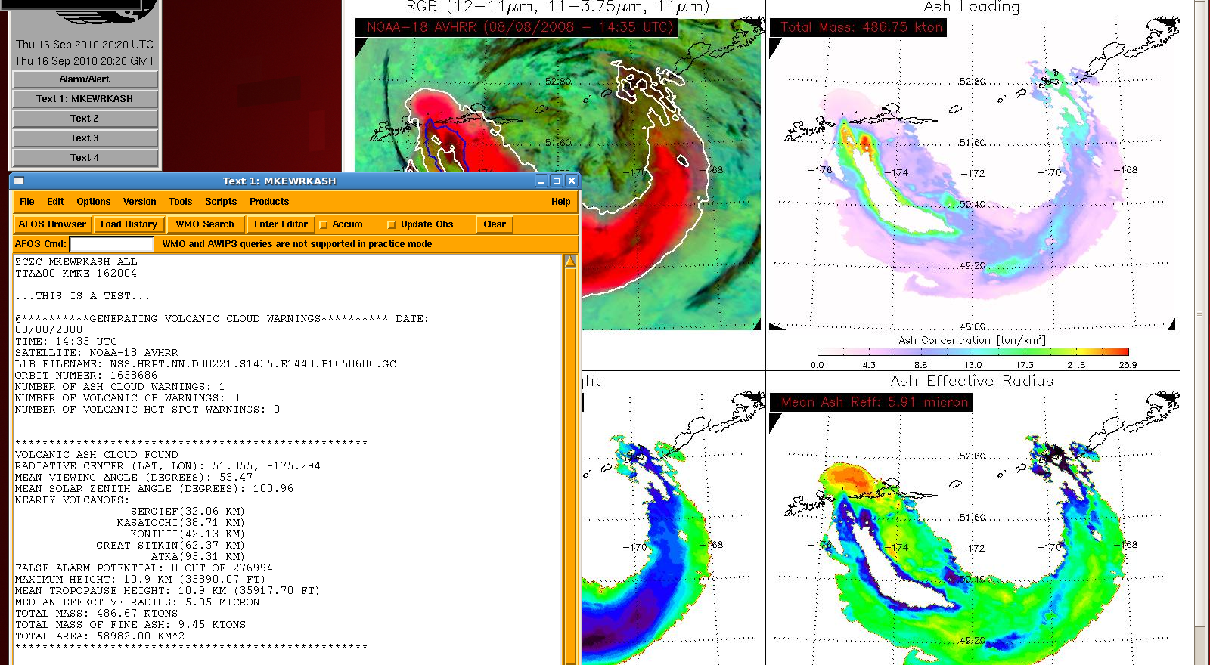
Automated Warning

Slide 33
Low Cloud/Fog

Slide 34
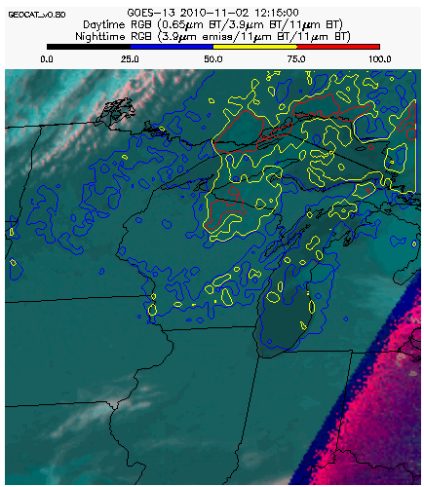
Fog Confidence Product

Slide 35
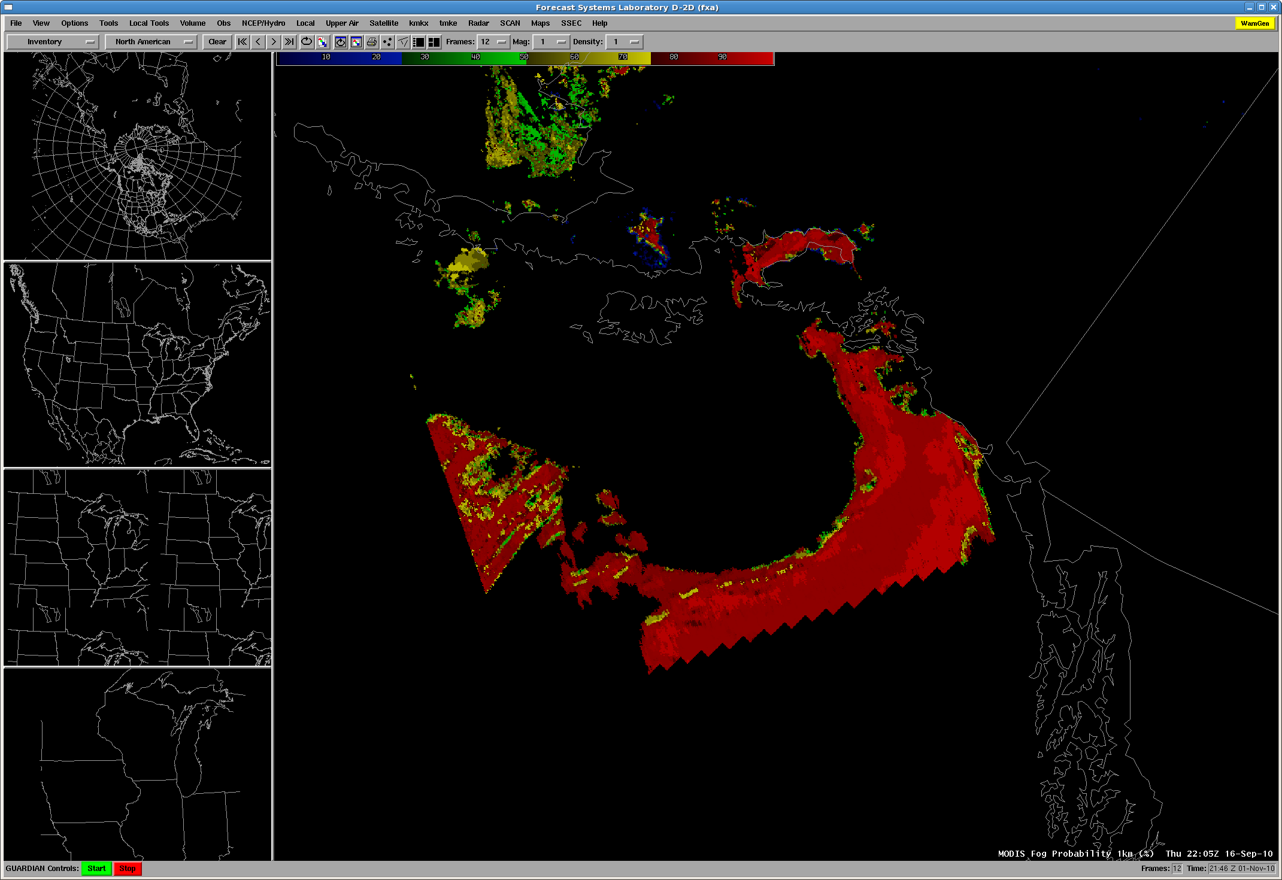
Alaska Fog/Low Cloud

Slide 36
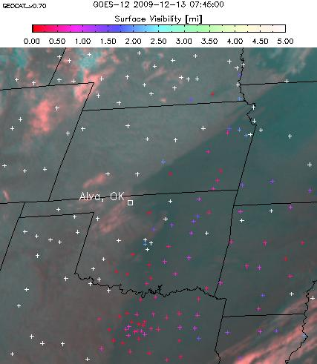
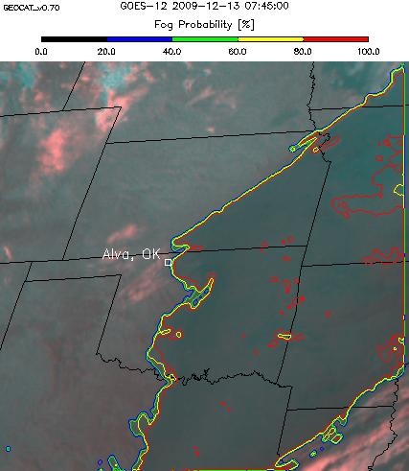
GOES-R Fog Detection Algorithm (night)
36

Slide 37
Cloud Type

Slide 38
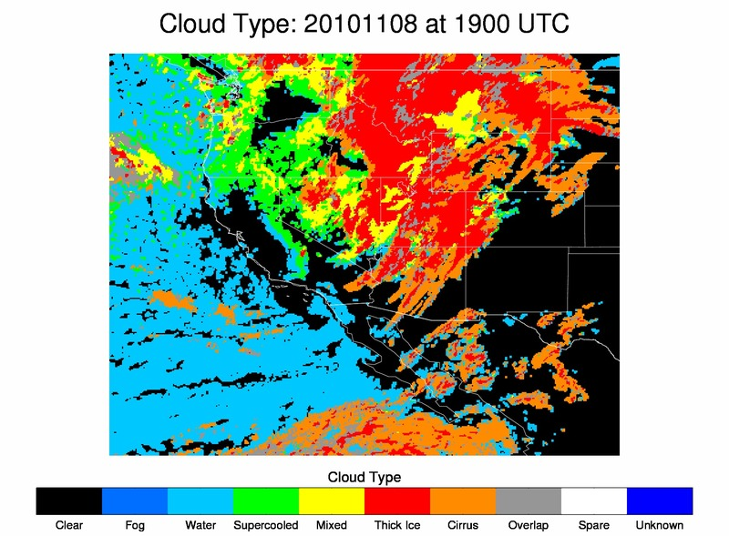

Slide 39
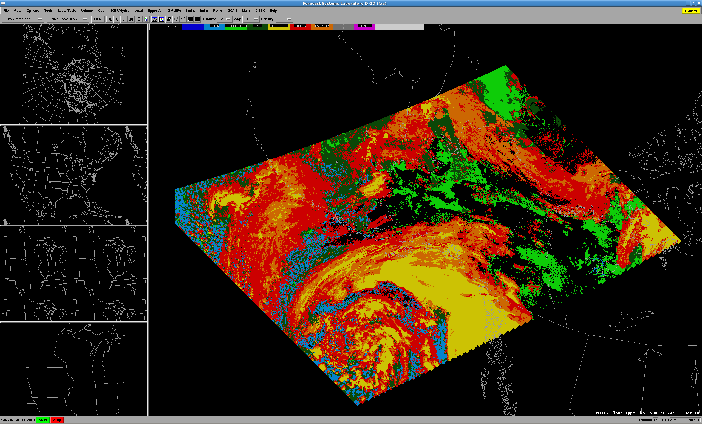
MODIS Cloud Typing

Slide 40
UW-CIMSS PG Decision Support Summary
The following list of products offers opportunity for near-real time Warning Related utility. Now Available – Orange, Near Future - Green
Baseline Products:
Volcanic Ash: detection & Height
Cloud and Moisture Imagery
Hurricane Intensity
Lightning Detection: Events, Groups & Flashes
Rainfall Rate / QPE
Total Precipitable Water
Fire/Hot Spot Characterization
Option 2 Products:
Aircraft Icing Threat
Turbulence
Convective Initiation
Enhanced “V” / Overshooting Top Detection
Low Cloud and Fog
SO₂ Detection

Slide 41
UW-CIMSS and ASPB GOES-R Products
R3 and Decision Aids
Demonstration Product | Category | PG Testbed Activity
Nearcasting (Petersen/Aune) | GOES-R3 | SPC and NWS WFO
GOES Sounder Ozone -- CAPE (Li) | GIMPAP | NWS WFO
GOES Sounder Stability Indexes -- CAPE (Li) | GIMPAP | SPC and NWS WFO
MODIS Imagery and Products | - | NWS WFO
AVHRR Imagery and Products | - | NWS WFO
AIRS Stability Indexes (Schmit) | - | currently internal

Slide 42
NWS Collaborations
CIMSS and ASPB Continue NWS Collaborations on Satellite-based Products: On May 27, 2010, as part of the GOES-R Proving Ground's Hazardous Weather Testbed (HWT), R. Aune (STAR) and J. Gerth (CIMSS) worked an eight hour shift at National Weather Service Forecast Office in Sullivan, Wisconsin to learn how CIMSS satellite-based products are used in the severe weather warning process. Feedback was obtained on how CIMSS convective initiation (CI) and nearcasting products are used to identify and track the potential for severe weather. These satellite based products are used in conjunction with forecast model output, satellite imagery and lightning data within AWIPS environment to identify thunderstorm cells with the best potential for producing severe weather. Although a few minor problems were identified, in general, the products were found to be a very useful contribution to the severe weather warning process.

Slide 43
Bob A.

Slide 44
NWS Collaborations
CIMSS participation in NOAA Hazardous Weather Testbed: The CIMSS ran a five week period of participation in the NOAA Hazardous Weather Testbed (HWT) supporting GOES-R Proving Ground activities. CIMSS provided University of Wisconsin convective initiation (UWCI), overshooting-top/enhanced-V, and Weather Research and Forecasting (WRF) Advanced Research WRF (ARW) model-simulated Advanced Baseline Imager (ABI) radiances for the Advanced Weather Information Processing System (AWIPS) terminals as proxies for future GOES-R ABI decision support products. Two CIMSS scientists participate each week, working directly with four NWS forecasters. The goal is to provide this additional information to forecasters as they are involved in real-time or archived convective events while including all other sources of decision support (radar, mesonet, wind profiler, etc.) normally available in warning process. In addition, forecasters are using output from a new, advanced radar algorithm and GOES-R Geostationary Lightning Mapper (GLM) proxy lightning data. The purpose is to see how satellite decision support would be folded into an end-to-end warning process. During the first two weeks of participation, UWCI has been viewed very favorably as a way to hone in on locations where active convective is first forming, providing advanced lead time. This allowed forecasters to access GLM proxy cloud-to-cloud lightning in conjunction with GOES imager based convective initiation/cloud-top cooling within AWIPS. Cloud-to-cloud lightning was shown to first occur at first indication of cloud-top cooling in this case. Daily updates of the NOAA HWT CIMSS Proving Ground activity are at http://goesrhwt.blogspot.com. An overview of decision support products is at http://cimss.ssec.wisc.edu/goes_r/proving-ground/SPC/SPC.html.

Slide 45
Volcanic Ash and related Products
London VAAC: Volcanic ash products (ash height, mass loading, and effective particle radius), developed for the next generation Geostationary Operational Environmental Satellite (GOES-R), were provided to the London Volcanic Ash Advisory Center (VAAC) for detailed post event analysis of the Eyjafjallajokull eruption April 14-19, 2010 in Iceland. Near real-time GOES-R volcanic ash products are available for Iceland at http://cimss.ssec.wisc.edu/goes_r/proving-ground/geocat_ash/.
Developmental SEVIRI based Volcanic Ash Trajectory Predictions: As part of activities under the NOAA Volcanic Ash Working Group (VAWG) Science Team, Advanced Satellite Products Branch (ASPB) scientists used aerosol trajectory forecast capabilities from the International version of Infusing Satellite data into Environmental Applications (IDEA-I) to demonstrate how Spinning Enhanced Visible and Infrared Imager (SEVIRI) volcanic ash visible optical depth and ash top pressure retrievals could be used to initialize volcanic ash trajectory predictions associated with the April 2010 Eyjafjoll eruption in southern Iceland. IDEA-I trajectory initialization software was adapted for SEVIRI ash retrievals and delivered to scientists at the NOAA Air Resources Laboratory (ARL) for use in Operational HYbrid Single-Particle Lagrangian Integrated Trajectory (HYSPLIT) volcanic ash predictions.

Slide 46
Volcanic Ash (continued)
Alaska Aviation and Volcanic Ash Workshop: M. Pavolonis (NOAA/NESDIS) attended the Alaska Aviation and Volcanic Ash Workshop in Anchorage, AK, September 20 – 23, 2010. The goals of the workshop, which was hosted by the National Weather Service (NWS), were to gather customer (commercial and general aviation) feedback on current aviation decision support systems, identify gaps in aviation decision support systems, to provide users with an overview of current volcanic ash remote sensing and modeling capabilities, and discuss lessons learned from previous volcanic eruptions. M. Pavolonis presented an overview of the volcanic ash products recently developed by NOAA/NESDIS/STAR and the Cooperative Institute for Meteorological Satellite Studies (CIMSS). The NOAA/CIMSS volcanic ash products will be made available to the Anchorage VAAC via the next generation GOES-R proving ground.
Interagency Meeting on Volcanic Ash: The United States Geological Survey (USGS) and NOAA held a bi-agency meeting in Anchorage, AK on September 24, 2010 to discuss collaborations on volcanic ash cloud monitoring and forecasting, with the ultimate goal of ensuring that the combined expertise and resources of NOAA and the USGS are being used efficiently during the response to a volcanic eruption. M. Pavolonis represented NOAA/NESDIS. Both agencies agreed that volcanic ash forecasts could be improved through collaboration.
WMO Workshop on Volcanic Ash Dispersion Forecasting and Civil Aviation: M. Pavolonis (NOAA/NESDIS/STAR) attended a workshop on volcanic ash dispersion forecasting at the World Meteorological Organization (WMO) headquarters in Geneva, Switzerland October 18 – 20, 2010. The workshop was dedicated to evaluating the current state of ash dispersion forecast models used at operational and research centers around the world and determining the steps needed to improve volcanic ash dispersion forecasts. The workshop participants agreed that satellite data are critical for improving dispersion forecasts through data assimilation, model validation, and model parameterization development efforts. The volcanic ash products developed by NOAA/NESDIS/STAR and the CIMSS were identified as the primary source of satellite-based ash cloud property information that can be used to improve models. M. Pavolonis gave an invited overview of the STAR/CIMSS volcanic ash products, which included potential model applications. A WMO endorsed workshop report will be created in the coming weeks.

Slide 47
Aviation Wx
Aviation Weather Proving Ground Meeting: M. Pavolonis (NOAA/NESDIS) attended the Aviation Weather Proving Ground planning meeting at the Aviation Weather Center (AWC) in Kansas City, MO. The goals of this meeting were to determine which satellite products will be included in the Proving Ground effort, and how those products will be made available to the AWC. The next generation Geostationary Operational Environmental Satellite (GOES-R) volcanic ash, sulfur dioxide, and fog products, developed by NOAA/NESDIS/STAR in collaboration with the Cooperative Institute for Meteorological Satellite Studies (CIMSS), will be tested in operations at the AWC during the fall of 2010. In addition, the University of Wisconsin - CIMSS Convective Initiation product will also be included in the Aviation Proving Ground beginning in August 2010.
Dr. Larry Carey Visits to Collaboration on GOES-R Lightning/Aviation Research: Dr. Larry Carey (University of Alabama-Huntsville) visited the Cooperative Institute for Meteorological Satellite Studies (CIMSS) from 30 June - 2 July 2010 to discuss possible lightning research collaborations between GOES-R Aviation, Fires, Cloud, and Imagery teams. The main purpose is to better join infrared radiance derived atmospheric properties (overshooting top detection, cloud top cooling rate, cloud phase, fire detection, turbulence) to occurrence of cloud-to-cloud lightning detection from Lightning Mapping Arrays (LMA) in Oklahoma, Alabama, Florida, and Washington DC as a proxy to future GOES-R Geostationary Lightning Mapper (GLM) applications.

Slide 48
Celebrates Four Years of Supplying MODIS Products in AWIPS to NWS Users
CIMSS Celebrates Four Years of Supplying MODIS Products in AWIPS to NWS Users: July 2010 marks the 4-year anniversary of the point that the Cooperative Institute for Meteorological Satellite Studies (CIMSS) first began to supply Moderate Resolution Imaging Spectroradiometer (MODIS) images and products to National Weather Service (NWS) users in an Advanced Weather Interactive Processing System (AWIPS) format. To date, 51 NWS forecast offices have begun to use the CIMSS-supplied MODIS imagery in their local AWIPS workstations, with 22 of these offices actively mentioning MODIS in their daily Area Forecast Discussions. Examples of the MODIS images being supplied in an AWIPS format can be found on the CIMSS Satellite Blog (http://cimss.ssec.wisc.edu/goes/blog/archives/6199).

Slide 49
Hawaii PG meeting
CIMSS and ASPB Participation at Proving Ground Meeting: T. Schmit, B. Aune, and M. Pavolonis of the Advanced Satellite Products Branch (ASPB), and Wayne Feltz, Jordan Gerth, and Allen Huang of the Cooperative Institute for Meteorological Satellite Studies (CIMSS) participated in the Next Generation Geostationary Operational Environmental Satellite (GOES-R) Proving Ground Meeting and the International Symposium on Geoscience and Remote Sensing (IGARSS), both held in Honolulu, HI during the week of July 25, 2010. At the Proving Ground meeting, presentations on the Advanced Baseline Imager (ABI), the current GOES constellation, convective initiation, assimilation of cloud properties and water vapor into numerical weather prediction models, and GOES-R volcanic ash, fog, cloud phase, and cloud height products, were given to help the Pacific Region of the National Weather Service (NWS) prepare a Proving Ground plan.
Since meeting, worked with NESDIS and NWS regarding the GOES Sounder data getting into AWIPS over HI.

Slide 50
Air Quality Proving Ground
First NOAA Air Quality Proving Ground Meeting: Brad Pierce gave a presentation entitled “Development of Proxy ABI Data for the AQPG” at the first NOAA Air Quality Proving Ground (AQPG) Advisory Group Workshop, held on September 14, 2010 at the University of Maryland Baltimore County (UMBC) campus outside of Baltimore, MD.
Brad Pierce was contacted by Bonnie Reed regarding a visibility demonstration with OPC. This would be done with MODIS data and would support the AWG aviation activities. Details still need to be defined.

Slide 51
17th Conference on Satellite Meteorology and Oceanography
ASPB Participates in the 17th Conference on Satellite Meteorology and Oceanography: T. Schmit and M. Pavolonis, both of the Advanced Satellite Products Branch (ASPB), participated in the 17th American Meteorological Society (AMS) Conference on Satellite Meteorology and Oceanography which was held in Annapolis, MD. T. Schmit gave an oral presentation on “The ABI (Advanced Baseline Imager) on the Geostationary Operational Environmental Satellite (GOES)-R series” and a poster on the “NOAA Science Test Results from the GOES-14 and -15 Imager and Sounder”. M. Pavolonis gave an oral presentation on monitoring Iceland's Eyjafjallajokull Volcano with GOES-R volcanic ash physical property retrievals, presented a poster on volcanically forced deep convection, and chaired a session on aerosol and volcanic ash remote sensing.
AMS Conference: Gerth, Jordan J., 2010: Confronting data delivery challenges of the future via the GOES-R Proving Ground. 17th Conference on Satellite Meteorology and Oceanography, Annapolis, Maryland, September 27-30, 2010. (Poster)

Slide 52
HWT
UW-CIMSS has been engaged in multiple GOES-R proving ground decision support product demonstrations within newly formed testbed opportunities. Main focus has been most mature testbed, the NOAA Hazardous Weather Testbed (HWT) where University of Wisconsin Convective Initiation (UWCI), GOES overshooting-top/enhanced-V (OTTC), and WRF ARW simulated decision support products where made available and NWS end user evaluation accomplished as GOES-R proxy information.
UW-CIMSS is providing real-time access to University of Wisconsin Convective Initiation (UWCI) and GOES overshooting-top/enhanced-V (OTTC) decision support products via AWIPS and N-AWIPS to the Storm Prediction Center (SPC) as part of the Hazardous Weather Testbed Experimental Warning Program (HWT EWP) Spring 2010 experiment as a proxy for future GOES-R option 2 detection capabilities. The UWCI decision support products were provided within the HWT via N-AWIPS gridded format, and the EWP in AWIPS gridded format for the 2010 Spring Experiment. The product utilizes GOES-13 infrared (IR) window brightness temperature changes based on an operational day/night cloud mask to infer cloud-top cooling as a proxy for vertical development in growing cumulus clouds as described by Sieglaff et al. (2010). UWCI (Sieglaff et al., 2010) is generated at the University of Wisconsin for each GOES-13 scan, including rapid-scans, and distributed via LDM in GRIB2 format.
In general, forecasters found that the UWCI products were a useful aid to help them increase situational awareness prior to warning operations during severe weather days.

Slide 53
Eastern Region Workshop
ASPB and CIMSS Presentations at the Eastern Region Satellite Virtual Workshop: STAR/ASPB and Cooperative Institute for Meteorological Satellite Studies (CIMSS) scientists gave three presentations at the Eastern Region Satellite Virtual Workshop that was held on November 9, 2010. “The Advanced Baseline Imager (ABI) on the GOES (Geostationary Operational Environmental Satellite)-R Series” was given by T. Schmit, NOAA/NESDIS STAR; “GOES-R Proving Ground Activities at CIMSS/ASPB” was given by W. Feltz, and “AWIPS II and GOES-R: When Updated Information Processing Systems and New Satellites Meet was given by Jordan Gerth, both of CIMSS. The workshop, which brought together operational users and researchers, was organized by Frank Alsheimer, of the National Weather Service Weather Forecast Office in Charleston, SC.

Slide 54
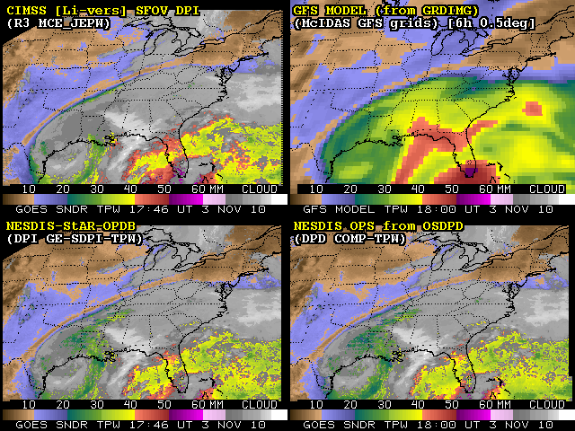
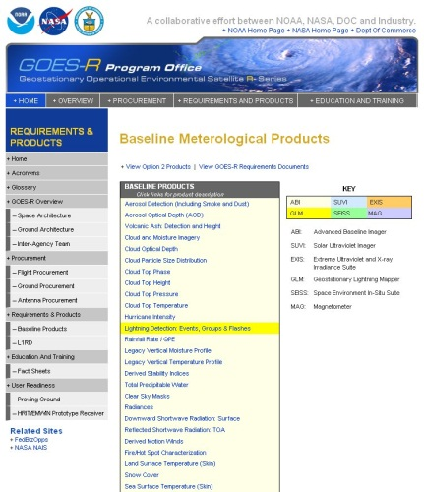

Current GOES Sounder products – proxy for GOES-R “legacy” soundings
The Li et al (2008) GOES Sounder retrieval algorithm (for vertical profiles of temperature and moisture, and resulting imagery of moisture (TPW) and stability indices) has been implemented at CIMSS, within McIDAS, and as of this month (Nov 2010), with no known deficiencies, except for lack of the inverted cone procedure for filtering observed radiances. This Li et al (2008) algorithm is the basis for the AWG ATBD for the GOES-R “legacy” soundings.
Proxy GOES-R “legacy” soundings are needed for, and to be evaluated by:
(1) GOES “Nearcast” system;
(2) CIMSS summer program with local NWS FO (MKX); and,
(3) HPC TPW assessments.
Testing remains to be done to stabilize radiance bias adjustments.
Comparison of real-time GOES Sounder TPW (total precipitable water) at nominal 1800 UT on 03 Nov 2010 showing the new Li-version (upper left), older (1999) Ma-version as available from NESDIS operations (bottom), as well as, the first guess from the GFS model (upper right).
http://cimss.ssec.wisc.edu/goes/realtime/compare/flanis-dpicom4all.html

Slide 55
HPC Plans
Simulated ABI Imagery (bands 8-16) over the CONUS
Hourly, using NSSL WRF
Details still unknown.

Slide 56
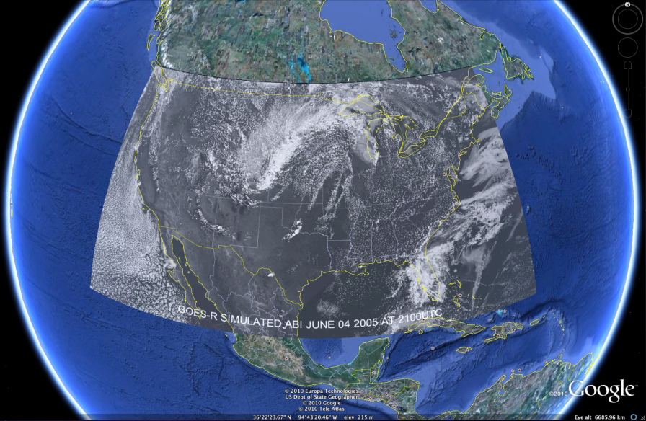
Google Earth
Sample ABI simulated data are available in several formats (google earth, netcdf, McIDAS area & png):
  http://cimss.ssec.wisc.edu/goes/abi/loops/links.html

Slide 57
Scott L.

Slide 58
GOES-15
GOES-15 Processing at CIMSS: Routine Geostationary Operational Environmental Satellite (GOES)-15 Sounder products are being generated at the Cooperative Institute for Meteorological Satellite Studies (CIMSS), including derived product imagery (DPI) of total precipitable water, Lifted Index (stability), and cloud-top pressure. The DPI are available at http://cimss.ssec.wisc.edu/goes/rt/sounder-dpi.php. This website allows for easy comparison of DPI from GOES-15 with that from GOES-11 and -13, and data on the website were used recently by GOES engineers to ascertain the results of switching the electronics on the GOES-15 Sounder from side 1 to side 2. The high-quality image navigation and registration can be seen in the following animation posted on the CIMSS satellite blog: http://cimss.ssec.wisc.edu/goes/blog/wp-content/uploads/2010/07/100713_g11_g15_g13_vis_anim.gif. The GOES-15 NOAA Science test will begin 11 August 2010.
Data Collection Period of the GOES-15 NOAA Science Test Concludes: The last day of the NOAA Geostationary Operational Environmental Satellite (GOES)-15 Science Test consisted of 1-minute imagery over the Midwest. More information and the rapid scan imagery can be found at http://cimss.ssec.wisc.edu/news/2010-09-24_goes15-1min.html or http://cimss.ssec.wisc.edu/goes/blog/archives/6849. The GOES-15 NOAA Science test began on 11 August 2010 and concluded on 22 September 2010. The NOAA Science Test was lead by T. Schmit and D. Hillger; other results can be found at http://rammb.cira.colostate.edu/projects/goes-p/.

Slide 59
GOES-14 Super Rapid Scan Test
Bryan A. Jackson* and Steven M. Zubrick
NOAA - National Weather Service, Sterling, Virginia
from: http://ams.confex.com/ams/pdfpapers/174374.pdf
“As part of the science testing for GOES 14, super rapid scan mode (featuring continuous 1-minute data) was implemented for particular regions during December 2009; including the 18th and 19th for the Mid Atlantic. A loop of IR imagery over the Mid Atlantic from 1639 UTC December 18 to 1350 UTC on the 19th reveals incredible temporal detail to the development of mesoscale and storm scale features in this storm system. For instance, cloud tops associated with leading convective snow bands cooled about 10°C from the NC/VA border to northern Virginia between 2300 UTC on the 18th and about 0130 UTC on the 19th. The ability to see convective cloud bands associated with particularly heavy precipitation in the developing low system as it pushed northeast through North Carolina and Virginia after 0900 UTC on the 19th at a much more frequent rate than radar volume scans would be very useful to near term forecasting of heavy snow. In fact, depiction of these features from a single perspective compared to a mosaic of radars revealed a more precise location of features such as the low center between 500 hPa and the surface and the axis of convergence as the system contracted east. Super rapid scan in the GOES satellites enables real-time analysis of mesoscale and storm scale processes in developing severe weather and is an exciting prospect for the future of weather analysis and forecasting.”

Slide 60
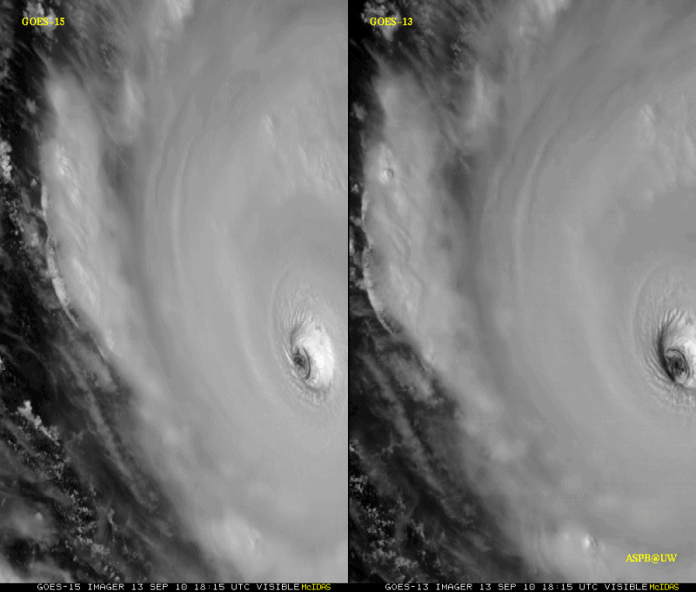
GOES-15: Sample “1-min” imagery
1-min
30-min
Visible data from the recent NOAA Science Test, lead by Hillger and Schmit
Notes:
Igor

