Slide 1
GOES-14 Imager 1-Minute Rapid Scan Data: How to decide on sector locations
Timothy J. Schmit (tim.j.schmit@noaa.gov)
NOAA/NESDIS/Satellite Applications and Research
Advanced Satellite Products Branch (ASPB), Madison, WI
D. T. Lindsey, S. J. Goodman, M. M. Gunshor, W. Line, A. S. Bachmeier, S. Lindstrom, F. Alsheimer, D. B. Radell, R. M. Rabin, C. M. Gravelle, K. Bah, Andrew Orrison, and Dan Nietfeld and many others
PG / UR
Norman, OK
May 2016
UW-Madison

Slide 2
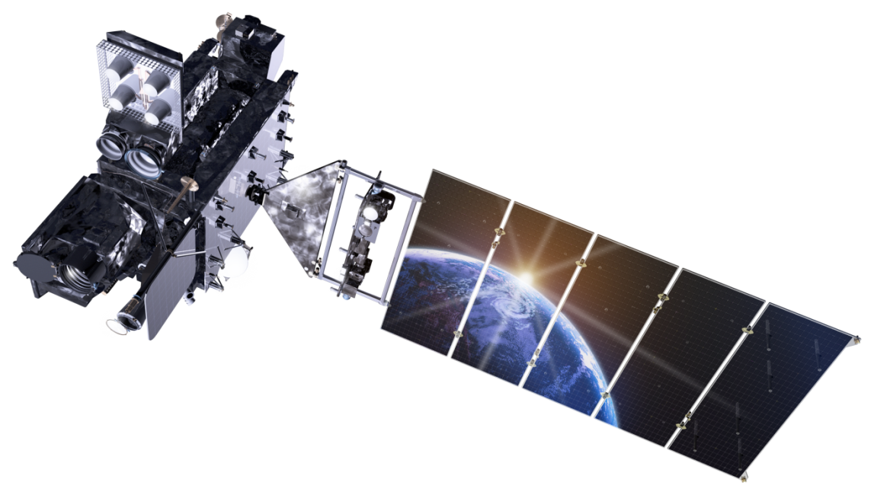
Outline
GOES SRSOR
History / PLT
Overview
SRSOR procedures
SRSOR examples
More information
Links (animations/references/data)
Lockheed Martin

Slide 3
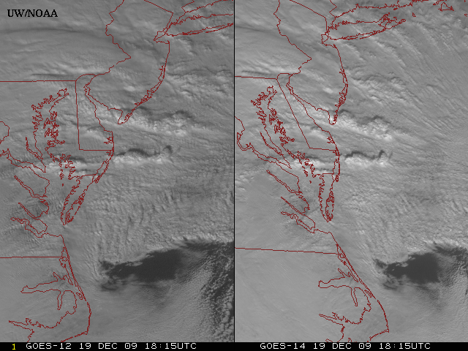
New GOES: Sample “1-min” imagery
GOES-12
GOES-14
See “what is happening”, not “what has happened”.
Notes:
Note the number of different levels of motion you can see (the cyclonic low level circulation over the ocean through the breaks in the higher clouds)... and you can't distinguish those on the GOES-12 loop.

Slide 4
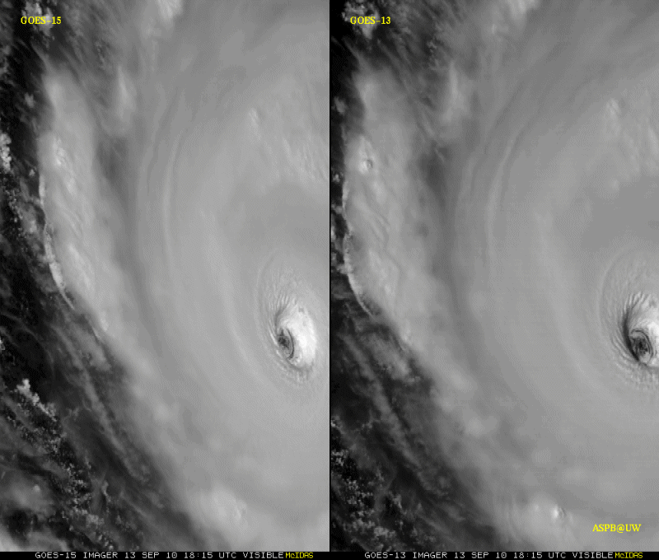
GOES-15: Sample “1-min” imagery
1-min
30-min
Visible data from the GOES-15 NOAA Science Test, led by Hillger and Schmit
Notes:
Igor

Slide 5
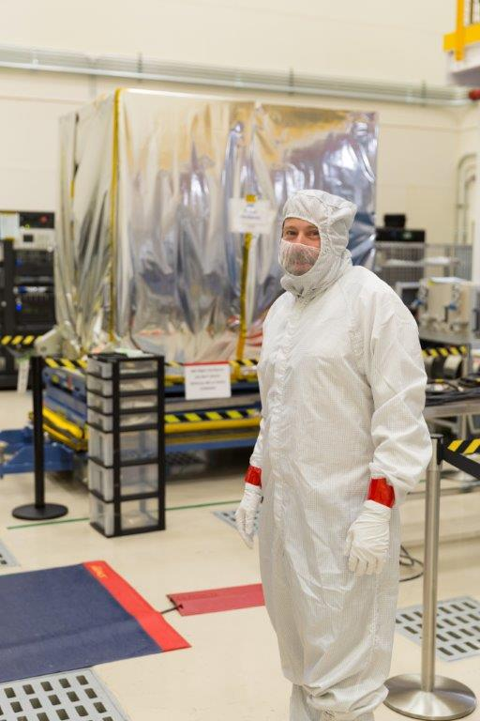
Outline
GOES SRSOR
History / PLT
Overview
SRSOR procedures
SRSOR examples
More information
Links (animations/references/data)
Lockheed Martin

Slide 6
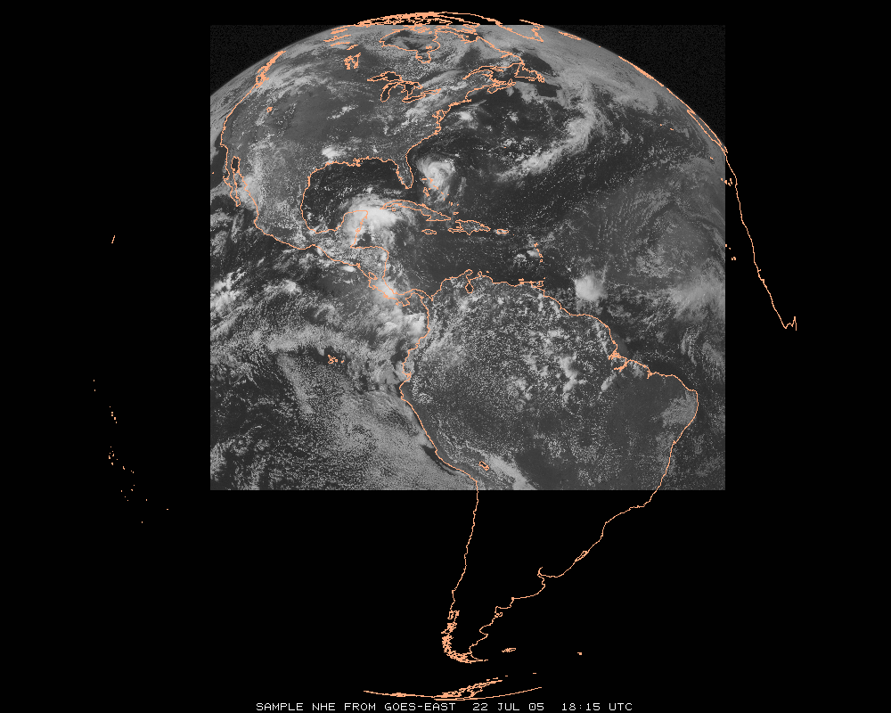
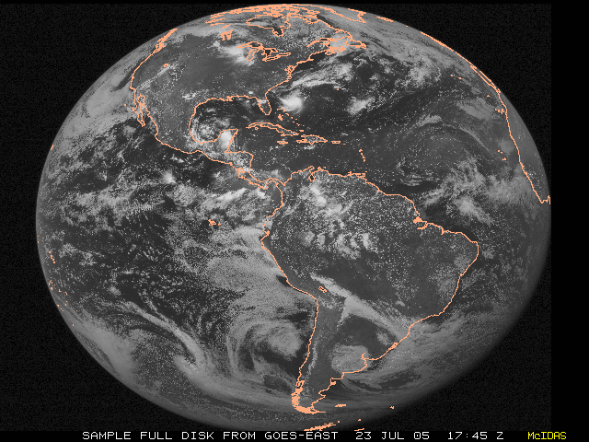
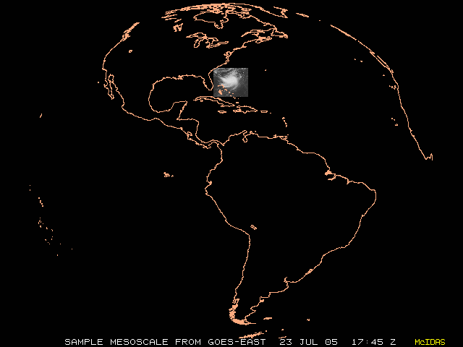
GOES Imager Schedules
http://cimss.ssec.wisc.edu/goes/blog/archives/13001
 | Routine | RSO | SRSO | SRSOR | SRSOR (No FD) | GOES-R ABI
# of images (in 3 hrs) | 16 | 26 | 56 | 129 | 157 | ~360
# of images covering part of CONUS (in 3 hrs) | 11 | 21 | 56* | 129* | 157* | ~360*
Finest delta-time (min) | 15 | 5 | 1 | 1 | 1 | 0.5
2nd largest delta-time (min) | 15 | 10 | 10 | 4 | 4 | 5
Largest delta-time (min) | 30 | 30 | 30 | 30 | 15 | 15
Sectors Scanned (listed by size) | FD, NHE,CONUS, SHEMI | FD, NH, CONUS, SA | FD, NH, CONUS, MESO | FD, MESO | FD, MESO | FD, CONUS, MESO
Run operationally? | Yes | Yes | Yes | No | No | Yes
Full Disk
NH-Extended
N. Hemisphere
CONUS
Mesoscale
Notes:
Example here is GOES-East on a ‘normal’ day.
ABI is mode 3, or ‘flex mode’.
* = depends on locations of meso-scale images.
RSO = Rapid Scan Operations
SRSO = Super Rapid Scan Operations
SRSOR = Super Rapid Scan Operations for GOES-R
FD = Full Disk
NHE = Northern Hemisphere Extended
NH = Northern Hemisphere
CONUS = Continental U.S.
SHEMI = Southern Hemisphere
SHSS = Southern Hemisphere Short Scan
MESO = meso-scale
More info: http://www.ospo.noaa.gov/Operations/GOES/schedules.html
Tim Schmit, NOAA NESDIS

Slide 7
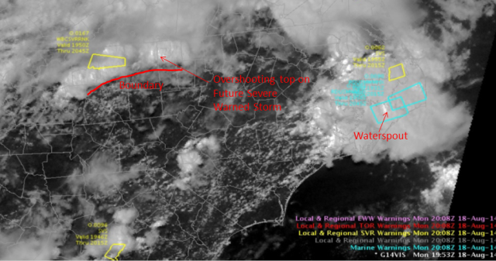
GOES-14: Special Rapid Scanning offers glimpse of the ABI
SRSOR (Super Rapid Scan Operations for GOES-R) from GOES-14 imager
More SRSOR data in both May 8-24 and August 14-28 of 2014.
http://cimss.ssec.wisc.edu/goes/srsor2014/GOES-14_SRSOR.html
Many phenomena were observed: convection, hurricanes, fires, smoke, ...
Data used by the NWS.
Data achived at a number of locations, including NOAA NESDIS CLASS.
NWS Forecaster: SRSOR “….certainly increased our confidence in our warning decisions and ultimately made the process more efficient … having the Super Rapid Scan data very valuable and very worthwhile, … should be able to be built into everyday operations at NWS weather forecast offices around the country.”
GOES-14 Image from CIMMSE blog
http://cimmse.wordpress.com/2014/08/24/an-example-of-how-goes-14-super-rapid-scan-operations-for-goes-r-helped-during-warning-operations-at-nws-wfo-raleigh-nc-on-18-august-2014/
GOES-14 provided very unique information and offers a glimpse into the possibilities that will be provided by the ABI on GOES-R.
Notes:
Data was provided to many groups: WPC, OPC, AWC, SPC, SAB, several WFO, who used the data for discussions and forecasts.

Slide 8
GOES-14 Super Rapid Scan Operations to Prepare for GOES-R
SRSOR (Super Rapid Scan Operations for GOES-R) from GOES-14 imager
Data between mid-August and September 24th and late October 2012; and two days in June and 12 days in mid-August, 2013; and mid-May, 2014, May and August 2015 and parts of 2016:
http://cimss.ssec.wisc.edu/goes/srsor/GOES-14_SRSOR.html
http://cimss.ssec.wisc.edu/goes/srsor2013/GOES-14_SRSOR.html
http://cimss.ssec.wisc.edu/goes/srsor2014/GOES-14_SRSOR.html
http://cimss.ssec.wisc.edu/goes/srsor2015/GOES-14_SRSOR.html
http://cimss.ssec.wisc.edu/goes/srsor2016/GOES-14_SRSOR.html
GOES-14 provided very unique data and offered a glimpse into the possibilities that will be provided by the ABI on GOES-R in one minute mesoscale imagery
Many phenomena were observed
The users can’t wait for 1-min data!
GOES-14 visible image showing rapid convective development

Slide 9
Real World Experience
Approximate number of SRSOR images taken to date:
250
2,500
25,000
250,000
1,000,000
Notes:
d

Slide 10
Outline
GOES SRSOR
History / PLT
Overview
SRSOR procedures
SRSOR examples
More information
Links (animations/references/data)
Lockheed Martin

Slide 11
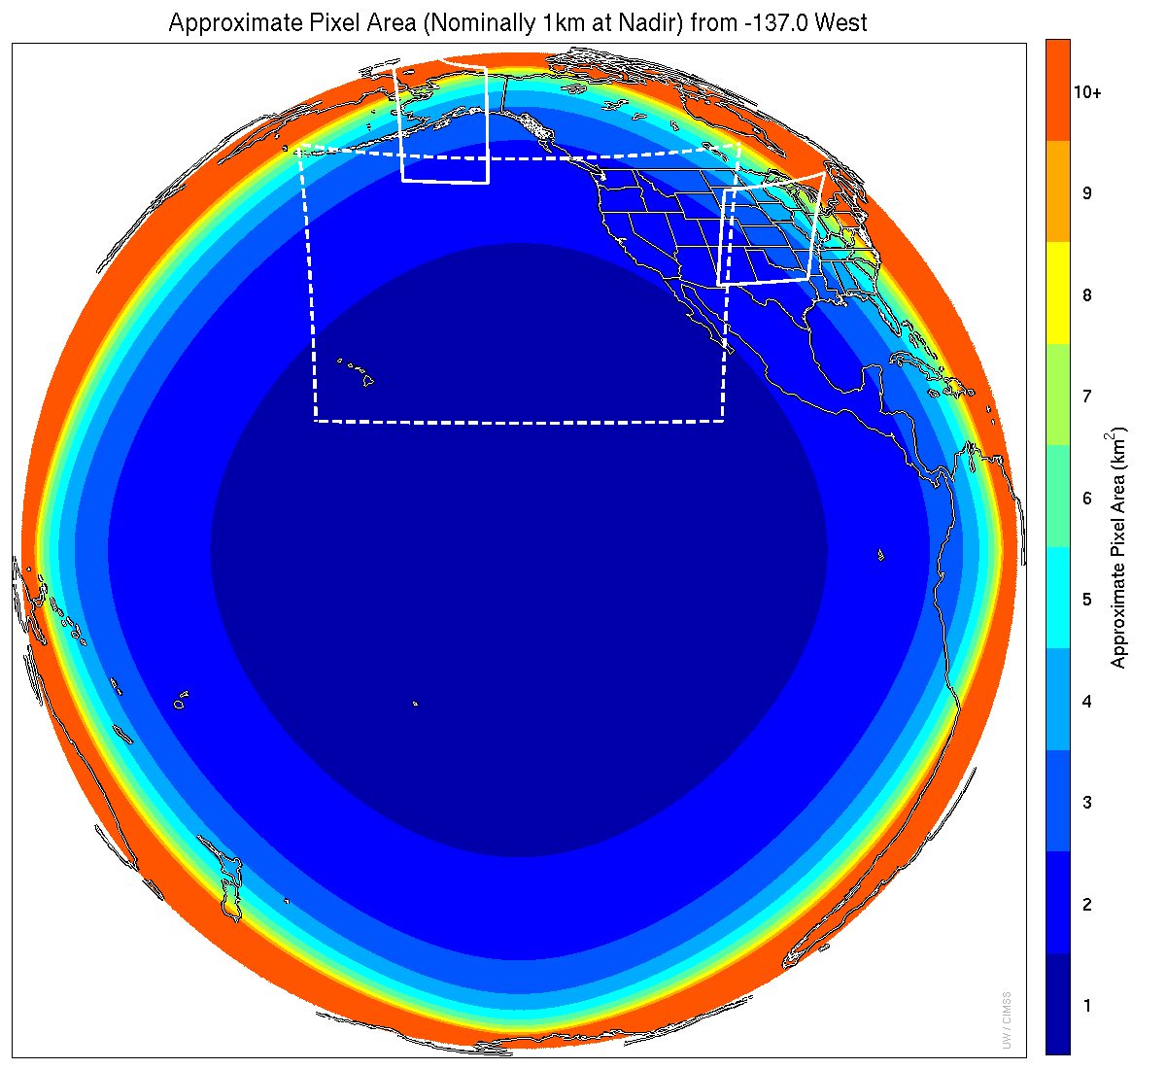
Meso-scale box locations are movable
1 min
1 min
5 min
15 min
Notes:
1-km² spatial resolution at satellite nadir. Pixel Areas are approximate. Each bin is rounded to the nearest 1km² until we get to 9.5km² and then all are binned into the red 10+ area. So the first, dark blue, ring covers pixel areas from 1 to 1.49km² and is labeled “1”, above 1.5 to below 2.5km² goes into the next ring and is called “2”, etc. GOES-West location. Proposed CONUS sector, approved by the NWS NOAT. Two meso-scale image sectors shown; these are selectable. The same central lat/lon used for these mesoscales produces a different sized and shaped area for different satellite locations.

Slide 12
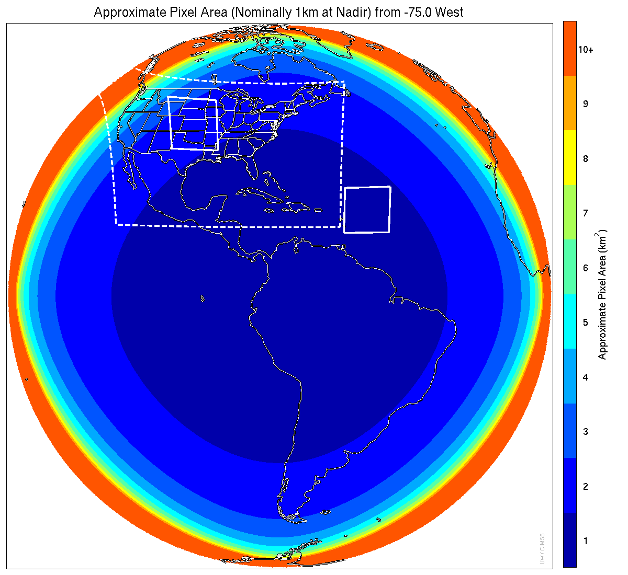
Meso-scale box locations are movable
1 min
5 min
1 min
15 min
Notes:
1-km² spatial resolution at satellite nadir. Pixel Areas are approximate. Each bin is rounded to the nearest 1km² until we get to 9.5km² and then all are binned into the red 10+ area. So the first, dark blue, ring covers pixel areas from 1 to 1.49km² and is labeled “1”, above 1.5 to below 2.5km² goes into the next ring and is called “2”, etc. GOES-East location. Proposed CONUS sector, approved by the NWS NOAT. Two meso-scale image sectors shown; these are selectable. The same central lat/lon used for these mesoscales produces a different sized and shaped area for different satellite locations.

Slide 13
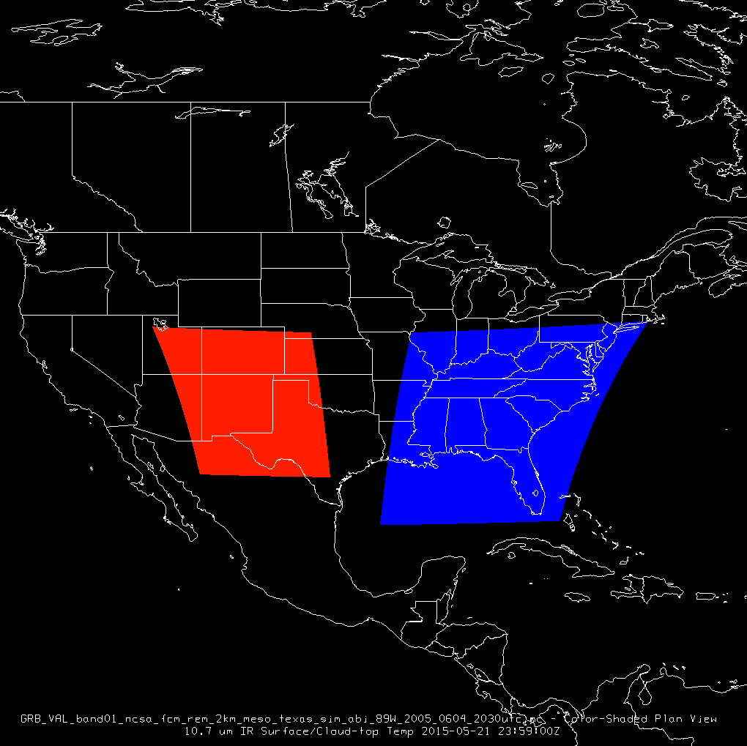
Relative sizes: SRSOR and mesoscale
SRSOR
GOES-R

Slide 14
Inputs to SRSOR location
Many inputs:
Current conditions
SPC convective outlooks
NHC Hurricane outlooks
SPC Fire weather outlooks
WPC Precip outlooks
Testbed experiments
Pre-approved field experiments
Previous SRSOR locations, volcanic activity
Previous phenomena scanned

Slide 15
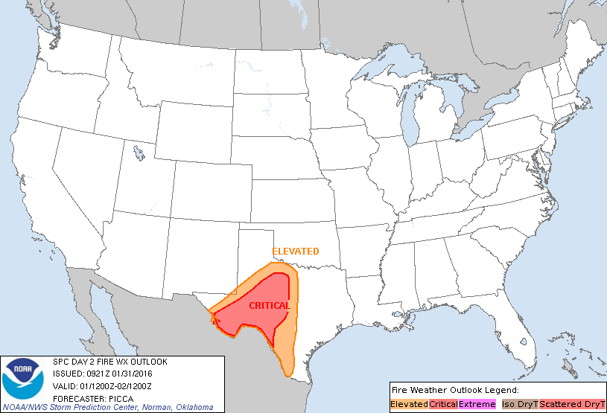
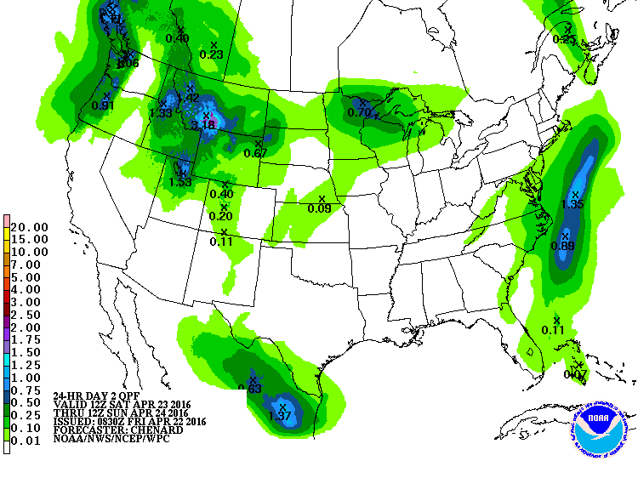
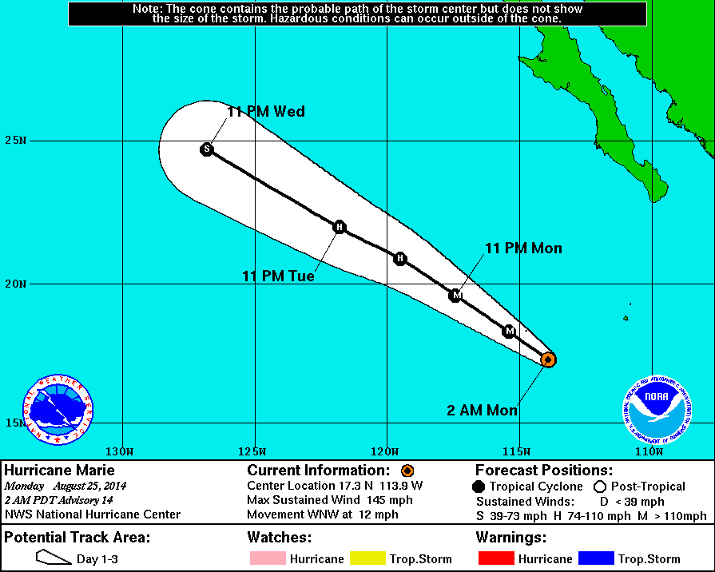
Inputs
+ forecasts, forecast imagery, dust, etc.

Slide 16
More on SRSOR locations
“Follow the weather”
Consider not just day 1, but day 2 forecasts (e.g., will there be a better fire or convection day later) and beyond
For research purposes: Minimize repeat looks over same area on subsequent days
“We don’t want anyone to be too happy”

Slide 17
Process for SRSOR location
The morning before:
Send email to small group with suggestion(s)
Include image of coverage domain
Discuss, wait for any other feedback
After 18 UTC:
Decide. Update web page location
Contact Satellite operators
Confirm Satellite operators got center point
Look at imagery, make loops, post, etc.
After 11:15 UTC:
confirm new center point used.

Slide 18
Process for SRSOR location
The morning before:
Send email to small group with suggestion(s)
Include image of coverage domain
Discuss, wait for any other feedback
After 18 UTC:
Decide. Update web page location
Contact Satellite operators
Confirm Satellite operators got center point
Look at imagery, make loops, post, etc.
After 11:15 UTC:
confirm new center point used.
Repeat…
(weekends, holidays, etc.)

Slide 19
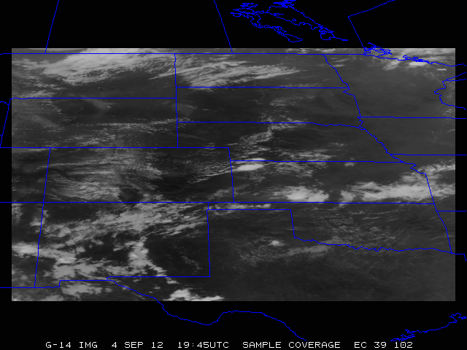
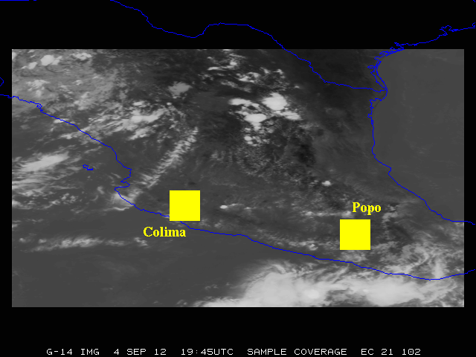
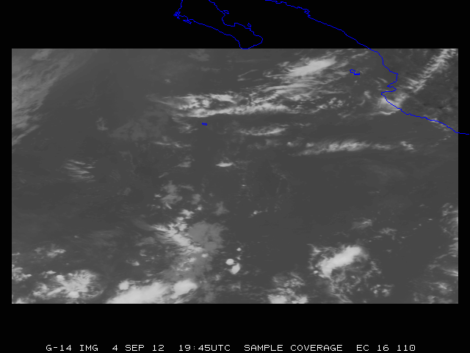
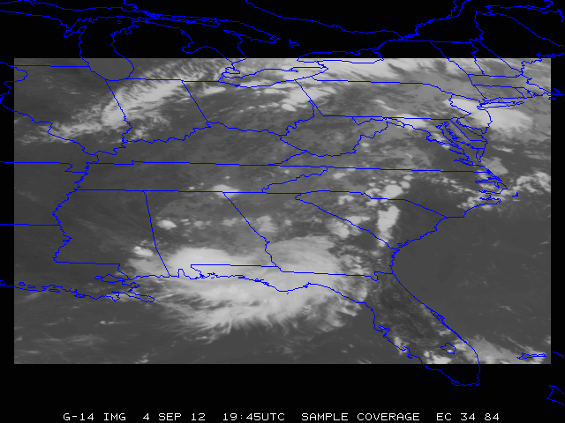
Sample Coverage images

Slide 20
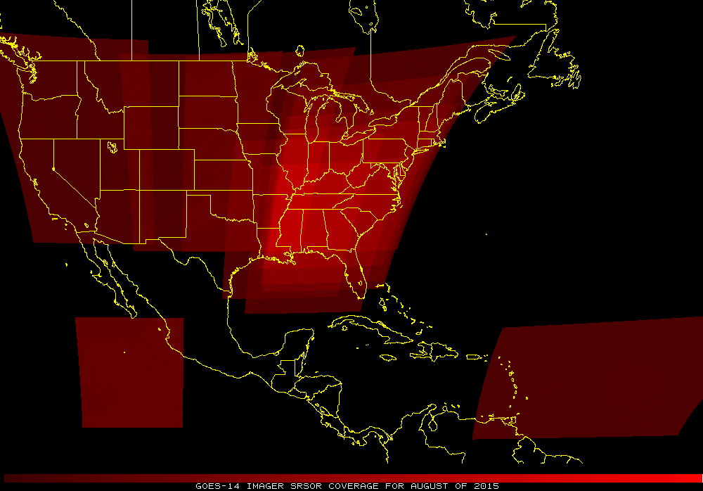
Sample Coverage images
Sandy: October 2012
August 2015

Slide 21
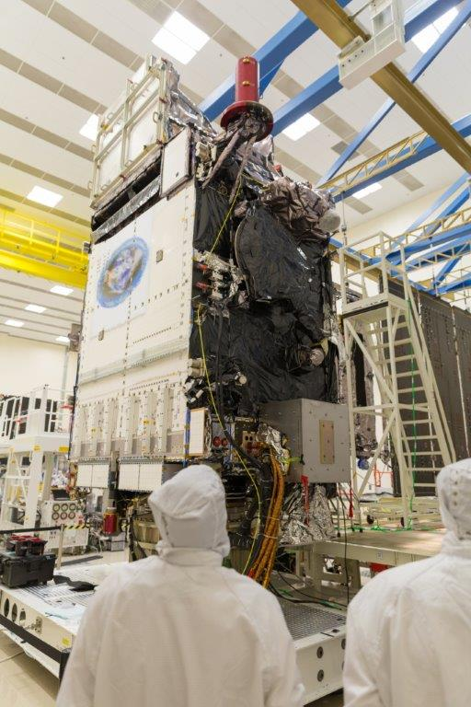
Outline
GOES SRSOR
History / PLT
Overview
SRSOR procedures
SRSOR examples
More information
Links (animations/references/data)
Lockheed Martin

Slide 22
A Glimpse into the Future
ABI-like
Hurricane Sandy from GOES-14 at two temporal resolutions

Slide 23
1-min imagery
1-min mode (SRSOR from GOES-14)
Operational (GOES-13)

Slide 24
SRSOR GOES-14 2014 Color-enhanced infrared window (1 vs 15 min)
Note the ‘enhanced-v’ is seen first on the 1 minute data.

Slide 25
SRSOR in SPC
7 direct references in SPC text forecast products during May and August GOES-14 SRSOR periods
SPC forecasters consistently viewed the 1-min imagery in Operations, incorporating it into their decision-making
Allowed for easier analysis, identification and tracking of:
deepening and clumping of BL cu, vertical growth of cumulus convection, identification and tracking of boundaries, overshooting and collapsing storm tops, character of storm anvils, convectively generated outflow, gravity wave progression, visual assessment of storm-top divergence and flanking line development, diagnosis of near-storm environment though convective trends and cloud character,
All on time scales not otherwise available.
Over time, this imagery will allow forecasters to gain a better understanding of processes related to CI
William Line, SPC Satellite Liaison

Slide 26
GOES-14 SRSOR in SPC
“The one-minute imagery helped me to anticipate areas of new convective development as well, which was useful in developing short-term forecasts and mesoscale discussions for severe weather. ”
“… having the data available routinely would very likely, over time, allow forecasters to gain a better understanding of processes related to convective initiation, as these processes occurring within a cu field would be visually revealed in high temporal -resolution data in a way that 15- or 30-minute imagery cannot as clearly depict.”
“In the pre-storm environment, these data were especially helpful in monitoring the vertical growth of cumulus convection and in the identification of boundaries.”
“I found it to be very useful in… Using cloud character and trends to diagnose boundary locations and motion, and nowcast their potential for either CI or influences on upshear storms to interact therewith.”
“This has provided extra confidence and lead time for the issuance of two mesoscale discussions compared to the normal satellite update frequency/latency. … quite striking. It’s analogous to the difference between watching high-def TVs vs. standard def, ... Satellite imagery at 1-min temporal resolution needs to become the new standard for severe weather operations.”
“Post-storm initiation, the high-resolution data allowed for careful analysis of overshooting and collapsing tops, the character of the storm anvils (ie. health of the storm) and the identification of convectively generated outflows.”
http://satelliteliaisonblog.wordpress.com/category/spc/
Notes:
Highlights added.

Slide 27
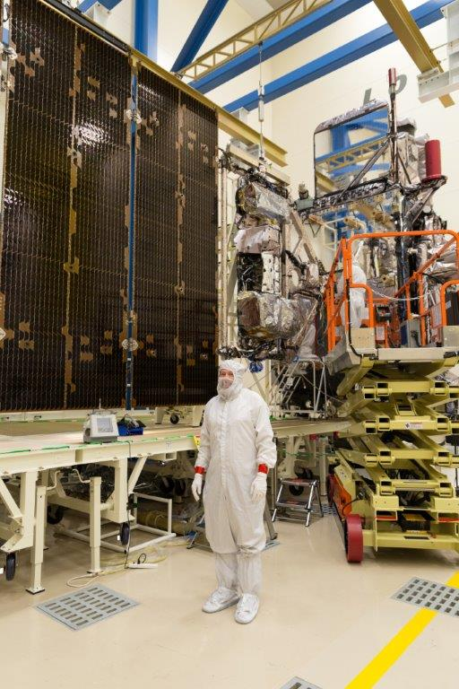
Outline
GOES SRSOR
History / PLT
Overview
SRSOR procedures
SRSOR examples
More information
Links (animations/references/data)
Lockheed Martin

Slide 28
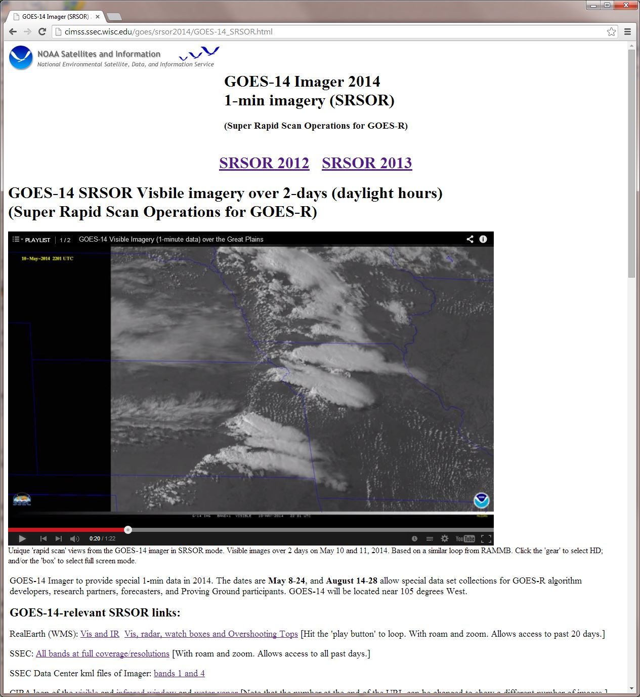
http://cimss.ssec.wisc.edu/goes/srsor2014/GOES-14_SRSOR.html

Slide 29
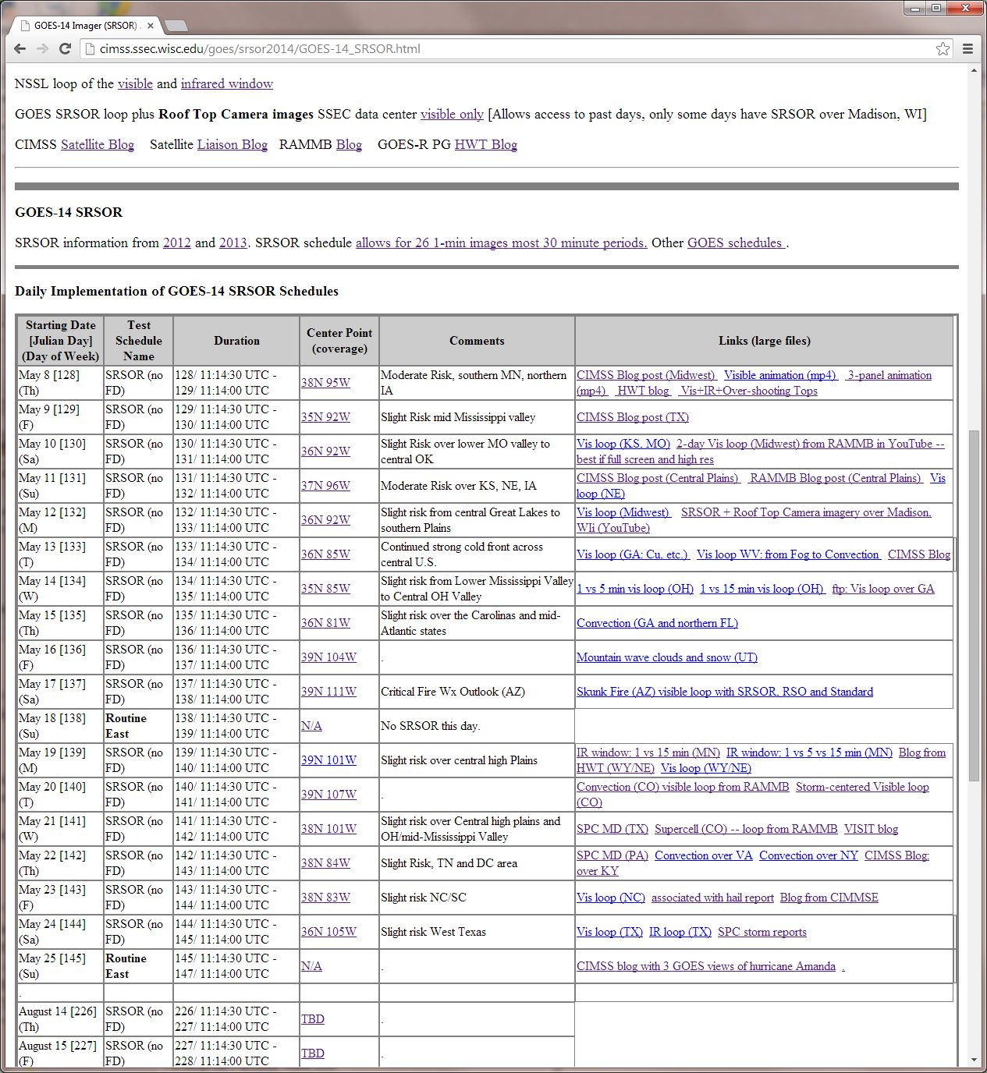
http://cimss.ssec.wisc.edu/goes/srsor2014/GOES-14_SRSOR.html

Slide 30
http://cimss.ssec.wisc.edu/goes/srsor2014/GOES-14_SRSOR.html

Slide 31
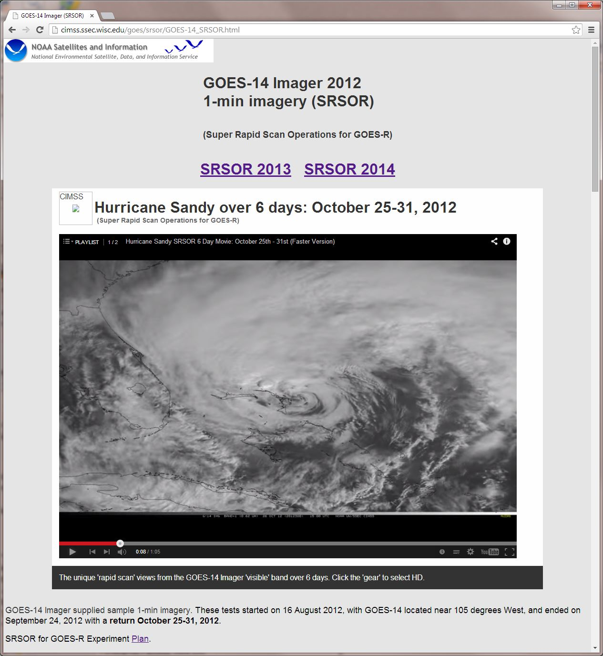

Slide 32
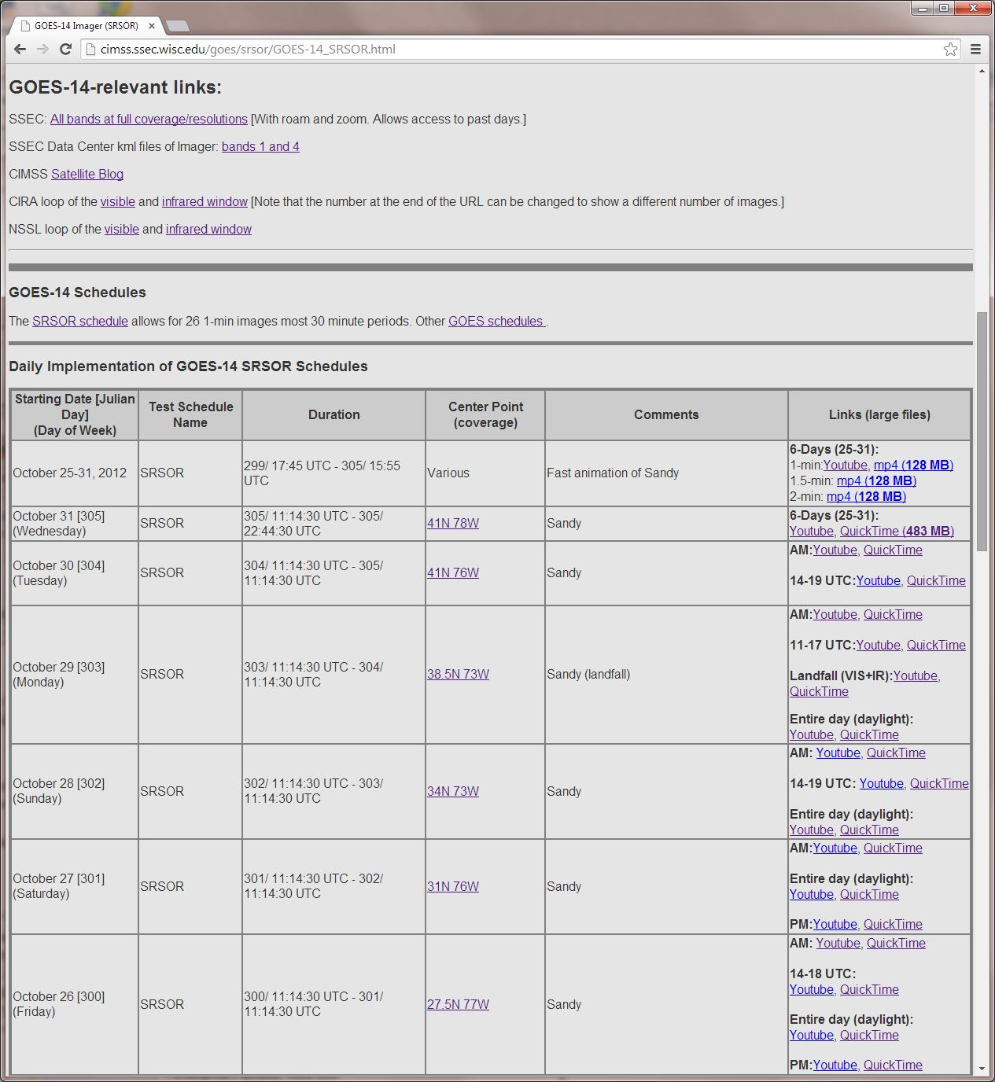

Slide 33
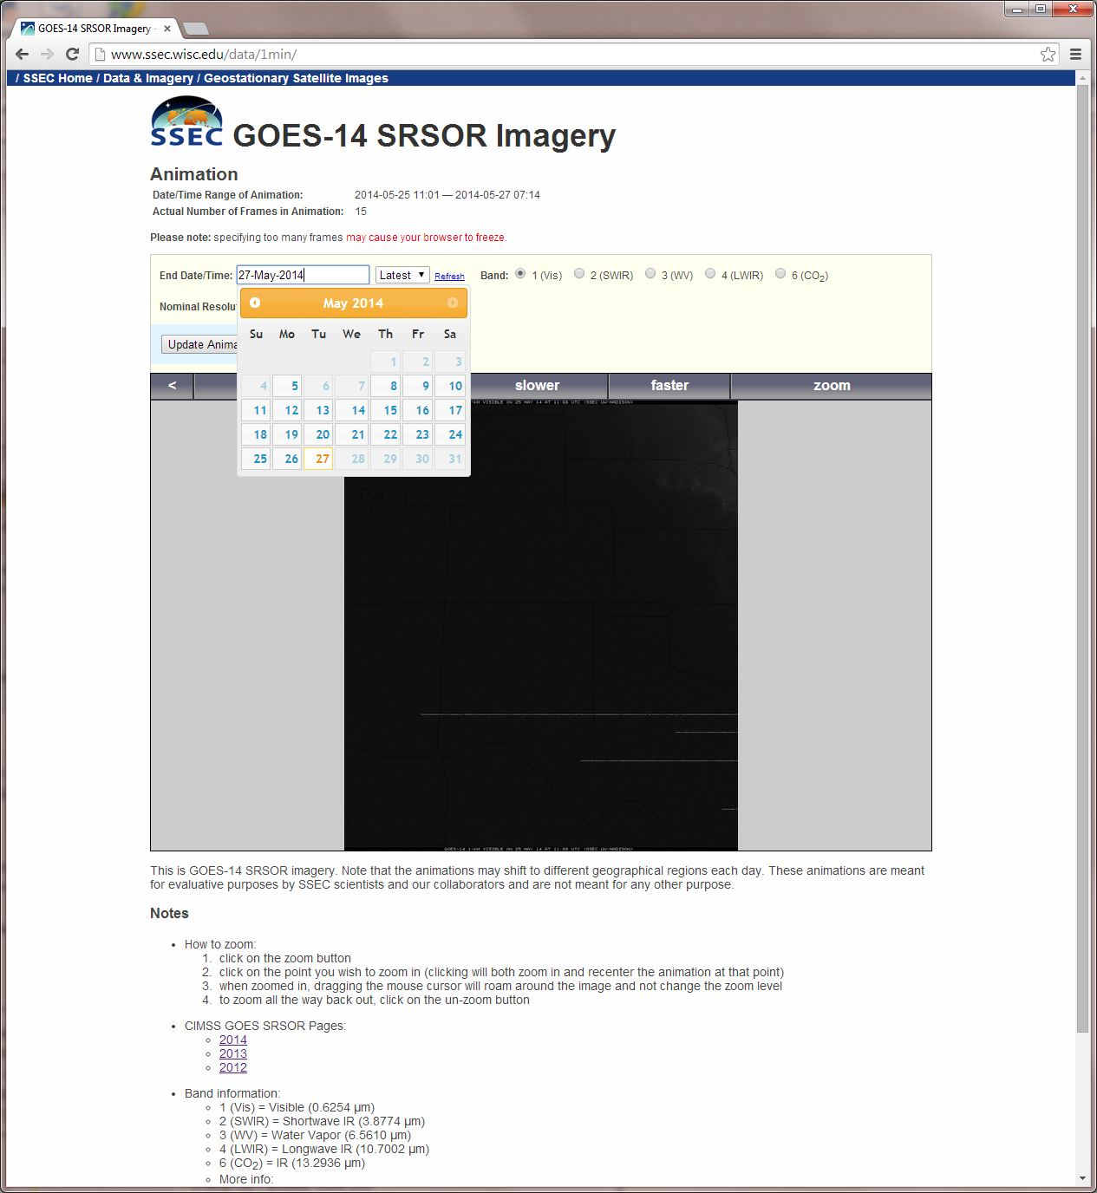
Select date….
http://www.ssec.wisc.edu/data/1min/

Slide 34
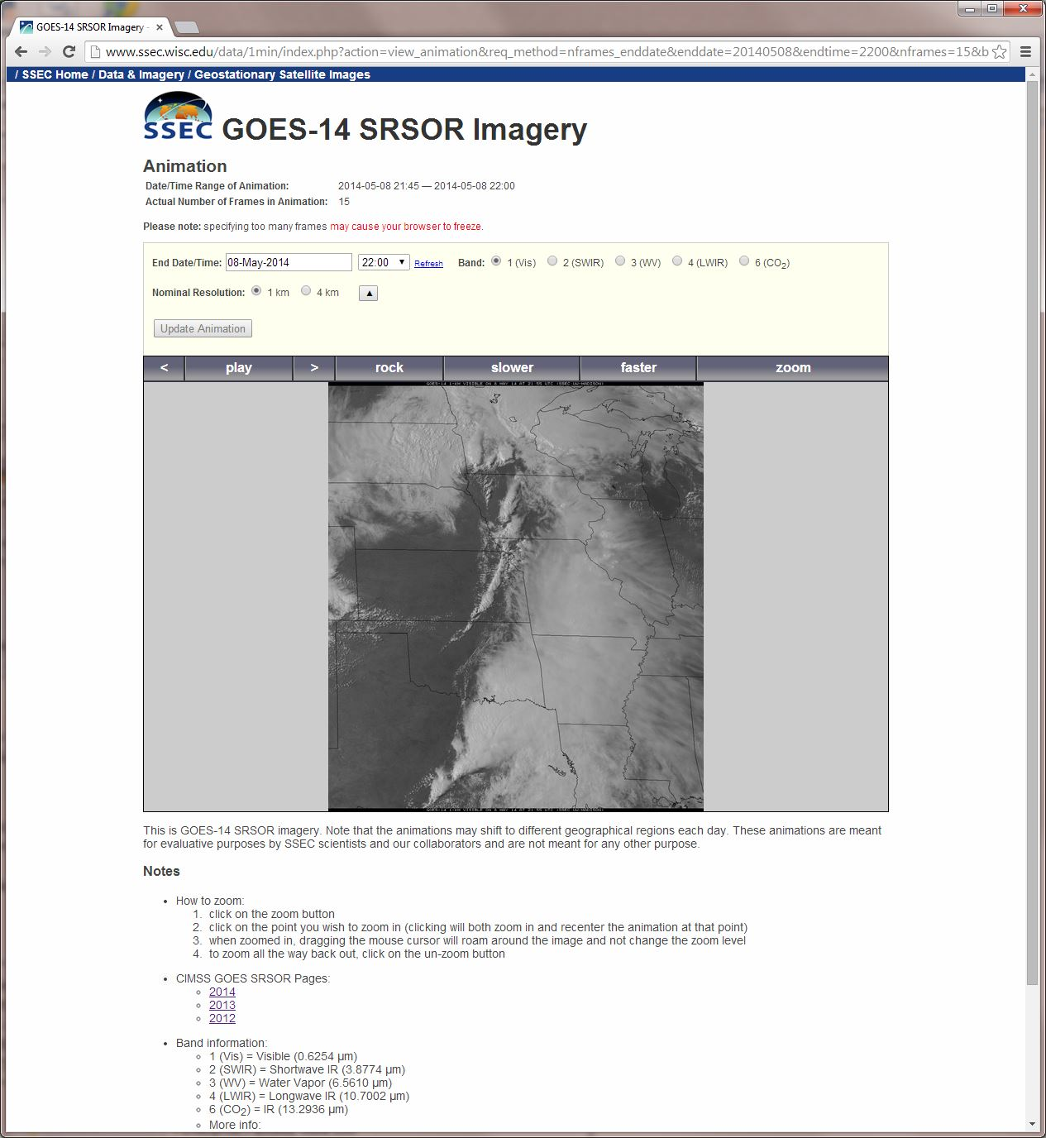
Zoom…
http://www.ssec.wisc.edu/data/1min/

Slide 35
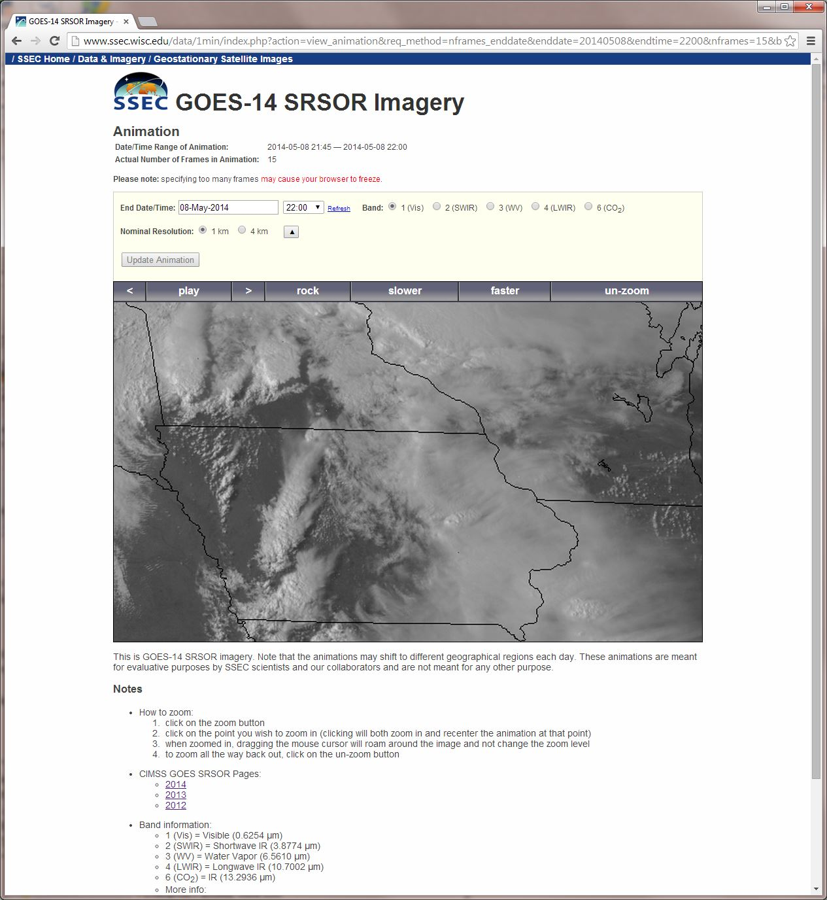
http://www.ssec.wisc.edu/data/1min/

Slide 36
Select References
Mecikalski, J. C. Jewett, J. Apke, L. Carey, Analysis of Cumulus Cloud Updrafts as Observed with 1-Min Resolution Super Rapid Scan GOES Imagery
DOI: http://dx.doi.org/10.1175/MWR-D-14-00399.1
William Line, Timothy J. Schmit, Daniel T. Lindsey, Steve Goodman, 2016: Use of Geostationary Super Rapid Scan Imagery by the Storm Prediction Center, accepted, WaF.
http://journals.ametsoc.org/doi/abs/10.1175/WAF-D-15-0135.1
Schmit, T. J., and co-authors, 2014: Rapid Refresh Information of Significant Events: Preparing users for the next generation of geostationary operational satellites, Bull. Amer. Meteor. Soc., accepted.
http://journals.ametsoc.org/doi/pdf/10.1175/BAMS-D-13-00210.1
Schmit T.J., Goodman S.J., Lindsey D.T., R. M. Rabin, K. M. Bedka, M. M. Gunshor, J. L. Cintineo, C. S. Velden, A. S. Bachmeier, S. S. Lindstrom, and C. C. Schmidt, 2013: Geostationary operational environmental satellite (GOES)-14 super rapid scan operations to prepare for GOES-R. J. Appl. Remote Sens. 0001;7(1):073462. doi:10.1117/1.JRS.7.073462.
http://remotesensing.spiedigitallibrary.org/article.aspx?articleid=1790703
Schmit, Timothy J.; Gunshor, Mathew M.; Menzel, W. Paul; Gurka, James J.; Li, Jun and Bachmeier, A. Scott. Introducing the next-generation Advanced Baseline Imager on GOES-R. Bulletin of the American Meteorological Society, Volume 86, Issue 8, 2005, pp.1079-1096.
http://journals.ametsoc.org.ezproxy.library.wisc.edu/doi/pdf/10.1175/BAMS-86-8-1079

Slide 37
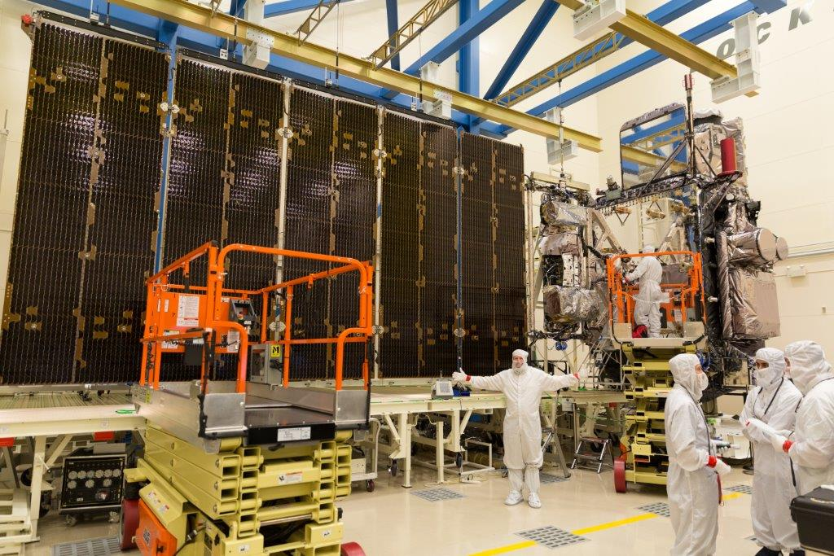
Summary
1. Over 7 months of GOES-14 1 min data collected; all data in CLASS
2. The center point was decided the day before collecting data, using a number of inputs (operational and research)
3. Each day there was at least one area of interest (even in February or August!)
4. Often there were 2 areas of interest
5. GOES-R ABI meso-scales are a bit smaller than SRSOR, but there are two locations, not just one; with four between the 2 satellites.

Slide 38
GOES-14: Special Rapid Scanning offers glimpse of the ABI
Animation from GOES-14 Imager visible image at 1-min time resolution. This case is over Texas during spring flooding.
Notes:
Note that the image is only an image, the loop could be embedded, but make sure all the frames show. If not, just show ‘stand-alone’.
This loops is when the operational GOES takes just one (full disk) image.

Slide 39
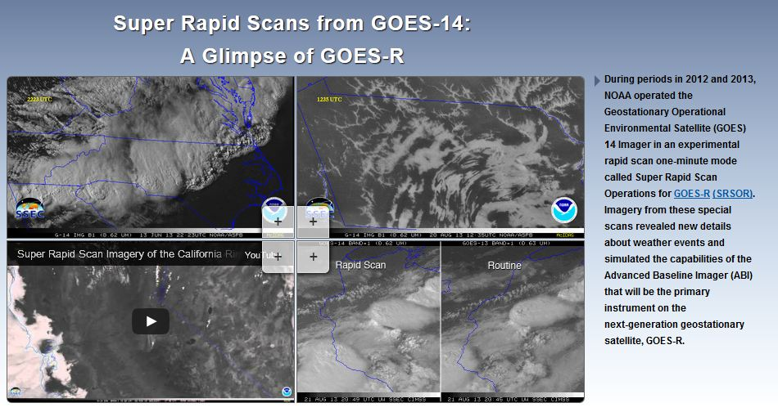
SRSOR Links
http://cimss.ssec.wisc.edu/goes/srsor/GOES-14_SRSOR.html
http://cimss.ssec.wisc.edu/goes/srsor2013/GOES-14_SRSOR.html
http://cimss.ssec.wisc.edu/goes/srsor2014/GOES-14_SRSOR.html
http://cimss.ssec.wisc.edu/goes/srsor2015/GOES-14_SRSOR.html
http://cimss.ssec.wisc.edu/goes/srsor2016/GOES-14_SRSOR.html
http://www.nesdis.noaa.gov/fourbox/09-23-13/

