Slide 1
NWA Talk
Background
Spectral
Temporal
  ABI CONUS locations
  Baseline scan modes
  Exploratory scan modes
Spatial
Misc
  AHI
  NSC?

Slide 2
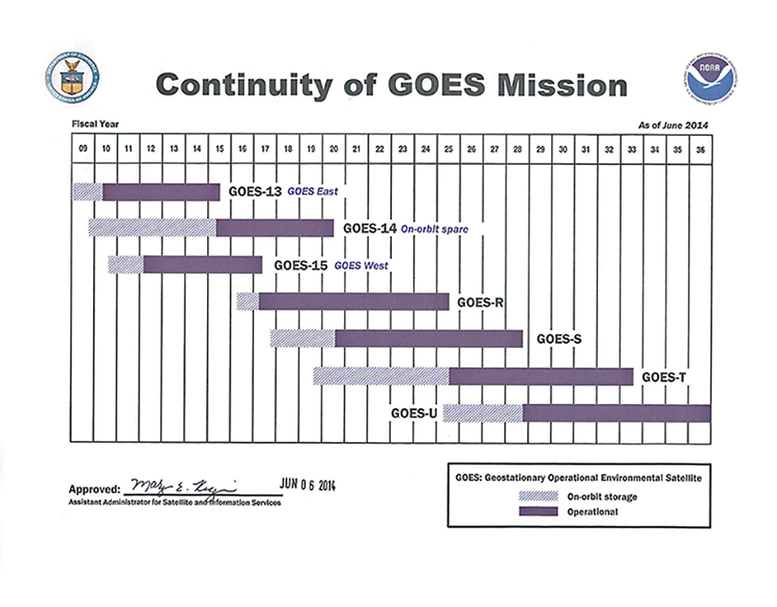
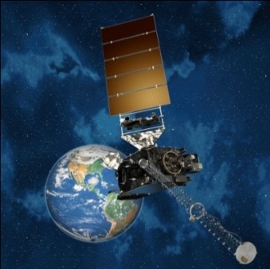
Continuity of GOES Operational Satellite Program
GOES-R Launch Readiness
2Q FY 2016
2
Notes:
GOES-R moved from October 2015 Launch Commitment Date to 2Q FY2016 and GOES-S shifted to 3Q FY17. GOES-T and U LCD remain unchanged.

Slide 3
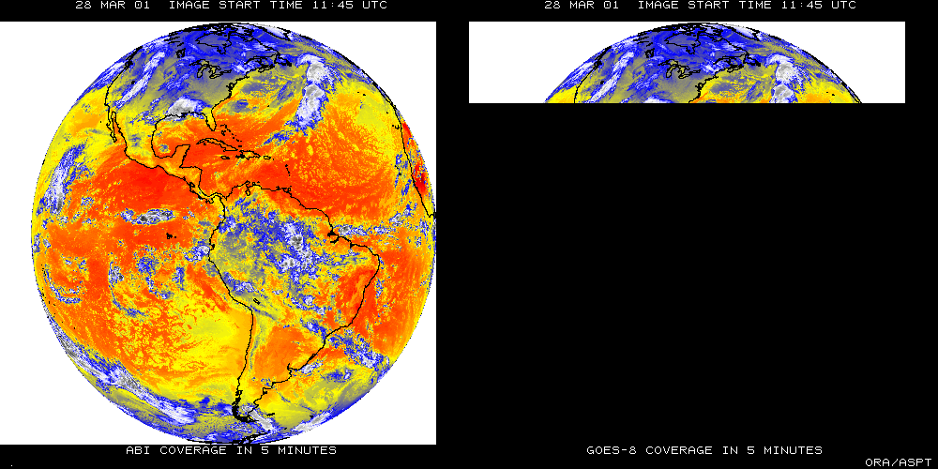
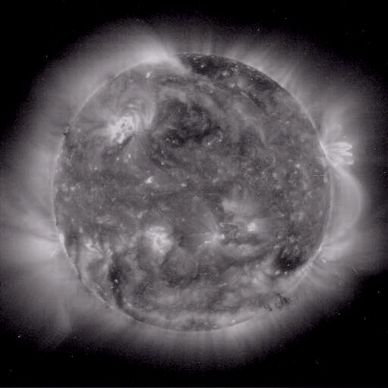
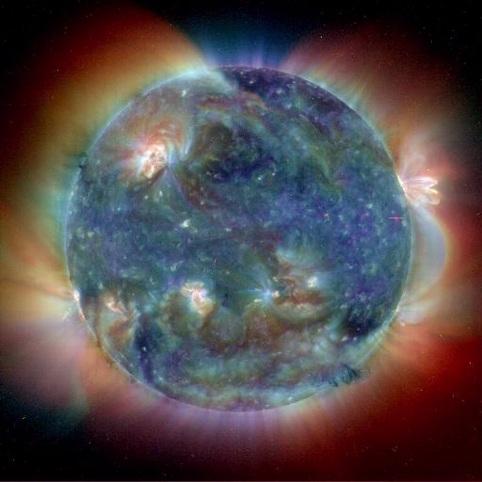
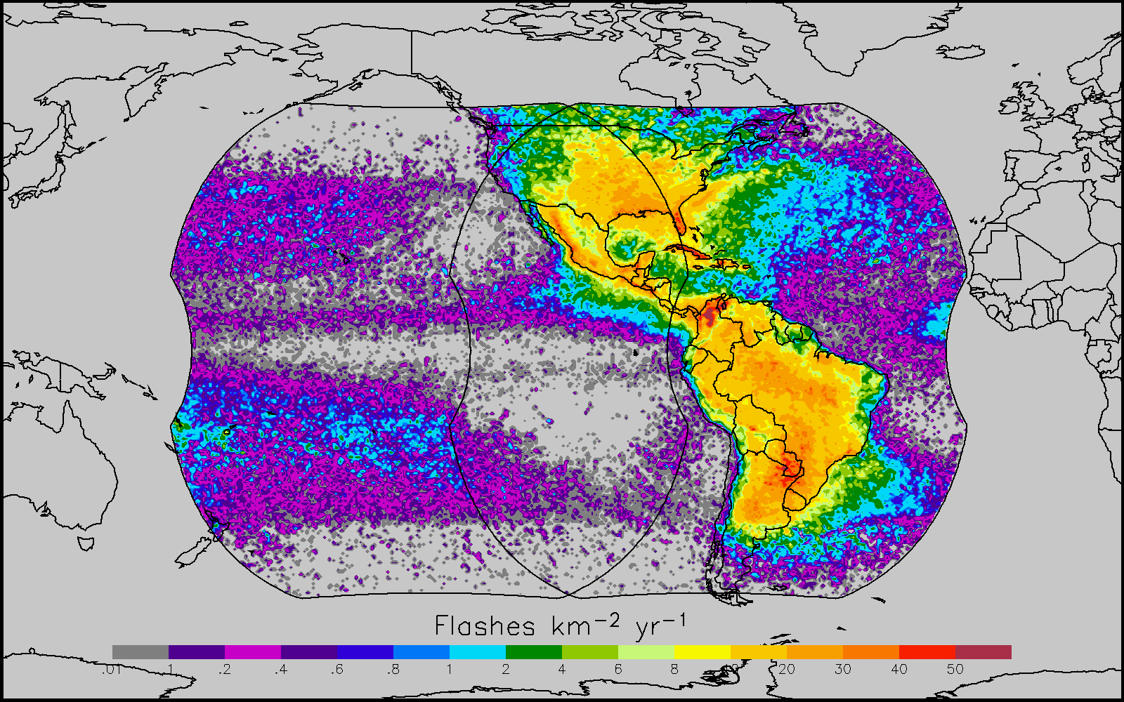
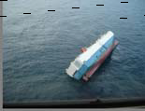
GOES-R main instruments
ABI – Advanced Baseline Imager
Space Weather/Solar
SEISS
SUVI
EXIS
Magnetometer
ABI covers the earth 5X faster than current Imager
Geostationary Lightning Mapper
Images courtesy of SOHO EIT, a joint NASA/ESA program
Unique Payload Services
No Sounder

Slide 4
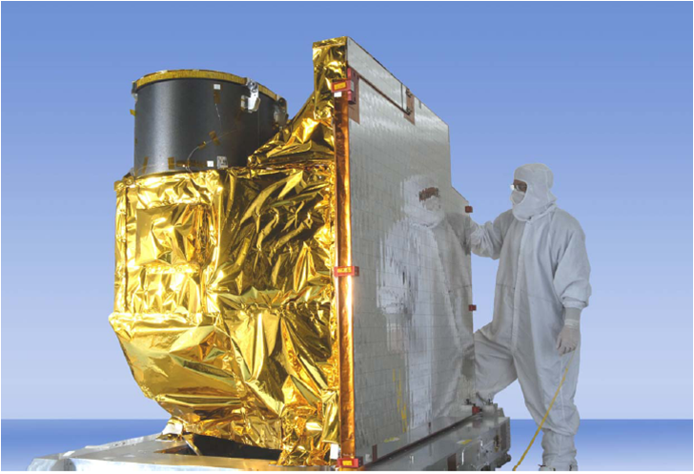
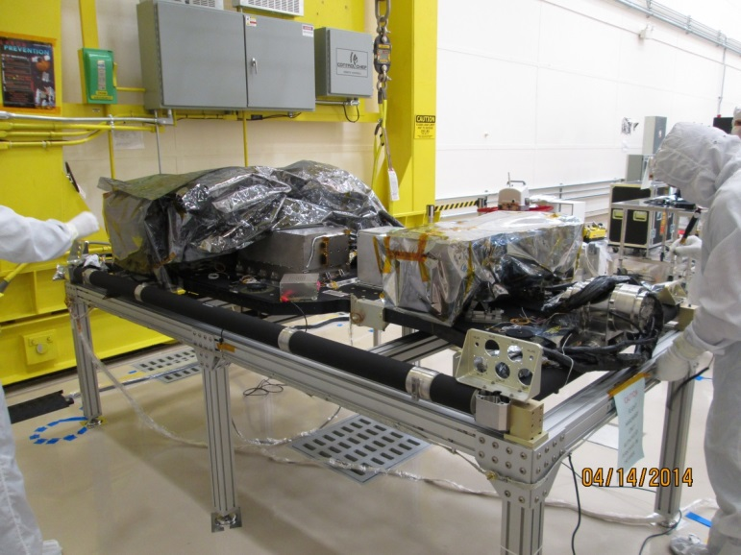
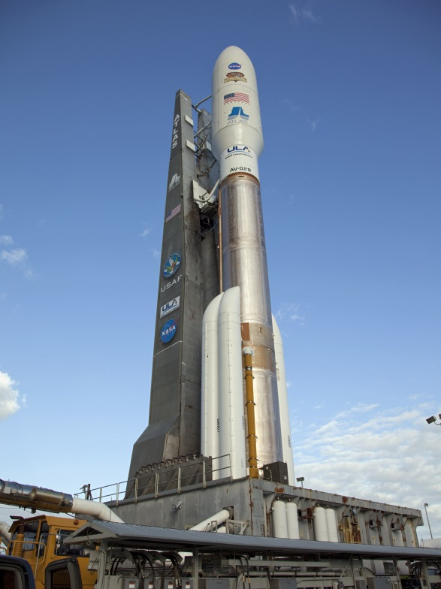
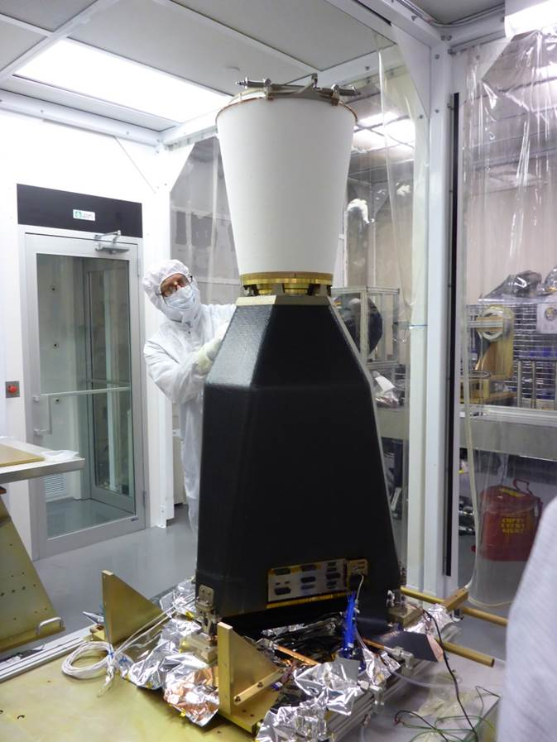
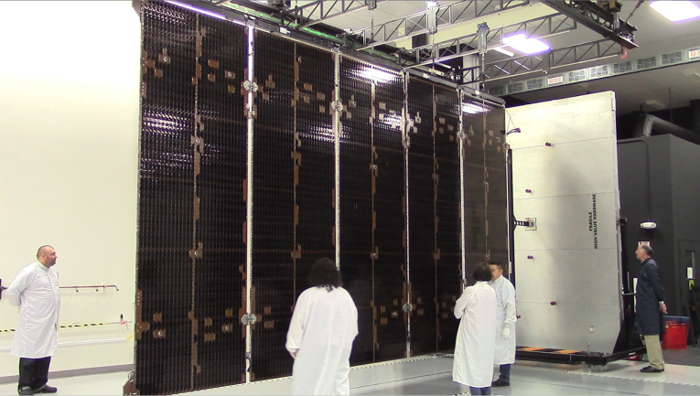
GOES- R Flight Segment
GOES-R ABI
SUVI and EXIS (solar/space instruments
GLM vibration testing complete
Atlas V 541 ELV
Solar Array Wing deployment
4
Notes:
Credit: GOES-R web page and G. Mandt presentation

Slide 5
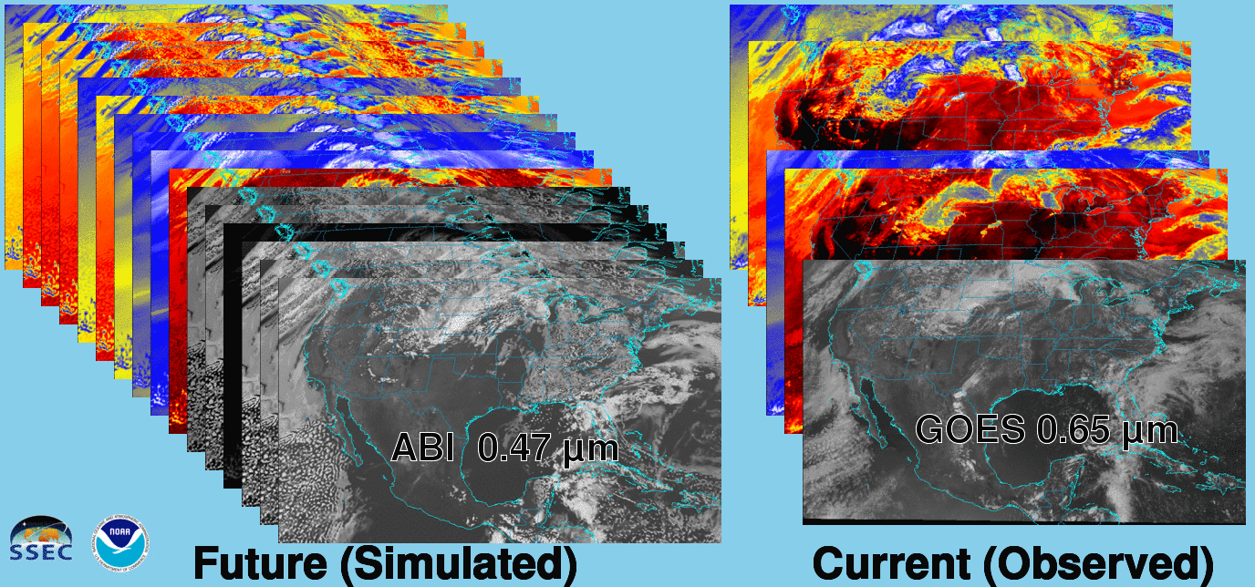

16 (ABI) versus only 5 (GOES Imager) bands
Notes:
http://cimss.ssec.wisc.edu/goes/goes-r/

Slide 6
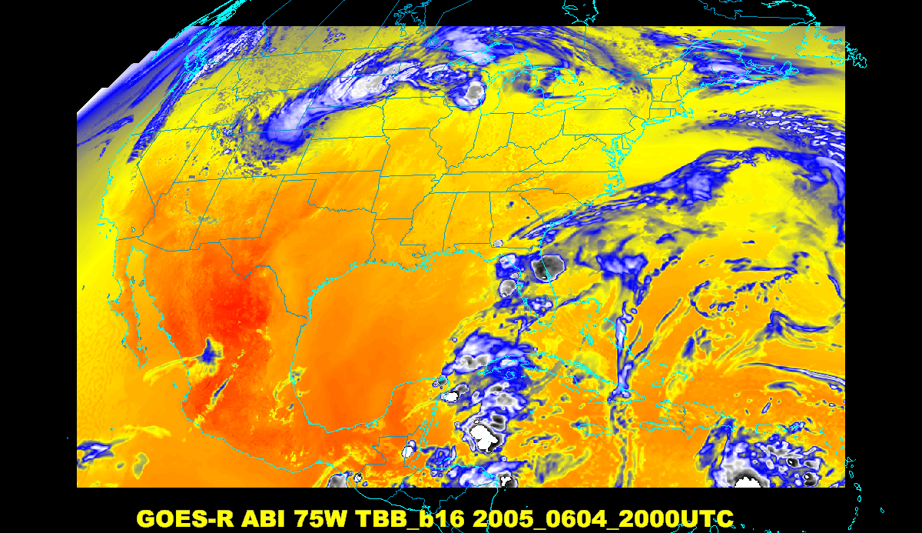
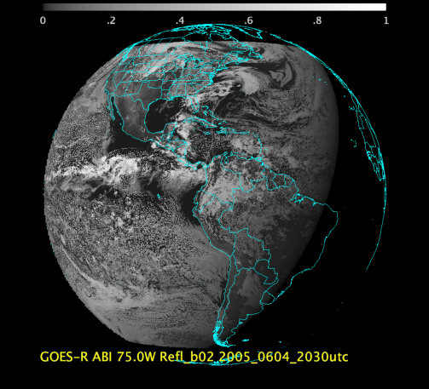
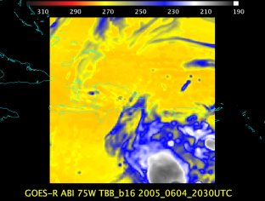
Baseline ABI Scan Modes
FD
CONUS
MESO
‘Flex mode’ for the ABI:
Full disk every 15 minutes + 5 min CONUS
+ 1-min mesoscale sectors (2 locations)
‘Continuous Full Disk’ (CFD) is a full disk every 5 min
Notes:
CONUS image is the shifted center point.

Slide 7
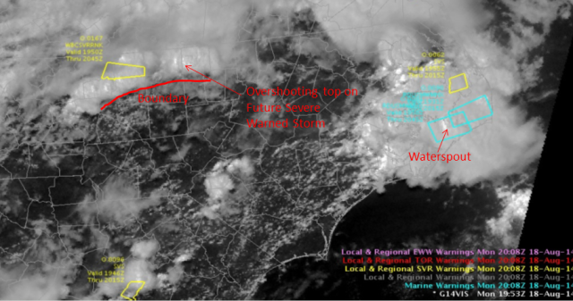
GOES-14: Special Rapid Scanning offers glimpse of the ABI
SRSOR (Super Rapid Scan Operations for GOES-R) from GOES-14 imager
More SRSOR data in both May 8-24 and August 14-28 of 2014.
http://cimss.ssec.wisc.edu/goes/srsor2014/GOES-14_SRSOR.html
Many phenomena were observed: convection, hurricanes, fires, smoke, ...
Data was provided to many groups: WPC, OPC, AWC, SPC, SAB, several WFO, who used the data for discussions and forecasts.
NWS Forecaster: SRSOR “….certainly increased our confidence in our warning decisions and ultimately made the process more efficient … having the Super Rapid Scan data very valuable and very worthwhile, … should be able to be built into everyday operations at NWS weather forecast offices around the country.”
GOES-14 Image from CIMMSE blog
http://cimmse.wordpress.com/2014/08/24/an-example-of-how-goes-14-super-rapid-scan-operations-for-goes-r-helped-during-warning-operations-at-nws-wfo-raleigh-nc-on-18-august-2014/
GOES-14 provided very unique information and offers a glimpse into the possibilities that will be provided by the ABI on GOES-R. Data used by the NWS.
Notes:
mp4

Slide 8
GOES-14: Special Rapid Scanning offers glimpse of the ABI
SRSOR (Super Rapid Scan Operations for GOES-R) from GOES-14 imager
More SRSOR data in both May 8-24 and August 14-28 of 2014.
http://cimss.ssec.wisc.edu/goes/srsor2014/GOES-14_SRSOR.html
Many phenomena were observed: convection, hurricanes, fires, smoke, ...
Data was provided to many groups: WPC, OPC, AWC, SPC, SAB, several WFO, who used the data for discussions and forecasts.
Animation of 1-min GOES-14 Imager data on May 16, 2014
http://cimss.ssec.wisc.edu/goes/goes-r/
http://cimss.ssec.wisc.edu/goes/goes-r/600x800_GOES_B1_CLDS_SLC_animated_2014136_130000_182_2014136_230000_182_EB_TSTORM.mp4
GOES-14 SRSOR posts from the CIMSS blog
http://cimss.ssec.wisc.edu/goes/blog/archives/category/goes-14
GOES-14 provided very unique information and offers a glimpse into the possibilities that will be provided by the ABI on GOES-R. Data used by the NWS.
Notes:
http://cimss.ssec.wisc.edu/goes/goes-r/

Slide 9
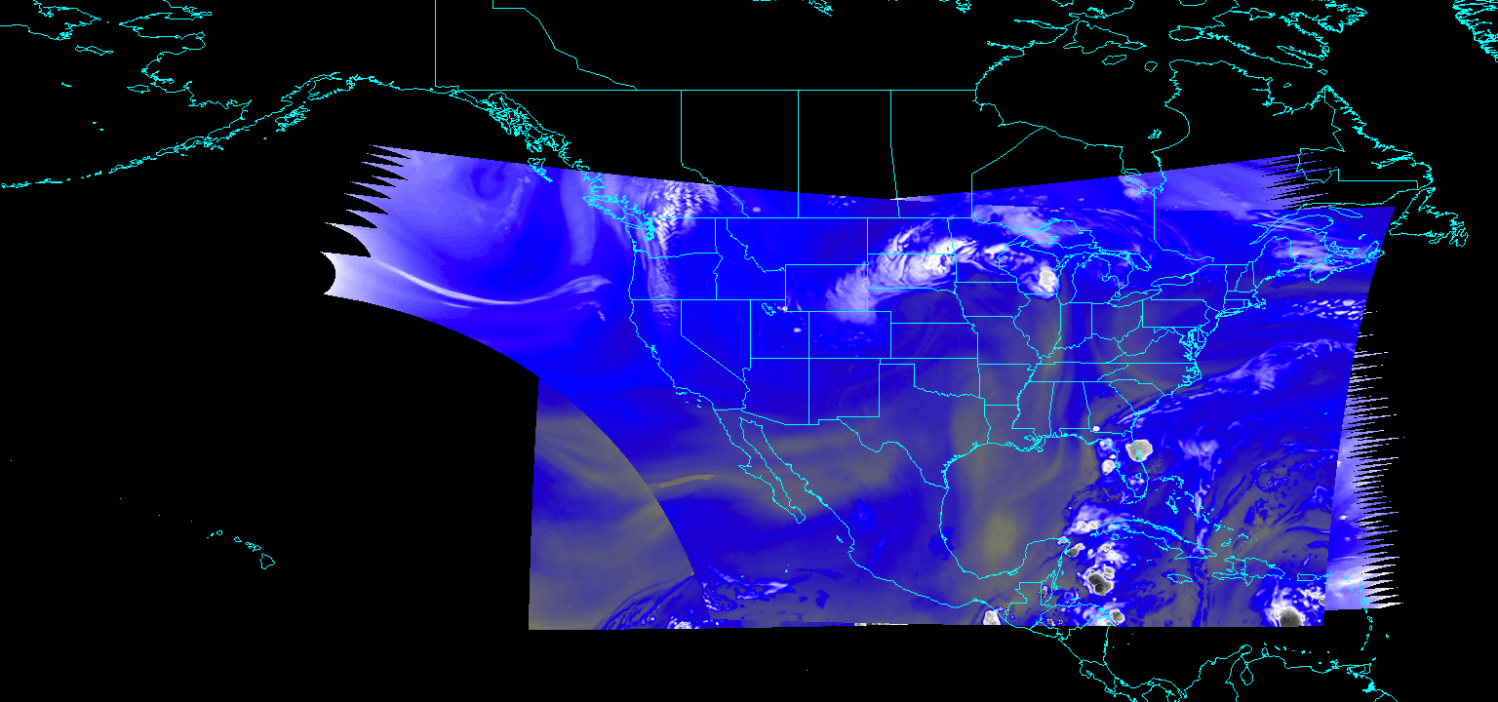
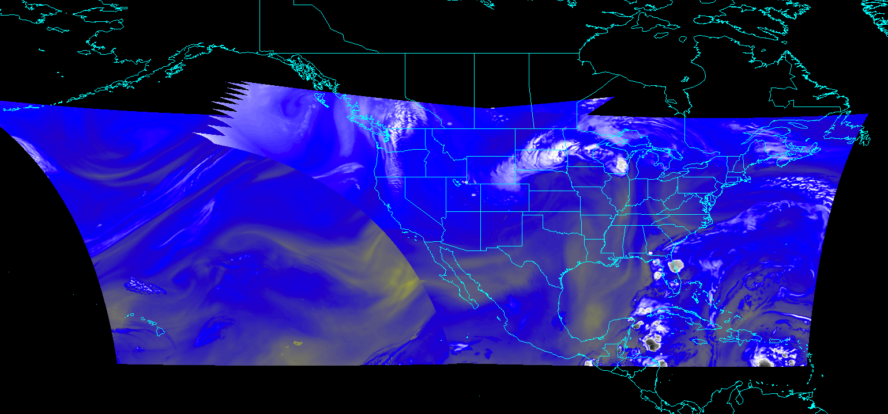
ABI CONUS Sector Locations
Worked with the GOES-R Program Office and the NWS on moving the ABI CONUS center points for both the GOES-East and -West positions to better address operational needs
Current (PUG) sectors for GOES-East and -West
Proposed (NOAT and GORWG-approved)

Slide 10
Exploratory ABI Scan Mode
At some point, other ABI scan mode could be possible. Although, this requires an upgrade to the ground system.
One option is to use the idle time of when the ABI instrument is not scanning in mode 3 (‘flex’). For example, increase to an ‘extended CONUS’ image. There are other optimized scan options as well.
The ABI instrument is capable of supporting other scan modes.

Slide 11
Mode 3 (‘flex’) “Time-Time” chart
This chart represents what the ABI scans when (over 15 minutes), i.e., FD, CONUS, Meso-scale sectors or star views (for navigation) and calibration events.
Approximate times
Notes:
Copy and pasted from excel. Pasted as a picture. Resized to 44% by 44% of original. Arrange -> Align -> Align Center & Align Middle

Slide 12
Proposed Mode ”3a” with Extended CONUS
Note larger (taller and wider) CONUS scans, while keeping full disk and meso-scale scans
The ‘special’ sector could be over American Samoa, volcanoes, or other areas (TC).
Approximate times
Notes:
Copy and pasted from excel. Pasted as a picture. Resized to 44% by 44% of original. Arrange -> Align -> Align Center & Align Middle

Slide 13
Baseline Time-Time Mode 4
This is the Continuous Full Disk (every 5 min) mode ‘time-time’ chart.
This is the highest data rate.

Slide 14

Exploratory ABI Scan Strategies
There are some alternative ABI scan strategies to baseline modes (3 and 4)
One extended “CONUS” sector
every 5 minutes
Option
A
&
Every 15 minutes
One mesoscale sector
every 30 seconds
(or 1 minute at two locations)
&
One wider “CONUS” sector
in 6 minute gaps
CONUS covered every 3 minute!
Every 3 minutes
(with 6 min gap)
&
Option
B
Every 15 minutes
&
One mesoscale sector
every 30 seconds
(or 1 minute at two locations)
Notes:
Scan areas and timing are approximate. Option B has special southern hemisphere scans.

Slide 15
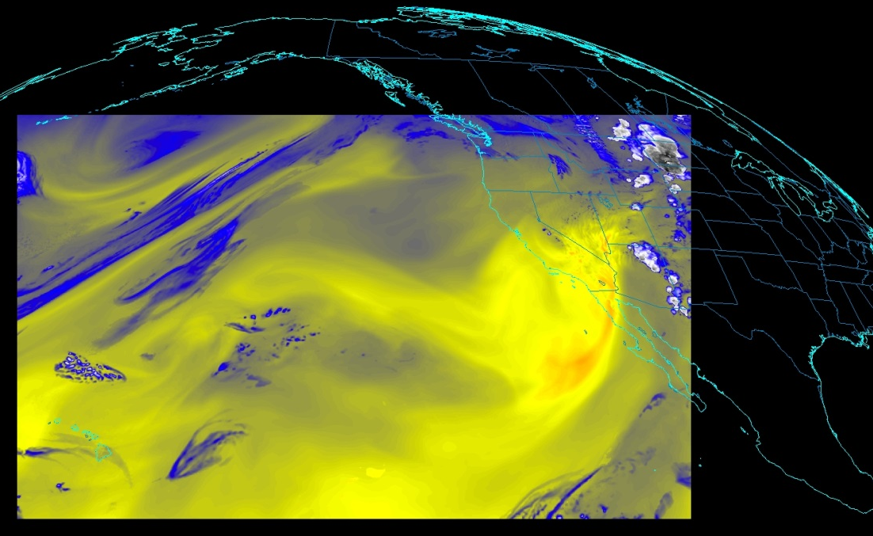
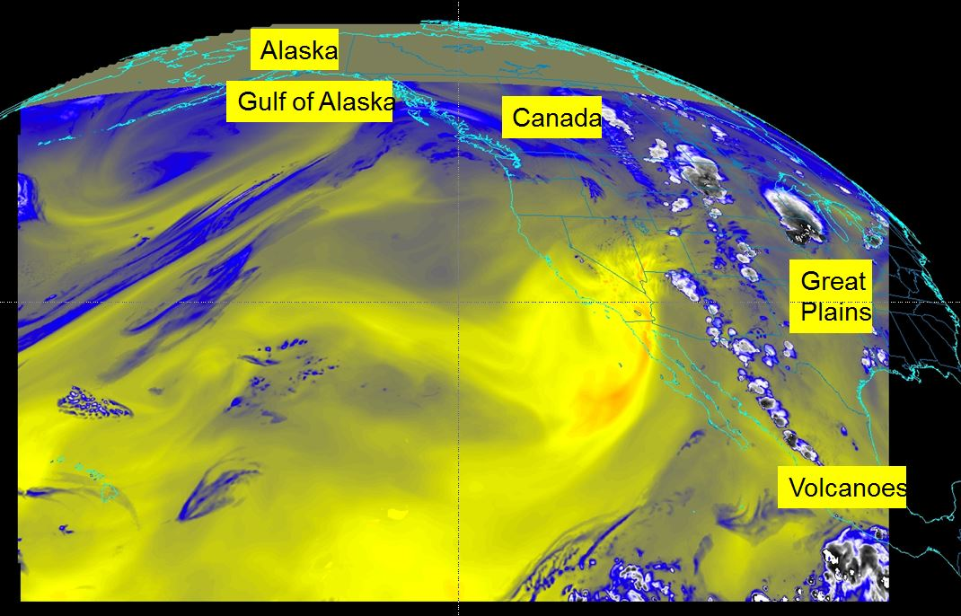
ABI CONUS Sector Size
Working on extending the ABI CONUS size to better address operational needs (and use time when the ABI instrument would be idle)
This would need a ground system upgrade
Other scan modes are being explored
Current CONUS Sector for ABI
Proposed CONUS Sector for ABI

Slide 16

CONUS from 137W

Slide 17
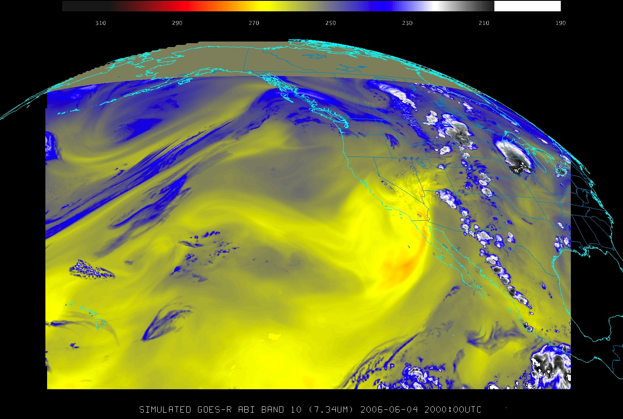
Alaska
Gulf of Alaska
Canada
Great
Plains
Volcanoes
Proposed Extended ‘CONUS’ from 137W
Notes:
The northern region, including Alaska, was not covered in this simulation, but would be covered by this extended ‘CONUS’.

Slide 18
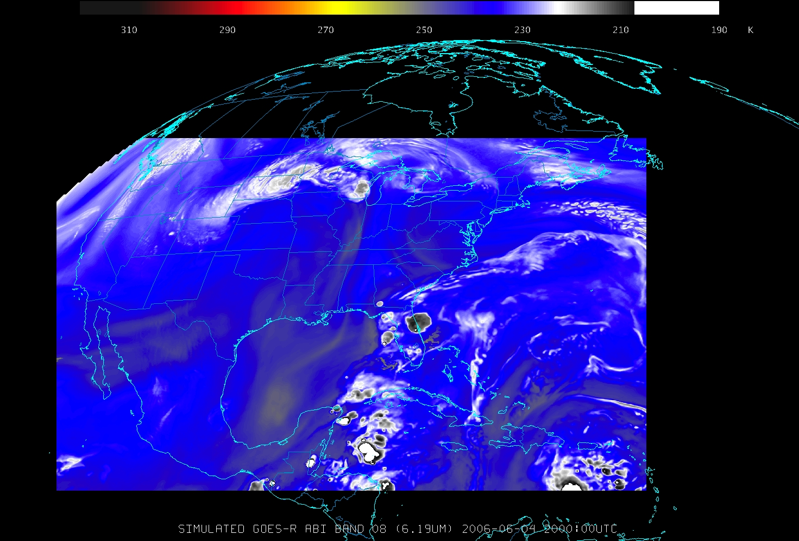
CONUS from 75W

Slide 19
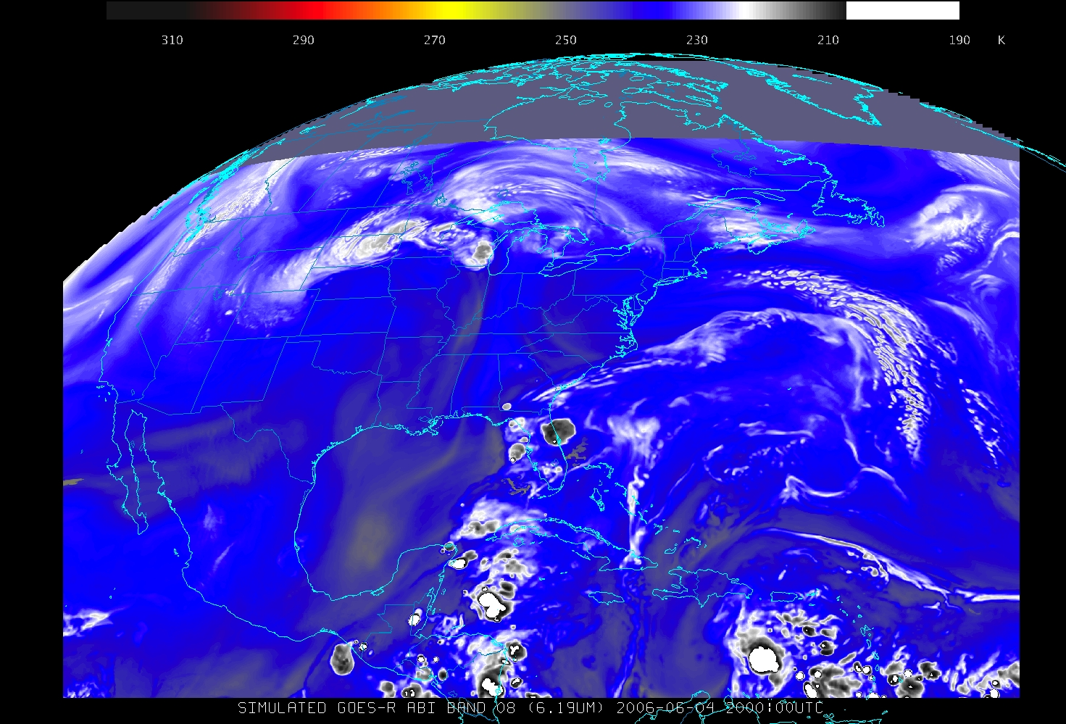
Canada
Atlantic
Atlantic
Volcanoes
Proposed Extended ‘CONUS’ from 75W
Notes:
The northern region, including Canada, was not covered in this simulation, but would be covered by this extended ‘CONUS’.

Slide 20
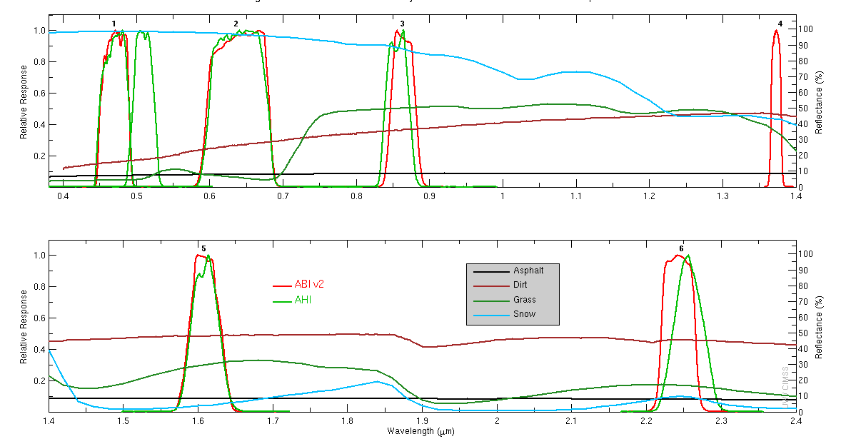
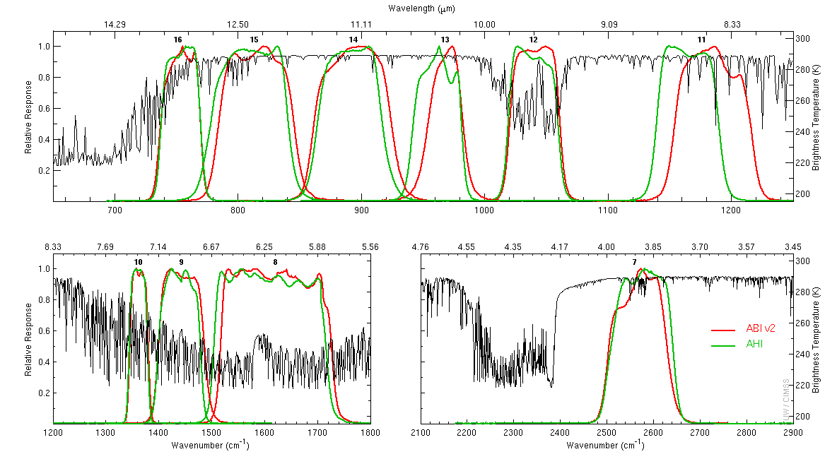
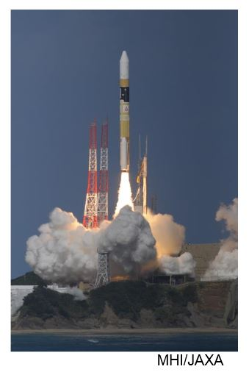
Himawari launched!
Himawari-8 launched!
7 October 2014
16-band Advanced Himawari Imager (AHI)
10-min Full Disk
ABI-like
  15 of the 16 bands
AHI built by Exelis
Visible/near Infrared
Infrared
Notes:
http://www.data.jma.go.jp/mscweb/en/himawari89/

Slide 21
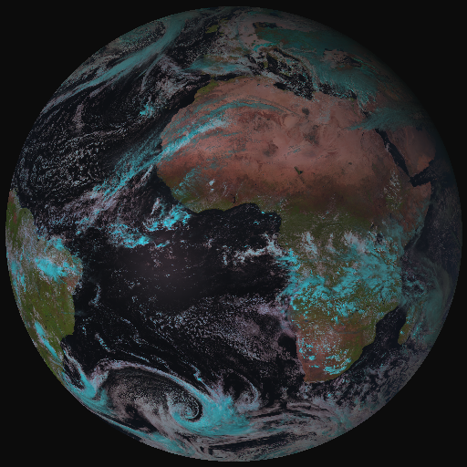
From MSG-SEVIRI to MTG-FCI
MTG FCI outbids MSG SEVIRI observations on cloud, aerosol, moisture and fire:
by adding new channels
by improving temporal-,
spatial-, and radiometric
resolution
a Full-Disk High-Spectral-resolution
Imagery (FDHSI)
High-Resolution Fast Imagery
Coverage Repeat cycle FDHSI mission 18ºx18º 10 min
HRFI mission 1/4 FD 2.5 min
Notes:
Flexible Combined Imager

Slide 22
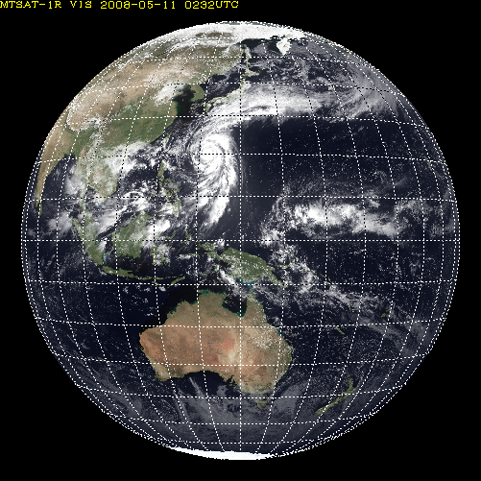
AHI Sectored Observations in 10 minutes
Full disk
Interval : 10 minutes (6 times per hour)
23 swath
Region 1 JAPAN (North-East)
Interval : 2.5 minutes (4 times in 10minutes)
Dimension : EW x NS: 2000 x 1000 km
2 swath
Region 1
N-E JAPAN
Region 2
S-W JAPAN
Region 3
Typhoon
Region 2 JAPAN (South-West)
Interval : 2.5 minutes (4 times in 10minutes)
Dimension : EW x NS: 2000 x 1000 km
2 swath
Region 3 Typhoon
Interval : 2.5 minutes (4 times in 10minutes)
Dimension : EW x NS: 1000 x 1000 km
2 swath
Region 5
Land mark
Region 4
Land mark
Region 4 Land mark
Interval : 0.5 minutes (20 times in 10minutes)
Dimension : EW x NS: 1000 x 500 km
1 swath
Region 5 Land mark
Interval : 0.5 minutes (20 times in 10minutes) Dimension : EW x NS: 1000 x 500 km
1 swath

Slide 23




































































4.3 COMS & GEO-KOMPSAT-2A
resolution 4times upgrade
channel 3times increase
products 3.5 times increase
COMS
Geo-KOMPSAT-2A
COMS
Geo-KOMPSAT-2A
COMS
VIS 1km
IR 4km
Geo-KOMPSAT-2A
VIS 0.5~1km
IR 2km
1
(Black and white)
4
(color image)
Cloud/pre. : 5
Cloud/pre. :19
VIS
Observation frequency 4 times
Aerosol : 5
Aerosol : 16
1hr
2
SW
IR
O
Full disk : 1
Full disk : 4
AMV : 3
AMV : 6
4
10
NH : 2
NH : 10
IR
Land sfc. : 3
Land sfc. : 11
…....
KP : every 15min
KP : every 2min
5 channel
16 channel
Total : 16
Total : 52

Slide 24
Beyond GOES-R Series
Discussions have began investigating options related to GOES-V and –W
NWS, NESDIS and the GPO, along with others are involved
Some have suggested evolving the ABI capabilities and adding back instruments cancelled on GOES-R
  high spectral sounder
  coastal water imager
GOES-V (currently) slated for operational use beginning in 2033

Slide 25


