Slide 1

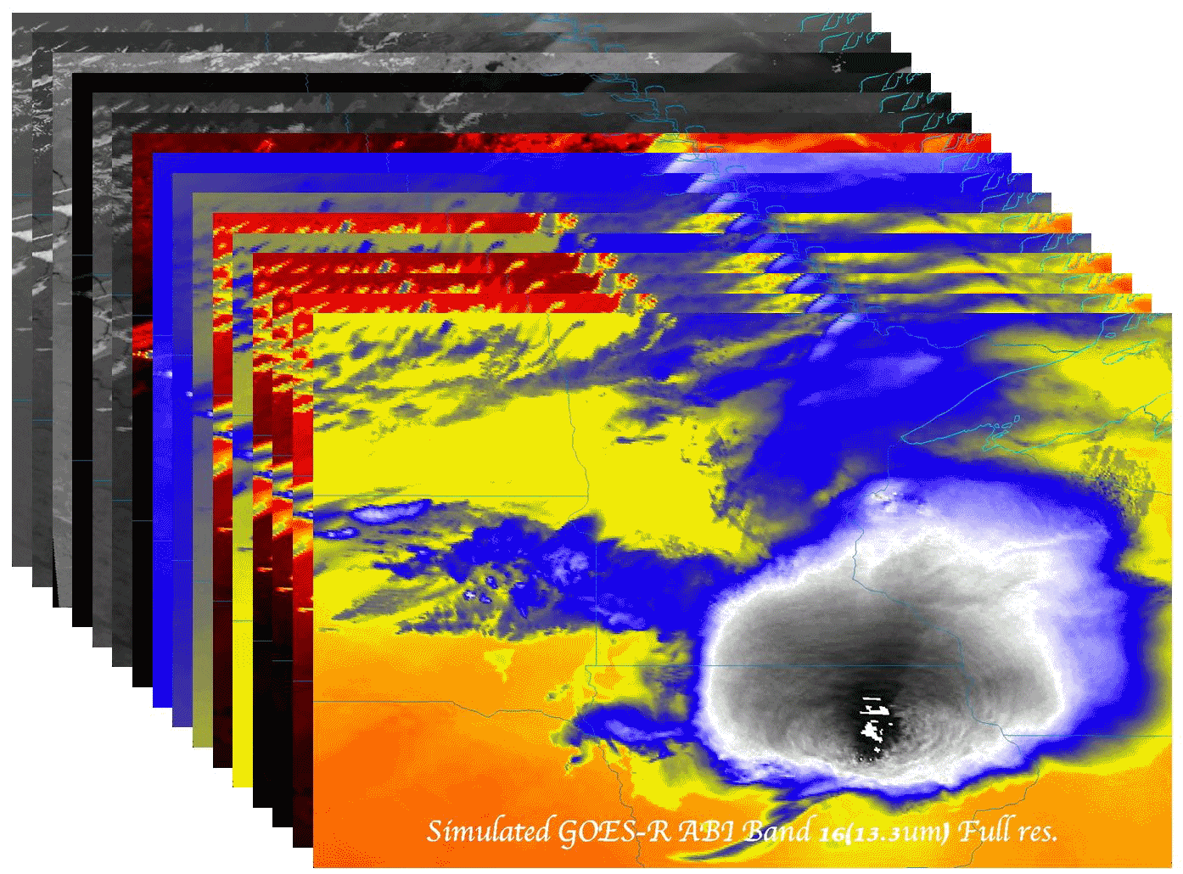

Government employment opportunities
  Timothy J. Schmit (tim.j.schmit@noaa.gov)
DoC/NOAA/NESDIS/Satellite Applications and Research (STAR)
Advanced Satellite Products Branch (ASPB)
Madison, WI
NWA Annual Meeting
Student Session
October 7, 2012
Madison, WI

Slide 2
Outline
Introduction
The ‘graying’ of the
workforce
Options
Logistics
“Tips” and Links
Questions

Slide 3
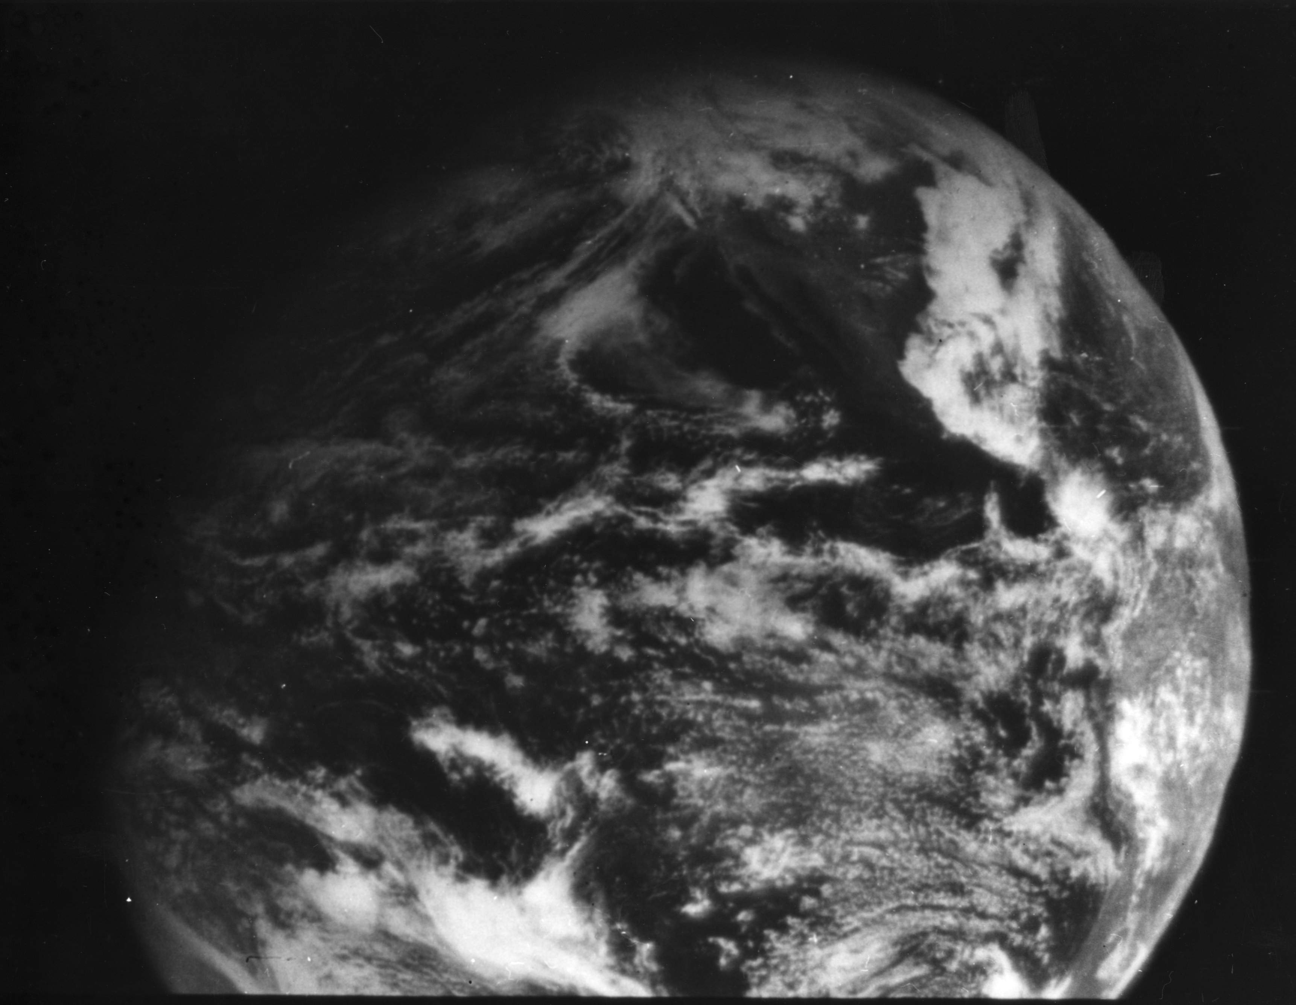
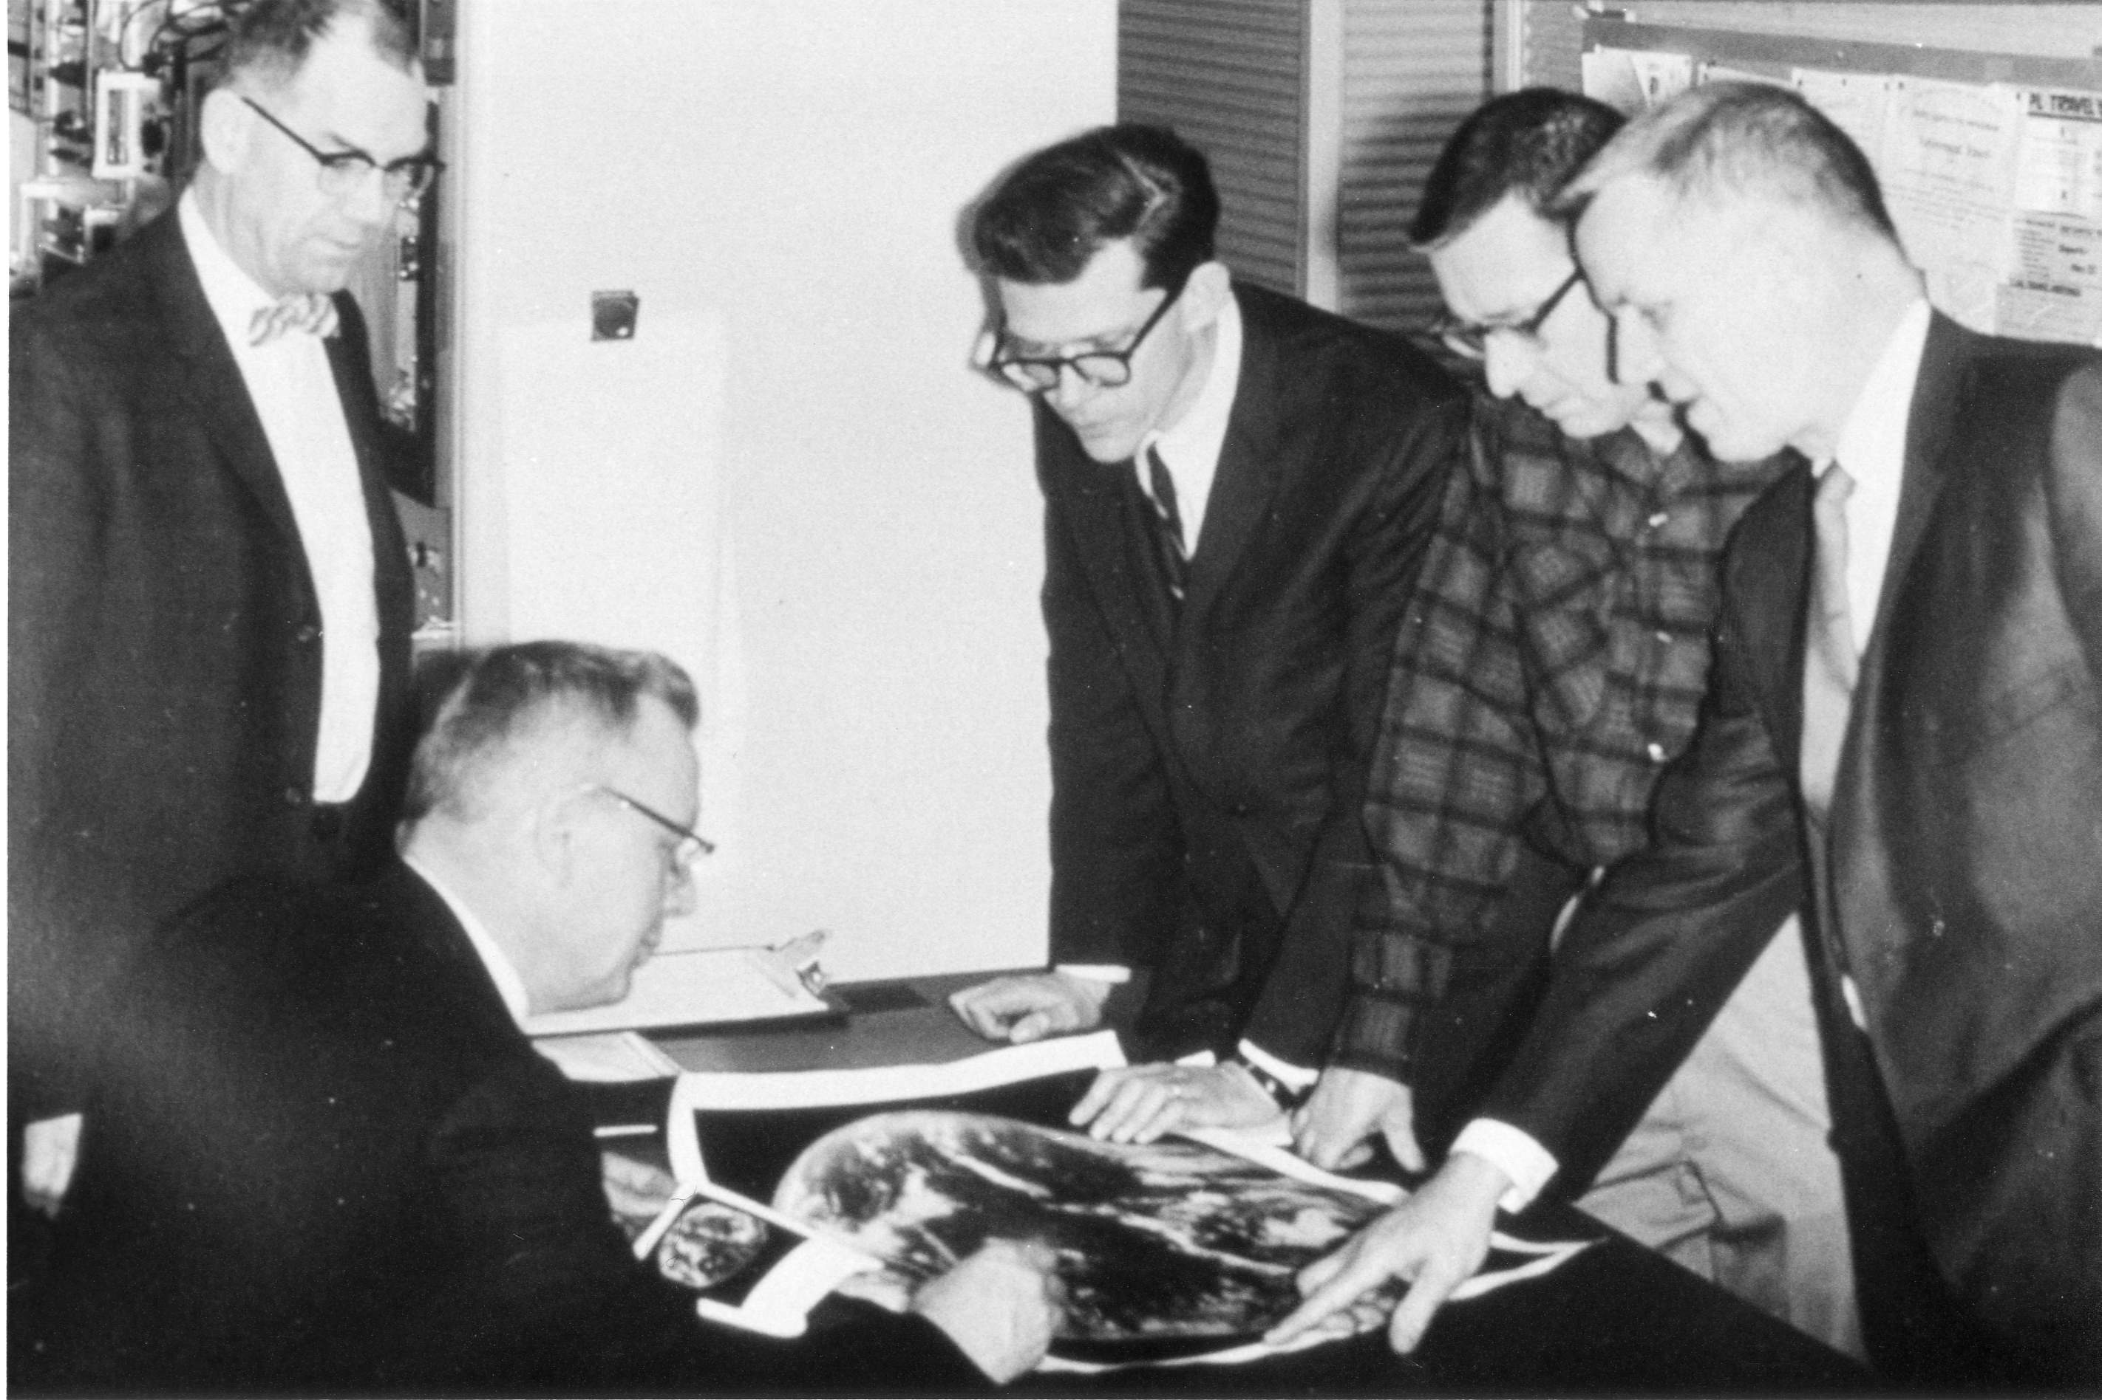
1966: ATS-1 launched
Applications Technology Satellite (ATS)-1 was the first geostationary imager, launched 6 December 1966. Imaging instrument designer and SSEC (Madison, WI) co-founder, Verner E. Suomi, proclaimed, “the clouds move, not the earth”.
11 December 1966
Notes:
http://cimss.ssec.wisc.edu/news/geo_image_anniversary.html

Slide 4
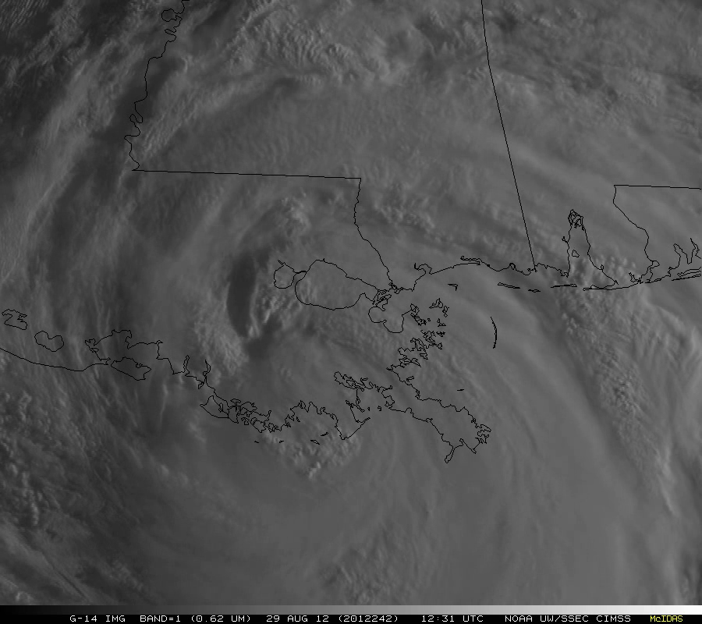
Click to animate
Notes:
http://cimss.ssec.wisc.edu/goes/srsor/GOES-14_SRSOR.html

Slide 5
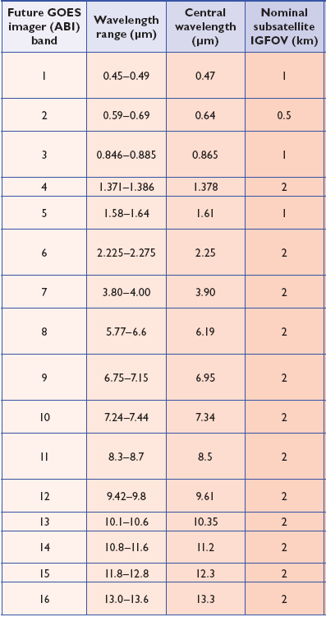
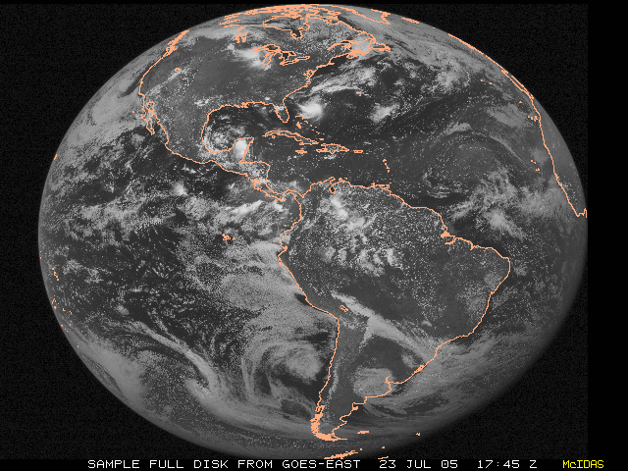
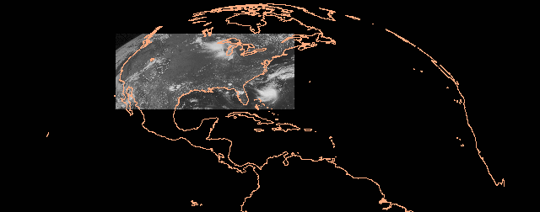
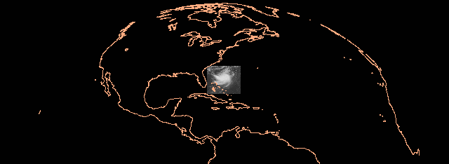
ABI Spectral Bands
ABI Scans (in 30 min)
Full Disk (2X)
CONUS (6X)
Mesoscale (60X)
The next generation geostationary imager offers more bands, more often
Notes:
In 30 min of “rapid” scan. Of course the spatial and spectral attributes are improved as well. Slide from T. Schmit, STAR. Table from Schmit et al, 2005.

Slide 6
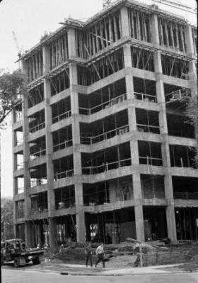
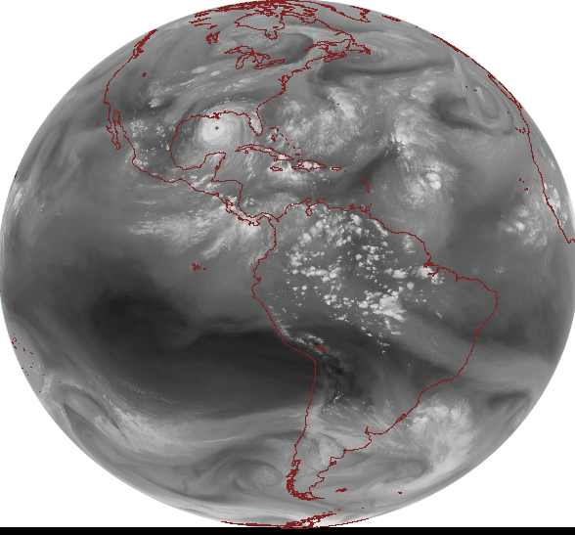
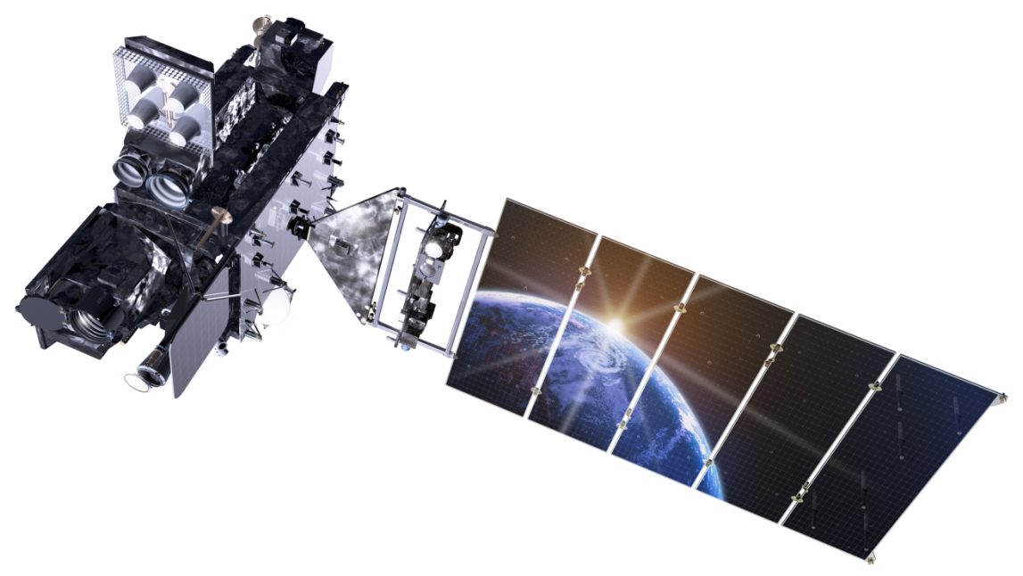
Outline
Introduction
The ‘graying’ of the
workforce
Options
Logistics
“Tips” and Links
Questions
Lockheed Martin

Slide 7
STAR WORKFORCE
Age Distribution
Approximately 40% of STAR’s workforce retired in the last 5 years
40% of STAR’s workforce MAY RETIRE in the next 5 years
7
Notes:
From Al Powell, STAR director.

Slide 8
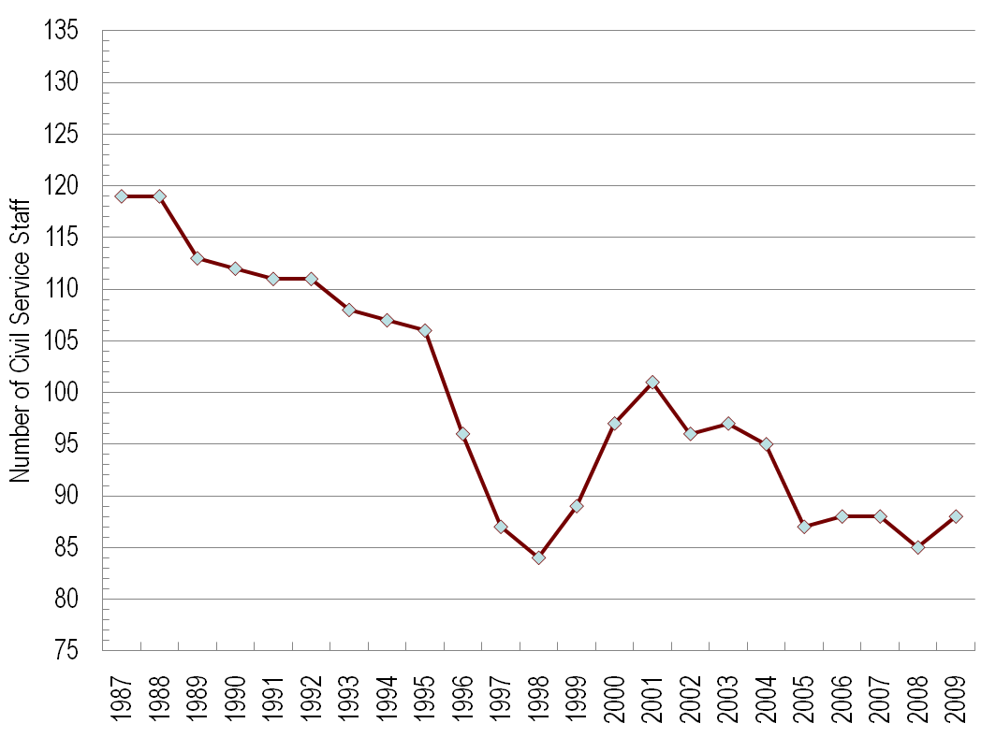
STAR FACTS
Civil Servant Staffing
Available 1987 FTE positions: 140
YEAR:
STAR workforce planning is essential to maintain a viable science office
8
Notes:
From Al Powell, STAR director.
8

Slide 9
STAR WORKFORCE
NUMBER OF RECENT HIRES
  2005 11 hires
  2006 12 hires
  2007 8 hires
  2008 5 hires
  2009 6 hires
  Total: 42
Turnover of STAR workforce will impact future readiness
9
Notes:
From Al Powell, STAR director.

Slide 10
Outline
Introduction
The ‘graying’ of the
workforce
Options
Logistics
“Tips” and Links
Questions
Lockheed Martin

Slide 11
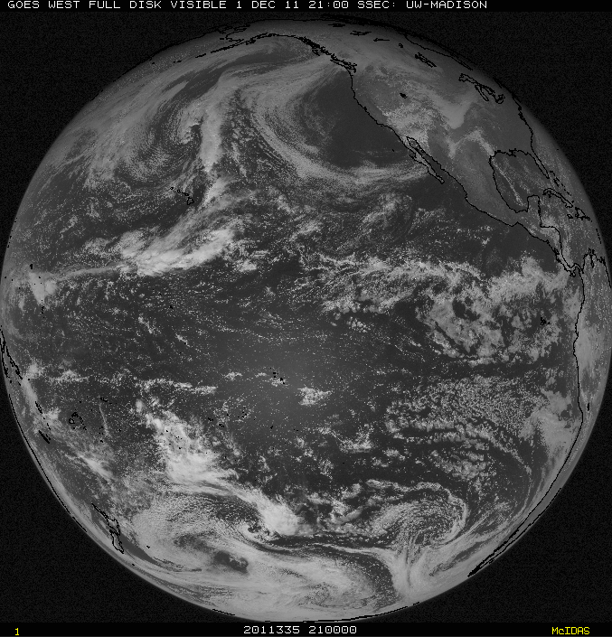
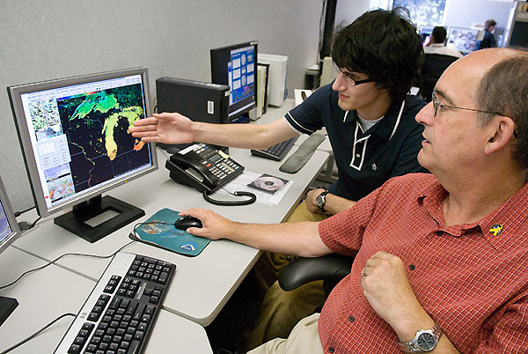
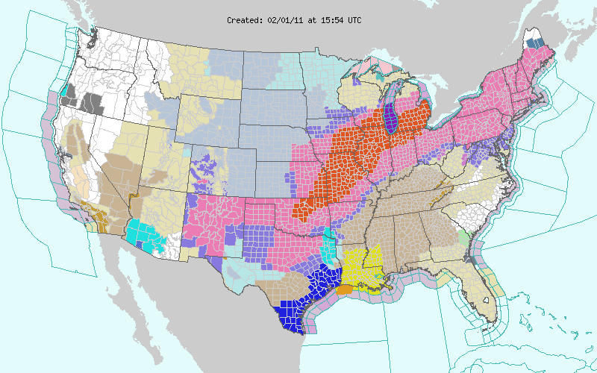

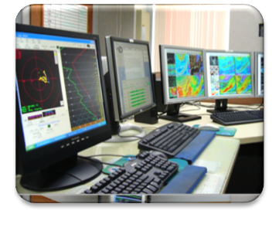
Four Pillars of NOAA
People
Critical
Environmental Intelligence
Observations
Computation & Modeling
Research
People are key for each pillar!
Notes:
Slide modified from Laura Furgione, NWS
Ppt: ‘crop to shape’ and ‘picture effects, bevel, soft round’
NOAA=Critical Environmental Intelligence
Our Nation's environmental predictive capabilities are supported by four foundational pillars: observations, computer models, research, and our people, who provide forecasts, warnings, and decision assistance to key decision makers.
By strengthening the pillars – through improved satellite and in-situ observations, computational capacity, and coupled atmosphere, ocean, land models, and necessary research – we can revolutionize the forecast process across the entire spectrum, from relatively small-scale, short range applications to long range weather and climate predictions.
From a physical science perspective, NOAA continues to make strides and achieve success with its uptake, responsiveness, technological advances, etc.
11

Slide 12
Options
NOAA/NWS or NOAA/NESDIS
DOE or DOI or EPA or FAA or NASA
DoD (Airforce, Navy, etc.)
“Government-support”
  NOAA Cooperative Institutes, etc.
  Contractors

Slide 13
Details
NOAA/NWS: operational forecasters, modelers (NCEP), hydrologist, NHC, HPC, OPC, AWC, SPC, etc.
NOAA/NESDIS: Satellite algorithm/product development and research; satellite operator, volcanic ash advisory, synoptic analysis, etc.
NOAA/NESDIS/OAR: research, surface observing, etc.

Slide 14
Details
NASA: satellite products, research, etc.
DOE (Energy): solar, etc.
DOI (Interior): wildfires, etc.
EPA: air quality, etc.
DOA (Agriculture): researcher, etc.
FAA: 4-d data cube, hazards to aviation
DoD (Airforce, Navy, etc.)
  Operational forecasts
  Modelers
  Etc.

Slide 15
Details
“Government-support”
  NOAA Cooperative Institutes, UCAR, etc.
  http://www.nrc.noaa.gov/ci/locations/index.html
  Research on many topics
  Contractors
  http://www.corpblogspot.org/
  Full range of support from operations to IT to research
  http://www2.ucar.edu/opportunities

Slide 16
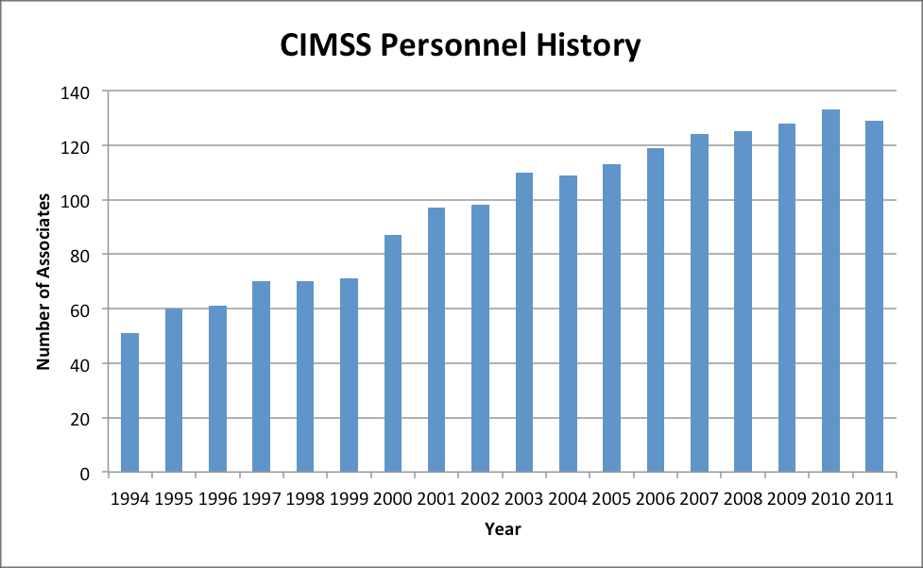
CIMSS Personnel (now 136)
Notes:
From Steve Ackerman, CIMSS Director.

Slide 17
Outline
Introduction
The ‘graying’ of the
workforce
Options
Logistics
“Tips” and Links
Questions
Lockheed Martin

Slide 18
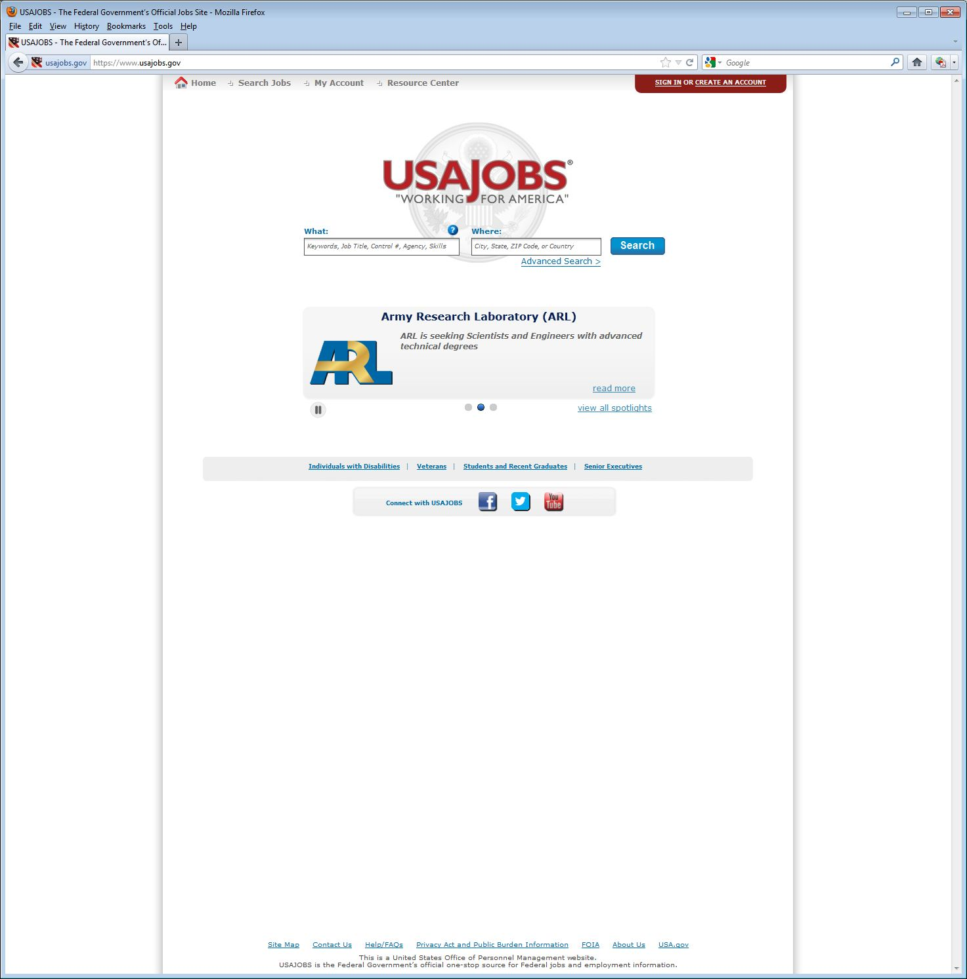
https://www.usajobs.gov/

Slide 19
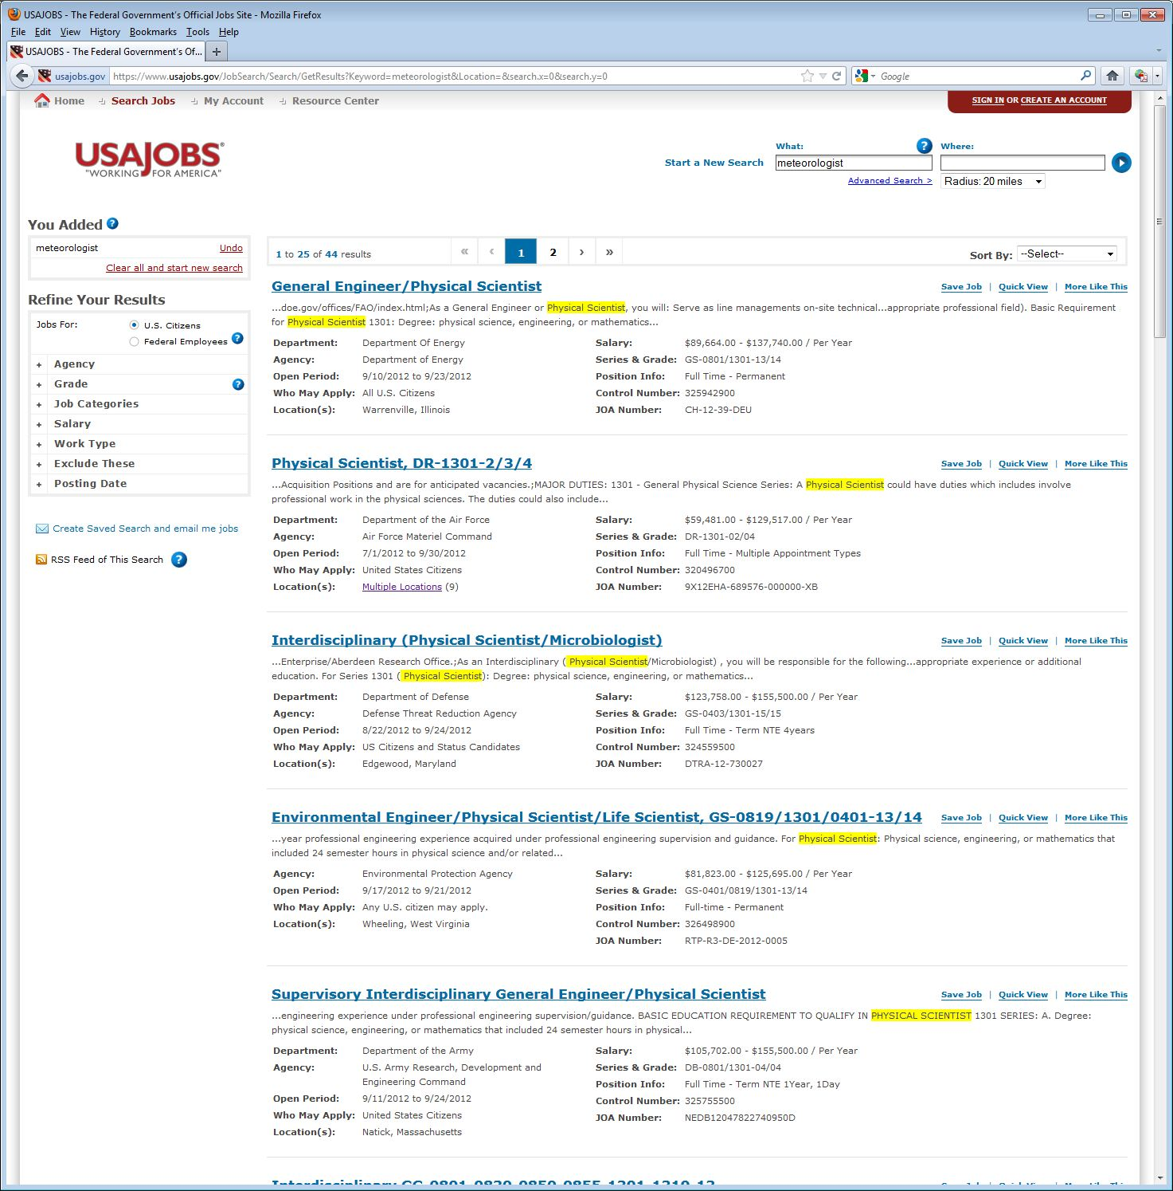

Slide 20
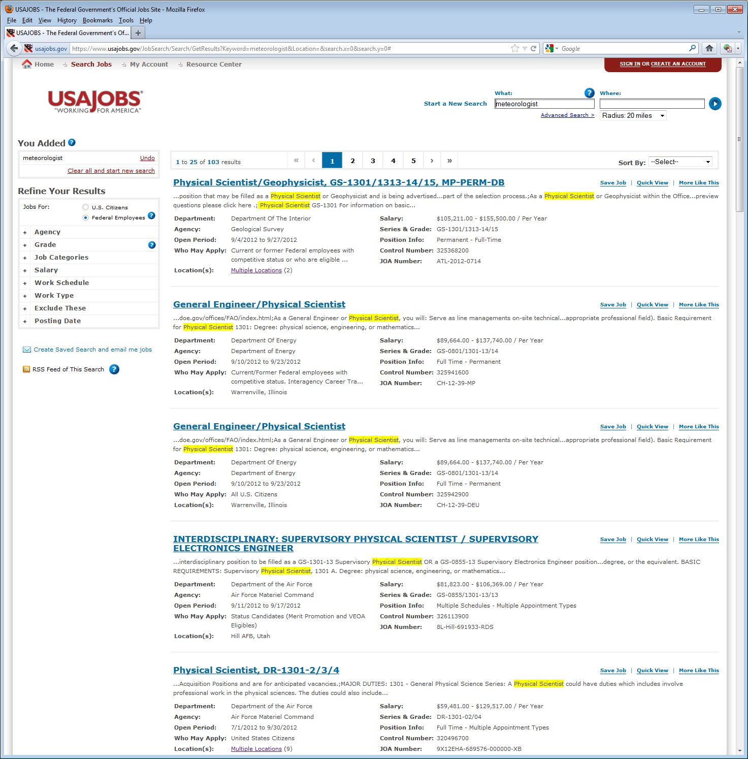

Slide 21
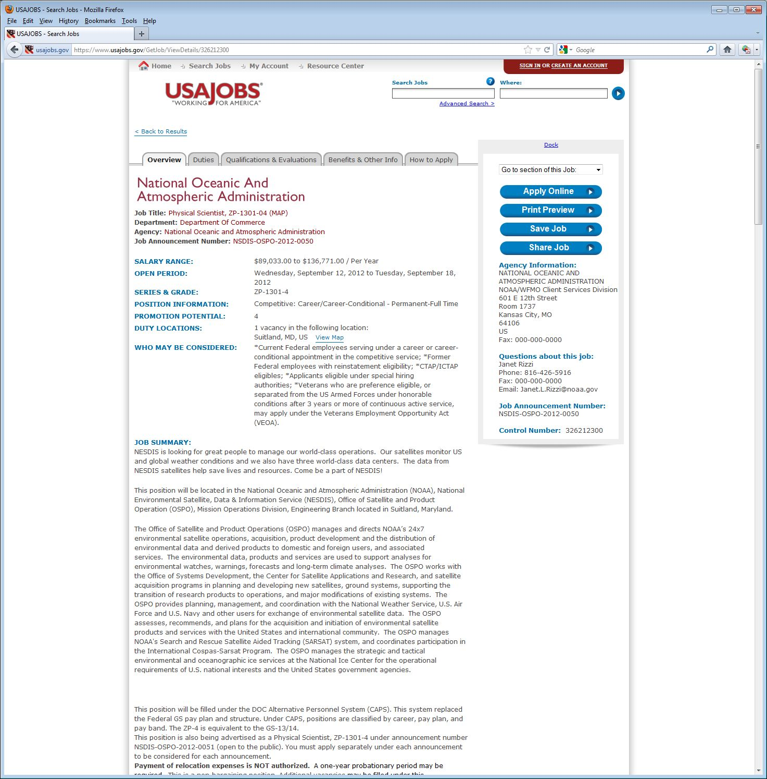
Watch close dates.
Notes:
https://www.usajobs.gov/GetJob/ViewDetails/326212300

Slide 22
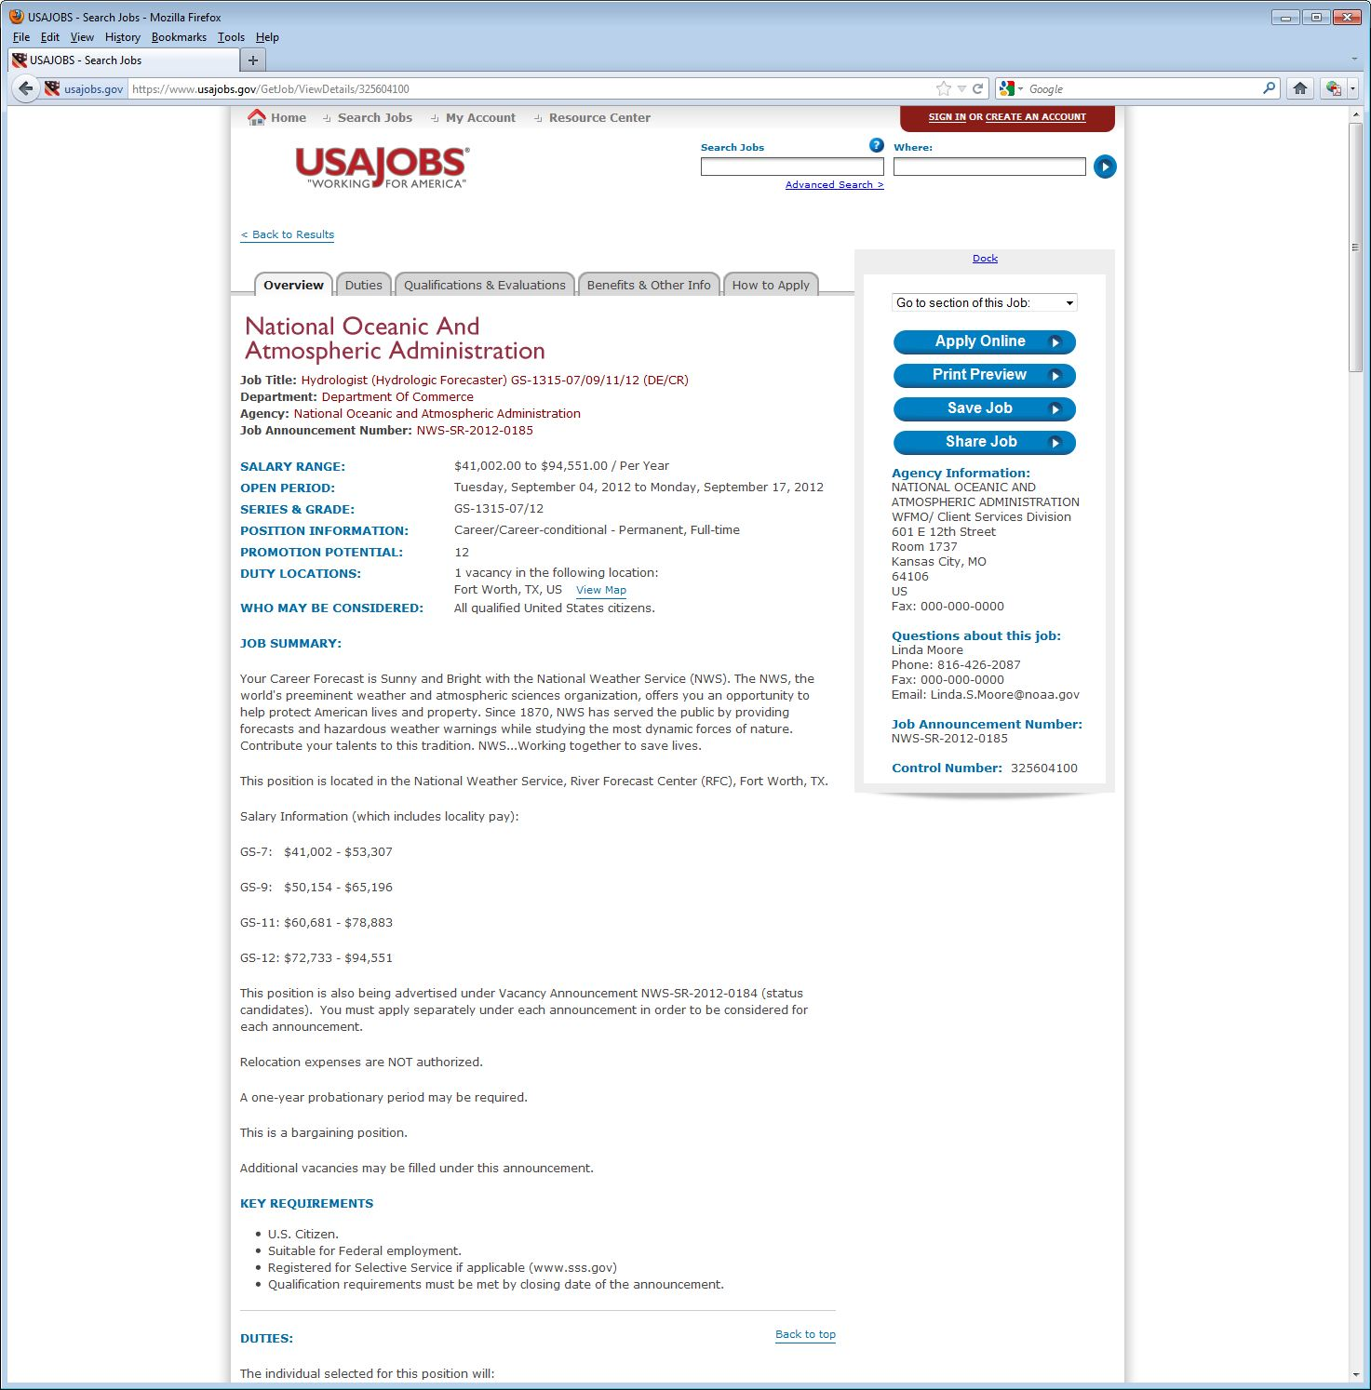

Slide 23
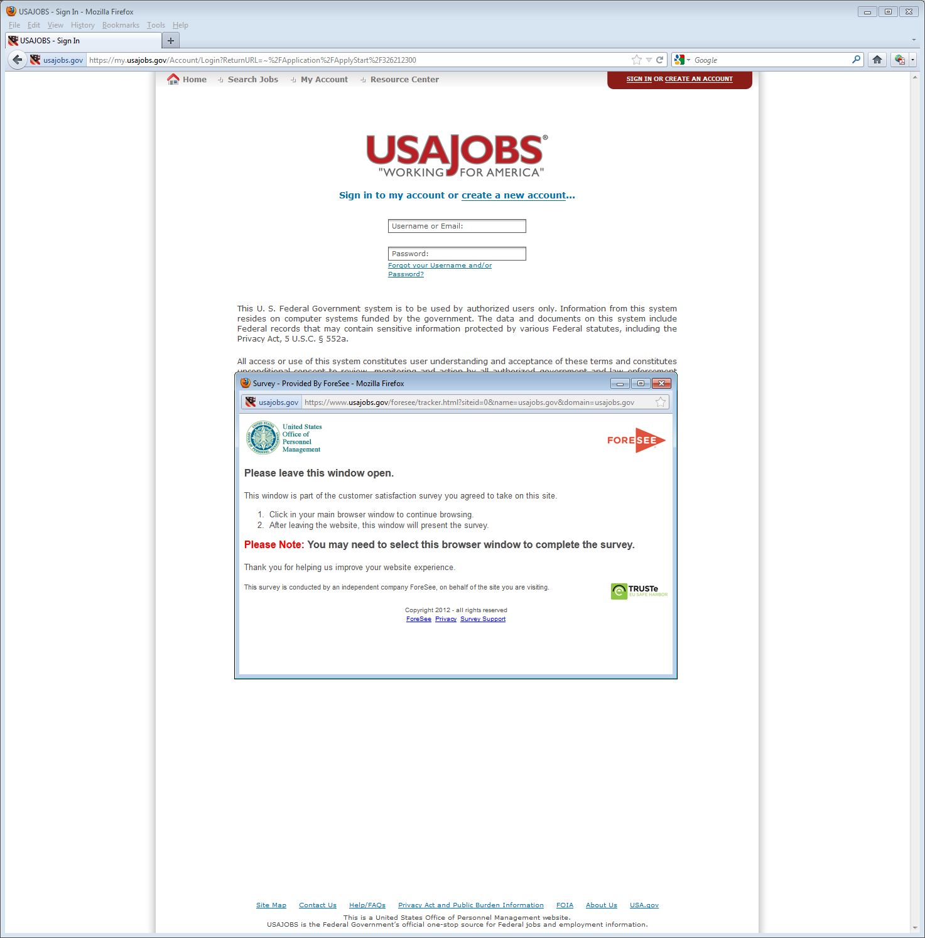

Slide 24
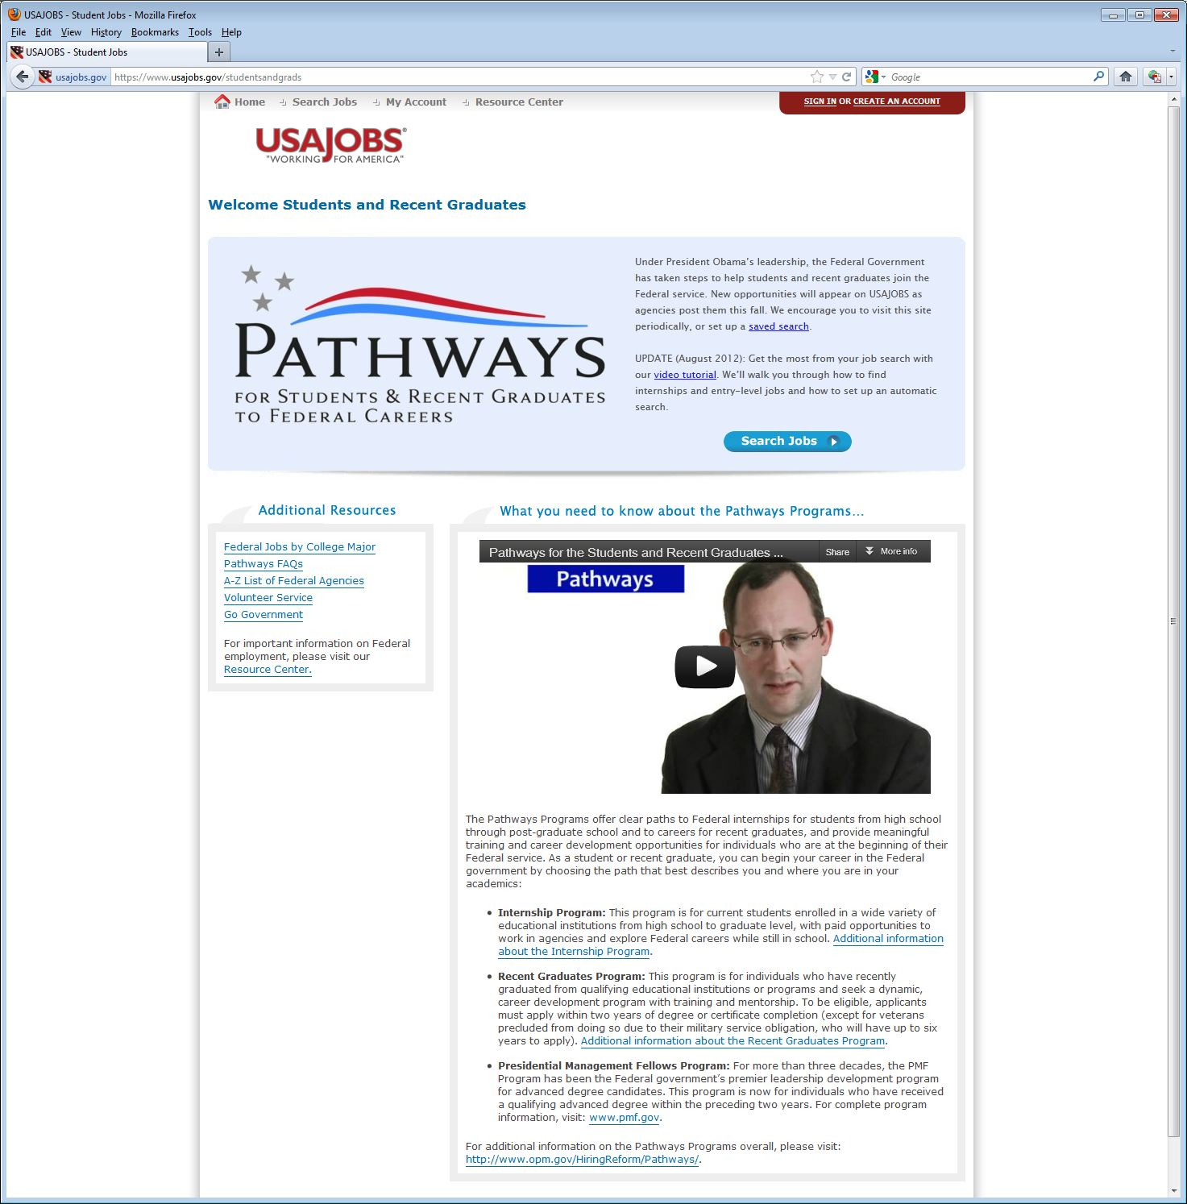
https://www.usajobs.gov/studentsandgrads

Slide 25
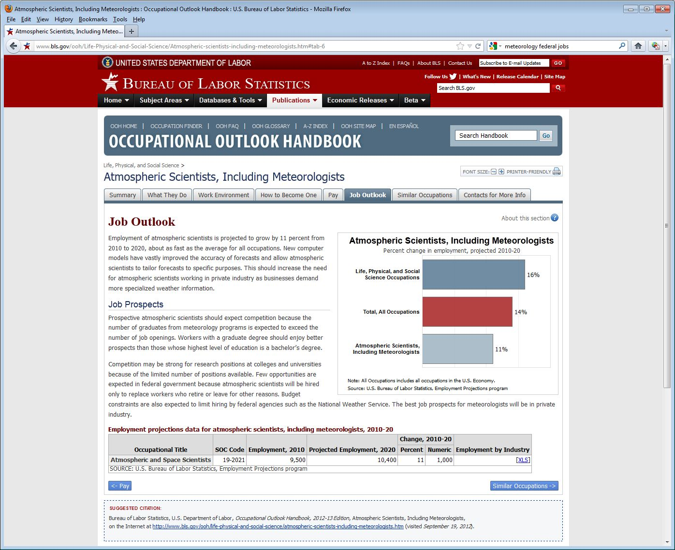
US Bureau of Labor Statistics: http://www.bls.gov/ooh/Life-Physical-and-Social-Science/Atmospheric-scientists-including-meteorologists.htm#tab-6
Atmospheric scientists…projected to grow by 11%...

Slide 26
US Bureau of Labor Statistics:
Prospective atmospheric scientists should expect competition because the number of graduates from meteorology programs is expected to exceed the number of job openings.
Workers with a graduate degree should enjoy better prospects than those whose highest level of education is a bachelor’s degree.
Competition may be strong for research positions at colleges and universities because of the limited number of positions available.
Few opportunities are expected in federal government because atmospheric scientists will be hired only to replace workers who retire or leave for other reasons.
The best job prospects for meteorologists will be in private industry.

Slide 27
Outline
Introduction
The ‘graying’ of the
workforce
Options
Logistics
“Tips” and Links
Questions
Lockheed Martin

Slide 28
“Tips”
Gain experience to stand apart from others
  Take more courses than required
  Consider getting a minor
  Get a masters degree
  Computer skills (programming, web, etc.)
  Consider for internships, coops, Student Career Experience Program (SCEP), etc.
  Business / management courses
Notes:
Thanks to Tom Renkevens for some of these ideas.

Slide 29
“Tips”
"You can't teach enthusiasm!“
Do your homework about the agency/group
Be flexible wrt location, other options await
Join profession groups (NWA, AMS, etc.)
“You only need one job”
Don’t be shy – advertise yourself
Get involved, network (+ social media)
Investigate ‘government-support’ positions, such as at NOAA Cooperative Institutes

Slide 30
Select Links
https://www.usajobs.gov/
http://www.careers.noaa.gov/special_programs.html
http://www.theweatherprediction.com/jobs/
http://www.navy.com/careers.html
http://www.airforce.com/careers/
http://jobs.faa.gov/
http://www.bls.gov/ooh/Life-Physical-and-Social-Science/Atmospheric-scientists-including-meteorologists.htm
http://www.nwas.org/jobs.php (member portal)

Slide 31
Outline
Introduction
The ‘graying’ of the
workforce
Options
Logistics
“Tips” and Links
Questions

Slide 32
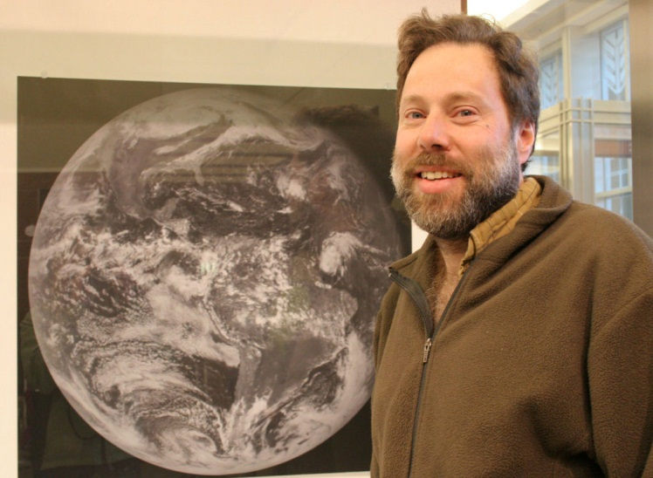
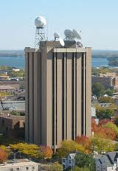
Questions?

