Slide 1
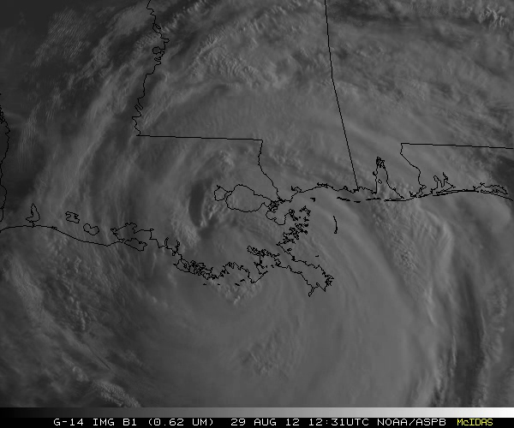
GOES-14: Special Rapid Scanning offers glimpse of the ABI
SRSOR (Super Rapid Scan Operations for GOES-R) from GOES-14 imager while it was out of storage.
Decided on daily location for scanning between mid-August and mid-September, 2012
Posting many animations
http://cimss.ssec.wisc.edu/goes/srsor/GOES-14_SRSOR.html
Many phenomena were observed: convection, hurricanes, fires, smoke, etc.,
Data to many groups HPC, OPC, AWC, SPC, etc.
Animation from GOES-14 Imager water at 1-min time resolution.
GOES-14 provided unique information and offers a glimpse into the possibilities that will be provided at even higher resolutions by the ABI on GOES-R.
Notes:
http://cimss.ssec.wisc.edu/goes/srsor/GOES-14_SRSOR.html

Slide 2
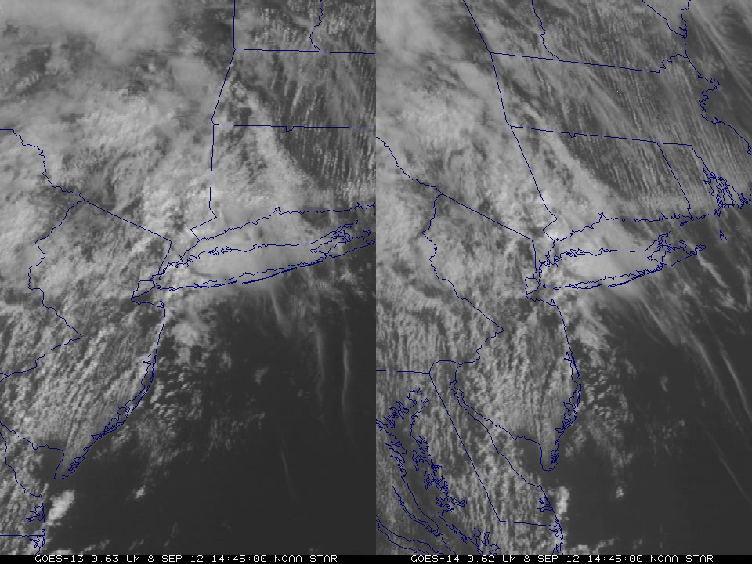
1-min imagery
Operational (GOES-13)
1-min mode (SRSOR from GOES-14)
Notes:
More info at: http://cimss.ssec.wisc.edu/goes/srsor/GOES-14_SRSOR.html
Or
http://cimss.ssec.wisc.edu/goes/blog/archives/11291

