Slide 1
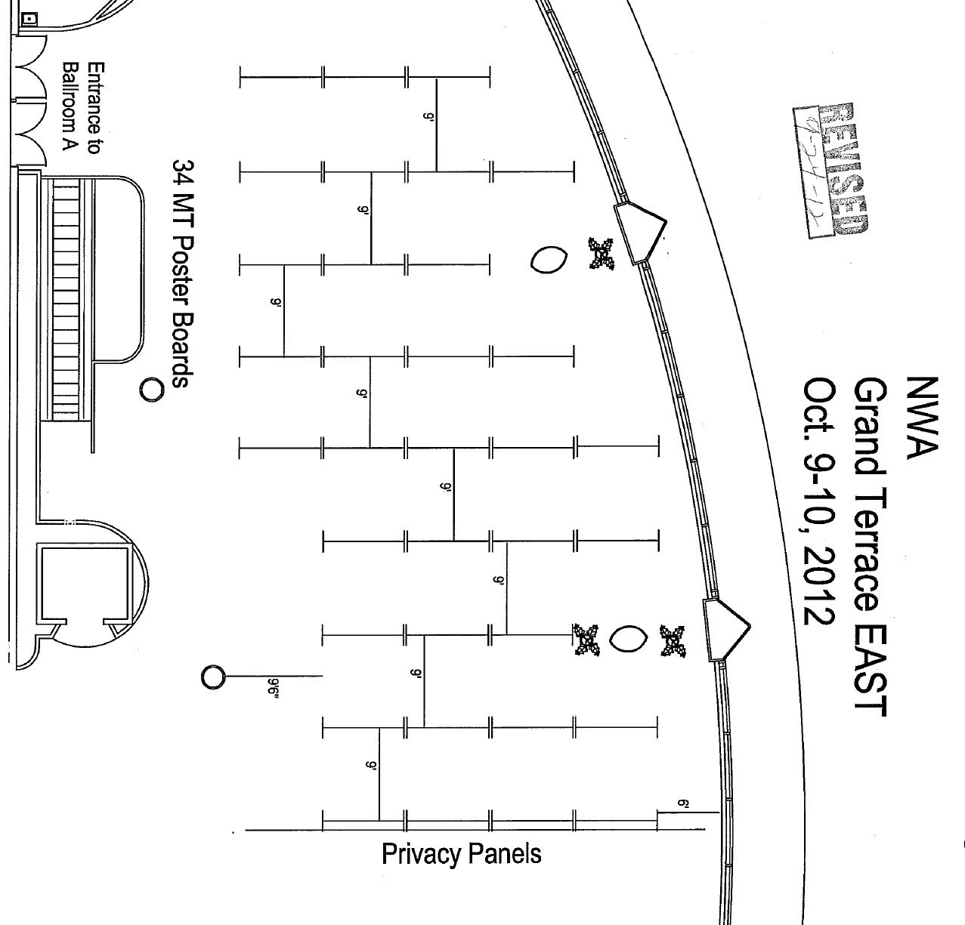
41
31
Sat
51
59
67
68
16
24
32
40
43
48
52
58
70
8
30
60
66
1
7
9
15
17
22
25
29
33
47
53
56
61
65
P0
39
44
2
5
10
14
38
18
21
46
54
55
63
64
Sat
26
28
34
45
3
4
11
13
19
20
Sat
35
36
27
Poster Session 2

Slide 2
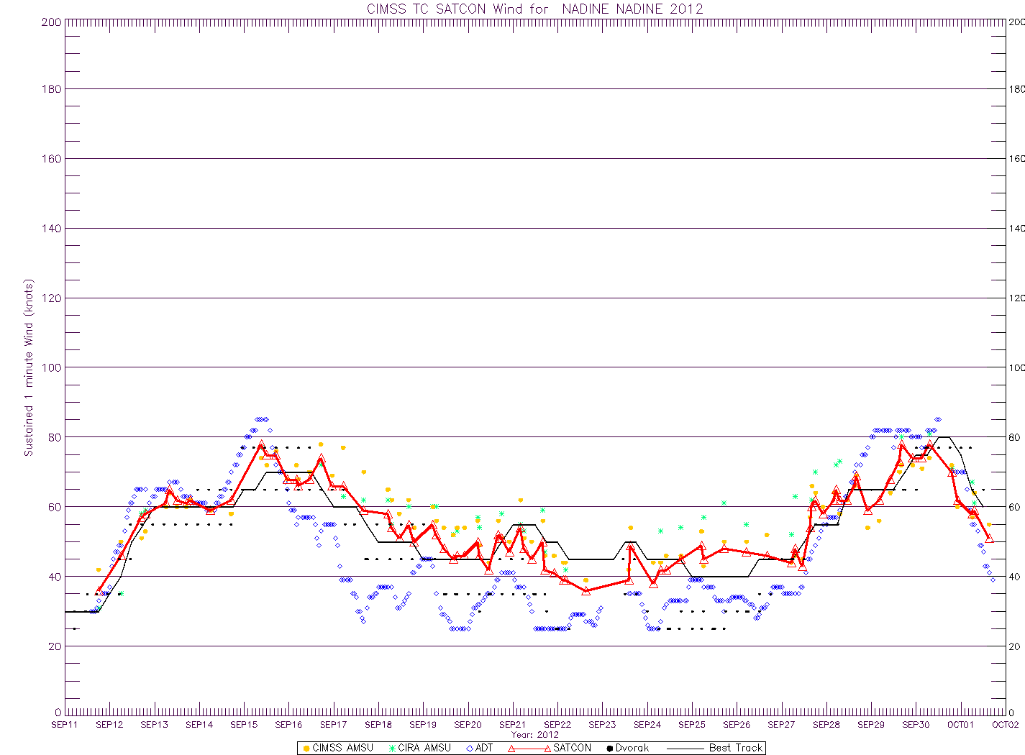
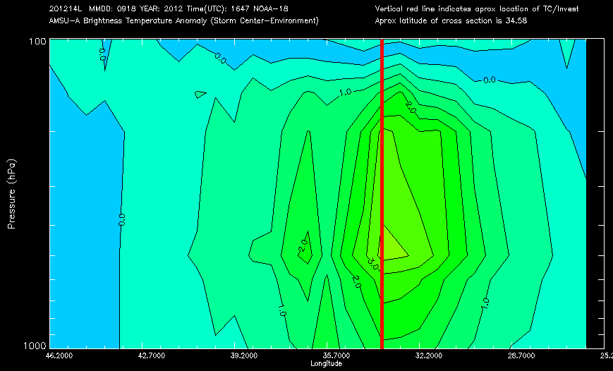
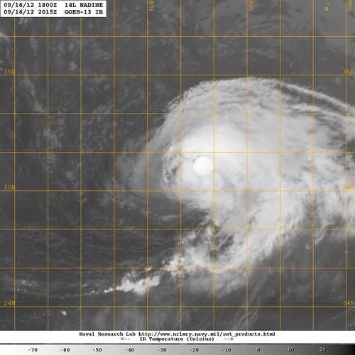
CIMSS SATellite CONsensus (SATCON) Algorithm for Estimating the Intensity of Tropical Cyclones
Derrick Herndon and Chris Velden (Univ of Wisc CIMSS)
Jeff Hawkins (Naval Research Lab Monterey, CA)
95 % of all TC intensity estimates
come from satellite imagery
Objective methods used for
estimating TC intensity vary in
skill based on imagery type, TC
structure and TC/satellite
geometry
SATCON produces a weighted
consensus estimate by combining
objective intensity estimates from
multi-spectral imagery
Accurate assessment of current
intensity improves forecasts and
historical intensity data.
53-55 GHz
Infrared
85 -91 GHz
SATCON for Hurricane Nadine 2012
P2.2

Slide 3
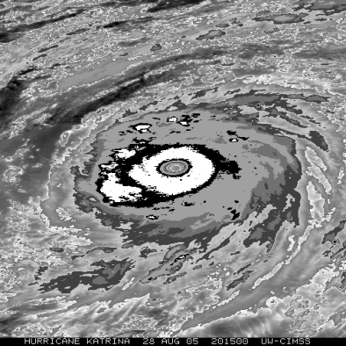
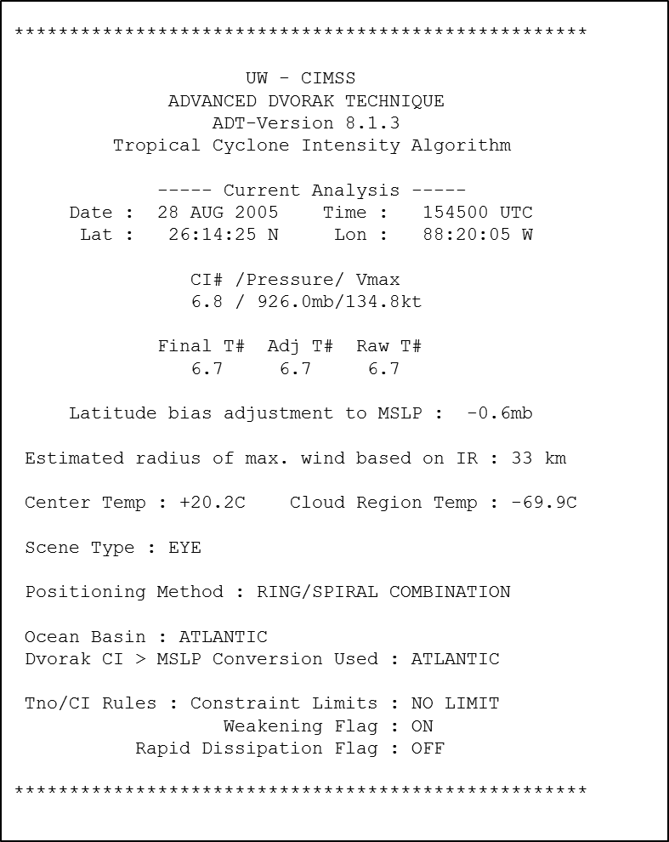
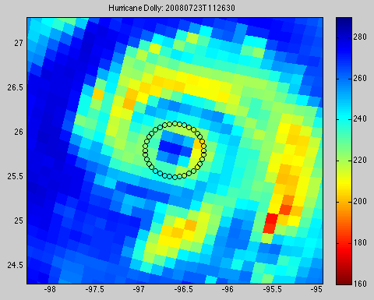
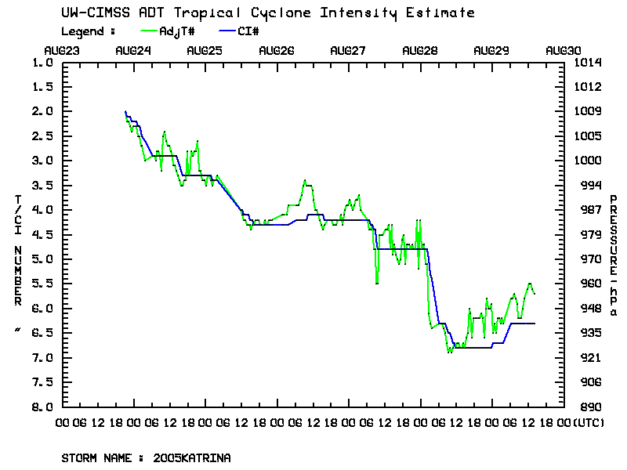
The UW-CIMSS
Advanced Dvorak Technique (ADT)
TIMOTHY OLANDER and Christopher Velden
University of Wisconsin-Madison
Cooperative Institute for Meteorological Satellite Studies
Development Overview
Current Algorithm Status
Statistical Comparisons
Future Directions
P 2.5

Slide 4
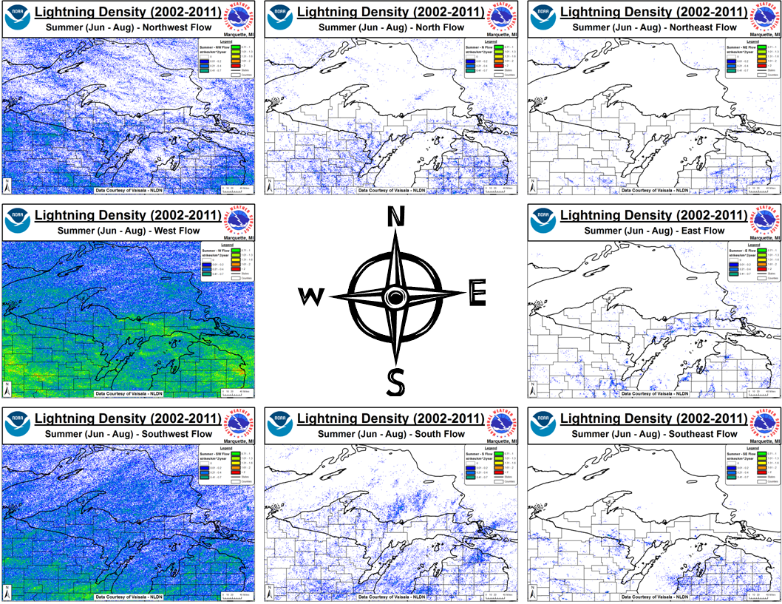
A Cloud to Ground (CG) Lightning Climatology for the Lake Superior Region
Steven Fleegel and Michael Dutter
NOAA/National Weather Service – Marquette, MI
A mesoscale look at the influence of the Great Lakes on lightning in the Lake Superior region
General (Monthly, Seasonal, and Hourly) lightning climatology
Focus on 700 hPa wind direction and speed climatology, displayed using gridded 1 km² lightning density charts
Additional investigation on role terrain and land use have with lightning density
Summer 700 hPa Flow – Lightning Climatology
P2.19

Slide 5
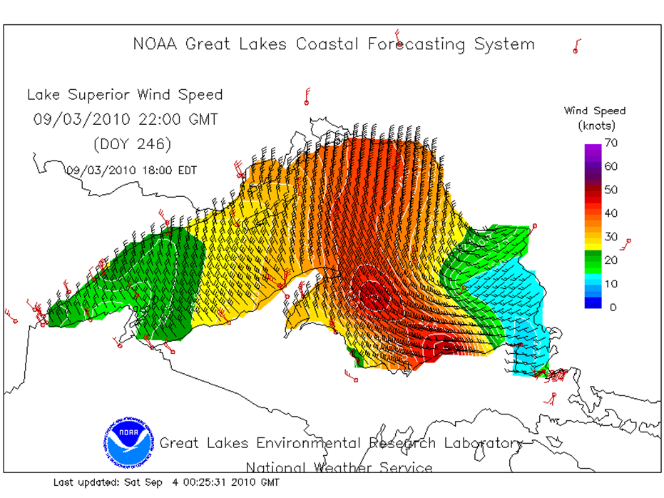
Gales of September? Analysis and Customer Impacts of the 03-04 Sept. High Wind Event across Lake Superior
Michael Dutter
NOAA/National Weather Service
Marquette, MI
The Labor Day Weekend 2010 wind storm was arguably the strongest September Wind Storm across Lake Superior in the last 30 years
Numerous wind and wave records were broken or nearly broken
Wind gusts in excess of 50 m/s reported by the M/V Indiana Harbor
Unusual low track for high winds across Lake Superior
Wind Speed Analysis from 22 UTC 09/03/2010
(courtesy GLERL)
P2.20

Slide 6
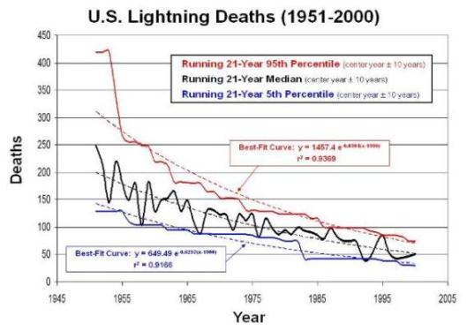
Lightning has Fallen to Third Leading Source of Storm Deaths in the U.S.
William P. Roeder
Private Meteorologist
Rockledge, FL
Lightning Now #3 Source of U.S. Storm Deaths
Tornadoes Now #2
Statistically Significant
New Analysis Accounts for Lightning’s Declining Fatality Rate
Poster 2.29
P2.29

Slide 7
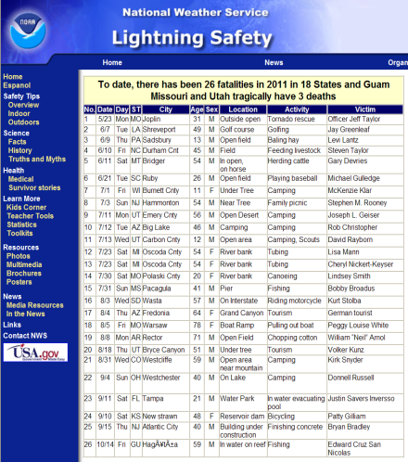
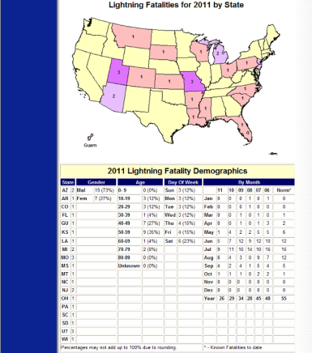
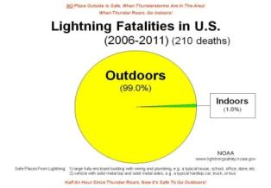
Lightning Safety Applications of NOAA’s New Lightning Fatality Database
William P. Roeder John Jensenius
Private Meteorologist National Weather Service
Rockledge, FL Gray, ME
New Lightning Fatality Database from NOAA
U.S. (2006 – Present)
16 New Graphics for Teaching Lightning Safety
Available On-line
www.lightningsafety.noaa.gov
Poster 2.30
P2.30

Slide 8
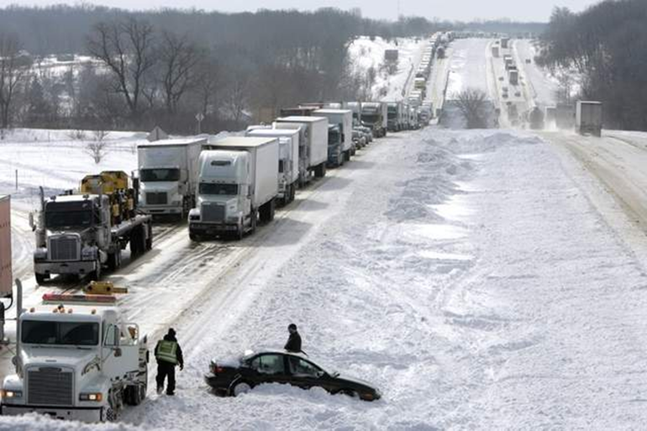
An Examination of Decision Support Services Provided by the National Weather Service During Major Winter Storms
Dennis VanCleve and Marcia Cronce, NOAA/NWS WFO Milwaukee/Sullivan, WI
Jamie Enderlen, NOAA/NWS WFO Chicago, IL
Three storms studied
January 1-3, 1999 Blizzard; February 5-6, 2008 Winter Storm; 2011 Groundhog Day Blizzard
Past DSS
What services were provided?
How have they improved?
Future DSS
Continue & improve upon successful services
Develop new impact-based services tailored to users needs
Stranded vehicles during February, 2008 winter storm
P2.33

Slide 9
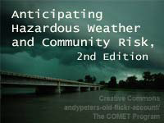
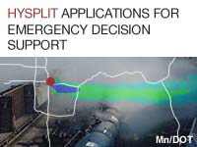
MetEd Resources for Weather and Natural Hazards Decision Support
Amy Stevermer, Victoria Johnson, Elizabeth Mulvihill Page, Wendy Schreiber-Abshire
UCAR/COMET, Boulder, CO
What information do emergency managers and the aviation industry need in their operations?
Online modules overview preparedness and response efforts related to tsunamis, hurricanes, hazmat releases, and other events
Aviation-related training explores impacts of space weather, volcanic ash, and various weather events on air traffic management
Some of the available module titles…
and more…free at www.meted.ucar.edu
P2.38

Slide 10
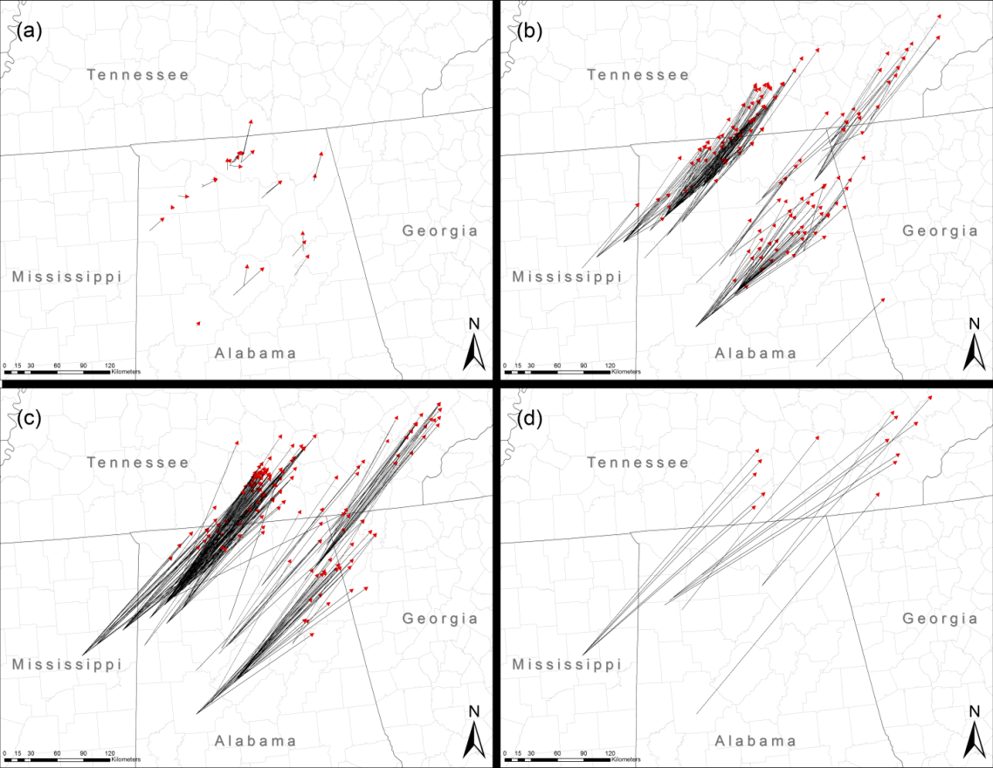
Analysis of Tornado Debris During the April 27, 2011 Super Outbreak as Determined Using Social Media Data
John A. Knox, J.A. Rackley, A.W. Black, V.A. Gensini, M. Butler, M. Phan,
C. Dunn, T. Gallo, M.R. Hunter, L. Lindsey, R. Scroggs, and S. Brustad
Department of Geography, University of Georgia et al.
We used a Facebook page of lost-and-found items from a tornado outbreak to create a scientific dataset:
934 objects, most ever studied
Farthest-traveled object: 353 km, new record!
Longest trajectories to right of average tornado track vector, new result
HYSPLIT modeling suggests a reason why
Tracks of debris objects that traveled a) < 50 km; b) 50 to 150 km; c) 150 to 250 km; d) >250km
P2.46

Slide 11
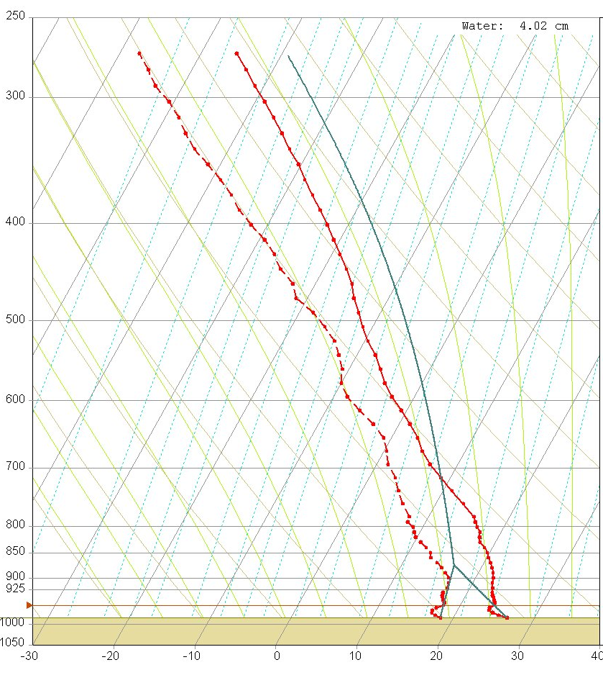
Persistent Daytime Superadiabatic Surface Layers Observed by a Microwave Temperature Profiler
Alan C. Czarnetzki
University of Northern Iowa
Cedar Falls, IA
Surface based microwave radiometers can measure atmospheric thermodynamics in real time
Superadiabatic layers are persistent features of the daytime boundary layer
Only the lowest, surface-based layer is occasionally seen to be autoconvective
Superadiabatic layers should not be summarily dismissed as erroneous or transient
Example of near-surface superadiabatic layer observed by a microwave radiometer
P2.55

Slide 12
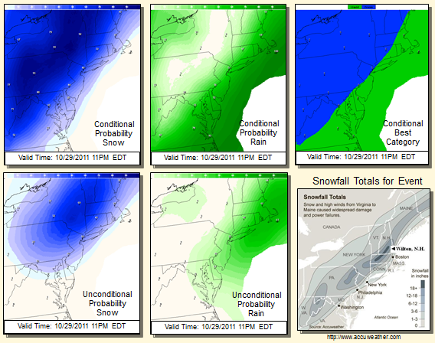
MOS Probabilistic Winter Weather Guidance: Prototype Products for “Weather-Ready Nation” Pilot Initiative
Phillip E. Shafer*, Geoffrey A. Wagner**, and Kenneth Widelski***
*NWS/MDL Silver Spring, MD **AceInfo Solutions, Inc., Reston, VA ***NWS WFO Sterling, VA
Pilot project at WFO Sterling:
Objective – develop suite of probabilistic forecast products for winter weather for impact-based decision support services.
MDL has developed two prototypes:
GFS-based MOS probabilistic precipitation type
GFS-based MOS probabilistic 24-h snowfall amount
Provides uncertainty information to support Pilot Project objectives.
P2.63

Slide 13
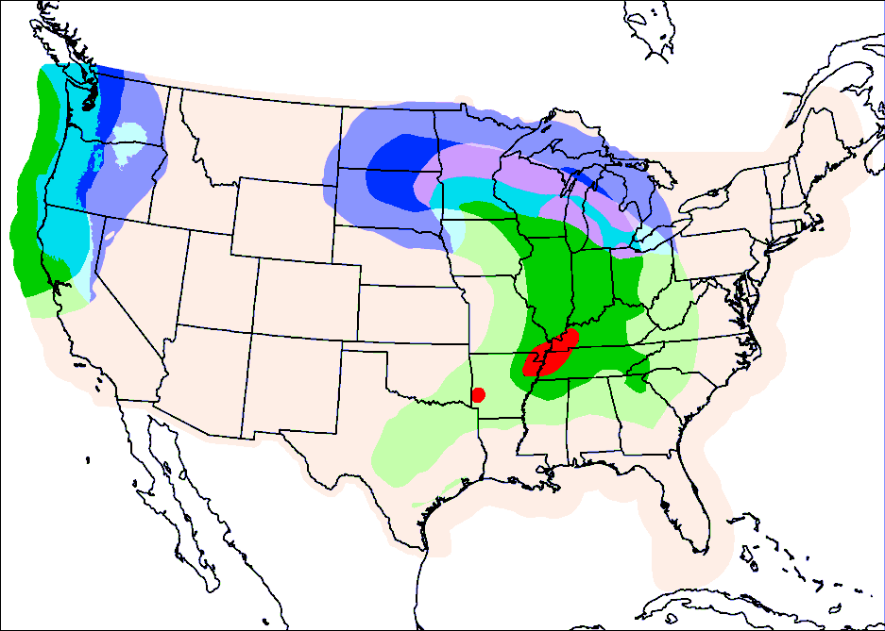
MOS Precipitation Forecasts Formatted for the National Digital Forecast Database
Tabitha L. Huntemann, Phillip E. Shafer, Matthew R. Peroutka, Kathryn K. Gilbert
NOAA/NWS/MDL Silver Spring, MD
NDFD "Weather" element contains precipitation type, probability, and intensity information
Gridded MOS guidance for "Weather" has been developed
Adds to MOS product suite of guidance for NWS forecasters
None
Rain
Snow
Ice
Mix
Severe
Gridded MOS Weather February 28, 2012 00Z 33-h forecast
P2.64

Slide 14
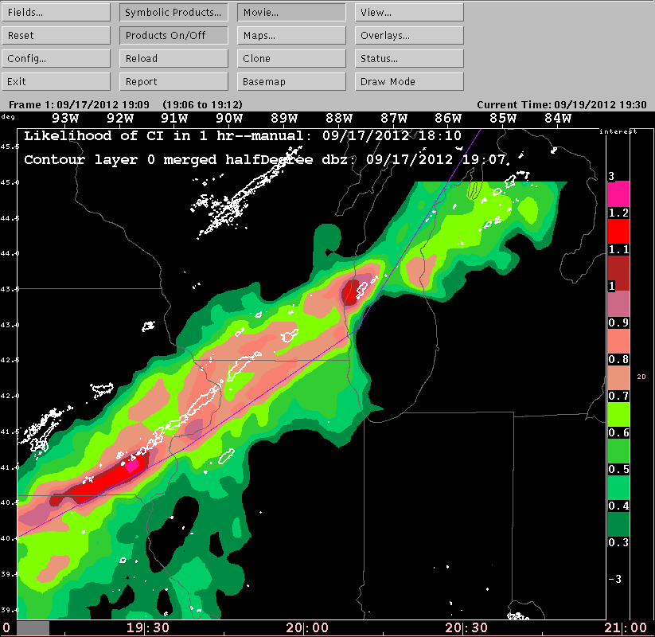
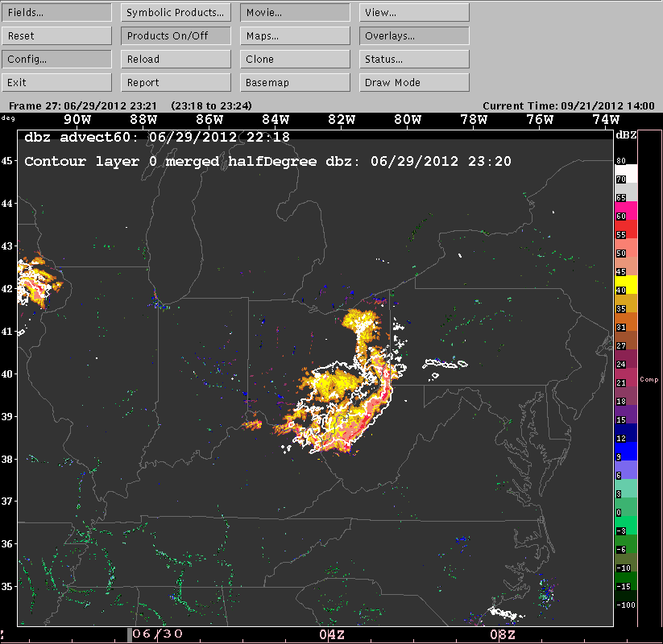
Preliminary Results of AutoNowCaster Over a Large Domain
Mamoudou Ba¹, Lingyan Xin¹, John Crockett¹, Kenneth Sperow¹, Tatiana Gonzalez¹, Rita Roberts², Eric Nelson², Dan Megenhardt², Amanda Anderson², Eric Lenning³, Patricia Wontroba³ ¹NOAA/NWS, Meteorological Development Laboratory, Silver Spring, MD 20910 ²NCAR, Boulder, CO 80301; ³NOAA/NWS, WFO Chicago, Romeoville, IL 60446
AutoNowCaster (ANC)
Automatic, deterministic nowcasts
Rapid updates (every 5 to 6 minutes)
60-minute nowcasts of the likelihood of new thunderstorm initiation
60-minutes nowcasts of the advection of existing thunderstorms (including growth and decay)
The thunderstorm initiation nowcast is designed to alert forecasters quickly to areas where new convection is likely to occur in 60 minutes.
ANC initiation likelihood nowcast valid at 1907Z on Sept.
17, 2012. White contours are reflectivities >=35 dBZ.
Derecho event on June 29, 2012
ANC 60-minute storm advection (values >= 35 dBZ). White contours are reflectivities >=35 dBZ.
P2.65

Slide 15
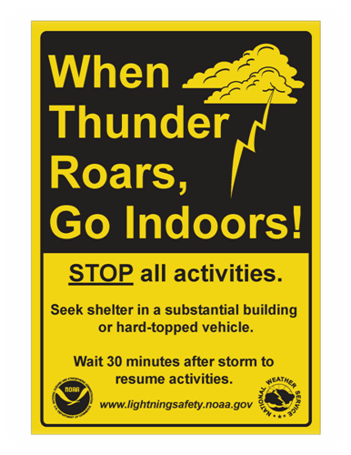
The Expansion of Lightning Toolkits
to Outdoor Recreation
Charles Woodrum, NOAA/NWS, Pittsburgh, PA
Karen Oudeman, NOAA/NWS, Cleveland, OH
Michael Kyle, Kean University, Union, NJ
Ellen Bryan, WTVQ-TV, Lexington, KY
Large Outdoor Venues
Lifeguards
Community Events
Sign art available to those who complete a toolkit.
Lightning safety toolkits now available for a broad spectrum of vulnerable outdoor recreation activity.
P0.12

Slide 16
41
31
Sat
51
59
67
68
16
24
32
40
43
48
52
58
70
8
30
60
66
1
7
9
15
17
22
25
29
33
47
53
56
61
65
P0
39
44
2
5
10
14
38
18
21
46
54
55
63
64
Sat
26
28
34
45
3
4
11
13
19
20
Sat
35
36
27
Poster Session 2

