Slide 1
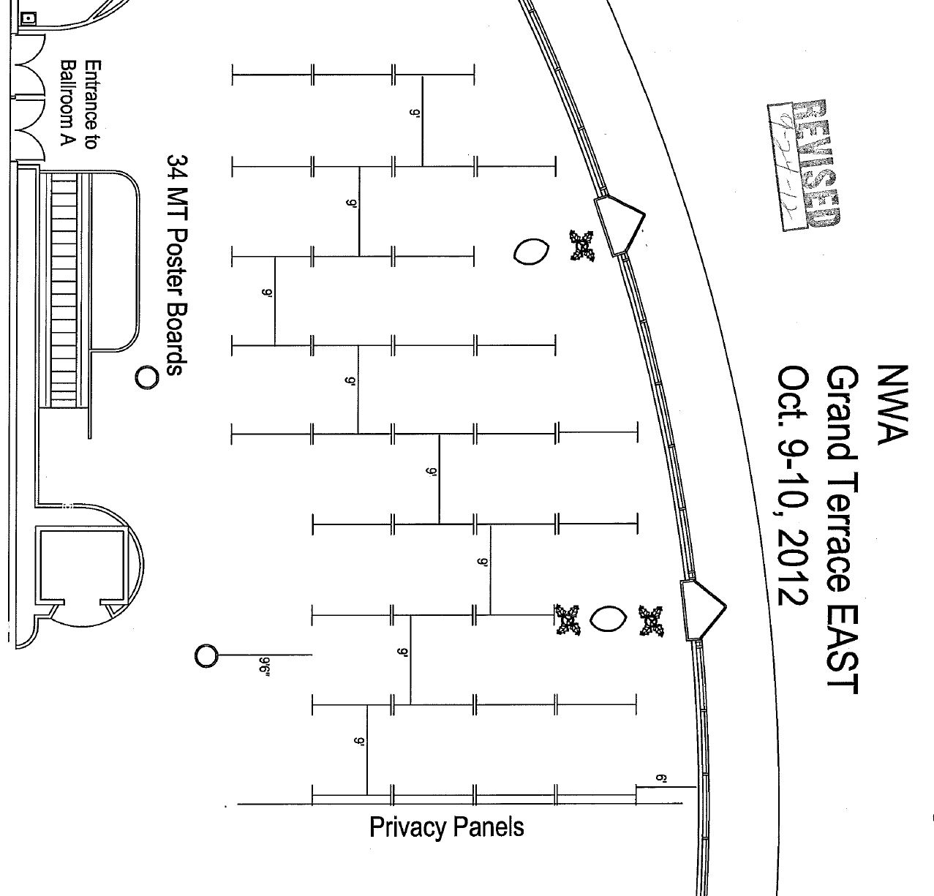
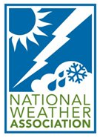
40
48
30
41
56
63
Sat
7
15
22
29
31
39
42
47
49
55
57
62
64
1
6
8
14
16
21
23
28
32
43
46
50
54
58
61
65
38
2
5
9
12
20
24
37
45
51
52
66
17
27
34
44
59
60
3
4
10
11
18
19
26
35
36
25
Poster Session 1

Slide 2
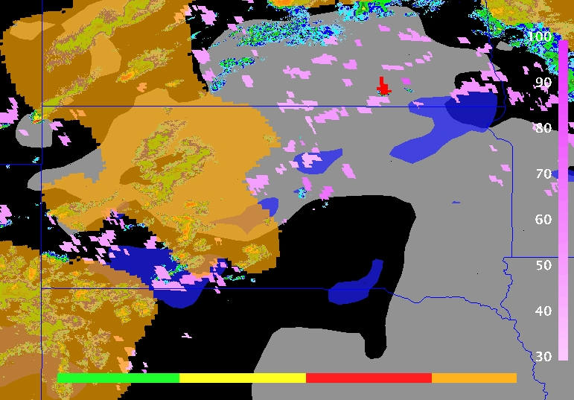
Data Fusion with the GOES-R Proving Ground Convective Initiation Products in the Plains
Dan Nietfeld¹, Jason Apke², Mark R. Anderson², Adam Taylor² and Casey Griffin²
¹ NWS Valley, NE (OAX)
² Earth and Atmospheric Sciences Dpt., University of Nebraska-Lincoln
UAH SATCAST and UWCI algorithms compared to rapid refresh data
  Data will be combined into experimental fused products to assist National Weather Service Forecasters
  Changes in Rapid Refresh data monitored to create experimental ‘mask’ products
  Factors such as high CIN and high CAPE can affect algorithm performance
Pre CI
CI Likely
CI Occurring
Mask
Experimental Fused product with UWCI (scale on bottom) and UAH SATCAST (scale on right) with Rapid Refresh CIN values <-100 J*kg⁻¹ (blue) and CAPE values >1500 J*kg⁻¹ (grey)
P1.4

Slide 3
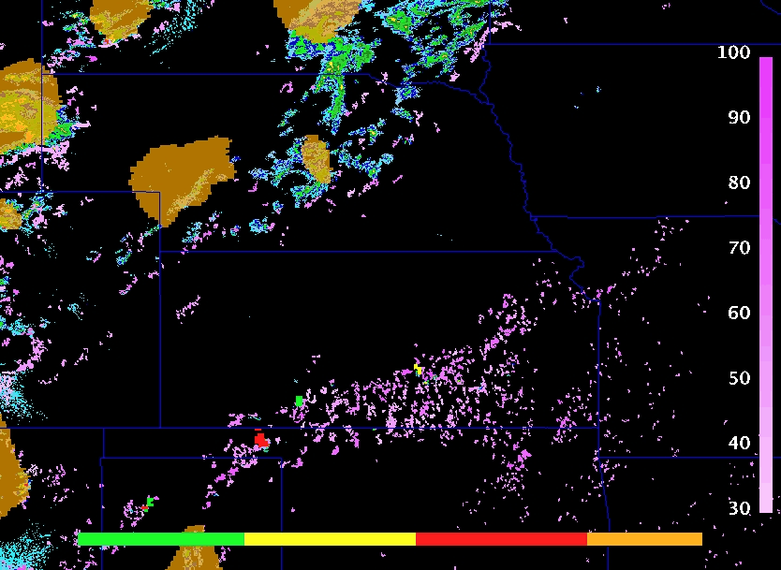
Evaluation of the GOES-R Proving Ground Convective Initiation Nowcasting Products in the Plains
Jason Apke¹, Dan Nietfeld², Mark R. Anderson¹, Adam Taylor¹ and Casey Griffin¹
¹ Earth and Atmospheric Sciences Dpt., University of Nebraska-Lincoln
² NWS Valley, NE (OAX)
UAH SATCAST and UWCI products evaluated using case studies
  Determining what environmental factors affect algorithm performance, not to find which algorithm is better
  Products remapped to a constant grid plain
  Compared to National Mosaic QPE and Rapid Refresh Data
Pre CI
CI Likely
CI Occurring
Mask
2012 July 25 20:00 UTC UAH SATCAST data (scale on right) and UWCI (scale on bottom) with National Mosaic QPE
P1.7

Slide 4


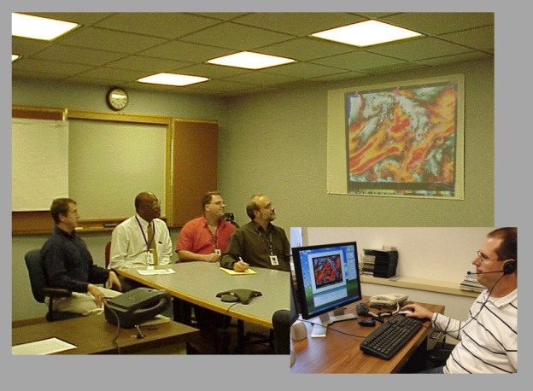
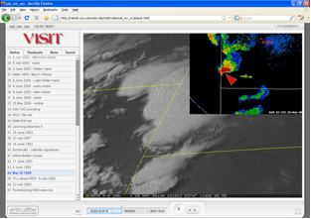
Recent VISIT and SHyMet Training: Applications of Satellite Imagery and Products to Operational Forecasting
Dan Bikos*, Bernie Connell*, Ed Szoke*, Scott Bachmeier, Scott Lindstrom, Anthony Mostek, Mark DeMaria, and Jeff Braun
* Cooperative Institute for Research in the Atmosphere (CIRA)
Colorado State University
Fort Collins, CO
The Virtual Institute for Satellite Integration Training (VISIT) and Satellite Hydrology Meteorology (SHyMet) programs.
  Transfer research results into NWS operations via distance education techniques.
  Recent training has focused on GOES-R imagery and products.
VISIT teletraining:
Instructor teaching
NWS forecasters
while at their office.
VISIT & SHyMet audio /
video playback training
sessions via web-pages.
Can be taken anytime.
P1.9
Notes:
P1.9

Slide 5
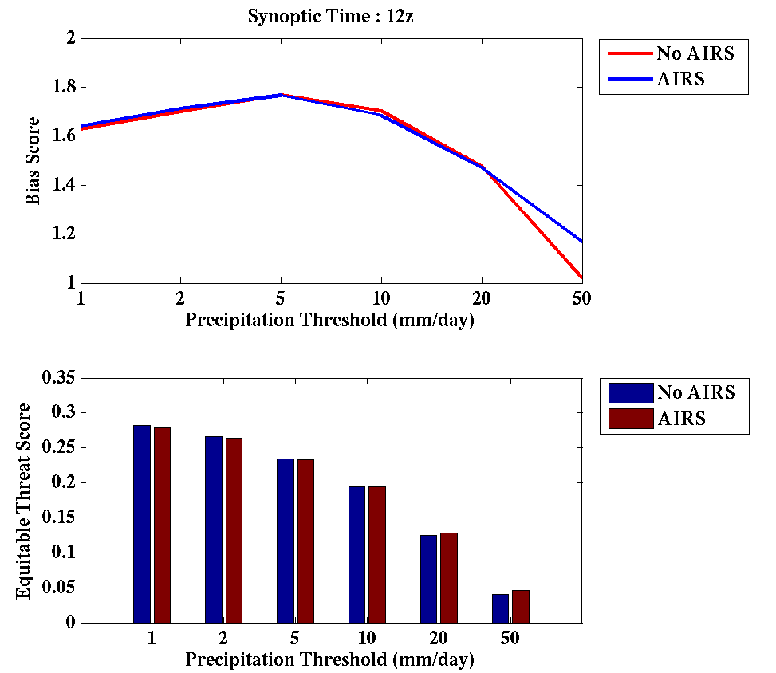
Assimilation of AIRS Radiances using GSI/WRF for Short Term Regional Forecasts
Agnes Lim^{1,2}, Jim Jung², Allen Huang² and Steve Ackerman^{1,2}
Department of Atmospheric and Oceanic Sciences
Cooperative Institute of Meteorological Satellite Studies
Madison, WI
Even sampling of the Earth’s surface by satellite provides information of horizontal and vertical gradients of temperature and humidity that are important to the predictability of convection.
Assimilation of clear-sky AIRS radiances to improve initial conditions for NWP.
Improvement in temperature bias when verified with rawinsondes.
Improvement in bias and ETS for heavy precipitation
Bias and ETS for 24 hour accumulated precipitation. Verified against 4km NCEP Stage 4 precipitation.
P1.16
Notes:
P1.16

Slide 6
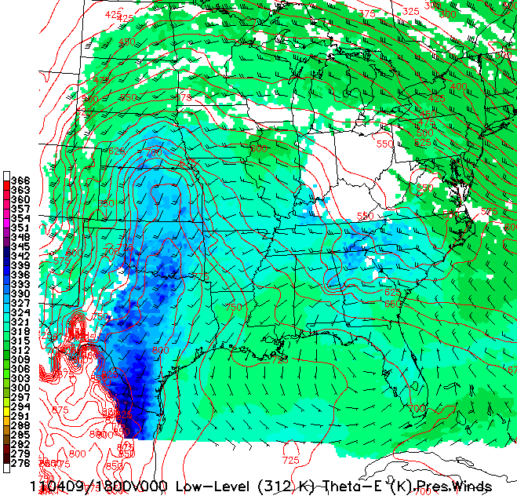
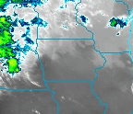
Future Improvements to Very-short-range Forecasts of the
Pre-convective Environment Using Operational
Geostationary Satellite Observations
P1.17
William Line¹, Ralph Petersen¹ and Robert Aune²
¹ CIMSS/SSEC/University of Wisconsin–Madison, Madison, Wisconsin
² NOAA/NESDIS/STAR, Advanced Satellite Products Team, Madison, Wisconsin
The isentropic version of the Nearcasting model is a lagrangian trajectory model that helps to determine the convective potential of the atmosphere in the near future by dynamically projecting geo. sat. observations along isentropic surfaces.
This provides 1-9 hour forecast guidance as well as expanding the use of satellite products from observations to forecasts.
Information made available to us by this new model framework (and what it means):
  Theta-E lapse rates (convective instability)
  Convergence, moisture convergence, total layer moisture convergence (lift, moisture supply)
  Pressure advection, local pressure tendency (lift)
  Mass in layer (total moisture available)
  Static stability (convective potential)
This will help forecasters determine whether convection will be a deep, rapid , severe event or a longer-lived, heavy precip. event.
Upward flow of high theta-E air along this low-level, 312 K surface were some of the factors leading to this April 09, 2011 severe weather and heavy precip. event.
Notes:
P1.17

Slide 7
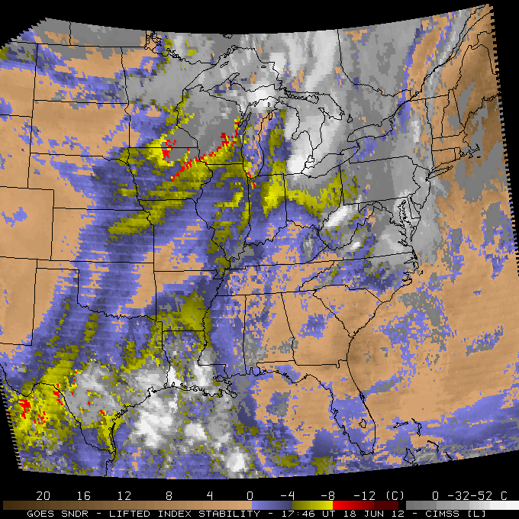
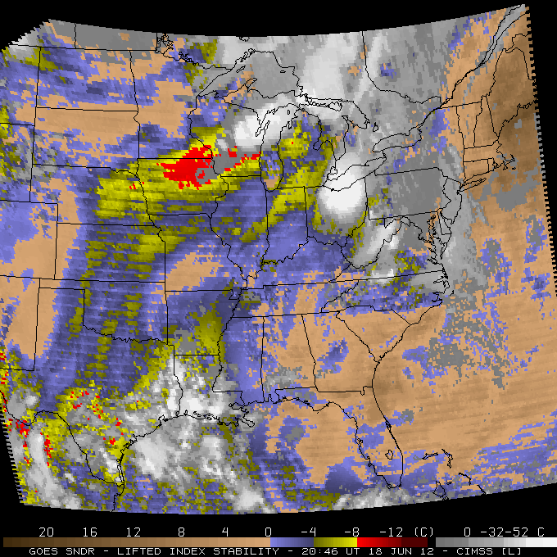
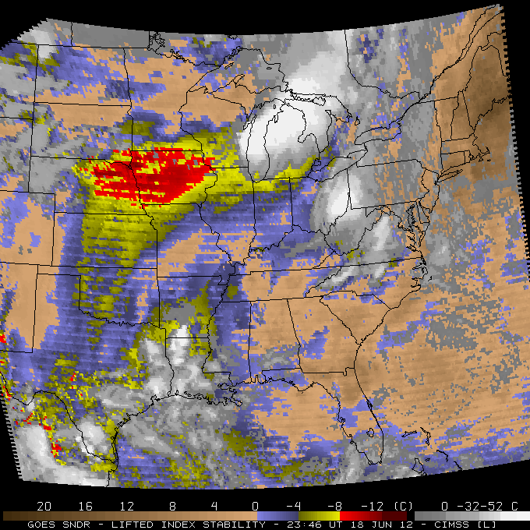
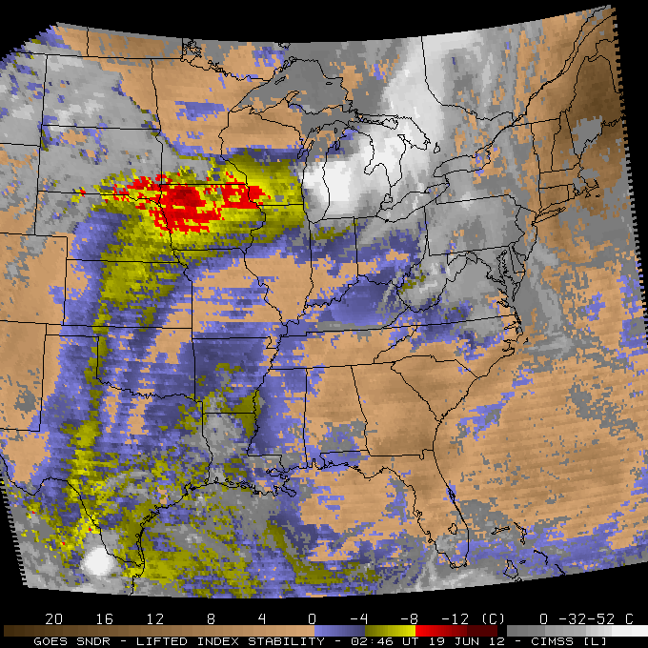
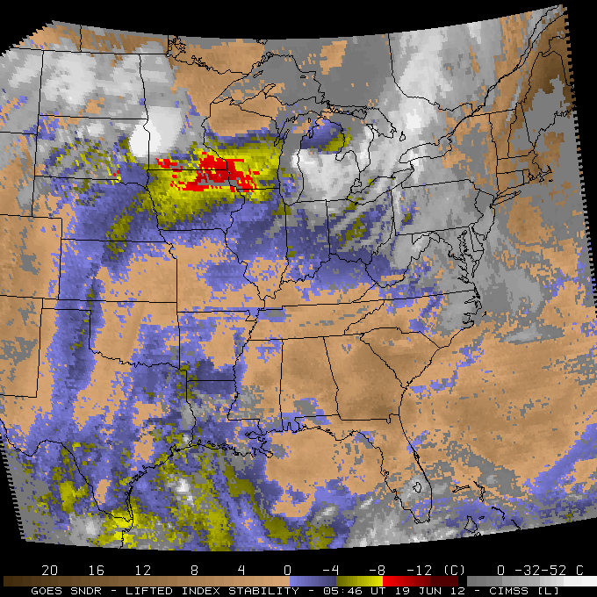
Are sounding profiles from geostationary satellites helping us yet?
Gary S. Wade
NOAA/NESDIS/StAR/CoRP Advanced Satellite Products Branch (ASPB)
Madison, WI
{ J. Nelson², T. Schmit¹, A. Allegrino³, S. Gutman⁴, R. Petersen², D. Birkenheuer⁴, J. Li², Z. Li², K. Holub⁴,and R. Dworak² [1. NOAA/NESDIS ASPB 2. UW-CIMSS 3. IM Systems Group 4. NOAA/OAR/ESRL] }
1800 UT
The vertical profile retrieval algorithm for the GOES-R “legacy soundings”, applied to current GOES Sounder radiances, has shown improvement over the first-guess.
Further assessment and application of current GOES soundings are relevant, to forecasters, for establishing reliability and utility for the GOES-R “legacy soundings”.
2100 UT
Time
0000 UT
0300 UT
0600 UT
Evolution of Lifted Index (LI) stability derived from current GOES Sounder on 18-19 Jun 2012.
P1.22
Notes:
1. File name is: P1.22-poster-slide-gswade-20121001.pptx.

Slide 8
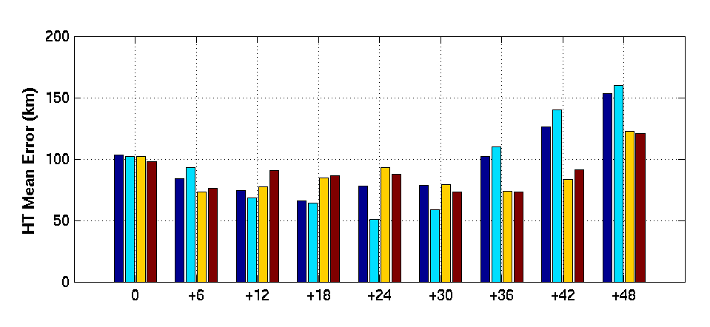
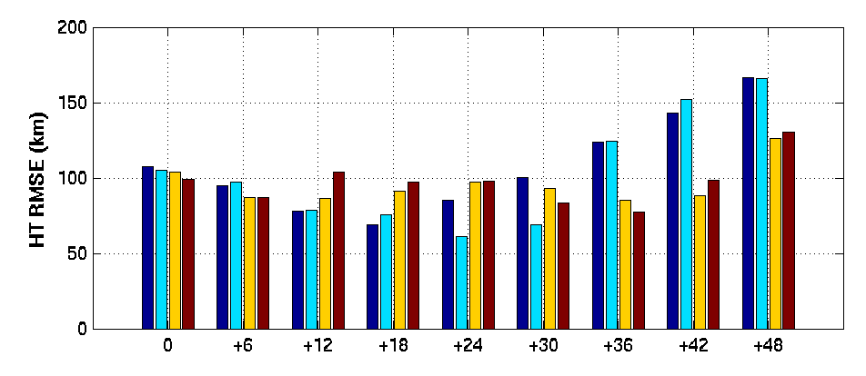
Improve Tropical Cyclone Forecasts with
Hyperspectral Infrared Sounder Data
Pei Wang, Jun Li, Tim Schmit, and Jinlong Li
Department of Atmospheric and Oceanic Sciences
Cooperative Institute for Meteorological Satellite Studies
NOAA/NESDIS/Center for Satellite Applications and Research/Advanced Satellite Products Team Madison, WI
BIAS
The AIRS sounding data in clear skies are used in GSI/WRF system and show positive impacts on the forecasts of Hurricane Irene
  The bias correction of AIRS sounding data decrease the error between observation and background, and the error between observation and analyses
  The bias correction of AIRS sounding data improves the hurricane track forecasts
RMSE
RMSE and BIAS for track, minimum sea level pressure and maximum wind speed of Hurricane Irene
P1.23
Notes:
P1.23

Slide 9
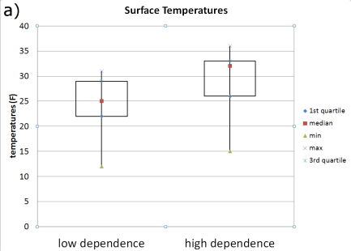
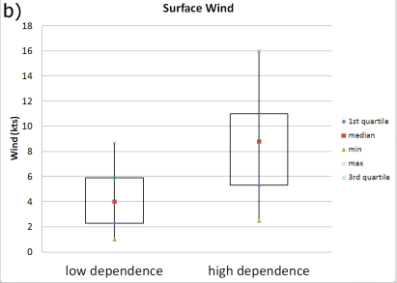
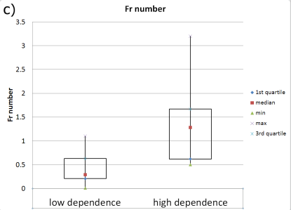
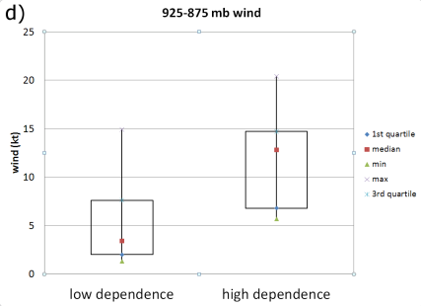
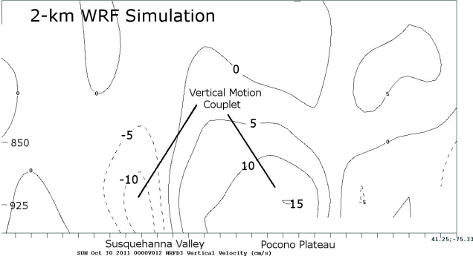
A preliminary examination of the elevation dependence of snowfall in northeast Pennsylvania
Michael Evans
NOAA/NWS Binghamton, NY
Michael Jurewicz, Robert Ballentine
Examination of 78 Northeast Pennsylvania snow events found an average high elevation vs. low elevation snowfall ratio of 1.4.
Events with larger ratios tend to have surface temperatures near freezing, stronger low-level winds and less blocking of the flow at ridge-top level vs. smaller-ratio events.
Events with larger ratios tend to be associated with more amplified mid-level flow vs. smaller-ratio events.
A case study of a large-ratio event using a high-resolution (2 km) simulation indicated a stationary mountain-wave like vertical motion pattern tied to the terrain.
Parameters for small elevation ratio vs. large elevation ratio events: a) surface temperature, b) surface wind, c) 925-875 hPa wind, d) 925-875 hPa Froude number
2 km WRF vertical motion (upward positive) – valid 00 UTC October 28, 2011
P1.28
Notes:
P1.28

Slide 10
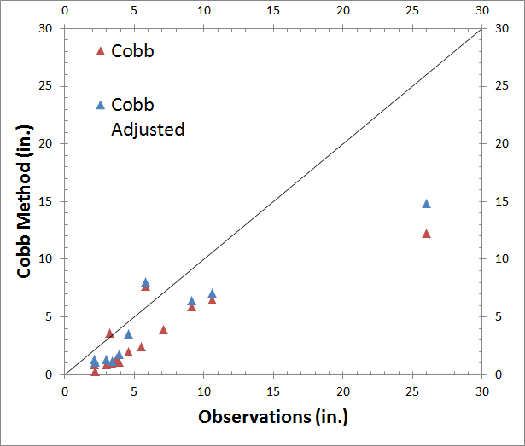
Lake Effect Snowfalls and Evaluation
of the Cobb Method
Seth L. Kutikoff and Mark R. Anderson
Earth and Atmospheric Sciences Department, University of Nebraska–Lincoln
  Western stations generally had a higher percentage of lake effect snow events compared to eastern locations
  Cobb Method generated snowfall amounts are less than observations
  Cobb hourly snow ratios are more dense than observations
  The impact of RUC vertical velocities and convective parameterization on Cobb Method snow ratios must be addressed
Comparison of lake-effect snowfall observations and Cobb Method derived snowfall
P1.29
Notes:
P1.29

Slide 11
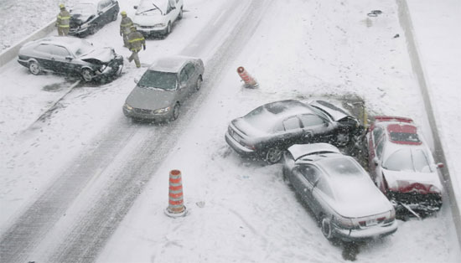
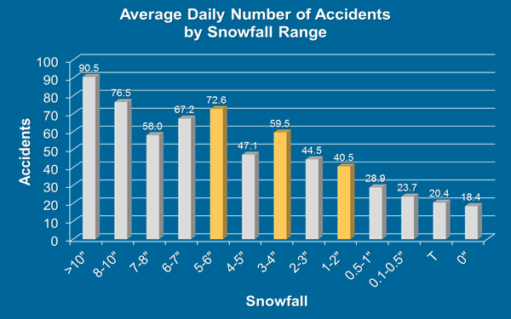
A Review of Traffic Accidents Compared
with Observed Weather
Todd J. Shea
NOAA/NWS La Crosse, WI
Accident numbers from 2000-12 were compared against weather to better understand related impact.
  Precipitation, especially winter type, has big impact overall.
  NWS winter advisories and warnings align well with impact.
  Bitter cold temperatures also have impact on accidents due to road treatment limitations and refreezing.
Accident averages compared to snowfall ranges
P1.31
Notes:
P1.31

Slide 12
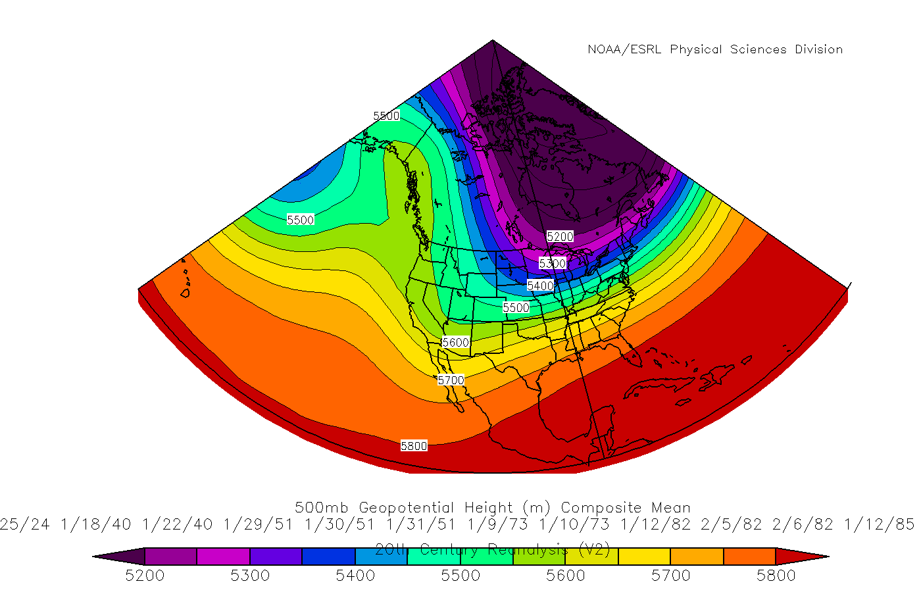
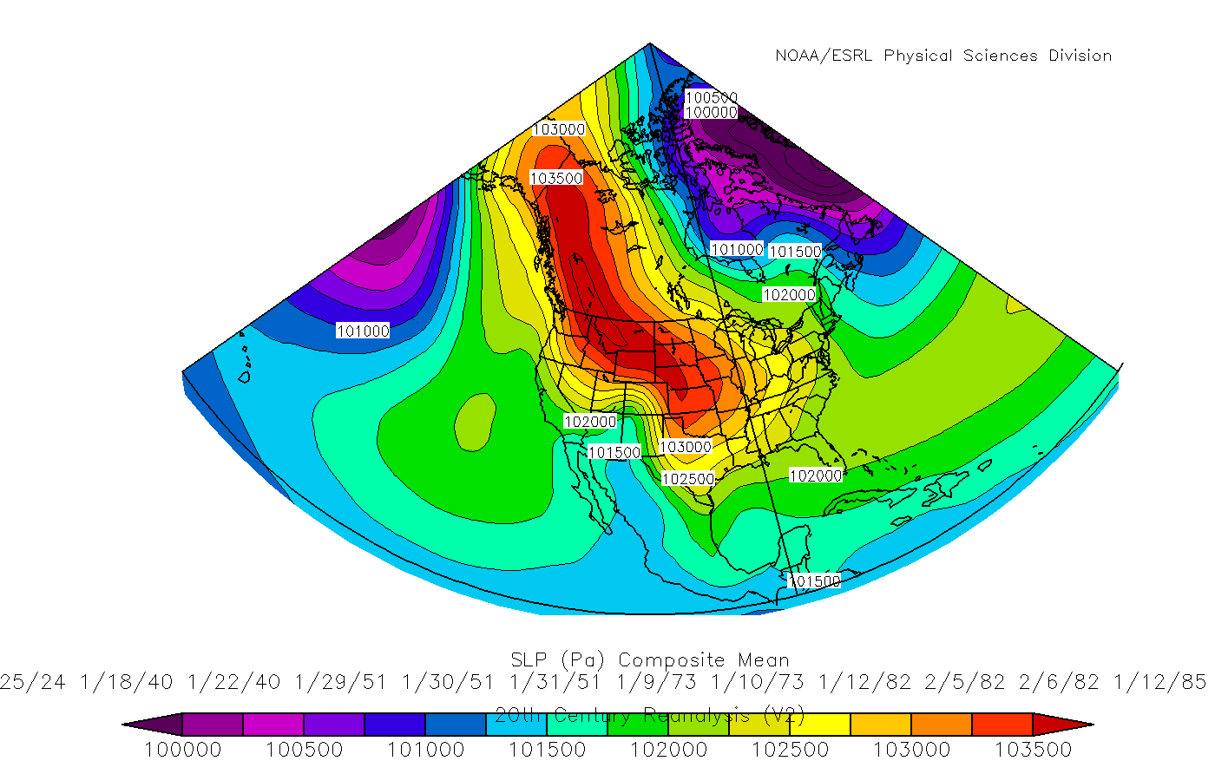
Significant Ice Storms Affecting Corpus Christi
Michael Buchanan
National Weather Service
Corpus Christi, TX
9 significant Corpus Christi ice storms were identified using a combination of surface observations and socio-economic data.
  1/19-25, 1924
  1/18-22, 1940
  1/29-31, 1951
  1/9-10, 1973
  1/12, 1982
  2/5-6, 1982
  1/12-14, 1985
  2/4-7, 1989
  2/3-4, 2011
The 1924, 1951 and 1985 storms were the “worst” due to one or more of the following:
  Ice thickness
  Damage
  Fatalities & Injuries
  Duration of icing event and freezing conditions
  Travel & Communication disruption
  Road/Business/School/Airport closures
Mean 500 hPa composite during these ice storms.
Mean Surface (Mb) composite during these ice storms.
P1.38
Notes:
P1.38

Slide 13
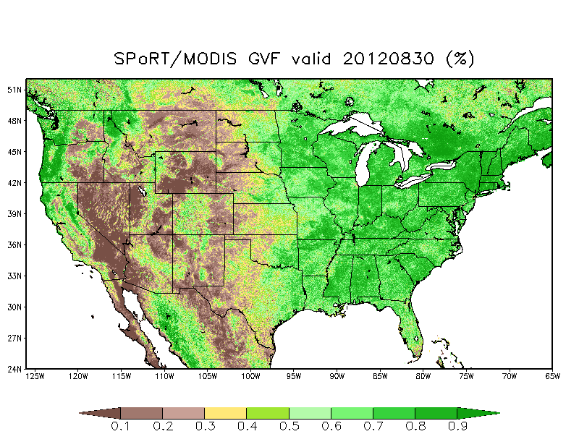
P1.40 Recent Upgrades to NASA SPoRT Initialization Datasets for the Environmental Modeling System (EMS)
Jonathan Case, Frank LaFontaine, Andrew Molthan, Bradley Zavodsky, & Robert Rozumalski
NASA SPoRT generates three unique, high-res surface datasets for local model runs in the EMS
  NASA Land Information System (LIS) land surface model output on a 3-km grid (below)
  2-km SST composites (middle)
  1-km res real-time MODIS Green Vegetation Fraction (GVF, far right)
Poster P1.40 and extended abstract describe:
  Dataset characteristics
  Recent changes and upgrades
  Citations of papers that showed impact / improvement of these datasets on model forecasts
2-km SST & Great Lakes LST/sea-ice
3-km NASA Land Information System
1-km real-time MODIS vegetation fraction
Notes:
P1.40

Slide 14
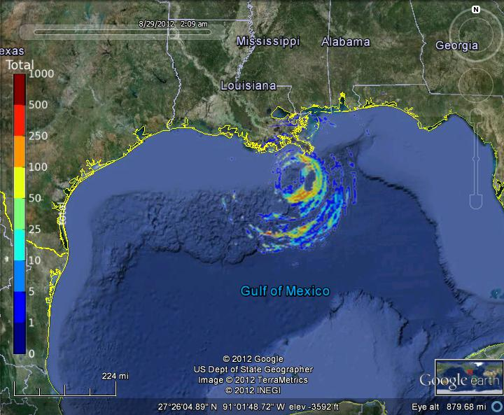
WRF Lightning Forecasts Derived from High Resolution, Rapid Refresh Numerical Model Data
Dr. Barry Lynn and Gary Ellrod
“Dynamic” lightning forecast system developed by Weather-It-Is, Ltd.
  Provides 4km forecasts of total and CG (positive and negative) flashes using WRF-RAP data
  Forecasts for 3-hr intervals out to 12-hr
  Verification indicates better skill than with statistical forecast methods
  Web: www.lightning-forecast.com
Lightning forecast for 3-hr period ending 2AM CDT,
28 Aug 12, at maximum intensity of Hurricane Isaac
P1.42
Notes:
P1.42

Slide 15
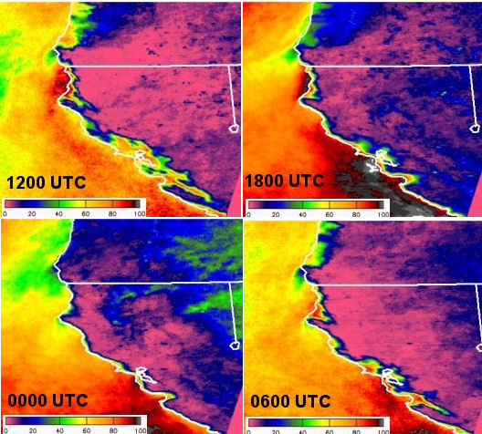
P1.43
The Pacific Coast Fog Project:
A Multi-disciplinary Effort to Provide Web-based
Climate Products for Ecologists
Gary Ellrod, Alicia Torregrosa, Cindy Combs, and Ismail Gultepe
Describes previous and ongoing research on Pacific Coast fog and low clouds for benefit of natural resource managers in northern CA
  Exploits fog climatology research based on surface weather observations and satellite (GOES, MODIS) data
  Participants include federal and state agencies, universities, and private industries
  Output products to show fog frequency, fog persistence and fog water characteristics, along with short term forecasts and climate modeling
Eleven-year GOES low cloud climatology for northern CA (Combs, CIRA)

Slide 16

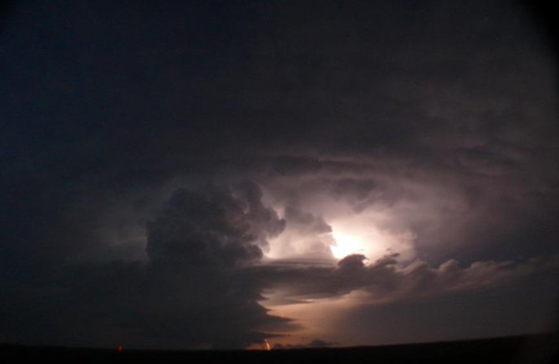
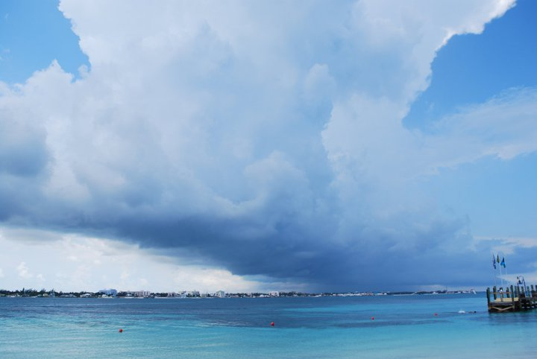
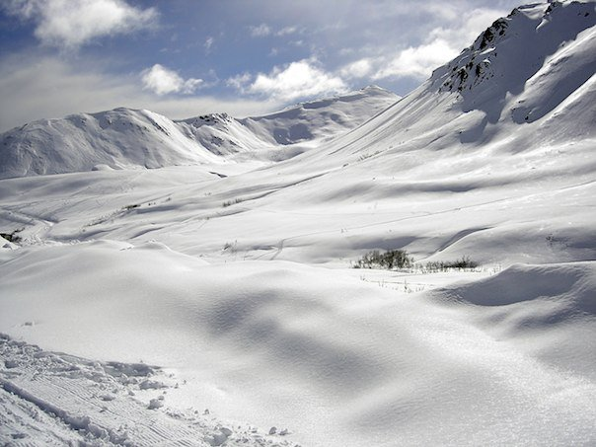
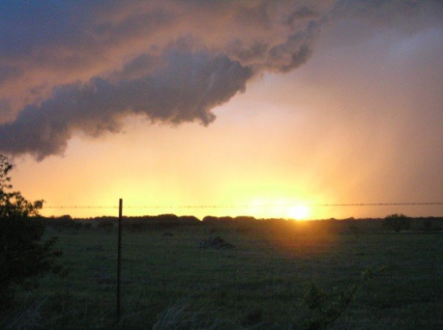
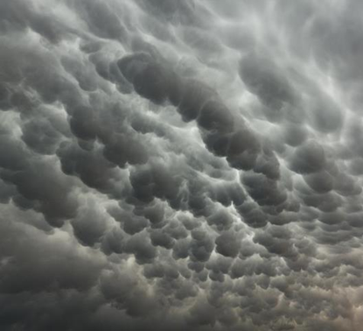
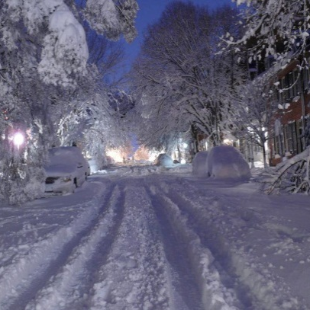
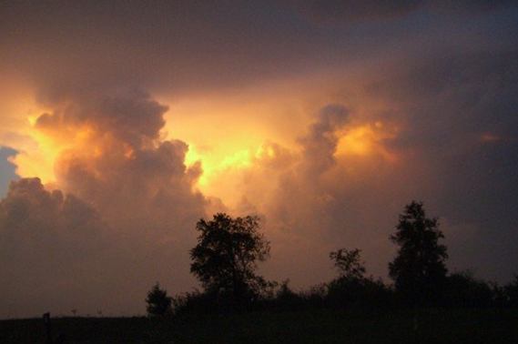
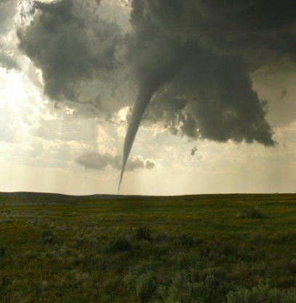
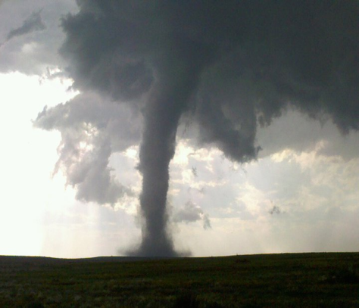
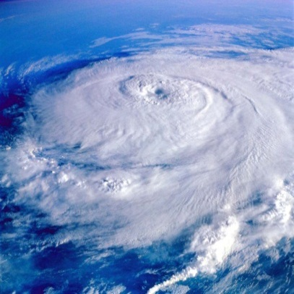

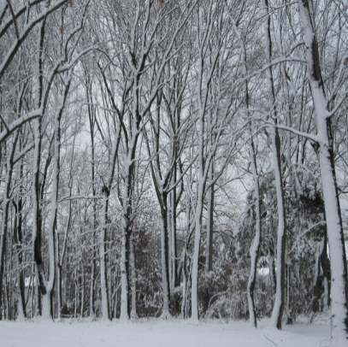
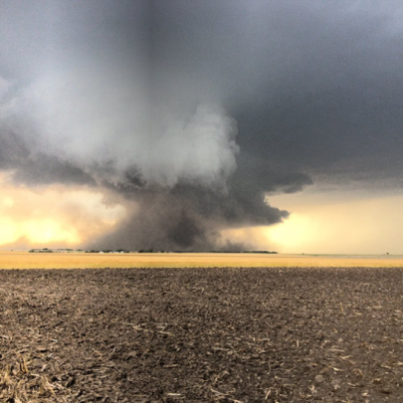
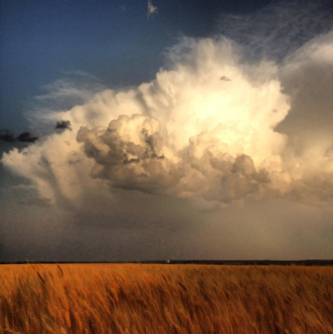
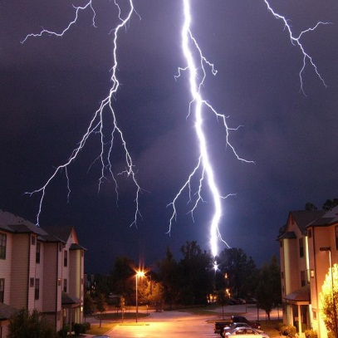
Monitoring the Pulse of
the Nation’s Weather:
Events, Impacts, Readiness.
Who we are.
  What we do for our Partners.
  What we do for the Government.
P1.45
Notes:
P1.45

Slide 17
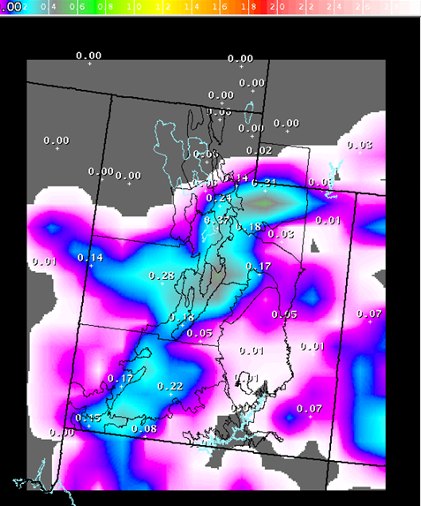
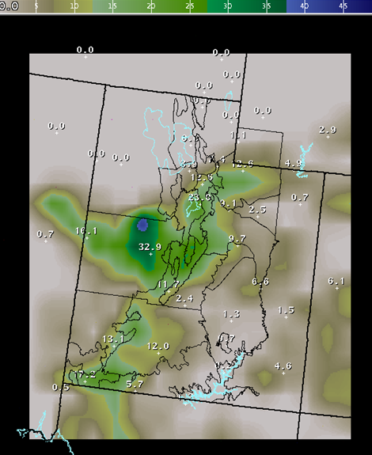
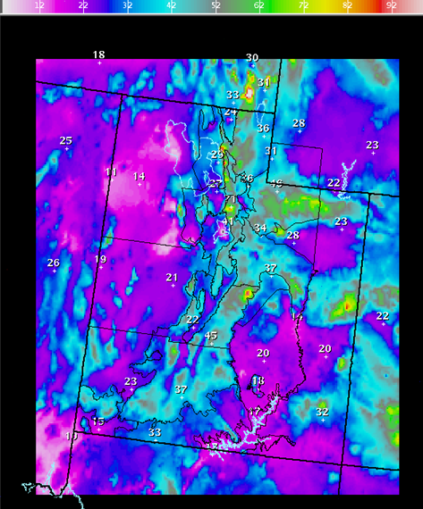
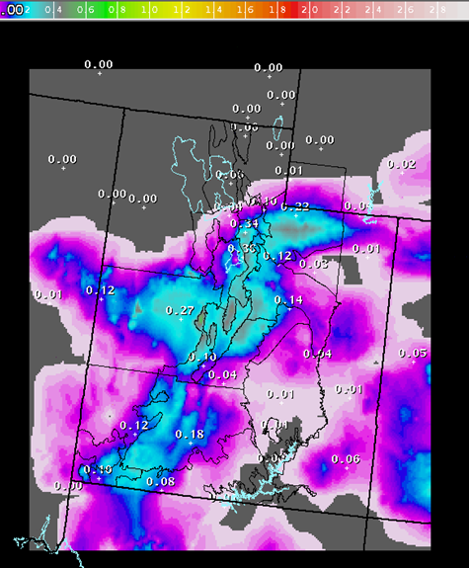
Exploring the Utility of Downscaled SREF Grids for Generating Probabilistic Snowfall Forecasts
Glen Merrill and Randy Graham, National Weather Service, Salt Lake City UT
Project to improve probabilistic snowfall forecasts
Individual SREF members are downscaled using the PRISM climatology
  Increases spread
  Improves model QPF bias
  Variety of displays created for forecasters - probability of exceedance, Max, Median values etc.
Can this experimental technique lead to improved forecasts?
Depiction of the downscaling technique utilized in the study
P1.46
Notes:
P1.46

Slide 18
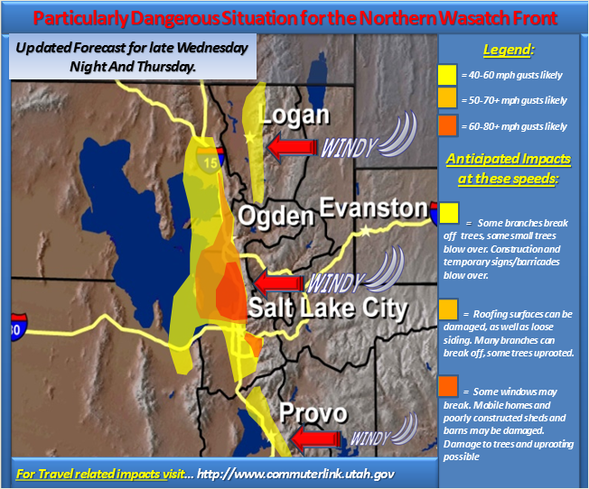
The Role of High Resolution Modeling in Decision Support Services Leading up to the 1 December 2011 Downslope Windstorm north of Salt Lake City, Utah
Stephen J. Rogowski
NOAA/National Weather Service Salt Lake City, UT - Weather Forecast Office
A 12-hour Downslope Wind event with gusts exceeding 100 mph
  What went into the development of this web graphic, and how accurate was it?
  Come for the local modeling…Stay for the Decision Support Services
P1.47
Notes:
P1.47

Slide 19
An Analysis of BUFKIT Methodologies to Forecast Wind and Wind Gust Speed for the Upper Ohio River Valley
Thomas A. Green, Jr.
NOAA/NWS Pittsburgh, PA
Use of BUFKIT mixed layer wind forecast as proxy for peak wind gust valid in Wichita, KS forecast area, but not in Pittsburgh, PA area
  Cook and Williams (2007) found that GFS and RUC mixed layer forecasts from BUFKIT have little bias/error for predicting peak wind gusts in high wind events in Kansas
  Similar study in Upper Ohio River Valley shows larger biases, with mixed layer forecasts showing negative bias to peak wind gusts
Average bias between BUFKIT wind forecast and observations at six sites in two NWS forecast areas. X = mean mixed layer; T = top of mixed layer.
P1.48
Notes:
P1.48

Slide 20
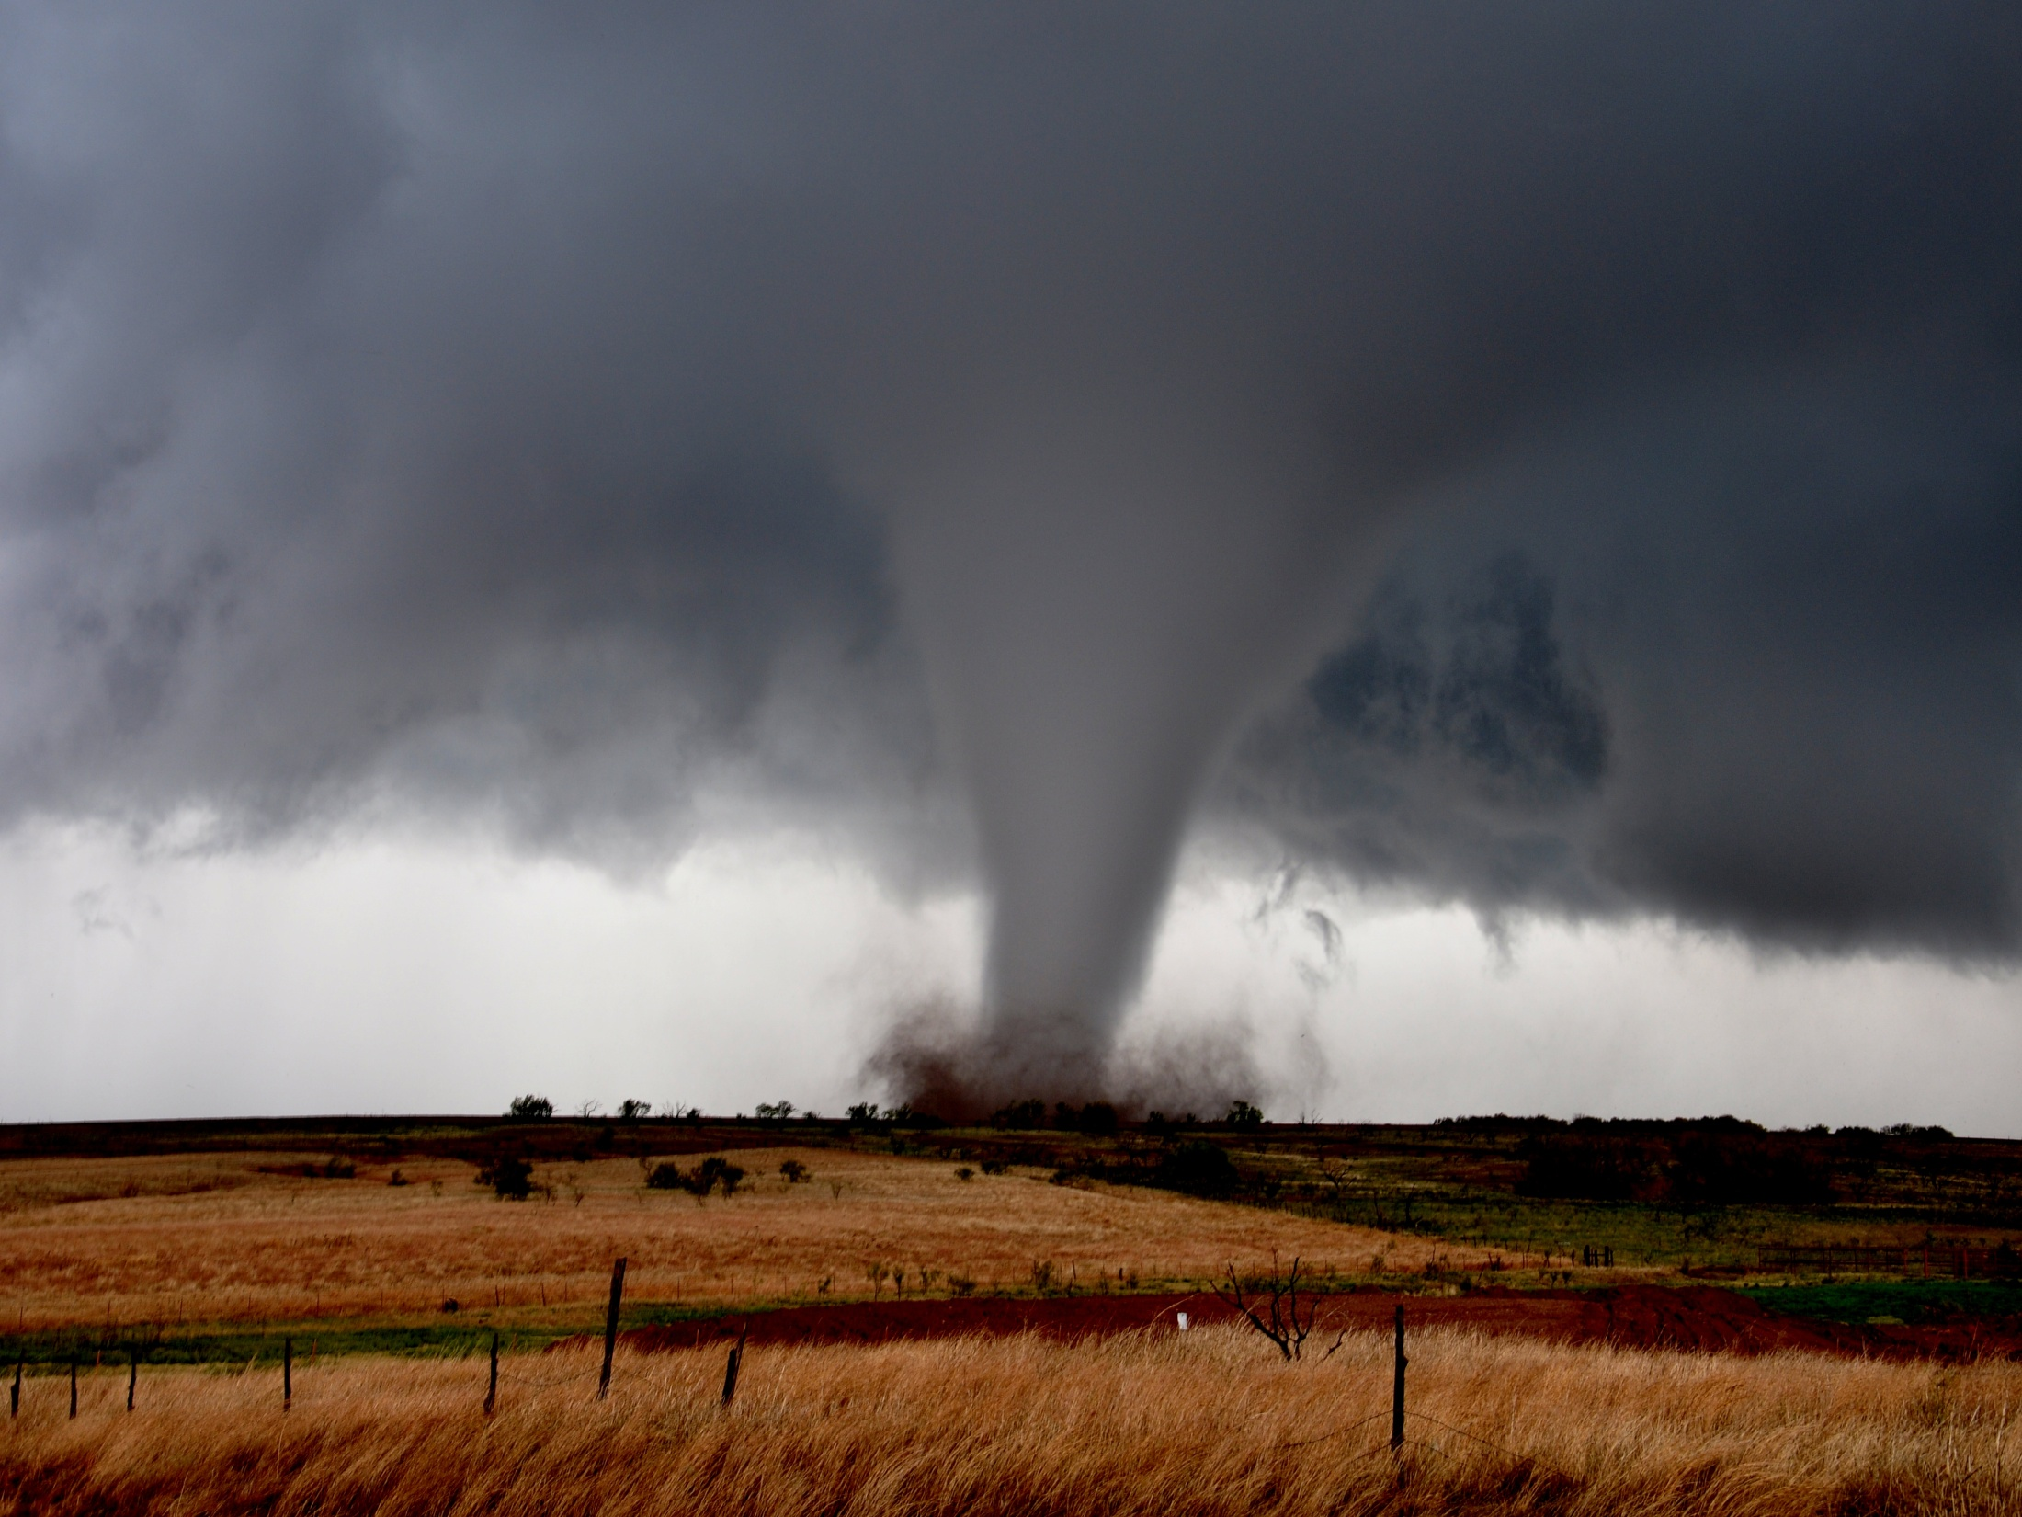
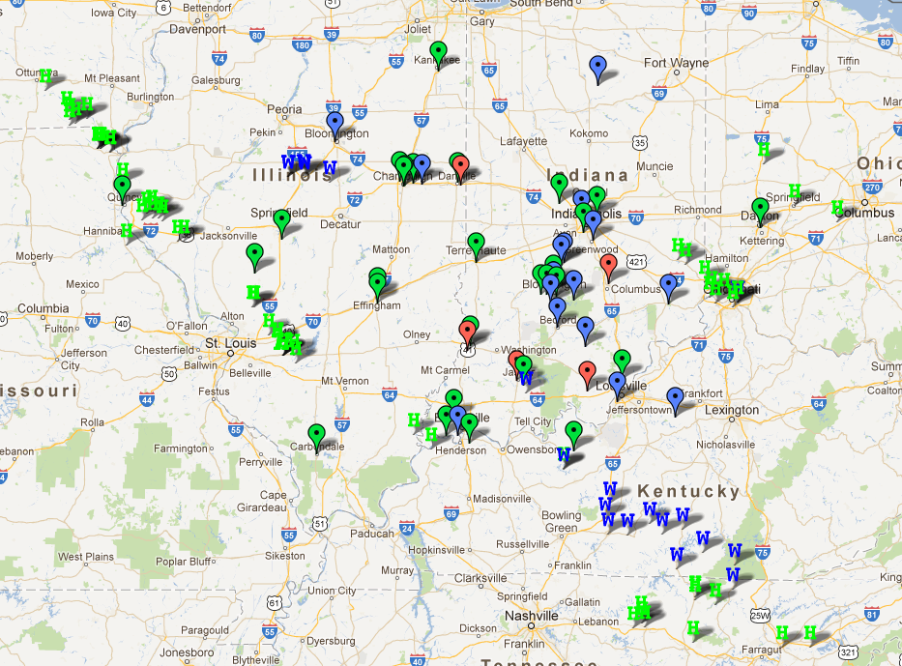
Challenging Forecasters Through Experiential Learning
Christopher S. Spannagle, Veronica L. Holtz and James G. LaDue
CIMMS/NOAA/NWS/Warning Decision Training Branch
Norman, OK
Continual learning experience
Allowed students to practice forecasting for severe weather and receive “immediate” feedback
Easy interaction with instructors and fellow students
Part of a larger severe weather course
P1.56
Notes:
P1.56

Slide 21

NASA Develop Program: An Investigation of High-Impact Non-Convective Wind Events associated with Intense Extratropical Cyclones using NASA Data Products
Mallory Cato, Nicholas Elmer, Michelle Hogenmiller, Sarah Trojniak
Saint Louis University
Using GOES-R RGB Air Mass imagery to further understand non-convective high wind events
  Helps identify moisture and temperature characteristics of the air masses
  Improves the examination of dry intrusions over conventional GOES satellite imagery
  Helps establish a connection between stratospheric intrusions and high surface winds when compared to NASA MERRA reanalysis data
RGB Air Mass image 26 October 2010 at 1700 UTC derived from GOES-11/13 courtesy of GOES-R Proving Ground, NOAA/NESDIS/STAR and NASA SPoRT.
P1.57
Notes:
P1.57

Slide 22

P1.58 Preliminary Results of a U.S. Deep South Modeling Experiment using NASA SPoRT Initialization Datasets for Operational National Weather Service Local Model Runs
Lance Wood, Jeffrey M. Medlin, Brad Zavodsky, Jonathon Case and Andrew Molthan
A collaboration between the NOAA National Weather Service (NWS) and NASA SPoRT
Focus on two U.S. Deep South forecast challenges: the initiation of deep convection during the warm season; and heavy precipitation during the cold season.
Objectively quantify the impacts of NASA SPoRT datasets (LIS, MODIS SSTs, GVF) on the summertime deep convective initiation problem.
Highlight how a NWS Operational Meteorologist-Researcher collaboration is invaluable towards addressing forecast problems, and how this approach could set a precedent for future local and/or mesoscale modeling.
SPoRT WRF Precipitation vs. Stage 4 Precipitation

Slide 23

P1.59
Radar and Lightning Analyses of Gigantic
Jet-Producing Storms
Tiffany Meyer
Warning Decision Training Branch/OU/CIMMS, CSU
Norman, OK
Environment, radar and lightning structure of 6 Gigantic Jet cases in the United States
  Looked at data from 3-D lightning mapping arrays, NLDN, GLD360, radars, and soundings
  Strong updrafts/lighting suggests convective surge leading to mixing of the screening layer allowing GJ’s to occur
  - GJ’s usually occurred at the peak of the storm in high CAPE, unstable environments
Plan view of KINX radar reflectivity data at the time a GJ. Area of cross section (dotted line), GJ (*) (top). Vertical cross section through above line. Melting level and tropopause height (horizontal lines), jet location (vertical line), OK-LMA lightning sources (black contour) (bottom).
Notes:
P1.59

Slide 24






Non-Typical Blizzards and the Role of Differential Cold Air Advection
Jacob Beitlich
National Weather Service Twin Cities Weather Forecast Office
Chanhassen, MN
Non-typical blizzards have occurred with no lead time
  Snowfall amounts are sub-advisory (less than 3 inches)
  These storms may have come without warning, but they did not come out of nowhere
  Differential Cold Air Advection is used to diagnose blizzards conditions
  BUFR soundings are used to forecast these events
24hr NAM forecast sounding loop of Non-Typical Blizzard
P1.63
Notes:
P1.63

Slide 25






P1.65 Weather Readiness Across International Borders
Richard. Okulski, Noelle Runyan NOAA/NWS/ER
Hurricane Irene – August 2011
Hurricane Irene tracks up the eastern seaboard
  Track Affects New England and Eastern Canadian Provinces
  Heavy Rain
    Widespread 3 to 5 in (~80 to 130mm)
    Pockets of 7 to 10 in (~160-250mm)
  Flash Flooding Portions of
  New England and Quebec
    Numerous Roads Washed Out
    Significant Damage to Infrastructure
Communication and Data Sharing
  National Centers
    National Hurricane Center Coordinated
    Forecast Guidance Packages with the
    Canadian Hurricane Centre (CHC)
  River Forecast Centers
    Northeast RFC Held Coordination Calls
    With the Quebec Weather Office
  Weather Forecast Offices
    WFO Caribou and Environment
    Canada (EC) Shared High Impact
    Weather Briefings via Email
    NWSchat
Post Event Recommendation
  Develop Stronger WFO/EC
  Relationship With More
  Frequent Coordination
Rapid River Ice Breakup and Ice Jam Flooding – March 2012
Unprecedented March Warmth
  120 Hours Above Freezing Temperatures
  Three Consecutive Days With Highs In The 70s
Rapid Snow Melt
  Snow Depth at WFO Caribou
    March 15th – 26 Inches
    March 23rd – Bare Ground
Rapid River Ice Breakup
  Commences on March 22nd
  Fort Fairfield, ME
    Serious Ice Jam Flood For Six Hours
  Perth – Andover, New Brunswick
    Confluence Aroostook/St John Rivers
    Worst Ice Jam Flooding On Record
Weather Readiness Actions
  Hydro Outlook Briefings
    Fort Fairfield River Watch
    State/County Emergency Managers
High Impact Water Briefings
  March 16-20
    Sent to Environment Canada
    Based on NERFC Contingency Forecasts
Post Event Actions
  Meeting With New Brunswick River Watch
  Agreement To Exchange Briefings
Irene Transitions from Tropical to Extra Tropical
over New England
Fort Fairfield, ME – March 22, 2012
Total Rainfall - Maine
Total Rainfall – Quebec/NB
Ice Hitting Bridge – March 22, 2012

Slide 26



An Update on CIRA’s GOES-R Proving Ground Activities
CIRA and RAMMB Team, Fort Collins & Boulder, Colorado
Stop by to see what is going on – new partners welcome! Poster 1.66

Slide 27
40
48
30
41
56
63
Sat
7
15
22
29
31
39
42
47
49
55
57
62
64
1
6
8
14
16
21
23
28
32
43
46
50
54
58
61
65
38
2
5
9
12
20
24
37
45
51
52
66
17
27
34
44
59
60
3
4
10
11
18
19
26
35
36
25
Poster Session 1

