Slide 1
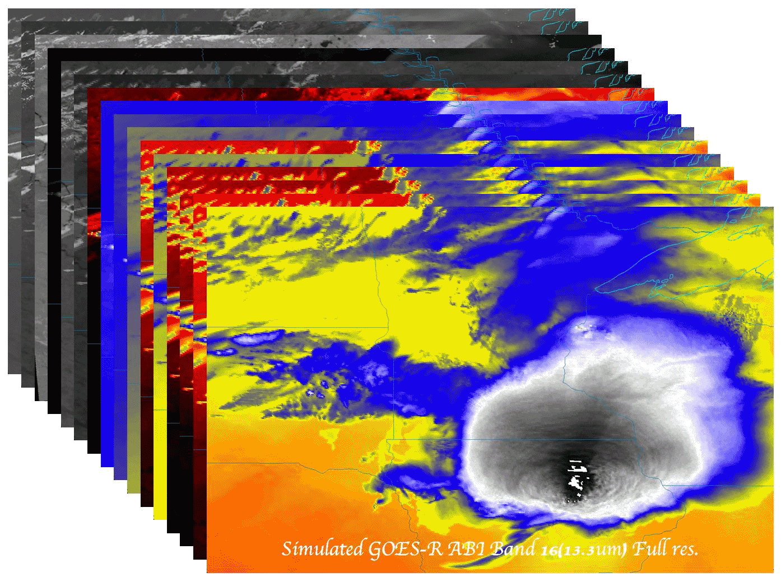
Operational uses of the ABI (Advanced Baseline Imager) on the GOES-R series
Timothy J. Schmit (tim.j.schmit@noaa.gov)
NOAA/NESDIS/Satellite Applications and Research
Advanced Satellite Products Branch (ASPB)
Madison, WI
Mathew M. Gunshor, Kaba Bah, James J. Gurka, Jason Otkin
National Weather Association 37th Annual Meeting Monona Terrace Convention Center, Madison, Wisconsin October 8, 2012
UW-Madison

Slide 2
Thanks to…
Scott Lindstrom, Scott Bachmeier, Joleen Feltz, William Straka, Jun Li, Scott Bachmeier, Steve Ackerman, Bob Aune, Don Hillger, Paul Menzel, Steve Ackerman, Tony Schreiner, Justin Sieglaff, Jim Jung, Elaine Prins, Brad Pierce, Wayne Feltz, Jean Phillips, Gary Wade, Don Hillger, Jinlong Li, Jing Zheng, Allen Huang, Bob Rabin, the SSEC data center, Mike Pavolonis, Jaime Daniels, ASPB, STAR, NESDIS, NSSL, MUG, Kevin Ludlum, GOES operators, GOES shift supervisors, Mark DeMaria, and many others!
GOES-R Program Office (Steve Goodman, etc.), NASA, ITT Industries, other industry partners, etc.
You.

Slide 3
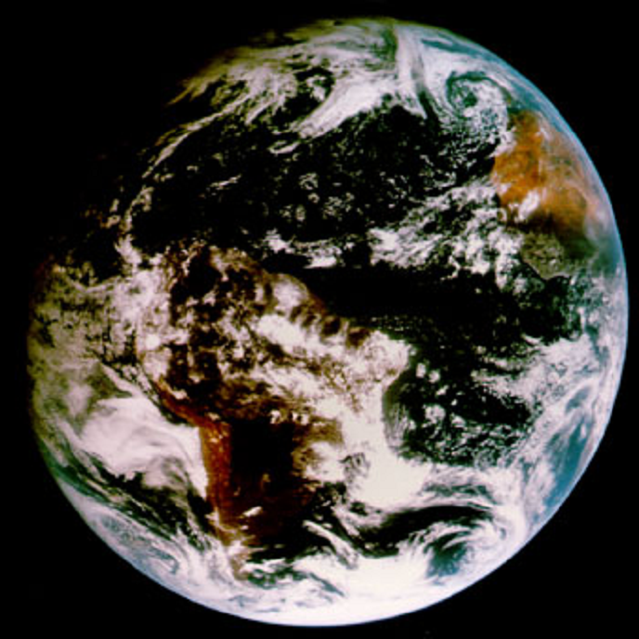
Outline
ABI (Advanced Baseline Imager)
Temporal
Spatial
Spectral
Products
Summary
More information
Questions

Slide 4
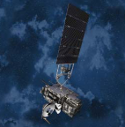
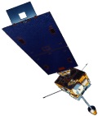
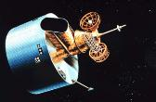
GOES-R series is 5th Generation!
GOES-1/3
Launched
1975
1977 1978
One visible and one infrared .
Operational.
GOES-4/7
Launched
1980
1981
1983
1987
VISSR–VAS visible, 12 IR. MSI (visible, IRW, and 2 additional IR channels)
GOES-8/12
Launched
1994
1995
1997
2000
2001
3-axis stabilized.
Imager Bands: 4 IR; 1 visible.
Operational Sounder
(18 IR bands)
GOES-13/14/15
Launched
2005
2009
2010
Better navigation and calibration.
No eclipse outages.
Better spatial resolutions for the 6.5 um on GOES-12+ and the 13.3 um band on GOES-14/15.
Operational Sounder
GOES-R/S+
Planned Launch
2015
2017
2020
2025
Faster coverage.
16 Imager Bands.
Improved spatial.
No sounder.
GLM
Notes:
The circles represent an estimate of the impact of GOES on regional scale numerical models.

Slide 5
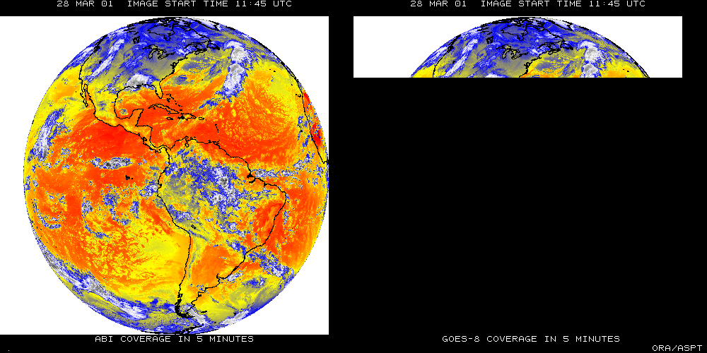
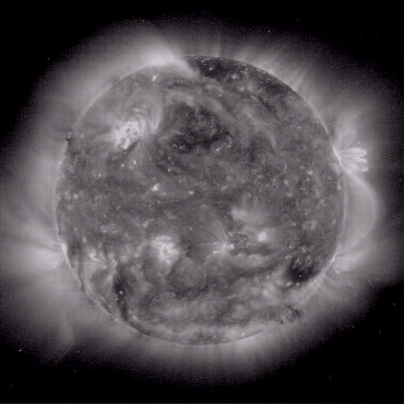
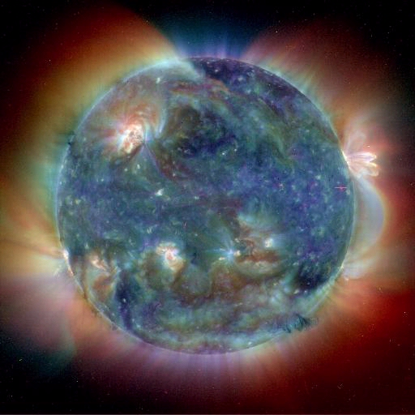
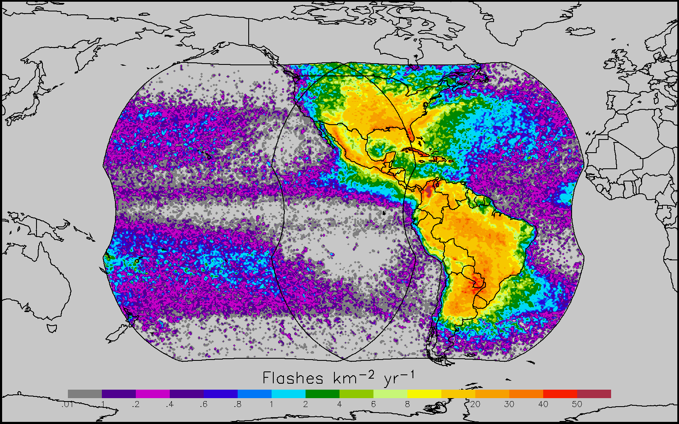
GOES-R main instruments
ABI – Advanced Baseline Imager
Space Weather/Solar
ABI covers the earth approximately five times faster than the current Imager.
Geostationary Lightning Mapper
Images courtesy of SOHO EIT, a joint NASA/ESA program

Slide 6
GOES-R Overview
Advanced Baseline Imager (ABI)
Geostationary Lightning Mapper (GLM)
Space Weather
Space Environmental In-Situ Suite (SEISS)
Solar Ultra Violet Imager (SUVI)
Extreme Ultra Violet/X-Ray Irradiance Sensor (EXIS)
Magnetometer
No dedicated Sounder
Communications
GOES Rebroadcast (GRB)
Low Rate Information Transmissions (LRIT)
Emergency Managers Weather Information Network (EMWIN)
Search and Rescue (SAR)
Data Collection System (DCS)
Notes:
Advanced Baseline Imager (ABI) Earth-viewing
Geostationary Lightning Mapper (GLM) Earth-viewing
Solar Ultra-Violet Imager (SUVI) Sun-viewing
EUVS and XRS Irradiance Sensors (EXIS) Sun-viewing
Space Environment In-Situ Suite (SEISS) Space-viewing
Magnetometer (MAG) Space-viewing

Slide 7
GOES Fly-out Schedule

Slide 8
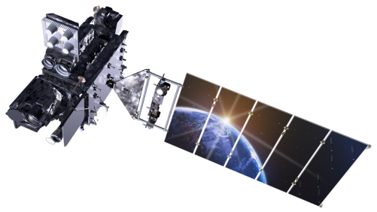
Outline
ABI (Advanced Baseline Imager)
Temporal
Spatial
Spectral
Products
Summary
More information
Questions
Lockheed Martin

Slide 9
The Advanced Baseline Imager:
ABI Current
Spectral Coverage
16 bands 5 bands
Spatial resolution
0.64 μm Visible 0.5 km Approx. 1 km
Other Visible/near-IR 1.0 km n/a
Bands (>2 μm) 2 km Approx. 4 km
Spatial coverage
Full disk 4 per hour Scheduled (3 hrly)
CONUS 12 per hour ~4 per hour
Mesoscale Every 30 sec n/a
Visible (reflective bands)
On-orbit calibration Yes No

Slide 10
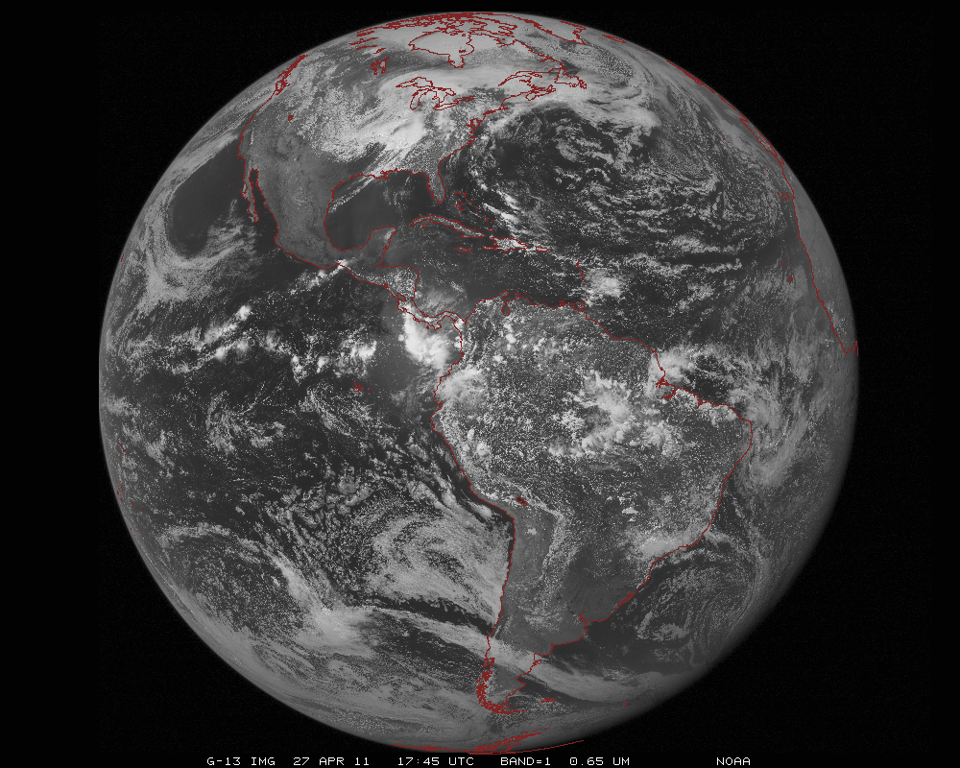
ABI scans about 5 times faster
than the current GOES imager
Anticipated scan mode for the ABI:
- Full disk images every 15 minutes + 5 min CONUS images + mesoscale.

Slide 11
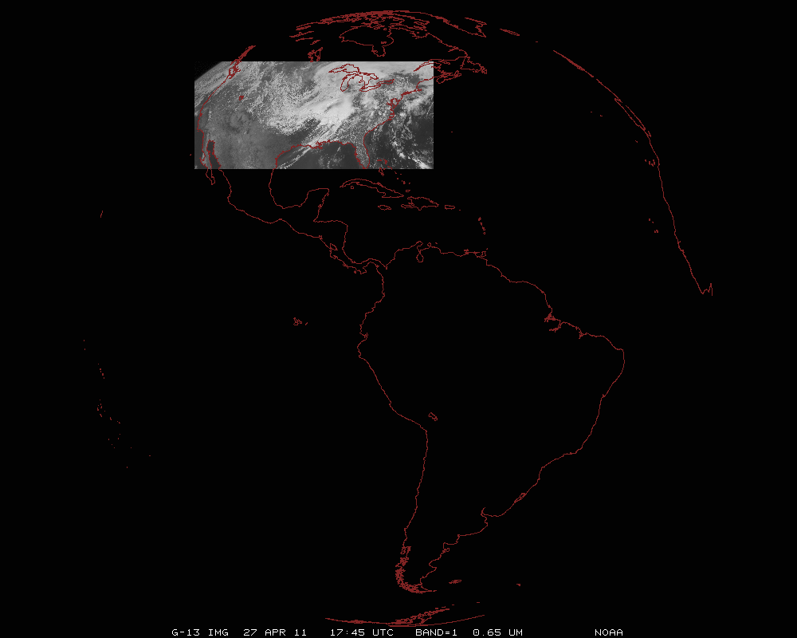
ABI can offer Continental US images every 5 minutes for routine monitoring of a wide range of events (storms, dust, clouds, fires, winds, etc).
This is every 15 or 30 minutes with the current GOES in routine mode.
Notes:
Approx. size of CONUS

Slide 12
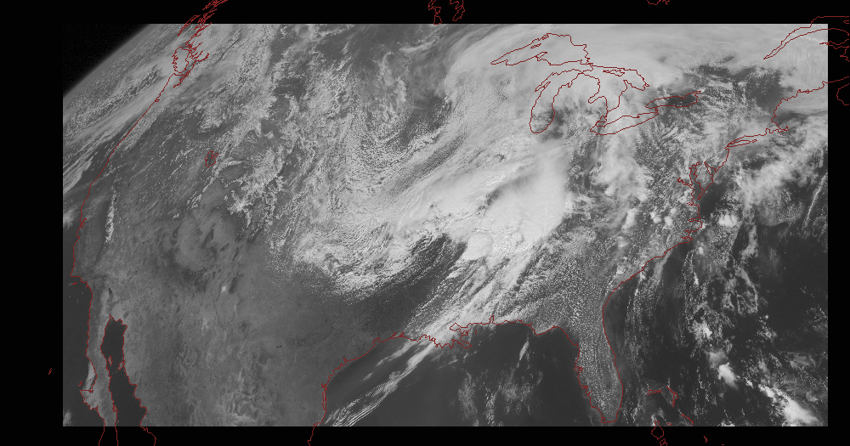
Notes:
Approx. size of CONUS

Slide 13
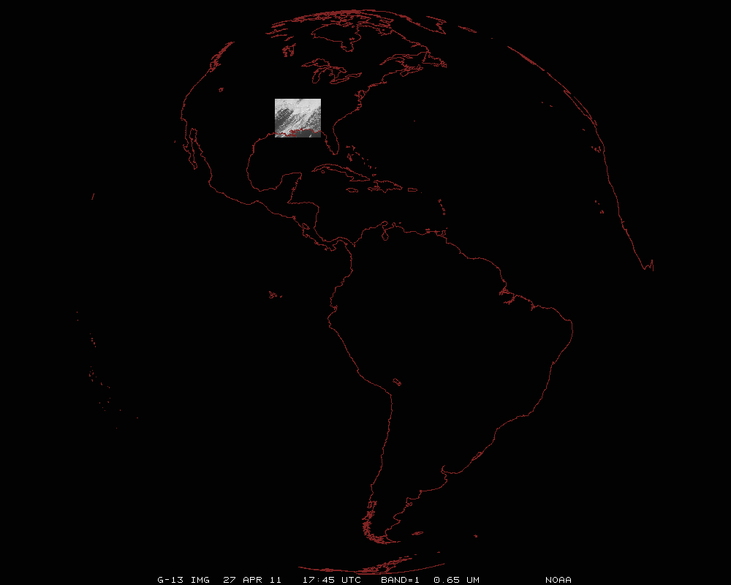
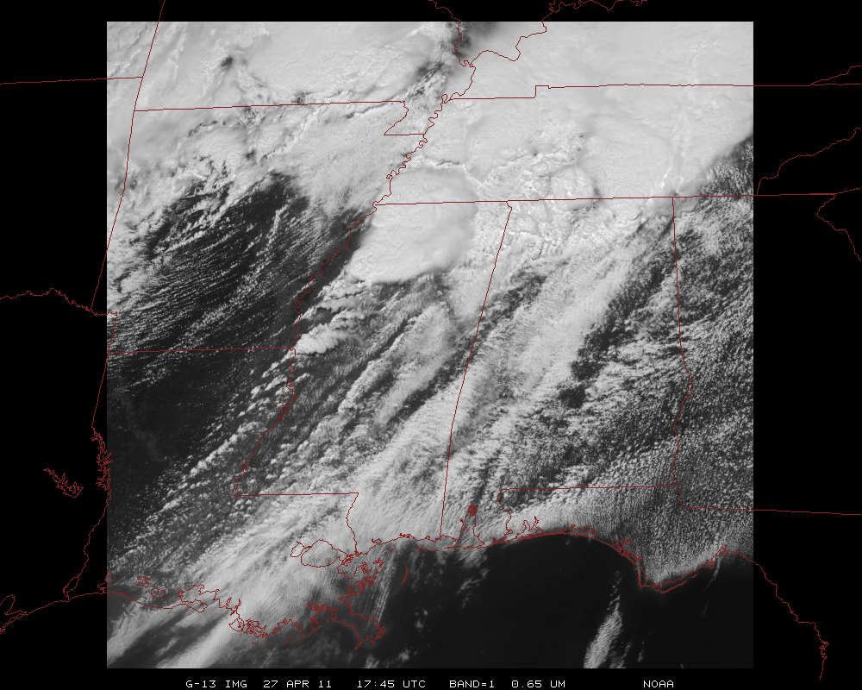
Mesoscale images every 30 seconds for rapidly changing phenomena
(thunderstorms, hurricanes, fires, etc). Or two regions every 60 seconds.
Notes:
Approx. size of meso-scale showing “Franklin”.

Slide 14
1-min imagery
Operational (GOES-13)
1-min mode (SRSOR from GOES-14)

Slide 15
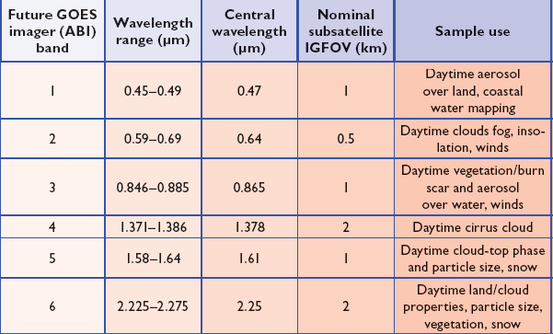
ABI Visible/Near-IR Bands
Schmit et al, 2005
Notes:
Schmit, T. J., M. M. Gunshor, W. P. Menzel, J. J. Gurka, J. Li, and A. S. Bachmeier, 2005: Introducing the next-generation Advanced Baseline Imager on GOES-R. Bull. Amer. Meteor. Soc., 86, 1079-1096.

Slide 16
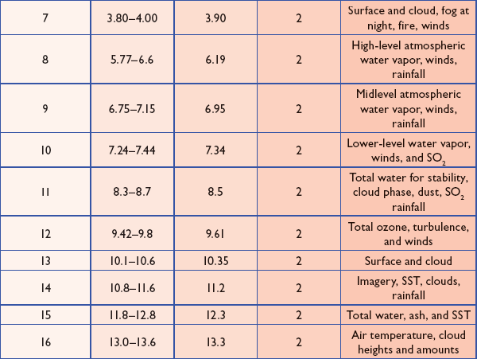
ABI IR Bands
Schmit et al, 2005
Notes:
Schmit, T. J., M. M. Gunshor, W. P. Menzel, J. J. Gurka, J. Li, and A. S. Bachmeier, 2005: Introducing the next-generation Advanced Baseline Imager on GOES-R. Bull. Amer. Meteor. Soc., 86, 1079-1096.

Slide 17
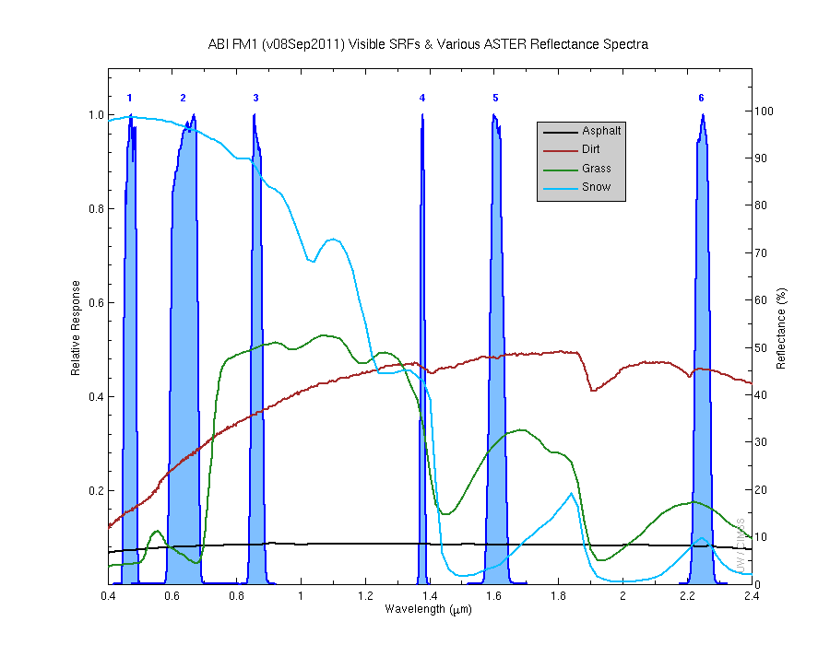
Visible and near-IR channels on the ABI
Aerosols, Insolation
Clouds, Snow
Vegetation, Imagery
Cloud mask, Suspended matter
Snow, Phase
Cloud Particle size
Sample use only, many other uses
The ABI visible and near-IR bands have many uses.
Notes:
Schmit, T. J., M. M. Gunshor, W. P. Menzel, J. J. Gurka, J. Li, and A. S. Bachmeier, 2005: Introducing the next-generation Advanced Baseline Imager on GOES-R. Bull. Amer. Meteor. Soc., 86, 1079-1096.

Slide 18
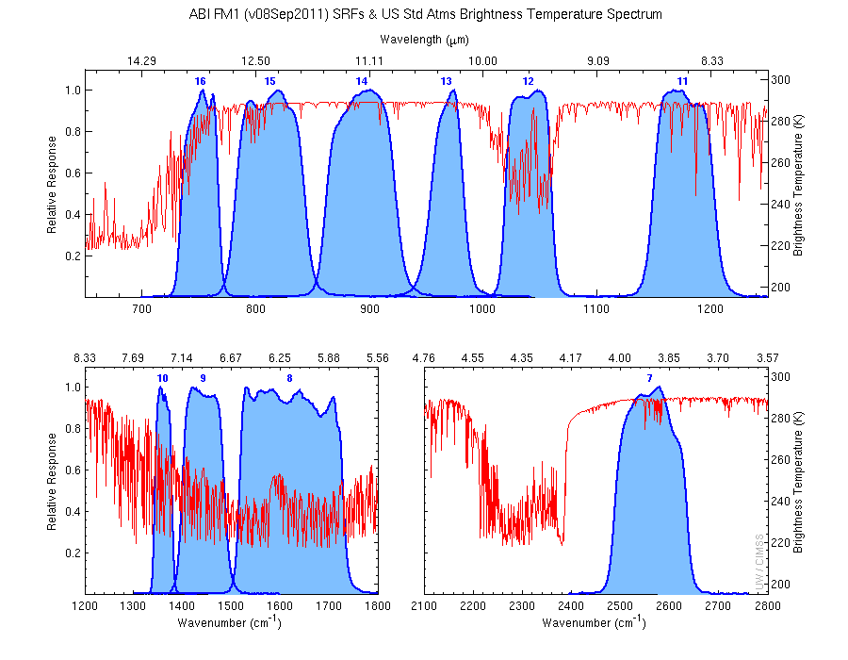
The IR channels on the ABI
Clouds, Stability Indices
SST, Fires, Radiances
Ozone, Downward Radiation
Rainfall, Aerosol
Hurricane, Imagery
Cloud Phase, SST
Sample use only, many other uses
SO2, Radiances
Winds, WV profiling
TPW, Rainfall rate
Fires, Fog
ABI has many more bands than the current operational GOES imagers.
Notes:
Schmit, T. J., M. M. Gunshor, W. P. Menzel, J. J. Gurka, J. Li, and A. S. Bachmeier, 2005: Introducing the next-generation Advanced Baseline Imager on GOES-R. Bull. Amer. Meteor. Soc., 86, 1079-1096.

Slide 19
http://cimss.ssec.wisc.edu/goes/srsor/GOES-14_SRSOR.html

Slide 20
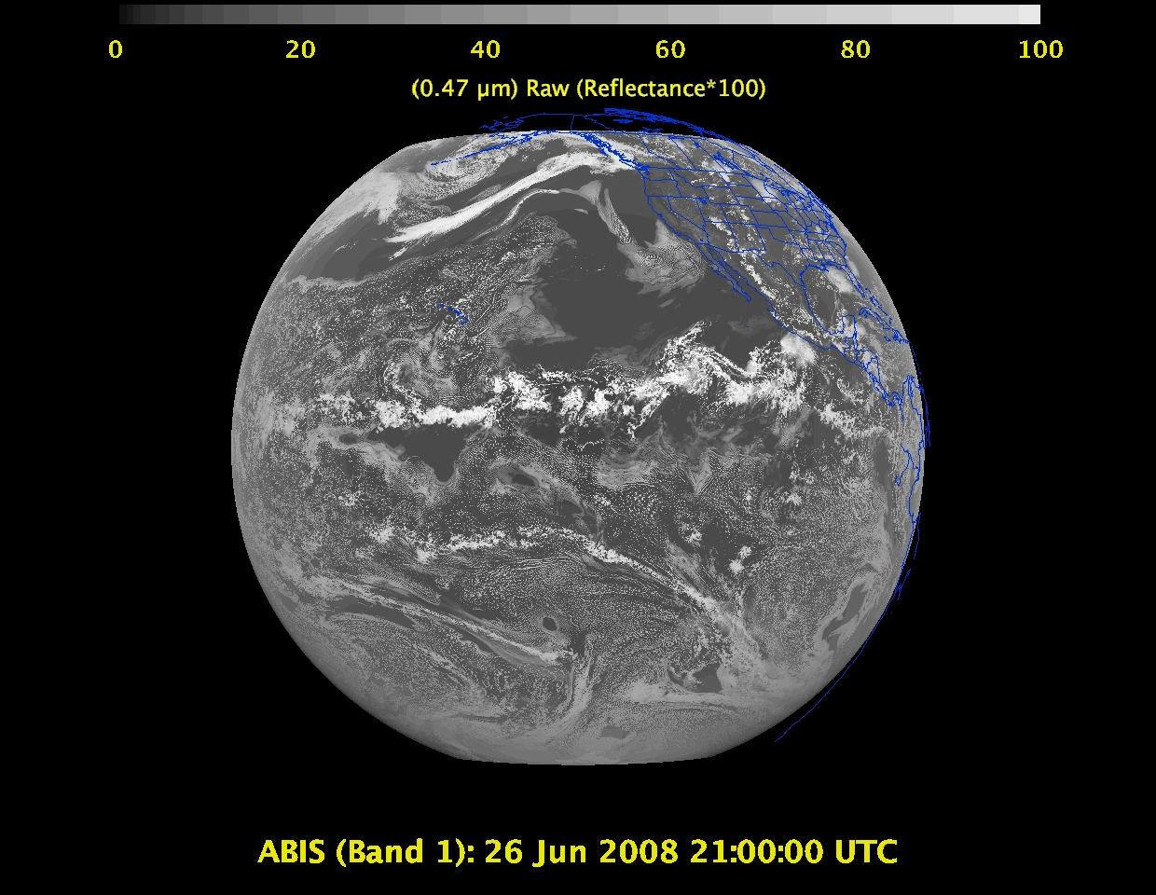
Daytime “Blue” band – aerosols, solar insolation, snow cover

Slide 21
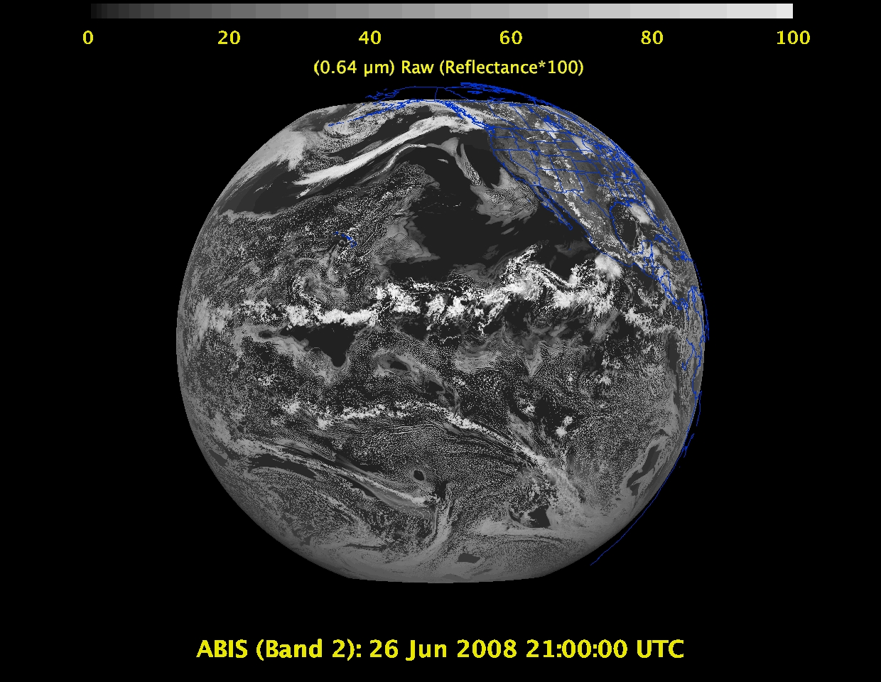
Daytime “Red” band – clouds, cloud-mask, optical depth, winds, etc.

Slide 22
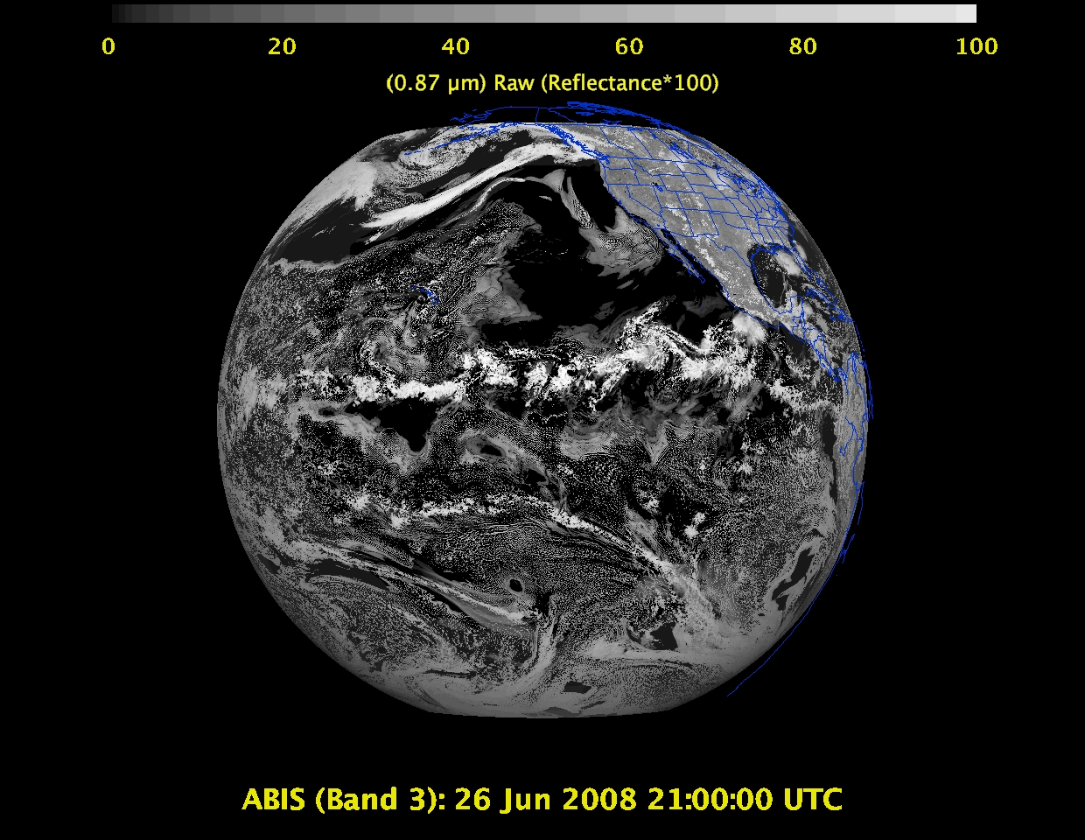
Daytime “Veggie” band – NDVI, solar insolation, snow cover

Slide 23
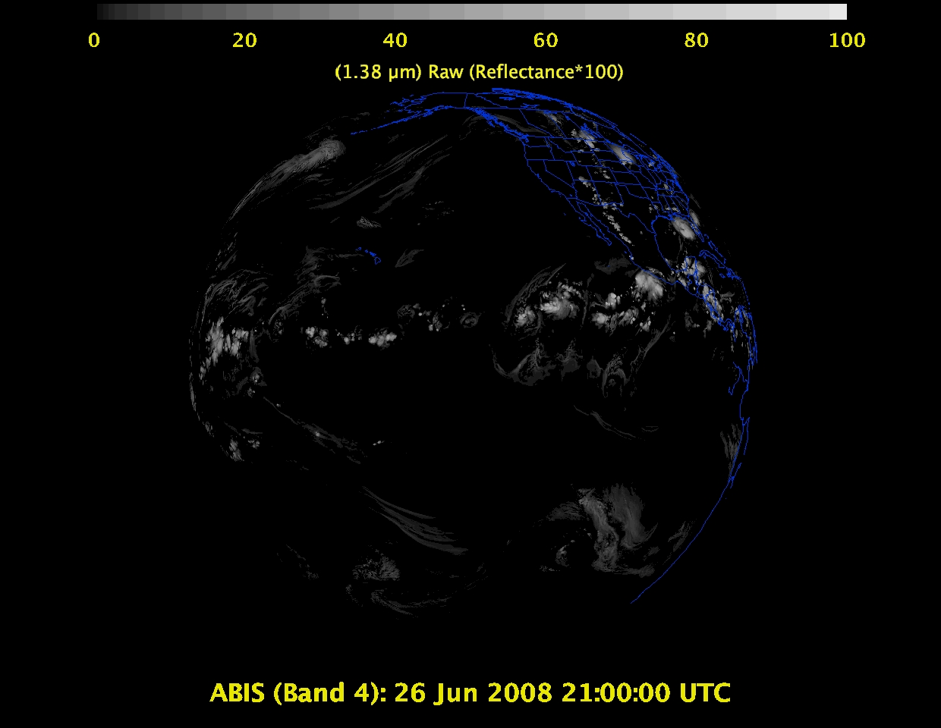
1 Daytime “Cirrus” band – cloud mask, aerosol detection

Slide 24
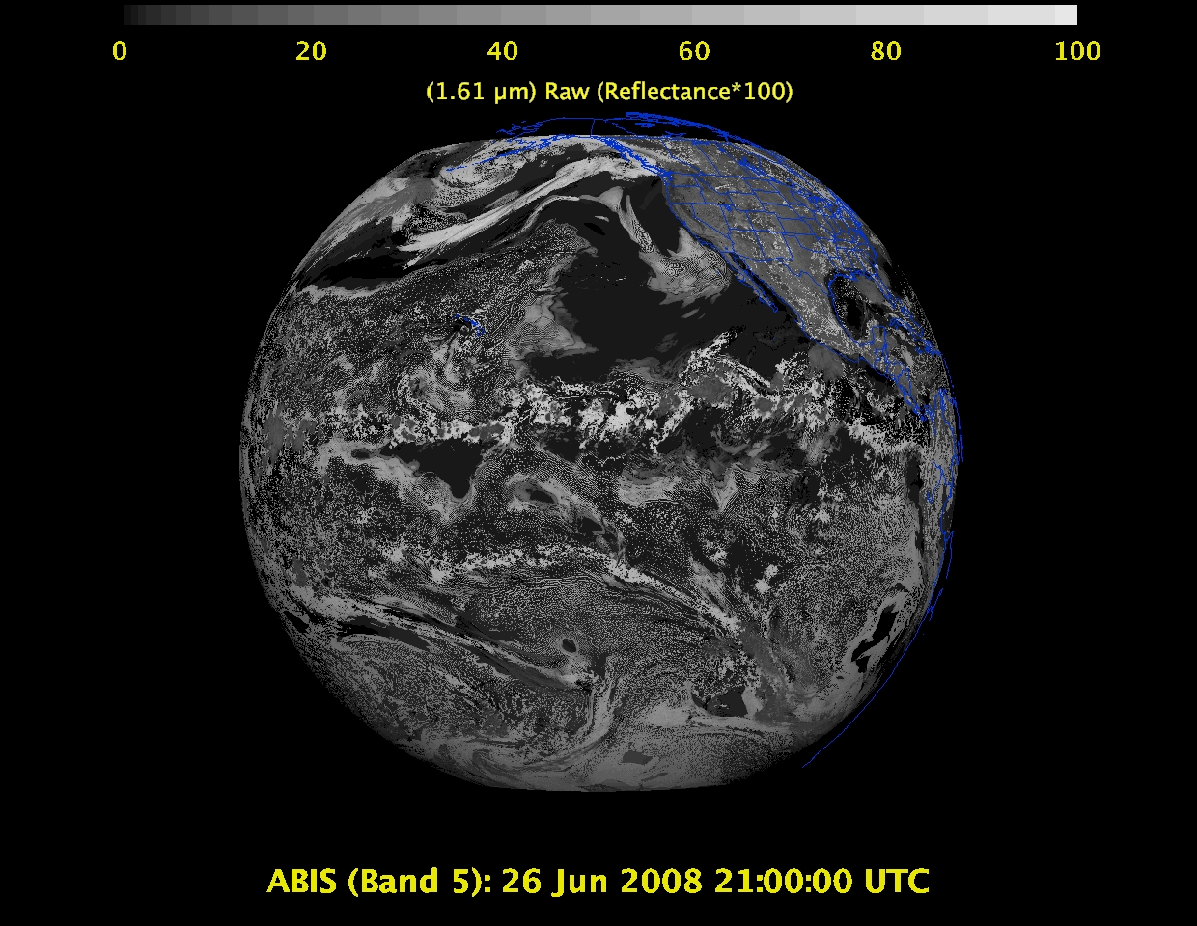
Daytime “Snow” band – snow cover, cloud mask, etc.

Slide 25
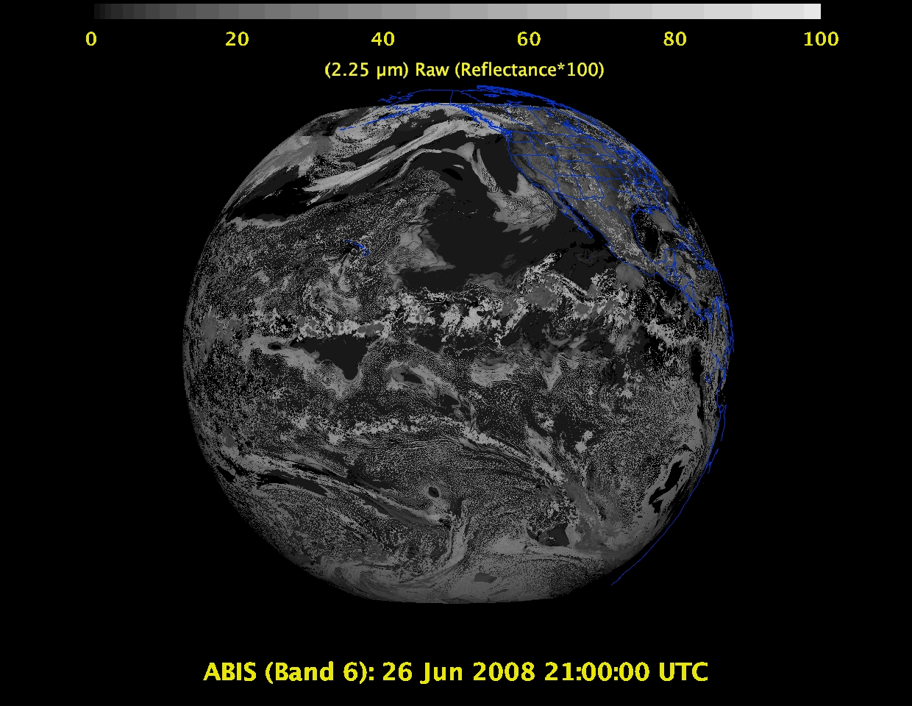
Daytime “Cloud-top phase” band – cloud particle size, snow cover

Slide 26
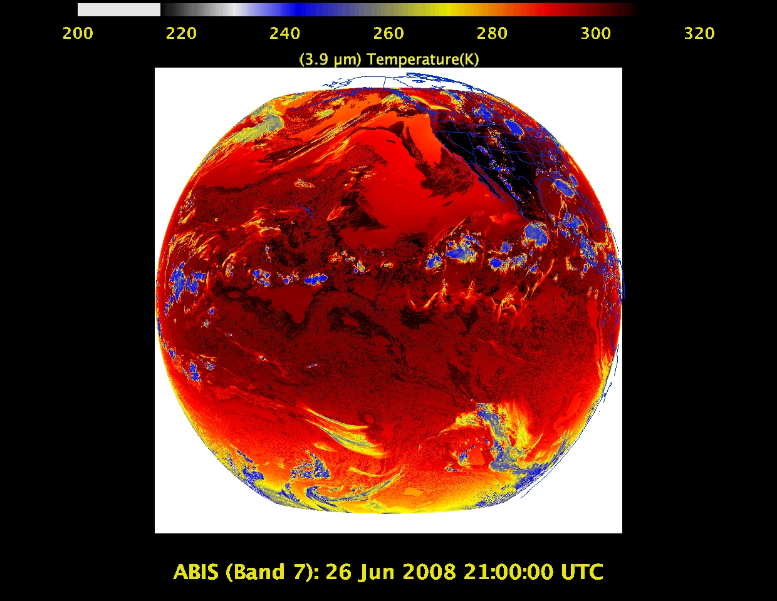
Shortwave IR window band - fog, fires, winds, SST, etc.

Slide 27
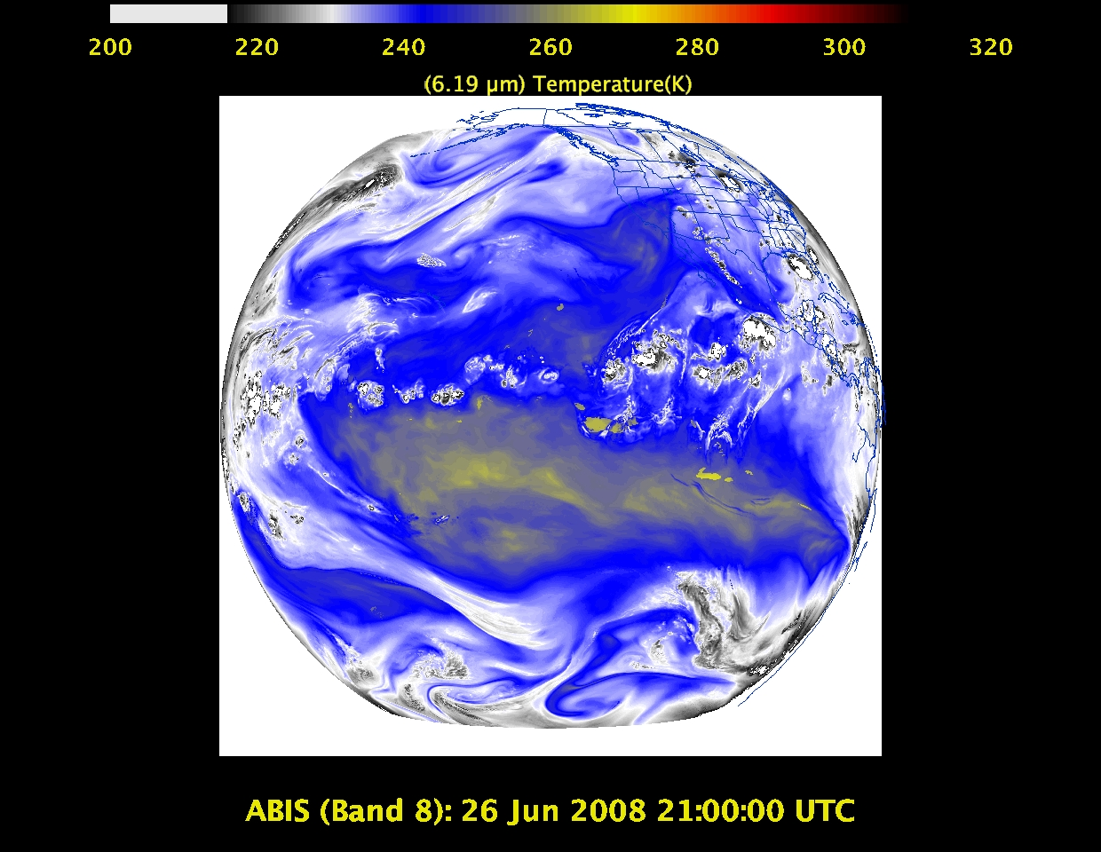
Upper-level tropospheric water vapor band – moisture, flow, winds

Slide 28
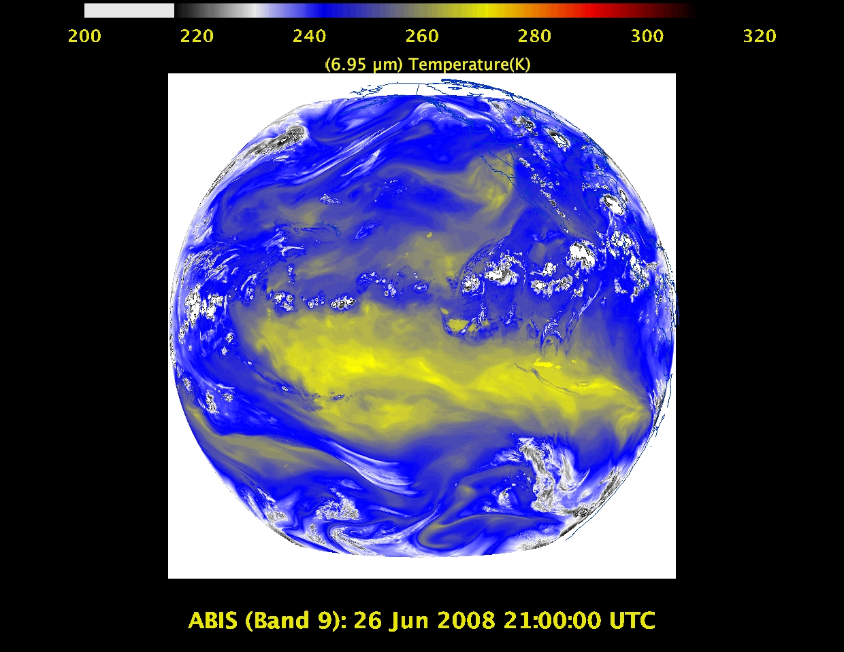
Upper/mid-level tropospheric water vapor band – moisture, flow, winds

Slide 29
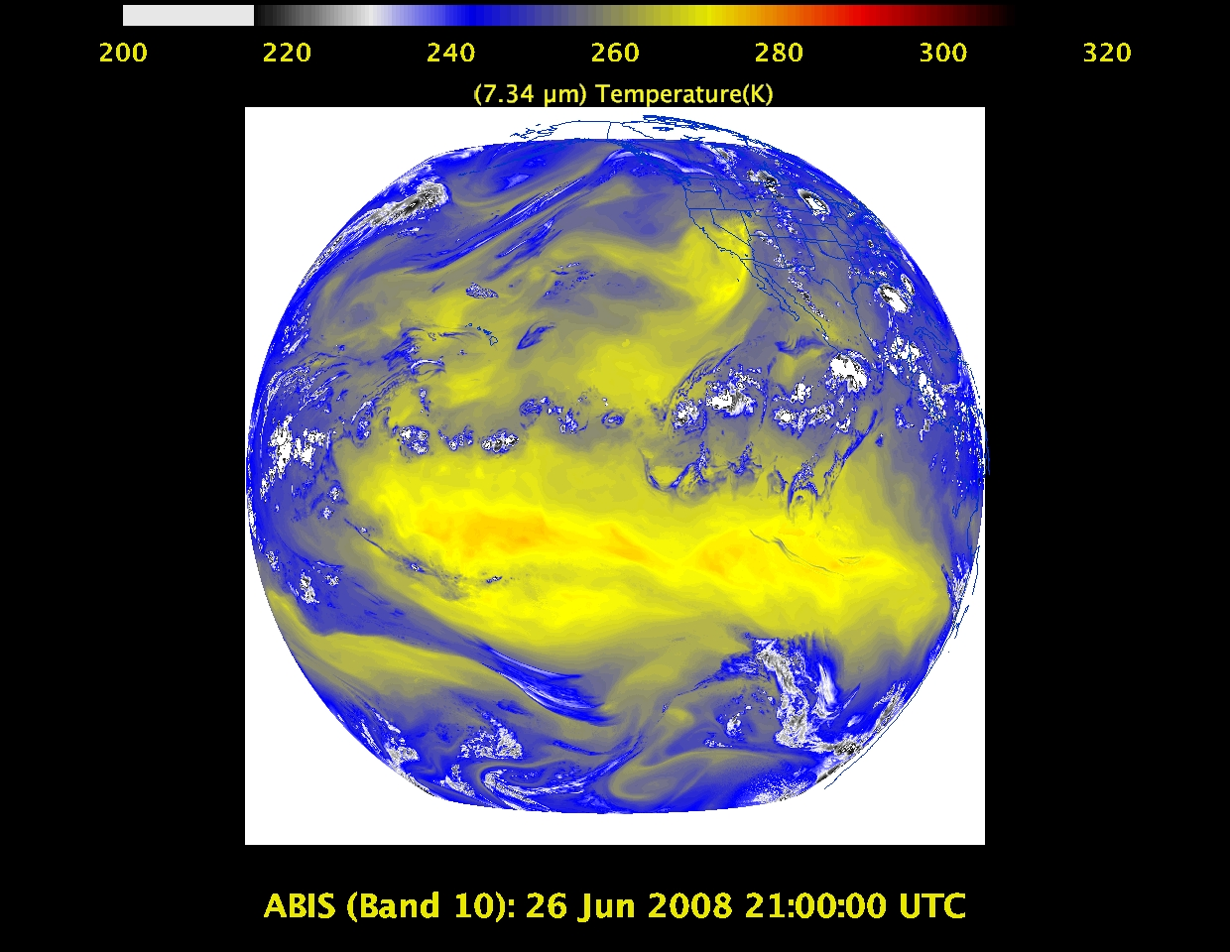
Lower mid-level tropospheric water vapor band– moisture, flow, winds

Slide 30
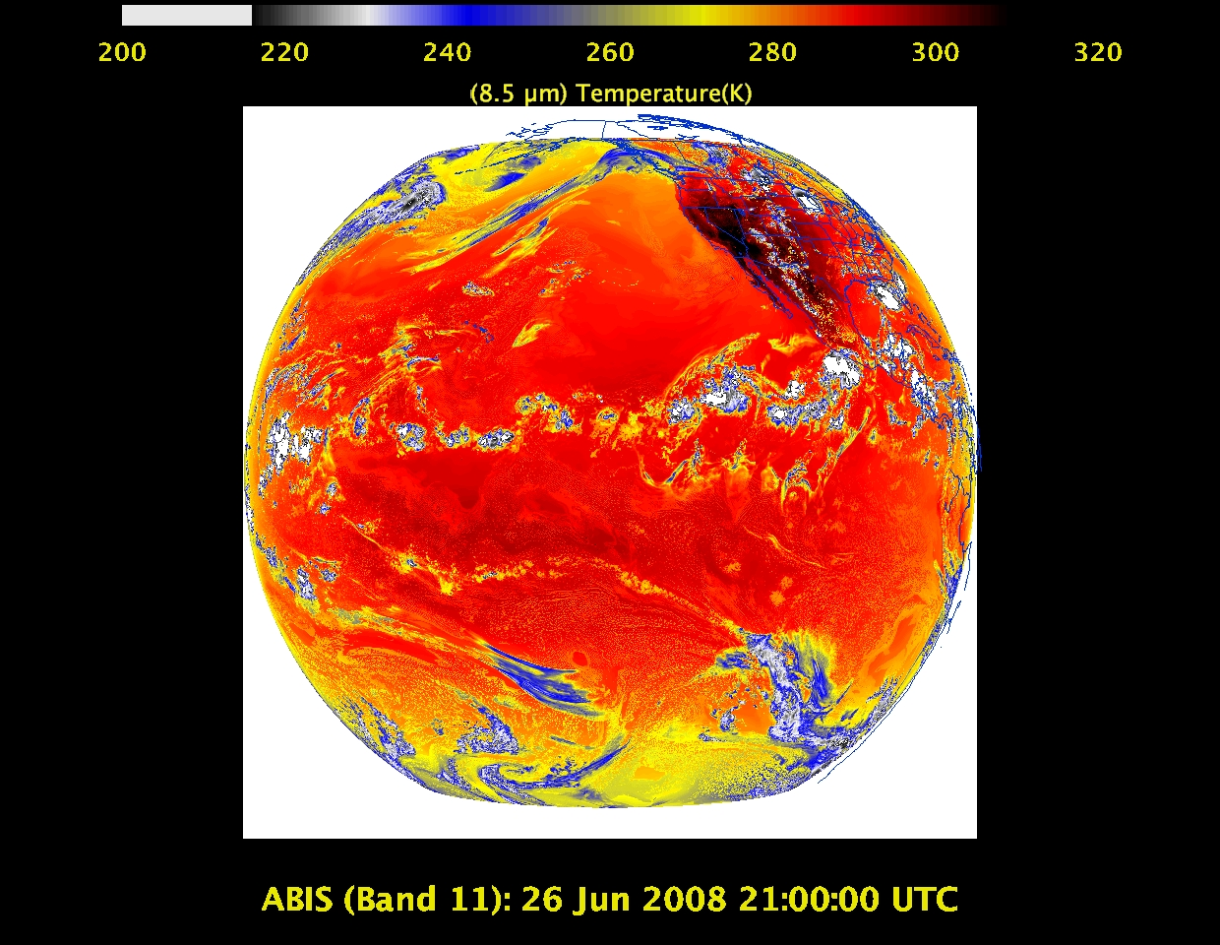
“Cloud-top phase” band – SO₂, dust, SST, stability indices, etc.

Slide 31
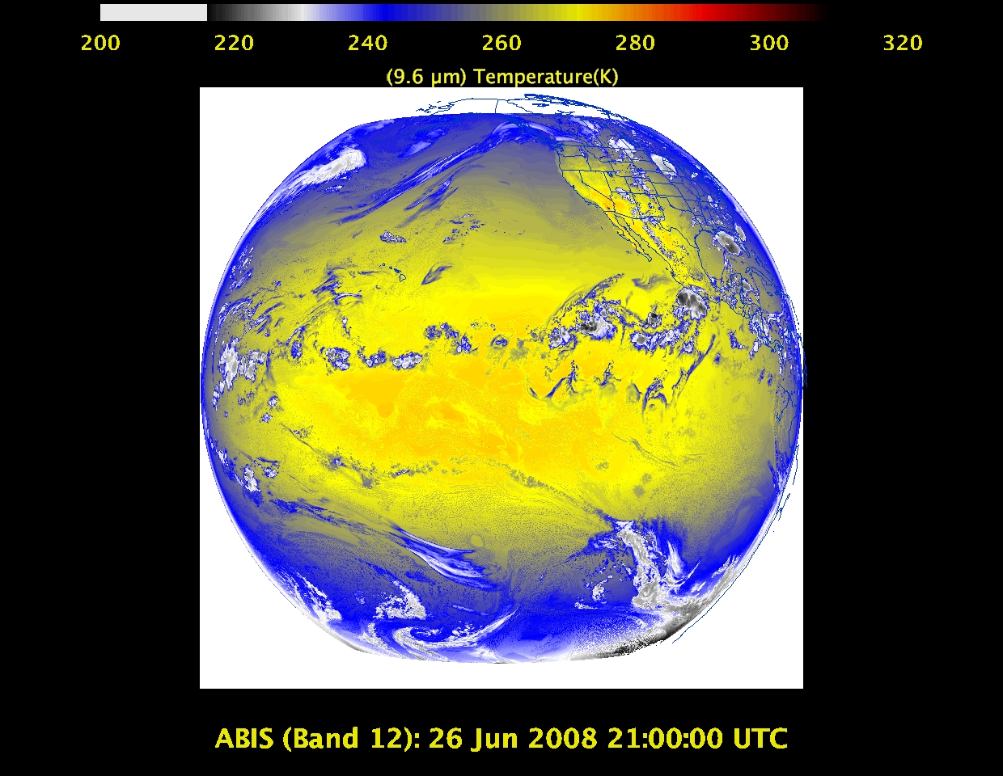
“Ozone” band

Slide 32
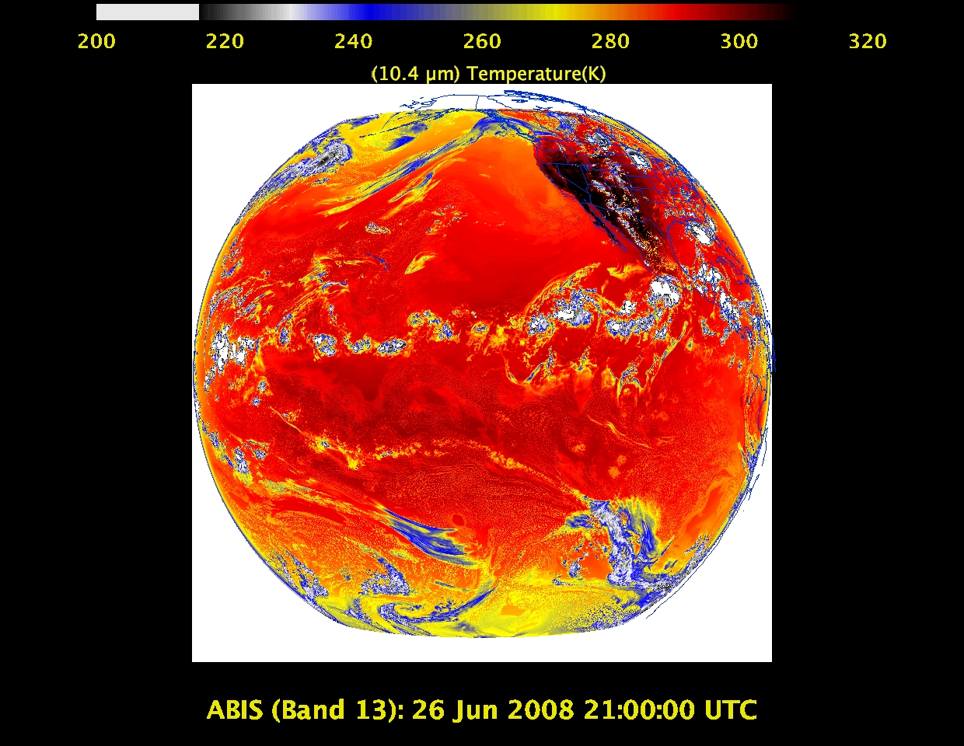
“Clean” IR longwave window band – imagery, TPW, etc.

Slide 33
IR longwave window band – many cloud parameters, SST, snow cover

Slide 34
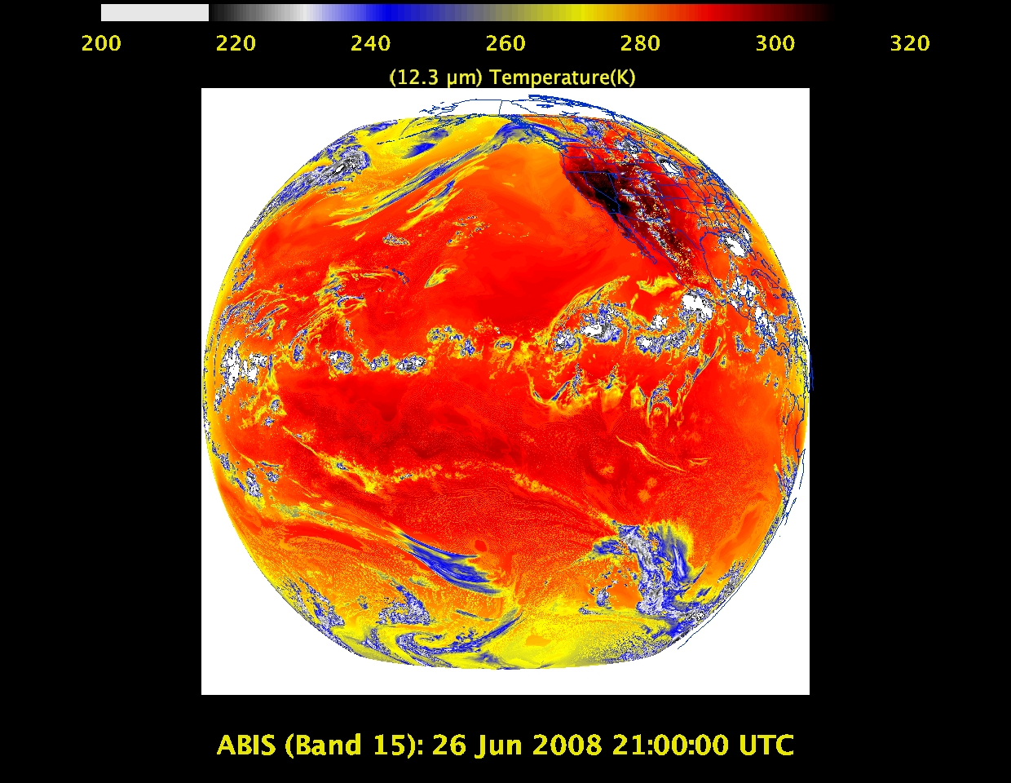
“Dirty” IR longwave window band – many cloud parameters, TPW

Slide 35
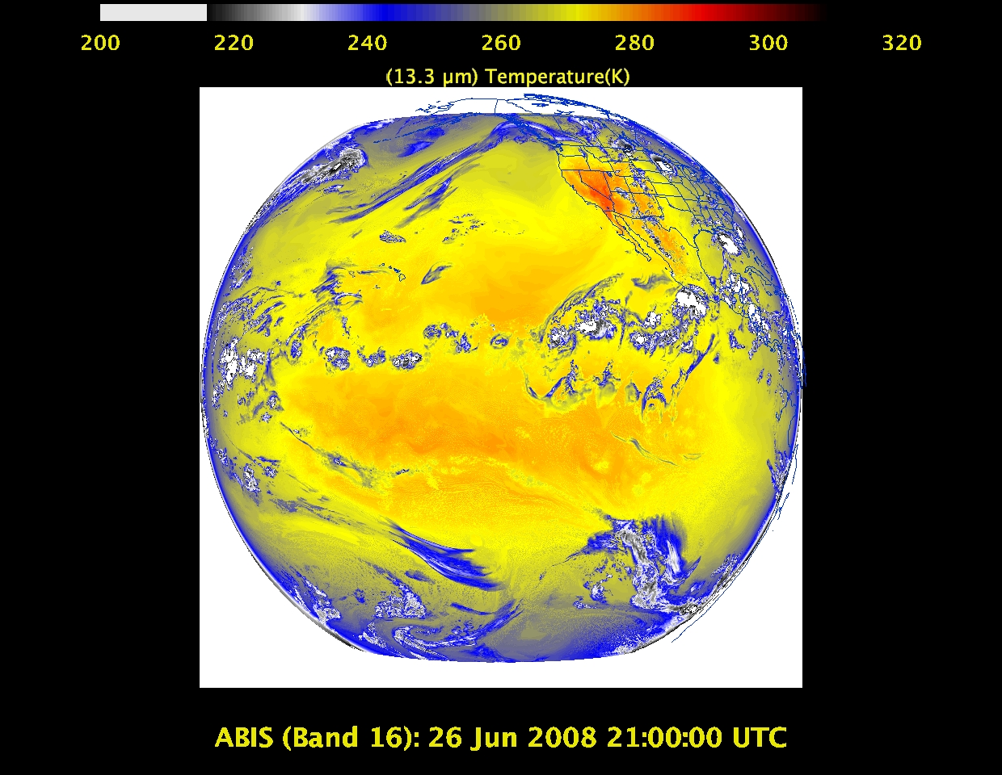
“CO2” longwave IR band – cloud height/pressure, stability indices

Slide 36
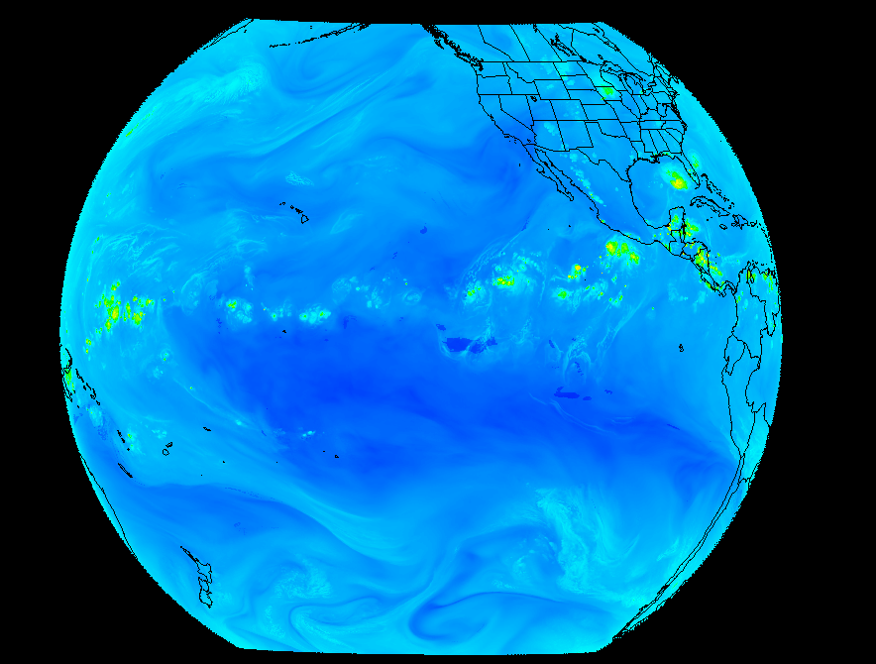
Outline
ABI (Advanced Baseline Imager)
Temporal
Spatial
Spectral
Products
Summary
More information
Questions

Slide 37
GOES-R ABI Products
Baseline Products
Future Capabilities
Advanced Baseline Imager (ABI)
Aerosol Detection (Including Smoke and Dust) Aerosol Optical Depth (AOD) Clear Sky Masks Cloud and Moisture Imagery Cloud Optical Depth Cloud Particle Size Distribution Cloud Top Height Cloud Top Phase Cloud Top Pressure Cloud Top Temperature Derived Motion Winds Derived Stability Indices Downward Shortwave Radiation: Surface Fire/Hot Spot Characterization Hurricane Intensity Estimation Land Surface Temperature (Skin) Legacy Vertical Moisture Profile Legacy Vertical Temperature Profile Radiances Rainfall Rate/QPE Reflected Shortwave Radiation: TOA Sea Surface Temperature (Skin) Snow Cover Total Precipitable Water Volcanic Ash: Detection and Height
Advanced Baseline Imager (ABI)
Absorbed Shortwave Radiation: Surface Aerosol Particle Size Aircraft Icing Threat Cloud Ice Water Path Cloud Layers/Heights Cloud Liquid Water Cloud Type Convective Initiation Currents Currents: Offshore Downward Longwave Radiation: Surface Enhanced “V”/Overshooting Top Detection Flood/Standing Water Ice Cover Low Cloud and Fog Ozone Total Probability of Rainfall Rainfall Potential Sea and Lake Ice: Age Sea and Lake Ice: Concentration Sea and Lake Ice: Motion Snow Depth (Over Plains) SO₂ Detection Surface Albedo Surface Emissivity Tropopause Folding Turbulence Prediction Upward Longwave Radiation: Surface Upward Longwave Radiation: TOA Vegetation Fraction: Green Vegetation Index Visibility

Slide 38
Three Groups of Users
Direct use of radiances/imagery
Numerical models
Forecasters
Broadcasters
General public/private sector/Internet
Direct use of satellite products
Numerical models
Forecasters
Blended products, etc.
General public/private sector/Internet
Use of services which use data/products
Basically everyone!

Slide 39
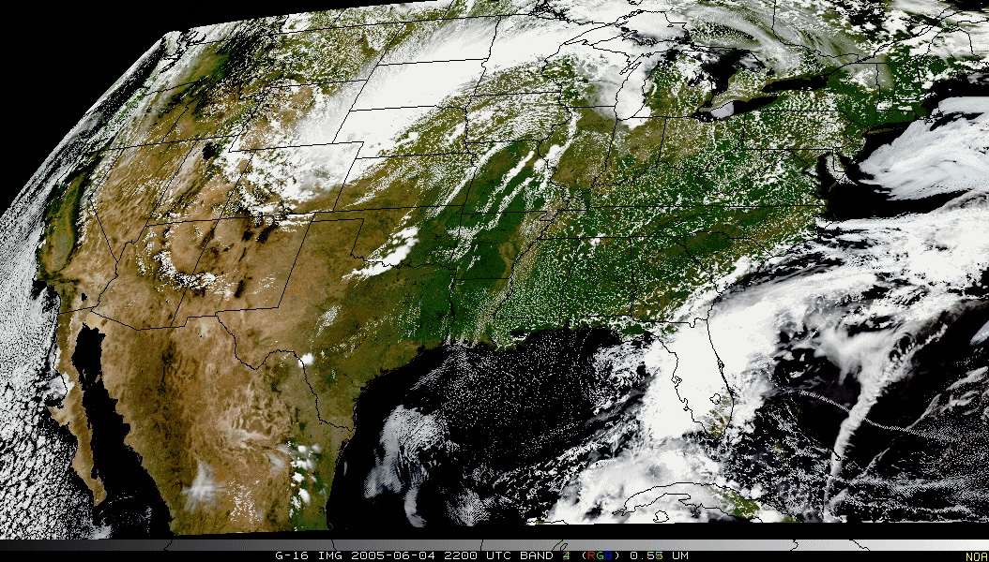
Pseudo-Natural Color

Slide 40
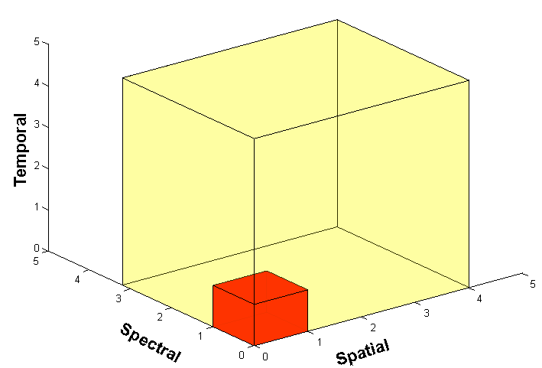
Outline
ABI (Advanced Baseline Imager)
Temporal
Spatial
Spectral
Products
Summary
More information
Questions

Slide 41
Approximate spectral and spatial resolutions of US GOES Imagers
~ Band Center (um) | GOES-6/7 | GOES-8/11 | GOES-12/N | GOES-O/P | GOES-R+
0.47
0.64
0.86
1.6
1.38
2.2
3.9
6.2
6.5/6.7/7 | 14km
7.3
8.5
9.7
10.35
11.2
12.3
13.3
Visible
Near-IR
Box size represents pixel size
8
4
2
“MSI mode”
Infrared
Notes:
0.40 inches = 4km; 0.80 inches = 8km
MSI is Multi-Spectral Imaging Mode (dashed boxes)
This does not show other improvements: SNR, MTF, bit-depth, navigation, coverage rates, etc.

Slide 42
Summary
1. The GOES-R ABI provides mission continuity
2. Two times the image navigation quality
3. Three times the number of imaging bands
4. Four times the spatial resolutions
5. Five times the coverage rate

Slide 43
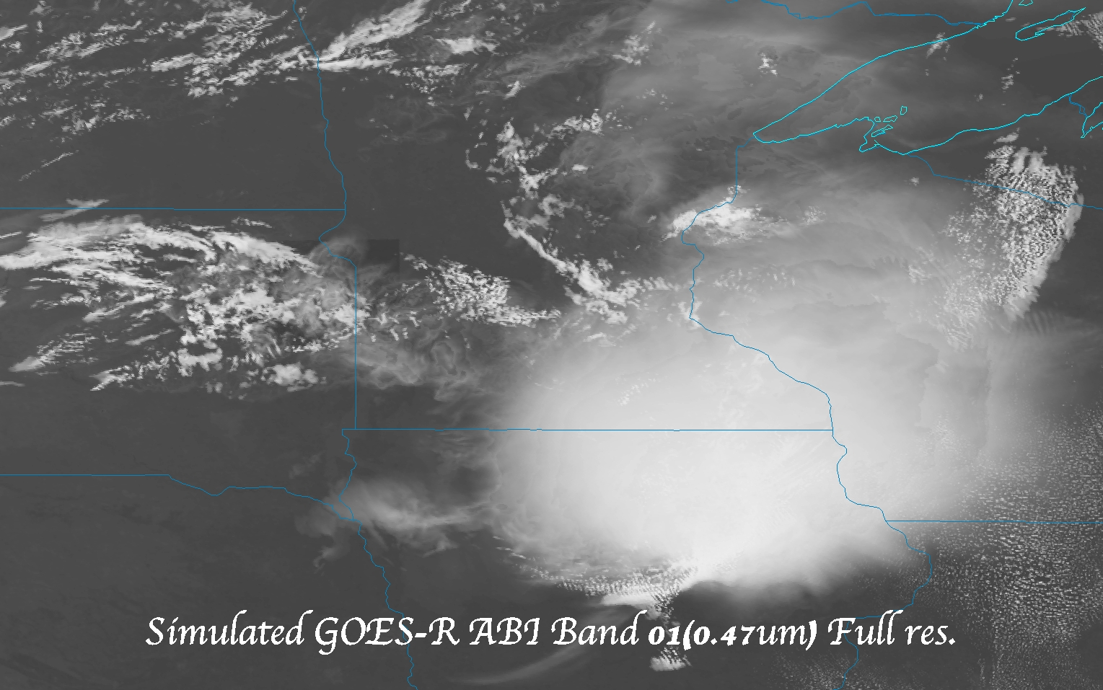
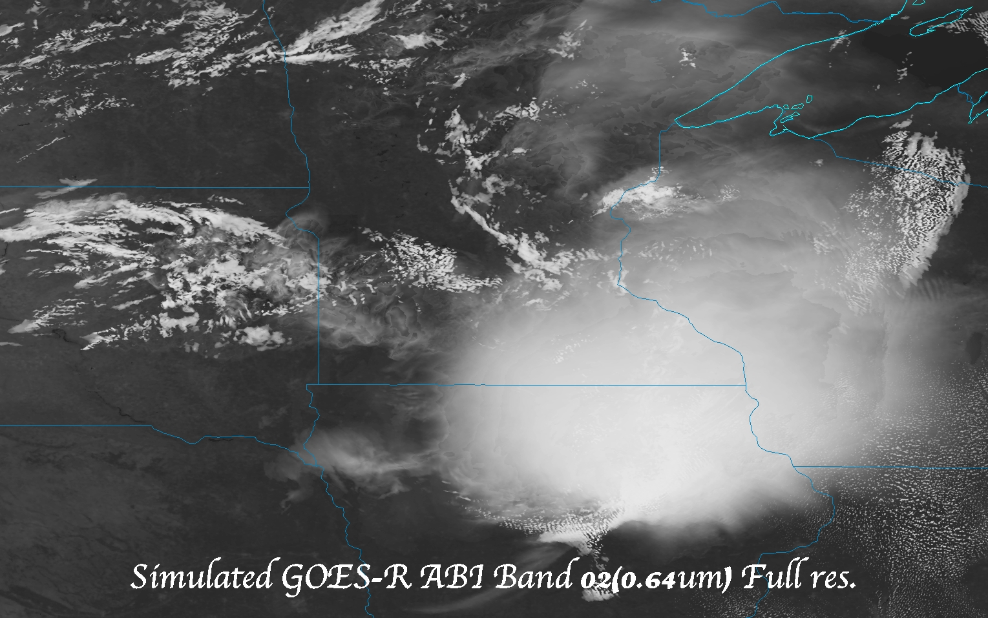
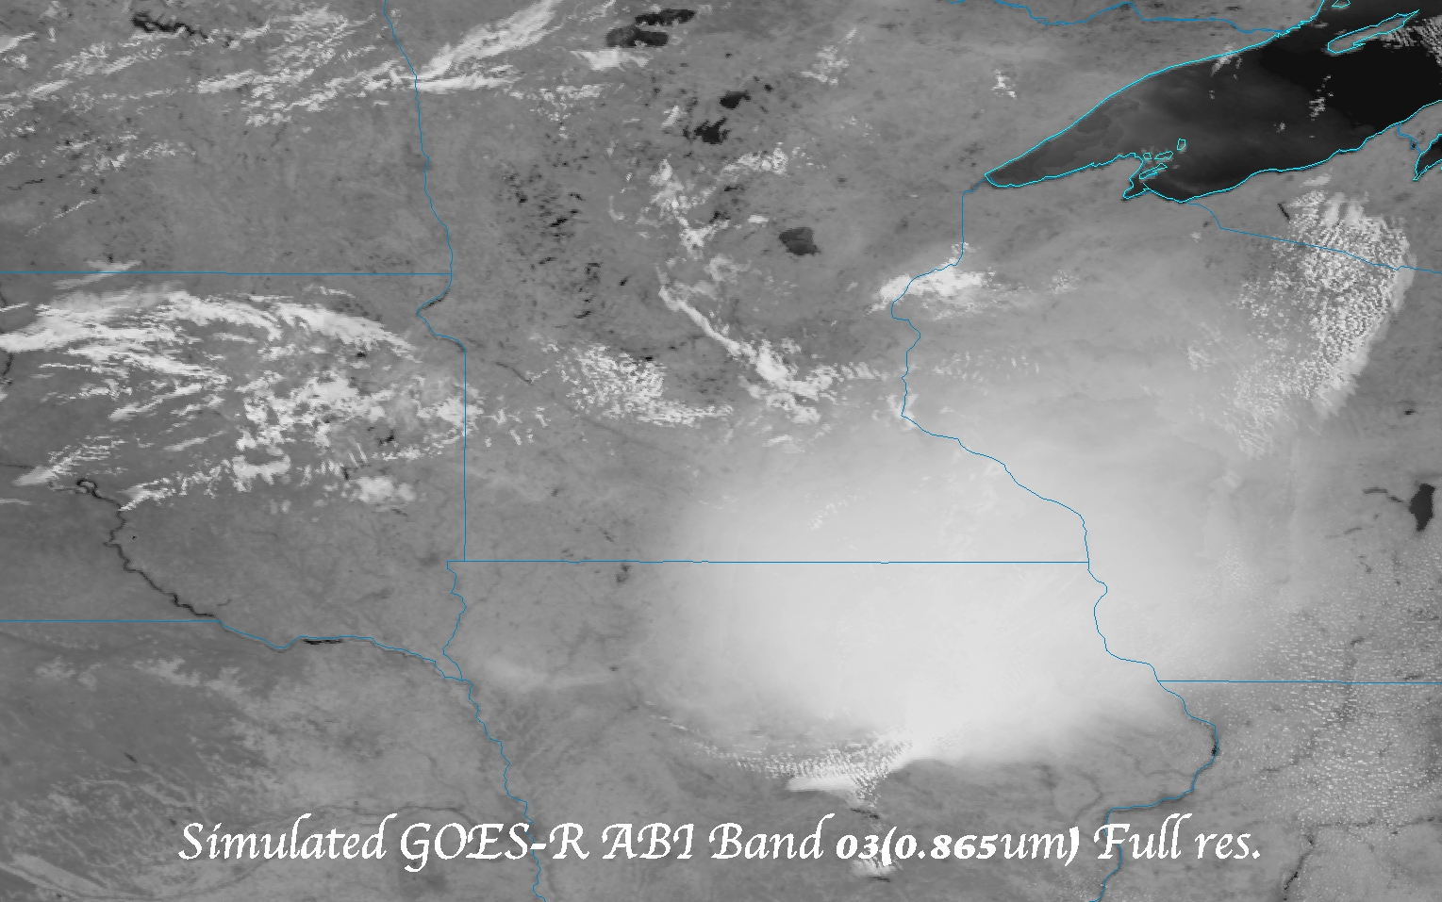
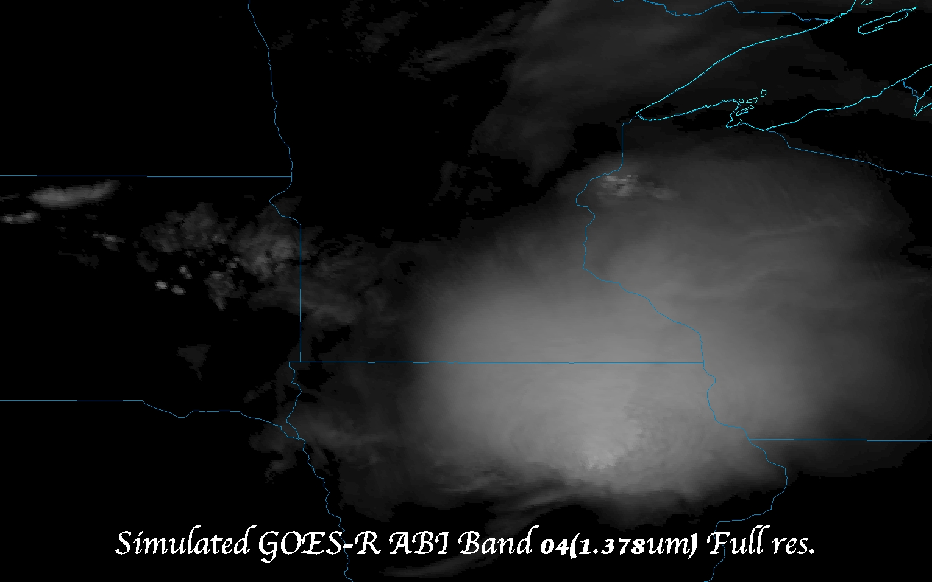
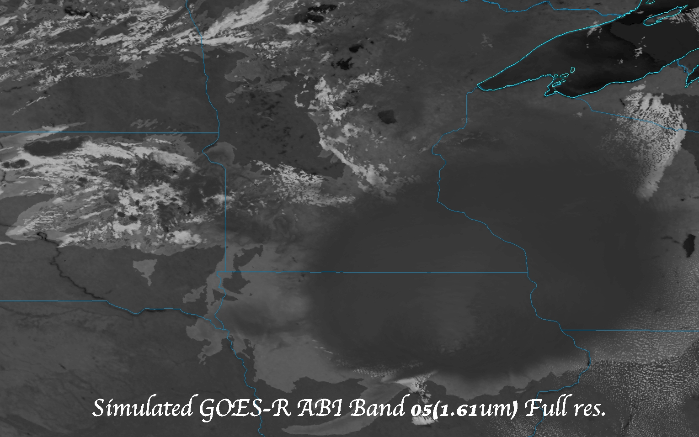
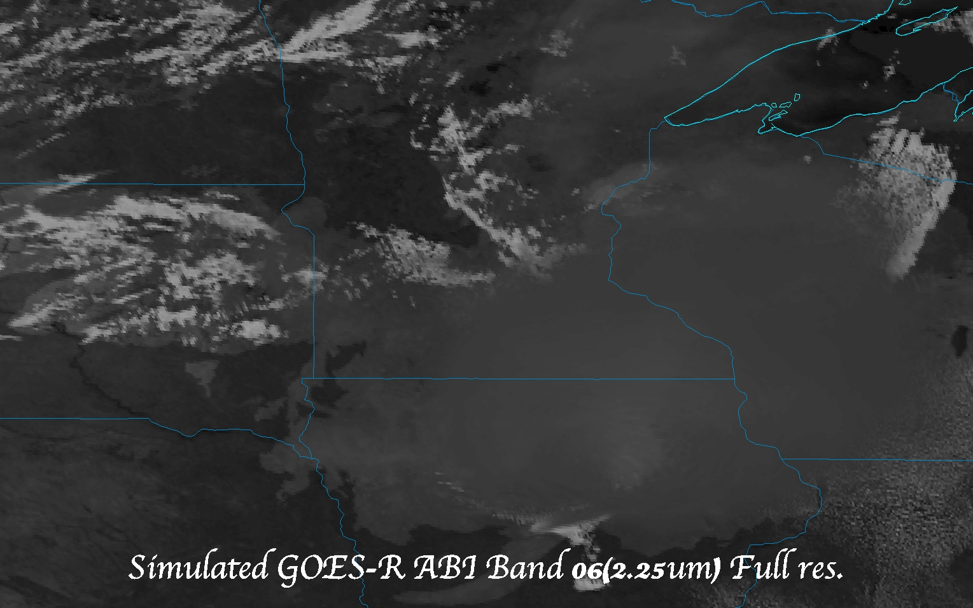
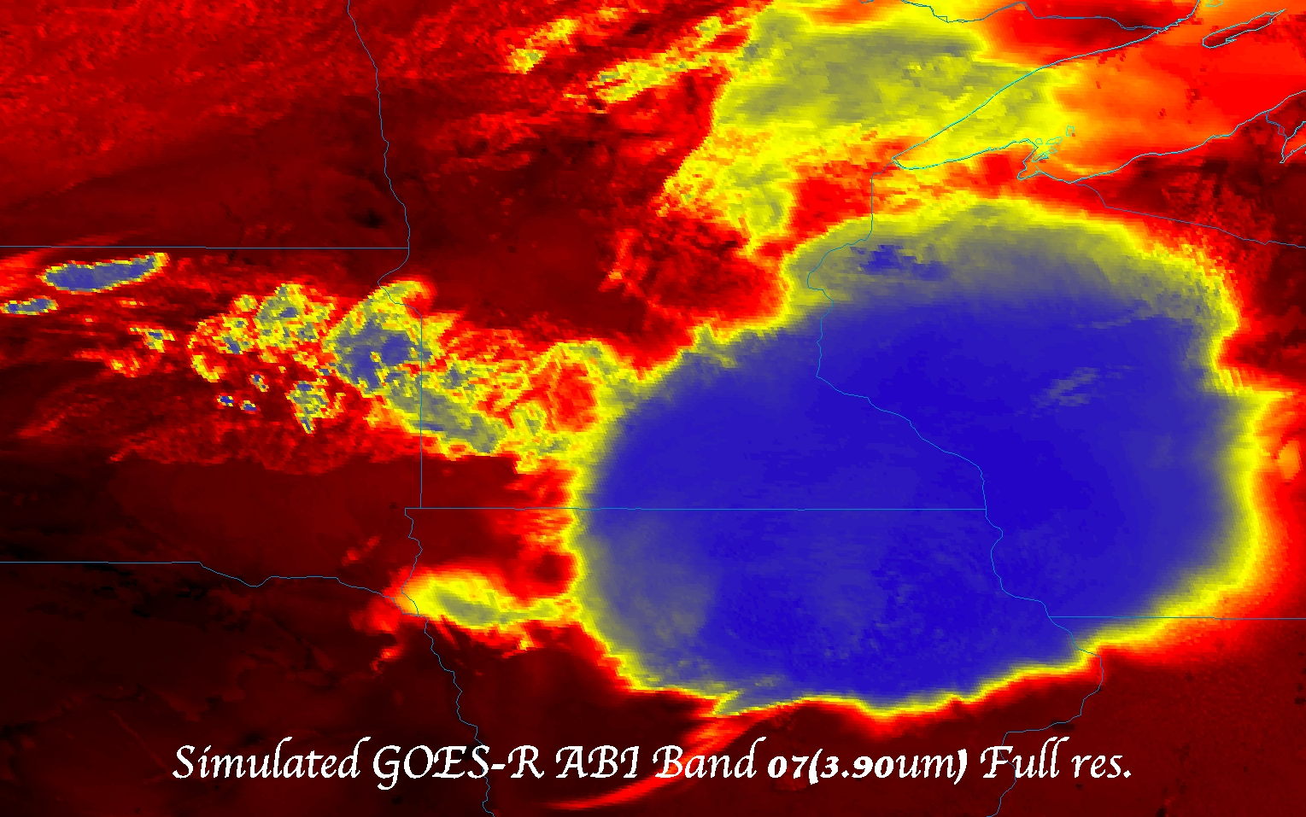
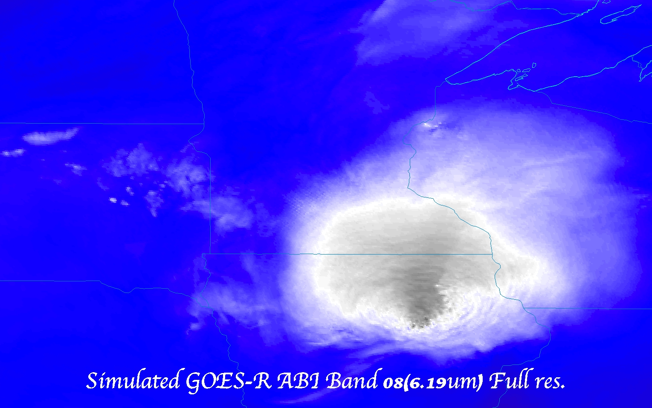
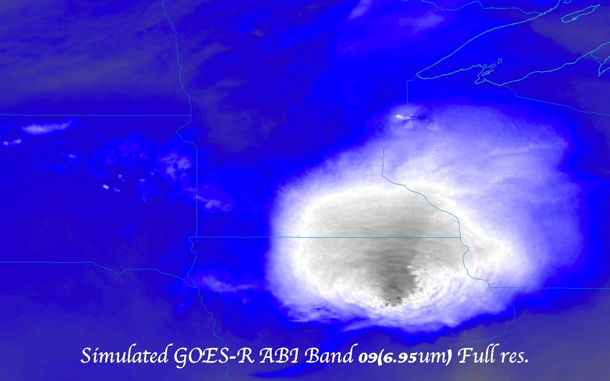
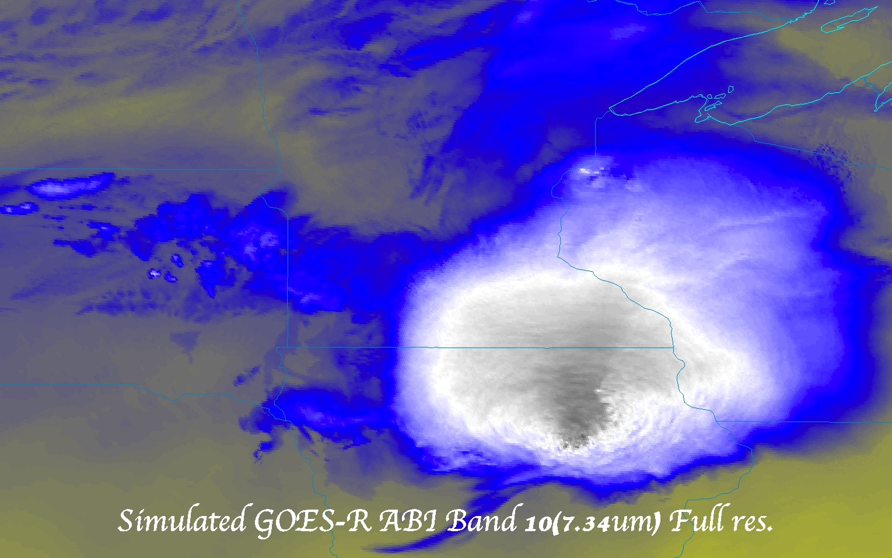
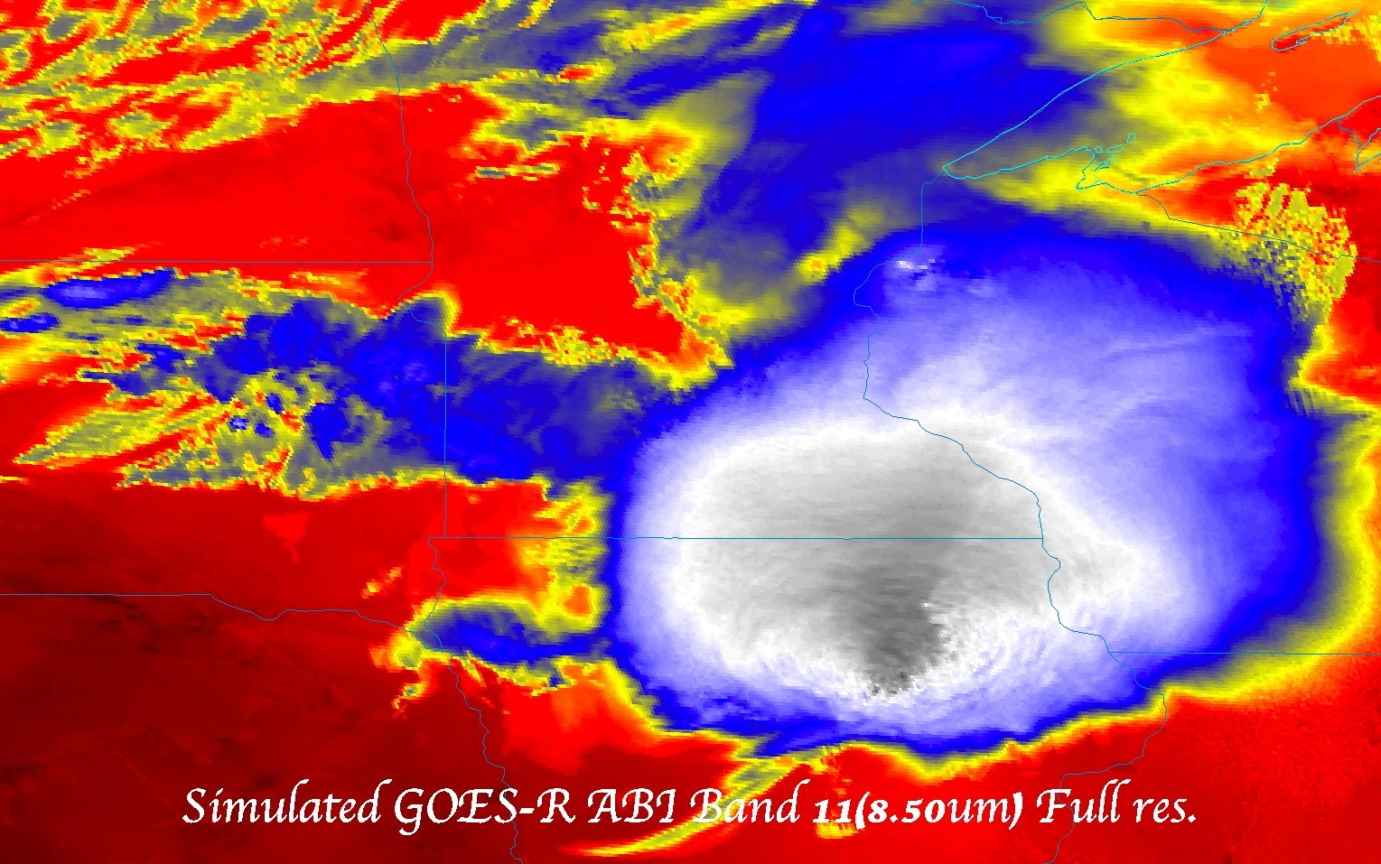
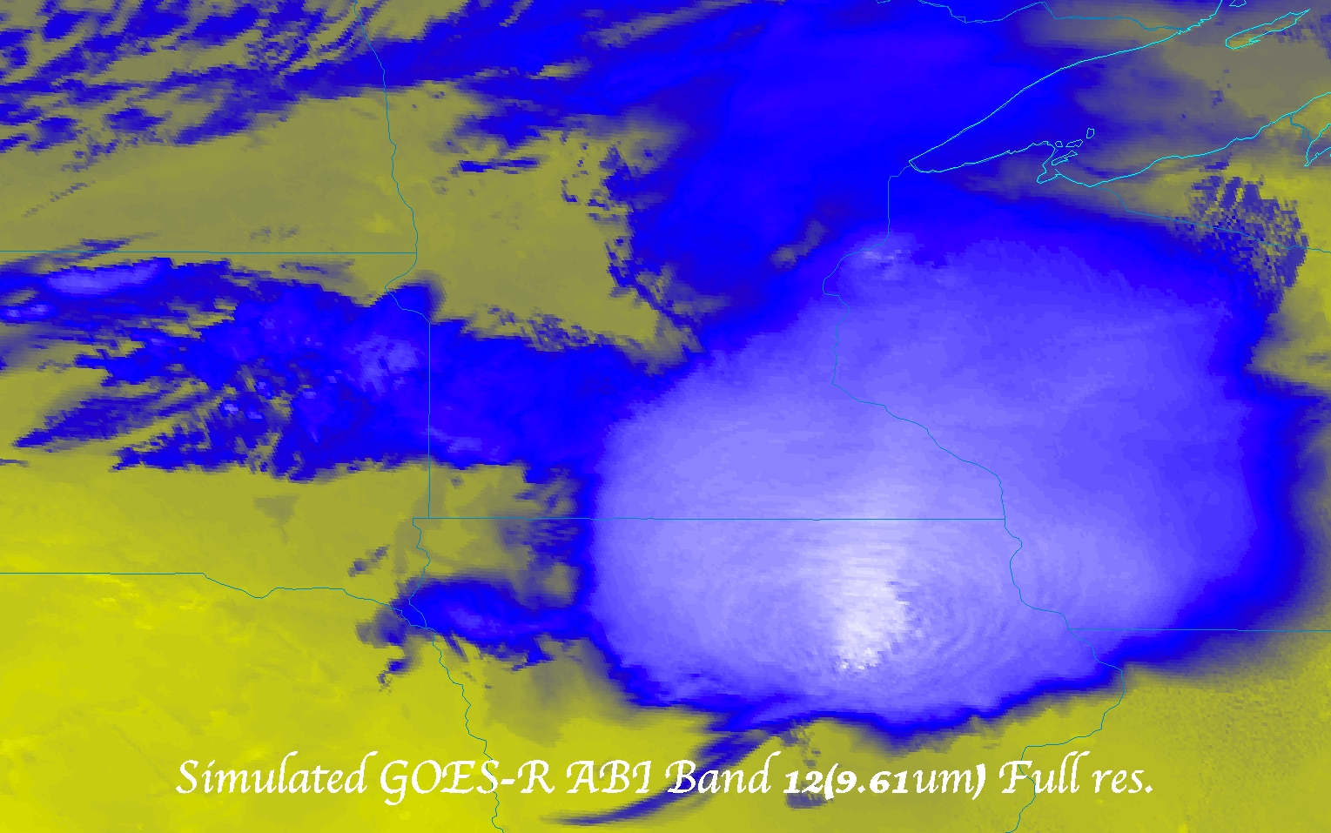
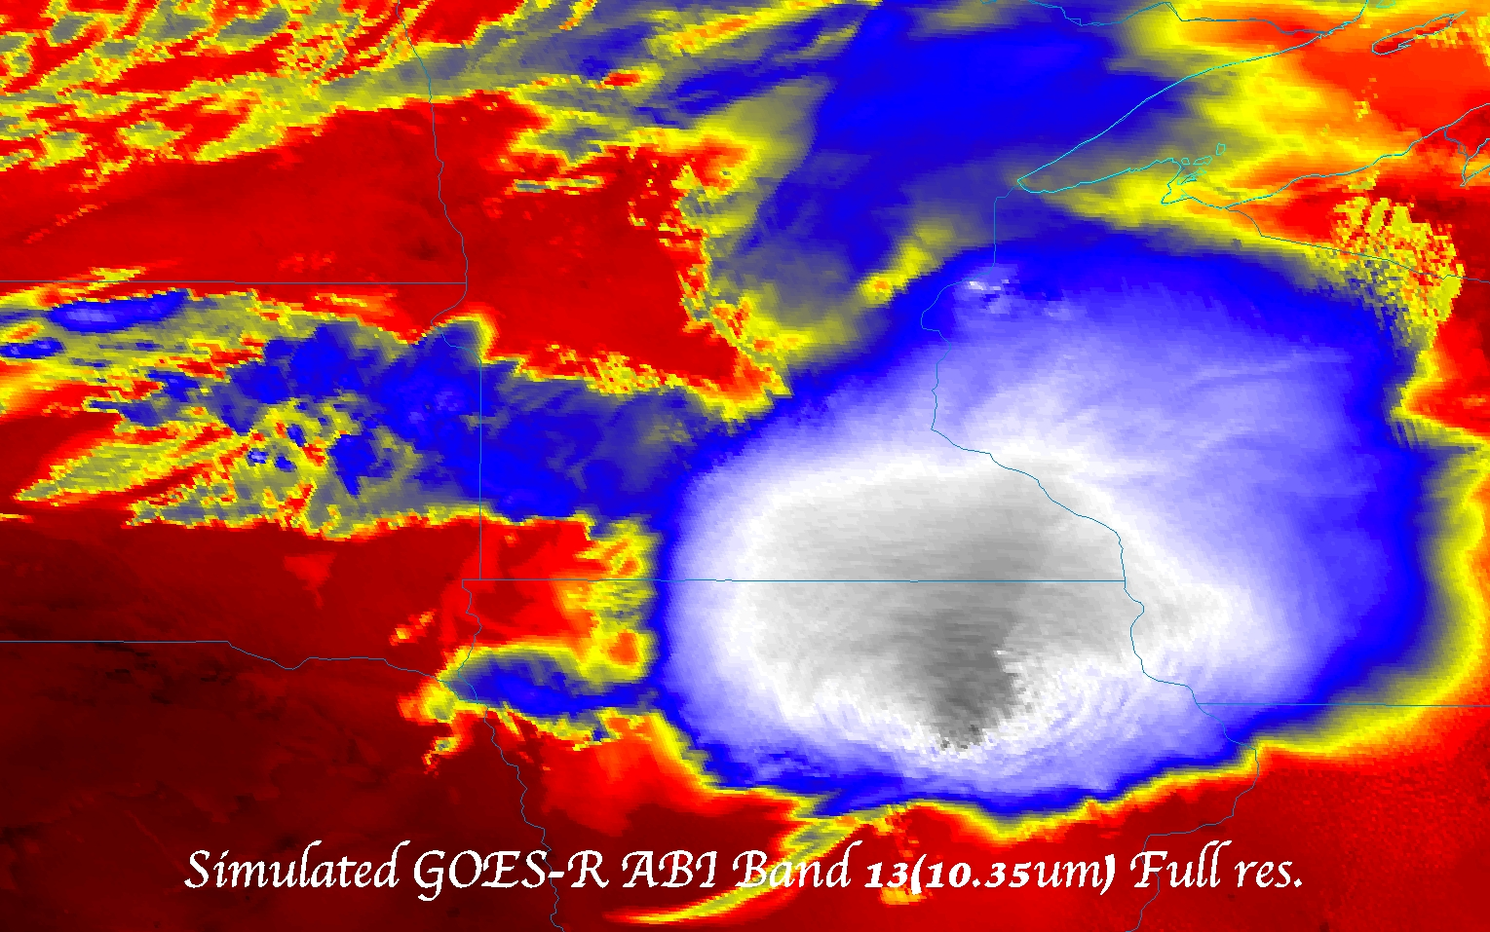

Slide 44
More information
GOES-R:
http://www.goes-r.gov
http://www.meted.ucar.edu/index.htm
http://cimss.ssec.wisc.edu/goes_r/proving-ground.html
GOES and NASA:
http://goespoes.gsfc.nasa.gov/goes/index.html
http://goes.gsfc.nasa.gov/text/goes.databookn.html
UW/SSEC/CIMSS/ASPB:
http://cimss.ssec.wisc.edu/goes_r/proving-ground/nssl_abi/nssl_abi_rt.html
http://cimss.ssec.wisc.edu/goes/abi/
http://cimss.ssec.wisc.edu/goes/blog/
http://www.ssec.wisc.edu/data/geo/
http://cimss.ssec.wisc.edu/goes/srsor/GOES-14_SRSOR.html
AMS BAMS Article on the ABI (Aug. 2005)

