Slide 1


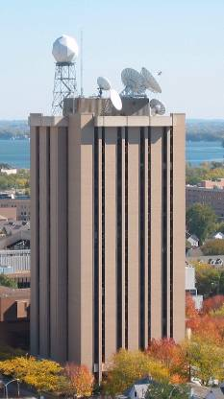
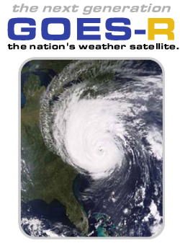

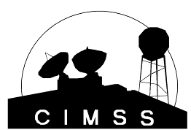
The Advanced Baseline Imager (ABI) on the GOES-R series
  Timothy J. Schmit -- (tim.j.schmit@noaa.gov)
NOAA/NESDIS/Satellite Applications and Research
Advanced Satellite Products Branch (ASPB)
Kaba Bah, Mathew M. Gunshor, Jun Li, Scott Bachmeier, Jason Otkin, etc.
CIMSS, Madison, WI
Steve Goodman, James J. Gurka, etc.
GOES-R Program Office
National Weather Association
Birmingham, AL
20 October 2011
UW-Madison

Slide 2
Also Thanks to…
Achtor, Tom; Ackerman, Steve; Antonelli, Paolo; Aune, Bob; Baggett, Kevin; Baum, Bryan; Ellrod, Gary; Feltz, Joleen; Feltz, Wayne; Frey, Rich; Griffin, Michael K.; Gumley, Liam; Heymann, Roger; Hillger, Don; Huang, Allen; Key, Jeff; Knuteson, Bob; Mecikalski, John; Menzel, Paul; Moeller, Chris; Mosher, Fred; Nelson, James; Nasiri, Shaima; Olander, Tim; Plokhenko, Youri; Prins, Elaine; Rabin, Bob; Revercomb, Hank; Schmidt, Chris; Schreiner, Tony; Seemann-Wetzel, Suzanne; Sieglaff, Justin; Strabala, Kathy; Sun, Fengying; Will Straka, Tobin, Dave; Velden, Chris; Wade, Gary; Whittaker, Tom; Woolf, Hal, Jason Otkin, etc.
Jaime Daniels, Mitch Goldberg, AWG co-chairs, AWG Leads, Walter Wolf, GPO, Jordan Gerth, Chian-Yi Liu, Thomas Greenwald, Monica Coakley, GOES-R flight/ground, Bill Smith, ASPB, PG, SSEC data center, CWG, etc.
ITT Industries, Lockheed-Martin, other industry partners, etc.

Slide 3
GOES-R Overview
Advanced Baseline Imager (ABI)
No dedicated Sounder
Geostationary Lightning Mapper (GLM)
Space Weather
  Space Environmental In-Situ Suite (SEISS)
  Solar Ultra Violet Imager (SUVI)
  Extreme Ultra Violet/X-Ray Irradiance Sensor (EXIS)
  Magnetometer
Communications
  GOES Rebroadcast (GRB)
  Low Rate Information Transmissions (LRIT)
  Emergency Managers Weather Information Network (EMWIN)
  Search and Rescue (SAR)
  Data Collection System (DCS)
Notes:
Advanced Baseline Imager (ABI) Earth-viewing
Geostationary Lightning Mapper (GLM) Earth-viewing
Solar Ultra-Violet Imager (SUVI) Sun-viewing
EUVS and XRS Irradiance Sensors (EXIS) Sun-viewing
Space Environment In-Situ Suite (SEISS) Space-viewing
Magnetometer (MAG) Space-viewing

Slide 4
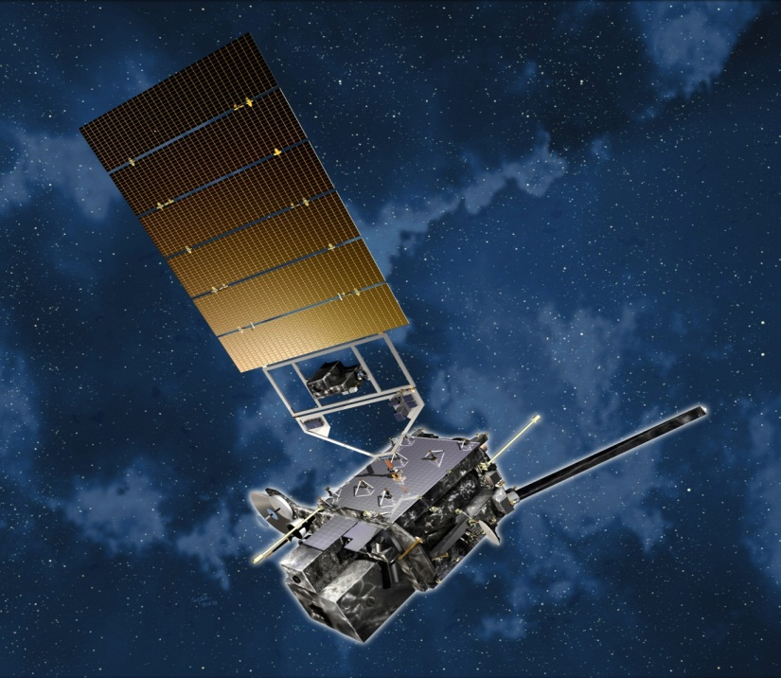
Overview
ABI (Advanced Baseline Imager)
  Temporal
  Spatial
  Spectral
  Imagery
Select Products
Summary
  More information
Lockheed Martin

Slide 5
The Advanced Baseline Imager:
ABI Current
Spectral Coverage
16 bands 5 bands
Spatial resolution
0.64 μm Visible 0.5 km Approx. 1 km
Other Visible/near-IR 1.0 km n/a
Bands (>2 μm) 2 km Approx. 4 km
Spatial coverage
Full disk 4 per hour Scheduled (3 hrly)
CONUS 12 per hour ~4 per hour
Mesoscale Every 30 sec n/a
Visible (reflective bands)
On-orbit calibration Yes No

Slide 6
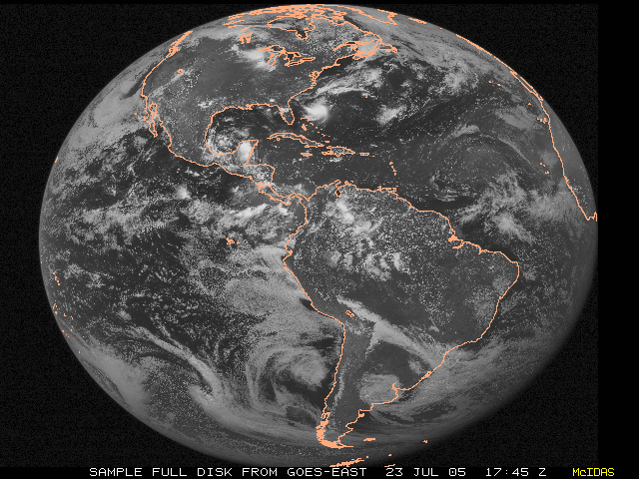
ABI scans about 5 times faster
than the current GOES imager
There are two anticipated scan modes for the ABI:
- Full disk images every 15 minutes + 5 min CONUS images + mesoscale.
or - Full disk every 5 minutes.

Slide 7
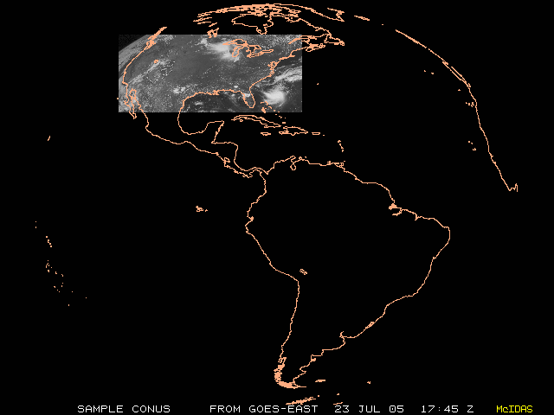
ABI can offer Continental US images every 5 minutes for routine monitoring of a wide range of events (storms, dust, clouds, fires, winds, etc).
This is every 15 or 30 minutes with the current GOES in routine mode.
Notes:
Approx. size of CONUS

Slide 8
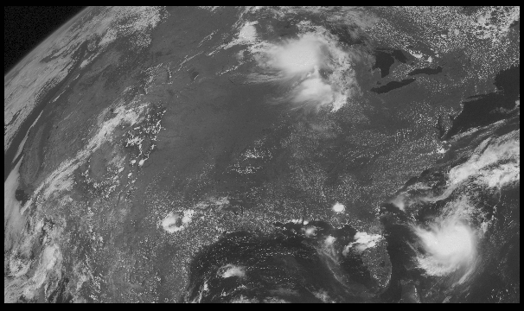
Notes:
Approx. size of CONUS

Slide 9
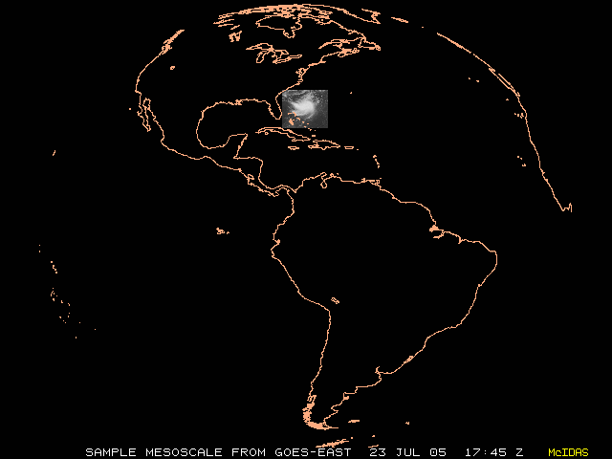
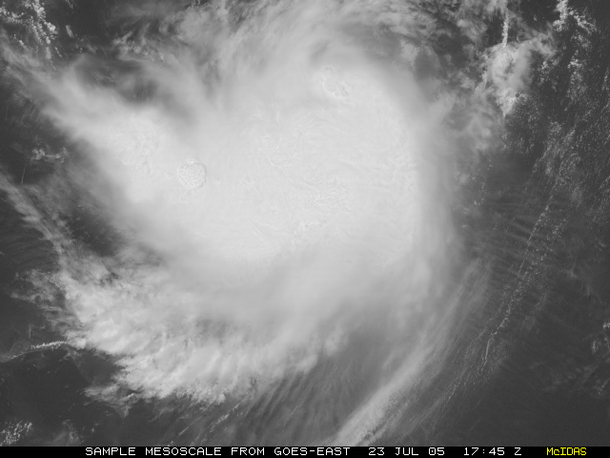
“Franklin”
Mesoscale images every 30 seconds for rapidly changing phenomena (thunderstorms, hurricanes, fires, etc). Current GOES can not offer these rapid scans while still scanning other important regions
Notes:
Approx. size of meso-scale showing “Franklin”.

Slide 10
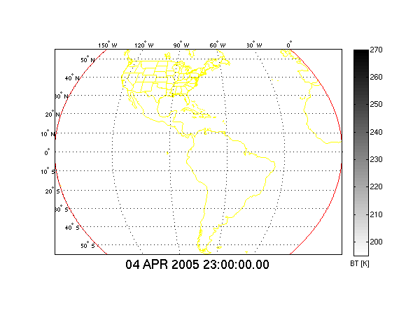
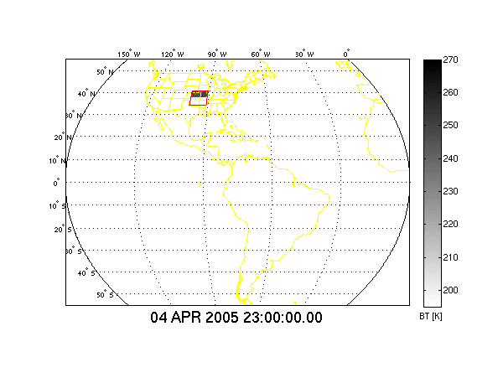
In 15 Minutes
Current GOES Imager can scan:
Most (3/5) of a Full Disk Image
Current GOES Imager scan coverage within 15 minutes
In 15 Minutes
ABI (“Flex Mode”) will scan:
30 Mesoscale Images
3 CONUS Images
1 Full Disk Image
GOES-R ABI scan coverage within 15 minutes
CIMSS
Notes:
From Jun Li and Chian-Yi Liu (CIMSS). Water vapor Image. Data from AWG Proxy Teams.

Slide 11
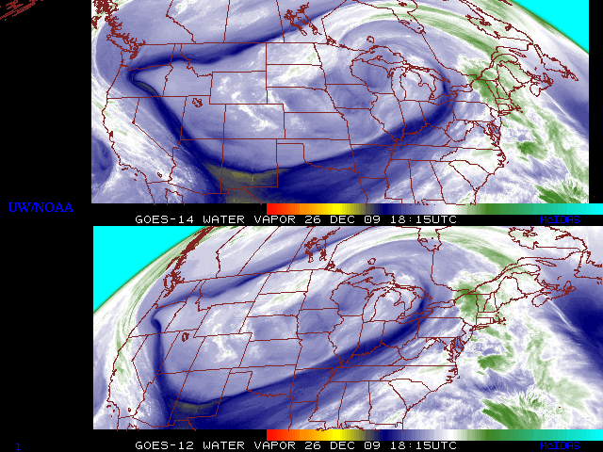
GOES-14: Sample “5-min” imagery
GOES-14
GOES-12
“Water vapor” data from the GOES-14 NOAA Science Test, lead by Hillger and Schmit
Notes:
Note the comma head is forming in the dry slot as a vort max swings around. This is not obvious from the 15 min.

Slide 12
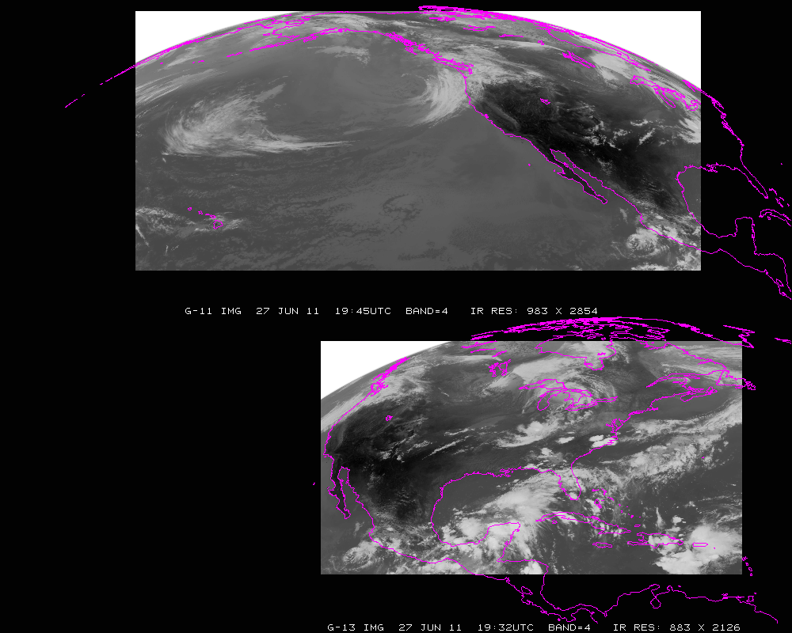
Current GOES Imager scans: PACUS and CONUS (note that PACUS is one-third larger). These regions are sub-selected for AWIPS.

Slide 13
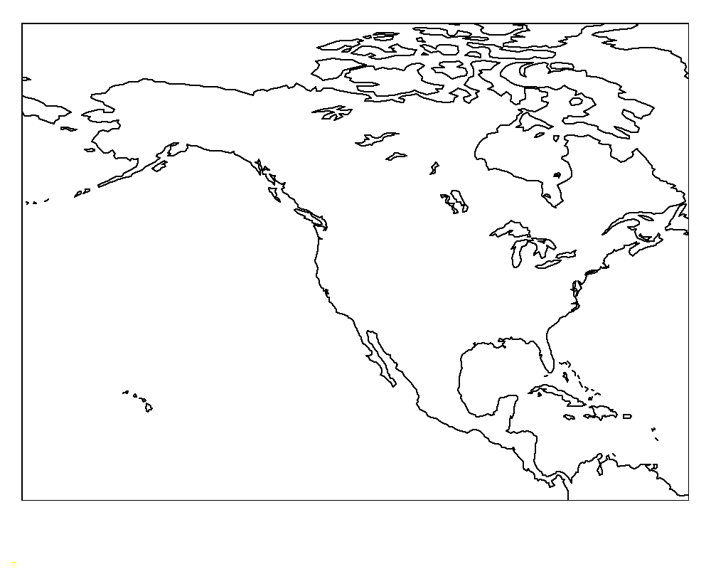
Proposed –Shifted “5 min PACUS”
“5 min PACUS”
Proposed “shifted” “PACUS” would give a 5 min scan of southern AK and western CONUS. This would mean that Hawaii could be covered with one of the meso-scales (and 15 min FD); if in ‘flex mode (3)’. Note that the positions are approximate.

Slide 14
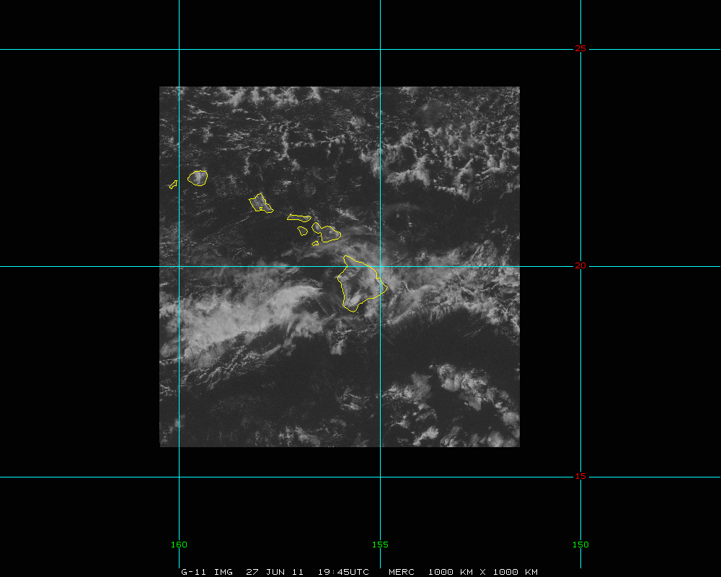
Hawaii and surrounding area -- mesoscale
Approximately 1000 km x 1000 km.

Slide 15
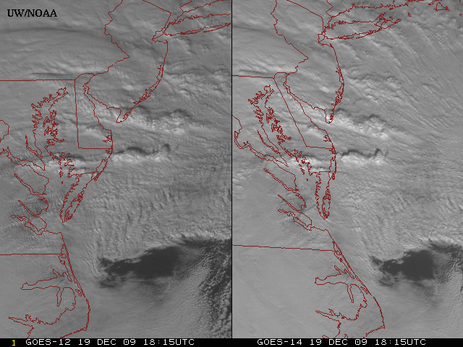
GOES-14: Sample “1-min” imagery
GOES-12
GOES-14
Visible data from the GOES-14 NOAA Science Test, lead by Hillger and Schmit
Notes:
Note the number of different levels of motion you can see (the cyclonic low level circulation over the ocean through the breaks in the higher clouds)... and you can't distinguish those on the GOES-12 loop.

Slide 16
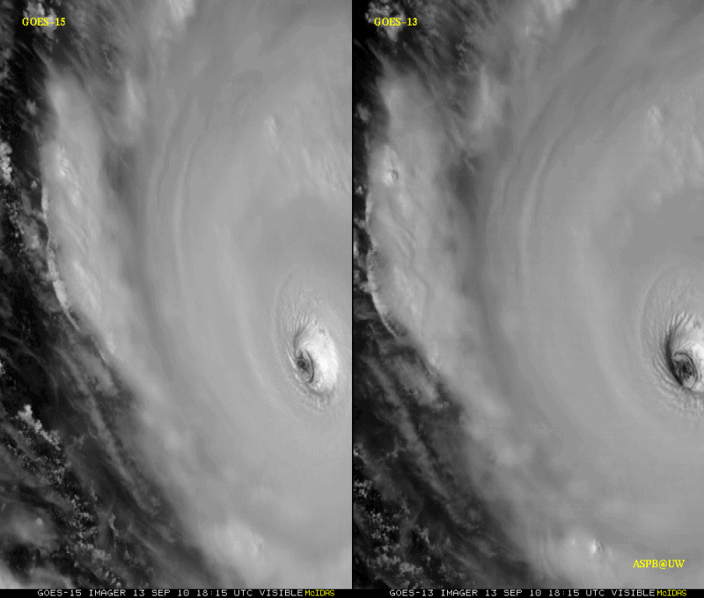
GOES-15: Sample “1-min” imagery
1-min
30-min
Visible data from the GOES-15 NOAA Science Test, lead by Hillger and Schmit
Notes:
Igor

Slide 17
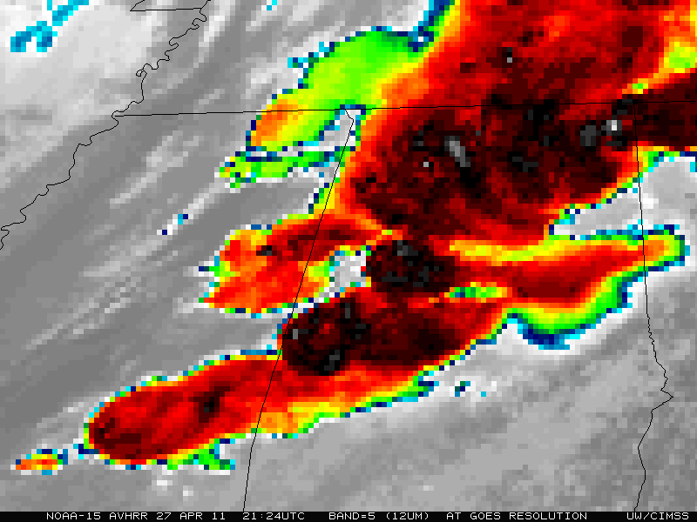
“GOES”

Slide 18

“ABI”

Slide 19
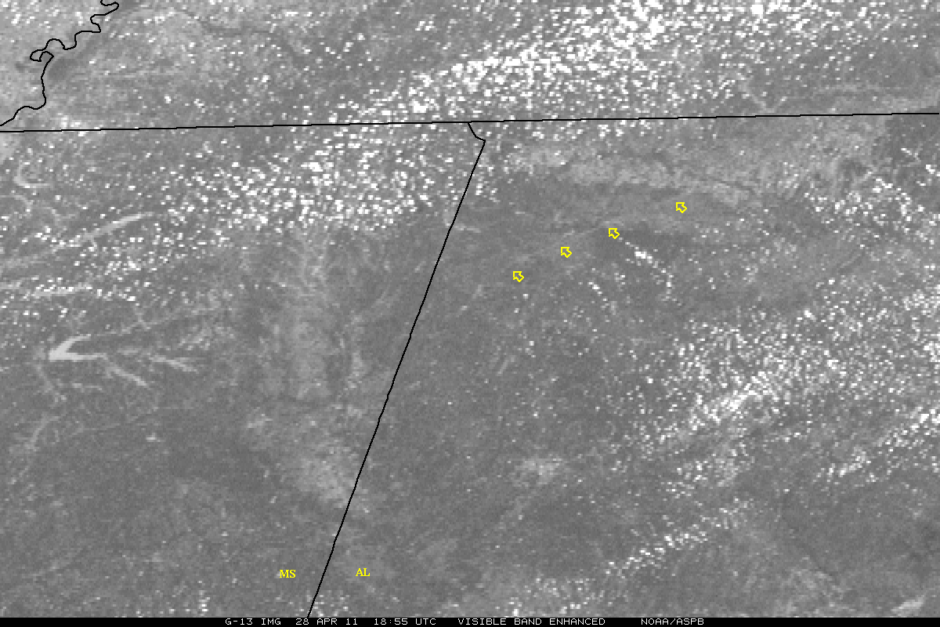
“GOES-13 Visible Loop”

Slide 20
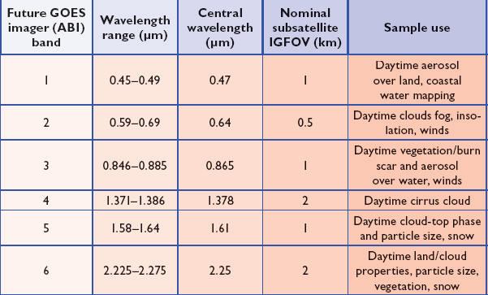
ABI Visible/Near-IR Bands
Schmit et al, 2005
Notes:
Schmit, T. J., M. M. Gunshor, W. P. Menzel, J. J. Gurka, J. Li, and A. S. Bachmeier, 2005: Introducing the next-generation Advanced Baseline Imager on GOES-R. Bull. Amer. Meteor. Soc., 86, 1079-1096.

Slide 21
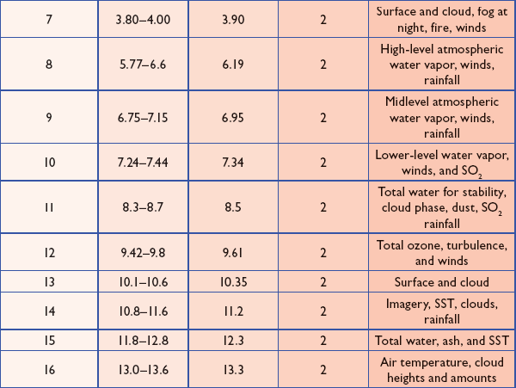
ABI IR Bands
Schmit et al, 2005
Notes:
Schmit, T. J., M. M. Gunshor, W. P. Menzel, J. J. Gurka, J. Li, and A. S. Bachmeier, 2005: Introducing the next-generation Advanced Baseline Imager on GOES-R. Bull. Amer. Meteor. Soc., 86, 1079-1096.

Slide 22
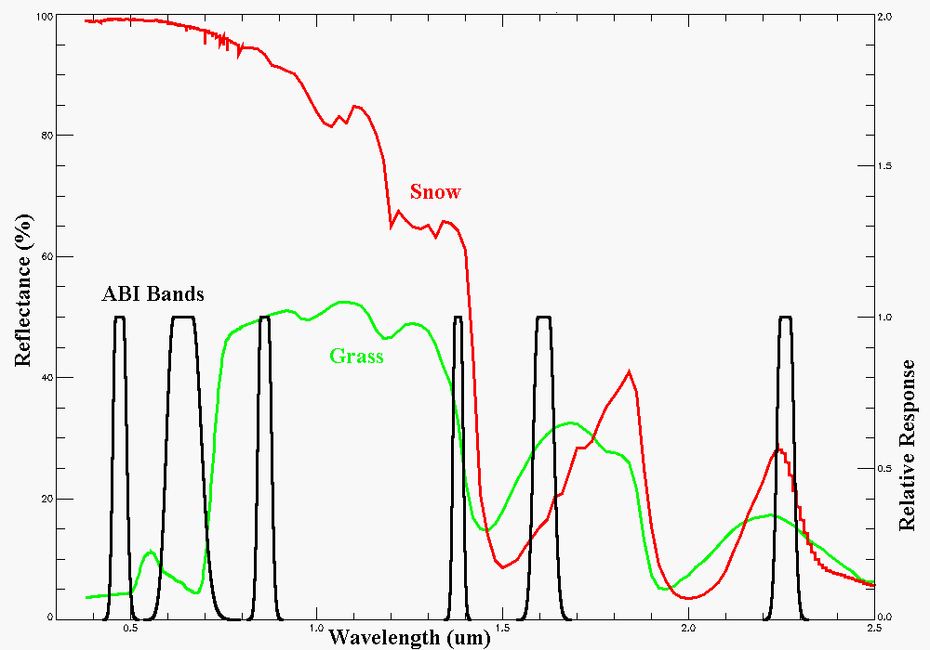
Visible and near-IR channels on the ABI
Snow, Phase
Part. size
Cirrus
Haze
Clouds
Veg.
The ABI visible and near-IR bands have many uses.
Notes:
Schmit, T. J., M. M. Gunshor, W. P. Menzel, J. J. Gurka, J. Li, and A. S. Bachmeier, 2005: Introducing the next-generation Advanced Baseline Imager on GOES-R. Bull. Amer. Meteor. Soc., 86, 1079-1096.

Slide 23
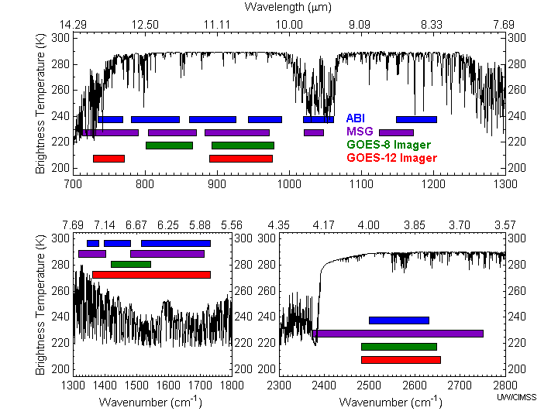
Similarities and differences for the spectral bands on Meteosat Second Generation (MSG), current GOES, and the Advanced Baseline Imager (ABI).
ABI has many more bands than the current operational GOES imagers.
Notes:
Schmit, T. J., M. M. Gunshor, W. P. Menzel, J. J. Gurka, J. Li, and A. S. Bachmeier, 2005: Introducing the next-generation Advanced Baseline Imager on GOES-R. Bull. Amer. Meteor. Soc., 86, 1079-1096.

Slide 24
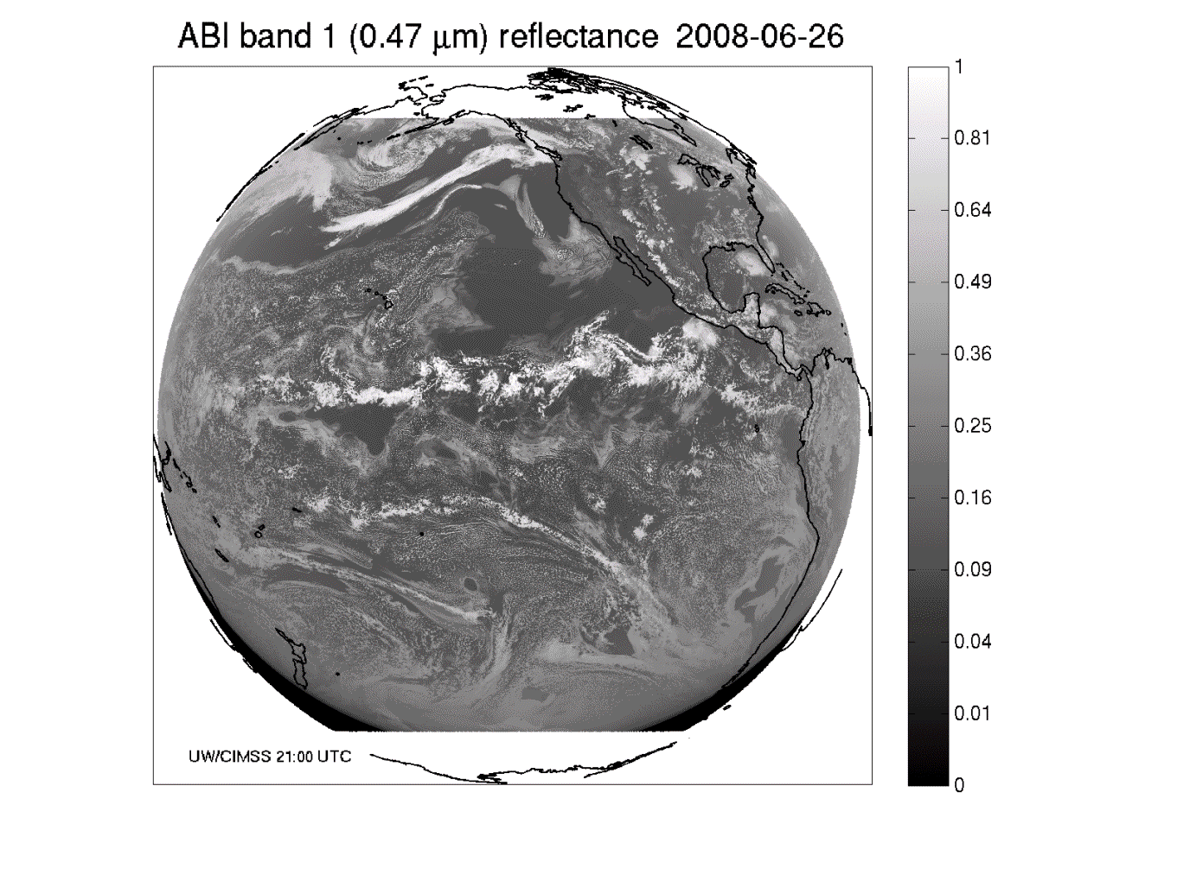
These NWP model simulations were performed on the 'cobalt' supercomputer at the National Center for Supercomputing Applications at the University of Illinois.
Band 1: Daytime “Blue” band -- aerosols

Slide 25
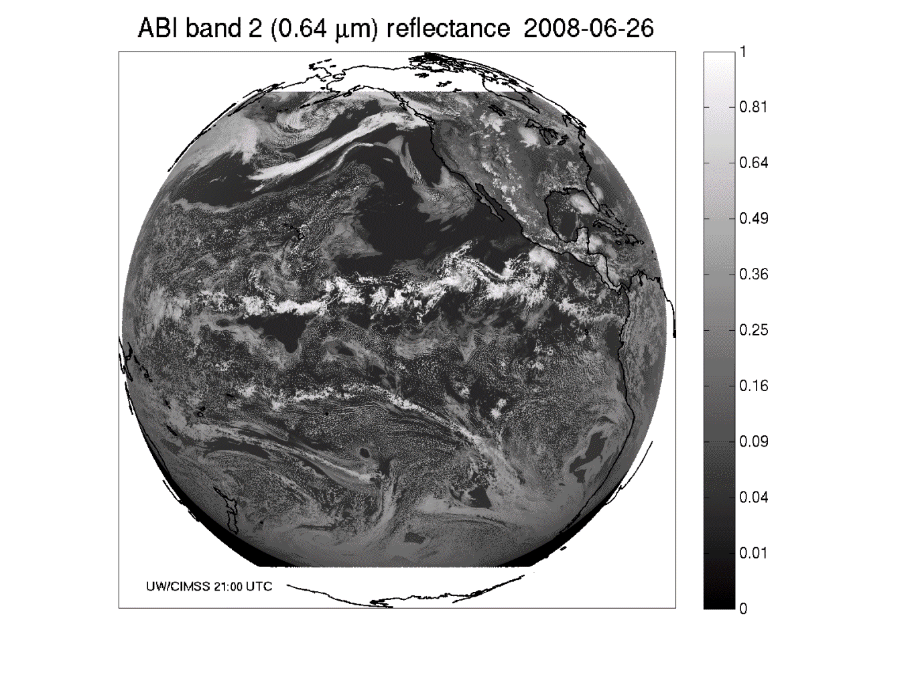
Band 2: Daytime “Red” band – clouds, etc.

Slide 26
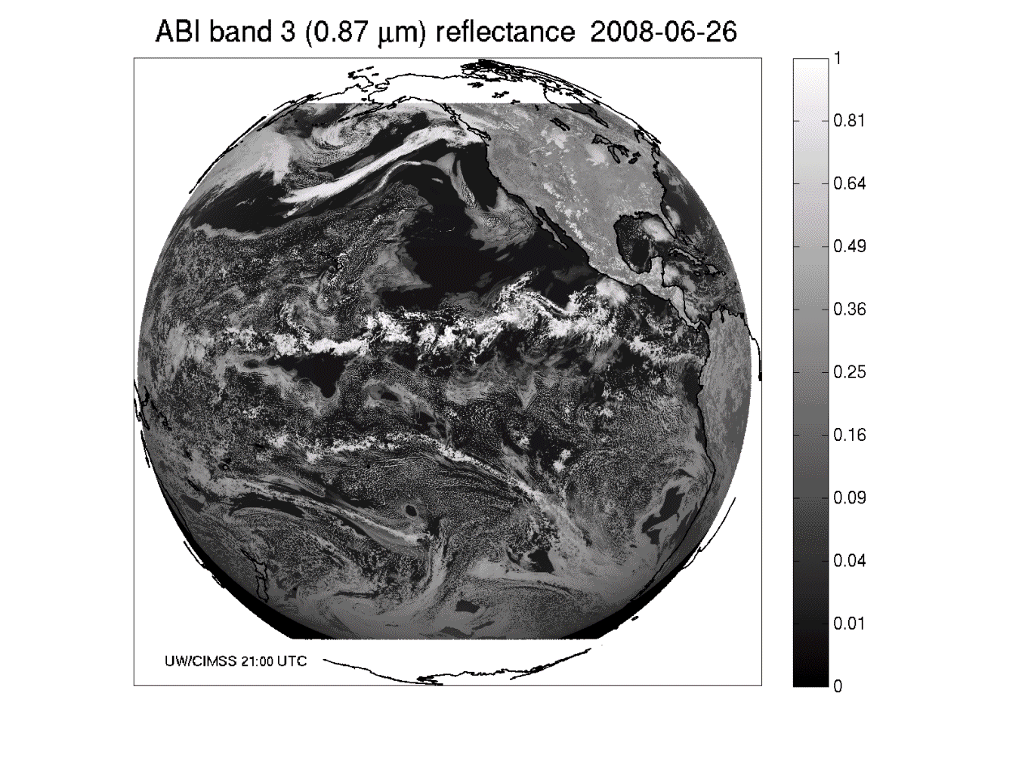
Band 3: Daytime “Veggie” band

Slide 27
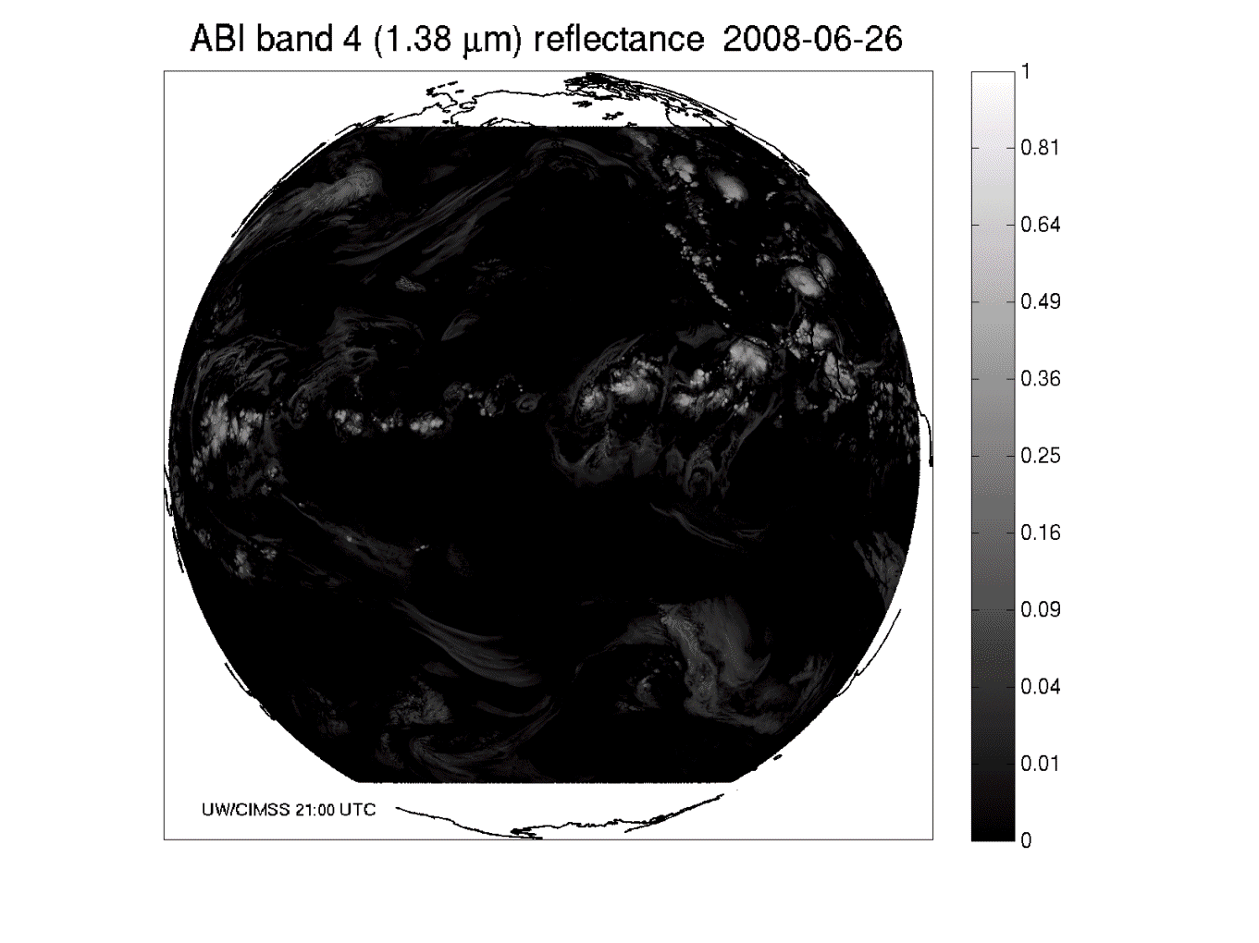
Band 4: Daytime “Cirrus” band

Slide 28
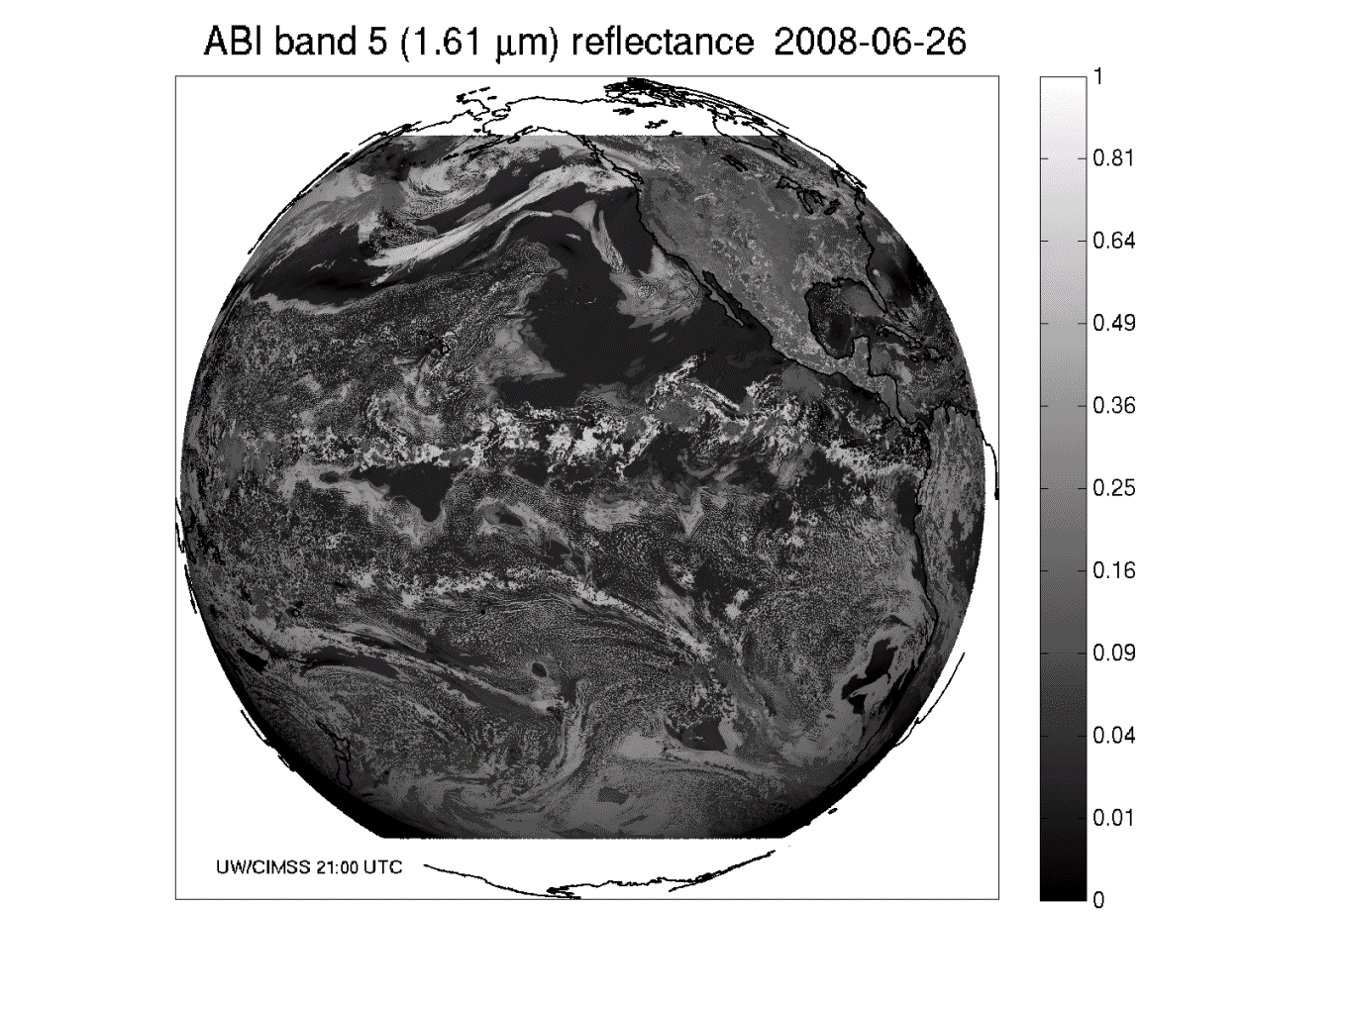
Band 5: Daytime “Snow” band

Slide 29
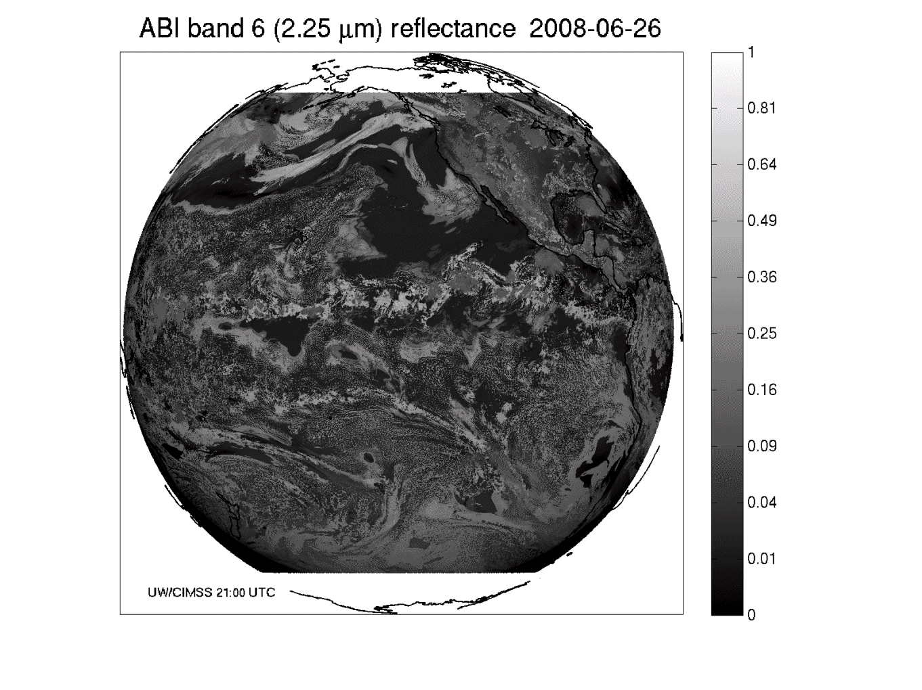
Band 6: Daytime “Cloud-top phase” band

Slide 30
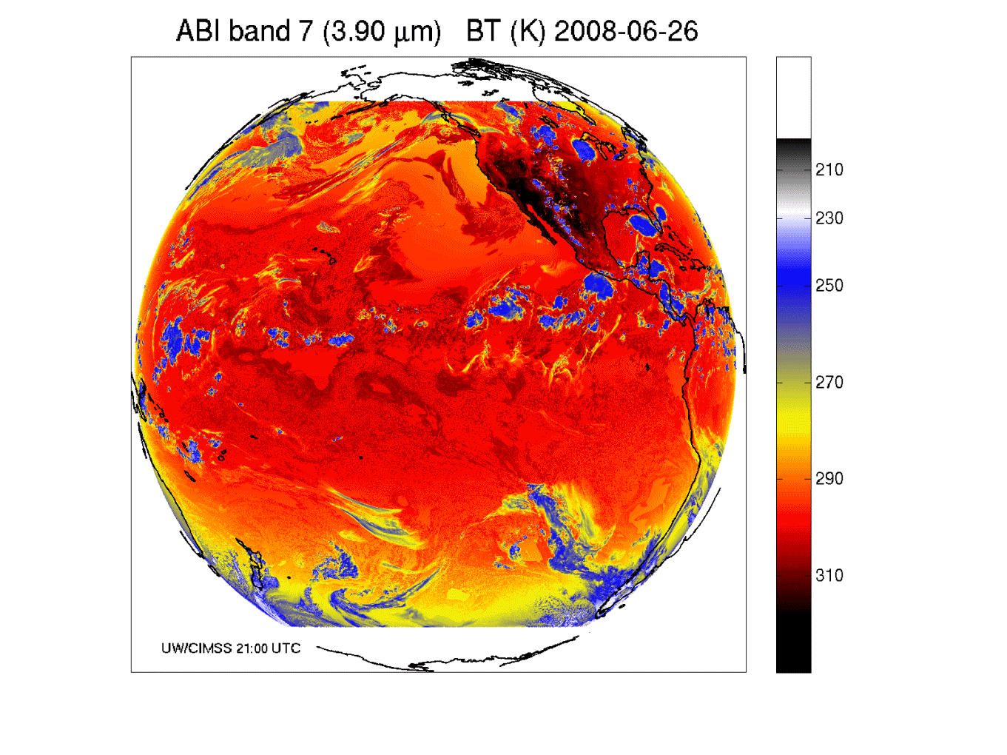
Band 7: Shortwave IR window band - fog, fires, etc.

Slide 31
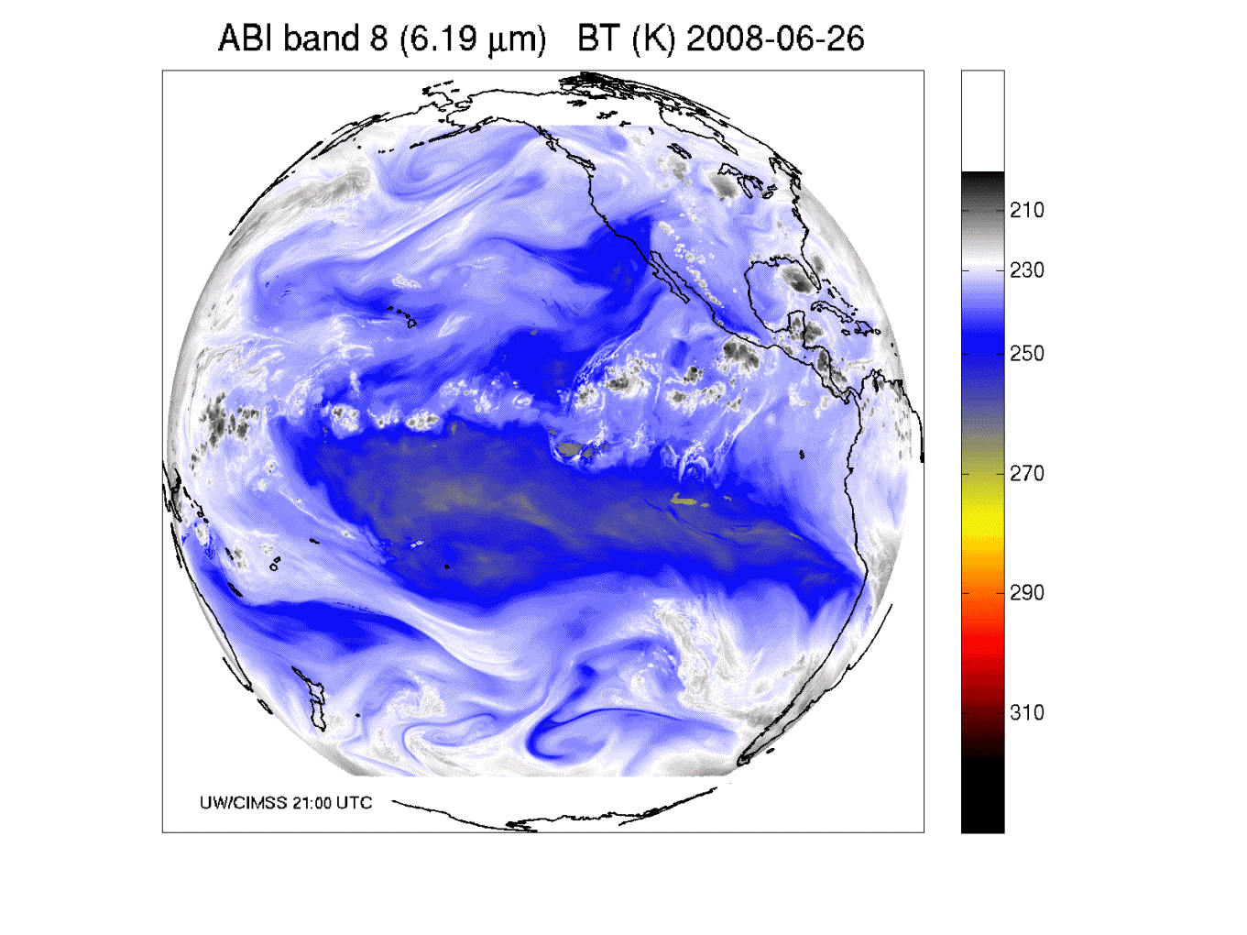
Band 8: Upper-level tropospheric water vapor band

Slide 32
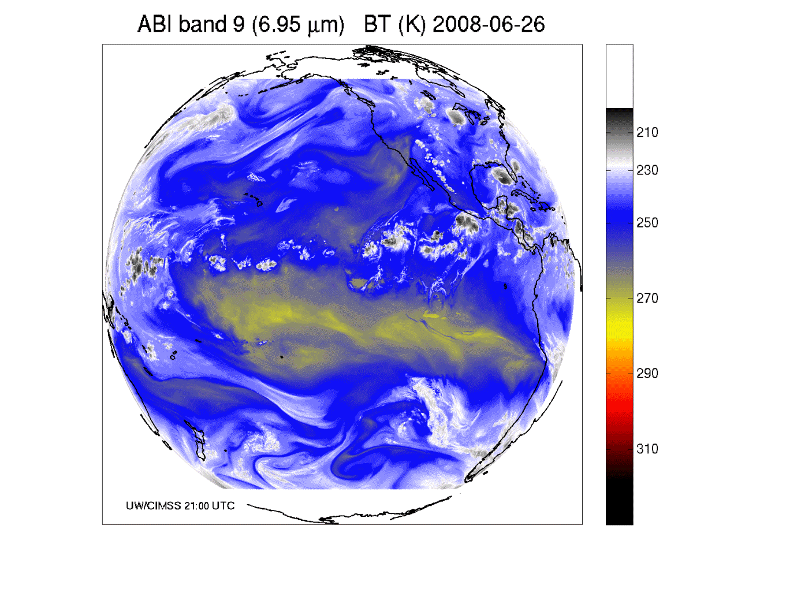
Band 9: Upper/mid-level tropospheric water vapor band

Slide 33
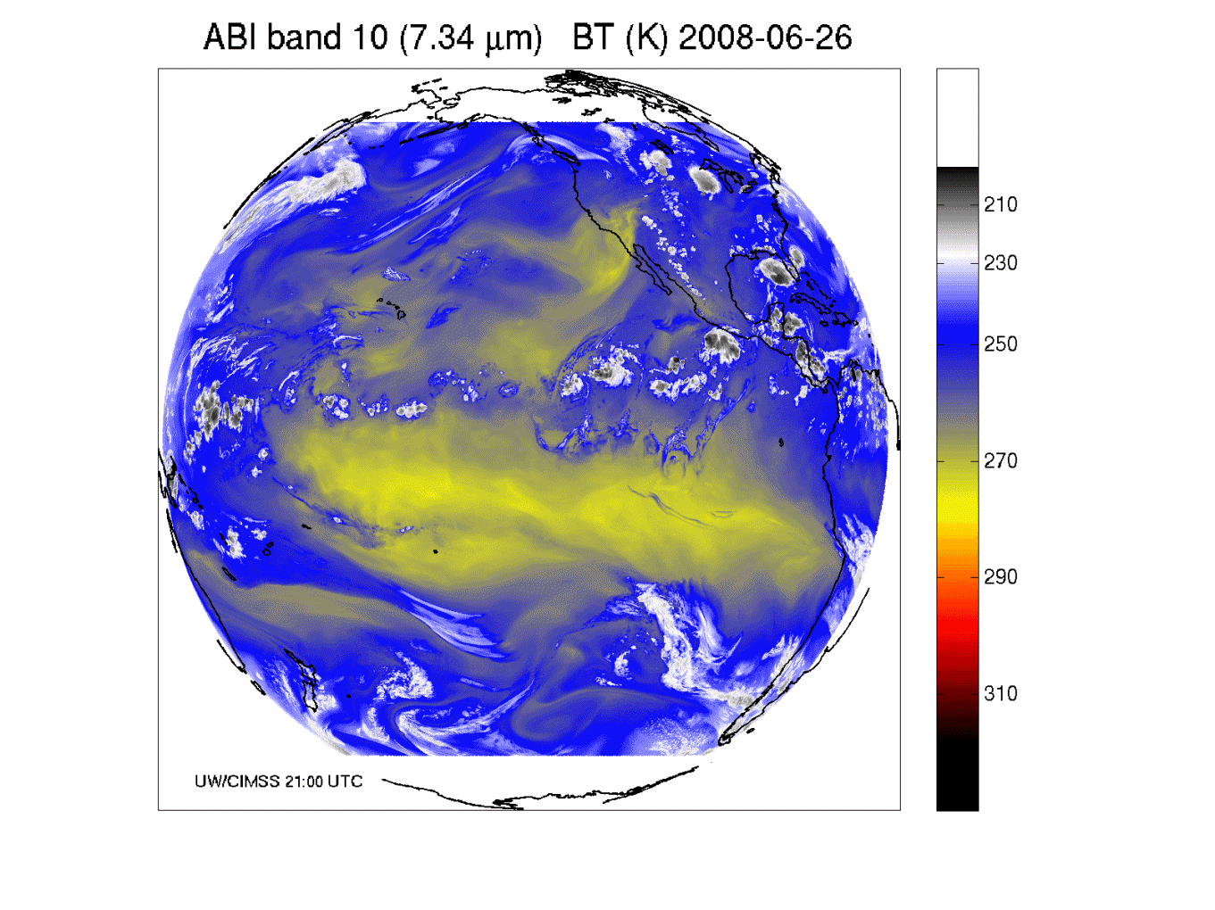
Band 10: Lower mid-level tropospheric water vapor band

Slide 34
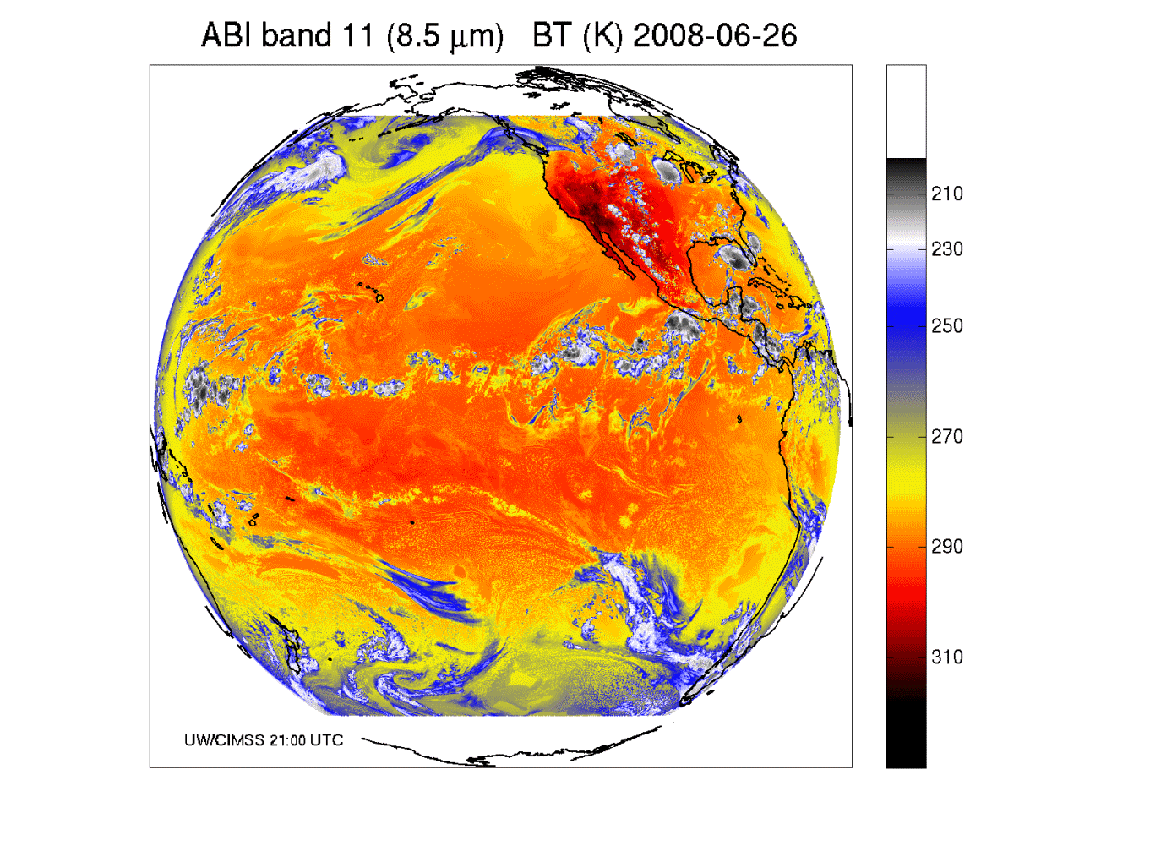
Band 11: “Cloud-top phase” band

Slide 35
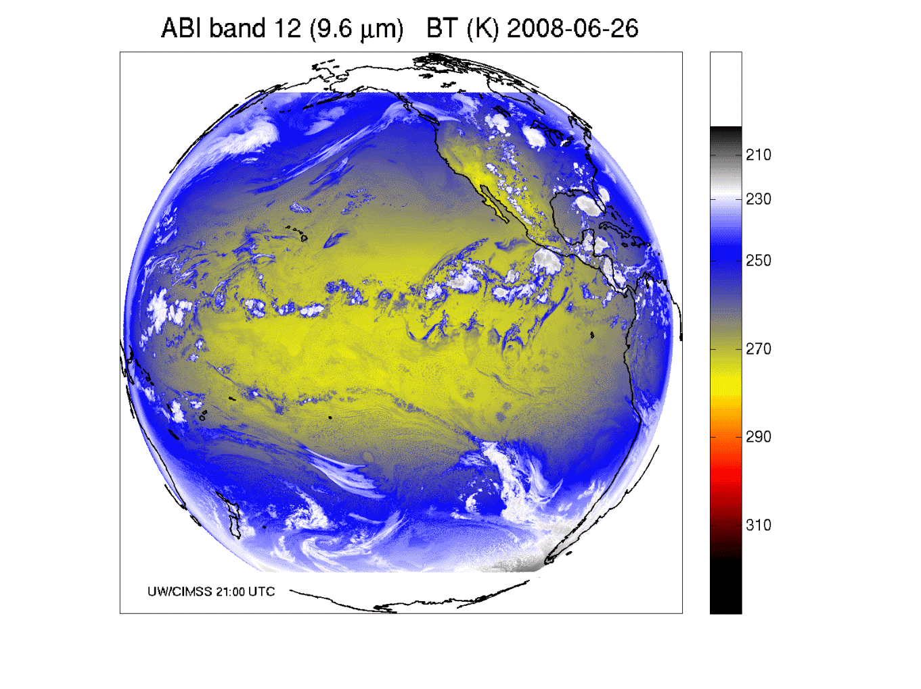
Band 12: “Ozone” band

Slide 36
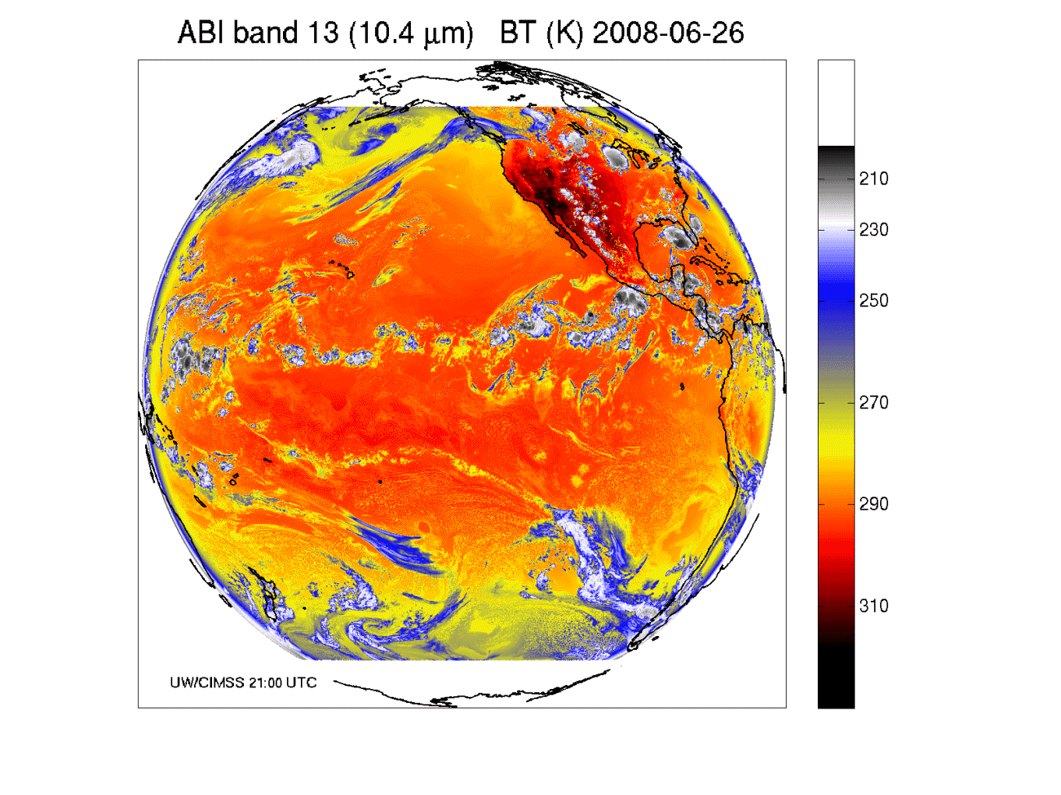
Band 13: “Clean” IR longwave window band

Slide 37
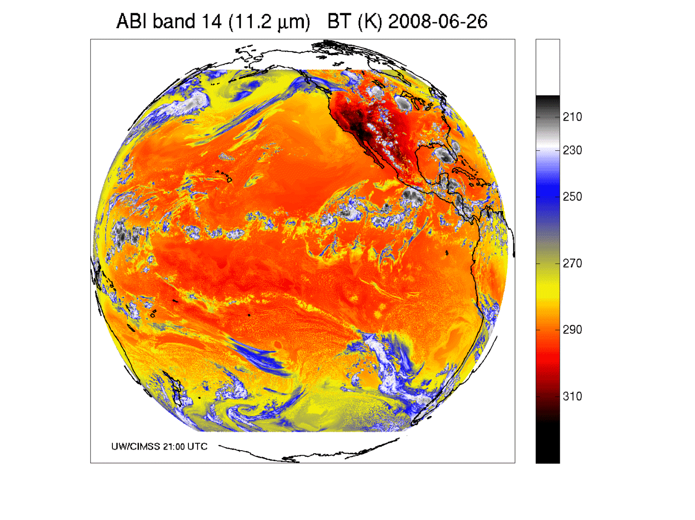
Band 14: IR longwave window band

Slide 38
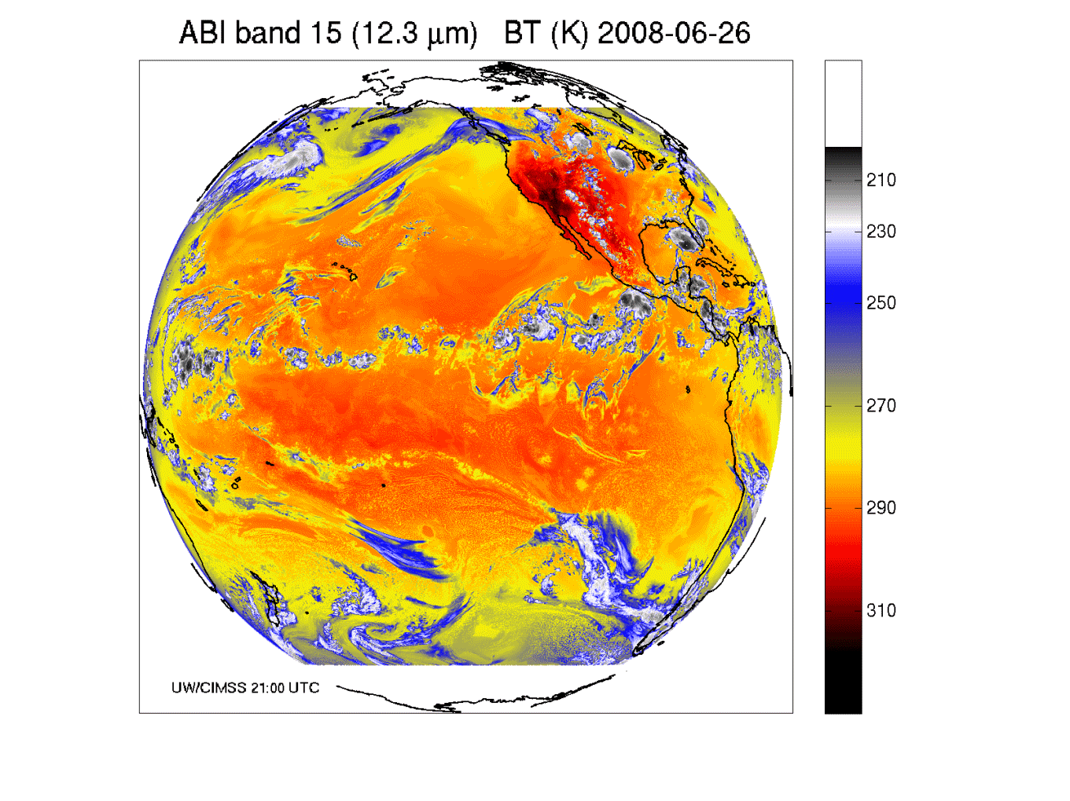
Band 15: “Dirty” IR longwave window band

Slide 39
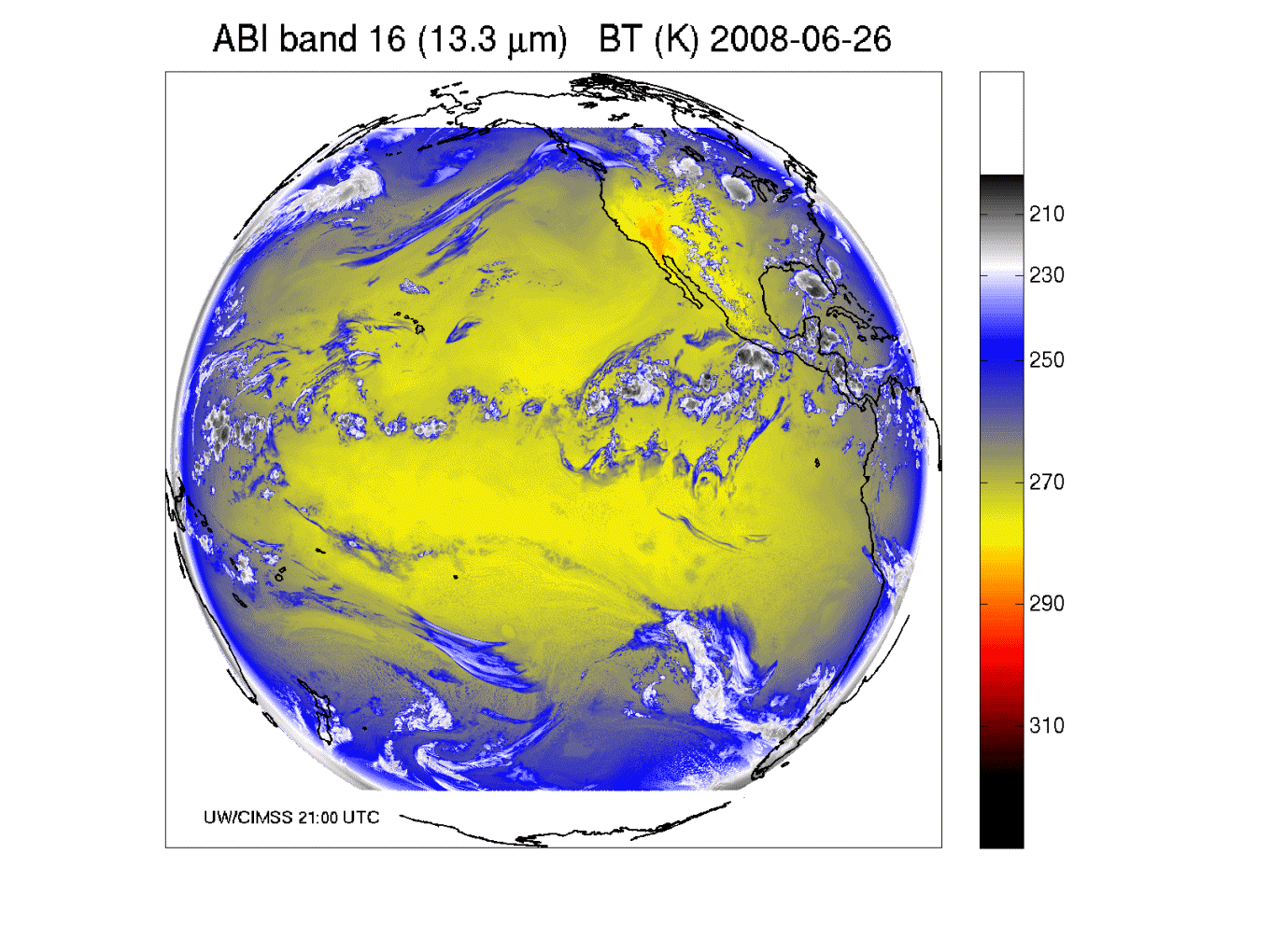
Band 16: “CO2” longwave IR band

Slide 40
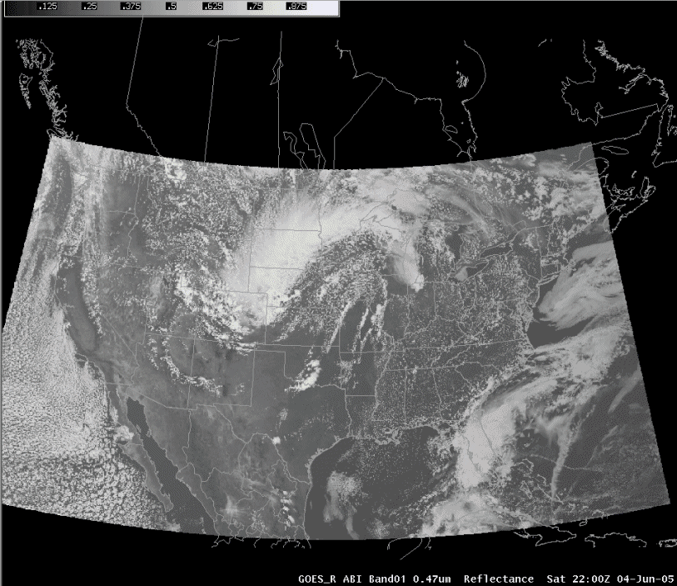
ABI in AWIPS (via netCDF)
J. Oktin et al., CIMSS
Simulated ABI bands; legacy AWIPS Wx Event Simulator (WES) available.
Notes:
http://cimss.ssec.wisc.edu/goes/abi/

Slide 41
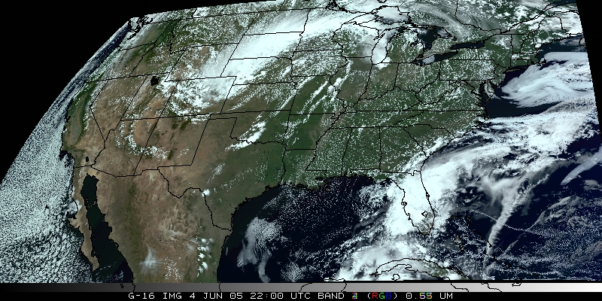
Visualization
(“decision aid”)
“True Color” with “synthetic” green from ABI simulated data (from CIMSS); image from Don Hillger, RAMMB.

Slide 42
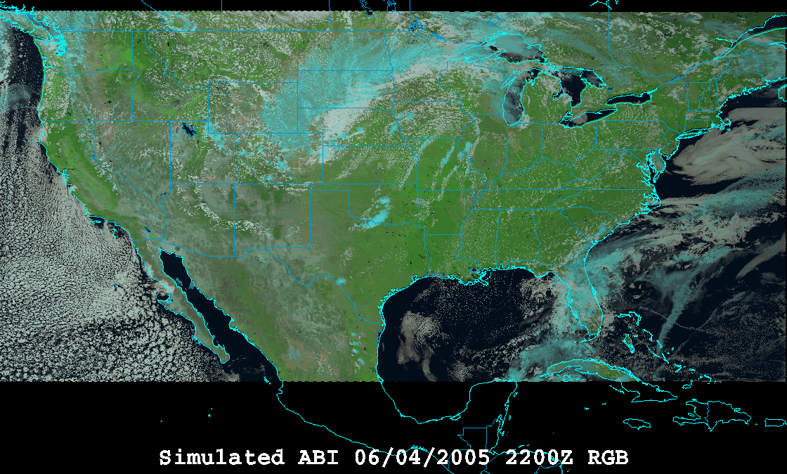
Visualization
(“decision aid”)
“RGB Color” (VIS 0.6, VIS 0.8, and NearIR 1.6 um) with ABI simulated data (from CIMSS); image from William Straka, CIMSS and using the EUMETSAT enhancement.
P4.3 Demonstration of RGB Composite Imagery at NOAA National Centers in Preparation for GOES-R

Slide 43
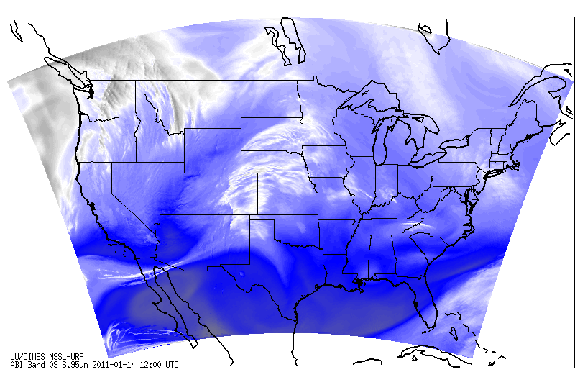
Simulated ABI band – NSSL WRF
http://cimss.ssec.wisc.edu/goes_r/proving-ground/nssl_abi/nssl_wrf_goes.html

Slide 44
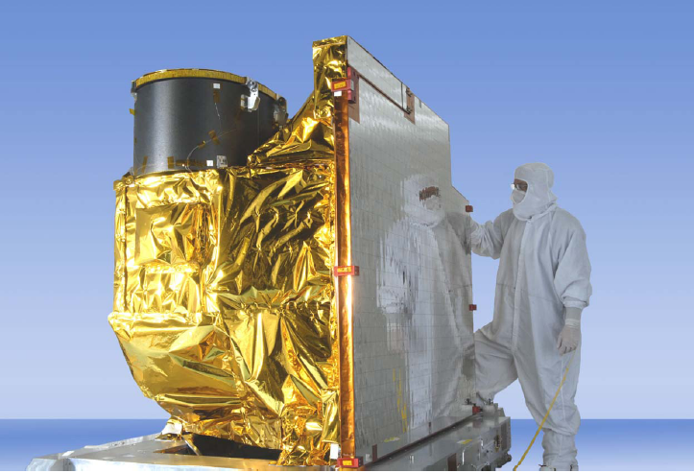
Overview
ABI (Advanced Baseline Imager)
  Temporal
  Spatial
  Spectral
  Imagery
Select Products
Summary
  More information
Photo courtesy of ITT Geospatial Systems
See Poster 4.1: ABI Flight Performance Predictions Based on PTM Test Results

Slide 45
Algorithm Working Group (AWG)
Develop algorithms for the Level 2 products
(Both ‘Baseline’ and ‘Future Capability’ products)
Cloud Layer/Heights
Cloud Ice Water Path
Cloud Liquid Water
Cloud Type
Convective Initiation
Turbulence
Low Cloud and Fog
Enhanced “V”/Overshooting Top
Aircraft Icing Threat
SO₂ Detections (Volcanoes)
Visibility
Upward Longwave Radiation (TOA)
Downward Longwave Radiation (SFC)
Upward Longwave Radiation (SFC)
Total Ozone
Aerosol Particle Size
Surface Emissivity
Surface Albedo
Vegetation Index
Vegetation Fraction
Flood Standing Water
Rainfall probability and potential
Snow Depth
Ice Cover
Sea & Lake Ice Concentration, Age, Extent, Motion
Ocean Currents, Currents: Offshore
Clouds and Moisture Imagery (KPP)
Clear Sky Mask
Cloud Top Pressure and Height
Cloud Top Phase
Cloud Top Temperature
Cloud Particle Size Distribution
Cloud Optical Path
Temperature and Moisture Profiles
Total Precipitable Water
Stability Parameters (Lifted Index, etc.)
Aerosol Detection
Aerosols Optical Depth
Derived Motion Winds
Hurricane Intensity
Fire/Hot Spot Characterization
Land and Sea Surface Temperature
Volcanic Ash
Rainfall Rate
Snow Cover
Downward Solar Insolation: Surface
Reflected Solar Insolation: TOA
Lightning Detection
Advanced Baseline Imager (ABI)
GLM

Slide 46

Imagery
Imagery for nowcasting
  Clouds
  Input for products
  Channel differences
  RGB
  General Users
  Etc.
Radiances for NWP
  Clear-sky
  Cloudy-sky
  Validations
  Monitoring
  Etc.

Slide 47
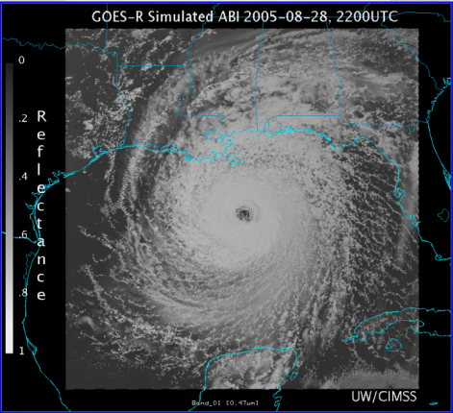
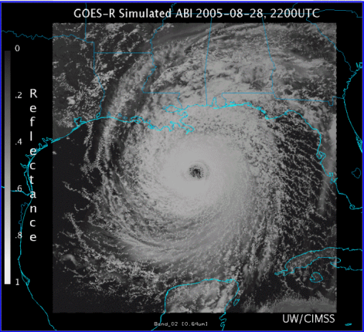
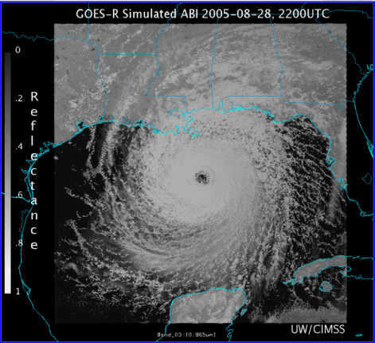
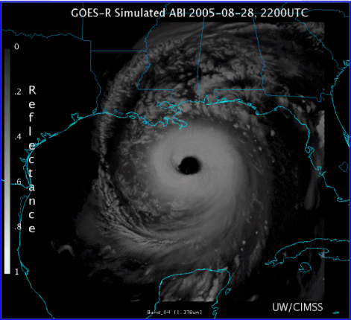
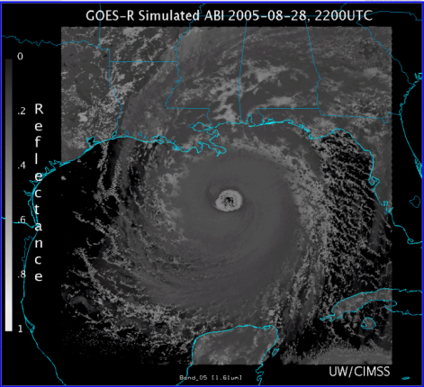
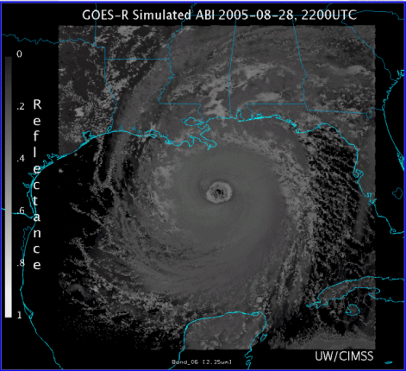










0.47 μm
0.64 μm
0.86 μm
1.38 μm
AWG Proxy ABI Simulations of Hurricane Katrina
1.61 μm
2.26 μm
3.9 μm
6.19 μm
NOAA/NESDIS STAR and GOES-R Imagery Team
6.95 μm
7.34 μm
8.5 μm
9.61 μm
10.35 μm
11.2 μm
12.3 μm
13.3 μm
Notes:
As shown in mcidas-v

Slide 48
Corresponding current Imager bands of Hurricane Katrina
NOAA/NESDIS STAR

Slide 49


Cloud Phase
Algorithm Highlights
  An Infrared only algorithm that exploits the rich IR information (7.4, 8.5, 11.2, and 12.3 μm) provided by the ABI
  Algorithm determines the cloud top (layer that the radiometer senses) thermodynamic phase of the highest cloud layer
  Exploits recent improvements in fast clear-sky radiative transfer models and ancillary data (land cover, surface emissivity
  Makes advanced use of spatial information
Operational Applications
  Prerequisite for other cloud property retrievals (height, temp)
  Climate prediction
  Aviation forecasting (Aircraft icing)
M. Pavolonis
49
49
49
49
49
Water, Supercooled Water, Mixed Phase, Ice
Notes:
49
49
49
49
49
This ABI Cloud Phase Algorithm determines the cloud top (layer that the radiometer senses) thermodynamic phase of the highest cloud layer.
The cloud phase output is a subset of a more detailed cloud classification produced by the GOES-R Cloud Type Algorithm
A unique infrared cloud classification scheme is used to determine the cloud type
ABI channels used: 10, 11, 14, and 15
Effective absorption optical depth ratios (β-ratios) are used to determine cloud type (liquid water, supercooled liquid water, mixed phase, opaque ice, semi-transparent ice, and multilayered clouds).
The cloud phase (liquid water, supercooled liquid water, mixed phase, and ice) is determined from the cloud type output (ice = opaque ice, semi-transparent ice, and multilayered clouds).

Slide 50

Derived Motion Winds
Algorithm Highlights
  Heritage in targeting, tracking, and QC algorithms lie with current NESDIS operational winds algorithms
  New nested tracking algorithm introduced that makes use of a two-dimensional clustering algorithm to capture the dominant motion in each target scene
  Utilizes clear sky mask product
  Wind height assignment will rely on utilization of pixel level cloud heights generated upstream via algorithms delivered by AWG cloud application team
  Leverages ABI’s higher spatial and temporal resolution data
Operational Applications
  Weather Forecasting
  Assimilation into mesoscale and global NWP models
  Aviation (flight routing)
Cloud-drift Winds derived from a Full Disk Meteosat-8 SEVERI 10.8 µm image triplet centered at 1200 UTC 01 February 2007
High Level 100-399 mb
Mid-Level 400–699 mb
Low-Level >700 mb
50
50
50
50
50
Courtesy J. Daniels: NOAA-STAR
Notes:
50
50
50
50
50

Slide 51


GOES-R Atmospheric Motion Vectors
Product Example: Hurricane Katrina
Low-mid level vectors- cyan Upper-level vectors - yellow
IR AMVs derived from WRF model images
using simulated future GOES-R radiances
2 km resolution; 5-minute time step
IR AMVs derived from current GOES-12
4km resolution; 15-minute time step
Courtesy C. Velden: UWisc-CIMSS/NOAA-STAR
Notes:
Will provide automated hurricane intensity estimates for tropical cyclone analysts over the GOES-R observation domain using infrared geostationary infrared window (IRW) imagery
Significant Heritage to draw from:
Based on Subjective Dvorak “Enhanced Infrared” (EIR) Technique (SDT) developed in the 1970’s and 1980’s by NOAA/NESDIS scientist Vern Dvorak.
Provides estimated hurricane intensity in oceanic regions where direct aircraft reconnaissance measurements of intensity are not available.
Satellite-based technique that employs image pattern recognition techniques and empirically based rules to derive an estimate of Tropical Cyclone (TC) intensity in “T numbers” which ultimately relate to surface wind speeds.
The increased higher density winds derived from the higher resolution GOES-R ABI allows forecasters to more accurately determine the extent of the eye and gale force winds (upper winds, not ground), and improve the model forecasts of track and intensity. Example compares the winds GOES-R ABI can produce with its 2-km IR spatial resolution and 5-min refresh rate as simulated using the Weather Research and Forecast (WRF) Model compared to the current GOES-R imager with 4-km IR resolution and 15 min or longer refresh rate.
GOES-R improves spatial and temporal resolution thereby increasing the accuracy of storm height assigment. GOES-R will also detect and more define eye helping to more accurately predict forward track.
The higher density winds derived from the GOES-R ABI allows forecasters to more accurately determine the extent of the eye and gale force winds, and will improve the model forecasts of track and intensity.

Slide 52

Fire/Hot Spot Characterization
Algorithm Highlights
  Heritage lies with the GOES operational Wildfire Automated Biomass Burning Algorithm (WF_ABBA)
  Dynamic, multi-spectral, thresholding contextual algorithm
  Utilizes the 0.64, 3.9, 11.2 and 12.3 μm channels
  Leverages ABI’s higher spatial and temporal resolution data
Operational Applications
  Fire weather forecasting
  Air quality forecasting
52
52
52
52
52
Courtesy C. Schmidt: CIMSS
Notes:
52
52
52
52
52

Slide 53




GOES-12 and GOES-R ABI
Simulation of Grand Prix Fire/Southern California
GOES-12
GOES-R ABI
GOES-12
GOES-R ABI
J. Feltz
Notes:
Here are two different fires. What we can see is a more defined peak in the higher resolution data and it is easier to pick out individual hotspots. In addition, the higher saturation tempearture of the ABI allows us to see that the fire is around 370K.

Slide 54

Temperature & Moisture Soundings, Precipitable Water, Atmospheric Stability Products
TPW
(mm)
Algorithm Highlights
  1D-variational physical retrieval algorithm that has heritage with MODIS and current operational GOES sounder physical retrieval algorithms
  Regression-based initial guess T/Q profiles
  Utilizes NWP forecast T/Q profiles
  Utilizes the 6.15, 7.0, 7.4, 8.5, 9.7, 10.35, 11.2, 12.3, and 13.3 μm bands)
  Exploits recent improvements in fast clear-sky radiative transfer models and ancillary data (surface emissivity)
Operational Applications
  Nowcasting
  Gulf of Mexico return flow
  Southwest US monsoon
  QPF (heavy rain, flash flooding)
  Convective potential and morphology
  Fog potential
  Situational awareness in pre-convective environments for potential watch/warning scenarios
  NWP
  Assimilation into regional and mesoscale NWP models (TPW)
54
54
54
54
54
J. LI, CIMSS
Notes:
54
54
54
54
54

Slide 55

Overview
ABI (Advanced Baseline Imager)
  Temporal
  Spatial
  Spectral
  Imagery
Select Products
Summary
  More information
P4.14 GOES-R Products List and Planned Availability

Slide 56
Approximate spectral and spatial resolutions of US GOES Imagers
~ Band Center (um) | GOES-6/7 | GOES-8/11 | GOES-12/N | GOES-O/P | GOES-R+
0.47
0.64
0.86
1.6
1.38
2.2
3.9
6.2
6.5/6.7/7 | 14km
7.3
8.5
9.7
10.35
11.2
12.3
13.3
Visible
Near-IR
Box size represents pixel size
8
4
2
“MSI mode”
Infrared
Notes:
0.40 inches = 4km; 0.80 inches = 8km
MSI is Multi-Spectral Imaging Mode (dashed boxes)
This does not show other improvements: SNR, MTF, bit-depth, navigation, coverage rates, etc.

Slide 57

Summary
The ABI on GOES-R will improve over the current instrument in many aspects (spectral, spatial, and temporal on orders of 3, 4 and 5, respectively), plus improved image navigation and registration and radiometer performance.
These improvements will
greatly assist a host of
applications, especially on
the regional and
meso-scales.
ITT

Slide 58


Google Earth
Sample ABI simulated data are available in google earth format:
  http://cimss.ssec.wisc.edu/goes/abi/loops/links.html

Slide 59

More information
GOES-R:
  http://www.goes-r.gov
  http://www.meted.ucar.edu/index.htm
  http://cimss.ssec.wisc.edu/goes_r/proving-ground.html
GOES and NASA:
  http://goespoes.gsfc.nasa.gov/goes/index.html
  http://goes.gsfc.nasa.gov/text/goes.databookn.html
UW/SSEC/CIMSS/ASPB:
  http://cimss.ssec.wisc.edu/goes_r/proving-ground/nssl_abi/nssl_abi_rt.html
  http://cimss.ssec.wisc.edu/goes_r/awg/proxy/nwp/
  http://cimss.ssec.wisc.edu/goes/abi/
  http://cimss.ssec.wisc.edu/goes/abi/wf
  http://cimss.ssec.wisc.edu/goes/blog/
  http://www.ssec.wisc.edu/data/geo/
AMS BAMS Article on the ABI (Aug. 2005)

Slide 60


Acknowledgements
The authors would like to thank the entire GOES-R team; within the government, industry and academia.
The views, opinions, and findings contained in this presentation are those of the authors and should not be construed as an official National Oceanic and Atmospheric Administration or U.S. Government position, policy, or decision.

