Slide 1
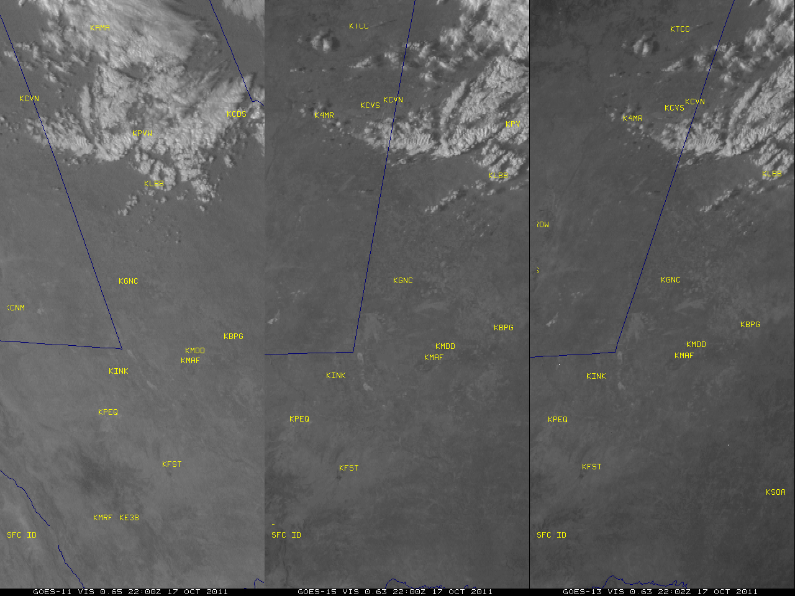
Notes:
http://cimss.ssec.wisc.edu/goes/blog/archives/9038 From Scott Bachmeier, CIMSS.

Slide 2
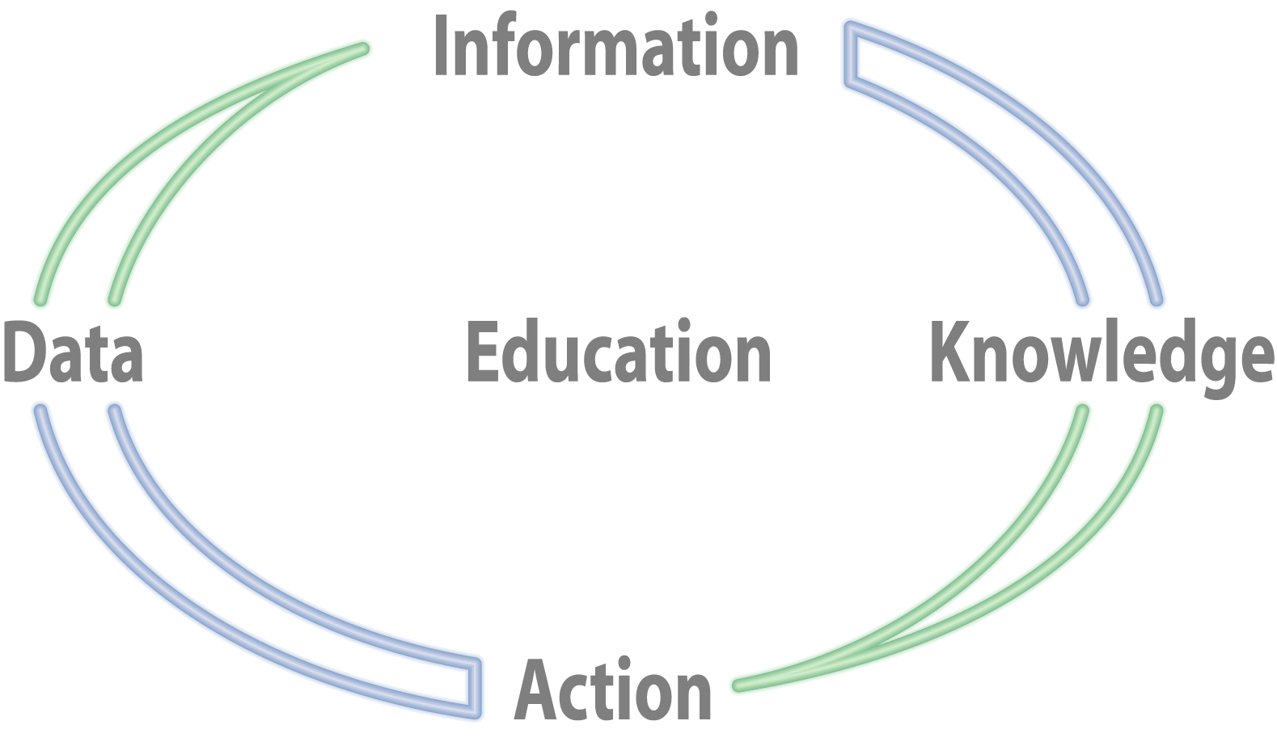
The full circle…
Federal Government
University Colleagues
Private Sector
Notes:
From Steve Ackerman, CIMSS.

Slide 3
Maybe we need another slogan?
When dust advects, do what’s best.
Or
When dust goes fast, you slow down!
Maybe researchers aren’t the best at slogans!

