Slide 1

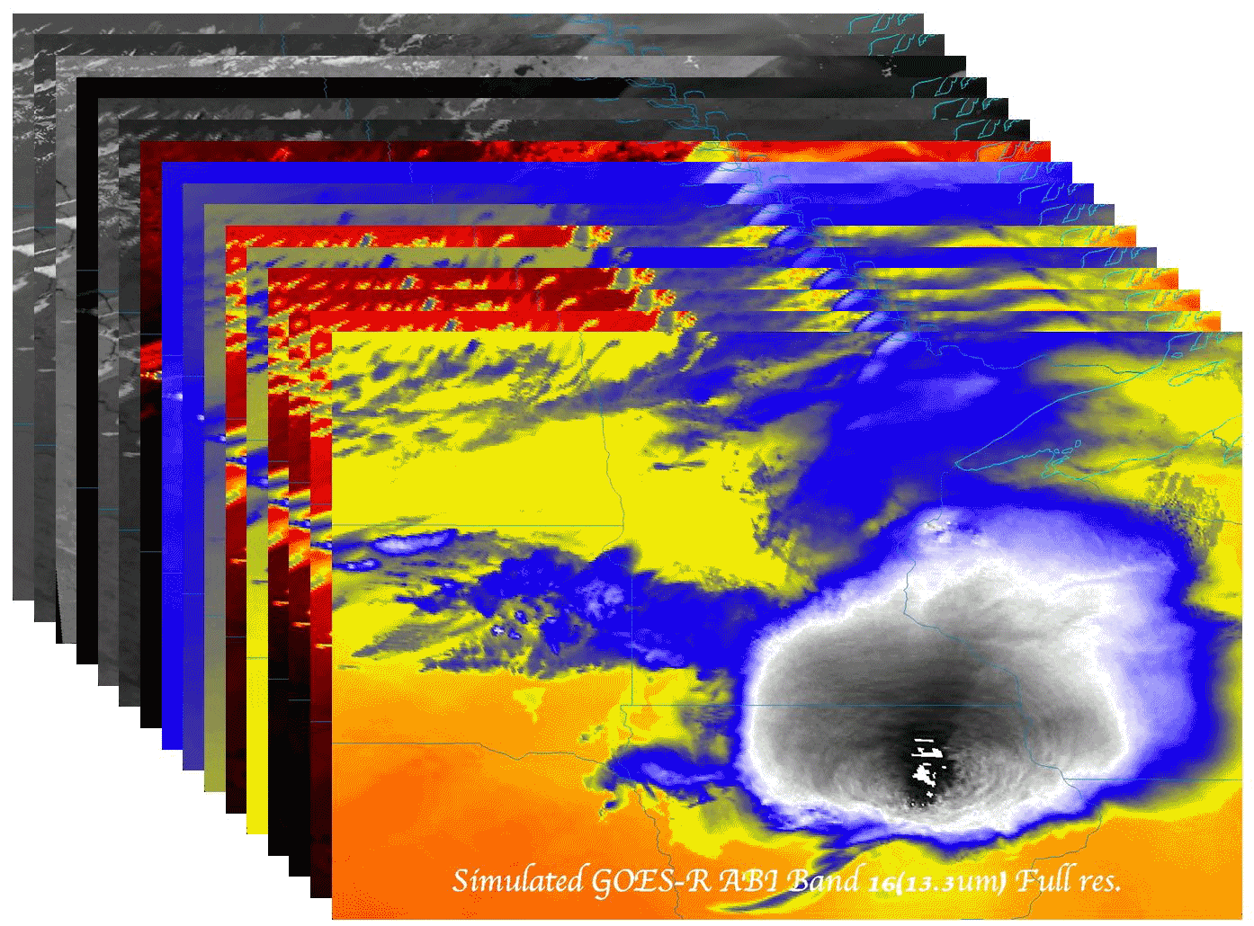

Government employment opportunities
  Timothy J. Schmit (tim.j.schmit@noaa.gov)
DoC/NOAA/NESDIS/Satellite Applications and Research (STAR)
Advanced Satellite Products Branch (ASPB)
Madison, WI
NSC 2017
Student Session
July 2017
Madison, WI

Slide 2
Outline
Introduction / History
The ‘graying’ of the
workforce
Options
Logistics
“Tips” and Links
Questions

Slide 3
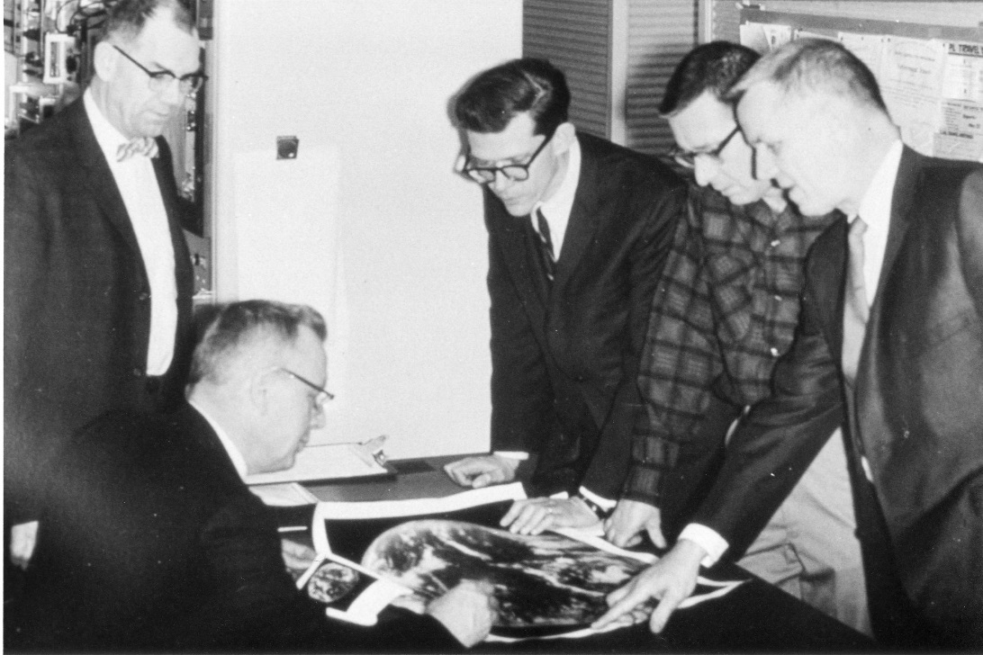

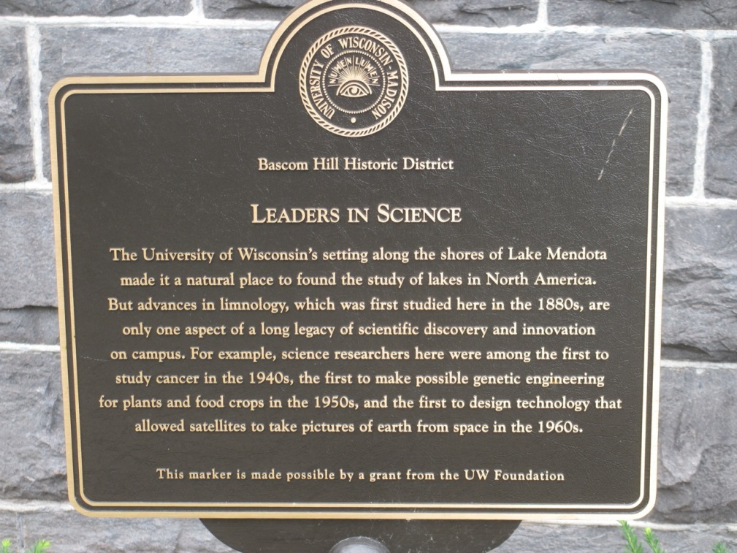
“Father of Weather Satellites”
Verner E. Suomi
“The first to design technology that allowed satellites to take pictures of the earth from space…”
Notes:
http://cimss.ssec.wisc.edu/news/geo_image_anniversary.html

Slide 4
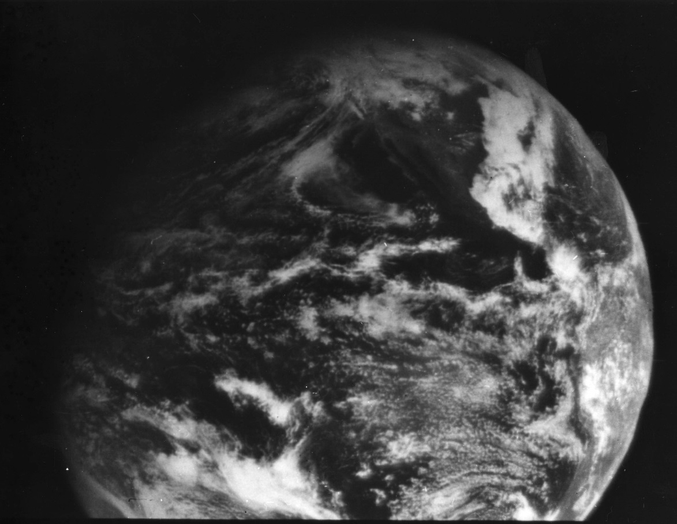
1966: ATS-1 launched
Applications Technology Satellite (ATS)-1 hosted the first geostationary imager, Spin-Scan Cloud Camera, launched 6 December 1966.
Imaging instrument designer and SSEC co-founder, Verner E. Suomi, proclaimed, “Now, the weather moves, not the satellite.”
11 December 1966
North America
Notes:
http://cimss.ssec.wisc.edu/news/geo_image_anniversary.html

Slide 5

ATS-1 Launched 1966
UW Suomi’s Spin-Scan Cloud Camera (visible imagery)
And it started in Wisconsin!

Slide 6
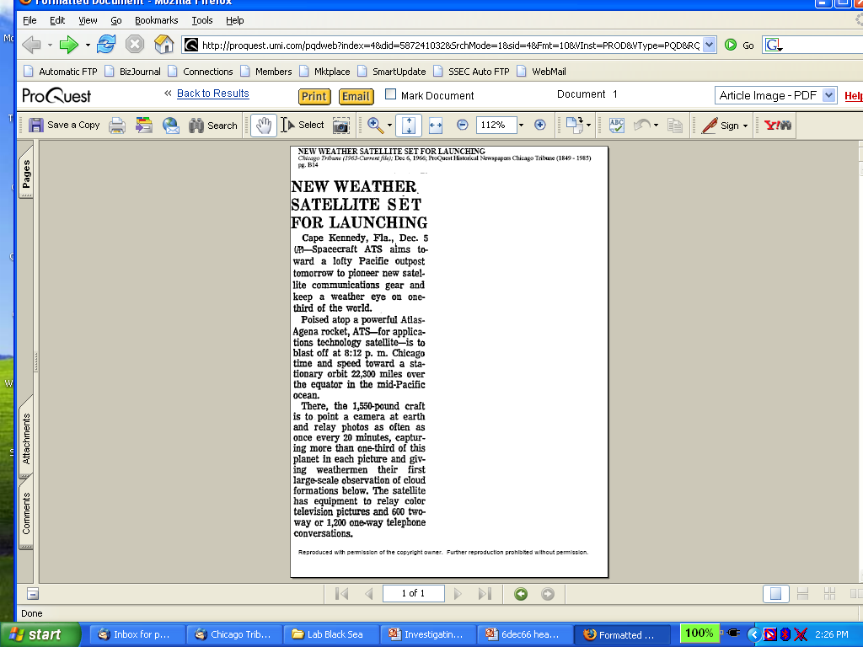
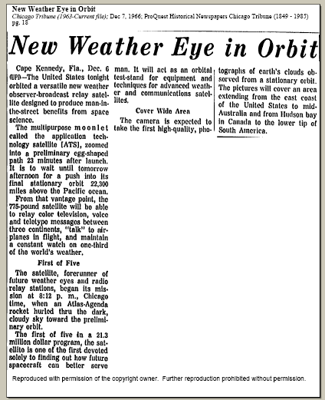
Suomi Introduced Time Continuous Imaging
Chicago Tribune
makes cautious
announcement
on 5 Dec 1966
of pending new
“weather eye”
On 7 Dec 1966 Tribune
declares
“multipurpose moonlet”
successfully launched
Notes:
Slide from Dr. Paul Menzel.

Slide 7
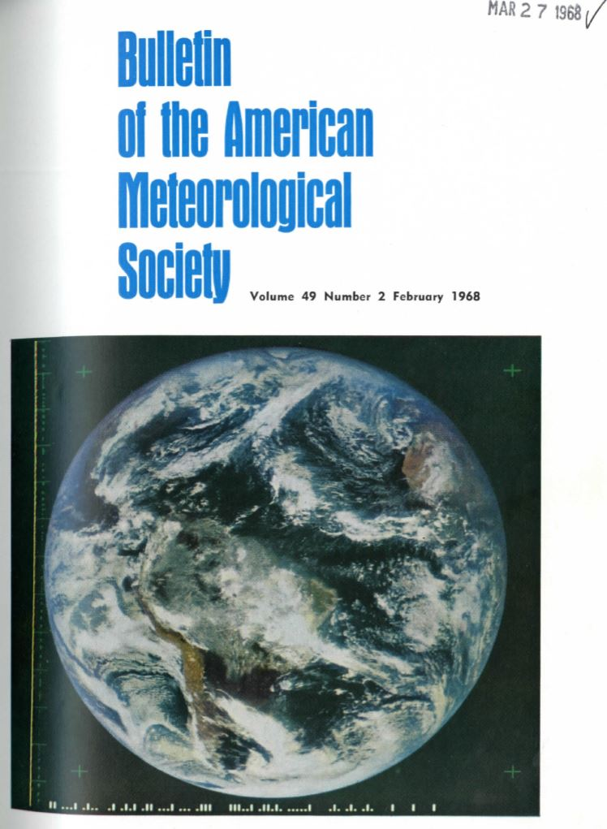
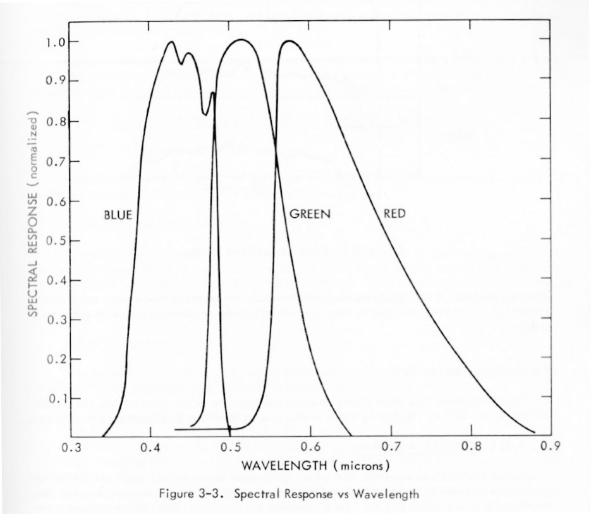
ATS-3
Cover photograph: The Earth in full color as seen from 35,800 km altitude. This photograph was taken by the Multicolor Spin-Scan Cloud Camera Experiment aboard NASA’s Applied Technology Satellite (ATS-3) on 10 November 1967.
Notes:
http://journals.ametsoc.org/toc/bams/current
, when the satellite was located in a geosynchronous orbit over the equator north of the Amazonas Delta (see articles by V. E. Suomi and R. J. Parent, and G. Warnecke and W. S. Sunderlin on
pages 74 and 75). (NASA Photograph).

Slide 8

ATS-3 Movie (1967)
UW Suomi’s Multicolor Spin-Scan Cloud Camera
And it started in Wisconsin!

Slide 9
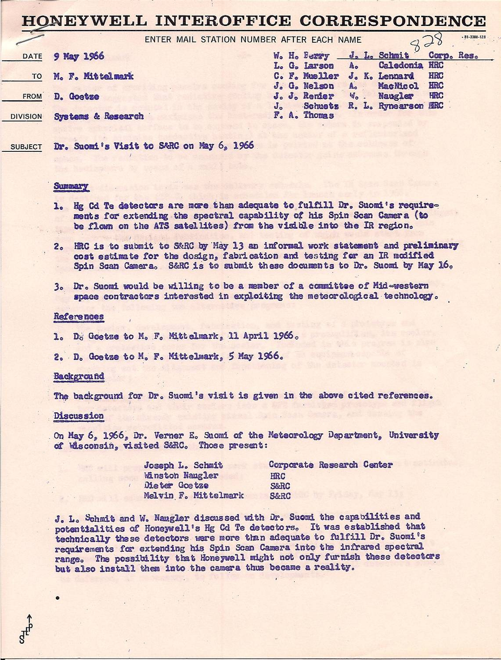
Honeywell memo (May 6, 1966 meeting). Note the idea of “…extending the spectral capability of [the] Spin Scan Camera (to be flown on the ATS) from the visible into the IR region”.

Slide 10
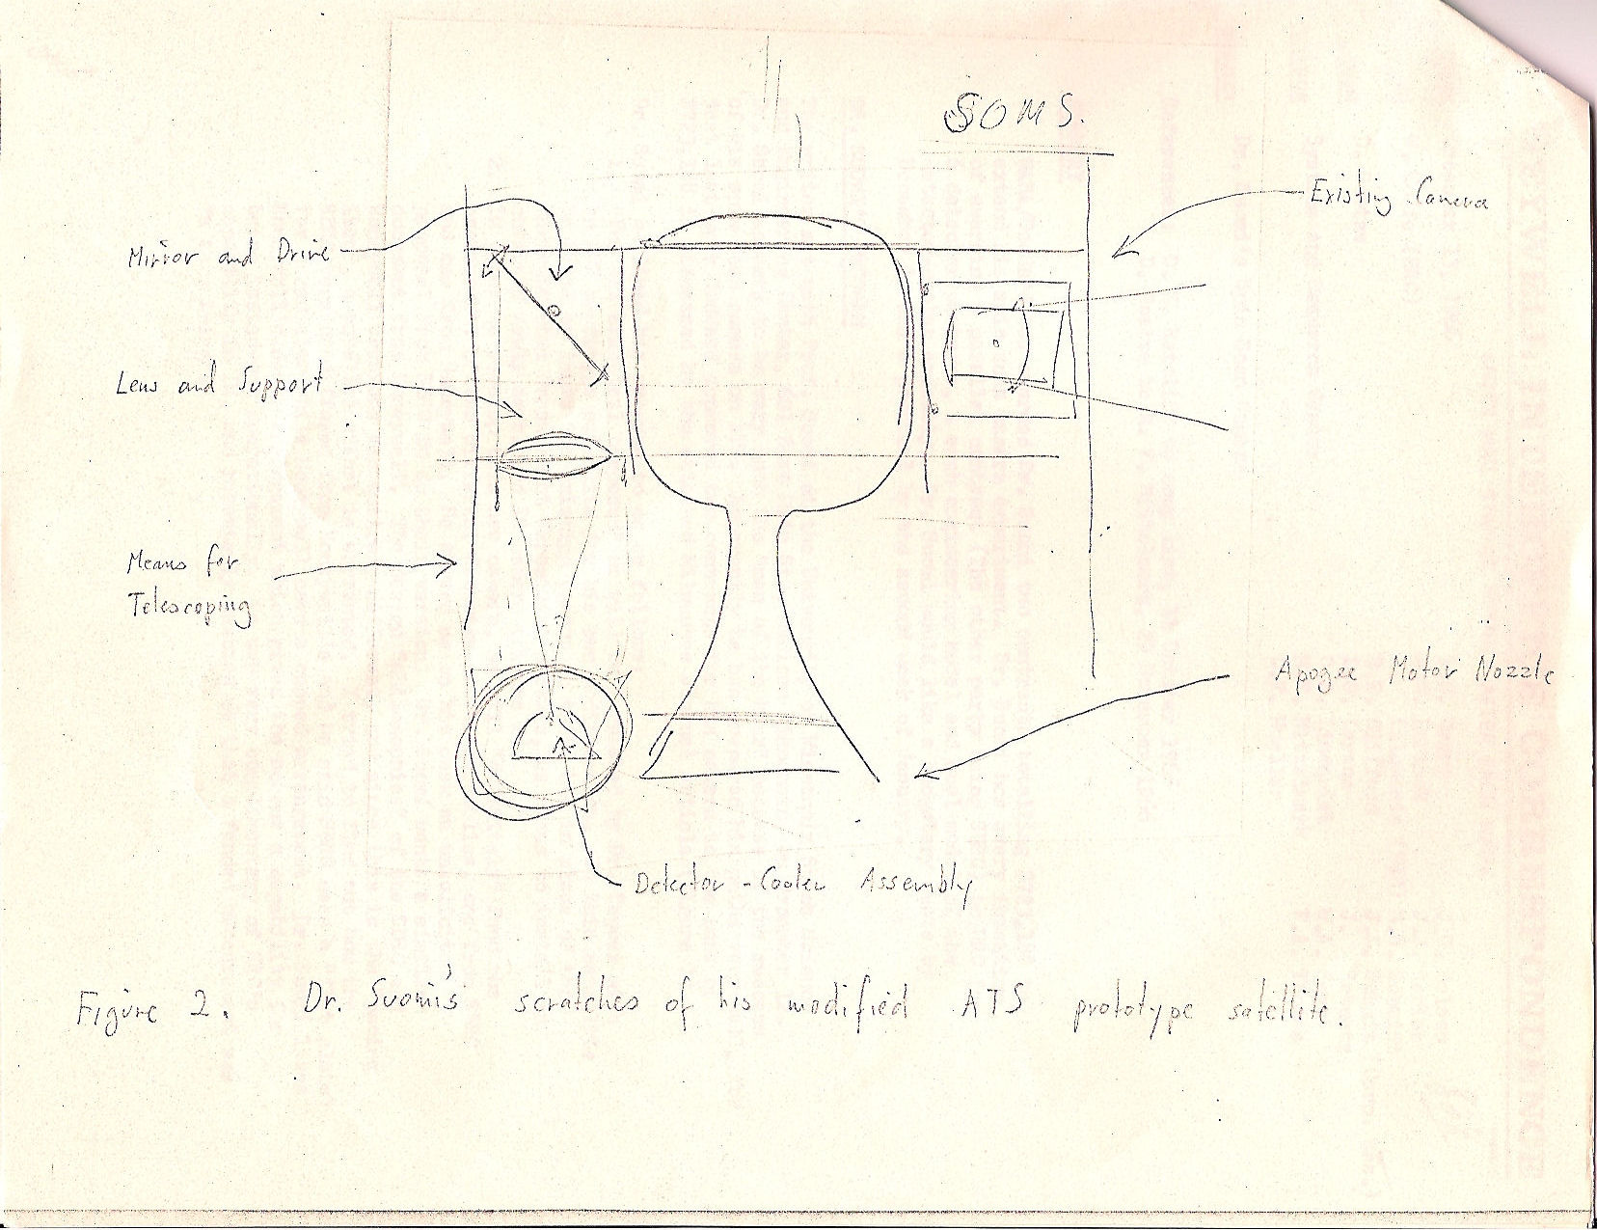
“Figure 2. Dr. Suomi’s “scratches” of his modified ATS prototype satellite”. (1966)
Unique insight to the early ideas of IR data in geostationary orbit by Dr. Suomi.
This was over eight years before SMS-1 did have IR data.

Slide 11
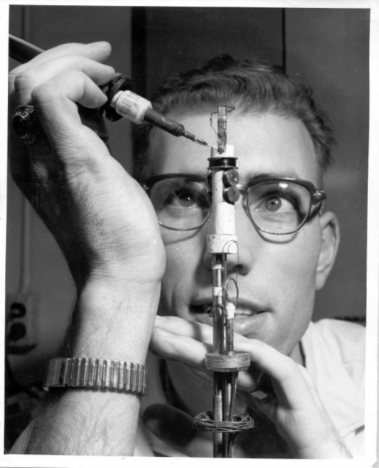
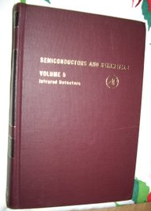
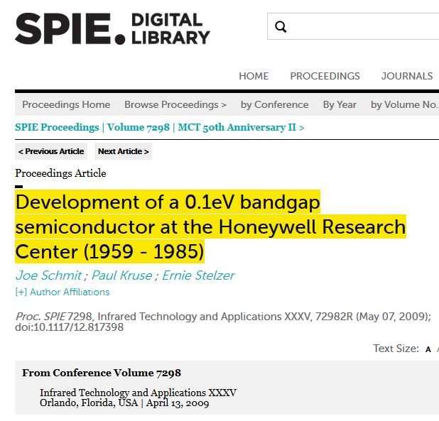
Early introduction to the Infrared
Joe Schmit (Honeywell Science Center): Leading researcher on Mercury cadmium telluride (Hg,Cd)Te crystal growth
Dozens and dozens of scientific papers
Lead or co-lead on over a dozen patents
Book chapter
  Semiconductors and Semimetals
Many real world applications:
  “seeing in the dark”
  “seeing the past”
  “seeing the future”
http://proceedings.spiedigitallibrary.org/proceeding.aspx?articleid=823895

Slide 12
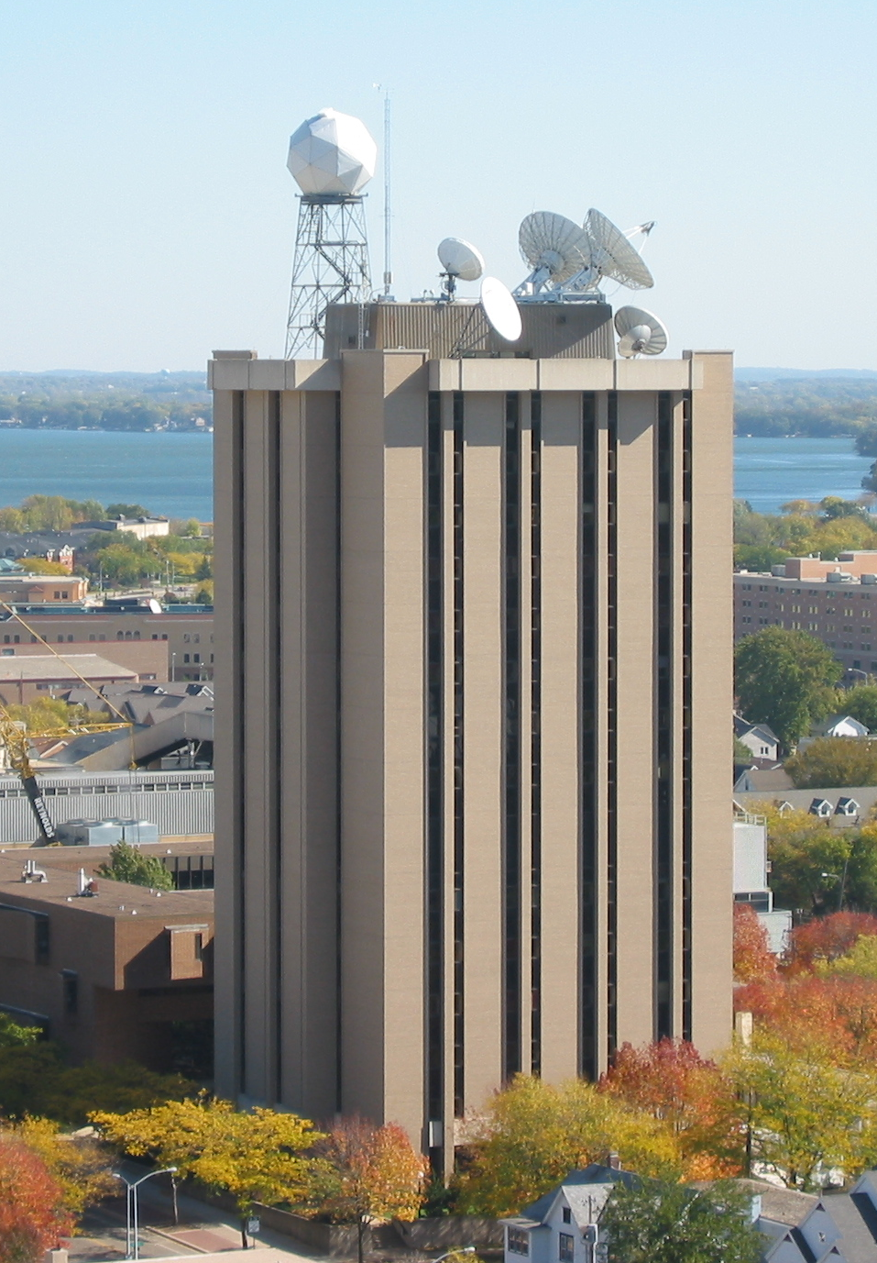
Atmospheric, Oceanic and Space Sciences
‘87
SSEC/CIMSS
(researchers, etc.)
AOS
(faculty, students)
‘85
NOAA
CIMSS (Cooperative Institute for Meteorological Satellite Studies)
NOAA (National Oceanic and Atmospheric Administration)

Slide 13
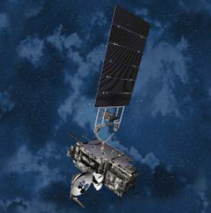
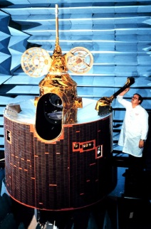
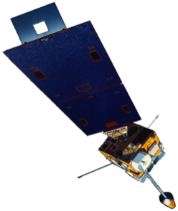
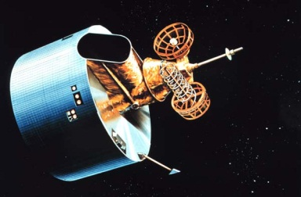
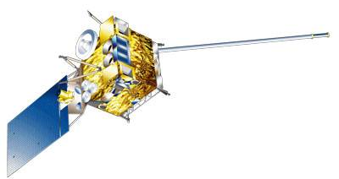
GOES History
GOES-1/3
Launched
1975
1977
1978
One visible and one infrared .
Operational.
GOES-4/7
Launched
1980
1981
1983
1987
VISSR–VAS visible, 12 IR. MSI (visible, IRW, and 2 additional IR channels)
GOES-8/12
Launched
1994
1995
1997
2000
2001
3-axis stabilized.
Imager Bands: 4 IR; 1 visible.
Operational Sounder
(18 IR bands)
GOES-13/14/15
Launched
2005
2009
2010
Better navigation and calibration.
No eclipse outages.
Better spatial resolutions for the 6.5 um on GOES-12+ and the 13.3 um band on GOES-14/15.
Operational Sounder
GOES-R/S+
Planned Launch
2015
2017
2020
2025
Faster coverage.
16 Imager Bands.
Improved spatial.
No sounder.
GLM
1G 2G 3G 4G 5G
Notes:
The circles represent an estimate of the impact of GOES on regional scale numerical models.

Slide 14
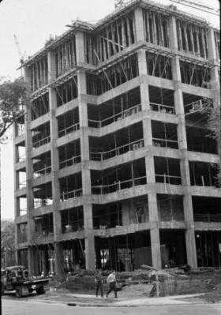
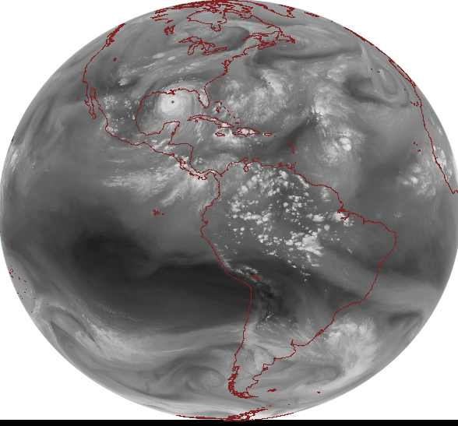
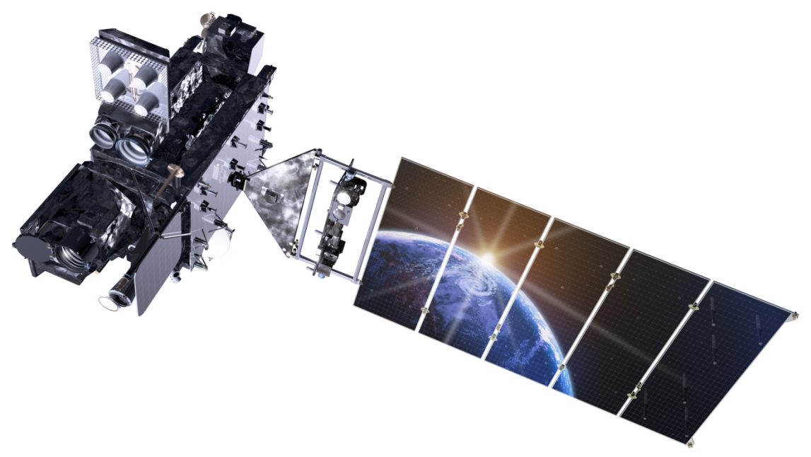
Outline
Introduction
The ‘graying’ of the
workforce
Options
Logistics
“Tips” and Links
Questions
Lockheed Martin

Slide 15
NOAA NESDIS STAR WORKFORCE
Age Distribution
Approximately 40% of STAR’s workforce retired in the last 5 years
40% of STAR’s workforce MAY RETIRE in the next 5 years
15
Notes:
From Al Powell, STAR director.

Slide 16
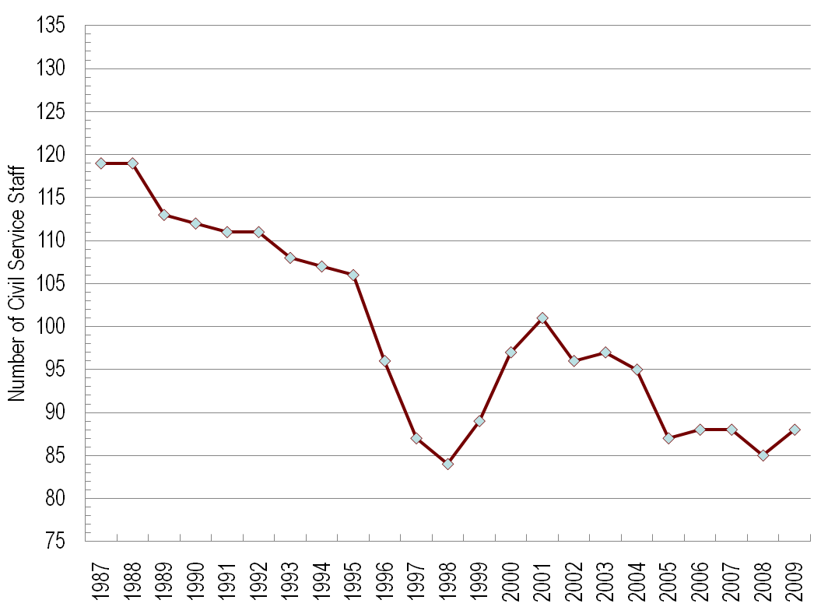
NOAA NESDIS STAR FACTS
Civil Servant Staffing
Available 1987 FTE positions: 140
YEAR:
STAR workforce planning is essential to maintain a viable science office
16
Notes:
From Al Powell, STAR director.
16

Slide 17
STAR WORKFORCE
NUMBER OF RECENT HIRES
  2005 11 hires
  2006 12 hires
  2007 8 hires
  2008 5 hires
  2009 6 hires
  Total: 42
Turnover of STAR workforce will impact future readiness
17
Notes:
From Al Powell, STAR director.

Slide 18
Outline
Introduction
The ‘graying’ of the
workforce
Options
Logistics
“Tips” and Links
Questions
Lockheed Martin

Slide 19
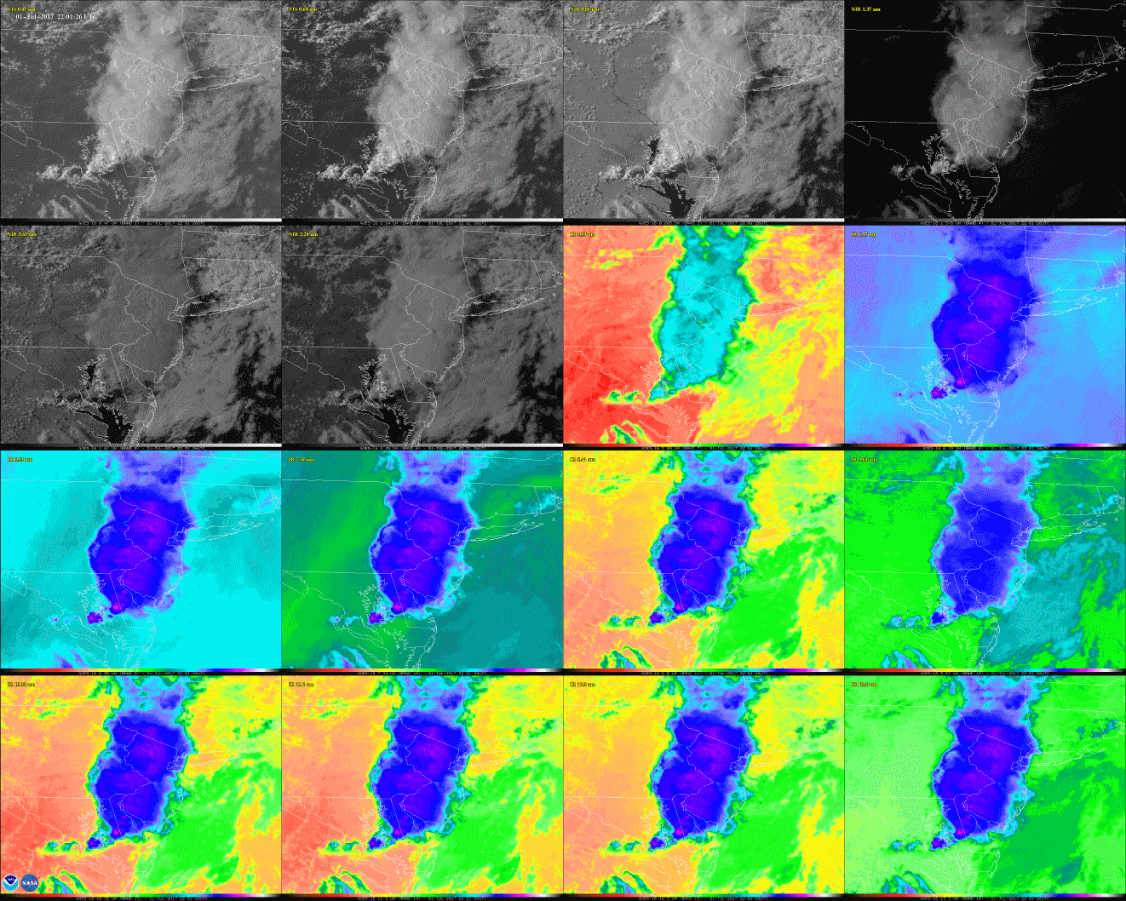
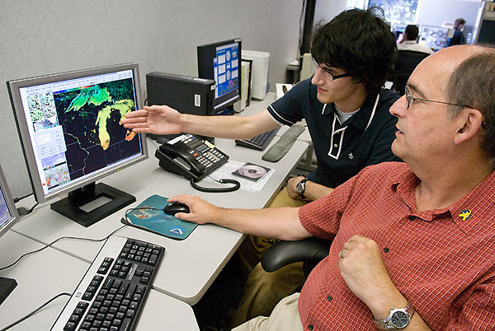
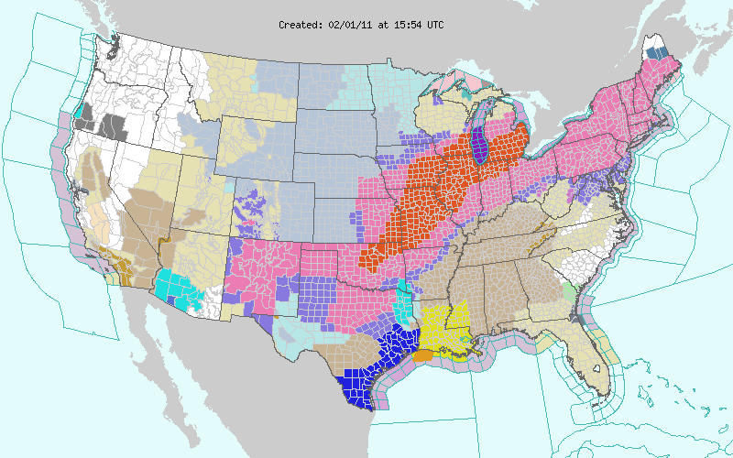

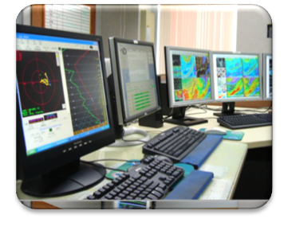
Four Pillars of NOAA
People
Critical
Environmental Intelligence
Observations
Computation & Modeling
Research
People are key for each pillar!
Notes:
Slide modified from Laura Furgione, NWS
Ppt: ‘crop to shape’ and ‘picture effects, bevel, soft round’
NOAA=Critical Environmental Intelligence
Our Nation's environmental predictive capabilities are supported by four foundational pillars: observations, computer models, research, and our people, who provide forecasts, warnings, and decision assistance to key decision makers.
By strengthening the pillars – through improved satellite and in-situ observations, computational capacity, and coupled atmosphere, ocean, land models, and necessary research – we can revolutionize the forecast process across the entire spectrum, from relatively small-scale, short range applications to long range weather and climate predictions.
From a physical science perspective, NOAA continues to make strides and achieve success with its uptake, responsiveness, technological advances, etc.
19

Slide 20
Options
NOAA/NWS or NOAA/NESDIS
DOE or DOI or EPA or FAA or NASA
DoD (Airforce, Navy, etc.)
“Government-support”
  NOAA Cooperative Institutes, etc.
  Contractors

Slide 21
Details
NOAA/NWS: operational forecasters, modelers (NCEP), hydrologist, NHC, HPC, OPC, AWC, SPC, etc.
NOAA/NESDIS: Satellite algorithm/product development and research; satellite operator, volcanic ash advisory, synoptic analysis, etc.
NOAA/NESDIS/OAR: research, surface observing, etc.

Slide 22
Details
NASA: satellite products, research, etc.
DOE (Energy): solar, etc.
DOI (Interior): wildfires, etc.
EPA: air quality, etc.
DOA (Agriculture): researcher, etc.
FAA: 4-d data cube, hazards to aviation
DoD (Airforce, Navy, etc.)
  Operational forecasts
  Modelers
  Etc.

Slide 23
Details
“Government-support”
  NOAA Cooperative Institutes, UCAR, etc.
  http://www.nrc.noaa.gov/ci/locations/index.html
  Research on many topics
  Contractors
  http://www.corpblogspot.org/
  Full range of support from operations to IT to research
  http://www2.ucar.edu/opportunities

Slide 24
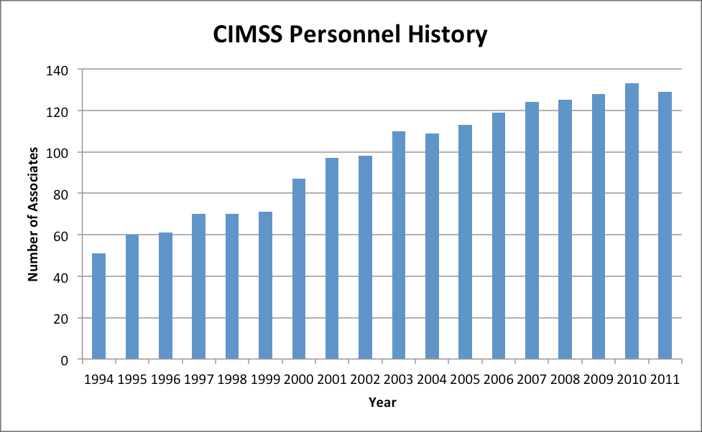
CIMSS Personnel (now 136)
Notes:
From Steve Ackerman, CIMSS Director.

Slide 25
Outline
Introduction
The ‘graying’ of the
workforce
Options
Logistics
“Tips” and Links
Questions
Lockheed Martin

Slide 26
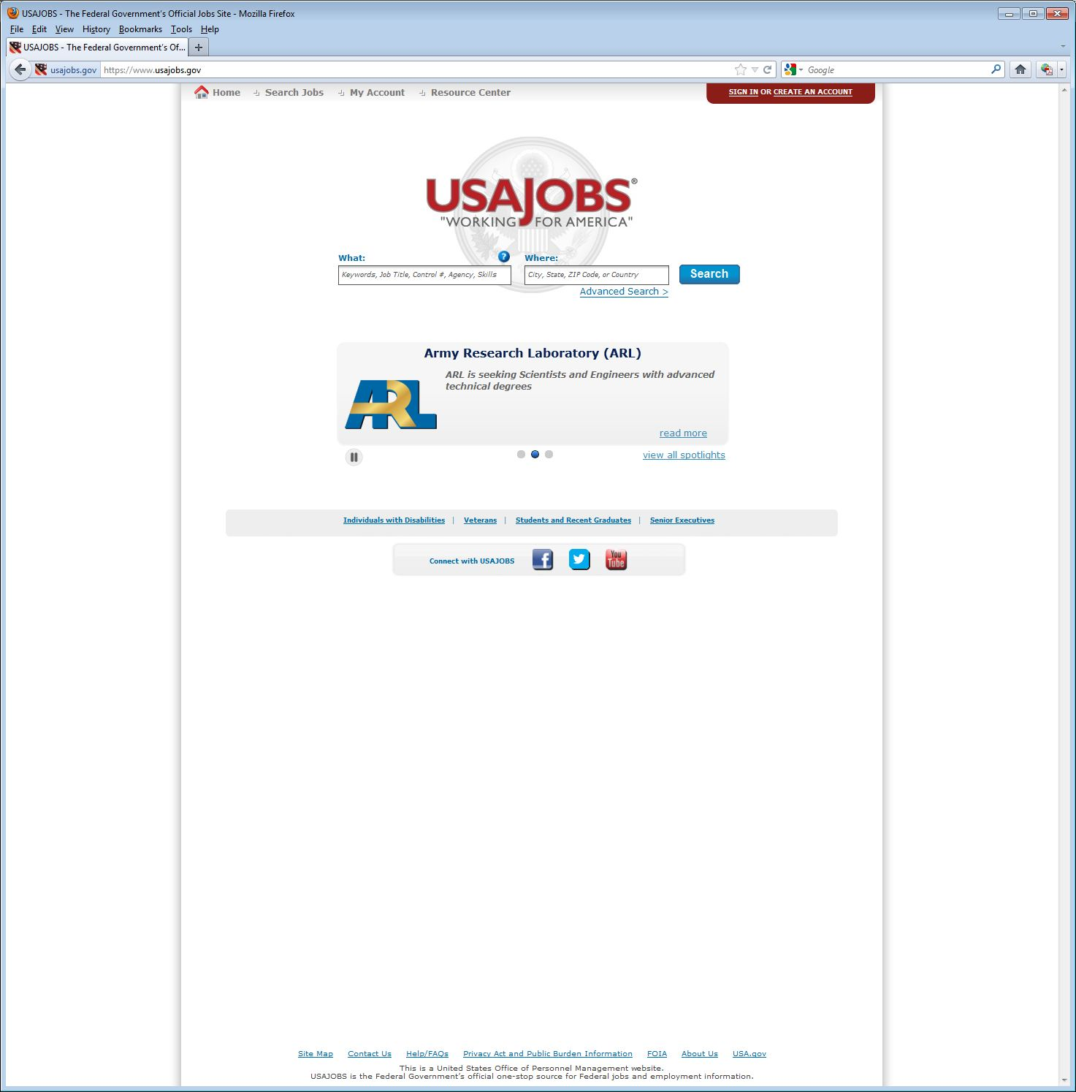
https://www.usajobs.gov/

Slide 27
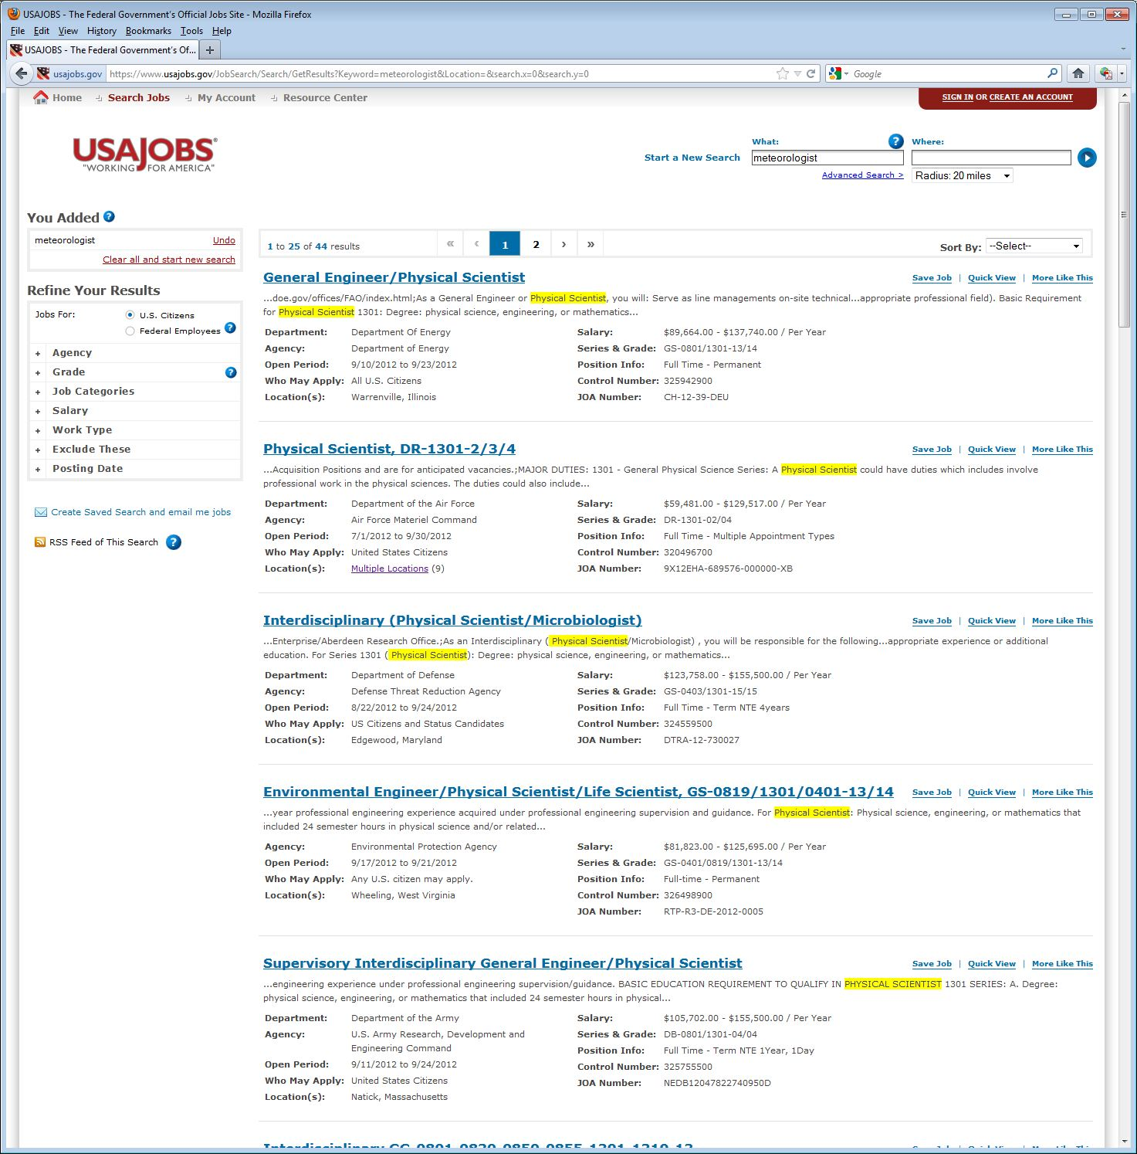

Slide 28
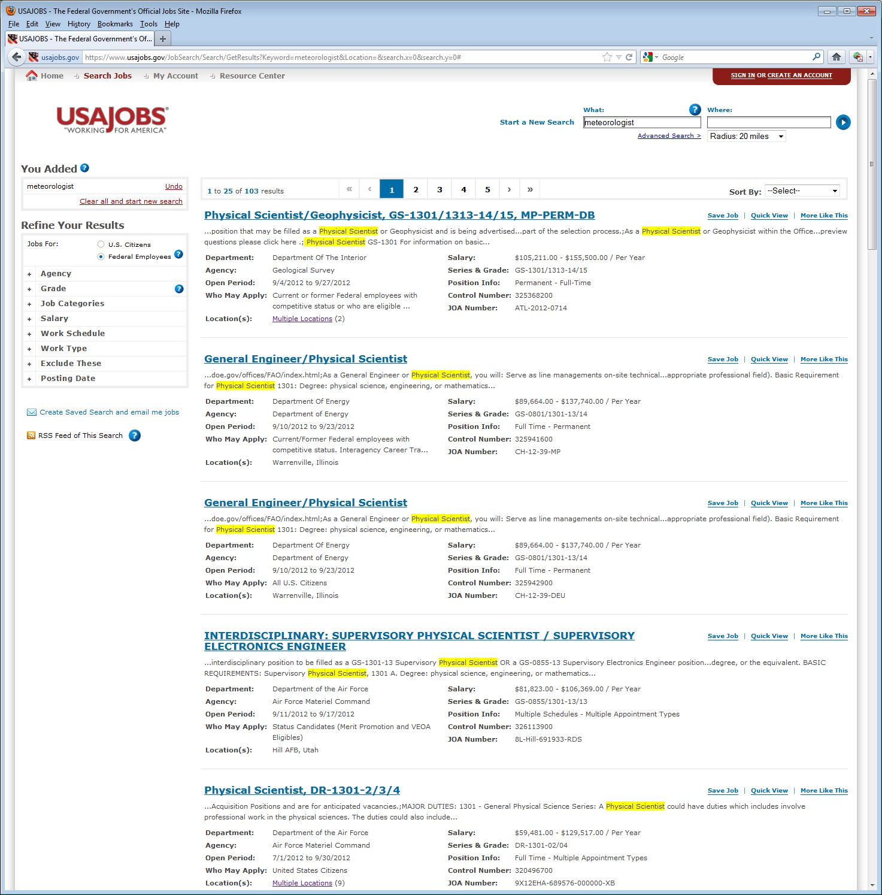

Slide 29
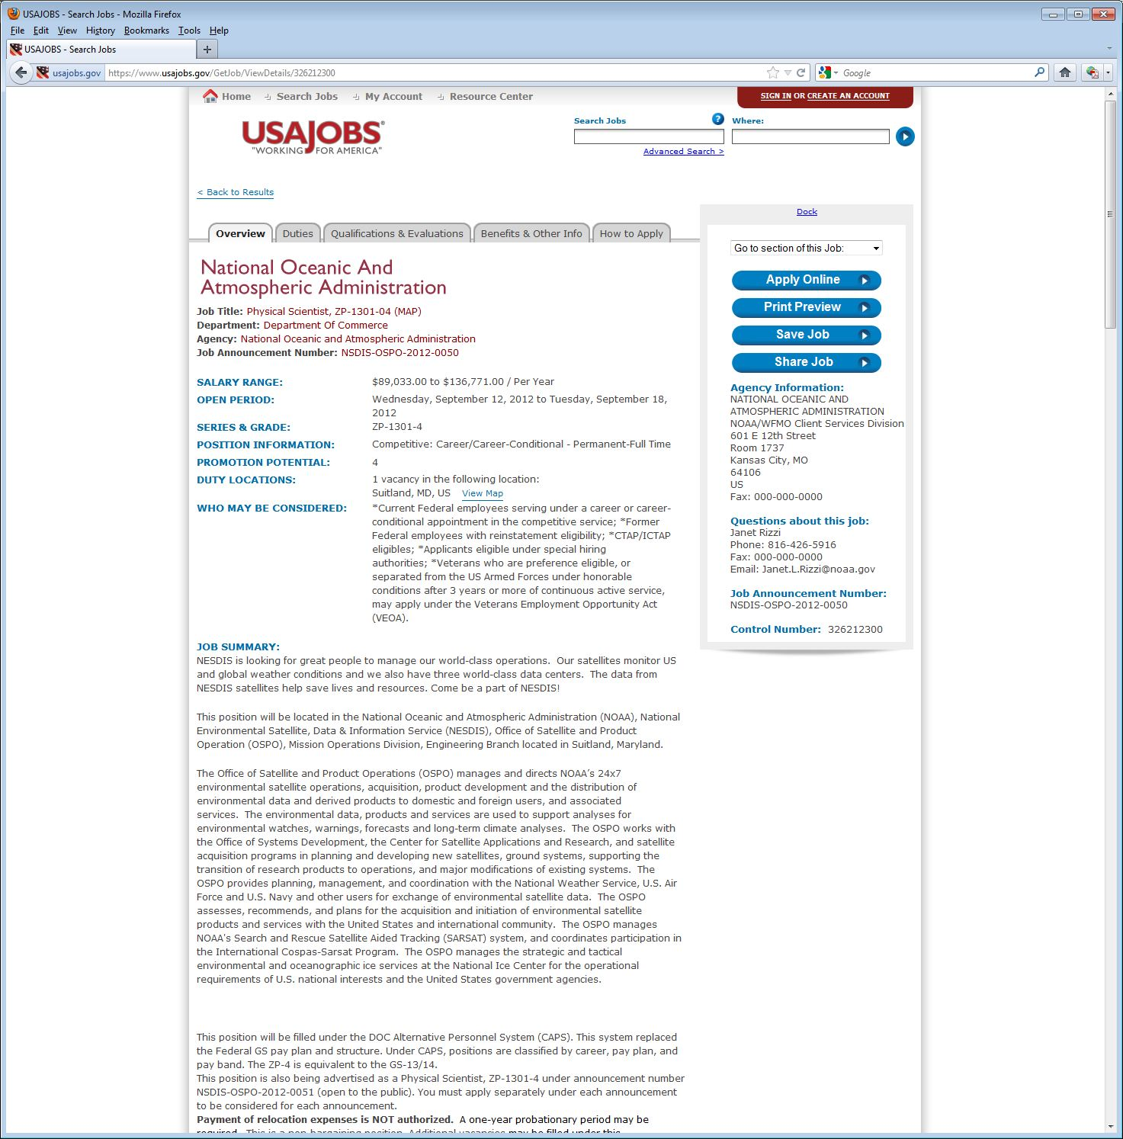
Watch close dates.
Notes:
https://www.usajobs.gov/GetJob/ViewDetails/326212300

Slide 30
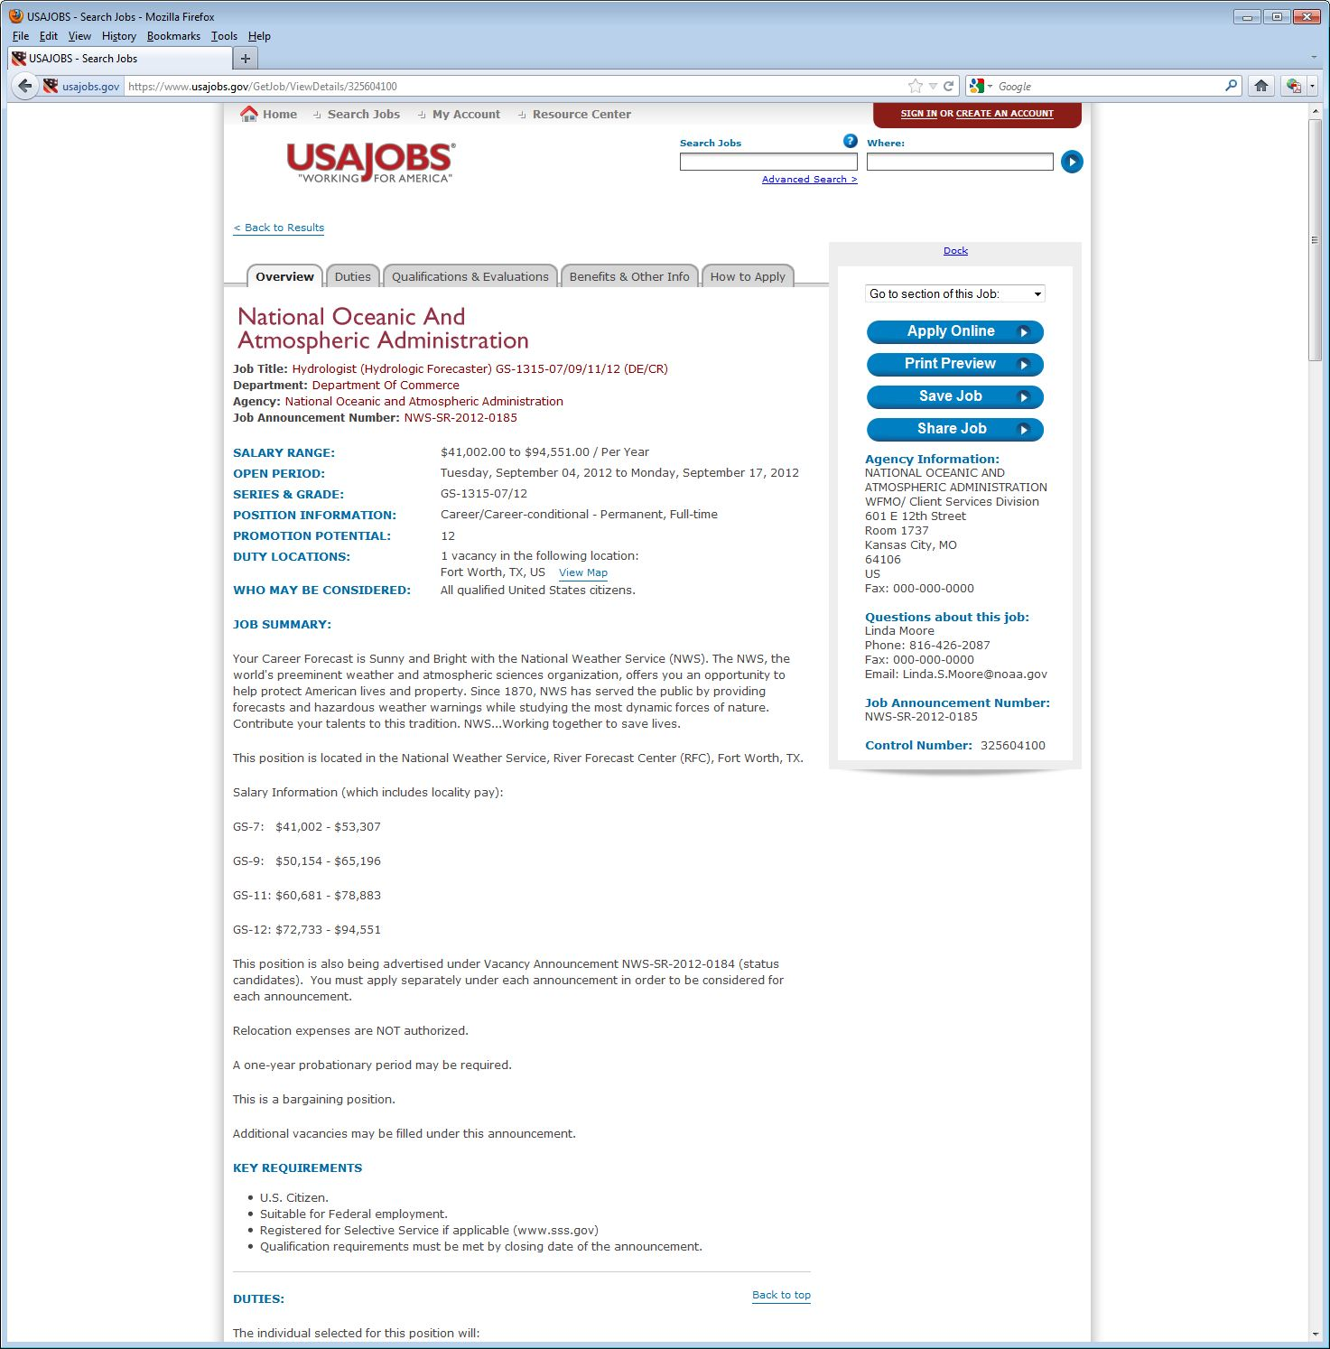

Slide 31
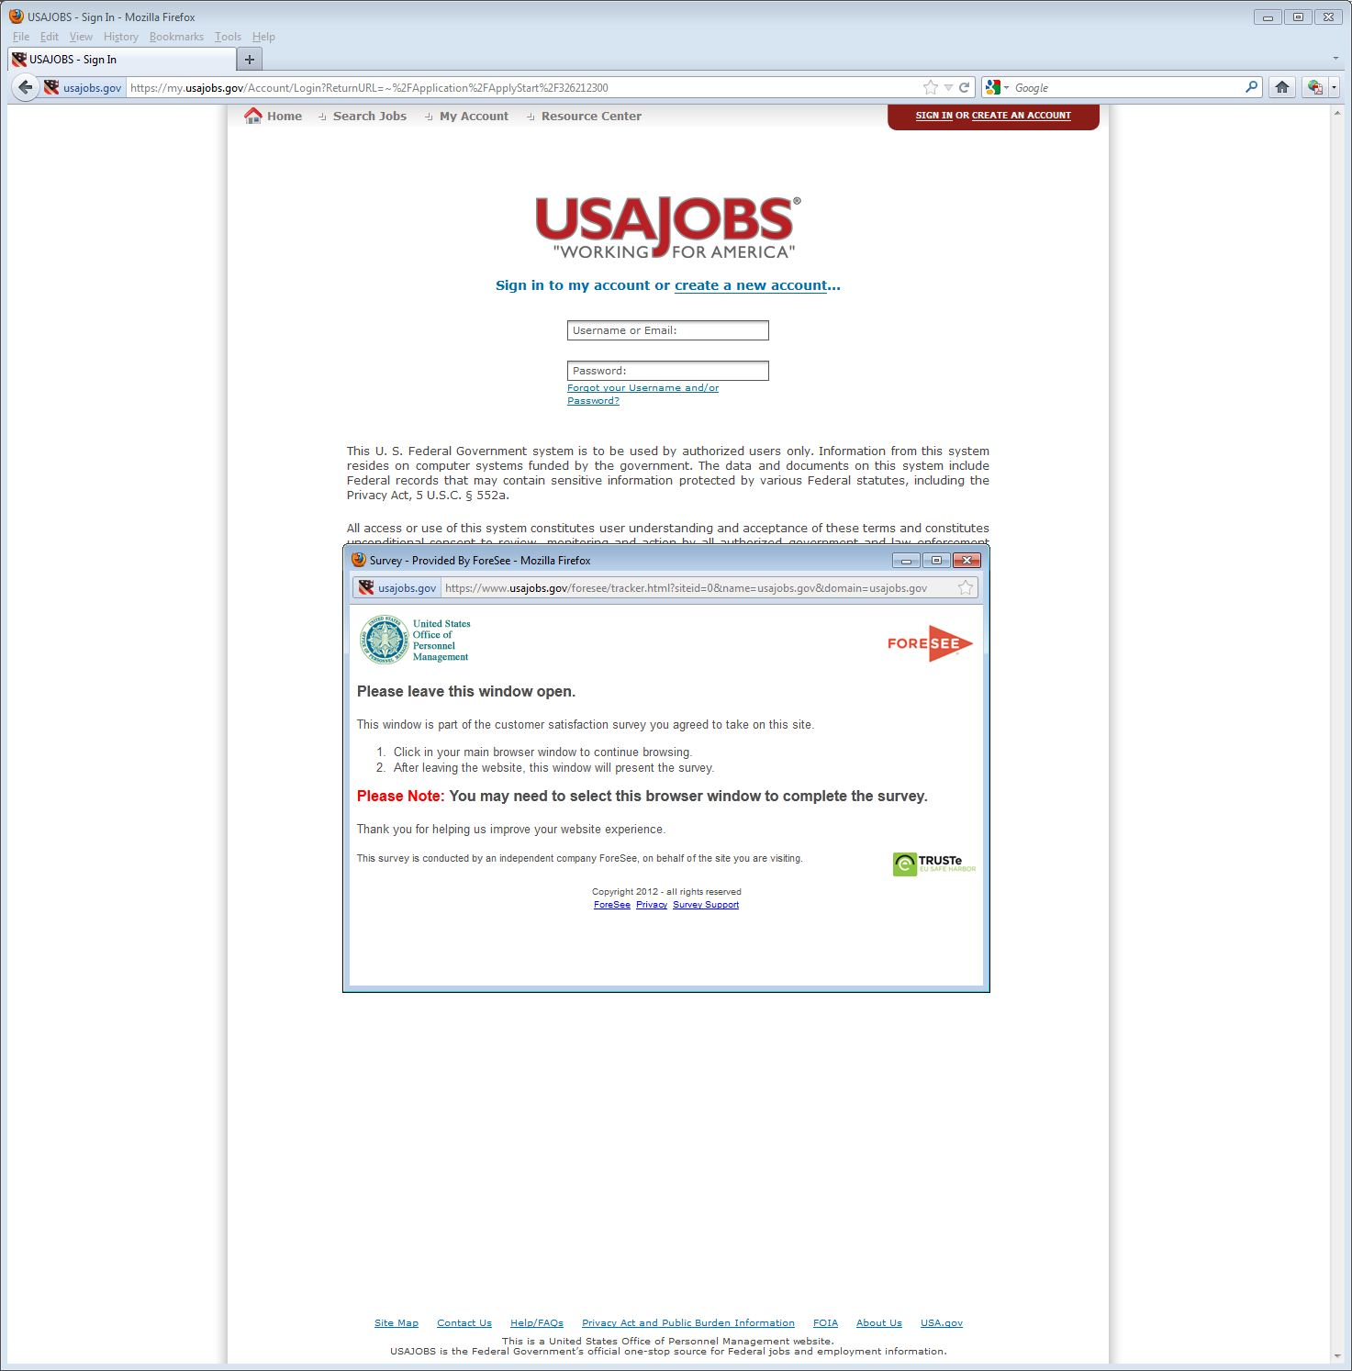

Slide 32
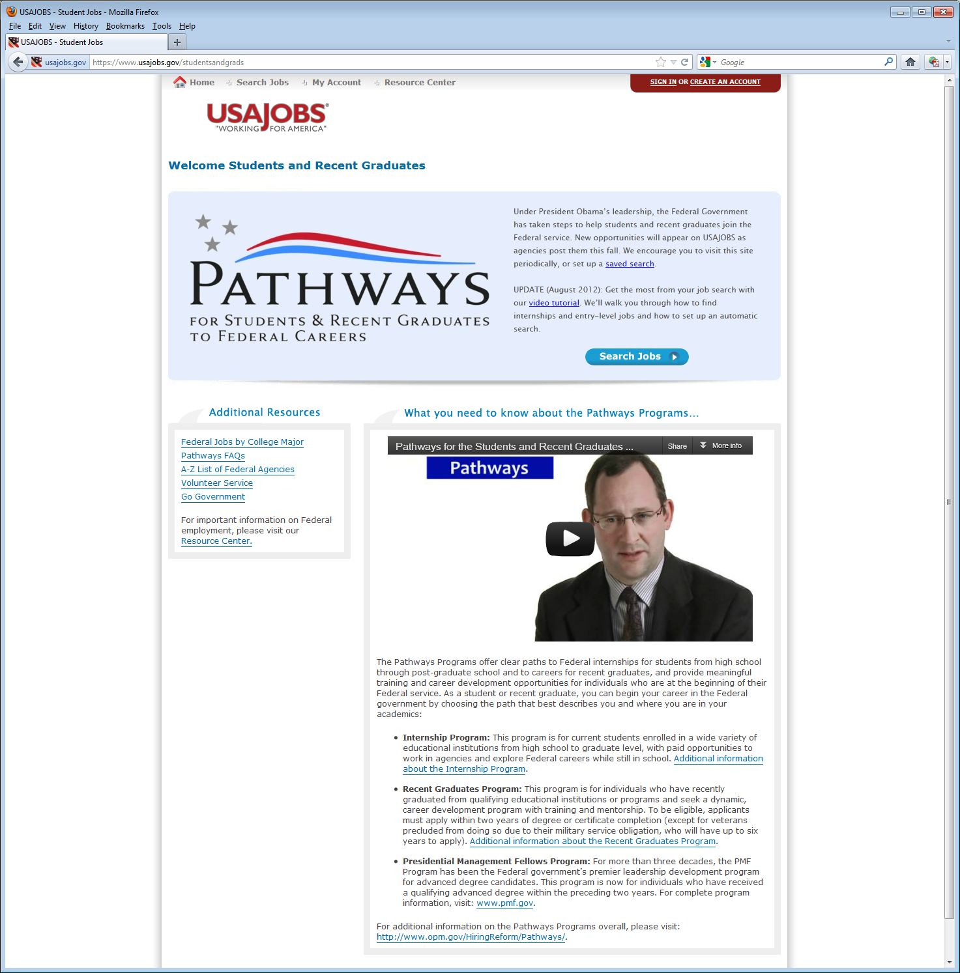
https://www.usajobs.gov/studentsandgrads

Slide 33
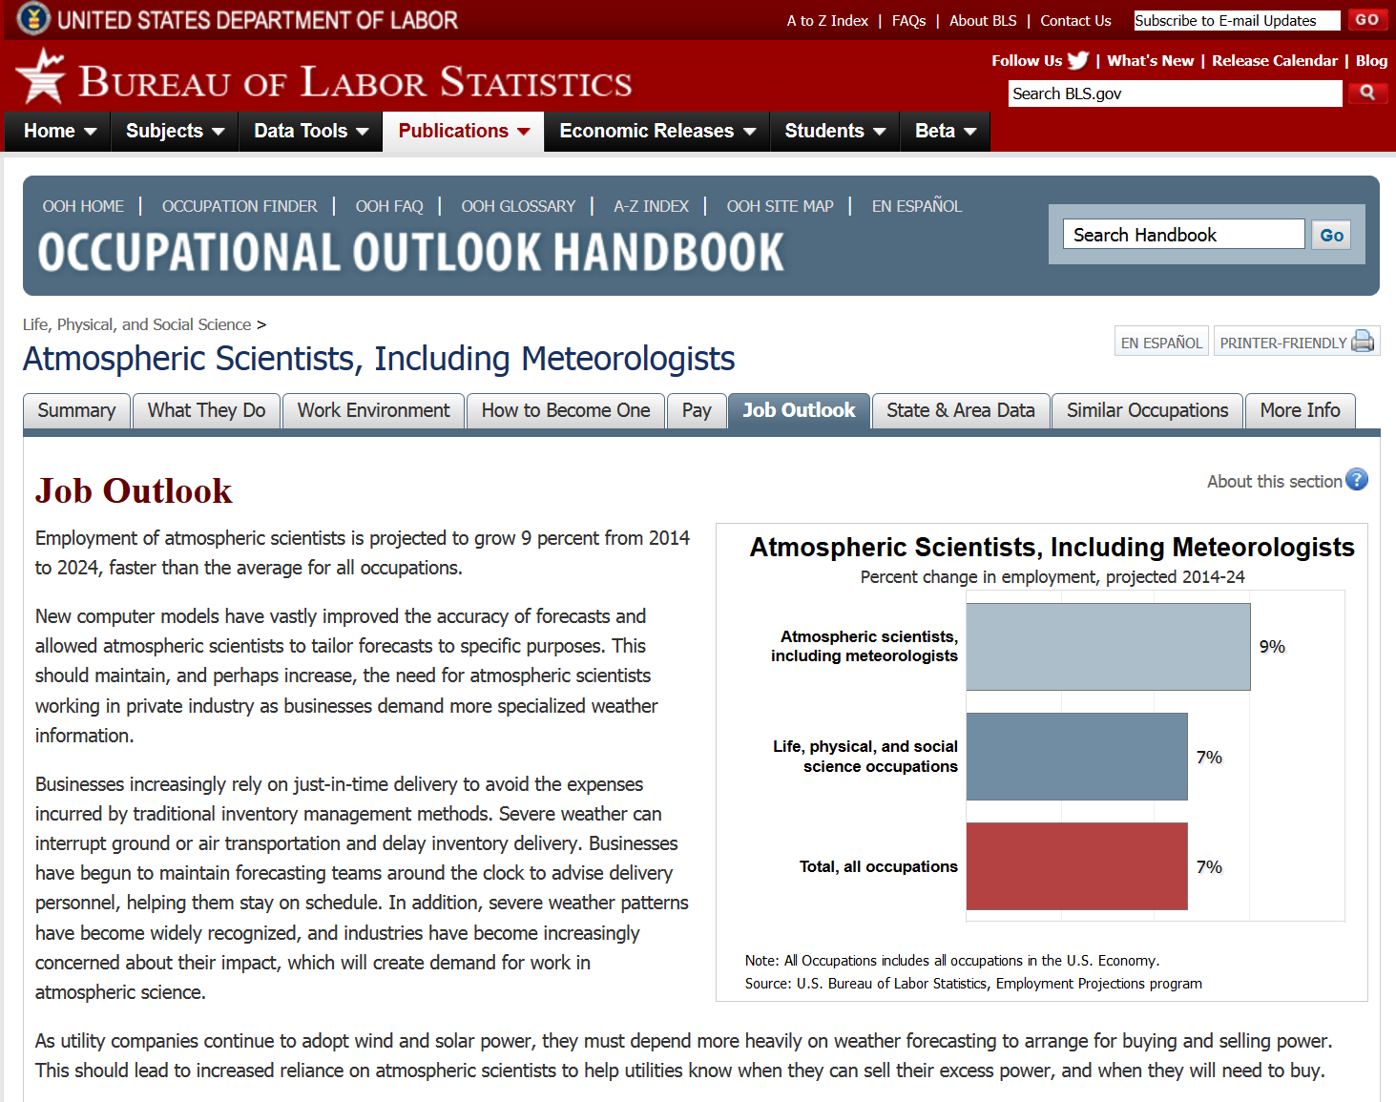
US Bureau of Labor Statistics: http://www.bls.gov/ooh/Life-Physical-and-Social-Science/Atmospheric-scientists-including-meteorologists.htm#tab-6
Atmospheric scientists…projected to grow by 9%...

Slide 34
US Bureau of Labor Statistics:
Prospective atmospheric scientists should expect competition because the number of graduates from meteorology programs is expected to exceed the number of job openings.
Workers with a graduate degree should enjoy better prospects than those whose highest level of education is a bachelor’s degree.
Competition may be strong for research positions at colleges and universities because of the limited number of positions available.
Few opportunities are expected in federal government because atmospheric scientists will be hired only to replace workers who retire or leave for other reasons.
The best job prospects for meteorologists will be in private industry.

Slide 35
Outline
Introduction
The ‘graying’ of the
workforce
Options
Logistics
“Tips” and Links
Questions
Lockheed Martin

Slide 36
“Tips”
Gain experience to stand apart from others
  Take more courses than required
  Consider getting a minor
  Get a masters degree
  Computer skills (programming, web, etc.)
  Consider for internships, coops, Student Career Experience Program (SCEP), etc.
  Business / management courses
Notes:
Thanks to Tom Renkevens for some of these ideas.

Slide 37
“Tips”
"You can't teach enthusiasm!“
Do your homework about the agency/group
Be flexible wrt location, other options await
Join profession groups (NWA, AMS, etc.)
“You only need one job”
Don’t be shy – advertise yourself
Get involved, network (+ social media)
Investigate ‘government-support’ positions, such as at NOAA Cooperative Institutes or contractors

Slide 38
Select Links
https://www.usajobs.gov/
http://www.careers.noaa.gov/special_programs.html
http://www.theweatherprediction.com/jobs/
http://www.navy.com/careers.html
http://www.airforce.com/careers/
http://jobs.faa.gov/
http://www.bls.gov/ooh/Life-Physical-and-Social-Science/Atmospheric-scientists-including-meteorologists.htm
http://www.nwas.org/jobs.php (member portal)

Slide 39
Outline
Introduction
The ‘graying’ of the
workforce
Options
Logistics
“Tips” and Links
Questions

Slide 40
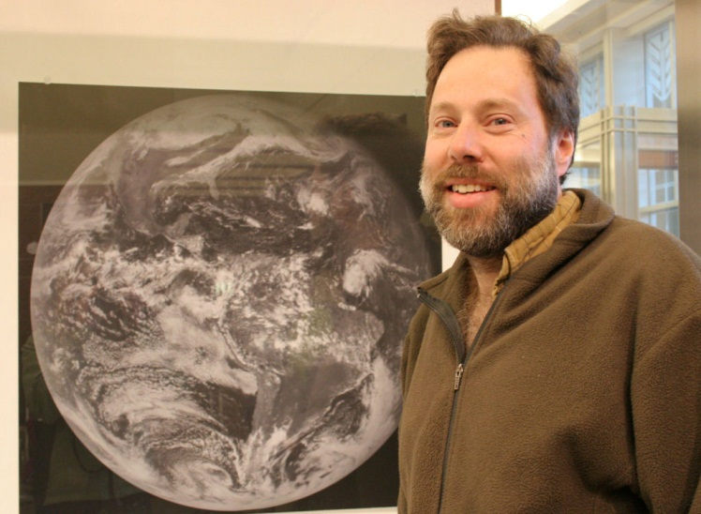
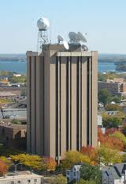
Questions?

