Slide 1
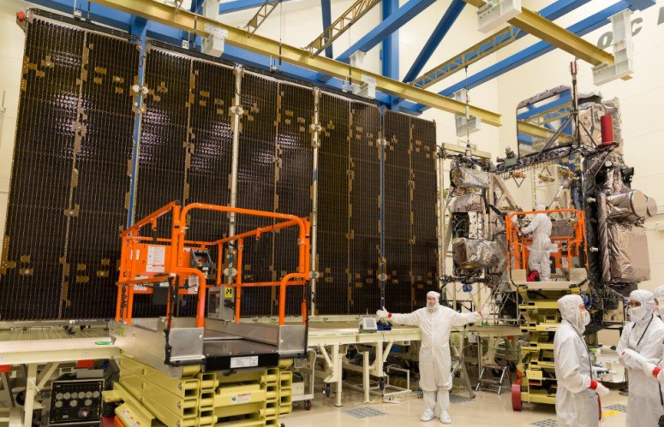
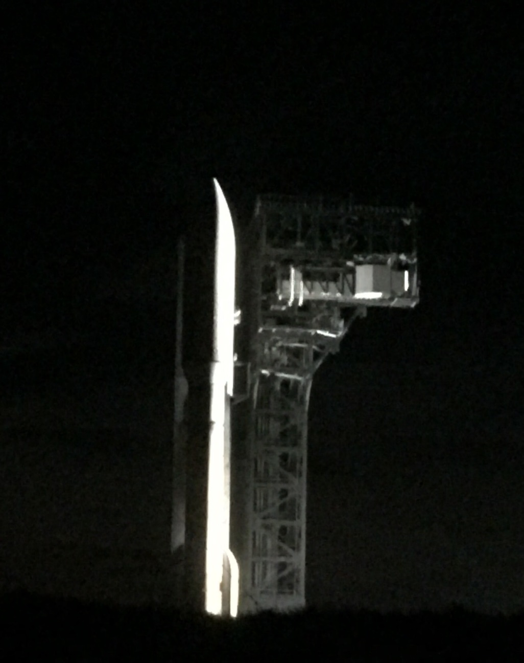
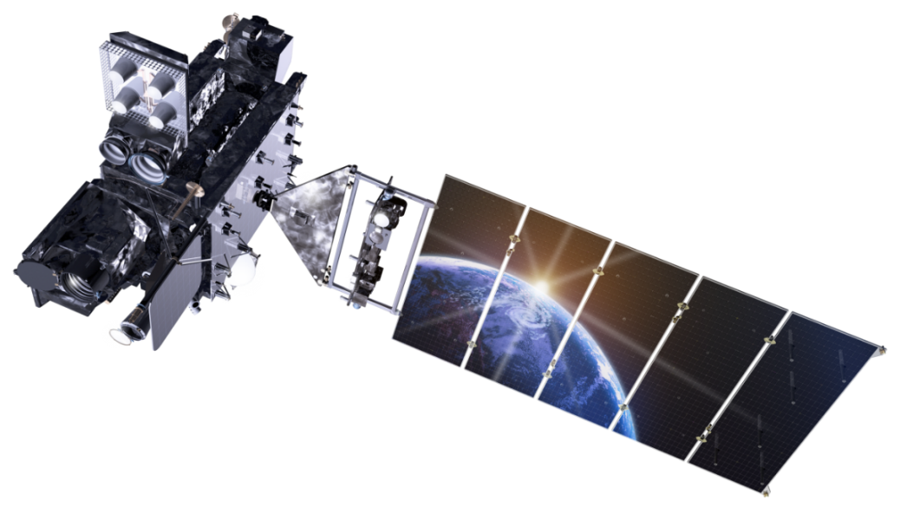
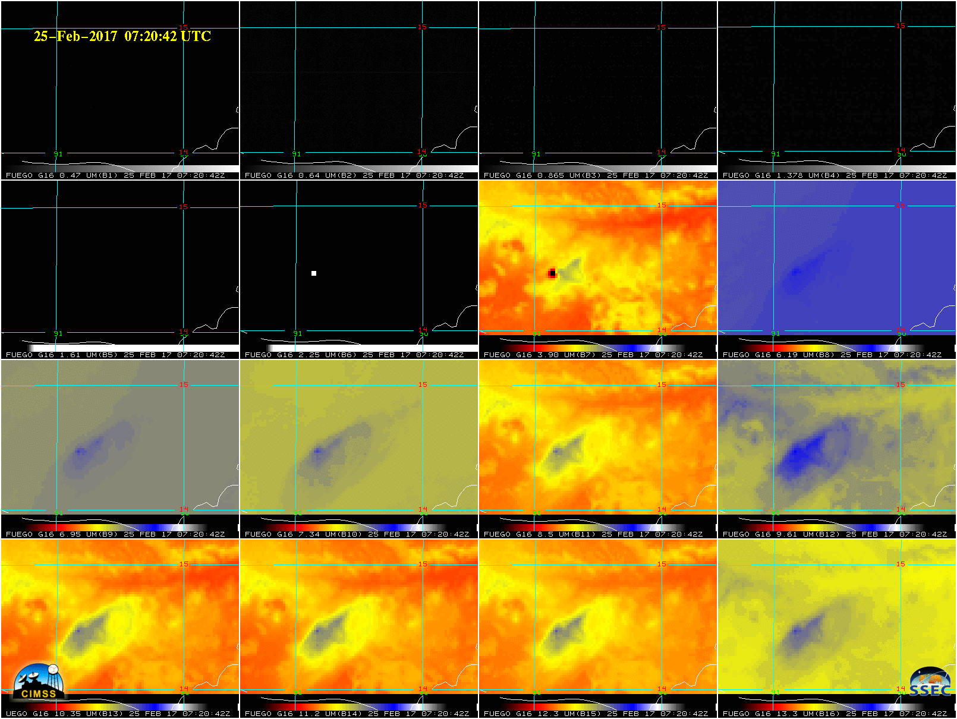
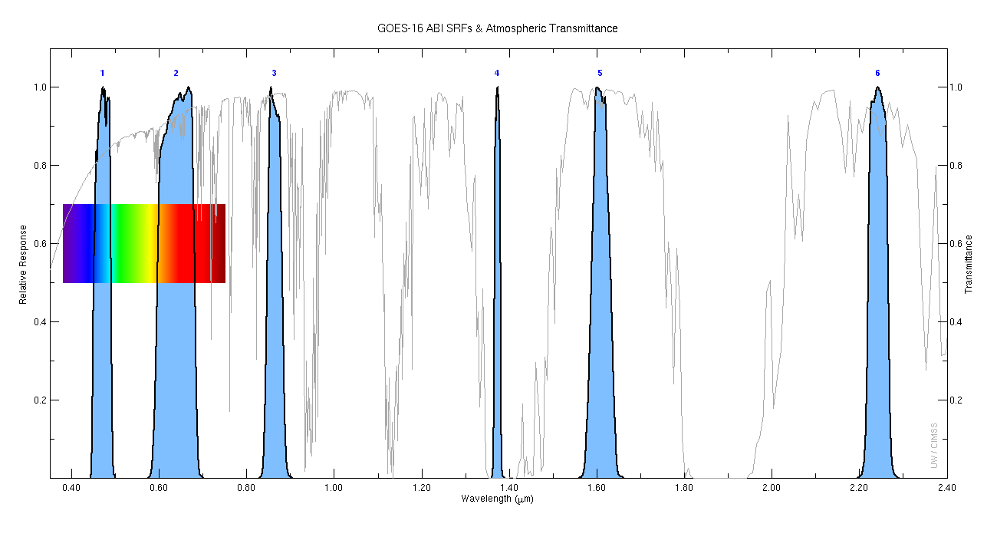
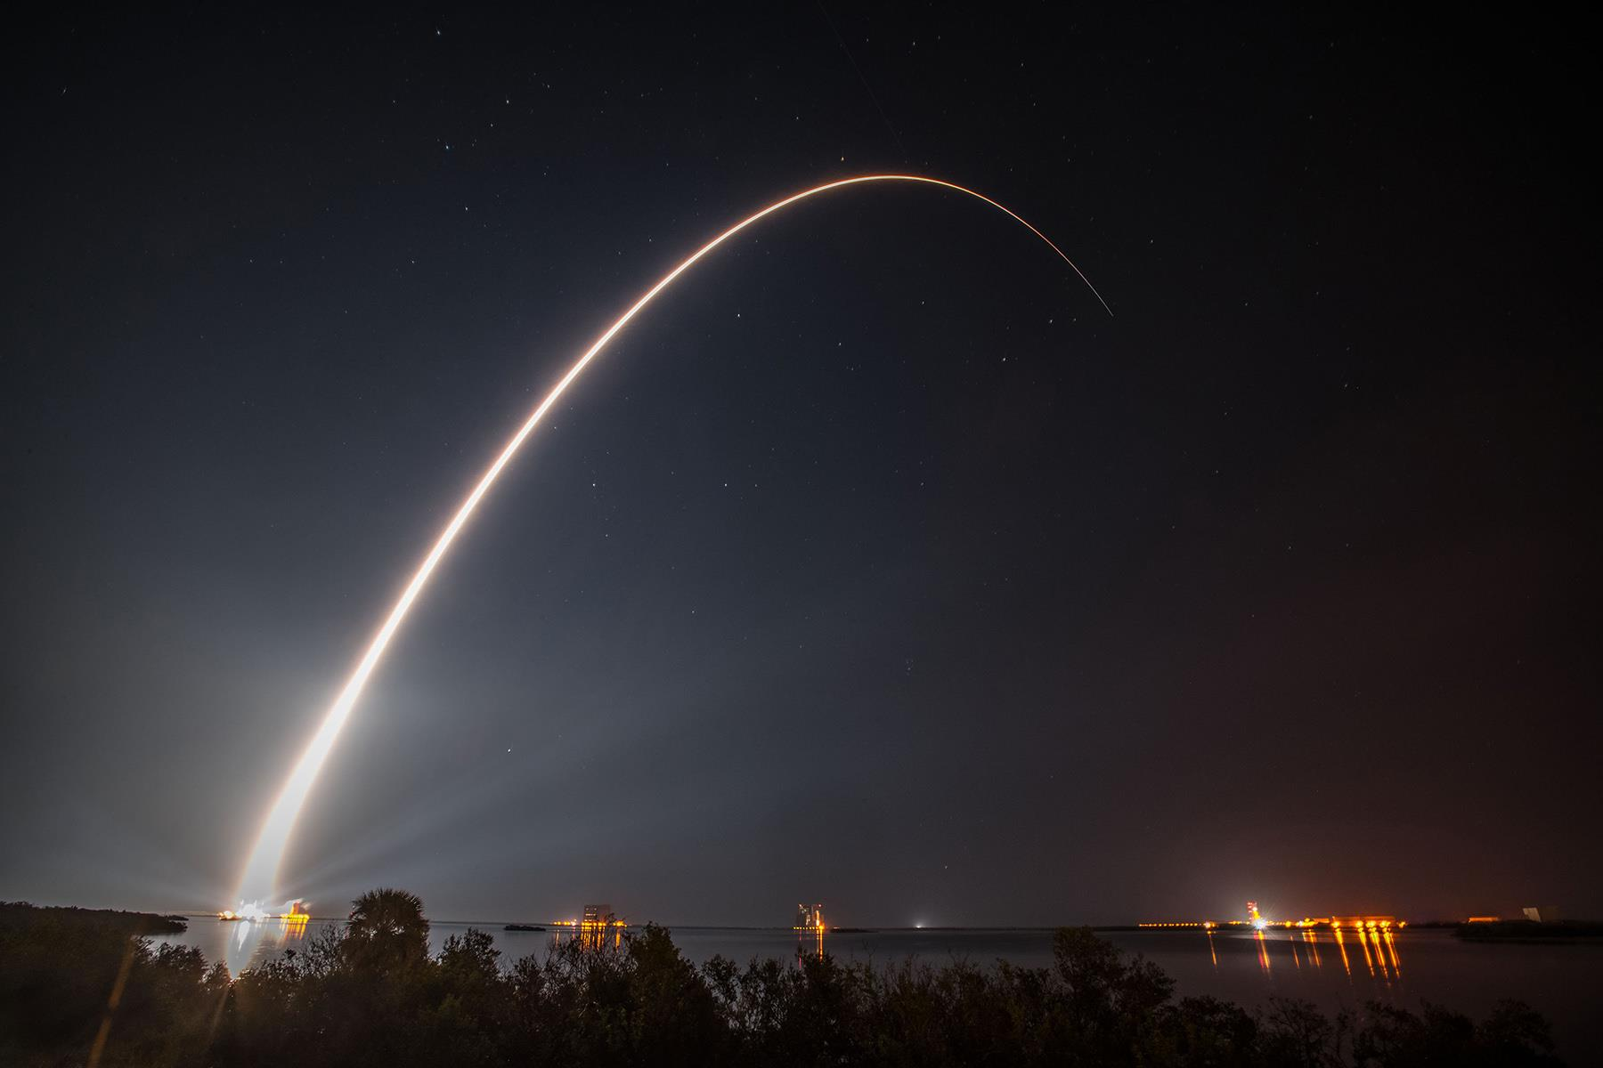
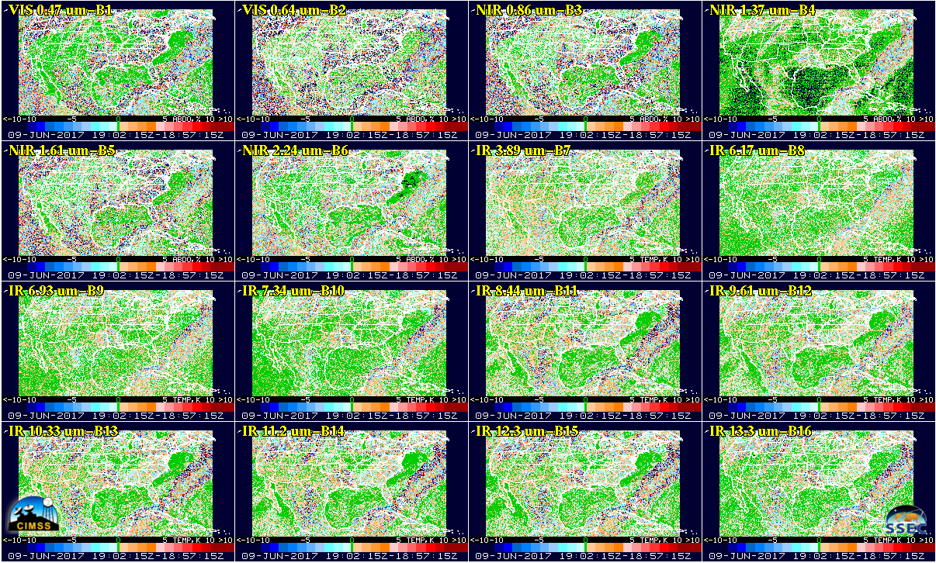
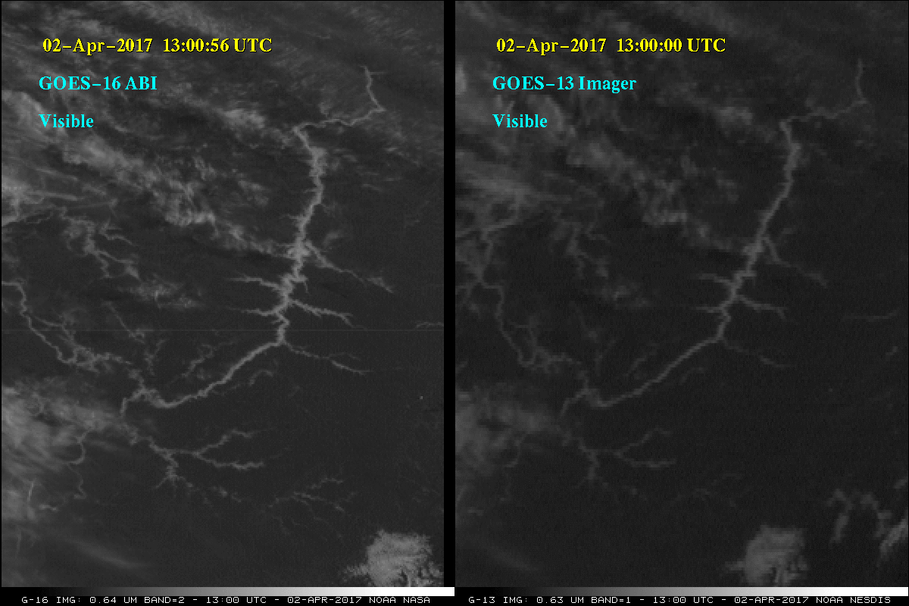
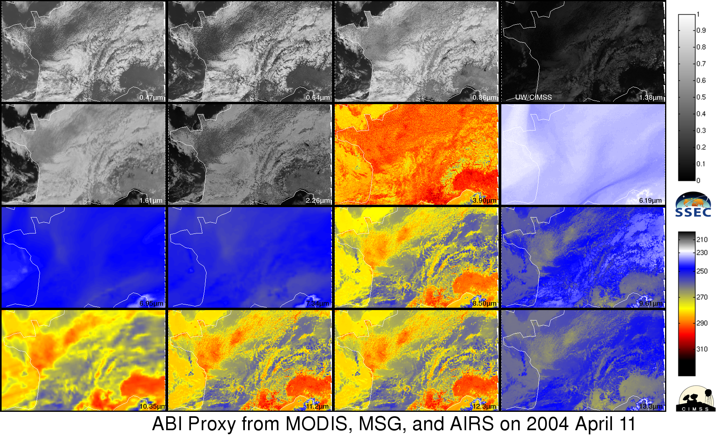
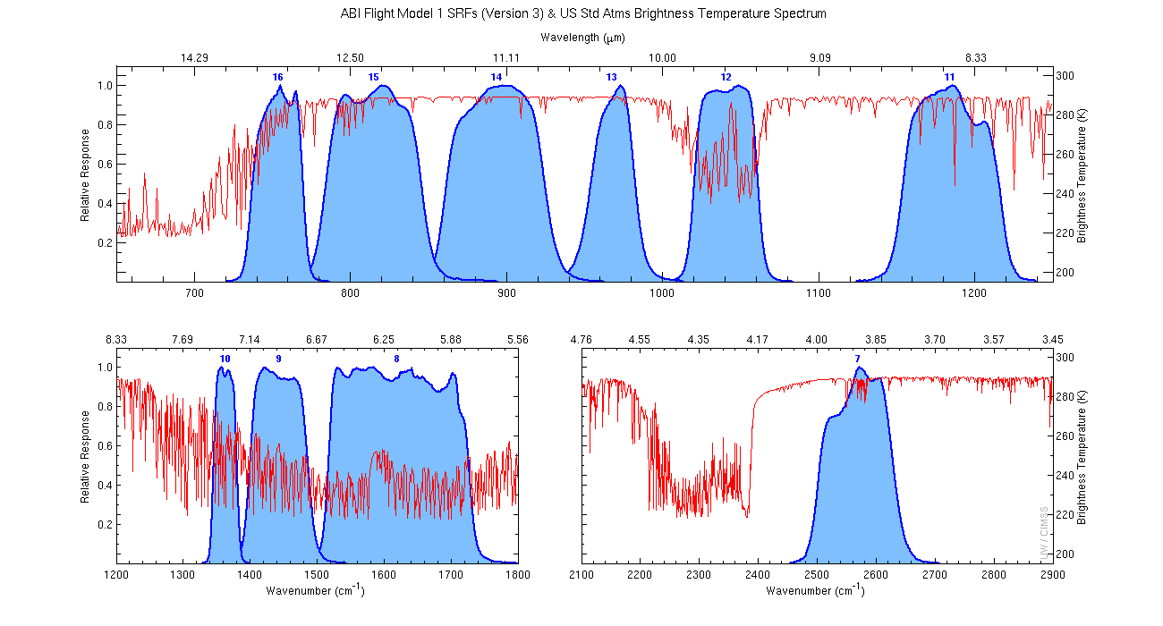
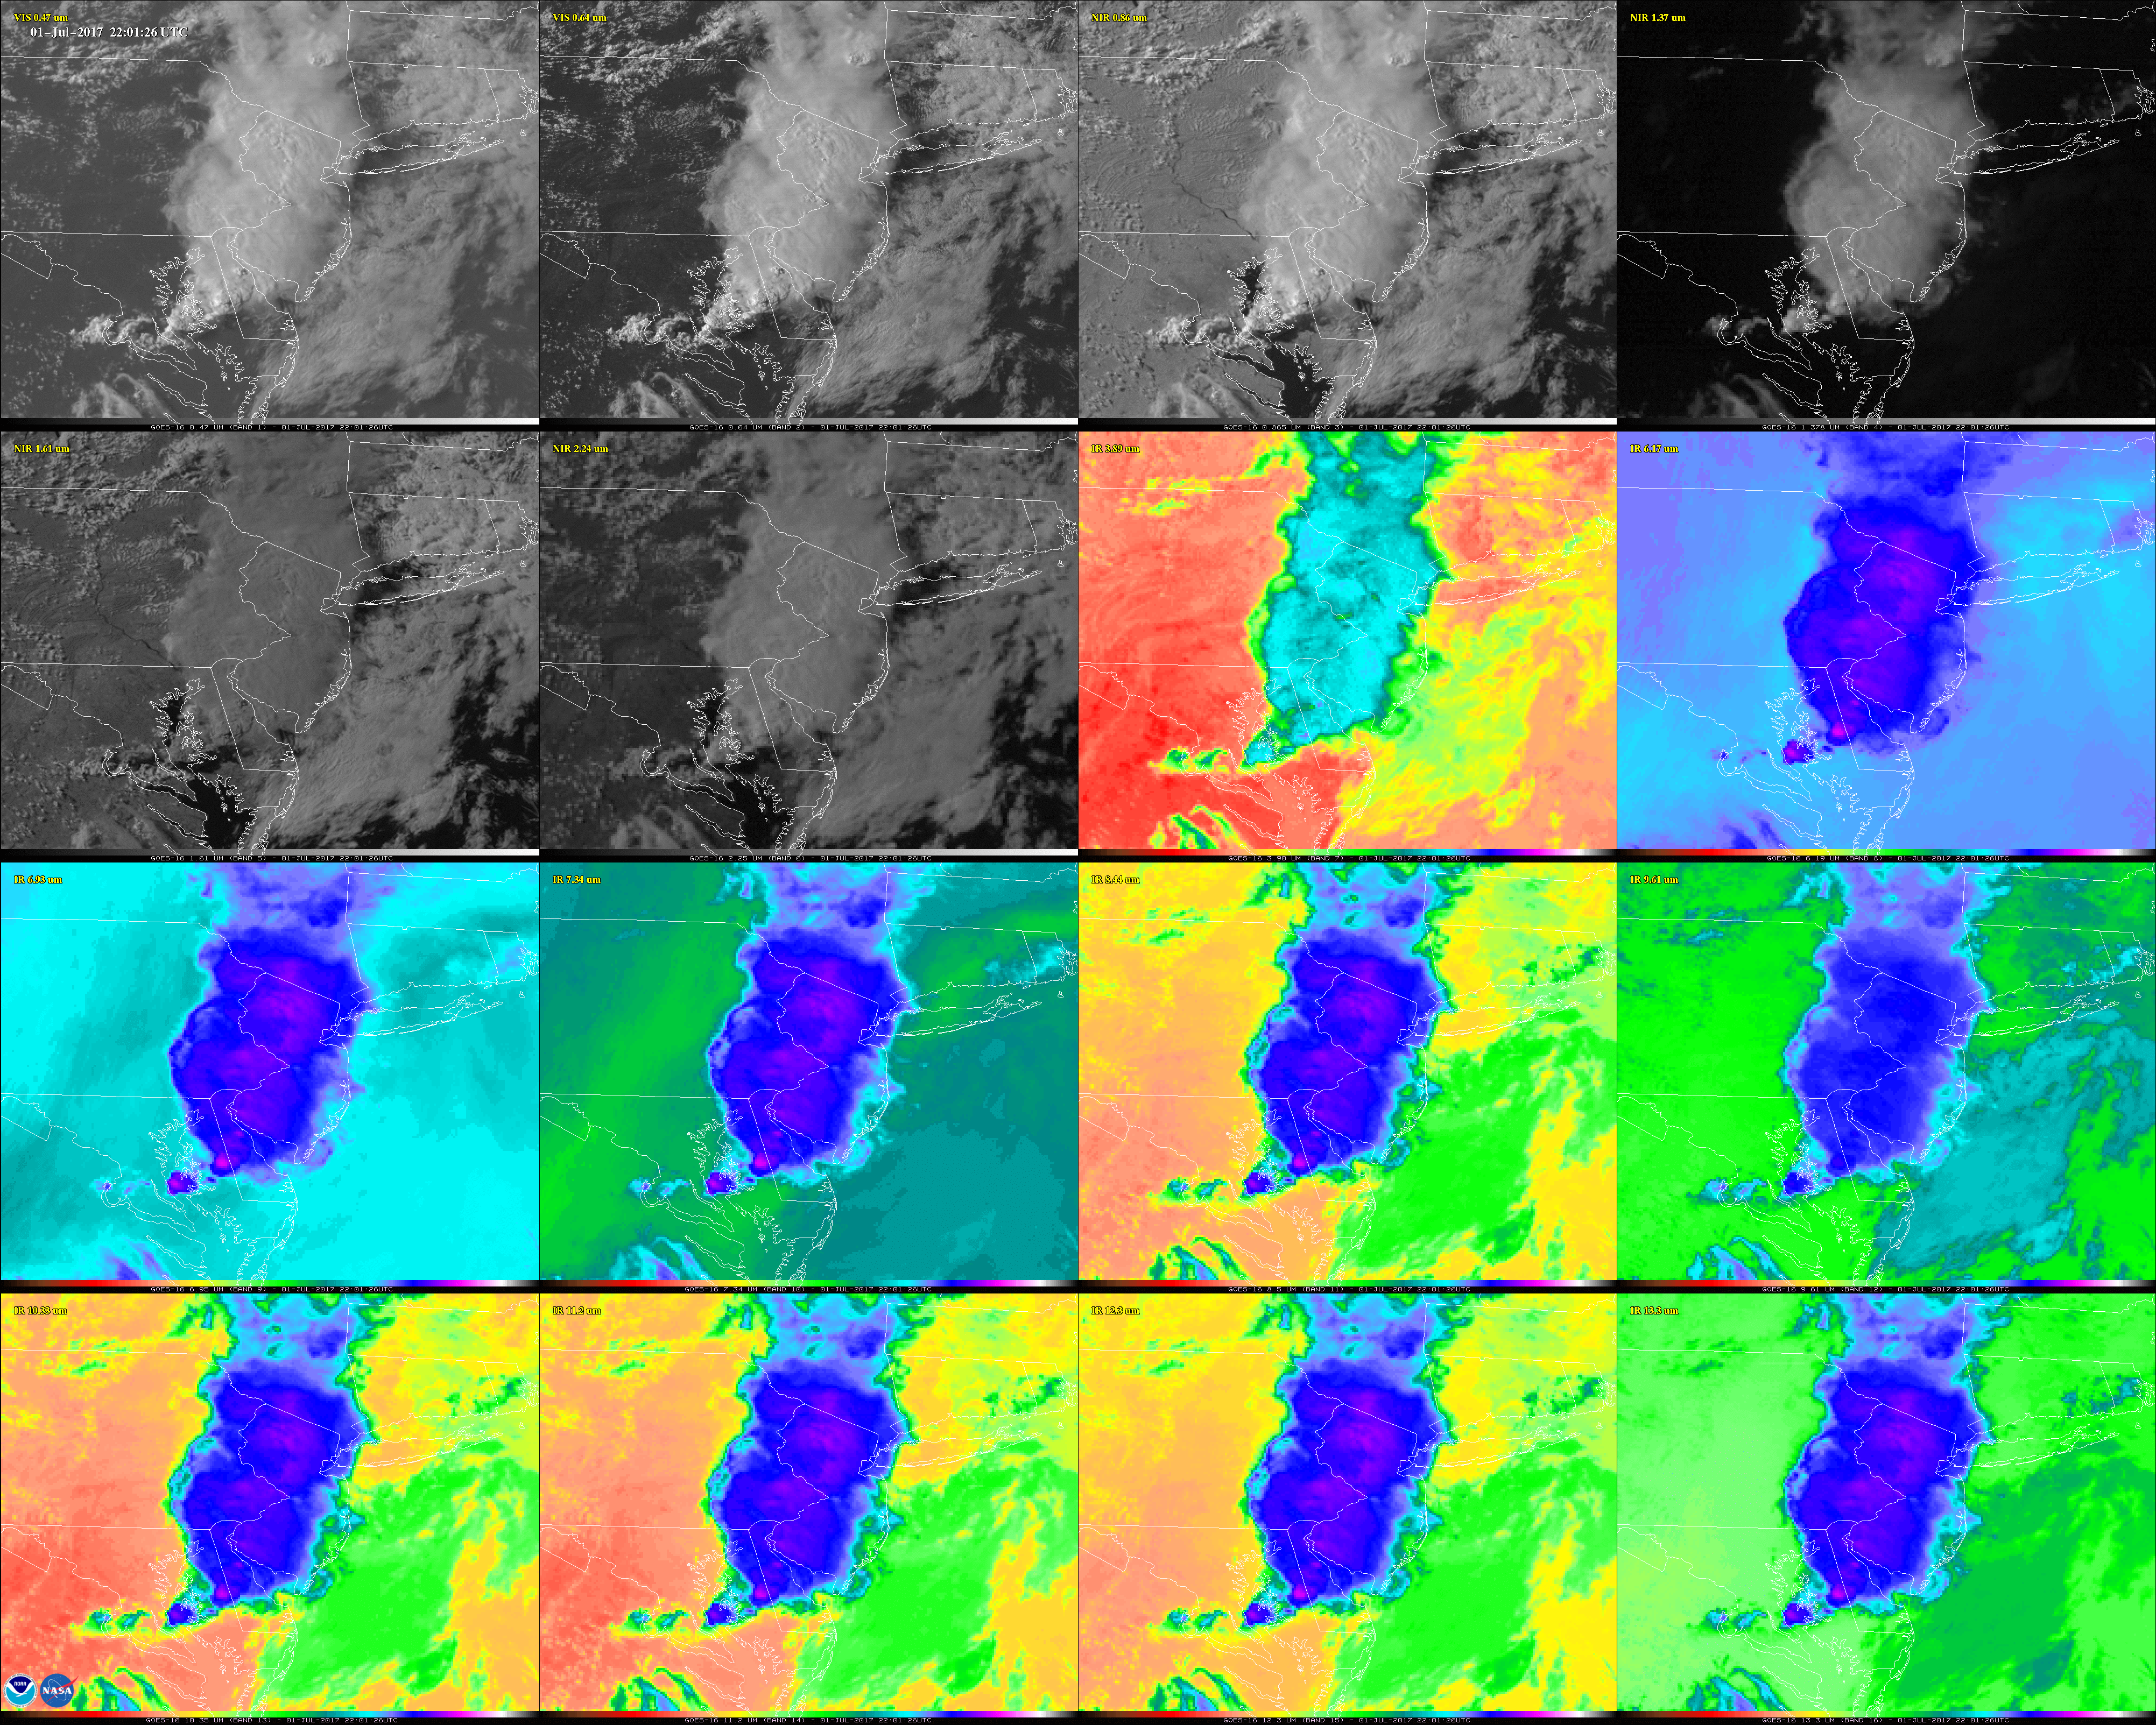
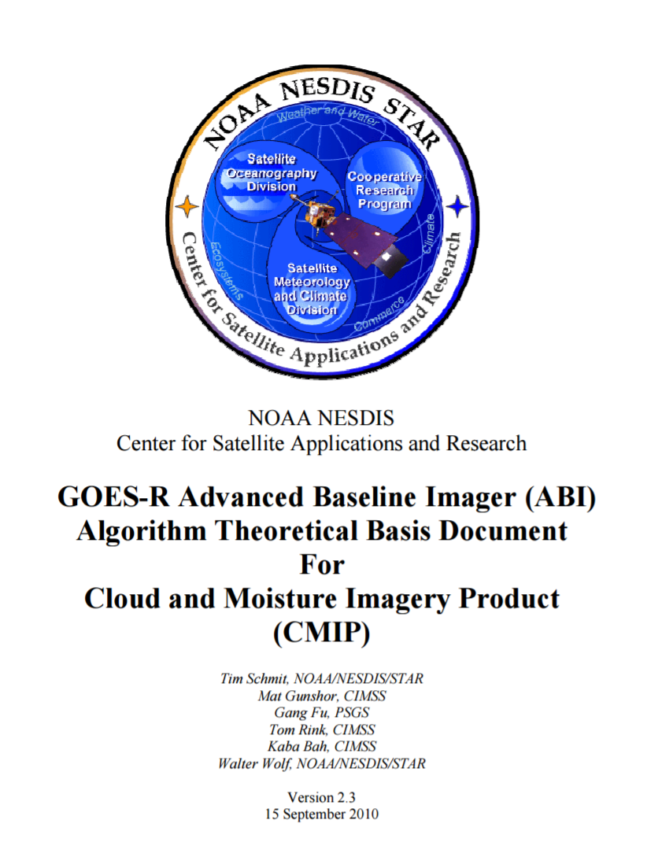
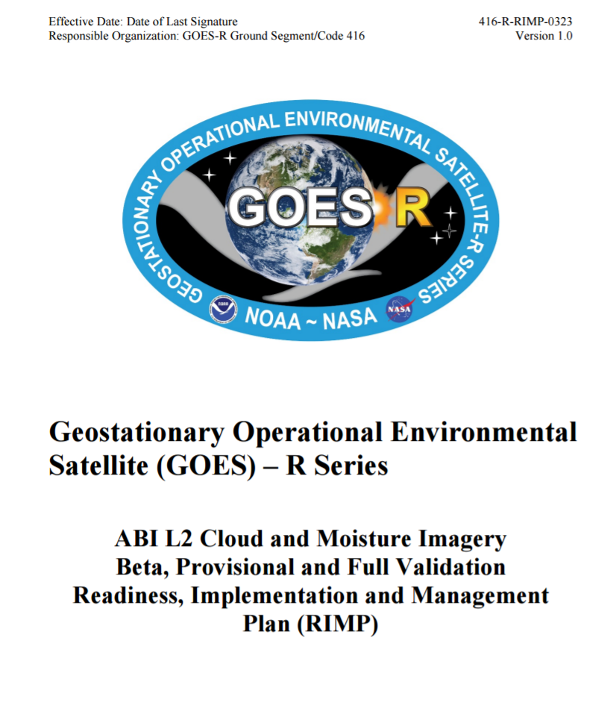
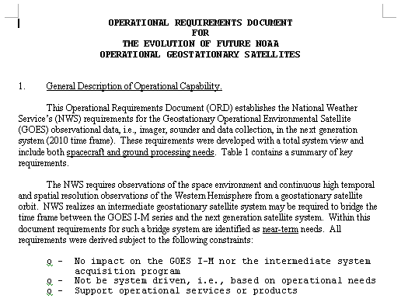
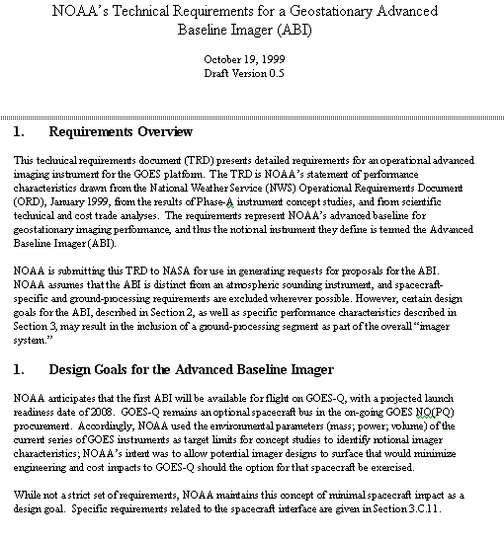
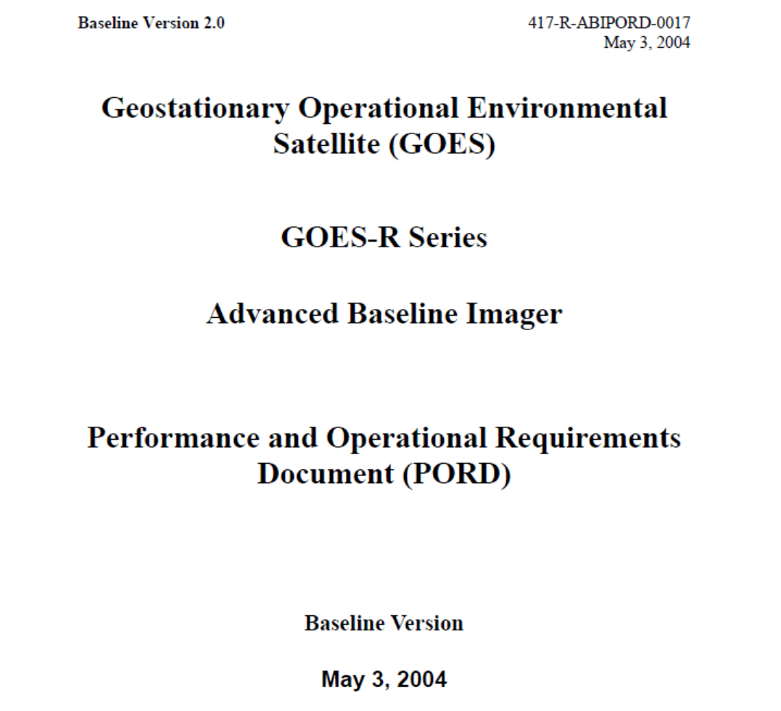
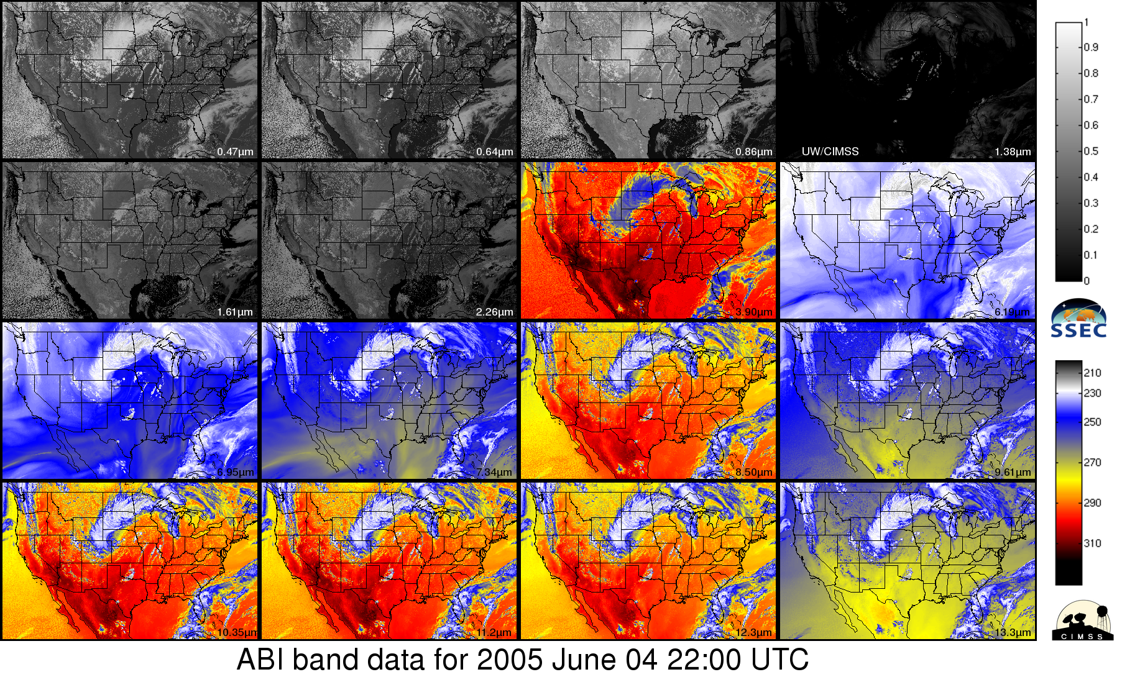
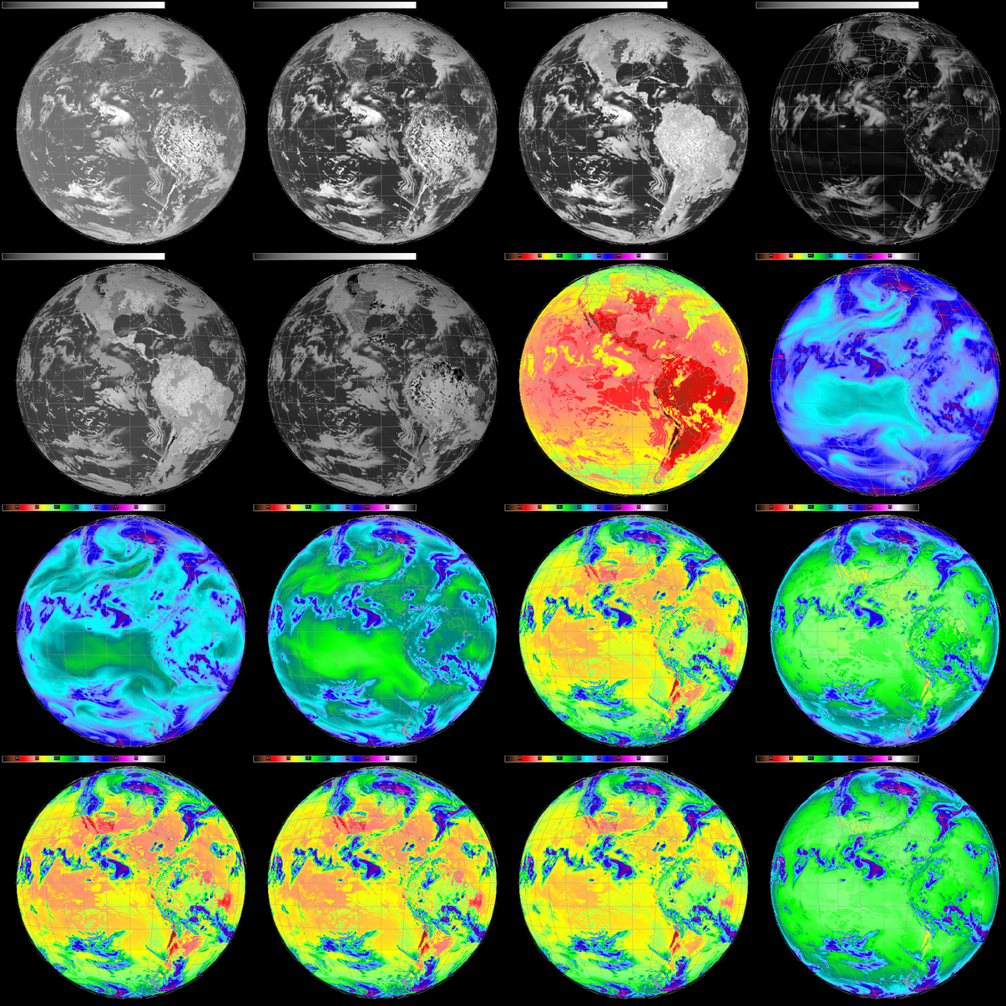
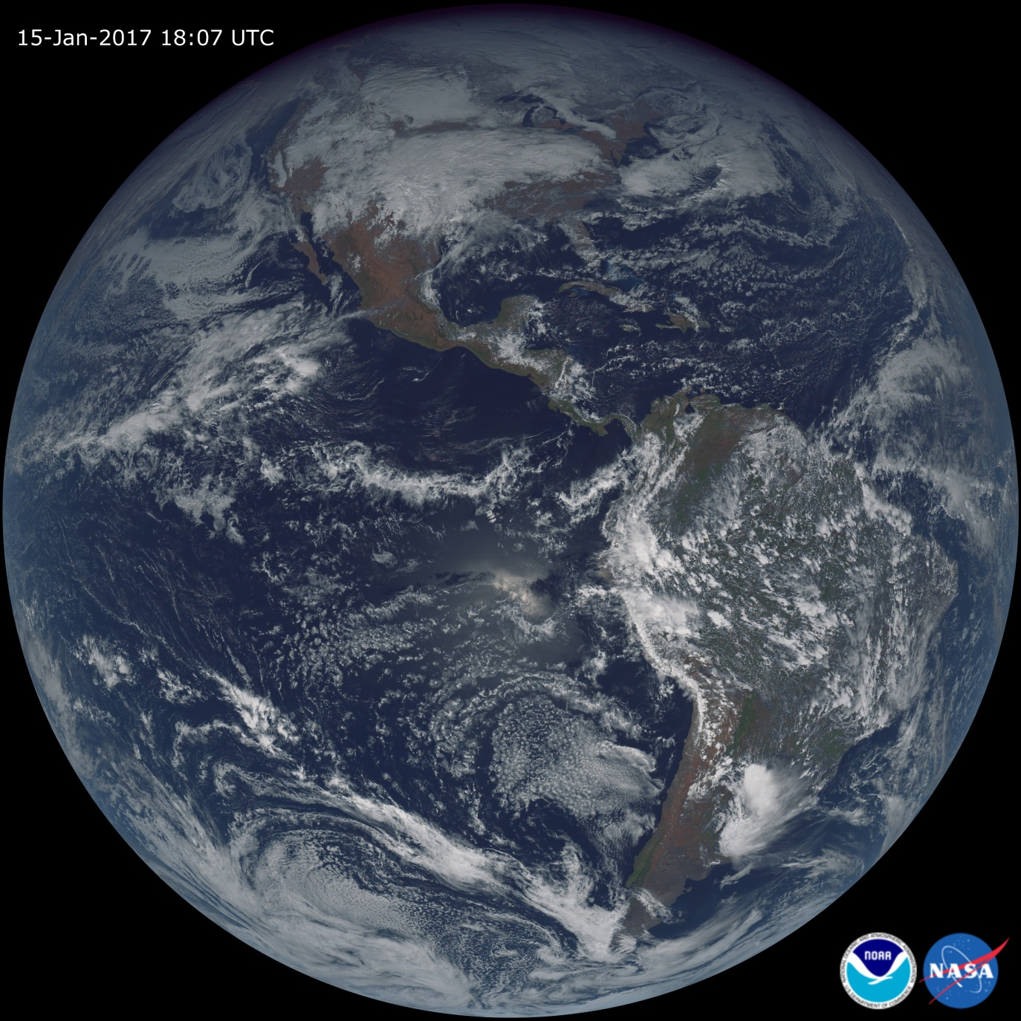
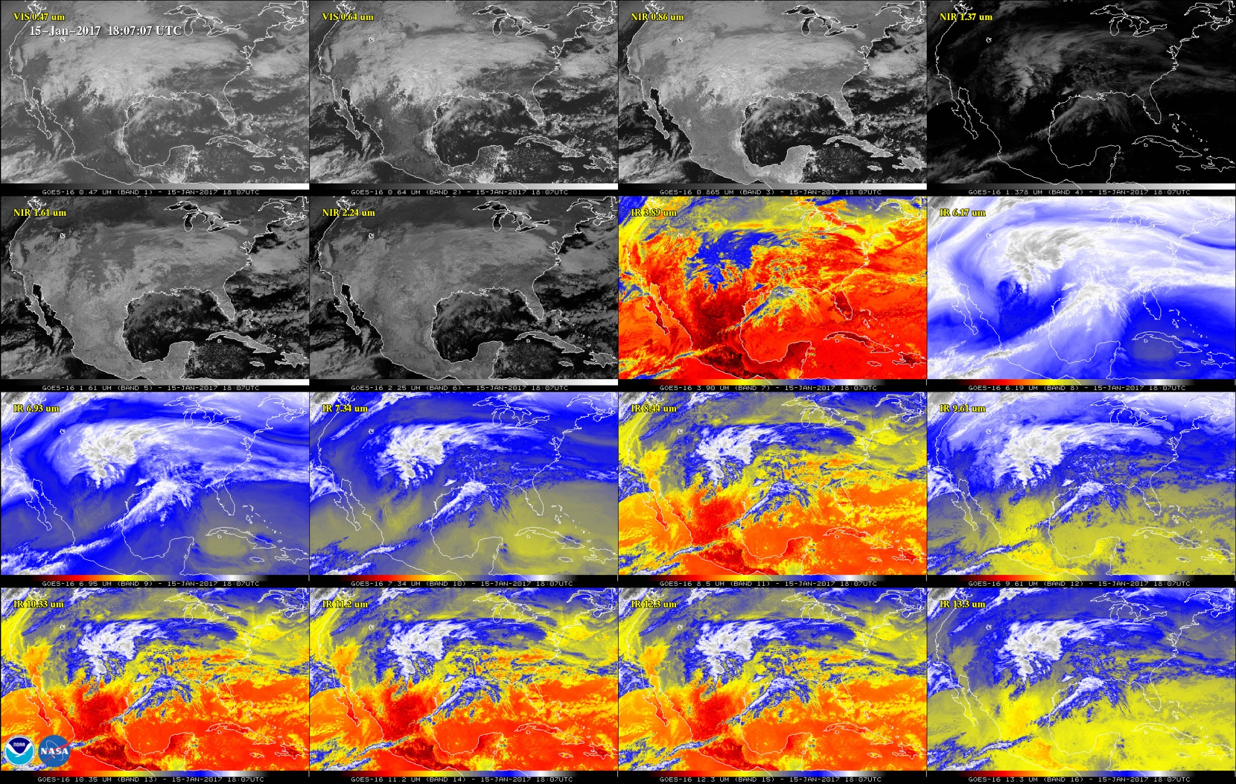
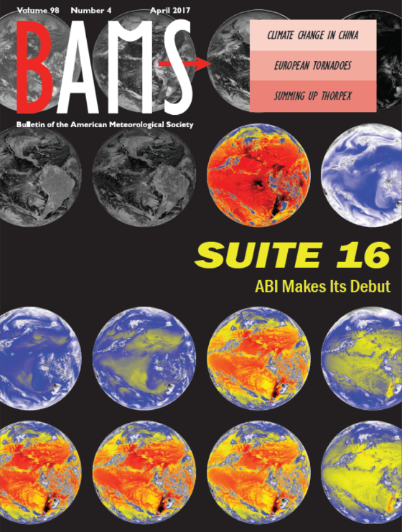
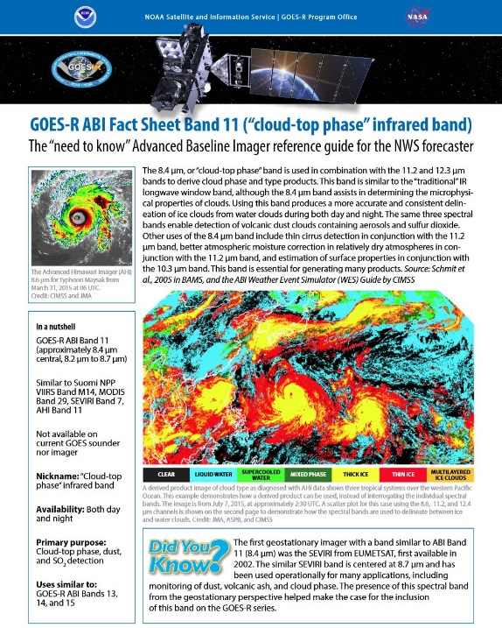
AWG Imagery Team: GOES-16 ABI Post Launch Test Timothy J. Schmit NOAA/NESDIS/STAR Advanced Satellite Products Branch (ASPB); Madison, WI USA Mathew M. Gunshor, Kaba Bah, Joleen Feltz, James P. Nelson III, and Hong Zhang Cooperative Institute for Meteorological Satellite Studies (CIMSS); University of Wisconsin-Madison, Madison, WI With help from many, many others (Dan Lindsey, Steve Miller, etc.)!
History
ABI: Bands 1-6 (Visible / NearIR)
Post Launch
ASPB, with SSEC/CIMSS and others work together to prepare the nation for the Advanced Baseline Imager (ABI) on GOES-R
Spectral band selection studies for ABI started in 1999, before the GOES-R Program Office.
By 2004 CIMSS had started generating proxy datasets for GOES-R scientists to use
First existing satellites (MODIS, AIRS, Meteosat, GOES) were used
Eventually high-resolution NWP model data were used to generate highly realistic simulated ABI data
Proxy data from NWP used by ABI ground system vendor in their GRB simulator, which was shipped to many users.
Efforts to generate proxy data from NWP continued beyond the launch of GOES-R and proved to be crucial in preparing the government, academia, and industry for the eventual use of real ABI data.
2007 GOES-R Algorithm Working Group (AWG) formed; CIMSS, with NOAA's Advanced Satellite Products Branch (ASPB), became lead algorithm developers on 17 out of 24 ABI baseline (Level 2) products.
CIMSS also contributes to the GOES-R Calibration Working Group (CWG) activities.
Visualization team preparing McIDAS (-X and -V) for eventual ABI data
CIMSS helped assess L2 product impacts of over 13 instrument waivers for GOES-R through –U
File comparison tool called Glance compares contents from 2 files, is still in use by GOES-R Program
Community Satellite Processing Package (CSPP) for GEOs, for direct-broadcast users and provided to NWS Centers
User Preparation, Education, Training, Outreach, & Satellite Liaisons
Advanced Baseline Imager (ABI) Baseline Products
Aerosol Detection (Smoke and Dust)
Aerosol Optical Depth (AOD)
Clear Sky Masks | @CIMSS/ASPB
Cloud and Moisture Imagery | @CIMSS/ASPB
Cloud Optical Depth | @CIMSS/ASPB
Cloud Particle Size Distribution | @CIMSS/ASPB
Cloud Top Height | @CIMSS/ASPB
Cloud Top Phase | @CIMSS/ASPB
Cloud Top Pressure | @CIMSS/ASPB
Cloud Top Temperature | @CIMSS/ASPB
Derived Motion Winds | @CIMSS/ASPB*
Derived Stability Indices | @CIMSS/ASPB
Downward Shortwave Radiation: Surface
Fire/Hot Spot Characterization | @CIMSS/ASPB*
Hurricane Intensity Estimation | @CIMSS/ASPB
Land Surface Temperature (Skin)
Legacy Vertical Moisture Profile | @CIMSS/ASPB
Legacy Vertical Temperature Profile | @CIMSS/ASPB
Radiances
Rainfall Rate / QPE
Reflected Shortwave Radiation: TOA
Sea Surface Temperature (Skin)
Snow Cover | @CIMSS/ASPB
Total Precipitable Water | @CIMSS/ASPB
Volcanic Ash: Detection and Height | @CIMSS/ASPB
ABI Band | Wavelength (µm) | Wavelength range (µm) | Sub-point pixel spacing (km) | Descriptive Name
1 | 0.47 | 0.45 - 0.49 | 1 | “Blue”
2 | 0.64 | 0.60 - 0.68 | 0.5 | “Red”
3 | 0.864 | 0.847 - 0.882 | 1 | “Veggie”
4 | 1.373 | 1.366 - 1.380 | 2 | “Cirrus”
5 | 1.61 | 1.59 - 1.63 | 1 | “Snow/Ice”
6 | 2.24 | 2.22 -2.27 | 2 | “Cloud Particle Size”
Volcano
Image Courtesy of Lockheed Martin
Volcanic Ash Plume
ABI: Bands 7-16 (Infrared)
The Launch
GOES-R was launched from Cape Canaveral, FL on November 19, 2016 at 6:42pm EST (23:46 UTC).
GOES-R reached geostationary orbit and was renamed GOES-16 on November 29, 2016.
GOES-16 reached the check-out location of 89.5W on December 6, 2016.
ABI “First Light” data, all 16 bands, were received on January 14, 2017 (via internet at CIMSS) and “First Light Images” were generated from January 15, 2017 data.
There were test visible data sent on January 7, 2017
Official press release was Jan 23, 2017 (First day of AMS)
Time
Differences
Wavelength | Band # | Champion
0.47 | 1 | Fred Mosher
0.64 | 2 | Vern Suomi
0.86 | 3 | Nagaraja Rao
1.38 | 4 | Bo-Cai Gao
1.61 | 5 | L. Stowe
2.25 | 6 | M. King
3.9 | 7 | Vern Suomi
6.16 | 8 | Pierre Morel
6.93 | 9 | W. L. Smith
7.34 | 10 | Gary Ellrod
8.5 | 11 | S. Ackerman
9.61 | 12 | Art Neuendorffer
10.33 | 13 | W. P. Menzel
11.2 | 14 | Vern Suomi
12.3 | 15 | Vern Suomi
13.3 | 16 | W. L. Smith
ABI Band | Wavelength (µm) | Wavelength range (µm) | Sub-point pixel spacing (km) | Descriptive Name
7 | 3.90 | 3.80 - 3.99 | 2 | “Shortwave window”
8 | 6.19 | 5.79 - 6.59 | 2 | “Upper-level Water Vapor”
9 | 6.93 | 6.72 - 7.14 | 2 | “Mid-Level Water Vapor”
10 | 7.34 | 7.24 - 7.43 | 2 | “Lower/Mid-level Water Vapor”
11 | 8.44 | 8.23 - 8.66 | 2 | “Cloud-top Phase”
12 | 9.61 | 9.42 - 9.80 | 2 | “Ozone”
13 | 10.33 | 10.18 - 10.48 | 2 | “Clean longwave window”
14 | 11.21 | 10.82 - 11.60 | 2 | “Longwave window”
15 | 12.29 | 11.83 - 12.75 | 2 | “Dirty longwave window”
16 | 13.28 | 12.99 - 13.56 | 2 | “CO₂”
Proxy Data in 2004
River Fog
Proxy Data in 2009
NWS ORD (1999)
ABI TRD (1999)
ABI PORD (2004)
CMI ATBD (2010)
CMI RIMP (2016)
ABI First Light Imagery From CIMSS
Imagery Status
GOES-16 ABI Imagery has passed both it’s beta (March 2017) and provisional (Summer 2017) stages.
(Non-operational) ABI Data is routinely flowing to users via a number of paths (GVAR, NOAAPort, CLASS, etc.)
Proxy Data in 2015
References
& Links
http://cimss.ssec.wisc.edu/goes-r/
http://www.goes-r.gov/
http://www.goes-r.gov/education/ABI-bands-quick-info.html
Schmit, T. J., P. Griffith, M. M. Gunshor, J. M. Daniels, S. J. Goodman, and
W. J. Lebair, 2017: A closer look at the ABI on the GOES-R series. Bull. Amer. Meteor. Soc., 98, 681-698, doi:10.1175/BAMS-D-15-00230.1.

