Slide 1
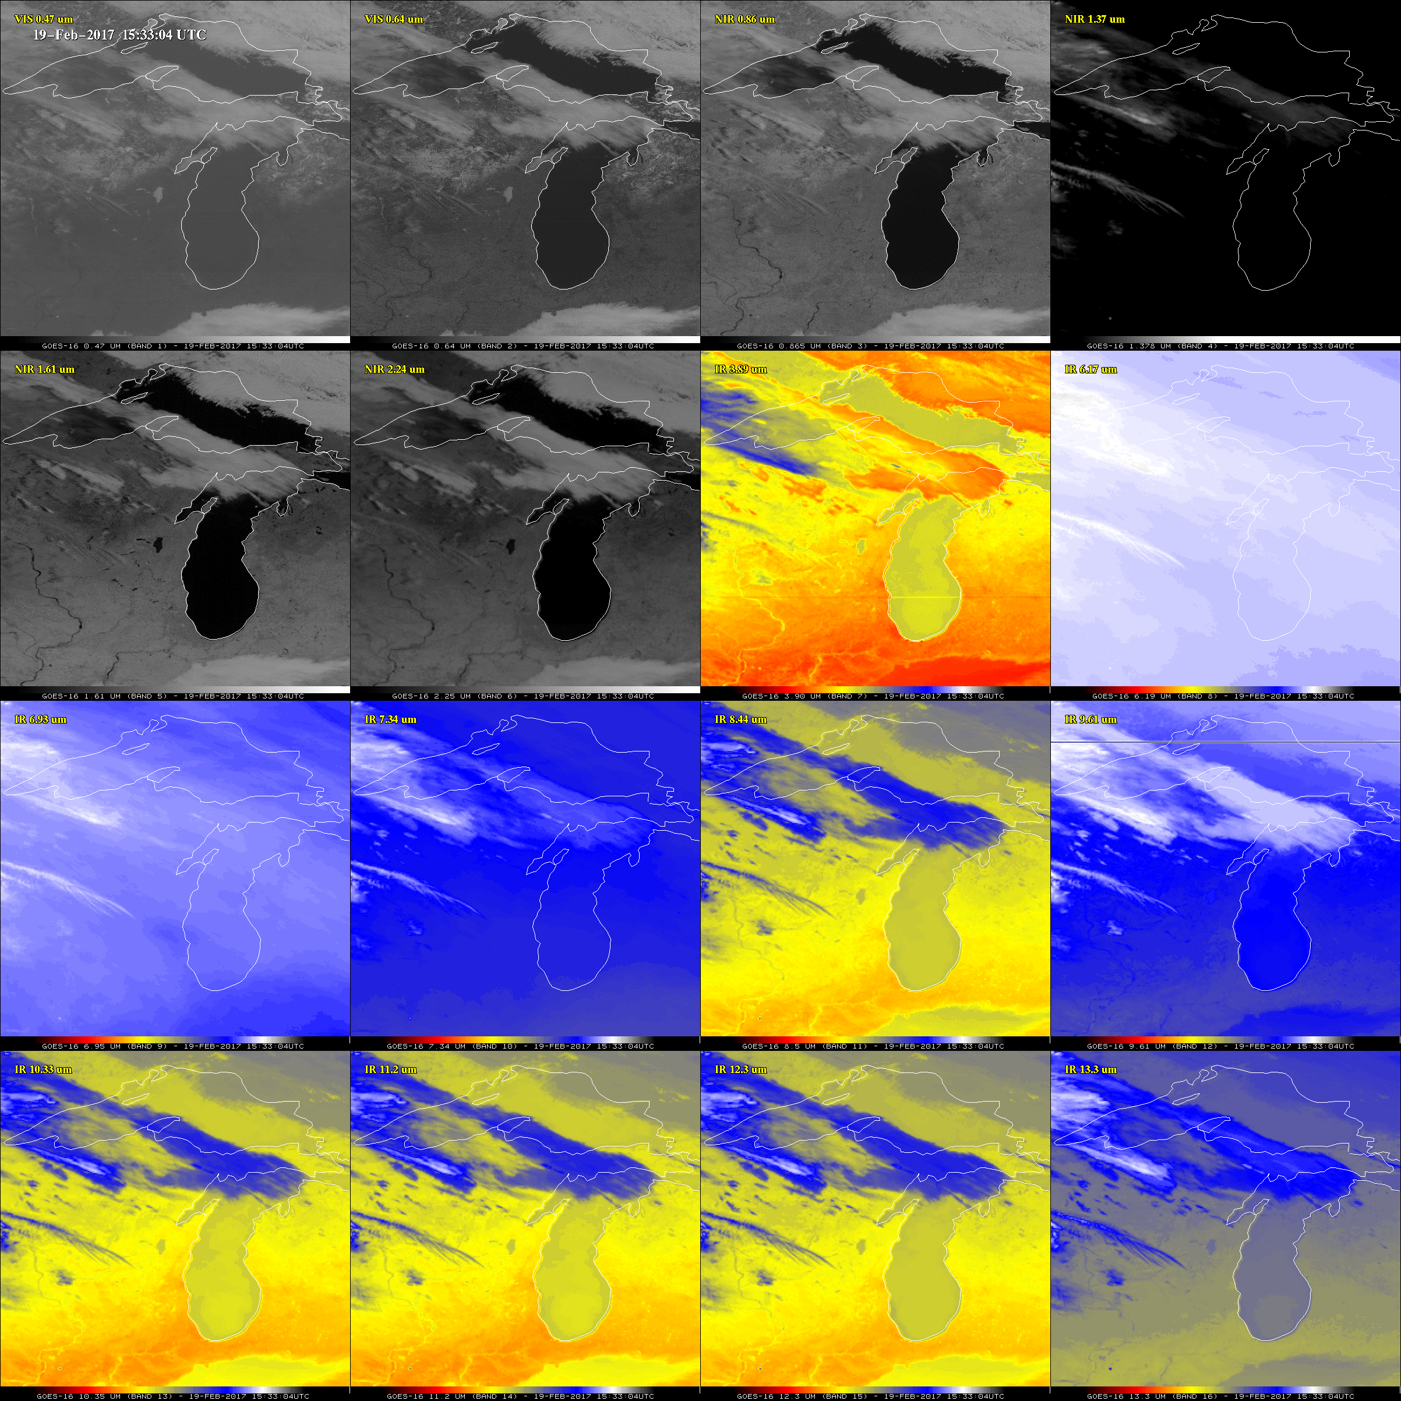
The improved imagery of the GOES-16 ABI Timothy J. Schmit
NOAA/NESDIS Advanced Satellite Products Branch (ASPB)
Madison, WI
The ABI on the GOES-16 greatly improves over the current Imager
Spectral, spatial, and temporal on orders of improvement of 3, 4 and 5, respectively
Improved image navigation and registration and radiometer performance
These critical improvements will provide for a host of applications and new products
Observed GOES-16 ABI
(Advanced Baseline Imager) data

