Slide 1
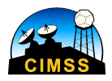
Introduction of JMA next generation Satellite “Himawari-8” and Convective Cloud Area Detection
Yasuhiko SUMIDA (ysumida@wisc.edu)
Meteorological Satellite Center(MSC) of Japan Meteorological Agency(JMA) University of Wisconsin-Madison
Cooperative Institute for Meteorological Satellite Studies (CIMSS)
Visiting Scholar
Notes:
Hello everyone! I’m Yasuhiko Sumida. I’m form Japan, Japan Meteorological Agency(JMA), Meteorological Satellite Center(MSC).
I really appreciate opportunity to invite me and collaborate with CIMSS and SSEC members.
I’m looking forward to my stay for one year.
Today I’d like to introduce Himawari-8 JMA launched last year and my developing product, convective cloud area detection.
My English presentation skill is not so good. If you don’t understand what I say, please ask me anytime.
This improvement is one of the most important purpose in the US.

Slide 2
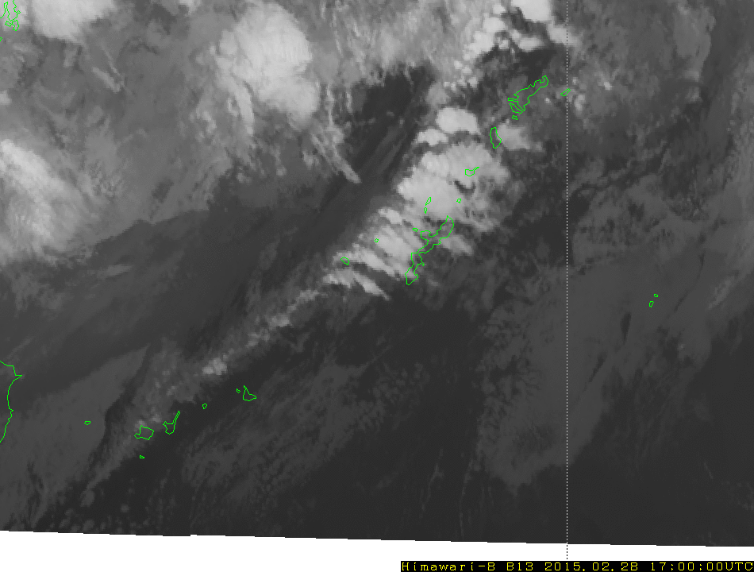
Himawari-8 observation: cold front
Japan area observation
（every 2.5 minutes）
March 1, 2015
Band 13 (10.4μm)
Cold front passing above Okinawa Islands, where many convective clouds developed.

