Slide 1

Poster Session I
Tuesday April 28, 2015
10:30 AM & 3:00 PM

Slide 2
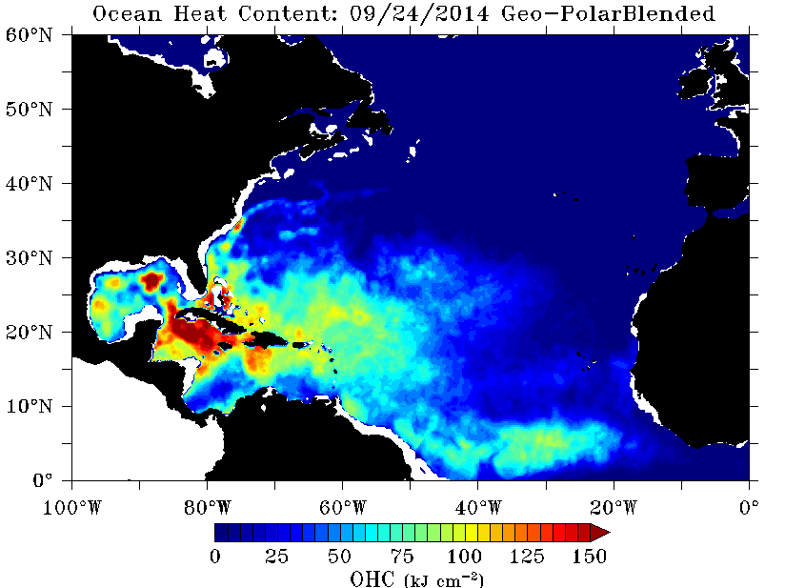
NOAA Operational Oceanic Heat Content Product Suite
David R. Donahue
NOAA/NESDIS/OSPO/SPSD Satellite Products Branch (SPB)
College Park, MD
Satellite derived Ocean Heat Content is a measure of integrated vertical temperature from the sea surface to the depth of the 26°C isotherm.
OHC is an important input to hurricane/typhoon forecast models.
Uses GOES-POES blended SSTs and altimeter derived Sea Surface Height Anomalies.
Currently operational over the North Atlantic and Pacific. Soon to be operational over the South Pacific.
Satellite derived Ocean Heat Content in the North Atlantic
Poster # 1-2

Slide 3
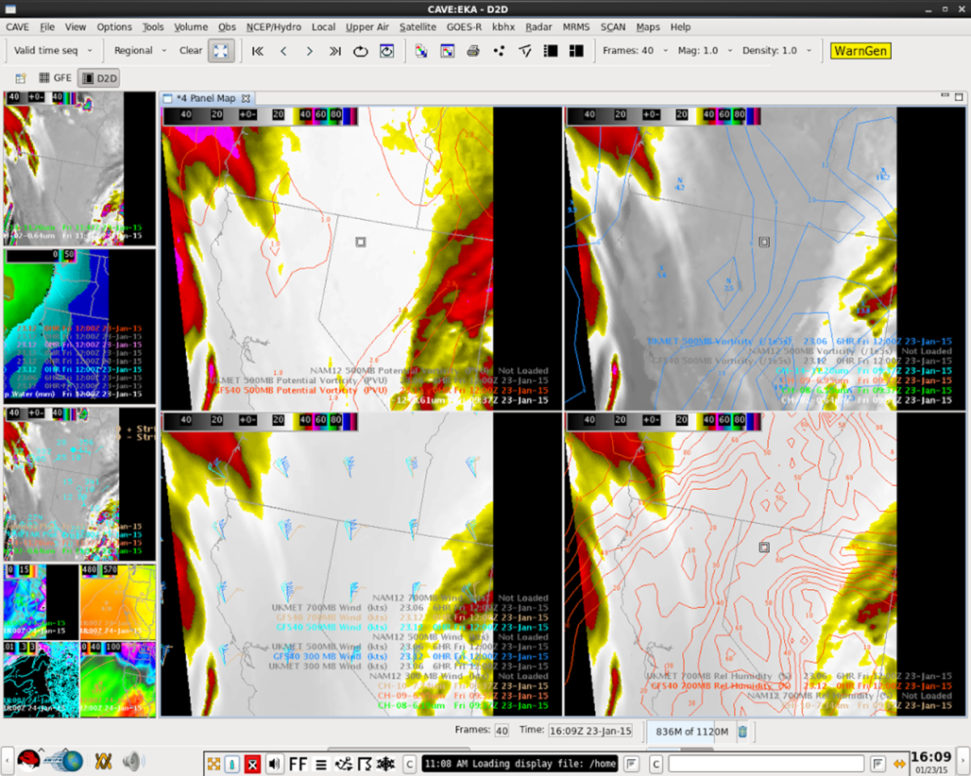
Total Operational Weather Readiness – Satellites (TOWR-S) Project
Eric M. Guillot, Michael W. Johnson, Joseph K. Zajic, R. Bradley Pierce, and Brian S. Gockel
NWS Office of Observations/Integrity Applications Incorporated/NESDIS STAR
TOWR-S is the NWS’ User Readiness project for GOES-R and JPSS
  Focus on AWIPS-II development
  Approach begins with forecaster and works backward to the satellite
  Use cases from NWS directives
  Developed and tested representative AWIPS-II procedures using simulated GOES-R data
AWIPS-II CAVE displaying simulated GOES-R imagery in real-time
Poster # 1-5

Slide 4
Comparison of CloudSat and TRMM Reflectivities
Authors: Kapil Dev Sindhu and G.S. Bhat
(Email id: kapil@caos.iisc.ernet.in)
Centre for Atmospheric and Oceanic Sciences, Indian Institute of Science, Bangalore
Bengaluru-560012, INDIA
CloudSat-CPR (cloud profiling radar) and TRMM-PR (precipitation radar) are space-borne radars which measure cloud’s characteristics.
The convective clouds’ towers are well captured by TRMM-PR while CloudSat-CPR can capture the spatial extent well while in convective region, the CPR signals get attenuated.
Although their technical specifications shows overlap with in range 17-40 dBZ while it is not a case. Both radars’ reflectivities show a little overlap (~ 2-5 dBZ).
Full published article is accessible here:
(www.ias.ac.in/jess/aug2013/947.pdf)
Contoured Frequency by Altitude Diagrams (CFADs) of CloudSat-CPR and TRMM-PR reflectivities
Poster # 1-7

Slide 5
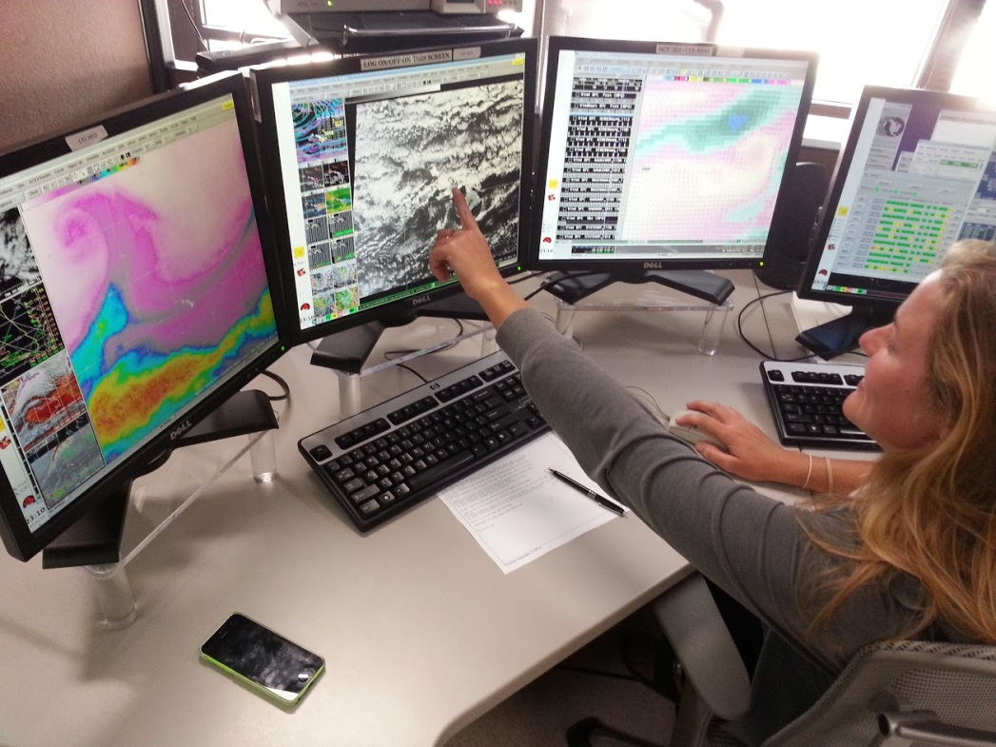
R2-Whoa
Challenges and solutions for executing best practices
in transferring NOAA's research to NWS operations
Jordan J. Gerth
CIMSS/Univ. of Wisconsin, Madison, WI
Operational user requirements now guide many satellite science activities under established and formalized proving grounds, but are they achieving the desired result?
Topics include:
  Oversight and Strategic Direction
  Operational Demonstrations
  Research Proposals
A meteorologist at the Honolulu forecast office uses VIIRS imagery while preparing an aviation forecast
Poster 1-8

Slide 6

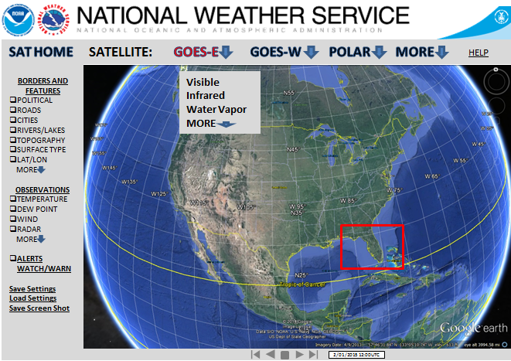
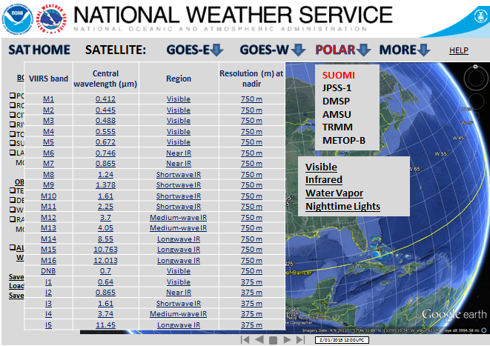

Display and Access Ideas for Future Earth Satellite Imagery
Robert Gillespie, Bill Bergen, Sterling Weems, Stacey Williamson
Carr Astronautics, Greenbelt, MD
The goal of this project is to present more accessible Satellite Imagery to decision-makers and the general public, funded under NOAA SBIR contract WC-133R-14-CN-0077.
The Earth Observer product is a general Earth Image viewing system with powerful localization and visual analytic tools
Provides near real-time display of Imagery and related data
Can be customized for Earth Imaging use, including National Weather Service Satellite Imagery
Scalable information display system
Integrates with map or globe display
Automatically ingests imagery and other Earth data
Intuitive, easy to use interface
Powerful localization and visual analytic tools
Platform agnostic – will run on any client/server
Supports GIS capabilities/functionalities
Poster
#1-12

Slide 7
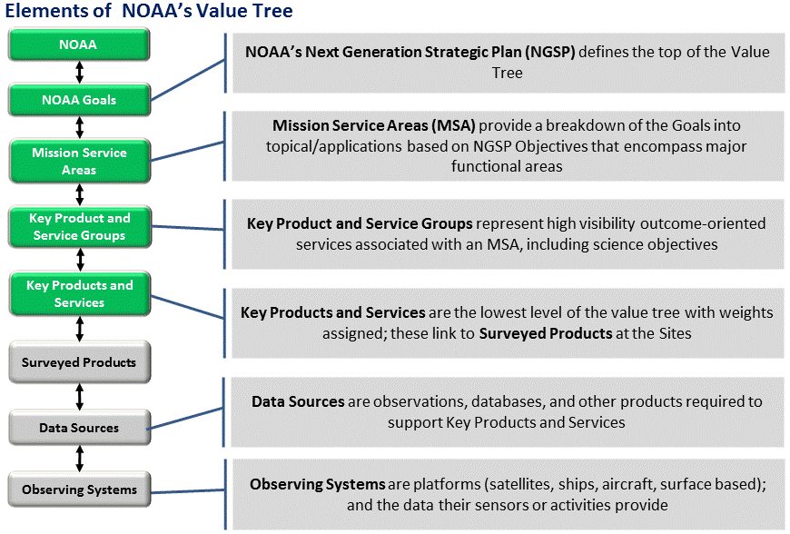
Assessment of GOES-R Product Potential Benefits using the NOAA Observing System Integrated Analysis II (NOSIA-II)
Louis Cantrell, David Helms, Robert Reining, and Aaron Pratt
NOAA/NESDIS Technology, Planning and Integration for Observation program (TPIO)
NOSIA-II Value Tree can translate incremental improvements in data sources for NOAA's key products and services into measurable benefits to each of NOAA’s Mission Service Areas
TPIO and GOES-R program offices working to measure improvements enabled by GOES-R
NOSIA-II Value Tree
Poster # 1.14

Slide 8
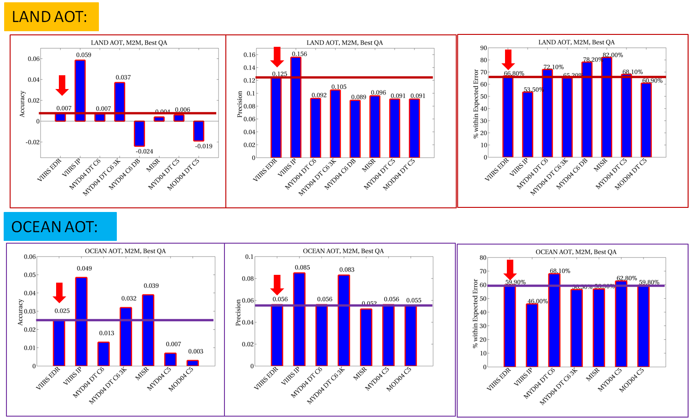
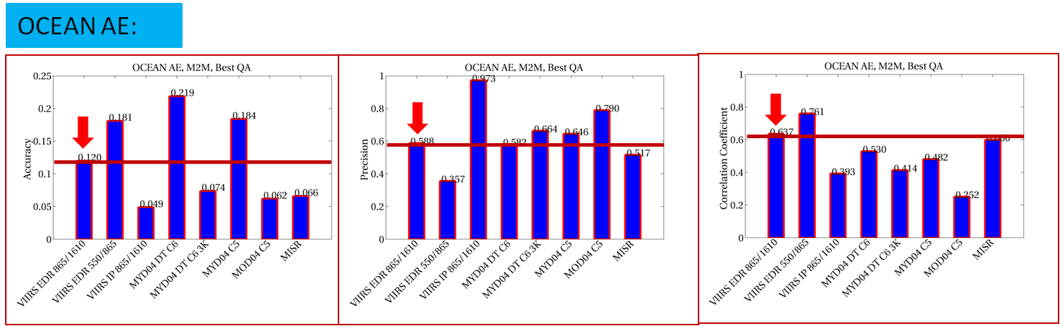
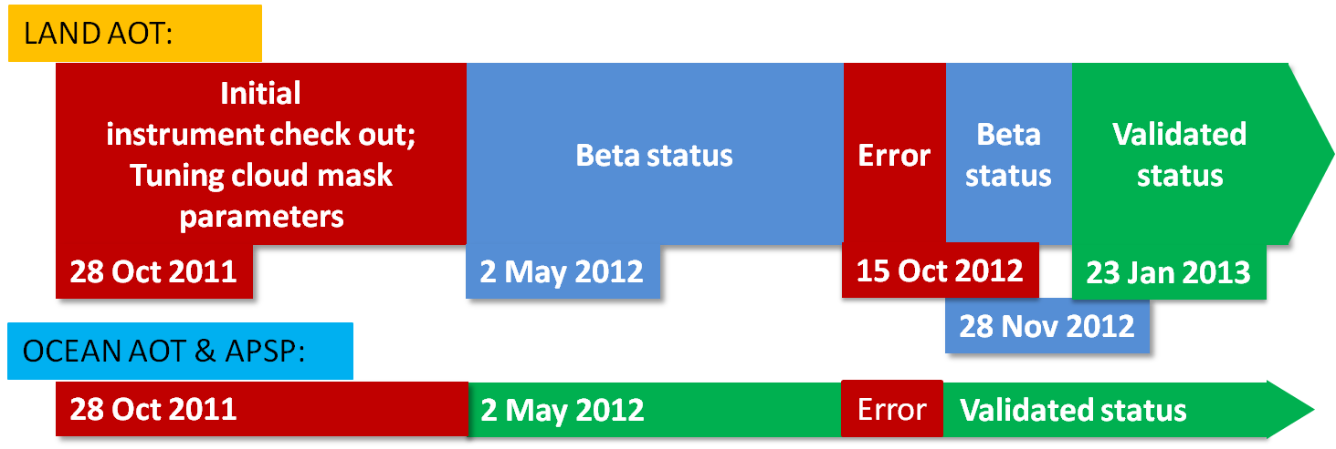
Spatial and Temporal Characterization of the Difference between Satellite Aerosol Retrievals and AERONET
Jingfeng Huang (NOAA @ UMD ESSIC), Hongqing Liu, Istvan Laszlo, Shobha Kondragunta, Lorraine A. Remer, Ho-Chun Huang, Hai Zhang, Stephen Superczynski, Maksym Petrenko, Brent N Holben, Robert C Levy, Ralph A Kahn & Charles M Ichoku
VIIRS Aerosol EDR achieves competitive performance to heritage sensors
  Accuracy and precision meet the JPSS1 Specification Thresholds
  Very competitive ocean AOT and AE retrieval performances
  Good accuracy but relatively higher uncertainty for Land AOT
VIIRS EDR and IP vs. Aqua/Terra MODIS DT (C6&3K), DB (C6) and Terra MISR
Poster # 1.16

Slide 9
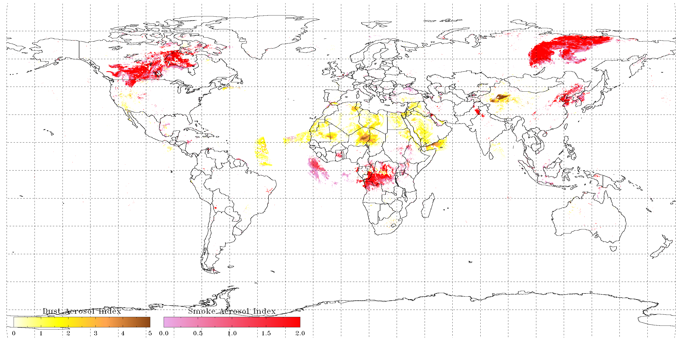
Algorithm to Detect Dust and Smoke
in Suomi-NPP VIIRS Imagery
Pubu Ciren ⁽¹⁾ and Shobha Kondragunta ⁽²⁾
(1). I.M. Systems Group, Inc.
(2). NOAA/NESDIS/STAR
An algorithm based on observations from deep-blue and shortwave-IR developed for MODIS has been adapted for VIIRS.
  The developed algorithm is simple, fast, and easy to be implemented operationally.
  Validations against AERONET observations and CALIOP VFM products indicated that accuracy and POCD for dust and smoke detection can be as high as 80% and 75%, respectively.
VIIRS RGB image (left) and the detected smoke (right) on August 3, 2014 over west coast of U.S.
Dust Aerosol Index
Smoke Aerosol Index
Global VIIRS smoke/dust detection on July 16,2014
Poster #
1-17

Slide 10
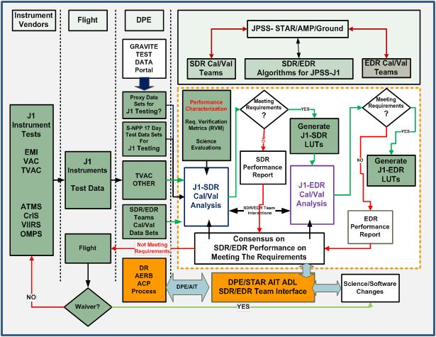
JPSS-1 Science Data Product Verification and Validation: Pre-Launch to Post-Launch Plans
Murty G. Divakarla¹, Lihang Zhou², Xingpin Liu¹, Walter Wolf²,
Eric Gottshall², Janna Feeley², Tom Atkins¹, Robert Steadley², and Ray Godin²
IM Systems Group@NOAA/STAR; ²NOAA/JPSS, College Park, MD 20740
The JPSS STAR (JSTAR) science teams in association with DPES and AMP assure an unmitigated success for JPSS-1 science data product verification and validation
The JSTAR science teams have the S-NPP experience and have all the expertise needed to develop, improve, and refine xDR science product algorithms to meet J1 science requirements.
The JSTAR science teams and JPSS-AIT/DPES team have all the infrastructure in place for routing J1/Uppers xDR algorithm(s) in compliance with the Algorithm Change Management Plan (ACMP).
Pathway for the J1 xDR Product Realization
Poster # 1.20

Slide 11
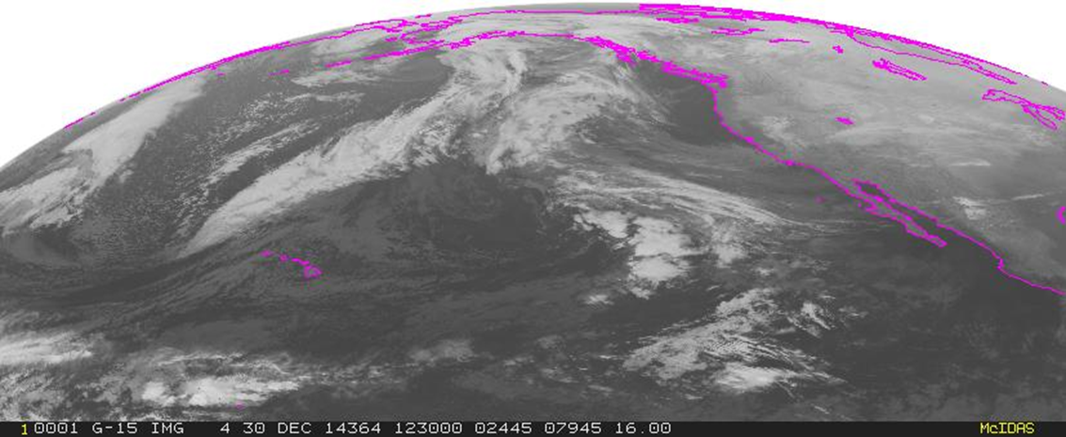
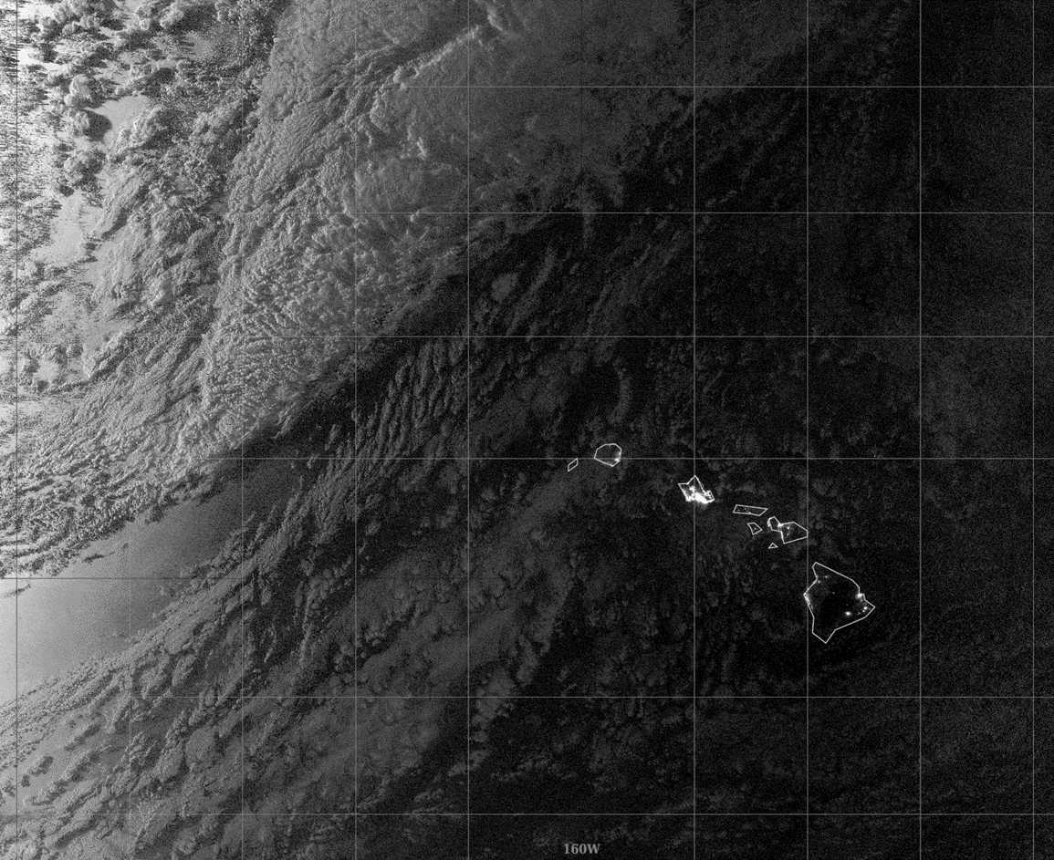
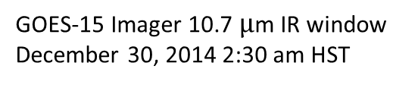
Subtropical and Tropical Frontal Passages: A Hawai`i Perspective
Jordan J. Gerth and Eric K. Lau
University of Wisconsin SSEC and NOAA/NWS/Pacific Region
Polar orbiting satellite data provide added value when used in conjunction with geostationary satellite data.
  Often times, frontal passages across Hawai`i are very weak, especially over the eastern portion of the Hawaiian Island Chain.
  Suomi NPP VIIRS Day Night band provide “night time” visible imagery and fills the gap of GOES-15 at night.
GOES-15 Imager 10.7 $μ$m IR window December 30, 2014 2:30 am HST
Suomi NPP VIIRS Day Night Band
December 30, 2014 2:18 am HST
Poster #
1-21

Slide 12
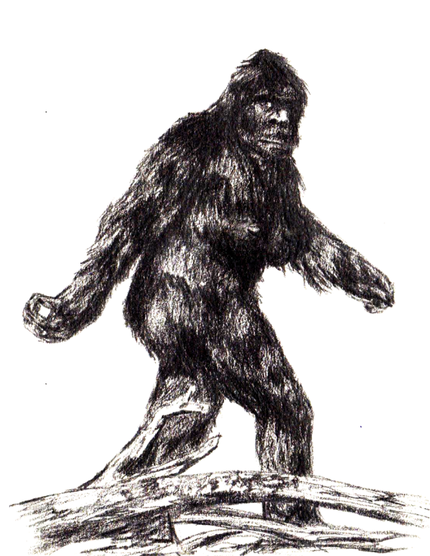
Facilitating JPSS-1 Algorithm Development
using EPL Review Process
V. J. Mikles¹, K. Sprietzer¹, B. Das¹, W. Wolf², and the STAR Algorithm Integration Team
¹IMSG, ²NOAA/NESDIS/STAR
Enterprise Lifecycle Review Process
  Follows JPSS and SPSRB standards
  Ensures consistency in design, documentation, and delivery
  Identifies and involves stakeholders at all stages
Quality Assurance
  AIT documentation is centrally located and managed
  AIT tracks and traces product requirements
  SASQUATCH and RiskQUATCH tools allow us to communicate requirements and risks in a controlled fashion
Algorithm Development
  Configuration Management in Clearcase ensures common baseline for all developers
  AIT-developed Chain Run tool facilitates efficient and consistent tests of interdependent algorithms
Poster #
1-22

Slide 13
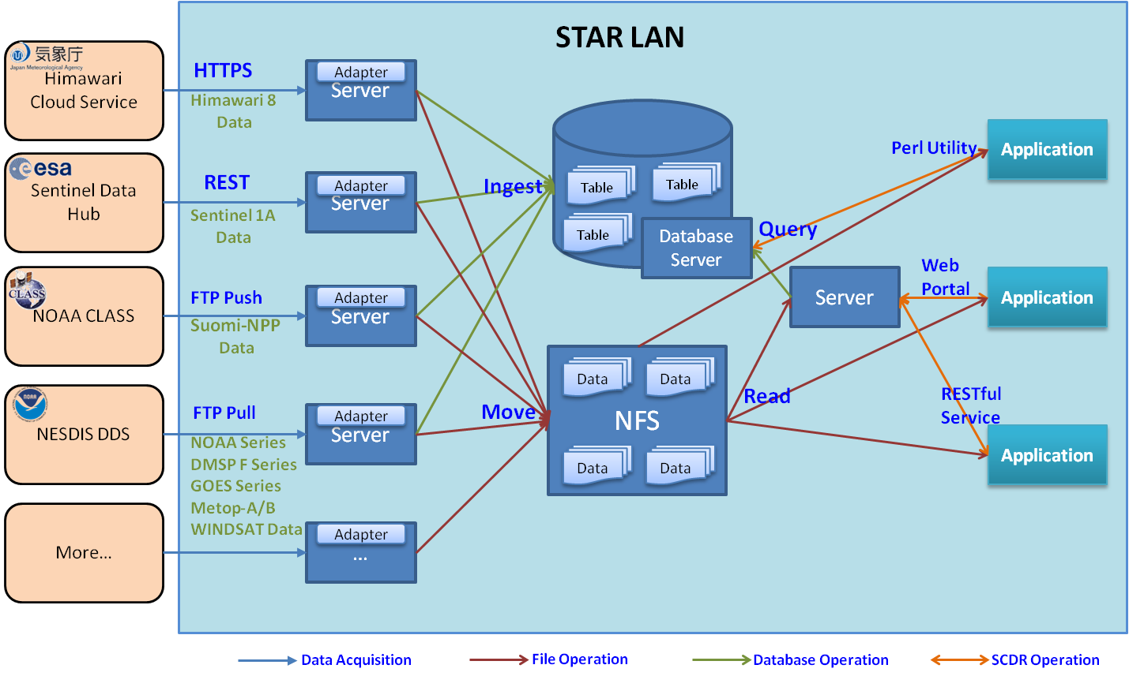
STAR Central Data Repository (SCDR): An Integrated and Effective Framework for Satellite Data Acquisition and Dissemination
Weiguo Han¹, Joseph Brust²
¹UCAR VSP at NOAA/NESDIS/STAR, ²NOAA/NESDIS/STAR
College Park, MD
SCDR provides a stable, reliable, and continually available near real-time satellite data source for calibration, validation, simulation, production, and monitoring activities
  Retrieve and ingest large amount of near real-time satellite and ancillary data from various providers
  Offer multiple easy and consistent interfaces to obtain satellite data of interest in a timely manner
  Save time and cost on data collecting, storing, and searching, and reduce data latency and data duplication
System Architecture
Poster # 1.23

Slide 14
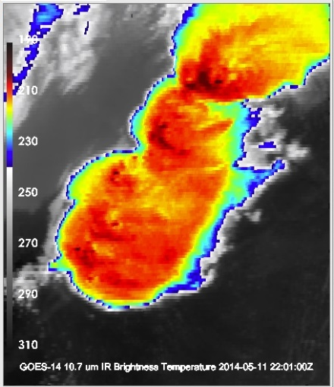
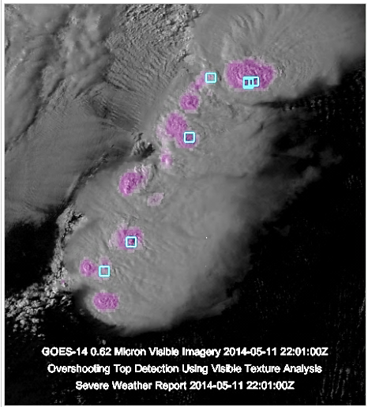
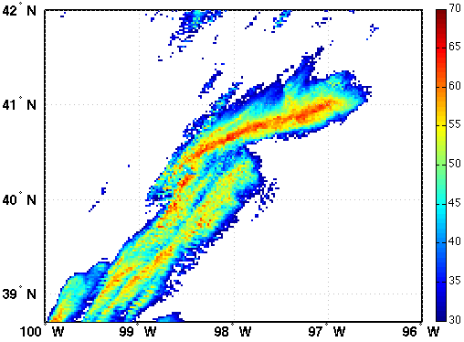
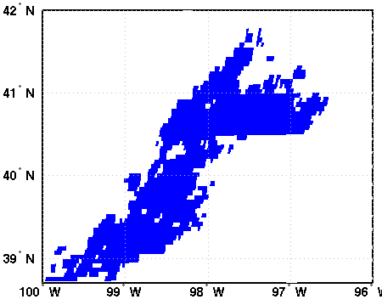
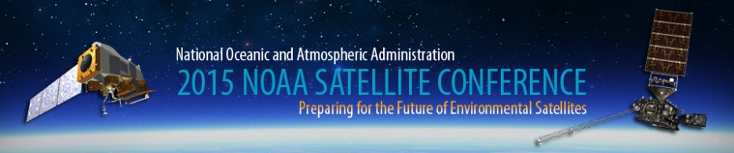
Advancement of Satellite-Imager Based
Overshooting Top Decision Support Products
Kristopher Bedka
NASA Langley Research Center
GOES-14 Visible
With OT Texture Detection and Severe Wx Reports
A 2nd generation probabilistic overshooting cloud top (OT) detection product has been developed, with improvements based on GOES-R Proving Ground feedback
  Detection algorithm uses enhanced visible & IR pattern recognition and additional NWP fields
  Algorithm trained and validated using a database of 2000+ global MODIS OT events
  Probabilistic framework eliminates fixed detection thresholds which improves detection capability
  Can be applied to any satellite imager, enabling both weather and global climate applications
An improved method for OT height assignment has also been developed using CloudSat, MODIS, and GEO imager observations
GOES-14 IR
Reflectivity at 4 km > 30 dBZ 2000-2259 UTC
GOES-14 OT Detection
2000-2259 UTC
Poster # 1-26

Slide 15
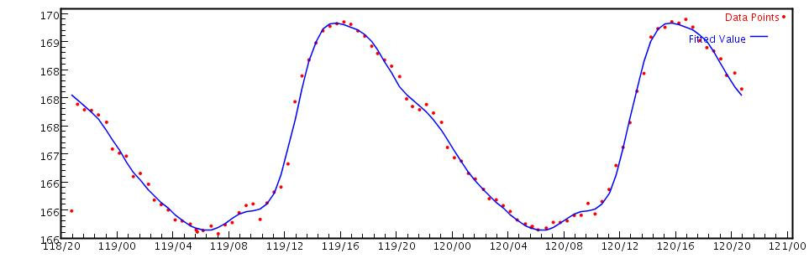
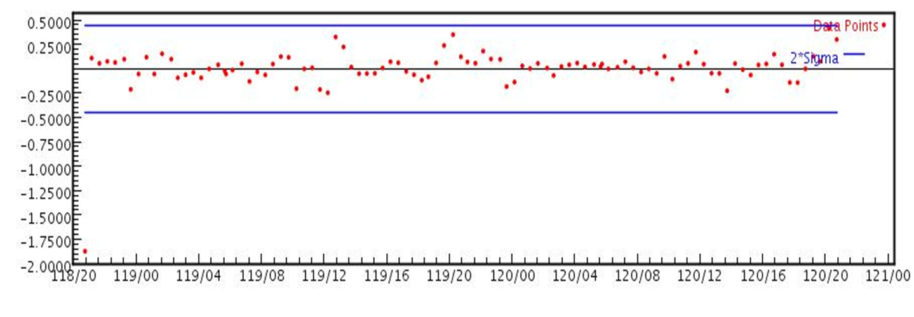
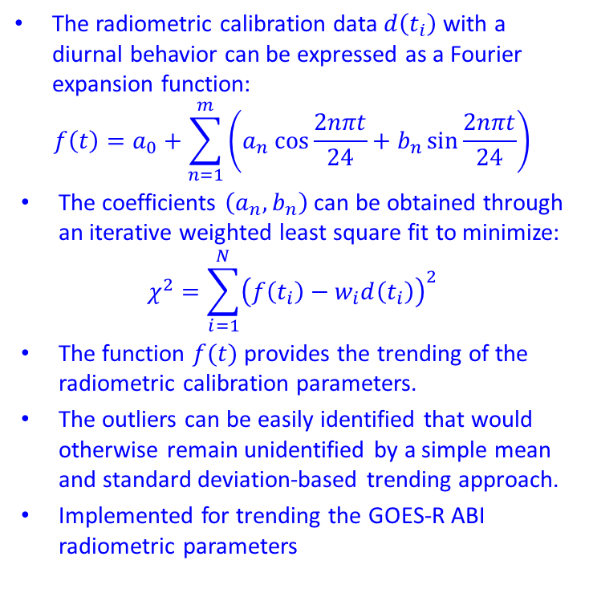

Adaptive Trending and Limit Monitoring Algorithm
Zhenping Li¹, Dave Pogorzala², Ken Mitchell¹, J. Paul Douglas¹,
1. ASRC Technical Services, Lanham, MD.
2. Integrity Applications Incorporated, Chantilly, VA
The radiometric calibration data $d\left(t_{i}\right)$ with a diurnal behavior can be expressed as a Fourier expansion function:
$$f\left(t\right)=a_{0}+\sum_{n=1}^{m}{\left(a_{n}\cos{\frac{2nπt}{24}}+b_{n}\sin{\frac{2nπt}{24}}\right)}$$
The coefficients $\left(a_{n}, b_{n}\right)$ can be obtained through an iterative weighted least square fit to minimize:
$$χ^{2}=\sum_{i=1}^{N}{{\left(f\left(t_{i}\right)−w_{i}d\left(t_{i}\right)\right)}^{2}}$$
The function $f(t)$ provides the trending of the radiometric calibration parameters.
The outliers can be easily identified that would otherwise remain unidentified by a simple mean and standard deviation-based trending approach.
Implemented for trending the GOES-R ABI radiometric parameters
The trending for GOES13 channel 4 detector 1 bias term
The difference $f\left(t_{i}\right)−d\left(t_{i}\right)$ the blue line represents
2σ deviation
Poster # 1.27

Slide 16
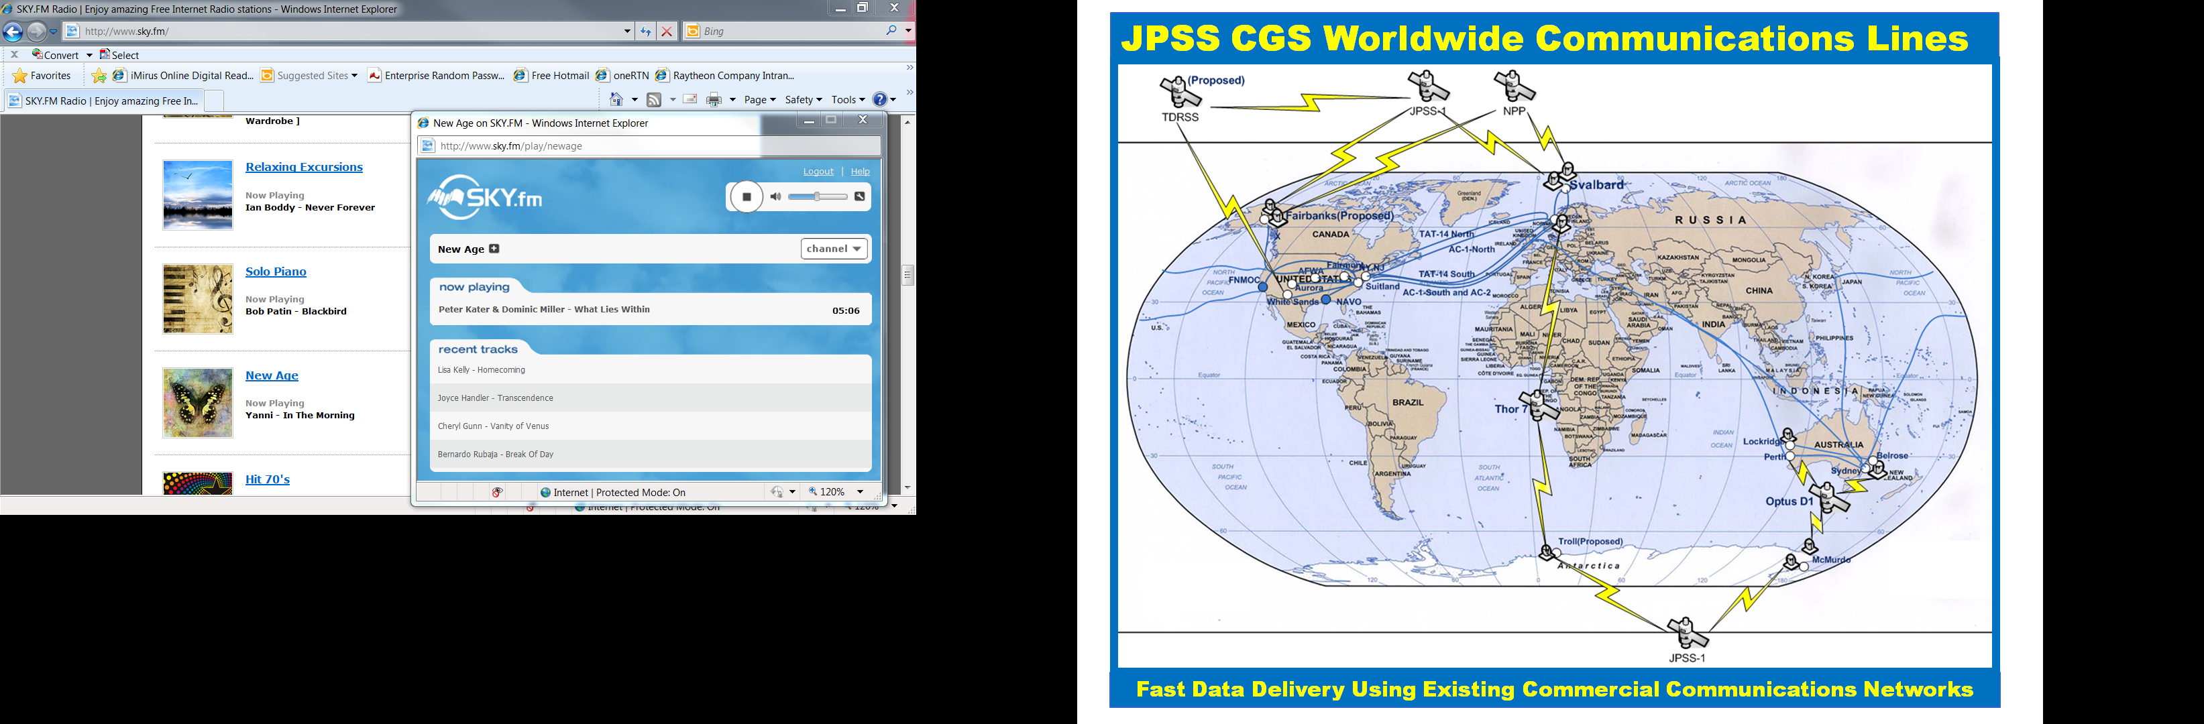
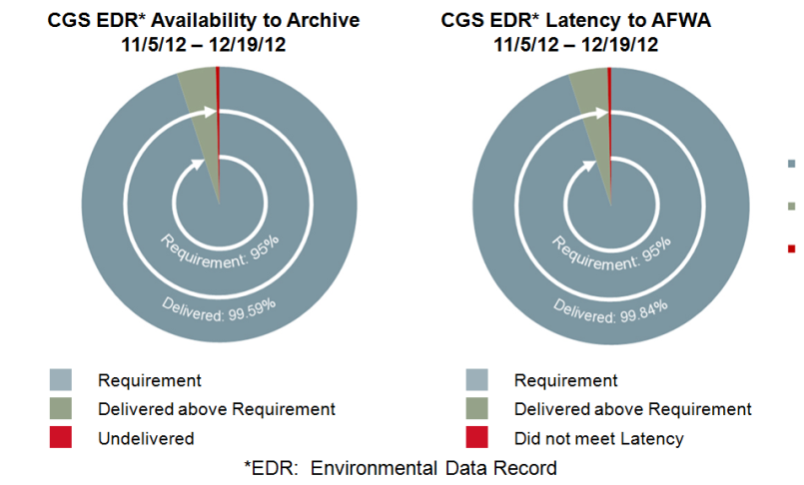
Assured Weather Satellite Information Delivery
Kerry Grant, Shawn Miller, Shawn Cochran
Raytheon Intelligence, Information and Services
Aurora, Colorado
The CGS plays a key role in facilitating the movement and value-added enhancement of data from satellite-based sensor data to delivery to the consumers
  Architecture advances implemented for JPSS-1 increase data availability and reduce latency for end user
  Improvements directly benefit user applications, such as the Global Forecast Models, Cloud Cover Analysis, and various unique missions, such as Forest Fire management and Post-Event Power Outage Assessments
Poster #
1-29

Slide 17
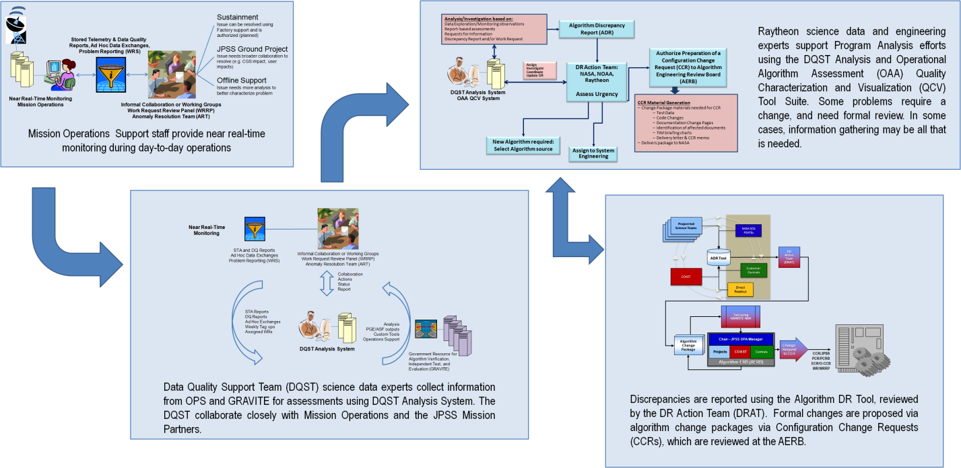
Maintaining JPSS Product Quality
Kerry Grant, Wael Ibrahim, Paula Smit, Kurt Brueske
Raytheon Intelligence, Information and Services
Aurora, Colorado and Omaha, Nebraska
Detecting, identifying, and resolving quality issues in a timely fashion is essential for operational systems
  Tools, techniques, and processes are in place to detect changes in product quality, identify root causes, and rapidly implement changes to the operational system to bring suspect products back into specification
Process to detect and analyze quality issues and initiate changes
Poster #
1-30

Slide 18
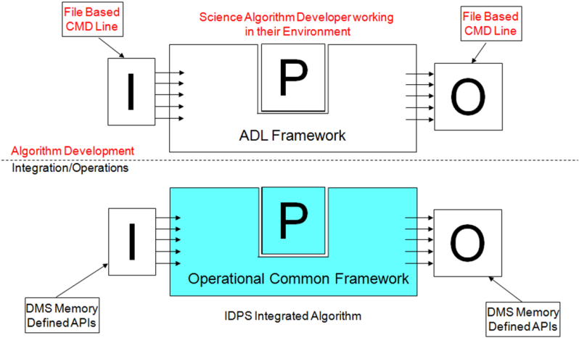
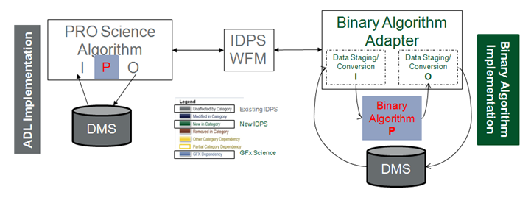
Rapid Algorithm Integration in JPSS CGS
Kerry Grant, Shawn Miller, Michael Jamilkowski
Raytheon Intelligence, Information and Services
Aurora, Colorado and Greenbelt, Maryland
Raytheon has developed tools, processes, and techniques to significantly shorten the time and effort required to implement algorithm changes into operations
  The Algorithm Development Library allows scientists to easily work in their home environments then drop production code directly into IDPS
  The Algorithm Integration Framework facilitates integration of binary or non-ADL source directly into IDPS
Algorithm Ingegration
Framework
Poster #
1-31

Slide 19
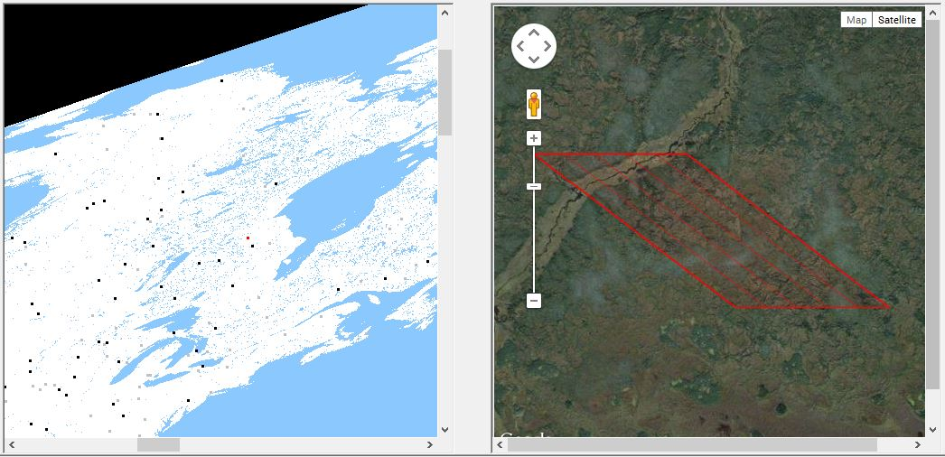
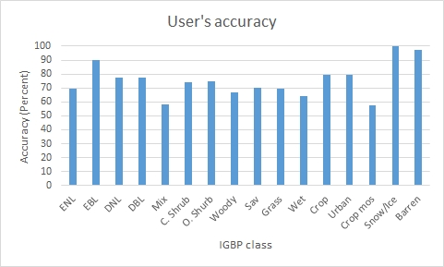
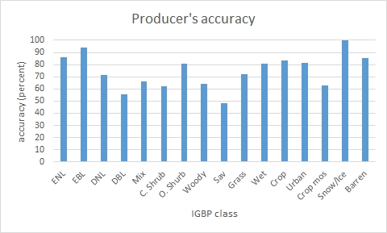
Validation of JPSS S-NPP VIIRS Surface Type EDR
Rui Zhang¹, Chengquan Huang¹, Xiwu Zhan²
1. Department of Geographical Sciences, University of Maryland, College Park, MD 20742
2. NOAA/NESDIS Center for Satellite Applications and Research (STAR), College Park, MD 20740
A new validation has been conducted on JPSS S-NPP Surface type EDR
  An integrated validation interactive tool has been developed for the validation.
  Approximate 5000 pixels were validated based on stratified random sampling.
  73.92% of overall classification accuracy has been obtained, which exceeds 70% requirement.
Poster #
1-32
Validation tool, user’s and producer’s accuracy

Slide 20
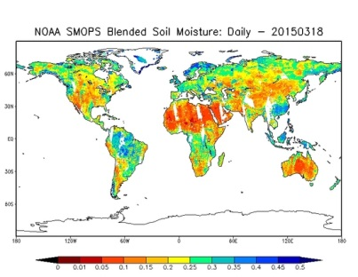
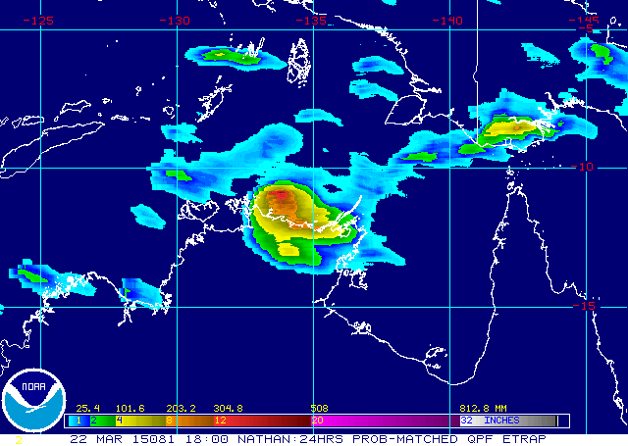
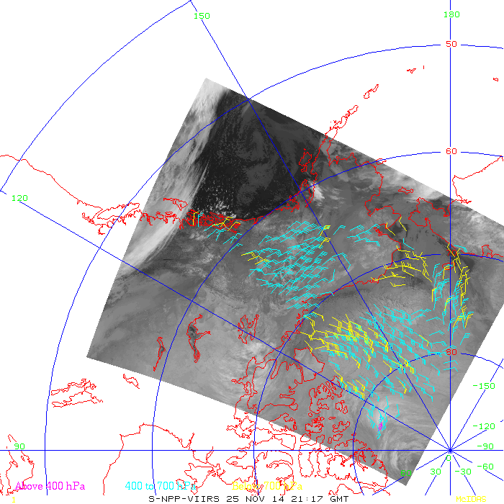
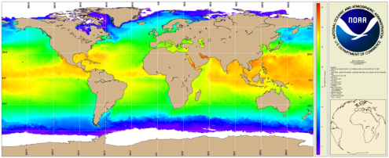
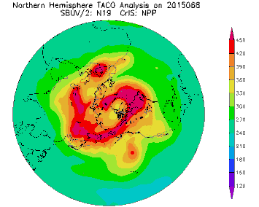
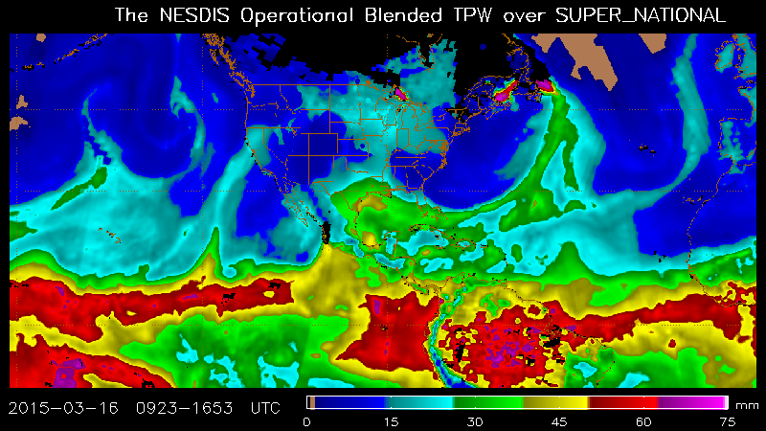
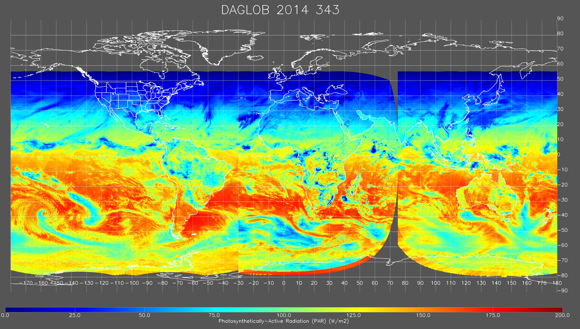
Research to Operations of New and Enhanced NESDIS Satellite Products
Stacy Bunin¹, Tom Schott², Bonnie Reed³
¹ Noblis, Falls Church, VA
² NOAA/NESDIS/OSGS, Suitland, MD
³ Science and Technology Corporation, Columbia, MD
Atmospheric, oceanic, and land surface satellite product development efforts transitioning to operations include
  Continuity products for replacement satellites
  New and enhanced capabilities from existing satellite systems
  New products from new satellite systems
Poster # 1.36

Slide 21
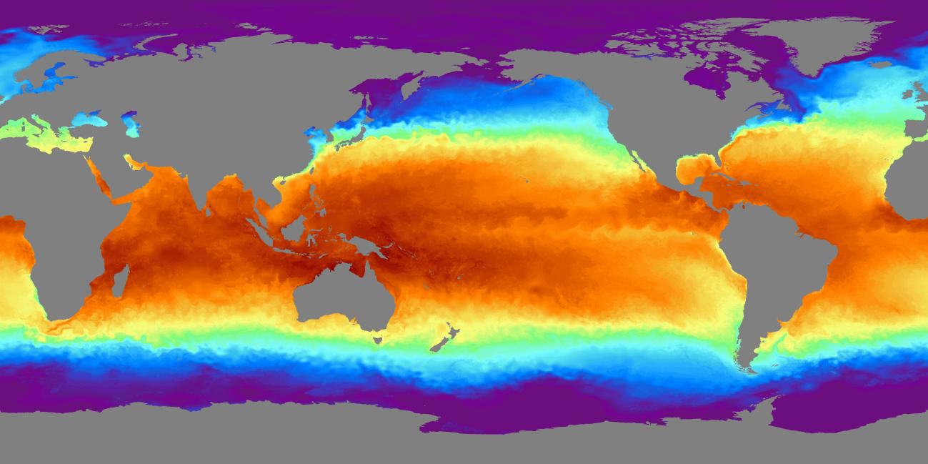
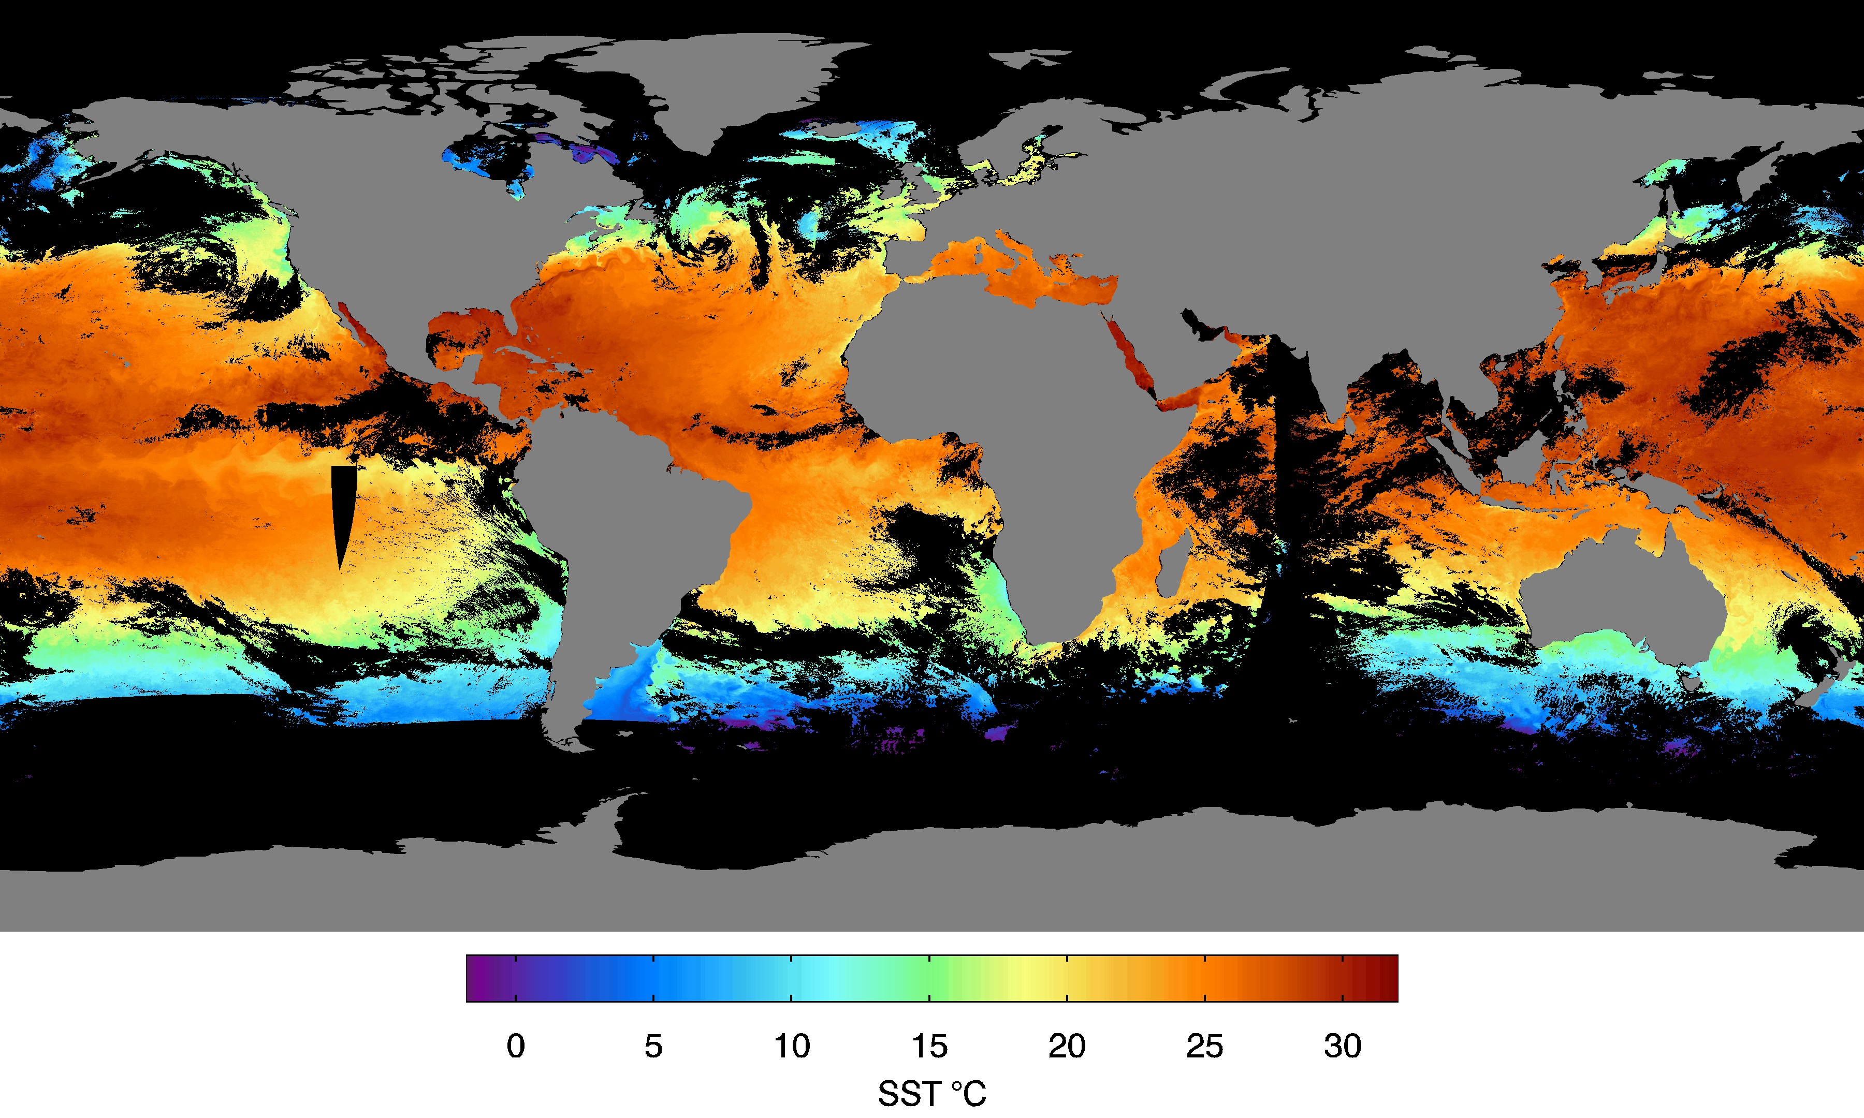
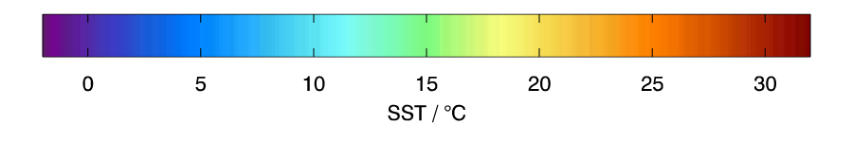
NOAA's Operational Sea Surface Temperature Products and Applications
Eileen Maturi-NOAA/NESDIS/STAR/SOCD-College Park, Maryland
Geostationary SST Product Coverage
5km Blended SST Analysis
GOES-W GOES-E Meteosat-10 {gap} MTSAT-2
GOES-W GOES-E Meteosat-10 {gap} MTSAT-2
APPLICATIONS
  Oceanic Heat Content Products Ocean Forecast Products
  Coral Reef Watch Products CoastWatch Products
  Marine Fisheries Products
Poster #
1-37

Slide 22
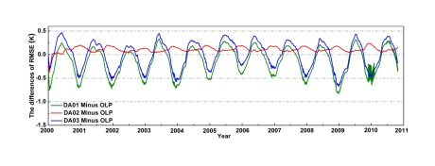


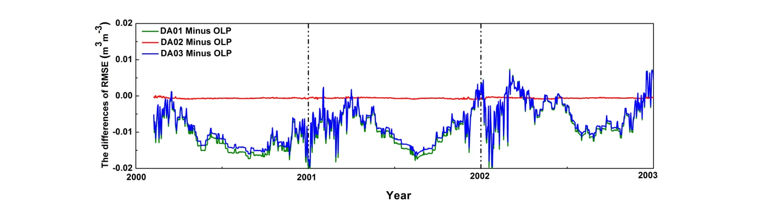
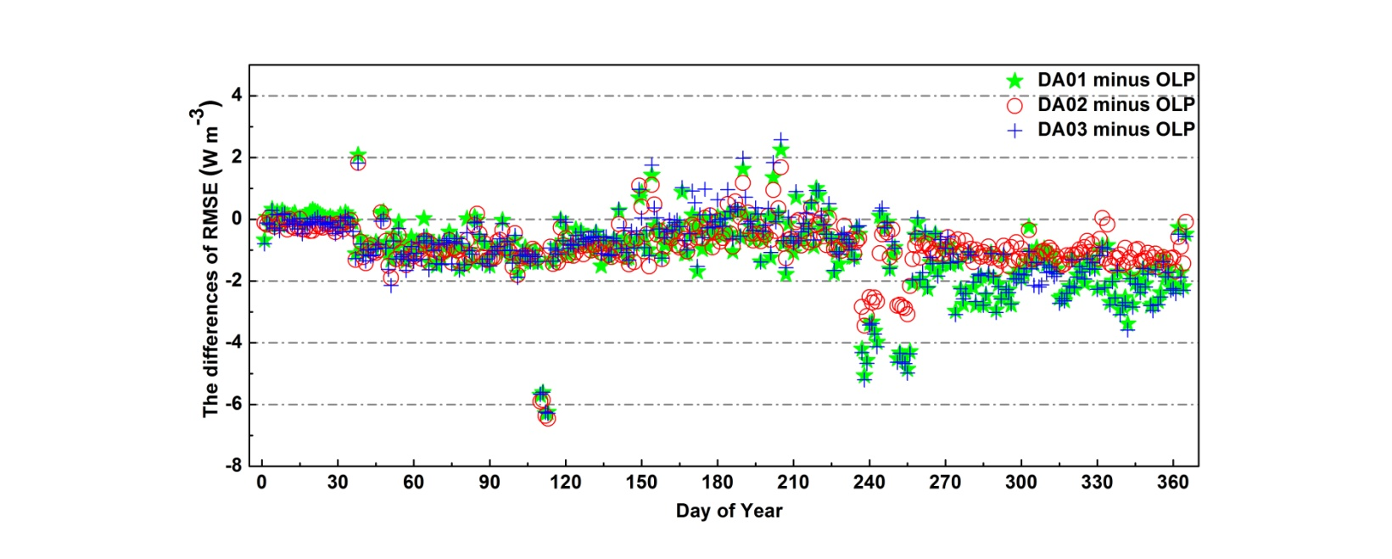
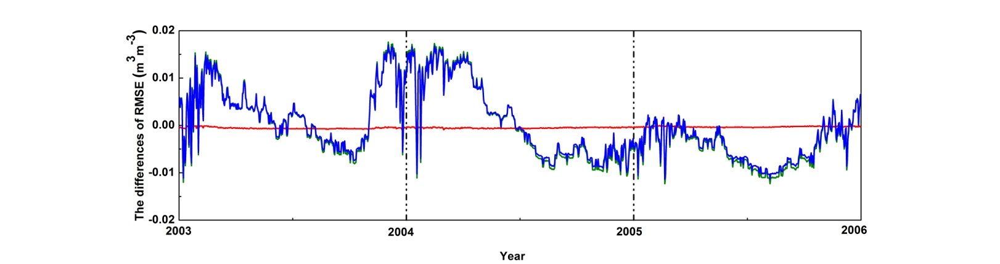
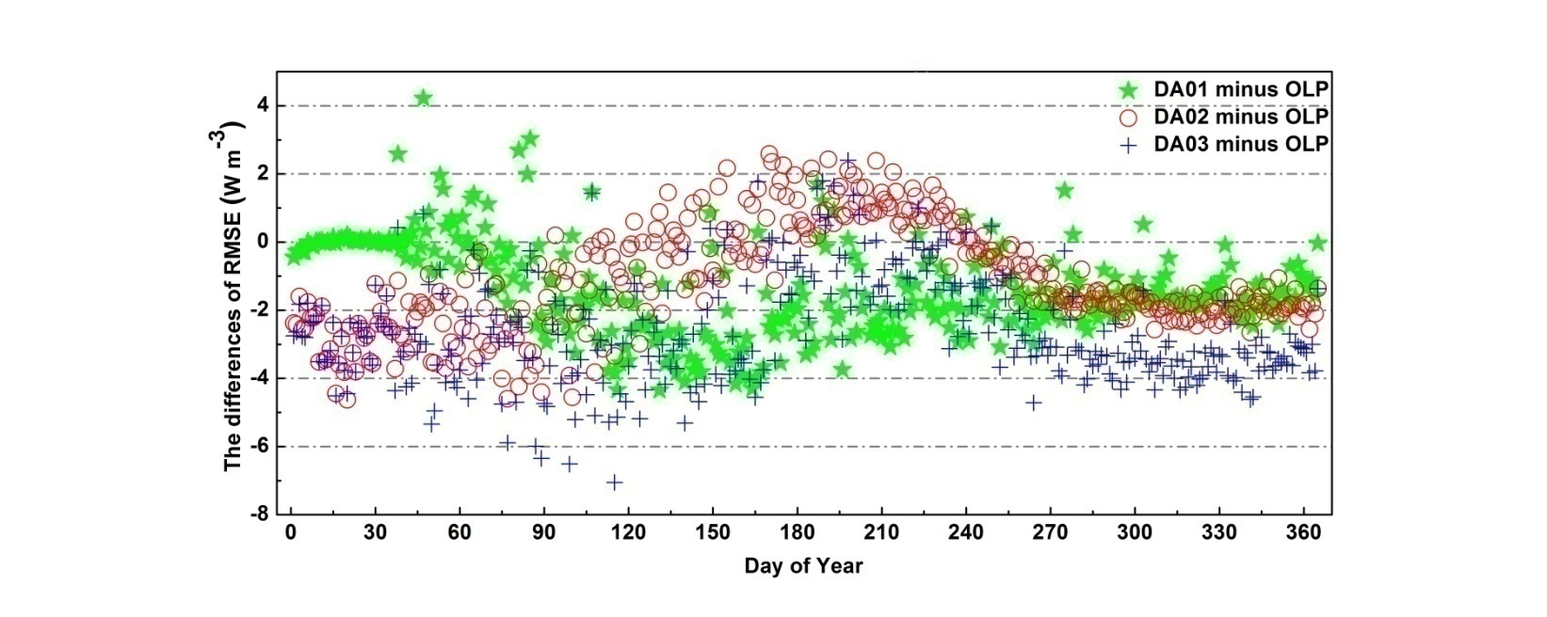
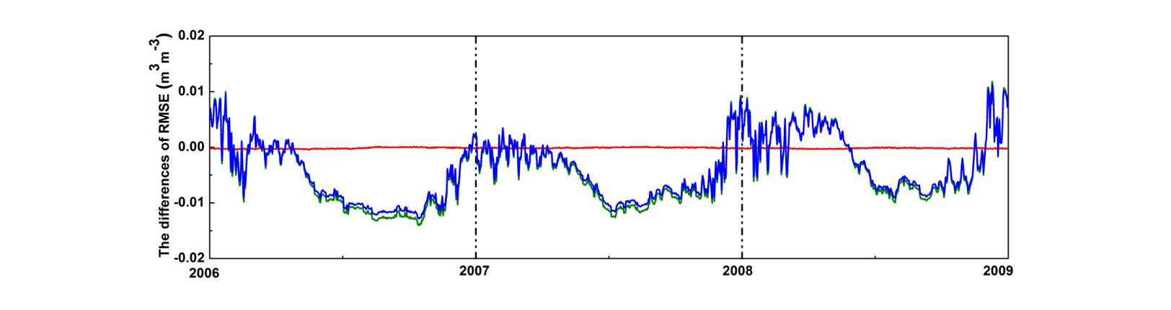
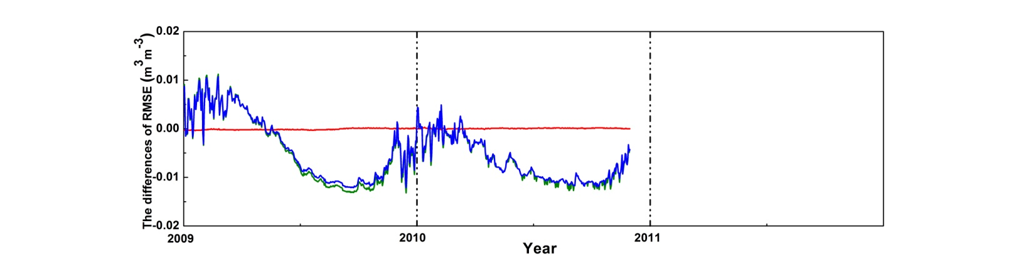
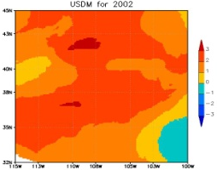





Greenbelt, MD, April 27 - May 1, 2015
Improving Noah LSM Performance using Near Real Time Surface Albedo and GVF
Jifu Yin, Xiwu Zhan, Christopher R. Hain, Li Fang, Jicheng Liu (NOAA/NESDIS/STAR, College Park, 20740 MD USA)
Experiment Details:
OLP—static GVF and Al;
DA01—weekly GVF and static Al
DA02—static GVF and monthly Al
DA03—weekly GVF and monthly Al
Major Results:
With respect to in-situ (179 SCAN sites and 7 SURFRAD sites) measurements, the improvements of assimilating the near real time (NRT) GVF and Al data on Noah LSM performance could be up to:
11.04% for root-zone SM
3.2% for root-zone ST
9% for net radiations
for time period longer than one week. And the drought monitoring capacity of the Noah LSM is significantly enhanced using NRT GVF and Al.
Figure 3. As Figure 1, but for LWnet (top) and SWnet (bottom).
Figure 1. Time series of daily differences in 60-100 cm soil moisture (SM) RMSE between OLP case and each of three DA cases. The positive (negative) values indicate DA cases increase (decrease) RMSE in comparison with OLP case.
Figure 4. USDM patterns during 2002-2004.
Figure 5. Domain (in Figure 4) averaged OLP/DA03 cases model 0-10 cm (left) and
60-100 cm (right) SM compared with in-situ Observations during 2002-2004 periods.
Figure 2. As Figure 1, but for 60-100 cm soil temperature (ST) .
Poster # 1-38

Slide 23

Evaluating the inter-FOV radiance difference of S-NPP CrIS Full Spectral Resolution (FSR) Data Product
Xin Jin et al.
NOAA/NESDIS/STAR and ERT, Inc., College Park, MD
NOAA/STAR provides the CrIS FSR SDR since last Dec 4. One critical issue is to evaluate the inter-Field-Of-View radiance difference
  Nadir-view clear sky pixels over tropical oceans are selected for evaluation
  Comparing to normal-resolution SDR products, the FSR SDR inevitably has higher noise. But improved calibration algorithm reduces at least part of the increased uncertainty.
  This study will help to establish a hyper-spectral radiance dataset with climate-level quality
Poster # 1.39

Slide 24



Physical retrieval of ocean surface wind speed and its application to Typhoon analysis using microwave satellite remote sensing
Sungwook Hong¹ ,Hwa-Jeong Seo² ,Inchul Shin² and Sang-Jin Lyu²
1. Sejong University, Korea, 2. National Meteorological Satellite Center, Korea Meteorological Administration
A unique sea surface wind speed retrieval method (Hong and Seo algorithm) from passive microwave satellite observations is developed for use in both rainy and rain-free conditions.
This algorithm is based on a combination of satellite-observed microwave brightness temperatures, sea surface temperatures, and horizontally-polarized surface reflectivities from RTTOV model, and surface and atmospheric profiles from ECMWF.
The retrieved wind speed($W_{S})$ shows the improved results (low bias and RMSE)
  $W_{S}$ was directly validated with the TAO buoy data and indirectly validated with the TCs intensity.
Poster
# 1-40
Fig.1 Sizes (radius of 15 m/s wind speed) of Typhoon DANAS using GCOM-W1/AMSR-2 6.9GHz(Hong & Seo algorithm) on 17:10 UTC Oct. 7, 2013 .

Slide 25




RGB product for convective clouds using COMS
Sungwook Hong¹ ,Yuha Kim² and Sang-Jin Lyu²
1. Sejong University, Korea, 2. National Meteorological Satellite Center, Korea Meteorological Administration
The convective cloud RGB is composed from a combination of 12.0-10.8㎛, 6.75-10.8㎛,10.8㎛ (Fig 1).
The threshold values of the RGB product for detection of convective clouds are taken from LUT of Convective Rainfall Rate(CRR) (Fig 1-e).
Typhoon center positions from the RGB convective cloud product shows comparable or even better result relative to the best track data (Fig 3~4) implying that the RGB convective cloud product can be used to improve the accuracy of typhoon center position analysis.
Poster 1-41

Slide 26

NOAA/STAR S-NPP CrIS Full Spectral Resolution SDR Processing
Xiaozhen (Shawn) Xiong^{1,2}, Yong Han², Yong Chen^{2,3},
Likun Wang^{2,3} , Denis Tremblay^{2,4}, Xin Jin^{1,2}, Lihang Zhou²
¹Earth Resources Technology, Inc, MD; ²NOAA Center for Satellite Applications and Research, College Park, MD; ³University of Maryland, MD; ⁴Science Data Processing Inc.
The CrIS full spectral (FRS) data on S-NPP and J-1 will greatly improve trace gases observation over normal resolution
Data is available since Dec.4, 2014;
A modified ADL code made by STAR SDR group is used to generate the data with a latency within 12 hours;
Data is delivered on STAR FTP site (ftp://ftp2.star.nesdis.noaa.gov/smcd/xxiong/) and GRAVITE (https://gravite.jpss.noaa.gov/).
CH₄
CO
CO₂
CrIS full spectrum with 2223 channels (non apodized, red) vs current normal resolution mode with 1317 channels(black).
Poster #
1-43

Slide 27

Applications of GOES data in Brazil
Nelson J. Ferreira
DSA/CPTEC Brazilian Institute for Space Research – INPE
Cachoeira Paulista, SP, Brazil
GOES-13 has been successfully used in Brazil providing imagery data every 30 minutes in routine mode and every 3 hours in RSO mode. This reception routine enabled to improve weather forecasts, disaster management, drought, fires warnings and to monitor extreme weather events. Also training material on the use of GOES over South America was designed to increase the forecasters’ skill in incorporating satellite data in the short-range forecast, and warning decision makers processes.
GOES Products available at CPTEC/INPE
Poster # 1-44

Slide 28




Joint Polar Satellite System (JPSS) Common Ground
System (CGS) Multimission Support #1-45
Mike Jamilkowski, Shawn Miller and Kerry Grant
Raytheon Intelligence, Information and Services
Greenbelt MD & Aurora CO
CGS design tenants emphasize ability to incorporate multiple missions
  – Modular functionality
  – Flexible interfaces
  – Improved information integration across missions
  – Generalized capabilities rather than point solutions
Support for new missions can be tailored to specific needs
  – Data acquisition and routing
  – Command and control
  – Data processing and delivery
Block 3.0 will provide opportunity to align the CGS with the NOAA Enterprise Ground vision
CGS Block 2.0: Operational, Multi-Mission Enterprise Ground

Slide 29

Improvements to Ensemble Tropical Rainfall Potential (eTRaP)
The eTRaP team: Robert J. Kuligowski, Stan Kidder, Liqun Ma, Robert Glassberg, Clay Davenport, Rachel Hatteberg, Mike Turk, Sheldon Kusselson, and Beth Ebert
An operational forecast of rainfall from tropical cyclones:
  Based on extrapolating satellite-retrieved rainfall along the predicted storm track
  Uses an ensemble of rainfall retrievals and forecast tracks
  Accumulations and exceedance probabilities in 6-h segments out to 24 h
  Used by forecasters worldwide
Recent and ongoing improvements:
  Removed biases in probabilities
  Additional ensemble members to improve forecast quality and reliability
eTRaP for Cyclone Pam at 0000 UTC 13 March 2015
Poster # 1-46

Slide 30

A Systematic Approach to Building and Maintaining
NOAA’s Climate Data Records (CDRs)
Daniel Wunder
NOAA/NCEI Asheville, NC
NOAA’s CDR Program office has transitioned 28 satellite CDRs to initial operational capability (IOC)
  Research to Operations (R2O) is a six phase process which culminates with an Operational Readiness Review (ORR).
  The source code, documentation and data are available to the public, ensuring a transparent and scientifically defensible CDR.
  A follow on commitment to sustained Operations and Maintenance (O&M) provides routine product generation extending the record.
  Specific applications are developed to help end users and decision makers better understand the CDR data and potential applications.
Poster # 1.49
Sample CDR Products

Slide 31


Adding a Mission to the Joint Polar Satellite System (JPSS) Common Ground System (CGS) #1-50
Shawn Miller, Kerry Grant and Mike Jamilkowski
Raytheon Intelligence, Information and Services
Aurora CO & Greenbelt MD
CGS Provides three different categories of services:
  Managed Mission Services: CGS flies the satellite, manages mission resources, acquires and/or routes the raw data, and generates and distributes data products.
  Data Processing Mission Services: CGS acquires and/or routes the raw data, generates and distributes data products.
  Data Acquisition and Routing Mission Services: CGS acquires and/or routes the raw data.
Scalability is a key tenet of the CGS. The CGS architecture, mapped to the Joint Architecture Reference Model (JARM) and locations of CGS extension points for scalability, enables the addition of new missions to the CGS, and essentially serves as a “checklist” per each new mission, which has been demonstrated in expanded CGS multi-mission support to date.
High-level architecture of the CGS as it applies to the three categories of services.
CGS Architectural Extension Points

Slide 32


Characteristics of detected salt storms by AVHRR sensor on NOAA satellites from 2006 to 2014 in Argentina
Diana Rodríguez
National Weather Service
Buenos Aires, Argentina
The occurrence of salt storms near the Mar Chiquita Lake (Argentina) from 2006 to 2014 is documented using satellite images captured by sensor AVHRR on NOAA 17, 18 and 19 satellites.
  The images reveal that these storms have occurred with varying degrees of development, from a weak plume to a thick cloud of great extent.
  These forms of expression are linked to hydrological and meteorological factors.
  The number of storms varies throughout the year and from one year to another.
  Most storms recorded occurred during the winter months, with winds almost exclusively south or north, but more with northerly winds
  The observed 11μm minus 12μm brightness temperature difference (BTD) is always negative for these clouds.
Poster #
1-53

Slide 33




The impact of the high temporal resolution GOES/GOES-R moisture information on severe weather systems in regional NWP model
Pei Wang, Jun Li, Yong-Keun Lee, Zhenglong Li, Jinlong Li, Zhiquan Liu, Tim Schmit, Steve Ackerman
SDAT – Satellite Data Assimilation for Tropical storm (CIMSS/SSEC/UW-Madison) http://cimss.ssec.wisc.edu/sdat/
WRF-ARW v3.6.1: 4 km horizontal resolution (400*280) , 52 vertical layers from surface to 10 hPa
GSI v3.1: 3-Dvar Data Assimilation Method
NAM background error covariance matrix
Cycled bias correction
Conventional Data – from GTS
Satellite radiances: AMSU-A from AQUA, Metop-A, NOAA-15 and NOAA-18
LPW: Layer Precipitable Water (three layers)
OBS
24-hour accumulated precipitation with different background fields.
High resolution helps get better precipitation forecasts
Details in
Poster # 1-55
FNL
2012 June Derecho
Jun 29 12z to Jun 30 12z, 2012
Impact from different background fields
Total three layers PW; separate layer PW
Background sensitivity
NCEP FNL: 1-degree, 26 vertical levels
ECMWF ERA-Interim: 0.7-degree, 37 vertical levels
ECMWF Operational: 0.14-degree, 25 vertical levels
ERA
ECMWF

Slide 34







NOAA/NESDIS SOUNDING DATA PRODUCTS FROM THE NEXT GENERATION OF SATELLITES
A.K. Sharma
NOAA/NESDIS Office of Satellite and Product Operations (OSPO) http://www.ospo.noaa.gov/Products/atmosphere/soundings/index.html
This poster presentation will include several of the tools developed and deployed for the sounding products monitoring and data quality assurance which lead to improve the maintenance and sustainment of the Environmental Satellites Processing Center (ESPC) processing systems. The presentation will include the discussion on the ESPC system architecture involving sounding data processing and distribution for CrIS, IASI, and GOES sounding products. Discussion will also include the improvements made for data quality measurements, granule processing and distribution, and user timeliness requirements envisioned from the next generation of JPSS and GOES-R satellites. There have been significant changes in the operational system due to system upgrades, algorithm updates, and value added data products and services.
N
U
C
A
P
S
Poster # 1-56

Slide 35

Using hyper-spectral sounding products to improve short-range forecasts in the Alaska Region
Ralph A. Petersen¹, Lee Cronce¹, William Line², Robert Aune³, Carven Scott⁴
¹CIMSS, University of Wisconsin-Madison, Madison, WI
²CIMMS, University of Oklahoma (and SPC), Norman, OK
³NOAA/NESDIS Advanced Satellite Products Branch (ASPB), Madison, WI
⁴NWS, Alaska Region, Anchorage, AK
Improving Alaska Region Forecasts by Adding Predictive Component to JPSS Soundings
  Assess accuracy of JPSS moisture retrievals over high latitude land through compares with GPS Total Precipitable Water (TPW) observations
  Provide forecasters tools to identify, track and anticipate extreme horizontal and vertical variations in the atmosphere (especially moisture fields).
Comparison of NearCasts using CIMSS, NESDIS and EUMETSAT Retrievals
Poster # 1-59

Slide 36

Infrared and Microwave Data Addition Observing System Experiment Impacts Using the NCEP Global Forecast System
James Jung¹ and Mitch Goldberg²
¹CIMSS/UW, Madison WI
²NOAA/NESDIS/JPSS, Greenbelt MD
Specific sensors (AIRS,IASI, CrIS, ATMS, AMSU, SSMIS) were added to a baseline of observations
  Infrared and Microwave sensors have relatively similar impacts (AIRS = AMSU).
  Microwave sensors ATMS and AMSU show similar and mostly equivalent improvements.
  IASI shows more overall improvements than the other infrared sensors.
Poster #
1-60

Slide 37


Slide 38
Thank you to all poster presenters!

