Slide 1
Poster Session II
Wednesday April 29, 2015
10:30 AM & 3:00 PM

Slide 2
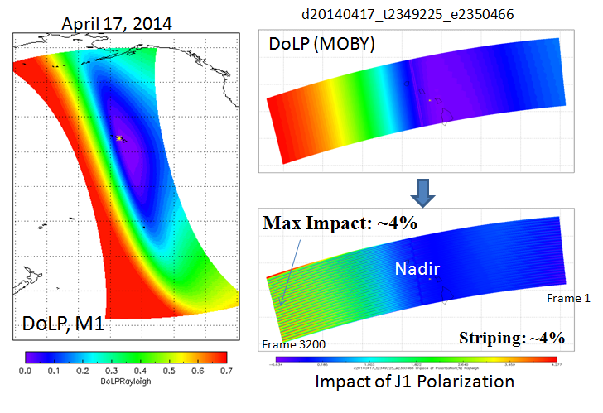
Assessment of J1 VIIRS Polarization Sensitivity
Impacts on Sensor Data Records ¹Wenhui Wang, ²Changyong Cao, and ¹Aaron Pearlman
¹Earth Resource Technology, Inc; ²NOAA/NESDIS/STAR
College Park, MD
The impacts of J1 polarization sensitivity was studied using prelaunch polarization characterization data and 6SV simulations:
The impact on band M1 TOA reflectance may be as large as ~4%;
Band M1 Stripping due to detector level polarization sensitivity differences may also be ~4%.
Poster # 2.1

Slide 3
Direct Broadcast and Stored Mission Data Behavior in Relation to CrIS Full Spectrum for S-NPP
Kevin Gross Sean Lyons
NOAA OSPO
To receive CrIS full length interferograms in the SWIR and MWIR bands, the APID to VCID mappings were modified to prevent Direct Broadcast or SMD data buffer overflow and resulting data loss
Behavior Before
SSR fills at slower rate
Shorter SSR dump time
Data loss during CrIS FS Test
Buffer overflow during CrIS FS Test
Behavior After
SSR fills at higher rate
No increase in HRDXDMA instances
No data loss after CrIS FS
No buffer overflow after CrIS FS
Data Flow and Telemetry Points
VCDUs
CDP FS MDF Output Queue
MDF Card Buffer
MDF Card DMA
Transmitter Buffer
1394 Insts.
SMDXBFULLF
1553 Insts.
MDFOTQFULL
MDFINQFULL
SMDXDMA
HRDXDMA
HRDXBFULLF
From S/C.
Poster #2-3

Slide 4
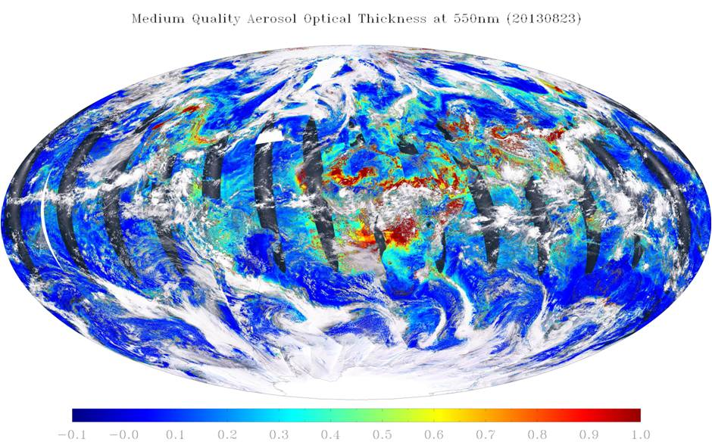
Evaluation of the VIIRS Risk Reduction Aerosol Optical Thickness Algorithm
Hongqing Liu⁽¹⁾ and Istvan Laszlo⁽²⁾
(1) I.M. Systems Group, Inc. (2) NOAA/NESDIS
The VIIRS risk reduction algorithm improves aerosol optical thickness retrieval
Extended spatial and measurement range
Updated aerosol models
Scene-dependent surface spectral reflectance relationship
Improved accuracy and precision
Can be driven by both VIIRS and ABI observations
Retrieved aerosol optical thickness by the VIIRS risk reduction algorithm
Poster # 2.5

Slide 5
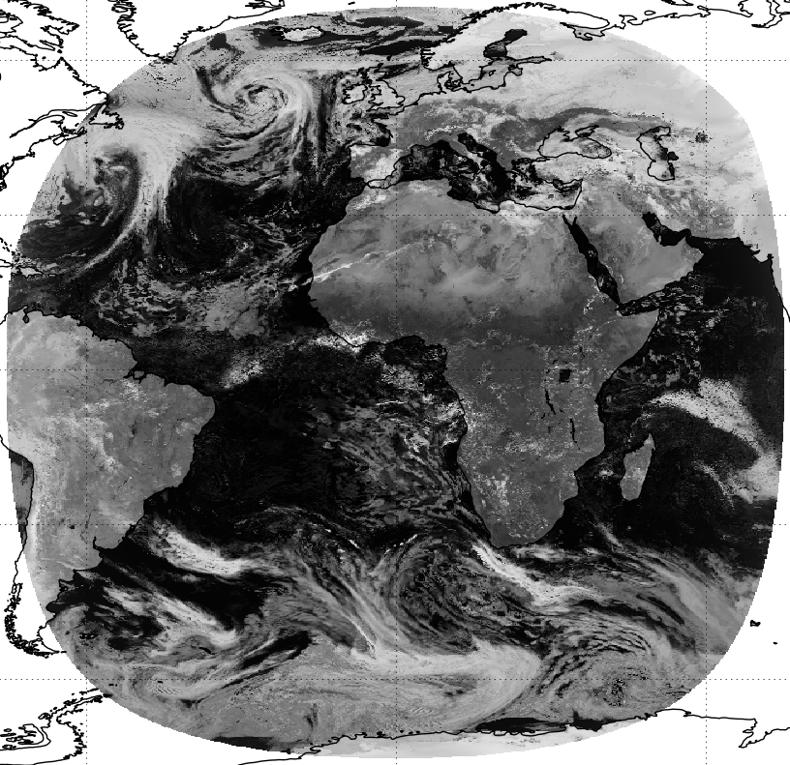
Simulated Satellite Imagery: Verifying NWP model analyses and forecasts Thomas Blackmore
Met Office
Exeter, UK
Interpreting NWP model analyses and forecasts and presenting them as if they were satellite images.
Direct comparison with observations.
Uses Met Office NWP models and a fast radiative transfer model (RTTOV-11).
Applications in Operational meteorology and NWP research.
Simulated MSG Visible channel imagery from Global model
Poster # 2.7

Slide 6
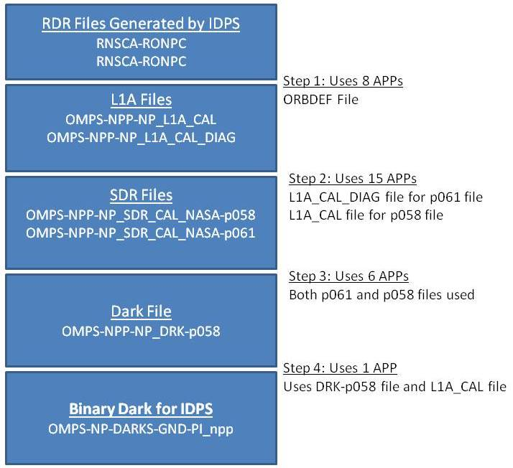
Facilitation of OMPS Dark Table Production Transition to GRAVITE by STAR Algorithm Integration Team (AIT)
Bigyani Das¹, Weizhong Chen¹, Kristina Sprietzer¹, Walter Wolf²
¹IMSG, Rockville, MD 20852, USA
²NOAA/NESDIS/STAR, College Park, MD 20740, USA
Steps in the DARK Generation Process
OMPS Dark Tables are produced on GRAVITE by using a master Perl script that combines the 4 main steps:
Step 1: Creating L1A files from Raw Data Record (RDR) files
Step 2: Using those L1A files to produce Sensor Data Record (SDR) files
Step 3: Using SDR files to create DARK files in HDF5 format
Step 4: Using the above HDF5 files to produce the final binary files
GRAVITE: Government Resource for Algorithm Verification, Independent Test, and Evaluation
Poster # 2-11

Slide 7
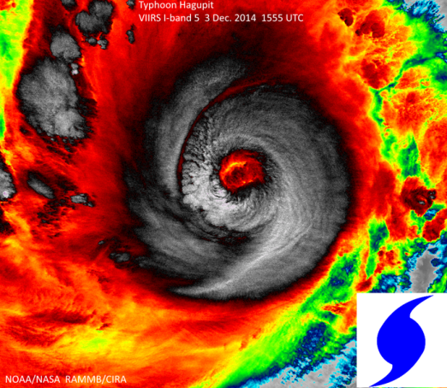
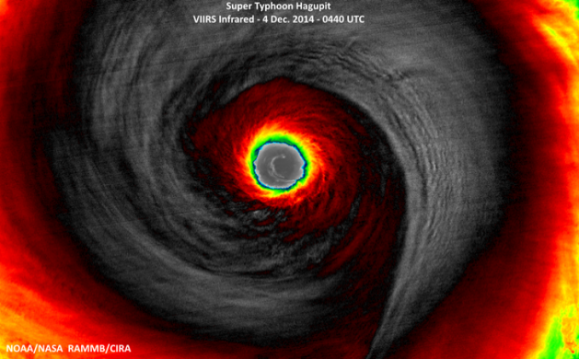
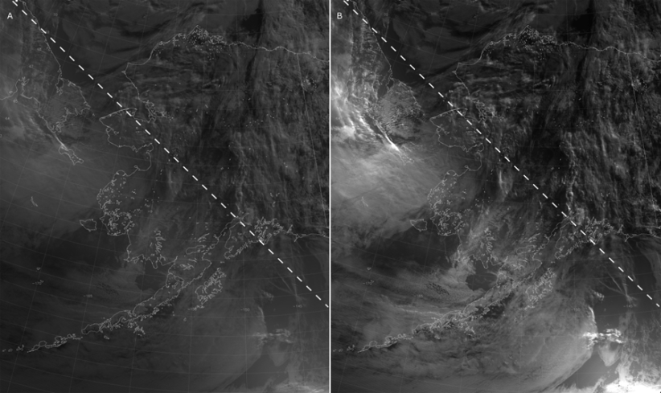
Suomi-NPP VIIRS Imagery Update Donald W. Hillger, NOAA/NESDIS, Fort Collins, CO; and C. J. Seaman, S. D. Miller, T. J. Kopp, R. Williams, and G. Mineart
VIIRS Imagery is excellent:
The I-bands provide high-resolution imagery of tropical storms, thunderstorms, RGB imagery, etc., depicting details in cloud formations or features on the ground which were not seen before (as noted in many of the VIIRS Blogs and VIIRS Imagery websites).
Users especially like DNB and/or NCC.
Some Improvements in VIIRS Imagery are possible:
Additional (all 16) M-band EDRs desired (currently only 6 M bands)
Improved “erf-dynamic scaling” (EDS) DNB
Data latency is main realtime usage issue (6 hour delay is not user friendly).
VIIRS I-band-5 Image of Typhoon Hagupit: rapidly-intensifying 1555 UTC on 3 Dec 2014, maximum intensify 0440 UTC on 4 Dec 2014.
VIIRS DNB and NCC images of a twilight scene on the night following a last quarter moon (13:23 UTC 19 July 2014). A) DNB image produced using the EDS method. B) NCC image. The dashed lines in (A) and (B) represent the 89° solar zenith angle contour with daylight in the upper right corner and night in the lower left corner.
Poster # 2-12

Slide 8
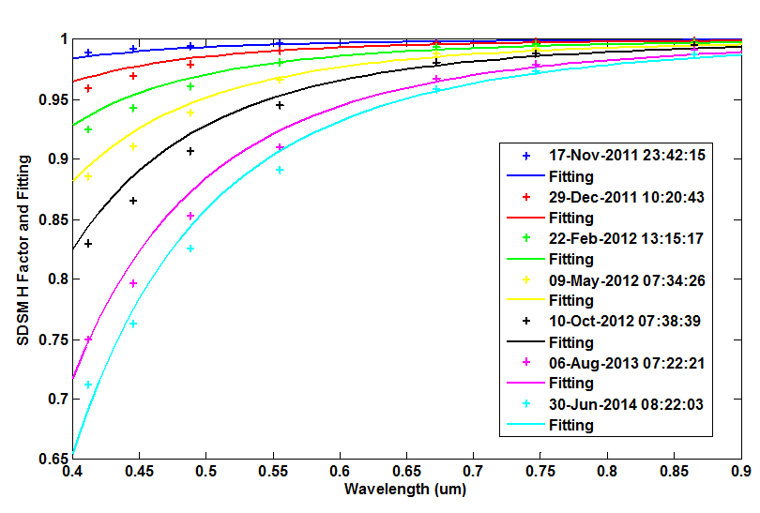
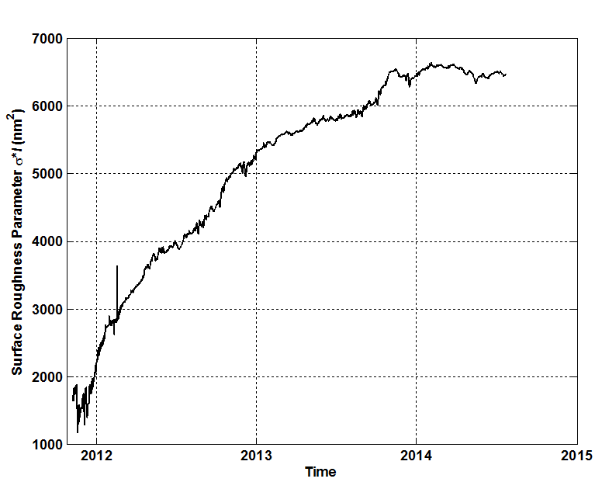
Modeling Suomi-NPP VIIRS Solar Diffuser Degradation due to Space Radiation Changyong Cao (NOAA/NESDIS/STAR) and Xi Shao (UMD)
Solar diffuser is made of Spectralon TM (one type of fluoropolymer) and was chosen because of its controlled reflectance in the VIS-NIR-SWIR region and its near-Lambertian reflectance profile.
Spectralon TM is known to degrade in reflectance at the blue end of the spectrum due to exposure to solar UV radiation and energetic protons.
VIIRS uses a SDSM to monitor the change in the Solar Diffuser reflectance in the 0.4 – 0.94 um wavelength range and provide a correction to the calibration constants.
The H factor derived from SDSM reveals that reflectance of 0.4 to 0.6um channels of VIIRS degrades faster than the reflectance of longer wavelength channels.
A model is developed to derive mean SD surface roughness height (l) and autocovariance length (σ) of SD surface roughness from the long term spectral degradation of SD reflectance.
These parameters are trended to assess surface roughness change of the SD of VIIRS.
Figure 1: Fitting of VIIRS SD spectral reflectance time series with Elson surface roughness model.
Figure 2: Trending of VIIRS SD surface roughness characteristic parameter $σl$
Poster # 2-14

Slide 9
Latest developments related to the improvement of the operational NOAA VIIRS active fire product I. Csiszar¹, L. Giglio², W. Schroeder² and E. Ellicott²
¹NOAA/NESDIS/STAR; ²University of Maryland Department of Geographical Sciences
College Park, MD
A new 750m VIIRS fire algorithm is transitioning into NOAA operations
global mask of thematic classes including water, cloud, non-fire clear land and fire at three confidence levels
fire radiative power for each fire-affected pixel
new algorithm elements to improve detection performance
The product is tailored subset of the NASA science product for real-time NOAA operations
fires
clear land
VIIRS fire mask over West Africa on 3/1/2015 at 14:15 UTC
water
Poster # 2.15
clouds
Data processed by STAR AIT from IDPS input

Slide 10
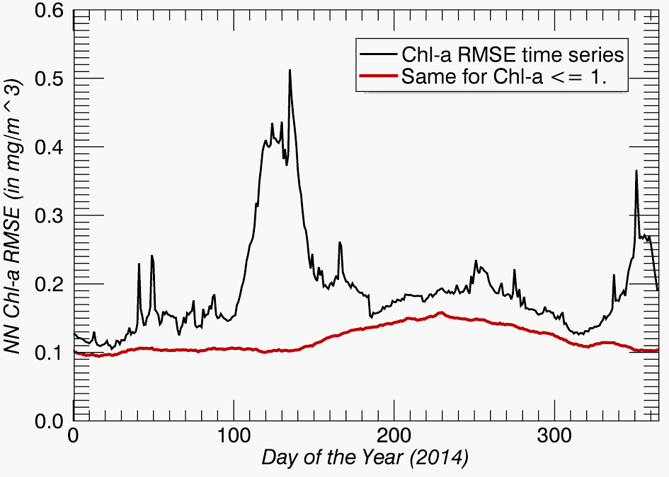
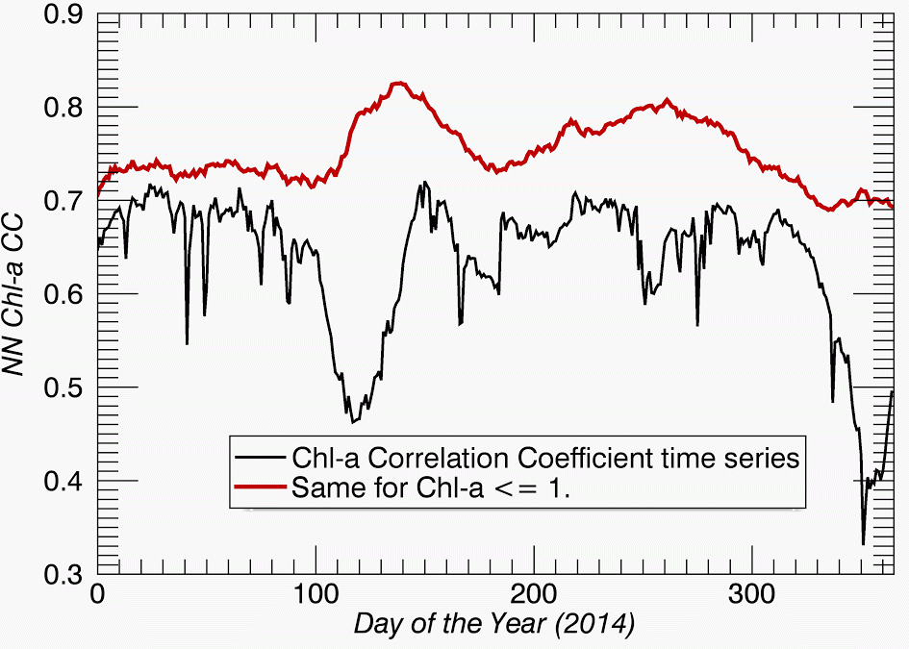
Neural Network Technique for Gap-Filling of Satellite Ocean Color Observations for use in Numerical Modeling Sudhir Nadiga¹, Vladimir Krasnopolsky², Avichal Mehra², Eric Bayler³, and David Behringer²
¹IMSG at NOAA/NCEP/EMC, NCWCP, College Park, MD; ²NOAA/NCEP/EMC, NCWCP; ³NOAA/NESDIS/STAR
A Neural Network (NN) Technique is used to estimate VIIRS ocean color fields using multiple independently observed inputs
Training Period: 01/2012-11/2013
NN accurately estimates chlorophyll-a (Chl-a) fields for many months subsequent to the training period.
NN inputs are:
daily satellite sea-surface height (SSH)
daily satellite sea-surface temperatures (SST)
daily satellite sea-surface salinity (SSS)
gridded Argo monthly vertical profiles of temperature (T) and salinity (S)
Output is daily Chl-a values.
Shows great promise for gap-filling when other independent observations (SSH, SST, SSS, T, S, etc.) are available
More sensitivity tests are required to obtain the optimal configuration of the NN technique
Seasonality in the root-mean-square error (RMSE) and in the cross-correlation between NN and VIIRS data.
Cross-correlation is highest in mid-latitudes and lowest in the equatorial Pacific Ocean.
Data points with Chl-a > 1 are less than 1% of points, but removing these noisy points (mostly in shallow waters), helped NN performance.
(1a)
(1b)
Figure 1: a) Chlorophyll-a root-mean-square error (mg m⁻³) for NN (black ) and with Chl-a > 1 mg m⁻³ removed (red); b) cross-correlation between NN and VIIRS data (black) and with Chl-a > 1 mg m⁻³ removed (red). The data for 2014 were not included in the NN training.
(2a)
(2b)
(mg/m^3)
(mg/m^3)
Figure 2: (a) 2014 chlorophyll-a root-mean-square error (mg m⁻³) for NN estimates; and (b) cross-correlation (percent) between NN and VIIRS data at zero time lag. The data for 2014 were not included in NN training.
Poster # 2.18

Slide 11
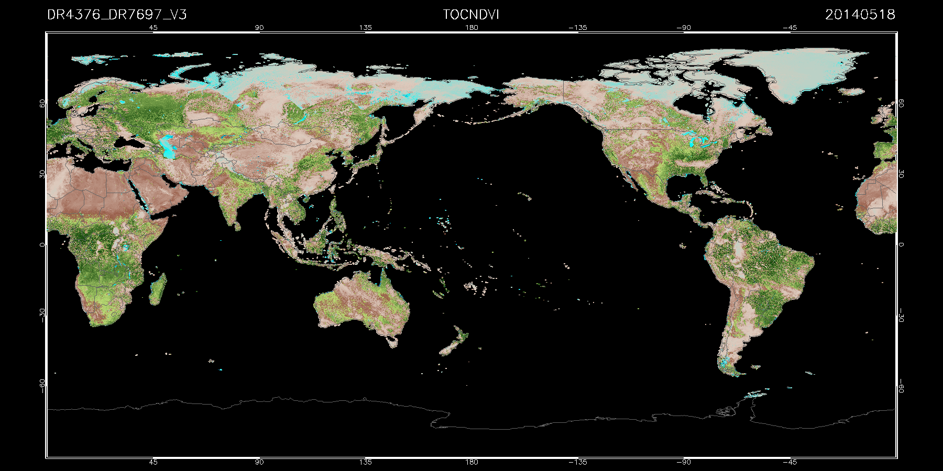
Integrating Changes to VIIRS Vegetation Index Algorithm using Algorithm Development Library (ADL)
Qiang Zhao¹, Bigyani Das¹, Weizhong Chen¹, Marina Tsidulko¹, Valerie Mikles¹, Walter Wolf²
¹IMSG, Rockville, MD; ²NOAA/STAR, College Park, MD
A new product, the TOC NDVI, has been developed and integrated into the VIIRS VI algorithm suite
Extensively tested through a series of ADL algorithm chain runs for two days of VIIRS data
Comparison studies were conducted to evaluate the impacts of upstream aerosol and surface reflectance algorithms changes on the VI products.
Poster # 2-19

Slide 12
Automated JPSS Products Processing of the Algorithm Development Library (ADL) by using Chain Run Scripts
Weizhong Chen
NOAA/NESDIS/STAR
College Park, MD
The ADL Chain Run script is developed by the STAR AIT.
The ADL chain run script is mainly Perl script to automate the staging and processing of multiple JPSS SDR and EDR products.
The script calls ADL’s “runADLChainRunner.pl” to process data.
The script uses a specified date with time range and/or a specified granule ID as an option to identify and stage input data.
The VIIRS Cloud Mask, Aerosol, Surface Reflectance and Vegetation Index will be used as examples to show how to use this script to process JPSS data.
Poster # 2-20

Slide 13
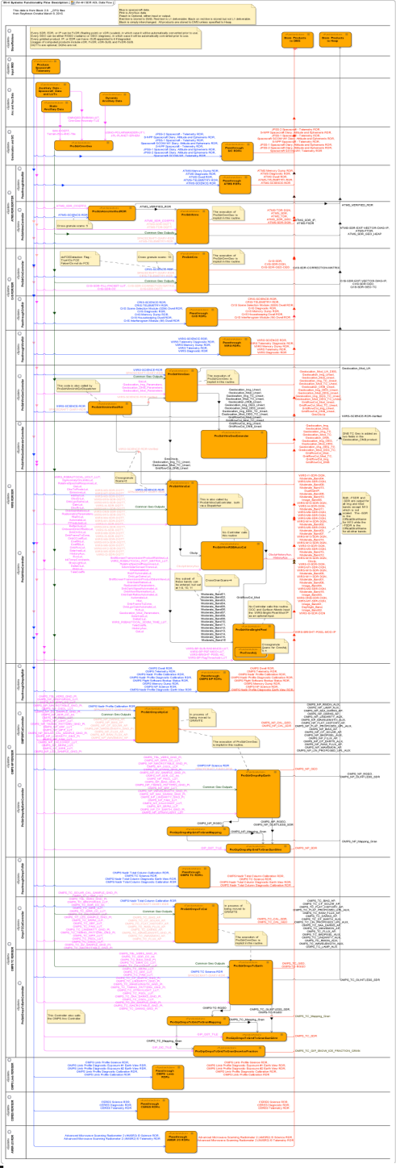
Accurate Data Flow Management Tool Facilitates
Operational Stability and Risk Management in a
Dynamic Science Processing Environment
Laura Ellen Dafoe, Jeffrey Hayden
Jeffries Technology Solutions, Inc in support of JPSS
Talk about an Eye Chart! See what this diagram is saying by visiting Poster 2-21. (hint: JPSS SDRs)
Data Flow Model of JPSS Science Processing
Accurate and Current: Built from Block 2.0 ADL code
Uses Operational Process Names & Collection Short Names
Critical for Determining Data Product Dependencies
Expandable to Include NDE and GOES-R Processing
Tracks Senders and Receivers of all JPSS Data Products
Covers flight science data, ground ancillary and auxiliary data, intermediate products and EDRs.
Poster # 2-21

Slide 14
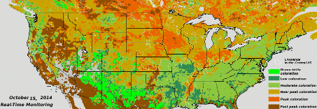
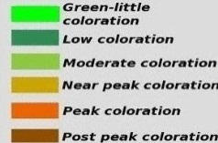
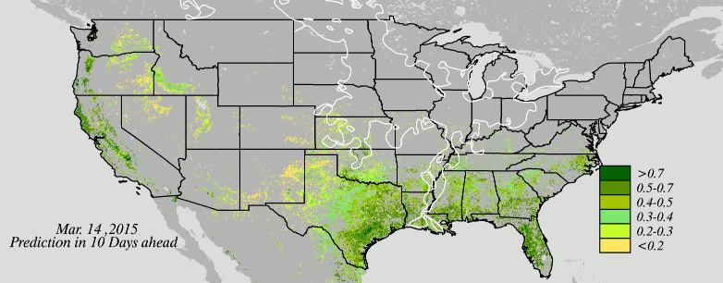
Real-time Monitoring Land Surface Vegetation Phenology from VIIRS Observations
Xiaoyang Zhang¹, Lingling Liu¹ & Yunyue Yu²
¹GSCE, South Dakota State University, Brookings, SD; ²NOAA/NESDIS/STAR, College Park, MD
Collect timely available daily JPSS VIIRS observations
Generate a set of potential temporal trajectories of vegetation development at a given time and pixel
Monitor in near real time and forecast in 10 days ahead the spring green vegetation growth and autumn color foliage status and uncertainties
GOES-R ABI could improve the monitoring quality of temporal foliage development greatly
Real-Time Monitoring of fall foliage coloration
Predication of spring green vegetation fraction in 10 days ahead
Poster # 2-22

Slide 15
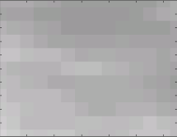
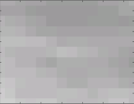
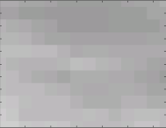
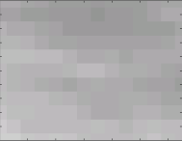
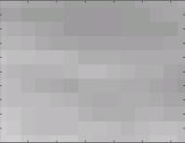
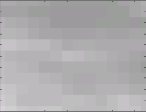
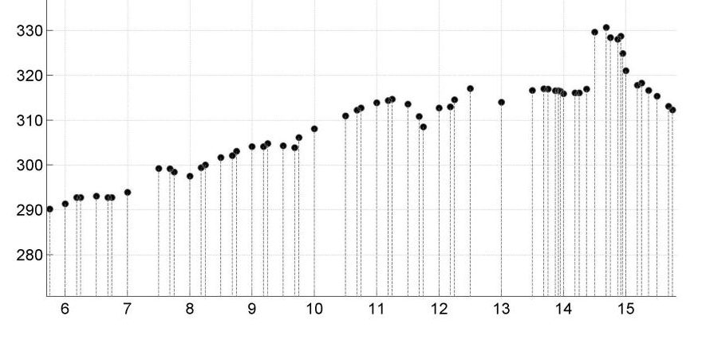
T H E D E V E L O P M E N T O F
GOES Early Fire Detection System to Reduce Disaster Vulnerability
Alexander Koltunov,
B. Quayle, S. Ustin, E. Prins,
V. Ambrosia, and C. Ramirez
GOES-EFD goal:
Timely Initial Detection of Wildfire Ignitions
Urgently needed to support first responders
Feasible from GOES, but not an objective of WF-ABBA
Requires a specialized algorithm focusing on fire starts
Can you tell which one image has the Rim Fire start signal?
hot
GOES-EFD (Alpha) prototype
Detects new ignitions faster than WF-ABBA
Can provide the earliest alarm for many incidents
cold
Brightness Temperature in GOES 3.9-µm channel
When was the earliest Rim Fire signal?
Rim Fire origin pixel, Aug 17, 2013
GOES-EFD offers an opportunity for NOAA
to maximize the GOES Program contribution
to wildfire disaster reduction
DEGREES (KELVIN)
CONTACT Alex Koltunov, akoltunov@ucdavis.edu
Brightness Temperature in GOES 3.9-µm channel
6:00
8:00
10:00
12:00
14:00
15:00
Poster # 2-23
HOURS: PST (Pacific Standard Time)

Slide 16
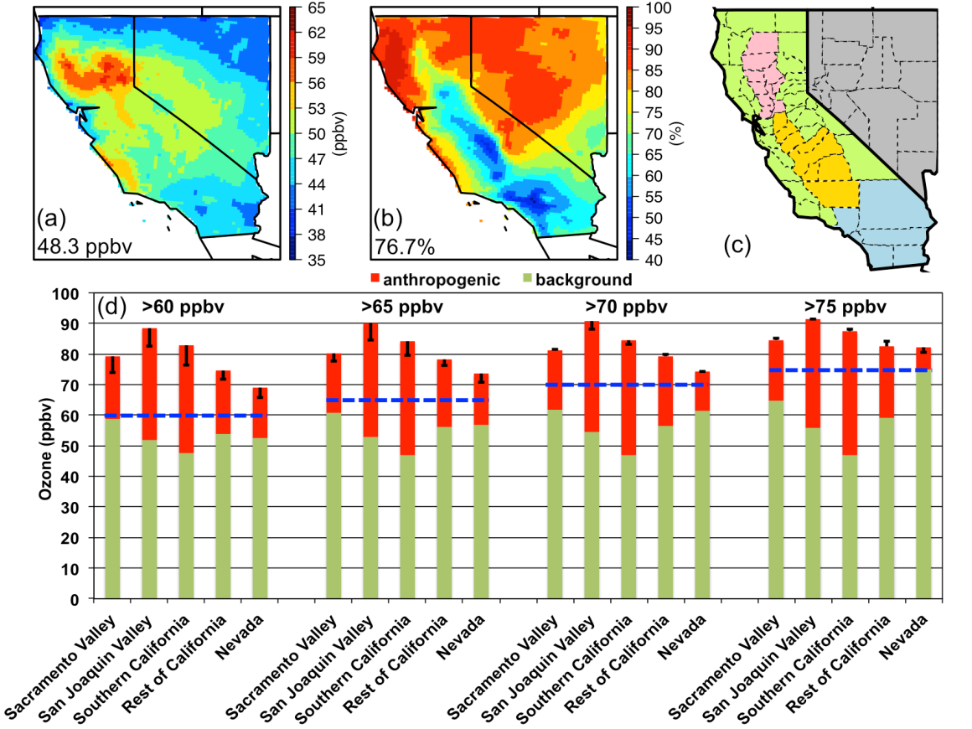
Evaluate and constrain modeled ozone and its source contributions in the US using satellite trace gas observations
(also in JGR paper doi:10.1002/2014JD022993) Min Huang et al., NOAA Air Resources Laboratory (ARL), College Park, MD
We used satellite chemical observations to improve total and background ozone estimates in a multi-scale modeling and assimilation system, which advanced our knowledge of policy-relevant science.
-Background ozone normally relies on pure model simulations and could be highly uncertain.
-Observation-constrained regional period-mean background O₃ and its contribution to the modeled total O₃ are ~48 ppbv and ~77%, respectively (a-b), 2.4 ppbv lower than products from a free-running modeling system, as a result of a 3.3 ppbv increase in the non-local source contributions offset by a 5.7 ppbv of decrease in the local biomass burning source contributions.
Satellite observation-constrained background ozone
Poster # 2-25

Slide 17
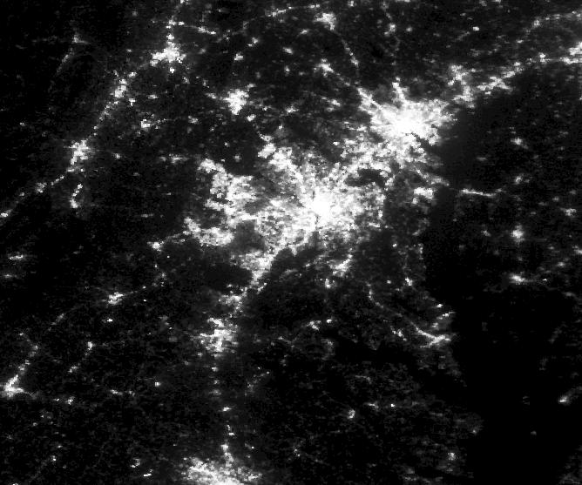
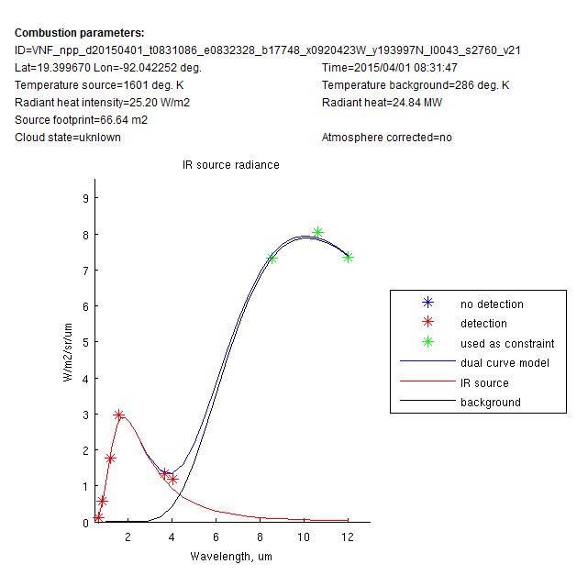
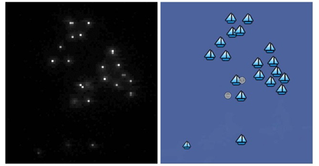
VIIRS Boats, Lights, Fires and Flares
Christopher D. Elvidge
NOAA/NESDIS National Centers for Environmental Information – Boulder
Kimberly Baugh, Feng-Chi Hsu, Mikhail Zhizhin, Tilottama Ghosh
Cooperative Institute for Research in the Environmental Sciences
Fishing Boat Detections
Support to State Dept. “Our Oceans Initiative”
Technical assistance to Indonesia’s fishery agency combating IUU fishing (USAID funded)
Global Gas Flaring
World Bank annual ranking of national gas flaring levels
Monitoring gas flaring reduction projects
Mapping carbon emissions for NOAA’s carbon tracker program
Global Nighttime Lights
World Bank monitoring of electrification projects
USAID Power Africa project
NASA Urban growth studies
USGS mapping of impervious surfaces
Poster # 2-26

Slide 18
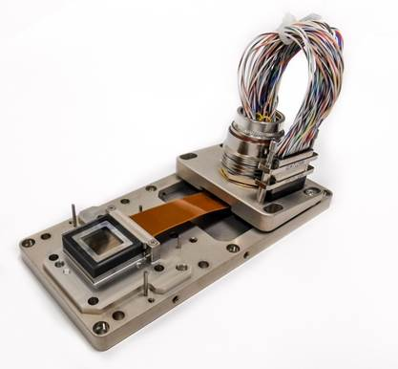
Development of the Visible Detector Assembly for the Flexible Combined Imager on MTG
J. Endicott, J. Pratlong, A. Pike, W. Hubbard, P. Jerram, A. Walker, D. Davies
e2v technologies, Space Imaging
e2v has been involved in many Solar Physics and Solar Weather satellites, Hinode (Solar-B), SETERO, SDO, IRIS and SUVI both in Europe and across the pond! We have also supplied many of Europe’s Earth monitoring weather and atmospheric satellites such as Envisat, Sentinel-2, 3 and now 4 and 5. We have supplied detectors into OMI for NASA’s Aura satellite and OMPS for NPOESS.
Here we report our development of the Visible Detector Assembly for the Flexible Combined Imager on Meteosat Third Generation, MTG FCI VisDA. e2v has successfully passed the Preliminary Design Review for the detector and has demonstrated in silicon that the detector is latch-up free up to the maximum energy of our test facility, 67.7MeV/mg/cm^2.
*MTG is an ESA programme
Image of a breadboard assembly for irradiation
Poster # 2-27

Slide 19
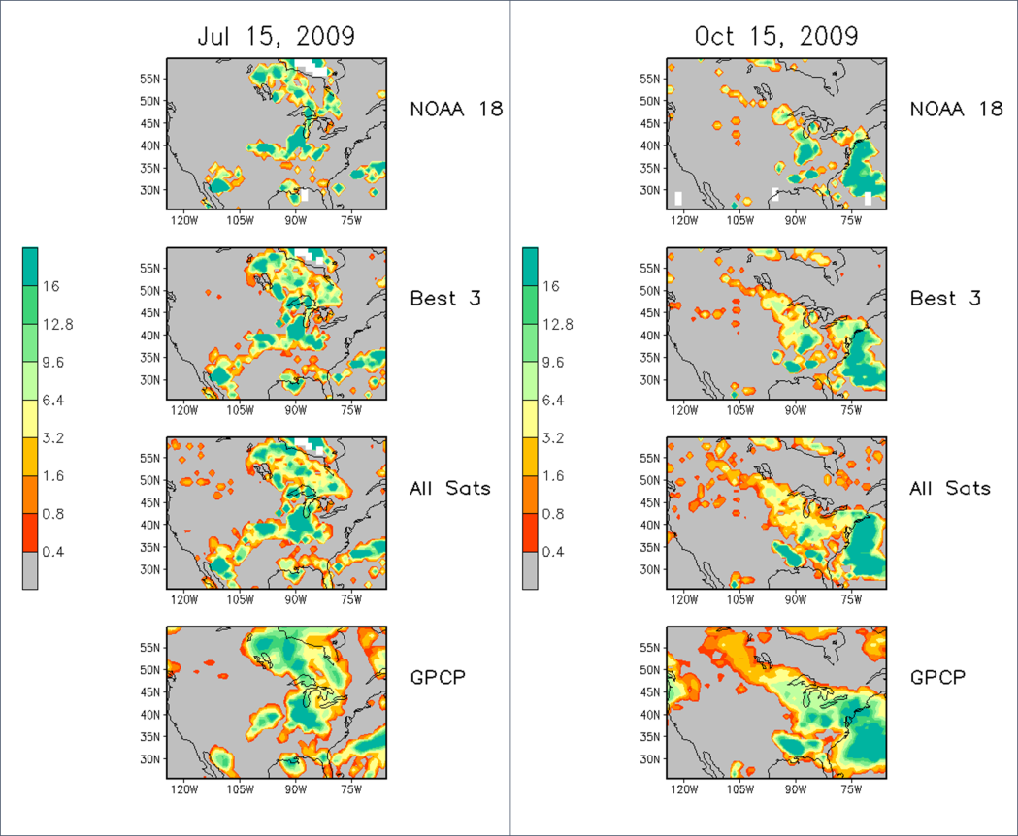
Impact of AMSU Derived Hydrological Products on Merged Precipitation Products
Thomas Smith, Ralph R. Ferraro, Huan Meng, and Wenze Yang
NOAA/NESDIS/STAR and ESSIC/CICS, College Park, MD
Sampling Experiments for Satellite Precipitation
Daily precipitation estimates with different numbers of satellite inputs
Testing in a region with gauge and satellite estimates
Multiple satellites give better resolution of the daily cycle
Daily cycle is not fully resolved by the available satellite inputs
Daily precipitation estimates for 2 days in 2009 using 1 satellite, 3 satellites, 5 satellites, and GPCP validation
Poster # 2-28

Slide 20
Developing VIIRS Ocean Color Products for Coral Reef Ecosystem Managers
AE Strong¹, M Wang², CM Eakin¹, W Hernandez³, M Cardona³ and E Geiger¹
NOAA/NESDIS/STAR Coral Reef Watch¹ & VIIRS Ocean Color Team²
With University of Puerto Rico’s Bio-Optical & Oceanography Lab³
Daily
Weekly
Monthly
VIIRS will be used to help coral reef managers assess land-based sources of pollution flowing over reefs in Puerto Rico, Hawaii, and American Samoa using:
Derived anomalies of K_{d}(490), Chl-a, and SST over manager-defined Virtual Areas (VA) located along stream outflow over reefs
K_{d} - 22 Dec 2014
K_{d} – 19-26 Dec 2014
K_{d} – Monthly Dec 2014
Daily
Weekly
Monthly
Chl-a - 22 Dec 2014
Chl-a – 19-26 Dec 2014
Chl-a – Monthly Dec 2014
Weekly K_{d} - All Three Major US Coral Reef Task Force Watersheds
Puerto
Rico
Maui
Hawaii
American
Samoa
True Color- All Three Major US Coral Reef Task Force Watersheds
Mar 2012 to Oct 2014 – K_{d} Climatology
Poster # 2.29
Guánica to La Parguera VA

Slide 21
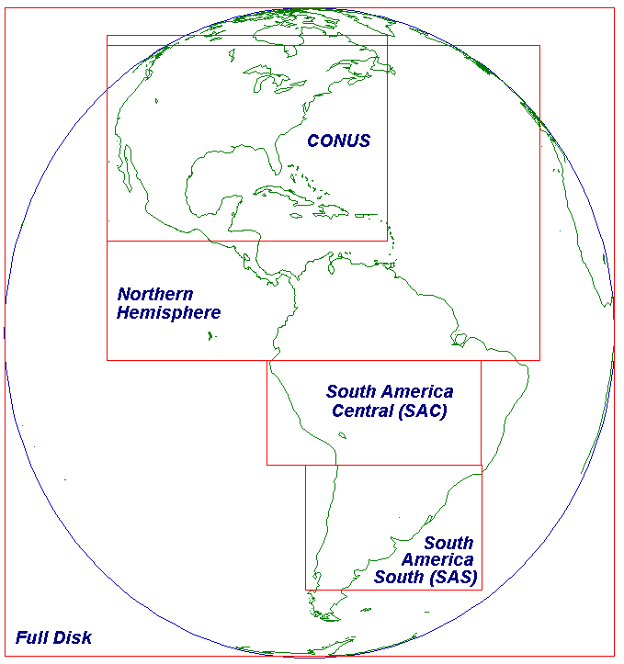
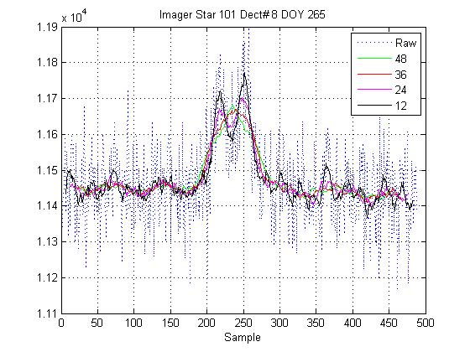
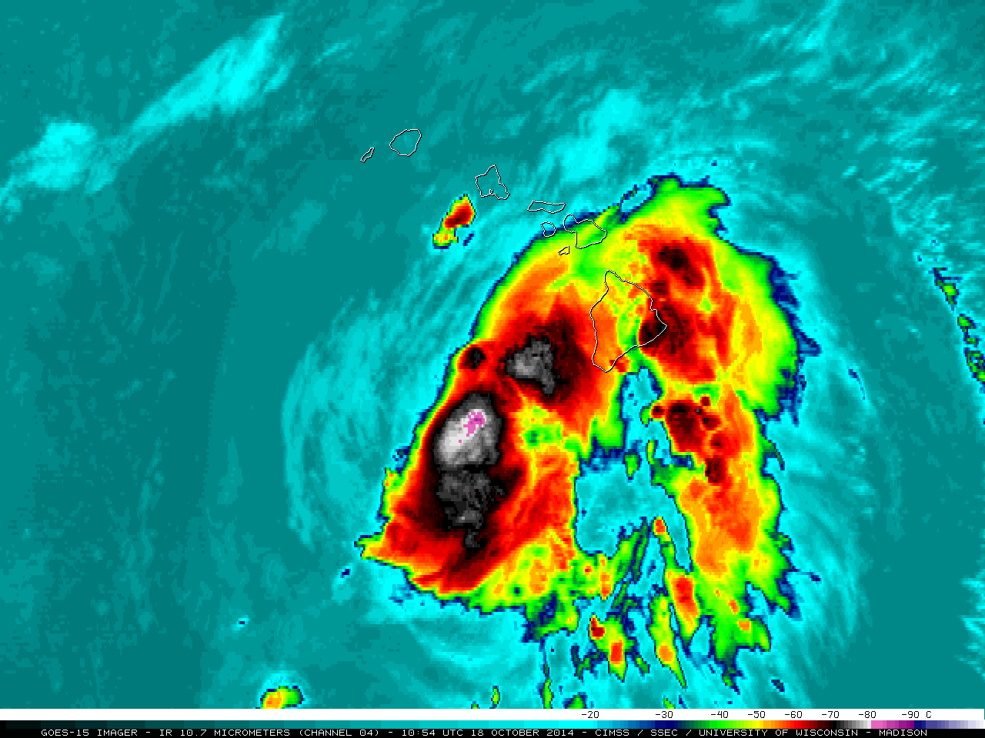
Survey of OSPO Efforts to Improve Operational GOES Imagery S. Hadesty*, K. Ludlum**, N. Sanders*, C. Thomas* * ASRC Federal Contractor – Engineering and Mission Operations Support Service (EMOSS) GOES INR Engineer ** NOAA Federal – National Environmental Satellite Data and Information Service (NESDIS) Office of Satellite and Product Operations (OSPO) Mission Operations Division (MOD) Support Branch
Improved geometric calibration of imagery through recovery of degraded navigation measurements
Increased image data quantity through schedule optimization and reduced payload idle durations
Restored special frames for rapid scans
Poster # 2.31

Slide 22
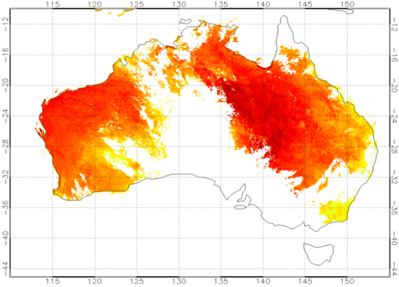
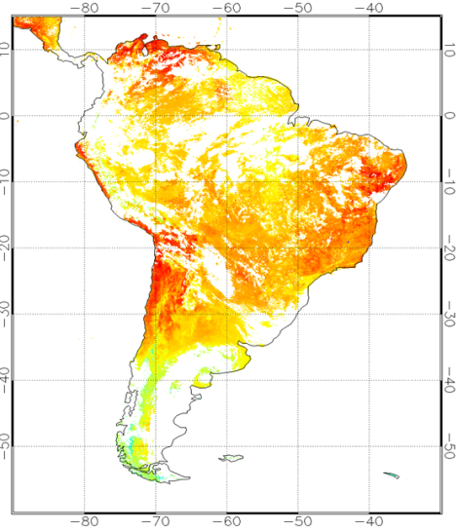
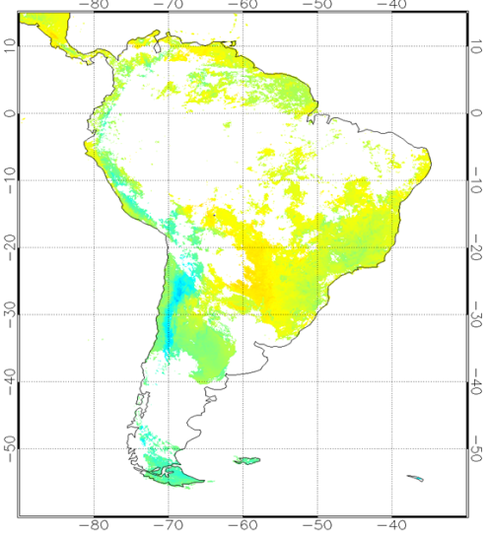
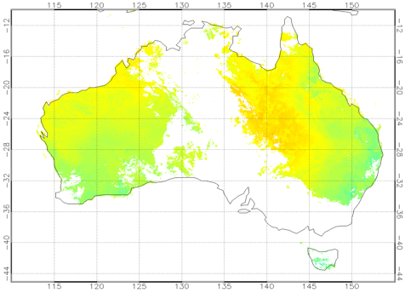
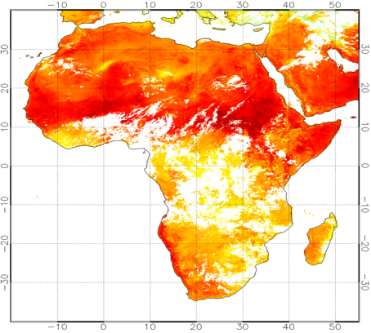
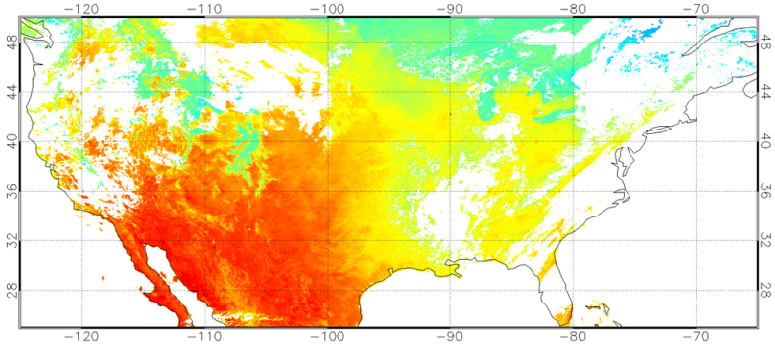
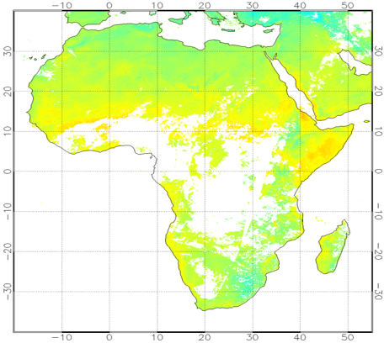
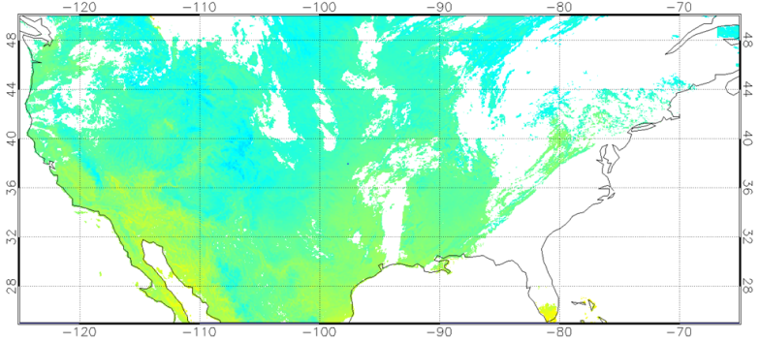
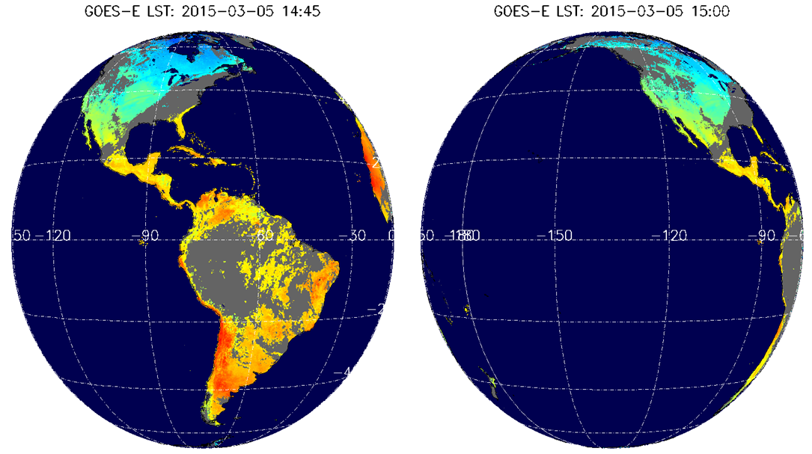
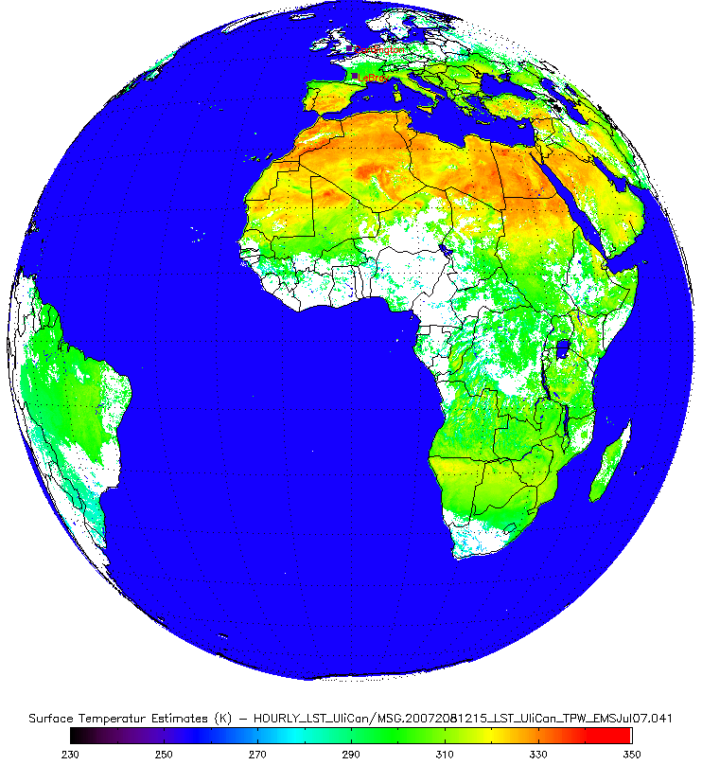
Production of Satellite Land Surface Temperature Dataset at STAR Yunyue Yu¹, Yuling Liu^{1,2}, Peng Yu ^{1,2}, Yuhan Rao^{1,2}, Ivan Csiszar¹
¹NOAA/NESDIS/STAR, ²Univ. of Maryland
Land surface temperature (LST) data is critical on understanding climate change, modeling the hydrological and biogeochemical cycles, and is one of prime candidate parameters for numerical weather prediction assimilation models.
The LST team at STAR is responsible for developing/improving/validating LST products for JPSS, GOES and the future GOES-R satellite missions.
We present details on our activities and accomplishments along with the above satellite missions. Also, we desire to obtain feedbacks from NOAA LST user community.
GOES LST Maps
LST maps from JPSS VIIRS LST EDR
GOES-R LST Tested using SEVIRI as proxy
Poster # 2.32

Slide 23
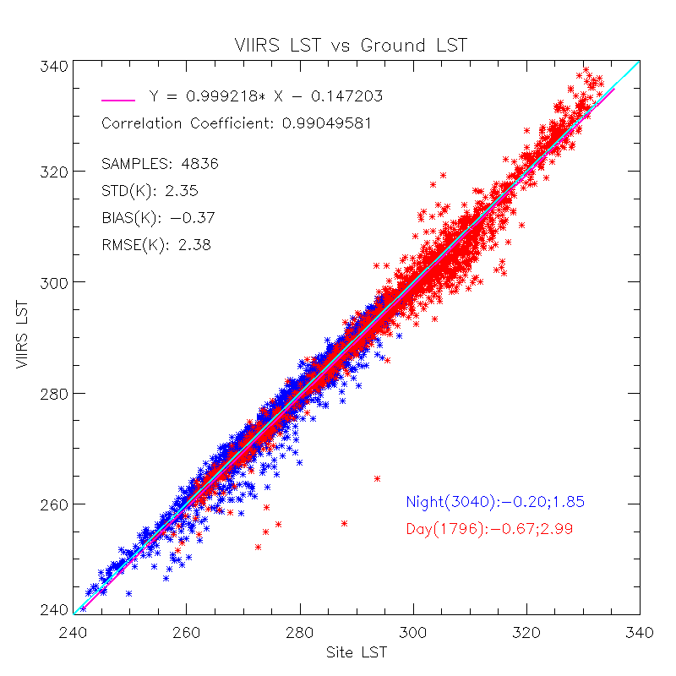
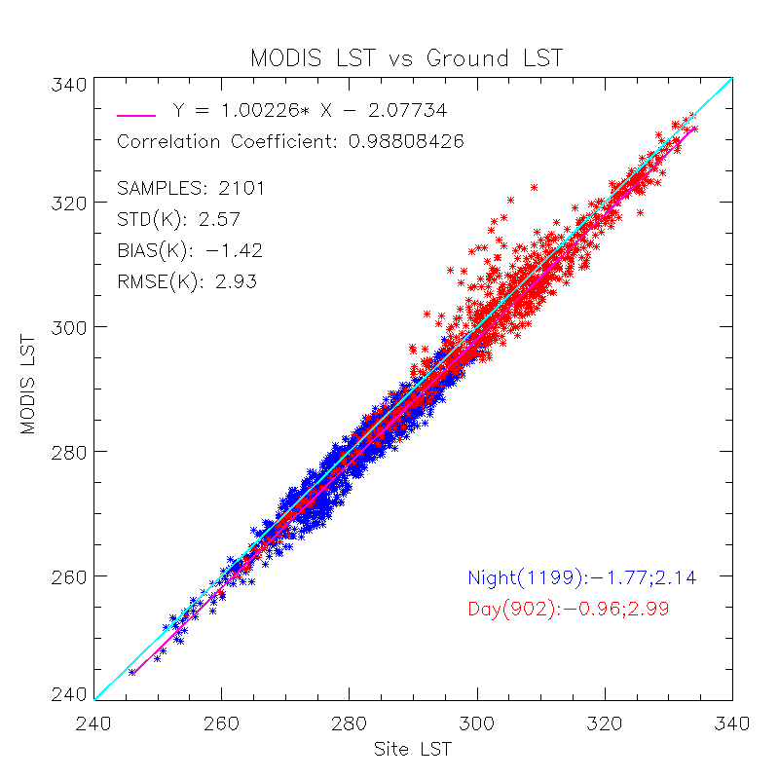
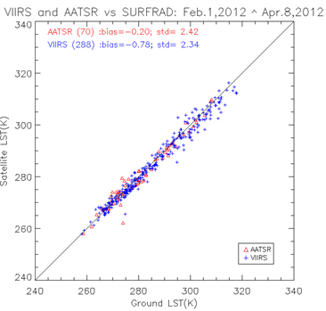
Quality Assessment of S-NPP VIIRS Land Surface Temperature Product Yuling Liu¹, Yunyue Yu², Peng Yu¹ and Zhuo Wang¹
¹ CICS/ESSIC/UMD, ²NOAA/NESDIS/STAR
Multi sensor LST comparison: VIIRS, MODIS and AATSR
Cross comparisons against the ground observations from SURFRAD indicate an overall good agreement among VIIRS LST, MODIS LST and AATSR LST.
Cloud contamination, particularly the cloud detection error over snow/ice surface, show significant impacts on LST validation quality.
VIIRS LST quality is strongly dependent on a correct classification of the surface type, which suggests that the ST dependent algorithm should be replaced with an Emissivity explicit algorithm for future satellite. e.g. J1.
VIIRS LST Uncertainty
The sensor noise, surface type accuracy as well as algorithm uncertainty causes an overall VIIRS LST uncertainty of 0.9K.
VIRIS LST V1 result is based on limited in-situ data.
VIIRS LST EDR is ready for scientific use of the data.
Uncertainty by Surface Type | Uncertainty by Sensor Noise | Algorithm Uncertainty | Overall LST product Uncertainty
0.73 | 0.198 | 0.46 | 0.88
LST V1 Product Uncertainty
Multi sensor LST comparison
Poster # 2.33

Slide 24
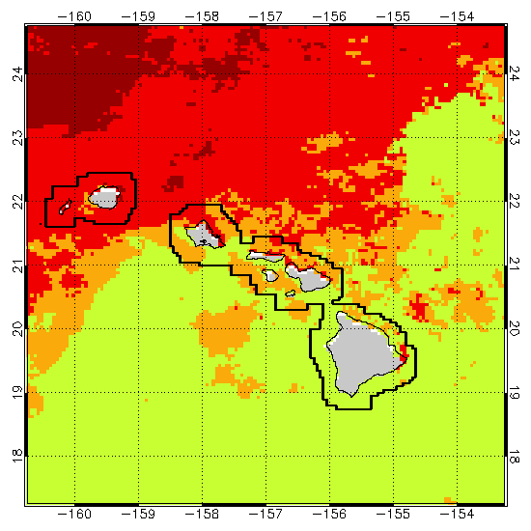
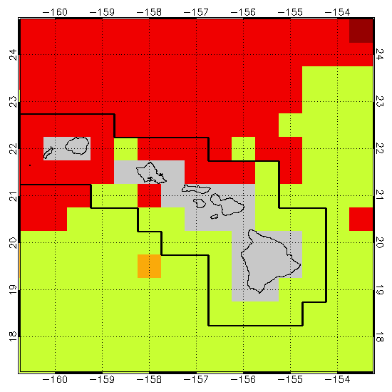
Addressing User Demands:
Enhancing NOAA Coral Reef Watch’s Satellite Decision Support System for Managers
EF Geiger, CM Eakin, G Liu, JL De La Cour, SF Heron, WJ Skirving, AE Strong
NOAA/NESDIS/STAR/CRW and GST
New coral bleaching thermal stress monitoring:
Daily, 5-km resolution, global coverage
More accurate alerts at or near reef scale
Uses NESDIS operational 5-km Blended SST
Climatology based on NOAA’s Pathfinder SST
Future direction:
Daily, 1-km resolution, regional products
Caribbean, Coral Triangle. Great Barrier Reef
To use NESDIS 1-km Blended SST based on
Sub-km SSTs from VIIRS
2-km SSTs from Himawari-8 and GOES-R
50-km
5-km
New 5-km and heritage 50-km Bleaching Alert Area products for Hawaii
Poster # 2.35

Slide 25
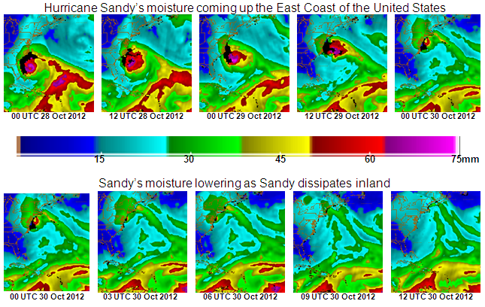
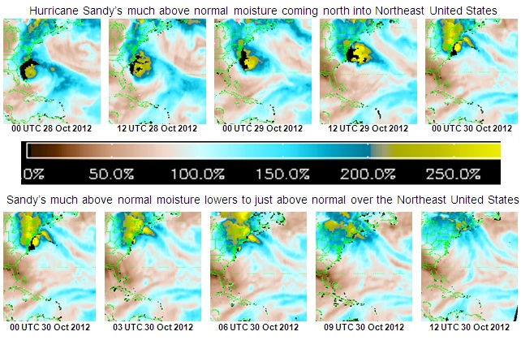
Updates on Operational Blended TPW Products
Limin Zhao¹,
Sheldon Kusselson¹, Stanley Kidder², John Forsythe², Andrew Jones ², Ralph Ferraro³, Clay Davenport⁴, Stephen Quinn⁵
¹NOAA/NESDIS/OSPO/Satellite Products and Service Division
²Cooperative Institute for Research in the Atmosphere, ³NOAA/NESDIS/STAR; ⁴SGT
Blended Total Precipitable Water (TPW) - a multi-satellites/sensors merged product
Eliminates the bias of retrievals from various sensors/retrieval algorithms through histogram matching (Kidder and Jones, 2007)
Provides a unified, meteorologically significant moisture field for satellite analysts and weather forecasters.
Its companion, Percentage of TPW Normal, provides TPW anomaly from climatology
Current Data Sources
Ocean – TPW from NOAA-15, -18, -19 and Metop-A & -B, DMSP F17 and F18
Land – TPW from NOAA-18, -19, Metop-A & -B and DMSP 18 over global, and also GOES-West & East and GPS-Met over CONUS
Upcoming: S-NPP, GCOM-W1 and GPM
Near Future: JPSS1, GOES-R, etc.
Applications
Improving analysis and prediction of heavy precipitation and flash flood
Getting more timely and continuous spatial information about moisture transfer/ “surges”.
Monitoring of the “atmospheric rivers” (ARs)
2-36
Hurricane Sandy observed from bTPW
Poster # 2.36

Slide 26
GOES-R GRB Direct Readout at NWS National Centers
J. Harlan Yates, Liz Nielsen & Allan Weiner Harris Corporation - Melbourne, FL
WxConnect™ is a powerful, reliable, and scalable delivery platform for your mission critical satellite imagery needs.
With WxConnect™, you will discover the value of more timely and higher resolution new generation imagery.
WxConnect™ is easily adaptable to emerging mission needs; e.g., now supporting GOES-R GRB and HimawariCast.
Poster # 2.37

Slide 27
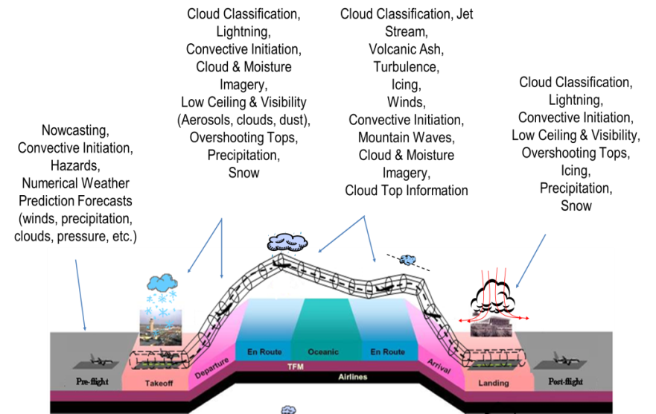
Weather Satellite Data in Federal Aviation Administration Operations Randy Bass and Steve Abelman
Aviation Weather Division, Federal Aviation Administration
Washington, DC
Weather satellites support the FAA mission to provide the safest, most efficient aerospace system in the world
Aviation weather analyses and forecasts, primarily provided by NOAA, support all aspects of flight from planning, departure and takeoff, en route, and through arrival and landing
Detect phenomena such as thunderstorms, turbulence, icing, clouds, visibility, space weather, and volcanic activity that adversely impact the National Airspace System
Research into utilizing satellite imagery in a capability to provide a real-time, radar-like estimate of precipitation offshore where NEXRAD radar does not exist, and transmitting satellite imagery into the cockpit to provide improved situational awareness for pilots beyond radar coverage
Poster # 2.39

Slide 28
Testing of Emissivity Explicit Retrieval Algorithms for VIIRS Land Surface Temperature
Peng Yu¹, Yunyue Yu², Yuling Liu¹, and Zhuo Wang¹
¹ CICS/ESSIC, UMD, ²STAR/NESDIS, NOAA
Testing of VIIRS LST retrieval algorithms
VIIRS LST EDR is in V1 maturity status
Current VIIRS LST retrieval algorithm in operation is surface type dependent
Preliminary testing results of candidate retrieval algorithms
Nine different emissivity-based algorithms listed in GOES-R LST ATBD have been tested
Algorithm 1, 6, and 8 were selected as potential candidate algorithms and have been adapted for further testing
High quality emissivity data is needed.
Site | Record No. | Bias | STD | RMSE
IDPS | 1802 | -0.61 | 2.31 | 2.39
1 | 1802 | -0.16 | 2.40 | 2.40
2 | 1802 | 0.18 | 2.59 | 2.60
3 | 1802 | -0.21 | 2.44 | 2.45
4 | 1802 | -0.19 | 2.43 | 2.44
5 | 1802 | -0.81 | 2.53 | 2.66
6 | 1802 | -0.19 | 2.45 | 2.45
7 | 1802 | -0.21 | 2.44 | 2.45
8 | 1802 | -0.22 | 2.44 | 2.45
9 | 1802 | -0.19 | 2.48 | 2.48
1’ | 1802 | -0.10 | 2.37 | 2.37
6’ | 1802 | -0.13 | 2.41 | 2.41
8’ | 1802 | -0.15 | 2.41 | 2.41
11 | 1802 | -0.16 | 2.33 | 2.35
12 | 1802 | -0.16 | 2.34 | 2.35
Testing results of different retrieval algorithms
Poster # 2.40

Slide 29
GOES-R Impact on NCEP Computing:
Enterprise Framework for High Performance Environmental Processing
James Gundy, Gregg Kowalski, Bradley Brown-Bergtold & Allan Weiner
Harris Corporation - Melbourne, FL
The Harris SOA Based Ground System Architecture is composed of Services for EM, MM, PG, & PD
Fault Tolerant Data Movement via the Ground System’s ESB ensures NOAA’s Mission Critical Applications run reliably
Fast, Reliable Product Processing efficiently manages the complexity of NOAA’s GOES-R Science Mission, leveraging Multiple HPC & High Reliability Technologies:
Parallel Processing at the Image Block Level in an HPC Cluster
Redundant, High Bandwidth, Low Latency Data Access through a High Performance Data Fabric
Enterprise Framework for Ground Processing
Poster # 2.41

Slide 30
Suomi NPP VIIRS Reflective Solar Band On-orbit Radiometric Performance Assessment Sirish Upretyª Changyong Cao^{b} ªCIRA, Colorado State University, ^{b}NOAA/NESDIS/STAR
Poster # 2.43
VIIRS on-orbit radiometric performance is regularly monitored and analyzed using calibration sites (such as Libya-4, Sudan-1, Dome C) and through the inter-comparison with AQUA MODIS and Landsat 8 OLI.
VIIRS moderate resolution reflective solar bands radiometric stability is within 1% ± 0.5%.
VIIRS Bias relative to MODIS: 2% ± 1% for M1 through M5 while M7 and M8 suggest nearly 3%. VIIRS bias at three sites agrees to within 1%.
VIIRS and OLI inter-comparison over Libya-4 for SWIR band M11 suggests more than 5% bias.
VIIRS Radiometric performance is also analyzed through SNO-x based intercomparison with MODIS over low latitude North African desert and ocean.
VIIRS bias relative to MODIS for bands M1-8 is mostly within 2% ± 1% however the short term bias are sometimes larger by as much as 3.5%.
Top: VIIRS bias (M1-8) at Libya-4, Sudan-1 and Dome C; Bottom: VIIRS Bias using SNO-x for M1-3.

Slide 31
Improved Ground-Based Polarization Sensitivity Measurement Capability for Next-Generation Environmental Remote Sensing Systems
Aaron Pearlman¹, Francis Padula², Raju Datla¹, Changyong Cao³, & Xiangqian Wu³
¹ERT Inc., ²GeoThinkTank LLC, ³NOAA/NESDIS/STAR
The spectral polarimeter will be deployed to support next generation system validation of L1b and L2+ products.
The polarimeter has been upgraded to:
Extend the polarimeter’s wavelength range (to 350-2500 nm)
Allow automation of the measurements
Remove the impacts of the spectrometer’s polarization sensitivity
Spectral Polarimeter
Incident radiation reflects off the mirror and propagates through the polarizer, integrating sphere, and collected by the ASD spectrometer’s fiber bundle.
Poster # 2.44

Slide 32
Evaluation of Near Surface UAV Capabilities
for the GOES-R Field Campaign
Francis Padula¹, Changyong Cao², Istvan Laszlo², Yunyue Yu², Steve Goodman³
(¹GeoThinkTank LLC; ²NOAA/NESDIS/STAR; ³NOAA/NESDIS/GOES-R Program Office)
Near surface UAV systems are being evaluated to address several heritage limitations and gaps in surface measurement and ground truth validation capabilities in support of post-launch validation of L1b and L2+ products
Two unique systems were investigated for near surface (≤ 20 m above ground level) collection:
Rotary UAV system to facilitate the collection of high quality goniometric observations of Earth surface targets
Fixed-wing UAV system to facilitate the collection of surface observations of Earth targets over extended regions
Poster # 2.45

Slide 33
The Algorithm Workbench Alexander Werbos, David Hogan, Daniel Hunt, Erik Steinfelt, T. Scott Zaccheo
Atmospheric and Environmental Research (AER)
Lexington, MA
Dynamic algorithm design, test and processing framework
Speeds algorithm development and transition of Research to Operations
Provides
Database-oriented approach to describe algorithm input data and output products
Software for automatic algorithm tree generation, visualization, and execution
Template approach for running C++ and FORTRAN algorithms
Extensible infrastructure for new user algorithms and tools
Concept Architecture
Real World Implementation:
Algorithm Architect Tool Visualizer
Poster # 2.46

Slide 34
Improved Engineering Analysis for GOES-R
Engineering Analysis (EA) is more than just a plotting program.
EA encompasses both Trending and Analysis – Two very different paradigms.
Trending
Analysis
The comprehensive review of telemetry to:
Observe changes in nominal behavior and detect impending failures
Quantify periodic variations so that they can be optionally removed in order to observe residual behavior
Quantify and track expected changes in spacecraft characteristics (e.g. mass properties modeling)
The targeted review of telemetry to:
Identify
Characterize
Explain and
Workaround
an observed anomaly or failure in a timely fashion.
Proactive — Comprehensive — Predictive — Automated
Reactive — Targeted — Investigative — Interactive
How can such diverse requirements be met in a safe and cost effective way?
A mission needs a telemetry system designed for analysis!
GOES-R integrates the (COTS) CASSIE™ Telemetry System for a low cost, highly flexible solution which provides:
A scalable, high-performance telemetry decommuation engine with integrated equations and statistics
A modular and extensible application infrastructure to efficiently include mission-specific algorithms
Visualization programs that can be used both interactively and batched for off-line production
Licensing without replication and per-seat fees
Poster # 2.48
Astrofrontiers, Inc.

Slide 35
Integrating Changes to JPSS Cross-Track Infrared Sounder (CrIS) SDR Algorithm using the Algorithm Development Library (ADL)
Vipuli Dharmawardane, Bigyani Das, Valerie Mikles, Walter Wolf
I. M. Systems Group, NOAA/NESDIS/STAR
CrIS has used nominal resolution data packets during the S-NPP era
Currently revisions to the CrIS Sensor Data Records (SDR) algorithm are underway to support production of the full resolution J1 SDRs
ADL is the test system that mimics the Interface Data Processing Segment (IDPS) and is used for testing, troubleshooting and integrating algorithm updates.
Pre-operational full spectral resolution algorithm is tested by the STAR Algorithm Integration Team (AIT) for product accuracy in the ADL environment before it is submitted to the ground project Data Products Engineering Services (DPES) for the unit testing.
Full resolution
Normal resolution
Comparison of Earth Scene full resolution and truncated (normal) resolution data for the short-wave band
Poster # 2.49

Slide 36
Use of JPSS ATMS and VIIRS data to Improve Tropical Cyclone Track and Intensity Forecasting
Galina Chirokova¹, Mark DeMaria², Robert DeMaria¹,
John Knaff³, Jack Dostalek¹, and John L. Beven²
(1) CIRA, Colorado State University, Fort Collins, CO (2) NOAA/NWS/National Hurricane Center, Miami, FL
(3) NOAA/NESDIS/StAR, Fort Collins, CO
Poster
# 2.51
Use of ATMS and VIIRS data has great potential for improving tropical cyclones track and intensity forecasting:
Statistical intensity forecast models and Rapid Intensification Index could be improved with ATMS data
Objective automated eye-detection algorithm using VIIRS data could further improve track and intensity forecasts
VIIRS DNB imagery provides TC forecasters with unique data
Bias-corrected ATMS
ATMS
LGEM
Eye Detection
VIIRS DNB
VIIRS IR

Slide 37
Processing Himawari-8 Geostationary Satellite Data Using GOES-R Algorithms for Algorithm Continuity in Operations Jonathan Wrotny¹, A. Li¹, H. Xie¹, M. Fan¹, R. Chen¹, T. Yu¹, S. Sampson¹, W Wolf², W. Straka³, A. Heidinger⁴, and J. Daniels²
¹IMSG, College Park, MD 20740, USA
²NOAA/NESDIS/STAR, College Park, MD 20740, USA
³CIMSS, Madison, WI 53706, USA
⁴NOAA, Madison, WI 53706, USA
The GOES-R Algorithm Working Group (AWG) Algorithm Integration Team (AIT) maintains and updates a data processing framework for GOES-R algorithm processing.
This poster describes updates made to the GOES-R Framework to process Himawari-8/AHI data for algorithm use.
System-level diagram of the AHI Winds Product System
Poster # 2-52

Slide 38
Impact Analysis of LEO Hyperspectral Sensor IFOV size on the next generation NWP model forecast performance
Allen Huang
CIMSS/SSEC Madison, WI
To assess the forecast impact obtained from assimilating CrIS observations at half the current spatial resolution
Observing System Simulation Experiment (OSSE)
G5NR
GFS @ T1534
Simulated observations: rawinsondes, aircraft, GPSRO, AMSU-A, MHS, HIRS-4, AIRS, IASI, ATMS, current CrIS and CrIS at half the resolution.
Comparison of simulated and observed bending angle for CHAMP at he start of the NR.
BT “observed” by flying CrIS in G5NR
Poster # 2.53

Slide 39
Using GOES Imagery as Pointing Truth
for TEMPO Image Navigation and Registration Kerrie Allen¹, James L. Carr¹, Brad Pierce²,
Joseph Fox-Rabinovitz¹, Norman Lo¹, David Zakar¹
1. Carr Astronautics, Greenbelt, MD
2. NOAA/NESDIS Center for Satellite Applications and Research (STAR), Madison, WI
TEMPO is a NASA sponsored Earth Venture Instrument to be flown on a commercial GEO communications satellite as an atmospheric chemistry mission:
Covers CONUS and parts of Canada and Mexico
Retrieves trace gas hourly
TEMPO will implement its Image Navigation and Registration (INR) using GOES imagery as a reference for pointing truth rather than using stars or landmarks
Accurately locating TEMPO pixels geographically is a key INR objective
Management of parallax due to cloud heights is key
GOES
WEST
TEMPO
GOES
EAST
Poster #2.54

Slide 40
On the Use of 1-Minute Satellite Imagery in the Storm Prediction Center Bill Line
OU/CIMMS and NOAA/NWS/Storm Prediction Center
Norman, OK
1-min satellite imagery from GOES-14 was utilized considerably in SPC operations during parts of Aug 2013, May 2014 and Aug 2014.
Benefits to SPC ops were realized during all parts of the convective nowcast cycle.
References in SPC mesoscale discussions and convective outlooks
“Potentially providing insight into processes important to storm development not currently recognized / diagnosable.”
“Satellite imagery at 1-min temporal resolution needs to become the new standard for severe weather operations.”
Generation of an orphan anvil is identified in GOES-14 1-min visible imagery on May 11, 2014 near the Kansas/Nebraska border, signaling imminent convective initiation in the area
Poster # 2-55

Slide 41
The VIIRS Active Fire Data for Fire Management:
A review of the Proving Ground and Risk Reduction (PGRR) Project efforts
E. Ellicott¹, I. Csiszar¹, L. Giglio¹, W. Schroeder¹ and C. Justice¹
¹University of Maryland Department of Geographical Sciences ²NOAA/NESDIS/STAR
The PGRR VIIRS AF project seeks to improve data, algorithms, and products for downstream operational and research users (gateways to the public).
The process includes product evaluation, validation, and improvement.
Collaboration with the wildland fire user community to develop product understanding, dissemination, and to leverage the VIIRS AF products for active and post-fire management.
Evaluation of VIIRS AF data for the Funny River fire, Alaska – May 2014
Poster # 2-58
Field & lab experiments to validate VIIRS AF data

Slide 42
High Resolution Atmospheric Motion Vectors (AMVs) for Application in High Impact Weather Events in the GOES-R era
Christopher Velden, Jaime Daniels, Wayne Bresky, Steve Wanzong and David Stettner
Development and optimization of mesoscale Atmospheric Motion Vectors (AMVs) using novel GOES-R processing algorithms on GOES-14 SRSO imagery and demonstrating the impact of assimilating these AMVs in the
NCEP HWRF/GSI System
Hurricane Sandy
H214- Operational HWRF run (All data, no AMVs)
CTL- Our control run (only radiosondes)
AMV1- CTL plus GOES AMVs (heritage)
AMV2- CTL plus GOES AMVs (GOES-R algorithm)
Hurricane Sandy 1-minute mesoscale AMVs (left), and results of Sandy assimilation experiments (above)
Hurricane force winds (> 75 mph)
Poster # 2-59

Slide 43
Evaluation of the impact of satellite radiance data within the hourly Rapid Refresh data assimilation system
Haidao Lin, Steve Weygandt, Ming Hu, Curtis Alexander, Stan Benjamin
NOAA/ESRL/GSD
Avg. obs count
Satellite radiance data have positive impact within the hourly Rapid Refresh (one-month retro)
The RARS direct readout data greatly improve the real-time hourly coverage
Larger positive impact (statistically significant) when the direct readout data are included
Radiance data impact comparable to raob data impact, but less than aircraft data impact (the largest impact data set in RAP)
Temperature
normalized impact (%)
Temperature
100-850 hPa RMS mean against raob
Poster # 2-60

Slide 45
Thank you to all poster presenters!

