Slide 1

Poster Session III
Thursday April 30, 2015
10:30 AM & 3:15 PM

Slide 2
3-D Printing with CLASS: Making Models for Education and Outreach Using Satellite Weather Imagery
Francis Reddy
Syneren Technologies Corp.
Arlington, VA
GOES infrared and visible imagery in NOAA’s CLASS archive can be transformed into models for 3-D printing
  Hold a hurricane in your hands
  Low-cost software converts pixel values into a printable digital mesh
  Models of Julio, Sandy and Katrina freely available
Katrina: GOES image, digital mesh, and 3D print
Poster # 3-1

Slide 3
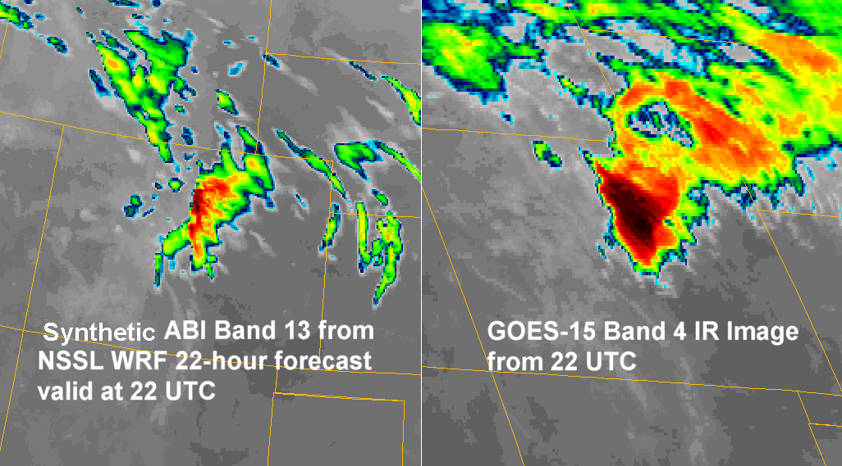
Synthetic Satellite Imagery: A New Tool for GOES-R User Readiness and Cloud Forecast Visualization
Dan Lindsey, NOAA/NESDIS/STAR/RAMMB, Fort Collins, CO
Louie Grasso and Dan Bikos, CIRA
Synthetic satellite imagery is being generated from high resolution NWP model output
The data is used as :
  A proxy for GOES-R ABI data
  A tool for preparing NWS forecasters for what GOES-R ABI bands will look like
  A visualization tool for forecasters to easily see clouds in the high resolution model forecasts
This poster will summarize the work on synthetic satellite imagery and provide examples of its many uses and benefits
Comparison between synthetic ABI band 13 (left) and observed GOES-15 band 4 (right) from 24 Nov. 2012
Poster #
3-4

Slide 4
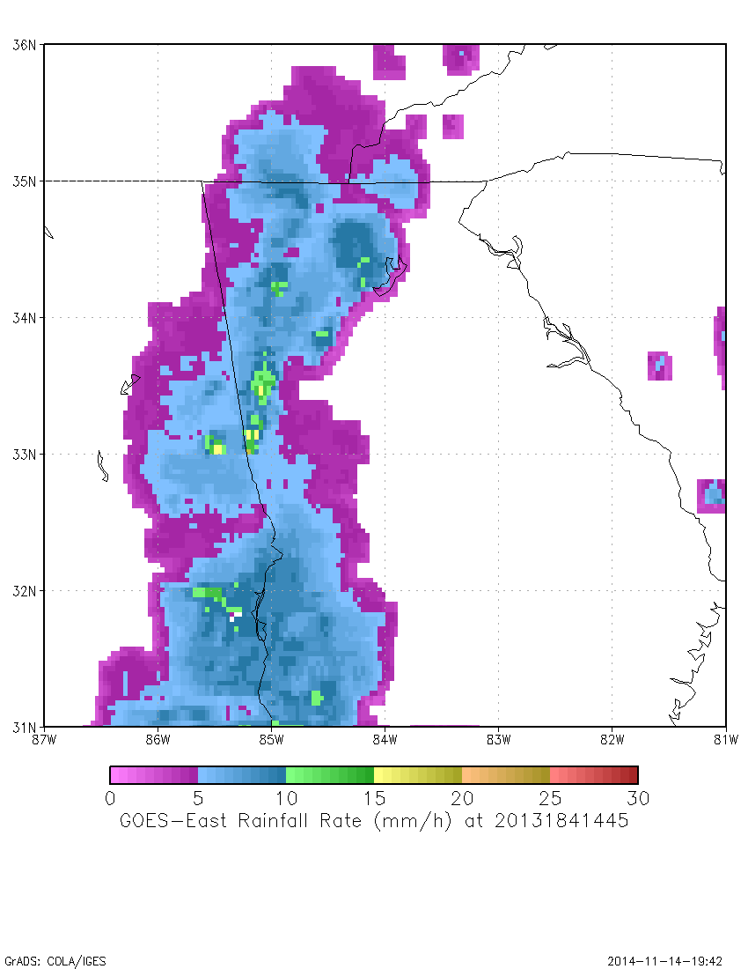
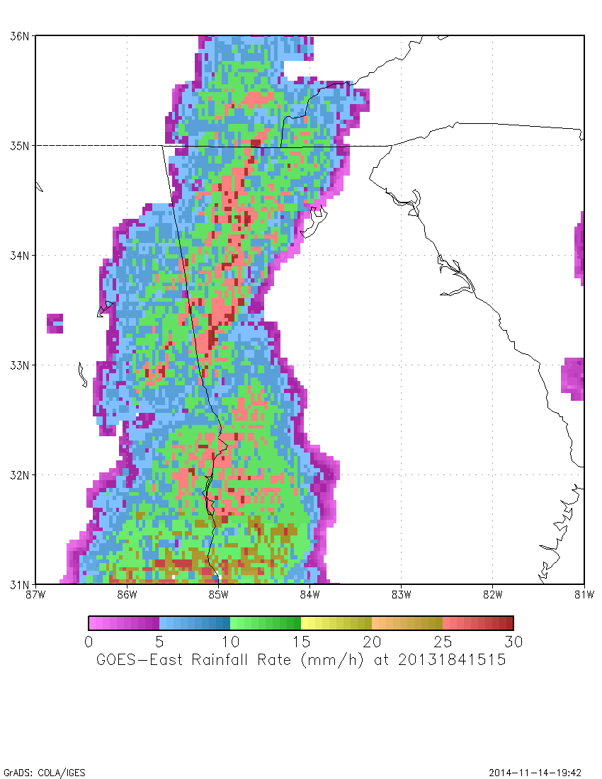
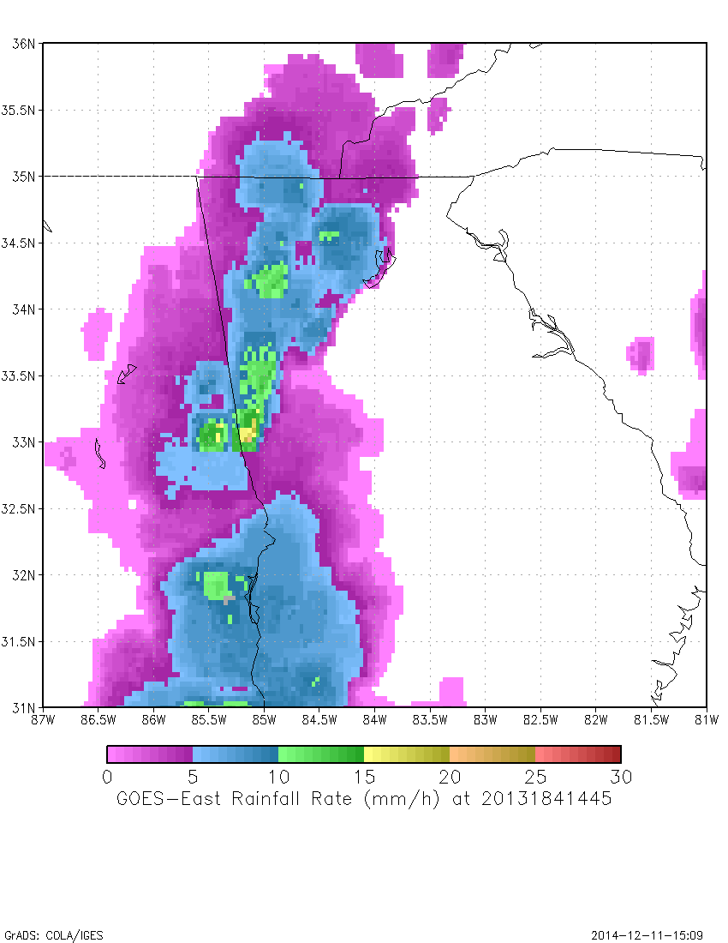
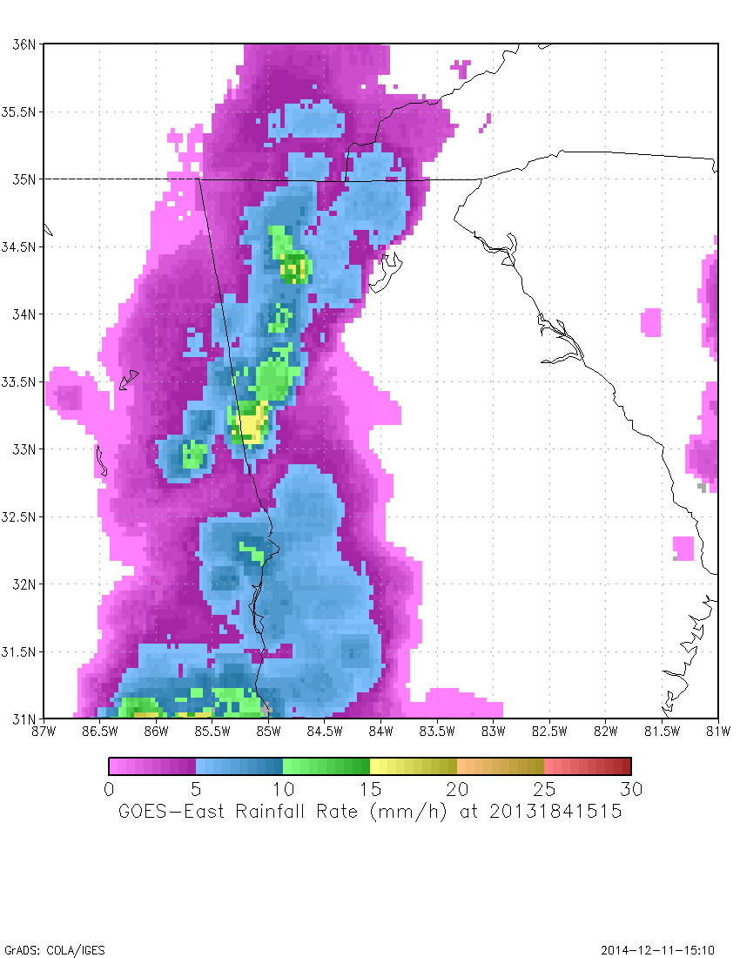
Improvements to SCaMPR Rainfall Rate Algorithm
Yan Hao¹, Robert J. Kuligowski² and Yaping Li¹
¹IMSG at NOAA/NESDIS/STAR, College Park, MD
²NOAA/NESDIS/STAR, College Park, MD
GOES-West
GOES-East
SCaMPR (the GOES-R Rainfall Rate algorithm) is a GOES-IR based algorithm that is dynamically calibrated in real time using LEO-based MW rain rates
Recent and ongoing improvements:
  Correcting for sub-cloud evaporation using NWP model relative humidity
  Employing smaller calibration regions to improve consistency
  Testing gauge-corrected Q3 radar data in the calibration data set
Original calibration regions
New calibration regions
Improved rain rate consistency
Poster #
3-5

Slide 5
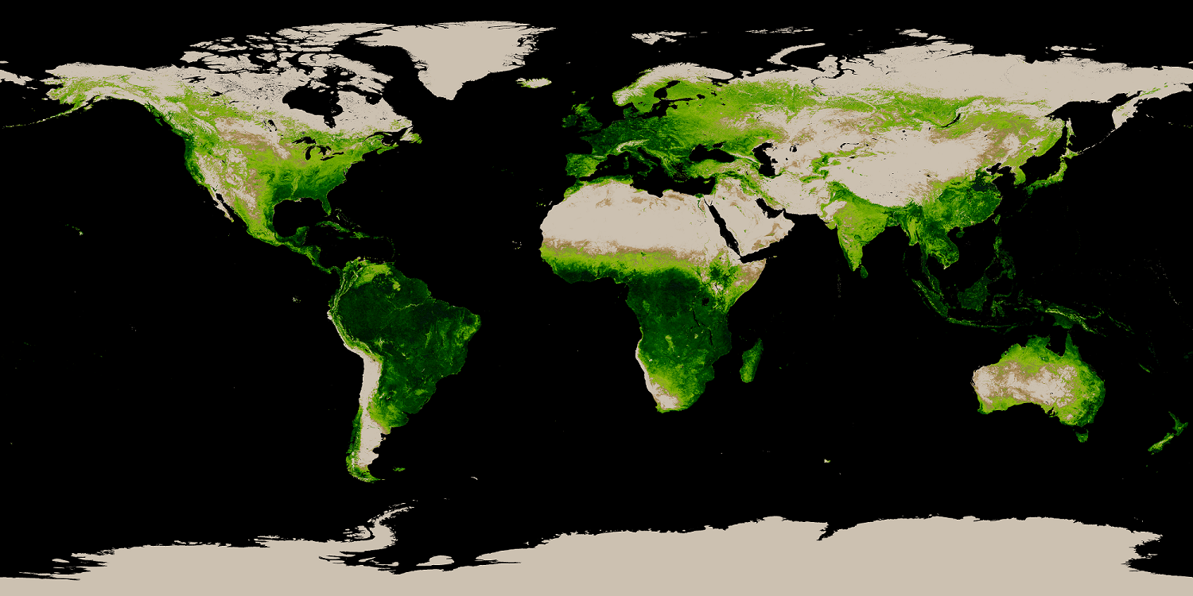
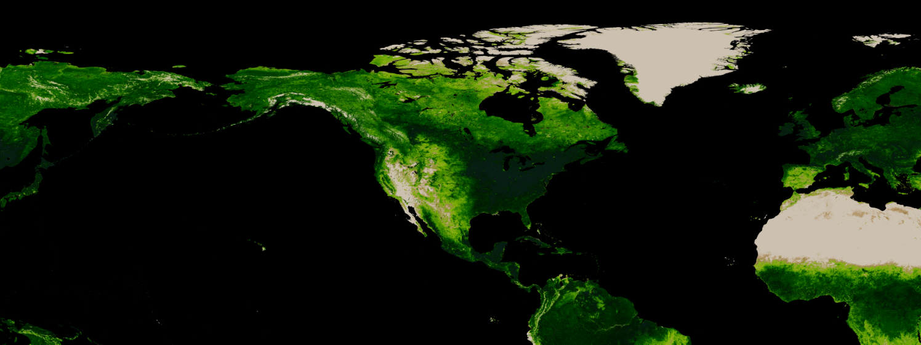
Green Vegetation Fraction (GVF) derived from SNPP-VIIRS sensor
Zhangyan Jiang^{1,2}, Marco Vargas¹, Junchang Ju^{1,2}, Ivan Csiszar¹
¹ NOAA/NESDIS/STAR, College Park, MD. ² AER inc. Lexington, MA
The SNPP VIIRS GVF system produces a global 4-km resolution GVF map and a regional 1-km GVF map once a day
  Represents the fractional area of the grid cell covered by live (green) vegetation
  VIIRS GVF accuracy, precision and uncertainty were lower than the specifications
  VIIRS GVF was tested in the NCEP Global Forecast System and showed improvements of forecasts
Global 4-km GVF for the week of 20140419-20140425
Regional 1-km GVF for the week of 20140809-20140815
Poster #
3-6

Slide 6
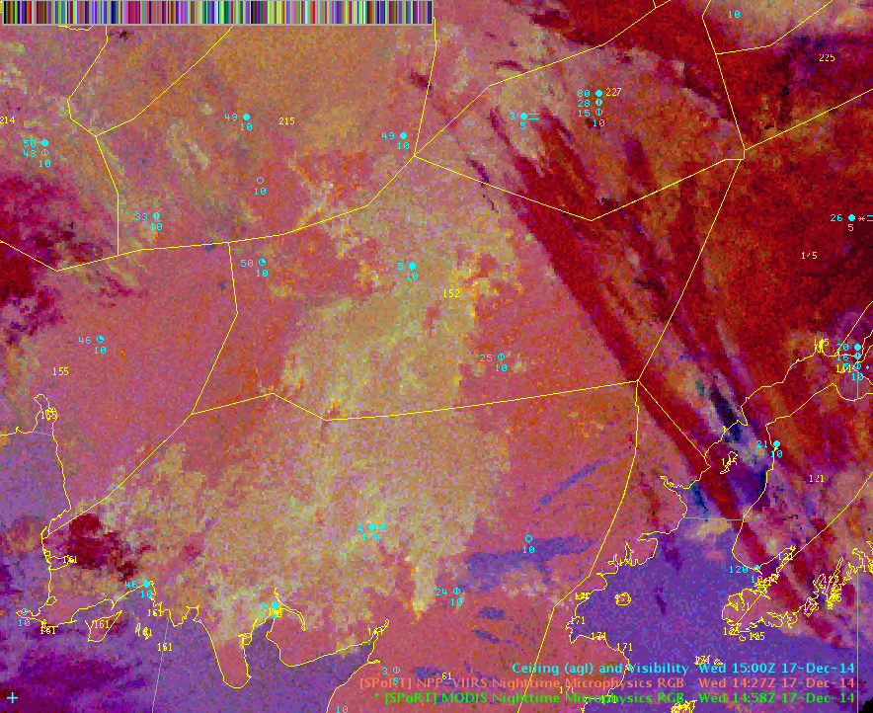
Two New Multi-Spectral Composite Satellite Products and Their Use by NWS Alaska Region in Aviation Forecasting
Eric Stevens¹, Kevin Fuell², Lori Schultz², and Matt Smith²
¹ Geographic Information Network of Alaska (GINA), ² University of Alabama in Huntsville, at NASA’s Short-term Prediction Research and Transition Center (SPoRT)
MODIS and VIIRS Direct Broadcast Data from GINA used by SPoRT to generate RGBs for the NWS
EUMETSAT’s nighttime and 24hr microphysics RGB products used for aviation and public forecasting
Useful for analysis of clouds and fog and as a precursor to future GOES-R/-S capabilities
Builds upon and provide more information than the traditional infrared channel differencing “fog product”
SPoRT RGB Nighttime Microphysics product, screen capture from operational AWIPS2 at NWS Forecast Office, Fairbanks, Alaska, Dec 17, 2014
Poster #
3-7

Slide 7



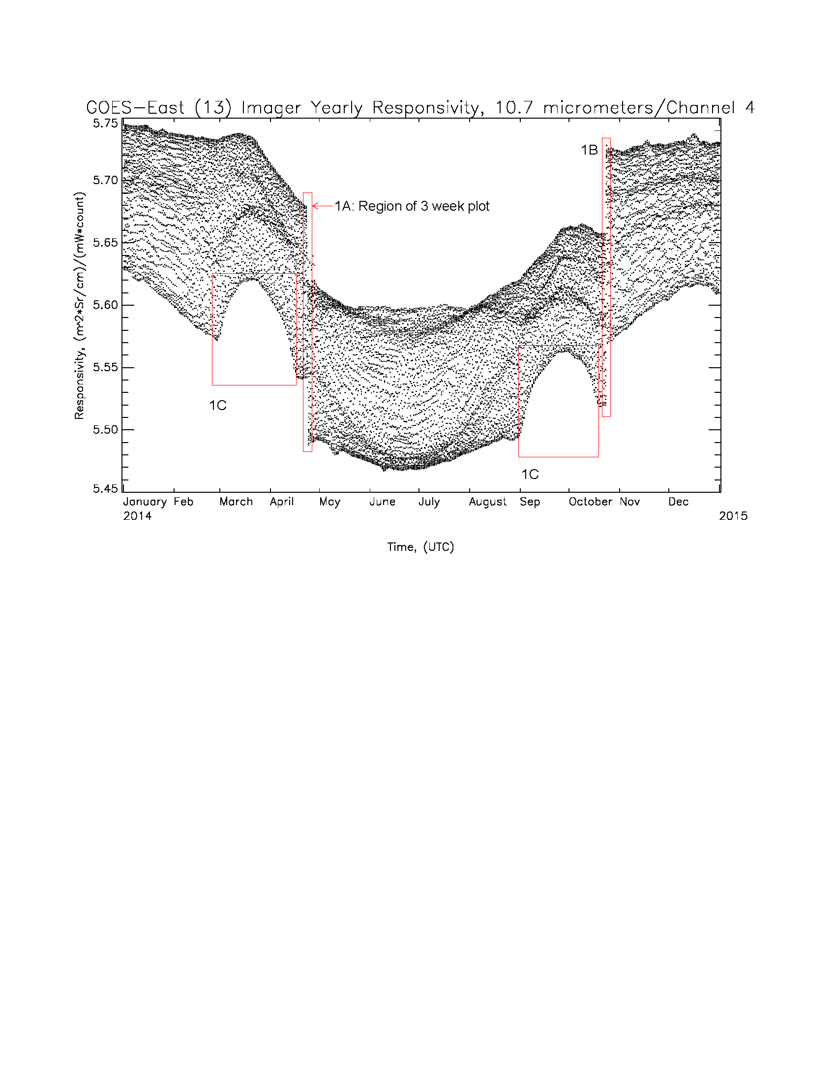
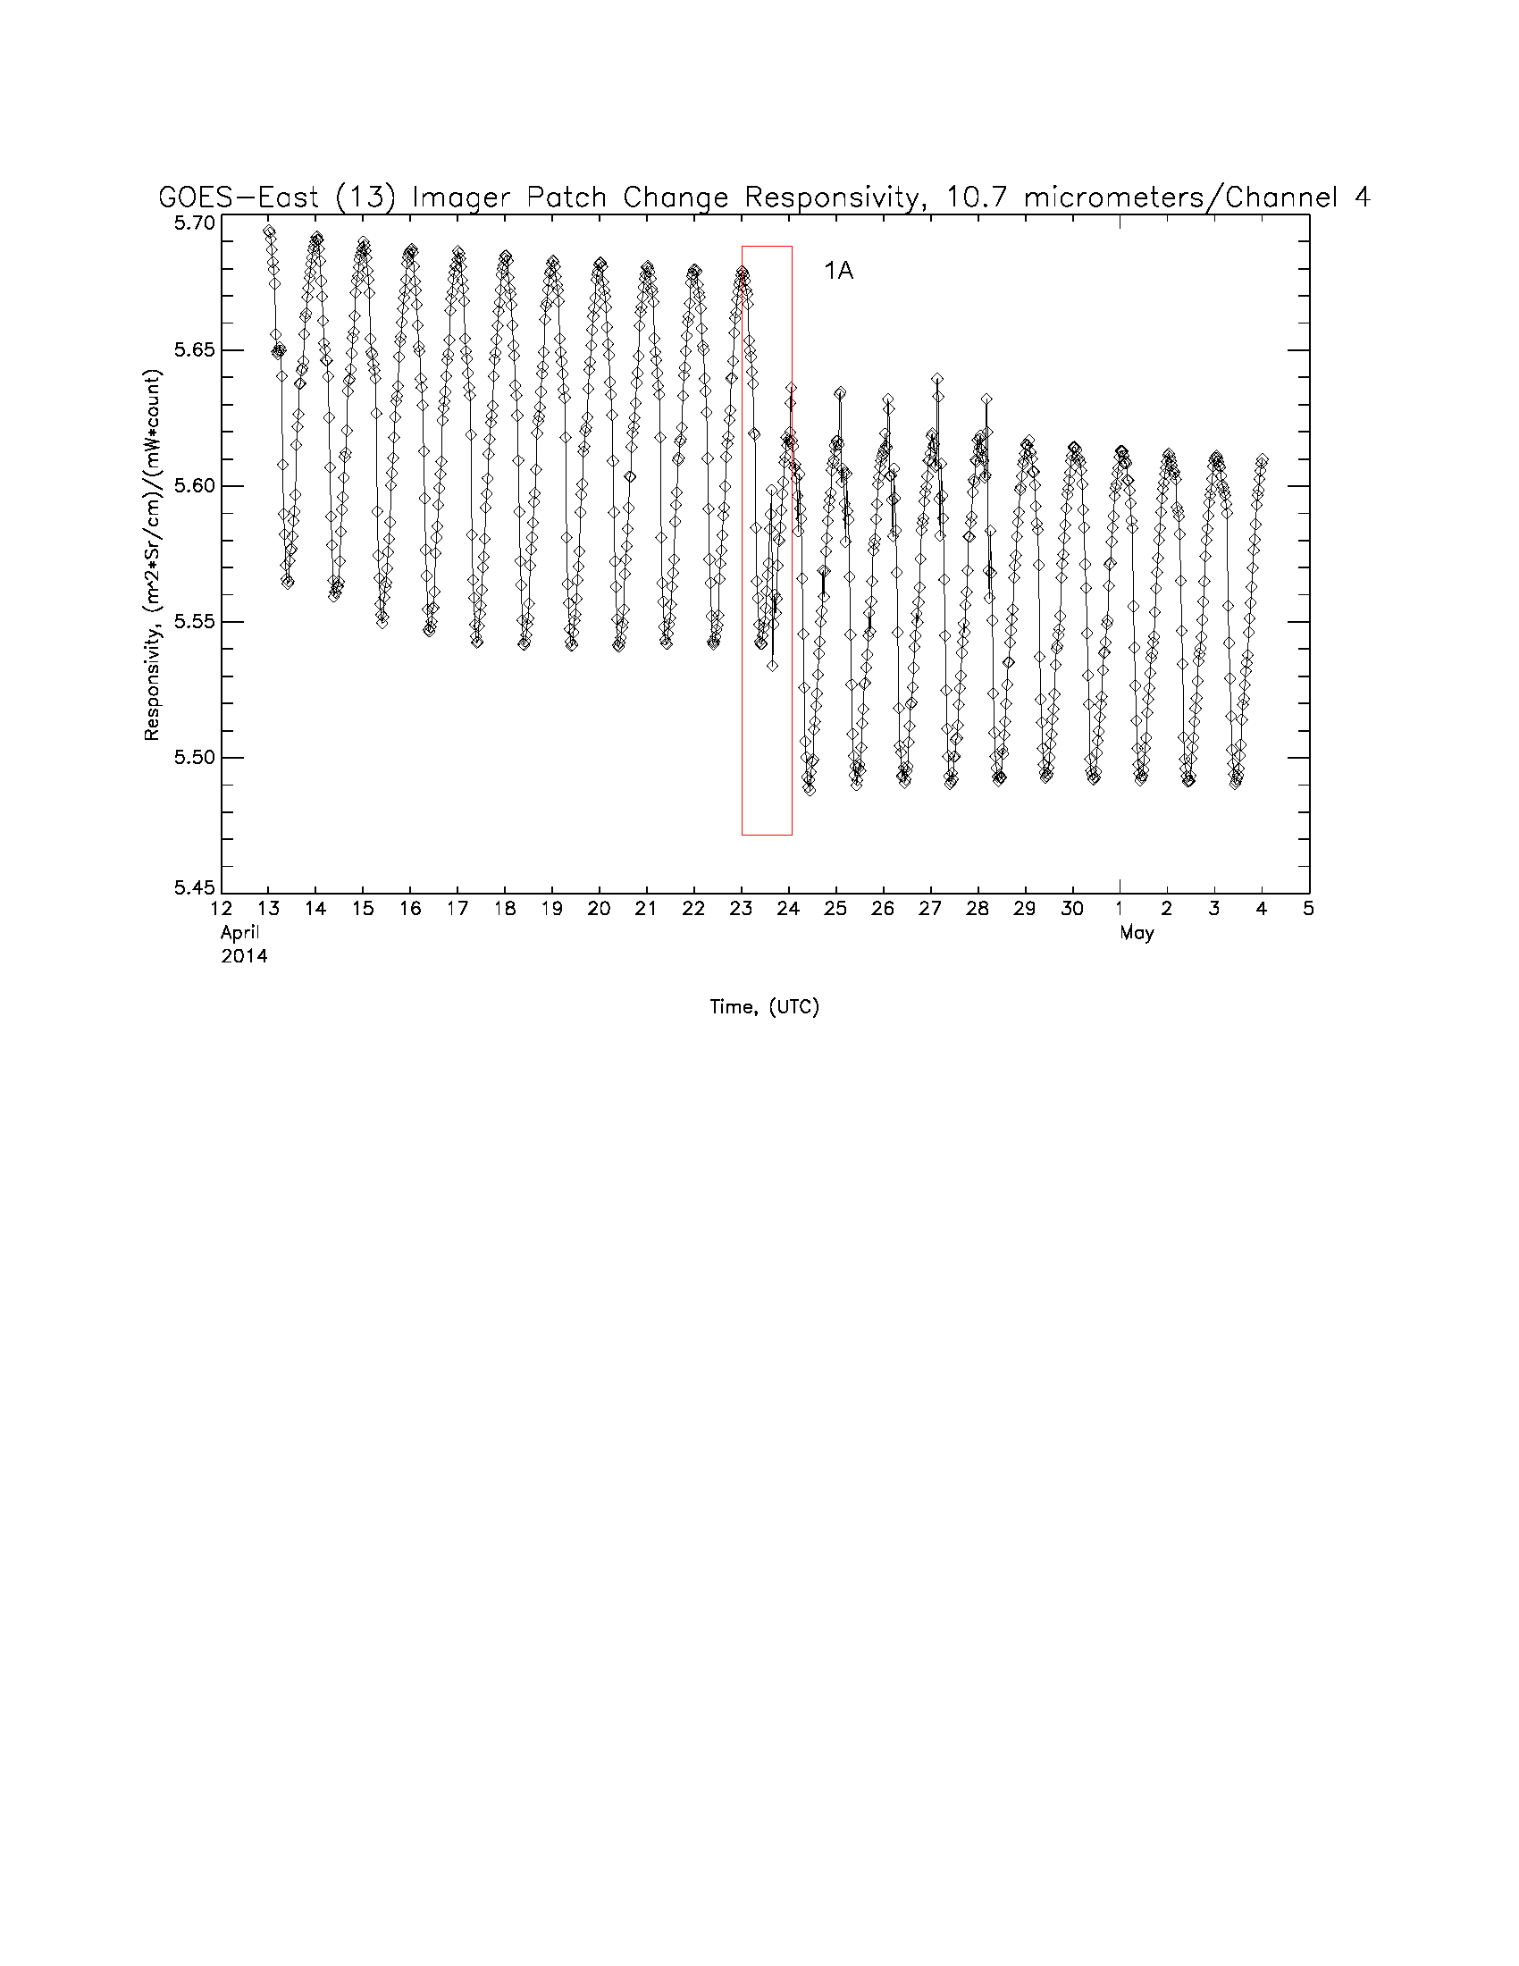
The Unique Radiometric Calibration Trending
Behavior of the GOES Imagers and Sounders
Authors: Kenneth Mitchell (ASRC Federal), Merrisa Griffin (HTSI), J. Paul Douglas (ASRC Federal)
The subtitle for this poster could be given as “what you see is NOT what you get”. That is, the variable radiometric environment of the GOES instruments on-orbit that is displayed in this poster is NOT what users find in the radiometrically stable radiances (and temperatures) contained in the delivered GOES L1b products. And this transition, from unstable to stable, is due to the application of the very responsivity coefficients that are displayed in this poster (the process called calibration).
Specifically, the poster seeks to:
Provide users with a feel for the (variable) trending behavior of the GOES Imager and Sounder radiometric responsivities over yearly (and shorter) timescales
Provide short explanations for the origin of the displayed responsivity variability; and
Categorize the various causes of the responsivity variability either as intrinsic instrument behavior or as due to commanded instrument operations which seek to maximize overall radiometric performance of the GOES instruments throughout the year.
Figure 1: GOES-East (13) Imager Yearly Responsiviity in Channel 4
Note intrinsic behavior in the annual and seasonal trends of the maxima and minima responsivities
Note responsivity jumps at the equinoxes due to commanded changes to the detector temperatures
Figure 2: GOES-East (13) Imager 3 week Responsivity in Channel 4 around a Detector Temperature Control Change
1. Note intrinsic diurnal variability of the responses due to orbital-modulated diurnal temperature effects on the instrument components and electronics
Poster # 3-8

Slide 8
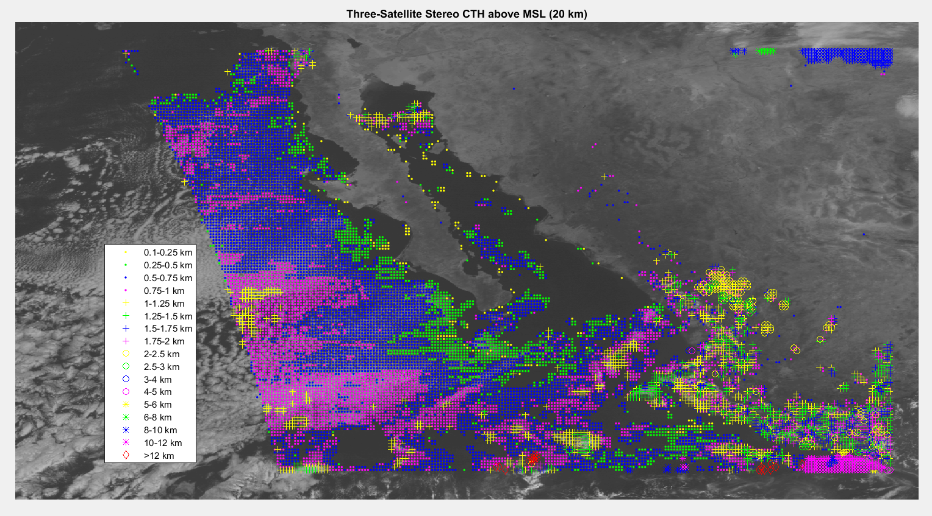

Stereo Cloud Top Height Products for
the GOES-R Era
Houria Madani¹, James L. Carr¹
1. Carr Astronautics, Greenbelt, MD
The Stereo Cloud Top Height (CTH) product is based on matching images of the same or similar spectral bands acquired quasi-simultaneously by GOES satellites from two or three different vantage points.
Once GOES-R is launched and operated at a central location, a near-full disk stereo-CTH product can be made. With two operational GOES satellites and coverage from another satellite such as TEMPO, a full CONUS stereo-CTH product can be made. We have generated a stereo-CTH product during hurricane Sandy when all 3 GOES satellites were operating as shown in the upper right figure.
Stereo-CTH values are shown in the lower right figure for the subset defined by the red box above. The Stereo-CTH has finer horizontal resolution than 10 km and better measurement accuracy than 500 m.
Poster
#3.9

Slide 9
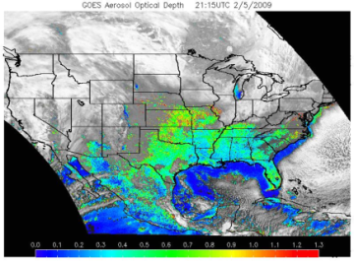
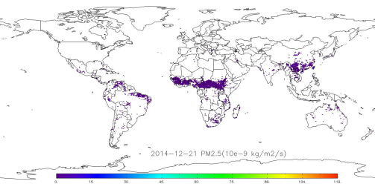
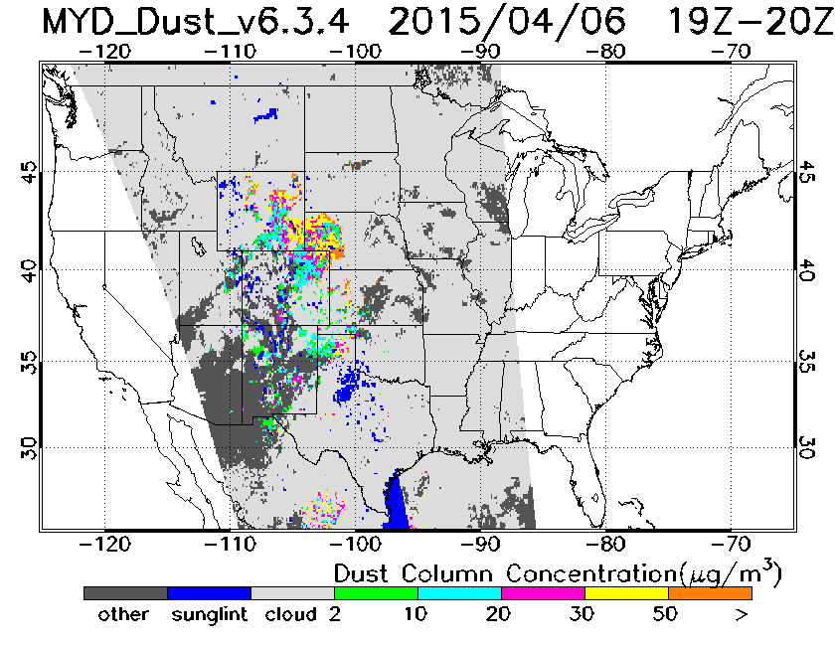
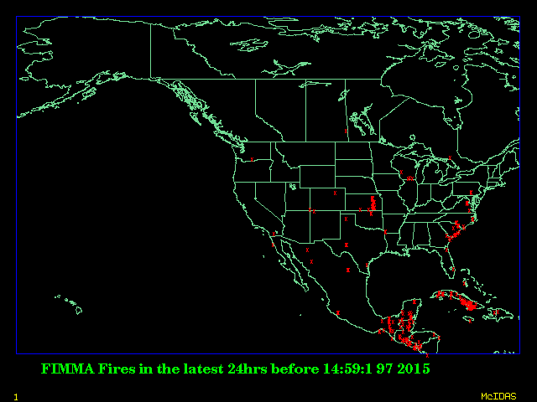
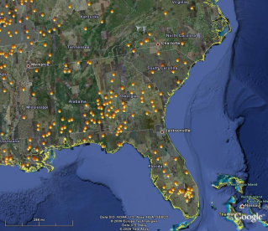
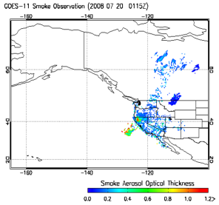
NOAA / NESDIS Air Quality Satellite Products
Liqun Ma, Shobha Kondragunta, Zhaohui Cheng, Hanjun Ding,Jian Zeng, Pubu Ciren, Chuanyu Xu, Mark Ruminski, Xaioyang Zhang, Hai Zhang
NOAA/NESDIS is operating, developing, and hosting numerous satellite-derived products for use by the air quality community. Current operational air quality products are:
  GOES Aerosol, Smoke, and Smoke Emissions Products(GASP)
  Automated Smoke Detection and Tracking Algorithm(ASDTA)
  MODIS Dust Mask Algorithm Product
  Blended Fire & Smoke Products - Hazard Mapping System (HMS)
  Global Biomass Burning Emissions Product (GBBEP)
  Automated Biomass Burning Algorithm (ABBA)
  AVHRR Fire Detects from the Fire Identification,
  Mapping and Monitoring Algorithm (FIMMA)
  Hosted products(VIIRS AOT, MODIS Fire Point, MODIS Aerosol, Aura OMI Aerosol Index)
GASP
GBBEP
FIMMA
MODIS Dust
HMS
ASDTA
Poster # 3-11

Slide 10
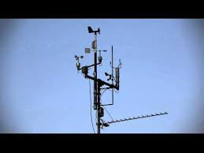
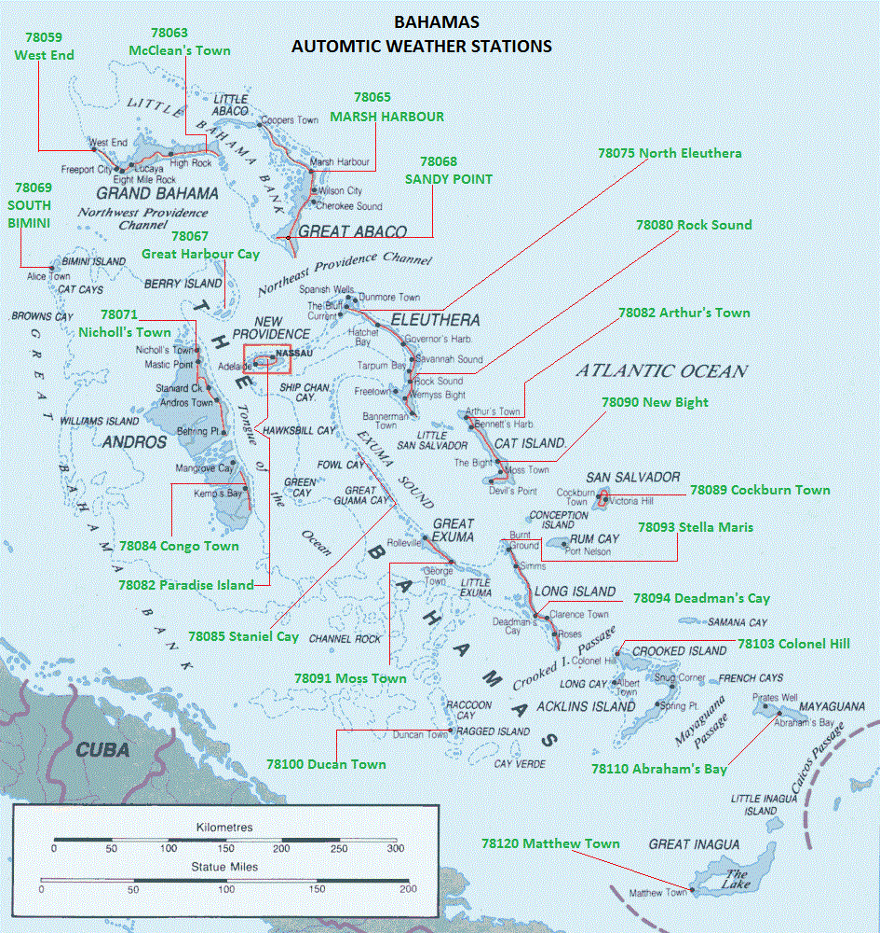
THE CARIBBEAN GOES SATELLITE
GREGORY G. GIBSON
NOAA/NESDIS
BAHAMAS
Poster # 3.12

Slide 11
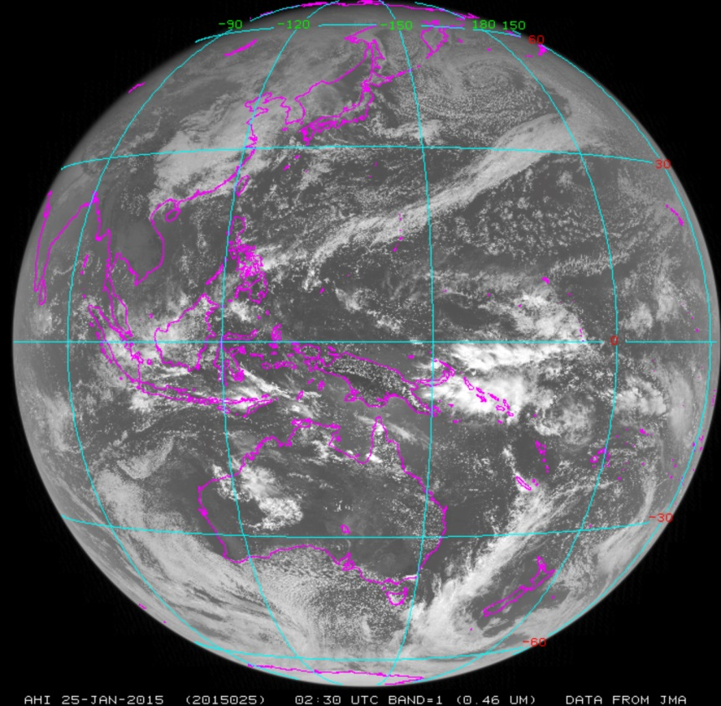
Access to GOES-R Satellite Data and Products with McIDAS and Mobile Apps
D. Santek, R. Dengel, S. Batzli, D. Parker, N. Bearson
University of Wisconsin-Madison
Madison, WI
McIDAS readiness for GOES-R data
  ADDE servers for ABI channel data, Level 2, Level 2+ products
  ADDE server for GLM data
  McIDAS-V access to GOES-R data and products
  Access to GOES-R data and products in RealEarth and mobile apps
  McIDAS-X and McIDAS-V access to Himawari-8 AHI data
Himawari AHI band 1 (0.46 μ)
Poster # 3-14

Slide 12
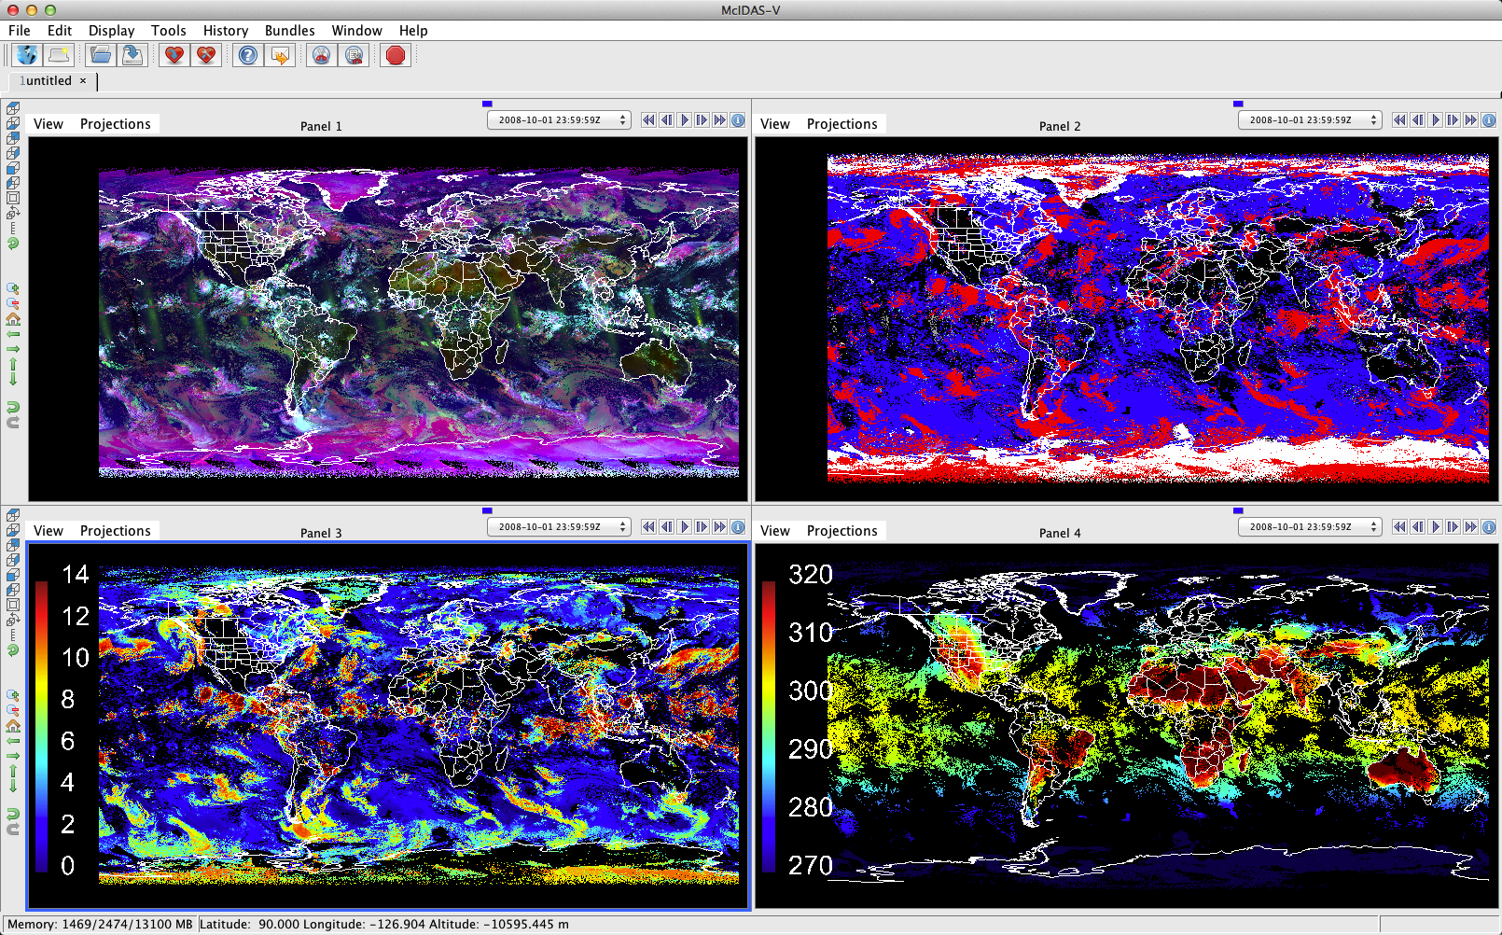
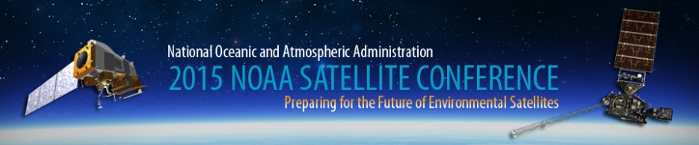
A CERES-Consistent Cloud Property Climate Data Record Using AVHRR Observations
Patrick Minnis
NASA Langley Research Center
New Climate Data Records of AVHRR Cloud Property Retrievals and Shortwave Channel Reflectance have been developed at NASA LaRC and are currently being delivered to NOAA NCDC
  Cloud detection and retrieval method consistent with methods used with MODIS for the NASA CERES program
  Shortwave calibration referenced to Aqua MODIS
  Products include cloud mask, phase, height, optical depth, effective particle size, overshooting cloud top detection, broadband radiation, and skin temp
  Validation indicates accuracy of cloud mask: 86%, cloud phase: 90%, cloud top height: ~1.5 km, and skin temperature: 0.6 (SST) to 2 K (LST)
Daytime False Color Composite
Cloud Phase Red: ICE, Blue: WATER, White: CLEAR SKY SNOW
Cloud Top Height
Clear Sky Skin Temperature
Poster # 3-16

Slide 13
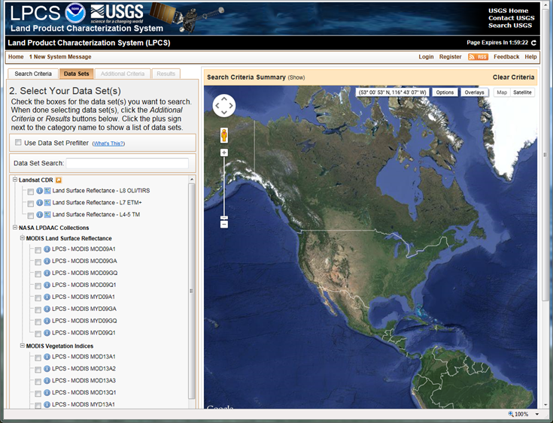
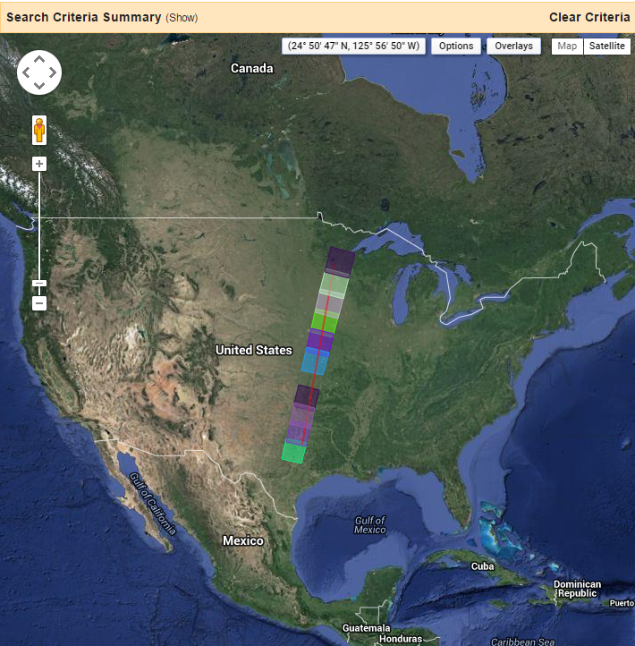
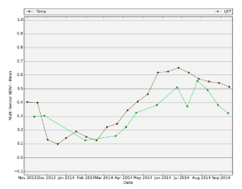
Land Product Characterization System (LPCS) for analysis and validation of ABI and VIIRS land products
Kevin Gallo¹, John Dwyer², Steve Foga³, Calli Jenkerson³, Ryan Longhenry² and Greg Stensaas²
¹NOAA/NESDIS, ²U.S. Geological Survey, ³Stinger Ghaffarian Technologies
LPCS automatically blends satellite products for analysis.
  Validation and characterization of GOES-R ABI and JPSS/VIIRS land products are required.
  A web-based system under development for validation and characterization of ABI and VIIRS data/products that facilitates access and use of land products from multiple sensors (e.g., Landsat and MODIS).
LPCS home page and sensor product comparison example.
Poster # 3-17

Slide 14


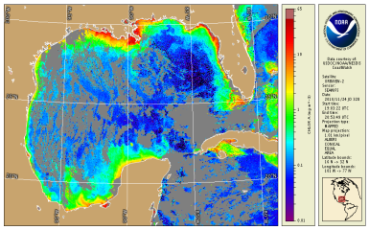
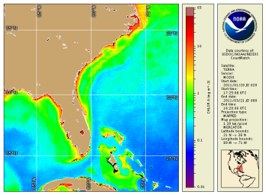
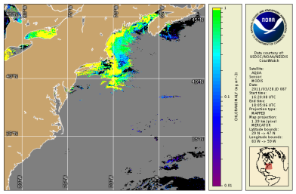
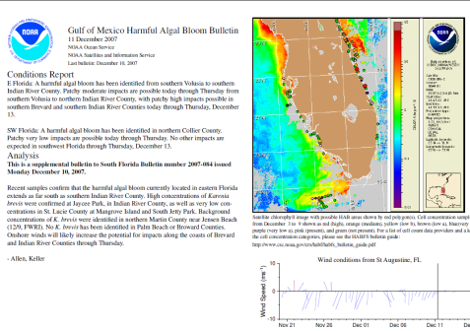
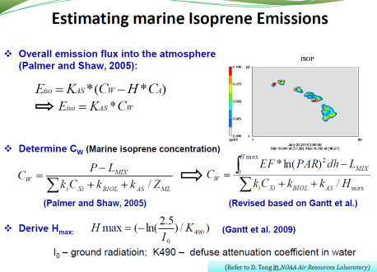
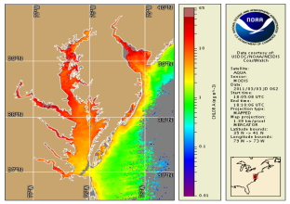
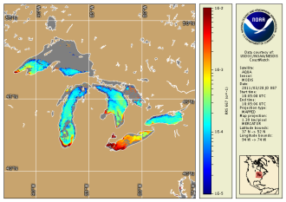
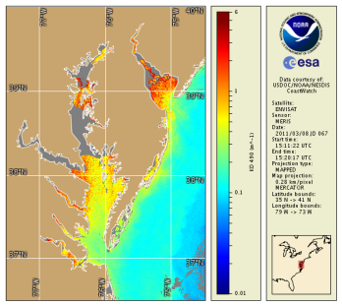
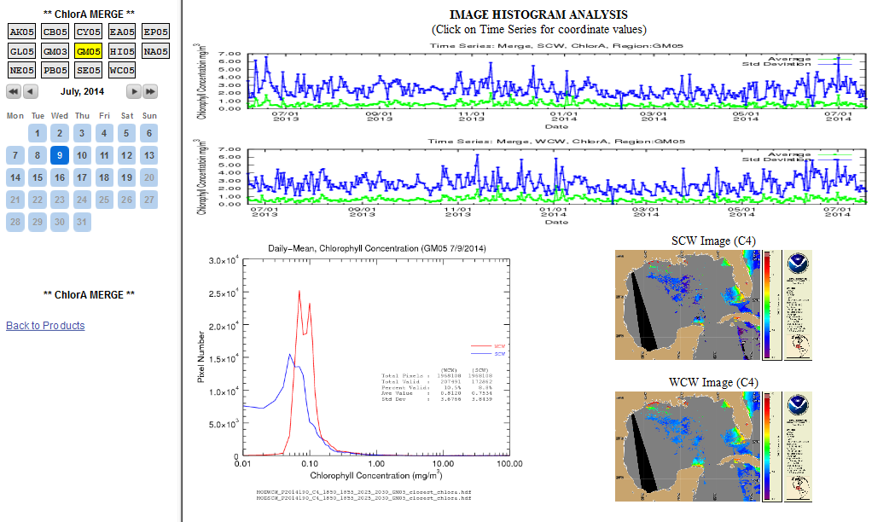
NOAA’S OPERATIONAL OCEAN COLOR PRODUCTS
FROM THE OSPO COASTWATCH OKEANOS SYSTEM
Poster # 3.18
Banghua Yan, Ian Simpson, Edmond Rodriguez and Antonio Irving
NOAA/NESDIS/OSPO/Satellite Products and Services Division
Operational Ocean Color Products
Products Users and Applications
Users
- National Ocean Service & NESDIS
- NOAA ocean forecast model
- Federal, state and local marine
scientists, and coastal managers
- Fisheries managers
- General public
Applications
- Track potential harmful algal blooms
- Assess air quality through marine
isoprene fluxes
- Assess water quality
- Assess habitat
- Review ocean features
Daily chlorophyll concentration
Bimonthly-mean chlorophyll
concentration
New algal growth (Positive
chlorophyll concentration
anomaly)
Predict Harmful Algal Bloom
Chesapeake Bay daily
chlorophyll concentration
Suspended sediment proxy
(Remote sensing reflectance at 667 nm)
Water turbidity(Diffuse
attenuation coefficient
at 490 nm)
New OSPO Okeanos Operational Web-Based QA Monitoring Tool (http://www.ospo.noaa.gov/Products/ocean/color/index.html)
  Monitor the availability and quality of operational ocean color (OC) products in near real time (NRT) mode
  Monitor time series of operational OC product statistics
  Detect suspicious OC products in NRT mode
  Monitor the ingest, process, generation, and distribution of Okeanos system in NRT mode
  Monitor the performance and stability of the system in NRT mode
An example of QA Tool: Monitor suspicious products
Interactive Date & Region for selected options.

Slide 15
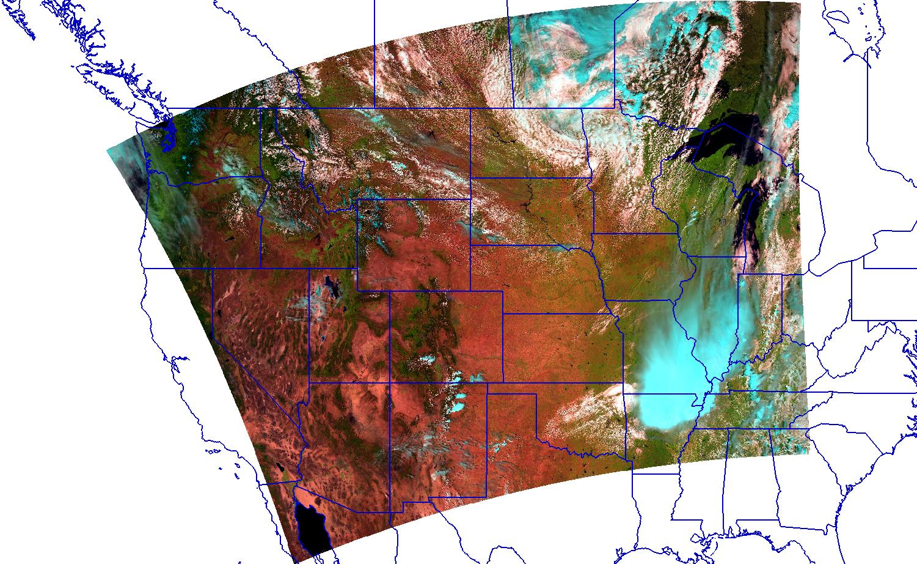
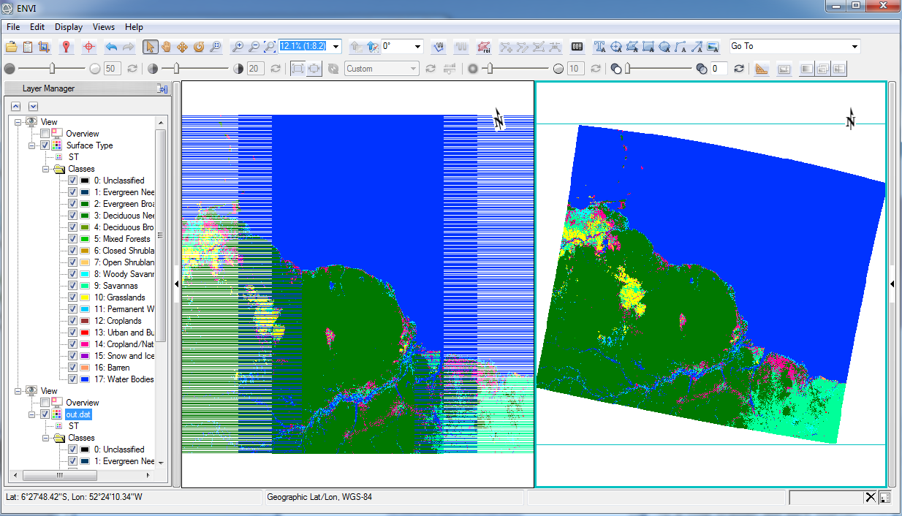
Ingest and Analysis of NPP-VIIRs Data from the NOAA CLASS System: Radiometric Calibration, Bow Tie Correction and Derived Dataset support in the ENVI COTS Software
ENVI image analysis software now supports VIIRS data from the NOAA CLASS system allowing users to open VIIRS Sensor Data Records (SDRs) in a point and click user interface with no a priori information about the dataset or the file format. Options for opening and processing the data include:
  Automatically opening I-bands, M-bands, Day-Night-Band (DNB), and the Near-Constant-Contrast (NCC) Environmental data record (EDR)
  Automatic calibration to radiance, reflectance, brightness temperature or albedo (depending on the data product)
  Optional Swath-to-Grid geocorrection with elimination of bow-tie deletion artifacts for SDRs
  Automatic granule merging to remove swath gap lines for (EDRs)
  Opening derived EDRs such as Aerosol Optical Thickness, Land Surface Temperature, Ocean Color/Chlorophyll, Sea Surface Temperature, Surface Type, and Vegetation Indices
  Scripting processes for working with many NPP-VIIRS scenes
Poster # 3.20

Slide 16
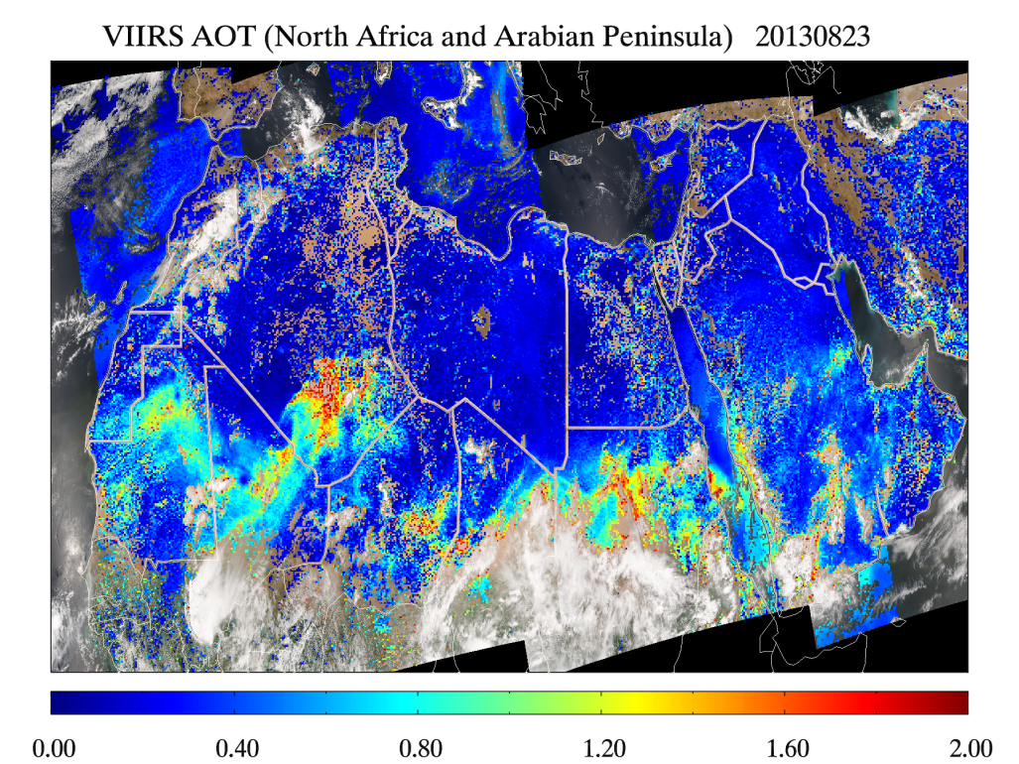
Development of surface reflectance ratios database for VIIRS AOT retrieval over land
Hai Zhang¹, Hongqing Liu¹, Shobha Kondragunta², Istvan Laszlo², Lorraine Remer³, Jingfeng Huang⁴, Stephen Superczynski⁵
1. IMSG at NOAA, 2. NOAA NESDIS, 3. UMBC, 4. UMD, 5. SRG
VIIRS surface reflectance ratios between selected bands were derived from the lower bound of the 2-year corrected TOA reflectances with a spatial resolution of 0.1º
VIIRS AOT retrieval using global surface reflectance ratios database improves AOT retrieval accuracy and data coverage
  Retrieve AOT over bright surface with good accuracy, where current operational retrieval algorithm cannot retrieve AOT
  Improve AOT retrieval accuracy over dark surface
Poster # 3.24

Slide 17
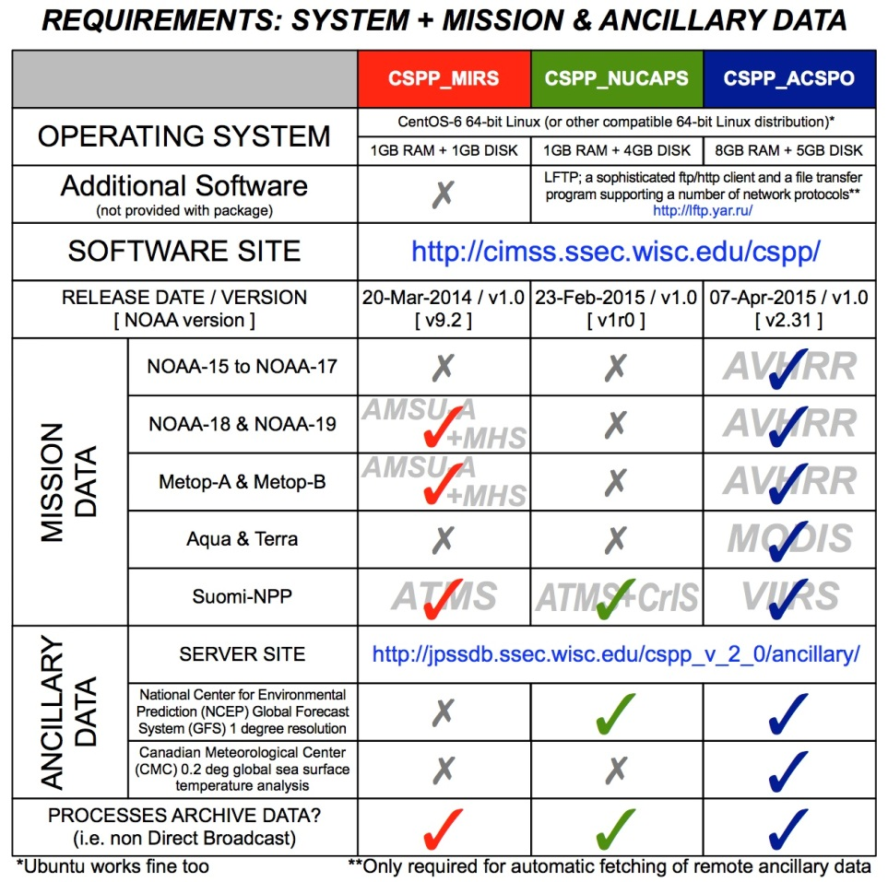
Recent additions to the Community Satellite Processing Package (CSPP) from algorithm developers at NOAA
James E. Davies & collaborators
Space Science and Engineering Center/University of Wisconsin-Madison, WI
CSPP supports the Direct Broadcast (DB) meteorological and environmental satellite community through packaging and distribution of science software that now includes:
  Microwave Integrated Retrieval System (MIRS)
  NOAA Unique CrIS/ATMS Processing System (NUCAPS)
  Advanced Clear-Sky Processor for Oceans (ACSPO)
Poster # 3-28

Slide 18
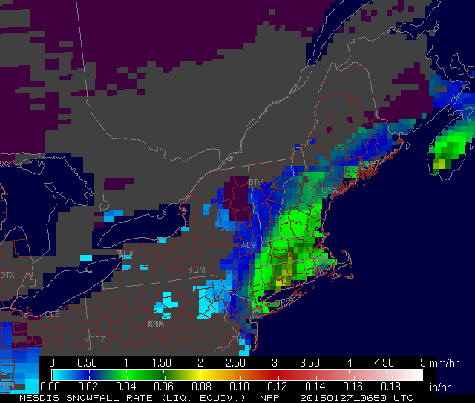
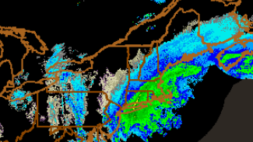
ATMS/AMSU Snowfall Rates during the 2014-15 Winter Season
Huan Meng¹, Cezar Kongoli², Jun Dong², Ralph Ferraro¹, Bradley Zavodsky³
¹ NOAA/NESDIS/Center for Satellite Applications and Research
² Cooperative Institute for Climate and Satellites (CICS), University of Maryland
³ NASA/Short-term Prediction Research and Transition Center (SPoRT)
ATMS and AMSU Snowfall Rate (SFR) products were evaluated in the 2014-2015 winter season
  AMSU SFR is operational at NESDIS. First season ATMS SFR became available
  SFR assessment at several NWS Forecast Offices, effort led by NASA/SPoRT
  Use direct broadcast data from UW/CIMSS and UAF/GINA
  Case studies
ATMS SFR (top) and composite radar reflectivity (bottom) during 2015 New England Blizzard
Poster # 3-31

Slide 19
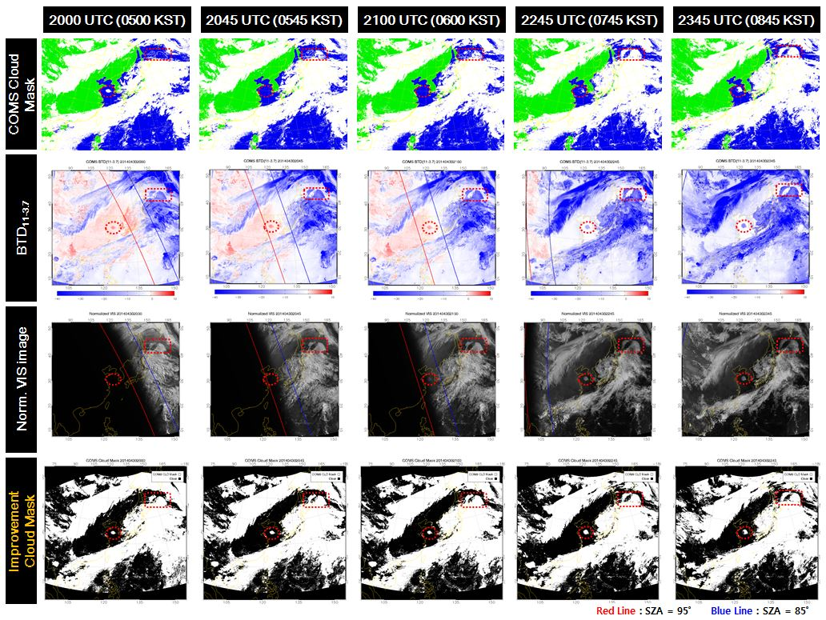
Improvement of Cloud Detection with COMS
in the Day-Night Transition Area
Byung-il Lee, Hyungmin Park, Sung-Rae Chung
Satellite Planning Division, NMSC/KMA, Republic of Korea, bilee01@korea.kr
We will improve the operational COMS CLD algorithm to solve discontinuity in transition area
  Operational CLD Algorithm consists of several tests
Single channel threshold test
Dual channel BTD test
Homogeneity test
Sun-glint test
Improved Algorithm
  Introduced normalized visible reflectance
  Applied dynamic threshold (11-3.7μm) in transition regions
Poster # 3.32

Slide 20
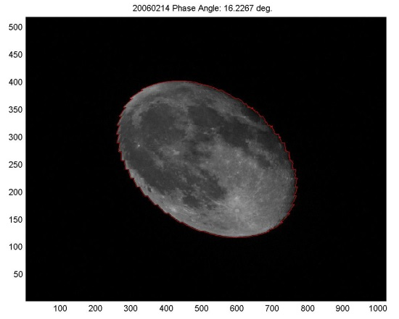
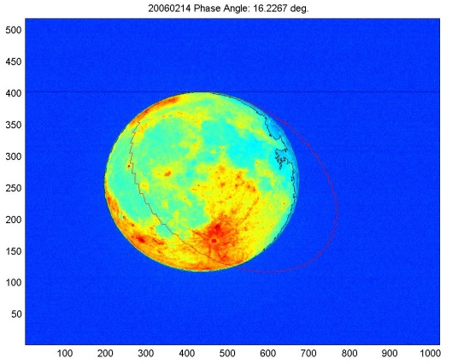
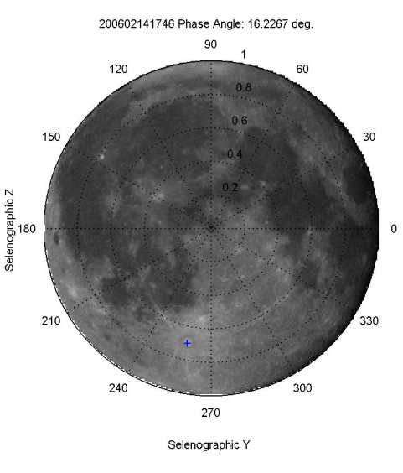
Selenographic Coordinate Mapping of Lunar Observations by GOES Imager
Xi Shao (ERT Inc., UMD), Xiangqian Wu (NOAA/NESDIS/STAR), Fangfang Yu (ERT Inc.)
Poster # 3-33
Lunar calibration for solar bands has been an important part of trending the instrument radiometric performance.
The lunar disk-equivalent irradiance has been used to trend the on-orbit degradation of the GOES imager and its performance is largely affected by the uncertainties in lunar phase and libration.
The lunar view by GOES imager provides opportunity to perform radiometric calibration of GOES imager using lunar radiances of selected locations on the Moon.
In this study, algorithms and procedures are developed. Both controlling point and landmark matching are applied to determine rotation angles and three consecutive rotations are performed to map onto selenographic coordinates.
Lunar observations of GOES-12 are processed and ROIs are identified. Lunar phase angle-dependence of lunar radiances at ROIs are analyzed.
Lunar radiance depends strongly on Sun-Moon-Satellite geometry and knowledge of BRDF of lunar surface help trending radiometric performance of GOES imager.
a
b
c
d
Figure: (a) lunar observation by GOES-12; (b) Image processing performed to scale lunar image to a disk; (c) Mapped lunar image in selenographic coordinate;
(d) Lunar radiance vs. moon phase angle around moon center

Slide 21
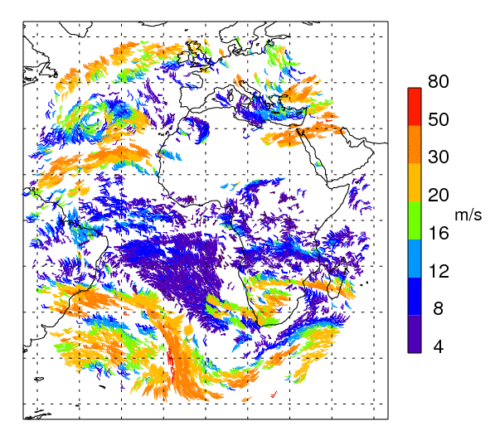
GOES-R Atmospheric Motion Vectors
Future Use in NCEP GFS
Sharon Nebuda¹, Jim Jung^{1,2}, David Santek¹, Jaime Daniels³, Wayne Bresky⁴
¹CIMSS UW Madison WI, ²JCSDA College Park MD ³NOAA/NESDIS STAR College Park MD,
⁴IM Systems Group Rockville MD
Proxy ABI Wind Data has been tested in NCEP GFS
  Applying the new Nested Tracking Algorithm to Meteosat SEVIRI data generated proxy ABI AMVs
  Quality control procedures have been established
  Seasonal runs assimilating this data in GFS have shown neutral to small positive impact on the forecast skill
IR AMV wind barbs 12Z 12 Dec 2013 Color indicates speed
Poster # 3.37

Slide 22
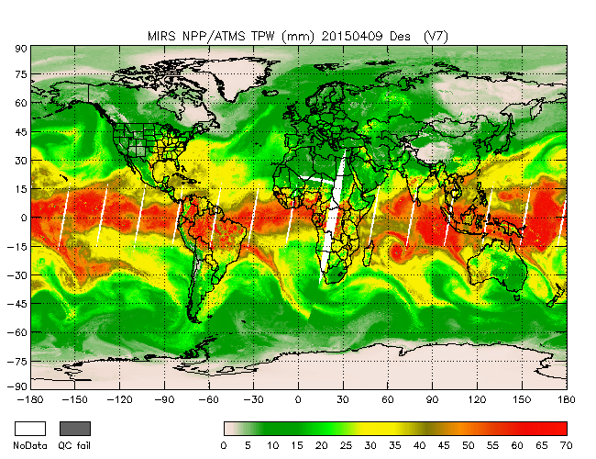
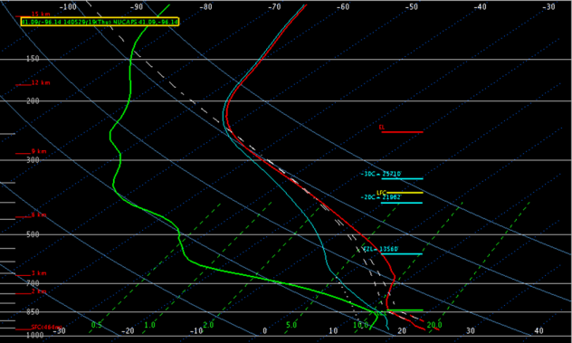
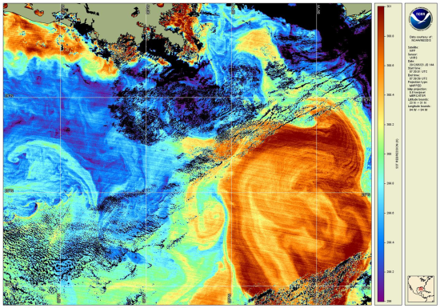
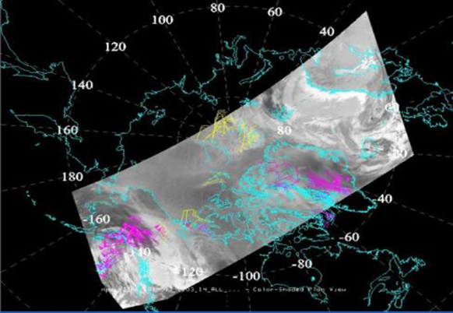
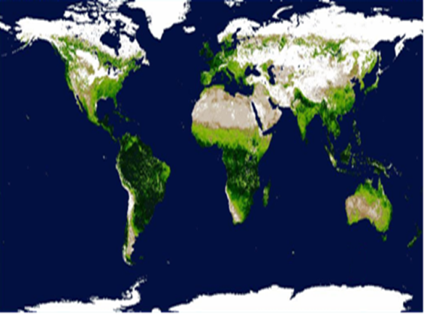
S-NPP Operational Products at NOAA/NESDIS/OSPO
Shuang Qiu and Antonio Irving
NOAA/NESDIS/OSPO Satellite Products Branch (SPB)
College Park, MD
OSPO provides timely access to atmospheric, oceanic, and land surface satellite data from S-NPP
  Advanced Clear Sky Processor for Oceans - SST
  Green Vegetation Fraction
  Microwave Integrated Retrieval System – ATMS
  NOAA Unique CrIS ATMS Product System
  VIIRS Polar Winds
  Blended Snow and Ice IMS V3
  Blended SST
Poster # 3.39

Slide 23

JPSS CGS Handling of SMD
Hårek Gamst, Kenneth Pettersen: Kongsberg Spacetec AS
  SMD data receivers
  JPSS SMD Hubs
  Reliable data capture & delivery
  Data consolidation
  Extensive reporting
  Multi mission
  Data driven operations
  Standardization & configurability
Poster # 3-40

Slide 24

Status and Future Plan of
Development of Meteorological Products through Korean Geo-KOMPSAT-2A Satellite
Sung-Rae Chung, Byung-il Lee, Tae-Myung Kim, Eun-Bin Park & Jae-Gwang Won
Satellite Planning Division, NMSC/KMA, Republic of Korea, csr@korea.kr
The AMI on the GK2A will be launched in 2018 which is followed on COMS. The 52 meteorological products will be developed and have greatly improved over the COMS products.
  Development schedule
    2014~2016 : Algorithm development
    2017~2018 : Validation and Operation
  4 algorithm groups/52 products
Cloud/Precipitation, Radiation/Aerosol,
Atmosphere/Aviation, Scene/Surface
COMS 16 products vs. GK2A 52 products
Group | Meteorological Products (16 ➔ 52)
Cloud/Rain | CTT, CTP, CTH, CP, CT, CA, COT, CER, LWP, IWP, RR, CLH, PoR, RP
Radiation/Aerosol | DADP, DAOD, ADP, AEP, AOD, VAP, VIS, RAD, RSR, DSR, OLR, ASR, ULR, DLR
Atmosphere/Aviation | AMV, VTP, VHP, AII, TPW, TFTD, CI, OT, Icing, SO2D, TOZ
Scene/Surface | CLD, SST, LST, FOG, FF, VI, FVC, LSE, SAL, SC, SD, SI, OC
Poster # 3.42

Slide 25


Not-So Silent Night: Suomi NPP’s Day/Night Band Makes Waves as a Disruptive Technology for Characterization of the Nocturnal Environment
Steven D. Miller
Cooperative Institute for Research in the Atmosphere
Colorado State University; Ft. Collins
The Day/Night Band (DNB) has exceeded performance expectations, and revealed unforeseen capabilities.
This poster provides a sampling of nocturnal parameters sensed by the DNB and their relevance to research and operations:
  Lunar reflectance
  Emissive sources, both natural and anthropogenic
Daytime visible, nighttime infrared, and DNB views of a snow field in northeast Colorado illustrates the utility of lunar reflectance to reveal composition.
Poster # 3-43

Slide 26




Verification of Soil moisture Estimations from
AMSR-E and AMSR-2
Gloria Cristina Pujol
Argentina National Meteorological Service
  The usefulness of AMSR-E and AMSR-2 daily soil moisture estimations for Argentine Pampas was explored.
  Global retrievals of daily soil moisture estimation from AMSR-E and AMSR-2 under wet and dry conditions were analyzed.
  Drought Severity Index (DSI) derived from MODIS, rain from observational data and retrievals from TRMM were also used for comparing.
Poster # 3.47

Slide 27

VIIRS Active Fires algorithm integration in NPP Data Exploitation (NDE) environment: research to operations
Marina Tsidulko¹, Walter Wolf², Ivan Csiszar², Louis Giglio ³, Wilfrid Schroeder ³
(1)IMSG at NOAA/NESDIS/STAR, College Park, MD, (2) NOAA/NESDIS/STAR, College Park, MD, (3)University of Maryland, College Park, MD
The current IDPS version of the VIIRS Active Fire algorithm runs over land and produces a list of fire detections in a sparse array format.
The University of Maryland (UMD) enhanced version of the algorithm:
- provides additional outputs including the Fire Radiative Power (FRP) of each fire pixel and a new attribute to describe land for each pixel (Fire Mask).
- has global coverage including water
- planned to be implemented in the NDE development environment
- initially will run on S-NPP data and is planned to create the J1 product in the future
The final product is in NetCDF-4 format and will be available for users through the OSPO distribution system.
Poster # 3.48

Slide 28







ALASKA DIRECT BROADCAST
G. Bryson, J. Cable, J. Dabney, C. Dierking, T. Heinrichs, S. Macfarlane, E. Stevens, G. Wirth
Geographic Information Network of Alaska, Geophysical Institute, University of Alaska Fairbanks, Fairbanks, AK
Increase satellite data acquisition, near-real time processing, and system redundancy by
  Installing a new 3.0 m antenna
  Deploying NRT processing and distribution capabilities at the NESDIS Fairbanks Command & Data Acquisition Station (FCDAS) in Fairbanks, AK
EXISTING
Big Dog Antenna
3.6 m
X-band
NEW
Sandy Dog Antenna
3.0 m
X, L, S-band
Poster # 3.52
THE NOAA ® EMBLEM IS A REGISTERED TRADEMARK OF THE U.S. DEPARTMENT OF COMMERCE, USED WITH PERMISSION. THE USE OF THE NOAA EMBLEM RECOGNIZES THE COLLABORATIVE RESEARCH PARTNERSHIP BETWEEN THE INSTITUTE AND NOAA AND DOES NOT CONSTITTUTE ENDORSEMENT BY THE DEPARTMENT OF COMMERCE/NATIONAL OCEANIC AND ATMOSPHERIC ADMINISTRATION OF THE INFORMATION, PRODUCTS, OR SERVICES CONTAINED THEREIN THAT WERE NOT DEVELOPED IN PARTNERSHIP WITH NOAA.
Site: UAF
Antenna
Frequency
Supported platforms

Slide 29
Meteorological Data Monitoring
Jorge Chira
National Meteorology and Hydrology Service of Peru
The Peruvian Weather Service monitors its Automatic Weather Stations (AWS) network with GOES 13 satellite transmission; through the Meteorological Data Monitoring Center.
The Monitoring Center, controls the daily data transmitted from all AWS and defines the performance of each one of them, for an optimal maintenance and recovering program.
Data Monitoring Flow
Poster # 3-54

Slide 30

OMPS Limb Profiler (LP) aerosol extinction algorithm development -- Robert Loughman¹, Ernest Nyaku¹, P.K. Bhartia² and Nick Gorkavyi³
¹Hampton University, Dept. of Atmospheric And Planetary Science, Hampton, VA
²NASA Goddard Space Flight Center / ³SSAI, Greenbelt, MD
The OMPS LP orbit offers great sensitivity to aerosols, particularly in the NH
  Efforts are underway to simplify the OMPS LP aerosol retrieval and make its residuals easier to interpret
  The updated algorithm uses the Chahine method to retrieve aerosol properties at 675 nm, with an improved radiative transfer model
  Retrieval quality depends on improved stray light characterization
Retrieved aerosol extinction profiles (674.5 nm) Imager) data
Poster # 3.57

Slide 31


Low Cost NOAA Satellite Signal Receiver for the Characterization of Astronomical Sites
Gary Flores1, Ericson Lopez1, Luis Tituaña1, Edwin Mena1, Daniel Vera1,
Jairo Armijos1 & Enrique Lascano2
Quito Astronomical Observatory of National Polytechnic School 1
and Ecuadorian Space Institute,2 Quito, Ecuador
  Astronomical sites can be characterized using low cost, satellite receiver built as university project.
  The radio system, developed at Quito Astronomical Observatory, was used to sensing interference in the frequency ranges: I (1-200 MHz) and II (1300-1400 MHz).
  In the I range, many spectral features (contamination) were found.
  While, the noise amplitude is low enough, as ~2 dB/sqrt(Hz) in the II range.
  Therefore, radio emission from astrophysical sources, in the 1300-1500 MHz range, would be not affected by radio interferences.
Radio spectra at Jerusalem Park, near Quito, Ecuador
Poster # 3.59

Slide 32
Suomi NPP CrIS and MetOp IASI Sounding Validation
William L. Smith Sr.
SSEC University of Wisconsin - Madison
Madison, WI
CrIS and IASI Soundings Can Improve Severe Storm Forecasts
  Diurnal changes of thermodynamic conditions antecedent to severe convective weather can be observed with the combination of CrIS and IASI vertical soundings
  Data from three airborne missions have been used to validate the accuracy of CrIS & IASI soundings and their potential forecast utility
Stability Change dLI/dt) Prior to Tornado Outbreak
Observed During 2013 SNPP Cal/Val-1 airborne Mission
Poster # 3-60

Slide 33


Slide 34
Thank you to all poster presenters!

