Slide 1

Poster Preview
  Timothy J. Schmit (tim.j.schmit@noaa.gov)
  NOAA/NESDIS/Satellite Applications and Research
Advanced Satellite Products Branch (ASPB)
Madison, WI
Thanks to all the poster presenters!
2013 NOAA Satellite Conference
College Park, MD
April 10, 2013

Slide 2
NSC-2013 Poster Plan
(NCWCP atrium)
Columns
= 25’ 2” between columns
= 16’ 8” between columns
STAIRS
= 11’ 11” between columns
79
~75’
82
67
77
83
89
70
65
86
71
87
74
50
47
75
64
61
60
55
32
29
27
46
43
42
37
13
26
54
51
12
23
36
33
9
22
~90’
8
19
5
18
4
15
1
SECURITY DESK

Slide 3


Application of DoDAF 2.0 and Underlying UPDM Model Based Systems Engineering Capability
Alan Jeffries, Jeffries Technology Solutions, Inc.
Captures and manages the complex data processing required to transform JPSS sensor data into a wide variety of Weather and Climate products.
The Poster illustrates the fidelity achievable in defining the cascade of space-based and ground-based data that is processed in stages to produce the critical information.
W-03
JeTSI
Notes:
W03

Slide 4
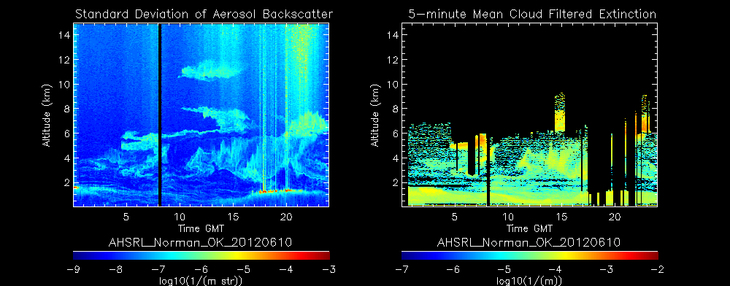
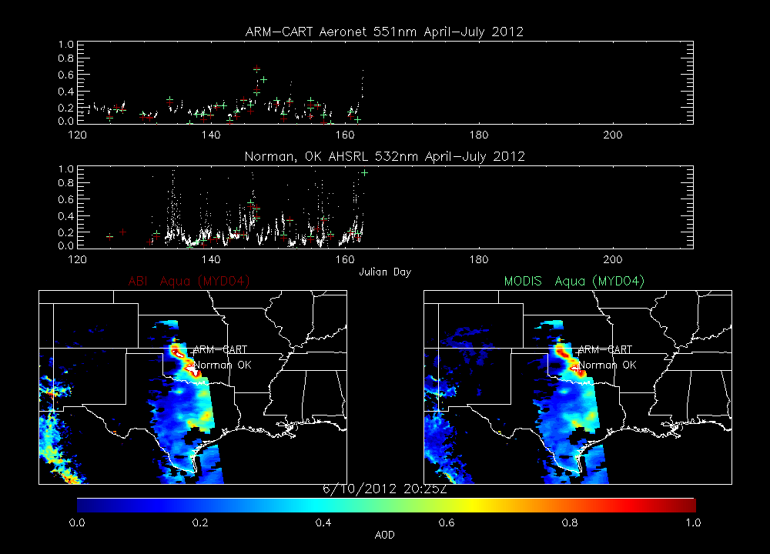
GOES-R Cloud and Aerosol Validation during the NSF DC3 field mission
Wayne Feltz¹, R. Bradley Pierce², Ed Eloranta³, K. Sebastian Schmidt⁴, Andrew Heidinger², Shobha Kondragunta⁵, Andi Walther¹
¹Cooperative Institute for Meteorological Satellite Studies (CIMSS), Space Science and Engineering Center (SSEC), University of Wisconsin – Madison, Wisconsin 53706, U.S.
²NOAA/NESDIS/STAR/CoRP Advanced Satellite Products Branch (ASPB) Madison, WI
³Space Science and Engineering Center (SSEC), University of Wisconsin – Madison, Wisconsin 53706, U.S.
⁴University of Colorado, Laboratory for Atmospheric and Space Physics (LASP), Boulder, CO, 80309
⁵NOAA/NESDIS/STAR/SMCD, Sensor Physics Branch College Park, MD
This poster focuses on validation of GOES-R Advanced Baseline Imager (ABI) aerosol and cloud retrievals using surface measurements
  Cloud height and aerosol optical depth validation was performed using ground based High Spectral Resolution (HSRL) measurements deployed at Norman, OK
  Cloud microphysical validation was performed using ground based high-spectral resolution Solar Spectral Flux Radiometer (SSFR) measurements of solar irradiance at Boulder, CO
Norman, OK AHSRL, ABI and MODIS AOD on June 10, 2012
W-05
Notes:
W05-1

Slide 5
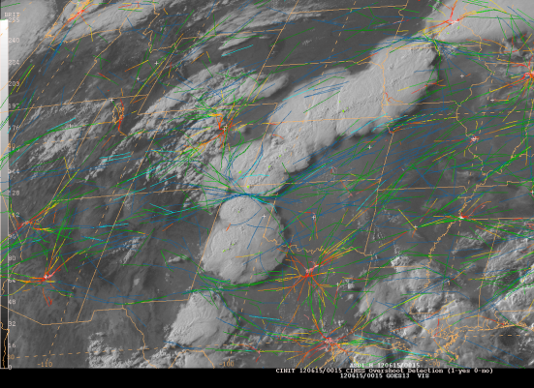
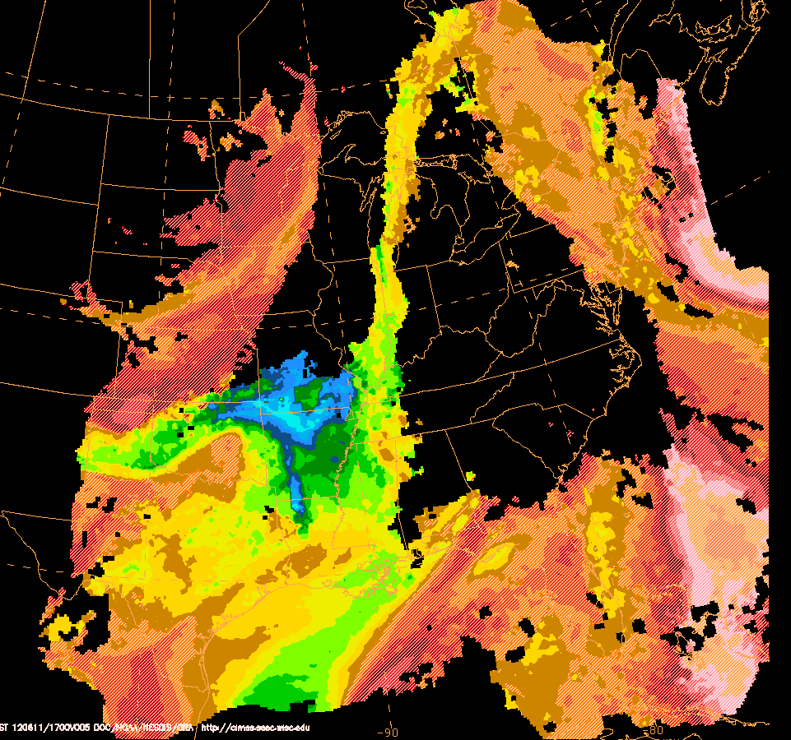
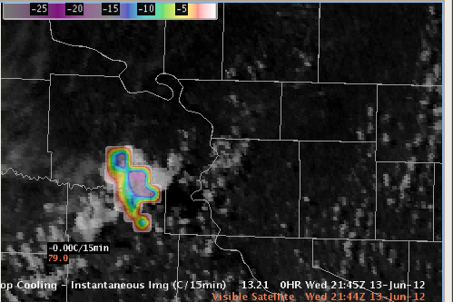
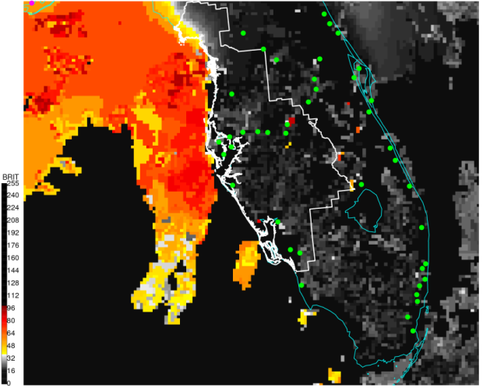
Overview of UW-Madison SSEC/CIMSS GOES-R Proving Ground Activities
Wayne F. Feltz et al.
SSEC/CIMSS University of Wisconsin – Madison
Madison, WI
Overshooting tops
and Aviation Routes
Nearcasting
Convective Instability
Providing multiple near real-time GOES-R proxy decision support products for evaluation at NOAA demonstration/testbed sites :
  Fog/cloud detection
  Convective cloud top cooling
  WRF simulated satellite imagery
  Convective overshooting-top
  Hurricane intensity estimation
  Fires
  Cloud properties
  Nearcasting
  Volcanic ash
  …
Convective Cloud Top Cooling
Fog/Low Cloud
Decision Support
W-05
Notes:
W05-2

Slide 6
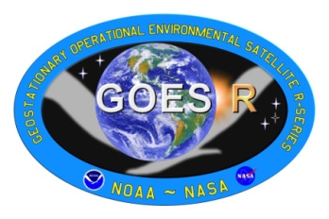
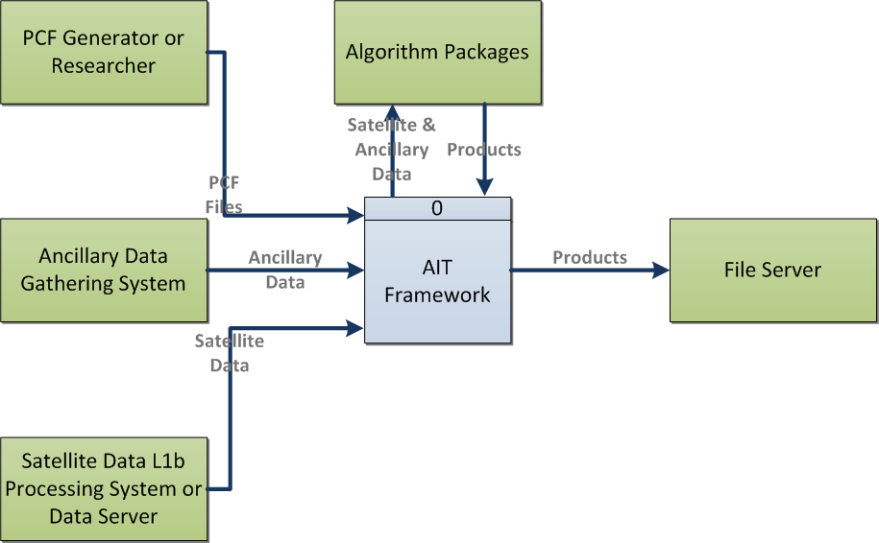
GOES-R AWG Product Processing System Framework: Current Capabilities and Future Plans
Walter Wolf, S. Sampson, X. Liu, A. Li, T. Yu, R. Garcia, G. Martin, W. Straka, E. Schiffer, and J. Daniels
The framework has enabled the development and testing of the Level 2 Advance Baseline Imager (ABI) and the GOES-R Lightning Mapper products
Currently being run near real-time to support algorithm verification and validation
  Support activities include: product monitoring, process monitoring, product visualization, and algorithm maintenance
Being used to transition the GOES-R AWG Derived Motion Vector Winds algorithm into operations for both GOES and Visible Infrared Imaging Radiometer Suite (VIIRS)
GOES-R AIT Framework Context Diagram
W-07
Notes:
W07

Slide 7
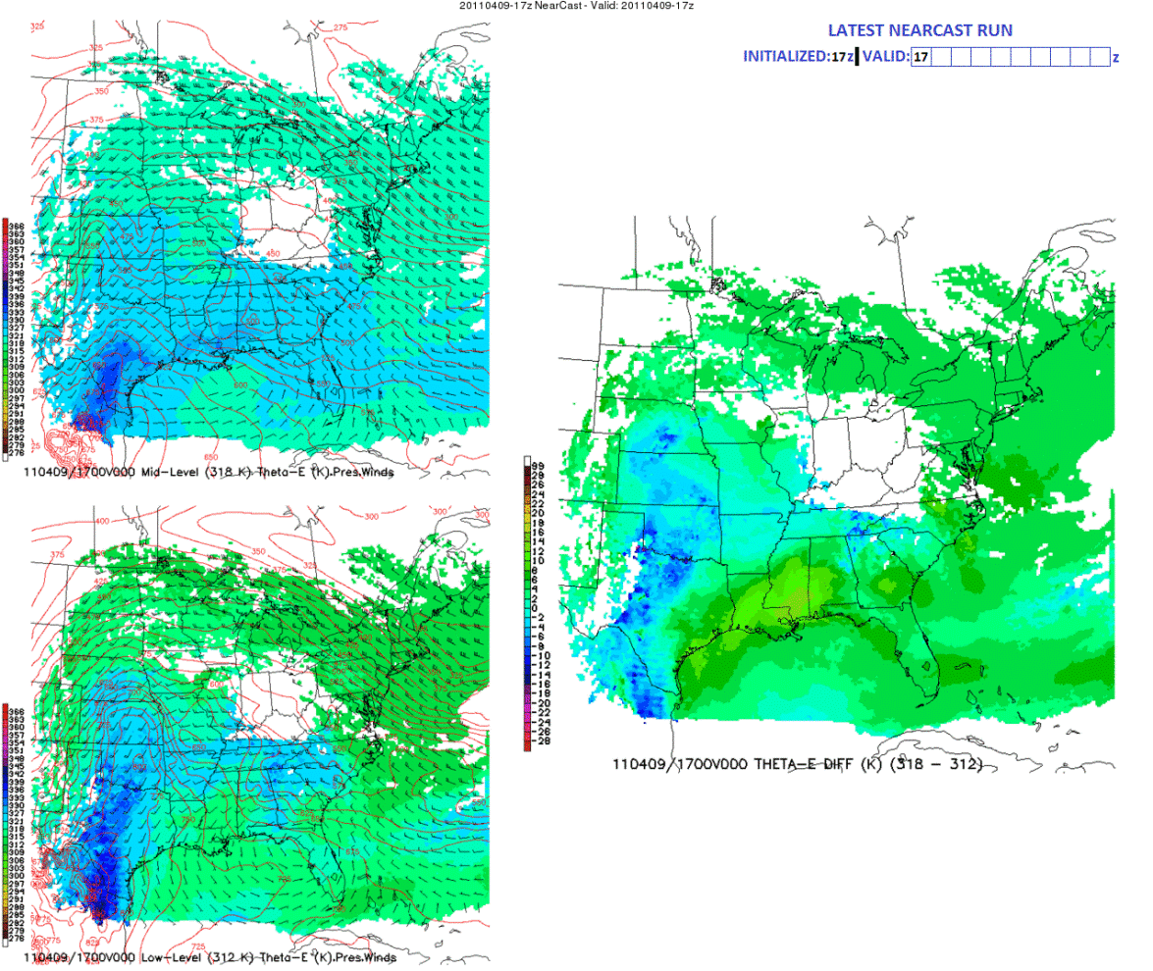
Improving very-short-range Forecasts of the Pre-Convective Environment and Heavy Precipitation Events
using operational Satellite Observations
Ralph A. Petersen¹, William Line¹ and Robert Aune²
CIMSS, University of Wisconsin-Madison
NOAA/NESDIS Advanced Satellite Products Branch (ASPB)
Madison, WI
Upper-Level (318K) θe
Lower-Level (312K) θe
Introducing a new, Isentropic Version of the CIMSS NearCasting Model
Builds upon recommendations from GOES-R Proving Grounds experiments
Is consistent with where GOES soundings are best:
  Cloud-free areas ( no latent heating )
    Adiabatic flow
Isentropic coordinates implicitly include vertical motions
  Upward transport at lower-levels can indicate potential lifting mechanisms
  Downward transport of upper-level dryness enhances gradients and Convective Instability signatures
Covariance of static stability and moisture fields helps differentiate Heavy Precipitation events from Severe Convection
April 9, 2011 –
Tornado near Mapleton, IA (western Iowa)
Heavy Precipition in Southern MN
W-09
Notes:
W09

Slide 8
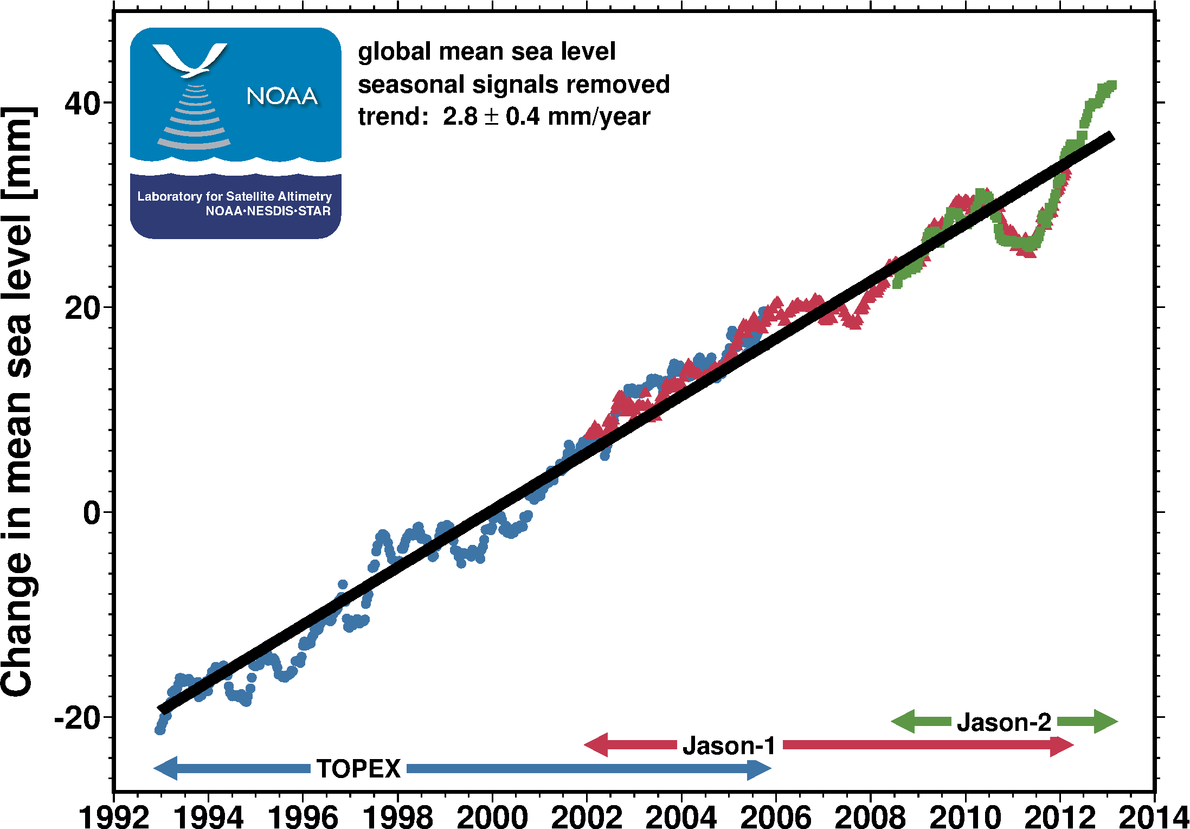
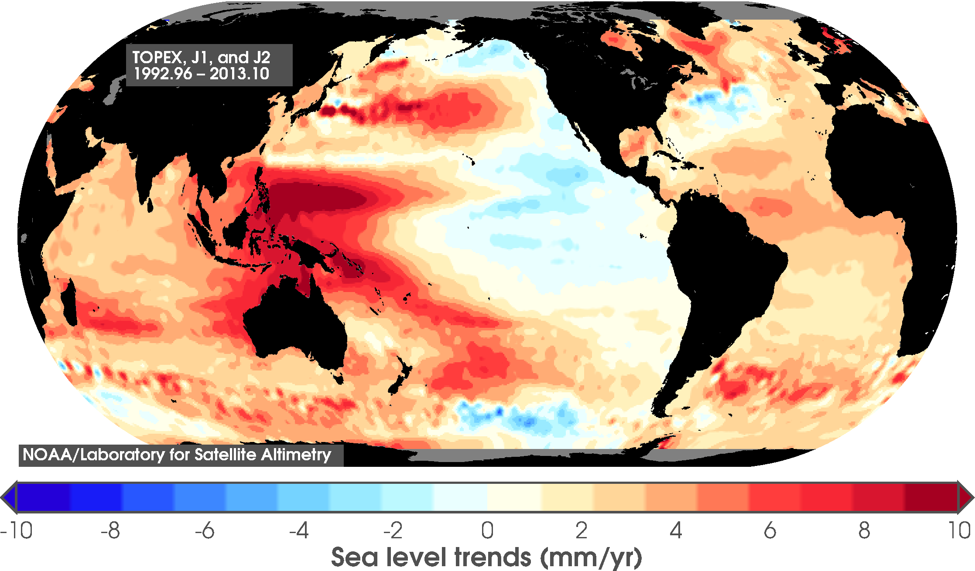
Jason altimetry and NOAA's Sea Level Climate Data Record
Eric Leuliette¹, Remko Scharroo^{1,2}, John Lillibridge¹, Gary Mitchum³, Deirdre Byrne⁴, Laury Miller¹
¹NOAA/NESDIS/STAR/Laboratory for Satellite Altimetry, ²Altimetrics LLC,
³University of South Florida, ⁴NOAA/NESDIS/NODC
Sea level observations from the Jason series of altimeters are essential to building a climate data record
  Measures global mean sea level to ~1 mm each ten days
  The observation strategy includes a rigorous inter- satellite calibration and calibration with a global network of tide gauges.
Satellite Altimetry Reference Missions
  TOPEX 1992–2005 NASA/CNES
  Jason-1 2001– NASA/CNES
  Jason-2 2008– NASA/CNES/NOAA/EUM
  Jason-3 2015 NOAA/EUM/NASA/CNES
  Jason-CS 2019 EUM/ESA/NOAA/CNES/NASA
20-year trends in local sea level rise.
W-11
Notes:
W11

Slide 9
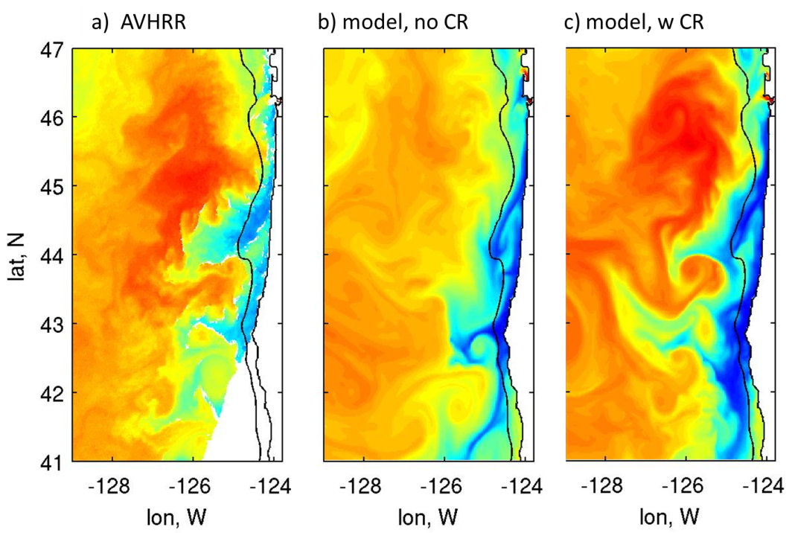
Partnerships in the use of GOES SST
In the Continental US
¹Alexander Kurapov, ²David Foley, ³Eileen Maturi, ⁴Andy Harris & ¹Ted Strub
¹CIOSS (Oregon State University), ²UC Santa Cruz, ³NOAA/NESDIS/STAR, ⁴CICS
Assimilation of GOES SST into coastal ocean forecast models improves when the Columbia River outfall is included.
Figure: SST during a strong upwelling event: (left to right, AVHRR SST for verification, model without CR, model with CR)
The model with CR reproduced better:
warmer temperature within the plume;
separation of the coastal current between 43°-45°N
W-11

Slide 10
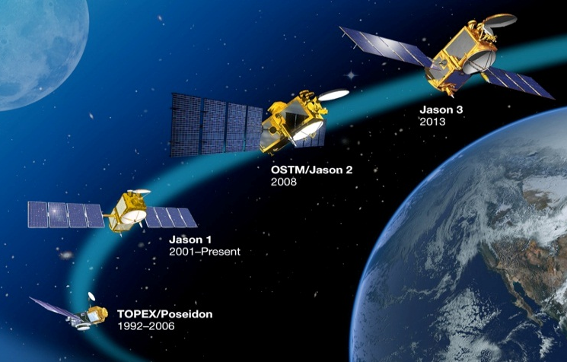
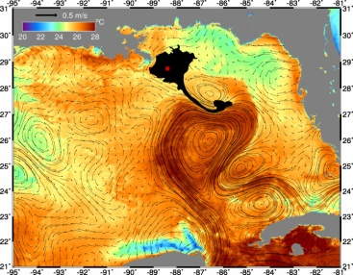
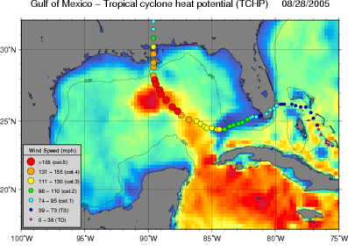
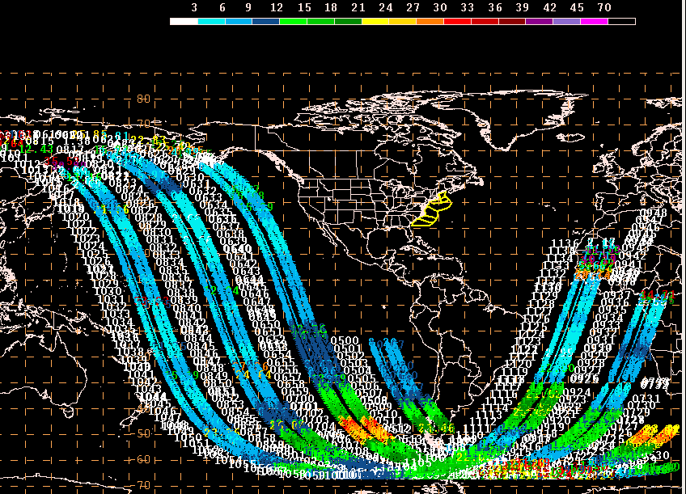
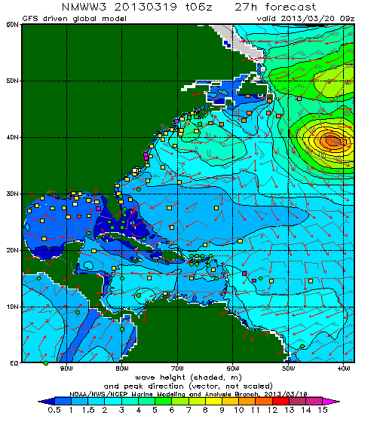
The Jason Altimetry Missions - NOAA/EUMETSAT Operational Products & Applications
John Lillibridge, David Donahue, Julia Figa-Saldaña, and Olivier Thépaut
Satellite Altimetry Reference Mission:
  Topex: 1992 - 2005 NASA/CNES
  Jason-1: 2001 - NASA/CNES
  Jason-2: 2008 - NASA/CNES/NOAA/EUM
  Jason-3: 2015 NOAA/EUM/NASA/CNES
  Jason-CS: 2019 EUM/ESA/NOAA/CNES/NASA
NOAA & EUM share Near Real-Time operations
  Each generates NRT products from its ground stations
  Data disseminated via EUMETCAST, GTS (BUFR) & FTP
  NODC, ESPC/DDS, CLASS: NOAA access & archive
Examples of Operational Applications
  Monitoring open ocean maritime conditions
  Hurricane intensity forecasting
  Assimilation into ocean models
  Validation of wave models
Ocean Model Assimilation
Hurricane Intensity
Maritime Monitoring
Wave Model Validation
W-14
Notes:
W14

Slide 11
The CrIS, IASI and AIRS:
A Perspective on Hyper Spectral Infrared Sounder Retrievals, Validation, and Applications
Murty Divakarla¹, C. Barnet², M. Wilson¹ ,E.Maddy²,
A. Gambacorta¹, N.Nalli¹, C. Tan¹, X. Xiong¹, and Mitch Goldberg²
¹IM Systems Group, Inc., ²STCorporation., ³NOAA/STAR
5830 University Research Court, College Park, MD 20737
High quality hyper-spectral infrared observations from CrIS (S-NPP), IASI (MetOp), and AIRS (Aqua) enable retrieval of atmospheric temperature, moisture, and many trace gas profiles.
Validation of the sounding products with model analysis fields and truth measurements provides confidence on:
  Cloud-cleared radiances for future NWP assimilation
  Climate quality data sets generation
Performance evaluation and characterization of various retrieval algorithms with a common data sets helps to optimize retrieval algorithms for future product generation.
850 hPa temperature product for May 15, 2012
CrIMSS IR+MW (upper left) and MW-only (upper middle)
AIRS IR+MW (lower left) and AMSU-only (lower middle)
Co-located ECMWF for CrIS (upper right) and AIRS (lower right)))
W-17
Notes:
W17

Slide 12
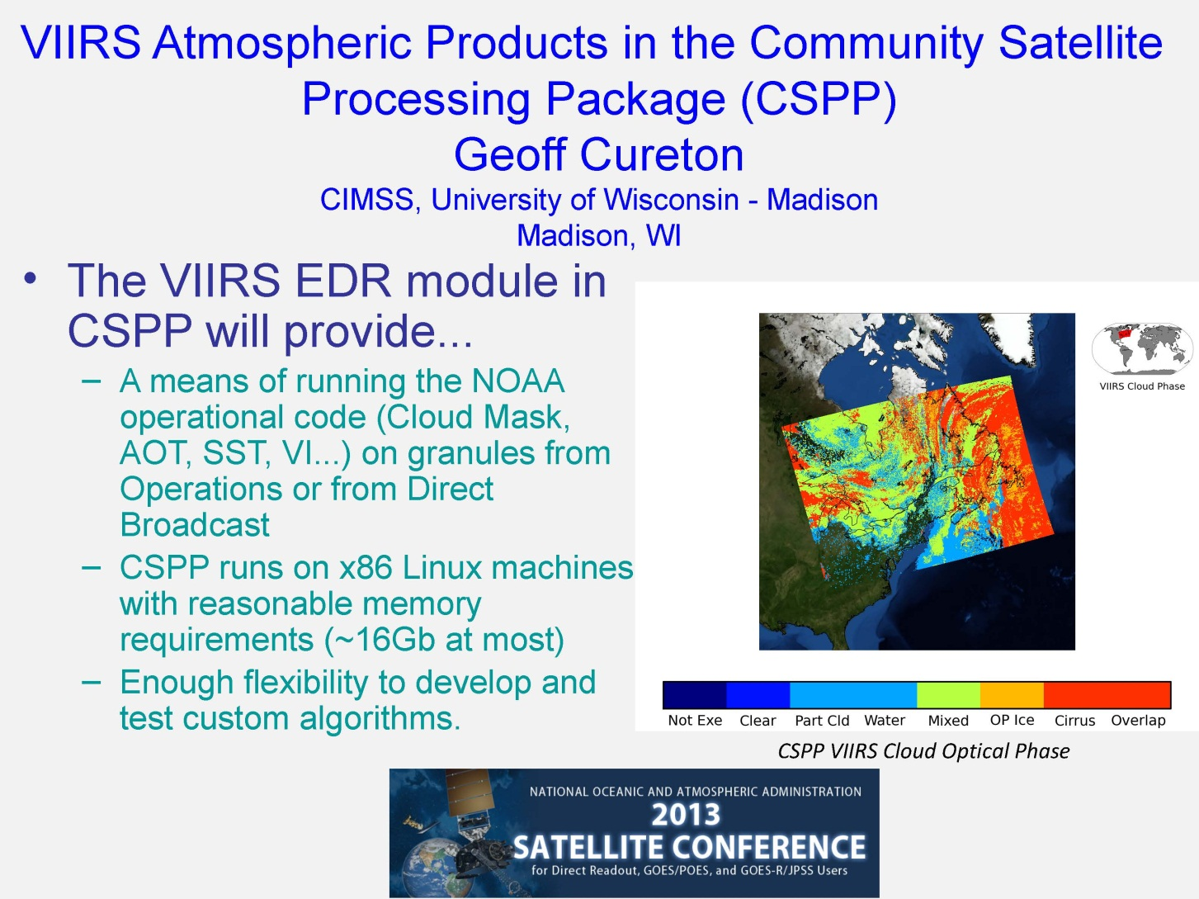
W-21

Slide 13
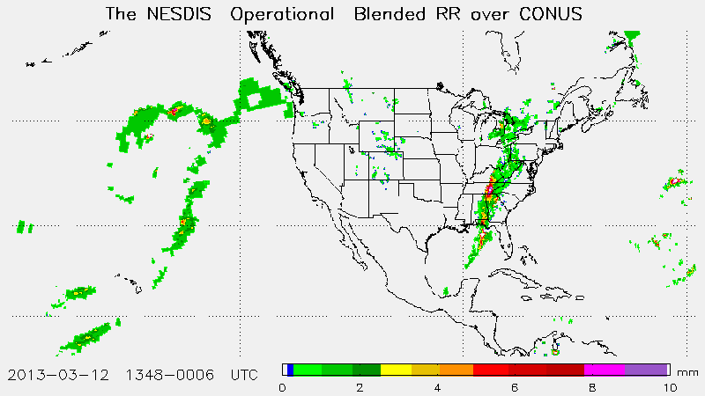
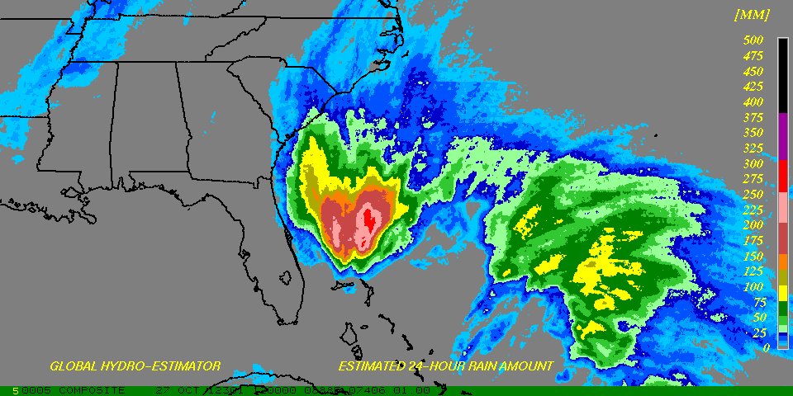
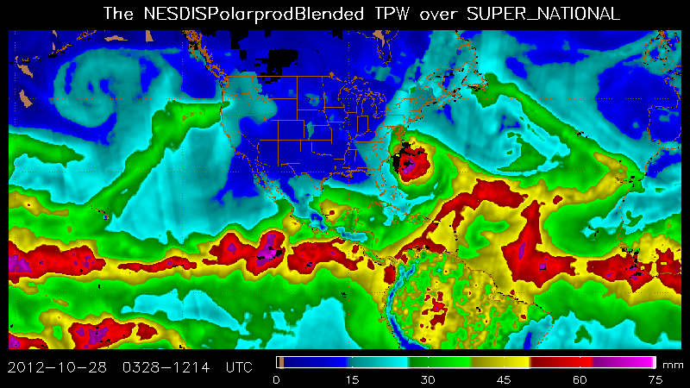
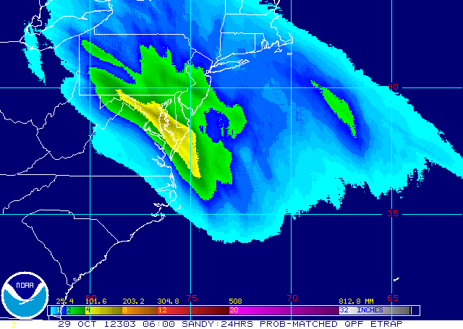
NOAA/NESDIS Operational Satellite Precipitation Products and Services
Limin Zhao¹, Ralph Ferraro², and Robert J. Kuligowski²
¹NOAA/NESDIS/OSPO
²NOAA/NESDIS/STAR
NOAA/NESDIS Operational Precipitation Products
  Available from a variety of satellites, including both polar (LEO) and geostationary (GEO) satellites, etc.
  Considerable utility to support NWS operations from short-term forecasts and warnings (e.g., flash floods, rainfall potential from tropical systems, etc.) to long-term climate studies (e.g., seasonal to inter-annual variability).
LEOs Products
  MSPPS: Instantaneous rainfall and snowfall rates derived from AMSU-A/MHS on board N18, N19 and Metop-A
  MiRS: Instantaneous rainfall rate derived from AMSU-A/MHS on board N18, N19 and Metop-A, and also from SSMIS on board DMSP F16 and F18
GEOs Products
  GHE: Instantaneous rain rate and multi-hour and multi-day rainfall derived from GOES-E, GOES-W, MTSAT, Meteosat-7 & -9
Blended Products
  Blended RR: Multi-sensors/algorithms merged rain rate product
  Blended TPW: Multi-sensor/algorithms merged total precipitable water product
  eTRAP: 24 hour ensemble mean rainfall accumulation and probability of rainfall exceeding different threshold values
Data Access
  ESPC DDS: http://www.ospo.noaa.gov/Organization/About/access.html
  Internet:
  MSPPS - http://www.ospo.noaa.gov/Products/atmosphere/mspps
  MiRS - http://www.ospo.noaa.gov/Products/atmosphere/mirs
  GHE - http:// ://www.ospo.noaa.gov/Products/atmosphere/ghe
  bRR - http://www.ospo.noaa.gov/Products/atmosphere/brr
  bTPW - http://www.ospo.noaa.gov/bTPW
  eTRAP - http://www.ssd.noaa.gov/PS/TROP/etrap.html
W-22
Notes:
W22

Slide 14
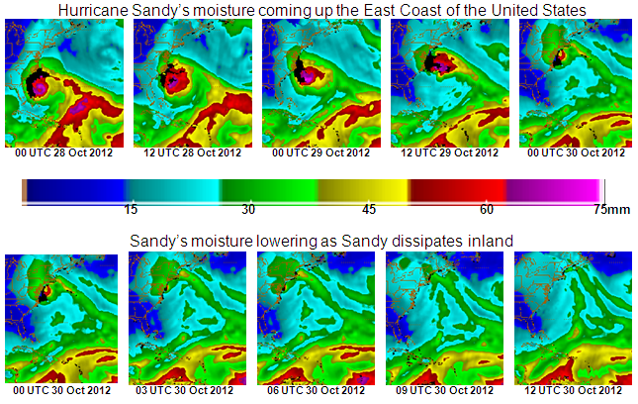
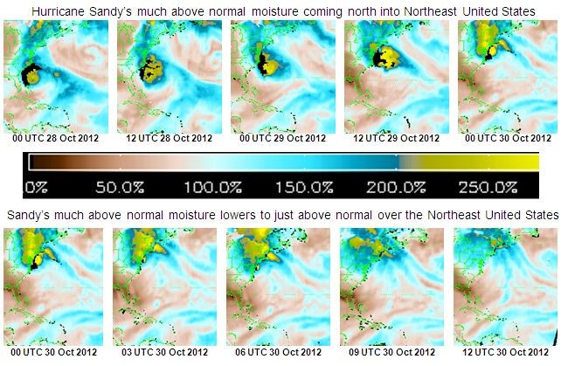
NESDIS Operational Blended TPW Products System
Limin Zhao¹, Stanley Kidder², Sheldon Kusselson¹, John Forsythe², Andrew Jones ², Ralph Ferraro³, Jiang Zhao⁴, Clay Davenport⁵
¹NOAA/NESDIS/OSPO/Satellite Products and Service Division
²Cooperative Institute for Research in the Atmosphere, ³NOAA/NESDIS/STAR; ⁴NASA/JPSS , ⁵SGT
Blended Total Precipitable Water (TPW) - a multi-sensor merged product
  Eliminates the bias of retrievals from various sensors/retrieval algorithms through histogram matching (Kidder and Jones, 2007)
  Provides a unified, meteorologically significant moisture field for satellite analysts and weather forecasters.
  Its companion product - Percentage of TPW Normal derived from climatology
Data Sources
  Ocean – TPW from NOAA-15, -16, -17, -18, -19 and Metop-A, DMSP F16 and F18
  Land – TPW from NOAA-18, -19 and Metop-A over global, and also GOES-West & East and GPS-Met over CONUS
  Upcoming: Metop-B, NPP, Megha-Tropiques, GCOM AMSR-2 to be included in next couple of years
  Beyond, JPSS, GOES-R, GPM, etc.
Applications
  Improving analysis and prediction of heavy precipitation and flash flood
  Getting more timely and continuous spatial information about moisture transfer/ “surges”.
  Monitoring of the “atmospheric rivers” (ARs)
Coming to see our poster for more details on products, their applications and data access
Hurricane Sandy observed from bTPW
W-23
Notes:
W23

Slide 15
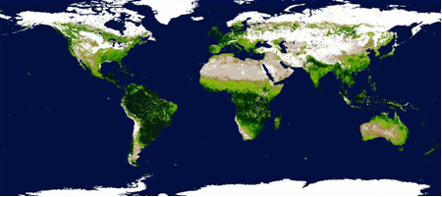
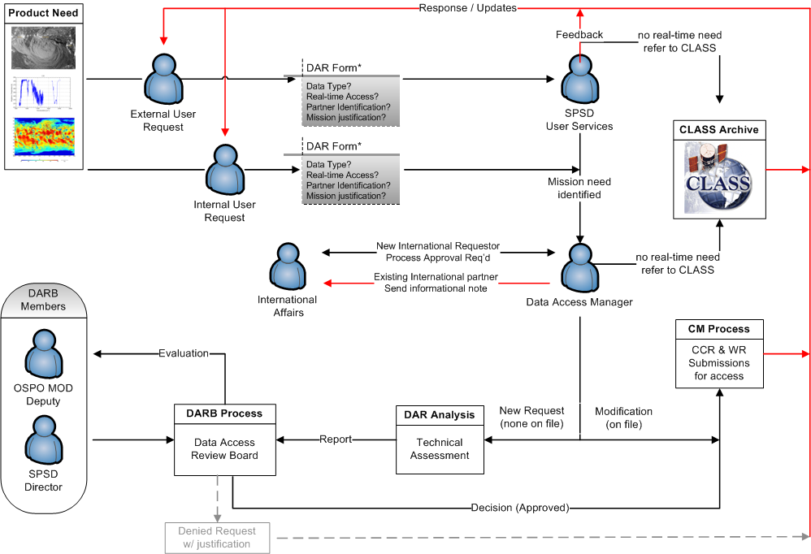
SNPP/JPSS Data Access Process and Operational Products
in Development at NOAA/NESDIS
Shuang Qiu, Christopher Sisko, Antonio Irving and Jingsi Gao
NOAA/NESDIS Office of Satellite and Product Operations (OSPO), College Park, MD
SNPP/JPSS provides observation continuity and new capabilities:
  OSPO policy on data access and distribution of environmental satellite data and products guides SNPP/JPSS data access via an established process.
  Operational products of SNPP serving user community are currently underway.
  Product generation and distribution of large volumes of data are a significant challenge for the existing infrastructure.
SNPP/JPSS products under development:
  ACSPO SST
  Green Vegetation Fraction
  Polar Winds
  MiRS
  NUCAPS
  Blended products e.g. SST, rainrate, etc.
NESDIS OSPO Data Access Policy available at:
http://www.ospo.noaa.gov/Organization/About/access.html
W-25
Weekly 4-km Green Vegetation Fraction map from VIIRS GVF team
Notes:
W25

Slide 16
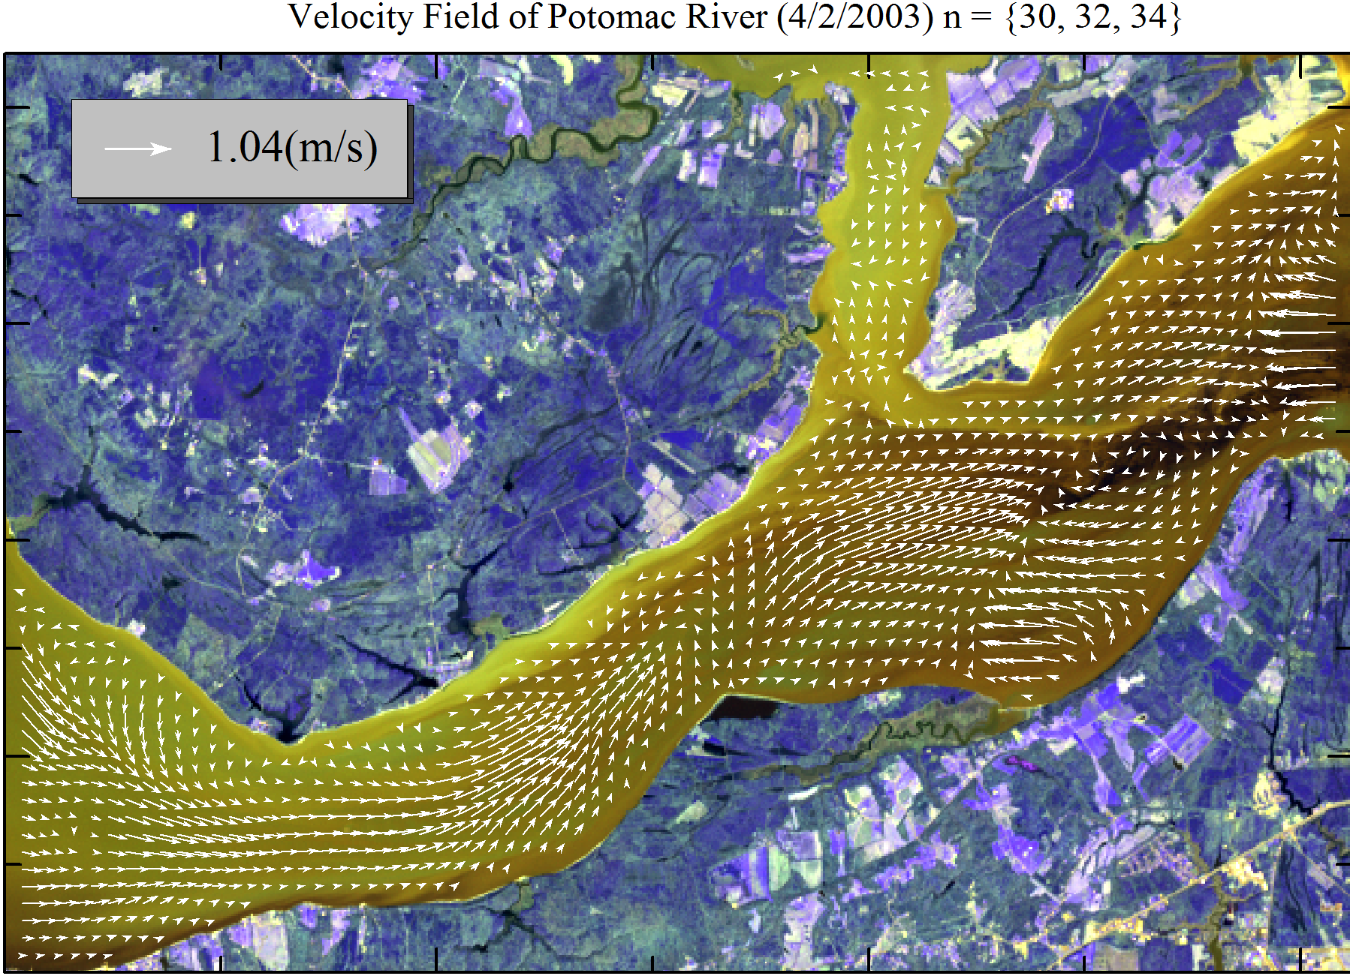
Estimation of Surface Velocity from Geostationary Satellite Multiband Imagery
Wei Chen and Richard P. Mied
Naval Research Laboratory, Remote Sensing Division, Washington, DC
A New Inverse Model for Retrieving Velocities
  Employ multiband images for complementary looks at the coherent structures
  Constrain velocity field to satisfy nonlinear surface tracer conservation equation
  Develop a unified adaptive framework to solve the nonlinear system of equations
  The retrieved velocities are the Global Optimal Solution (GOS)
Retrieved Velocities from LandSat and ASTER Images
W-32
Notes:
W32

Slide 17
Coastal Optical Characterization Experiment (COCE) Activities at STAR
Michael Ondrusek and Eric Stengel
NOAA/NESDIS/STAR/SOCD, College Park, MD
VIIRS Ocean Color In Situ Validation
  Florida Keys
  Hawaii
  Chesapeake Bay
Ocean Color Applications
  Total Suspended Matter
  Chesapeake Bay Runoff
  Red Tide Characterization
VIIRs validation, Hawaii, September 11, 2012
W-33
Notes:
W33

Slide 18
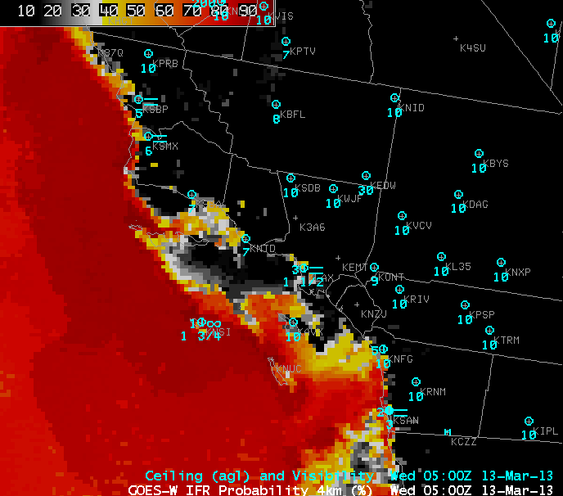
Introduction of a New Suite of Fog/Low Stratus (FLS) Products into NWS Operations via the Satellite Proving Ground
Michael Pavolonis, Corey Calvert*, Scott Lindstrom* and Chad Gravelle**
NOAA/NESDIS Center for Satellite Applications and Research Advanced Satellite Product Branch, Madison, WI
*Cooperative Institute for Meteorological Satellite Studies, Madison, WI
** Cooperative Institute for Meteorological Satellite Studies, Kansas City, Missouri
Algorithm fuses satellite with other data sets (e.g. NWP, SST, etc…) to estimate the probability of different aviation flight rule categories and estimate the thickness of fog layers
A summary of forecaster feedback and some examples of how the products are being used will be presented
GOES-R IFR probabilities offshore Southern California
W-35
Notes:
W05-3

Slide 19
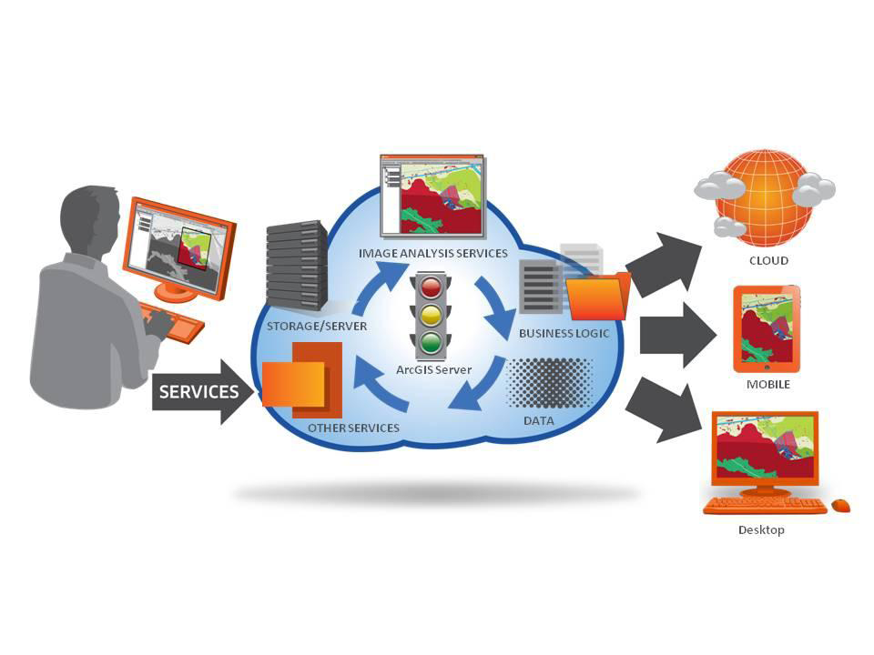
ENVI & IDL Services Engine:
Earth and Planetary Image Processing for the Cloud
Thomas Harris
Exelis Visual Information Solutions, Boulder, CO
Enterprise deployment of COTS Earth Science Geospatial Platform
  Existing IDL and ENVI code can be published for use in the enterprise
  Large-scale parallel computation is accessible via master/worker architecture
  Easy-to-use HTTP-based RESTful messaging for
IDL and ENVI Service Authoring, Deployment & Consumption
W-37
Notes:
W37

Slide 20
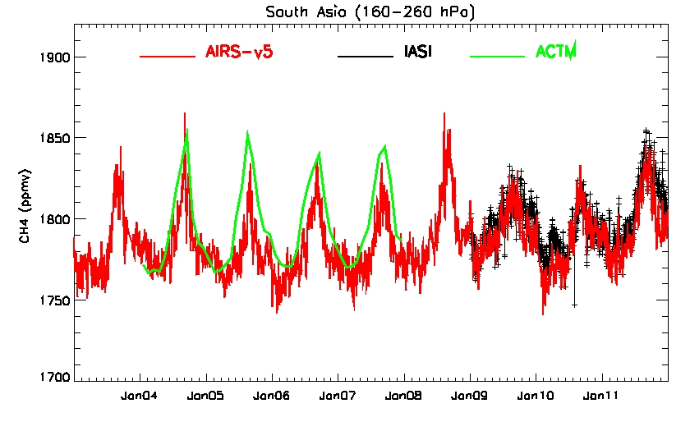
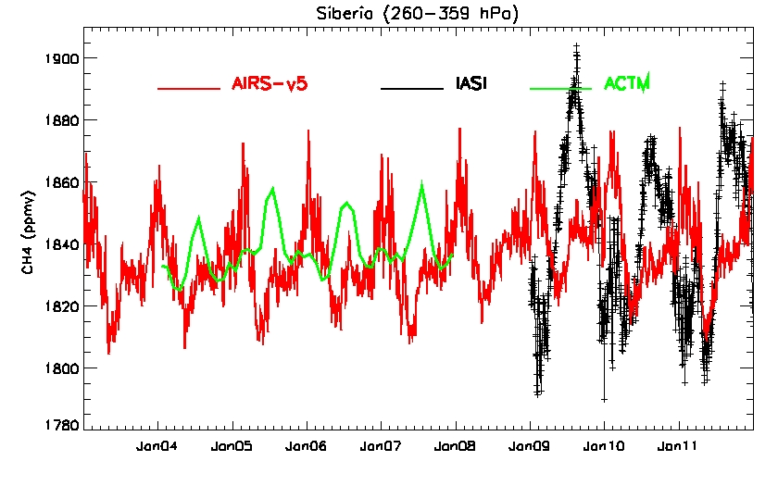
Satellite Observations of Mid-upper Tropospheric Methane using CrIS and its comparison with AIRS and IASI
Xiaozhen Xiong, Chris Barnet,
Antonia Gambacorta, Eric S. Maddy, Thomas.S.King
Atmospheric Methane (CH₄) from CrIS on NPP and JPSS, in conjunction with AIRS and IASI will provide a monitoring of CH₄ change and its feedback with climate change over 20 years
  Retrieval of CH₄ from CrIS on NUCAPS is characterized;
  It is expected the full spectrum will
  improve CH₄ retrieval;
Simulated ABI (Advanced Baseline Imager) data
W-41
Notes:
W41

Slide 21
Metop-B HIRS Cal/Val Summary
University of Maryland/ESSIC, NOAA/NESDIS/STAR
Metop-B HIRS on-orbit SIOV & Cal/Val activity started on 16 Oct, test results reviewed on 28 Nov as scheduled.
Test tasks including: BB temperature, channel noises, L1B data assessment, Geo-location evaluation, ICVS trending, et al.
NEdN of all IR channels and NEdA of VIS channel meet specification(top figure).
HIRS L1B data are evaluated with CRTM model simulation(middle figure) and NPP/CrIS observation(bottom figure) and reached coincident conclusion, biases are within 1K for all IR channels except ch1 and ch16.
NEdN
Metop-A
Metop-B
W-42
Notes:
W42

Slide 22
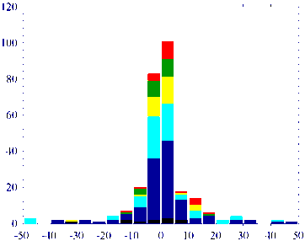
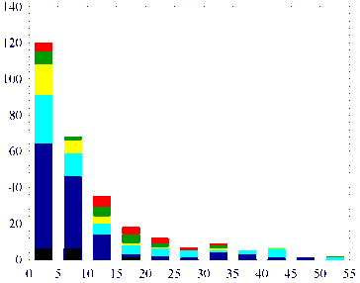
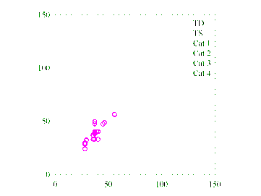
ATMS/AMSU Humidity Sounders for Hurricane Study
Xiaolei Zou¹, Qi Shi¹, Zhengkun Qin¹, and Fuzhong Weng²
¹Department of EOAS, Florida State University
²NOAA/STAR/NESDIS, Washington D. C.
The ATMS (channels 17-22)
and MHS provide useful information within and
around hurricanes
Frequency
Frequency
Frequency
  TC location and radius of
  maximum wind can be
  determined from MHS
  channel 2 (157 GHz)
Distance (km)
GOES-13 Ch4
Cloudy Points
  A new cloud detection
  algorithm is developed
  for ATMS/MHS and
  can be implemented
  into HWRF
W-47
Notes:
W47

Slide 23
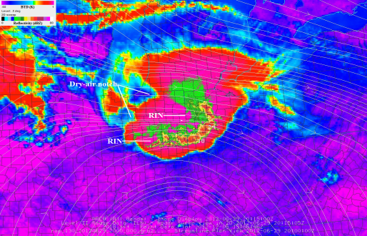
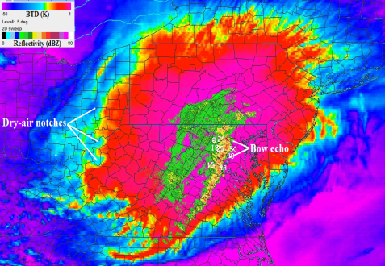
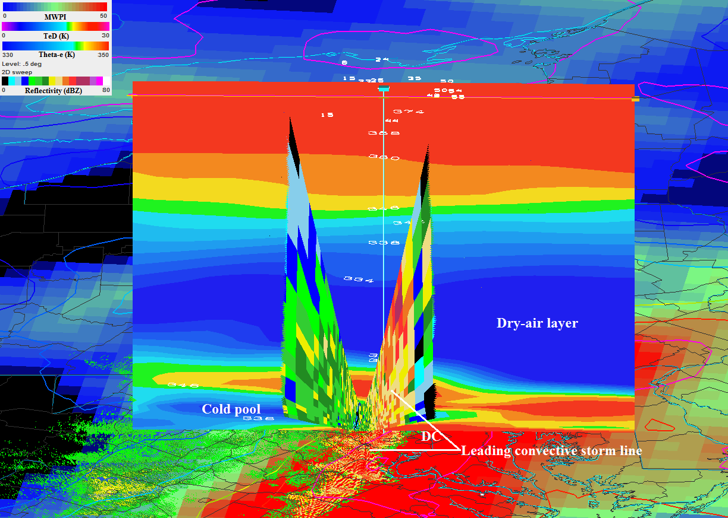
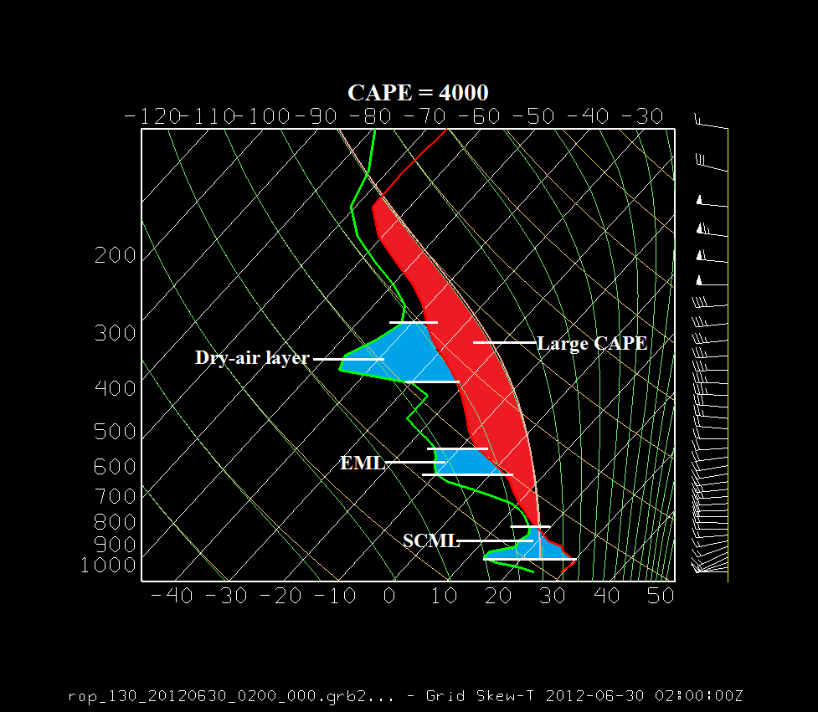
A Downburst Study of the June 2012 Derecho
Kenneth L. Pryor and Colleen Wilson
NOAA/NESDIS Operational Products Development Branch (OPDB)/
Dept. of Atmospheric and Oceanic Science, Univ. of MD
College Park, MD
GOES-13 and NEXRAD observed widespread downburst activity with the June 2012 Derecho
  Severe downburst events from the time of initiation over northern Indiana to the time that the derecho moved over the Atlantic coast have been documented.
  Downburst clusters were primarily responsible for regions of enhanced severe winds.
GOES WV-IR BTD-NEXRAD composite imagery (top); NEXRAD-Theta-e cross section (bottom left), RAP model sounding profile over Reston, Virginia (bottom right)
W-48
Notes:
W48

Slide 24
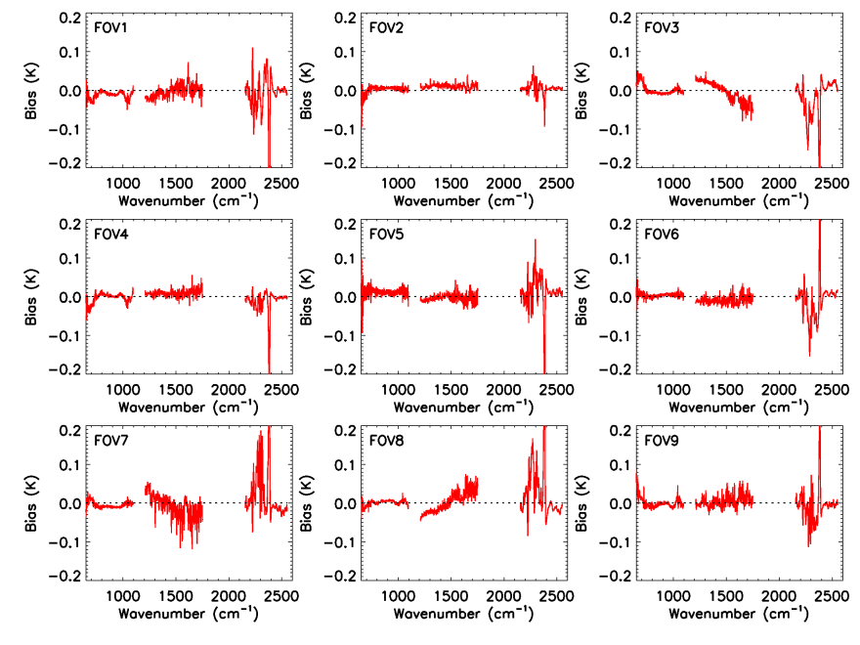
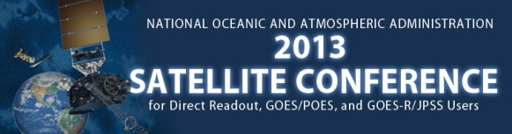
Assessment of S-NPP CrIS Radiometirc and Spectral Accuracy using Community Radiative Transfer Model
Yong Chen¹, Yong Han², and Fuzhong Weng²
¹ UMD/ESSIC, ²NOAA/NESDIS/STAR, College Park, MD
CrIS SDR meets the high quality standard for the usage by NWP and the scientific community
  FOV-2-FOV variability is small (less than 0.1 K); The sweep direction bias among FORs is also small. Results from the double difference with IASI show that the differences are within ±0.2 K for most of channels.
  About 3 ppm and 4 ppm uncertainty are found in CrIS SDR data in band 1 (LWIR), and band 2 (MWIR), respectively.
FOV-2-FOV variability and long-term spectral shift
W-51
Notes:
W51

Slide 25
Detection of Earth-rotation Doppler Shift from S-NPP Cross-track Infrared Sounder
Yong Chen¹, Yong Han², and Fuzhong Weng²
¹ UMD/ESSIC, ²NOAA/NESDIS/STAR, College Park, MD
The Doppler shift detected from CrIS observations is very close to theoretical Doppler shift, which indicates that the spectral stability from CrIS instrument is very high.
  The observations from CrIS exhibit a relative Doppler shift up to 2.5 part per-million (ppm) due to the Earth’s rotation near the Equator and at the satellite scan edge for field of regard (FOR) 1 and 30.
  The magnitude of the Doppler shift varies with the latitude and the scan position of the observation.
Doppler shift detected from CrIS observations
W-52
Notes:
W52

Slide 26

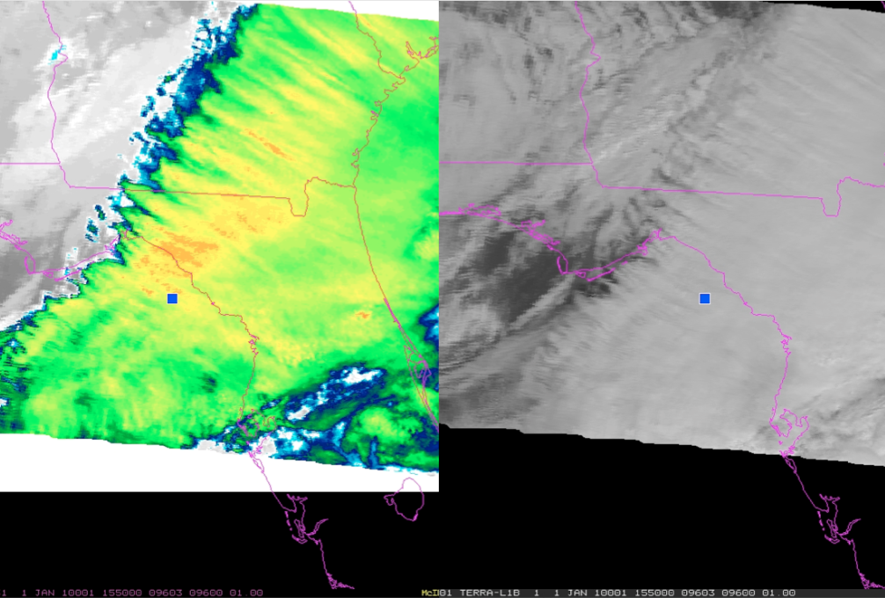
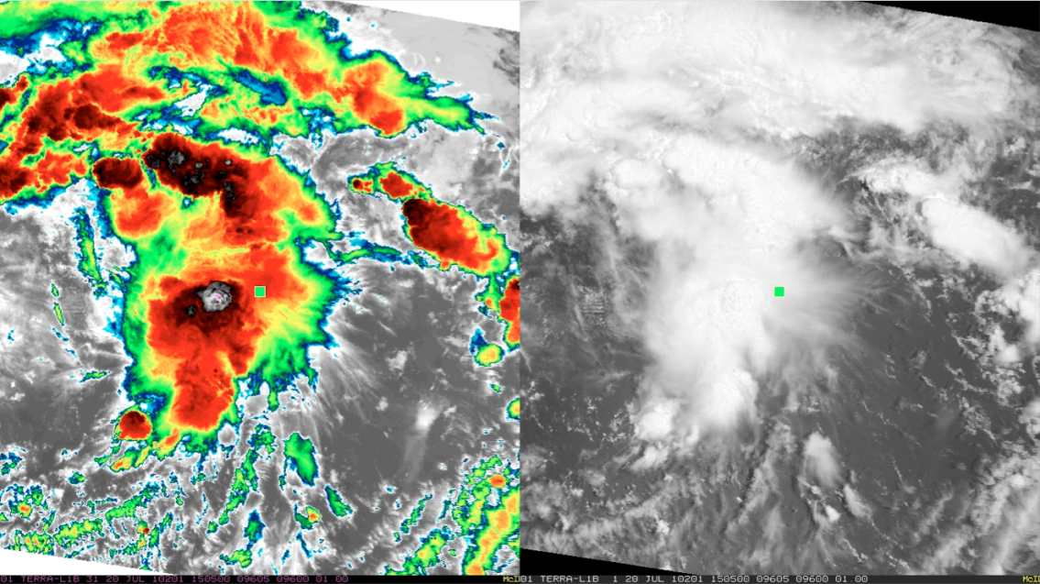
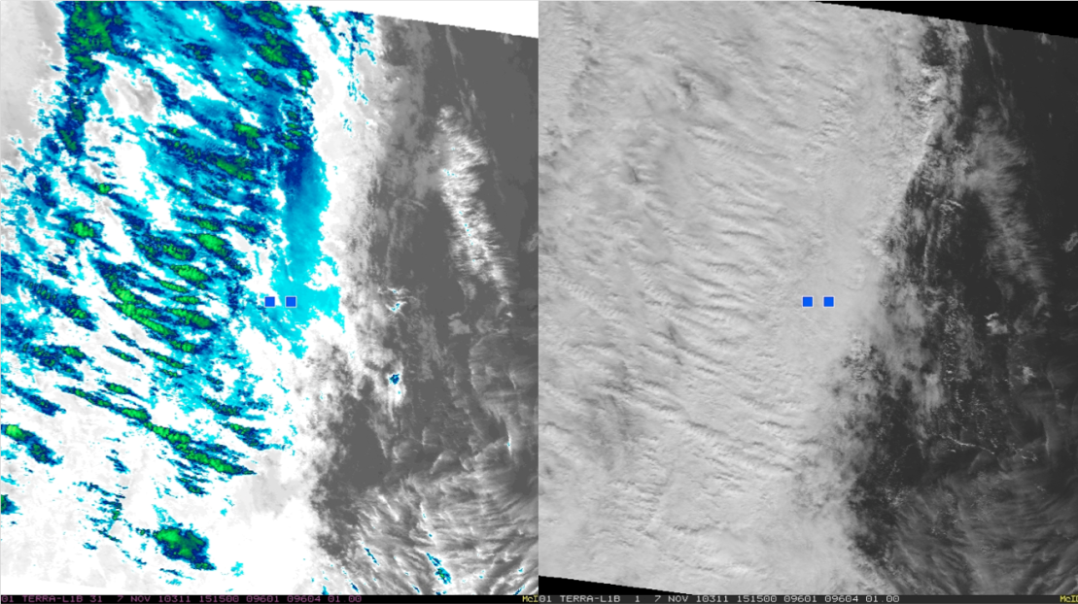
Satellite-Observed Signatures Associated with Moderate to Severe Turbulence Events
Amanda Terborg – UW CIMSS/SSEC and AWC, Kansas City, MO
Kristopher Bedka – SS&A at NASA LaRC, Hampton, VA
- The most prominent source of MOG turbulence reports from 2010-2011 were the mountain/gravity wave and transverse banding features
- The majority of reports were well away from the robust convective cores, but were often associated with newly developing convection
0.25 > EDR < 0.35
0.35 >= EDR < .45
EDR >= .45
W-58
- While satellite data is very useful in identifying these signatures, it should not be used as a standalone. NWP fields and atmospheric conditions must also be analyzed
Notes:
W58

Slide 27



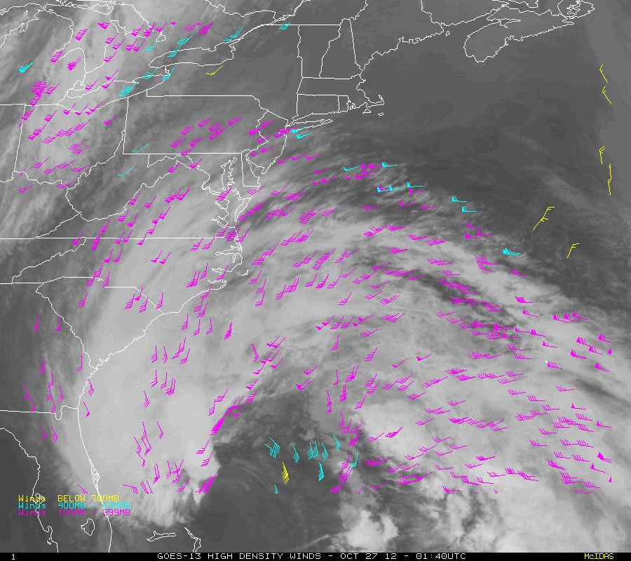
Title: Atmospheric Motion Vectors Derived from the
Future GOES-R Advanced Baseline Imager (ABI):
Methods and Error Characteristics
Jaime Daniels, Wayne Bresky, Steven Wanzong, Andrew Bailey, Chris Velden
Hurricane Sandy
New, innovative approach to derive
atmospheric motion vectors
Development, testing, and validation
done with GOES, Meteosat/SEVIRI,
and simulated ABI data
Significant reduction in the slow speed
bias typically observed with satellite-
derived winds
Major Goal: Improve the impact of
AMVs on Numerical Weather Prediction
(NWP) forecast skill
High-Level 100-400 mb
Mid-Level 400-700 mb
Low-Level >700 mb
Cloud-drift winds derived from 15-minute GOES-13 11um imagery over Hurricane Sandy over the period October 27 (0140 UTC) through October 30 (1240 UTC) , 2012
W-60

Slide 28
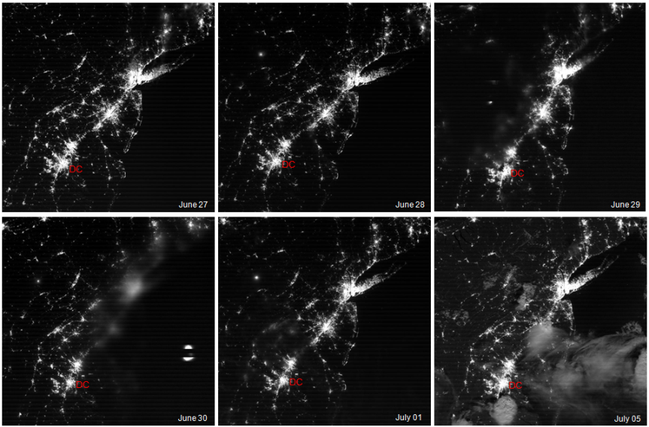
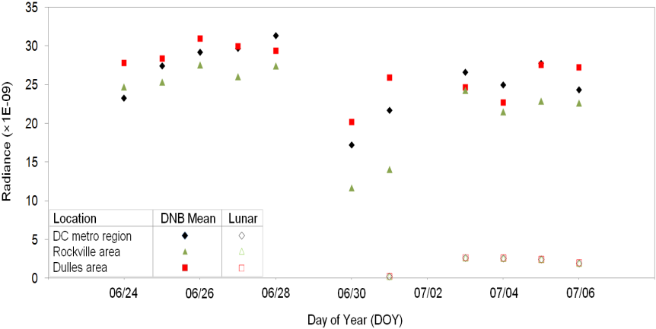
Quantifying Power Outages after Severe Storms using the
S-NPP/VIIRS Day Night Band Radiances
Changyong Caoª, Xi Shao^{b}, and Sirish Uprety^{c}
ªNOAA/NESDIS/STAR, College Park, MD, USA
^{b}Department of Astronomy, University of Maryland, College Park, MD, USA
^{c}CIRA, Colorado State University, CO, USA
This study explores the use of the well calibrated VIIRS Day/Night Band (DNB) for quantifying power outages due to the Derecho storm in the Washington DC metropolitan area in June 2012, and Hurricane Sandy at the end of October 2012 on the east coast of United States.
The results show that the DNB data are very useful for quantifying power outages through light loss detection, but also with some challenges due to clouds, lunar illumination, and straylight effect.
Comparison of power outage and recovery trend determined from DNB data with power company survey shows reasonable agreement, demonstrating the usefulness of DNB for independently verifying and complementing the statistics from power companies.
VIIRS DNB Images and time series of corrected mean DNB radiance during the Derecho storm in Washington DC metropolitan region.
W-61
(b)
Figure 1: (a) VIIRS DNB Images showing nighttime Washington DC metropolitan region (marked with red “DC”) from June 27 to July 05, 2012; (b) Time series of corrected mean DNB radiance and corresponding lunar radiance corrections [W/(cm²-sr)] at selected ROIs (DC metro area size: 40km × 40km; Rockville and Dulles area size: 10km × 10km) during the derecho.
Notes:
W61

Slide 29
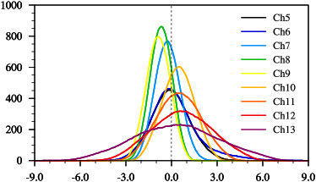
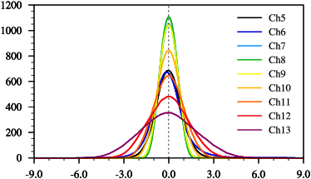
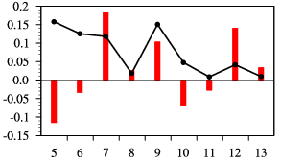
Absolute Calibration of ATMS Upper Level Temperature Sounding Channels Using GPS RO Observations
Xiaolei Zou¹, Lin Lin², and Fuzhong Weng²
¹ Department of Earth, Ocean and Atmospheric Sciences, Florida State University, U.S.A.
² NOAA/NESDIS/STAR, College Park, Maryland, U.S.A.
The COSMIC RO data are used to estimate ATMS TDR absolute accuracy for chs 5-13.
  Mean biases of observed TDR are positive for chs 6, 10-13 and negative for chs 5, 7-9, with magnitude less than 0.7K
  After bias removal, the residual errors have normal Gaussian distribution
  The difference of simulations from measured SRF versus Boxcar SRF using LBL RTM is around 0.2K
Before
After
Frequency
O-B^{GPS} (K)
O-B^{GPS} (K)
Mean & Std. Dev. s K)
Channel
W-63
Notes:
W63

Slide 30
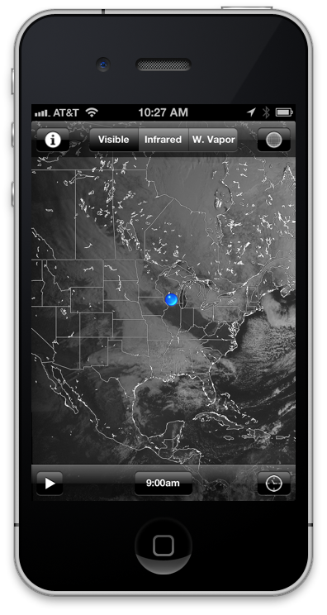


Real-time Access to Weather Satellite Data
and Products on Mobile Devices
D. Santek, D. Parker, R. Dengel, S. Batzli, N. Bearson
University of Wisconsin-Madison
Madison, WI
Over 150 weather products
  View on mobile & desktop browsers
Global satellite imagery
  Full resolution visible, infrared, and water vapor composite images
  Updated hourly
  View with free iPhone/iPad App
http://wms.ssec.wisc.edu/app
Visible image on iPhone
W-64
Notes:
W64

Slide 31


Upscaling of in situ Land Surface Temperature for Satellite Validation
Robert Hale¹, Yunyue Yu², and Dan Tarpley³
¹CIRA/Colorado St. Univ., ²NOAA/NESDIS STAR, ³Short & Assoc.
Mismatches in scales of measurement between in situ and coarse-resolution satellite LST data result in errors that adversely affect validation efforts
  Regression models have been developed in an effort to reduce these errors
  Statistically significant error reduction is seen at U.S. Climate Reference Network sites, though absolute reduction is fairly small (~0.2 K)
http://www1.ncdc.noaa.gov/pub/data/uscrn/documentation/site/photos/stationsbystate_hires.pdf
USCRN Site
FOV: 1.6 m
Satellite LSTs
Resolution: 1km
1 km
W-65
Notes:
W65

Slide 32

W-66. Angular Anisotropy of Satellite Observed Land Surface Temperature
Konstantin Y. Vinnikov, Yunyue Yu, Mitchell D. Goldberg, Dan Tarpley, Peter Romanov, Istvan Laszlo, Ming Chen. University of Maryland and NESDIS/NOAA
We developed a technique to convert directionally observed LST into direction-independent equivalent physical temperature of the land surface. The anisotropy model consists of an isotropic kernel, an emissivity kernel (LST dependence on viewing angle), and a solar kernel (effect of directional inhomogeneity of observed temperature). Application of this model reduces differences of LST observed from two satellites and between the satellites and surface ground truth -SURFRAD station observed LST.
Figure . Estimated universal angular dependence of
satellite observed LST for different solar zenith angles ξ. T(γ,ξ,β)/T₀ is displayed in a polar coordinate system (viewing zenith angle γ – radial coordinate 0-90º, relative azimuth β - angular coordinate 0-360º). The value of this function at the center of each subplot (γ=0) is equal to one, by definition.
Publication: Vinnikov, K. Y., Y. Yu, M. D. Goldberg, D. Tarpley, P. Romanov, I. Laszlo, and M. Chen (2012), Angular anisotropy of satellite observations of land surface temperature, Geophys. Res. Let. , 39, L23802, doi:10.1029/2012GL054059
W-66
Notes:
W66

Slide 33

Arctic and Antarctic Satellite Composites:
Construction and Applications
Matthew Lazzara, Dave Santek, Rick Kohrs, Brett Hoover, & Dave Mikolajczyk
Antarctic Meteorological Research Center, Space Science and Engineering Center, CIMSS, University of Wisconsin-Madison, Madison, WI
A satellite mosaic using both Polar-orbiting & Geostationary Satellites
  Made hourly at 4 km resolution over both polar regions, 5 channels (IR, WV, Vis, LWIR, SWIR)
  Made considering limb darkening, pixel resolution, observation time, etc.
  Applications in forecasting, research, including making Atmospheric Motion Vectors (AMVs) from a version of the composite
Arctic Infrared Composite Satellite Image
W-68

Slide 34

McIDAS-V: A Powerful Visualization and Data Analysis Tool for Geostationary Environmental Satellites
D. Santek, T. Achtor, T. Rink, W. Straka, J. Feltz, R. Schaffer
University of Wisconsin-Madison
Madison, WI
Data Analysis and Visualization
  Free, open-source software
  Import data from GOES, MSG, MTSAT, FY2, GOES-R
  Overlay grids and observations
  Use with data from EUMETCast and GEONETCast Americas
McIDAS-V screenshot
http://www.ssec.wisc.edu/mcidas/software/v/
W-69
Notes:
W69

Slide 35


Monitoring Quality of VIIRS Vegetation Index (VI) EDR Retrievals With MODIS and AVHRR VI Data Using a Web-based Tool
Nikolay V. Shabanov and Marco Vargas
NOAA/NESDIS/STAR/SMCD, College Park, MD
  The VIIRS VI EDR product (TOC EVI and TOA NDVI) is operational since November 2011
  A Near Real Time (NRT) web-based automated tool has been set up at STAR to continuously monitor VIIRS VI global time series (statistical performance, potential anomalies/artifacts, impact of environmental conditions, including residual clouds, aerosols, view/observation geometry, etc). http://www.star.nesdis.noaa.gov/smcd/viirs_vi/Monitor.htm
  Major component in assessment of VIIRS VI product accuracy is comparison with with key heritage data sets from MODIS and AVHRR.
  The VIIRS VI-EDR reached Beta Maturity Status in February 06 2013. The product will be available to the public with a Beta level quality as of May 02, 2012
Top panel: 16-day composite of VIIRS TOC EVI for Jan1-16, 2013. Bottom panel: Statistics on consistency between VIIRS and MODIS VI- time series of mean and STD) of per-pixel difference between VIIRS and MODIS Aqua TOC EVI, calculated over all land and individual vegetation types (7 biomes).
W-74
Notes:
W74

Slide 36




Radiometric Comparison between Suomi NPP VIIRS and AQUA MODIS using Extended Simultaneous Nadir Overpass in the Low Latitudes
Sirish Upretyª Changyong Cao^{b} Slawomir Blonski^{c} Xi Shao^{d} ªCIRA, Colorado State University, ^{b}NOAA/NESDIS/STAR, ^{c, d}CICS, University of Maryland
Extended Simultaneous Nadir Overpass (SNO-x) approach for quantifying radiometric accuracy and calibration stability of S-NPP VIIRS
  Extends SNO orbits to low latitudes for inter-comparing sensors over a wide dynamic range (analyzed over desert and ocean).
  VIIRS measurements for VNIR radiometric bands agree with MODIS within 2% (uncertainty < 1%).
  Antarctica Dome C site can be used to evaluate and verify the calibration stability and radiometric bias calculated using SNO-x approach.
M-1
M-5
Top: SNO-x Events Mid: VIIRS Bias using SNO-x Bottom: VIIRS Bias at Antarctica Dome C
W-75

Slide 37
Monitoring Quality of VIIRS Vegetation Index (VI) EDR Retrievals With MODIS and AVHRR VI Data Using a Web-based Tool
Nikolay V. Shabanov and Marco Vargas
NOAA/NESDIS/STAR/SMCD, College Park, MD
  The VIIRS VI EDR product (TOC EVI and TOA NDVI) is operational since November 2011
  A Near Real Time (NRT) web-based automated tool has been set up at STAR to continuously monitor VIIRS VI global time series (statistical performance, potential anomalies/artifacts, impact of environmental conditions, including residual clouds, aerosols, view/observation geometry, etc). http://www.star.nesdis.noaa.gov/smcd/viirs_vi/Monitor.htm
  Major component in assessment of VIIRS VI product accuracy is comparison with with key heritage data sets from MODIS and AVHRR.
  The VIIRS VI-EDR reached Beta Maturity Status in February 06 2013. The product will be available to the public with a Beta level quality as of May 02, 2012
Top panel: 16-day composite of VIIRS TOC EVI for Jan1-16, 2013. Bottom panel: Statistics on consistency between VIIRS and MODIS VI- time series of mean and STD) of per-pixel difference between VIIRS and MODIS Aqua TOC EVI, calculated over all land and individual vegetation types (7 biomes).
W-77

Slide 38



Operational Impacts of NASA SPoRT Products
Brian J. Guyer & Deirdre Kann
National Weather Service
Albuquerque, NM
The partnership between NWS Albuquerque & NASA SPoRT has transitioned innovative satellite imagery into forecast operations.
  SPoRT products supplement data void areas, improve various office forecast programs, and enhance decision support services.
  The products serve as an effective training tool for future capabilities of GOES-R.
  One of our recent efforts focuses on the evaluation of a suite of RGB products and their impact on the
  detection of critical fire weather patterns.
MODIS
RGB
Image
GOES
Water
Vapor
Image
MODIS Airmass Red-Green-Blue (RGB) Image
200pm Friday, February 8, 2013
W-79
Notes:
W79

Slide 39

Validation and Improvement of the GOES-R Rainfall Rate Algorithm
Robert J. Kuligowski, Yaping Li
NOAA/NESDIS/STAR Satellite Meteorology and Climatology Division (SMCD)
College Park, MD
A simplified GOES-R Rainfall Rate algorithm applied to current GOES:
  Supports GOES-R Proving Ground and working with users for feedback
  Has been used to identify significant false alarms in their algorithm and their causes
  Will also be used to evaluate further algorithm improvements
Loop of the current-GOES version of the GOES-R Rainfall Rate algorithm during 23 July 2012.
W-81
Notes:
W81

Slide 40

NASA SPoRT GOES-R Proving Ground Activities
Kevin Fuell, Gary Jedlovec, Andrew Molthan, Matthew Smith, Geoffrey Stano, Kevin McGrath, and Brad Zavodsky
Short-term Prediction Research and Transition (SPoRT) Center
Huntsville, Alabama
SPoRT provides a suite of products to collaborative WFOs and National Centers to demonstrate the future utility of ABI and GLM products
Forecast issues / applications:
severe weather and lightning safety
reductions in ceiling / visibility due to low clouds and fog
dynamical structure of storms
convective initiation
QPE
Improved situational awareness
Table at right indicates the offices that are receiving the various Proving Ground products
GOES-R Proxy and Demonstration Products transitioned by SPoRT
W-82

Slide 41
Operational Ozone Products Available from NOAA/NESDIS
Vaishali Kapoor
NOAA/NESDIS /OSPO/Satellite Products Services Division(SPSD)
There are many agencies, groups and instruments making ozone products from satellites. This poster explains the operational ozone products produced by the US National Oceanic and Atmospheric Administration (NOAA), National Environmental Satellite, Data, and Information Service (NESDIS) that are available to support near-real time operations. These products are used by United States and international environmental modeling groups for input into weather models, into other satellite algorithms to enhance radiative transfer models, for UV forecast models, and for climate monitoring. These products are available to users in a variety of formats such as BUFR, Binary, GRIB, GRIB2, and ASCII. Poster will also provide information on how to obtain operational access to the following products.
NOAA currently produces near-real-time (NRT) total ozone and profile ozone products from the SBUV/2 instruments designed to measure scene radiance in the spectral region from 160 to 400 nm on the NOAA Polar-orbiting Operational Environmental Satellites (POES) N16 and N17, and N19.
The GOME-2 instrument was designed by the European Space Agency to measure radiation in the ultraviolet and visible part of the spectrum (240 - 790 nm) and derives measurements of atmospheric ozone and other trace gases. It is a scanning instrument (scan width 1920 km) with near global coverage daily. The field-of-view on the ground is 80 km X 40 km.
TOAST is a near real-time operational ozone map generated by combining Advanced TIROS Operational Vertical Sounder (ATOVS) tropospheric and lower stratospheric (4 to 23 km) ozone retrievals with SBUV/2 spatially smoothed mid-to-upper stratospheric (24 to 54 km) layer ozone retrievals. Daily products are created in imagery (png), binary or GRIB format.
W-85
Notes:
W85

Slide 42






NOAA/NESDIS SOUNDING SYSTEMS DATA PRODUCTS AND SERVICES
A.K. Sharma NOAA/NESDIS/OSPO/SPSD/SPB (NCWCP)
NOAA/NESDIS Sounding Systems
ATOVS (NOAA-15, 18, 19, Metop-1 and Metop-2),
GOES Sounders (GOES-East and West),
IASI (Metop-1, and Metop-2)
Operational Sounding Products
ATOVS - Near real-time atmospheric temperatures at 42 levels (from surface to 0.1 mb) and water vapor mixing ratios at 19 levels (from surface to 200 mb) with a 40 km horizontal resolution derived from the AMSU-A and HIRS measurements on board the NOAA polar orbiting and European Metop satellites series. AMSU-A brightness temperatures, HIRS channels radiances, layer temperatures and layer thicknesses (15 layers with 40 km resolution), geopotential heights, tropopause pressure, tropopause temperature, total ozone, cloud amount, cloud top temperature, cloud top pressure, layer precipitable water, cloud liquid water and total precipitable water in binary and BUFR format.
GOES - The products include standard imagery which is an image product of the raw sounder data and derived level 2 products (Clear-sky Radiances, Layer & Total Precipitable Water, Cloud-top retrievals (pressure, temperature, cloud amount), Surface Skin Temperature, Temperature and Moisture Profiles, Atmospheric Stability Indices, water Vapor Winds and Total Ozone.
IASI - Temperature and humidity profiles with vertical accuracies of 1 degree Kelvin and 10 % per 1-km layer respectively, water vapor mixing ratio, Ozone mixing ratio, mixing ratio of CO, CO2, CH4, trace gases, and the cloud cleared radiances (CCR) on a global scale.
W-86
Notes:
W86

Slide 43

A Dynamic Enhancement Background Reduction Algorithm (DEBRA) Applicable to GOES-R ABI
Steven D. Miller
Cooperative Institute for Research in the Atmosphere, Colorado State University
Ft. Collins, CO
GOES-R ABI will offer new and improved dust detection capabilities
  Traditional 12-11 μm ‘reverse split-window’ augmented by 8.5-11 μm and daytime 0.47 and 1.38 μm
  Uses surface emissivity and temperature climatology to reduce land-surface false alarms
  Provides quantitative detection confidence factor [0-1]
Example DEBRA Enhancement over the Middle East
W-87
Notes:
W87

Slide 44


Developing a compositing algorithm for retrieval of green vegetation fraction from the Suomi NPP satellite
Zhangyan Jiang, Junchang Ju, Marco Vargas, Ivan Csiszar
NOAA/NESDIS /STAR College Park, MD
A Maximum View-angle Adjusted SAVI (MVA-SAVI) compositing algorithm is developed for the SNPP GVF system
  Select high quality observations from low view zenith angles
  Favor observations close to the nadir view
  High but not necessary maximum vegetation index values are selected
Histograms of global sensor zenith angles composited by MVC and MVA-SAVI algorithms
W-88
Notes:
W88

Slide 45
Poster Preview
Thanks to all the poster presenters!
Note the large range of activities!
Thanks to the whole poster committee!
2013 NOAA Satellite Conference
College Park, MD
April 10, 2013

