Slide 1

Poster Preview
  Timothy J. Schmit (tim.j.schmit@noaa.gov)
  NOAA/NESDIS/Satellite Applications and Research
Advanced Satellite Products Branch (ASPB)
Madison, WI
Thanks to all the poster presenters!
2013 NOAA Satellite Conference
College Park, MD
April 9, 2013

Slide 2
NSC-2013 Poster Plan
(NCWCP atrium)
Columns
= 25’ 2” between columns
= 16’ 8” between columns
STAIRS
= 11’ 11” between columns
79
~75’
82
67
77
83
89
70
65
86
71
87
74
50
47
75
64
61
60
55
32
29
27
46
43
42
37
13
26
54
51
12
23
36
33
9
22
~90’
8
19
5
18
4
15
1
SECURITY DESK

Slide 3

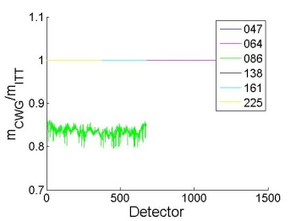
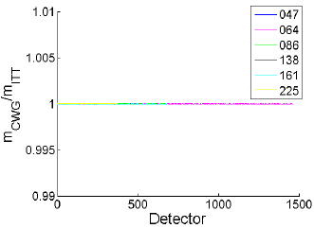
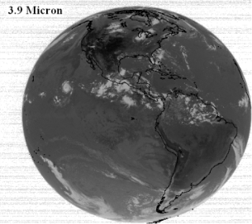
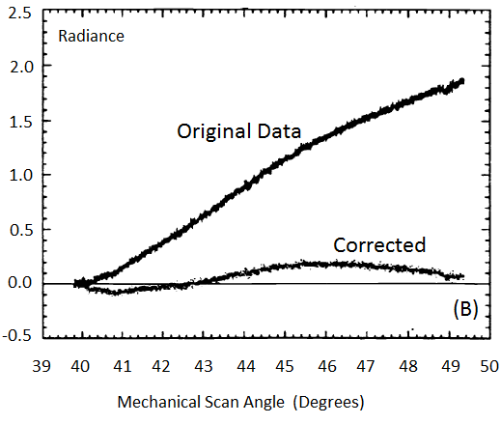
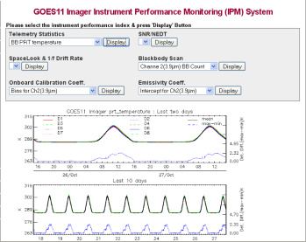
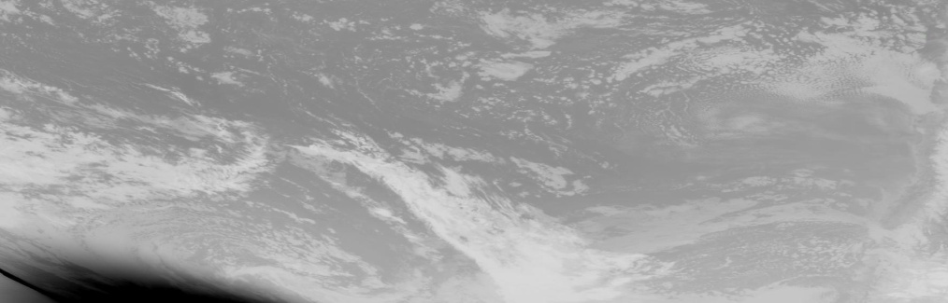

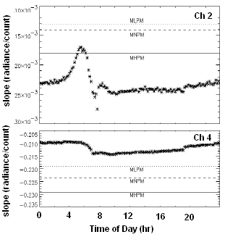
GOES-R Program Calibration and Validation
Robert A. Iacovazzi, Jr.* (1), Edward C. Grigsby (1), Steve Goodman (2), Changyong Cao (3), Jaime Daniels (3), and Kathleen McIntyre (1)
NASA (1), NOAA/NESDIS/GOES-R (2), and NOAA/NESDIS/STAR (3)
E-mail-Robert.A.Iacovazzi@nasa.gov Physical Address - NASA GSFC, Code 410.0, 8800 Greenbelt Rd, Greenbelt, MD 20771
Focus on GOES-R Instrument Calibration/ Validation (Cal/Val) and L1b Product Val
Before (left) and after (right) Government-Vendor reconciliation of scan mirror reflectance value used in ABI test data analysis.
  Pre-launch Cal/Val
    Vendor instrument calibration testing
    Government team validation of testing results
    L1b algorithm design and implementation
  Post-Launch Testing (PLT) Cal/Val
    GOES-R observatory cal/val assets
    Product quality evaluation
    On-board calibration system evaluation
    On-orbit calibration and L1b product anomaly resolution
Example comparison between GOES-R CWG and Vendor cal test analyses: Ratio of CWG to Exelis cal coefficients for ABI reflective channels.
Determine and Correct Scan-Angle Dependent Radiance (e.g., Beaucom et al., Proceedings of SPIE, 1999)
GOES-10 Ch. 4A
GOES-13 Hemispheric Image Tiles
Instrument Noise, Blackbody Temp and Cal Slope Monitoring
GOES-13 eclipse season stray light before fix (left) and after fix (right)
(Courtesy of J. Paul Douglas, OSPO)
T-01
Notes:
T01

Slide 4
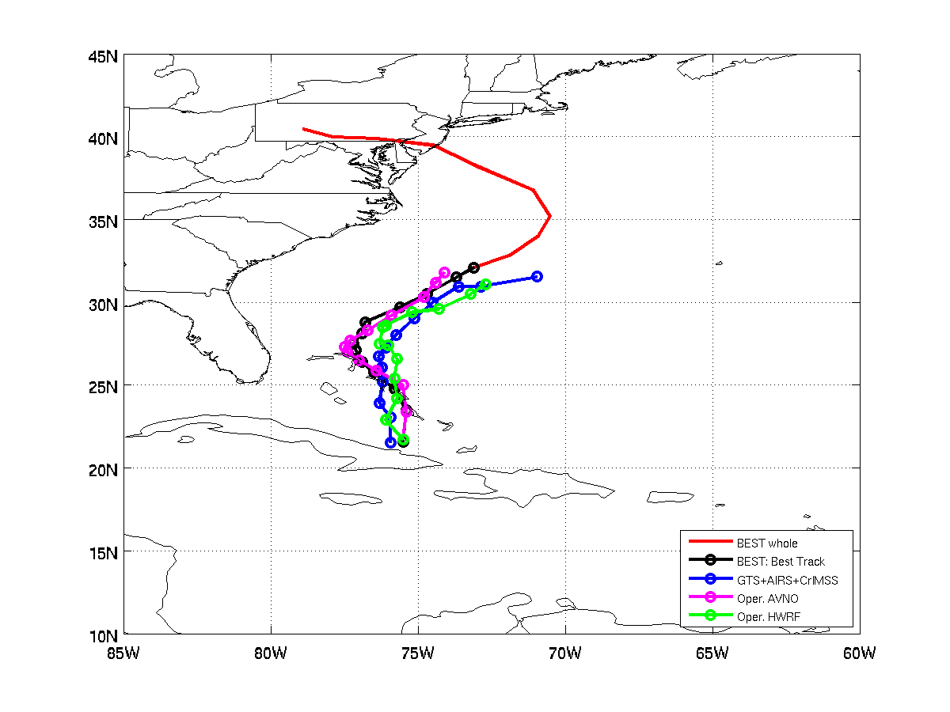
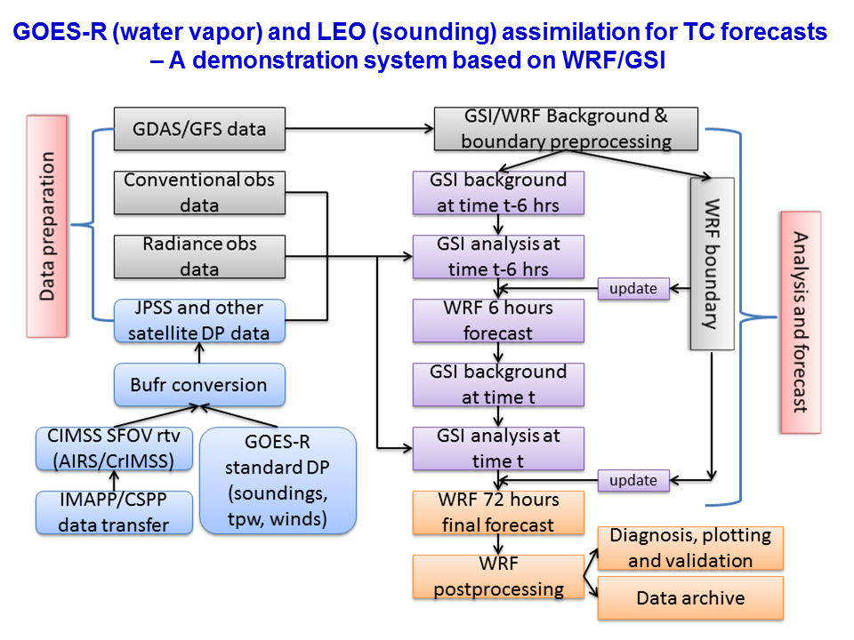
Application of JPSS Sounding and GOES-R Moisture Measurements for Tropical Cyclone Forecasts - A Near Real-Time Assimilation System
Jun Li@, Tim Schmit&, Mitch Goldberg#, Jinlong Li@, Pei Wang@, and John L. Beven*
@CIMSS/SSEC; &STAR/NESDIS; #JPSS Program Office; *National Hurricane Center
T-02
Hurricane Sandy track 72-hour forecasts started from 12 UTC 25 Oct 2012 valid to 18 UTC 30 Oct 2012.
Notes:
T02

Slide 5
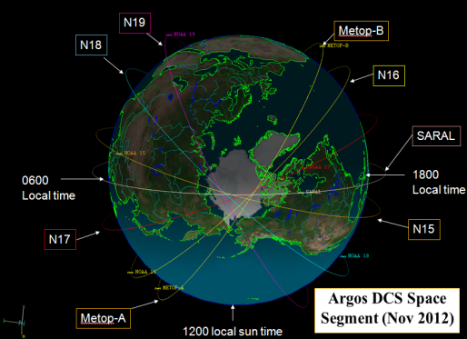
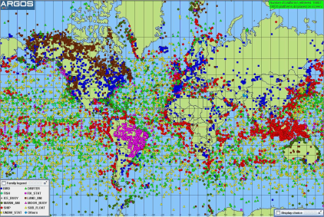
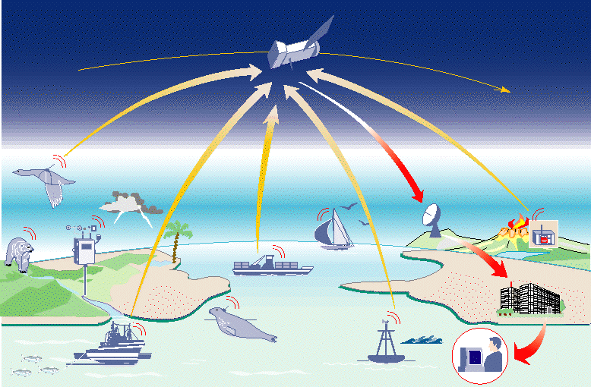
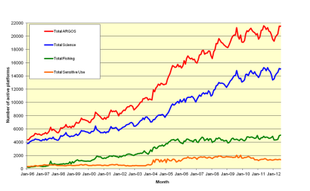
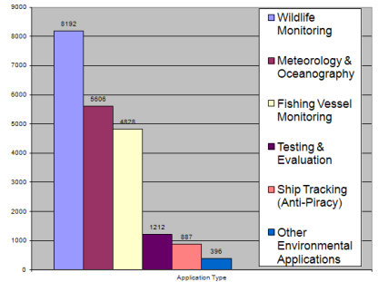

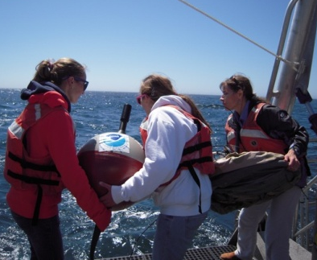
The Future of the Argos
Data Collection and Location System
Scott Rogerson
NOAA/NESDIS/OSPO/SPSD – Direct Services Branch (DSB)
Suitland, MD
Argos DCS Space
Segment (Nov 2012)
Global Distribution of Argos Platforms
Major Applications
Wildlife Studies
Meteorology & Oceanography
Fishing Vessel Monitoring
Ship Tracking (Anti-Piracy)
Growth in Argos Use
(1996-2012)
Future Plans
Space Segment
2016-2030: Metop-C, EPS-SG and JPSS launches
Ground Segment
Optimized HRPT Network (for all satellites)
Argos-4 Instrument (for JPSS+)
Expanded bandwidth
Increased receiver sensitivity and data throughput
Two-way comms w/spread-spectrum downlink
Number of Active Platforms for Major Applications
T-05
Notes:
T05

Slide 6
LARGE WILDFIRE GROWTH DAYS AND
DRY SLOTS IN THE UNITED STATES
Dry Slots influence wildfire wx - abrupt surface drying, decreased fuel moistures, strong gusty winds, rapid increased fire behavior.
Double Trouble State Park Wildfire
WVI “ribbon of dry air”, 1215 UTC, 2 June 2002
Courtesy of Charney and Keyser (2010)
2 June 2002 - 1800, RH lowest, <10% - A drop of 50%+ humidity in 4 hours!
Lowest RH, dew points, highest winds – alignment – rapid increased fire behavior as visible dry slot passes over the fire area.
Winds, 70+ mi/h. Dry cold front. Lower tropospheric pool of dry air.
Fire wx characteristics very similar to Mack Lake Fire of 1980.
T-06
Notes:
T06

Slide 7
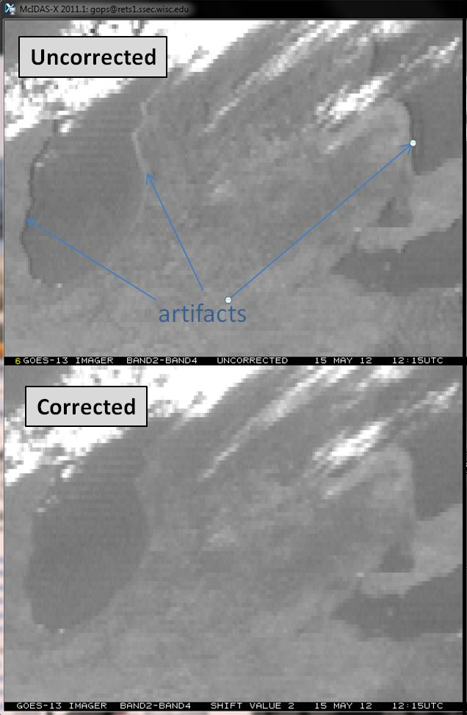
GOES Imager IR Channel to Channel Co-Registration Correction Program
Zhenping Li
SGT Inc, Greenbelt, MD.
The program consists of two components:
  GOES IR Channel to Channel Co-Registration Characterization to monitor and retrieve the co-registration errors between IR channels.
  The Image Resampling on the Images in an IR channel to correct the co-registration errors.
    Will be implemented in GOES Ground System.
    GVAR Block 0 will be updated with the Image resampling status word.
The data quality of the weather products that rely on the combination of the images in the IR channels has improved significantly after the co-registration errors are corrected with the resampled images.
GOES-13 Imager band difference (band 2 – band 4) for the uncorrected (top panel) and corrected images (lower panel).
T-07
Notes:
T07

Slide 8
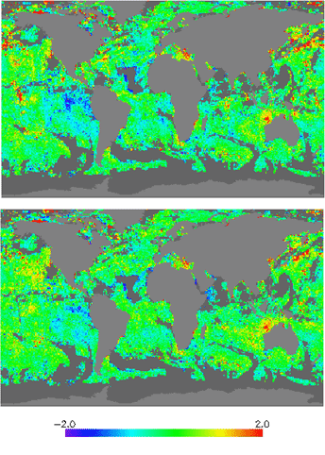
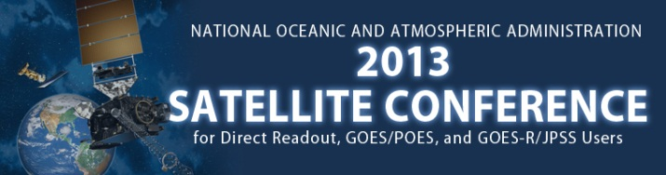
Incremental Regression SST Algorithm for NPP VIIRS within the ACSPO
NOAA/NESDIS/STAR, College Park, MD
Daytime composite maps of SST - Reynolds
produced from VIIRS data with Conventional Regressionand incremental Regression algorithms
The S-NPP satellite with VIIRS instrument onboard was launched on 28 October 2011.
At NESDIS/STAR, VIIRS SDRs are processed into L2 SST with the Advanced Clear-Sky Processor for Oceans (ACSPO)
Currently ACSPO uses Conventional Regression SST algorithms (CR), but the plan is to add RTM-based Incremental Regression algorithm
The IncR was:
    Developed and tested for MSG SEVIRI as proxy of GOES-R ABI;
    Internally tested for AVHRR and MODIS
    Tested for AVHRR within the ESA Climate Change Initiative (CCI) project.
According to all tests, the IncR produces more uniform SST accuracy and precision, compared with conventional regression algorithms
Conventional Regression
Incremental Regression
T-08
Notes:
T08

Slide 9
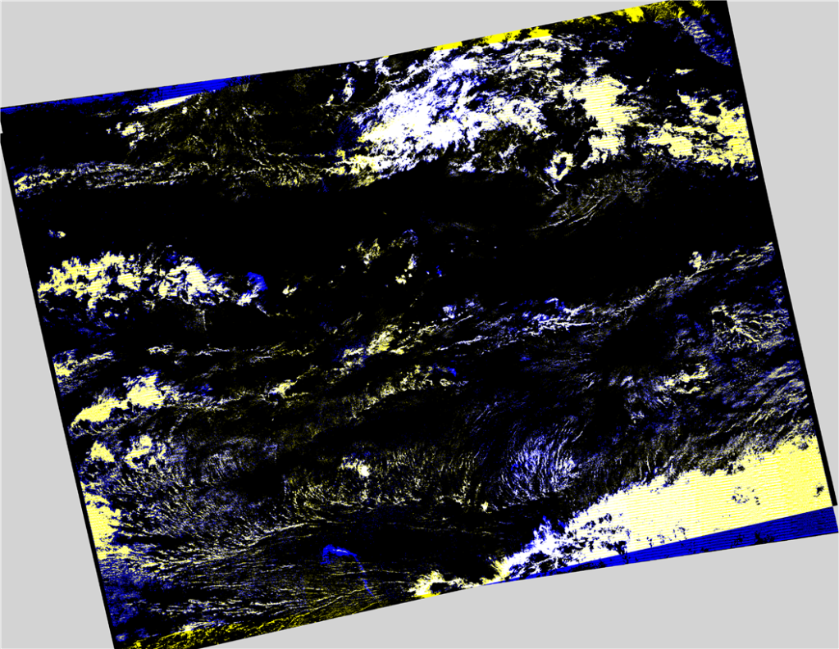
A Rapid Cloud Mask Algorithm
for Suomi NPP VIIRS Imagery EDRs
Mark Piper
Exelis Visual Information Solutions
Boulder, Colorado
A cloud mask algorithm, based on the Landsat 7 ACCA, has been adapted for VIIRS Imagery EDRs
  Provides a quick assessment of the cloud cover in a VIIRS Imagery EDR at 350 m resolution
  Less accurate and less detailed than the VIIRS Cloud Mask Intermediate Product
A comparison of the rapid cloud mask algorithm with information from the VIIRS Cloud Mask IP.
T-09
Notes:
T09

Slide 10
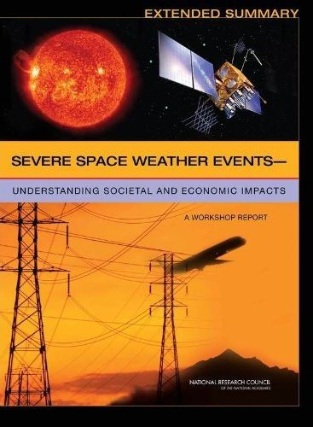
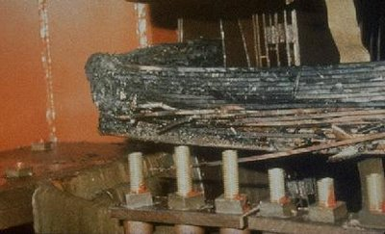
Societal Impacts of Space Weather
W. Denig¹ & S. Hill²
¹NOAA/NESDIS/National Geophysical Data Center (NGDC)
²NOAA/NWS/Space Weather Prediction Center (SWPC)
In 2008 the NRC released a report stating that the socio-economic impacts of a severe space weather event could exceed $2T. While such events are rare it has happened before and it will happen again.
Transformer Meltdown - 1989
National Research Council
T-11

Slide 11
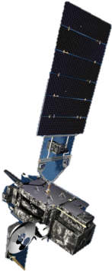
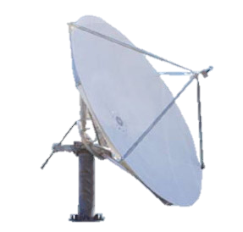
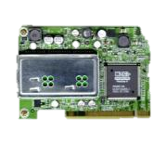


Preparing the Direct Broadcast Community for GOES-R
Karen Friedman Dubey
SeaSpace Corporation
No current gvar ground station will be able to receive GRB
GOES-R will have 2742% more data than GOES-P
  Higher spatial and temporal resolution, more channels
Direct broadcast is the fastest way to get GRB data
Real-time data necessary for operational agencies
Antenna
DVB-S2 Receiver(s) #2
+
Acquisition Computer
High Powered Processing Computer
SeaSpace Direct Broadcast Ground Station for GOES-R
T-12
Notes:
T12

Slide 12
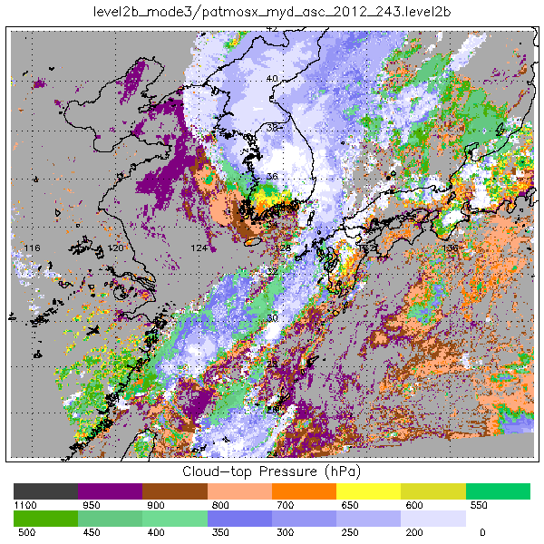
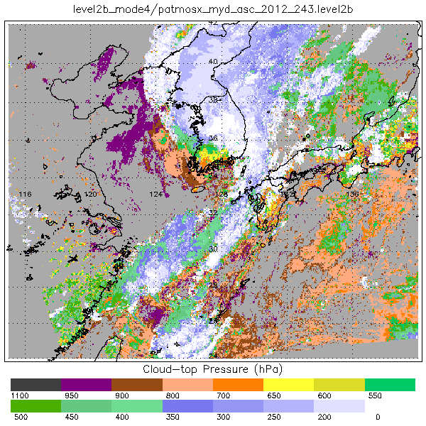
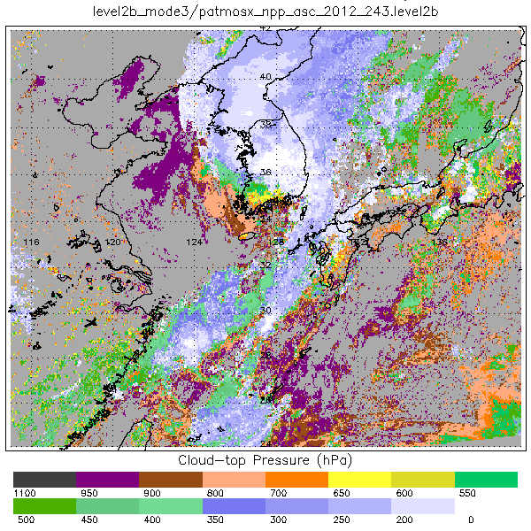
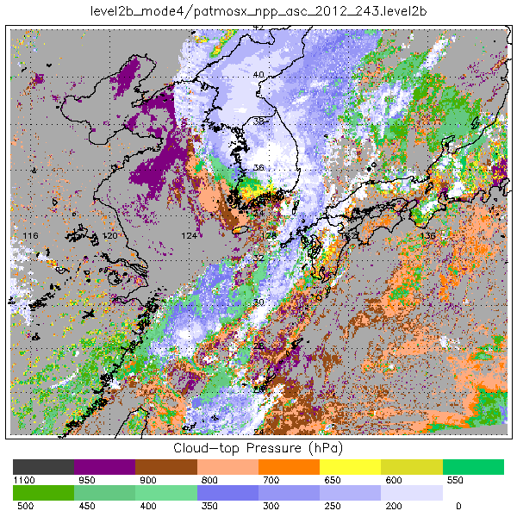
Cloud-Top Pressure Estimation from VIIRS using Statistically Reconstructed 13.3 micron channel
Irina Gladkova¹, James Cross¹, Andrew Heidinger², Paul Menzel³, Michael Grossberg¹
NOAA/CREST, City College of New York
NOAA/NESDIS, Office of Satellite Applications and Research
NOAA/CIMSS, University of Wisconsin
VIIRS doesn't have 13.3μm band important for cloud-top pressure estimates
CrIS has hyperspectral measurements in the CO2 absorption band at lower spatial resolution
Aqua has MODIS and AIRS which can serve as proxy for VIIRS and CrIS
We have developed an algorithm which uses available VIIRS bands along with CrIS measurements for estimating a virtual VIIRS 13.3 micron band.
Tests showed that similarly-synthesized data would allow VIIRS/CrIS to match GOES-R in terms of cloud-top pressure determination, to within the GOES-R specifications.
Cloud-Top Pressure: MODIS with real 13.3um (Top Left), MODIS without 13.3um (Top-Right), VIIRS with pseudo 13.3um (Bottom Left), VIIRS without 13.3um (Bottom Right)
T-13
Notes:
T13

Slide 13
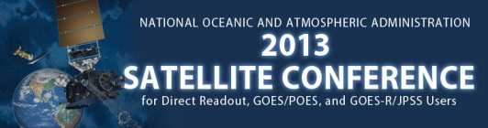
The Development of Polar Orbiting Satellite Processing Packages
in Support of International Direct Broadcast Community
Allen Huang, Liam Gumley, and Kathy Strabala, SSEC/CIMSS UW-Madison
And Mitch Goldberg, JPSS Program Office, NOAA
IMAPP (International MODIS/AIRS Processing Package):
  L0 to L1 & L1 to L2 for MODIS, AIRS/AMSU, & AMSR-E
  Used by more than 1600 users in 70 countries
  Infusing Satellite Data into Environmental Applications – International (IDEA-I) released in June 2012 for regional Air Quality Forecasts
  Products distributed to more than 59 NWS forecast offices in real time, supporting:
    Fire Weather Forecasting (NDVI, Surface Temperature, Visible bands)
    Fog and Visibility forecasting (Fog Product)
    Precipitation forecasting (TPW product)
    Temperature Forecasting (SST, Surface Temperature)
    Severe Weather Damage Analysis (NDVI, True Color)
    Turbulence (WV Band Mountain Wave Identification)
    Snow/Ice extent, blowing dust, blowing smoke (True Color Imagery)
    Space Shuttle Weather Forecasting
CSPP (Community Satellite Processing Package):
  1st release (March, 2012) just a few months after launch of Suomi NPP
  VIIRS, ATMS and CrIS calibration and geolocation software (Raw Data Records (RDRs) to Science Data Records (SDRs));
  VIIRS Cloud Mask and Active Fires Environmental Data Records (EDRs);
  VIIRS SDR reprojection software for the creation of GeoTIFFs and/or AWIPS NetCDF files;
  CrIS, AIRS and IASI University of Wisconsin dual regression single Field-of-View (FOV) Temperature, Moisture, Surface and Cloud Retrieval Environmental Data Record (EDR).
http://cimss.ssec.wisc.edu/imapp/
http://cimss.ssec.wisc.edu/cspp/
T-14
Notes:
T14

Slide 14
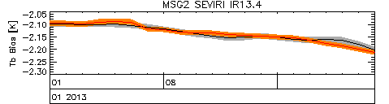
Migrating from Metop-A/IASI to Metop-B/IASI as GSICS inter-calibration reference for Geostationary IR Imagers
Tim J. Hewison
EUMETSAT
Darmstadt, Germany
(Meteosat9/SEVIRI-MetopA/IASI)
(Meteosat9/SEVIRI-MetopB/IASI)
Biases for standard scene radiances (clear sky)
First 2 months data from Metop-B/IASI
Double differences are small (<|40mK|) for all channels
MetopB/IASI equivalent to MetopA/IASI
No true Metop-B/A SNOs possible
  Orbits ~180° out of phase
But Meteosat-9/SEVIRI can be collocated with both Metop’s
  Use as transfer standard
  Define Delta Corrections in SEVIRI channel space
T-15
Notes:
T15

Slide 15
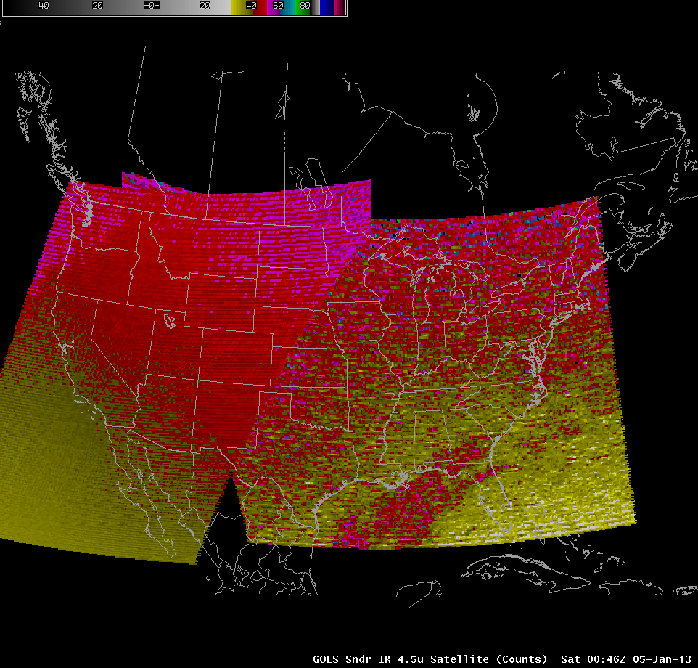
The ingredients for sustaining success in NOAA R2O for GOES-R
Jordan Gerth
CIMSS/SSEC/Univ. of Wisconsin
Madison, WI
Learn how NOAA Cooperative Institutes and a consolidation of oversight in satellite research to operations (R2O) programs can improve the value of NOAA’s scientific portfolio and provide a foundation for enhancing NOAA’s operational services through:
Decreasing the time to negotiate the R2O process
Leveraging existing relationships and infrastructure on the R2O interface
This GOES Sounder imagery is sent to forecasters hourly
T-16
Notes:
T16

Slide 16
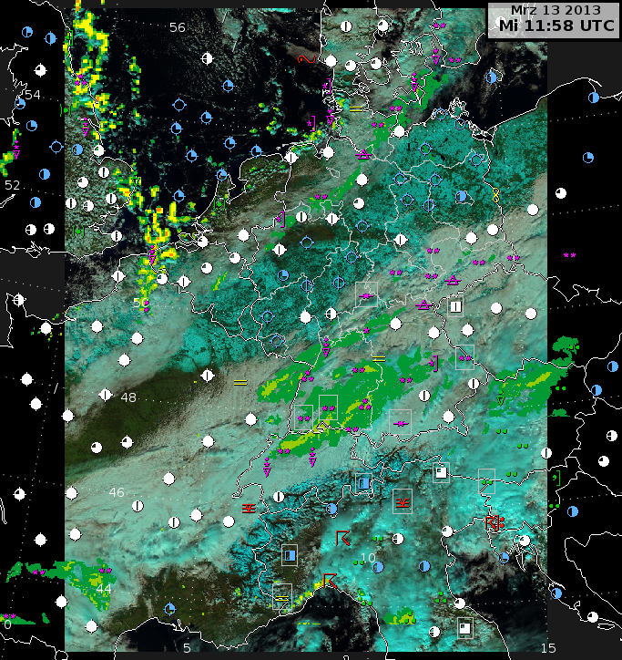
VIIRS Imagery in NinJo
K. Hungershoefer¹, D. Hoese², W. Straka III², R. Garcia², E. Schiffer², J. Asmus¹, K. Strabala²
¹Deutscher Wetterdienst, Central Development Division, Germany
²CIMSS/SSEC, University of Wisconsin, USA
New satellite data has to be made available in the forecasters visualization systems
  CIMSS has developed the CSPP VIIRS re-projection software Polar2Grid to show VIIRS SDR data within AWIPS I and II
  In cooperation with DWD, CIMSS added the possibility to generate special TIF files for the visualization system NinJo
Suomi NPP VIIRS RGB, radar and surface data combined in NinJo
T-17
Notes:
T17

Slide 17
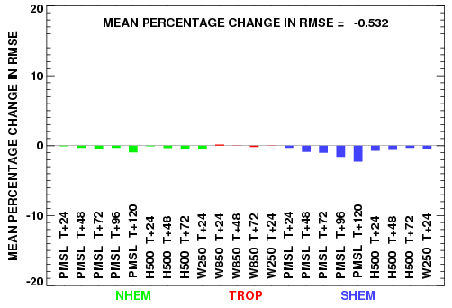
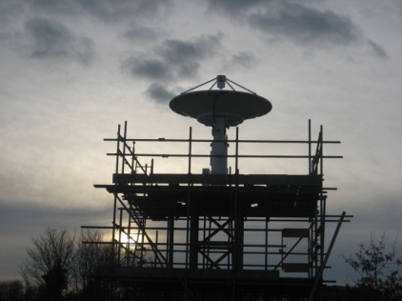
The Utilization of Data from Suomi NPP at the
Met Office (UK)
Satellite Applications, Met Office, Exeter, UK
Near Real Time Reception
  Modification of our local direct broadcast reception system
  EUMETCast delivery
  Use of AAPP and CSPP for preprocessing of data
Operational Utilization
  ATMS & CrIS operationally assimilated into global weather prediction model
  VIIRS imagery for forecasters
Preprocessing system for ATMS&CrIS&VIIRS
Reduction in forecast error when ATMS & CrIS data are added to the
Met Office global NWP system
X-band upgraded antenna
T-18
Notes:
T18

Slide 18
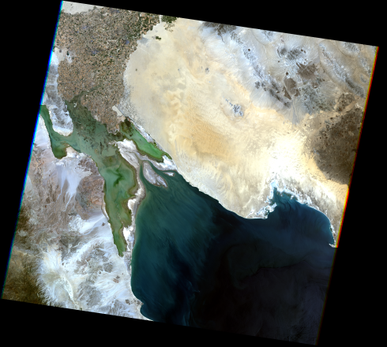
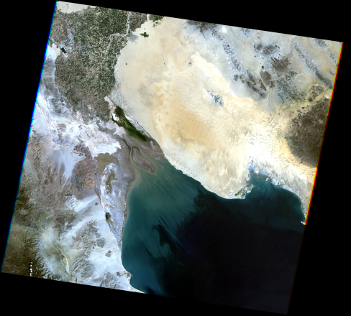
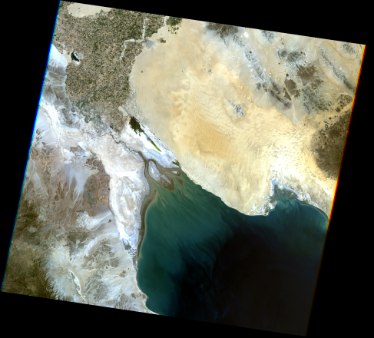
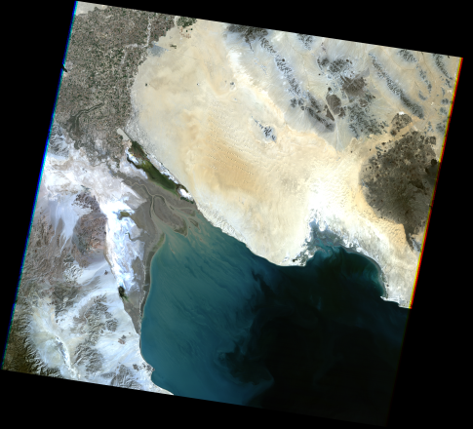
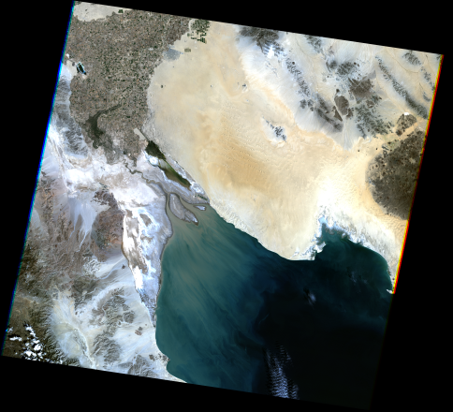
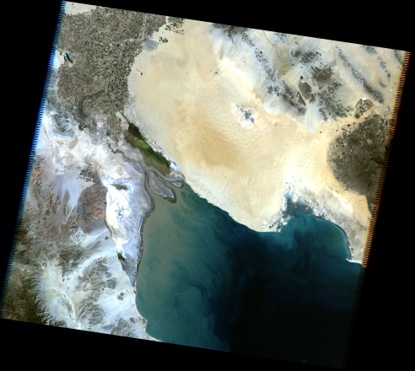
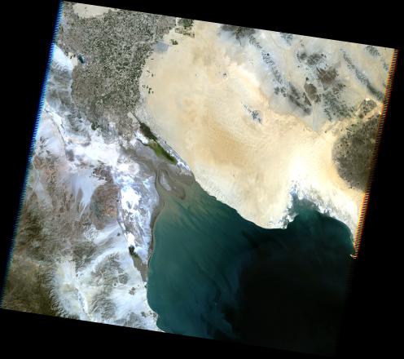
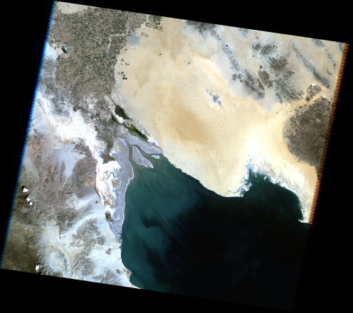
Sensor Calibration Inter-comparison
using the Sonoran Desert
A. Angal ¹, X. Xiong ², A. Wu ³, G. Chander ⁴ and T. Choi ³
¹ Science Systems and Application Inc. ² NASA GSFC ³ Sigma Space Corp. ⁴ SGT/USGS EROS
The Sonoran Desert (+32.35°,-114.65°) is a large flat area, partially vegetated, with typical horizontal visibilities of around 30-45 km
  The goal of this work is to demonstrate the suitability and assess its temporal stability for sensor calibration intercomparison efforts
  Study uses measurements from Terra and Aqua MODIS, Landsat 7 Enhanced Thematic Mapper (ETM+), and Landsat 5 Thematic Mapper (TM)
  Landsat Climate Data Record (CDR) Surface Reflectance product generated using ETM+ has been used to assess the suitability of the Sonoran desert target for long-term radiometric calibration.
1984
1988
1992
1996
2000
2004
2008
2011
Sonoran Desert seen by Landsat 5 Thematic Mapper (RGB composite)
T-22
Notes:
T22

Slide 19
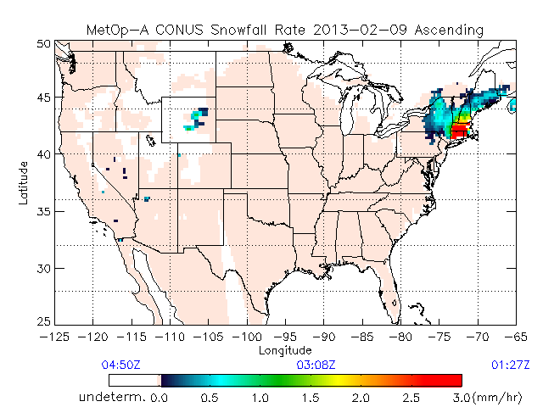
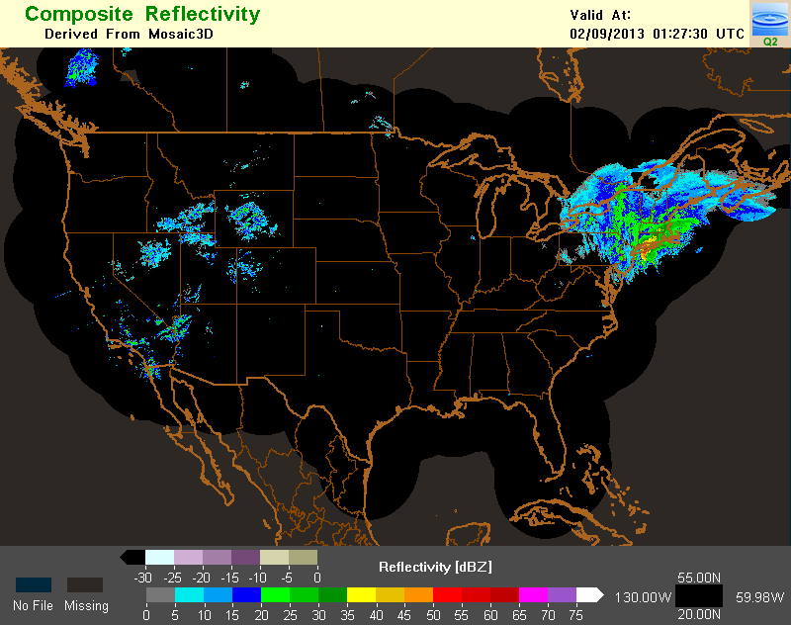
Snowfall Rate Retrieval Using Passive Microwave Measurements
¹Huan Meng, ²Banghua Yan, ¹Ralph Ferraro, ³Cezar Kongoli, ³Nai-Yu Wang, ²Limin Zhao
¹NOAA/NESDIS/STAR, ²NOAA/NESDIS/OSPO, ³UMCP/ESSIC/CICS
Operational AMSU/MHS snowfall rate product
  Global, over land, water equivalent
  Aboard four satellites(NOAA-18/19 and Metop-A/-B), up to eight retrievals per day at any location at near real-time
  Validated against radar and gauge snowfall data
  Applications in hydrology, blended precipitation products, weather forecast etc.
ATMS snowfall algorithms under development
  A JPSS RRPG project
  Two algorithms: snowfall detection and snowfall rate
  Completion by December 2013
AMSU/MHS snowfall rate (top) and NEXRAD reflectivity (bottom)
T-24
Notes:
T24

Slide 20
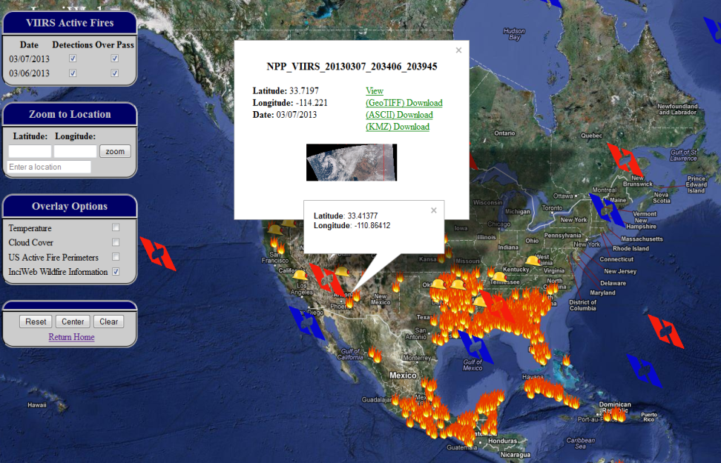
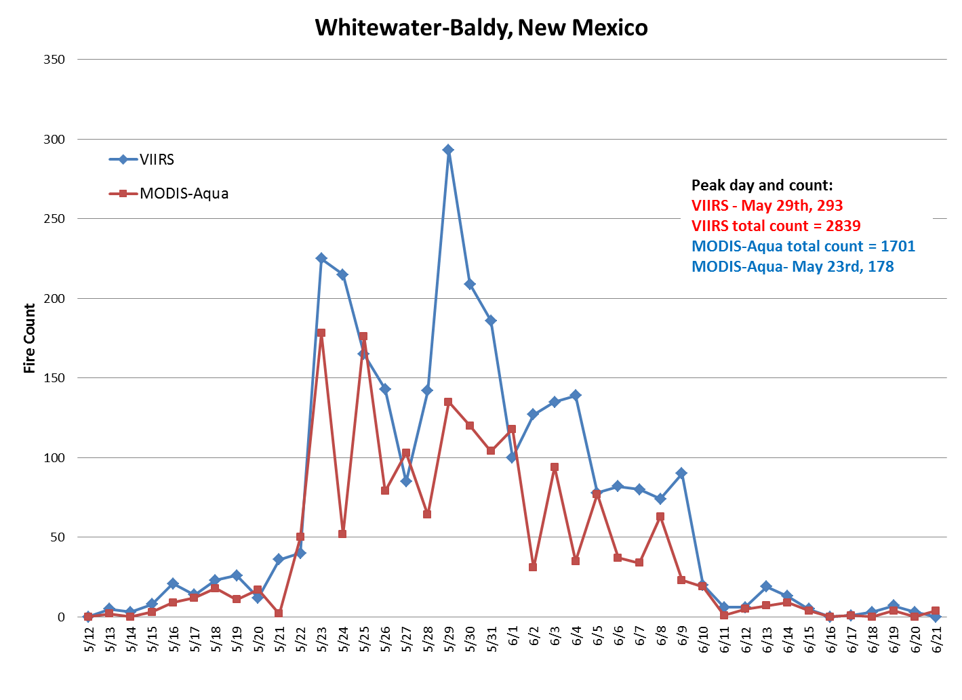
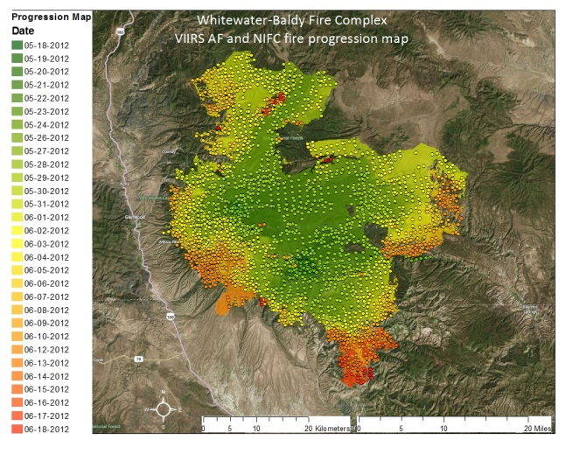
Suomi NPP (SNPP) VIIRS Active Fire Data for Fire Management and Fire Weather Applications
Evan Ellicott
Department of Geographical Sciences, University of Maryland, College Park, MD
The VIIRS Active Fire product is used by real-time resource and disaster management; air quality monitoring; ecosystem monitoring; climate studies, etc.
The goals of the VIIRS AF Proving Ground project are product evaluation and improvement and the development of a near-real-time enhanced product delivery system to support fire management and NOAA operations.
http://viirsfire.geog.umd.edu/
Screen capture of interactive data map from VIIRS AF website
Evaluation of VIIRS AF product from 2012 U.S. wildfire season demonstrates utility and accuracy.
At Right: Example evaluation from the Whitewater-Baldy fire, NM
T-25
Notes:
T25

Slide 21
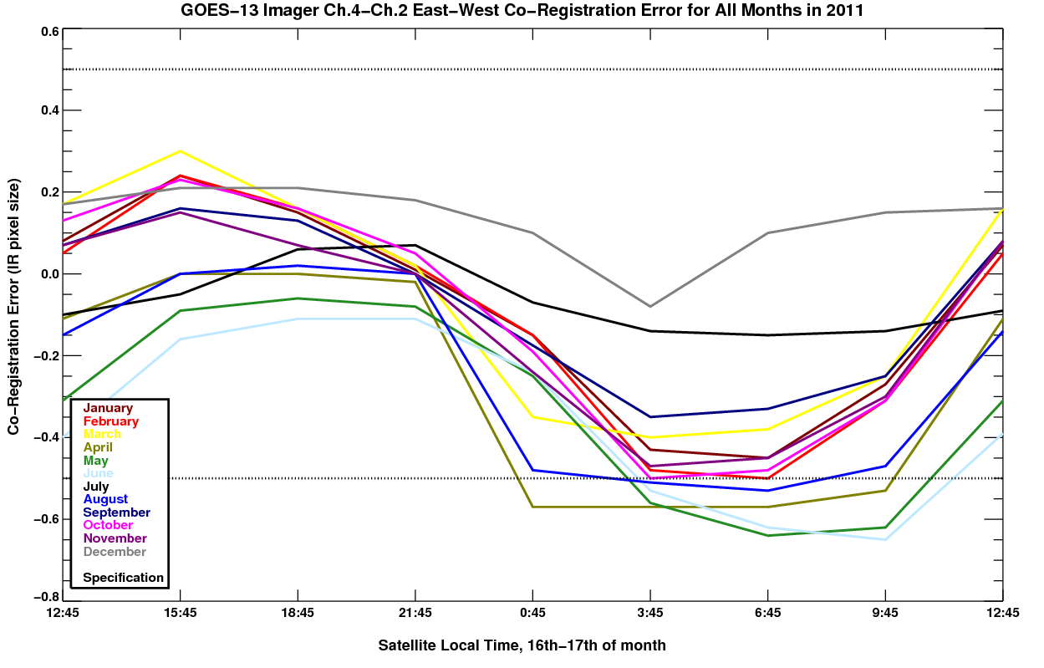
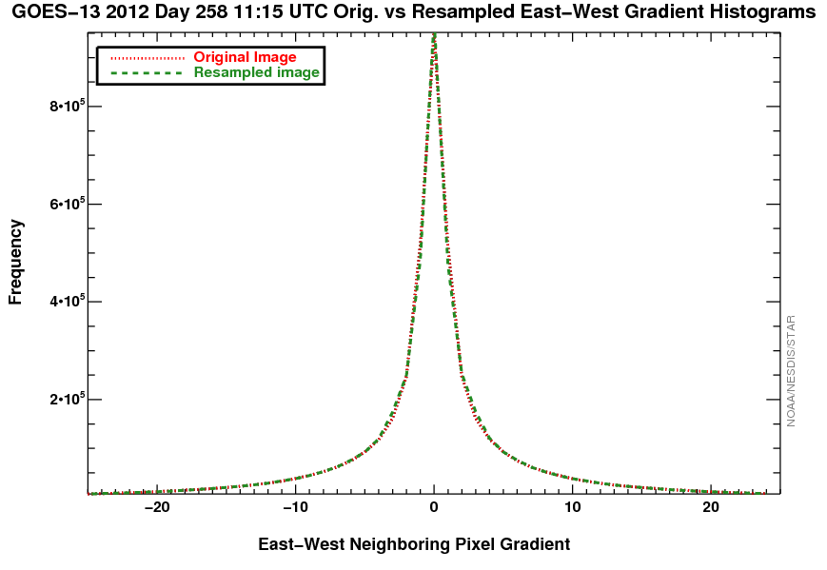
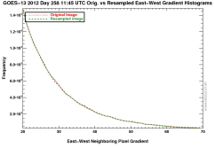
On-orbit characterization of the GOES Imager channel-to-channel co-registration and correction algorithm evaluation
Michael G. Grotenhuis
ERT, Inc. @ NOAA/NESDIS Center for Satellite Applications and Research (STAR)
College Park, MD
The GOES-13 Imager infrared channel-to-channel co-registration error has been characterized and a resampling correction algorithm has been evaluated
  STAR characterized the co-registration error, which sometimes exceeds specifications
  STAR evaluated the proposed co-registration correction algorithm for image quality
Top: Co-registration error characterization by month
Bottom: Evaluation of resampled image gradients
T-26
Notes:
T26

Slide 22






NOAA/NESDIS Coral Reef Watch, College Park, Maryland
NOAA Operational Satellite SST for Monitoring Coral Bleaching Thermal Stress: Coral Reef Watch’s Satellite Decision Support System for Coral Reef Managers
Gang Liu et al. NOAA/NESDIS Coral Reef Watch, College Park, Maryland
Monitoring stresses harmful to coral reef ecosystems worldwide
Guiding management actions/practices
Contributing to climate impact mitigation
Improving and expanding the Decision Support System
Applying new NESDIS satellite products
Expanding monitoring capacity
Communicating directly with users
Serving the global coral reef community effectively for more than a decade
Substantial coral bleaching thermal stress in 2010, as viewed by Coral Reef Watch products
T-27
Notes:
T27

Slide 23








Overview of the GOES-R Proving Ground Activities at the National Hurricane Center
Christopher Velden¹, Mark DeMaria², John Knaff², Mike Brennan³, Jack Beven³, Hugh Cobb³, Jessica Schauer³, Kevin Fuell⁴, Jason Dunion⁵, Michael Folmer⁶
¹Cooperative Institute for Meteorological Satellite Studies (CIMSS) Madison, WI
²NOAA/NESDIS Regional and Mesoscale Meteorology Branch (RAMMB), Ft. Collins, CO
³National Hurricane Center (NHC), Miami, FL
⁴NASA Short-term Prediction Research and Transition Center (SPoRT), Huntsville, AL
⁵Cooperative Institute for Marine and Atmospheric Studies (CIMAS), Miami, FL
⁶Cooperative Institute for Climate and Satellites (CICS), College Park, MD
9 GOES-R products demonstrated in 2012
  Focus on Tropical Cyclone applications and general tropical analyses
  Baseline, and future capabilities
  GOES-R proxy data employed (i.e. Meteosat SEVIRI, MODIS)
  NHC/TAFB feedback obtained
    Forecasters gaining experience
    Feedback helping product refinement
    S-NPP products to be added in 2013
T-28
GOES-R natural color for Hurricane Isaac after landfall
(MODIS proxy data)
Notes:
T28

Slide 24

Enhanced data access and retrieval for analysis and validation of ABI and VIIRS land data and products
Kevin Gallo,
NOAA/NESDIS and USGS/EROS, Sioux Falls, SD
System under development to enhance ABI and VIIRS product characterization and validation.
Validation and characterization of ABI and VIIRS land products are required.
  System facilitates access and use of multiple sensors (e.g., Landsat and MODIS) and in situ data (e.g., CRN, AMERIFLUX, SURFRAD, CEOS) for validation and characterization of ABI and VIIRS data & products.
Land Product Validation System prototype web page for initiation of in situ and satellite data searches.
T-29
Notes:
T29

Slide 25



Overview of the NOAA GCOM AMSR2 Algorithm Software Processor (GAASP) Package
L. Soulliard, T. King, E. McMichael, Z. Jelenak, W. Wolf, P. Chang, and R. Ferraro
NOAA/NESDIS/STAR Satellite Meteorology and Climatology Division (SMCD)
College Park, MD
AMSR2 is the microwave instrument on board GCOM from which hydromet parameters will be produced:
  Tb, TPW, CLW, SST, SSW, SMOIS, SIC, SWE, etc.
The software developed to process AMSR2 data is based on the NUCAPS system.
  Preprocessor: Ingest AMSR2 SDR files.
  Algorithms: Day 1 / Day 2 EDR split.
  Postprocessor: Convert EDRs to netCDF4 for distribution.
  Data handling and algorithms written in FORTRAN 90, all
  wrapped in Perl
  scripts.
T-31
Notes:
T31

Slide 26



T.33
Status and Prospective of Operational Ocean Color Products
from the NOAA CoastWatch Okeanos System
Banghua Yan
NOAA/NESDIS/OSPO Satellite Products Branch(SPB)
College, MD
The NOAA CoastWatch Okeanos system has been providing the following high quality ocean color operational products from MODIS observations:
  Regional daily and bi-monthly mean chlorophyll concentrations (chl-a) and remote sensing reflectance at 667 nm (Rrs667)
  Regional water attenuation coefficient at 490 nm (Kd490)
  Regional daily chl-a and Rrs667anomaly
  Regional chlorophyll fronts (magnitude and direction)
  Global Emiliania huxleyi (Ehux) bloom and calcite concentration map
Gulf-of-Mexico bimonthly mean chl-a
T-33
Chesapeake Bay monthly mean chl-a
Notes:
T33

Slide 27


The GRB Simulator: A Testing System for GOES-R Rebroadcast (GRB) Receivers
Authors: K. Gibbons¹, C. Miller¹, G. Dittberner¹, R. Race², and E. Czopkiewicz¹
¹Harris Corporation, ²CTSI
Provides high-fidelity streams of Consultative Committee for Space Data Systems (CCSDS) formatted GRB packet data equivalent to live GRB data
GRB Simulator provides
  Instrument data packets
  Metadata packets
Instrument packets provide data simulated from any instrument
  Imagers (ABI, SUVI)
  Non-Imagers (GLM, SEISS, EXIS, MAG)
T-34
Notes:
T34

Slide 28


Joint Polar Satellite System Common Ground System (JPSS CGS)
Algorithm Development Library (ADL) for Environmental Satellite Missions
Kerry Grant, JPSS CGS Chief Scientist
Raytheon Intelligence and Information Systems, Aurora CO
Gary Metz, IDPS ING/PRO Software Manager, Bryan Henderson IDPS ADL Lead Software Engineer
Paul Siebels, IDPS Deputy Software Manager
Raytheon Intelligence and Information Systems, Omaha, NE
The ADL provides significant time and cost savings during algorithm development and implementation into an operational baseline.
  It is estimated that by using the ADL, algorithm developers can achieve 10 - 25% cost savings and that operational conversion/implementation can achieve 25 – 50% cost savings compared to the cost of typical algorithm development and conversion into an operational baseline
T-35

Slide 29

Suomi National Polar-orbiting Partnership (S-NPP)
Environmental Products
Kerry Grant, Raytheon Intelligence and Information Systems, Aurora CO
Robert Hughes and Nancy Andreas, Northrop Grumman Aerospace Systems, Redondo Beach, CA
Mike Haas, Frank Eastman, Gary Mineart, and Jane Whitcomb, Joint Polar Satellite System
As S-NPP products become available in the archive, users require information about product sizes, coverage, and measurement range
  Products are presented by sensor with a description of the product itself, its anticipated use, its size based on the actual non-aggregated data granule, coverage, and measurement range
T-36

Slide 30


Joint Polar Satellite System Common Ground System (JPSS CGS)
Operational Ground System Performance for Suomi National Polar-Orbiting Partnership (S-NPP)
Kerry Grant, JPSS CGS Chief Scientist, Craig Bergeron, CGS System Performance Manager
Raytheon Intelligence and Information Systems, Aurora CO
In a recent operational performance test, the CGS exceeded its availability and latency requirements over a 45 day measurement period
  CGS delivered 99.59% of the 1,964,168 possible products to the archive facility.
  95% of 2,265,484 EDRs were required to be delivered to the Air Force Weather Agency within the latency period; CGS delivered 99.84%
Availability Performance
Latency Performance
T-37

Slide 31

AMSU-A Only Atmospheric Temperature TCDRs
Wenhui Wang¹ and Cheng-Zhi Zou²
¹ I. M. Systems Group, Rockville, Maryland, USA
² Center for Satellite Applications and Research, NESDIS/NOAA, Camp Springs, Maryland, USA
Global monthly averaged gridded AMSU-A atmospheric temperature thematic climate data records (TCDRs)
  Based on STAR recalibrated AMSU-A level 1c radiances from 6 satellites
  Methodologies
    Corrected for sensor incidence angle and frequency shift effects
    Corrected for diurnal drift effects
    Removed residual warm target temperature effect and Earth location-dependent constant bias
  11 layers of well-merged global gridded (2.5° x 2.5 °) TCDRs
    Lower-troposphere to the top of stratosphere
    1998 - 2011
  Support high vertical resolution and MSU/AMSU-A, SSU/AMSU-A merged long-term climate trend studies and monitoring.
AMSU-A global mean layer temperature anomaly time series and trends (gray dash vertical lines show the 2002/03 and 2009/10 El Niño events).
T-38

Slide 32


Predicting Severe Weather from Sounding Pairs
W. Smith Sr.^{1,2}, E. Weisz¹, and N. Smith¹
¹ University of Wisconsin-Madison
² Hampton University
Ultraspectral Sounders
On 4 Satellites
  Aqua/AIRS (13:30 LST)
  Suomi-NPP/CrIS (13:30 LST)
  Metop-A/IASI (09:30 LST)
  Metop-B/IASI (08:45 LST)
Applications
  Time tendencies of atmospheric
  variables from consecutive orbits
  Moisture flux
  Pre-convective stability change
  Cloud top height changes associated
  with storm intensity tendency
  Environmental steering currents
¹
Hurricane
Sandy
T-39
Notes:
T38

Slide 33


Integrating JPSS Algorithms with Efficiency and Ease: STAR Algorithm Integration Team (AIT)
Bigyani Das, Walter Wolf, Valerie Mikles, Youhua Tang, Marina Tsidulko, Weizhong Chen and Kristina Sprietzer
STAR AIT provides expertise and support in effective integration of science algorithms for Sensor Data Records (SDRs), Environmental Data Records (EDRs), and Intermediate Products (IPs) into operational systems to meet JPSS Science mission goals. AIT assists in:
  Integration of new or updated algorithm and Look-up Tables (LUTs) in ADL (Algorithm Development Library) framework.
  Emulation of various operational testing scenarios
  Facilitation of communication between scientists and JPSS Ground Project Data Products Engineering (DPE) Team
  Submission of algorithm change packages (ACPs) with regard to Discrepancy Reports (DRs)
  Analysis of test results for scientific comparison
Algorithm | Discrepancy Reports (DRs) | AIT Support
CrIMSS EDR | Seven Discrepancy Reports (DRs) 4922, 4926, 4942, 4943, 4945, 4946, 4958 with code updates and two LUT updates for correcting channel indexing errors and for greater yield and performance | Integrated code and LUT updates in ADL; Tested and emulated different IDPS versions; Delivered ACP; Followed up with various functional tests and reviews.
VIIRS EDR –Land Surface Albedo | DR 4704 - Update VIIRS-LSA-BPSA-LUT and corresponding code changes | Performed tests and troubleshooting in ADL; Delivered ACP; Followed up with tests and reviews.
VIIRS EDR – Active Fire Team | DR 5029 - Filter out false fire counts | Performed ADL tests and troubleshooting,
STAR AIT Support in Algorithm Integration Activities
T-40
Notes:
T40

Slide 34










Application of NOAA Coral Reef Watch’s Near-Real-Time Satellite Decision Support System to Local Coral Reef Management
Jacqueline L. Rauenzahn et al.
NOAA/NESDIS Coral Reef Watch (CRW)
College Park, MD
NOAA CRW’s satellite-based Decision Support System (DSS) helps managers and stakeholders worldwide prepare for/respond to climate change stressors on coral reefs
  CRW Data and Products:
    Guide local & regional management responses to acute coral bleaching stress
    Provide climate outlooks for effective management planning/resource allocation
    Contribute to regional & local coral bleaching/disease response plans
    Assist in comprehensive risk assessments of climate impacts to coral ecosystems
    Contribute to reef resilience capacity building, responding to climate change training, and MPA design
T-41
Notes:
T41

Slide 35

Using Satellite Data to Reconstruct Variations in Times with No Satellites
Thomas Smith^{1,2}, Phillip Arkin², Li Ren², Sam Shen³
1. NOAA/NESDIS/STAR/CoRP/SCSB, 2. ESSIC/CICS, University of Maryland, 3. San Diego State University
Satellite-based analyses resolve global variations for a limited period
Climate studies often need longer analyses
Reconstructions use satellite-based statistics and in situ data to extend analyses
Statistical testing shows the reliability of historical reconstruction
GPCP and cross-validation reconstructions using historical sampling for two years.
T-42
Notes:
T42

Slide 36
End-to-End Design, Development and Testing of
GOES-R Level 1 and 2 Algorithms
Alex Werbos
Atmospheric and Environmental Research
Lexington, MA
Advances in ground system design are required to meet the diverse needs of the GOES-R program
  Flexible data interfaces that allow algorithms to be seamlessly transitioned from development/testing to operations
  Algorithms that are parameterized in execution area allowing flexibility in computational load-balancing
Algorithm
Executor
Algorithm
Context
Science
Data
Context
Algorithm
Product Assembly
Full
Scene
Context
Algorithm
End Product
Context
Algorithm
Algorithm Execution Parameterization
T-43
Notes:
T43

Slide 37

Design and Development of the GOES-R
Inspect & Analyze Client Visualization Application
Jordan Bentley
Atmospheric and Environmental Research
Lexington, MA
“Inspect & Analyze” provides an operational, graphics-based decision aid to continuously monitor the quality of the GOES-R products, instrument calibration data, and product performance metrics in the real-time environment.
Inspect & Analyze Graphical User Interface
T-44
Notes:
T44

Slide 38


Investigating the use of Deep Convective Clouds to monitor on-orbit performance of the Geostationary Lightning Mapper (GLM) using Lightning Imaging Sensor (LIS) measurements
D. E. Buechler, H.J. Christian, W.J. Koshak, S.J. Goodman
University of Alabama Huntsville (UAH)
Deep Convective Clouds are used as invariant calibration targets
  LIS on TRMM is similar in design to GLM
  DCCs identified using VIRS 11 µm observations
  The radiance of LIS DCCs exhibit no discernible degradation from 1998-2010
  Less than 0.8% yearly deviation from mean LIS DCC radiance
T-47
Notes:
T47

Slide 39


Inter-calibration of the SEVIRI VIS0.6 channel with MODIS Aqua, using Deep Convective Clouds as transfer targets
Sébastien C. Wagner, T. Hewison
EUMETSAT
Darmstadt, Germany
SEVIRI Met-9 (01/04/2010 – 12:57)
DCC identification
  Time: for MET-9 (0.0 Lat / 0.0 Lon) ➔ 11:00 < t < 14:00
  Geometry:
    Lat / Lon < ±20.0 degrees of SSP
    SZA and VZA < 40 degrees
  DCC identification ⇒ T_{b}(11μm) <205K
  Spatial homogeneity (over boxes of pixels in the “11 μm” BT + in the “0.6 μm” radiances)
Conversion from counts to overhead sun
    Use of an Angular Distribution Model (Hu et al. 2004)
Spectral band Adjustment for MODIS, SEVIRI SRFs
  Use of correction factors as given by the GSICS ATBD (Doelling et al, 2011)
Construction of monthly Probability Density Functions
Derivation of the gain from the calibration equation:
SEVIRI Met-9 DCC counts – 0.6 μm
T-50
Notes:
T50

Slide 40

Joint Polar Satellite System (JPSS)
Common Ground System (CGS) Multimission Support
Michael Jamilkowski, Raytheon JPSS CGS Customer Liaison, Greenbelt MD
Shawn W. Miller, Raytheon JPSS CGS Chief Architect, and Kerry Grant, JPSS CGS Chief Scientist, Aurora CO
The JPSS Common Ground System (CGS) currently supports and/or manages nine (9) environmental satellite missions + NSF McMurdo communications
  CGS will support/manage at least 12 future missions
  CGS’s flexible architecture allows for multimission capabilities that offer significant opportunities for cost reduction and improved information integration across missions
The CGS Multi-Mission Operations Concept
T-53

Slide 41



Near-Real-Time Proxy ABI Products for GOES-R User Readiness
T. Greenwald, B. Pierce*, T. Schaack, J. Otkin, K. Bah, J. Davies, J. Sieglaff, A. Lenzen, J. Nelson, M. Rogal, A. Huang
CIMSS, University of Wisconsin-Madison, WI; *NOAA/NESDIS ORA ASPB
CIMSS is producing simulated ABI products in near-real-time over CONUS from WRF-Chem model forecasts and the CRTM to support Proving Ground activities by making these products available within AWIPS
Current Products:
ABI 16-band imagery
Cloud mask, cloud top height & pressure (with Andy Heidinger, AWG Cloud lead)
Temp/moisture profiles and more …
Sample proxy ABI products for the Jan 29-30, 2013 tornado outbreak
Simulated ABI band 14 (11.2 µm)
Simulated ABI band 9 (6.95 µm)
T-54
Simulated Cloud Top Height
Notes:
T54

Slide 42

Near-Real-Time validation of simulated GOES-R ABI radiances and derived products, using the WRF-Chem model forecast over CONUS for all 16 ABI bands
Kaba Bah¹, Tom Greenwald¹, Brad Pierce², Allen Lenzen¹, Marek Rogal¹, Jim Nelson¹, Jason Otkin¹, Todd Schaack¹, Jim Davies¹, Eva Borbas¹, Justin Sieglaff¹ and Hung-Lung Huang¹
¹Cooperative Institute for Meteorological Satellite Studies (CIMSS), Space Science and Engineering Center (SSEC), University of Wisconsin – Madison, Wisconsin 53706, U.S.
²NOAA/NESDIS Office of Research and Applications, Advanced Satellite Products Branch (ASPB), Madison, WI, 53706, U.S.A.
This poster summarizes our efforts to provide and validate near-real-time proxy data for all 16 ABI bands.
  We are supporting GOES-R PG activities through development of a WRF-CHEM/CRTM based framework for generation of real-time proxy radiances for all 16 GOES-R ABI bands.
  The hourly simulated radiances are delivered daily to AIT in ABI Fixed Grid Format, compatible with the GOES-R Re-Broadcast Level 1b data.
  We have developed a near-real-time validation system for verification of model simulated ABI radiances and simulated derived products using GOES sounder data.
  The simulated ABI derived products are generated using the GEOCAT framework and distributed in HDF format
Simulated ABI (Advanced Baseline Imager) data
T-54
Notes:
T54

Slide 43

Near-real-time VIIRS Aerosol Imagery over CONUS for Air Quality Monitoring and Forecasting Applications
Hai Zhang¹, Shobha Kondragunta², Hongqing Liu¹, Pubu Ciren¹
1. IMSG; 2. NOAA/NESDIS/STAR
Near-real-time CONUS VIIRS imagery is available on IDEA (Infusing satellite Data into Environmental Applications) site
Products include:
  VIIRS AOT, RGB, dust mask, fire hotspots images
  KML format for Google Earth
  48-hour forward trajectories
Validation shows that VIIRS AOT has similar accuracy as MODIS AOT over CONUS
https://www.star.nesdis.noaa.gov/smcd/spb/aq/index_viirs.php?product_id=4
T-56
Notes:
T56

Slide 44

GRAFIIR and JAFIIR – Efficient End-to-End Semi-Automated Algorithm Performance Analysis and Implementation Verification Systems
Mathew Gunshor, Hong Zhang, Eva Schiffer, Ray Garcia, and Allen Huang
Cooperative Institute for Meteorological Satellite Studies (CIMSS), Space Science and Engineering Center (SSEC), University of Wisconsin – Madison, Wisconsin
GRAFIIR and JAFIIR measure the effect of instrument effects on radiances and products
  GRAFIIR has responded to 9 waiver/deviation requests to date.
  Glance: an efficient comparison analysis tool built to assess and evaluate satellite data and product output.
  JAFIIR is the newly developing JPSS sister-program to GOES-R’s GRAFIIR.
T-57
Notes:
T57

Slide 45







T58
VIIRS Imagery: Applications and Outreach at CIRA
C. Seaman¹, D. Hillger², and S. Miller¹
¹CIRA/Colorado State University ²NOAA/NESDIS/StAR/RAMMB
Applications of VIIRS imagery:
  Severe weather, tropical cyclones
  Smoke, haze, dust, volcanic ash
  Fires, floods, vegetation health
  Auroras, lightning, power outages, oil/gas flares
  Snow/ice discrimination, cloud phase, monitoring glaciers/ice sheets
  Water quality/turbidity, ocean currents
  And many more...
Outreach:
  Developed new RGB imagery products
  VIIRS Imagery Team blog
  BAMS articles
Goals:
  Promote high quality VIIRS imagery
  Investigate new uses of VIIRS
  Get people excited about science!
T-58
Notes:
T58

Slide 46

T59
Suomi NPP VIIRS Imagery after 1 Year
D. Hillger¹, T. Kopp², S. Miller³, D. Lindsey¹, and C. Seaman²
¹NOAA/NESDIS/StAR/RAMMB ²The Aerospace Corp. ³CIRA/Colorado State University
One year+ since Suomi NPP launch (October 2011)
VIIRS EDR Imagery (and Visualization) Team:
  NOAA/STAR and many others
Image products:
  22 VIIRS M-bands (750 m) [6 EDRs]
  5 VIIRS I-bands (375 m) [5 EDRs]
  DNB/NCC [SDR/EDR] Imagery
Imagery maturity levels:
  Non-NCC EDR Imagery at “Provisional” level
  NCC Imagery at “Beta” level; still resolving “issues”
VIIRS displayed using McIDAS-V, McIDAS-X, and IDL
BAMS article (accepted for 2013 publication) and JGR manuscript (to be submitted) on VIIRS Imagery
Simulated ABI (Advanced Baseline Imager) data
T-59
Notes:
T59

Slide 47

Ozone Instrument Calibration and EDR Product Validation with STAR ICVS
Wei Yu³, Larry Flynn¹, Jianguo Niu², Eric Beach³, F. Wu¹, Zhihua Zhang³, Hao Yan³
¹NOAA/NESDIS/STAR, ² ERT Inc. for NOAA, ³ IMSG Inc. for NOAA
1.Introduction
2.Objectives
3.Monitoring S-NPP OMPS Performance and Products
4. Monitoring NOAA SBUV/2 and Metop-B Performance and Products
5. Conclusion.
T-60
Notes:
T61

Slide 48



Performance of Products from the OMPS on S-NPP
Lawrence E. Flynn
NOAA/NESDIS
10/5/2012
NASA OMI NOAA OMPS
Nadir Mapper (IDPS)
  Daily maps of total ozone, reflectivity and aerosol
Nadir Profiler (IDPS)
  Ozone profiles along the orbital track
Limb Profiler (NDE future)
  High vertical resolution ozone and aerosol profiles
Comparisons to ground-based and satellite data show good performance
NP & LP for 9/6/2012
T-61
Notes:
T-61

Slide 49


Thinking inside the grid:
from multi-instrument satellite data to uniform space-time information
Nadia Smith¹, Paul Menzel¹, Elisabeth Weisz¹, Bryan Baum¹
Cooperative Institute for Meteorological Satellite Studies (CIMSS)
University of Wisconsin-Madison
Space-Time Gridding
Characterizing the signal-to-noise ratio of instrument measurements mapped to a uniform equal-angle space-time domain
Multi-instrument data analysis
  Imager: Suomi-NPP Visible Infrared Imaging Radiometer Suite (VIIRS)
  Sounder: Suomi-NPP Cross-track Infrared Sounder (CrIS)
Comparison of Brightness Temperature measurements
  Infrared window region (~11 micron)
  Sounder spectra convolved to Imager band (M15)
  Calculate bias and root-mean-square-error (RMSE) at different spatial scales, from 0.25 to 2.0 degree.
  The lessons learned here will apply directly to the aggregation of geophysical retrieved parameters (Level 2) into a global gridded product (Level 3)
T-67
Notes:
T67

Slide 50


Application of DCC targets with GOME-2 observation for vicarious
calibration of visible channels of NOAA GOES instruments
Haifeng Qian¹, Xiangqian Wu², Fangfang Yu³ and Trevor Beck²
1: I.M. Systems Group, Inc., Rockville, MD; 2: NOAA/NESDIS/STAR, Camp Spring, MD; 3: ERT, Inc., Columbia, MD
The study shows that DCC from GOME-2 hyper-spectral observation is reliable as an invariant target, and quantify that the contribution due to SFRs difference of GOES to the bias can been narrowed to <1%.
  Characterized DCC temporal and spatial variation, and investigate the spectral calibration uncertainty with DCC calibration to provide insights to improve GOES SFR accuracy.
  DCC from GOME-2 hyper-spectral observation was suggested reliable as an invariant target.
  Quantified the contribution due to SFRs difference to the bias can been narrowed to <1% with a small increasing tendency with reflectance in DCC pixels.
  Found lower O₂ absorption may offsets the contribution from the wider right tailor of GOES-11 SRF, might resulting in that the contribution from GOES-11 SRF is very close to MODIS SRF.
  Found a lightly decreasing tendency of the DCC reflectance at GOME-2 off nadir, which implies somewhat influence of the satellite viewing angle on the morning sunshine.
Monthly geographical distribution of DCC over 0.4° x 0.4° grids in 2010. DCCs are indicated in red.
Scatter diagram of GOME-2 convoluted MODIS reflectance vs. the convoluted reflectance difference between the SFRs and MODIS
T-71
Notes:
T71

Slide 51






T 72
Satellite Training Activities: What’s new
and what’s being recycled?
Bernie Connell, D. Bikos, E. Szoke, S. Bachmeier, S. Lindstrom,
A. Mostek, M. Davison, K. Caesar, V. Castro, L. Veeck
Virtual Monthly Satellite Chats
New GOES-R training
WMO Satellite Competence Requirements
On the Horizon: SHyMet GOES-R instruments and products
VLab FG
Feb 2013
VISIT Satellite Chat
Feb 2013
T-72
Modules and recordings of virtual sessions.
Notes:
T72-1

Slide 52


T 73
Training Videos Through GEONETCast?
What Will They Think of Next!
Bernie Connell, P. Seymour, K. Caesar, and L. Veeck
GEONETCast Americas is the West Hemisphere contribution to a global environmental data disseminations system
Training to accompany products
Near-real time video clips from virtual Focus Group sessions
Repurpose training materials
Training via GEONETCast Americas Broadcast
T-73
Notes:
T72-2

Slide 53




Validation of Suomi NPP/VIIRS Operational Aerosol Products through Multi-Sensor Intercomparisions
Huang , Jingfeng*, I. Laszlo*, S. Kondragunta*, H. Liu*, H-C. Huang*, L. Remer, H. Zhang*, P. Ciren*,H. Cronk, S. Jackson, C. Hsu, B. Holben, A. M. Sayer, M. Oo, R. E. Holz, E. J. Hyer, L. Munchak, R. Levy, S. Mattoo, M. Petrenko, C. Ichoku, R. Kahn, A. Smirnov
*NOAA/NESDIS Center for Satellite Applications and Research (STAR), College Park, MD
Suomi NPP/VIIRS provides the aerosol Environment Data Records (EDRs) of:
  Aerosol optical thickness (AOT) (6km at nadir, released as Beta from 05/02/2012)
  Aerosol particle size parameter (APSP) EDR (Angstrom Exponent (AE) herein, 6km at nadir, released as Beta from 05/02/2012, not recommended over land)
  Suspended matter (SM) EDR (750m at nadir, not yet released)
Through the intercomparisons with multi-sensor products(MODIS, MISR, CALIPSO, AERONET, and MAN), the VIIRS Aerosol EDRs demonstrate great potential in global aerosol monitoring, continuing their heritage satellite products but with better spatial resolution over a wide spectral range and increased daily spatial coverage.
The VIIRS aerosol EDRs are available form NOAA's Comprehensive Large Array-data Stewardship System (CLASS) (http://www.class.ngdc.noaa.gov).
VIIRS Aerosol Products Users’ guide:
http://www.star.nesdis.noaa.gov/jpss/ATBD.php#S126472
VIIRS Aerosol Products README:
http://www.nsof.class.noaa.gov/saa/products/welcome
Acknowledgement:
Supports from S-NPP and JPSS Programs, MODIS, MISR, CALIPSO, AERONET, MAN, and MAPSS teams are greatly appreciated.
T-75
Notes:
T75

Slide 54










Coastal Diurnal Warming Study through In-situ and Satellite data
Xiaofang, Peter Minnett, Jim Hendee, Carrie Manfrino, Ray Berkelmans, Helen Beggs
Diurnal warming is important for the validation of SST against in-situ measurements at buoy depths and satellite data blending. For coastal regions, the phenomenon is also linked to coral bleaching and better management of coral reef health
Two in-situ coastal shallow temperature datasets located at Caribbean and Great Barrier Reef were analyzed for diurnal warming characters and relationships with the coastal environments.
The warming character include the warming amplitudes, timing, vertical profiles, seasonality.
The environmental parameters being explored include the influence of tide, local geographic features as well as well-studied ones including wind and solar radiation.
In addition, hourly SST data from geostationary satellite MTSAT1R data have been analyzed for diurnal warming signal at the Great Barrier Reef region. Preliminary results have shown 5 out of 32 days have clear afternoon warming
T-78

Slide 55

Community Satellite Processing Package (CSPP)
Cross-track Infrared Sounder (CrIS) Dual-Regression Retrievals and Applications
Elisabeth Weisz
Cooperative Institute for Meteorological Satellite Studies (CIMSS)
University of Wisconsin-Madison
Suomi-NPP CrIS
Retrieval Products
  Temperature, humidity and ozone profiles, surface and cloud parameters, at single FOV resolution
Retrieval Applications
  Direct Broadcast (regional real-time)
  Quantitative interpretation of satellite imagery
  Time tendencies of atmospheric variables when used with AIRS and IASI
  Global and long-time climate trend studies
  NWP and forecasts (anticipated)
Direct Broadcast CrIS Brightness Temperatures
and Cloud Top Pressure Retrievals
T-80
Notes:
T80

Slide 56

JPSS Common Ground System (CGS) Overview and Evolution
Shawn Miller, Michael Jamilkowski, and Kerry Grant
Raytheon
The CGS supports multiple missions today, and more will be added in the future
  Mission management, command and control, data acquisition and routing, and data processing and distribution
  Architecture updates are leveraging Suomi-NPP lessons learned
  Improving operational robustness (COOP, reliable protocols, modularity)
JPSS CGS Concept of Operations
T-81
Notes:
T81

Slide 57

Image Navigation and Registration for
the next Generation Geostationary Weather Satellites
Houria Madani¹, Jim Carr¹, Francis Olivier²
Carr Astronautics, 6404 Ivy Lane Ste. 333 – Greenbelt, Maryland, U.S.A.
Thales-Alenia Space, 100 bvd du Midi, 06156 Cannes la Bocca Cedex, France
GOES-R is the next generation weather satellite program for the western hemisphere and is a follow on to GOES I-P. Similarly, Meteosat Third Generation (MTG), is a continuation of the successful Meteosat Second Generation (MSG) program.
  Image Navigation and Registration (INR) methods used by the two satellite systems will be discussed.
T-83
Notes:
T83

Slide 58
Poster Preview
Thanks to all the poster presenters!
Note the large range of activities!
Thanks to the whole poster committee!
2013 NOAA Satellite Conference
College Park, MD
April 9, 2013

