Slide 1
GOES-14: Special Rapid Scanning offers glimpse of the ABI
SRSOR (Super Rapid Scan Operations for GOES-R) from GOES-14 imager
Data between mid-August and September 24th and late October 2012; and two days in June and 12 days in mid-August, 2013.
http://cimss.ssec.wisc.edu/goes/srsor/GOES-14_SRSOR.html and http://cimss.ssec.wisc.edu/goes/srsor2013/GOES-14_SRSOR.html
Many phenomena were observed: convection, hurricanes, fires, smoke, ...
Data to many groups HPC, OPC, AWC, SPC, SAB, several regions, etc.
Animation from GOES-14 Imager visible image at 1-min time resolution.
GOES-14 provided very unique information and offers a glimpse into the possibilities that will be provided by the ABI on GOES-R.

Slide 2
1-min imagery
1-min mode (SRSOR from GOES-14)
Operational (GOES-13)

Slide 3
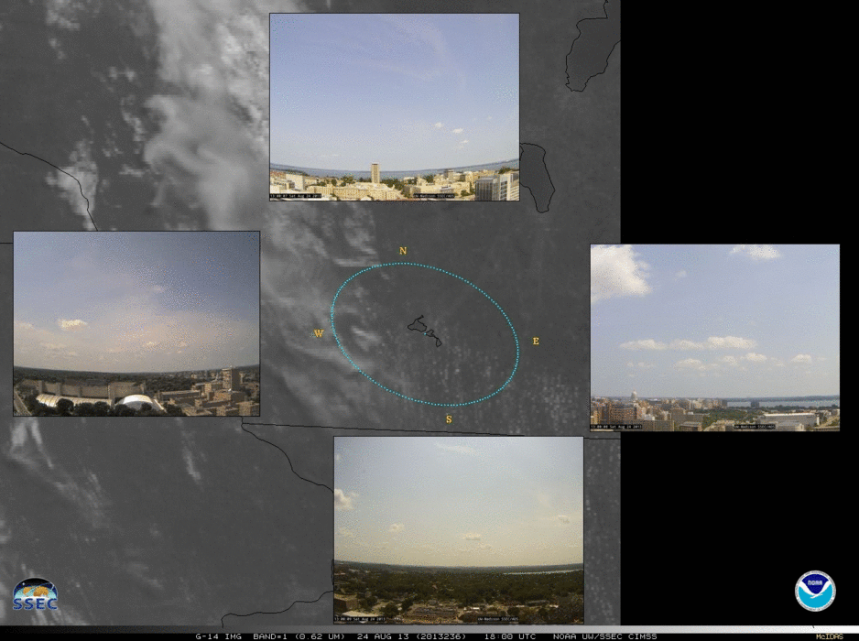
GOES-14 imagery: Plus time-synched roof top cameras
SRSOR (Super Rapid Scan Operations for GOES-R) from GOES-14 imager allowed for smoother time animations, combined with Roof Top Cameras (RTC)
From GOES-14 SRSOR (select days): http://cimss.ssec.wisc.edu/goes/rtc/
And from GOES-13 (on-going): http://cimss.ssec.wisc.edu/goes/rtc_goes_east/
Work done in part by a CIMSS intern from Germany (Philipp Ratz), working with Paul Menzel and others.
Animation from GOES-14 Imager visible image at 1-min time resolution with time synched root top camera images over Madison, WI.
Tying together the ground-based and satellite perspectives allow a better understanding of each.

