Slide 1
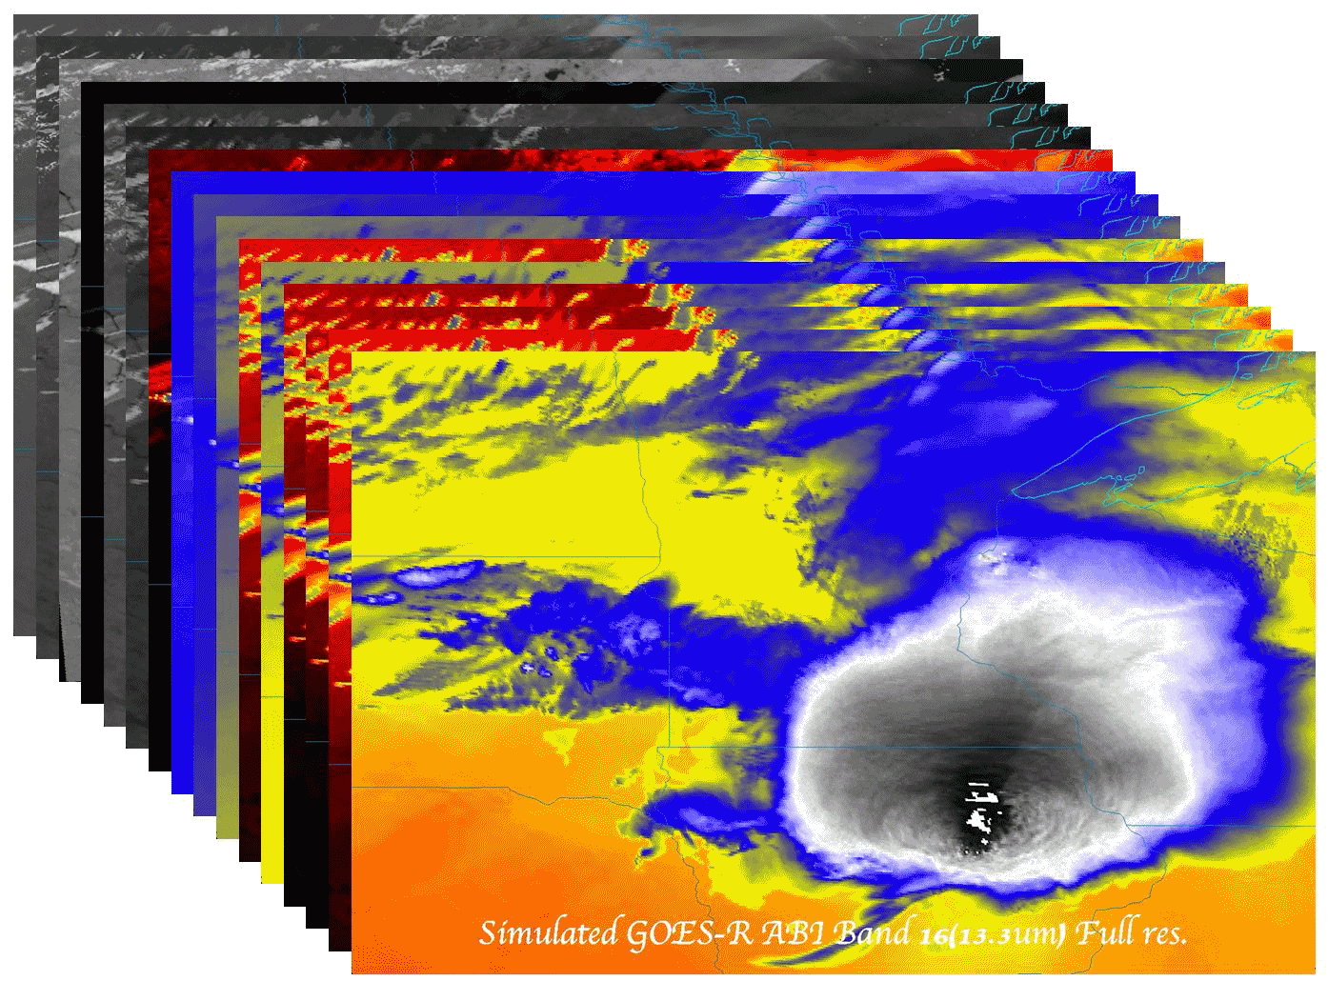
The ABI on the GOES-R Series:
Past, Present and Future
Timothy J. Schmit (tim.j.schmit@noaa.gov)
NOAA/NESDIS/Satellite Applications and Research (StAR)
Advanced Satellite Products Branch (ASPB)
Madison, WI
(“The birthplace of Satellite Meteorology”)
A former National Hurricane Center director once said that if he had only one tool to do his forecasting job, it would be the geostationary weather satellite.
Lockheed Martin
Littleton, CO
November 19, 2015
UW-Madison

Slide 2
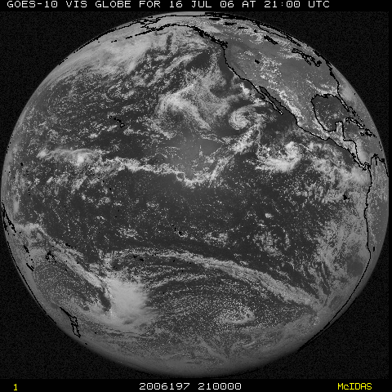
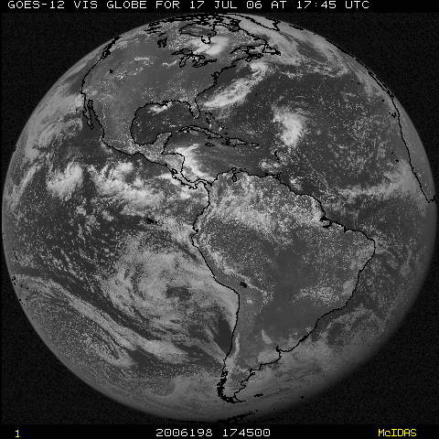
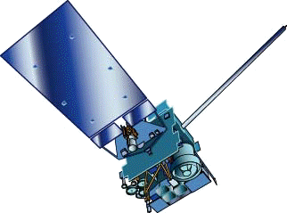
NOAA GOES Constellation
GOES-West
GOES-15
(135W)
GOES-East
GOES-13
(75W)
GOES-14 (105W) is on-orbit back-up

Slide 3
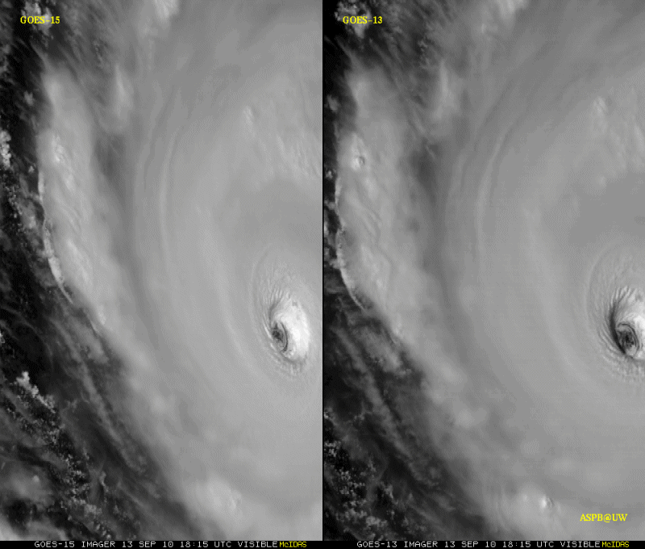
GOES-15 Science Test
The Science Test part of Post Launch Testing for GOES-15 occurred in the summer of 2010.
Co-led by Hillger and Schmit.
Unique 1-minute rapid scan imagery acquired
GOES-15 data analysis will continue. All the GVAR data archived.
Many products generated in near real-time.
A NOAA Technical Report was generated.
1-min
30-min
Unique GOES-15 Imager Visible data from the NOAA Science Test
Notes:
Igor

Slide 4
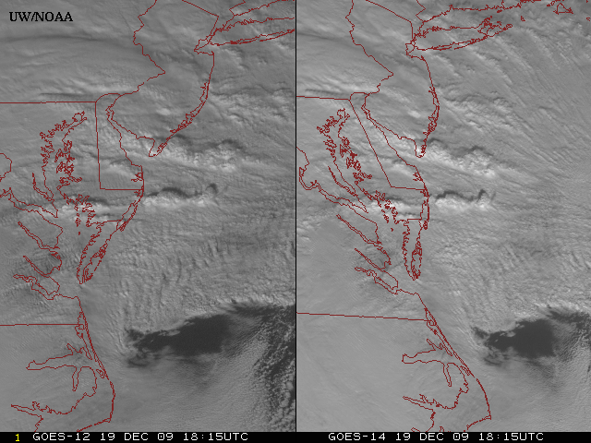
New GOES: Sample “1-min” imagery
GOES-12
GOES-14
See “what is happening”, not “what has happened”.
Notes:
Note the number of different levels of motion you can see (the cyclonic low level circulation over the ocean through the breaks in the higher clouds)... and you can't distinguish those on the GOES-12 loop.

Slide 5
GOES-14 Super Rapid Scan Operations to Prepare for GOES-R (SRSOR)
Data during parts of 2012 (Hurricane Sandy, convection), 2013 (CA Rim Fire, convection) and 2014 (Hurricane Marie, convection):
http://cimss.ssec.wisc.edu/goes/srsor/GOES-14_SRSOR.html
http://cimss.ssec.wisc.edu/goes/srsor2013/GOES-14_SRSOR.html
http://cimss.ssec.wisc.edu/goes/srsor2014/GOES-14_SRSOR.html
GOES-14 provided very unique data and offered a glimpse into the possibilities that will be provided by the ABI on GOES-R in one minute mesoscale imagery
GOES-14 visible image showing rapid convective development
Notes:
http://cimss.ssec.wisc.edu/goes/srsor2015/GOES-14_SRSOR.html

Slide 6
1-min imagery
1-min mode (SRSOR from GOES-14)
Operational (GOES-13)

Slide 7
A Glimpse into the Future
ABI-like
Hurricane Sandy from GOES-14 at two temporal resolutions

Slide 8
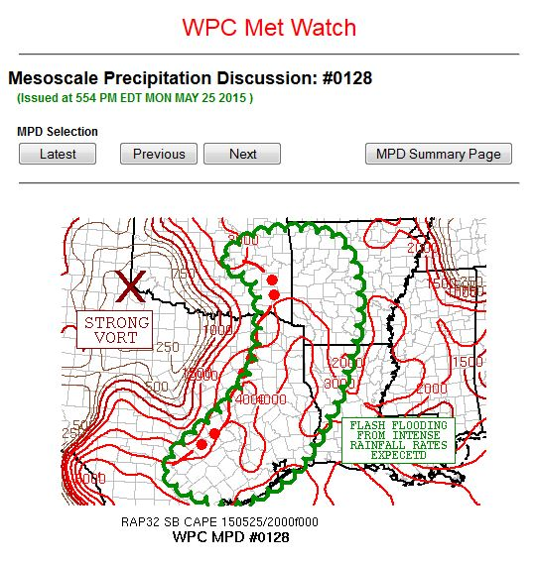
GOES-14 Super Rapid Scan Operations to Prepare for GOES-R (SRSOR)
SRSOR for 2015 included May 18-June 12, and August 10-22:
http://cimss.ssec.wisc.edu/goes/srsor2015/GOES-14_SRSOR.html
Used by many in the NWS, including NOAA’s Storm Prediction Center (SPC), Weather Prediction Center (WPC) and others.
GOES-14 provides unique data and offers a glimpse into the possibilities of the ABI on GOES-R in one minute mesoscale imagery
GOES-14 visible image showing rapid convective

Slide 9
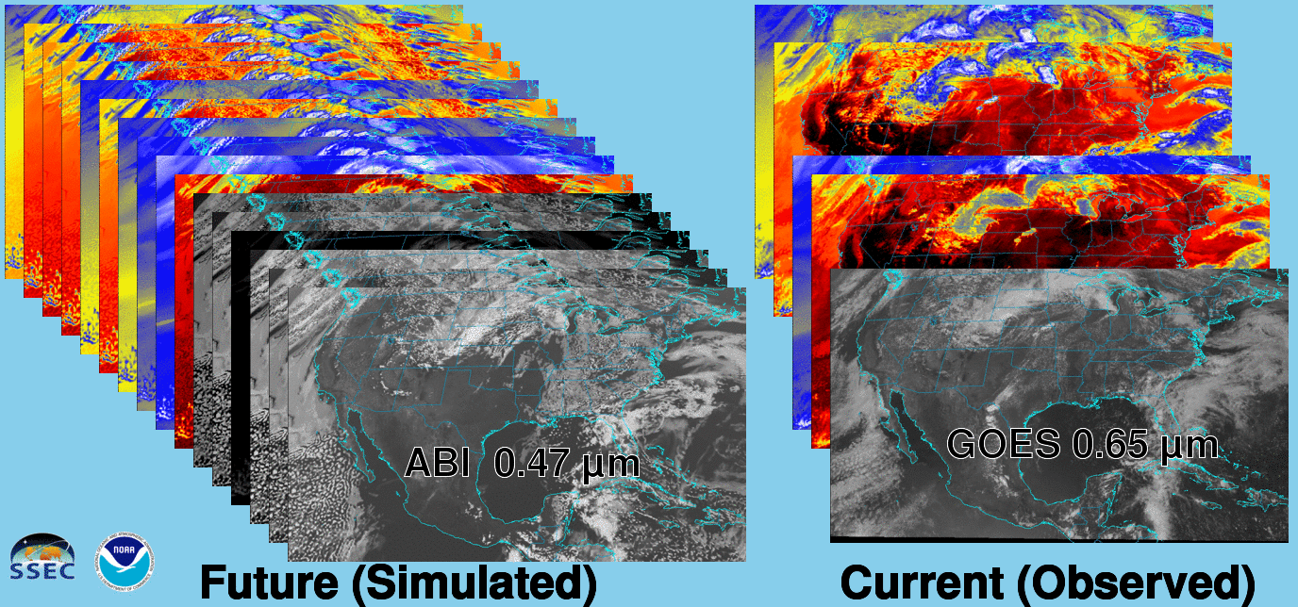
Future vs. Current Spectral Bands
The current GOES (right) has 5 spectral bands, while the GOES-R series ABI (left) will have 16 spectral bands.

Slide 10
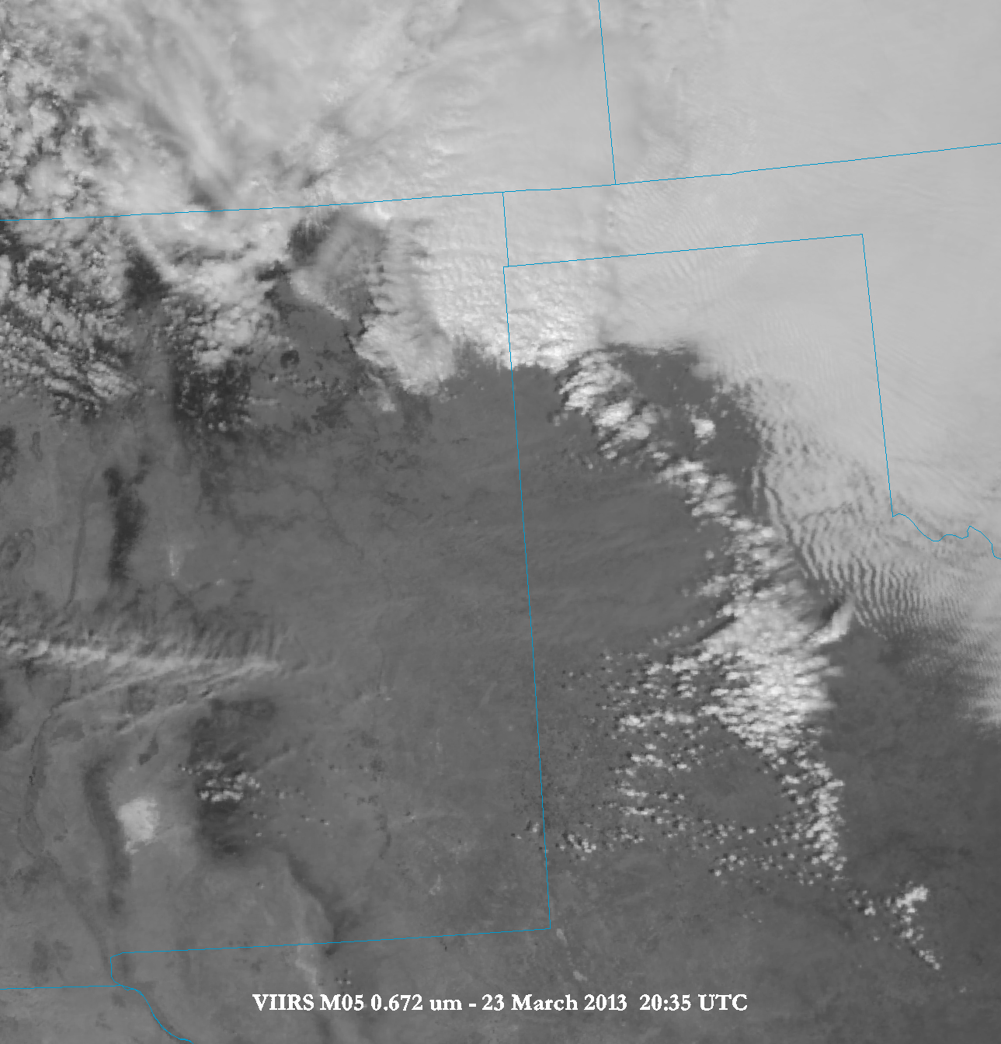
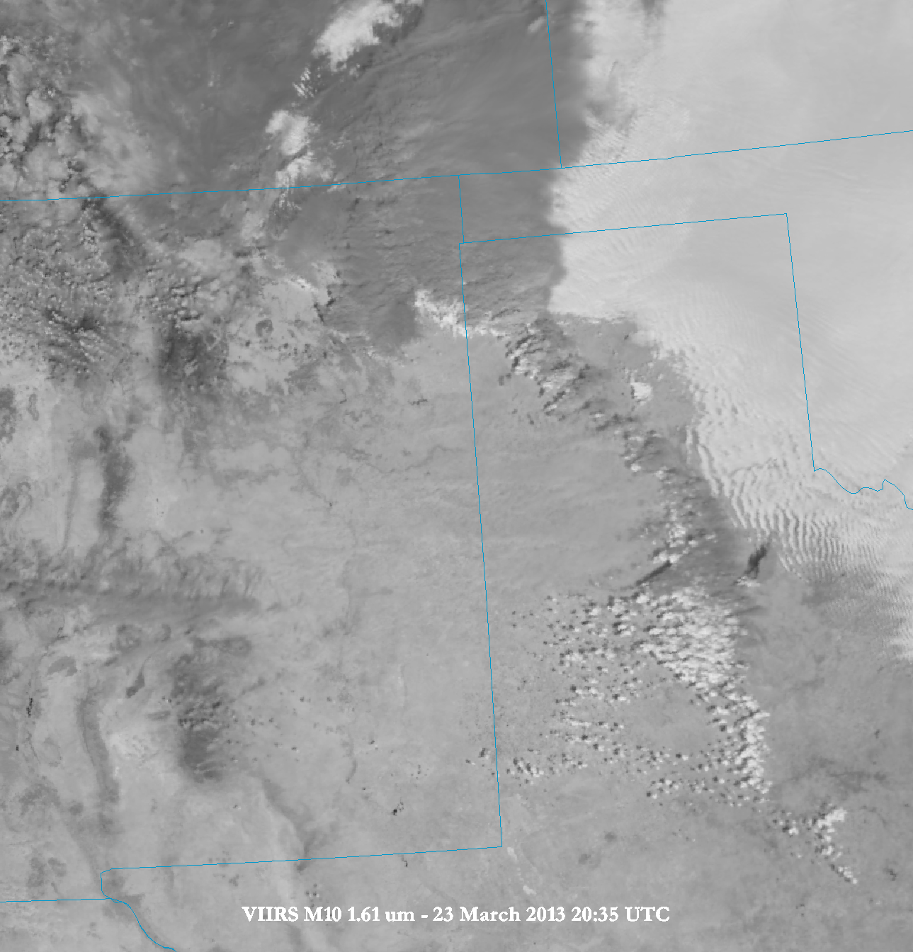
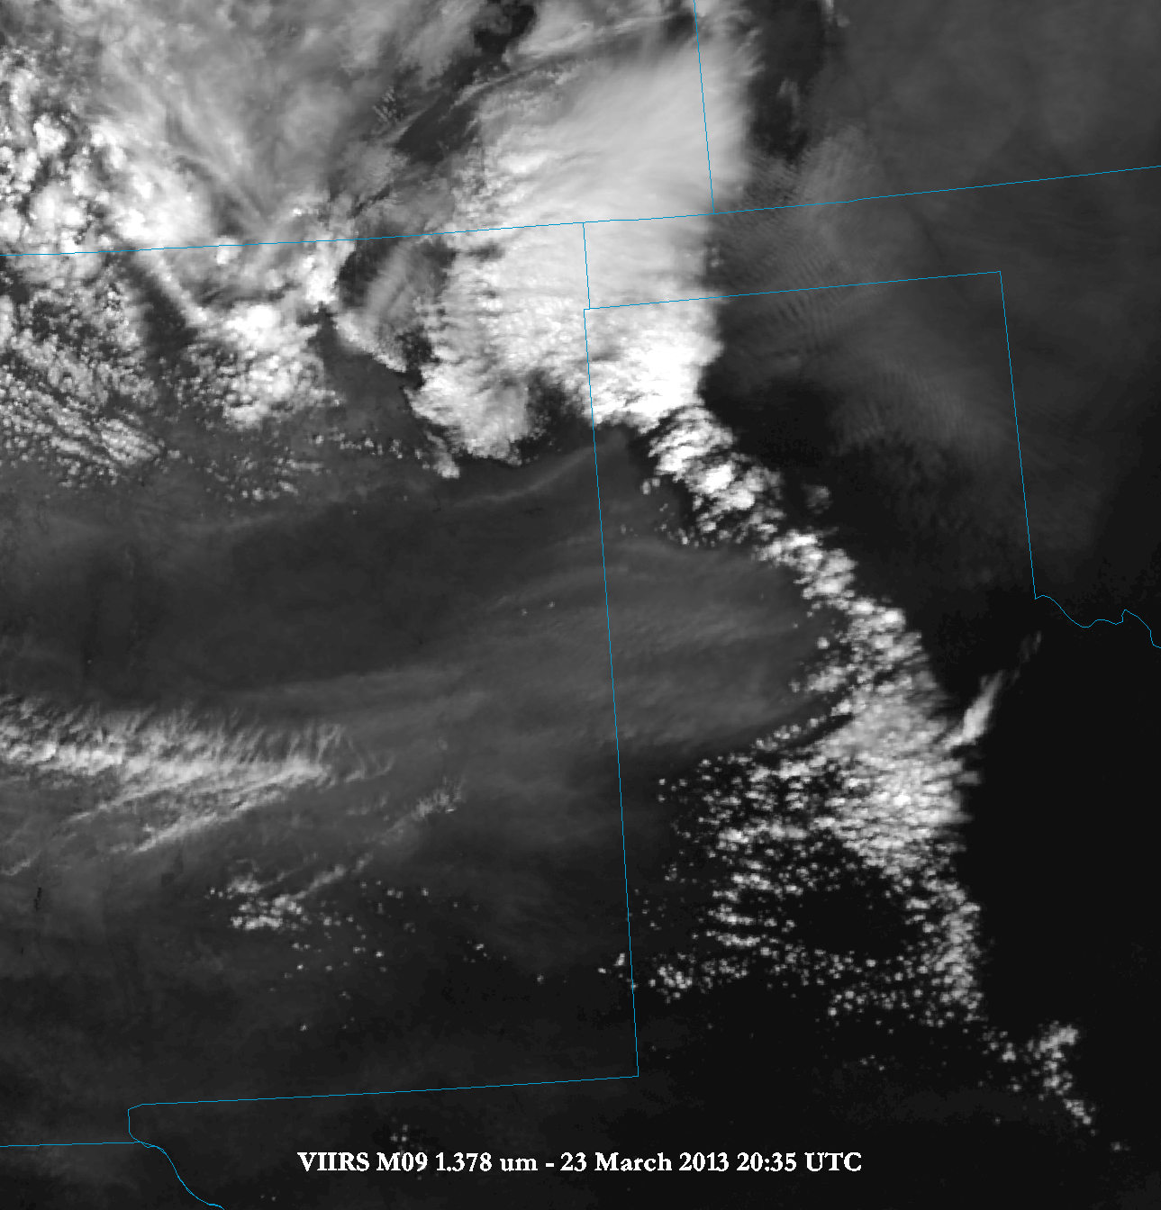
Using a multi-spectral approach….
Current GOES has one visible band

Slide 11
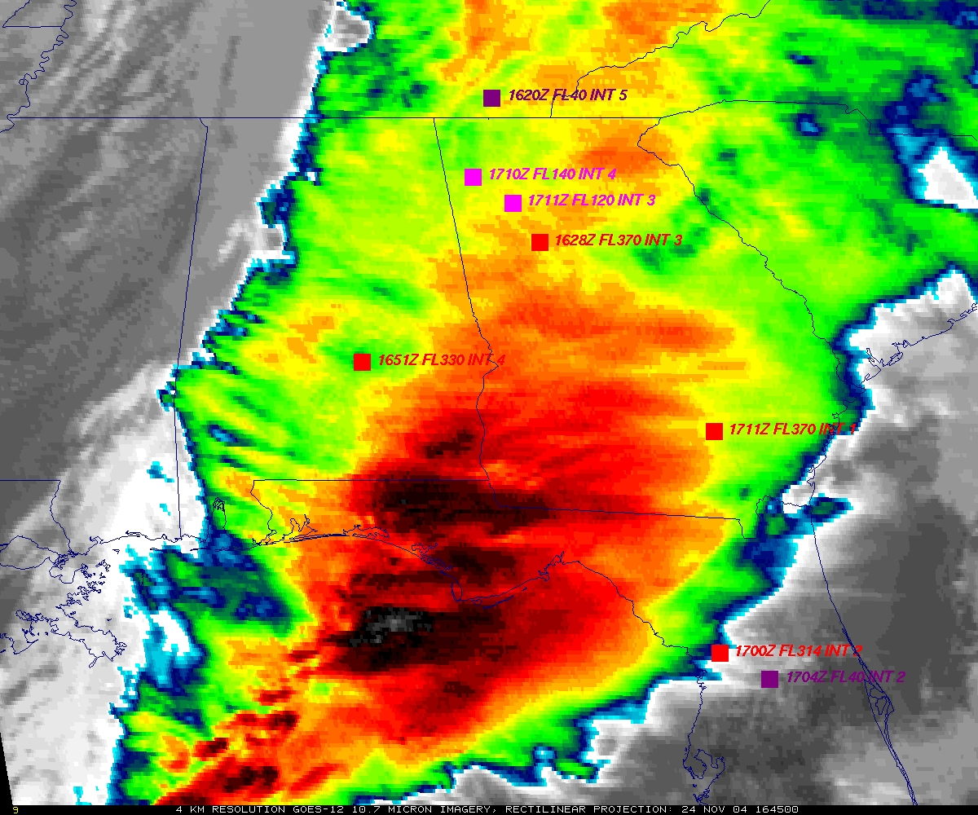
GOES
Figure courtesy of K. Bedka and W. Feltz

Slide 12
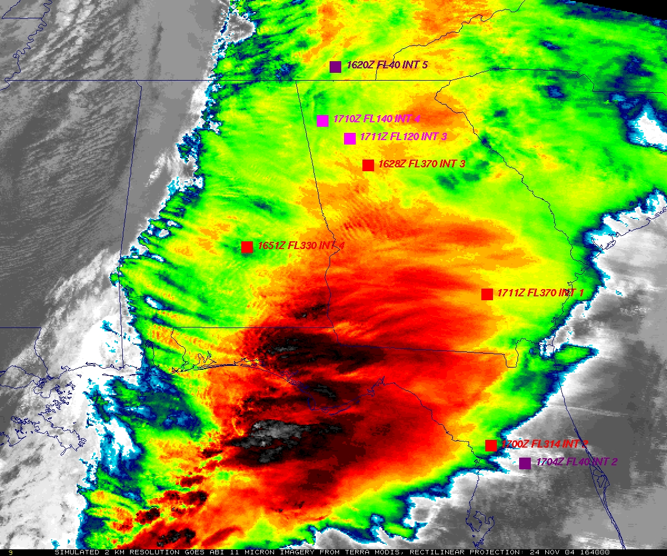
“ABI” from MODIS
Figure courtesy of K. Bedka and W. Feltz

Slide 13
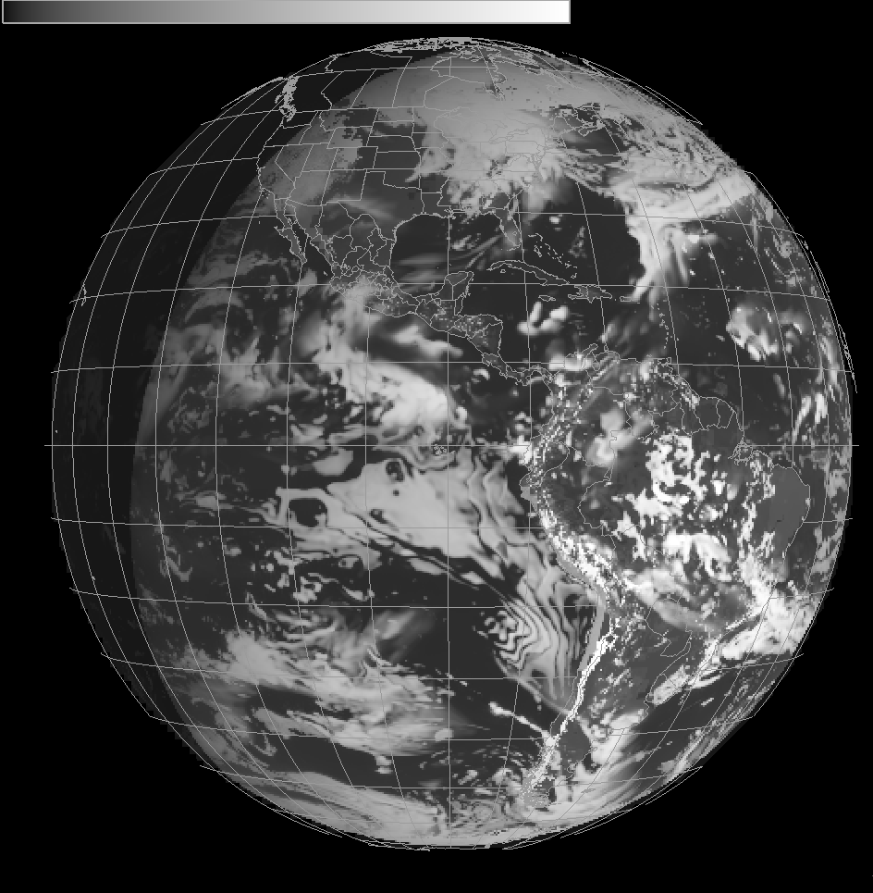
Cloud and Moisture Imagery and Level 2 products: Daily Real-time End-to-End Testing (from NWP to AWIPS-2)
Simulated ABI, on model grids
AWG / STAR / CIMSS
To NWS, remap, emulate ABI mode, released as PG blocks, sent over NOAA Port and into AWIPS-2, re-assembled.
Simulated ABI , in AWIPS-2
Notes:
Datasets are used not just for KPP, but level 2 processing as well.

Slide 14
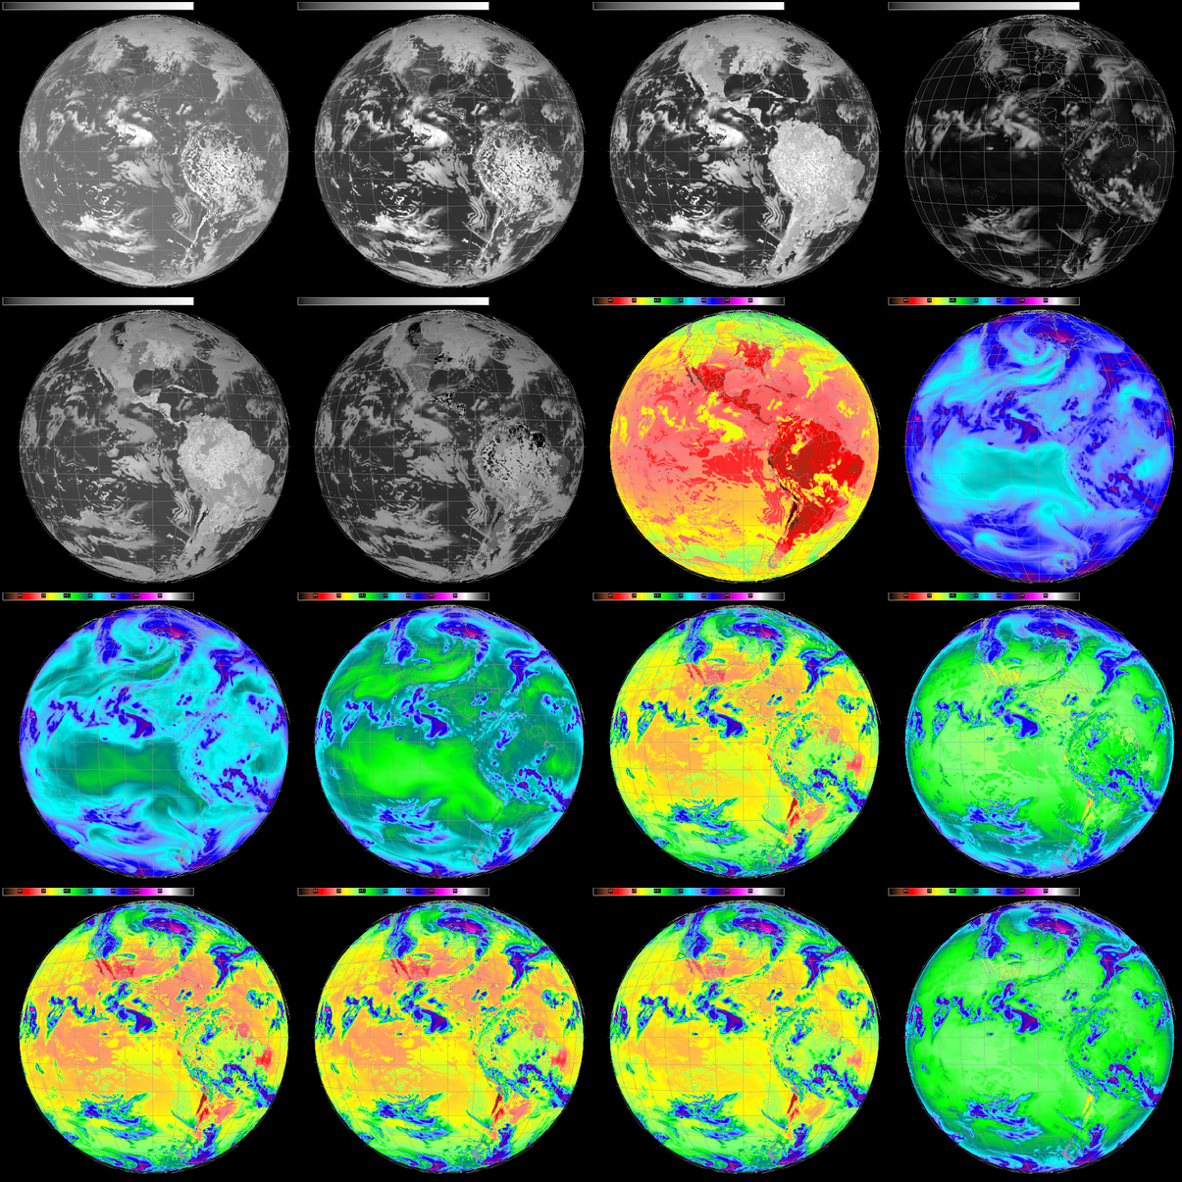
16 Simulated
ABI Bands
Visible (2)
Near IR (4)
IR (10)
AWIPS-2
Full Disk
Central location
(Test)
Realistic (simulated) imagery flowing for end-to-end system testing
Notes:
18 UTC. 28-Oct-2015. 11-bit enhancement

Slide 15
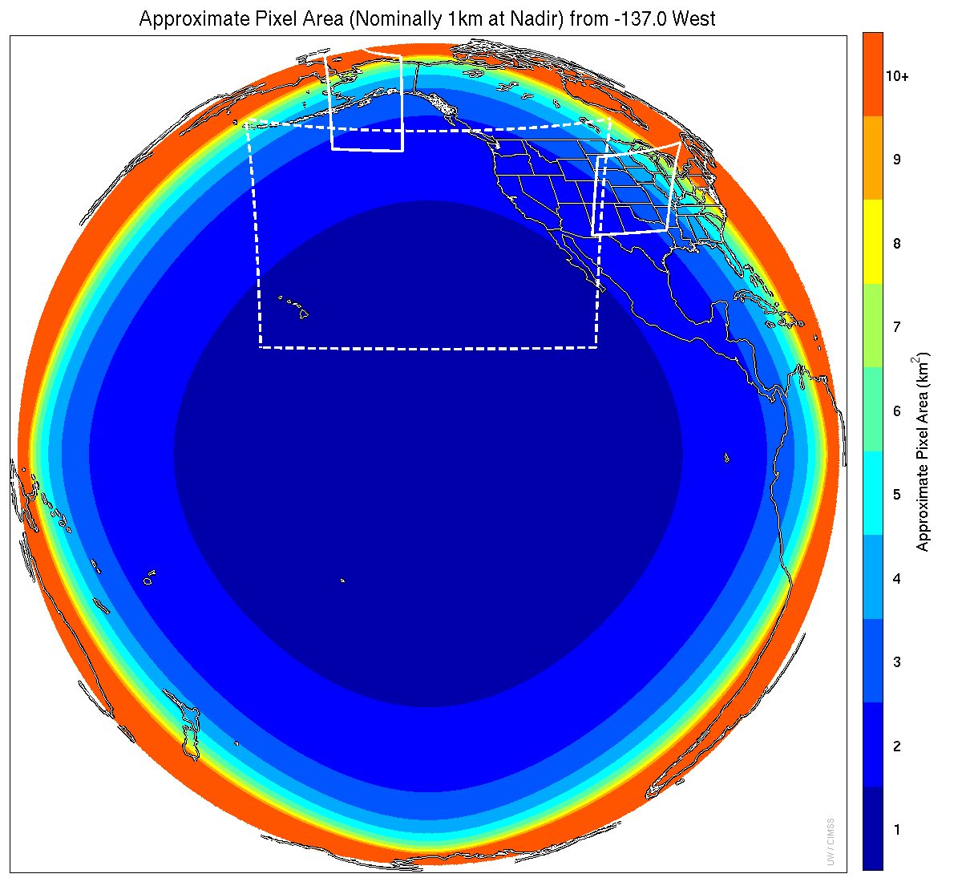
1 min
1 min
5 min
15 min
Notes:
1-km² spatial resolution at satellite nadir. Pixel Areas are approximate. Each bin is rounded to the nearest 1km² until we get to 9.5km² and then all are binned into the red 10+ area. So the first, dark blue, ring covers pixel areas from 1 to 1.49km² and is labeled “1”, above 1.5 to below 2.5km² goes into the next ring and is called “2”, etc. GOES-West location. Proposed CONUS sector, approved by the NWS NOAT. Two meso-scale image sectors shown; these are selectable. The same central lat/lon used for these mesoscales produces a different sized and shaped area for different satellite locations.

Slide 16
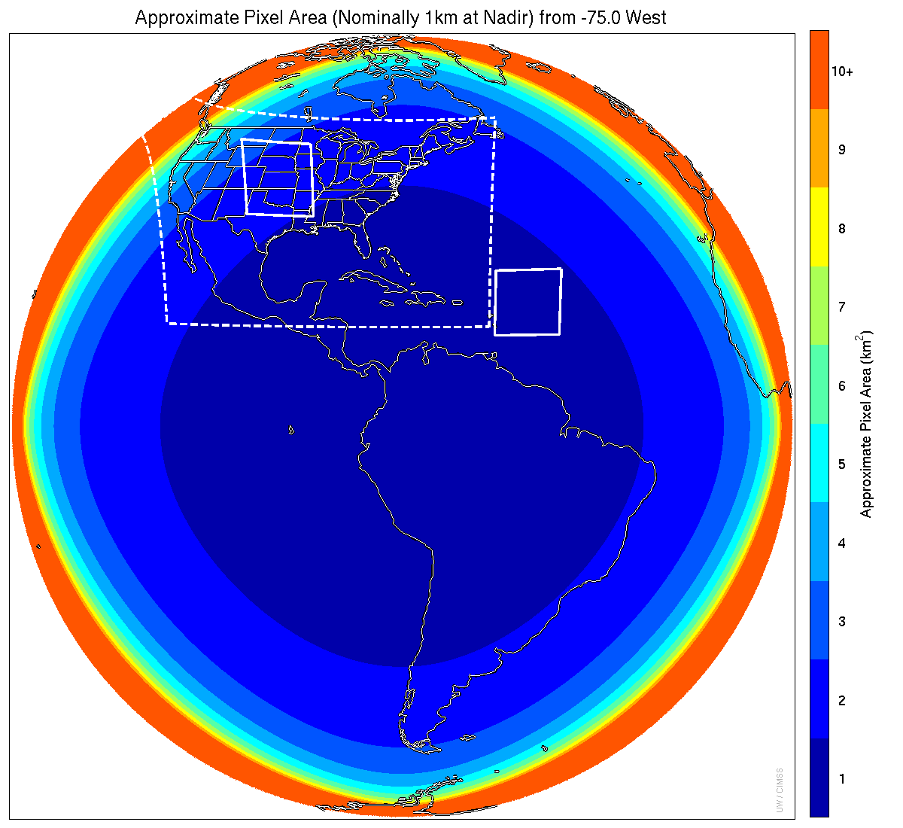
1 min
5 min
1 min
15 min
Notes:
1-km² spatial resolution at satellite nadir. Pixel Areas are approximate. Each bin is rounded to the nearest 1km² until we get to 9.5km² and then all are binned into the red 10+ area. So the first, dark blue, ring covers pixel areas from 1 to 1.49km² and is labeled “1”, above 1.5 to below 2.5km² goes into the next ring and is called “2”, etc. GOES-East location. Proposed CONUS sector, approved by the NWS NOAT. Two meso-scale image sectors shown; these are selectable. The same central lat/lon used for these mesoscales produces a different sized and shaped area for different satellite locations.

Slide 17
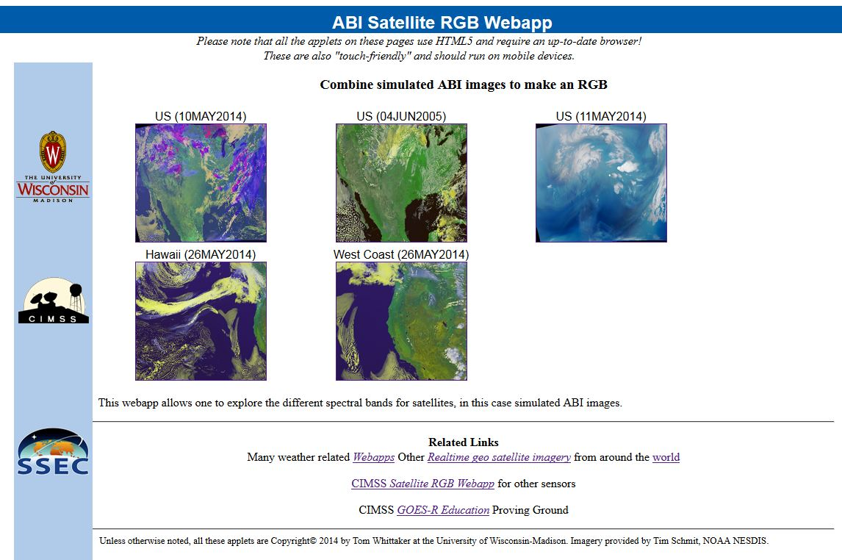
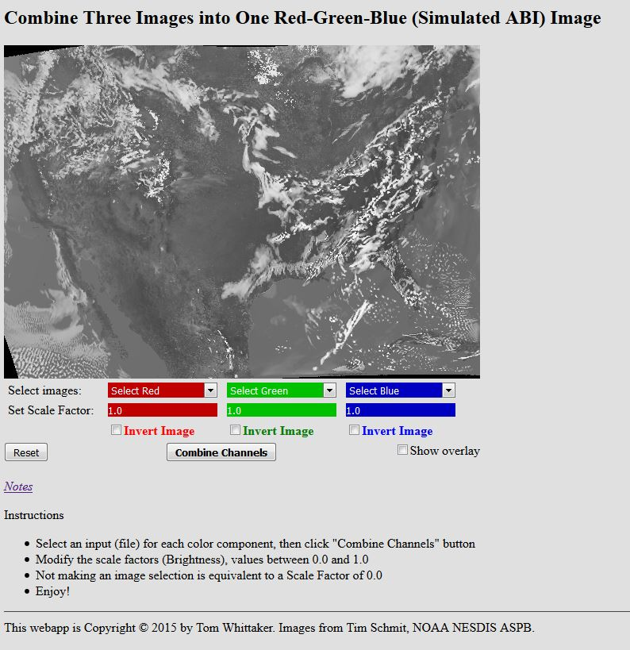
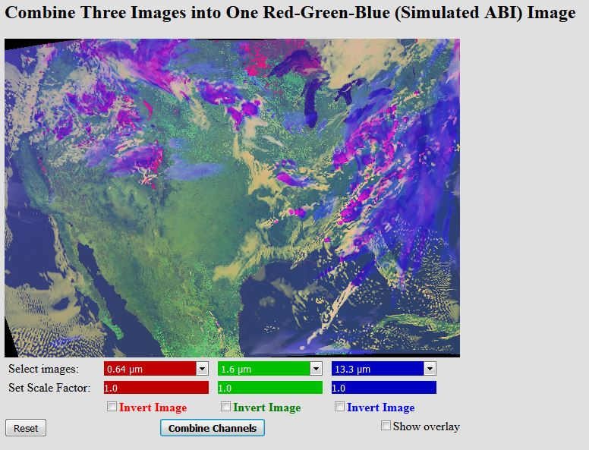
Educational RGB Webapp
Sample interactive “RGB” educational webapp using simulated ABI images:
http://cimss.ssec.wisc.edu/goes/webapps/satrgb/overview.html
Webapp to combine simulated ABI images into one image.
Notes:
Tim Schmit, ASPB
https://ams.confex.com/ams/95Annual/webprogram/Paper265203.html ABI = Advanced Baseline Imager
Other new webapps: one to change both the spatial and temporal sampling and the other only the pixel sampling

Slide 18
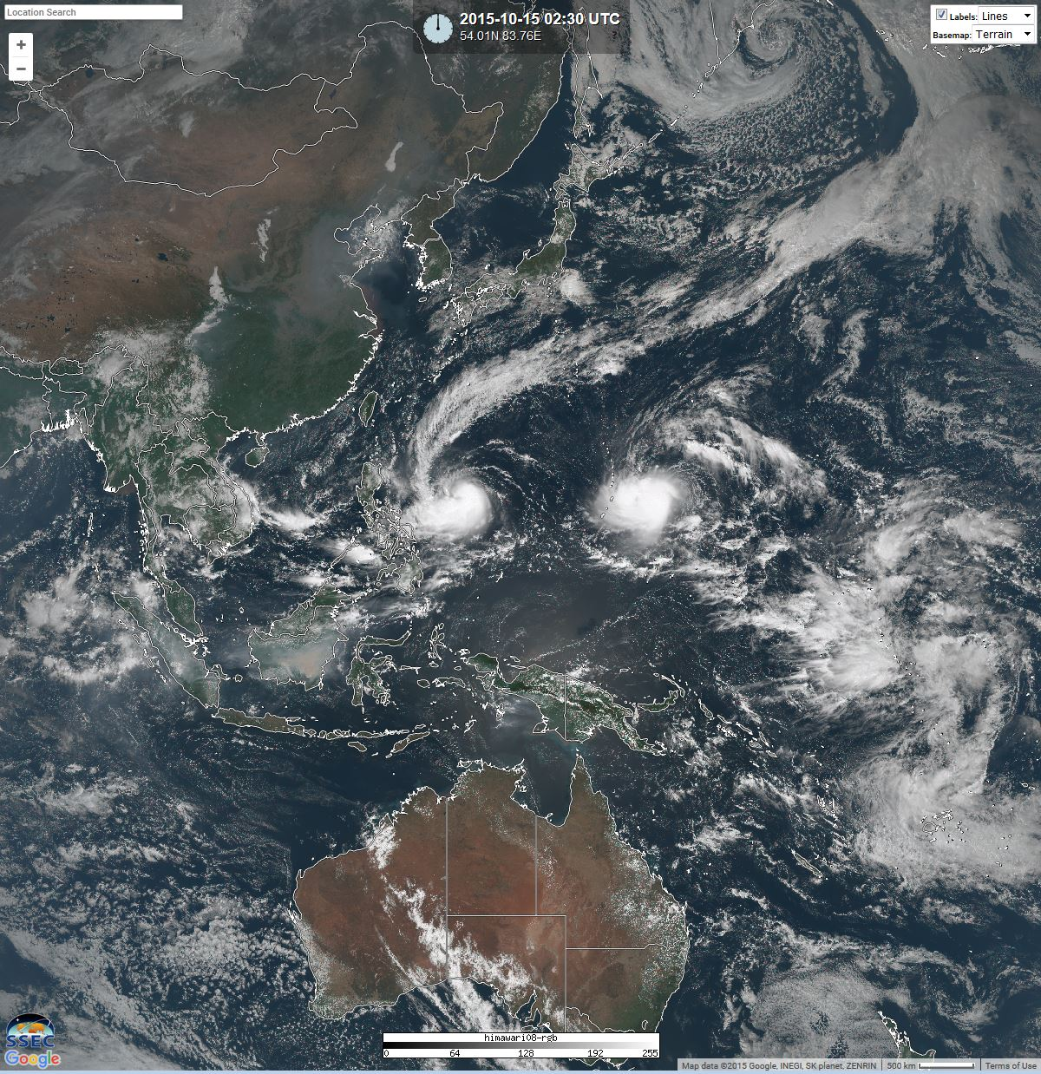
Recent AHI color image
in RealEarth

Slide 19
GOES-14 SRSOR 1-min
Click for animations
PyroCu
Hotspots
Vis / 4um
Vis/IRW
1/15 min
Storm Rel
1/15 min
Derecho
Fog
Texas
Marie
Sandy
http://cimss.ssec.wisc.edu/goes/srsor/overview_training.html
Notes:
Animations at: ftp://ftp.ssec.wisc.edu/ABI/LM2015

Slide 20
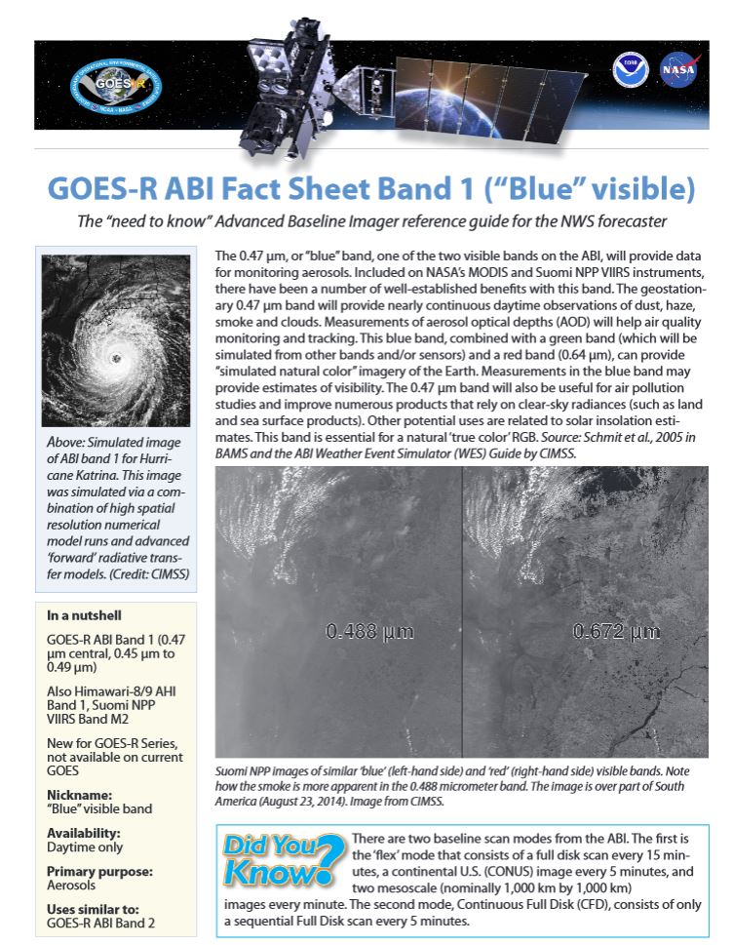
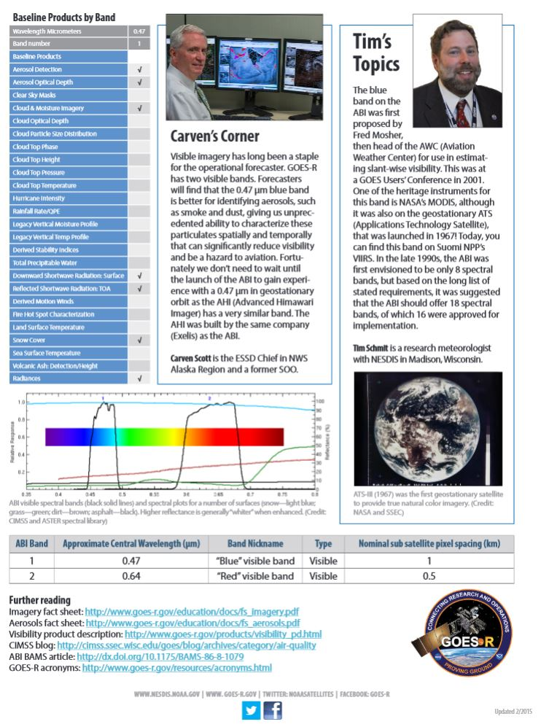
ABI Bands Quick Information Guides
http://www.goes-r.gov/education/ABI-bands-quick-info.html

