Slide 1



Recent Progress on Soundings and Derived Parameters such as Total Precipitable Water vapor
Tim Schmit¹, Jun Li², and Chris Barnet¹
¹ Center for Satellite Applications and Research, NESDIS/NOAA
² University of Wisconsin-Madison, CIMSS
NOAA Science Week
30 April – 04 May 2012
NWS Training Center in Kansas City, MO

Slide 2
Acknowledgements
GOES-R Program: Steve Goodman
JPSS Program: Mitch Goldberg, Lihang Zhou
AWG: Jaime Daniels
CIMSS: Zhenglong Li, Bill Smith, Elisabeth Weisz, Jinlong Li, Dave Tobin, Pei Wang, etc. ……
AIT: Graeme Martin, Walter Wolf, etc….

Slide 3
Outline
Synopsis of GOES-R Product Algorithm
      Algorithm description
      Product example(s)
Continuing AWG Validation Activities
      Latest algorithm performance statistics obtained
      Results/examples from any case study analyses
      Synopsis of any algorithm enhancements
      Showcasing of any validation tools developed
Thoughts, Plans, and Opportunities for:
      Satellite product algorithm enterprise solutions
      Smart multi-sensor applications
        integration of geo and leo products
Notes:
Presentation Guidelines (soundings example): Discuss the TPW algorithm, identify strengths and weaknesses, touch on Blended TPW and include CrIMMS products from JPSS if possible.

Slide 4
Products
Legacy atmospheric temperature profile (10 km, hourly, disk)
Legacy atmospheric moisture profile (10 km, hourly, disk)
Total precipitable water (10 km, hourly, disk)
  Layered PW only an intermediate product
Lifted index (10 km, hourly, disk)
Convective available potential energy (10 km, hourly, disk)
Total totals index (10 km, hourly, disk)
Showalter index (10 km, hourly, disk)
K-index (10 km, hourly, disk)
Notes:
Provide a list of products and their specifications (spatial and temporal resolution, coverage). Include an example display(s) of your products.

Slide 5
Requirements
Product | Accuracy | Precision | Latency (mesoscale) | horizontal resolution
Temperature profile (K) | 1K below 400 hPa and above boundary | 2K below 400 hPa and above boundary | 4.4 min | 10 km
Moisture profile (RH) | Sfc-500 mb: 18% relative humidity; 500-300 mb: 18% relative humidity; 300-100 mb: 20% relative humidity | Sfc-500 mb: 18% relative humidity 500-300 mb: 18% relative humidity 300-100 mb: 20% relative humidity | 4.4 min | 10 km
Derived stability indices | LI: 2 K CAPE: 1000 J/ kg SI: 2 K TT: 1 KI: 2 | Lifted Index: 6.5 K CAPE: 2500 J/ kg Showalter index:6.5 K Total totals Index:4 K index: 5 | 2.7 min | 10 km
TPW | 1 mm | 3 mm | 4.4 min | 10 km
5
Notes:
5
To a quick review of most stringent requirements.

Slide 6
LAP Sounding Processing Schematic
BT: Channel 7 to 16 IR Brightness Temperature
T(p) = Temperature profile
W(p) = Moisture profile
P_{sfc} = Surface air pressure
T_{skin} = Surface skin temperature
E_{sfc} = Surface IR emissivity
Flag_{lw} = Land/water flag
LZA = Local zenith angle
Lat = Latitude
Mon = numerical month ID (1 to 12)
WS_{sfc} = Near surface wind speed
T_{sfc} = Near surface air temperature
W_{sfc} = Near surface air moisture
INPUT: (Required) BT, forecast T(p)/W(p)/P_{sfc}/T_{skin}, E_{sfc}, Flag_{lw}, LZA, Lat, Mon; (Optional) WS_{sfc}, T_{sfc}, W_{sfc}
Retrieval Algorithm
(Regression followed by physical iteration)
OUTPUT: Retrieved T(p)/W(P)/Ts
Calculate derived products
OUTPUT: TPW, layered PW, LI, CAPE, KI, TT, SI
6
Notes:
6
Algorithm Summary Slide

Slide 7
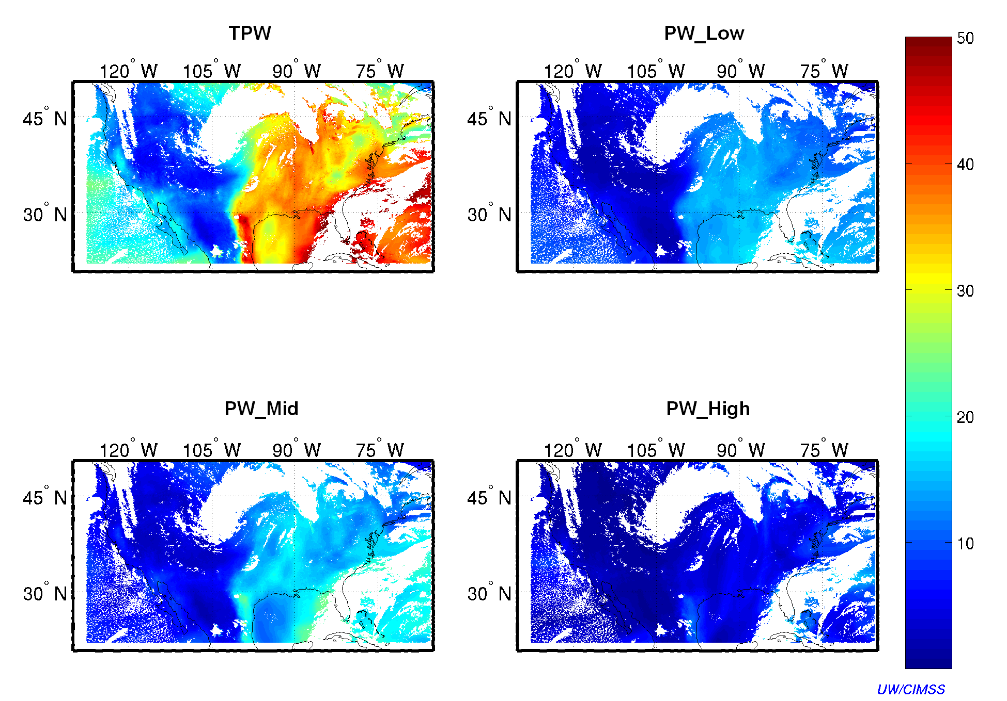
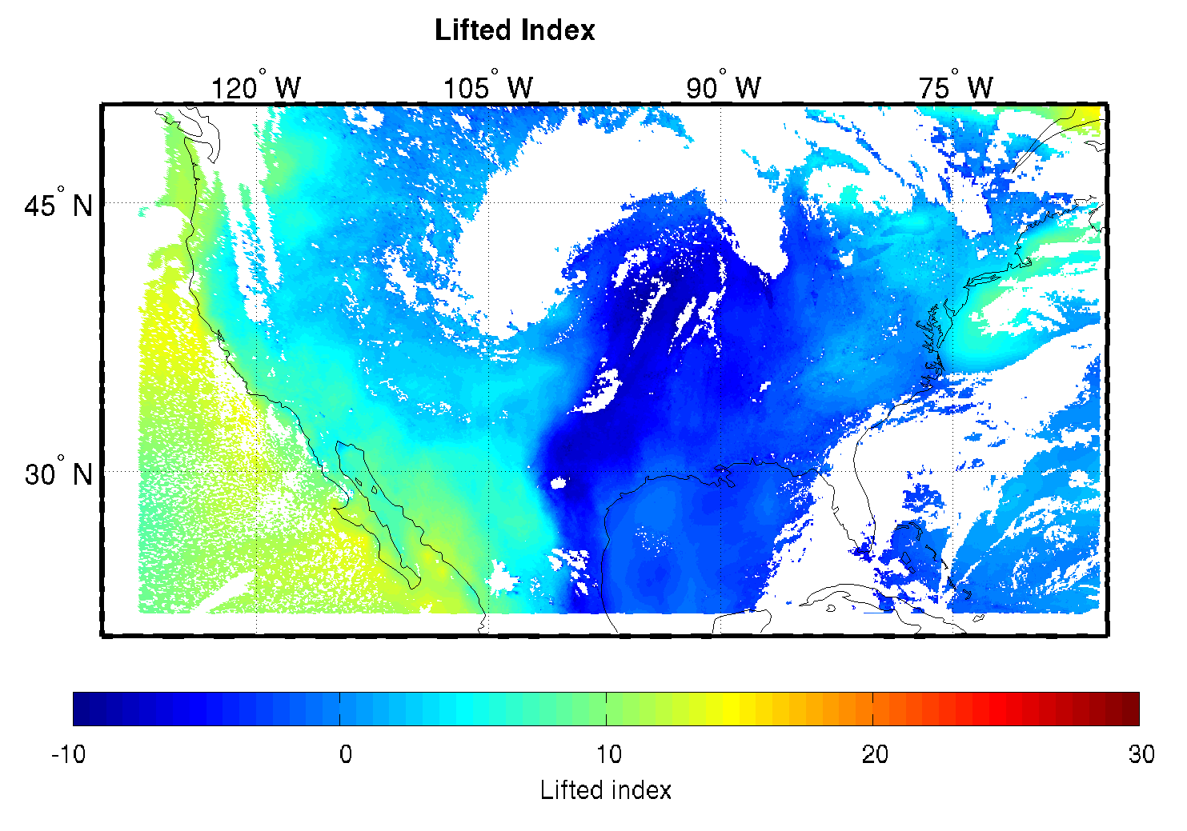
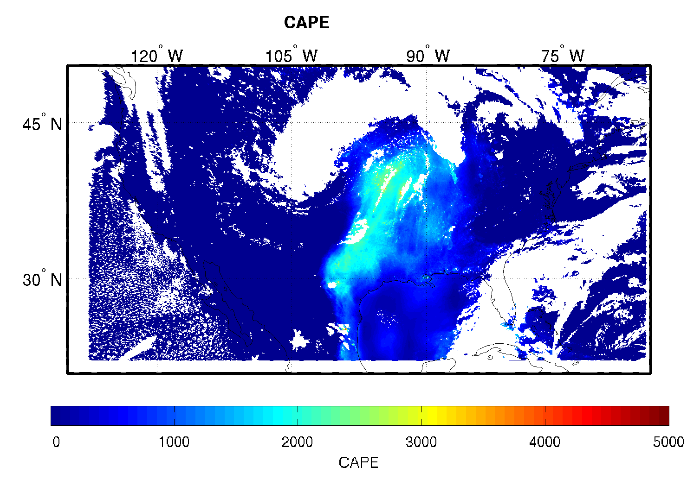
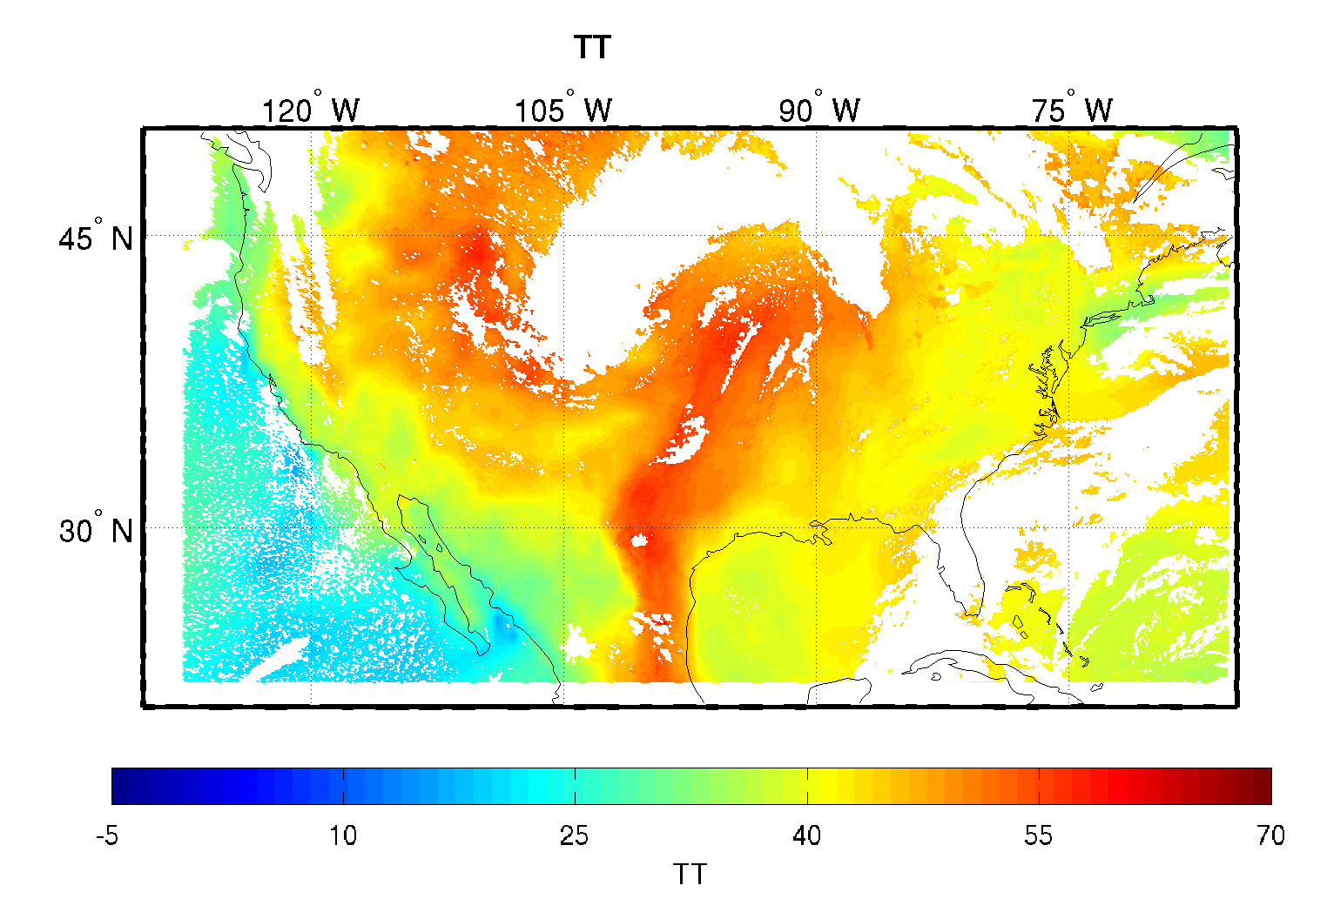
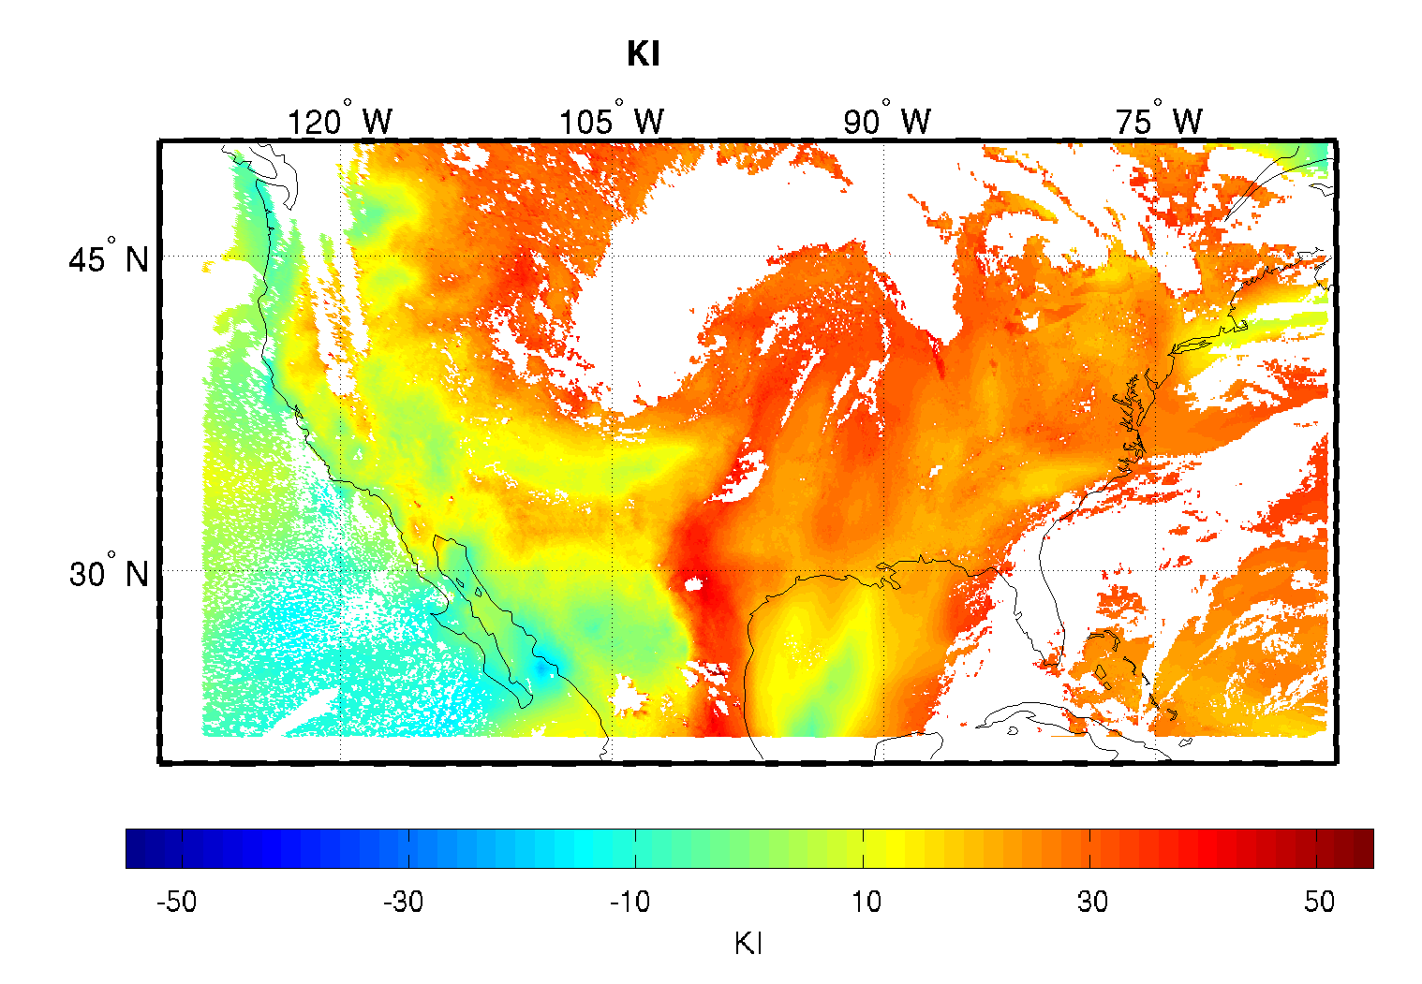
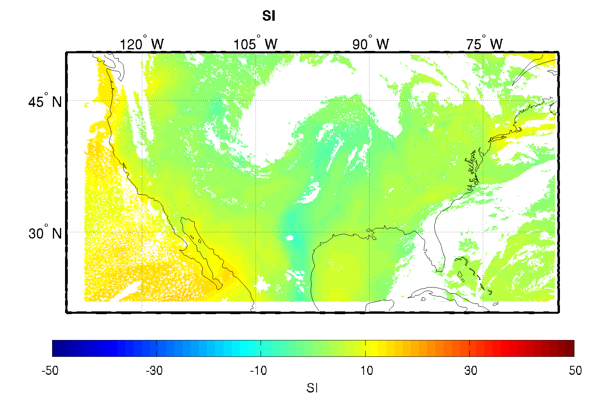
Example LAP Output using Simulated ABI data
TPW and layered PW
Lifted Index
Convective Available Potential Energy
Total Totals
K Index
Showalter Index

Slide 8
Outline
Synopsis of GOES-R Product Algorithm
      Algorithm description
      Product example(s)
Continuing AWG Validation Activities
      Latest algorithm performance statistics obtained
      Results/examples from any case study analyses
      Synopsis of any algorithm enhancements
      Showcasing of any validation tools developed
Thoughts, Plans, and Opportunities for:
      Satellite product algorithm enterprise solutions
      Smart multi-sensor applications
        integration of geo and leo products
Notes:
Presentation Guidelines: Discuss the TPW algorithm, identify strengths and weaknesses, touch on Blended TPW and include CrIMMS products from JPSS if possible.

Slide 9
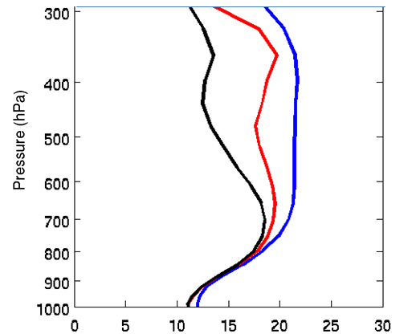
Validation with SEVIRI (both Meteosat-8 and -9)
Forecast
REG
PHY
RMSE (%)
The RH retrieval root mean square error (RMSE) from SEVIRI of Meteosat-9 compared with the spatially and temporally collocated radiosondes. Results are consistent with that of Meteosat-8
Notes:
Moisture profiles are the key.

Slide 10
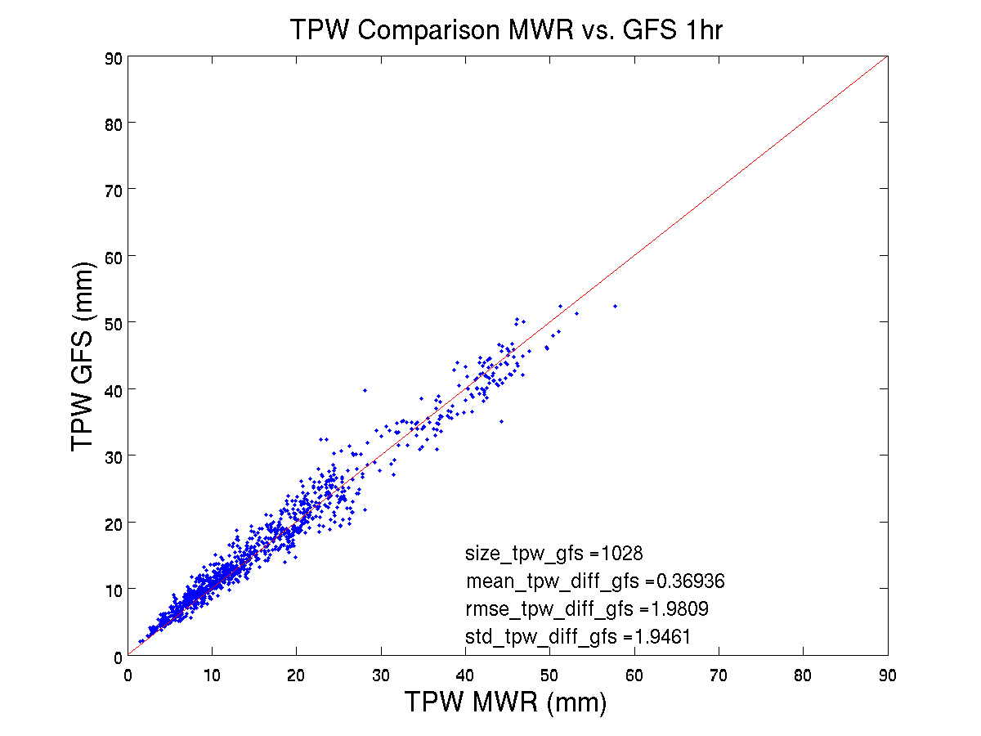
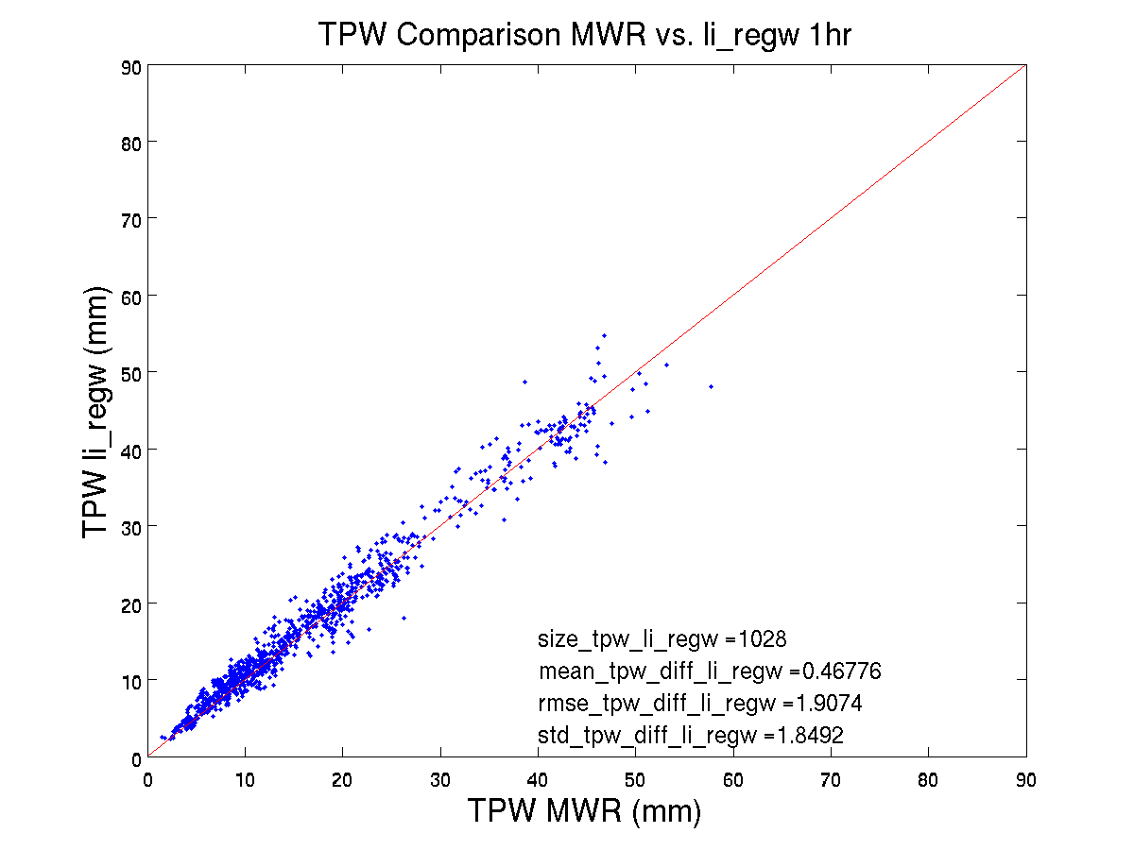
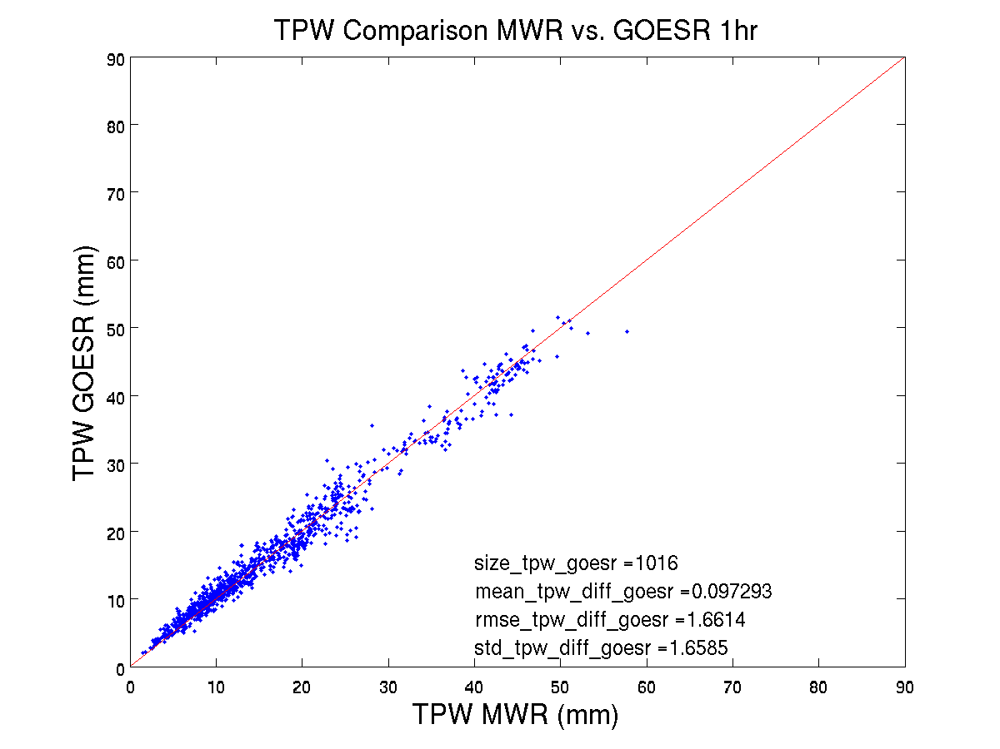
GFS TPW
GOES Li ALG TPW
GOES-R ALG TPW
TPW (mm) | Mean | RMSE | STD
GFS | 0.37 | 1.98 | 1.95
Li ALG | 0.47 | 1.90 | 1.85
GOES-R ALG | 0.10 | 1.66 | 1.66
Spec | 1.00 |  | 3.00
Notes:
The time coverage is from August 2010 to March 2011. GOES Sounder TPW evaluation with microwave radiometer TPW.

Slide 11
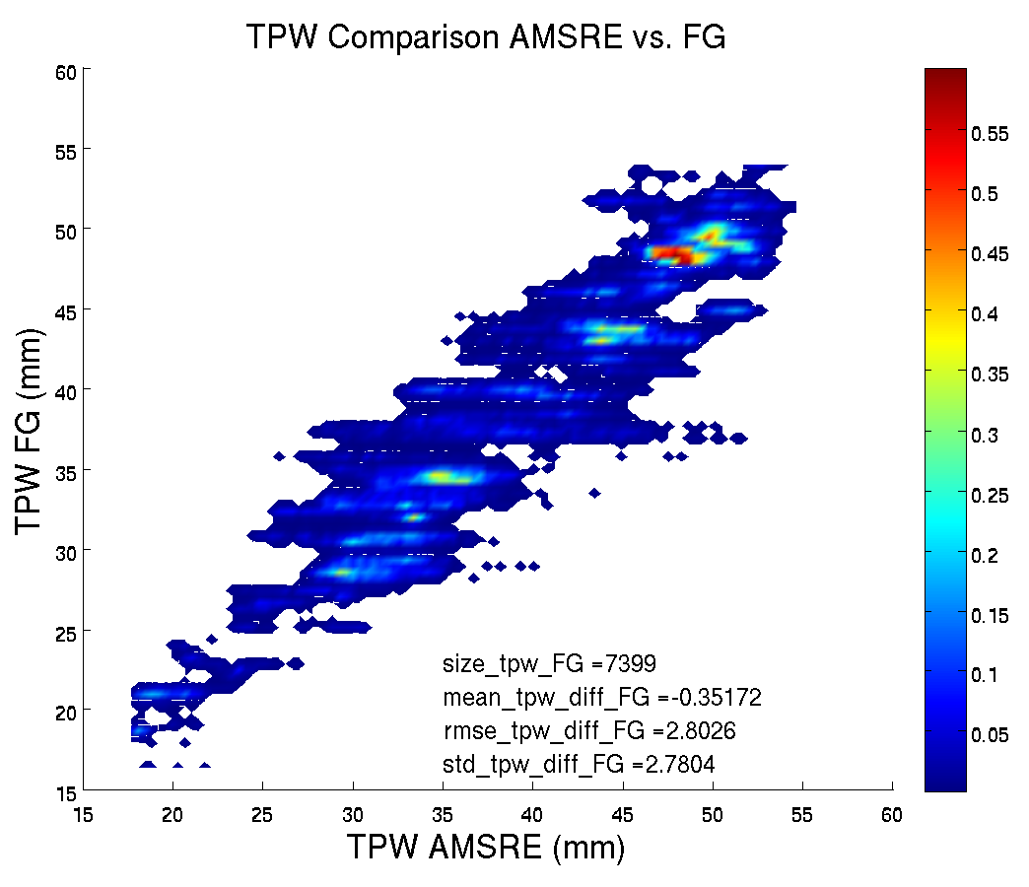
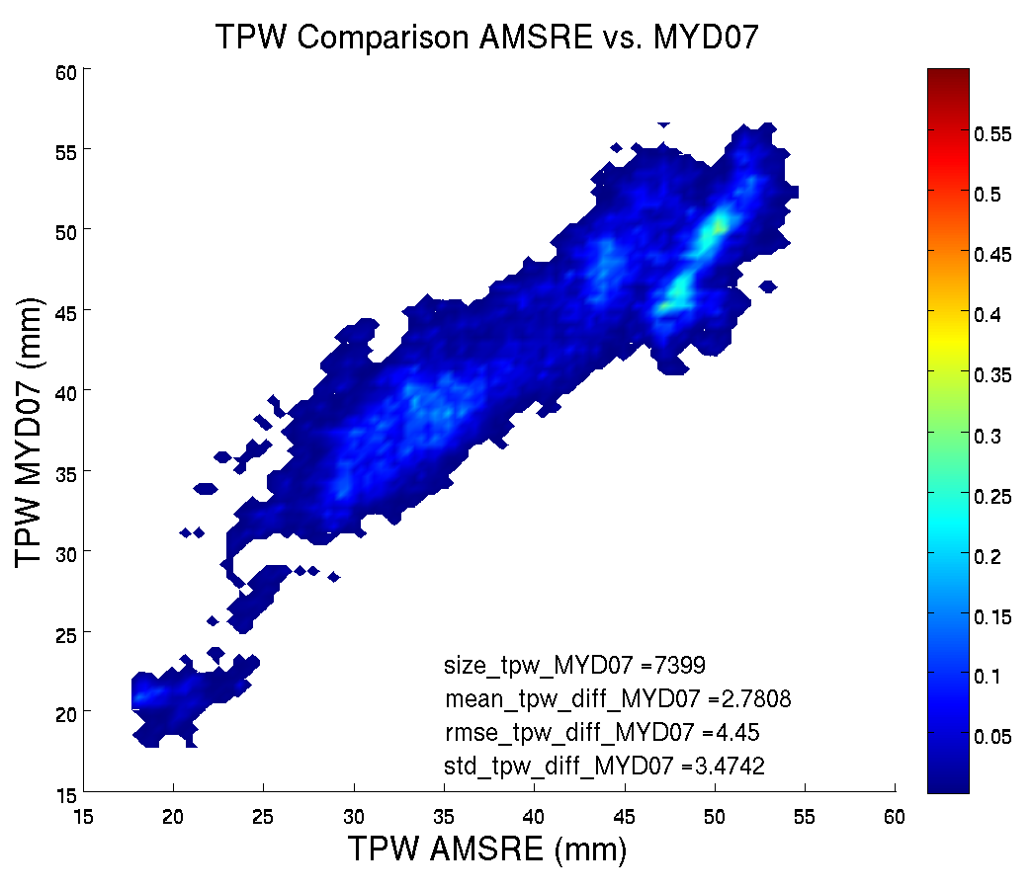
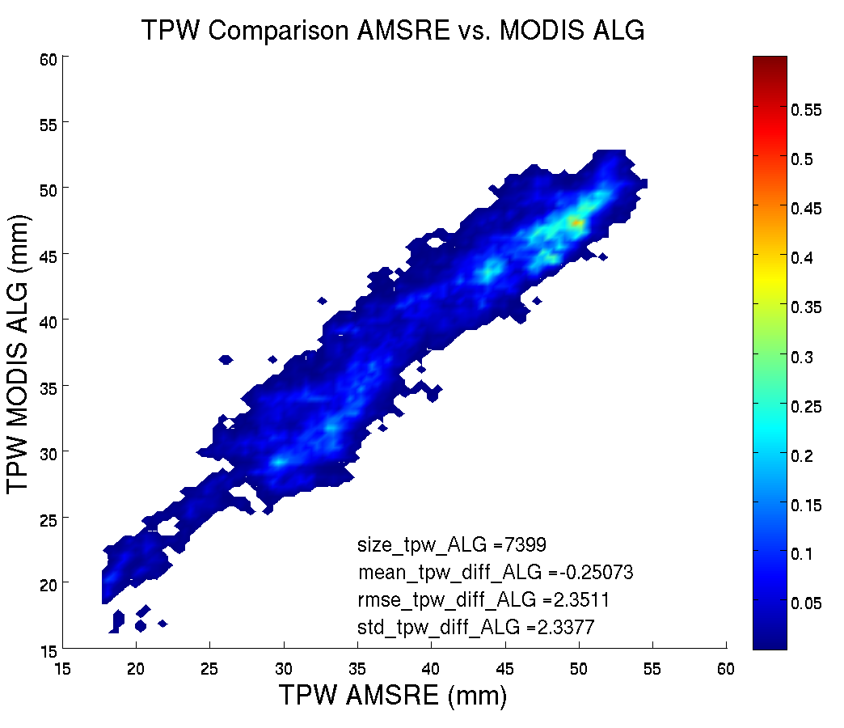
GOES-R algorithm validation with MODIS
(2008 Sep. 07 1825 UTC)
AMSR-E
GFS
AMSR-E
MODIS (Operational)
AMSR-E
MODIS (GOES-R LAP)

Slide 12
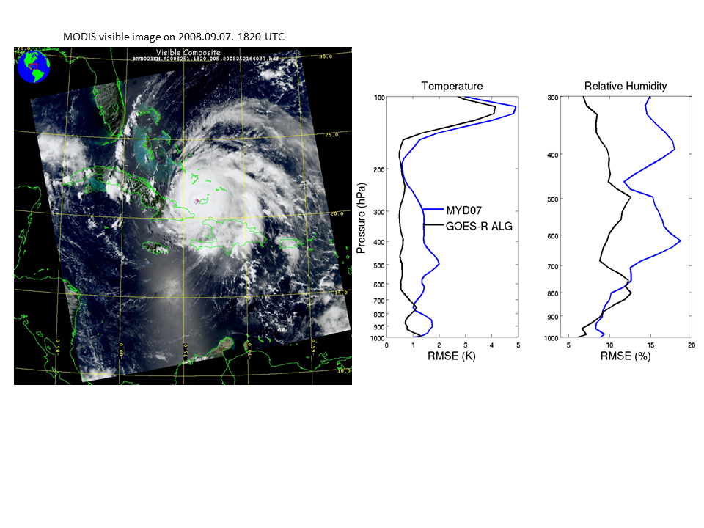
GOES-R LAP algorithm improves operational MODIS TPW product; the new
MODIS TPW with GOES-R algorithm will be used in 2012 HIW studies
MYD07
GOES-R Alg.
Notes:
JD: Over what period were comparison stats generated for? (Need to check). What is reference/truth data for these stats? (I think ECMWF analysis.)

Slide 13
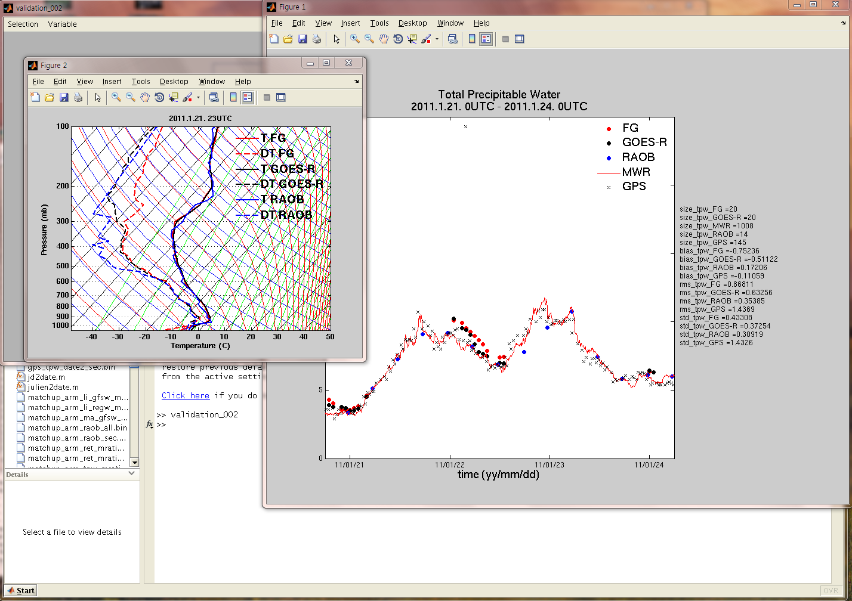
In the validation tool, the following functions are developed:
Once the time series is plotted, the tool will allow one to plot the vertical profiles of atmospheric temperature and water vapor for a specific time. Up to 3 Skew-T diagrams could be selected;
The time series will also show the number of comparisons, bias error, root mean square error, and standard deviation of each dataset for selected period;
Each dataset for TPW includes first guess (FG), retrieval from GOES-R, RAOB, MWR, and GPS TPW (GPS).
Notes:
Illustration of a val tool..

Slide 14
Outline
Synopsis of GOES-R Product Algorithm
      Algorithm description
      Product example(s)
Continuing AWG Validation Activities
      Latest algorithm performance statistics obtained
      Results/examples from any case study analyses
      Synopsis of any algorithm enhancements
      Showcasing of any validation tools developed
Thoughts, Plans, and Opportunities for:
      Satellite product algorithm enterprise solutions
      Smart multi-sensor applications
        integration of geo and leo products
Notes:
Presentation Guidelines: Discuss the TPW algorithm, identify strengths and weaknesses, touch on Blended TPW and include CrIMMS products from JPSS if possible.

Slide 15
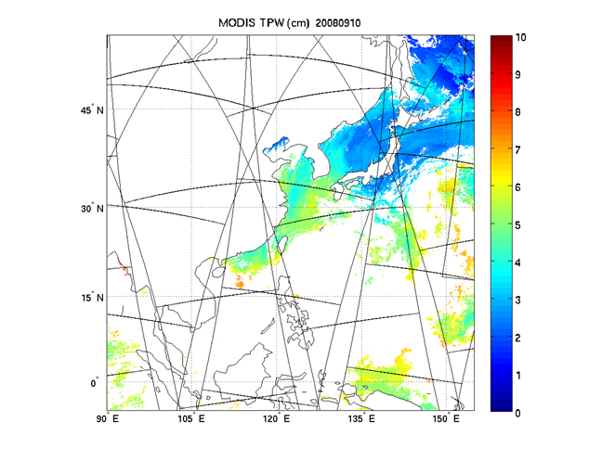
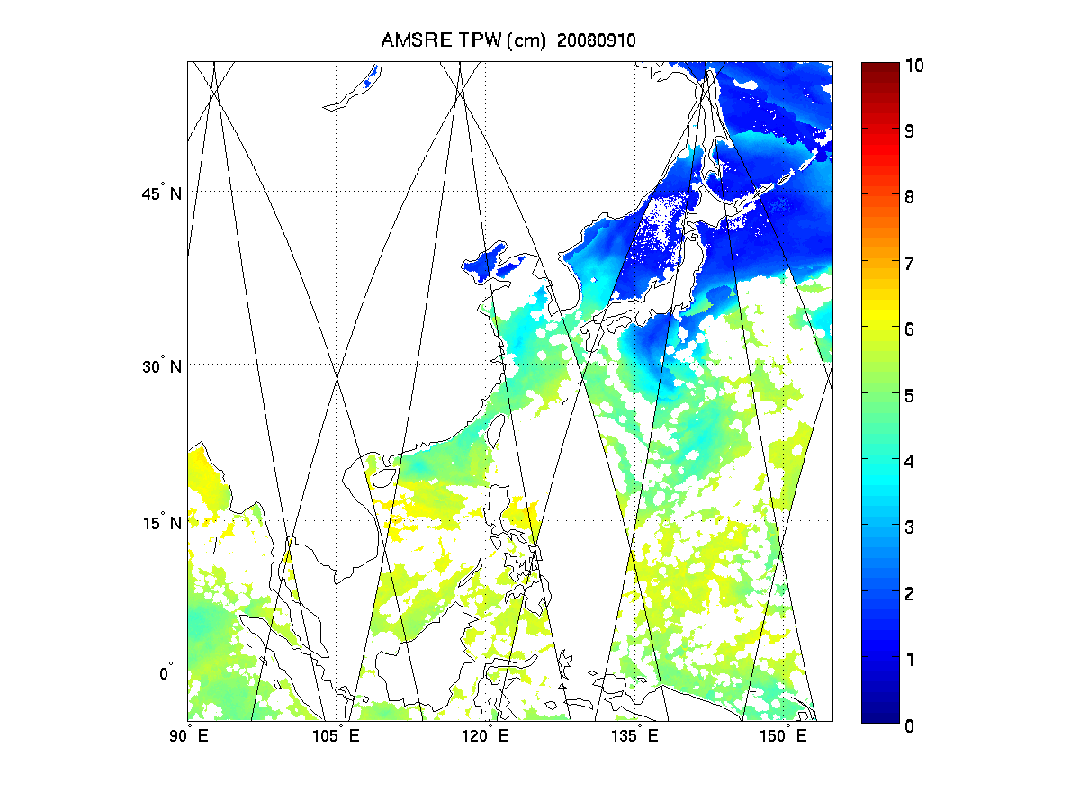
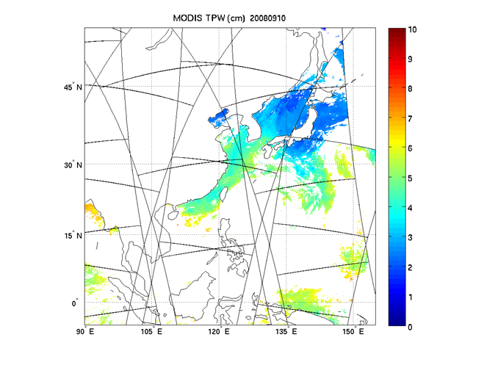
Terra TPW
AMSR-E TPW
Aqua TPW
Terra MODIS (upper left), Aqua MODIS (lower left) and AMSR-E (upper right) TPW images over ocean for 10 September 2008. The spatial resolution is 5 km for MODIS TPW and 17 km for AMSR-E TPW.
Notes:
JD: Were these TPW products generated with the GOES-R LAP algorithm? Generated with MODIS science team product.

Slide 16
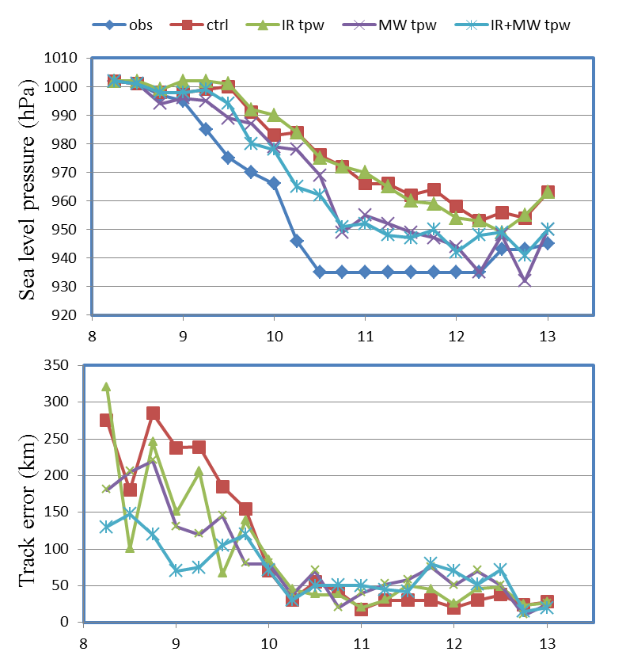
Sinlaku intensity and path analysis with TPW (WRF/DART)
(IR – MODIS; MW – AMSR-E)
CTL run: assimilate radiosonde, satellite cloud winds, QuikSCAT winds, aircraft data, COSMIC GPS refractivity, ship, and land surface data.
Rapid intensification from 9 to 10 September 2008 captured with TPW assimilated
NPP/JPSS soundings , GCOM AMSR TPW and GOES-R TPW will be used in tropical cyclone applications

Slide 17
NPP/JPSS sounding evaluation and applications
AIRS/CrIS brightness temperature comparison
AIRS/CrIS sounding comparisons with the same retrieval algorithm (CIMSS single FOV algorithm)
Radiances/soundings application demonstration

Slide 18
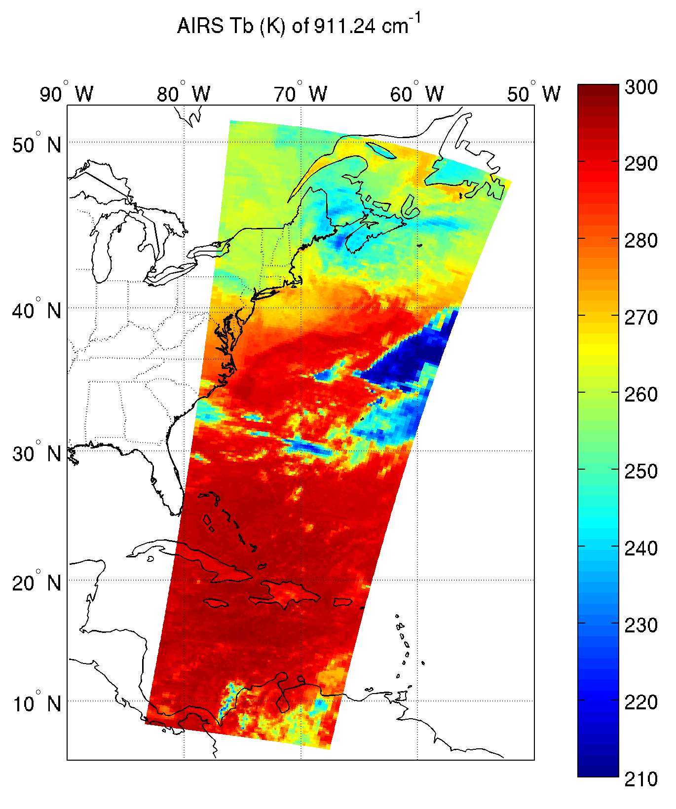
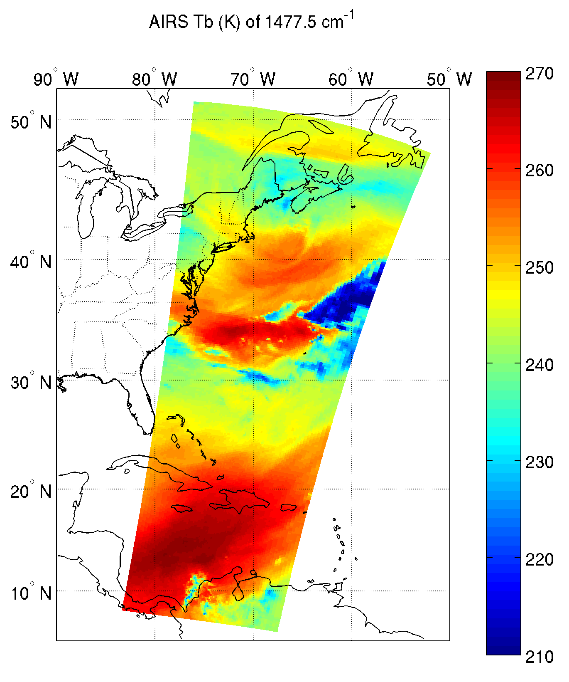
CrIS/AIRS BT Comparison
AIRS Window Channel Tb (K) AIRS Water Vapor Channel Tb (K)
6:30 UTC 6:30 UTC
6:36 UTC 6:36 UTC
6:42 UTC 6:42 UTC
03/12/2012 Two Granules

Slide 19
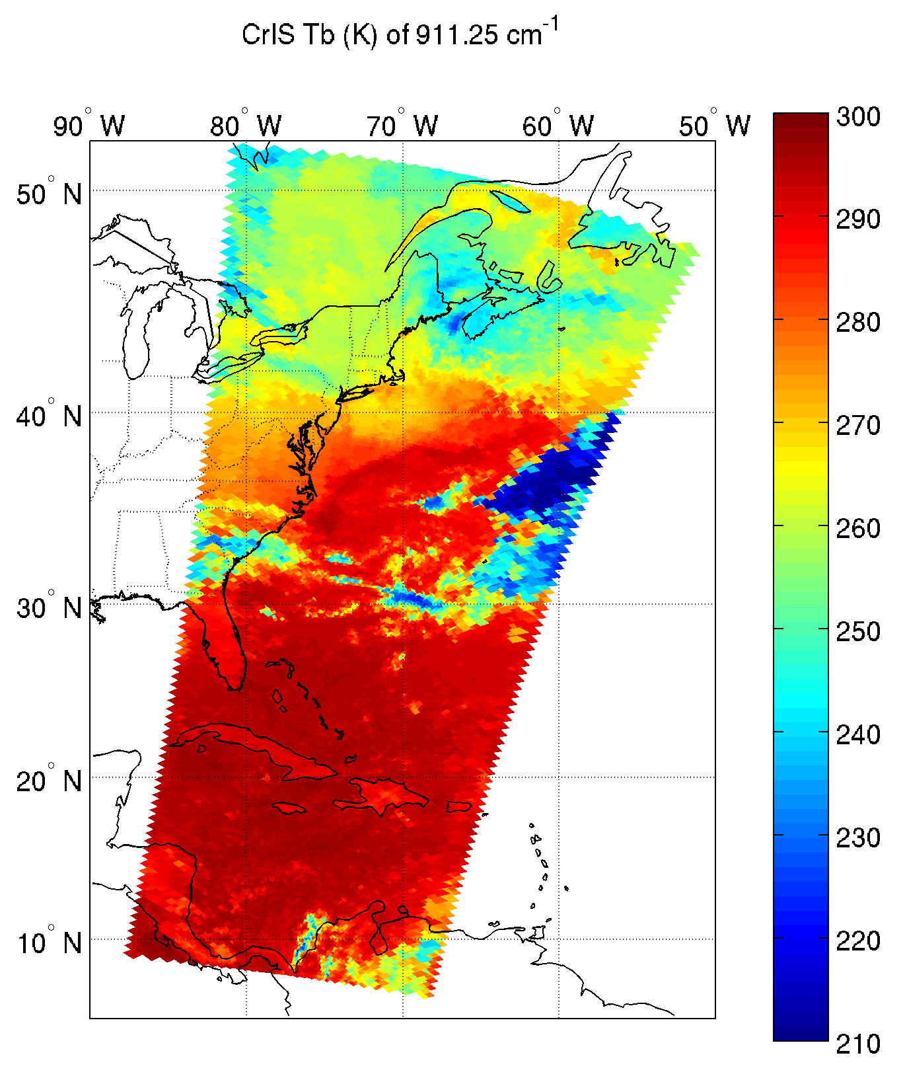
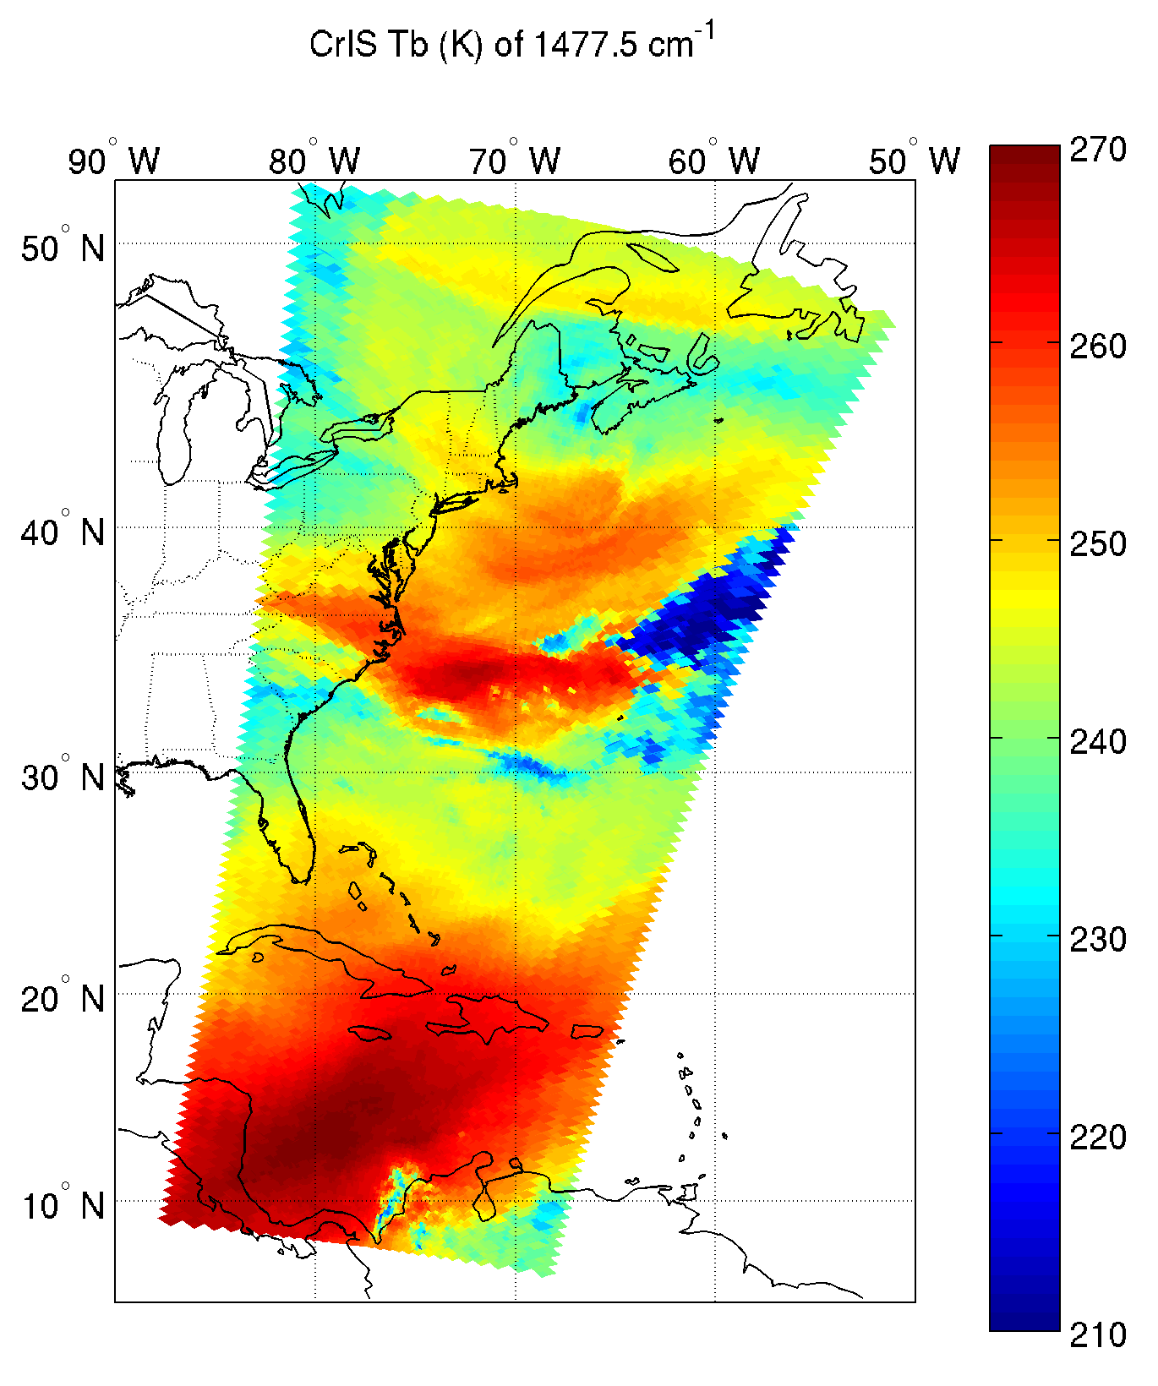
CrIS/AIRS BT Comparison
CrIS Window Channel Tb (K) CrIS Water Vapor Channel Tb (K)
6:28 UTC 6:28 UTC
6:34 UTC 6:34 UTC
6:40 UTC 6:40 UTC
03/12/2012

Slide 20
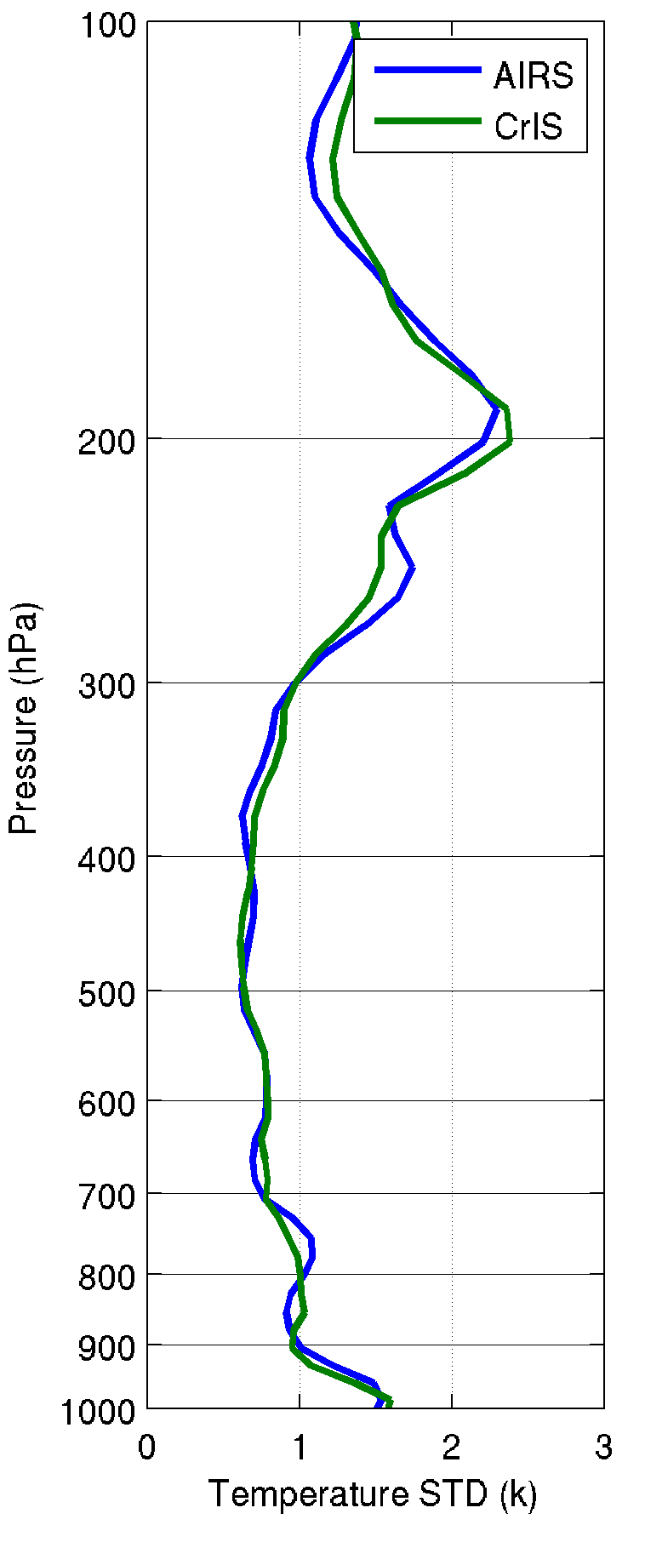
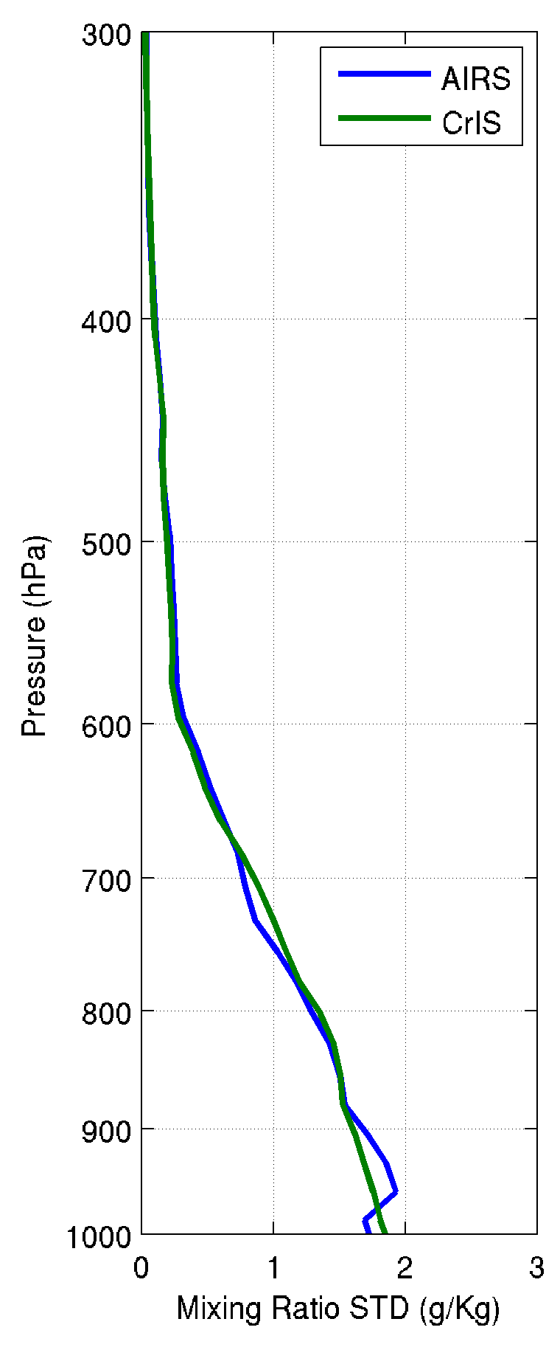
AIRS/CrIS sounding comparisons – AIRS and CrIS have the similar sounding precision
(2275 matchup comparisons, ECMWF analysis as reference)
Notes:
JD: What is significance of this information on this slide and the next one to GOES-R? None directly, I thought the NWS wanted me to over polar soundings as well. I guess the point is if folks know about the AIRS, the CrIS is similar. Recall Chris Barnet was to give half this talk.

Slide 21
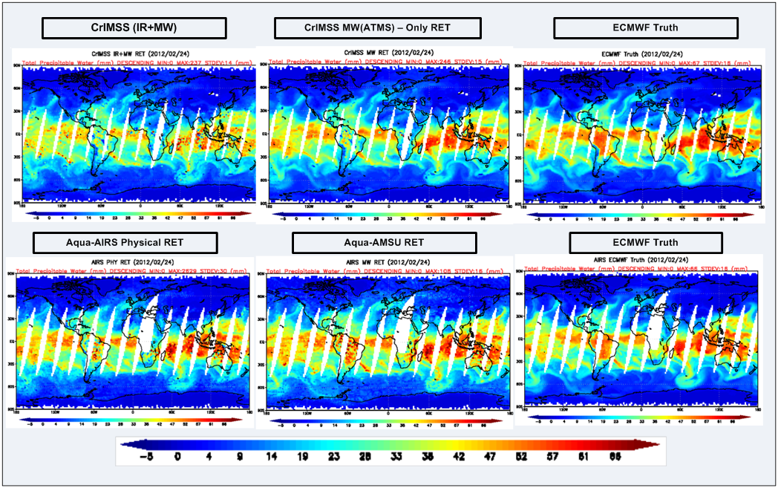
NGAS CrIMSS AVMP EDR: TPW
(Feb. 24, 2012 focus day)
Northrop Grumman Aerospace Systems Crosstrack Infrared and Microwave Sounding Suite Atmospheric Vertical Moisture Profile Environmental Data Record : Total Precipitable Water
Preliminary TPW without QC
  Seem to be issues with dry retrievals over land
Notes:
NGAS CrIMSS AVMP EDR: TPW =
Northrop Grumman Aerospace Systems
Crosstrack Infrared and Microwave Sounding Suite
Atmospheric Vertical Moisture Profile
Environmental Data Record :
Total Precipitable Water

Slide 22
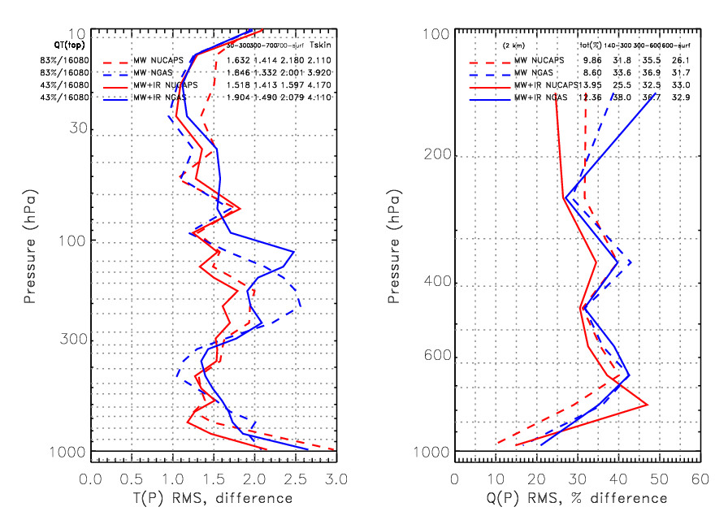
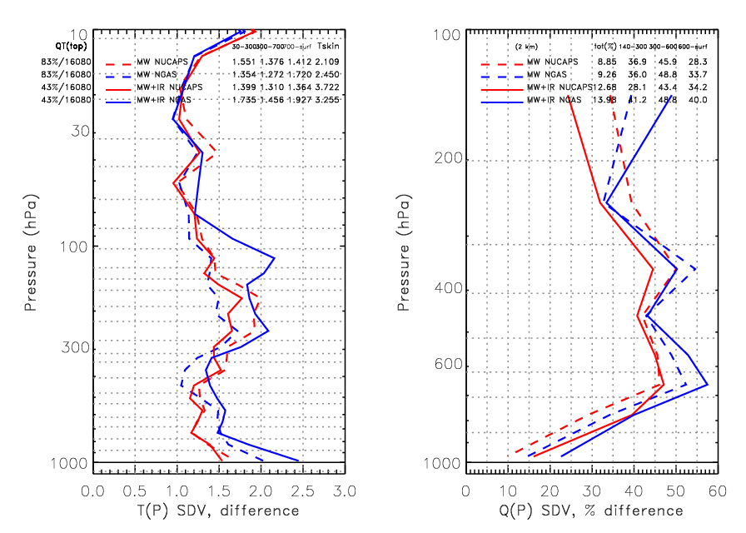
Preliminary comparison of NGAS & NUCAPS
(Northrop Grumman Aerospace Systems and NOAA-Unique CrIS/ATMS Processing system)
(134 ocean, night granules on Feb. 24, 2012)
Top panels shows the RMS difference of AVTP and AVMP w.r.t. ECMWF
  Solid lines are ATMS+CrIS (43% of the cases)
  Dashed lines are ATMS-only (83% of the cases)
  NUCAPS in red
  NGAS in blue
NUCAPS acceptance used for all cases
  Potentially some cases rejected by NGAS should be ignored
Bottom panel: Once empirical bias corrections are applied results should approach the SDV at right.

Slide 23
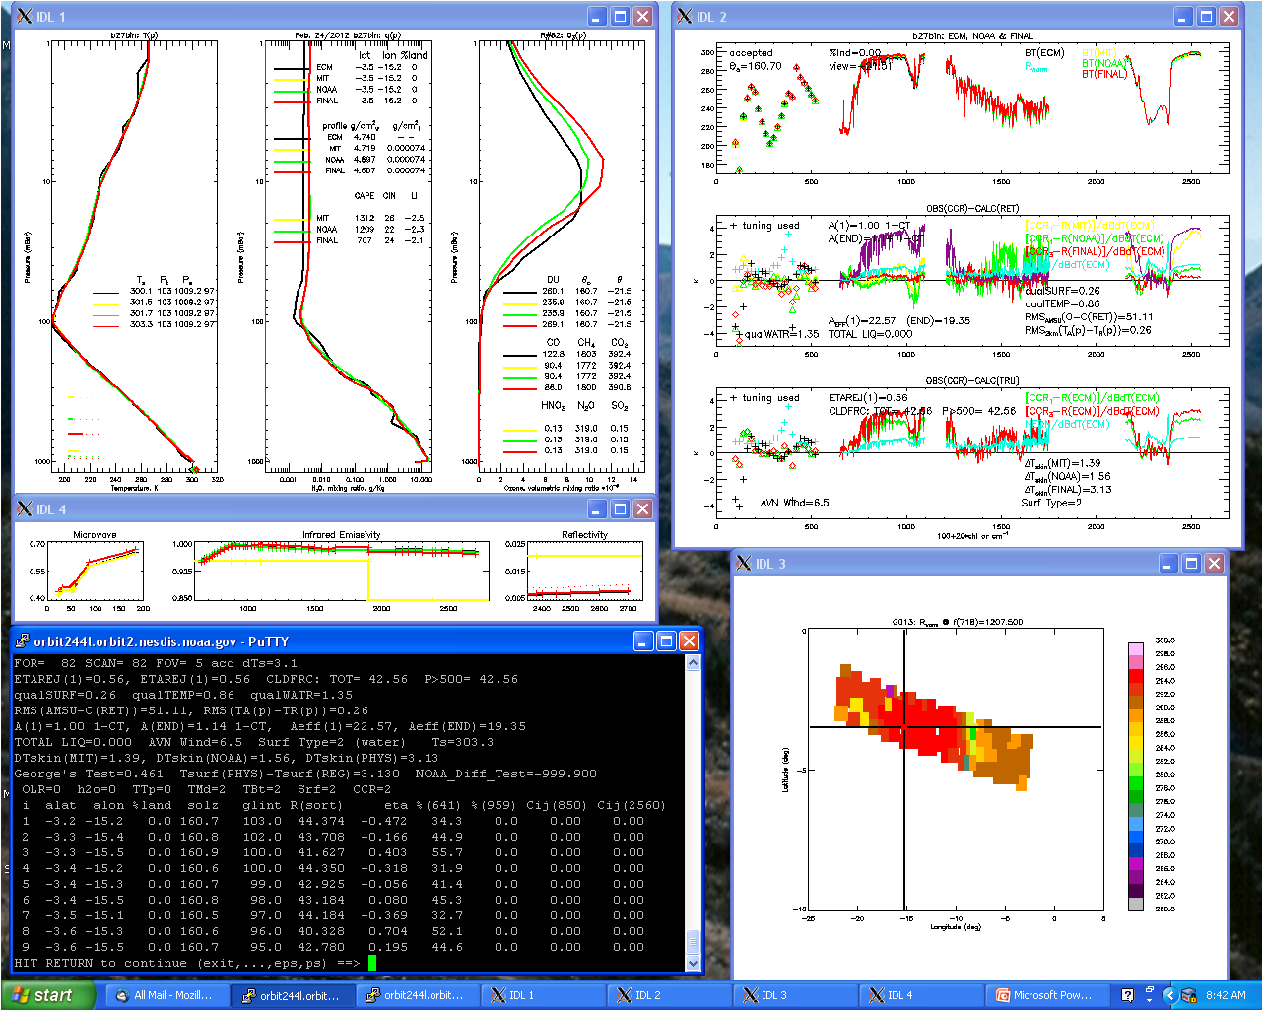
Preliminary example of diagnostic capability of NUCAPS: individual retrievals
Full state including
AVTP, AVMP,
clouds,
trace gases, emissivity, and reflectivity
Radiance
Residuals
Obs-Calc(ECMWF)
Details on QC, location, clouds, etc.
Map of 1 channel
X
This is a screen capture from a “deep-dive” diagnostic tool that allows simultaneous viewing of a single retrieval in geophysical and radiance space.

Slide 24
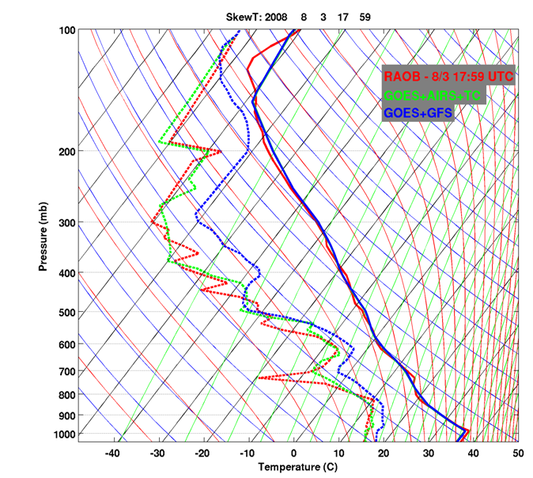
After 6 hours
GOES+AIRS+TC: using AIRS SFOV sounding as first guess for physical retrieval, and then using the previous time step retrieval as the first guess for the current time physical retrieval.

Slide 25
Animation
(GOES Sounder and AIRS)
Nearcast (using Sounder)
Sounder (Lifted Index)
AIRS (Lifted Index)
See poster on Nearcast
Loop from J. Feltz
Notes:
The main points: Current sounder data is being used in a new way. This will need to be continued with ABI soundings in the GOES-R era. GOES gives the time evolution, high spectral can and should be included as well.

Slide 26
Summary
GOES Sounder, MODIS, SEVIRI AMSR-E TPW as proxy show that GOES-R LAP algorithm provide moisture profiles better than forecasts;
GOES-R LAP algorithm provide better TPW accuracy than the current GOES Sounder algorithm (Li-ALG), suggest to use GOES-R LAP algorithm for operational GOES sounding product;
CrIS has the similar sounding precision of AIRS according to both retrieval and PC analysis;
Combined GOES-R TPW, JPSS soundings and GCOM AMSR TPW can improve hurricane forecasts.
Awaiting validation ATBD template
ABI isn’t a full sounder!

Slide 27
Back-up slides
Storm forecast in early stages
AIRS/CrIS/IASI principal component analysis
The ABI isn’t a full sounder!

Slide 28
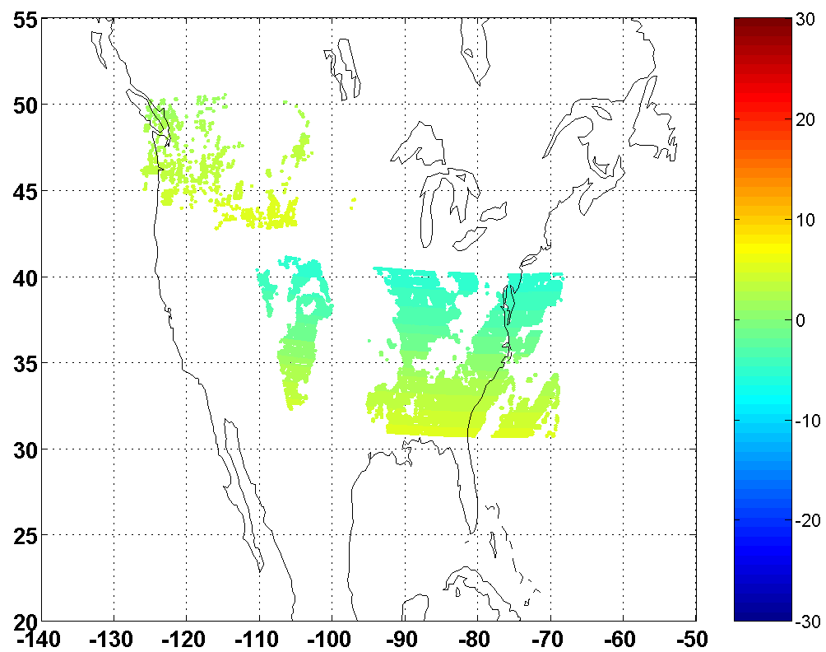
06:30
GOES (W11+E13), +/- 5min
06:05
06:00
05:55
n = 10112
=9207(E13)+905(W11)
05:30
Notes:
GOES Sounder clear sky coverage within a assimilation window of 10 minutes

Slide 29
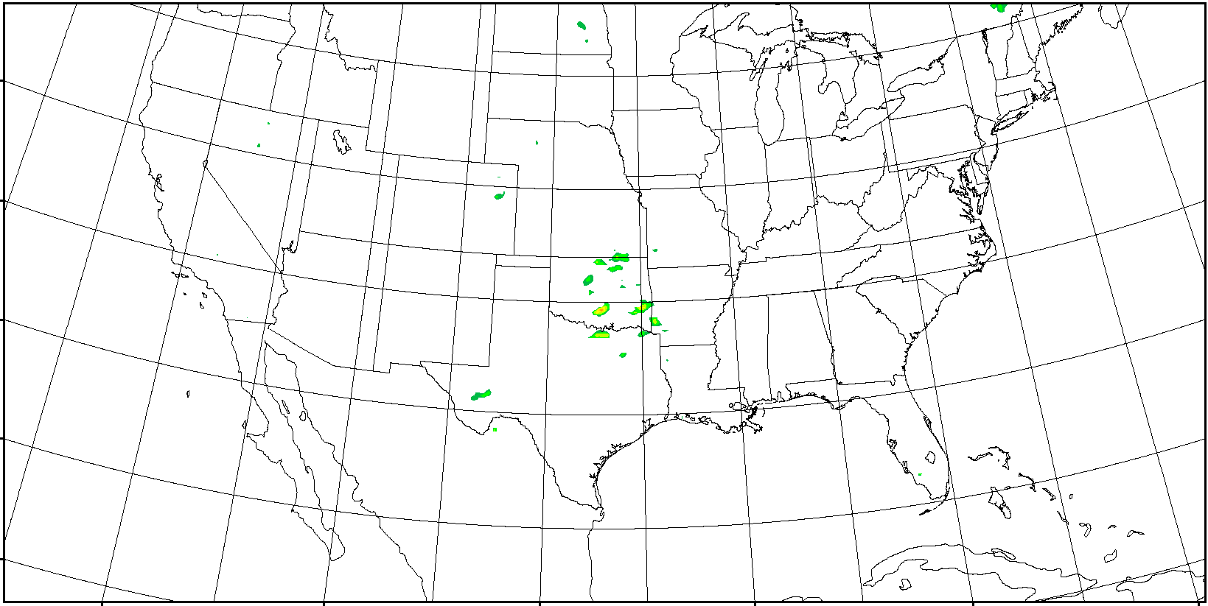
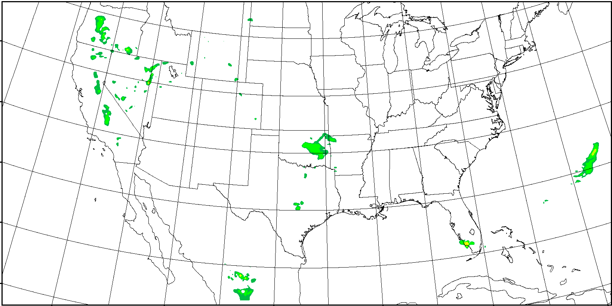
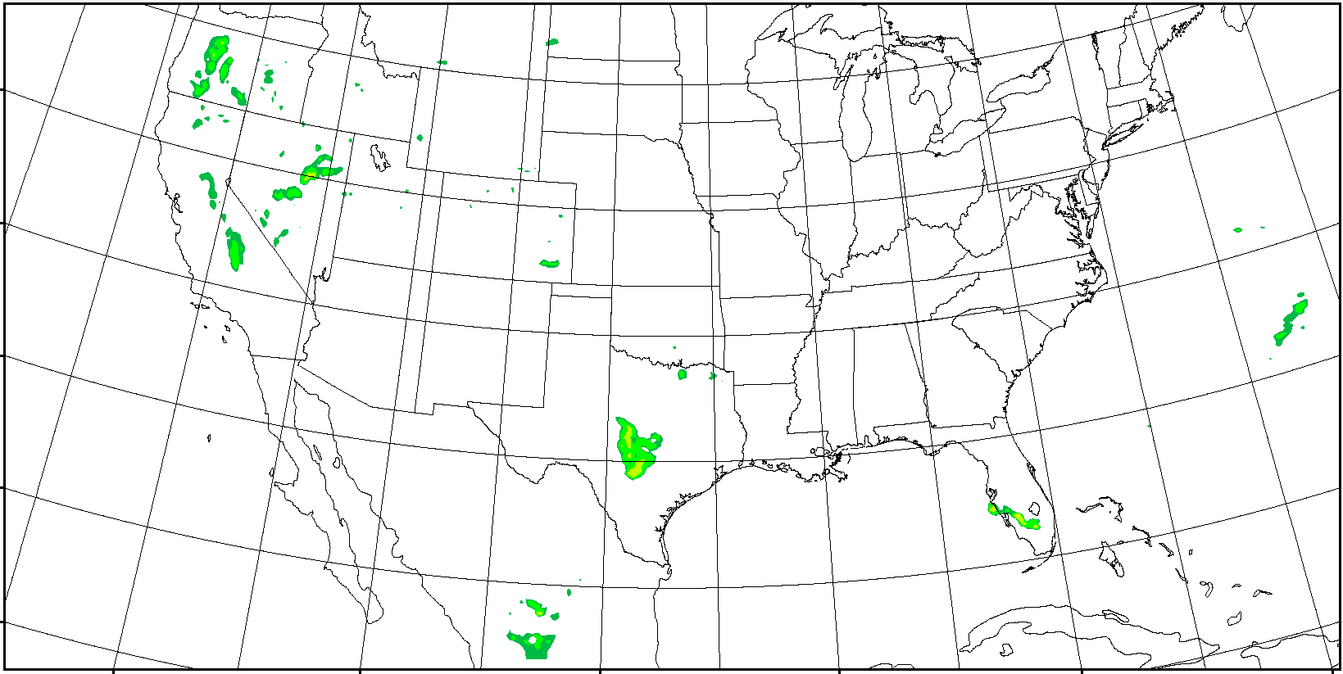
Hourly Precipitation Forecasts in Early Stage
2012/5/10 01 Z ~ 2012/5/10 12 Z
OBS
Forecast with GOES Sounder
Hourly precipitation forecast from 00 Z – 12 Z 05-10-2010 over CONUS with WRF/3DVAR, model resolution is 12 km, GOES Sounder 300 – 700 hPa precipitable water (PW) is used every 3 hours (preliminary results).
Forecast with Conventional data
Notes:
convert -delay 60 *png match_GCIP_prep1.gif
H:\CIMSS\NCEP_GCIP_prep_4km\match_GCIP_wrf_prep1

Slide 30
Forecast with
GOES Sounder
Observation
Cumulative precipitation forecast from 00Z to 06 Z 05-10-2010 over CONUS with WRF/3DVAR, model resolution is 12 km, GOES Sounder 300 – 700 hPa precipitable water (PW) is used every 3 hours (preliminary results).
Forecast with
Conventional

Slide 31
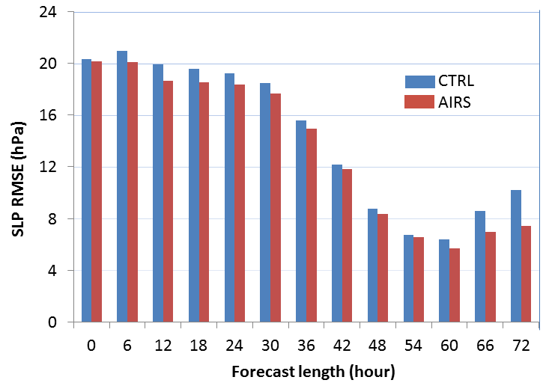
The Hurricane Irene (2011) central SLP forecast RMSE for 0-h (analysis), 6-h, to 72-h forecasts. Every 6 hours between 06 UTC 23 and 00 UTC 25 August 2011 the data are assimilated with WRF/DART followed by a 72-hour forecast. The SLP RMSE is calculated from comparisons with the best track observations from NHC. Control run assimilates radiosondes, AMVs, COSMIC GPS reflectivity, ship and land surface observations.

Slide 32
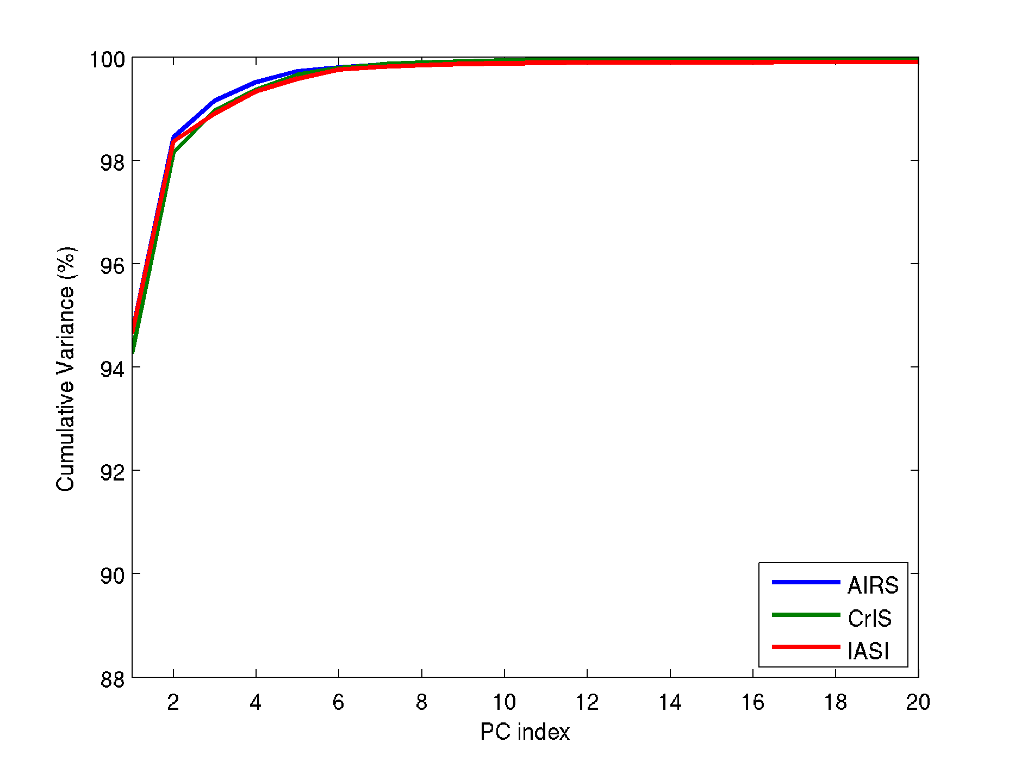
Cumulative total variances in percentage
(AIRS/CrIS/IASI have the similar information based on PCA)
CrIS: all 1305 channels
AIRS: total 1449 good channels
IASI: total 5420 channels, short wave (≥ 2000
cm⁻¹) noisy channels excluded

Slide 33
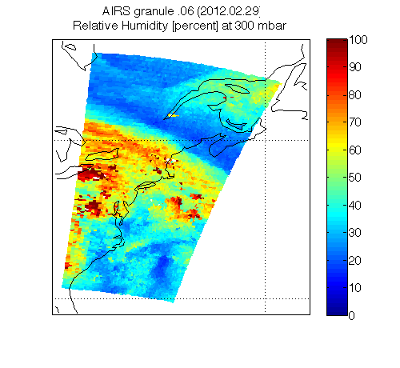

Slide 34
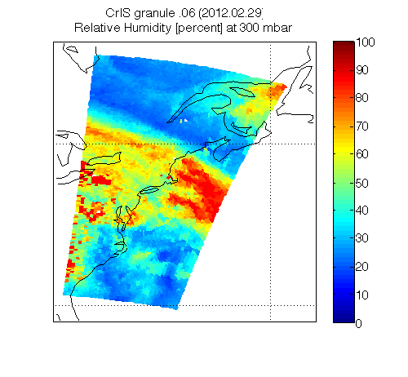

Slide 35
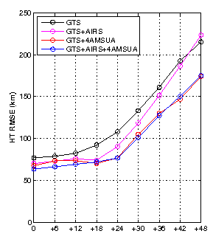
Lifecycle Hurricane Ike (2008) track RMSE for 0-h (analysis), 6-h to 48-h forecasts. The radiance assimilation of AIRS and AMSU are used in the experiments. GTS contains all the conventional data. WRF/GSI are used in the experiments.
Future work will include assimilation of radiances and/or soundings.

Slide 36
Routine Validation Tools
Capabilities:
- Monitoring the quality of atmospheric temperature and moisture profiles in near real time
- Monitoring the quality of TPW, LI, TT, CAPE, KI, and SI in near real time
Datasets used:
Radiosondes (conventional, ARM site); ARM site microwave radiometer TPW; NWP forecast used in the LAP retrieval; ABI IR brightness temperatures
Visualization and software tools (scripts + McIDAS + Matlab)
- Time series of BT difference (obs – cals (FCST)) images for ABI IR channels
- Time series of difference (RTVL - FCST) images (TWP, LI, CAPE, TT, KI, SI)
- Time series of LI, CAPE, TT, KI, SI from GOES-R RTVLs, FCSTs and radiosondes at ARM site
- Time series of GOES-R TPW, FCST TPW, and MWR TPW at ARM site
- Statistics of retrievals against conventional radiosondes over land
- Statistics of retrievals against ECMWF analysis over ocean
- Animations
- Generate zoomed difference images
- Monitor product quality
- Compare to other products (e.g., CrIS)
Notes:
For each product, describe and illustrate the routine validation tools that you have or are developing. At a minimum address the following:
- Capabilities (in their final state)
- Datasets used
- Visualization software tools used (IDL, McIDAS, other…) to visualize the products, intermediate products, diagnostic data, product performance measures, reference/”ground-truth” data, etc…
-

Slide 37
”Deep-Dive”
Validation Tools
Capabilities:
  Monitor any anomalies of any GOES-R LAP product and identify the cause
  Quantify the error/uncertainty of GOES-R LAP products for better applications
Tools include, but is not limited to:
  Full and/or zoomed difference (TPW, LI, CAPE, KI, TT, SI) between RTVLs and FCSTs images
  Generate residual images (obs – cals from FCSTs) for each IR channel
  Generate quality flag images
  Times series of GOES-R TPW, FCST TPW and microwave radiometer TPW over ARM CART site
    Longer times series
  Daily statistics of temperature and moisture profiles against radiosondes (FCSTs, RTVLs) over CONUS
    Longer times series
  Individual IR brightness temperature images with calibration events
  Cloud mask image
  Aerosol/dust product images
McIDAS + Matlab + scripts
Notes:
For each product, describe and illustrate the “deep-dive” validation tools that you have or are developing. At a minimum address the following:
- Capabilities (in their final state)
- Intended use
- Datasets used
- Visualization software tools used (IDL, McIDAS, other…) to visualize the products, intermediate products, diagnostic data, product performance measures, reference/”ground-truth” data, etc…

Slide 38
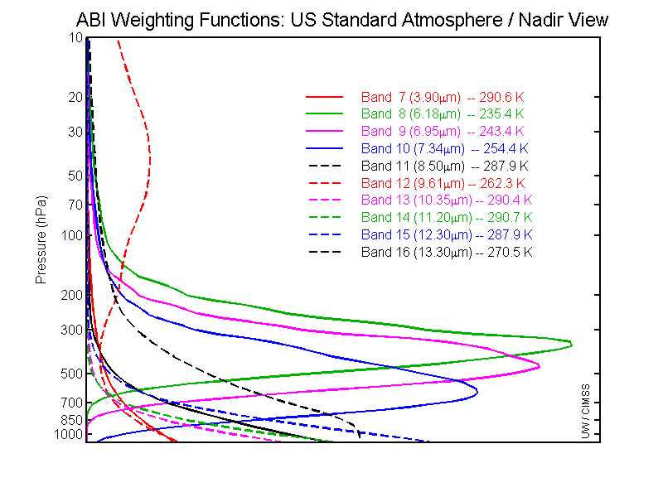
GOES-R ABI Weighting Functions

Slide 39
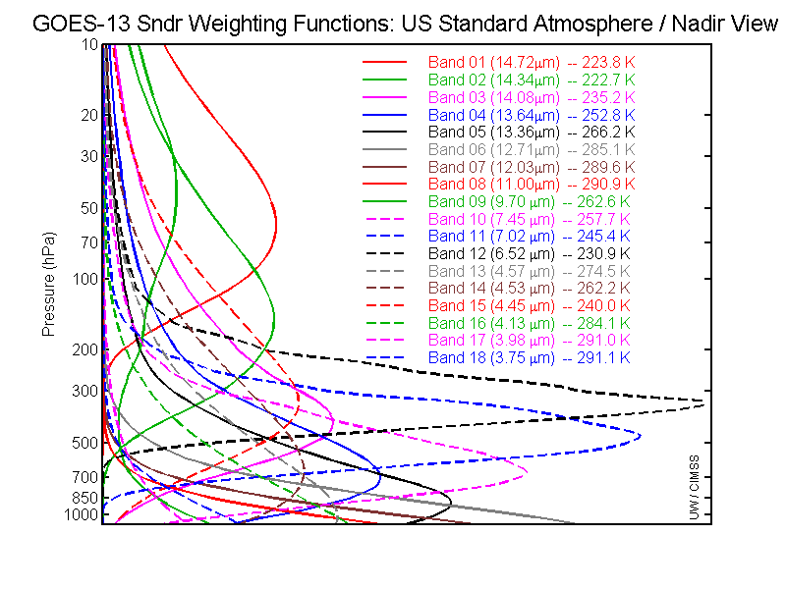
GOES-13 Sounder WFs

Slide 40
Profile information content analysis
J. Li et al
CIMSS
In general, note that the moisture content is similar between the ABI and the current GOES Sounder. The Sounder does show more temperature information than the ABI.
More than 300 profiles over CONUS with lifted index <0 (unstable atmosphere) are used in analysis.
This information content does not include any spatial or temporal differences.
November 6th, 2006

Slide 41
The relative vertical number of independent pieces of information is shown. Note that the moisture content is similar between the ABI and the current GOES Sounder. The Sounder does show more temperature information than the ABI. Caveat: Even if two systems have the same number of pieces of information, they may represent different vertical levels. This information content analysis does not account for any spatial or temporal differences.

