Slide 1
Soundings Discussion
Suggestion to include surface temperature and moisture observations in GOES-R LAP retrieval;
Not in current baseline. When can we update codes?
Expand retrieval coverage to cloudy region (warm clouds and thin clouds)
Is this extra coverage desired? Path forward?
AWIPS enhancements
Better defaults? Who’s responsibility?

Slide 2
GOES-12 Sounder W/O SFC OBS
200306-200409
FCST is GFS
Conventional RAOB as true
Bad near-surface retrievals

Slide 3
GOES-12 Sounder W/SFC OBS
200306-200409
FCST is GFS
Conventional RAOB as true
Better near-surface retrievals

Slide 4
GOES cloudy sounding significantly increase coverage
18 UTC on 13 April 2006
Non-retrieval area is reduced by 57 % from thin and low clouds!!!

Slide 5
Validation of cloudy moisture profiles using conventional RAOB
RAOB collected over CONUS from Jan 2007 to Nov 2008

Slide 6
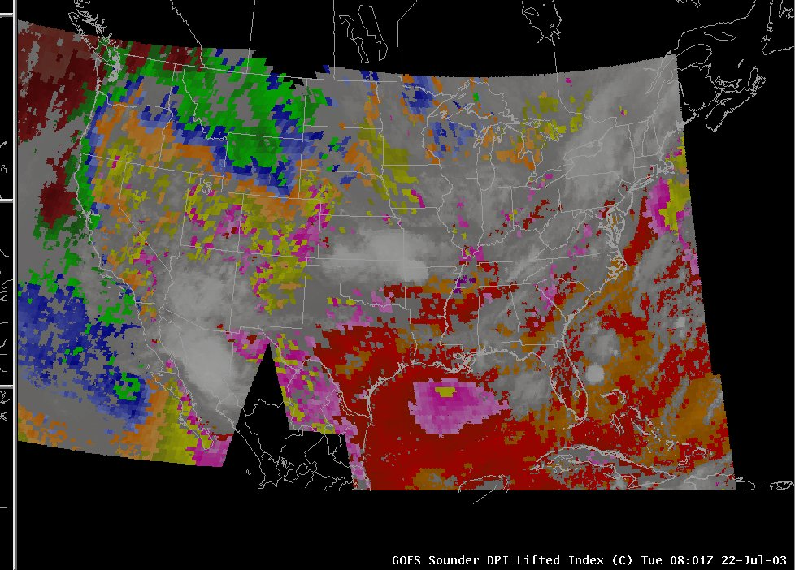
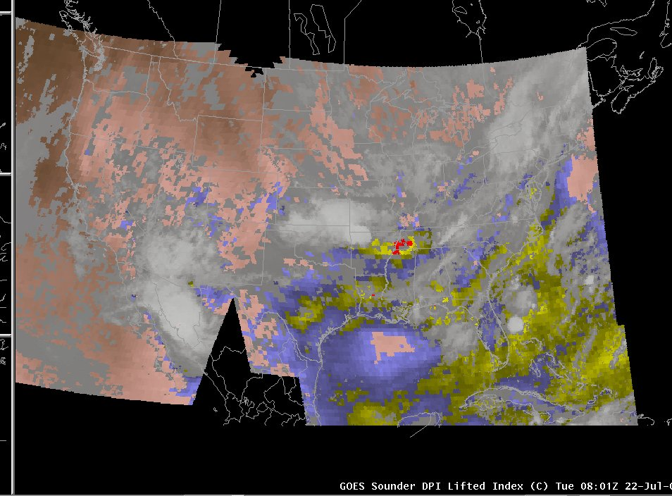
GOES Sounder DPI Enhancements
Note enhancement tables for Lifted Index
Default AWIPS
“CIMSS” TPW AWIPS
Memphis Derecho case (08 UTC 22 Jul 2003)
http://cimss.ssec.wisc.edu/goes/visit/sounder_enhancements.html
Notes:
The region of interest (lwr-mid MS Val) with greater instability seems much more apparent with the left hand side enhancement (CIMSS standard), than with the right hand side enhancement (AWIPS “default”).
The larger positive values, indicative of very stable air, are (generally) not of interest, and thus, should probably not be particularly enhanced.
These slides are from Scott L, Scott B, and Gary S. Wade.

