Slide 1
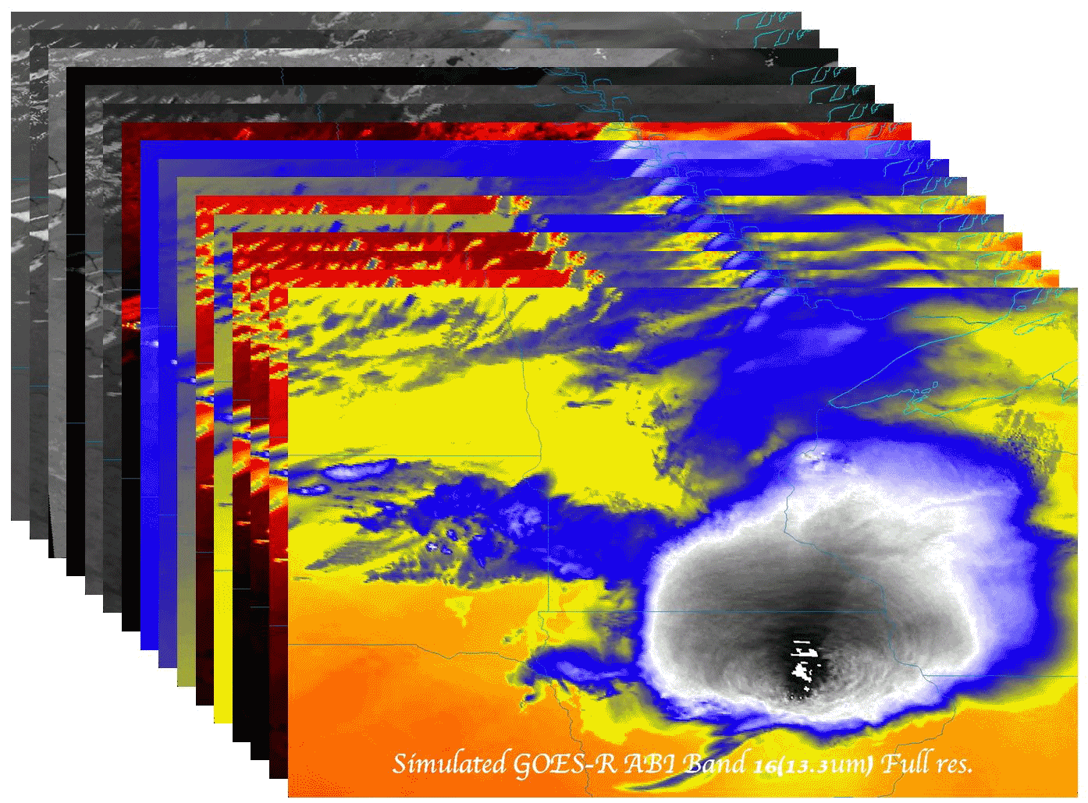
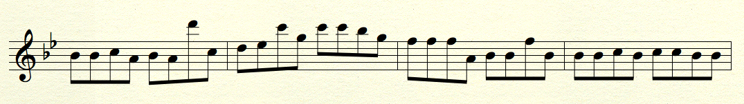
Cloud and Moisture Imagery
May 1, 2012
Tom Rink, CIMSS
Mat Gunshor, CIMSS
Kaba Bah, etc., CIMSS
AIT:
Walter Wolf, NOAA/NESDIS/STAR
William Straka, CIMSS
Wendy Zhang, Riverside Technology, Inc.
Etc.
Liaisons
Don Hillger, NOAA/NESDIS/STAR
Steve Miller, CIRA, Etc.
Presented By: Tim Schmit
NOAA/NESDIS/STAR
Thanks to the whole imagery team!

Slide 2
Outline
Synopsis of GOES-R Product Algorithm
      Algorithm description
      Product example(s)
Continuing AWG Validation Activities
      Latest algorithm performance statistics obtained
      Examples (routine and deep-dive)
      Showcasing of any validation tools developed
Thoughts, Plans, and Opportunities for:
      VIIRS
      Real-time simulated ABI
Notes:
Presentation Guidelines (soundings example): Discuss the TPW algorithm, identify strengths and weaknesses, touch on Blended TPW and include CrIMMS products from JPSS if possible.

Slide 3
Products
The purpose of the imagery team is two-fold:
  Demonstrate how to convert from GRB scaled radiances (eg, GRB integers) to other physical units, such as radiance, brightness temperatures and brightness values.
  Build files that can be used for processing most all of the ABI products, such as clouds, soundings, etc.
Imagery is the key product for GOES-R.
There are 54 KPP Cloud and Moisture Imagery End-Products (CMIP) (48 single band End-Products in netCDF format at the resolution native to each band and one multiband product at 2 km resolution in both netCDF & McIDAS Area file formats).
  16 products * 1 format (netCDF) * 3 coverage areas (Full Disk, CONUS, Mesoscale) Multiband products: 1 product * 2 formats (netCDF and McIDAS Area)* 3 coverage areas (Full Disk, CONUS, Mesoscale)
Notes:
Provide a list of products and their specifications (spatial and temporal resolution, coverage). Include an example display(s) of your products.

Slide 4
Requirements – Cloud and Moisture Imagery
Name | User & Priority | Geographic Coverage (G, H, C, M) | Vertical Resolution | Horizontal Resolution | Mapping Accuracy | Measurement Range | Measurement Accuracy | Refresh Rate/Coverage Time Option (Mode 3) | Refresh Rate Option (Mode 4) | Data Latency | Product Measurement Precision
Cloud and Moisture Imagery | GOES-R | C | N/A | 2 km, with finer daytime observations | 1 km | N/A | N/A | 5 min | 5 min | 50 sec | N/A
Cloud and Moisture Imagery Cloud and Moisture Imagery | GOES-R GOES-R | FD M | N/A N/A | 2 km, with finer daytime observations 2 km, with finer daytime observations | 1 km 1 km | N/A N/A | N/A N/A | 15 min 30 sec | 5 min | 50 sec 23 sec | N/A N/A
C – CONUS FD – Full Disk M - Mesoscale

Slide 5
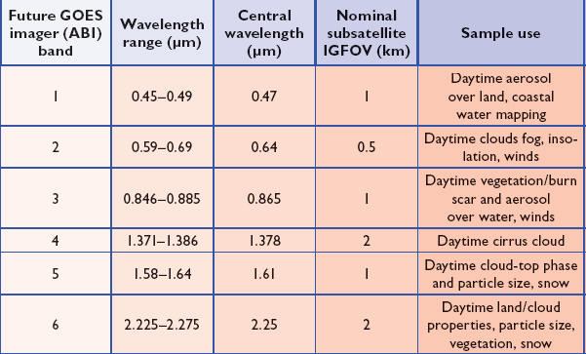
ABI Visible/Near-IR Bands
Schmit et al, 2005
Notes:
Schmit, T. J., M. M. Gunshor, W. P. Menzel, J. J. Gurka, J. Li, and A. S. Bachmeier, 2005: Introducing the next-generation Advanced Baseline Imager on GOES-R. Bull. Amer. Meteor. Soc., 86, 1079-1096.

Slide 6
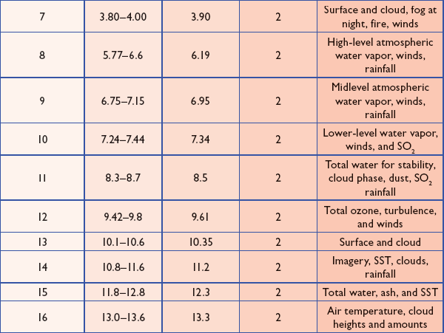
ABI IR Bands
Schmit et al, 2005
Notes:
Schmit, T. J., M. M. Gunshor, W. P. Menzel, J. J. Gurka, J. Li, and A. S. Bachmeier, 2005: Introducing the next-generation Advanced Baseline Imager on GOES-R. Bull. Amer. Meteor. Soc., 86, 1079-1096.

Slide 7
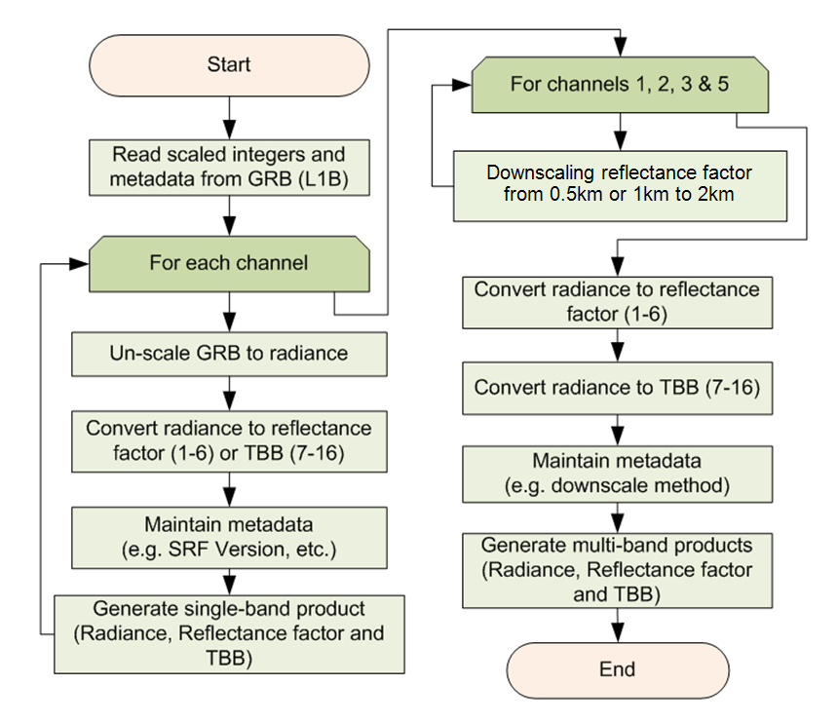
High level flowchart for generating CMIP

Slide 8
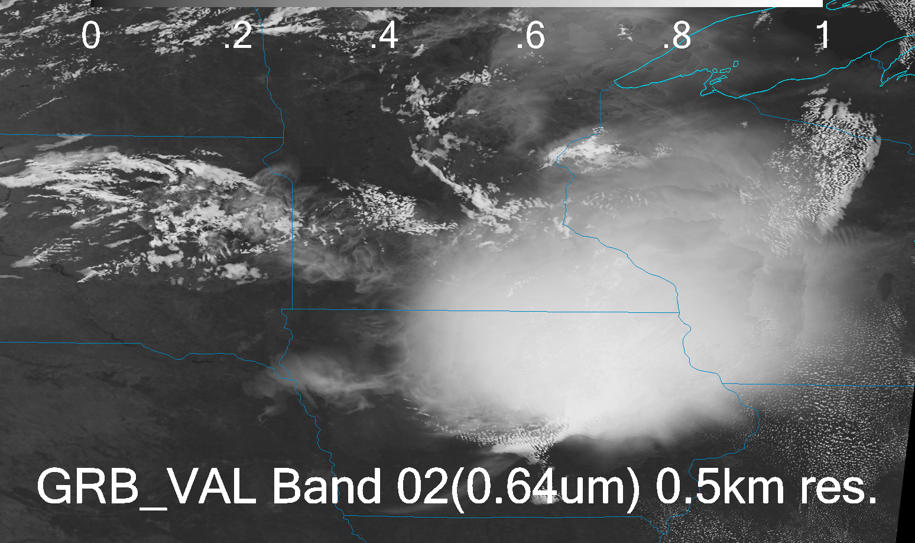
Down-scaling

Slide 9

Down-scaling

Slide 10
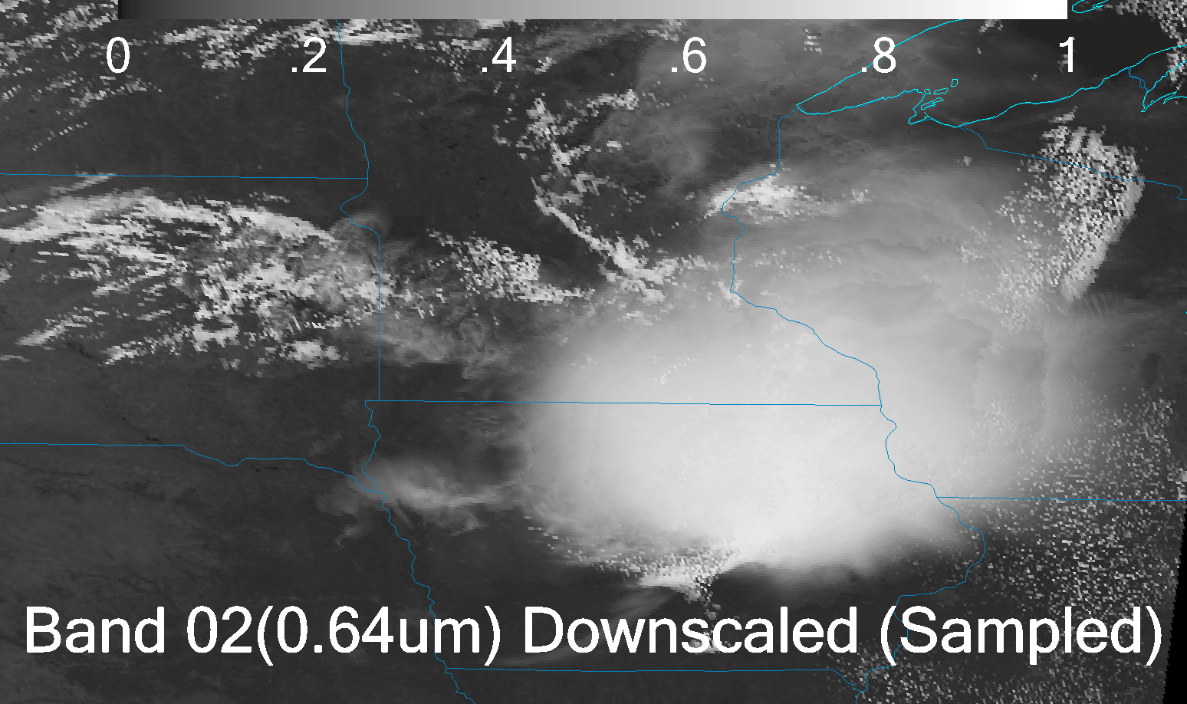
Down-scaling

Slide 11
Dataset Re-delivery
Meso-scale (75W)
CONUS (75W)
Full Disk (137W)
New units for the 6 visible/nearIR bands, FGF, etc.
Single time only

Slide 12
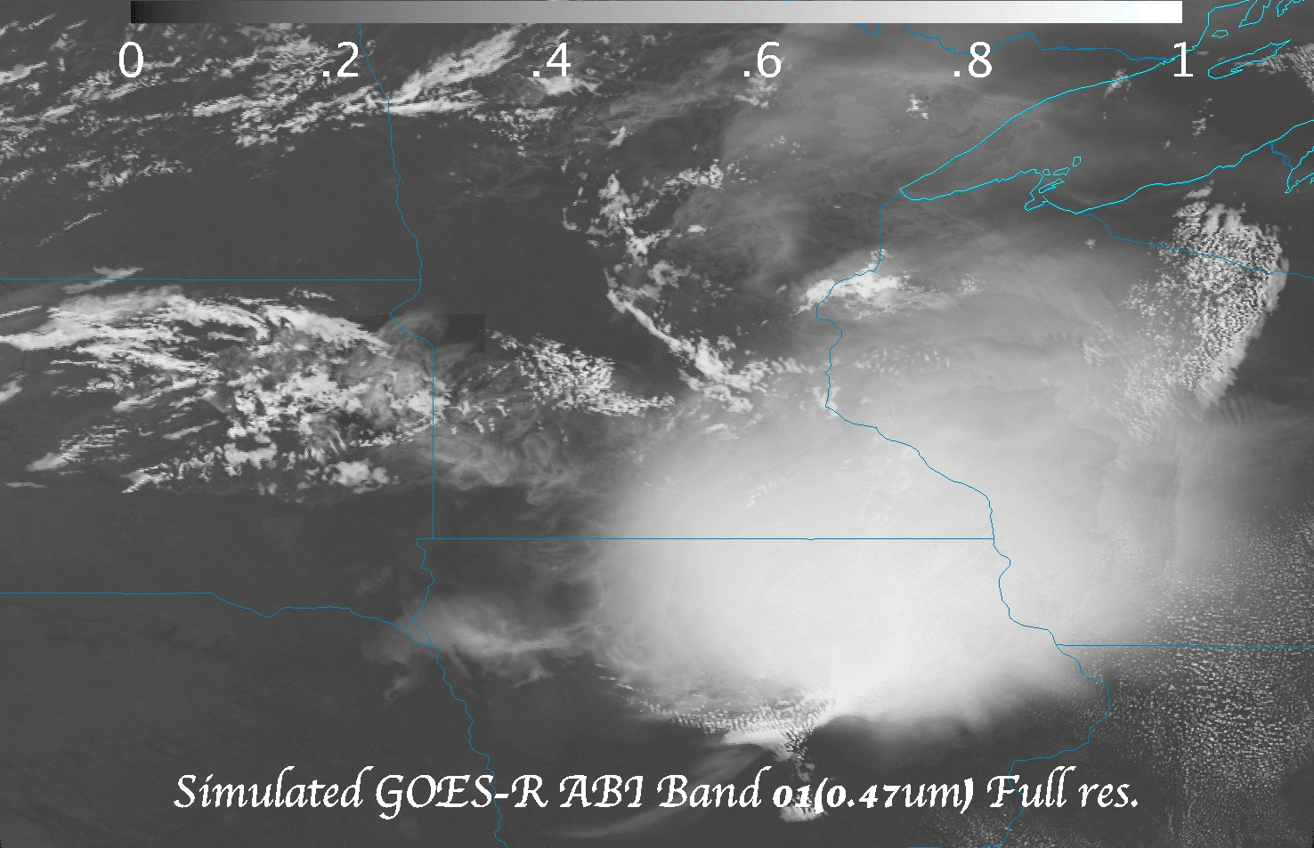
Dataset Re-delivery
(meso-scale)
Meso-scale (animated gif of the 16 ABI bands)

Slide 13
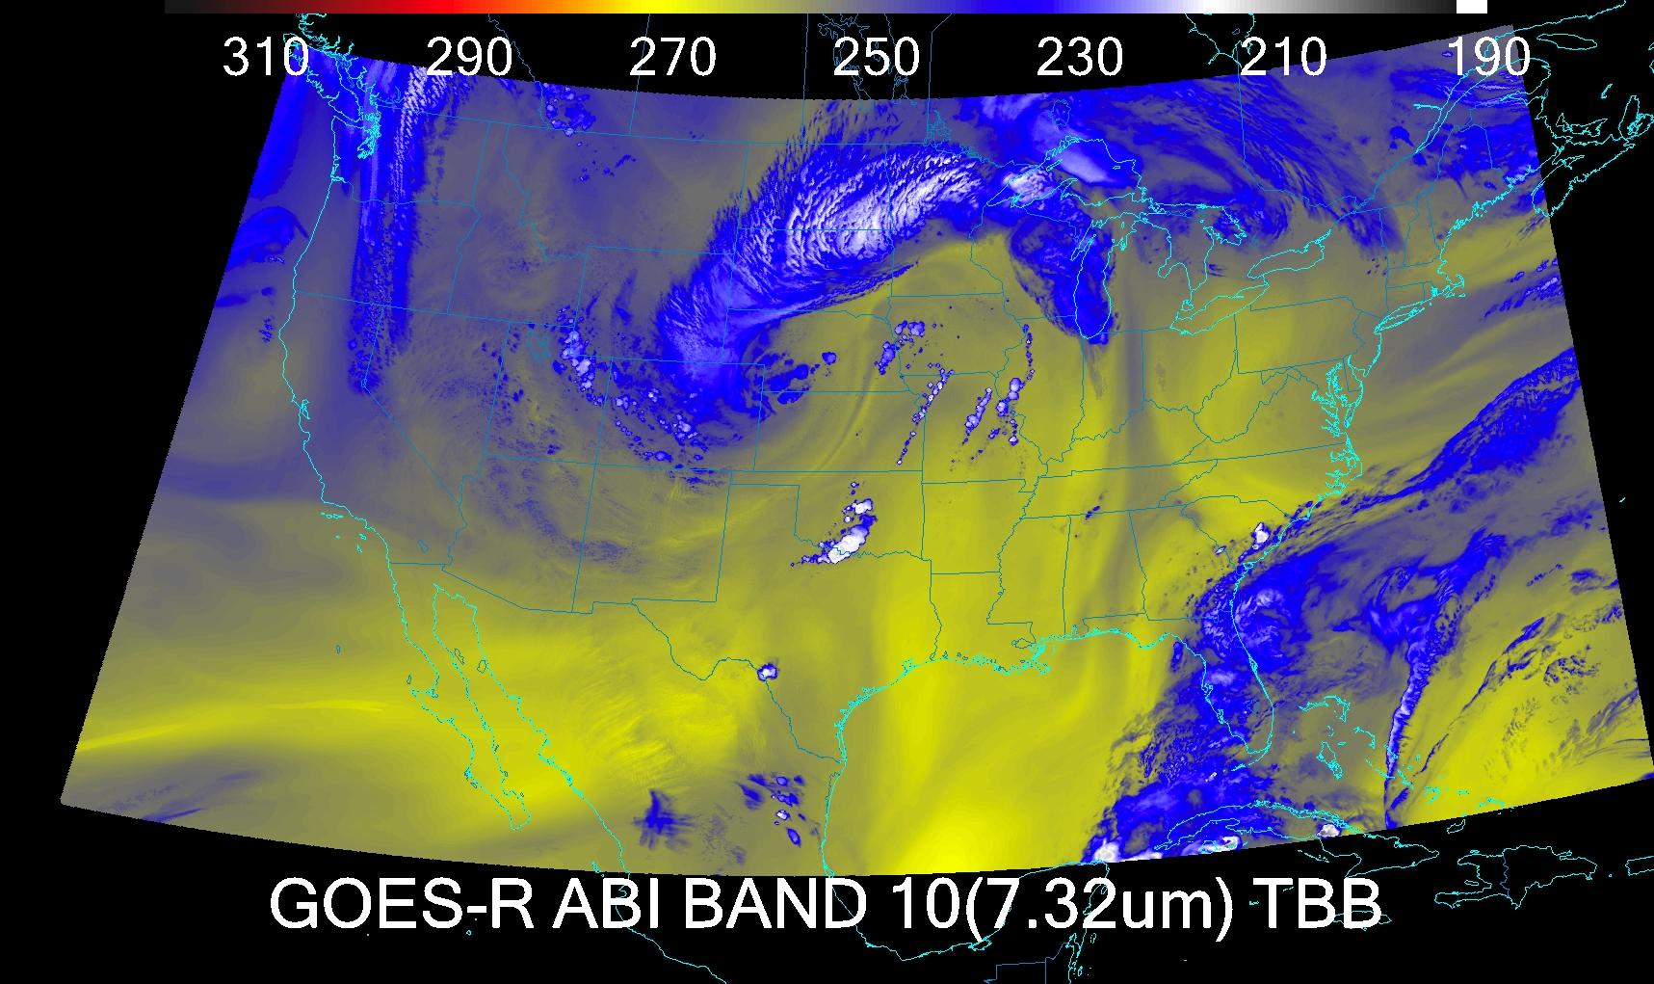
Dataset Re-delivery
CONUS

Slide 14
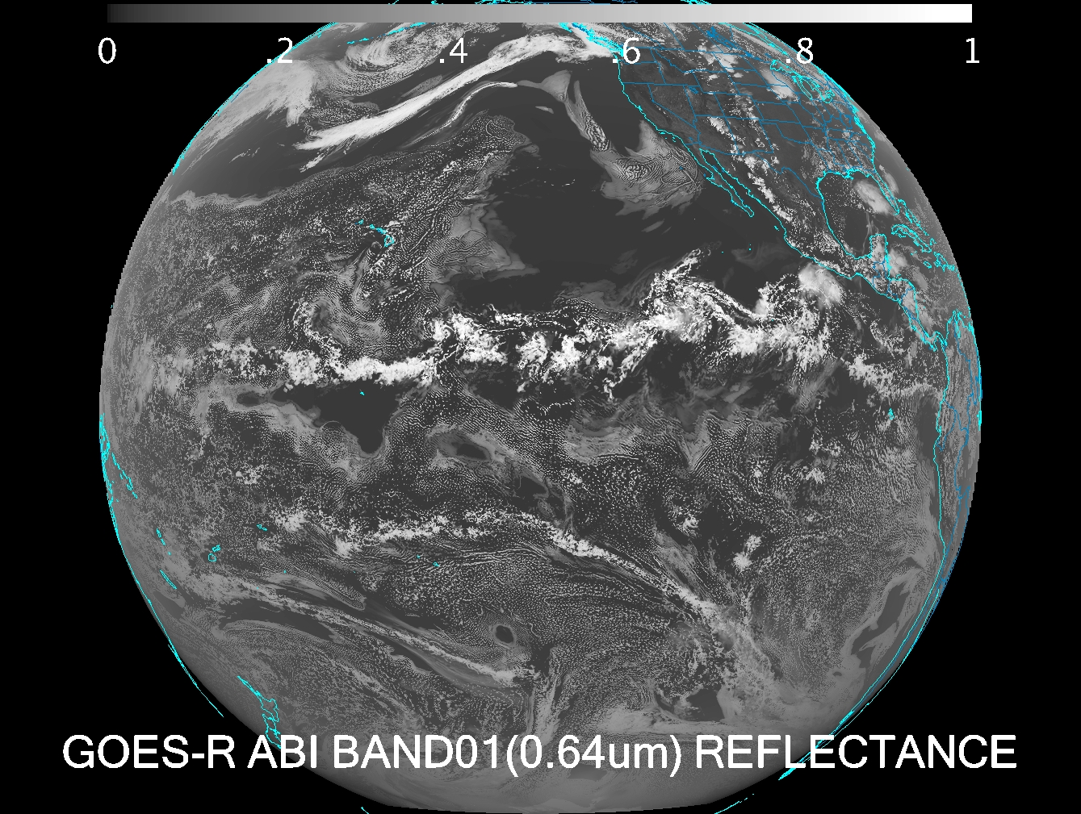
Dataset Re-delivery
Full Disk

Slide 15
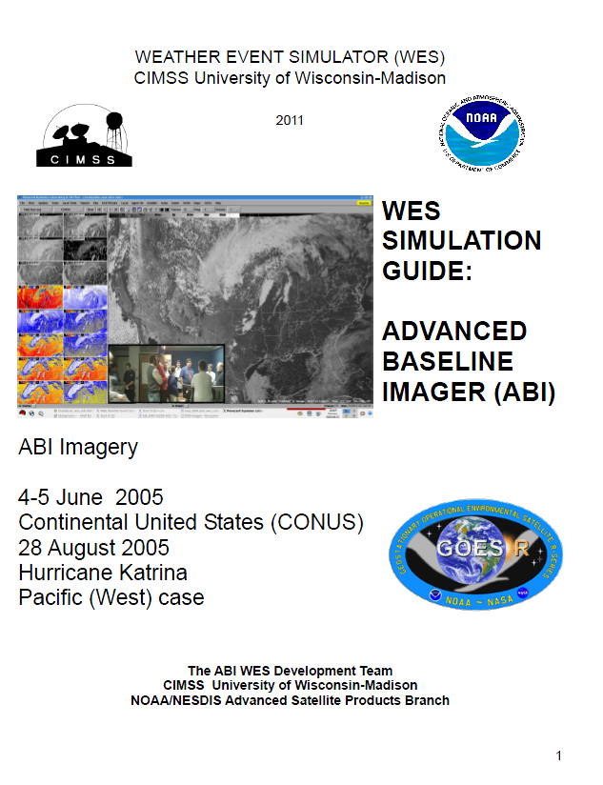
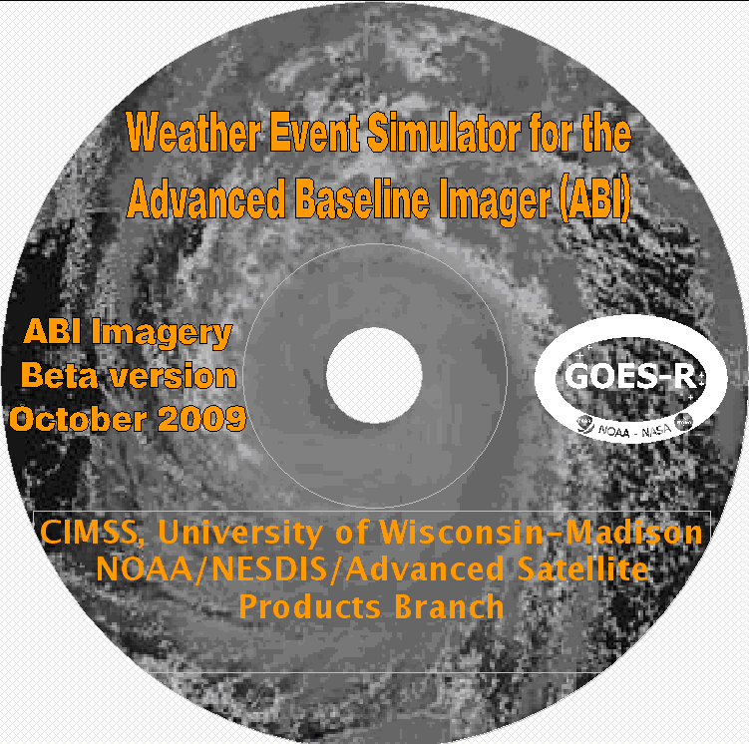
ABI WES
Contains simulated ABI for all bands for a June-2006 convective storm (CONUS and mesoscale), Hurricane Katrina, band differences, a WES guide, and images over the Pacific Ocean

Slide 16
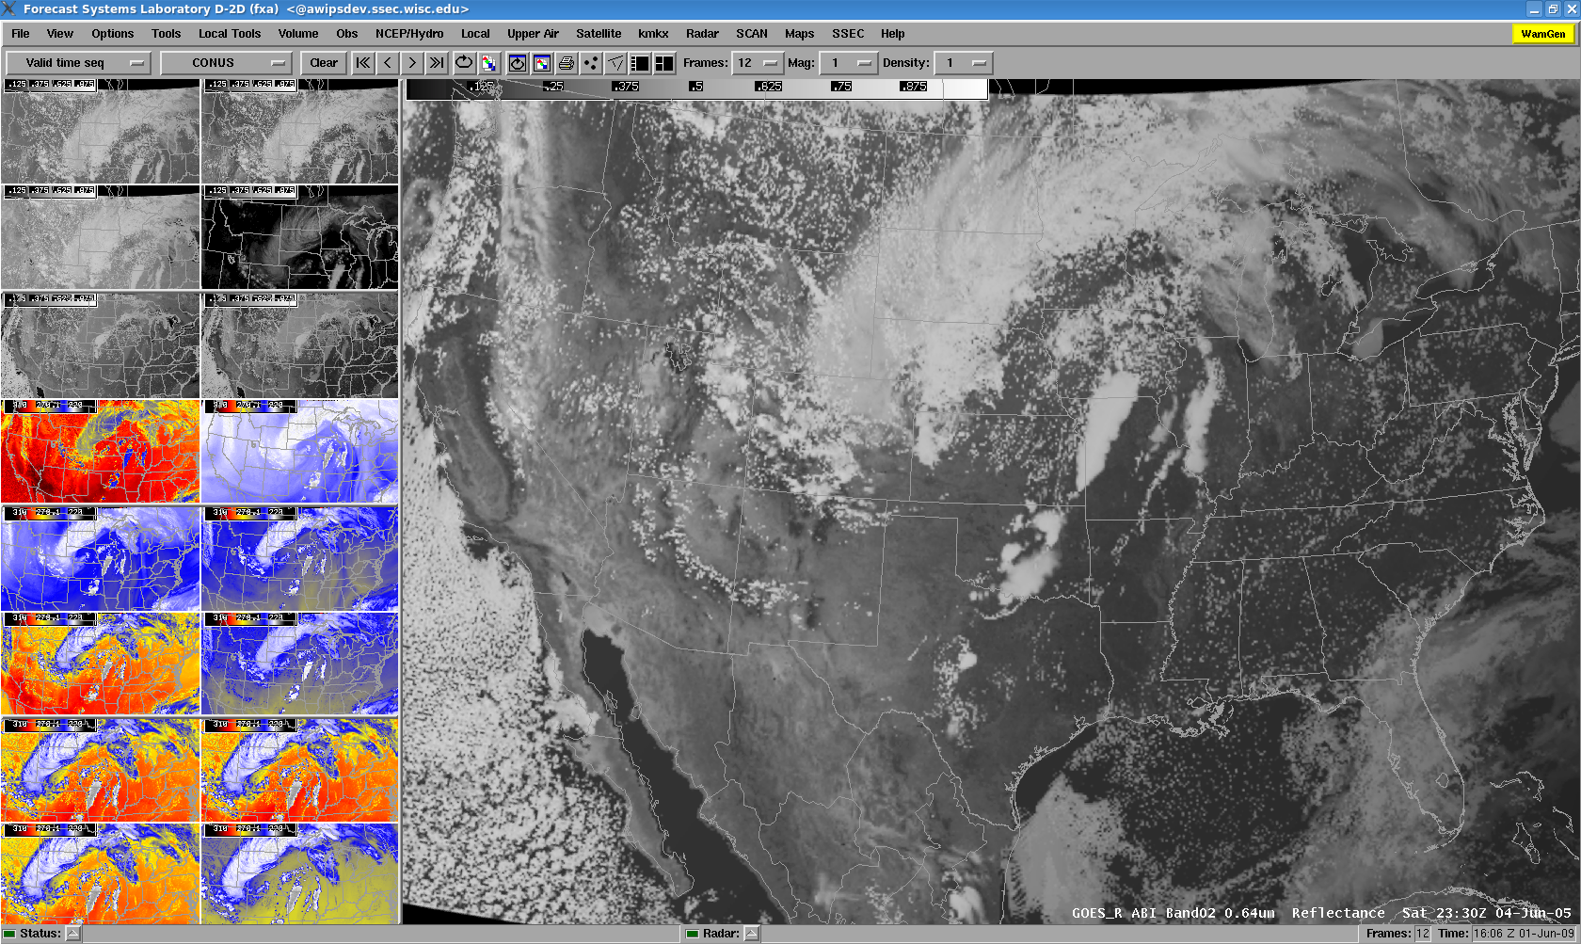
ABI in AWIPS

Slide 17
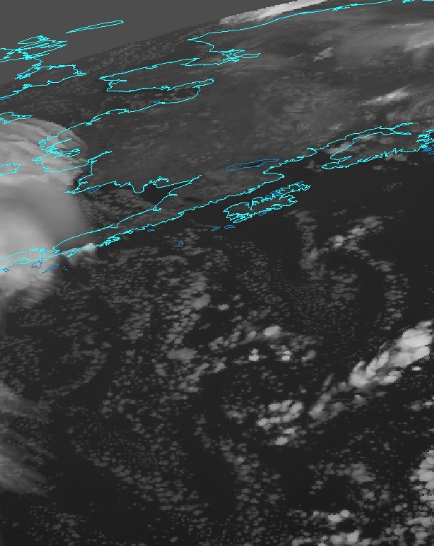
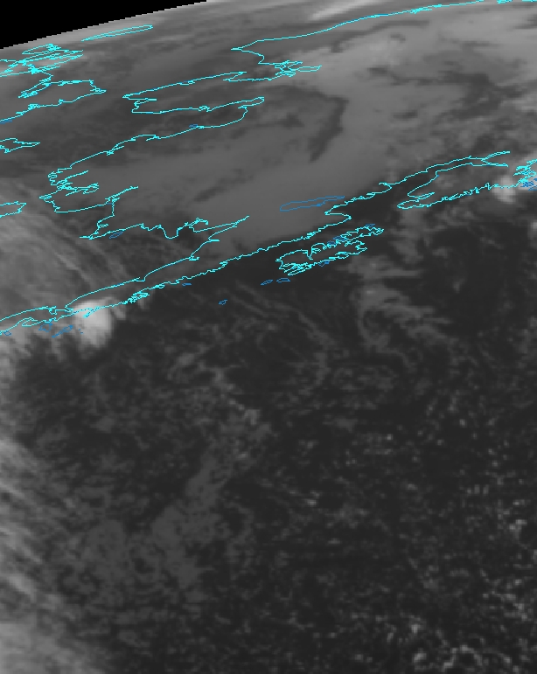
Simulated ABI – IR window
GOES Imager – IR window
Both images shown in ABI projection using McIDAS-V. September 29, 2011 at 06 UTC
WRF runs at the Arctic Region Supercomputing Center
Notes:
Preliminary.

Slide 18
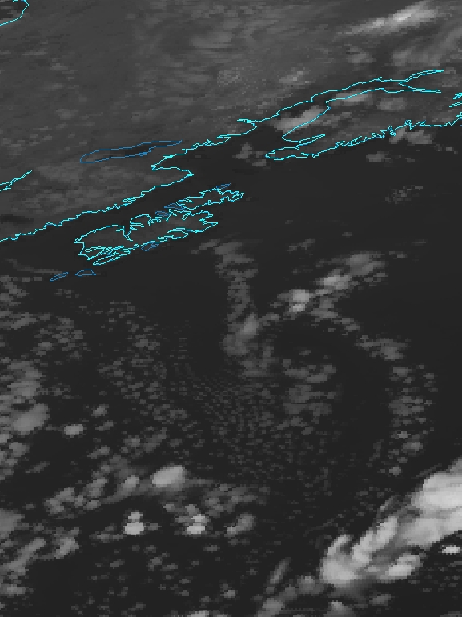
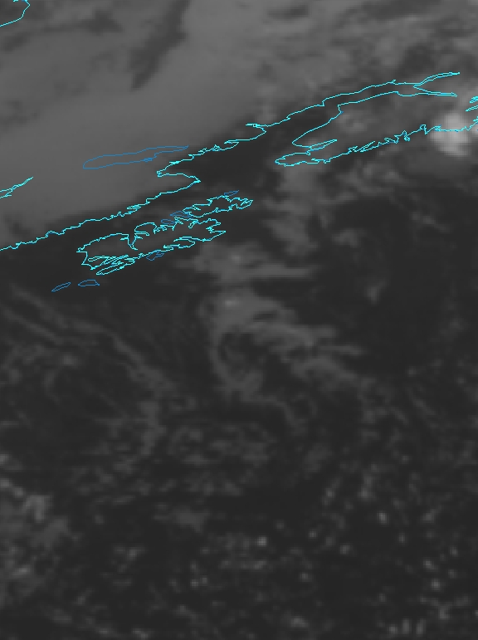
Simulated ABI – IR window
GOES Imager – IR window
Both images shown in ABI projection using McIDAS-V. September 29, 2011 at 06 UTC
WRF runs at the Arctic Region Supercomputing Center
Notes:
Preliminary.

Slide 19
Outline
Synopsis of GOES-R Product Algorithm
      Algorithm description
      Product example(s)
Continuing AWG Validation Activities
      Latest algorithm performance statistics obtained
      Examples (routine and deep-dive)
      Showcasing of any validation tools developed
Thoughts, Plans, and Opportunities for:
      VIIRS
      Real-time simulated ABI
Notes:
Presentation Guidelines (soundings example): Discuss the TPW algorithm, identify strengths and weaknesses, touch on Blended TPW and include CrIMMS products from JPSS if possible.

Slide 20
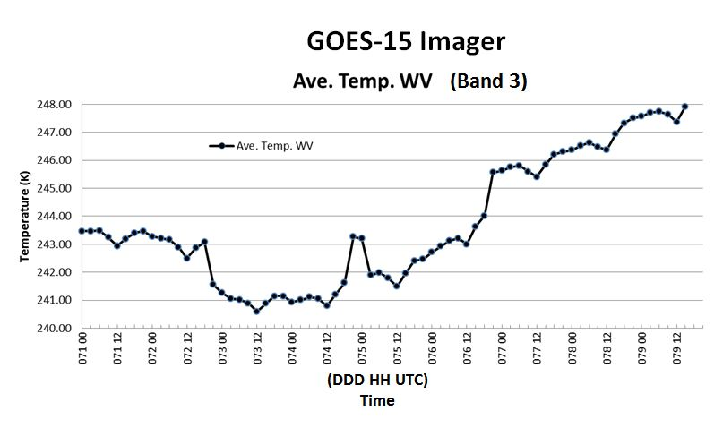
GOES Imager Water Vapor Mean brightness temperatures over water from 90 S to 90 N and 110 W to 170 W.

Slide 21
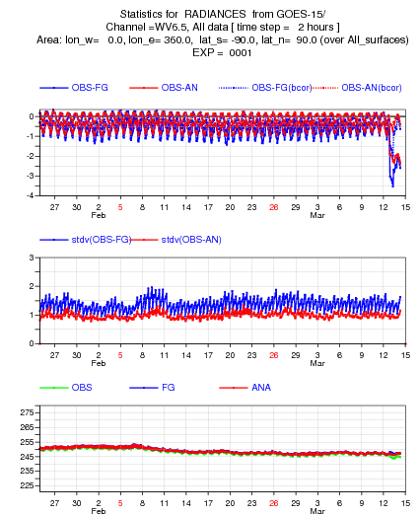
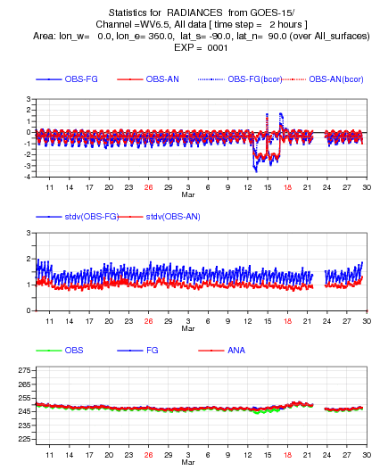
GOES-15 Imager Calibration Anomaly
(monitored by ECMWF)
Large observation minus calculation
Beginning of the anomaly
Encompassing the anomaly

Slide 22
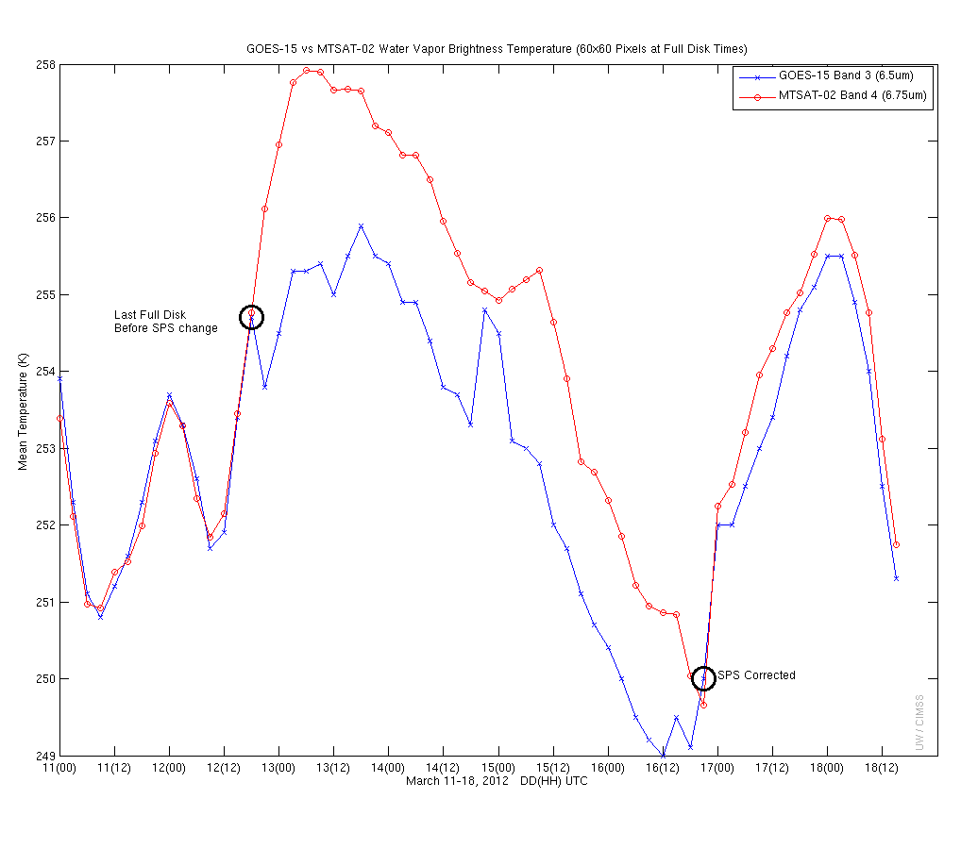
GOES-15 Imager Calibration Anomaly (by SPS)
SPS: 9 4 7 4 9
GOES-15 Imager water vapor band compared to co-located MTSAT values. Note large brightness temperature differences beginning near 21UTC on March 12, 2012. Plus, the SPS unit used for the generation of GVAR is noted (obtained from the GVAR signal). Image from: CIMSS and STAR.
Notes:
ECMWF= European Center for Medium range Weather Forecasting
SPS = Sensor Processing Subsystem
CIMSS = Cooperative Institute for Meteorological Satellite Studies
GSICS= Global Space-based Inter-Calibration System
MTSAT = Multi-functional Transport Satellite
GOES = Geostationary Operational Environmental Satellite

Slide 23
Routine Validation Tools
This (automated) tool set includes, but is not limited to:
Time series of reflectance factor (RF) and radiances/brightness temperatures
Statistics of RF, radiances/brightness temperatures
Generate a host of images, thumbnail images
Animations
Monitor “forward model calc” vs “satellite obs” (Calibration function?)
Monitor image quality
Etc.
Average of valid data samples
Number of valid data samples
Minimum value of valid data samples
Maximum value of valid data samples
Sum of valid data samples
Sum-of-squares of valid data samples
Total number of data samples within the sample set
Notes:
For each product, describe and illustrate the routine validation tools that you have or are developing. At a minimum address the following:
- Capabilities (in their final state)
- Datasets used
- Visualization software tools used (IDL, McIDAS, other…) to visualize the products, intermediate products, diagnostic data, product performance measures, reference/”ground-truth” data, etc…
-

Slide 24
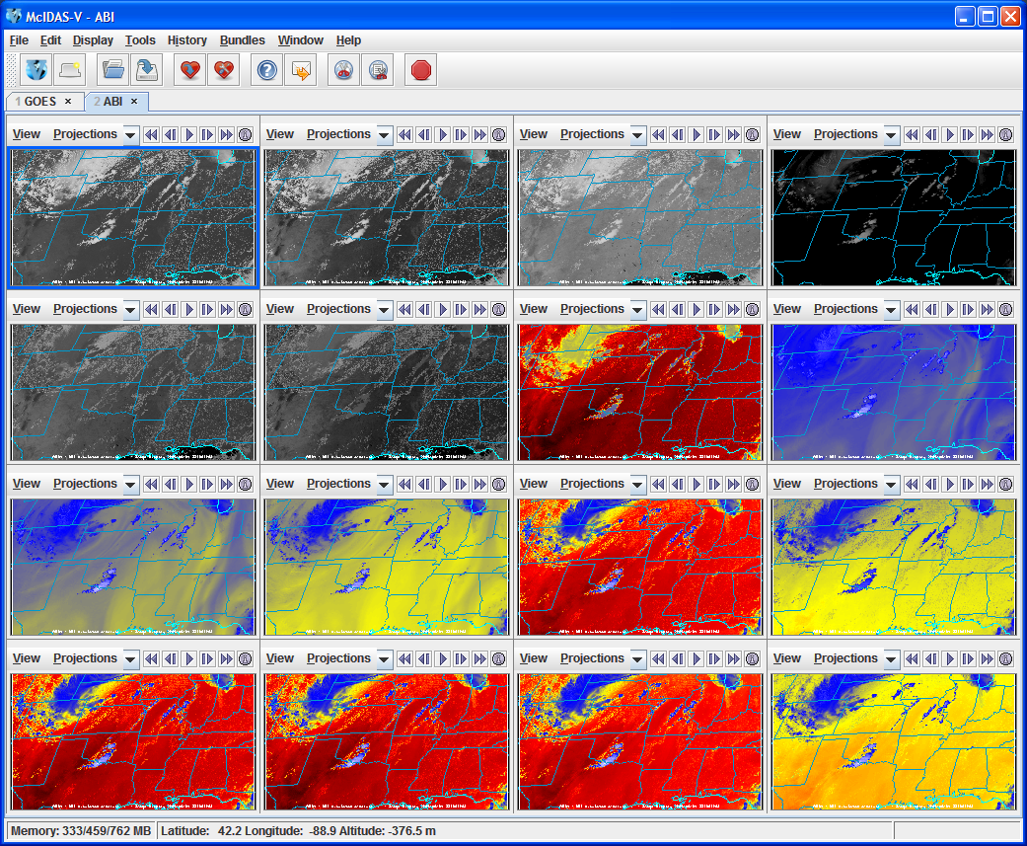
Example CMIP Output ABI bands in McIDAS-V

Slide 25
”Deep-Dive”
Validation Tools
This tool set includes, but is not limited to:
  Additional Thumbnail images
  Full size and/or zoomed images
  Generate difference images
    Temporal
    Spectral
  Times series of radiances/brightness temperatures
    Longer time-series
  Scatter plots, etc.
  Statistics of radiances/brightness temperatures
    Longer times series
  “Forward Model Calc” vs “Satellite Obs” information
    From raobs, NWP, etc.
  Correlate image artifacts with calibration events
  Compare to other imagery (e.g., VIIRS, etc.)
  Etc.
McIDAS + scripts
Notes:
For each product, describe and illustrate the “deep-dive” validation tools that you have or are developing. At a minimum address the following:
- Capabilities (in their final state)
- Intended use
- Datasets used
- Visualization software tools used (IDL, McIDAS, other…) to visualize the products, intermediate products, diagnostic data, product performance measures, reference/”ground-truth” data, etc…

Slide 26
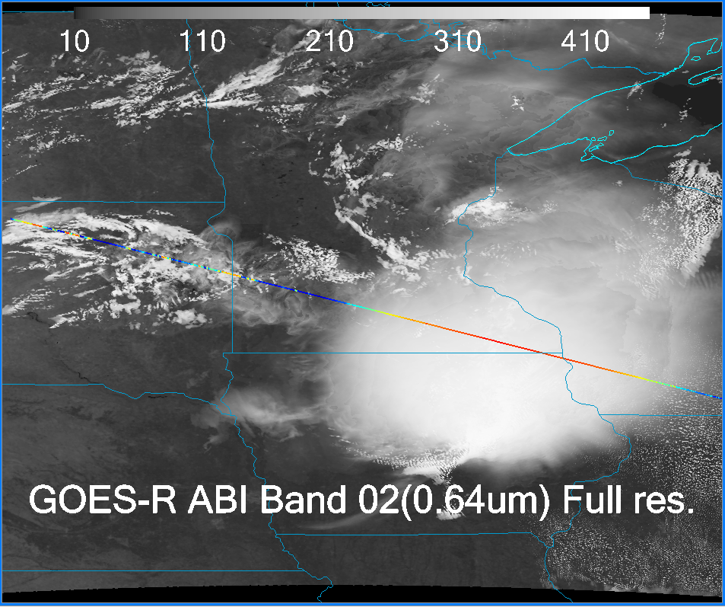
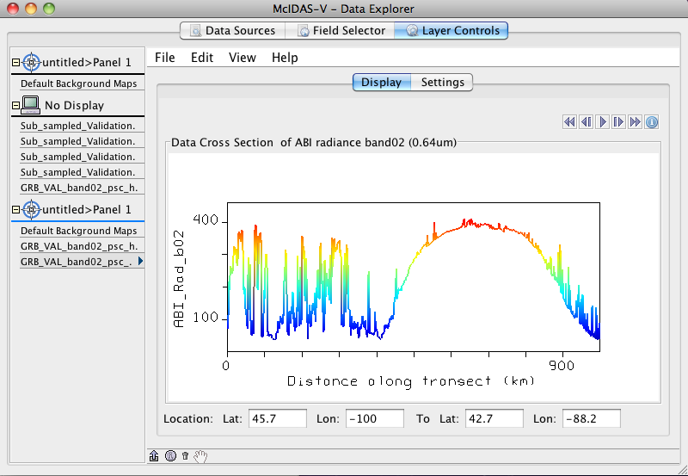
Transect (Mcidas-V)

Slide 27
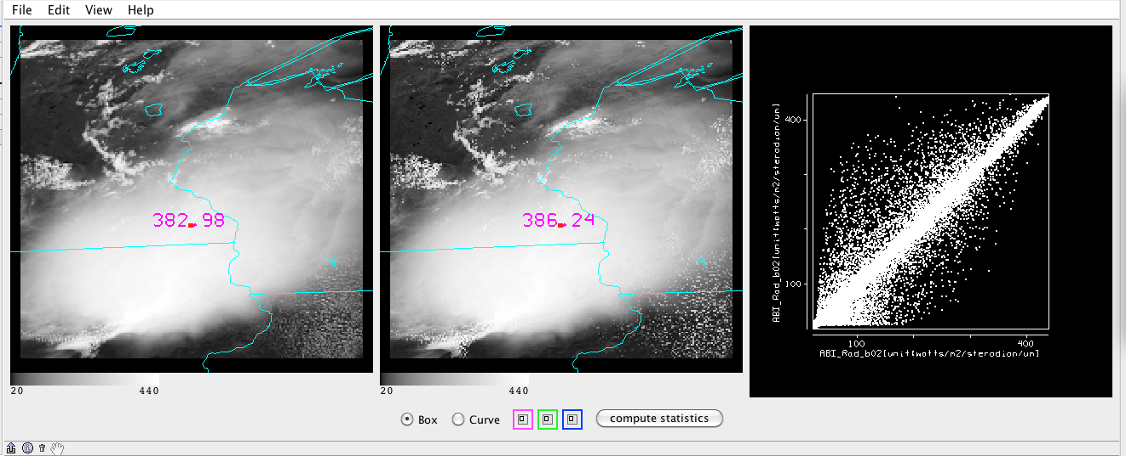
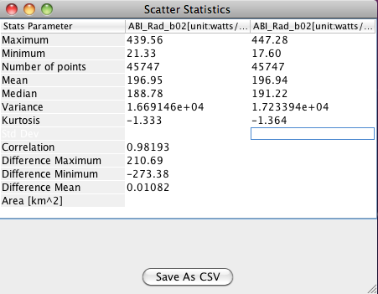
Interactive Scatter plot and Statistics

Slide 28
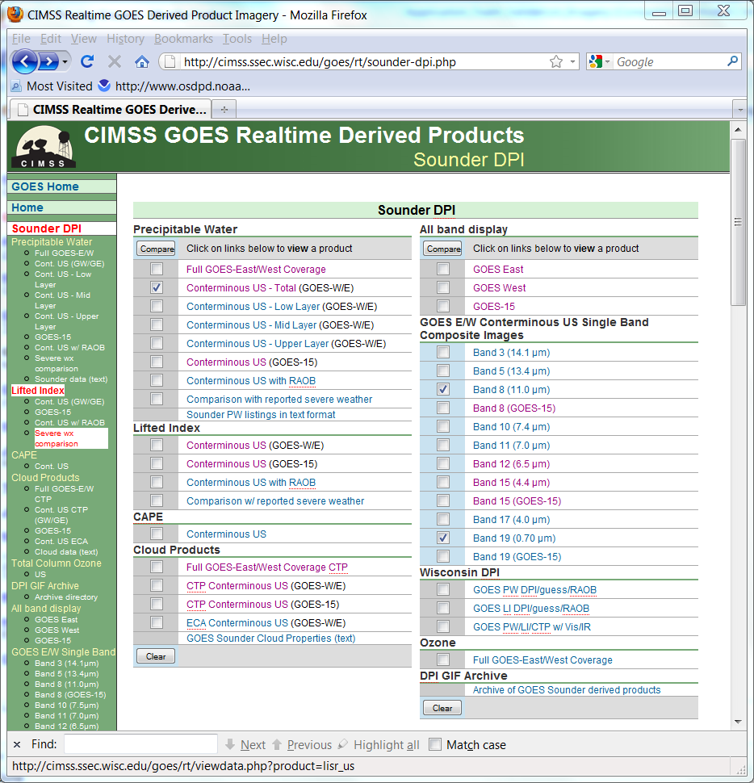

Slide 29
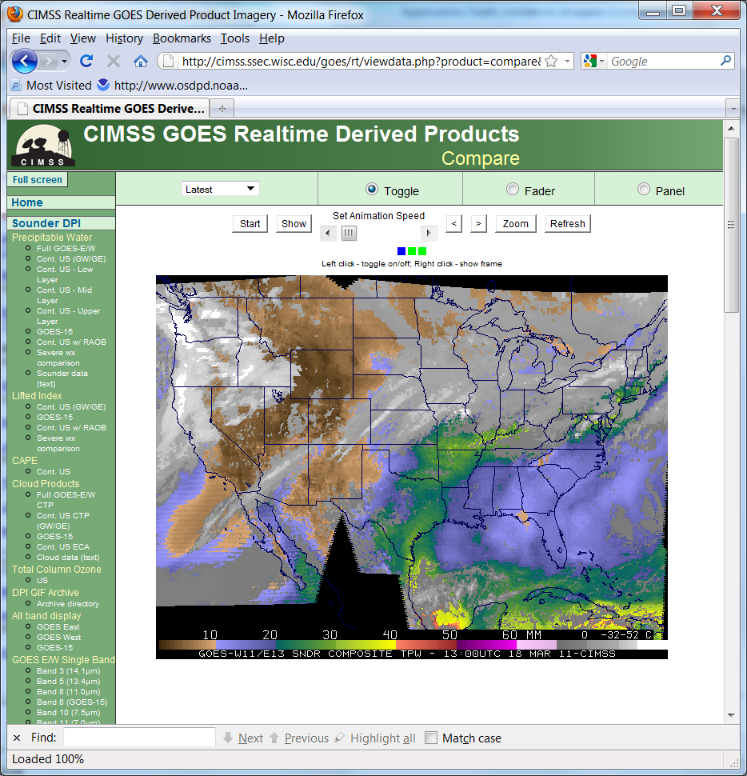

Slide 30
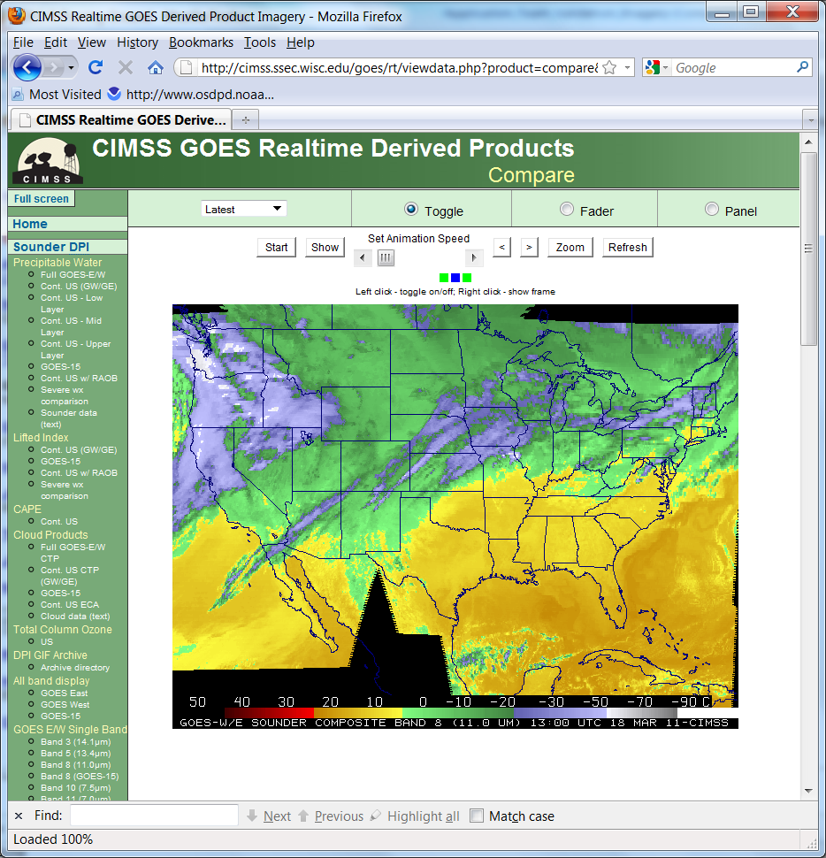

Slide 31
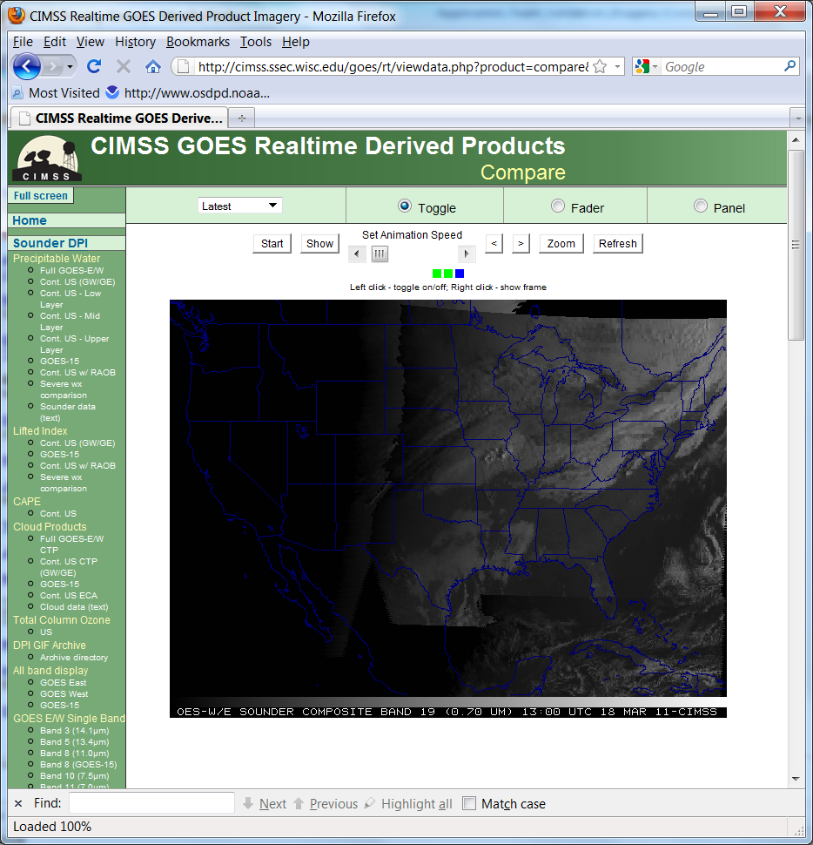

Slide 32
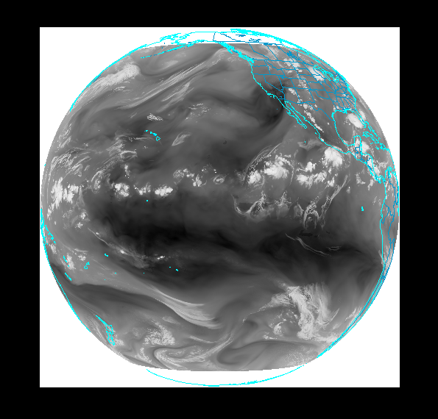
In ABI FGF (137W)
Working on the Fixed Grid Format (FGF) for ABI
- Iterating with Harris personnel verifying ABI FGF vs CGMS defined “Normalized Geostationary Projection”
- Continued development of beta version of software to compute transforms to and from FGF to longitude and latitude.
- Comparison of earth locations for 2km fixed grid between Harris and SSEC code shows a very close match.
- Continuing effort to define critical metadata for geostationary projections in CF/CF-satellite.
SSEC

Slide 33
Outline
Synopsis of GOES-R Product Algorithm
      Algorithm description
      Product example(s)
Continuing AWG Validation Activities
      Latest algorithm performance statistics obtained
      Examples (routine and deep-dive)
      Showcasing of any validation tools developed
Thoughts, Plans, and Opportunities for:
      VIIRS
      Real-time simulated ABI
Notes:
Presentation Guidelines (soundings example): Discuss the TPW algorithm, identify strengths and weaknesses, touch on Blended TPW and include CrIMMS products from JPSS if possible.

Slide 34


Suomi NPP Imagery EDR Team
Don Hillger¹ and Tom Kopp²
17-18 April 2012
VIIRS Cal-Val Workshop
GSFC Building 8
¹NOAA/NESDIS/StAR, Don.Hillger@NOAA.gov
²The Aerospace Corporation, Thomas.J.Kopp@aero.org

Slide 35
VIIRS EDR Imagery Team
NESDIS/StAR (D. Hillger, D. Molenar, D. Lindsey, T. Schmit – GOES liaison)
CIRA/CSU (S. Miller, S. Kidder, S. Finley, H. Gosden, R. Brummer, C. Seaman)
CIMSS/SSEC (T. Achtor, T. Jasmin, T. Rink)
Aerospace (T. Kopp, J. Drake, J. Feeley)
NOAA/NGDC (C. Elvidge)
AFWA (J. Cetola)
NIC (P. Clemente-Colon)
Northrop Grumman (K. Hutchison, R. Mahoney)
NASA (W. Thomas, P. Meade)
NOAA/OSPO (A. Irving)
NASA/SPoRT (G. Jedlovec, M. Smith)
FNMOC (J. Tesmer)
NRL (J. Hawkins, K. Richardson, J. Solbrig)
Northrup Grumman (K. Hutchinson, P. Meade)
NOAA/OSPO (A. Irving, M, Ruminski)
NASA/SPoRT (G. Jedlovec, M. Smith)

Slide 36
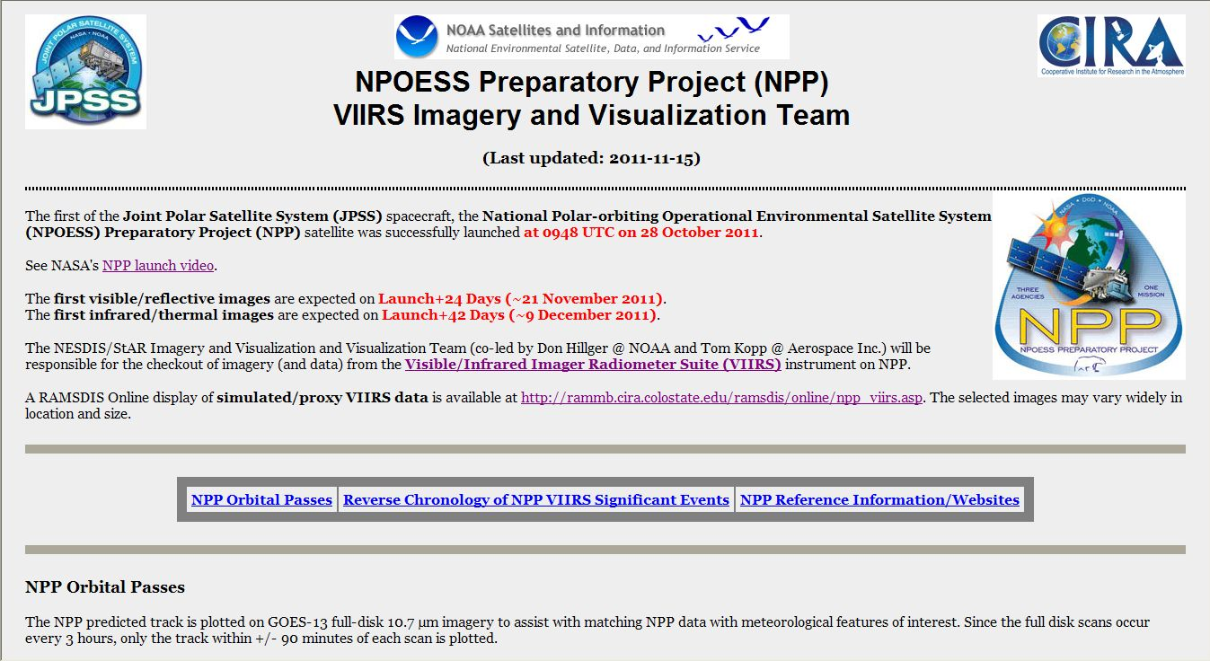
  Suomi NPP Imagery Team page http://rammb.cira.colostate.edu/projects/npp/

Slide 37
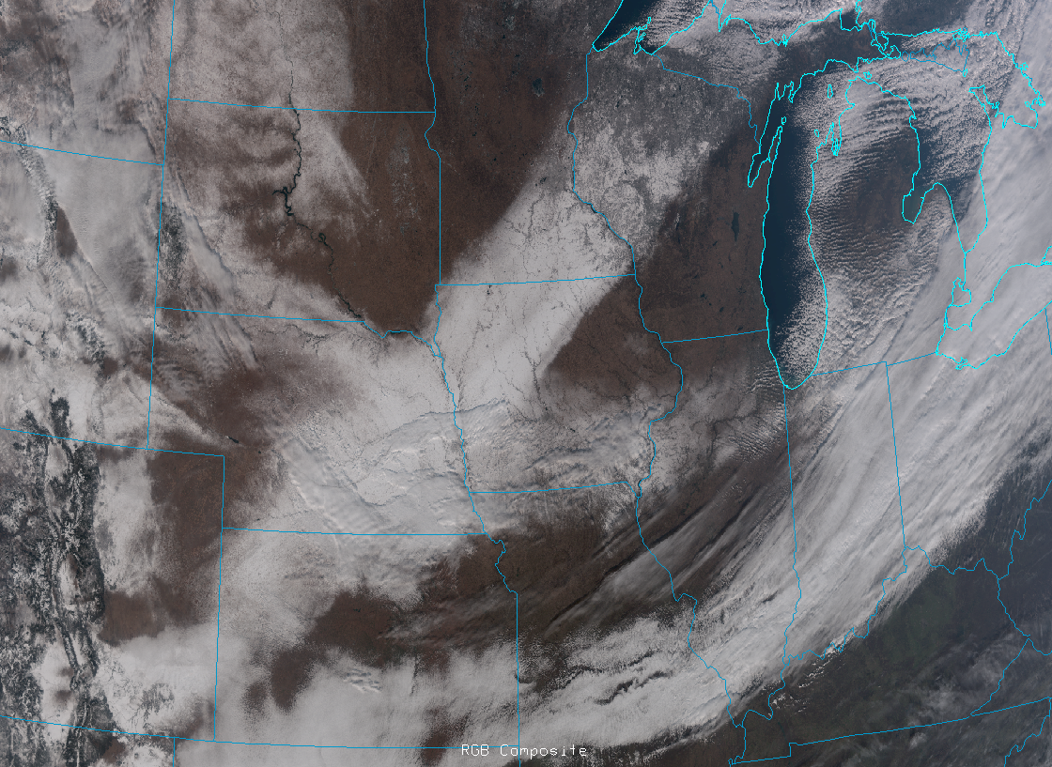
VIIRS M-band (750 m) true-color/RGB image (for 9 December 2011) over the U.S. Upper Midwest. [Image courtesy of Dan Lindsey, NOAA/StAR]

Slide 38


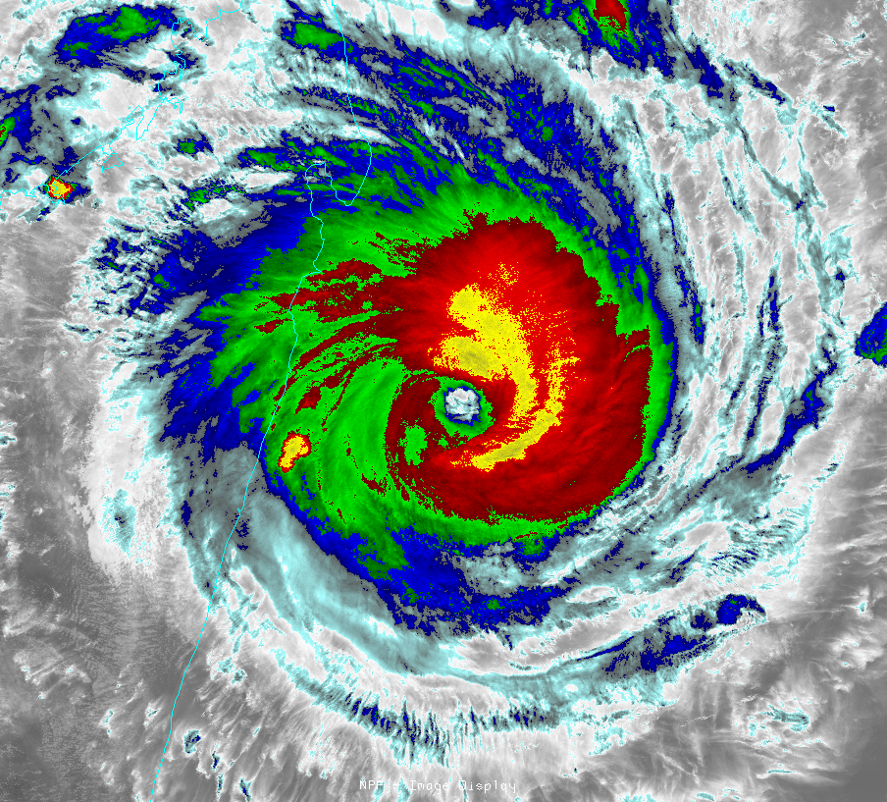
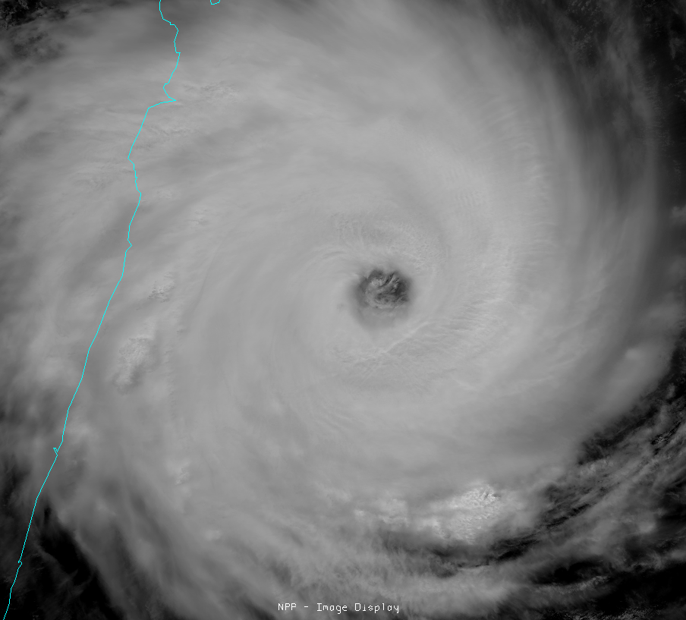
VIIRS Imagery Examples:
Tropical Cyclone Giovanna east of Madagascar
13 February 2012 at 0947 UTC
VIIRS channel I-5 (IR window, 11.45 µm)
VIIRS channel I-1 (visible, 0.64 µm )
Courtesy of Dan Lindsey

Slide 39
VIIRS Bands, Primary Purpose, Spectral Range

Slide 40
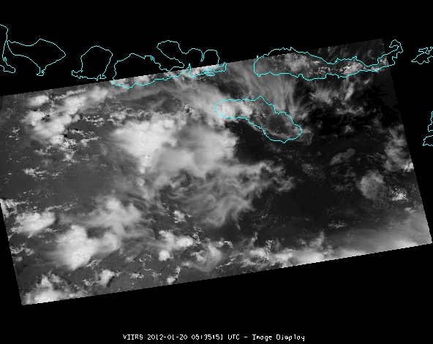
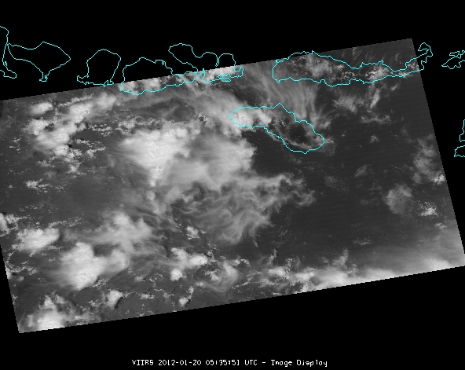
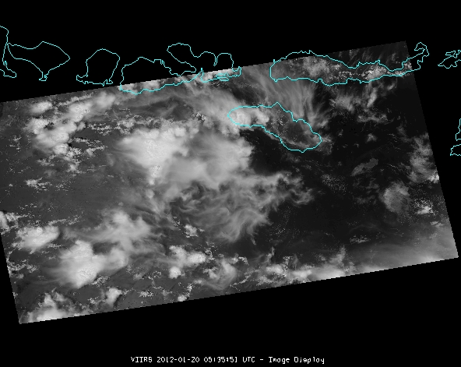

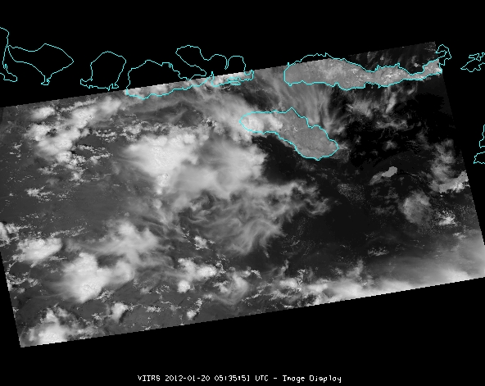
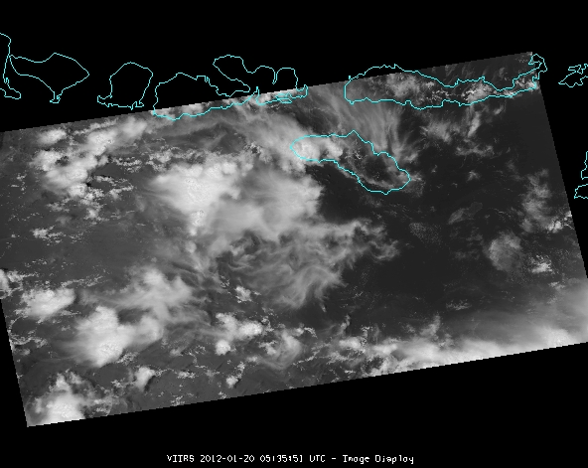
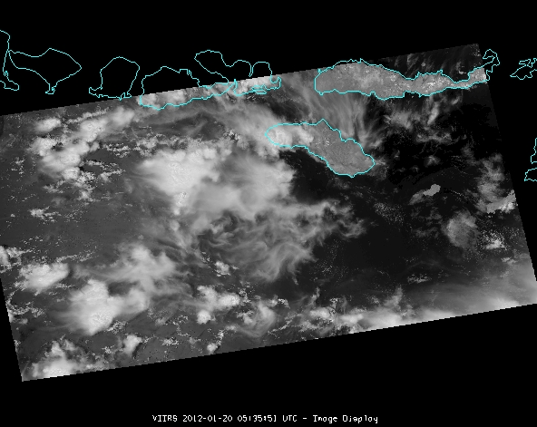
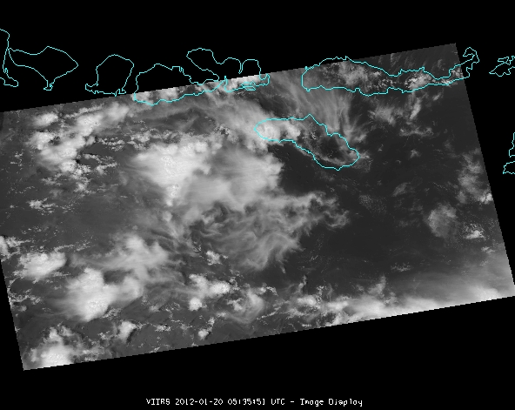
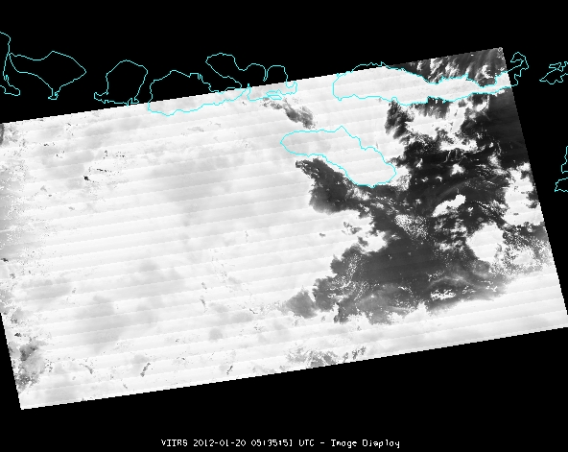
VIIRS M-1, 0.412 µm | VIIRS M-2, 0.445 µm | VIIRS M-3, 0.488 µm
VIIRS M-4, 0.555 µm | VIIRS I-1, 0.64 µm | VIIRS M-5, 0.672 µm
VIIRS M-6, 0.746 µm | VIIRS I-2, 0.865 µm | VIIRS M-7, 0.865 µm
Notes:
VIIRS Long-wave IR Channels.

Slide 41
VIIRS Bands, Primary Purpose, Spectral Range

Slide 42
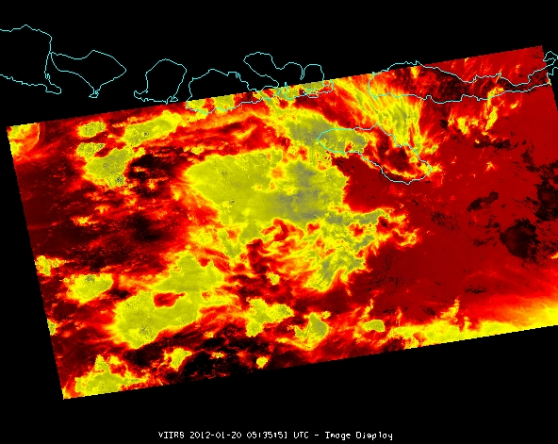
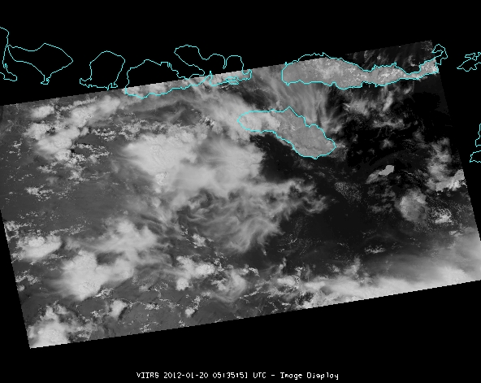

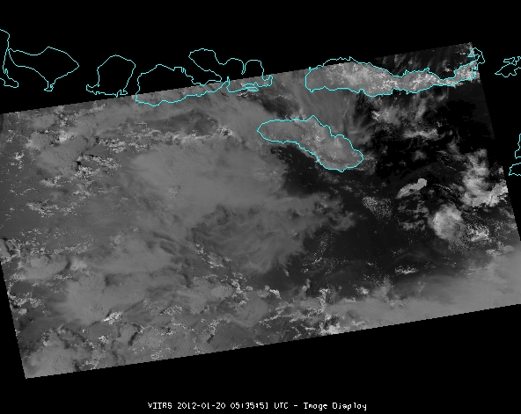
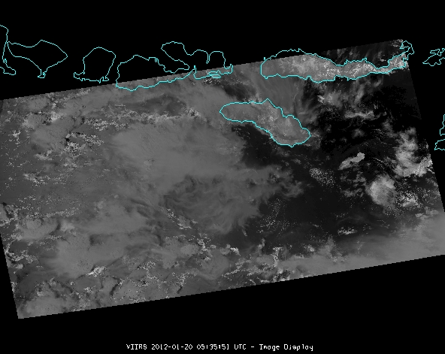
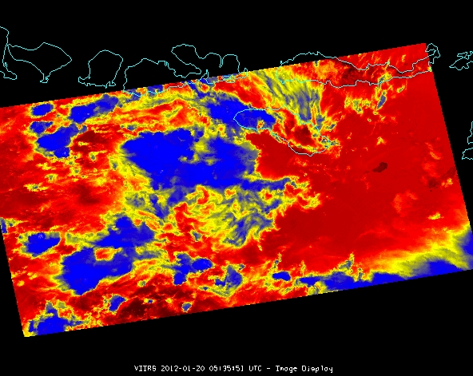
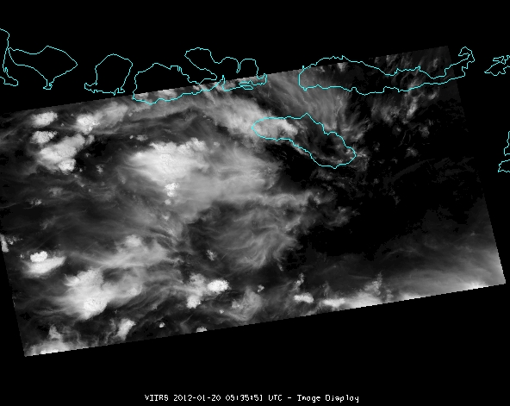
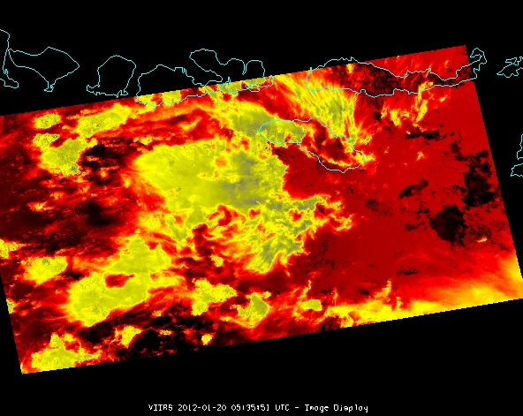
VIIRS M-8, 1.24 µm | VIIRS M-9, 1.378 µm | VIIRS I-3, 1.61 µm
VIIRS M-10, 1.61 µm | VIIRS M-11, 2.25 µm | VIIRS I-4, 3.74 µm
VIIRS M-12, 3.7 µm | VIIRS M-13, 4.05 µm
Notes:
VIIRS Long-wave IR Channels.

Slide 43
VIIRS Bands, Primary Purpose, Spectral Range

Slide 44




VIIRS M-14, 8.55 µm | VIIRS M-15, 10.76 µm
VIIRS I-5, 11.45 µm | VIIRS M-16, 12.01 µm
Notes:
VIIRS Long-wave IR Channels.

Slide 45


Slide 46


Slide 47

VIIRS
Band I05 (11 µm), 4/14/2012, 1925Z
BT = 188.8K
VIIRS in Mc-V
Norman, OK Storm Case Study
CIMSS/SSEC

Slide 48

VIIRS
Band I01 (0.64µm), 4/14/2012, 1925Z
VIIRS in Mc-V
Norman, OK Storm Case Study
CIMSS/SSEC
Notes:
VIIRS2AWIPS implementation Team: David Hoese¹, William Straka III¹, Ray Garcia¹, Kathy Strabala¹
Rough Analysis and discussion provided by: William Straka III¹
Special thanks to the NWS WFO the storm report websites used
¹SSEC/CIMSS

Slide 49

VIIRS
DNB, 4/15/2012, 0743Z
Stray light contamination
Lightning streaking
Kansas City lights being diffused by clouds

Slide 50

Suomi NPP VIIRS AWIPS
10.76 µm IR
Visible
10.76 µm IR
02 March 2012 Supercells
Near Louisville, KY
Enhanced-V feature
David Hoese, William Straka III, Ray Garcia, Kathy Strabala, Jordan Gerth

Slide 51

Midwest storms (3/2/2012) Convection, SVM05
SSEC/CIMSS

Slide 52

Midwest storms (3/2/2012) Wisconsin snow storm, SVM05
SSEC/CIMSS

Slide 53

Simulated ABI band – NSSL WRF
- Run in near-realtime each day.
- Future plans call for all ABI bands to be simulated, currently only 8 or 9 are being generated.
http://cimss.ssec.wisc.edu/goes_r/proving-ground/nssl_abi/nssl_wrf_goes.html

Slide 54

Simulated ABI band – NSSL WRF

Slide 55
Summary
Imagery is the key product and hence needs a sufficient validation tool set.
This tool set should at least include:
  Thumbnail images
  Full size and/or zoomed images
  Animations
  Times series of radiances/brightness temperatures
  Statistics of radiances/brightness temperatures
  Temporal difference images
  Spectral band differences
  Combine images
  Product generation!
  Forward model “Calc” vs “Obs” information
  Etc.
Need a flexible system, which allows zooming, roaming, specialized enhancements, etc.
  Hope for the best, plan for the worst.
Suomi NPP shows great promise.

Slide 56

















Slide 57
Cloud and Moisture Imagery
May 1, 2012
Presented By: Tim Schmit ¹
¹ NOAA/NESDIS/STAR
Thanks to the whole imagery team and all who gave inputs!

