Slide 1


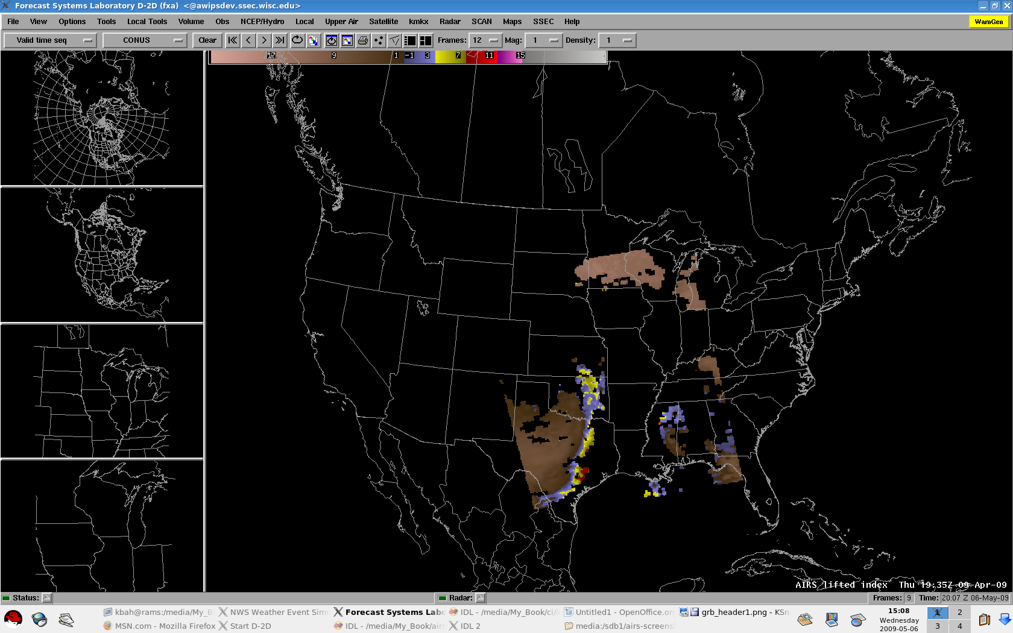
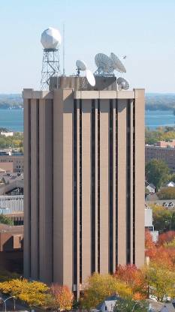

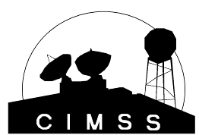
High-Spectral Resolution IR Observations for Weather-related Applications
  Timothy J. Schmit (tim.j.schmit@noaa.gov)
NOAA/NESDIS/Satellite Applications and Research
Advanced Satellite Products Branch (ASPB)
Jun Li, etc., CIMSS
16th Atmospheric Science from Space using Fourier Transform Spectrometry
Pyle Center, University of Wisconsin-Madison
Madison, WI
23-May-2012
UW-Madison

Slide 2
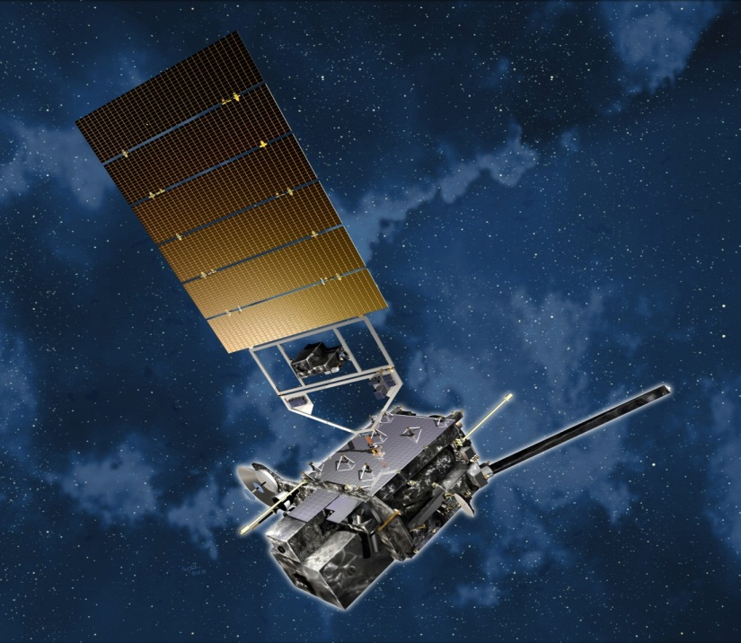
Overview
GOES-R Overview
  No dedicated Sounder
  Synergy with ABI
Current GOES Sounder
Select products
Sample applications
Summary
  More information
  References
Lockheed Martin

Slide 3
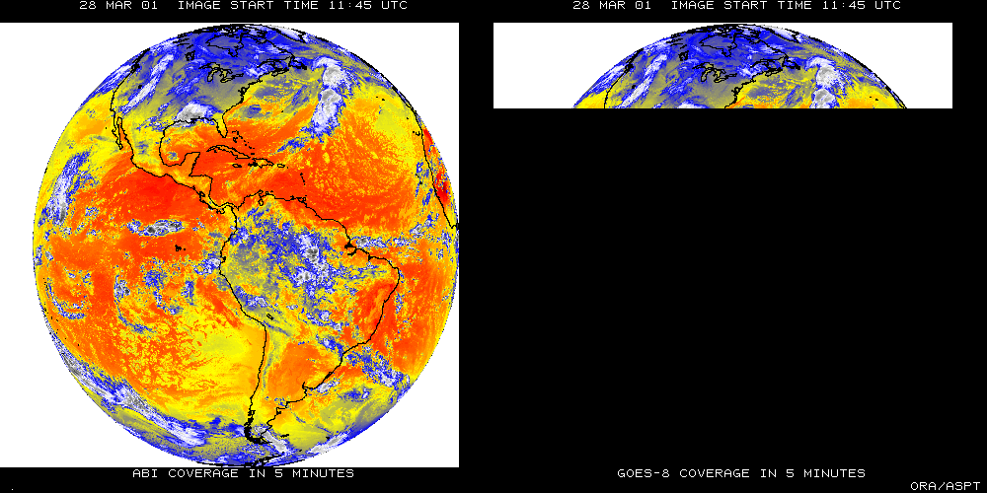
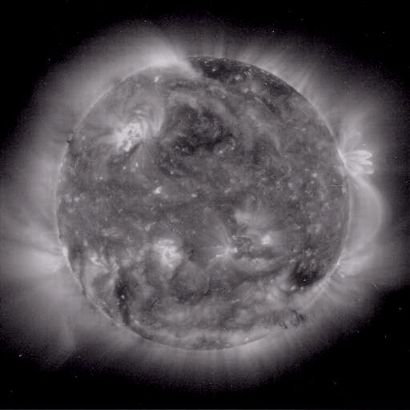
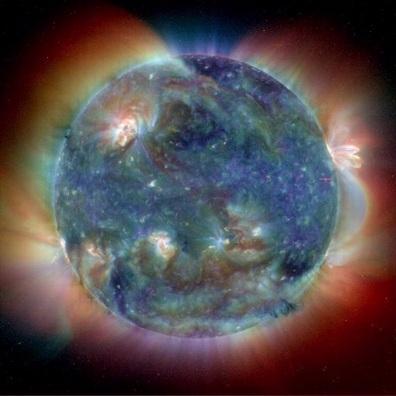
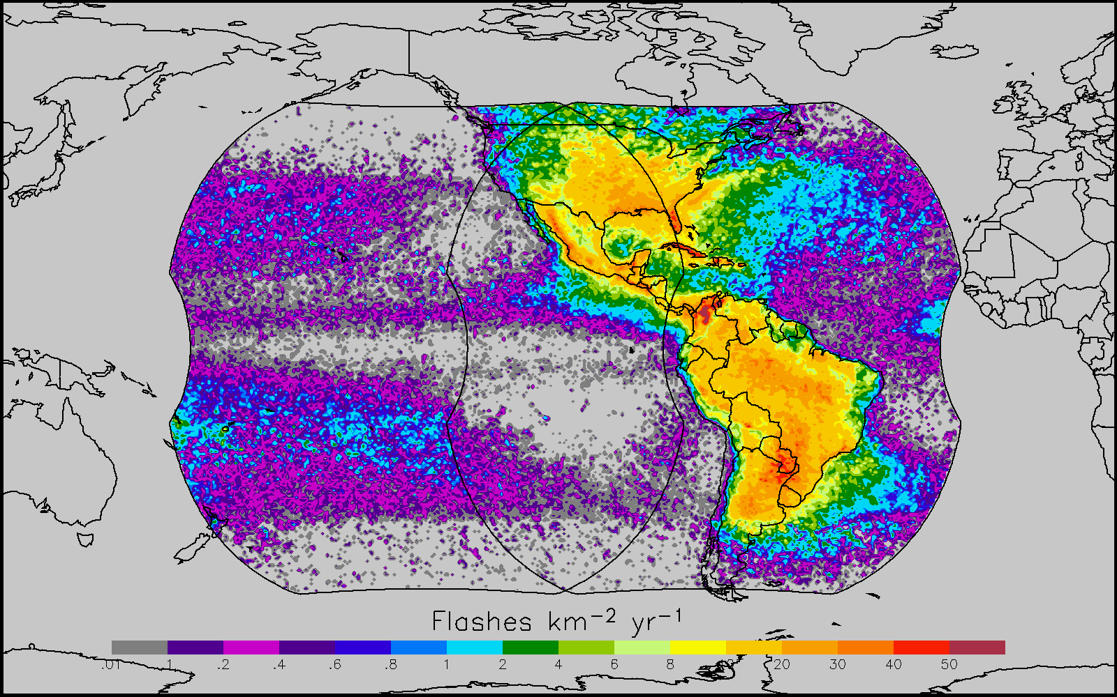
GOES-R main instruments
ABI – Advanced Baseline Imager
Space Weather/Solar
ABI covers the earth approximately five times faster than the current Imager.
Geostationary Lightning Mapper
Images courtesy of SOHO EIT, a joint NASA/ESA program

Slide 4
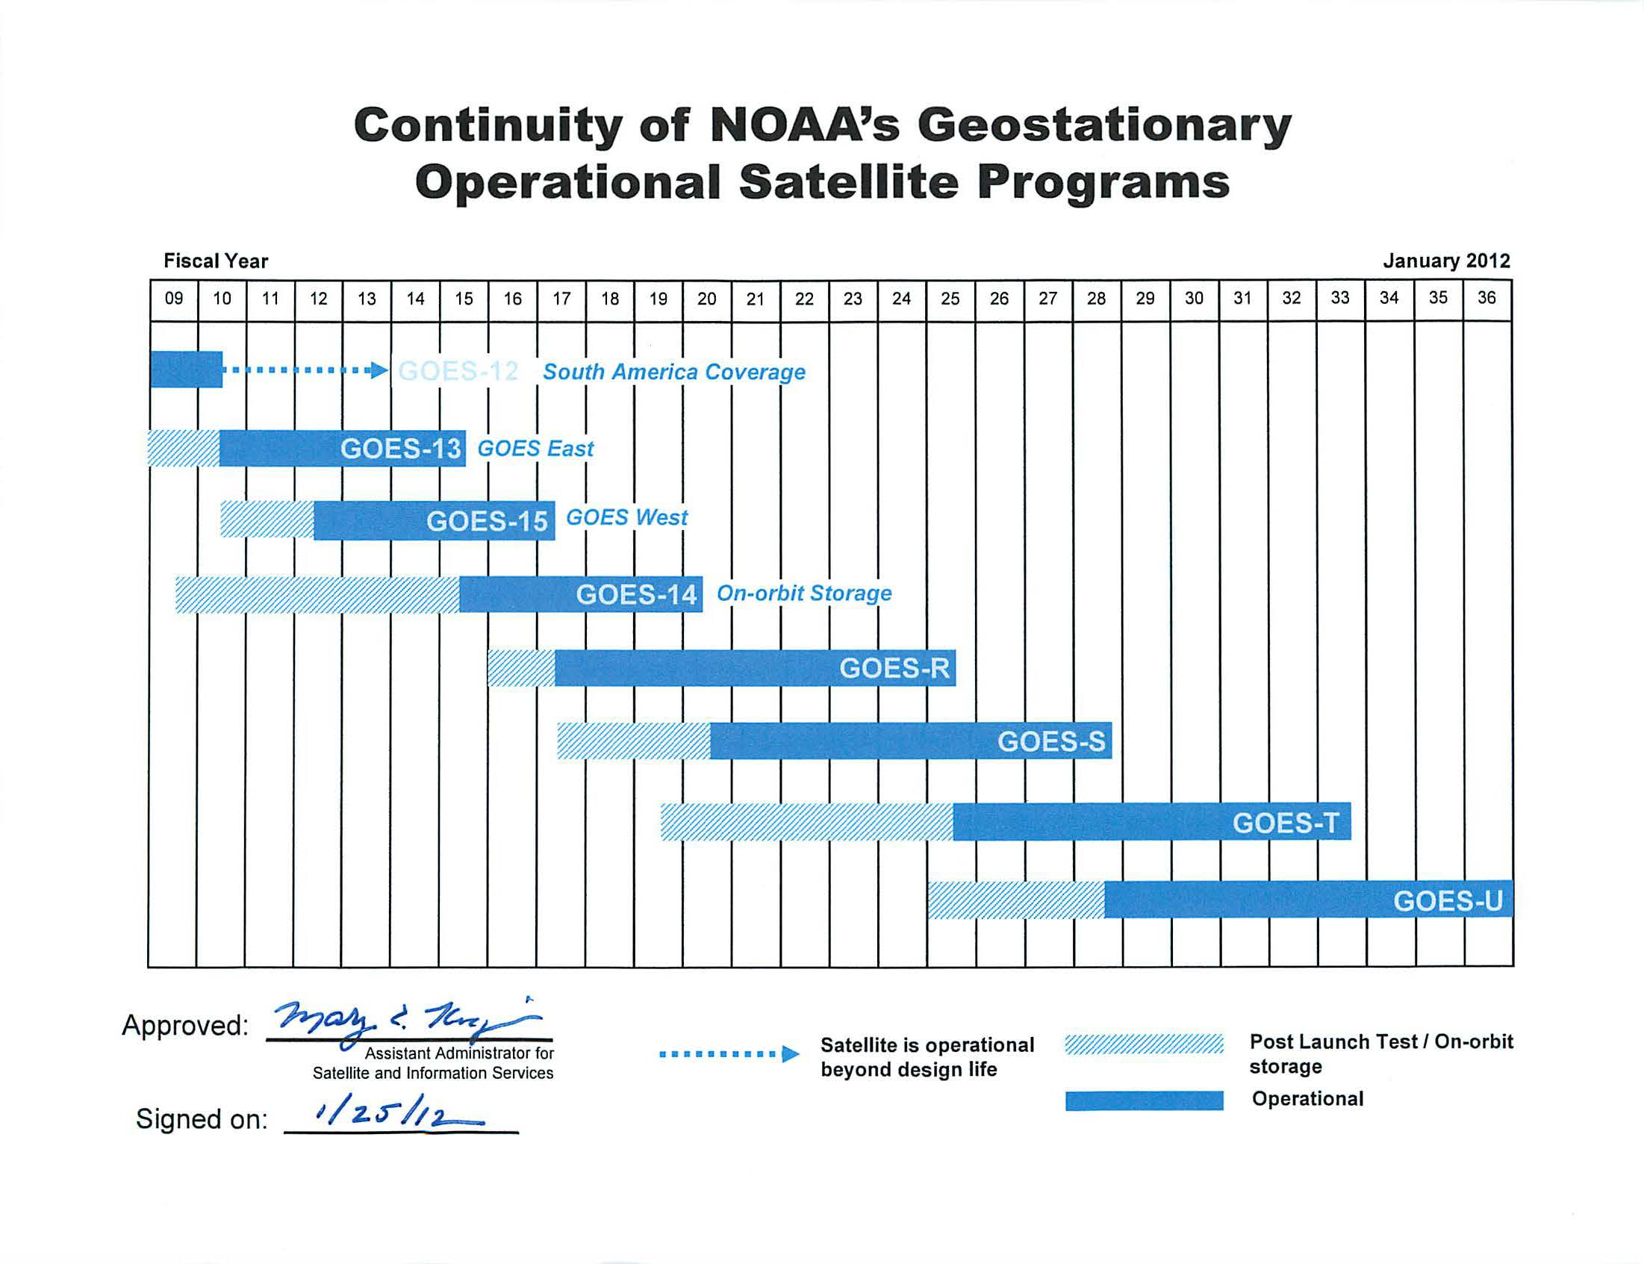
GOES Fly-out Schedule
http://www.goes-r.gov/

Slide 5
GOES-R Series Overview
No dedicated Sounder
Advanced Baseline Imager (ABI)
Geostationary Lightning Mapper (GLM)
Space Weather
  Space Environmental In-Situ Suite (SEISS)
  Solar Ultra Violet Imager (SUVI)
  Extreme Ultra Violet/X-Ray Irradiance Sensor (EXIS)
  Magnetometer
Communications
  GOES Rebroadcast (GRB)
  Low Rate Information Transmissions (LRIT)
  Emergency Managers Weather Information Network (EMWIN)
  Search and Rescue (SAR)
  Data Collection System (DCS)
Notes:
Advanced Baseline Imager (ABI) Earth-viewing
Geostationary Lightning Mapper (GLM) Earth-viewing
Solar Ultra-Violet Imager (SUVI) Sun-viewing
EUVS and XRS Irradiance Sensors (EXIS) Sun-viewing
Space Environment In-Situ Suite (SEISS) Space-viewing
Magnetometer (MAG) Space-viewing

Slide 6

Advanced Sounders
Timothy J. Schmit
NOAA/NESDIS/ORA
Advanced Satellite Products Team (ASPT)
in collaboration with
Cooperative Institute for Meteorological Satellite Studies
(CIMSS)
Madison, Wisconsin
[2001]
UW-Madison

Slide 7
Sounders, circa 2010
More than 5 years of high spectral measurements from polar orbits:
- AIRS (Atmospheric InfraRed Sounder)
- IASI (Infrared Atmospheric Sounding Interferometer)
- CrIS (Crosstrack Infrared Sounder)
Approximately 5 years of high spectral, spatial and temporal measurements from geostationary orbit:
- GIFTS (Geostationary Imaging Fourier Transform Spectrometer)
30 years of filter wheel technology in geostationary orbit:
- VAS and GOES Sounder
40 years since the first interferometer flown in space to study the weather: IRIS (Infrared Radiation Interferometer Spectrometer)
Forecast from 2001… with 67% accuracy!
The time is right to update the GOES sounder! The technology is mature. The need is documented.

Slide 8
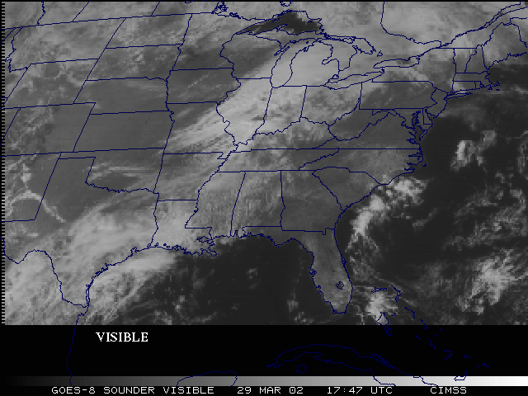
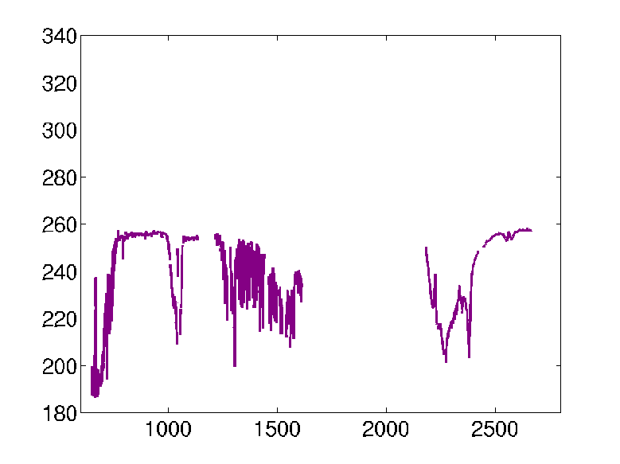
Improved products could be realized from combinations of ABI and HES (Hyperspectral Environmental Suite) data
Spatial
resolution
Temporal
resolution
Cloud
clearing
ABI
HES
Spectral
coverage
Surface
emissivity
Spectral resolution
cira 2004

Slide 9
Geo advanced sounder – a history
Low-earth demonstration -- IRIS (1970)
Successful aircraft demonstrations (1980s and 1990s, etc.)
G-HIS was (briefly) slated to be on GOES-L (eg, GOES-11)
GOES-N/O/P were to be advanced instruments
  they turned out to be continuation instruments
The Advanced Baseline Sounder (ABS) was slated to be on GOES-Q, then -R
The ABI was designed assuming a companion high-spectral resolution sounder
Successful low-earth spectral resolution IR sounders demonstrated
  IMG, AIRS, IASI, etc.
HES was removed from GOES-R/S series (2006)
Strong support from the NRC Decadal study and others.
Plans for operational geo sounders by EUMETSAT and China
ABI is not an advanced sounder, and hence cannot meet the original sounding or derived requirements
CrIS launched on Suomi NPP
Notes:
The need for geo high-spectral resolution data have been demonstrated with aircraft and leo data.

Slide 10
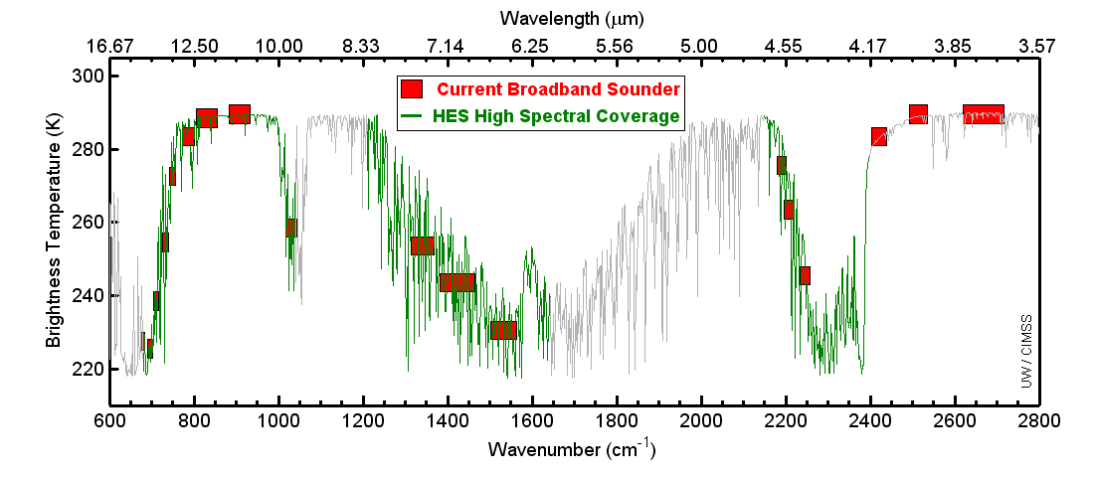
Example spectral coverage
Current GOES Sounder spectral coverage and that possible from an advanced high-spectral sounder. The broad-band nature of the current GOES limits the vertical resolution.

Slide 11
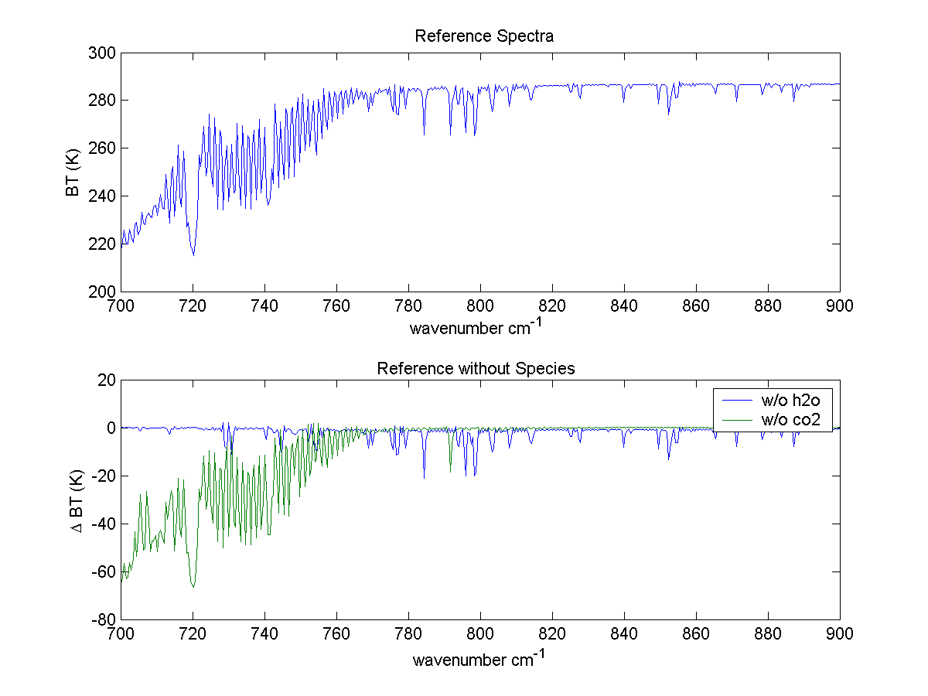
Why do we need a high spectral resolution sounder?
Analysis courtesy of Justin Sieglaff, CIMSS.
GOES-12 Sounder Bands
Smooth over required absorption lines
Compared to broadband sounders, observing absorption lines is mandatory to meeting requirements for temperature and moisture structure needed to improve weather forecasting
Many papers document science value of high spectral resolution sounder that support weather forecast needs. (Sieglaff et al.)
Notes:
These are calculated spectra, showing important features dealing with temperature and moisture are in the high-spectral data, but are smoothed over in the broad-band data. Figure courtesy of J. Sieglaff, CIMSS.
I’m not sure it is useful to show an entire spectrum. Rather I prefer to show the above and indicate that it is these little wiggles that make the HES so valuable and that the current GOES smears out.

Slide 12
High-Spectral, combined with High-Temporal Resolution is the key
Water Vapor and Carbon Dioxide absorption lines within the infrared window are sensitive to changes in the lower tropospheric thermodynamic state
Current GOES sounders are spectrally too broad to resolve these lines
High-time information obtained from a high spectral resolution IR GEO sounder would be very useful for monitoring pre-convective clear sky regions

Slide 13
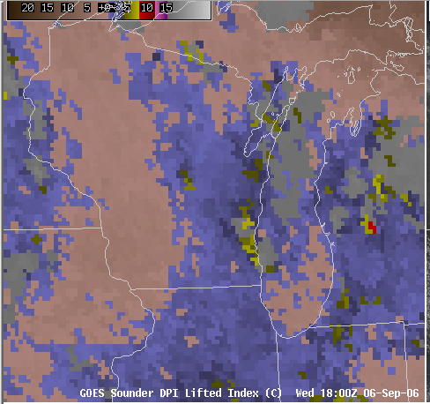
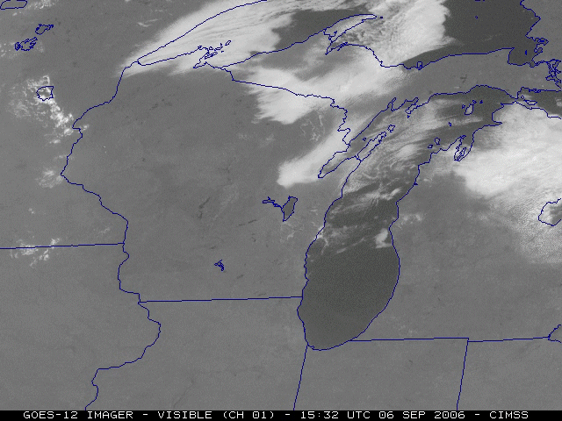
Need to monitor rapidly evolving situations

Slide 14
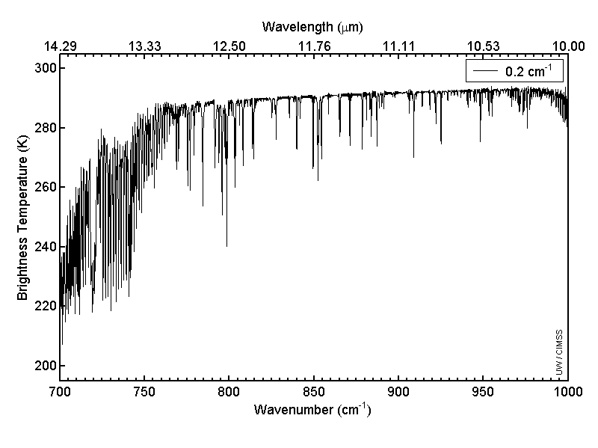
Allen Huang, CIMSS
On-line/off-line “signal”
Longwave window region

Slide 15
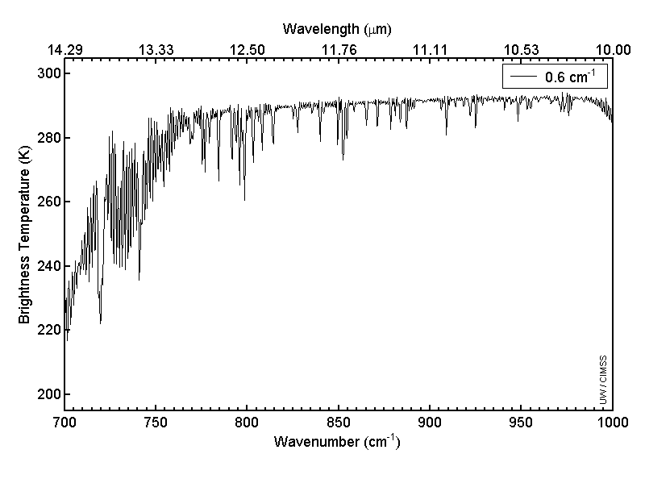
Allen Huang, CIMSS
“AIRS or IASI-like”
Longwave window region

Slide 16
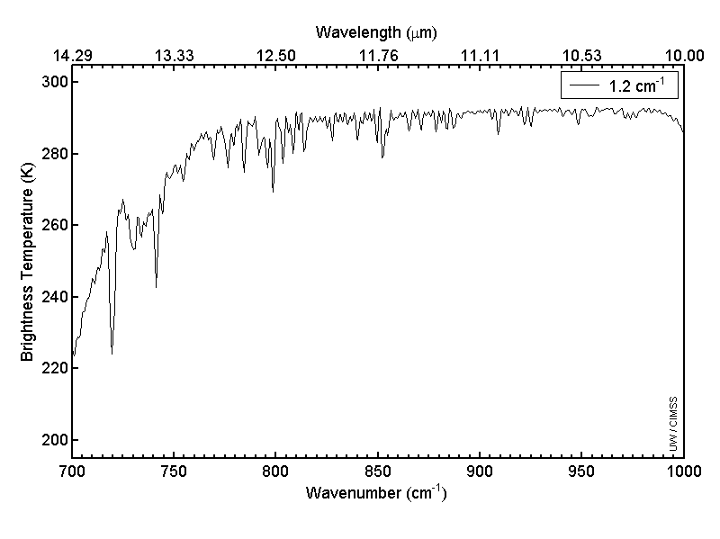
Allen Huang, CIMSS
Longwave window region

Slide 17
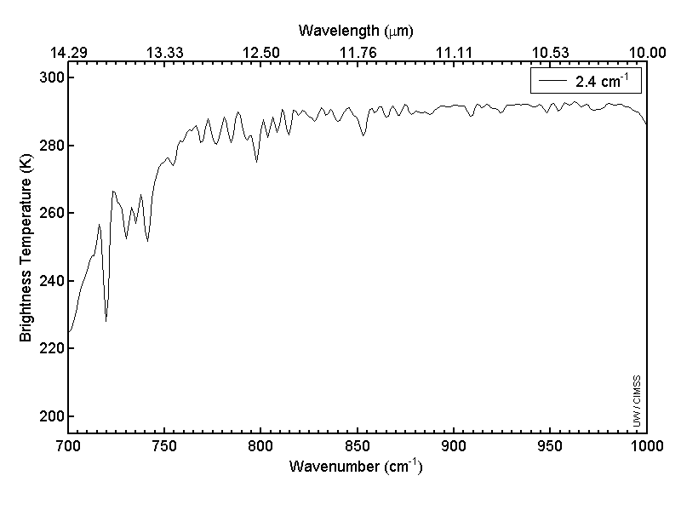
Allen Huang, CIMSS
Longwave window region

Slide 18
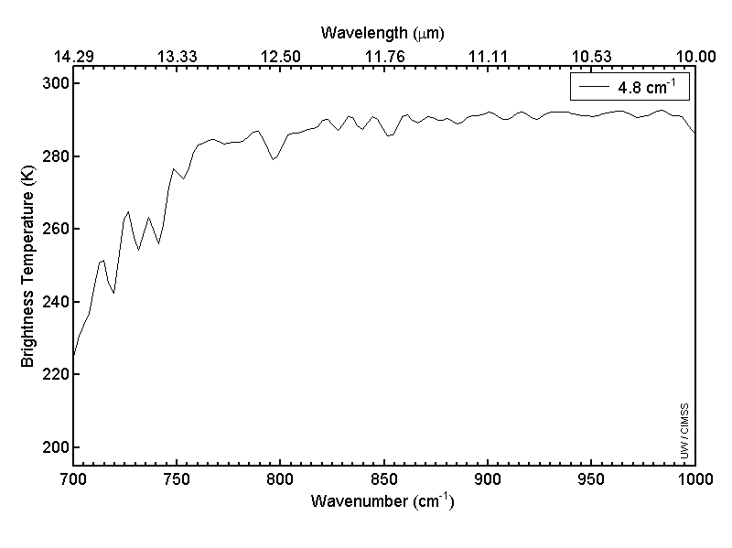
Allen Huang, CIMSS
Longwave window region

Slide 19
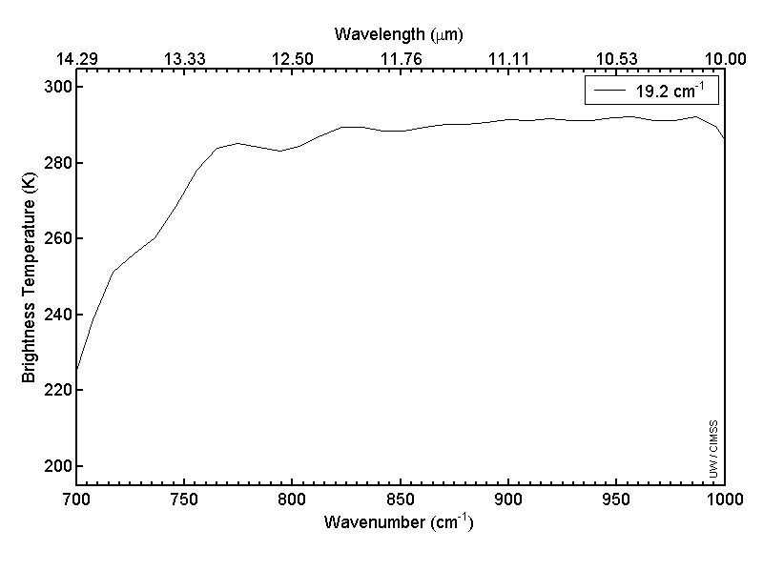
Allen Huang, CIMSS
Longwave window region

Slide 20

Allen Huang, CIMSS
“Current GOES-like”
Longwave window region

Slide 21
The relative vertical number of independent pieces of information is shown. Note that the moisture content is similar between the ABI and the current GOES Sounder. The Sounder does show more temperature information than the ABI. Caveat: Even if two systems have the same number of pieces of information, they may represent different vertical levels. This information content analysis does not account for any spatial or temporal differences.

Slide 22
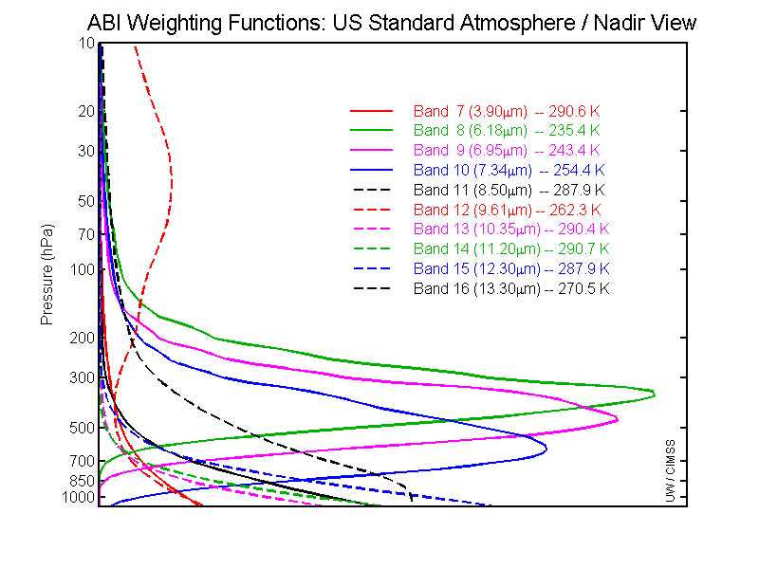
GOES-R ABI Weighting Functions
ABI has only 1 CO₂ band, so upper-level temperature will be degraded compared to the current sounder. Hence short-term NWP temperature information will be needed.

Slide 23
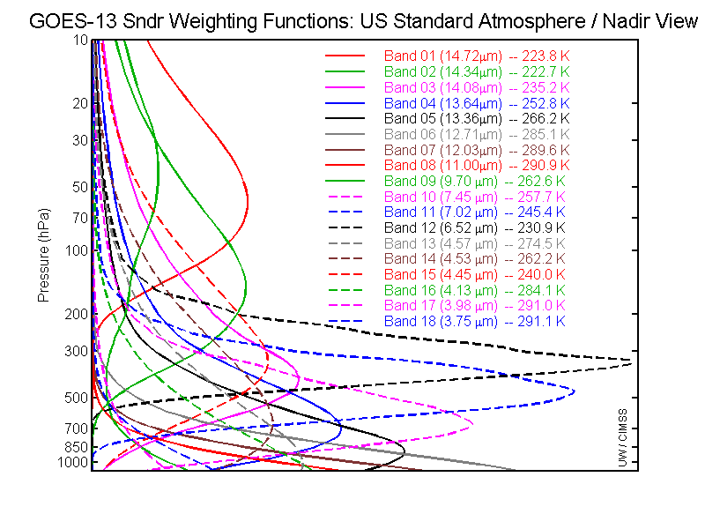
GOES-13 Sounder Weighting Functions
The current GOES sounders have 5 CO₂ bands, and more SW bands than ABI

Slide 24
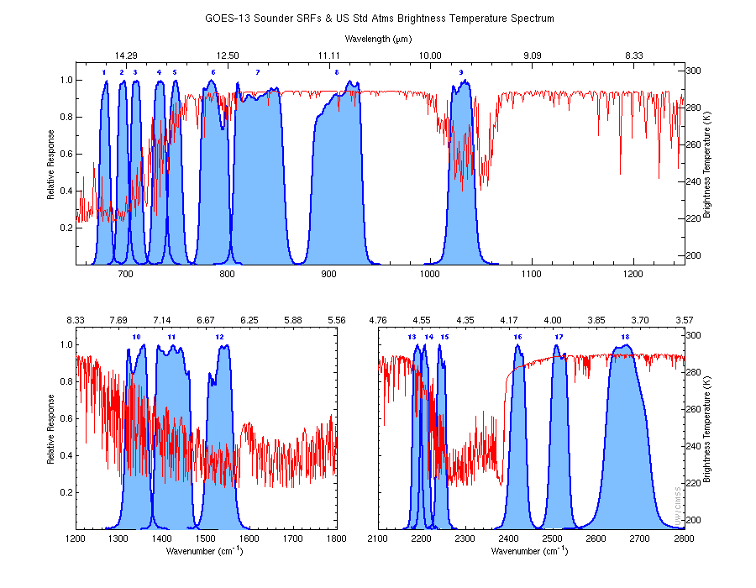
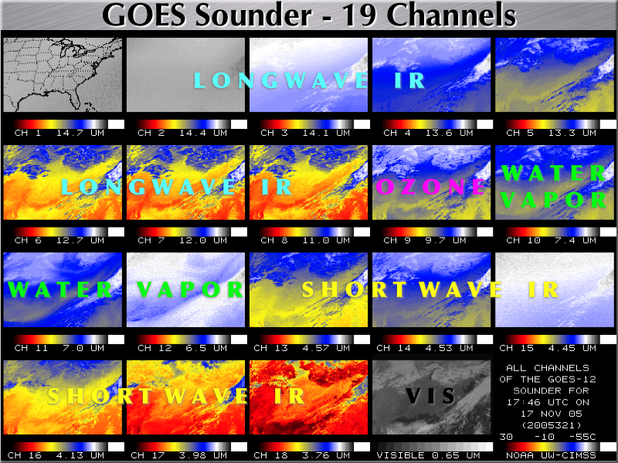
Overview
GOES-R Overview
  No dedicated Sounder
  Synergy with ABI
Current GOES Sounder
Select products
Sample applications
Summary
  More information
  References
http://cimss.ssec.wisc.edu/goes/rt/sounder-dpi.php

Slide 25
Current Sounder Operational Uses
GOES Sounder Product | Operational Use within the NWS
Clear-sky Radiances | Assimilation into NCEP operational regional & global NWP models over water
Layer & Total Precipitable Water | Assimilation into NCEP operational regional & global NWP models; display and animation within NWS AWIPS for use by forecasters at NWS WFOs & National Centers in forecasting precipitation and severe weather
Cloud-top retrievals (pressure, temperature, cloud amount) | Assimilation into NCEP operational regional NWP models; display and animation within NWS AWIPS for use by forecasters at NWS WFOs; supplement to NWS/ASOS cloud measurements for generation of total cloud cover product at NWS/ASOS sites
Surface skin temperature | Image display and animation within NWS AWIPS for use by forecasters at NWS WFOs
Profiles of temperature & moisture | Display (SKEW-Ts) within NWS AWIPS for use by forecasters at NWS WFOs in forecasting precipitation and severe weather
Atmospheric stability indices | Image display and animation within NWS AWIPS for use by forecasters at NWS WFOs in forecasting precipitation and severe weather
Water Vapor Winds | Image display and animation within NWS AWIPS for use by forecasters at NWS WFOs
Courtesy of J. Daniels, STAR
While there are limitations, the current GOES sounder is used today!
Notes:
Note the many operational uses of today’s sounder, even with its limited spatial and spectral attributes.

Slide 26
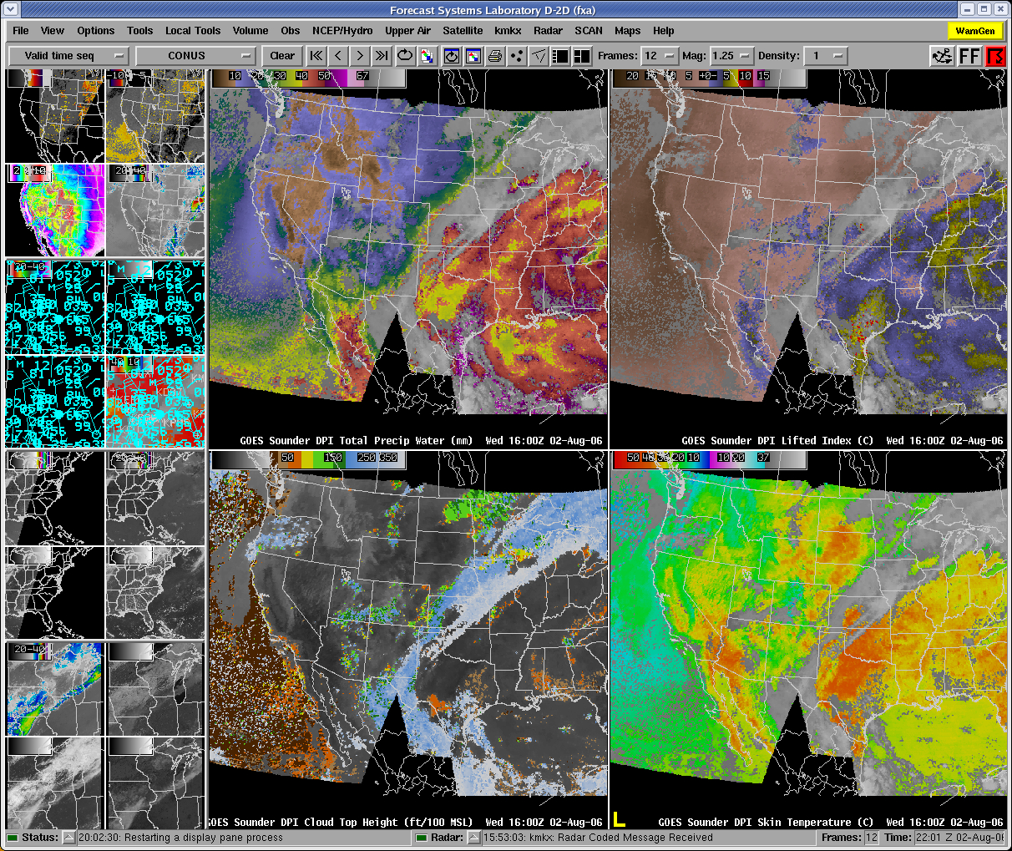
AWIPS Display
Lifted Index
Total Precipitable Water
Courtesy of J. Daniels, STAR
Cloud-Top Height
Surface Skin Temperature

Slide 27
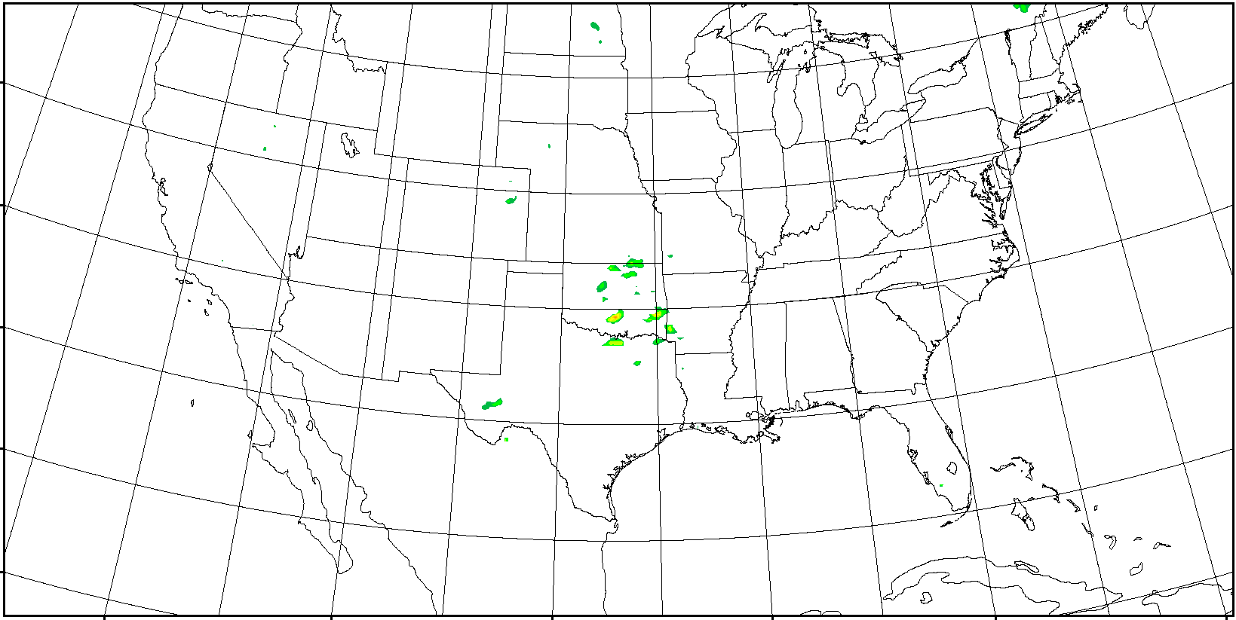
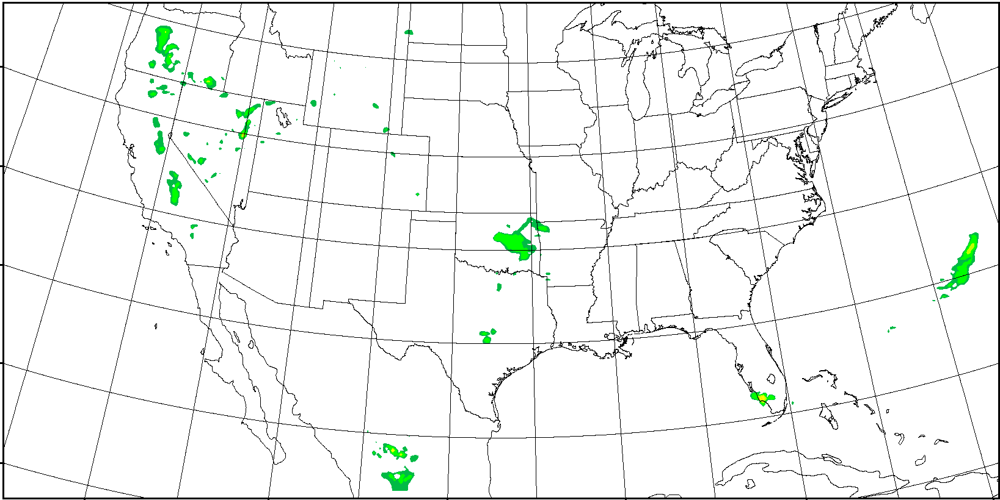
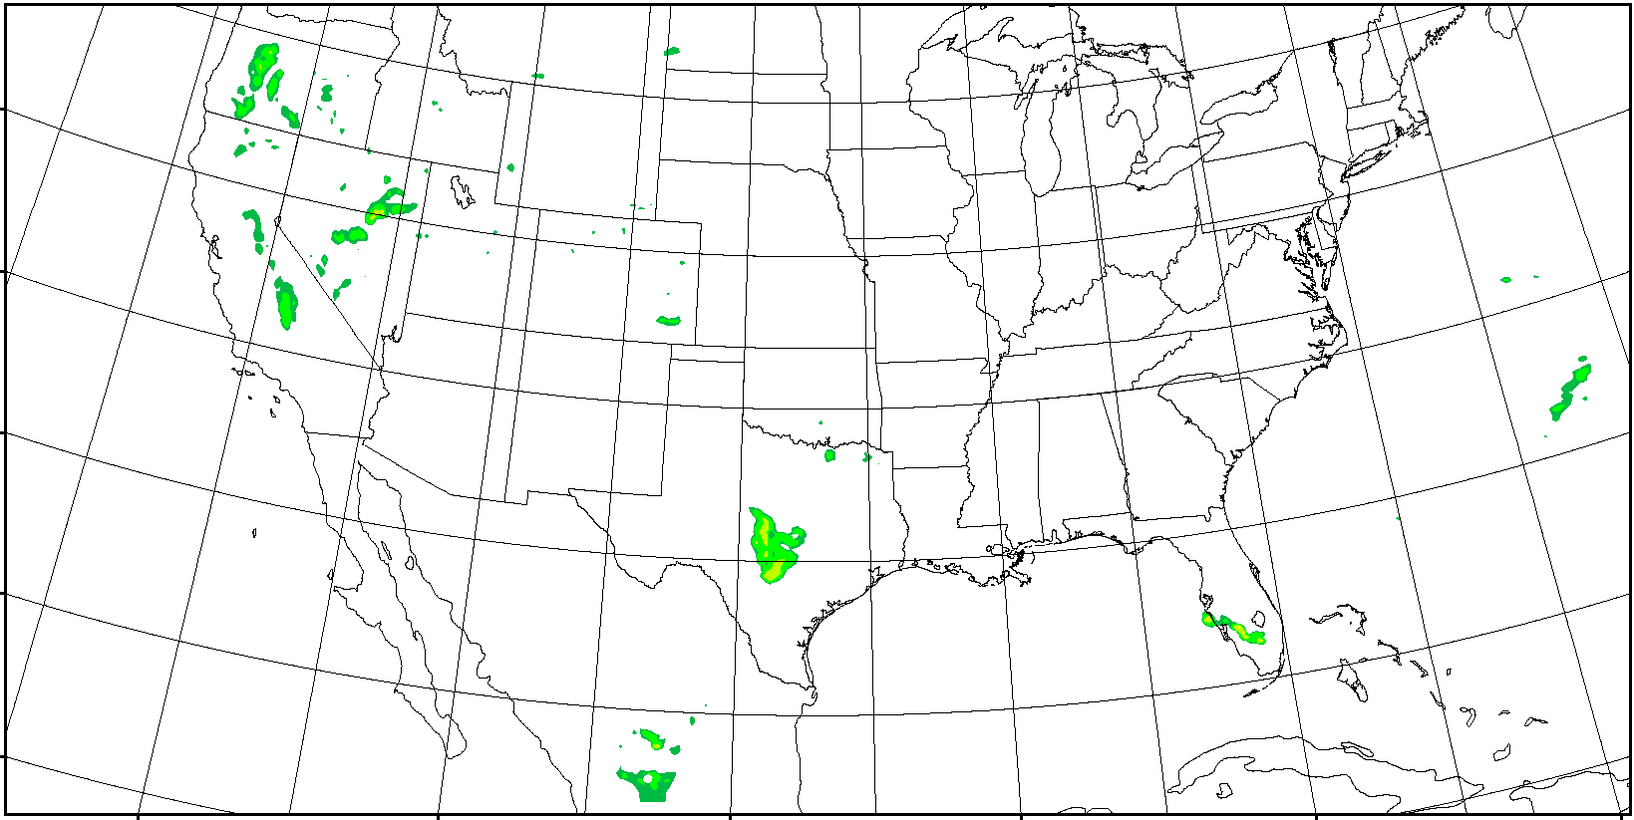
Hourly Precipitation Forecasts in Early Stage
2012/5/10 01 Z ~ 2012/5/10 12 Z
OBS
Forecast with GOES Sounder
Hourly precipitation forecast from 00 Z – 12 Z 05-10-2010 over CONUS with WRF/3DVAR, model resolution is 12 km, GOES Sounder 300 – 700 hPa precipitable water (PW) is used every 3 hours (preliminary results).
Forecast with Conventional data
Notes:
convert -delay 60 *png match_GCIP_prep1.gif
H:\CIMSS\NCEP_GCIP_prep_4km\match_GCIP_wrf_prep1

Slide 28
Forecast with
GOES Sounder
Observation
Cumulative precipitation forecast from 00Z to 06 Z 05-10-2010 over CONUS with WRF/3DVAR, model resolution is 12 km, GOES Sounder 300 – 700 hPa moisture profile is used every 3 hours.
Forecast with
Conventional

Slide 29
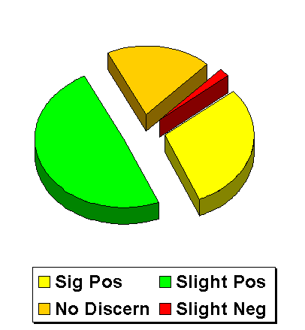
Forecasters value the current sounder
NWS Forecaster responses (Summer of 1999) to: "Rate the usefulness of LI, CAPE & CINH (changes in time/axes/gradients in the hourly product) for location/timing of thunderstorms."
There were 248 valid weather cases.
- Significant Positive Impact (30%)
- Slight Positive Impact (49%)
- No Discernible Impact (19%)
- Slight Negative Impact (2%)
- Significant Negative Impact (0)
National Weather Service, Office of Services
Notes:
This 1999 NWS survey was written up as part of a Schmit et al paper.
Note that almost 80% of the responses were positive in terms of forecasters support for satellite derived images from the existing GOES sounder.
Current NWS training programs (e.g. SHyMet) will hopefully increase the use and appreciation of new satellite data.
Main Objective of SHyMet (Satellite Hydrology and Meteorology) training program
To prepare National Oceanic and Atmospheric Administration (NOAA) and National Weather Service (NWS) users for the latest polar orbiting and geostationary satellite data and products in the warning and forecast programs with direct links to Government Performance Results Act (GPRA) goals.
Completes end-to-end program cycle for space-based remote sensing as part of NOAA's Strategic Plan for an Integrated Global Environmental Observation and Data Management System and Global Earth Observation System of Systems (GEOSS).

Slide 30
Forecasters need a better GEO sounder
Forecasters value the current GOES sounder products; however, the same forecasters also noted several limitations of the current sounder:
  retrievals limited to clear skies;
  the scanning rate is relatively slow, which limits coverage;
  the vertical resolution from the current generation GOES radiometers is limited.
Each of these limitations can be mitigated with an advanced sounder in the geostationary perspective.
Notes:
This is related to the pie chart of previous slide

Slide 31



What are NearCasts?
Can GOES sounder data improve short-range forecasts of Convection?
How can NearCasts be used to improve forecaster awareness and reduce false alarms?
Ralph Petersen¹, Robert M Aune² and Bill Line¹
¹ Cooperative Institute for Meteorological Satellite Studies (CIMSS), University of Wisconsin – Madison, Madison, Wisconsin ( Ralph.Petersen@ssec.wisc.edu and Bill.Line@ssec.wisc.edu )
² NOAA/NESDIS/ORA, Advanced Satellite Products Team, Madison, Wisconsin (Robert.Aune@noaa.gov )
Improving the utility of GOES products
in operational forecasting

Slide 32
What are we trying to improve?
Short-range forecasts of timing and locations of severe thunderstorms
- especially hard-to-forecast, isolated summer-time convection
What are NearCasts?
NearCasts are 1-9 hour forecasts specifically designed to monitor conditions where hazardous weather will (or will not) form.
NearCasts are designed:
to be available within minutes of observation times,
to be frequently updated (hourly or sub-hourly), and
to rely on observations more than traditional NWP products
GOES NearCasts use high-density observations of moisture and humidity made over land from the GOES sounder. These data are not included in any operational NWP system

Slide 33
What are we trying to improve?
Short-range forecasts of timing and locations of severe thunderstorms
- especially hard-to-forecast, isolated summer-time convection
What are we trying to correct?
Poor precipitation forecast accuracy in short-range NWP (esp. in summer)
Underutilization of satellite moisture information over land in NWP
Time delay in getting NWP guidance to forecasters
Excessive smoothing of mesoscale moisture patterns
in NWP data assimilation
- Loss of Infra-Red (IR) satellite information about the convective environment after convection has begun
Lack of objective, observation-based tools for use by forecasters in detecting and monitoring the pre-convective environments 1-9 hours in advance

Slide 34
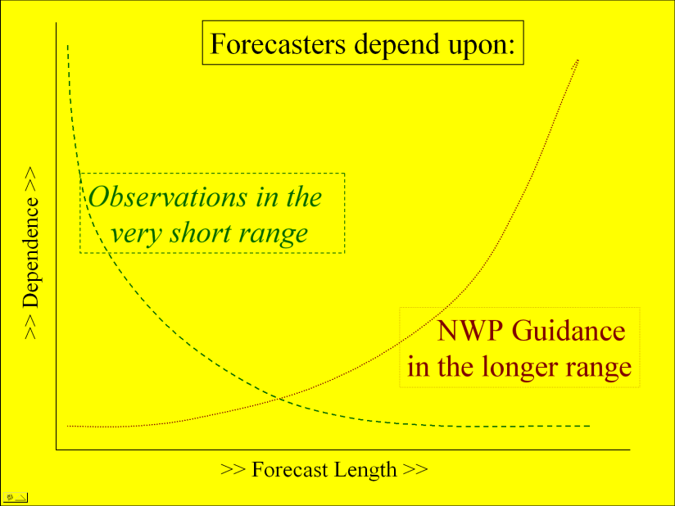
Basic premises - NearCasting Models Should:
Update/Enhance NWP guidance:
Be Fast (valid 1-9 hrs in advance)
Be run frequently
Use all available data quickly:
“Draw closely” to good data
Preserve observed gradients and
data extremes (maxima/minima)
Be used to anticipate rapidly developing weather events:
“Perishable” guidance products – need rapid delivery
Focus on the “pre-storm environment”
- Short-range forecasts of timing and locations of convective storms- especially hard-to-forecast, isolated summer-time convection
Filling the Gap
Between
<Nowcasts & NWP>
0 1 8 9 hours
Goals: - Increase the ability of forecasters to use frequent, quality GOES sounder observations to supplement NWP guidance in the next 1-9 hours
- Provide objective tools to help them do this

Slide 35
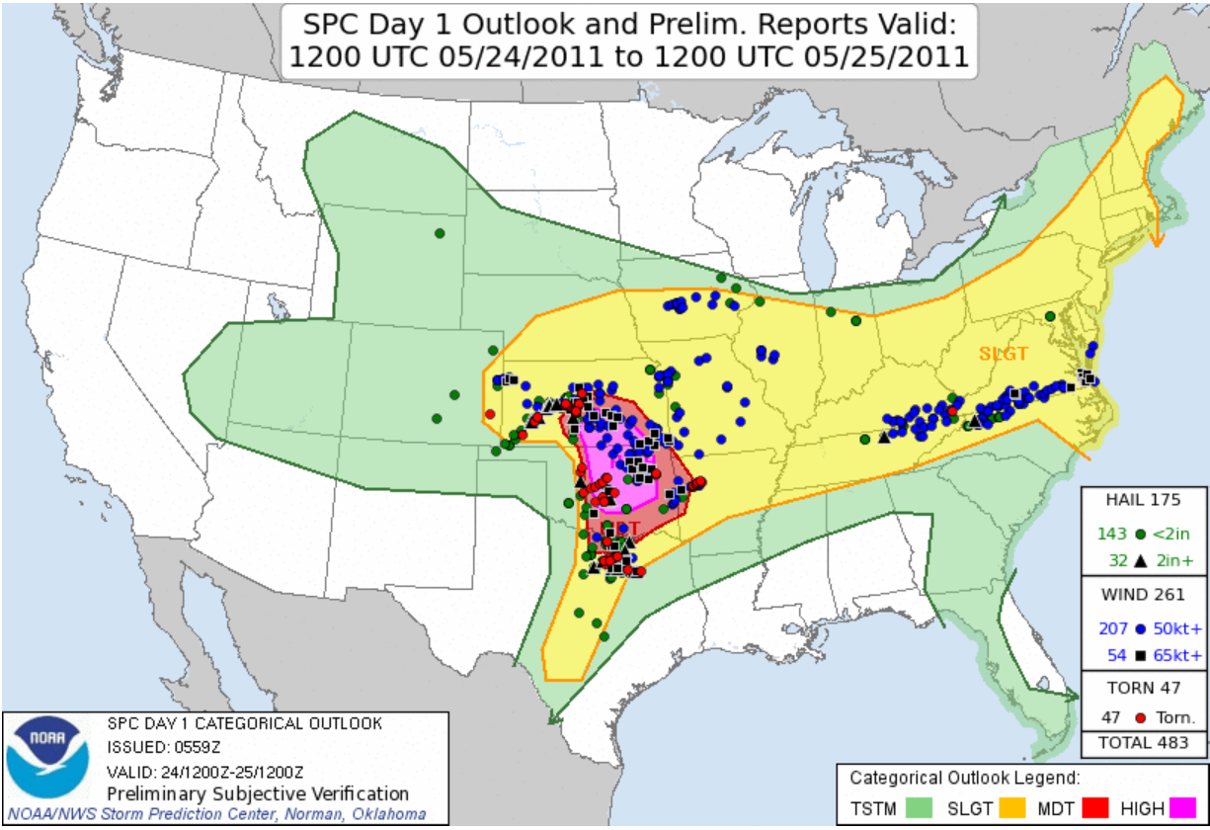
Example from 24 May 2011
Generally good forecasts, but
35

Slide 36
Example from 24 May 2011
Low-top supercells
In Colorado/Kansas
No storms in Chicago-NYC flight corridor
Few storms in
center of Outlook
Major sustained
storms near Dallas
Generally good forecasts, but
36

Slide 37
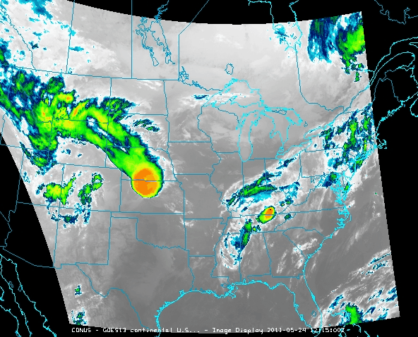
Example from 24 May 2011
Initial storms in
Nebraska died as they approached the Mississippi
No storms in Chicago-NYC flight corridor
Low-top supercells
In Colorado/Kansas
Early storms in
center of Outlook
Major sustained
storms later near Dallas
Generally good forecasts, but
37

Slide 38
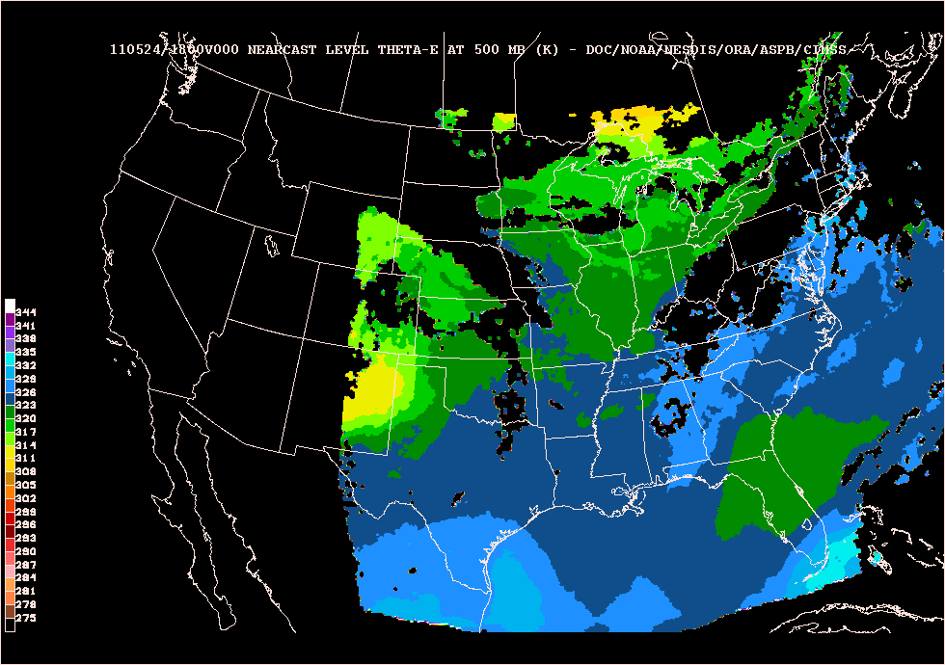
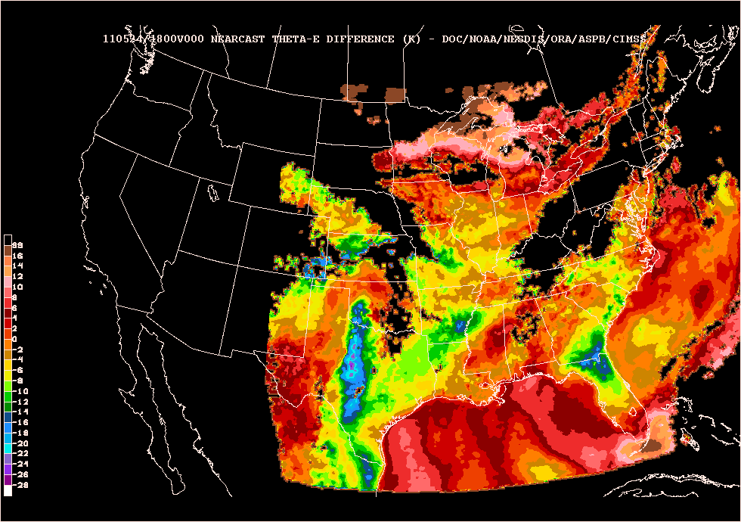
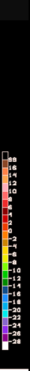
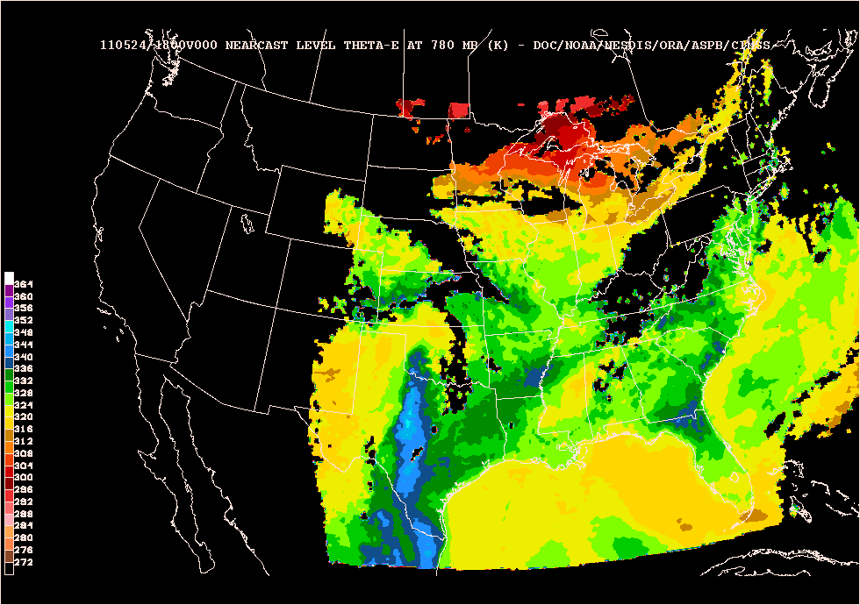
0 hours NearCasts from 1800 UTC 24 May 2011
Multiple-Parameter Displays that
explain the physical processes producing
Convective Instability
are more useful than
sets of single parameter images
Choice of color bars for display is critical
Mid-Level
Theta-E
CONVECTIVE INSTABILITY .
Mid to Lower-level Theta-E DiffERENCE
Lower-Level
Theta-E

Slide 39
Note:
- Instability moves first to central Oklahoma
- Instability increases, reaching Dallas later
- Instability intensifies over western Kansas near low-top super-cells
- Stable air remains over Great Lake, covers most of Pennsylvania by end of end of period
0-9 hours NearCasts from 1800 UTC 24 May 2011
Mid-Level
Theta-E
CONVECTIVE INSTABILITY .
Mid to Lower-level Theta-E DiffERENCE
Lower-Level
Theta-E

Slide 40
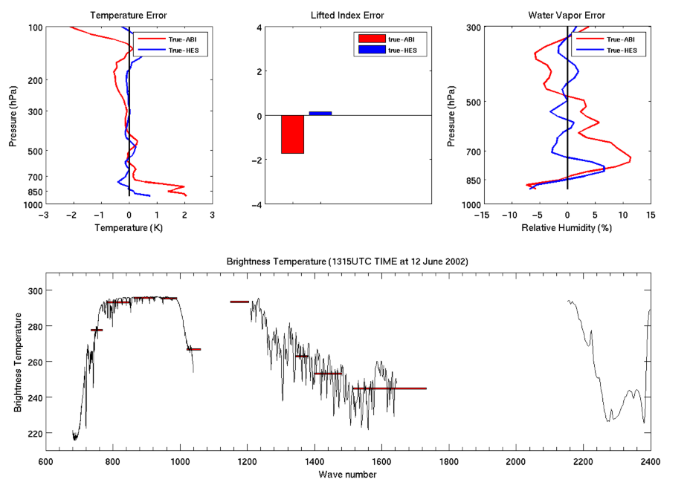
Overview
GOES-R Overview
  No dedicated Sounder
  Synergy with ABI
Current GOES Sounder
Select products
Sample applications
Summary
  More information
  References

Slide 41
Product Impacts and Requirements
With data from an advanced high-spectral sounder in the geostationary orbit, the following NOAA validated product requirements can be reinstated, improving now, short and long term forecasts :
Advanced Atmospheric vertical moisture profile;
Advanced Atmospheric vertical temperature profile;
Capping inversion information (height & strength);
Moisture flux;
Surface emissivity;
Cloud Base altitude;
Carbon monoxide concentration.
Plus, high spectral resolution IR data will help at least 17 other products.
Notes:
There are 6 products that will not meet requirements without a GEO high-spectral resolution sounder. This presentation focuses on T, Q vertical profiles, capping inversion and moisture flux.
Without an advanced high-spectral sounder on GOES, the following validated product requirements will either not be produced or will provide limited value added over numerical model guidance in the 2020 time frame

Slide 42
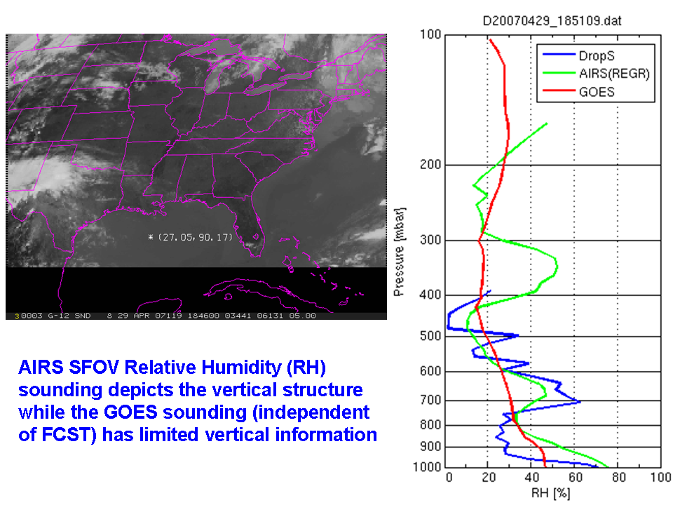

Slide 43
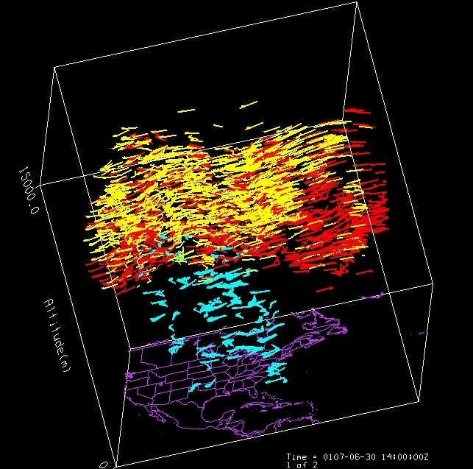
Atmospheric Motion Vectors from Sounder data
  Imager WV cloud tracked AMVs (yellow), Imager WV clear sky AMVs (red) and clear sky GOES Sounder AMVs (blue)
Much improved height-resolved winds from tracking features in retrieval fields from high spectral/temporal resolution rather than spectral images using broad band sounder
Iliana Genkova, Chris Velden, Steve Wanzong, Paul Menzel, CIMSS
Notes:
43
MM5 - Pennsylvania State University - National Center for Atmospheric Research Mesoscale Model.
GIFTS forward model retrievals from GIFTS water vapor channels. CIMSS retrievals of MM5 model run. Raw vectors. No winds beneath the clouds because of the cloud mask.
30 minute time steps at 50mb intervals. 1000mb – 350 mb. NASTI example compared well with LIDAR.
GIFTS - Geostationary Imaging Fourier Transform Spectrometer.

Slide 44
High spectral (HS) resolution IR data will help at least 17 other ABI-based products
GOES-R Observational Requirements:
Aerosol Detection (including Smoke and Dust)
Geomagnetic Field
Surface Albedo
Aerosol Particle Size
Probability of Rainfall
Surface Emissivity *
Suspended Matter / Optical Depth
Rainfall Potential
Vegetation Fraction: Green
Volcanic Ash *
Rainfall Rate/QPE
Vegetation Index
Aircraft Icing Threat
Legacy Atm. Vertical Moisture Profile *
Currents
Cloud Imagery: Coastal
Legacy Atm. Vertical Temperature Profile *
Sea & Lake Ice / Age
Cloud & Moisture Imagery
Derived Stability Indices *
Sea & Lake Ice / Concentration
Cloud Layers / Heights & Thickness *
Total Precipitable Water *
Sea & Lake Ice / Extent & Edge
Cloud Ice Water Path *
Total Water Content *
Sea & Lake Ice / Motion
Cloud Liquid Water
Clear Sky Masks
Ice Cover / Landlocked
Cloud Optical Depth
Radiances *
Snow Cover
Cloud Particle Size Distribution
Absorbed Shortwave Radiation: Surface
Snow Depth
Cloud Top Phase
Downward Longwave Radiation: Surface
Sea Surface Temps
Cloud Top Height *
Downward Solar Insolation: Surface
Energetic Heavy Ions
Cloud Top Pressure *
Reflected Solar Insolation: TOA
Mag Electrons & Protons: Low Energy
Cloud Top Temperature *
Upward Longwave Radiation *: Surface & TOA
Mag Electrons & Protons: Med & High Energy
Cloud Type
Ozone Total *
Solar & Galactic Protons
Convection Initiation
SO₂ Detection *
Solar Flux: EUV
Enhanced "V"/Overshooting Top Detection
Derived Motion Winds *
Solar Flux: X-Ray
Hurricane Intensity
Fire / Hot Spot Characterization
Solar Imagery: extreme UV/X-Ray
Low Cloud & Fog
Flood / Standing Water
Lightning Detection
Land Surface (Skin) Temperature *
Improved with HS
Turbulence
Visibility
* = Products degraded from original GOES-R (e.g.; now no HES)
ABI – Advanced Baseline Imager
Continuity of GOES Legacy Sounder Products from ABI
SEISS – Space Env. In-Situ Suite
EXIS – EUV and X-Ray Irradiance Sensors
GLM – Geostationary Lightning Mapper
Magnetometer
SUVI – Solar extreme UltraViolet Imager

Slide 45
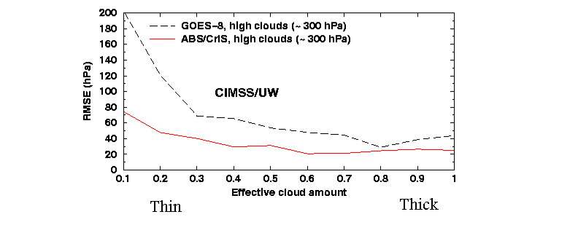
Better Observation of Cloud Properties
High spectral data allow a more accurate determination of high, thin clouds.
Notes:
Simulations. GOES-8 vs CrIS-type. 75 CONUS raob profiels. J. Li. 2001

Slide 46
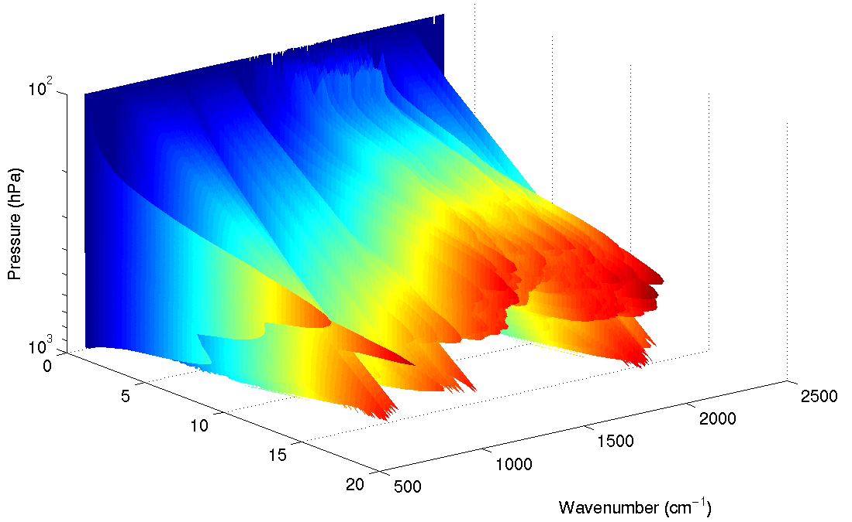
Overview
GOES-R Overview
  No dedicated Sounder
  Synergy with ABI
Current GOES Sounder
Select products
Sample applications
Summary
  More information
  References

Slide 47
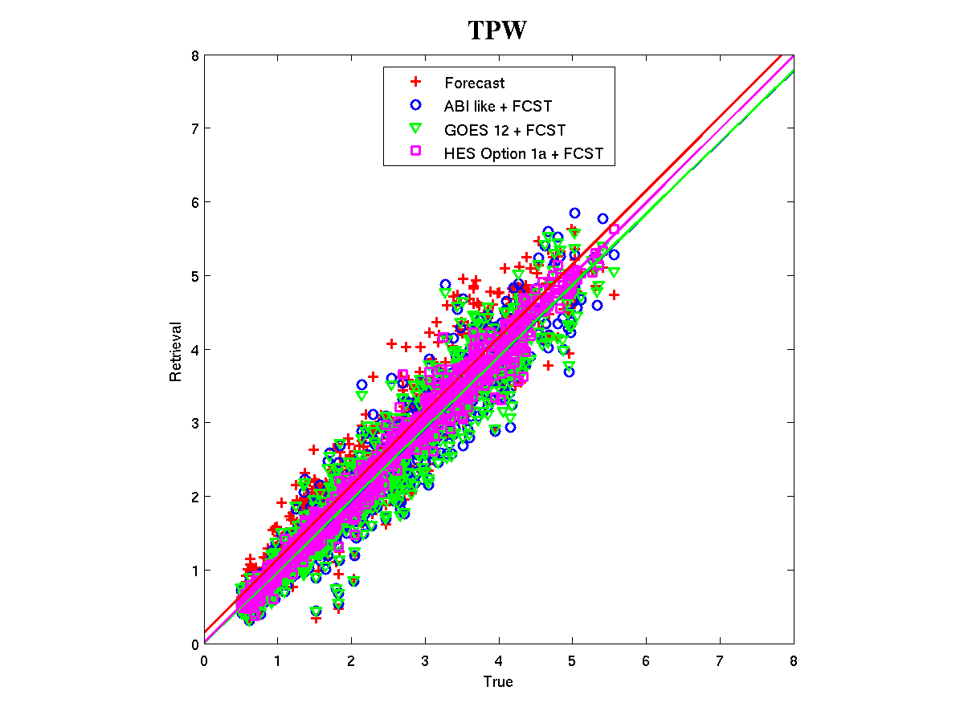
Benefits of high-spectral over broad-band measurements!
Root Mean Square Error
Forecast: 0.40
ABI like + fcst: 0.35
GOES 12 + fcst: 0.34
HES + fcst: 0.16
Experiments show that retrievals of Total Precipitable Water (TPW) from high-spectral (HES) data are much improved over current broadband (GOES-12+forecast).
Notes:
For TPW, the error is half from high-spectral data, compared to broad-band measurements.
Raob data are used for truth.
The ABI-like data are select sounder bands.
The GOES-12 case is GOES-12 sounder bands.
The HES (high-spectral) data are simulated.
The region is over CONUS.

Slide 48
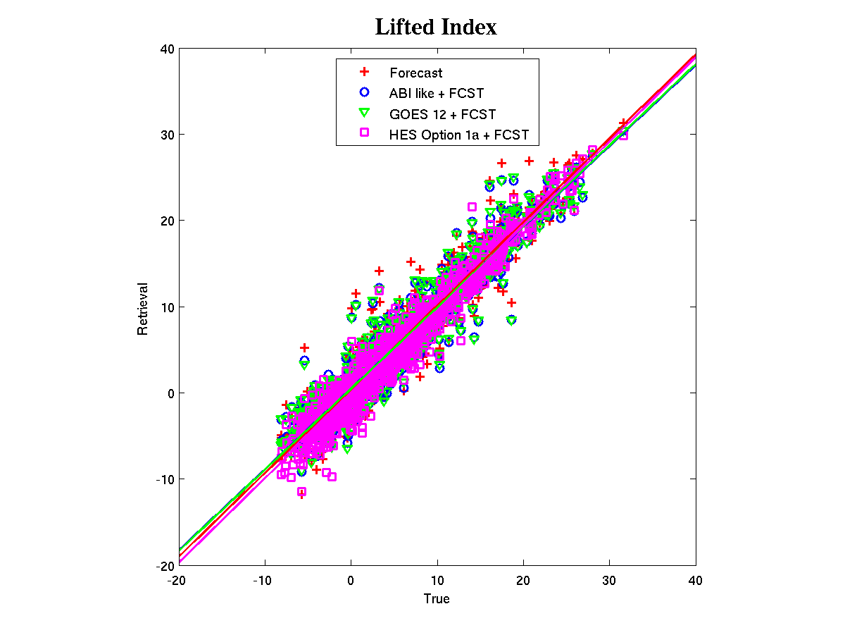
Benefits of high-spectral resolution over narrowband measurements!
Root Mean Square Error
Forecast: 2.27
ABI like + fcst: 2.20
GOES 12 + fcst: 2.18
HES + fcst: 1.79
Experiments show that retrievals of atmospheric instability from high-spectral (HES) data are much improved over current broadband (GOES-12+forecast).
Notes:
For LI, the error much less from high-spectral data, compared to broad-band measurements.
Raob data are used for truth.
The ABI-like data are select sounder bands.
The GOES-12 case is GOES-12 sounder bands.
The HES (high-spectral) data are simulated.
The region is over CONUS.

Slide 49
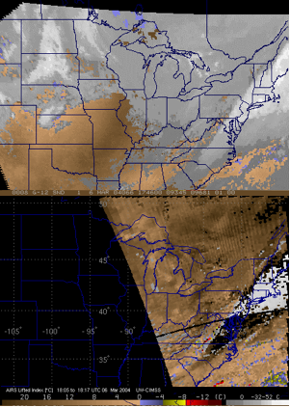
Derived Product Images of Lifted Index: GOES and AIRS
Current GOES Sounder showed a stable atmosphere.
No profiling via thin clouds.
Sample of AIRS (high-spectral IR) showed un-stable regions.
Retrievals generated through thin clouds.
Analysis courtesy of Jun Li, CIMSS.

Slide 50
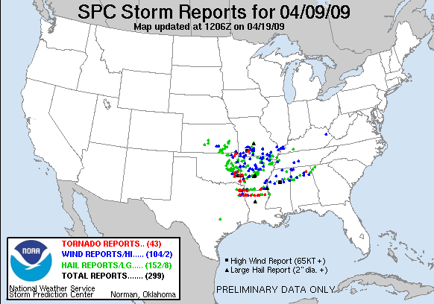
Sample AIRS (LI) in AWIPS
Might a polar Proving Ground reformat AIRS products in near realtime for AWIPS?

Slide 51
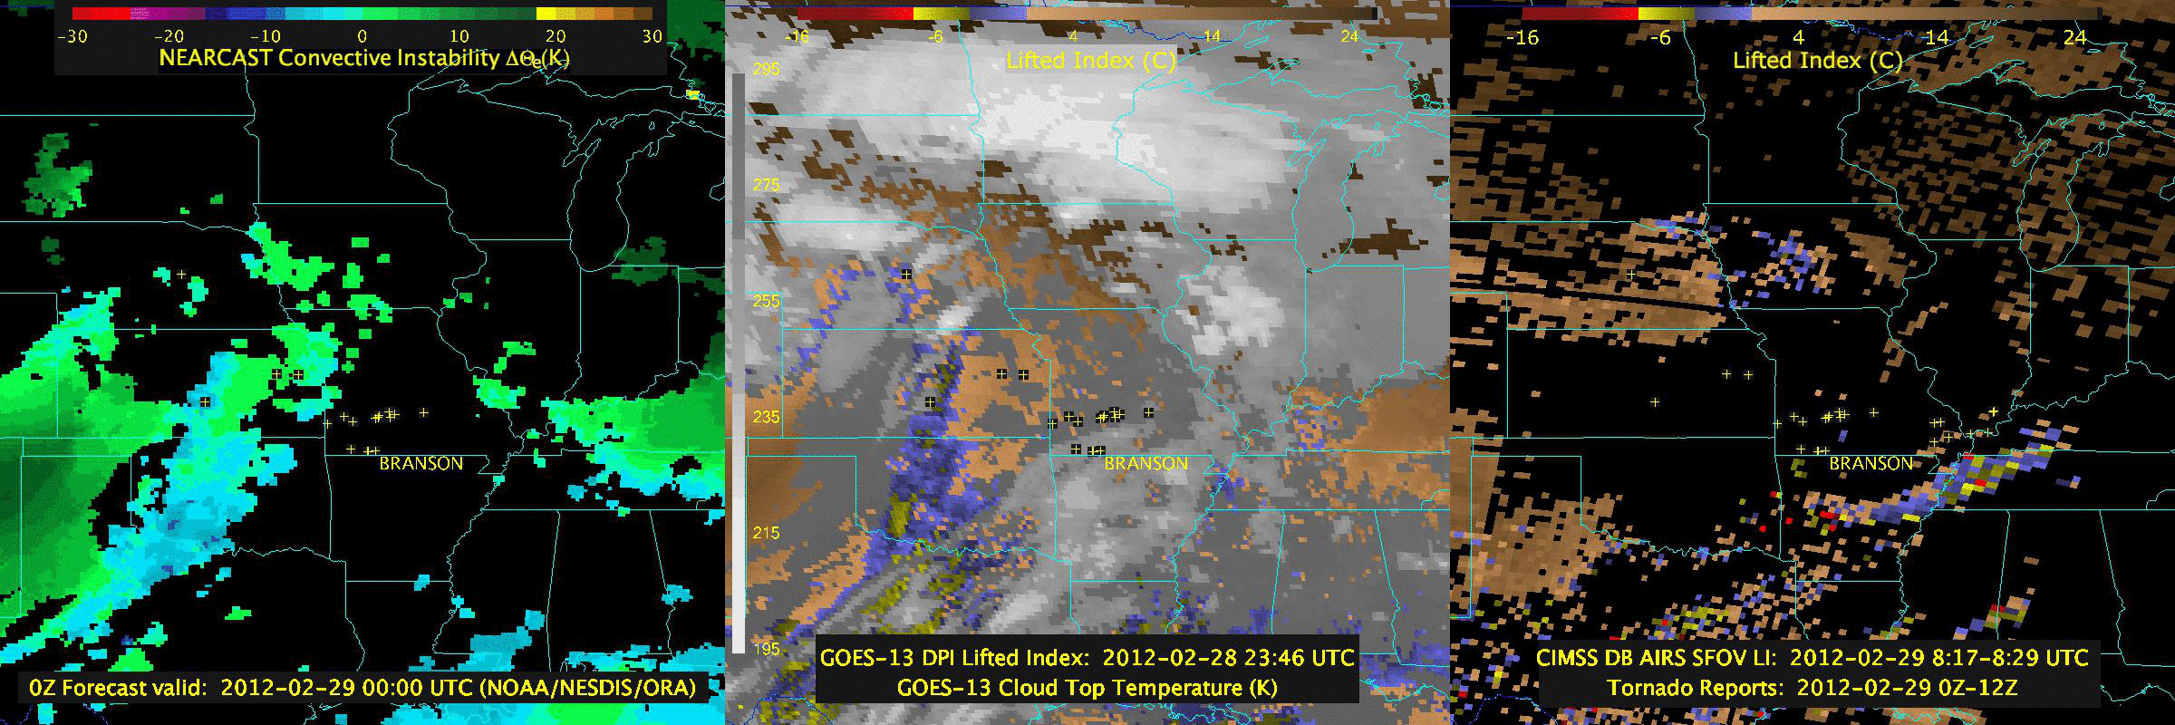
Animation
(GOES Sounder and AIRS)
Nearcast (using Sounder)
Sounder (Lifted Index)
AIRS (Lifted Index)
See poster on Nearcast
Loop from J. Feltz

Slide 52
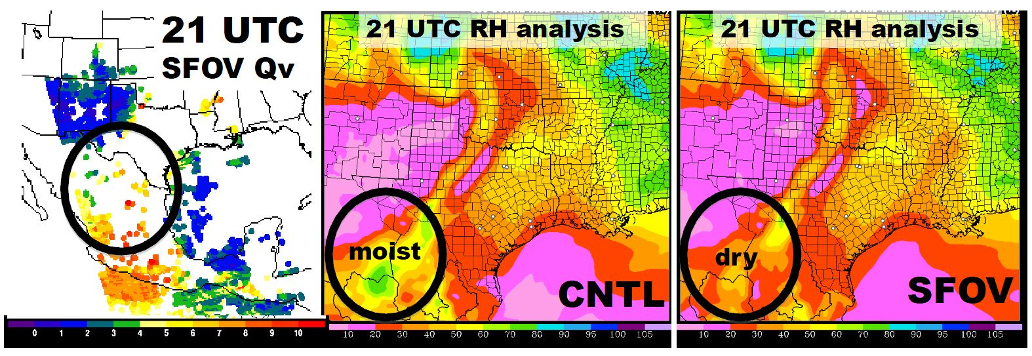
Assimilation of AIRS SFOV Retrieval Profiles in the Rapid Refresh Model System
Haidao Lin^{1,2}, Steve Weygandt¹, Ming Hu^{1,3}, Stan Benjamin¹, Curtis Alexander^{1,3}, Patrick Hofmann^{1,3}, Tim Schmit4, Jinlong Li⁵, Jun Li⁵
¹NOAA/ESRL/GSD Assimilation and Modeling Branch
²Cooperative Institute for Research in the Atmosphere, Colorado State University
³Cooperative Institute for Research in Environmental Sciences, University of Colorado at Boulder
⁴NOAA/NESDIS/STAR Advanced Satellite Products Branch
⁵Cooperative Institute for Meteorological Satellite Studies, University of Wisconsin-Madison
From Poster at NOAA Science Week: http://www.goes-r.gov/users/past-2012-science-week-abstracts.html
SFOV water vapor mixing ratio (g/kg) at 750 hPa
Analysis 850-500 hPa mean relative humidity (%) from RAP control run on 10 May 2010
Analysis 850-500 hPa mean relative humidity (%) from RAP AIRS SFOV run on 10 May 2010

Slide 53
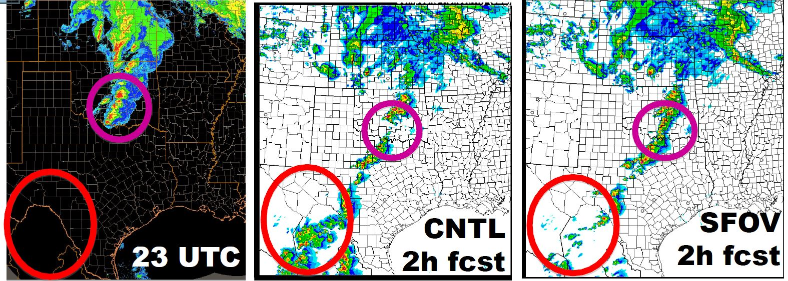
Assimilation of AIRS SFOV Retrieval Profiles in the Rapid Refresh Model System
Haidao Lin^{1,2}, Steve Weygandt¹, Ming Hu^{1,3}, Stan Benjamin¹, Curtis Alexander^{1,3}, Patrick Hofmann^{1,3}, Tim Schmit4, Jinlong Li⁵, Jun Li⁵
¹NOAA/ESRL/GSD Assimilation and Modeling Branch
²Cooperative Institute for Research in the Atmosphere, Colorado State University
³Cooperative Institute for Research in Environmental Sciences, University of Colorado at Boulder
⁴NOAA/NESDIS/STAR Advanced Satellite Products Branch
⁵Cooperative Institute for Meteorological Satellite Studies, University of Wisconsin-Madison
From Poster at NOAA Science Week: http://www.goes-r.gov/users/past-2012-science-week-abstracts.html
Observed radar composite reflectivity
HRRR forecast composite reflectivity initialized from control RAP run
HRRR forecast composite reflectivity initialized from AIRS SFOV RAP run

Slide 54
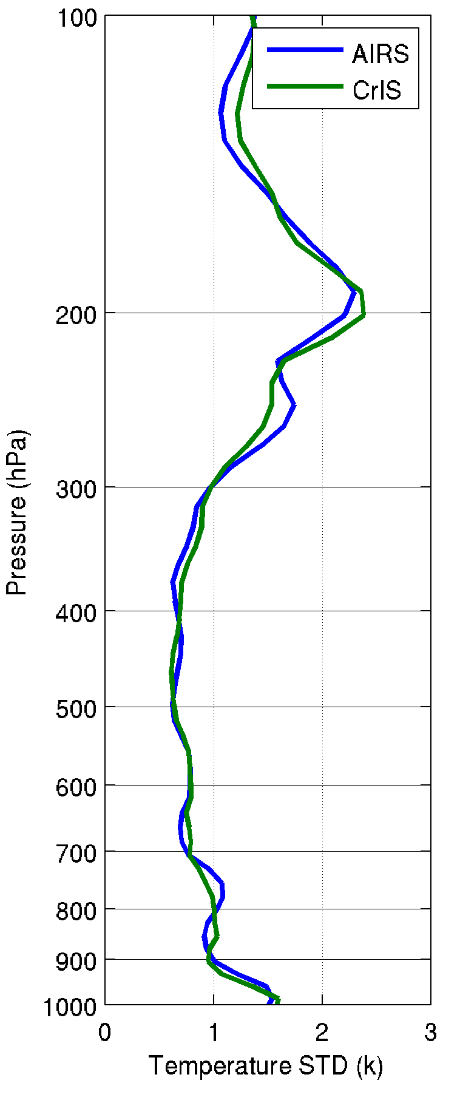

AIRS and CrIS has similar sounding accuracy
(Matchup comparisons, ECMWF analysis as reference)

Slide 55


Lifted Index (LI)
  0< LI → Stable
  -3< LI <0 → Moderate instable
  -6< LI <-3 → Instable
  -9< LI <-6 → Very instable
  LI <-9 → Extremely instable
This storm caused 1456 deaths and left another 309 people missing due to a massive mudslide in the urban area of Zhou Qu.
Lat=34.19; Lon=104.41
AIRS LI at 06:35 UTC on 07 August 2010 (rainfall started at 10 UTC on 07 August 2010)

Slide 56

Evolution of the Vertical Moisture is the Key!
Simulated Relative humidity cross-section at 20 UTC 12 June 2002
“Truth”
“GEO advanced IR sounder ”
“ABI”
“RUC”
Li et. al.
Notes:
Warning information in pre-convection environment from geostationary advanced infrared sounding system – a simulation study using the IHOP case
Jun Li, Jinlong Li, Jason Otkin, Timothy J. Schmit, Chian-Yi, LiuJournal of Applied Meteorology and Climatology

Slide 57




True
IRS/FY4
Red = extreme instability
Simulated Radar
RUC forecast
RUC forecasts
IRS/FY4 provides needed monitoring of pre-convective environment
hours earlier than regional forecast (+3-4 hrs) and Radar (+8 hrs)
Jun Li, Jinlong Li, Jason Otkin, and Tim Schmit
Notes:
LI>0 stable, -3 to 0 moderately stable, -6 to -3 moderately unstable, -6 to -9 very unstable, -6 to -9 extreme instability

Slide 58

Hurricane eye sounding provides good intensity estimate (hurricane Isabel as example)
Eye - Environment
Temperature
Eye Sounding
Environment
Sounding
Integrate Hydrostatic Equation Downward from 100 hPa to Surface
Environment Sounding: P_{s} = 1012 hPa
Eye Sounding: P_{s} = 936 hPa
Aircraft Recon: P_{s} = 933 hPa
Courtesy: Mark DeMaria, NOAA

Slide 59


Slide 60

Hyperspectral IR soundings improve tropical cyclone track forecasts (hurricane Ike as exmple), using WRF/3DVAR
Notes:
AIRS single FOV soundings in clear skies are used. WRF/3DVAR forecasting and assimilation system is used. Assimilation is done every 6 hours. 0-h is from analysis, others are forecasts.

Slide 61

Central sea level pressure (SLP) forecast RMSE (hPa)
（Hurricane Irene as example, 23 – 25 August 2011), using WRF/DART

Slide 62

Lifecycle Hurricane Ike (2008) track RMSE for 0-h (analysis), 6-h to 48-h forecasts. The radiance assimilation of AIRS and AMSU are used in the experiments. GTS contains all the conventional data. WRF/GSI are used in the experiments.
Future work will include assimilation of radiances and/or soundings.

Slide 63

Overview
GOES-R Overview
  No dedicated Sounder
  Synergy with ABI
Current GOES Sounder
Select products
Sample applications
Summary
  More information
  References

Slide 64

Current Sounder Data Volume
Current GOES Sounder
Horizontal
Notes:
Define current GOES sounder information volume to be 1 x 1 x 1 for the attributes.

Slide 65
Advanced High-Spectral IR Sounder
(GIFTS example)
Horizontal

Slide 66







Nearcasting Severe Weather using a Hyperspectral Environmental Sounder (HES)
[Aune, Lindstrom, Petersen]
Weak gradients of low-level Theta-E are indicated by ABI which has only two water vapor channels.
A WRF model simulation of the June 12, 2002 IHOP case was used to generate simulated radiances from an Advanced Baseline Imager (ABI), a geostationary Hyper-spectral Environmental Sounder (HES), and simulated radar reflectivity.
Temperature and moisture profiles were retrieved from the radiance datasets and assimilated by the CIMSS Nearcasting Model and compared. Detailed Theta-E gradients were resolved by HES.
Strong low-level Theta-E gradients are indicated by HES which has the ability to detect low-level moisture.
Simulated ABI
Simulated HES
5-hour NearCast for 2000 UTC
Low level Theta-E
5-hour NearCast for 2000 UTC
Low level Theta-E
Simulated composite reflectivity from nature run indication the formation of convection.
Simulated ABI
Simulated HES
5-hour NearCast for 2000 UTC
Low to Mid level Theta-E Differences
Rapid Development of Convection over Texas and Nebraska between 2000 and 2100 UTC 12 June 2002
5-hour NearCast for 2000 UTC
Low to Mid level Theta-E Differences
Notes:
Specific NOAA requirement(s) being addressed
Associated Science Question(s) being worked (objective(s) of the specific research effort)
(Traceability)
Who cares (recipients/beneficiaries of the work; societal benefit)?

Slide 67
Summary
An advanced geostationary sounder would overcome existing instrument limitations.
High-spectral infrared observations needed for trace gas monitoring could also be used for a number of weather-related applications.
High-spectral resolution IR observations will resolve high temporal and vertical fluctuations of moisture that are not resolved by current in-situ or satellite measurements. High temporal resolution is unique aspect of GEO measurements.
Critical meteorological parameters (temperature, moisture, clouds, winds) with necessary temporal, spatial and vertical resolutions will improve monitoring of atmospheric conditions.
An advanced high-spectral sounder in GEO will fulfill requirements of several validated products.
Studies have estimated the economic and societal benefits of a high-spectral resolution sounder to be at least $4.2 B (Centrec study).

Slide 68
Conclusions on the need for advanced geostationary IR observations wrt weather applications
As stated in 2001…
  Technology is mature
  Meteorological need is documented.
  Time is right to update geostationary sounding instruments to provide required high spectral resolution measurements with high temporal refresh rates.

Slide 69



Select References
Schmit, T. J., J. Li, S. A. Ackerman, and J. J. Gurka, 2009: High spectral and temporal resolution infrared measurements from geostationary orbit, Journal of Atmospheric and Oceanic Technology, 26, 2273 - 2292.
(a.k.a., why we need an advanced geo-sounder)
Sieglaff, J., M., T. J. Schmit, W. P. Menzel, S. A. Ackerman, 2009: Inferring Convective Weather Characteristics with Geostationary High Spectral Resolution IR Window Measurements: A Look into the Future. J. Atmos. Oceanic Technol., 26, 1527–1541.
(a.k.a., potential now-casting applications)
Schmit, T. J., J. Li, J. J. Gurka, M. D. Goldberg, K. Schrab, J. Li, W. Feltz, 2008: The GOES-R ABI (Advanced Baseline Imager) and the continuation of current sounder products. J. of Appl. Meteor., 47, 2696–2711.
(a.k.a., the ABI isn’t an advanced sounder)

Slide 70


Select References
Li, Jun, Chian-Yi Liu, Peng Zhang, Timothy J. Schmit, 2012: Applications of Full Spatial Resolution Space-Based Advanced Infrared Soundings in the Preconvection Environment. Wea. Forecasting, 27, 515–524. doi: http://dx.doi.org/10.1175/WAF-D-10-05057.1
Hyperspectral Earth Observation from IASI:
Five Years of Accomplishments
Fiona Hilton, Raymond Armante, Thomas August, Chris Barnet, Aurelie Bouchard, Claude Camy-Peyret, Virginie Capelle, Lieven Clarisse, Cathy Clerbaux, Pierre-Francois Coheur, Andrew Collard, Cyril Crevoisier, Gaelle Dufour, David Edwards, Francois Faijan, Nadia Fourrié, Antonia Gambacorta, Mitchell Goldberg, Vincent Guidard, Daniel Hurtmans, Samuel Illingworth, Nicole Jacquinet-Husson, Tobias Kerzenmacher, Dieter Klaes, Lydie Lavanant, Guido Masiello, Marco Matricardi, Anthony McNally, Stuart Newman, Edward Pavelin, Sebastien Payan, Eric Péquignot, Sophie Peyridieu, Thierry Phulpin, John Remedios, Peter Schlüssel, Carmine Serio, Larrabee Strow, Claudia Stubenrauch, Jonathan Taylor, David Tobin, Walter Wolf, Daniel Zhou
Bulletin of the American Meteorological Society
Volume 93, Issue 3 (March 2012) pp. 347-370
doi: http://dx.doi.org/10.1175/BAMS-D-11-00027.1

