Slide 1
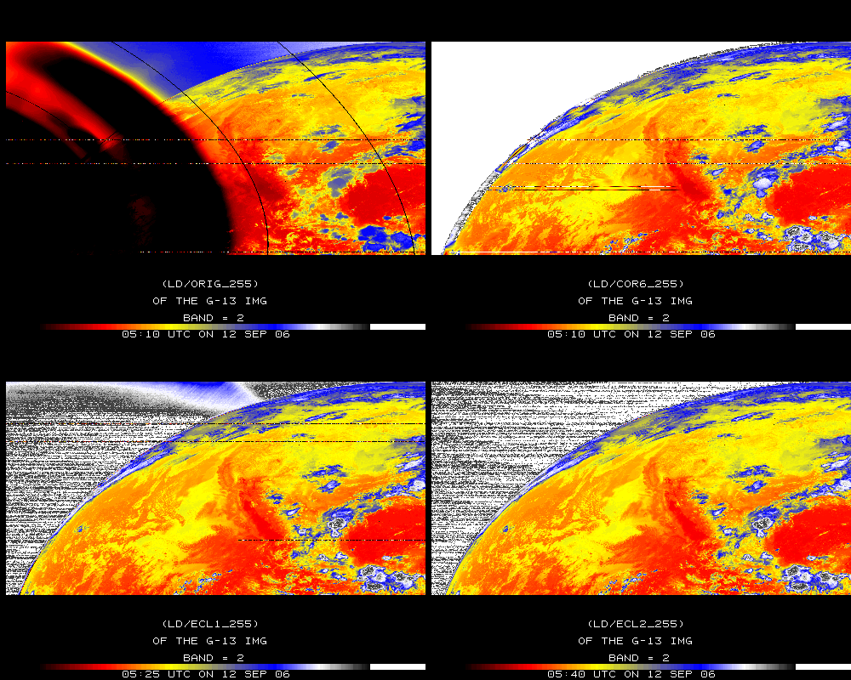
Stray Light Correction
Original
Corrected
GOES-13 Imager Band 2
Later image
Later image
Notes:
The 4 um (band 2 GOES imager) data can be over 50K too hot due to stray light. After being corrected, the image is more similar to subsequent (unaffected) images.
Data ingested by the SSEC data center.

