Slide 1
Stray Light Analysis GOES-13 Imager
Tim Schmit
ASPB
21-Oct-2010
Day 255
Day 257
Day 284

Slide 2
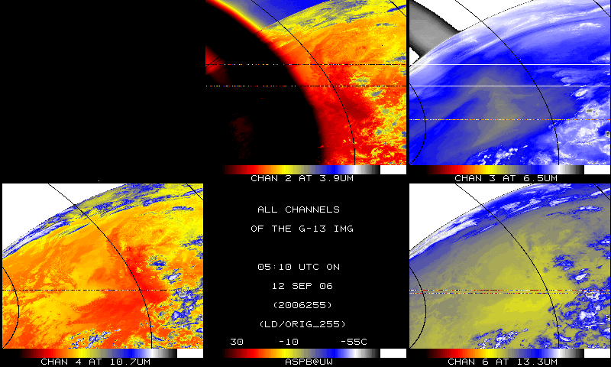
IR bands, Original

Slide 3
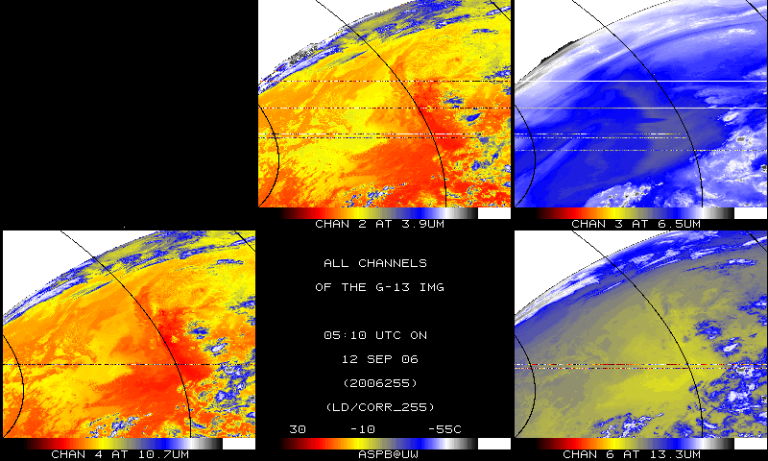
IR bands, Corrected

Slide 4
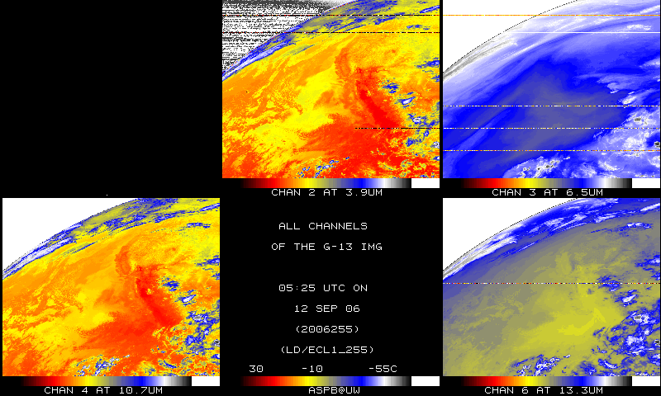
IR bands, 15-minutes later

Slide 5
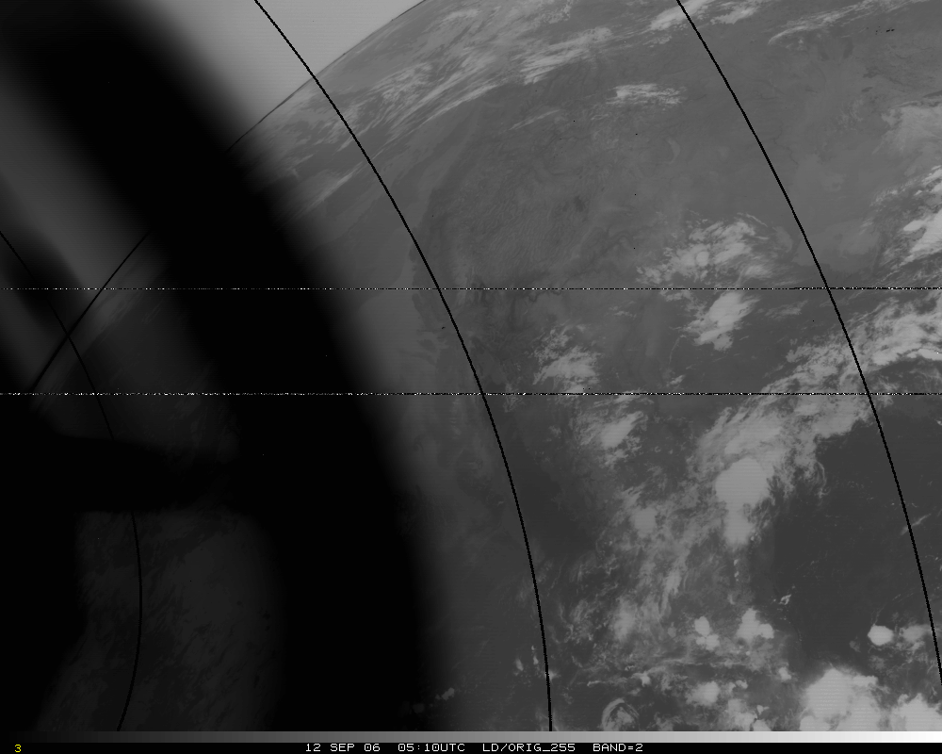
Band 2, Original

Slide 6
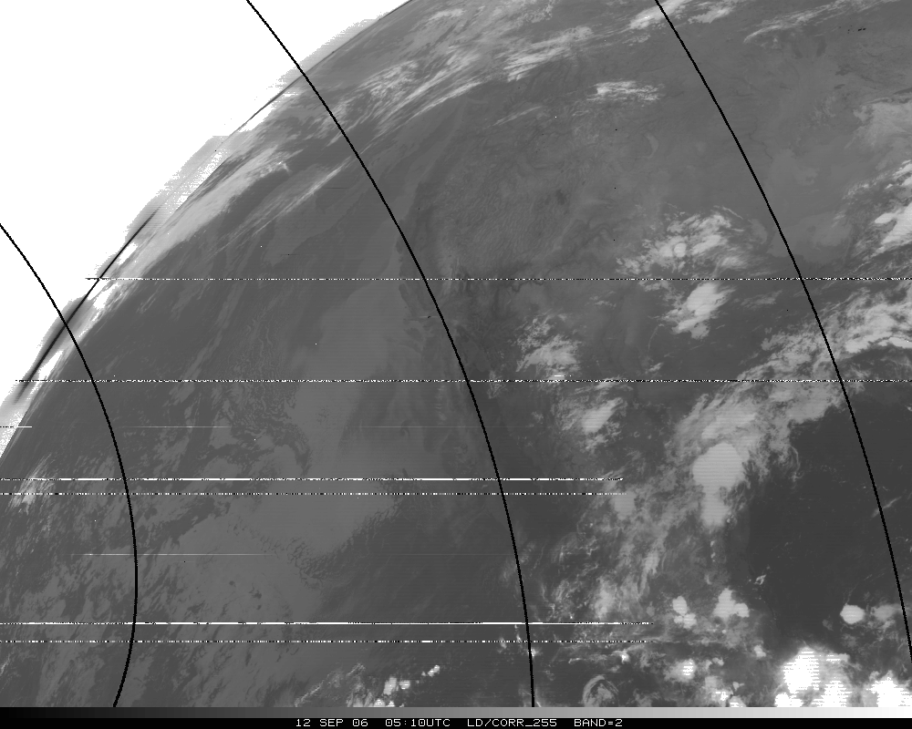
Band 2, Corrected

Slide 7
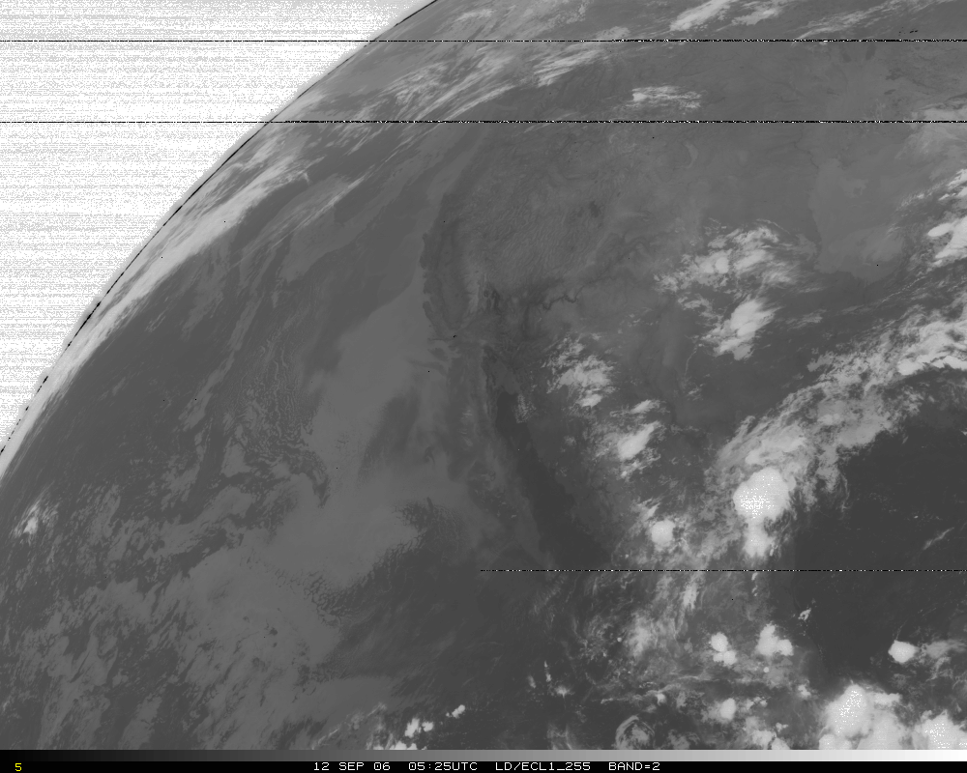
Band 2, later image

Slide 8
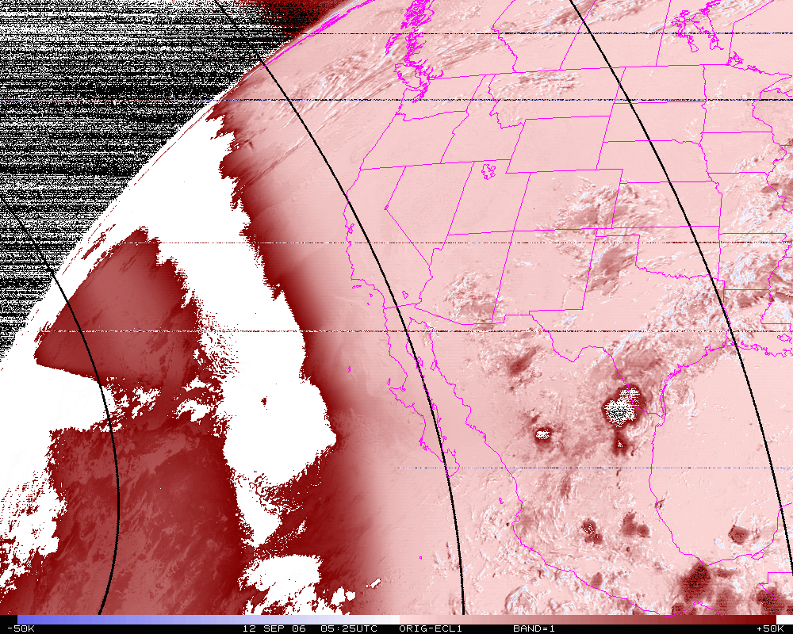
Band 2, difference image (org-eclipse)

Slide 9
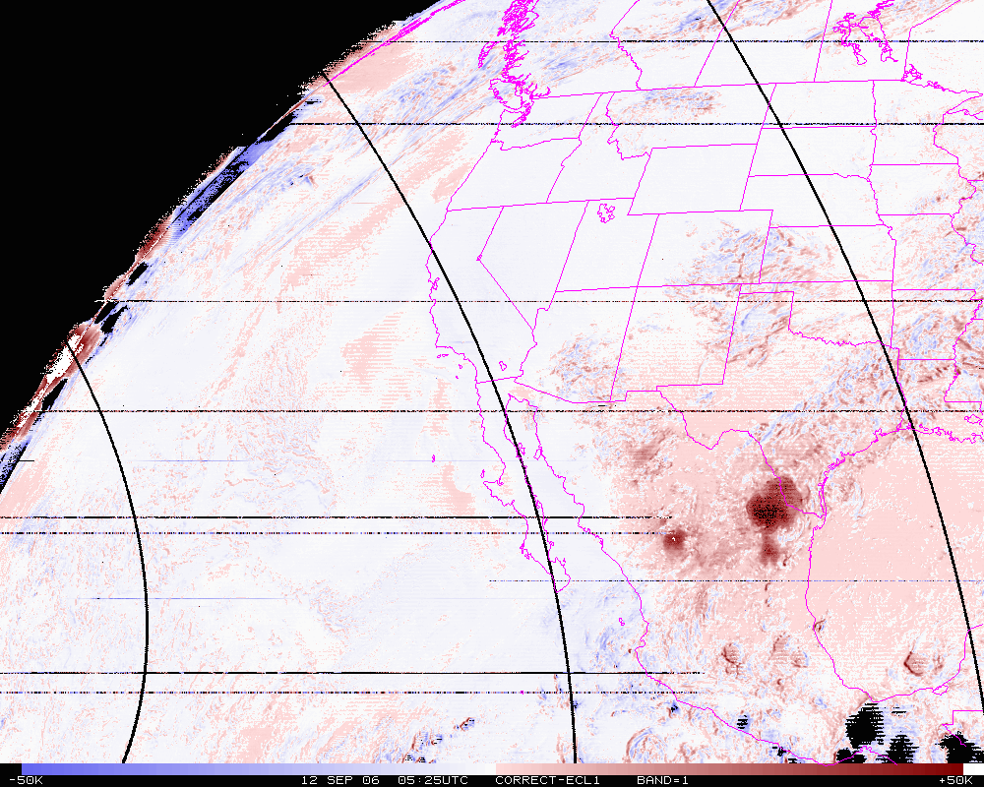
Band 2, difference image (corrected-eclipse)

Slide 10
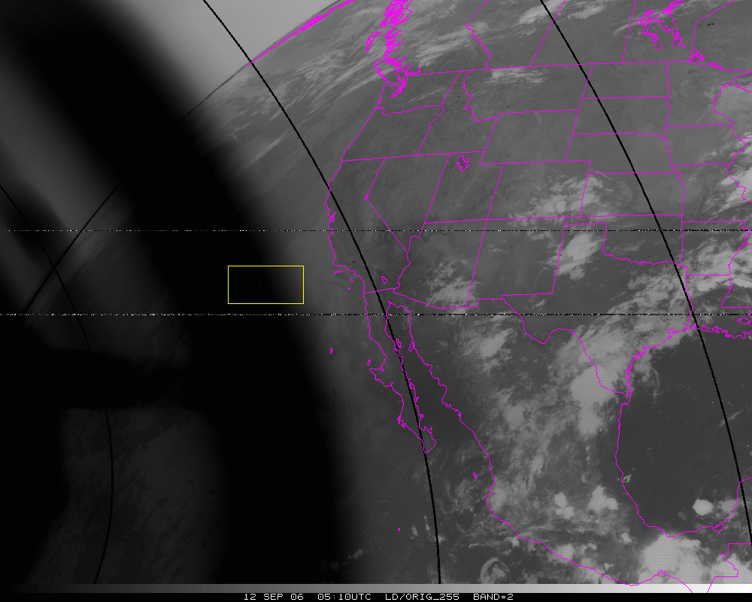
Band=2
N=10302
Org Mean= 325.6K
Cor. Mean= 281.0K
Ecl. Mean= 281.2K

Slide 11
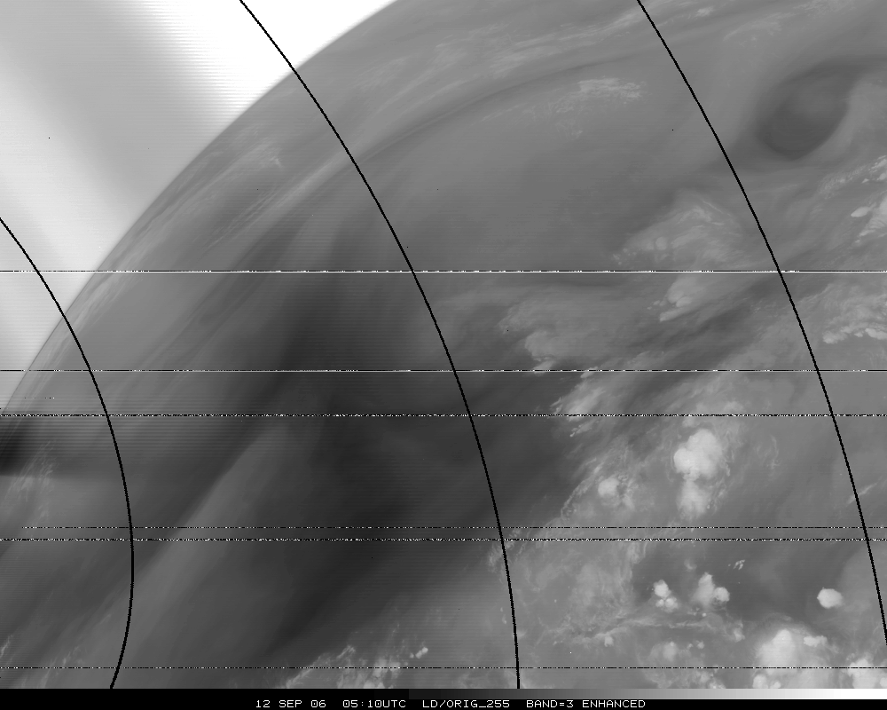
Band 3, Original

Slide 12
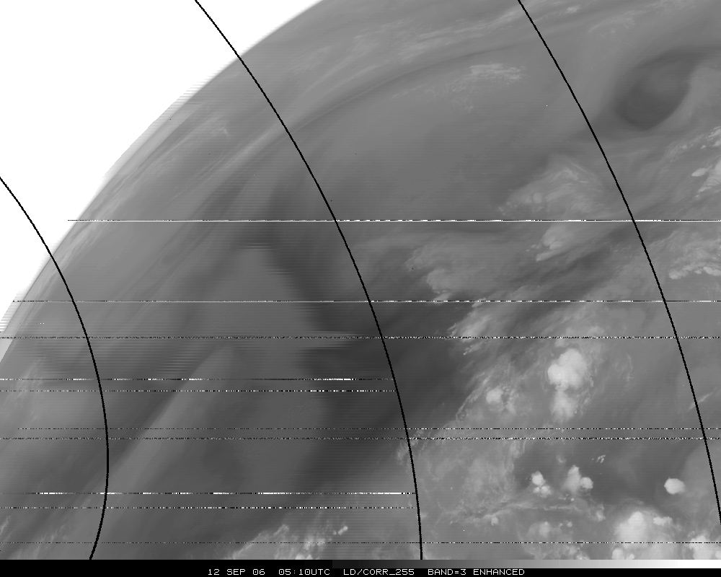
Band 3, Corrected

Slide 13
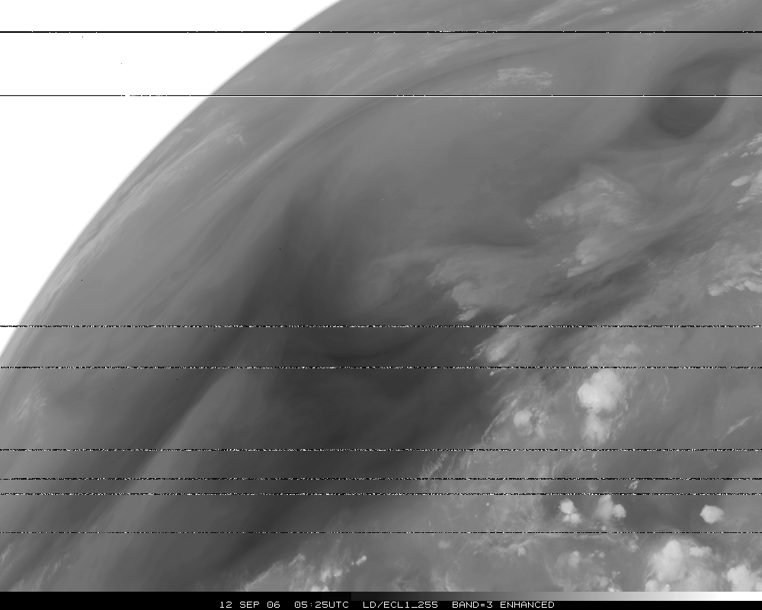
Band 3, Eclipse

Slide 14
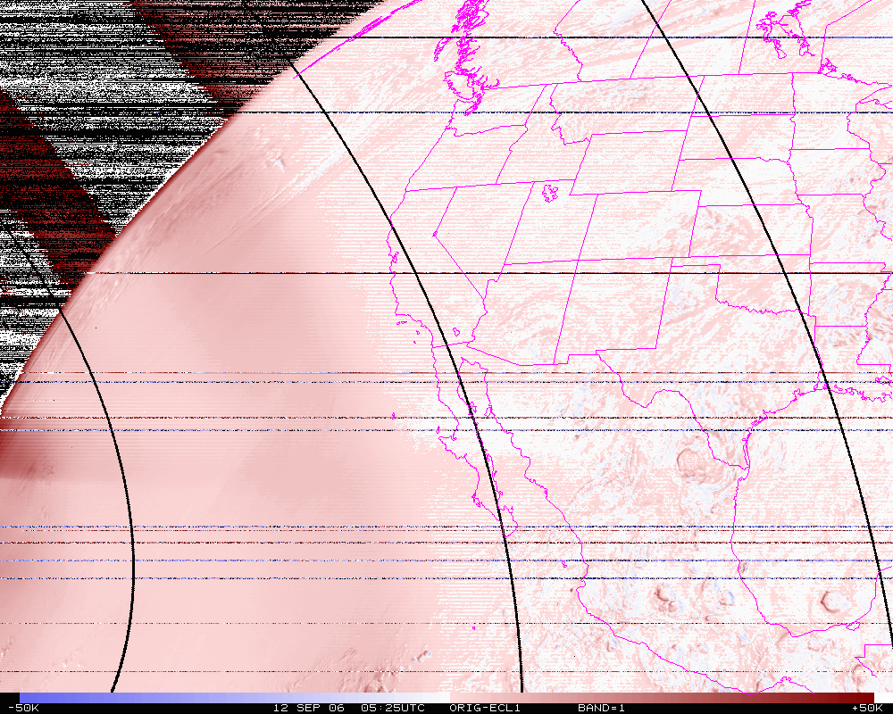
Band 3, difference image (org-eclipse)

Slide 15
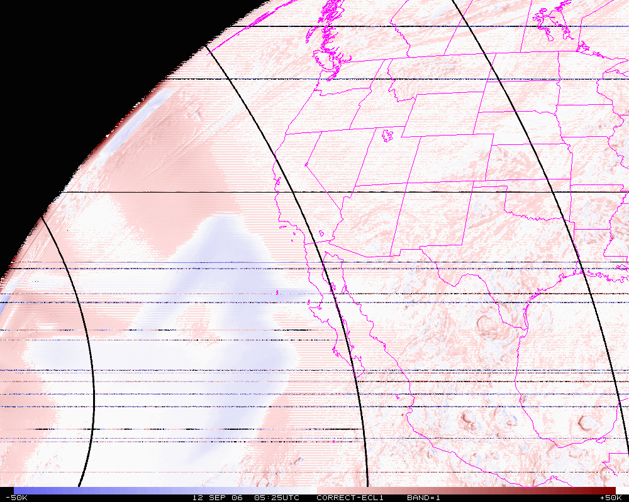
Band 3, difference image (corrected-eclipse)

Slide 16
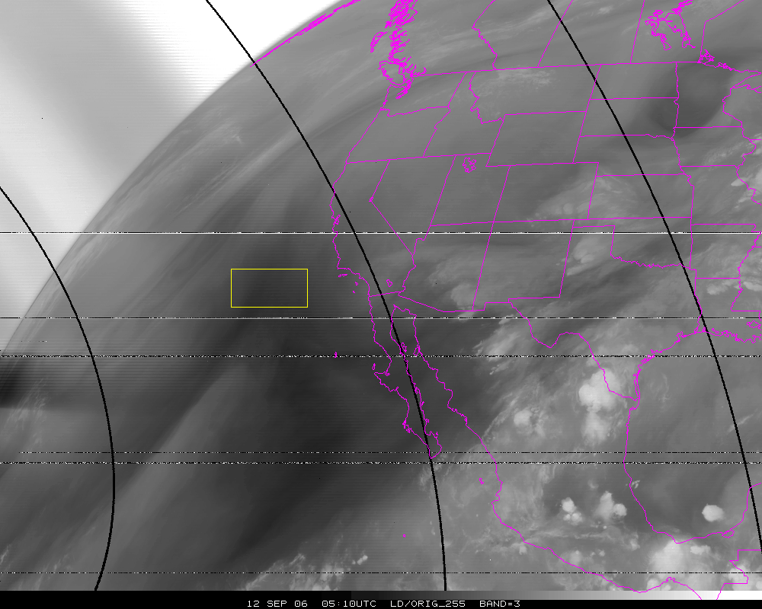
Band=3
N=10302
Org Mean= 258.6K
Cor. Mean= 249.1K
Ecl. Mean= 254.2K

Slide 17
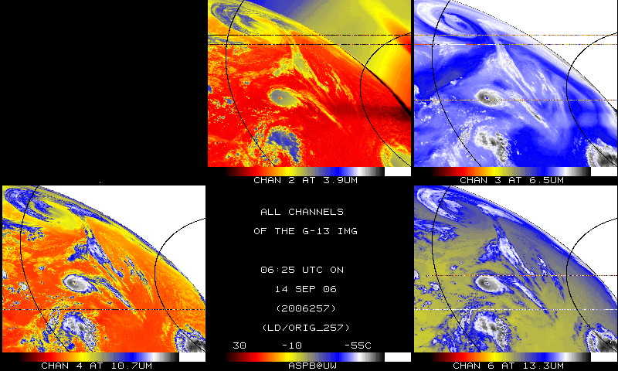
IR bands, Original – Day 257

Slide 18
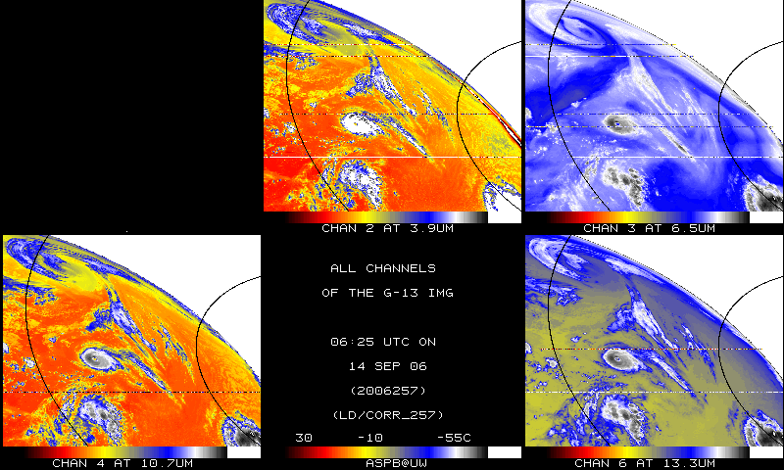
IR bands, Corrected– Day 257

Slide 19
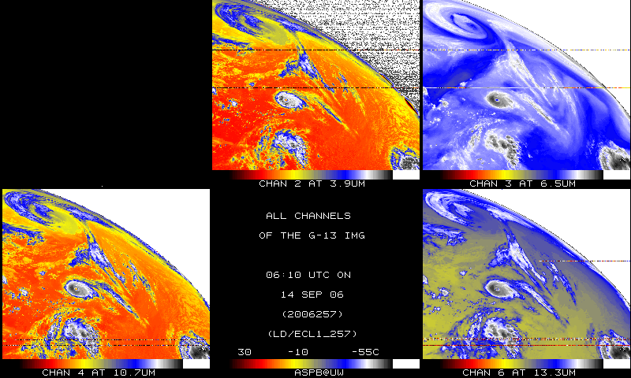
IR bands, 15-minutes earlier – Day 257

Slide 20
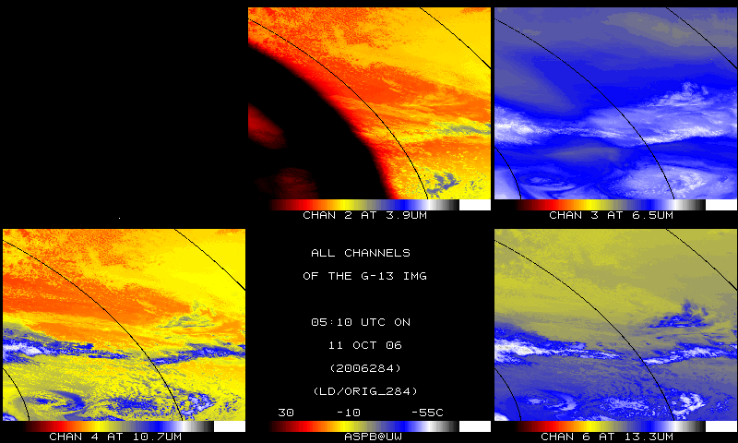
IR bands, Original – Day 284

Slide 21
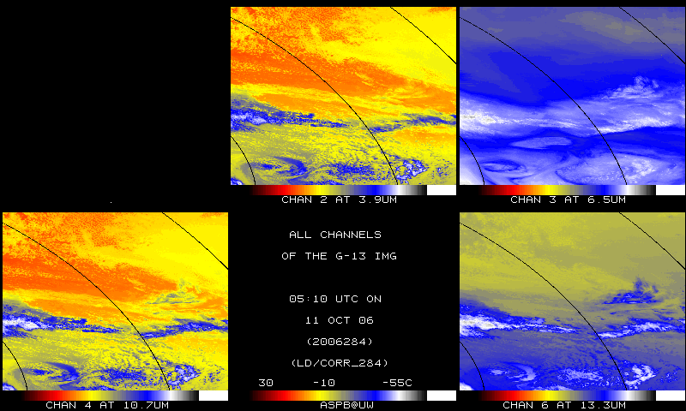
IR bands, Corrected – Day 284

Slide 22
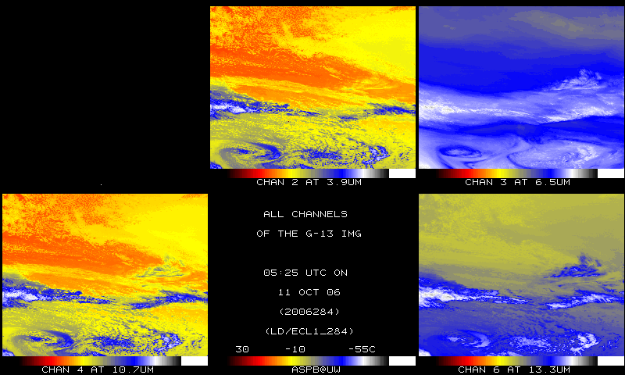
IR bands, 15-min later – Day 284

