Slide 1
Stray Light Analysis GOES-13 Imager Update with Corrected data
Tim Schmit, ASPB
Tony Schreiner, CIMSS
6-January-2011
Introduction
Day 255
Day 257
Day 284

Slide 2
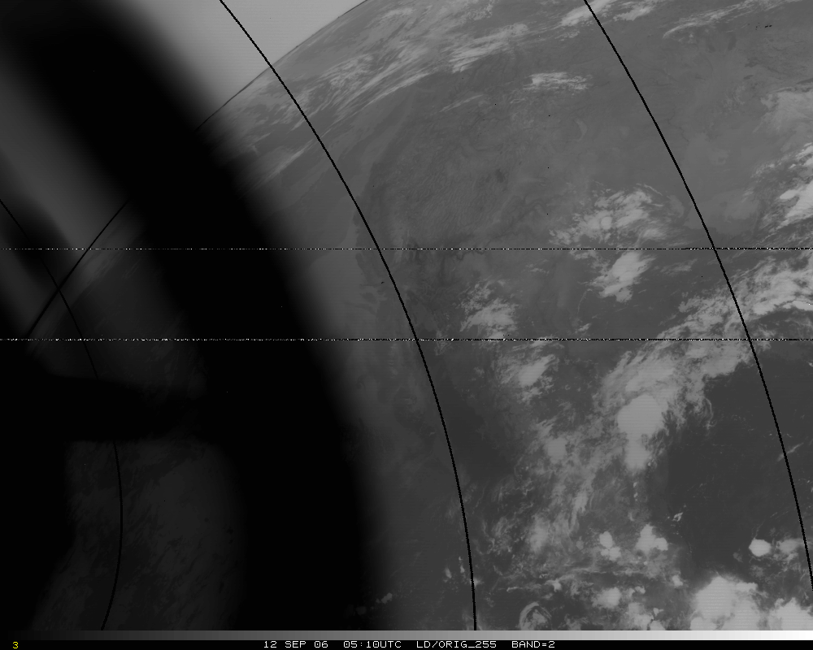
Band 2, Original – too hot by several K!
Band 2, Original – too hot by 50K!

Slide 3
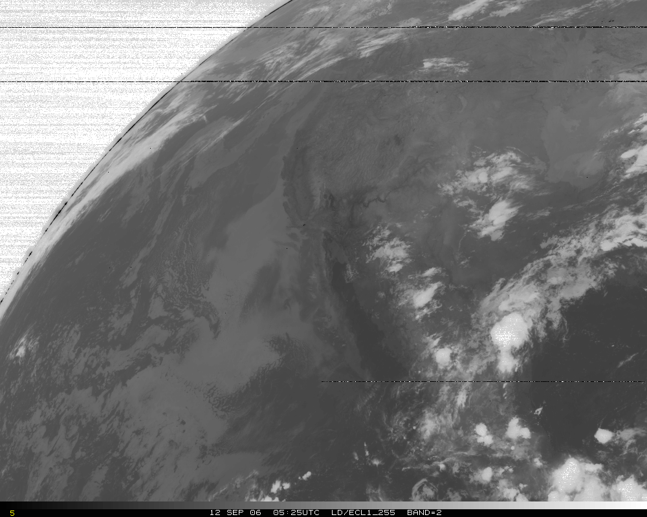
Band 2, later image

Slide 4
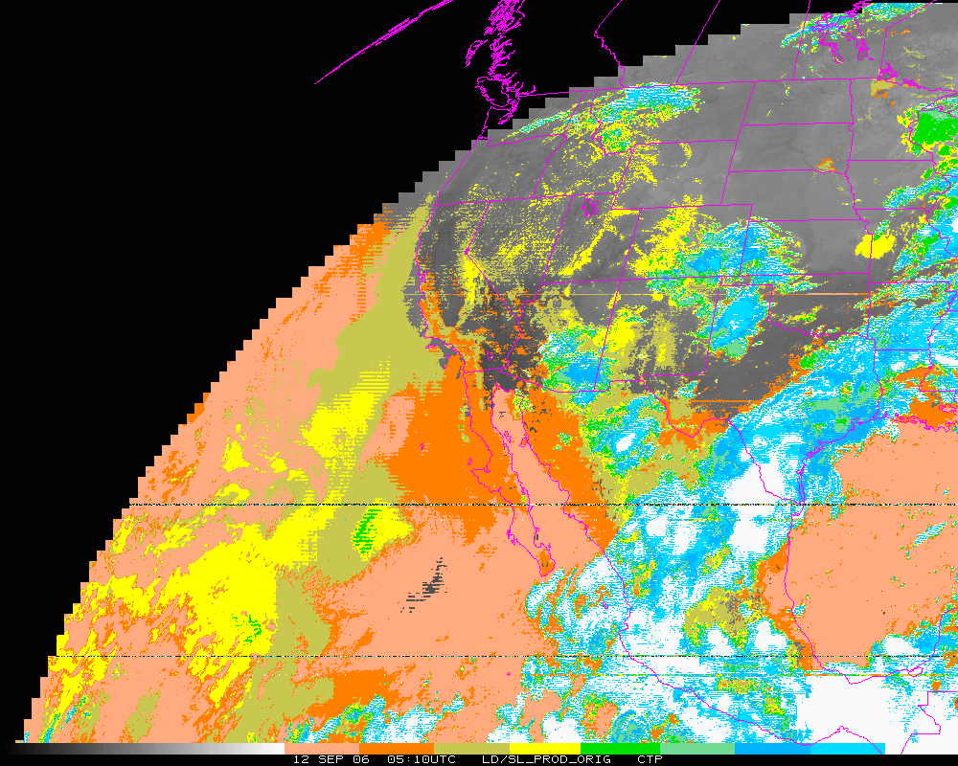
Cloud-top Pressure (color-range). Original – too “cloudy” over some regions, but misses other clouds!
Clear Low cloud High Cloud

Slide 5
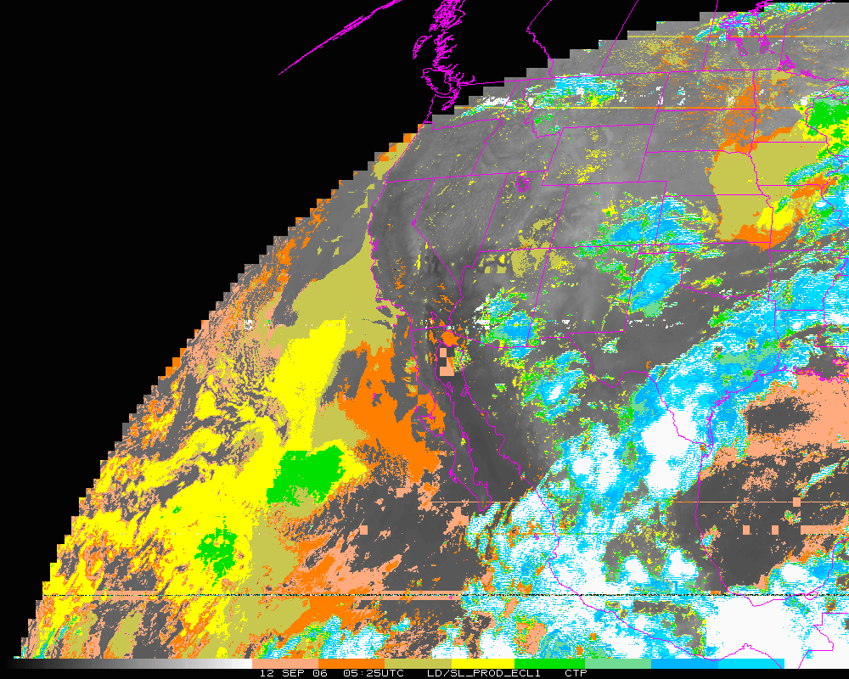
Cloud-top Pressure (color-range). Later image.
Clear Low cloud High Cloud

Slide 6
Stray Light Analysis GOES-13 Imager
Tim Schmit
ASPB
Day 255

Slide 7
Band 2, Original

Slide 8
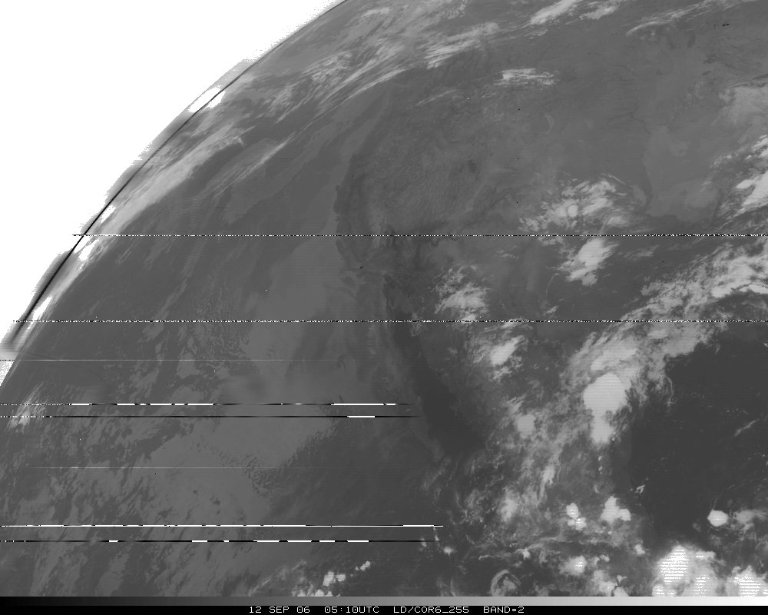
Band 2, Corrected

Slide 9
Band 2, later image

Slide 10
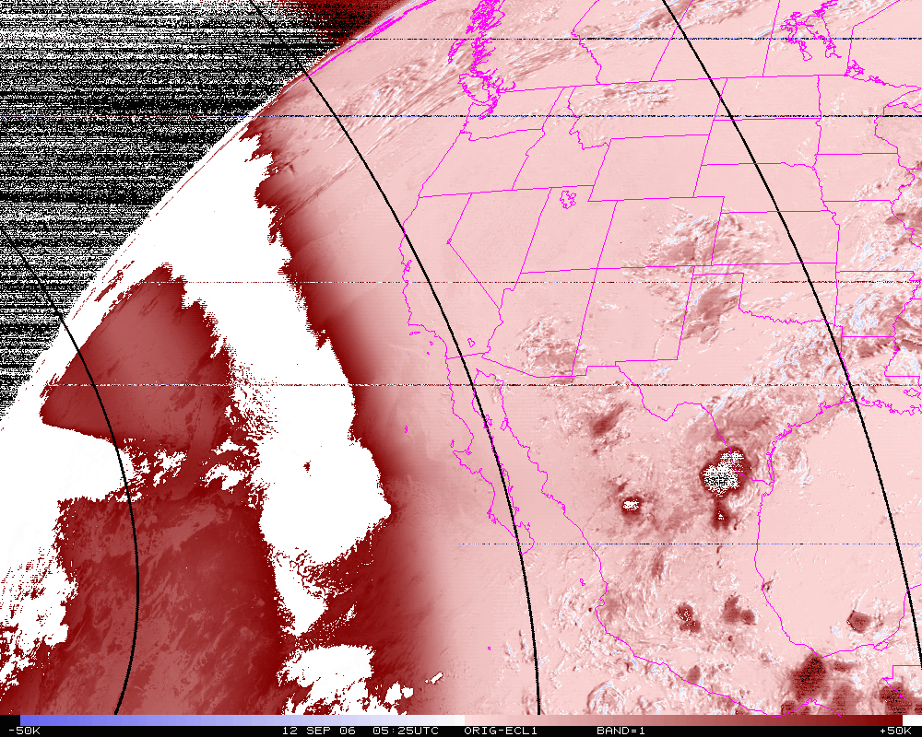
Band 2, difference image (org-eclipse)

Slide 11
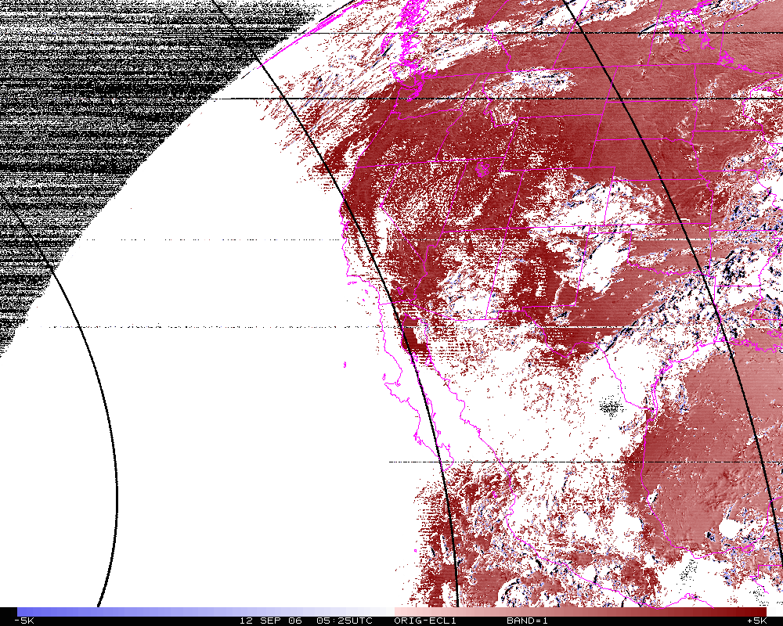
Band 2 Difference
N=14342
Mean= 4.0K
Band 2, difference image (org-eclipse). Smaller range.

Slide 12
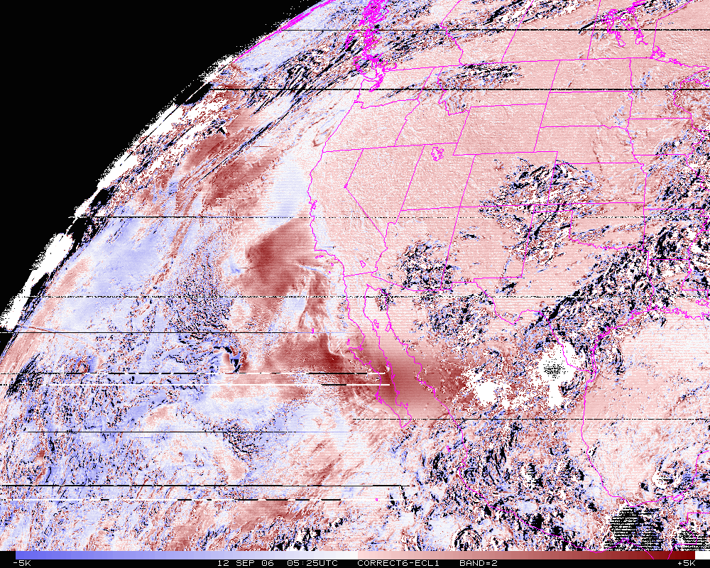
Band 2 Difference
N=14342
Mean= 0.6K
Band 2, difference image (corrected-eclipse). Smaller range.

Slide 13
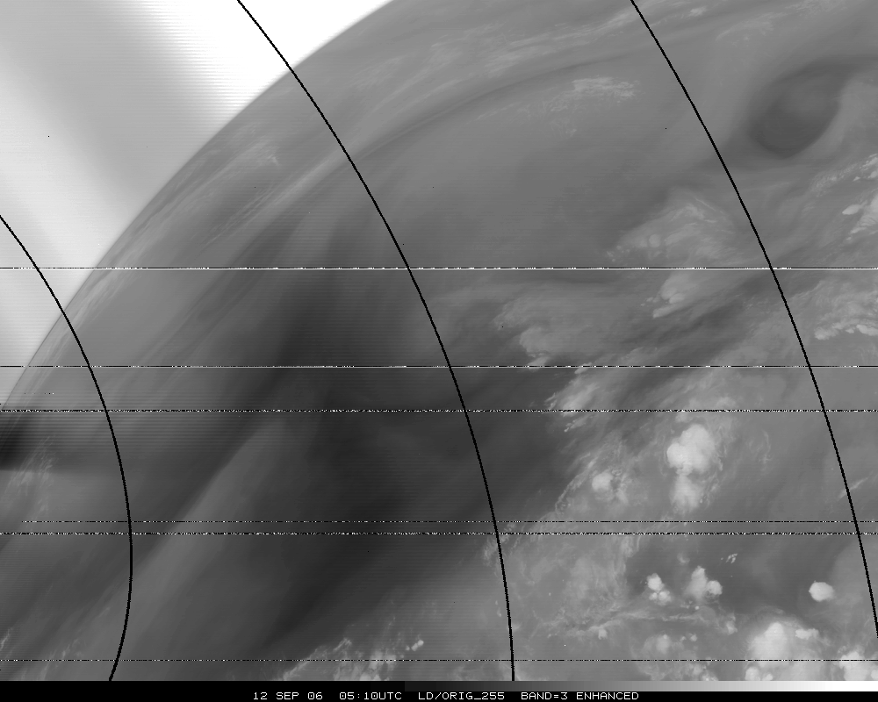
Band 3, Original

Slide 14
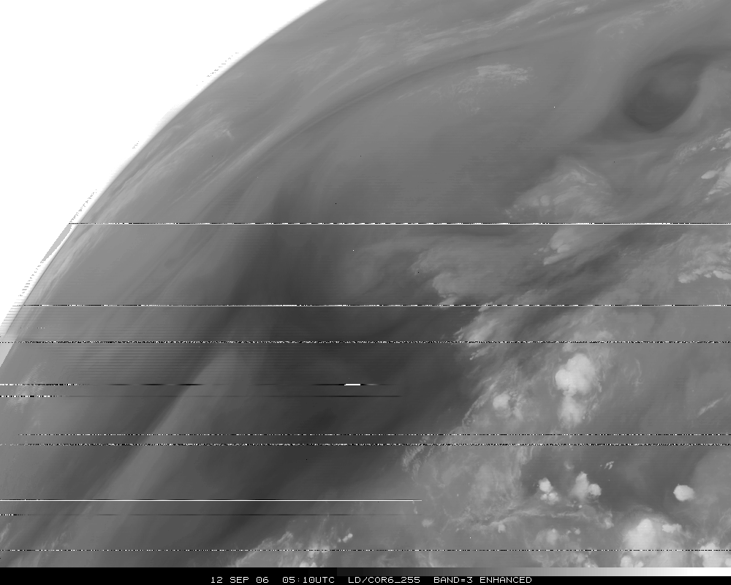
Band 3, Corrected

Slide 15
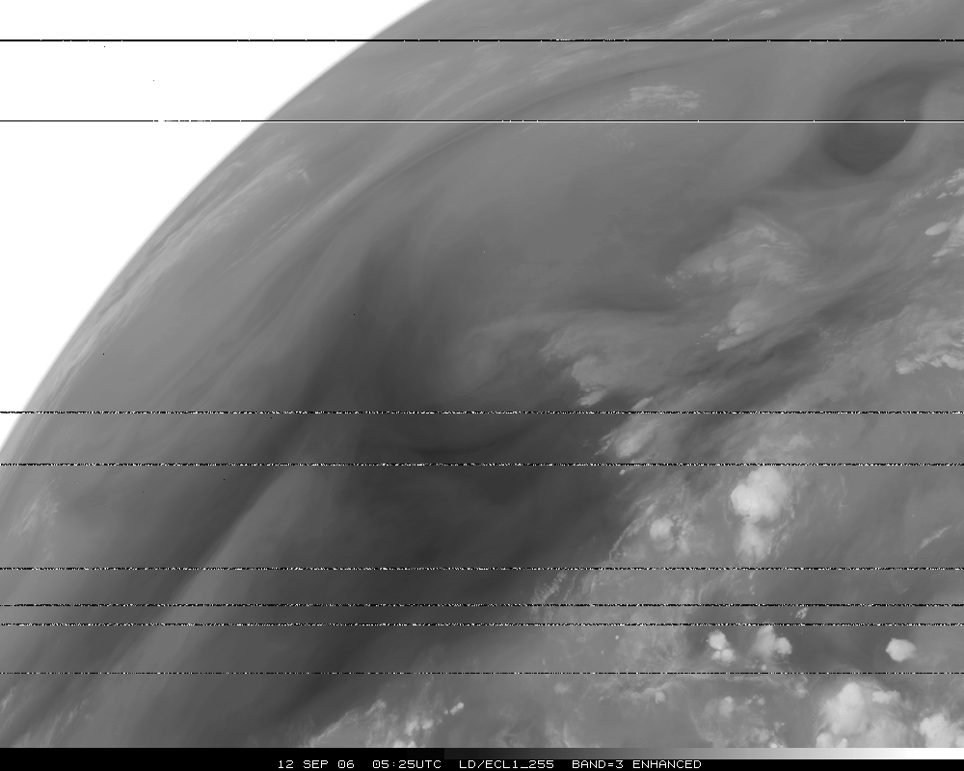
Band 3, Eclipse

Slide 16
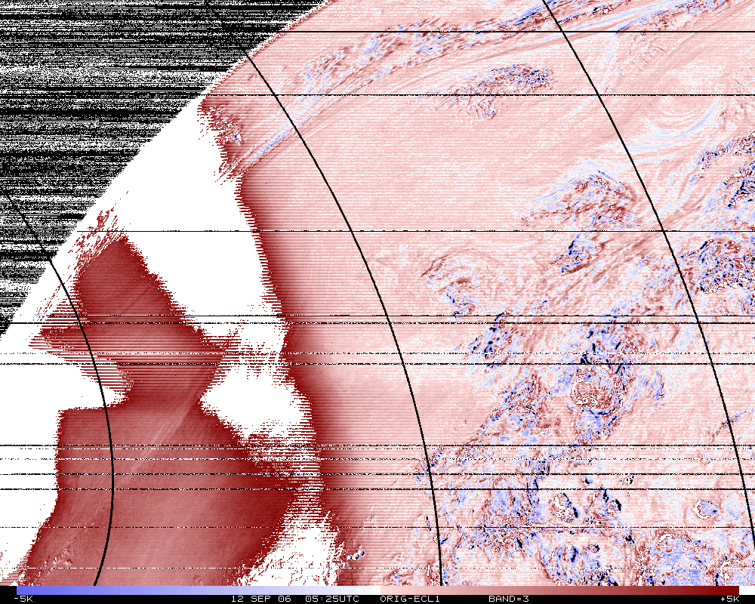
Band 3, difference image (org-eclipse)

Slide 17
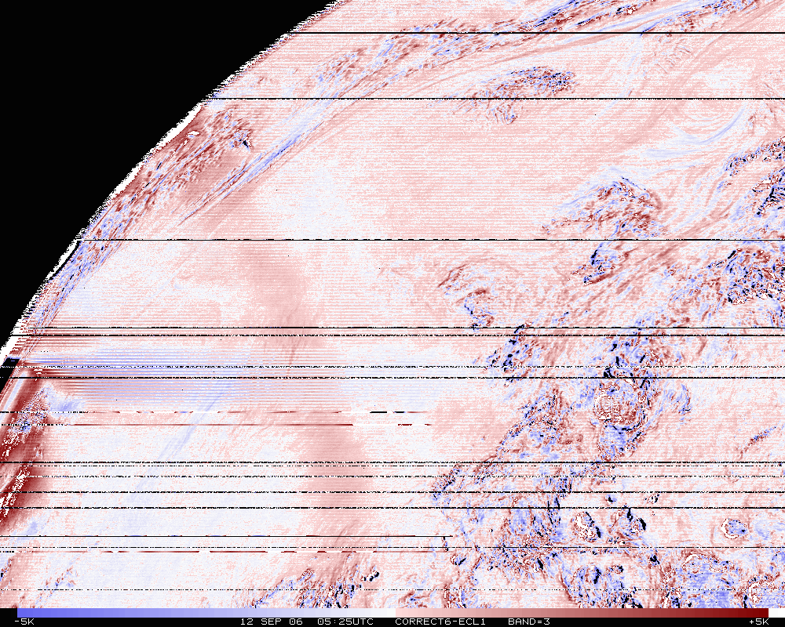
Band 3, difference image (Corrected-eclipse). Smaller range.

Slide 18
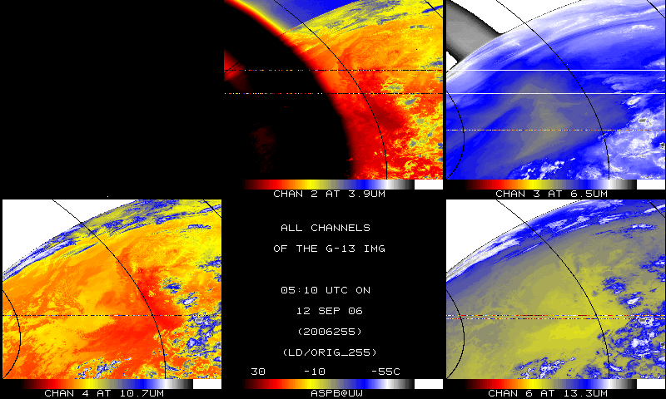
IR bands, Original

Slide 19
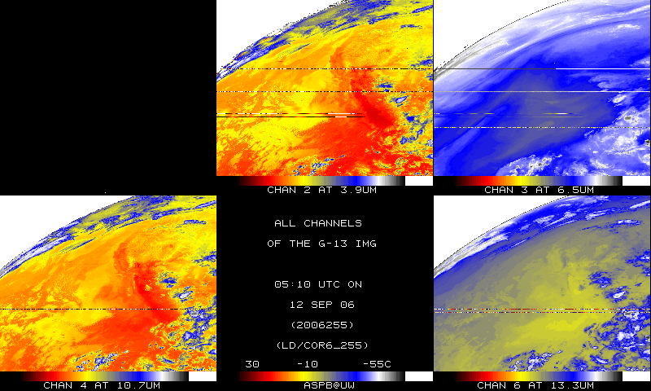
IR bands, Corrected

Slide 20
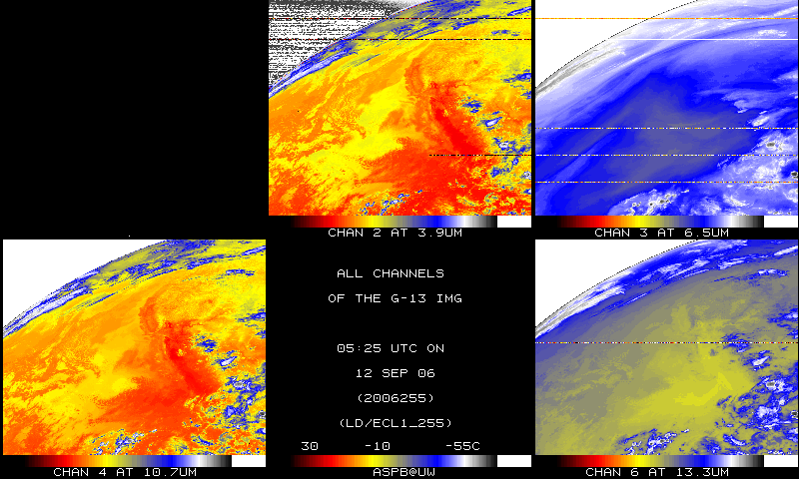
IR bands, 15-minutes later

Slide 21
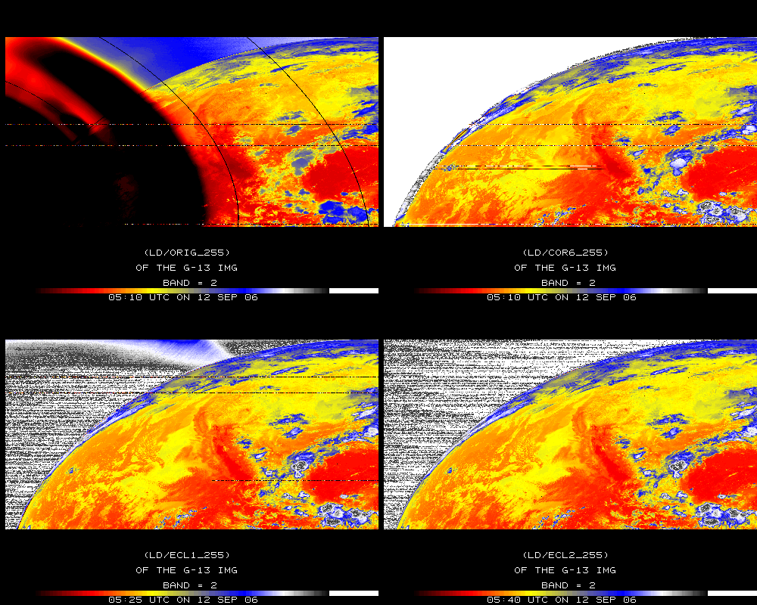
Band 2

Slide 22
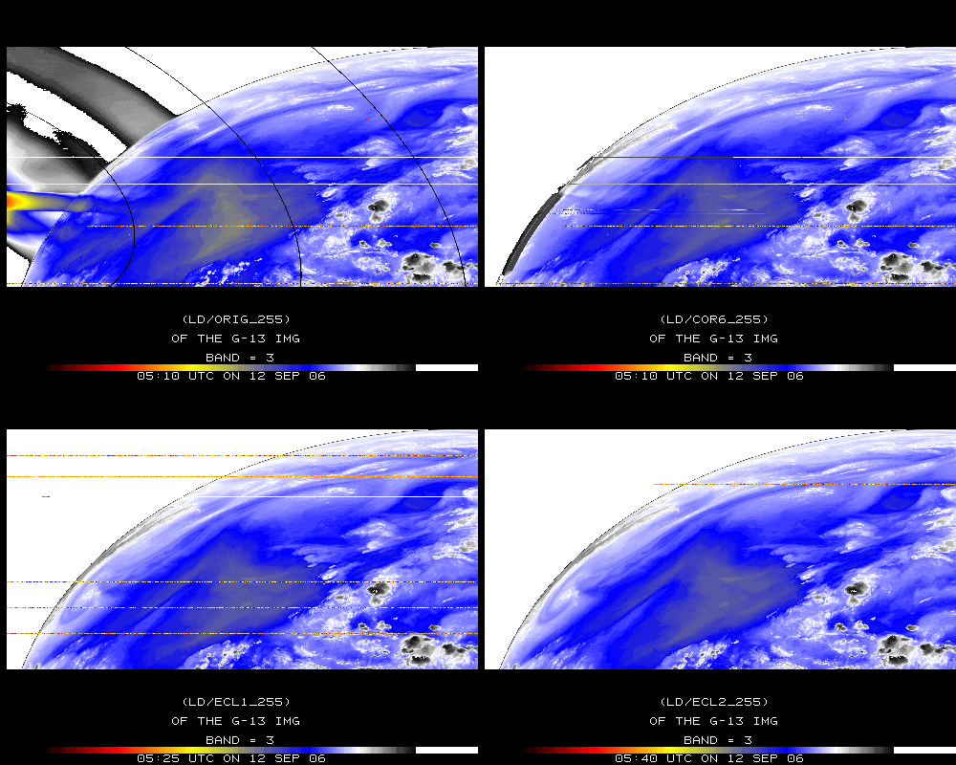
Band 3

Slide 23
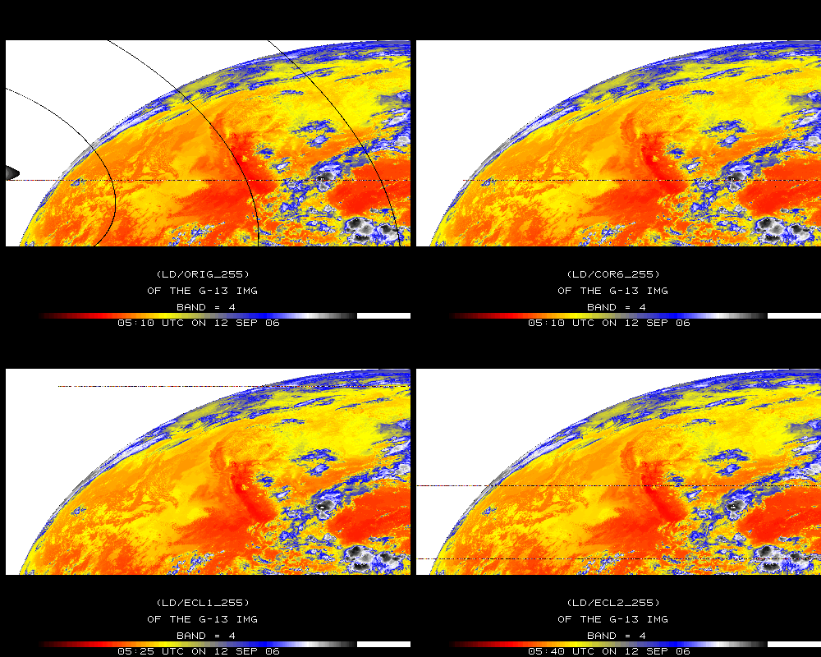
Band 4

Slide 24
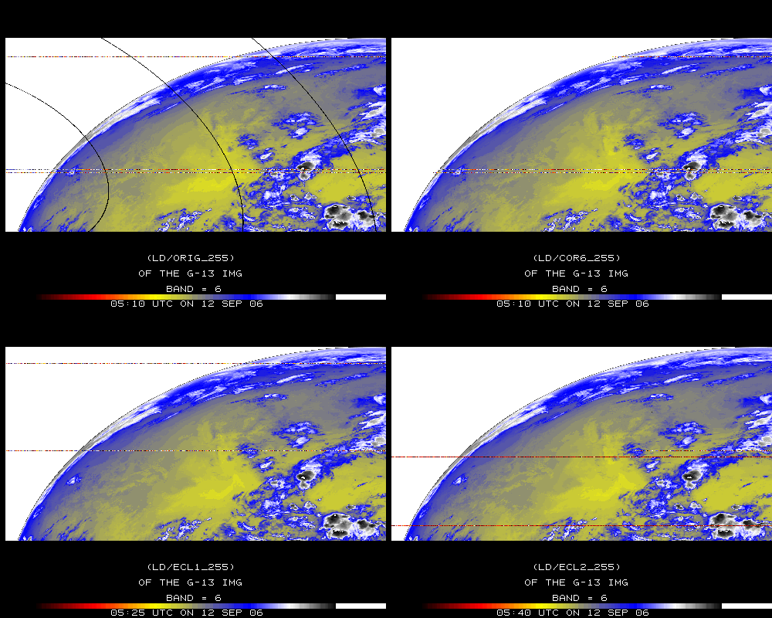
Band 6

Slide 25
Stray Light Analysis GOES-13 Imager
Tim Schmit
ASPB
Day 257

Slide 26
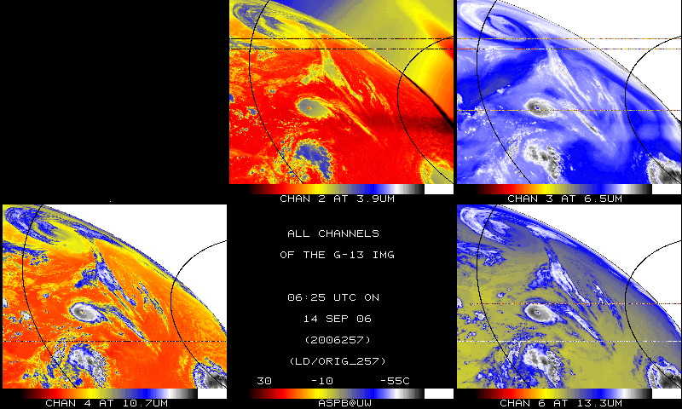
IR bands, Original – Day 257

Slide 27
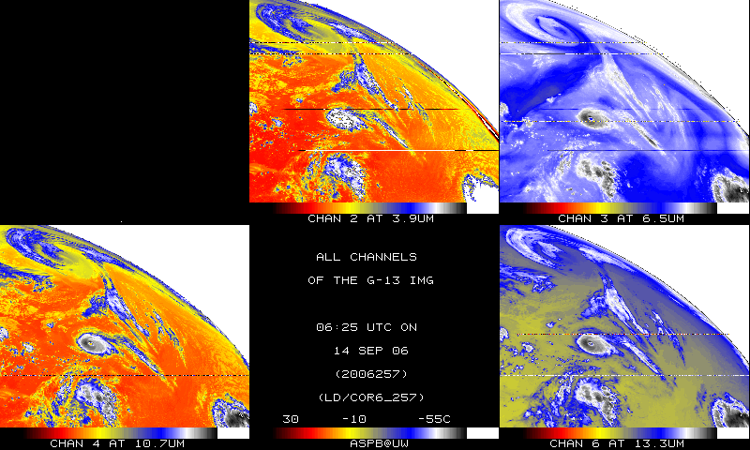
IR bands, Corrected– Day 257

Slide 28
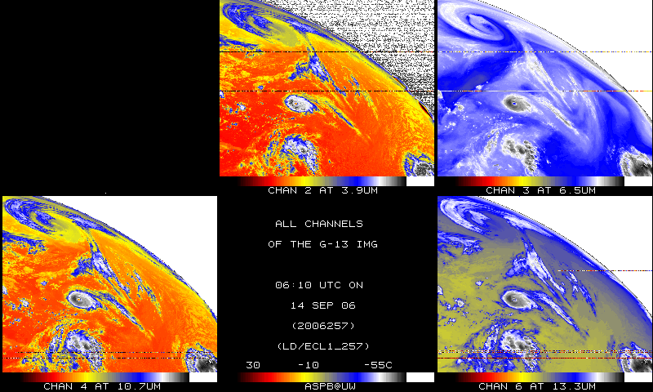
IR bands, 15-minutes earlier – Day 257

Slide 29
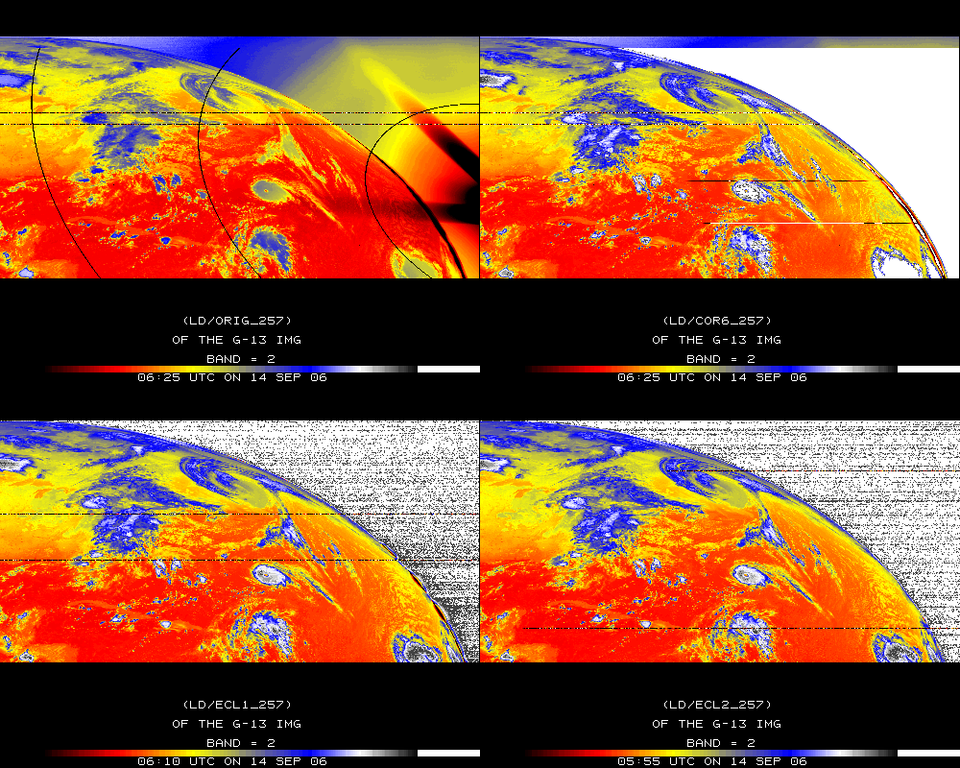
Band 2

Slide 30
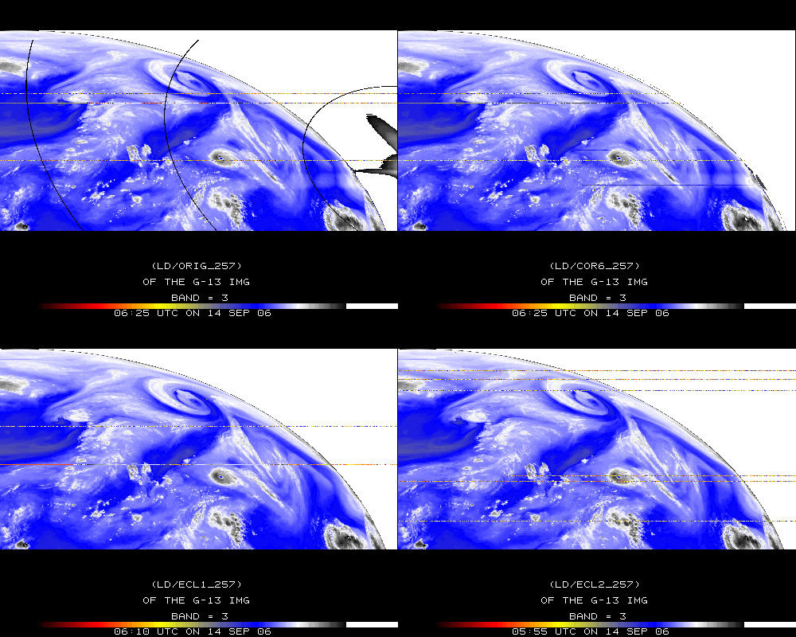
Band 3

Slide 31
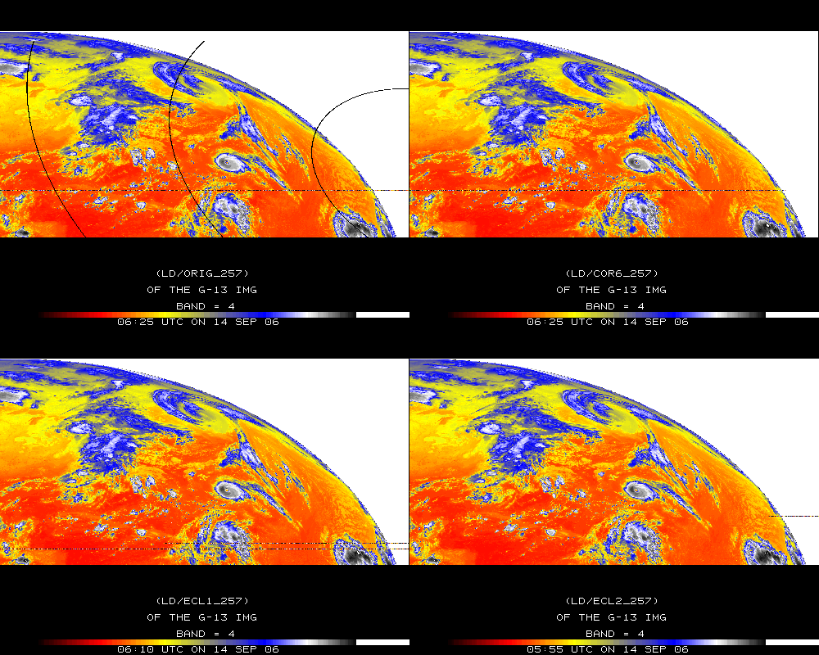
Band 4

Slide 32
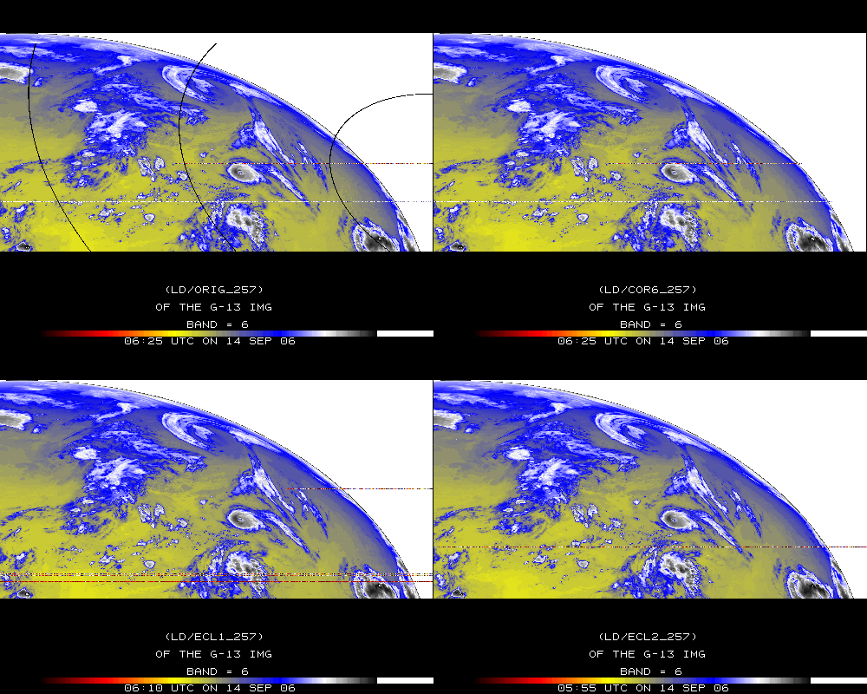
Band 6

Slide 33
Stray Light Analysis GOES-13 Imager
Tim Schmit
ASPB
Day 284

Slide 34
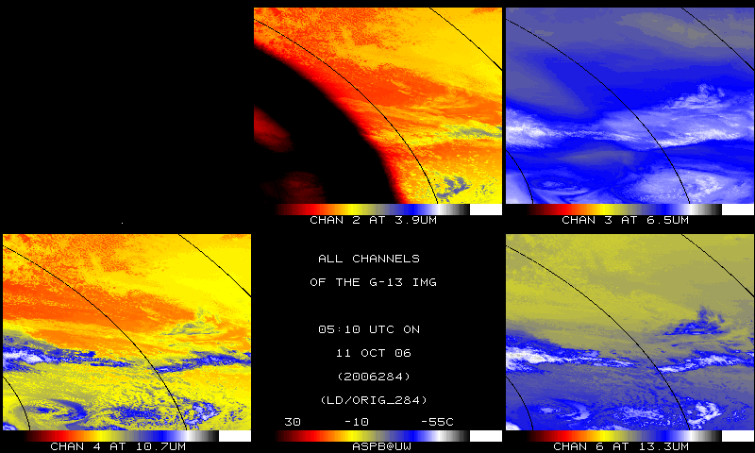
IR bands, Original – Day 284

Slide 35
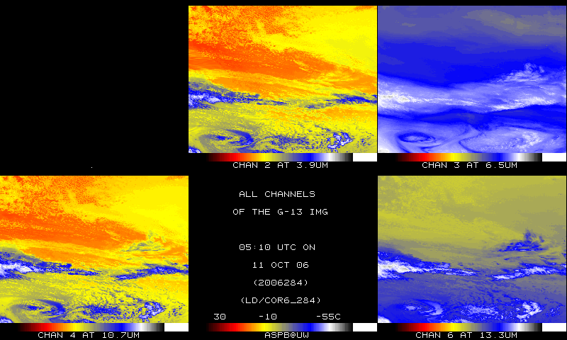
IR bands, Corrected – Day 284

Slide 36
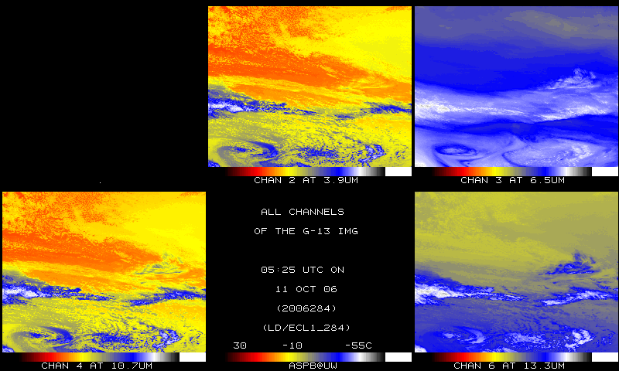
IR bands, 15-min later – Day 284

Slide 37
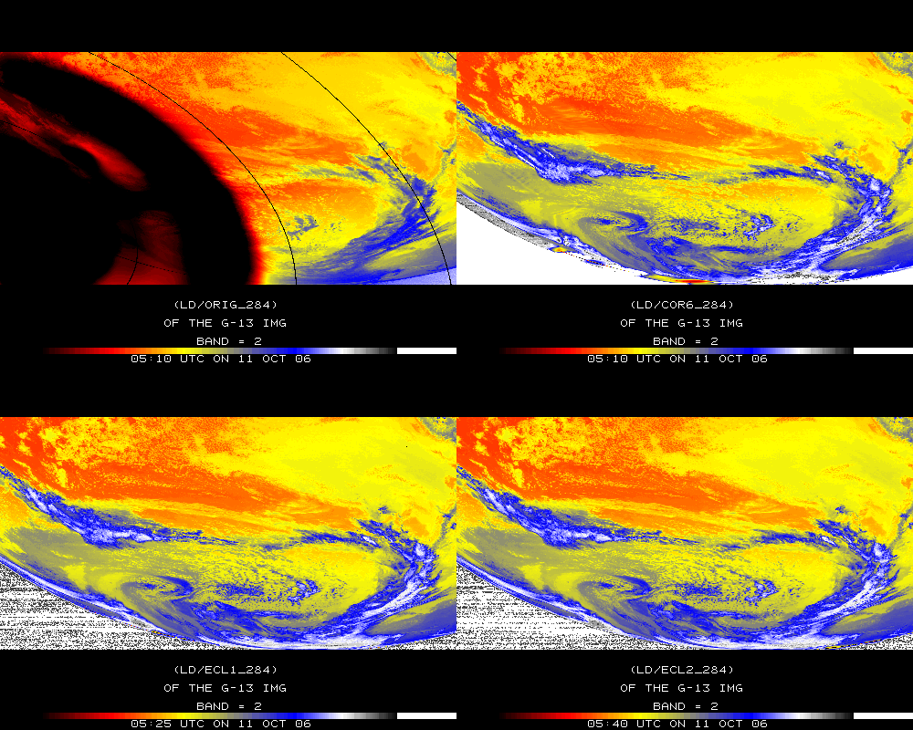
Band 2

Slide 38
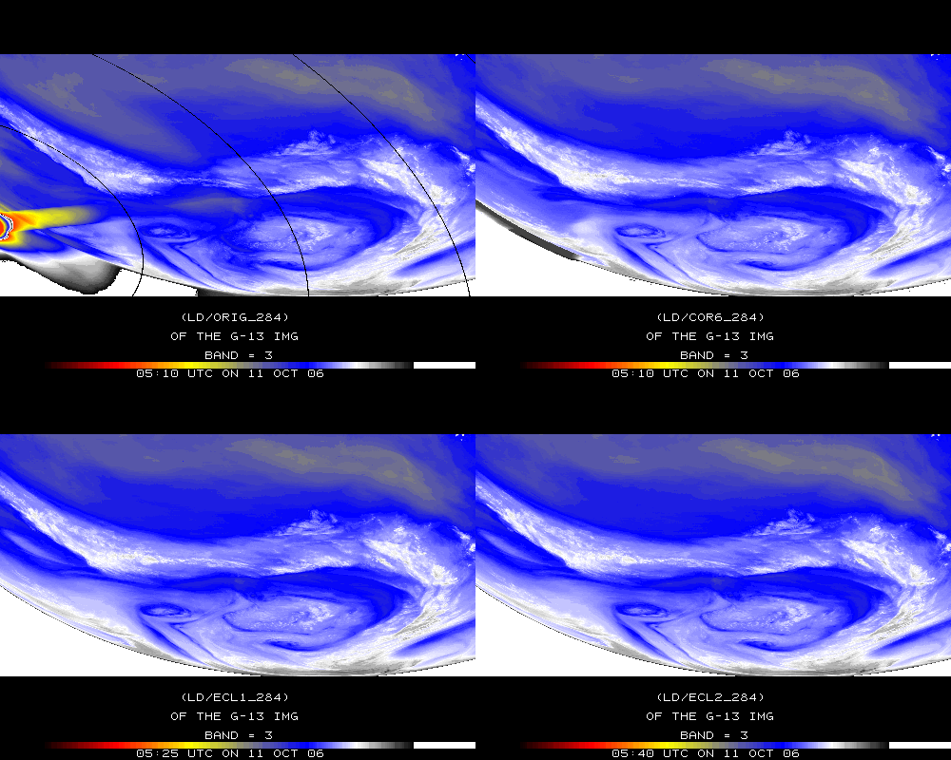
Band 3

Slide 39
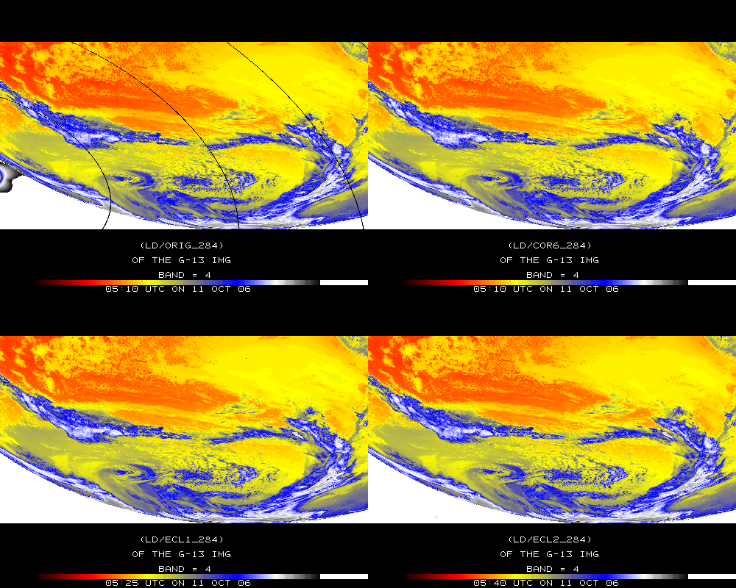
Band 4

Slide 40
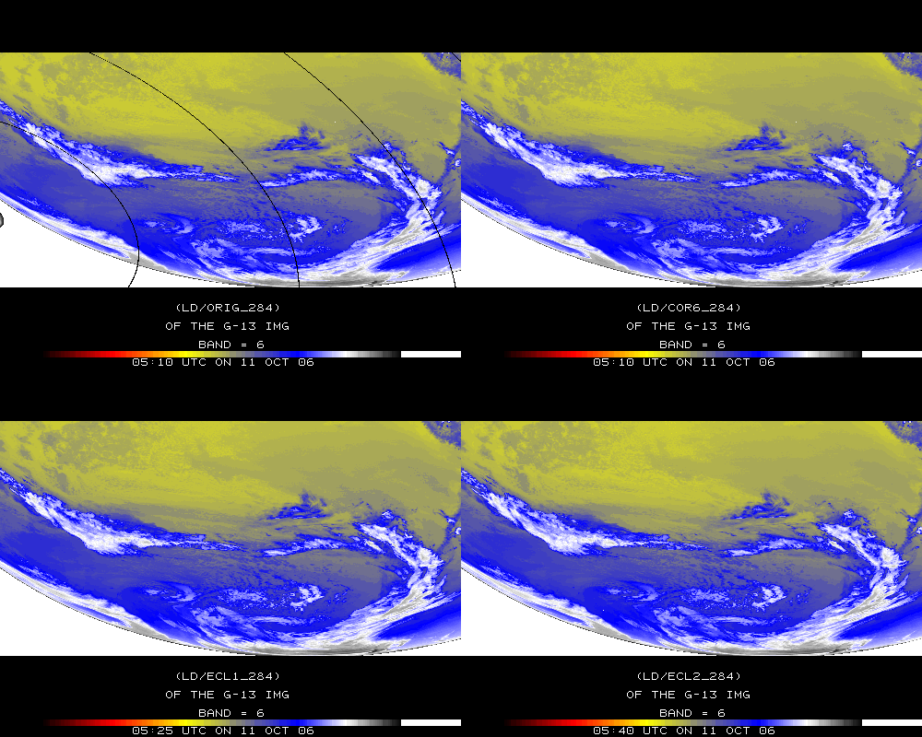
Band 6

